Slide 1


Hadron Structure on the Light-front
Xingbo Zhao
With
Kaiyu Fu, Hengfei Zhao, Siqi Xu,
Chandan Mondal, Yang Li,
James P. Vary
Institute of Modern Physics
Chinese Academy of Sciences
Lanzhou, China
10th Workshop on Hadron Physics in China and Opportunities Worldwide
Weihai, July 28, 2018

Slide 2
Outline
Hamiltonian approach to quantum field theory
  Light-front quantization
Basis Light-front Quantization
  A nonperturbative approach
Applications
  Physical electron
  Positronium
  Baryon
Summary and Outlook

Slide 3
Outline
Hamiltonian approach to quantum field theory
  Light-front quantization
Basis Light-front Quantization
  A nonperturbative approach
Applications
  Physical electron
  Positronium
  Baryon
Summary and Outlook

Slide 4
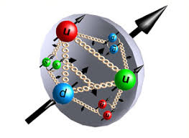
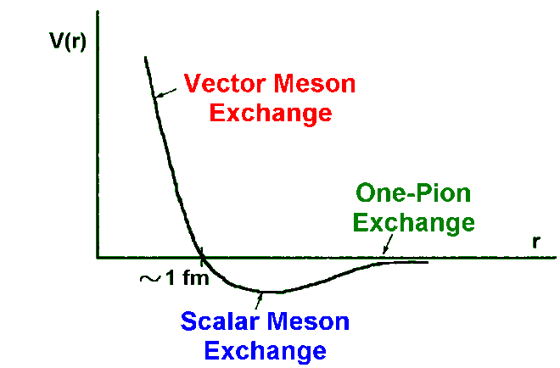
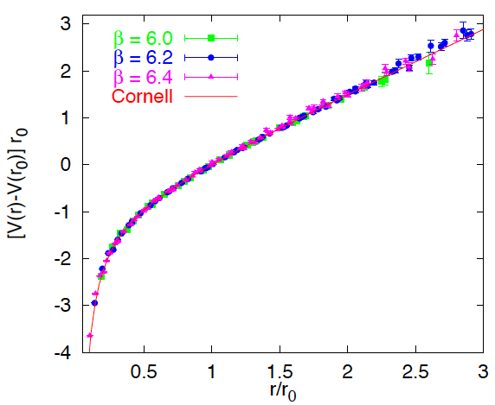
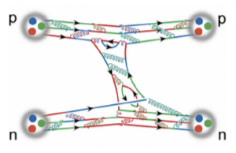
Nuclear Physics
Low energy
High energy
Relevant deg. of freedom:
nucleons
partons
Mass of building block:
~GeV
~MeV
Interaction:
Hadron mass, spin, interaction arise as emergent phenomena?
Let us investigate hadron 3D structure!

Slide 5
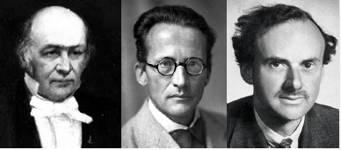
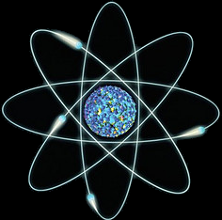
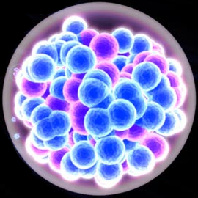
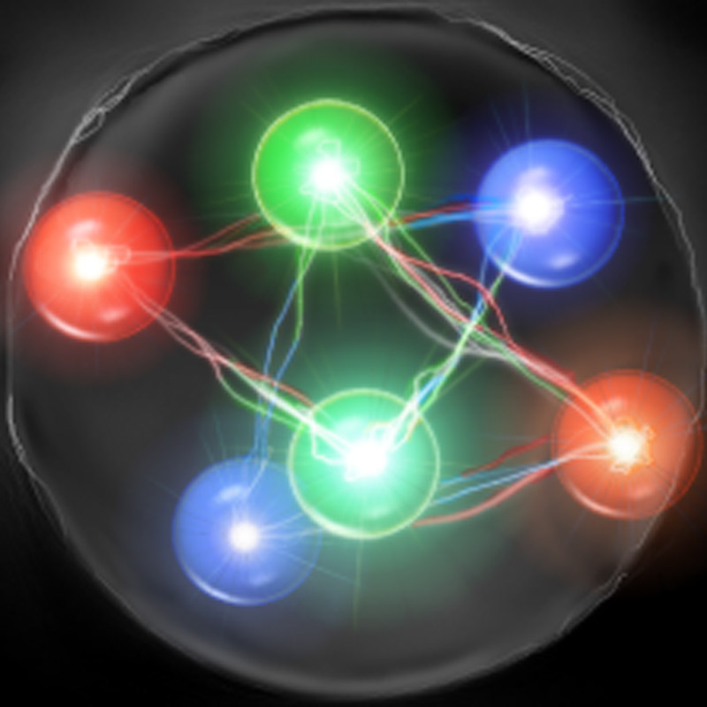
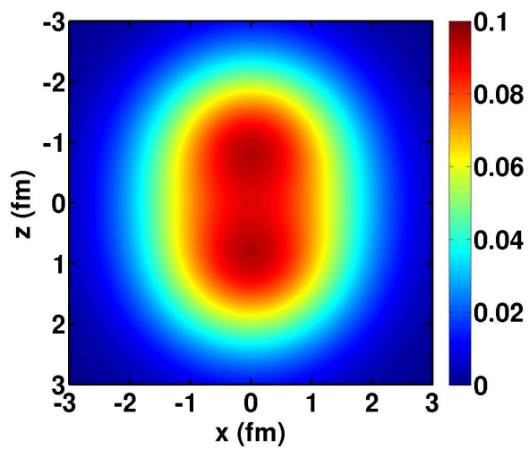
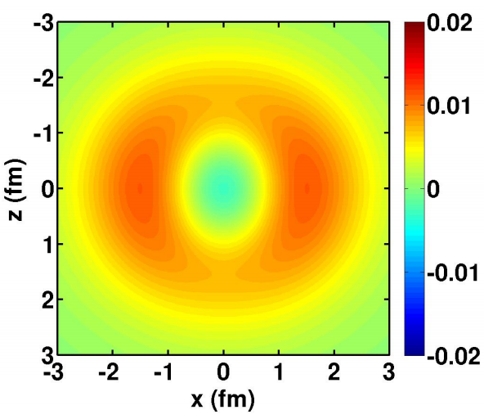
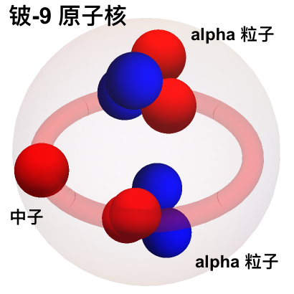

Hamiltonian Formalism
Schrödinger equation universally describes different physics：
$$H|ψ〉=E|ψ〉$$
atom
nucleus
hadron
Nonrelativistic, few-body
Nonrelativistic, many-body
Relativistic, many-body
Wave functions encode full information of the system
⁹Be nucleus
Example：⁹Be
nucleus
Proton density
Neutron density – proton density
[Cockrell ’12]

Slide 6
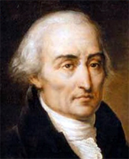
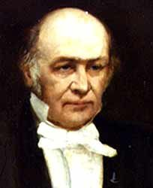





Nonperturbative Quantum Field Theory
Two complimentary frameworks
Formalism：
Lagrangian
Hamiltonian
Relativity：
Euclidean + Wick rotation
Minkowskian
Key Quantity：
Correlators$\left\langle O(x_{1},x_{2}, …, x_{n})\right\rangle$
Wavefunctions $|ψ(P, J, λ)〉$
Path-integtal ${〈O〉=∫D}_{ψ}{O e}^{−\frac{i}{ℏ}S_{E}}$
Main Eq.：
Schrödinger Eqn $H|ψ〉=E|ψ〉$
Time-dependence：
$$i\frac{∂}{∂t}|ψ〉= H|ψ〉$$
?
Examples：
Lattice Gauge Theory
Dyson-Schwinger Approach
…
Light-front Quantization
…

Slide 7
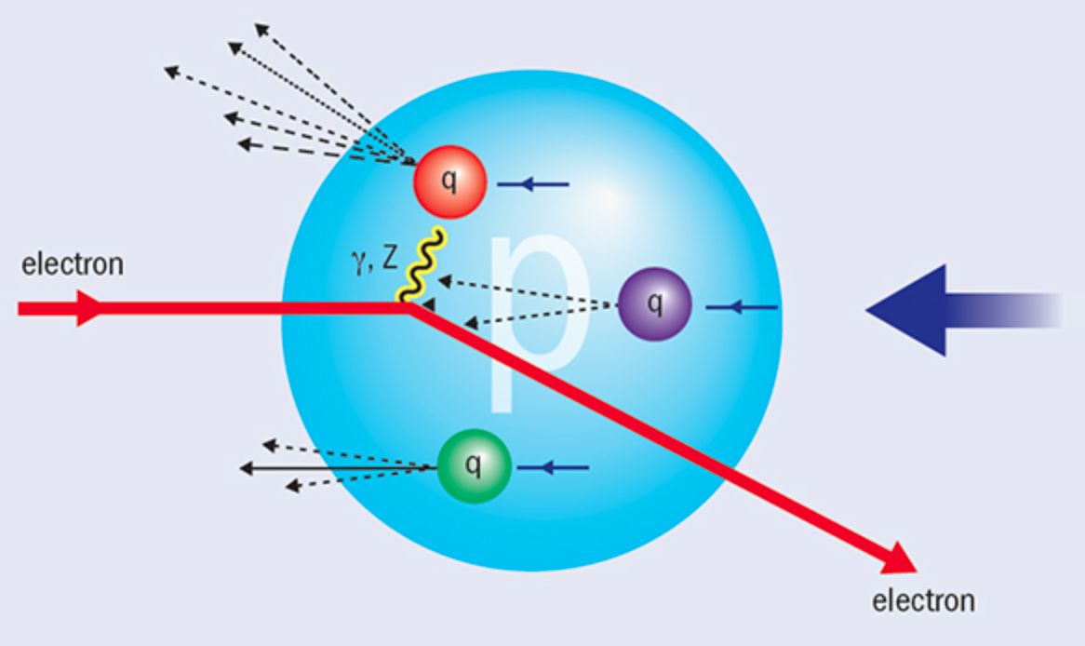




How Is Hadron Structure Measured
Modern Rutherford experiment– DIS(SLAC 1968)
Photon measures hadron structure at fixed light-front time $x^{+}=t+z$
e’
e
$$γ$$
P
Fixed $x^{+}=t+z$
DIS is lightcone dominated

Slide 8
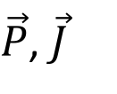
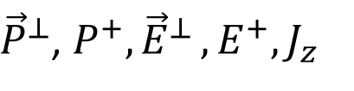
Light-front vs Equal-time Quantization
[Dirac 1949]
equal-time dynamics vs v light-front dynamics
$\vec{P}$, $\vec{J}$
${\vec{P}}^{⊥}$, $P^{+}{,\vec{E}}^{⊥},E^{+}, J_{z}$
Notes:
The approach I am introducing today is based on the Light-front field theory. Its basic idea is to solve the Schrodinger equation numerically for the quantum field. The difference from the traditional equal time formalism is that we redefine our light-front time to be the linear combination of the regular time and one of the spatial direction, usually we choose z direction. In the traditional equal time formalism we specify the initial state on a equal time plane and the Schroedinger equation will tell us its evolution time on future times. In the light front theory we specify the initial state on the equal light front surface and the Schrodinger equation will evolve afterwards. The benefits of the lightfront theory includes the fact that the Hamiltonian operator does not have the square root in it. also its amplitude is boost invariant and has simpler vacuum structure.

Slide 9
Common Variables in Light-front Dynamics
Light-front time
Light-front Hamiltonian
Longitudinal coordinate
Longitudinal momentum
Transverse coordinate
Transverse momentum
Equal-time dispersion relation
Light-front dispersion relation

Slide 10
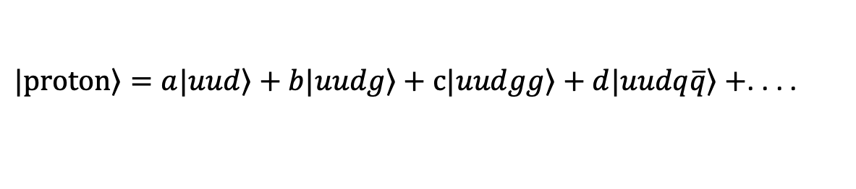

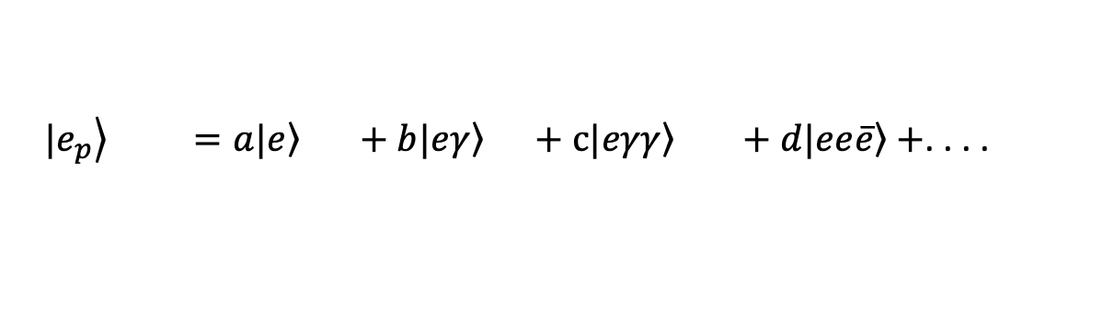
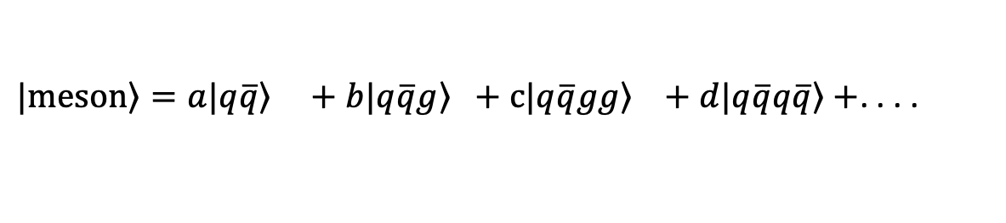
Why Go To Light-front?
Boost invariant light-front wave-function
Simple vacuum $\sim$ free theory vacuum (ignore zero mode)
Hamiltonian formalism for quantum field theory
$\left.|e_{p}\right\rangle =a\left.|e\right\rangle +b\left.|eγ\right\rangle +c\left.|eγγ\right\rangle +d\left.|ee\overline{e}\right\rangle +$. . . .
$\left.|proton\right\rangle =a\left.|uud\right\rangle +b\left.|uudg\right\rangle +c\left.|uudgg\right\rangle +d\left.|uudq\overline{q}\right\rangle +$. . . .
$\left.|meson\right\rangle =a\left.|q\overline{q}\right\rangle +b\left.|q\overline{q}g\right\rangle +c\left.|q\overline{q}gg\right\rangle +d\left.|q\overline{q}q\overline{q}\right\rangle +$. . . .
. . . .

Slide 11
Outline
Hamiltonian approach to quantum field theory
  Light-front quantization
Basis Light-front Quantization
  A nonperturbative approach
Applications
  Physical electron
  Positronium
  Baryon
Summary and Outlook

Slide 12
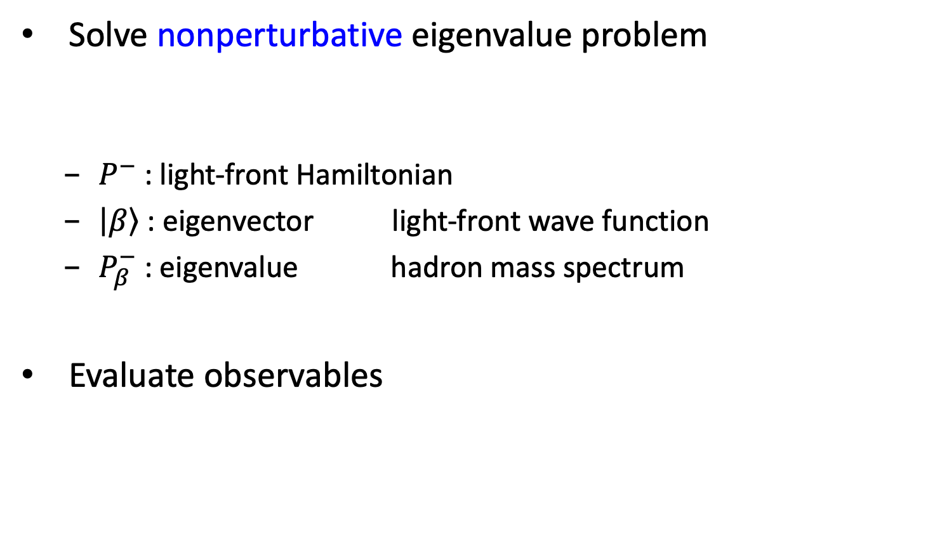
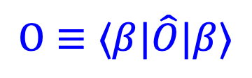
Basis Light-front Quantization
[Vary et al, 2008]
  Solve nonperturbative eigenvalue problem
    $P^{−}$ : light-front Hamiltonian
    $\left|\left.β\right\rangle \right.$ : eigenvector light-front wave function
    $P_{β}^{−}$ : eigenvalue hadron mass spectrum
  Evaluate observables
$$O≡⟨β|\hat{O}|β⟩$$

Slide 13
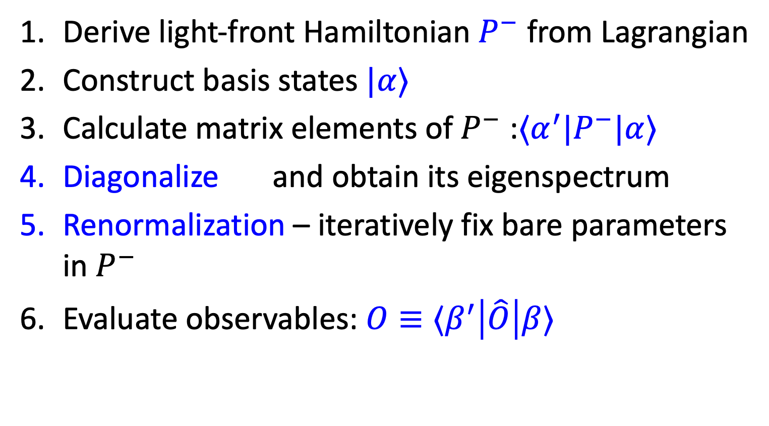
Procedure
Derive light-front Hamiltonian $P^{−}$ from Lagrangian
Construct basis states $|α⟩$
Calculate matrix elements of $P^{−}$ :$⟨α^{′}|P^{−}|α⟩$
Diagonalize and obtain its eigenspectrum
Renormalization – iteratively fix bare parameters in $P^{−}$
Evaluate observables: $O≡⟨β^{′}\left|\hat{O}\right|β⟩$

Slide 14
Light-front QED Hamiltonian
QED Lagrangian
QED Light-front Hamiltonian
kinetic energy terms
vertex interaction
instantaneous photon interaction
instantaneous fermion interaction

Slide 15

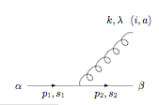

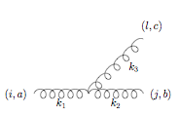
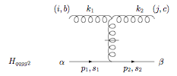
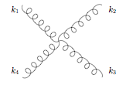
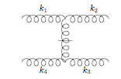
Elementary vertices in LF gauge
QED & QCD
QCD

Slide 16
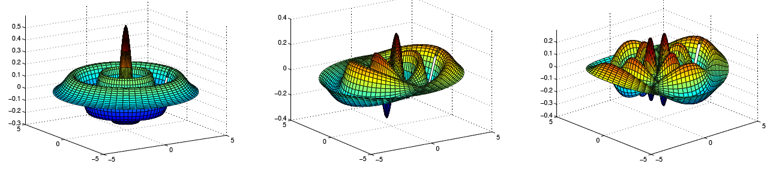
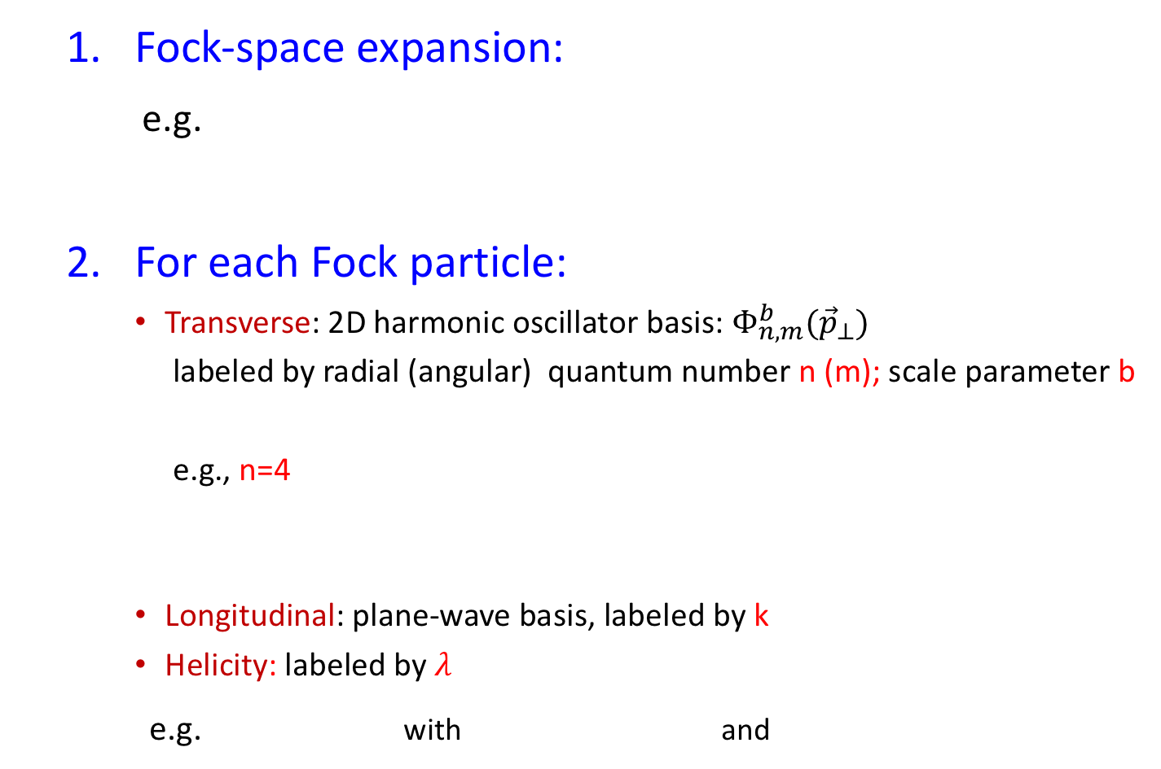
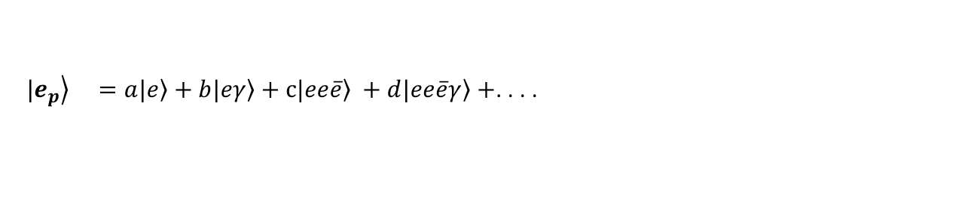
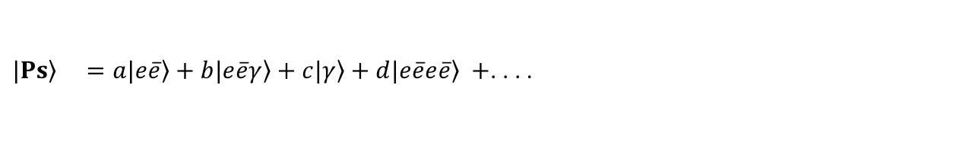
Basis Construction
  Fock-space expansion:
e.g.
  For each Fock particle:
    Transverse: 2D harmonic oscillator basis:${ Φ}_{n,m}^{b}({\vec{p}}_{⊥})$
    labeled by radial (angular) quantum number n (m); scale parameter b
    e.g., n=4
    Longitudinal: plane-wave basis, labeled by k
    Helicity: labeled by $λ$
  e.g. with and
$\left.|e_{p}\right\rangle =a\left.|e\right\rangle +b\left.|eγ\right\rangle +c\left.|ee\overline{e}\right\rangle +d\left.|ee\overline{e}γ\right\rangle +$. . . .
$\left.|Ps\right\rangle =a\left.|e\overline{e}\right\rangle +b\left.|e\overline{e}γ\right\rangle +c\left.|γ\right\rangle +d\left.|e\overline{e}e\overline{e}\right\rangle +$. . . .
m=0
m=1
m=2

Slide 17


Basis Truncation Scheme
Symmetries of Hamiltonian:
- Net fermion number:
- Total angular momentum projection:
- Longitudinal momentum:
Further truncation:
- Fock sector truncation
1, 2, 3…. bosons
- Discretization in longitudinal direction
$k_{i}=$
0.5, 1.5, 2.5 … fermions
- “N_{max}” truncation in transverse directions
$UV cutoff Λ\sim b\sqrt{N_{max}}$; $IR cutoff λ\sim b/\sqrt{N_{max}}$

Slide 18

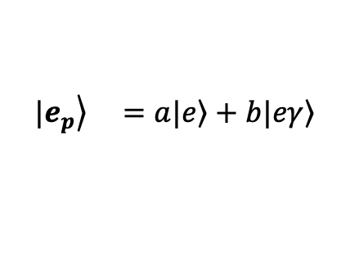

Outline
Hamiltonian approach to quantum field theory
  Light-front quantization
Basis Light-front Quantization
  A nonperturbative approach
Applications
  Physical electron
  Positronium
  Baryon
Summary and Outlook
$$γ$$
$$e^{−}$$
$$\left.|e_{p}\right\rangle =a\left.|e\right\rangle +b\left.|eγ\right\rangle$$

Slide 19
Light-front QED Hamiltonian
QED Lagrangian
QED Light-front Hamiltonian
kinetic energy terms
vertex interaction
instantaneous photon interaction
instantaneous fermion interaction

Slide 20
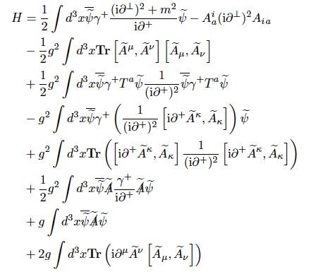
Light-front QCD Hamiltonian

Slide 21
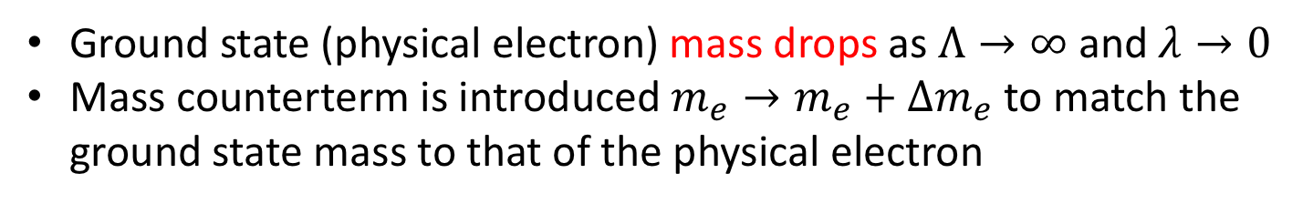
Naïve Diagonalization
Ground state (physical electron) mass drops as $Λ→∞$ and $λ→0$
Mass counterterm is introduced $m_{e}→m_{e}+Δm_{e}$ to match the ground state mass to that of the physical electron
[Shuo Tang et al, in preparation]

Slide 22
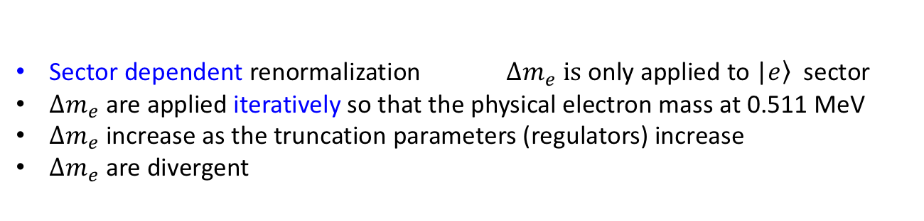
Mass Counterterm
[Karmanov et al, 2008, 2012]
Sector dependent renormalization $Δm_{e} is$ only applied to |$\left.e\right\rangle$ sector
$Δm_{e}$are applied iteratively so that the physical electron mass at 0.511 MeV
$Δm_{e}$increase as the truncation parameters (regulators) increase
$Δm_{e}$are divergent
[Shuo Tang et al, in preparation]

Slide 23
Electron GPDs and Form Factors
With mass renormalization, agreement with perturbation theory is reached
[Shuo Tang et al, in preparation]

Slide 24
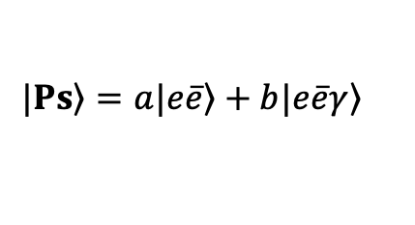
Outline
Hamiltonian approach to quantum field theory
  Light-front quantization
Basis Light-front Quantization
  A nonperturbative approach
Applications
  Physical electron
  Positronium
  Baryon
Summary and Outlook
e⁺
γ
$$\left.|Ps\right\rangle =a\left.|e\overline{e}\right\rangle +b\left.|e\overline{e}γ\right\rangle$$
e⁻

Slide 25
Application to Positronium
e⁺
γ
e⁻

Slide 26
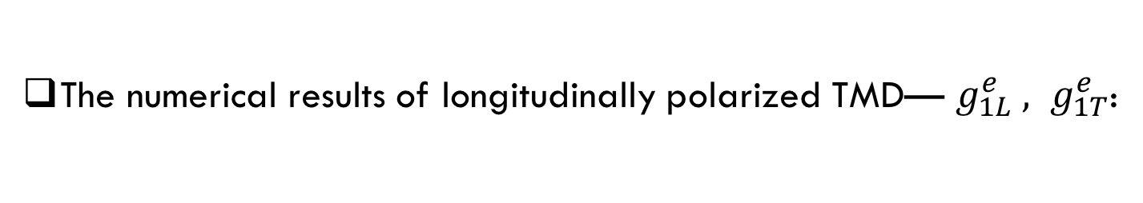

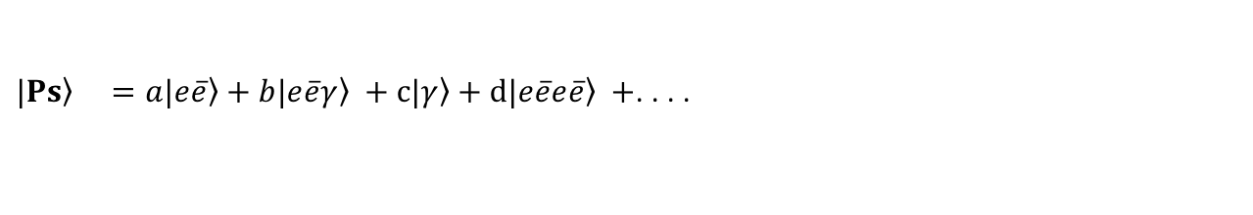

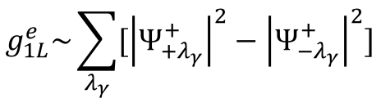
Structure of Hamiltonian Matrix
m_{e}=1.0MeV $α=0.3$
$\left.|Ps\right\rangle =a\left.|e\overline{e}\right\rangle +b\left.|e\overline{e}γ\right\rangle +c\left.|γ\right\rangle +d\left.|e\overline{e}e\overline{e}\right\rangle +$. . . .
 |  | 0
H_{int}
$$\left.|e\overline{e}\right\rangle$$
$$\left.|e\overline{e}γ\right\rangle$$
$$\left\langle e\overline{e}|\right.$$
$$\left\langle e\overline{e}γ|\right.$$

Slide 27
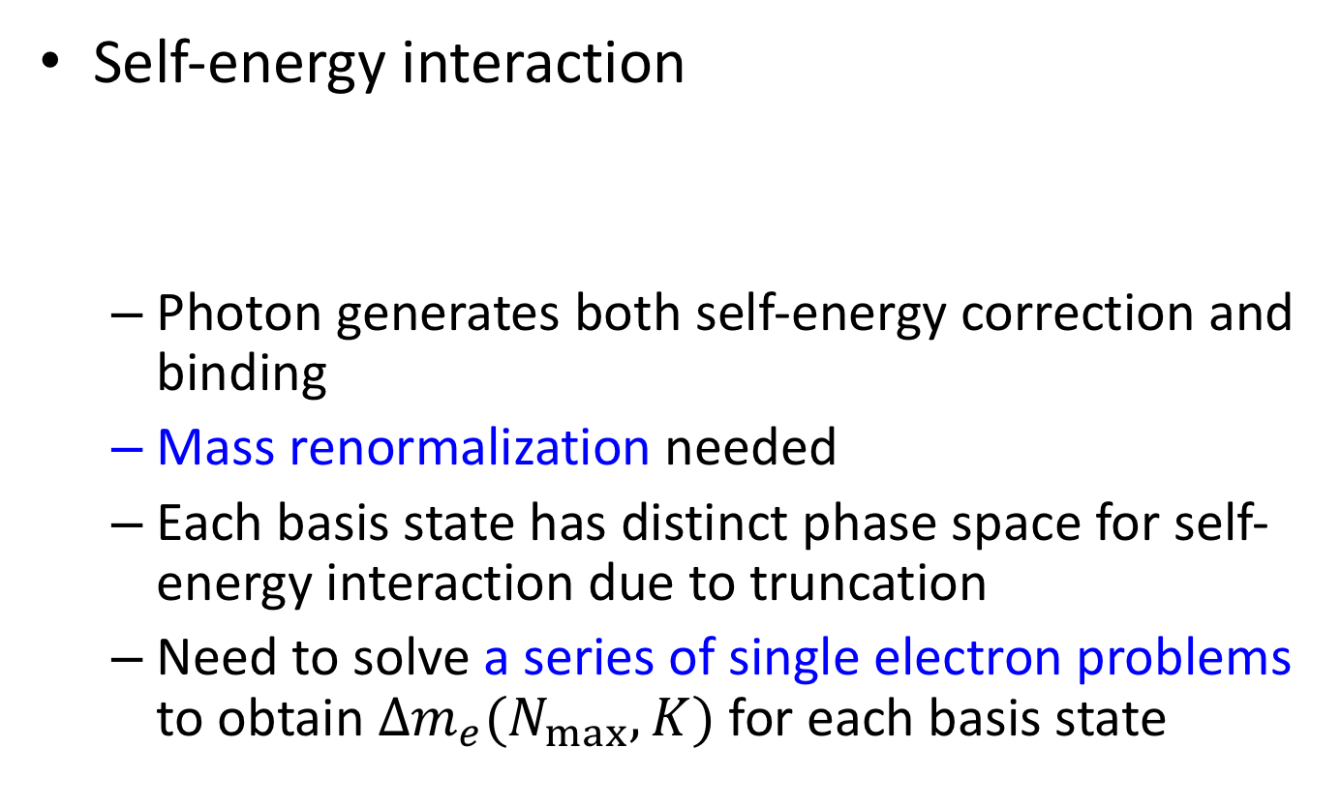
Challenge I
Self-energy interaction
  Photon generates both self-energy correction and binding
  Mass renormalization needed
  Each basis state has distinct phase space for self-energy interaction due to truncation
  Need to solve a series of single electron problems to obtain $Δm_{e}(N_{max},K)$ for each basis state

Slide 28
Mass Counterterms and Z factors
All of them are needed in the positronium problem with N_{max}=20, K=69

Slide 29
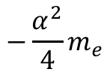
Ground State Binding Energy
$$−\frac{α^{2}}{4}m_{e}$$
Results seem converging
[Kaiyu Fu et al, in preparation]

Slide 30

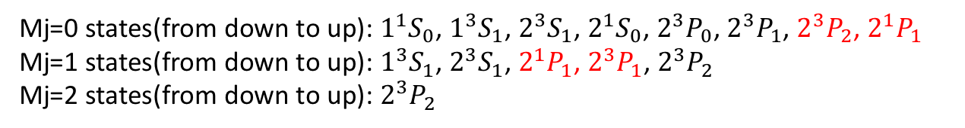
Positronium Mass Spectrum
Nmax=16, K=19, $α=0.3$, M_{e}=1MeV
Mj=0 states(from down to up): $1^{1}S_{0}$, $1^{3}S_{1}$, $2^{3}S_{1}$, $2^{1}S_{0}$, $2^{3}P_{0}$, $2^{3}P_{1}$, $2^{3}P_{2}$, $2^{1}P_{1}$
Mj=1 states(from down to up): $1^{3}S_{1}$, $2^{3}S_{1}$, $2^{1}P_{1}$, $2^{3}P_{1}$, $2^{3}P_{2}$
Mj=2 states(from down to up): $2^{3}P_{2}$
[Kaiyu Fu et al, in preparation]

Slide 31
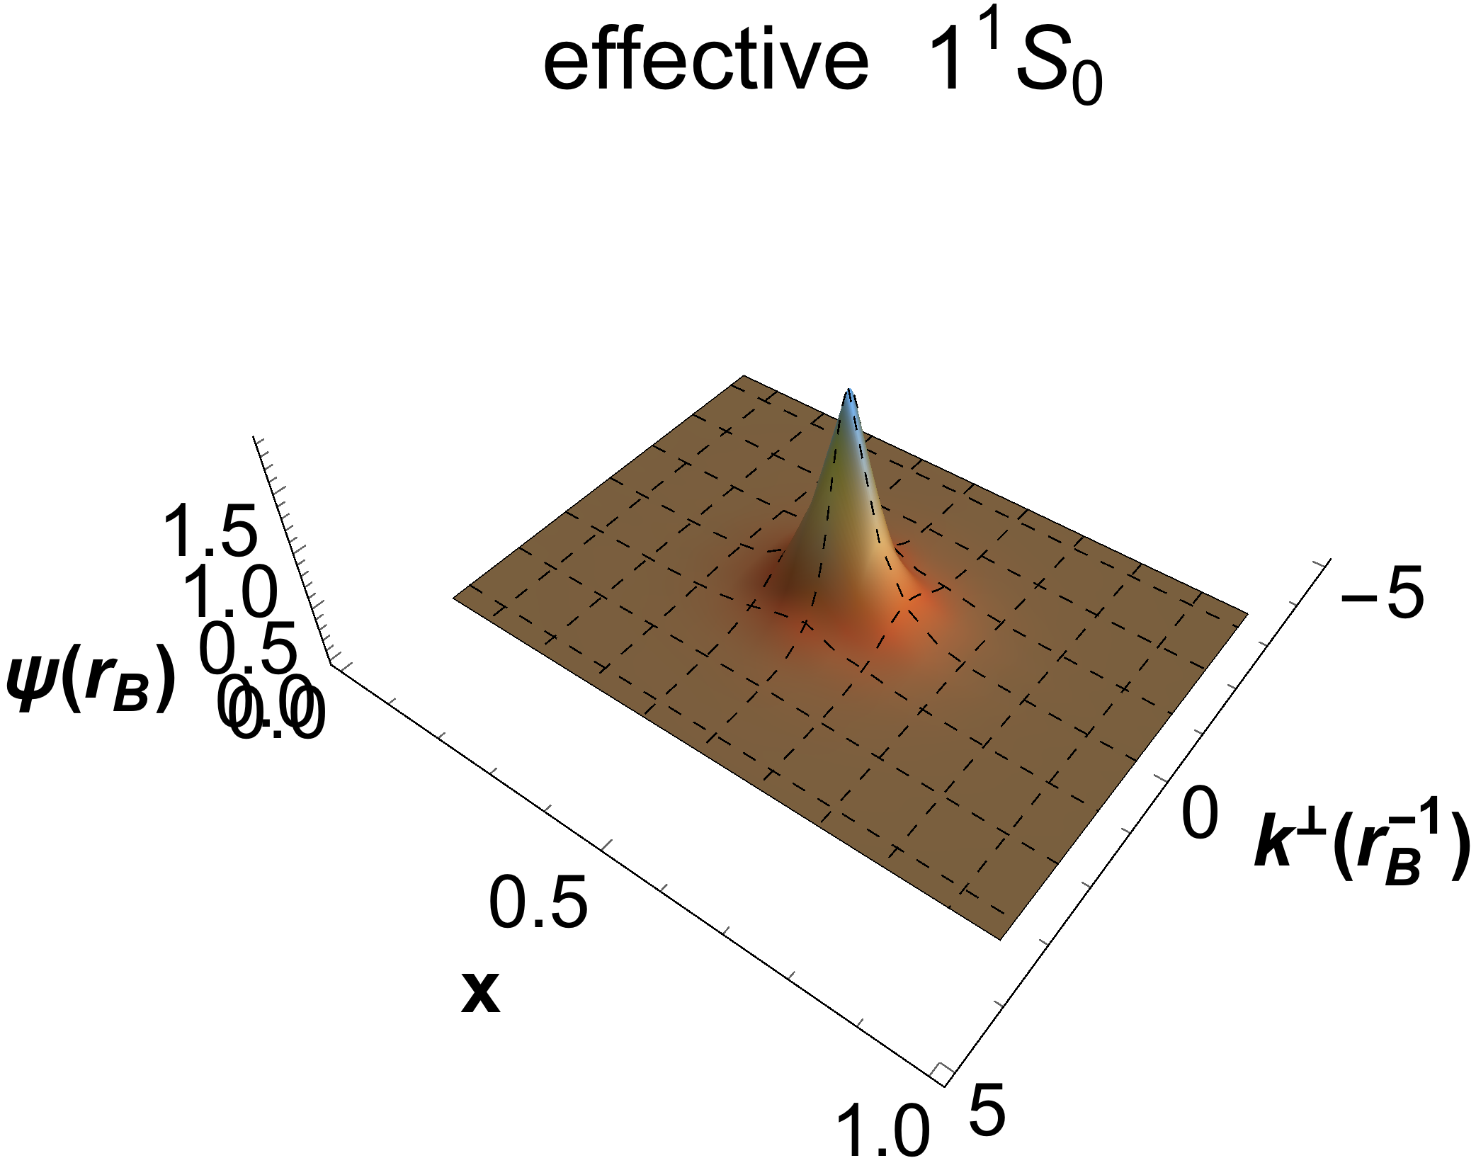
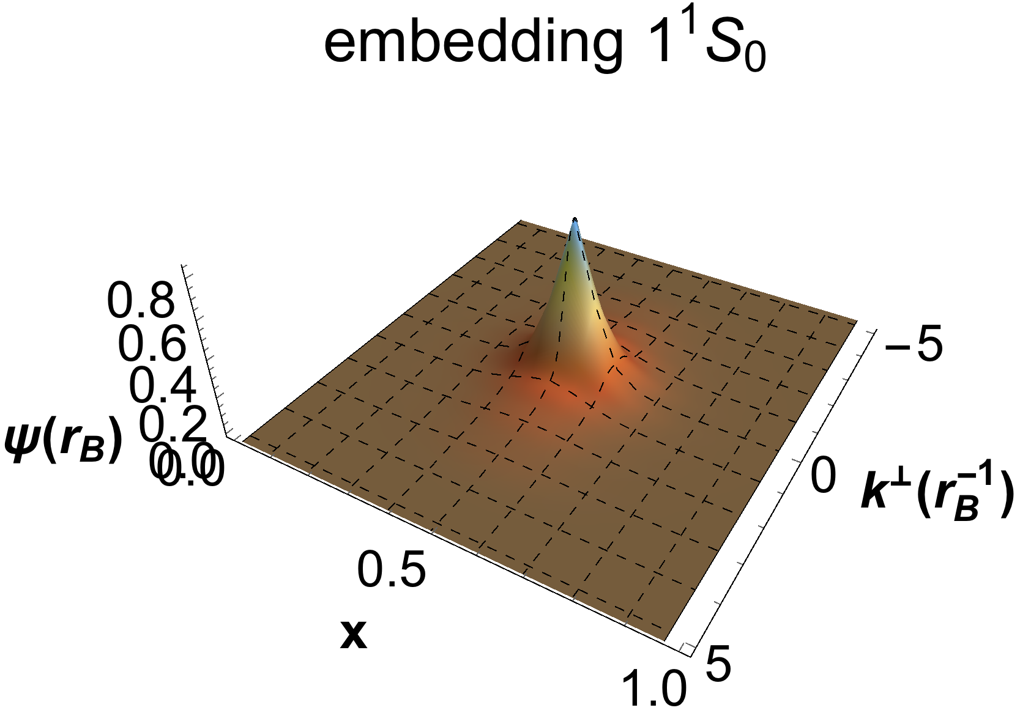
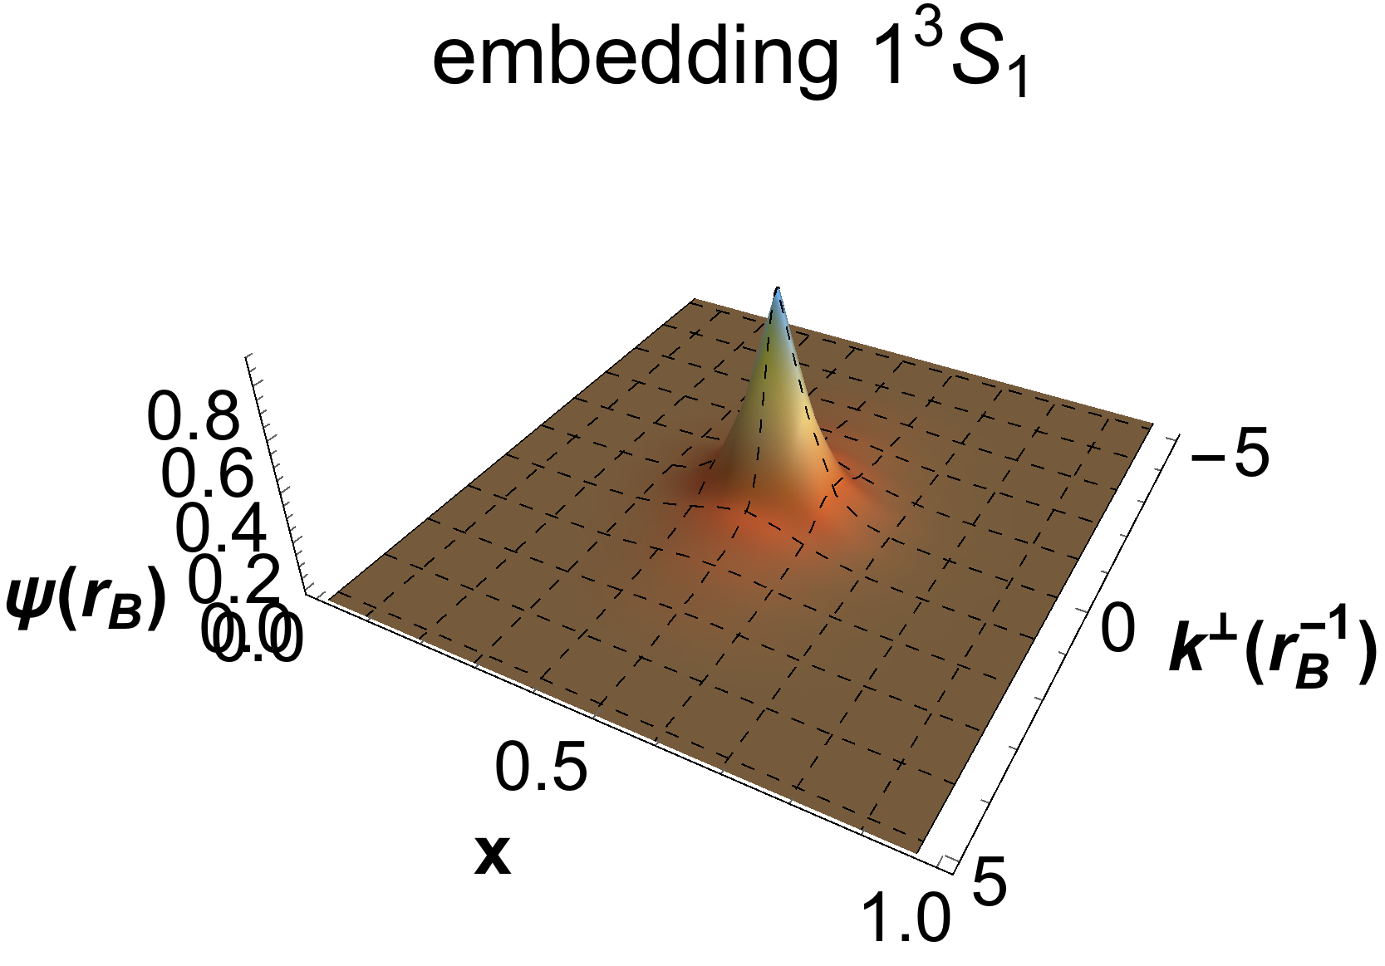
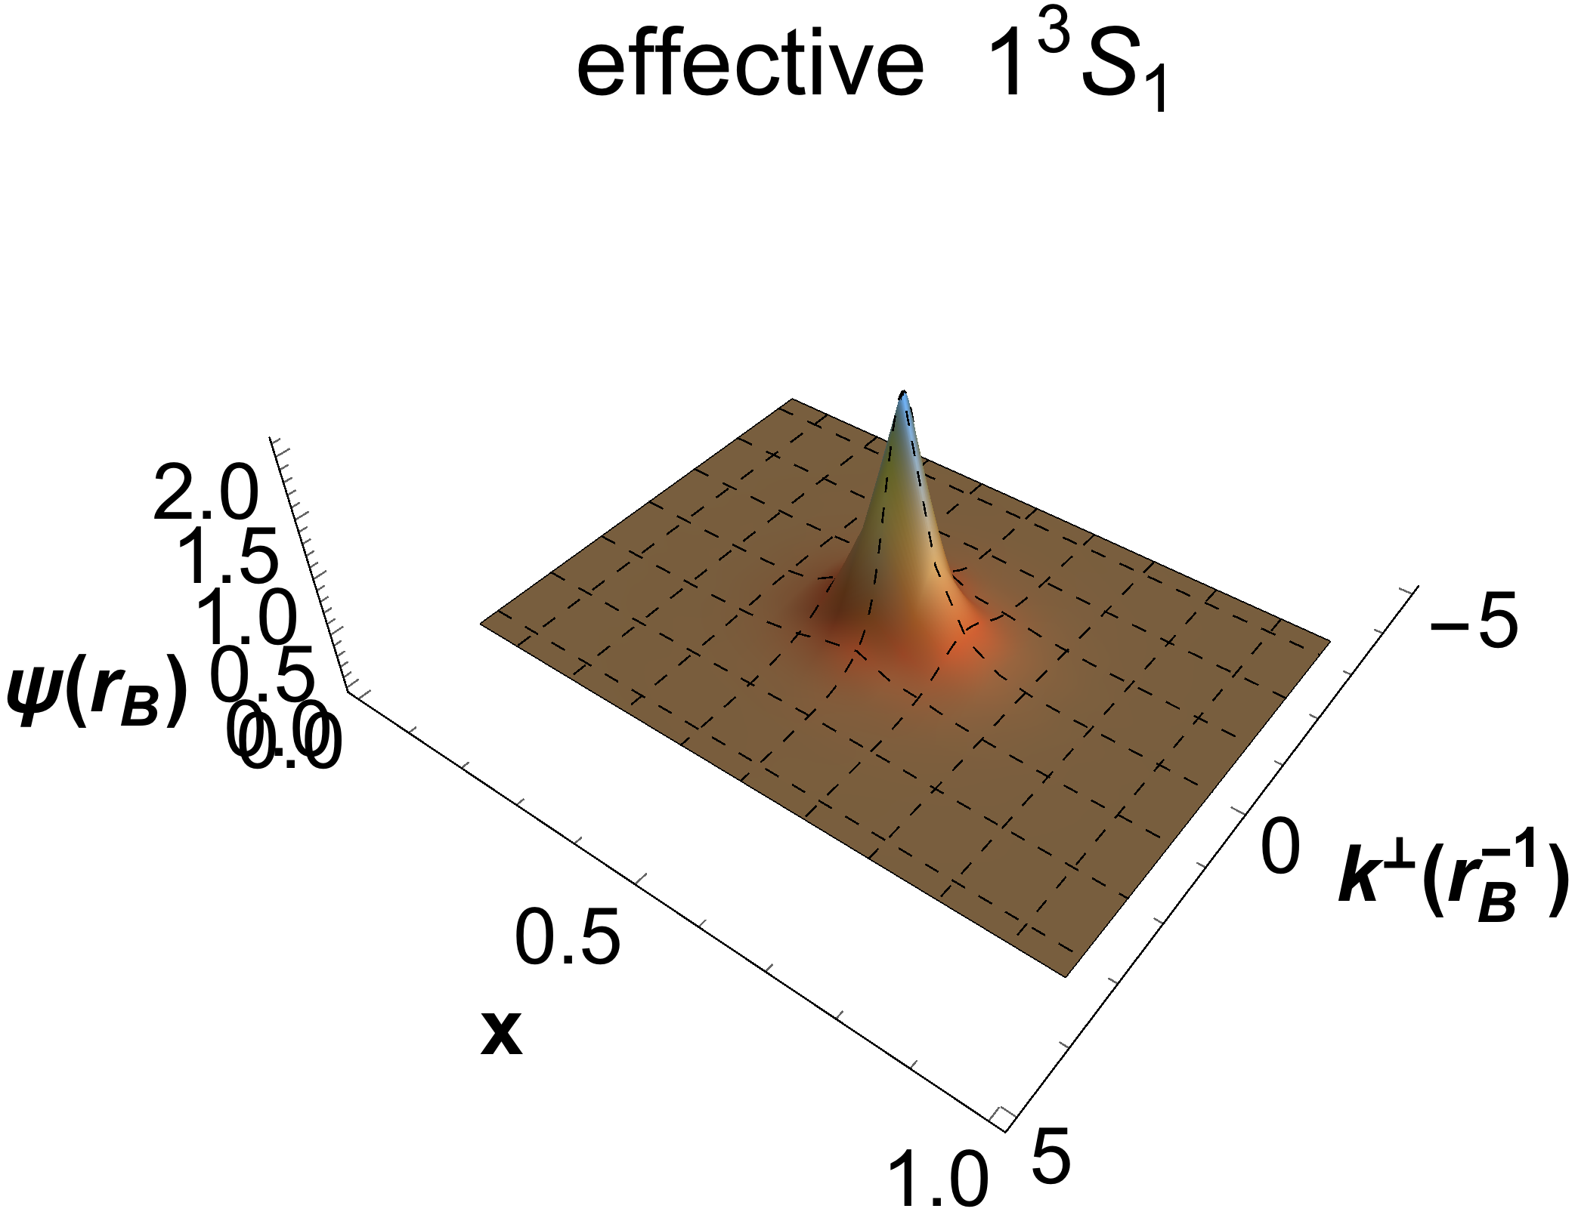
Wave Function Comparison
[Wiecki, et al, 2015]
embedding wavefunction at Nmax=16, K=19,
optimal b_{inst} and b=0.312MeV
effective wavefunction at Nmax=16, K=19, b=0.3MeV
[Kaiyu Fu et al, in preparation]

Slide 32
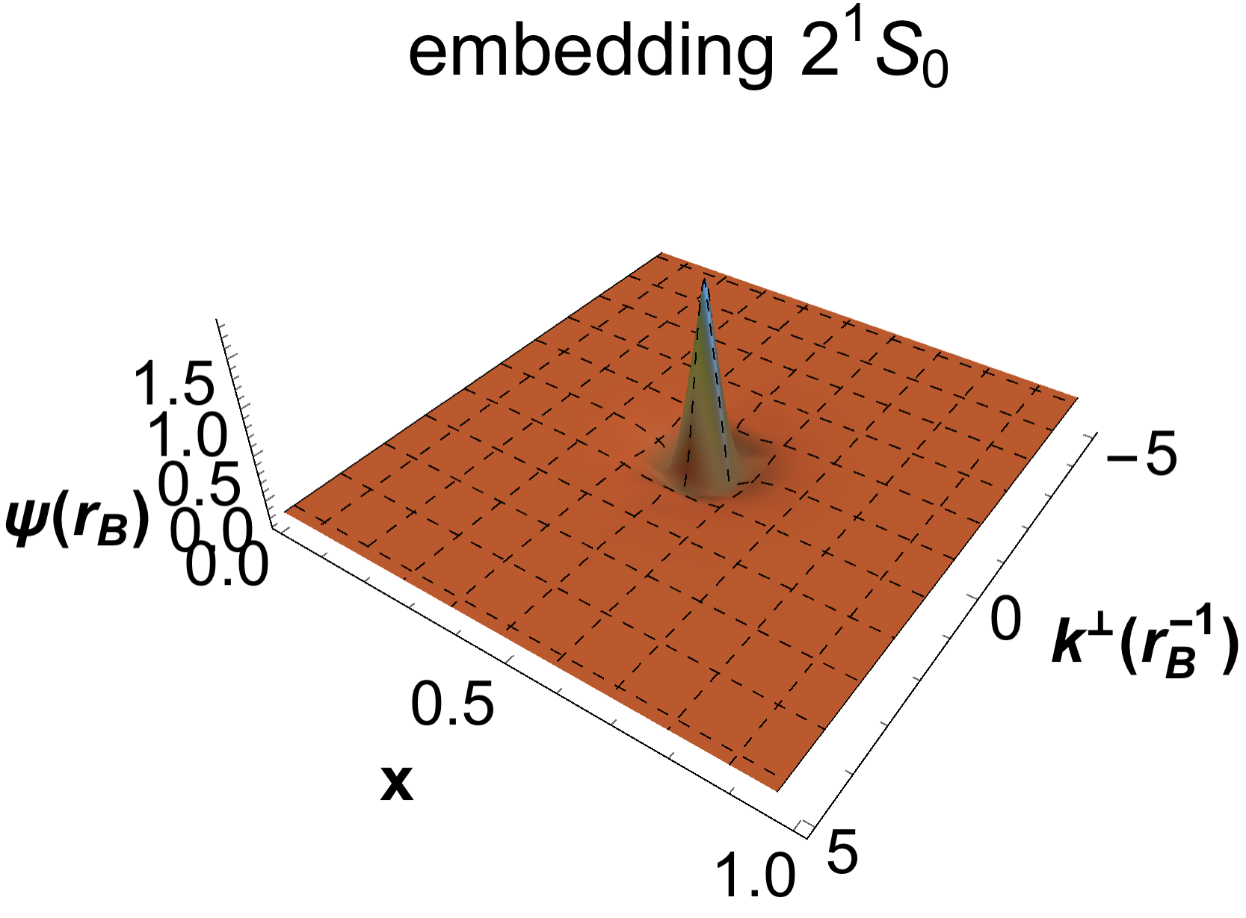
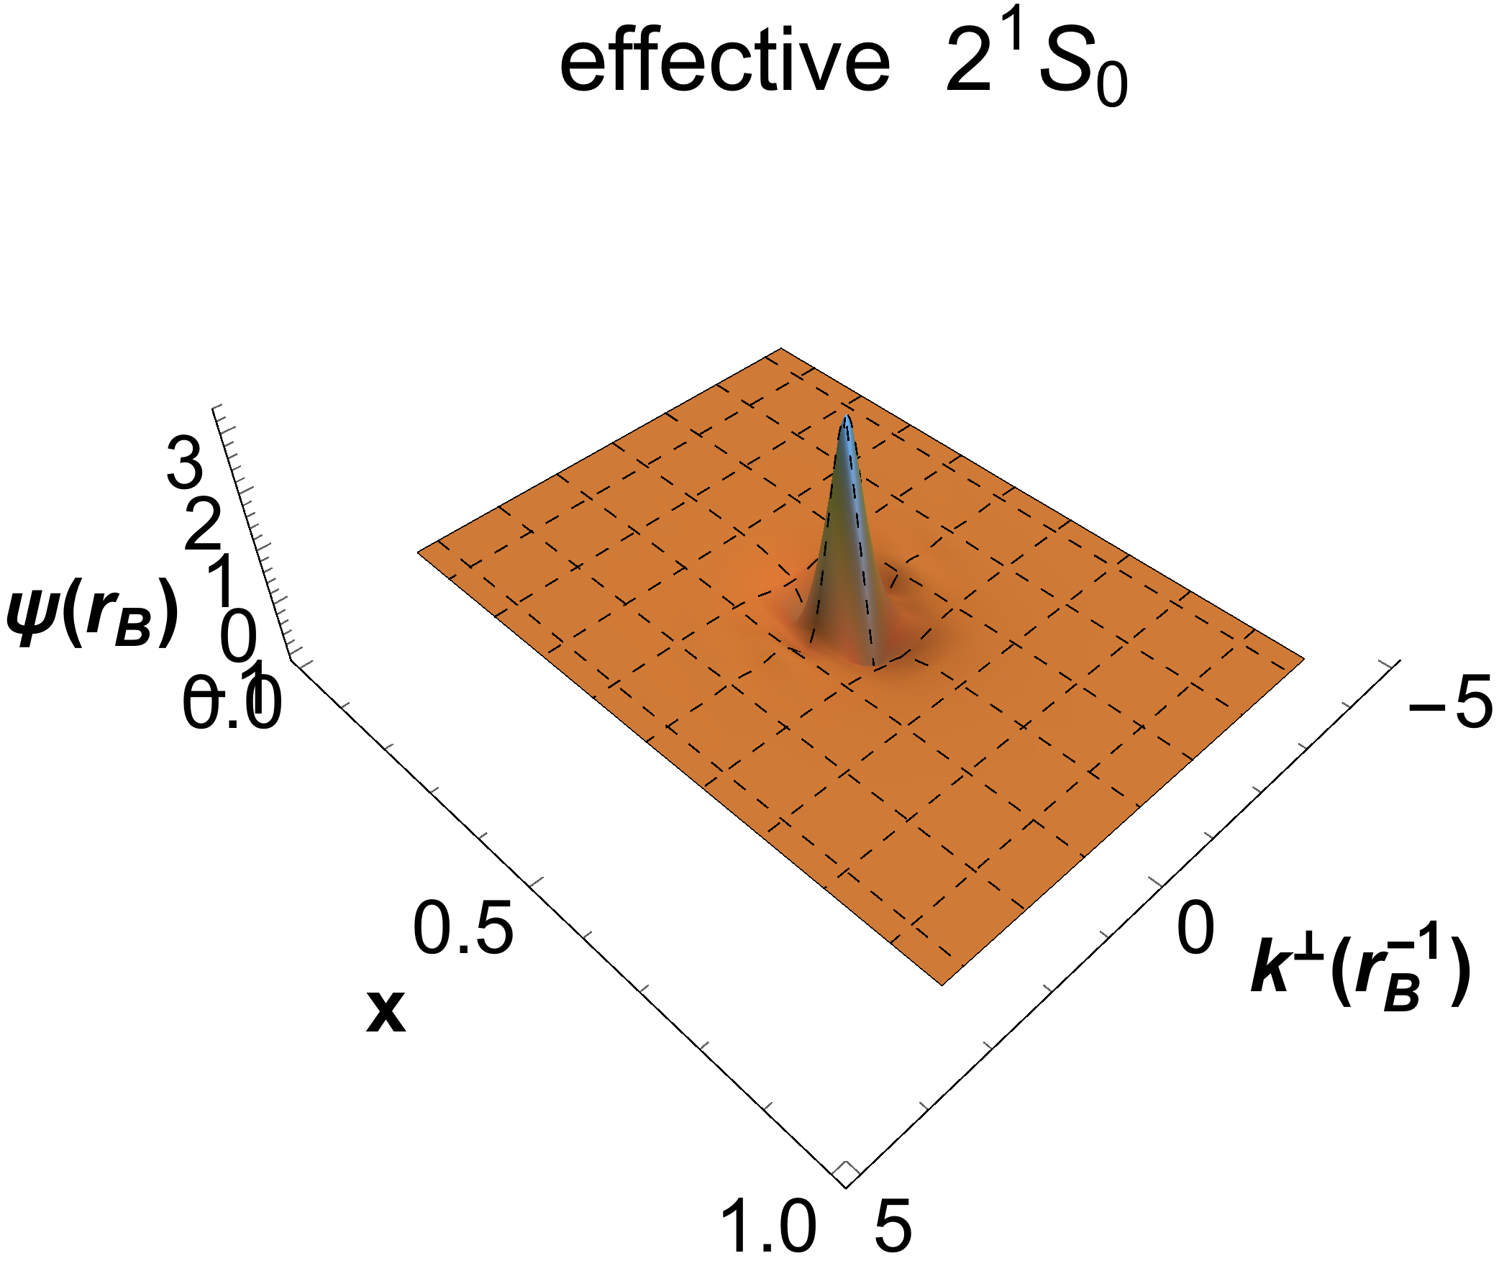


Wave Function Comparison
Nodal structure in radial direction

Slide 33




Wave Function Comparison
Nodal structure in azimuthal direction

Slide 34


Photon Content in Positronium
$${\left|a\right|}^{2}$$
$$\left.|Ps\right\rangle =a\left.|e\overline{e}\right\rangle +b\left.|e\overline{e}γ\right\rangle$$
Photon content increases with N_{max}($\sim \sqrt{Λ}$), reminiscent of DGLAP evolution
[Kaiyu Fu et al, in preparation]

Slide 35

Compare with Photon distribution in Single Electron
photon pdf of physical electron
pdfs of proton
Positronium ¹S₀
Single electron
Proton
[Kaiyu Fu, et al, in preparation]
[Shuo Tang, et al, in preparation]
Small-x photons are largely suppressed
Consistent with the “smaller size” of positronium

Slide 36
Ground State Binding Energy
(Without Mass Renormalization)

Slide 37

Hyperfine Splitting (³S₁-¹S₀)
$$−\frac{α^{4}}{3}m_{e}$$

Slide 38

Outline
Hamiltonian approach to quantum field theory
  Light-front quantization
Basis Light-front Quantization
  A nonperturbative approach
Applications
  Physical electron
  Positronium
  Baryon
Summary and Outlook
  $$|\left.P_{baryon}\right\rangle =|\left.qqq\right\rangle$$

Slide 39







Light-Front Hamiltonian
$$P_{baryon}^{−}=H_{K.E.}+H_{trans}+H_{longi}+H_{OGE}$$
$$H_{K.E.}=\sum_{i}{\frac{p_{i}^{2}+m_{q}^{2}}{p_{i}^{+}}}$$
$$m_{u}=0.3GeV, m_{d}=0.301GeV$$
$H_{trans} \sim κ_{T}^{4}b^{4}ζ^{2}$
-- Brodsky, Teramond Physics Reports 584 (2015) 1–105
$$H_{longi}=−\sum_{ij}{κ_{L}^{4}b^{4}∂_{x_{i}}\left(x_{i}x_{j}∂_{x_{j}}\right)}$$
---Y Li, X Zhao , P Maris , J Vary PLB 758(2016)
$$H_{OGE}=−\frac{C_{F}4πα_{s}\left(Q^{2}\right)}{Q^{2}}\sum_{i,j(i<j)}{{\overline{u}}_{s_{i}^{′}}\left(k_{i}^{′}\right)γ^{μ}u_{s_{i}}\left(k_{i}\right){\overline{u}}_{s_{j}^{′}}\left(k_{j}^{′}\right)γ_{μ}u_{s_{j}}(k_{j}) }$$
Infrared cut off : $m_{g}=0.01 GeV$

Slide 40



Basis Construction
the basis states of baryon in QCD
Fock-Space expansion:
  $|\left.P_{baryon}\right\rangle =|\left.qqq\right\rangle +\left|qqqg\right\rangle +\left|qqq q\overline{q}\right\rangle + ⋅⋅⋅⋅⋅⋅$
For Each Fock Particle:
  For quark: $n_{q}, m_{q}, k_{q}, { λ}_{q}^{z}=(\frac{1}{2},−\frac{1}{2})$
For First Fock states:
  $\left|qqq\right\rangle =\left|n_{q_{1}},m_{q_{1}},k_{q_{1}},λ_{q_{1}}^{z}\right\rangle ⊗\left|n_{q_{2}},m_{q_{2}},k_{q_{2}},λ_{q_{2}}^{z}\right\rangle ⊗\left|n_{q_{3}},m_{q_{3}},k_{q_{3}},λ_{q_{3}}^{z}\right\rangle$
Basis truncation:
we only consider the leading Fock sector: $|\left.P_{baryon}\right\rangle =|\left.qqq\right\rangle$
For Fock states, we have : $K_{max}=\sum{k_{q}} N_{max}≥\sum{\left(2n_{q}+\left|m_{q}\right|+1\right)}$
Although truncating to the leading Fock sector, we are trying to solve the multi-particle system.

Slide 41








Mass spectrum without One-Gluon Exchange
Mass spectrum for symmetry case
$$M=\sqrt{p^{−}p^{+}}$$
$$J=|Max(m_{J})|$$
$$L=\left|L_{Z}\right|$$
$$S=J−L$$
$n$ is radial quantum number
$$n=3$$
$$n=2$$
$$n=1$$
Téramond and Brodsky, Physics Reports 584 (2015) 1–105
$$n=0$$
Orbital and radial baryon excitation spectrum is in more or less agreement with LF holographic model

Slide 42






Form Factor
Electron Magnetic Form Factors in light front
$$F_{1}\left(Q^{2}\right)=\left\langle P+q,Λ | \frac{J^{+}\left(0\right)}{2P^{+}} | P,Λ\right\rangle$$
$$\frac{−(q^{1}−iq^{2})}{2M}F_{2}\left(Q^{2}\right)=\left\langle P+q,Λ | \frac{J^{+}\left(0\right)}{2P^{+}} | P,−Λ\right\rangle$$
In BLFQ, our results is in agreement with experiment data for Dirac Form Factor.

Slide 43



Generalized Parton Distributions
Dirac form factor in light-front
$F_{1}\left(Q^{2}\right)=\left\langle P+q,Λ | \frac{J^{+}\left(0\right)}{2P^{+}} | P,Λ\right\rangle ;$ $F_{1}\left(Q^{2}\right)=\int{dx}H^{q}(x,t)$.
In terms of overlap of light-front wave functions:
$$t=−q^{2}$$
$$H^{q}\left(x,Q^{2}\right)= \sum_{λ_{i}}{\int{\prod_{i=1}^{3}{dx_{i}d^{2}k_{⊥i}δ\left(1−∑x_{j}\right)δ\left(x−x_{1}\right)δ^{2}\left(∑k_{⊥j}\right)}Ψ_{λ_{i}}^{Λ∗}(x_{i},k_{⊥i}^{′})Ψ_{λ_{i}}^{Λ}(x_{i},k_{⊥i}^{′})}}$$
The height of picks are almost same with LF quark-diquark model.
In LF quark-diquark model, the quark mass is zero.
Eur. Phys. J. C (2015) 75:261

Slide 44






Parton Distribution functions
Parton distribution functions in light front:
$$f_{1}\left(x\right)=H^{q}(x,0)$$
The PDFs is equal to the GPDs in forward limit (t=0).
$$<x_{q}>=\int{dx}{xf}_{1}^{q}(x)$$
Average momentum is carried by the quark.
Here, we use the DGLAP equation to evolve the PDF. Qualitative behavior of PDF is almost same with the global fit MSTW(2008) PDF.
Note: In order to evolve PDF, we fit the BLFQ data to function of $x$
$Q_{0}$ is the initial scale
$$<x_{q}>\left(Q_{0}^{2}\right)=0.32378$$
$$<x_{q}>\left(Q=1GeV\right)=0.185245$$
$$<x_{q}>\left(MSTW\right)=0.142816$$
Note: In DGLAP, we use leading order running coupling constant:
$α_{s}\left(Q^{2}\right)=\frac{4π}{9ln⁡(\frac{Q^{2}}{Λ^{2}})} ; Λ=0.226$ GeV

Slide 45
Conclusions
Hamiltonian formalism
  Access to hadron structure through wave functions
Suitable for observables defined on the light-front
  PDF, GPD, TMD, GTMD…
Allows for first-principles calculations
  Truncation and renormalization need more work
Initial tests look promising
  First-principles calculation of positronium based on QED
  Correct state ordering
  Reasonable wave functions

Slide 46








Outlook
Baryon
Meson
$$|qqq⟩$$
$$|q\overline{q}⟩$$
$$|qqqg⟩$$
Gluons
$$|q\overline{q}g⟩$$
$$|qqqq\overline{q}⟩$$
Sea quarks
Exotic hadrons
$$|q\overline{q}q\overline{q}⟩$$
$$|qqqgg⟩$$
Glueballs
…
$$|q\overline{q}gg⟩$$
…
…
Systematically improvable
Tremendous opportunities in the future!

Slide 47
Thank you!
Welcome to collaborate with us!
Suggestions/comments are welcome!

