Slide 1
R&D on μRWELL Tracking Detectors
Daojin Hong
On behalf of USTC MPGD Group
State Key Laboratory of Particle Detection and Electronics, China
University of Science and Technology of China
July 29, 2018

Slide 2
Outline
Motivation
Overview of μRWELL detector
R&D on μRWELL detector
Summary and Outlook
R&D on the resistive layer-DLC
Detector Design
Performance study

Slide 3
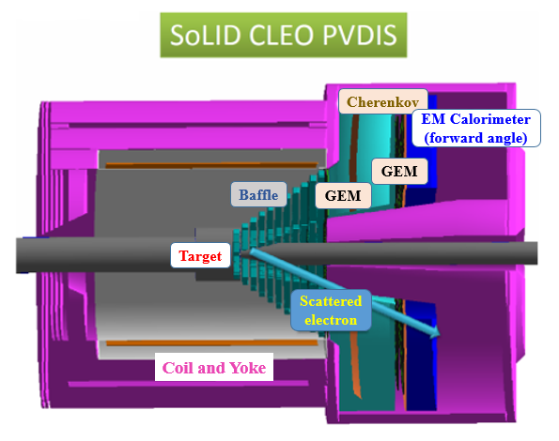
Motivation
GEM (Gas Electron Multiplier) is the solution
for SoLID tracker detector
Main requirements for GEM detectors @SoLID
  A new gaseous detector named μRWELL provides a promising candidate for SoLID tracker detector.
  High rate: up to the order of 1 MHz/cm²
  Position resolution: ~100μm
  Tracking efficiency: >90%
  …
μRWELL detector
G. Bencivenni et al, RD51 Mini-week report

Slide 4
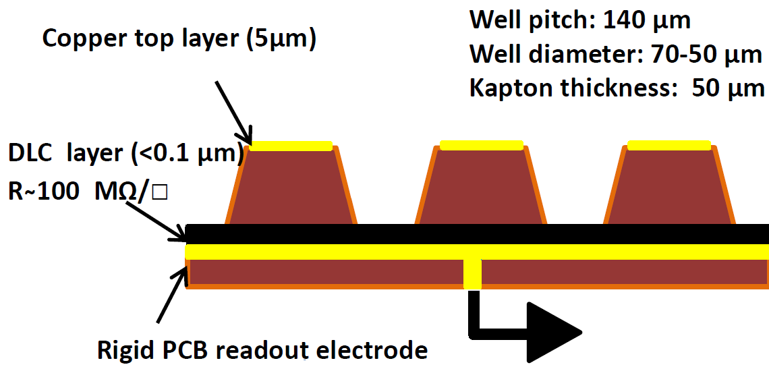
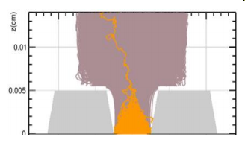
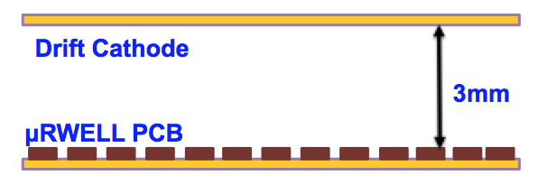
Overview of μRWELL detector
Schematic of Micro Resistive Well (μRWELL) detector
resistive layer
Drift gap
G. Bencivenni et al., JINST, 10, (2015), P02008
Advantages of the μRWELL detector
Simple and compact: no transfer or induction gap
Low mass: no stretching, no gluing and no spacers
Suitable for large area
A resistive layer for discharge suppression and current evacuation
DLC - Diamond-like carbon

Slide 5
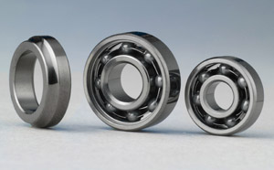

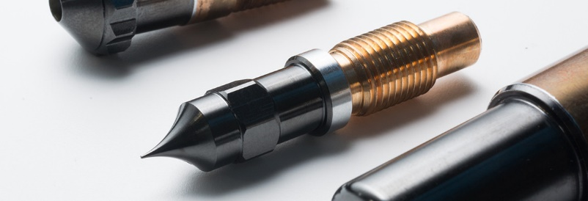
Introduction to DLC
Diamond-like carbon (DLC) is a class of amorphous carbon material that displays some of the typical properties of diamond.
Low friction factor
High hardness
Thermal conductive
…
Applications
Why use DLC as the resistive layer?
  Widely applied in industry
  Chemical stability
  Thermal stability
  High resistivity
Useful link of DLC: https://en.wikipedia.org/wiki/Diamond-like_carbon

Slide 6
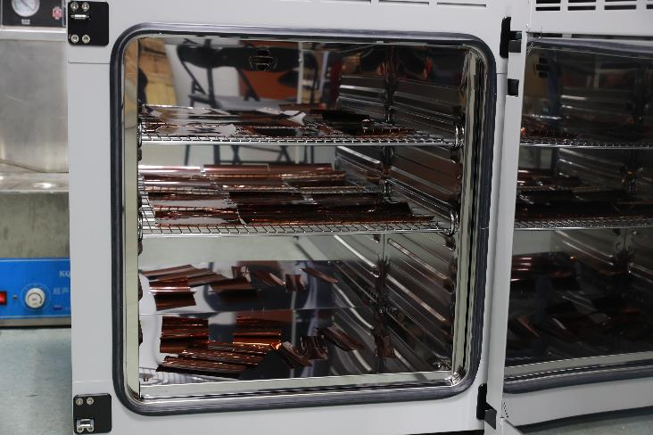
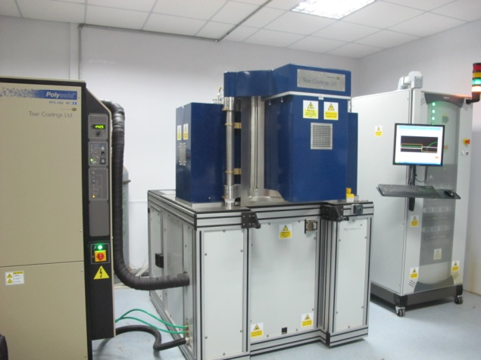
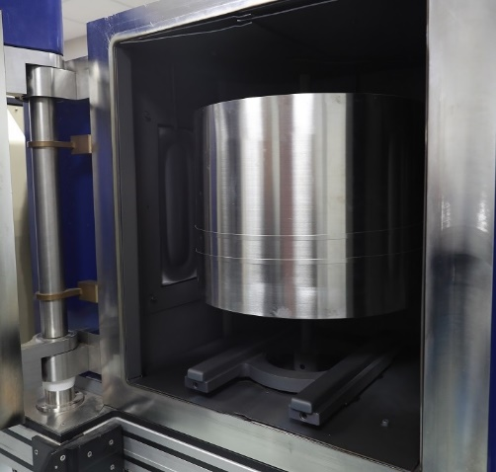
DLC deposition procedure and devices
Sample Baking
DLC is deposited on a kapton substrate by the magnetron sputtering method
The Magnetron sputtering system (Teer 650)
Sample Clamping
Baking
Vacuum Pumping
Sample Pre-treating
Deposition
Main deposition procedure:
Baking base material at 70 degrees for 12 hours.
Vacuum pumping to remove the air from the chamber (should be less than 3×10⁻⁵Torr).
Start procedure to coat DLC on the pre-treated sample.
Cooling in vacuum to release the inner stress uniformly of the sample.
Cooling in Vacuum
Sample
taking down
Sample Support
State Key Laboratory of Solid Lubrication, Lanzhou Institute of Chemical Physics, Chinese Academy of Sciences

Slide 7
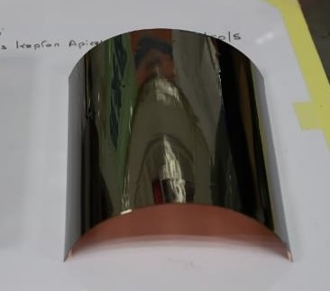
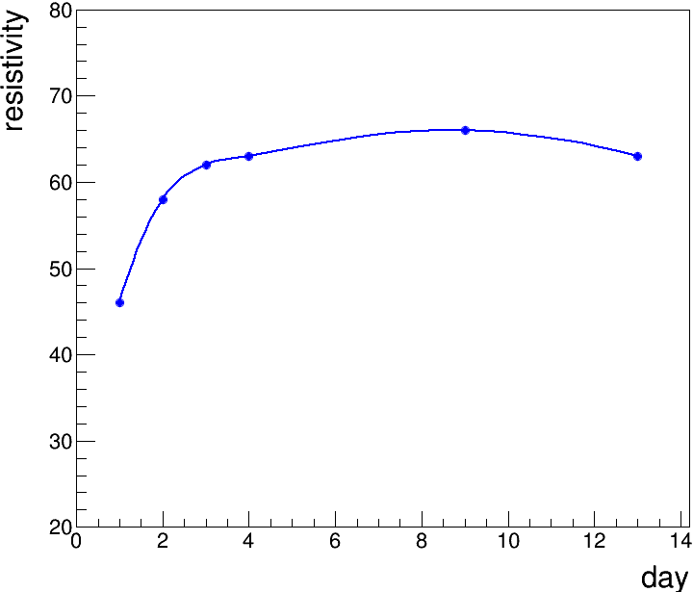
DLC Sample Performance
DLC parameters
After take down the DLC sample, we expose the DLC sample in air.
Thickness : ～100nm
Resistivity uniformity : 13%
Resistivity VS Time
51 MΩ/□ | 52 MΩ/□ | 51 MΩ/□
41 MΩ/□ | 42 MΩ/□ | 42 MΩ/□
46 MΩ/□ | 45 MΩ/□ | 46 MΩ/□
～65MΩ/□
A 15cm×15cm DLC Sample
Resistivity Uniformity: ~13%
Resistivity of the DLC keep stable after 3~4 days
Notes:
Possible reason is the passivation in air

Slide 8
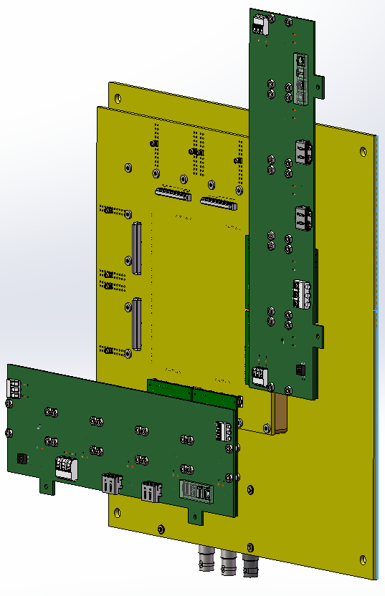
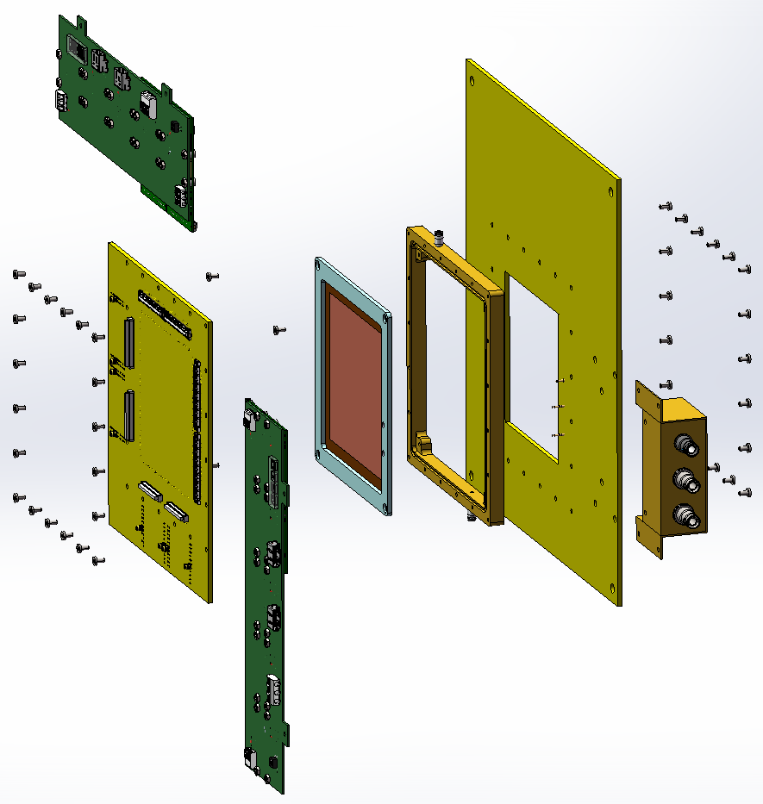
Design of μRWELL Detector
2-D μRWELL Detector prototype
Assembly
HV
μRWELL PCB
Drift
Frame
Window
Backplane for APV25 chip

Slide 9
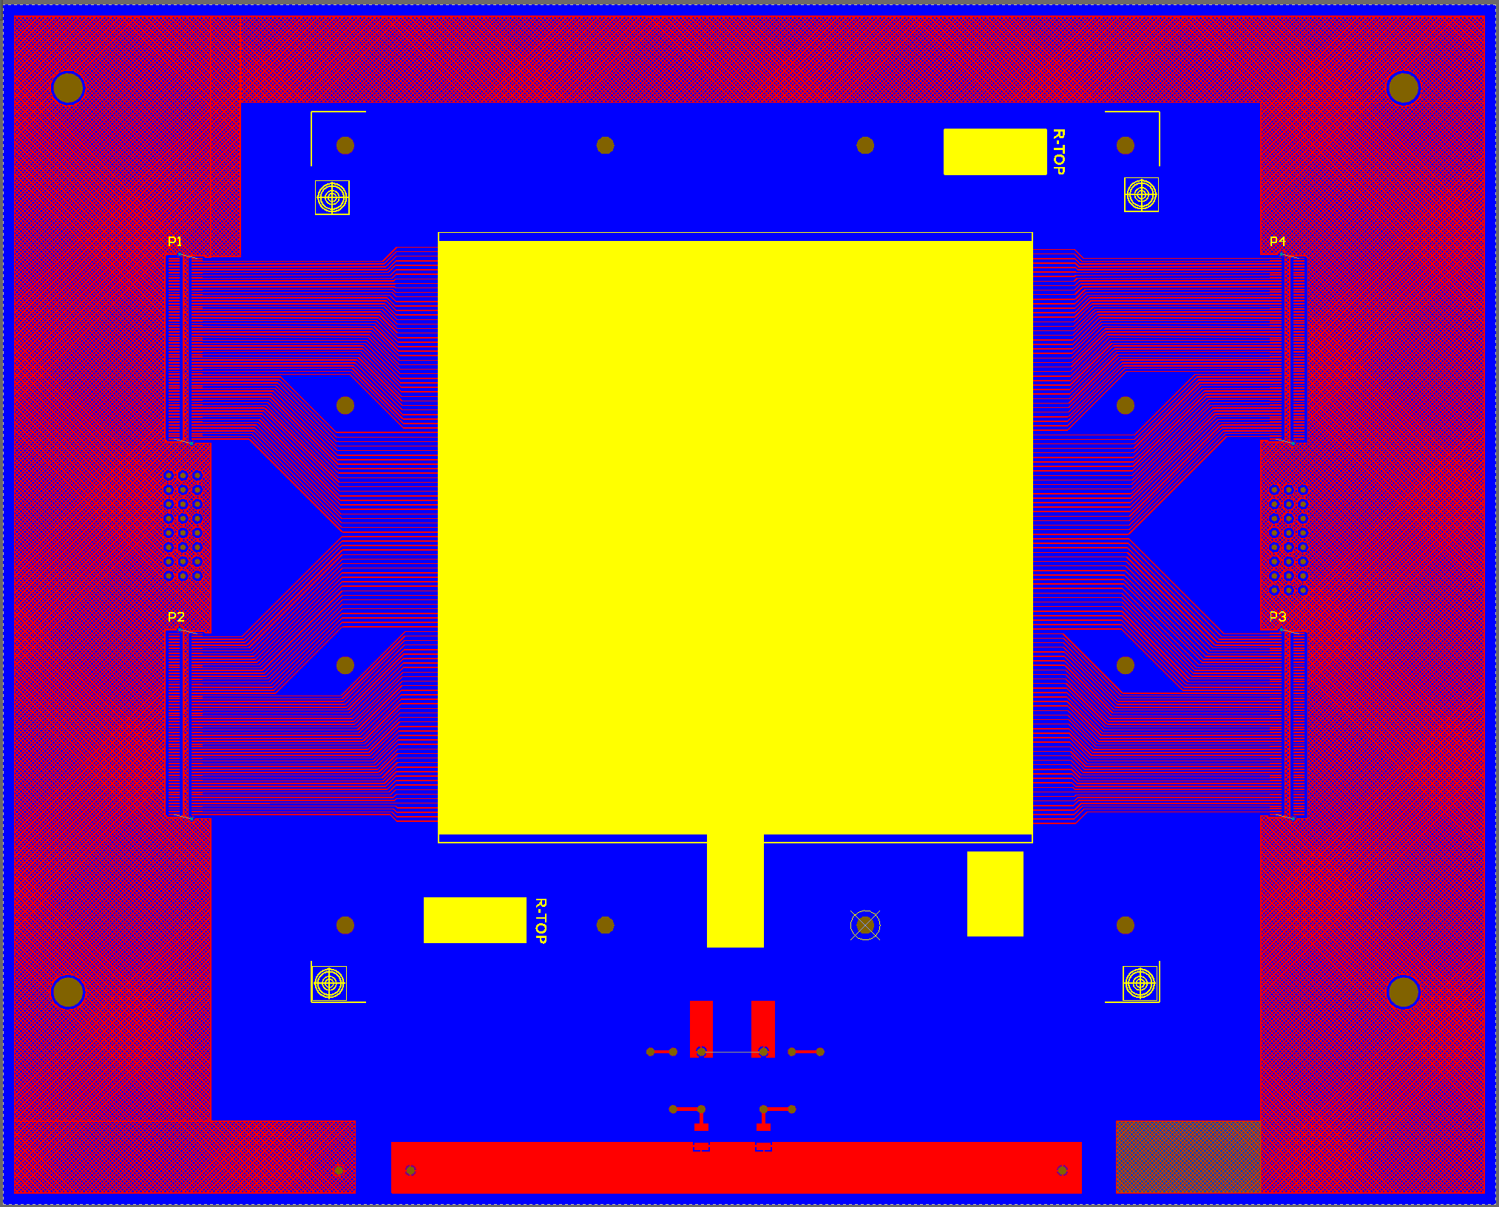
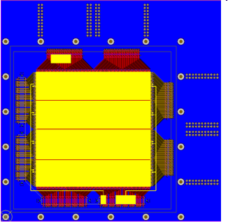
Design of μRWELL PCB
1st
3rd
The WELL structure is split into 4 segments to avoid failure of the whole detector as a defect only in small area.

Slide 10
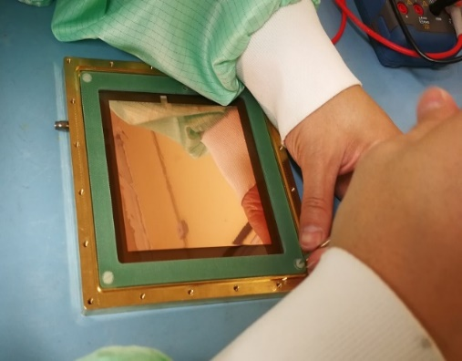
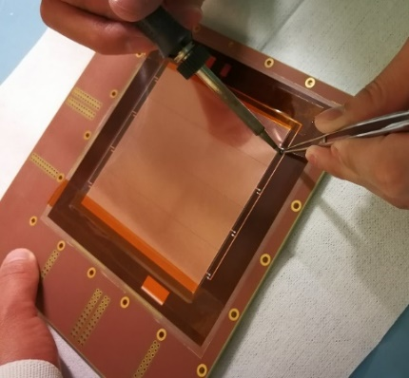
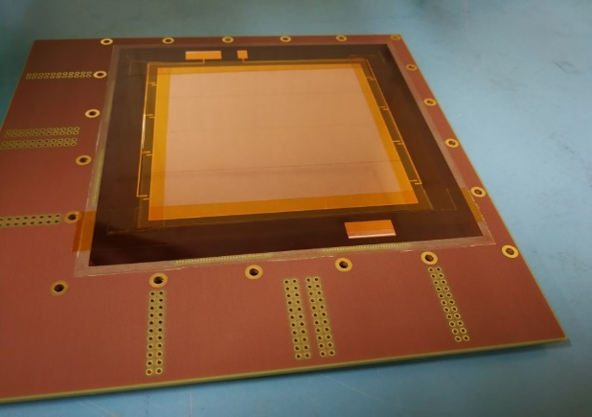
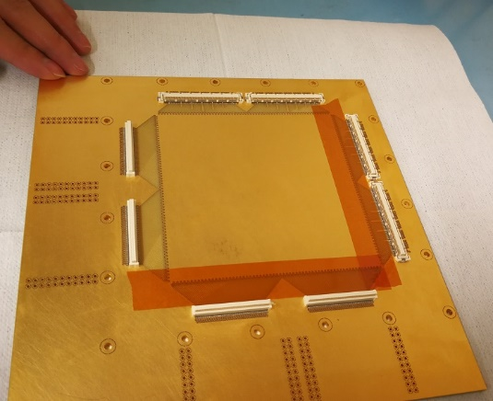
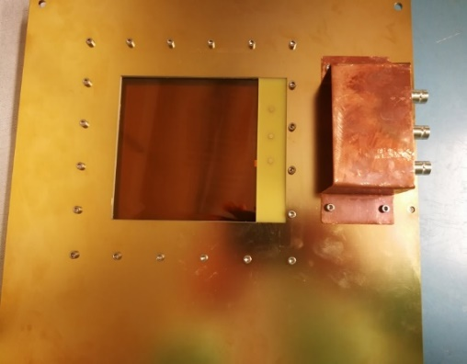
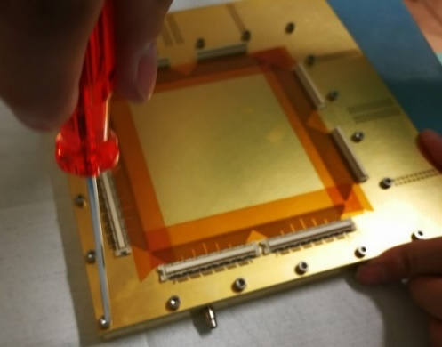
Fabrication of μRWELL detector
μRWELL detector
  10cm×10cm active area
  3mm drift gap
Fix drift electrode
Solder HV Connector
(HV or signal output)
μRWELL PCB
μRWELL Detector
Fix μRWELL PCB
A simple and fast assembly procedure!

Slide 11
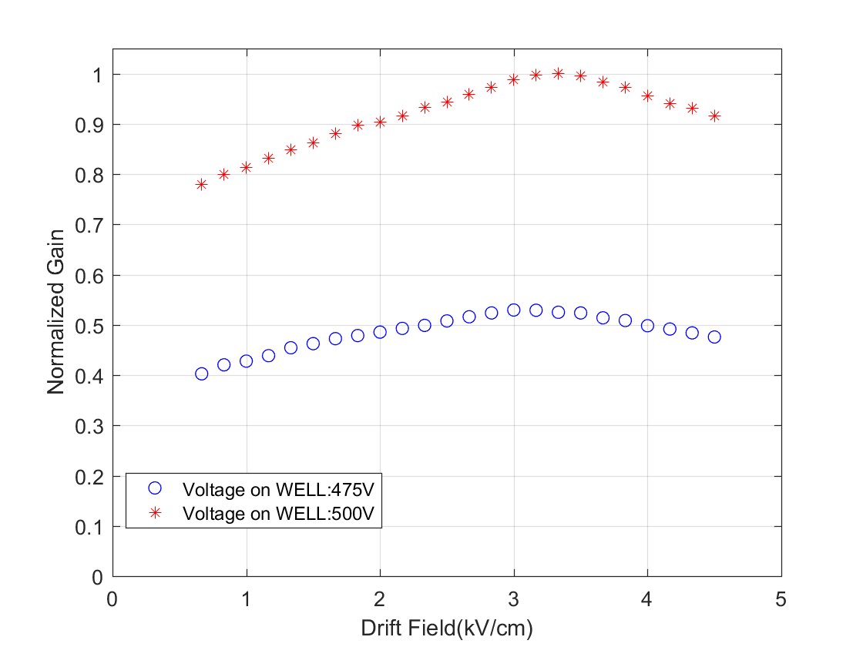
Charge collection efficiency .VS. Drift field
Gas: Ar/CO2(70/30)
Collection efficiency of primary electrons .VS. Drift field
Test setup
X_ray
HV
uRWELL
Pre-Amp
Spectrascopy Amplifier
~3.3 kV/cm
MCA
Gain reach the maximum @3.3kV/cm drift field

Slide 12
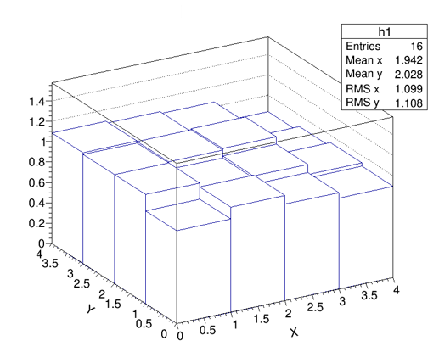
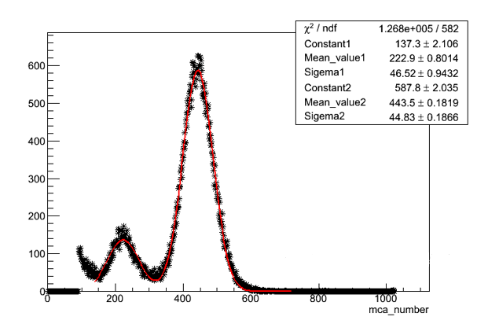
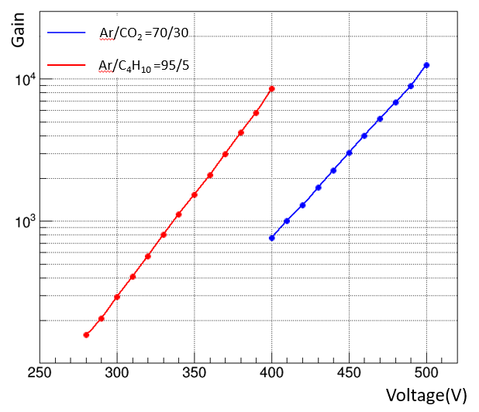
Gain of the μRWELL detector
Detector area:10 cm ×10 cm
Gas: Ar/CO2=70/30
Gain uniformity
Gain of the μRWELL detector
Energy spectrum of 5.9 keV x-ray
Gain: could reach 10⁴
Energy resolution：~22%
Gain：~1800× (1±10%)

Slide 13
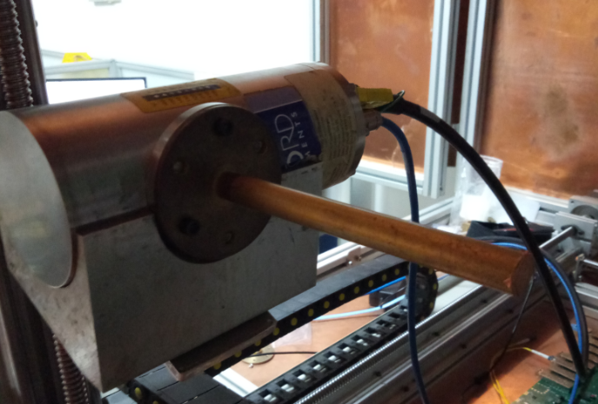
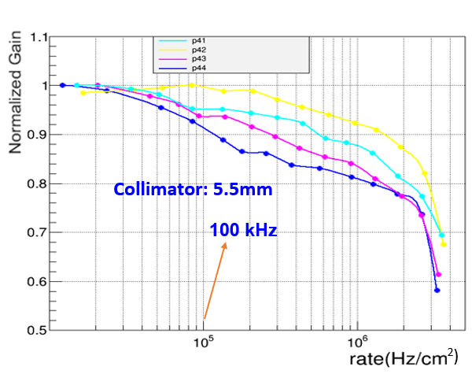
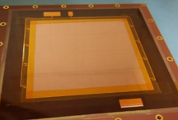
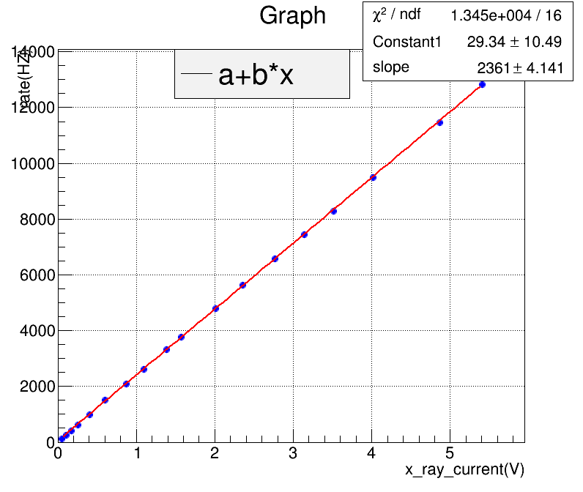
Rate Capability
Resistive electrode
X ray tube
X ray current VS counting rate
P41 | P42 | P43 | P44
P31 | P32 | P33 | P34
P21 | P22 | P23 | P24
P11 | P12 | P13 | P14
X ray counting rate is linear with current of X ray tube
Gain of the μRWELL detector drop about 2% @100kHz/cm²
Notes:
Rate capability is an important parameter for a detector in high rate occasion

Slide 14
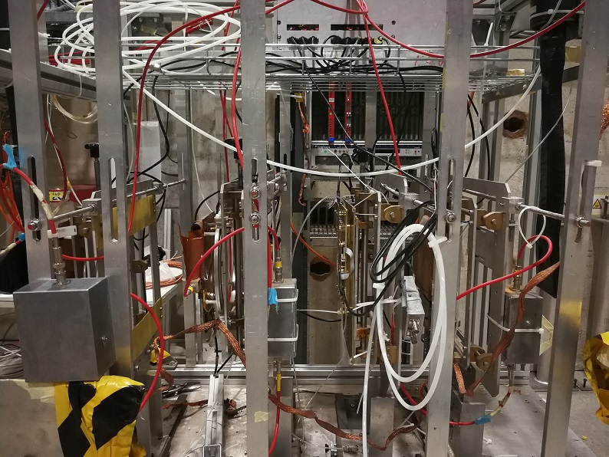
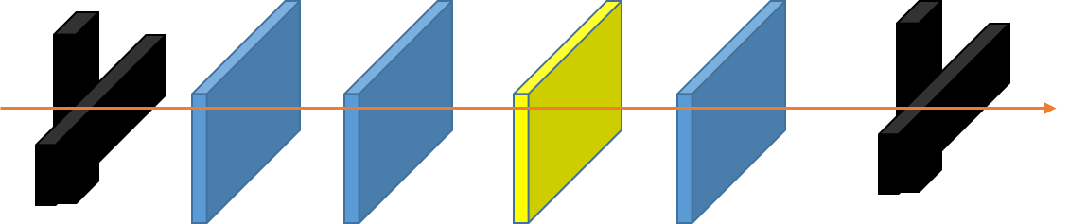
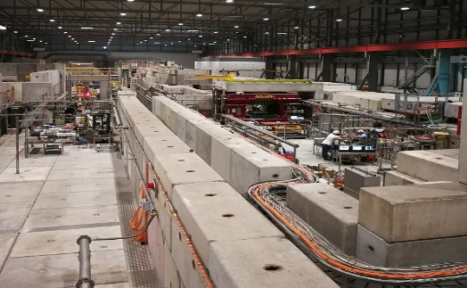
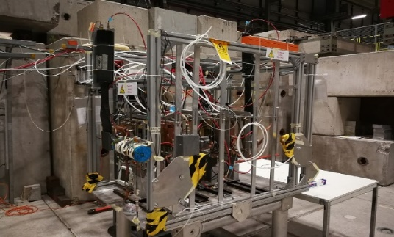
Beam Test Setup
Scintillator for trigger
RD51 GEM Tracker
APV25 readout chip
Muon beam momentum: 150GeV/c
SRS
S1 & S2 for trigger
S3 & S4 for trigger
Beam line
GEM1
GEM2
μRWELL
GEM3
GEM tracker
Notes:
Four scintillator detectors are used as a trigger for the whole system, and three GEM detectors provide a tracker for the 2-D Urwell detector.

Slide 15
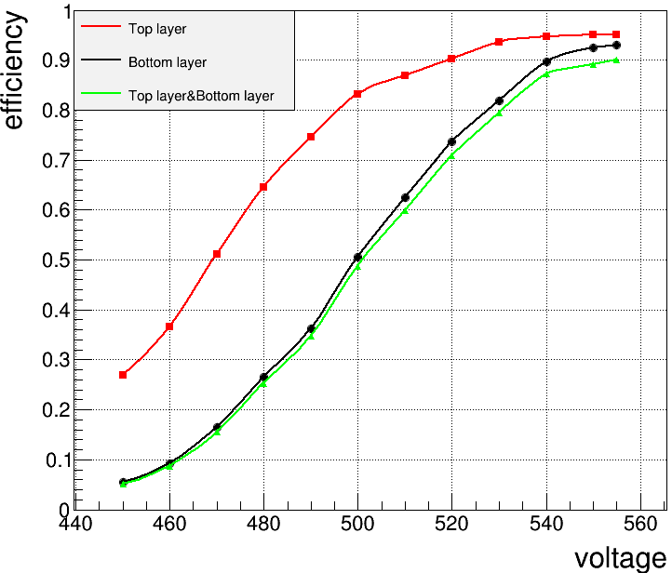
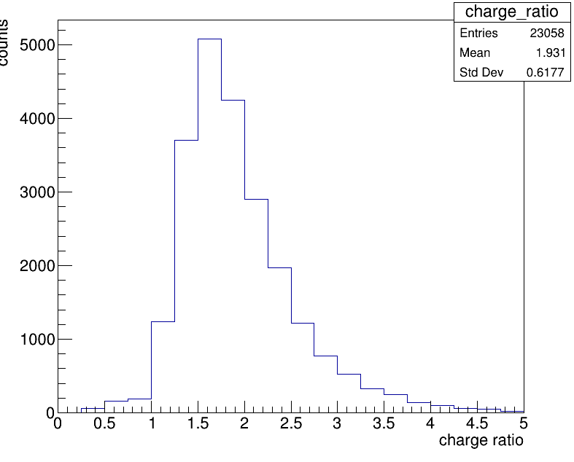
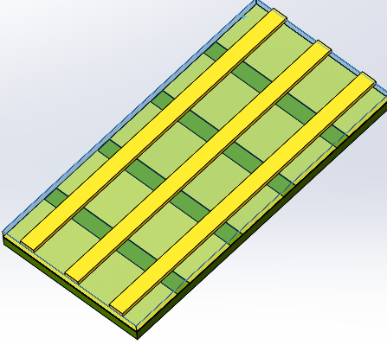
Detection efficiency
Parameter of readout strips
Detection efficiency VS avalanche voltage
Pitch: 400 μm
Top layer: 80 μm
Bottom layer: 350 μm
Top layer Charge/Bottom layer charge
Top layer efficiency : ~95%
Bottom layer efficiency: ~92%
Top & Bottom efficiency: ~90%
The Top layer induced charge is 1.9 times of Bottom layer

Slide 16
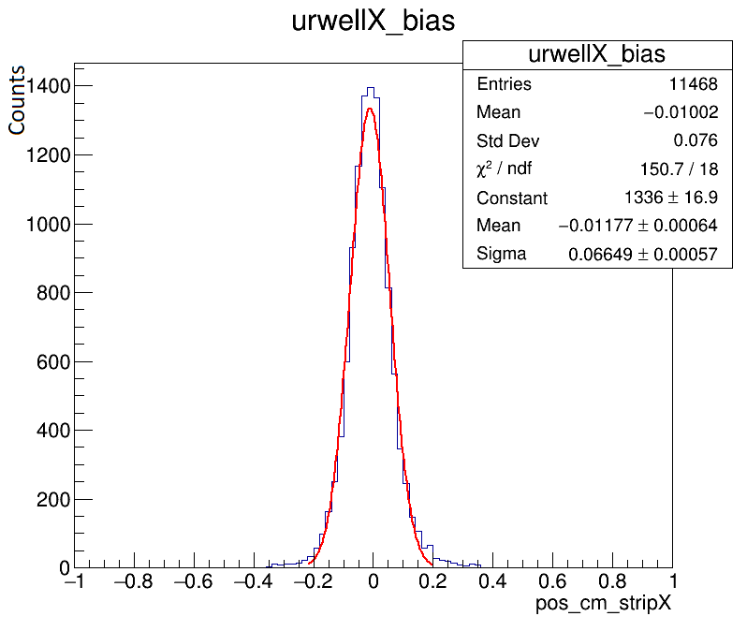
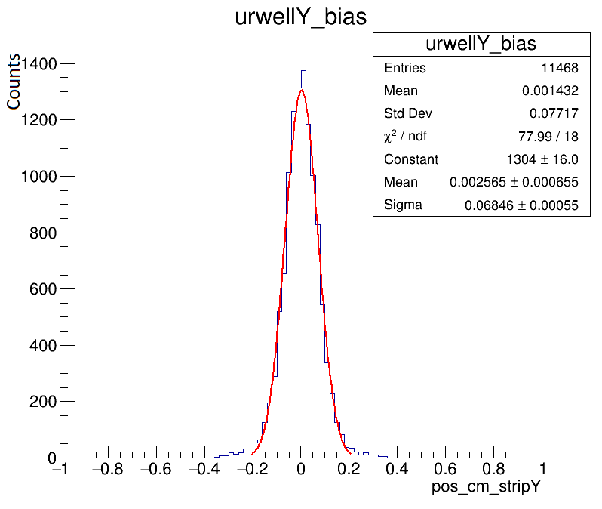
Position resolution
Sigma: 66 μm
Sigma: 68 μm
Notes:
X position resolution(Bottom layer): 66um

Slide 17
Summary and Outlook
Summary
Micro Resistive Well (μRWELL) is a compact detector, it is simple and easy to fabricate.
Performance of a μRWELL detector is studied in lab/ muon beam.
Gas gain: could reach 10⁴
Rate capability: >100kHz/cm²
Position resolution: ～70 μm.
Detection efficiency to 150 GeV/c muon: >90%
Thanks!
Outlook
Special Thanks to:
Teixeira, R. De Oliveira and G. Bencivenni for
providing technical support
R&D on larger size DLC sample.
R&D on large area μRWELL detector.
R&D on high rate μRWELL detector.

