Slide 1

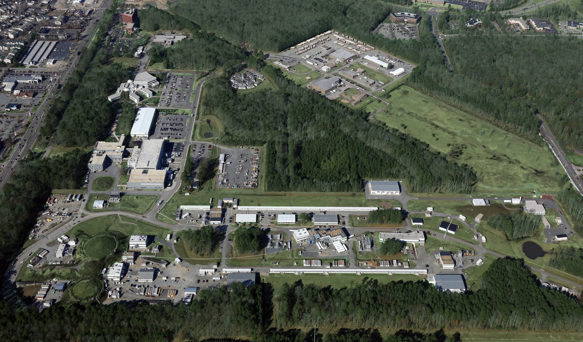
Introduction to the GlueX Experiment at JLab
Shuang Han
Experimental Physics Division Seminar, Jan 18, 2018

Slide 2
Outline
  Spectrum of Mesons
  The GlueX experiment
  Early Results
  Future Prospects

Slide 3
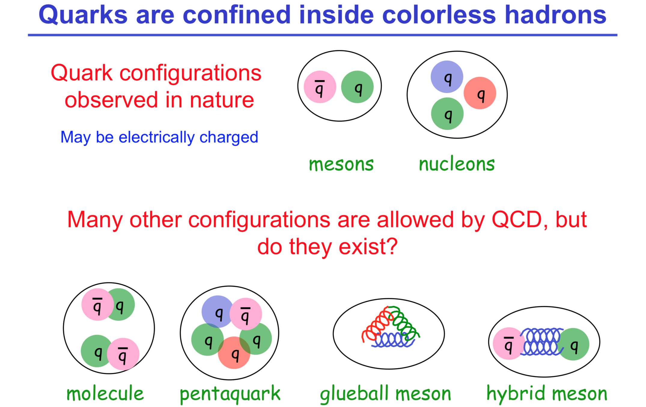
Cite from: Elton S. Smith Ohio University Seminar

Slide 4
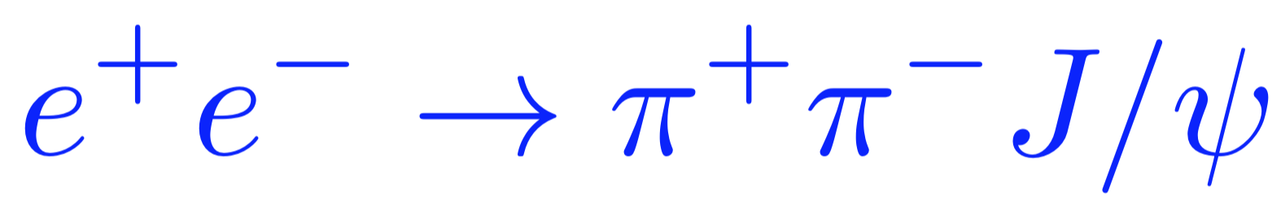

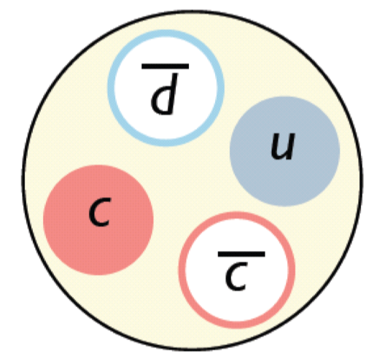
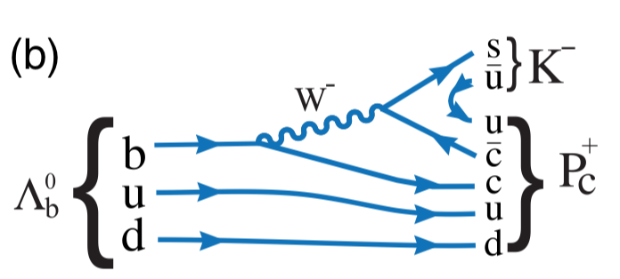



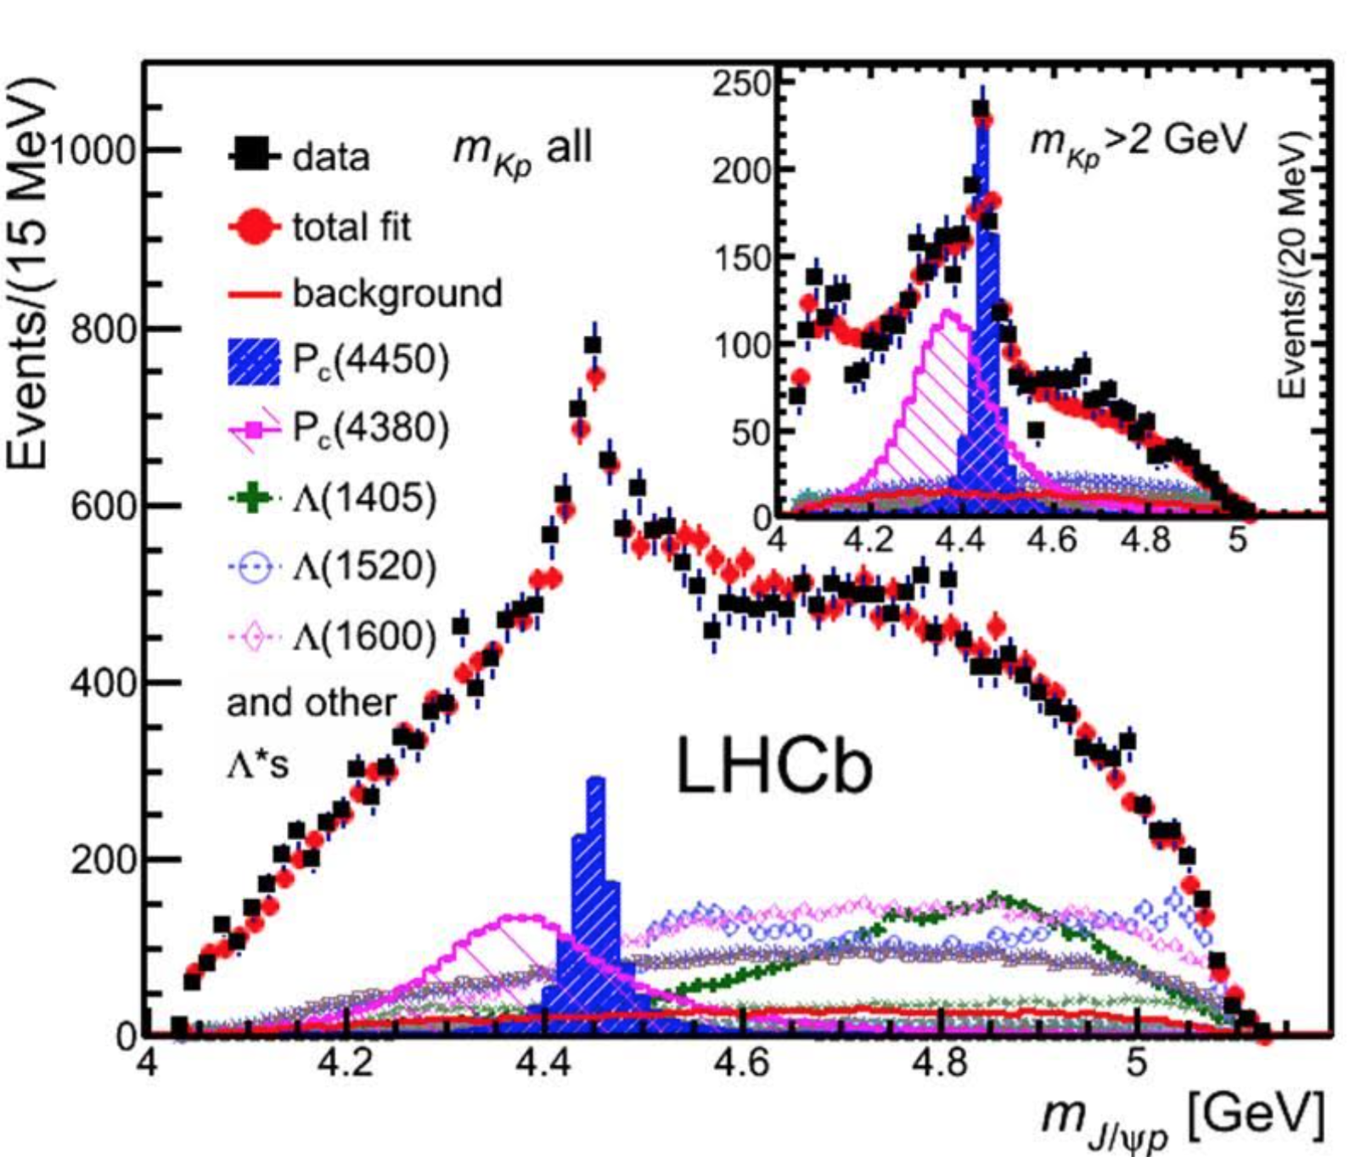
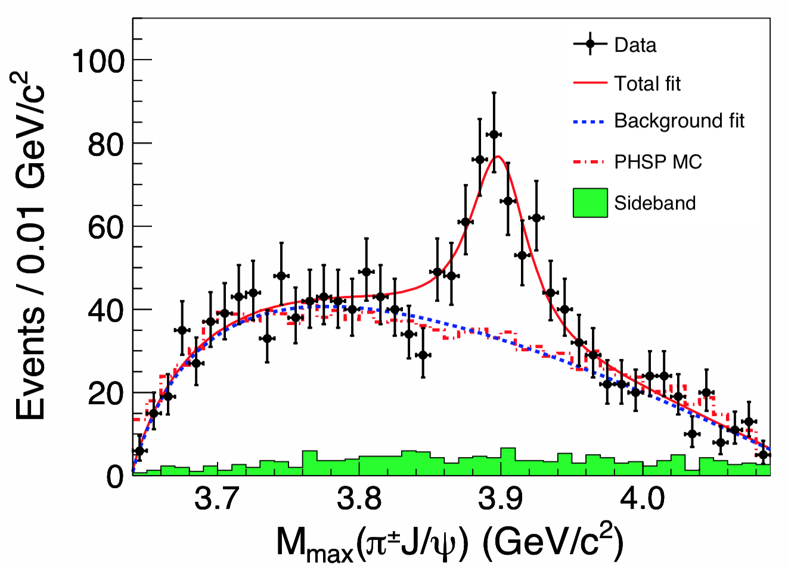
Tetraquark and Pentaquark Candidates
BESIII PRL 110 (2013) 252001
BELLE PRL 110 (2013) 252002
LHCb PRL 115 (2015) 072001

Slide 5
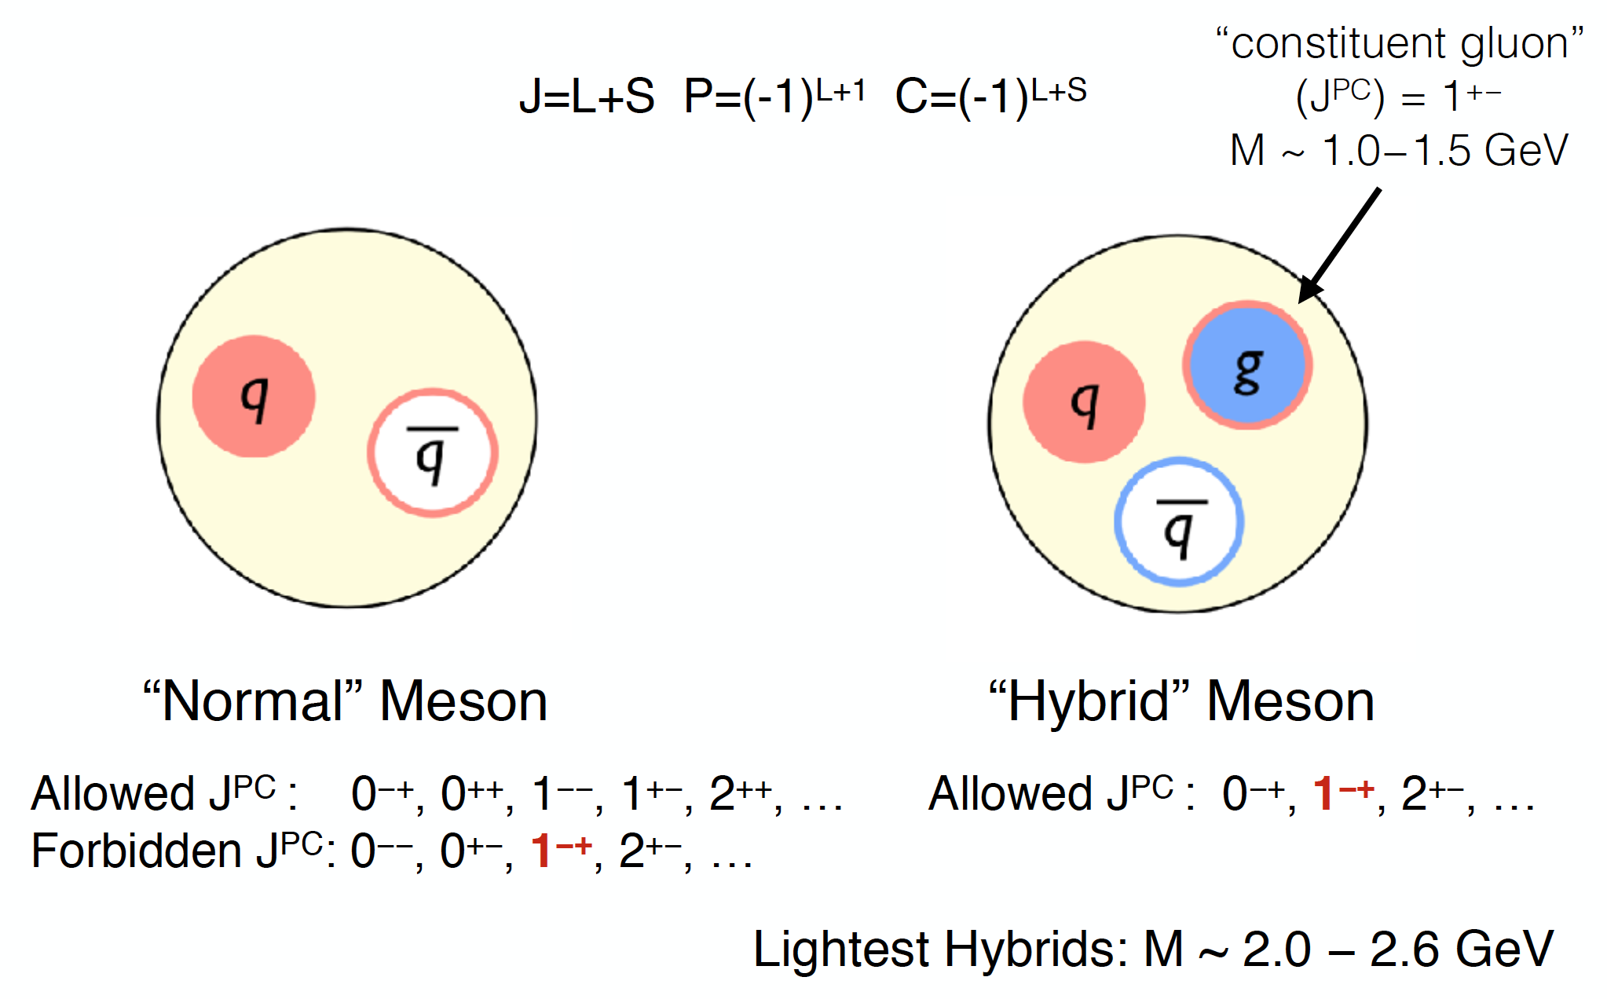
Meson Quantum Numbers

Slide 6
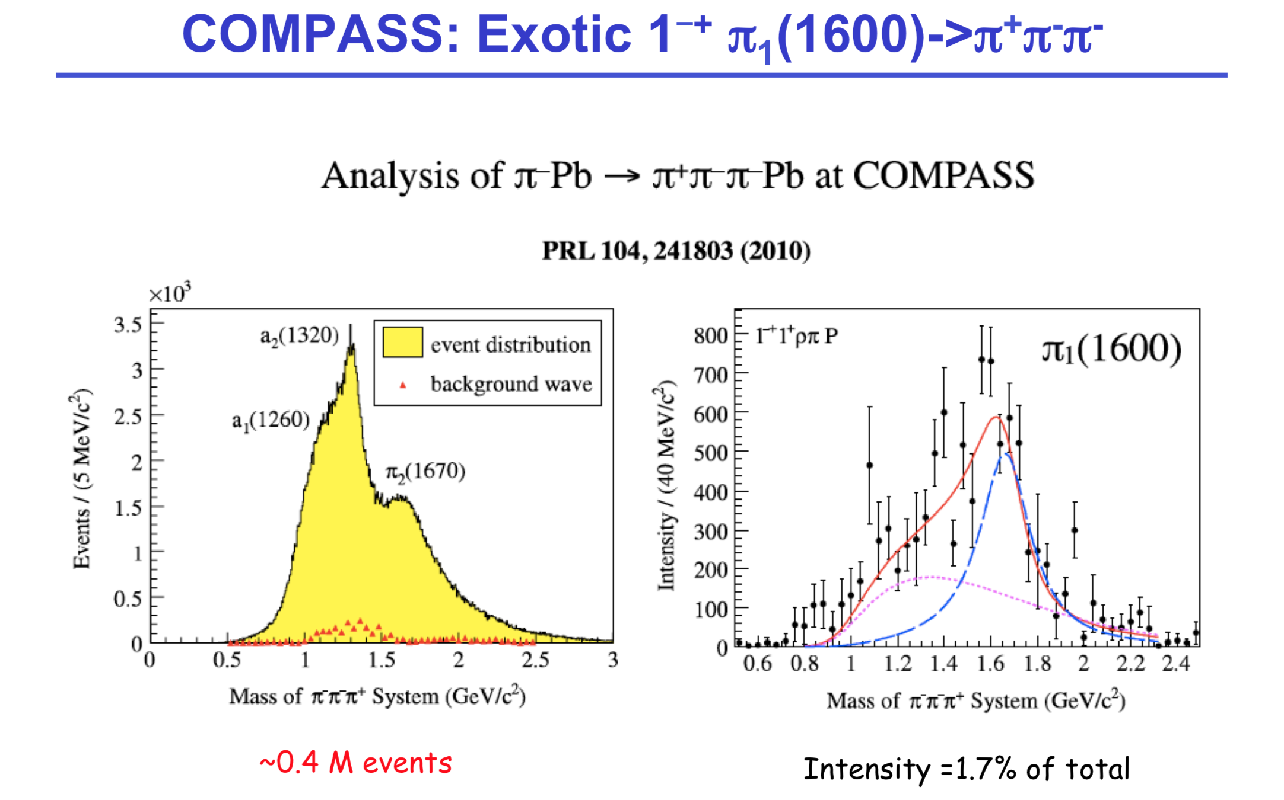

Slide 7
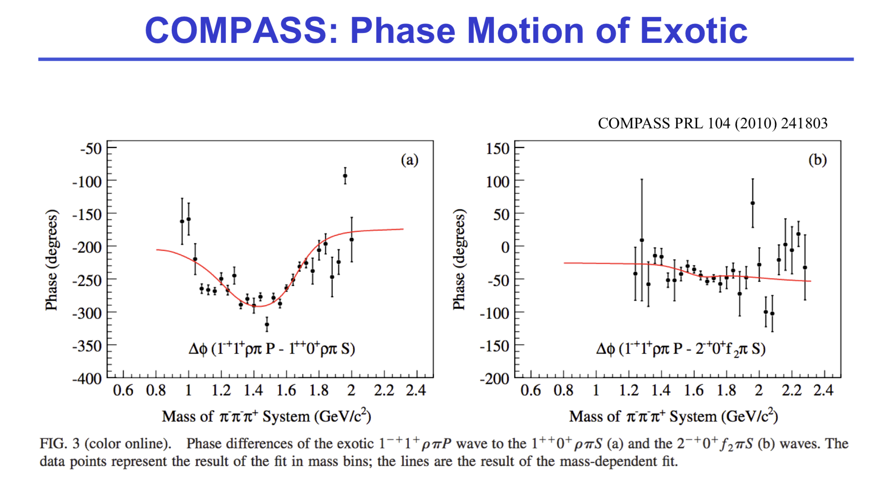

Slide 8
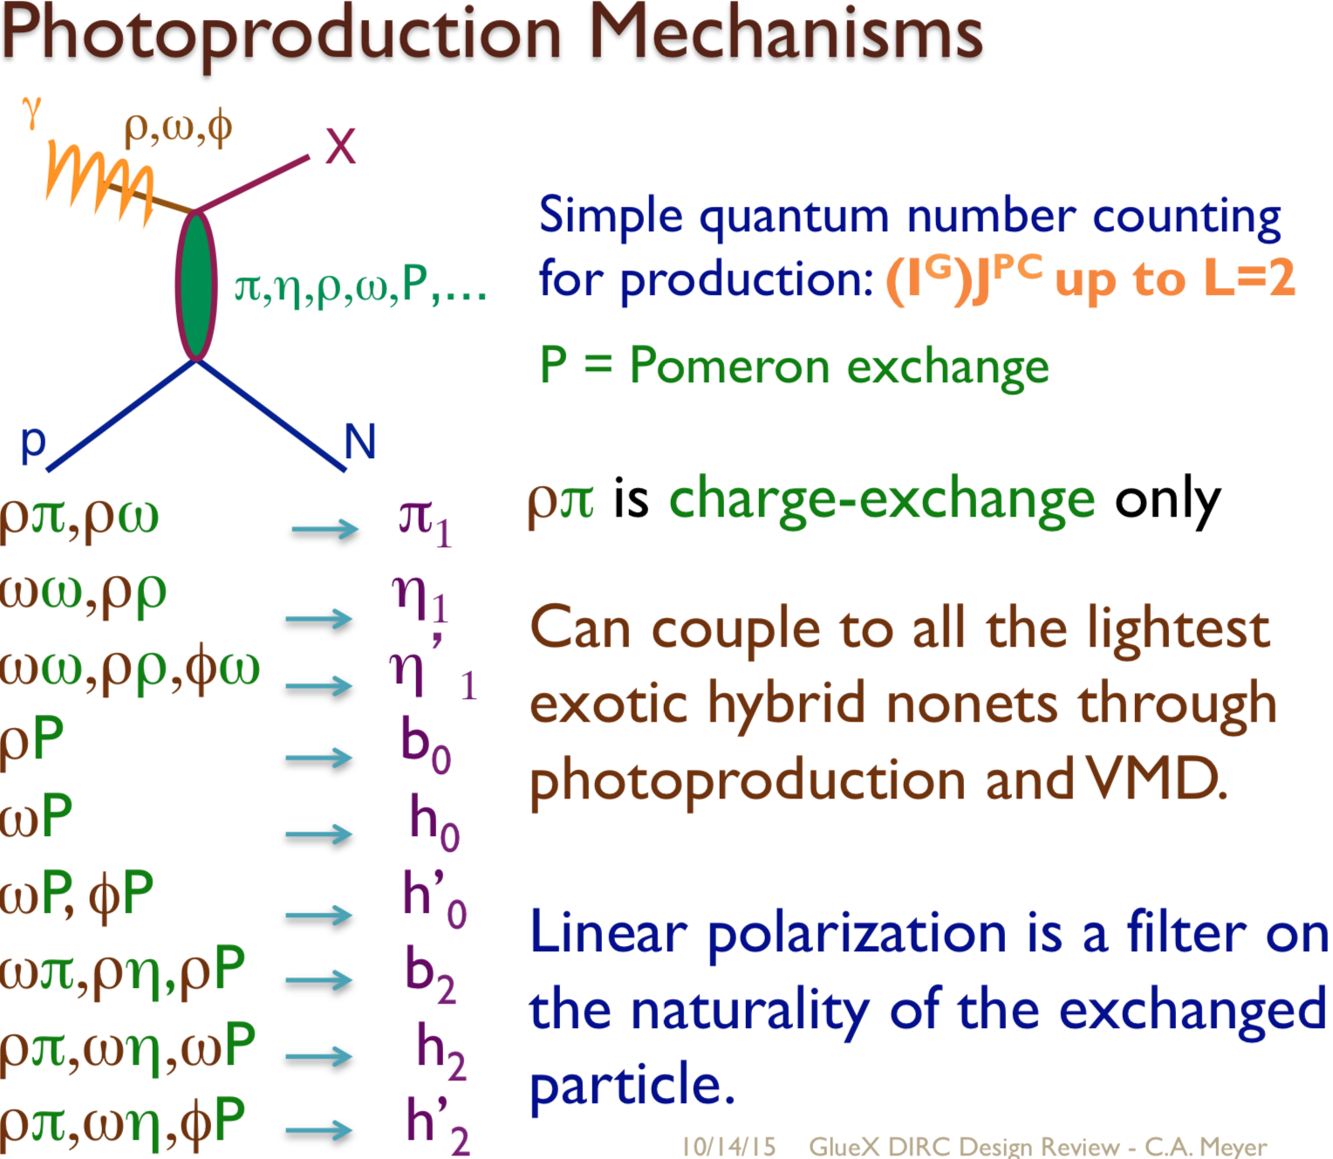
Cite from: C. A. Meyer GlueX Design Review

Slide 9
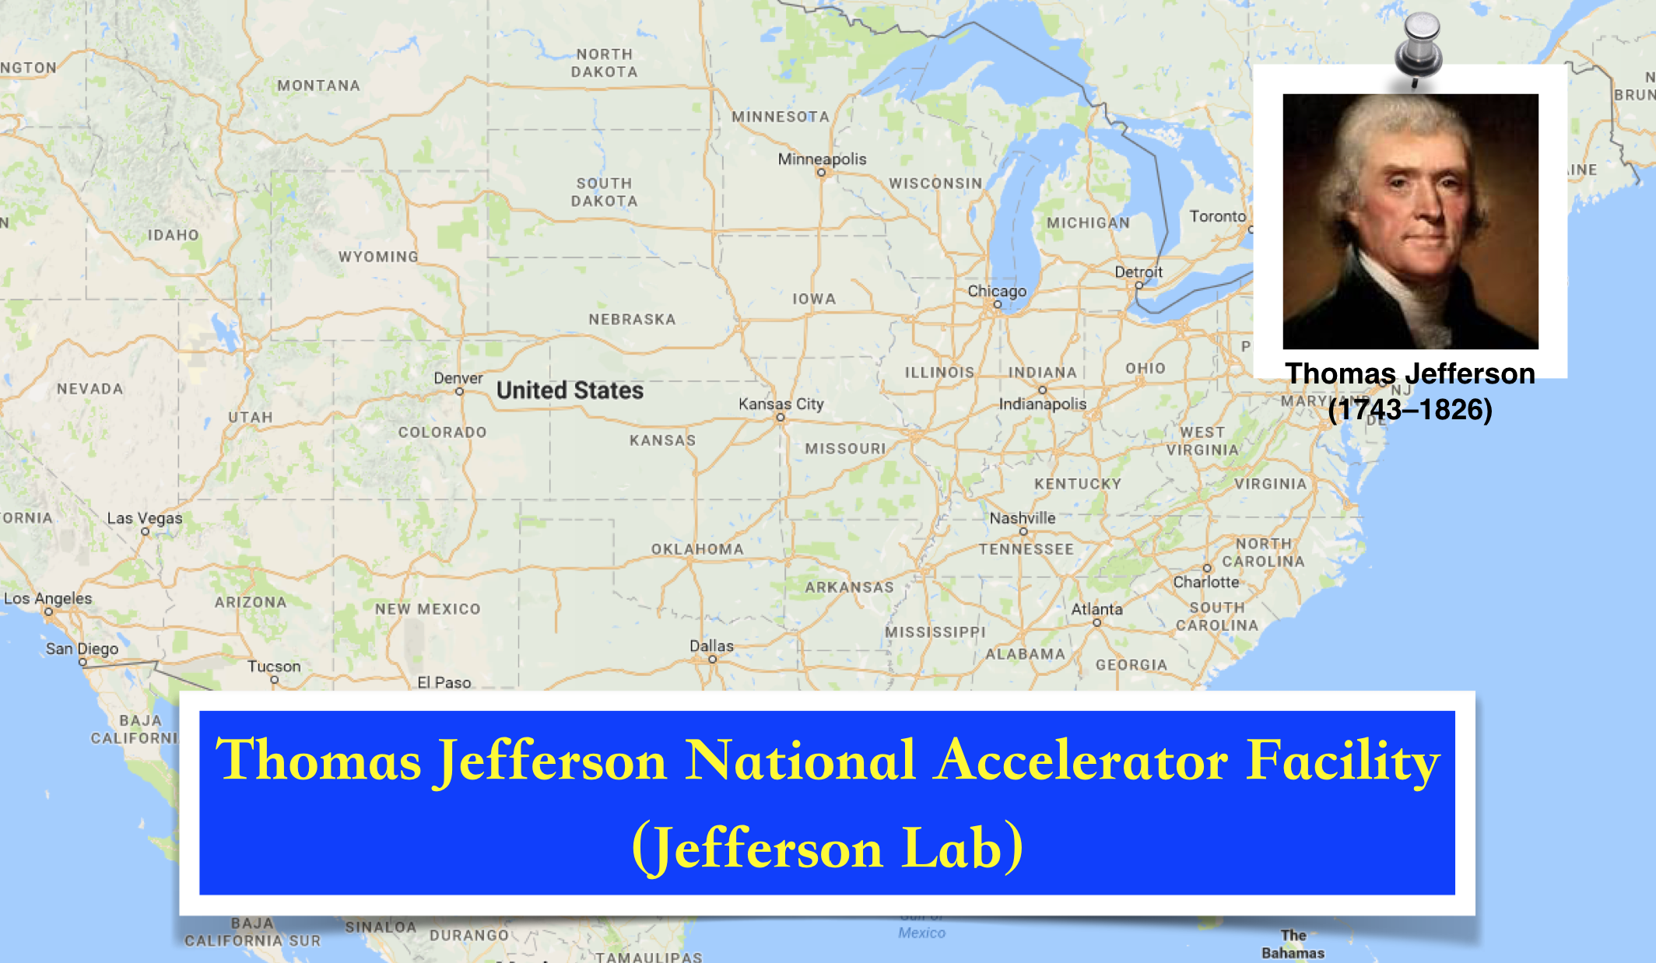

Introduction

Slide 10
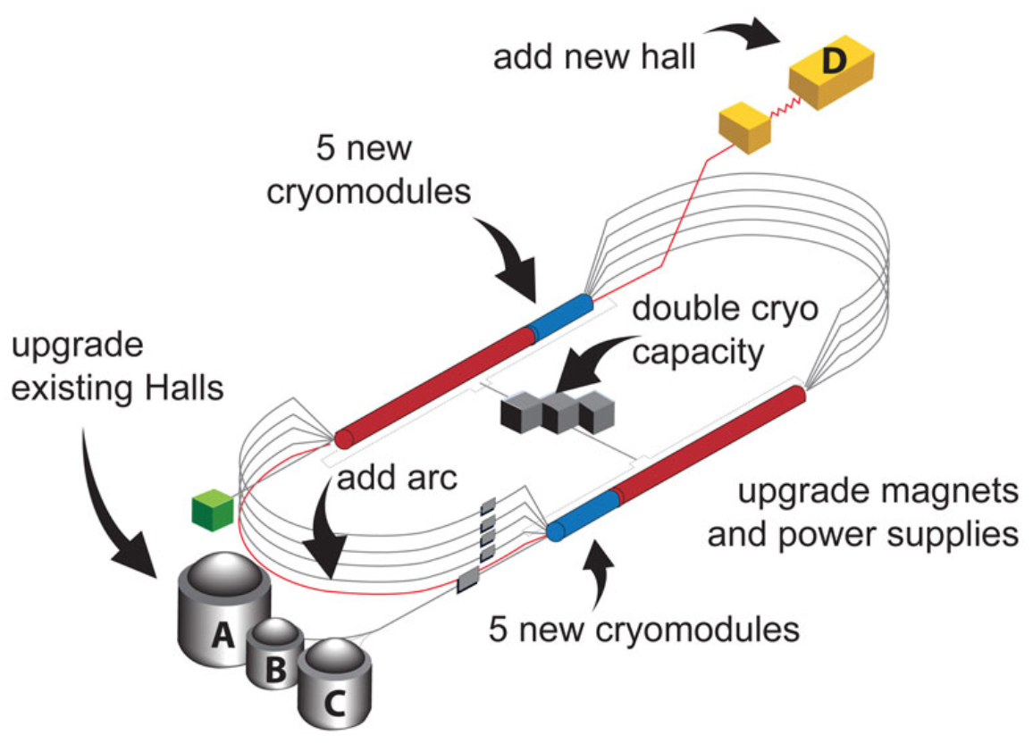
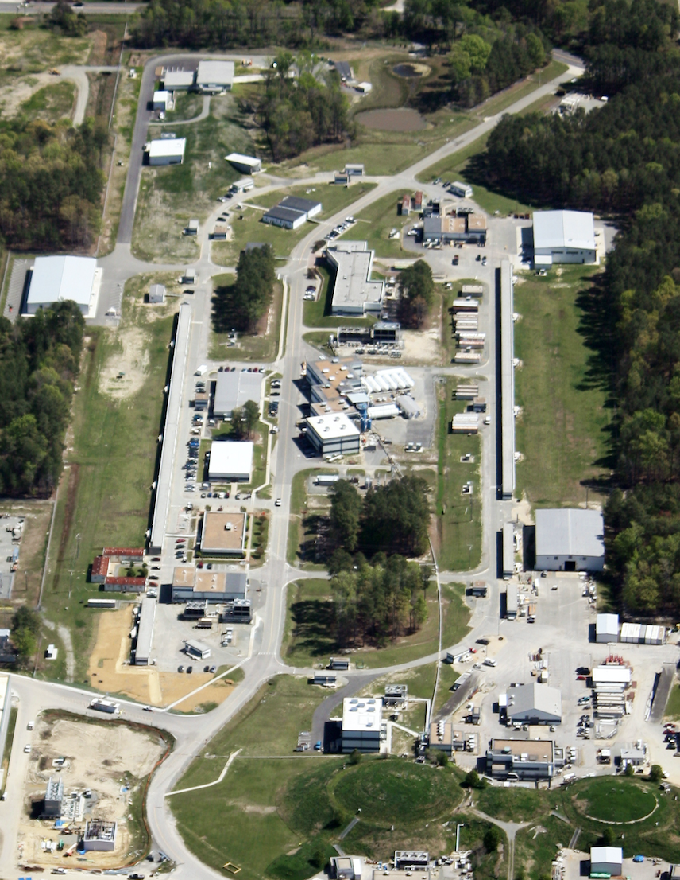
The Accelerator: CEBAF
East
D
North
South
West
The 12 GeV upgrade is coming to the accomplishment
Accelerator: 2.2 GeV/pass
Halls A, B, C: 1-5 passes <11 GeV
Hall D: 5.5 passes →12 GeV
Halls A&D started data taking in 2016 spring
Halls B&C started data taking in 2017 spring
CEBAF
A
B
C

Slide 11
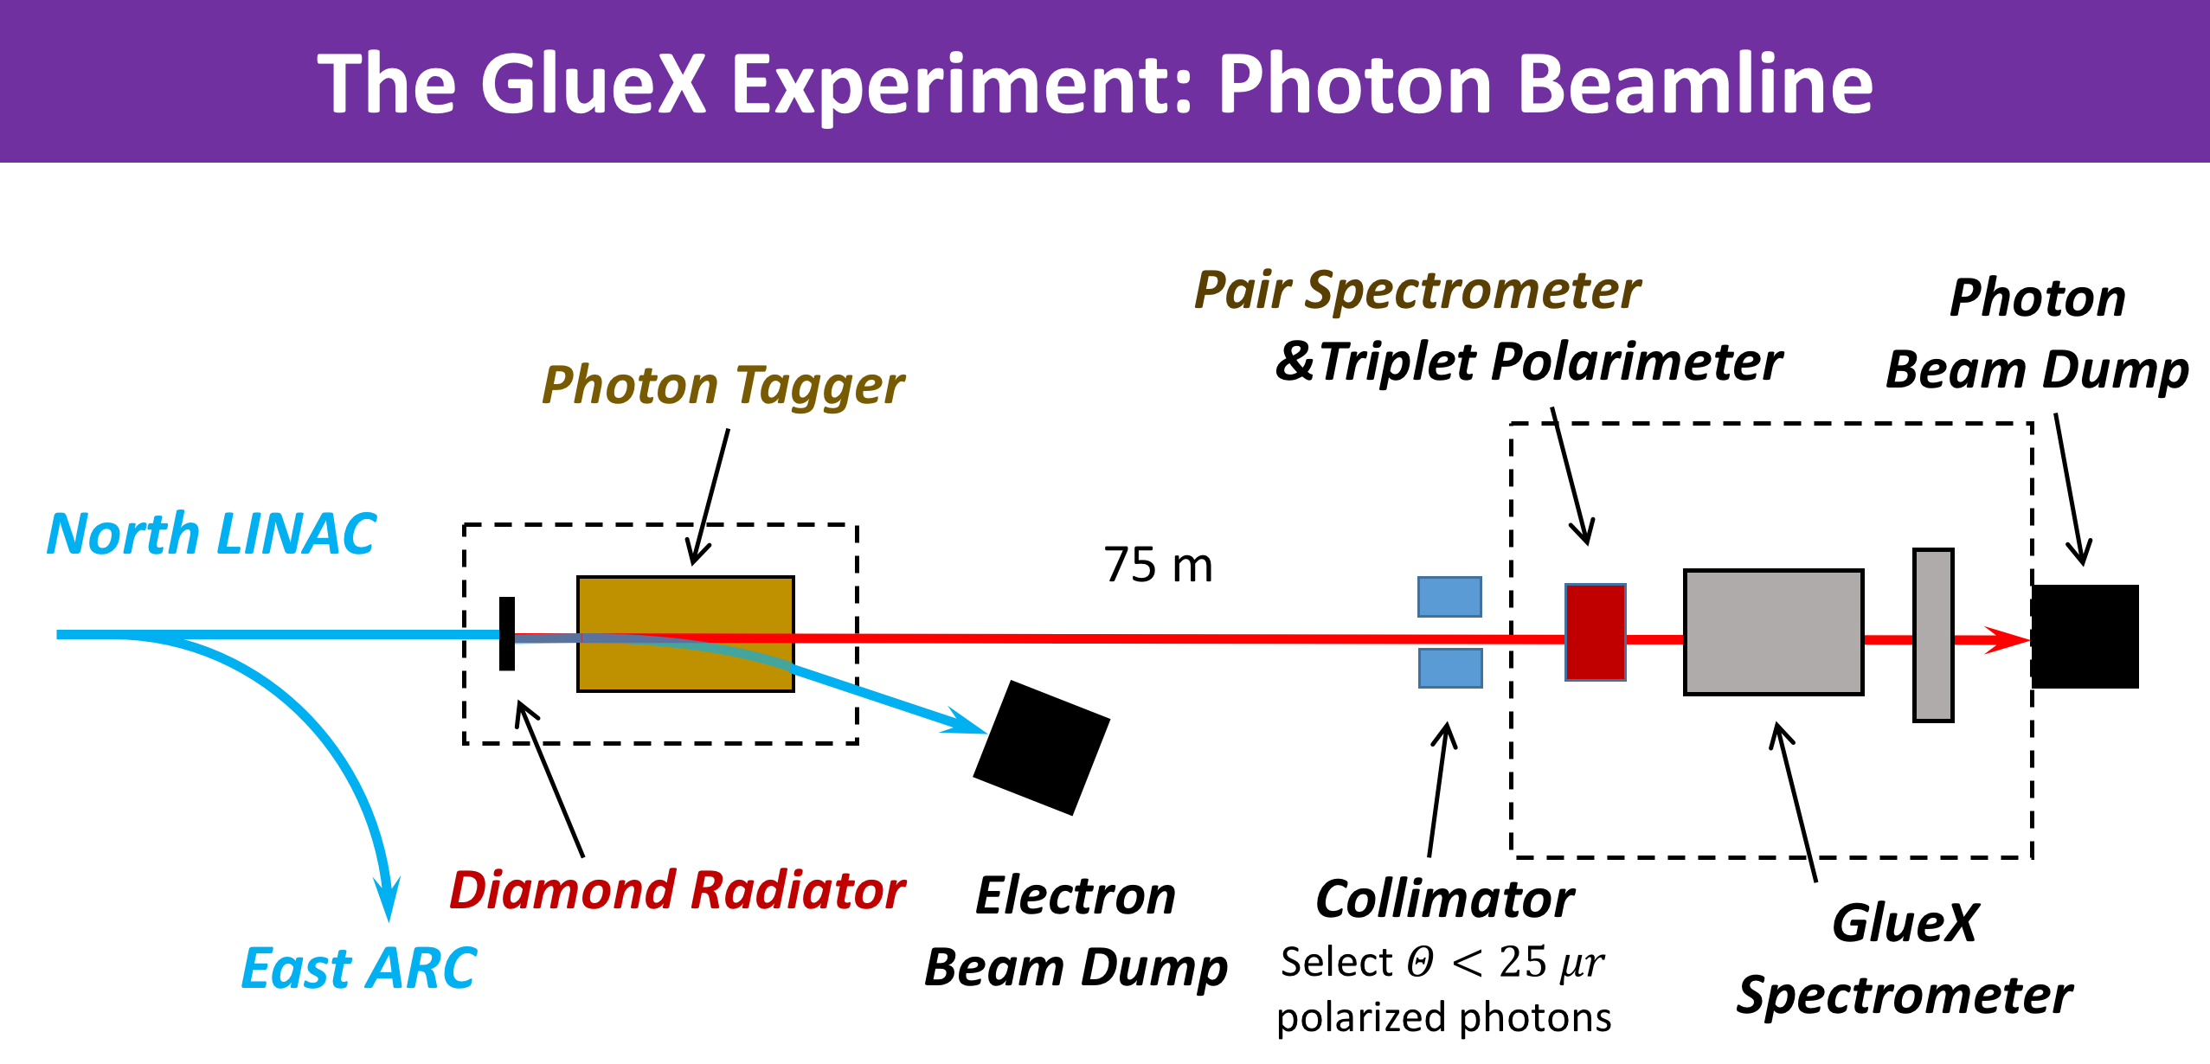
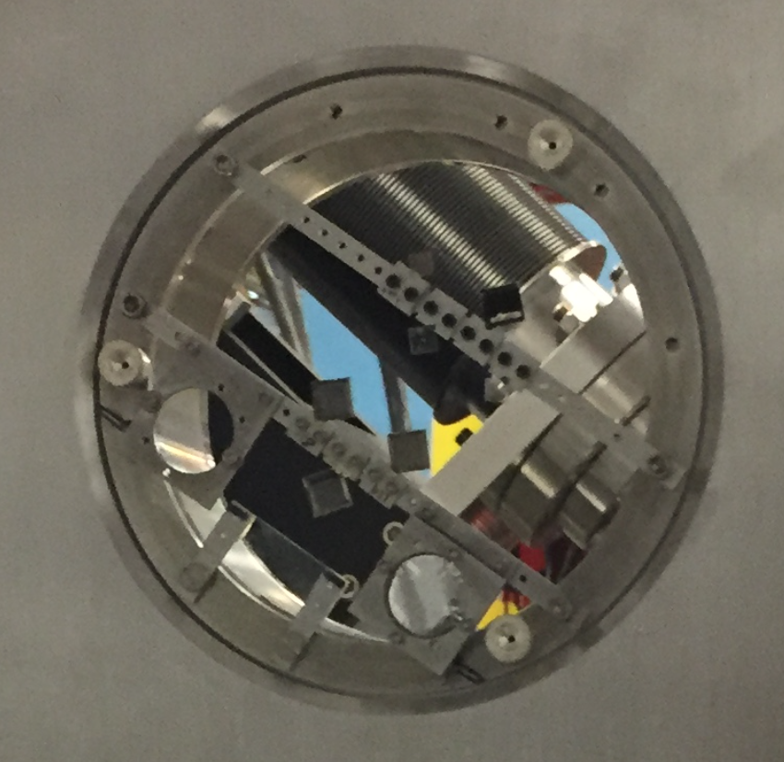
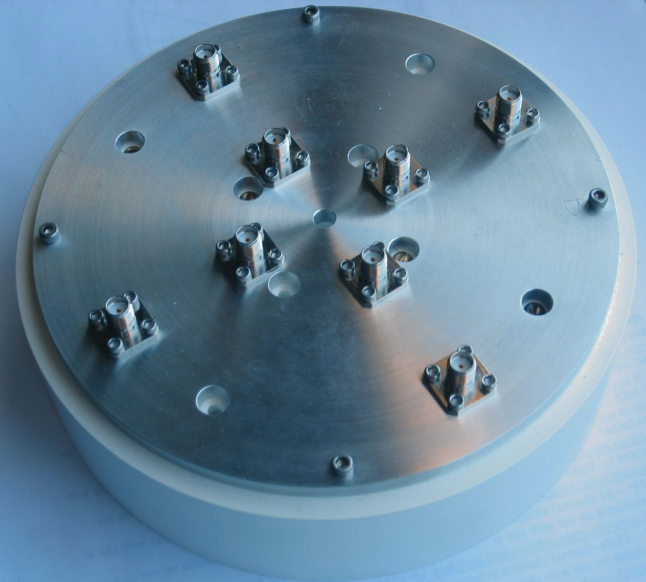
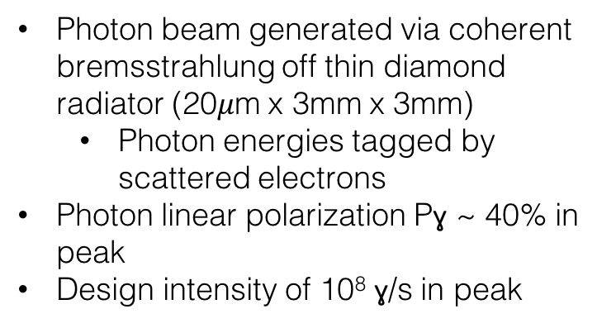
Not properly scaled
Photon beam generated via coherent bremsstrahlung off thin diamond radiator (20$μ$m x 3mm x 3mm)
  Photon energies tagged by scattered electrons
Photon linear polarization Pɣ ~ 40% in peak
Design intensity of 10⁸ ɣ/s in peak

Slide 12
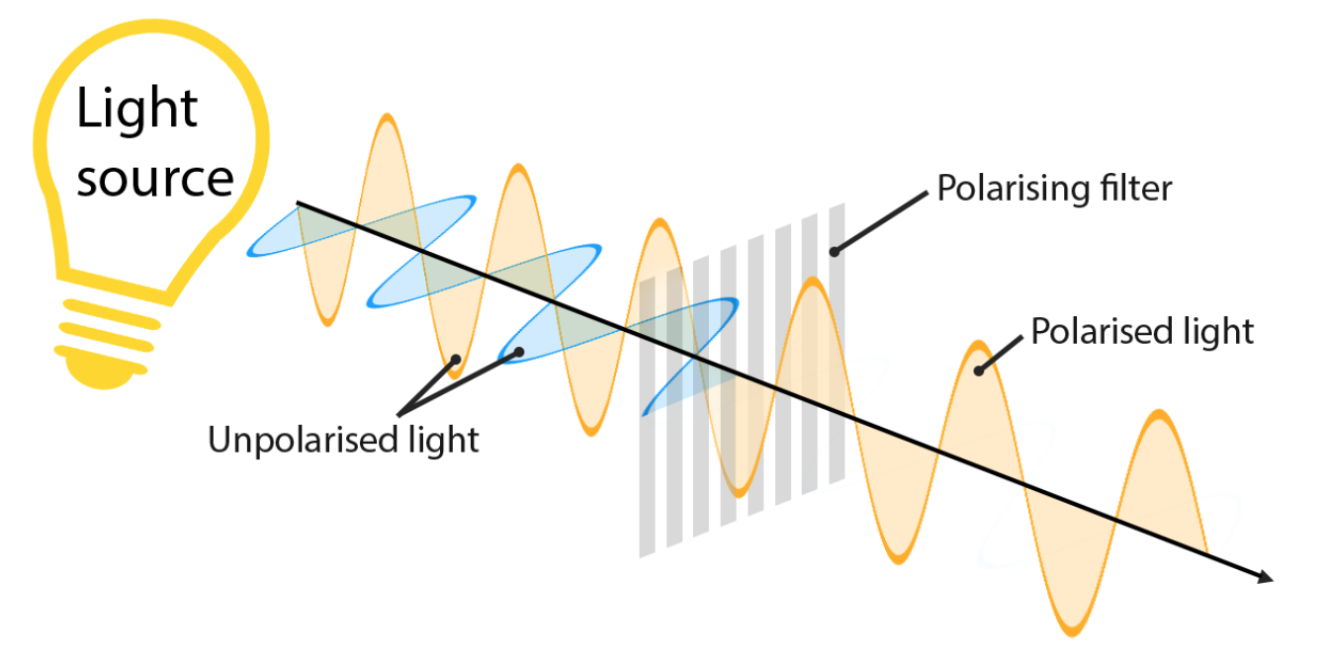
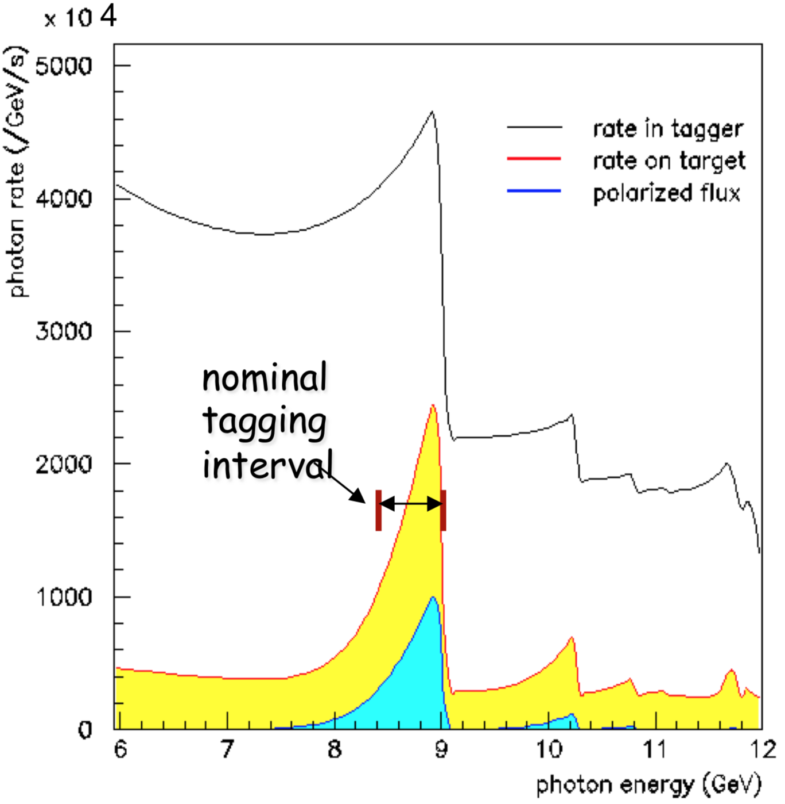
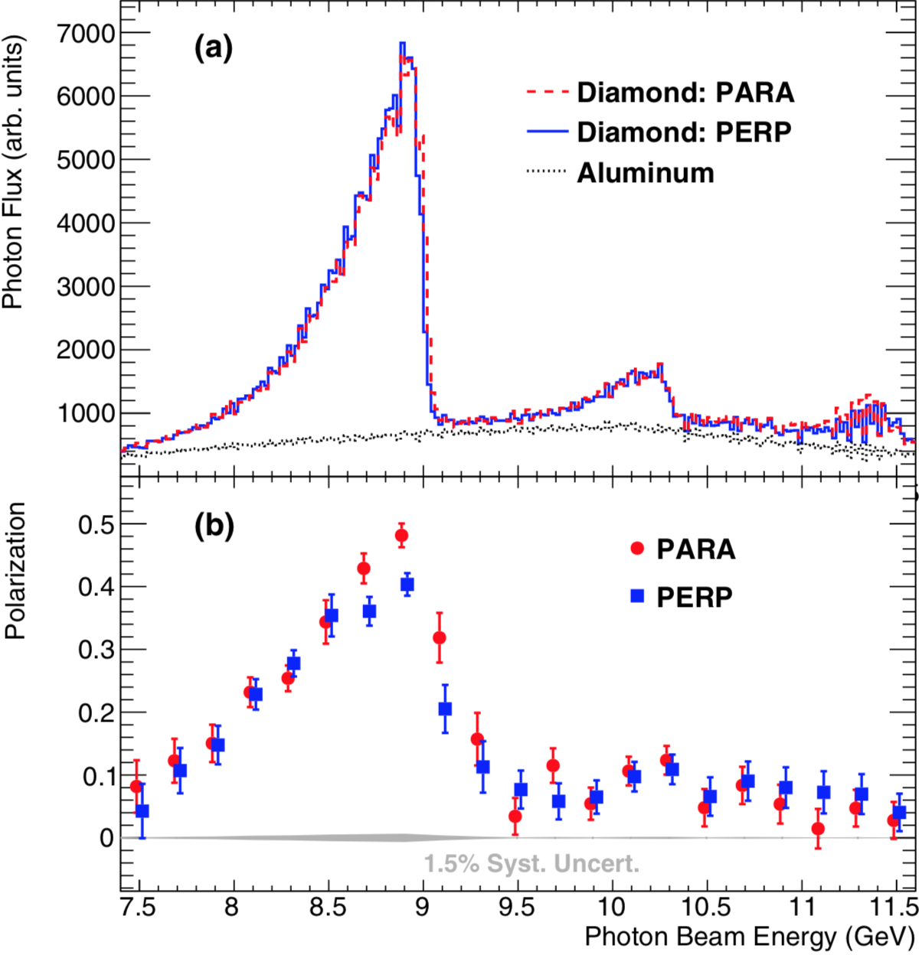

Linearly polarized photon beam
The beam photons are predominantly produced along the direction of the incident electron beam
Angular distribution for coherent bremsstrahlung is narrower than incoherent process.
Calculated Spectrum
(12 GeV beam)
Measured Spectrum
$$\vec{γ}e_{n}^{−}→e_{recoil}^{−}(e^{+}e^{−})$$

Slide 13
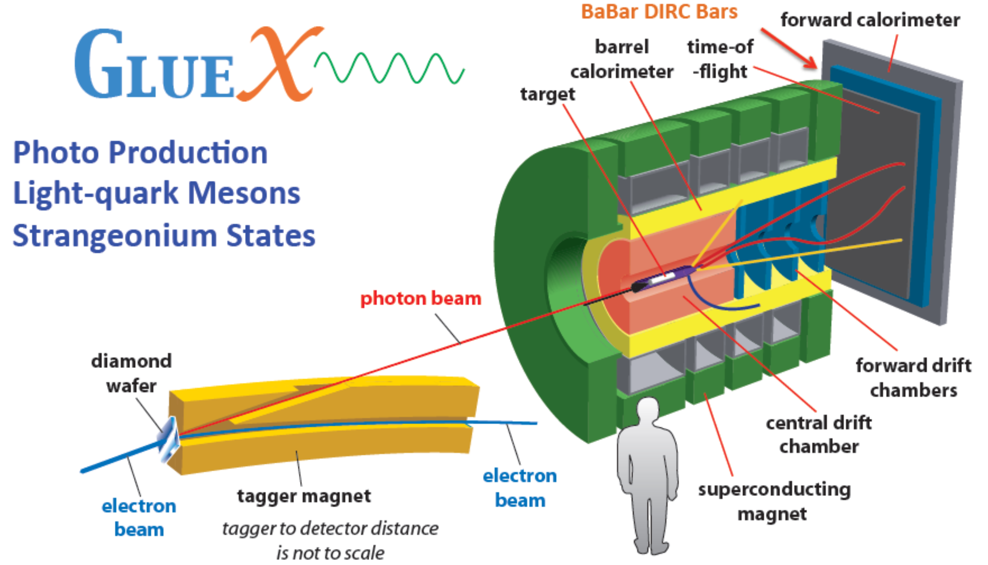
The GlueX Detector

Slide 14
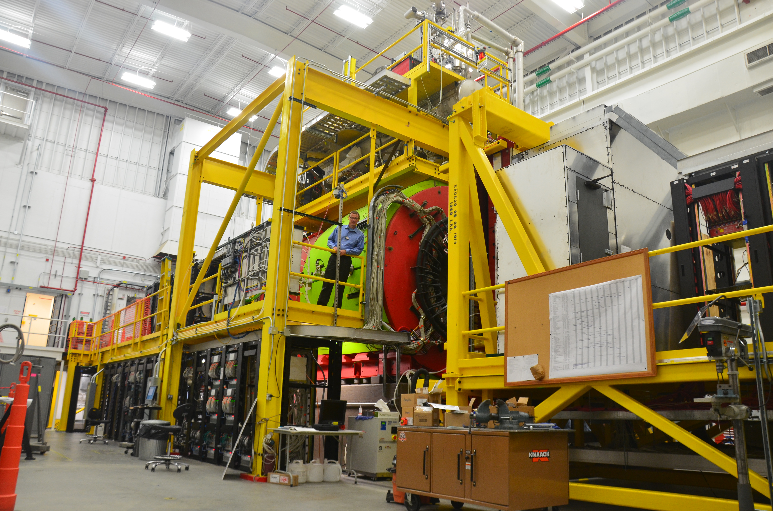
Equipment in Hall D

Slide 15
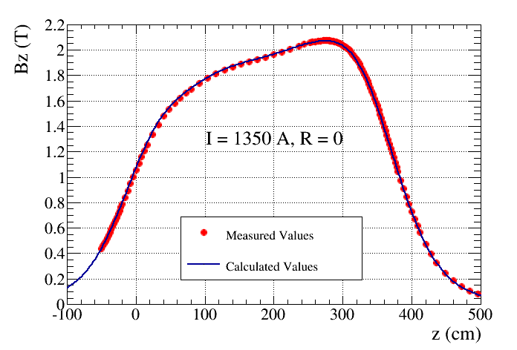
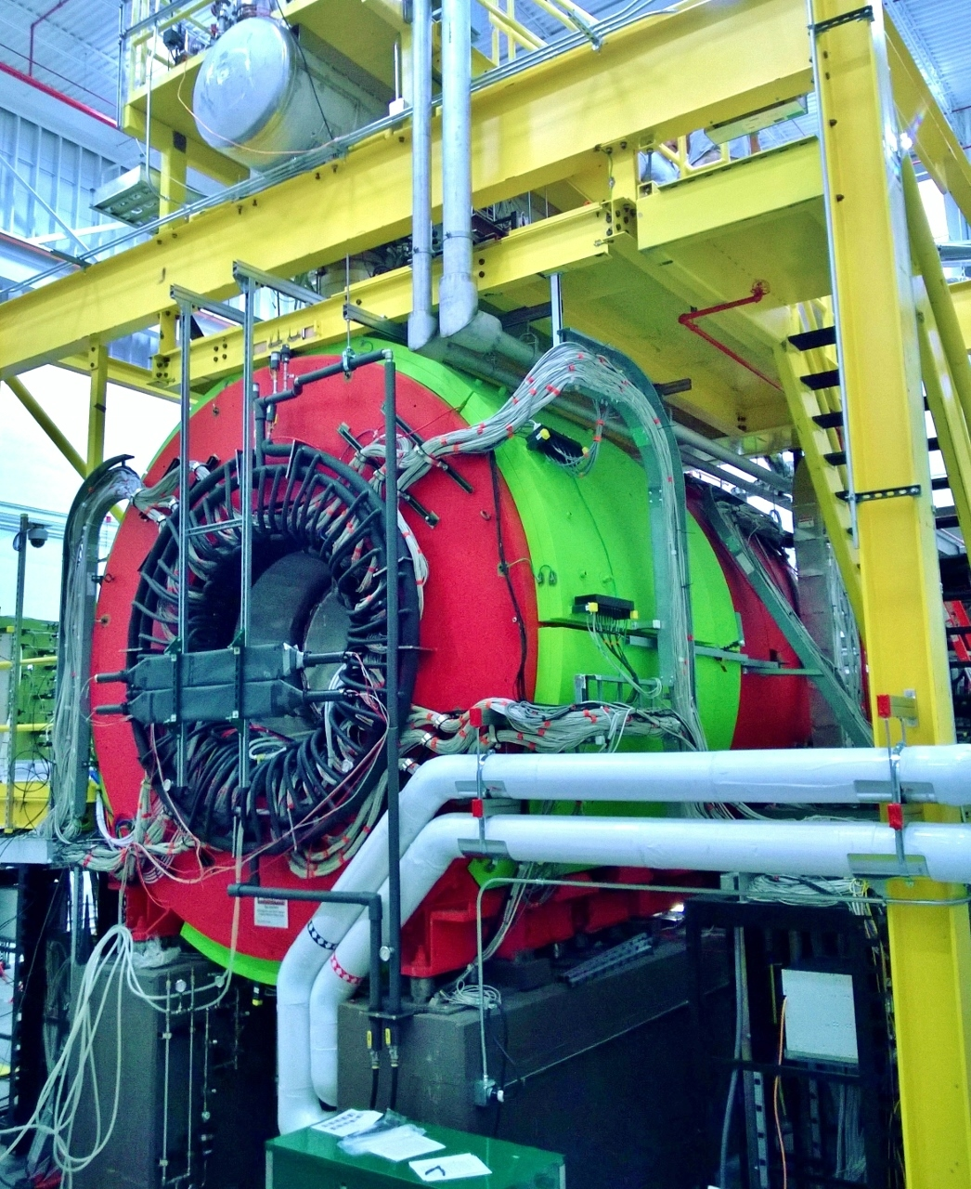
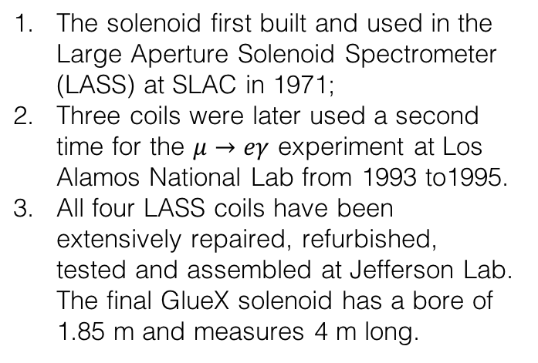
The Superconducting Solenoid
The solenoid first built and used in the Large Aperture Solenoid Spectrometer (LASS) at SLAC in 1971;
Three coils were later used a second time for the $μ→eγ$ experiment at Los Alamos National Lab from 1993 to1995.
All four LASS coils have been extensively repaired, refurbished, tested and assembled at Jefferson Lab. The final GlueX solenoid has a bore of 1.85 m and measures 4 m long.

Slide 16
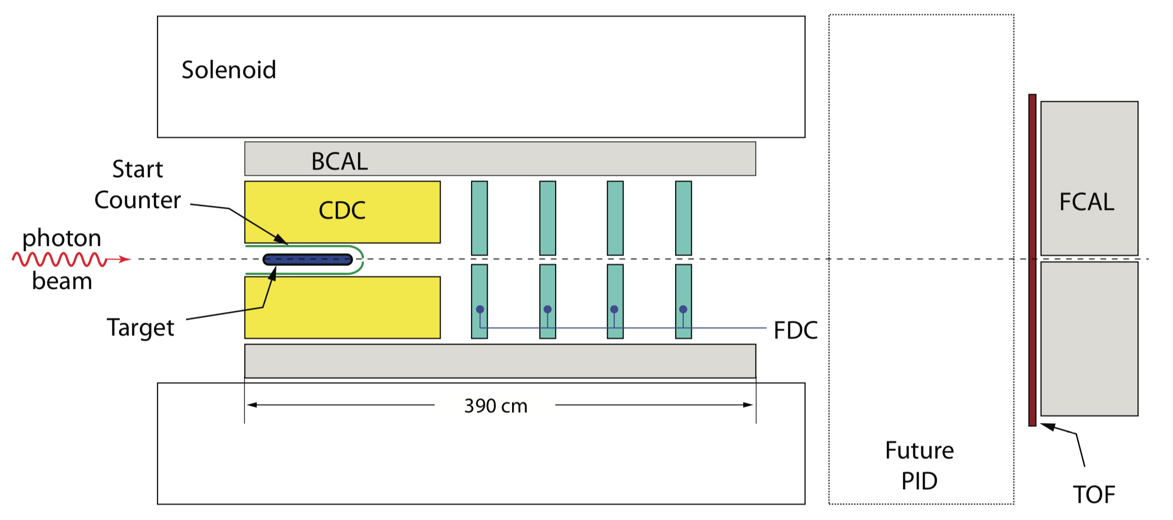
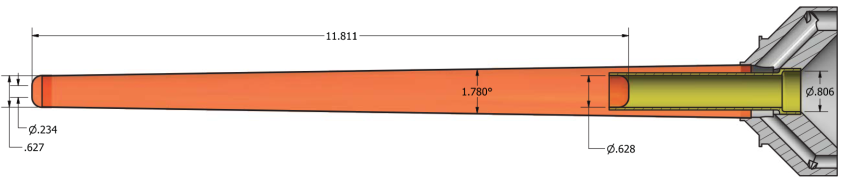
The GlueX Detector and Target

Slide 17
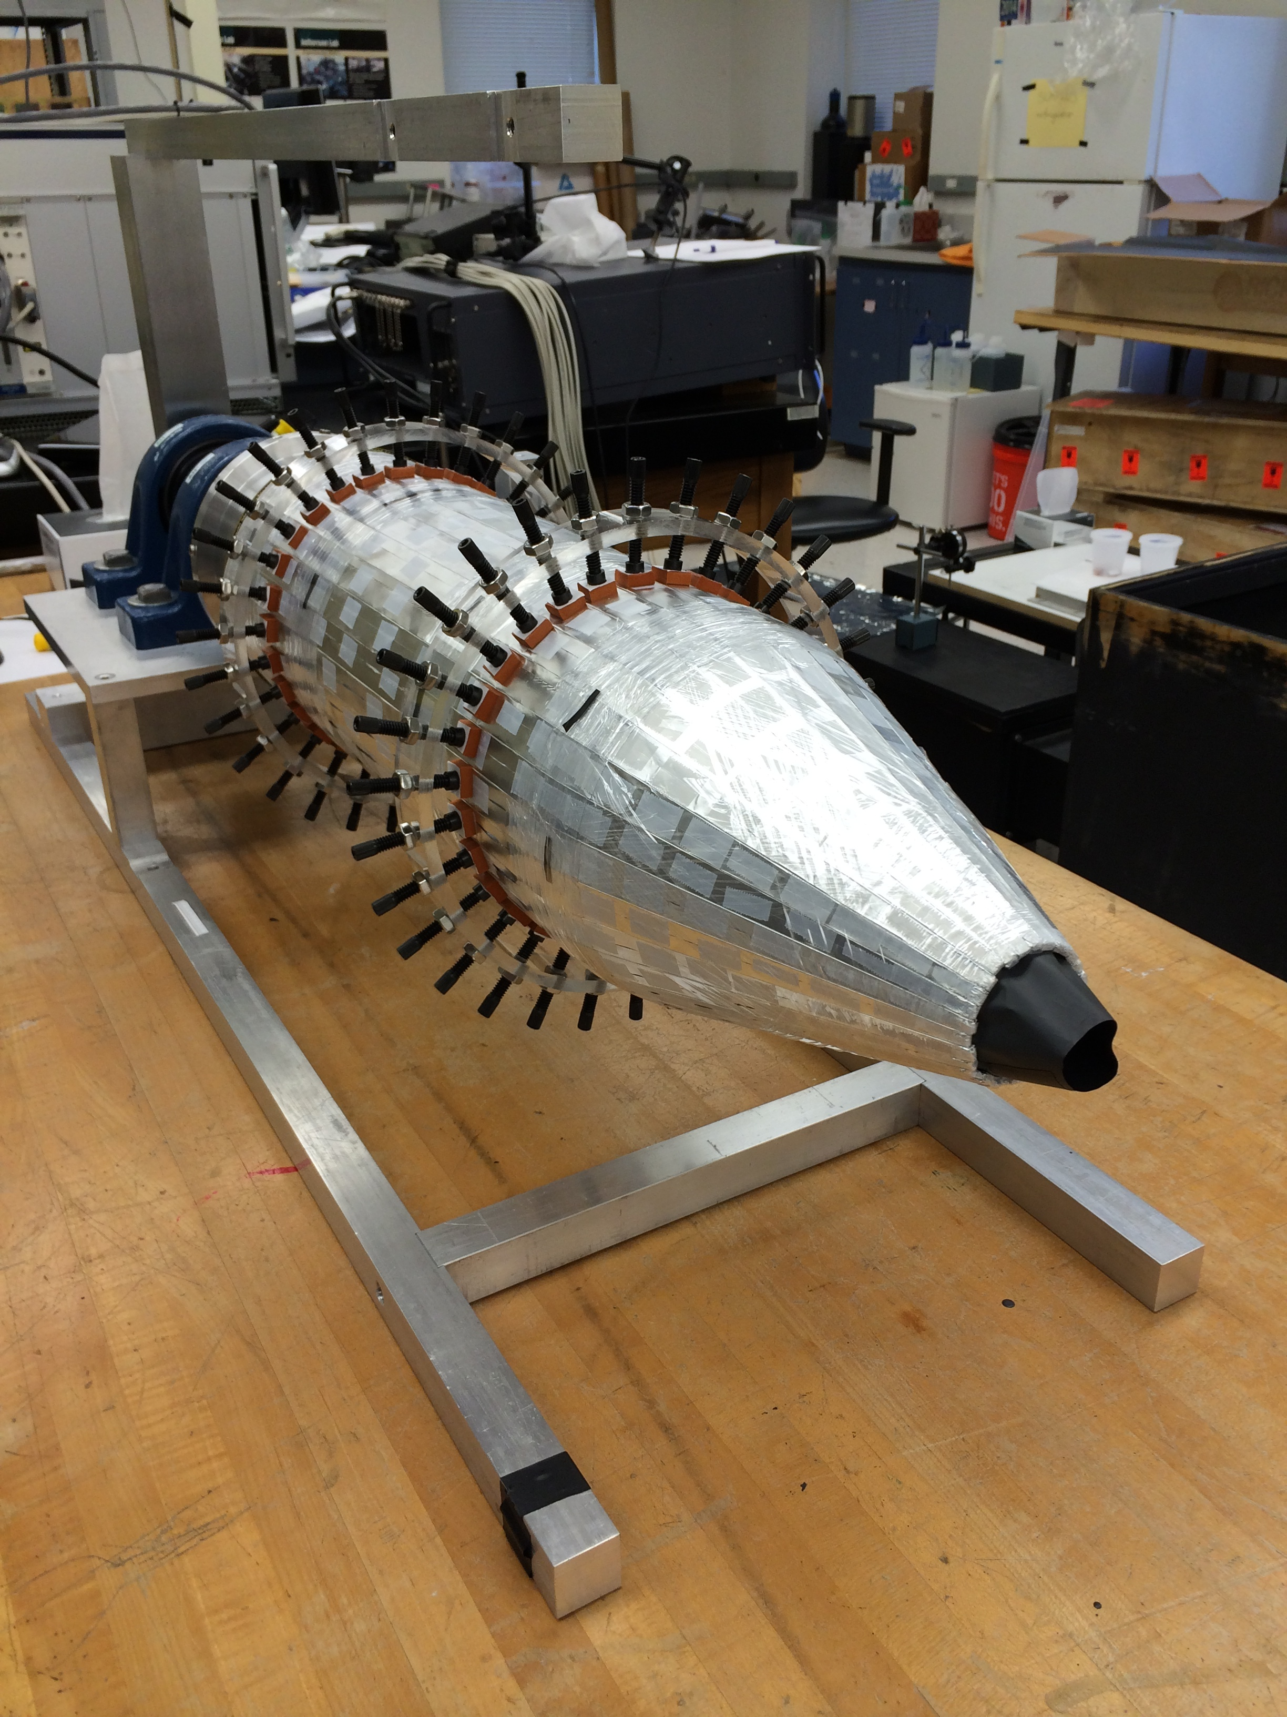
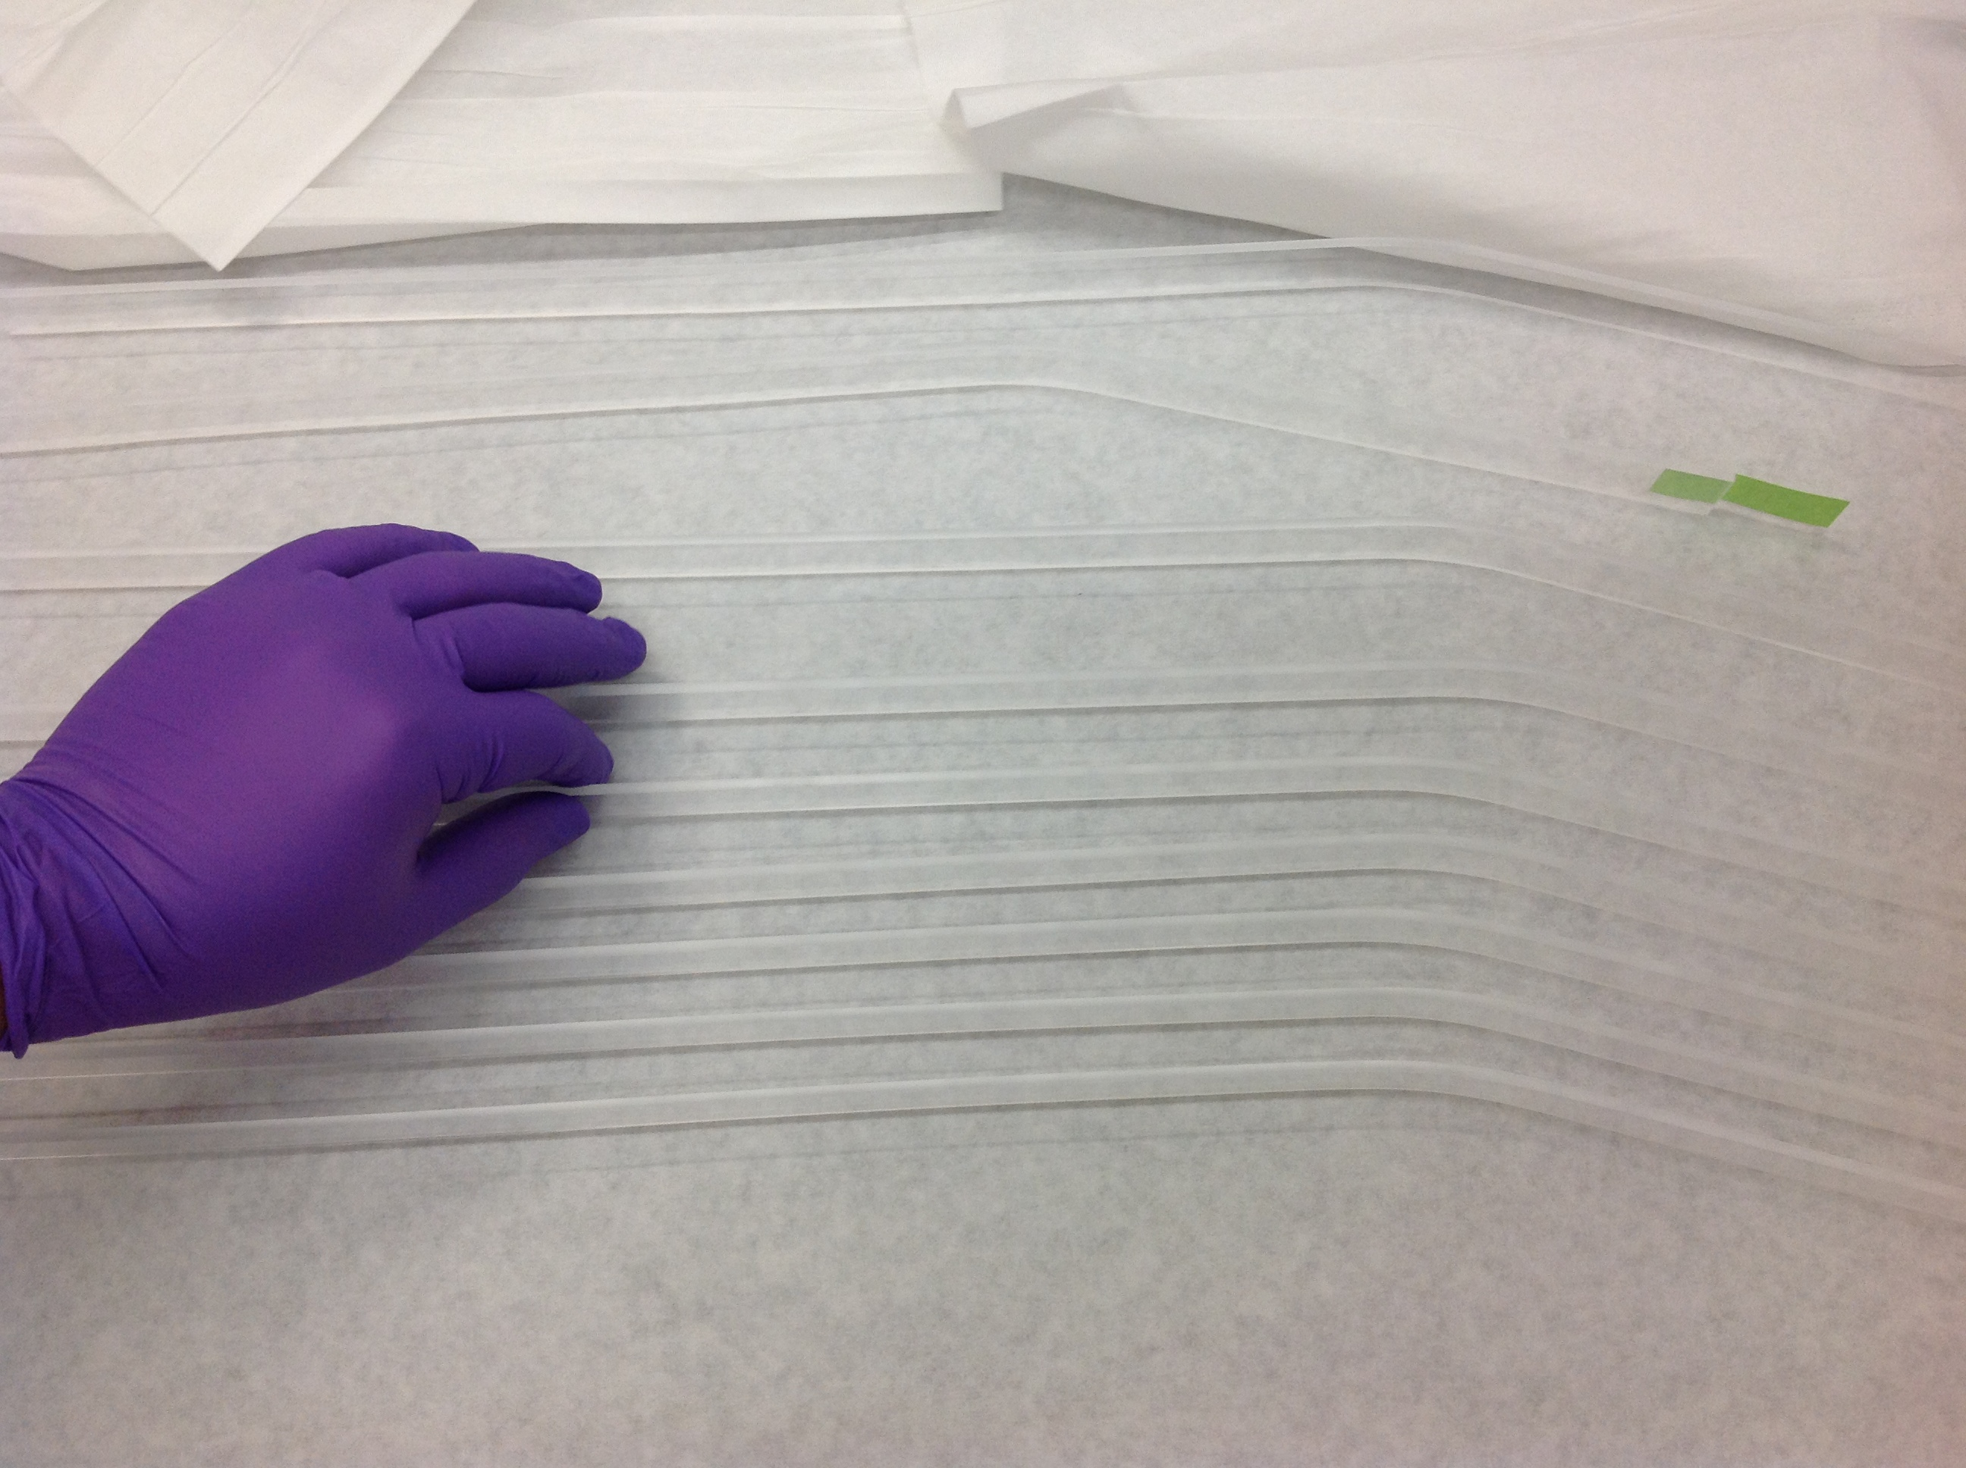
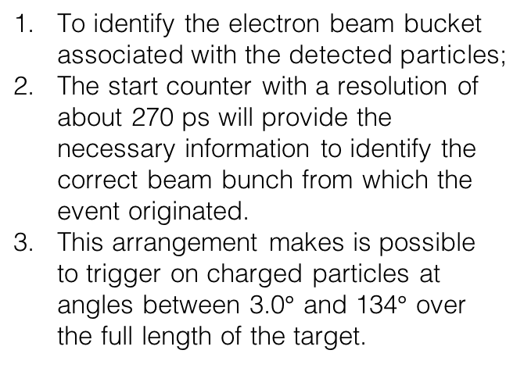
The Start Counter
To identify the electron beam bucket associated with the detected particles;
The start counter with a resolution of about 270 ps will provide the necessary information to identify the correct beam bunch from which the event originated.
This arrangement makes is possible to trigger on charged particles at angles between 3.0$°$ and 134$°$ over the full length of the target.
An array of 40 scintillators

Slide 18
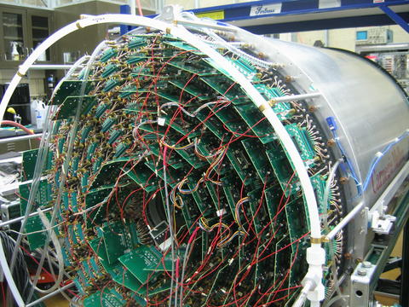
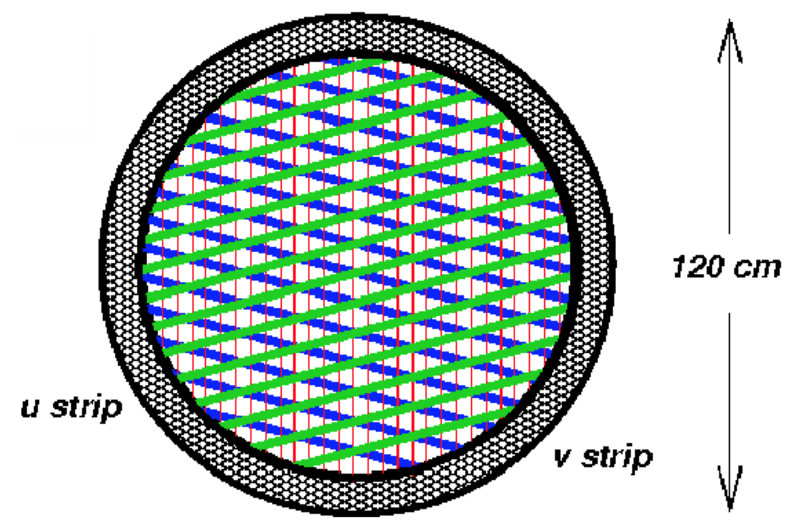
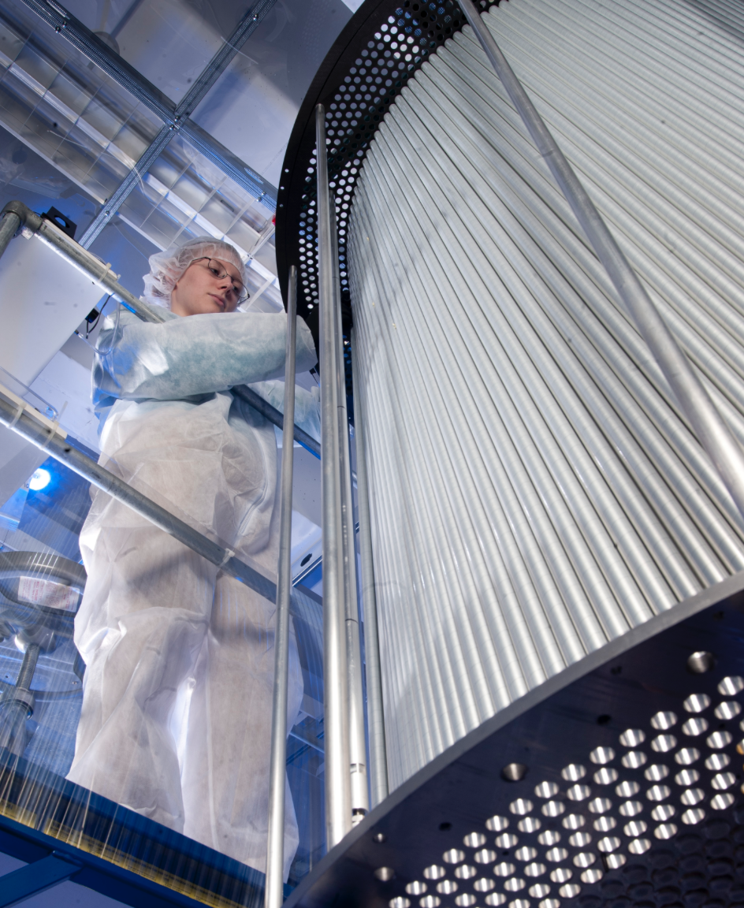
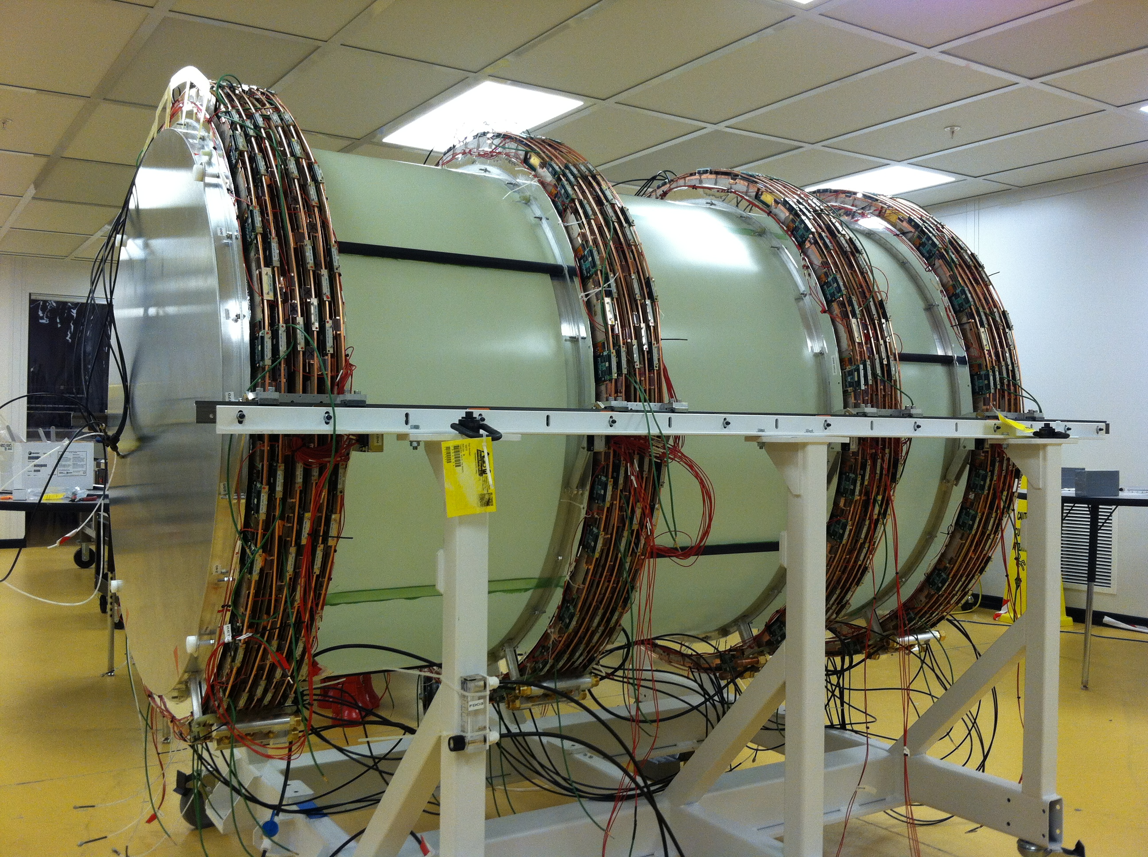
Central and Froward Drift Chamber
Central Drift Chamber
4 packages x 6 planes
Straw tube chamber
by CMU
Forward Drift Chamber (JLab)

Slide 19
Drift Chamber Performance
Drift Chamber exceed designed position resolution

Slide 20
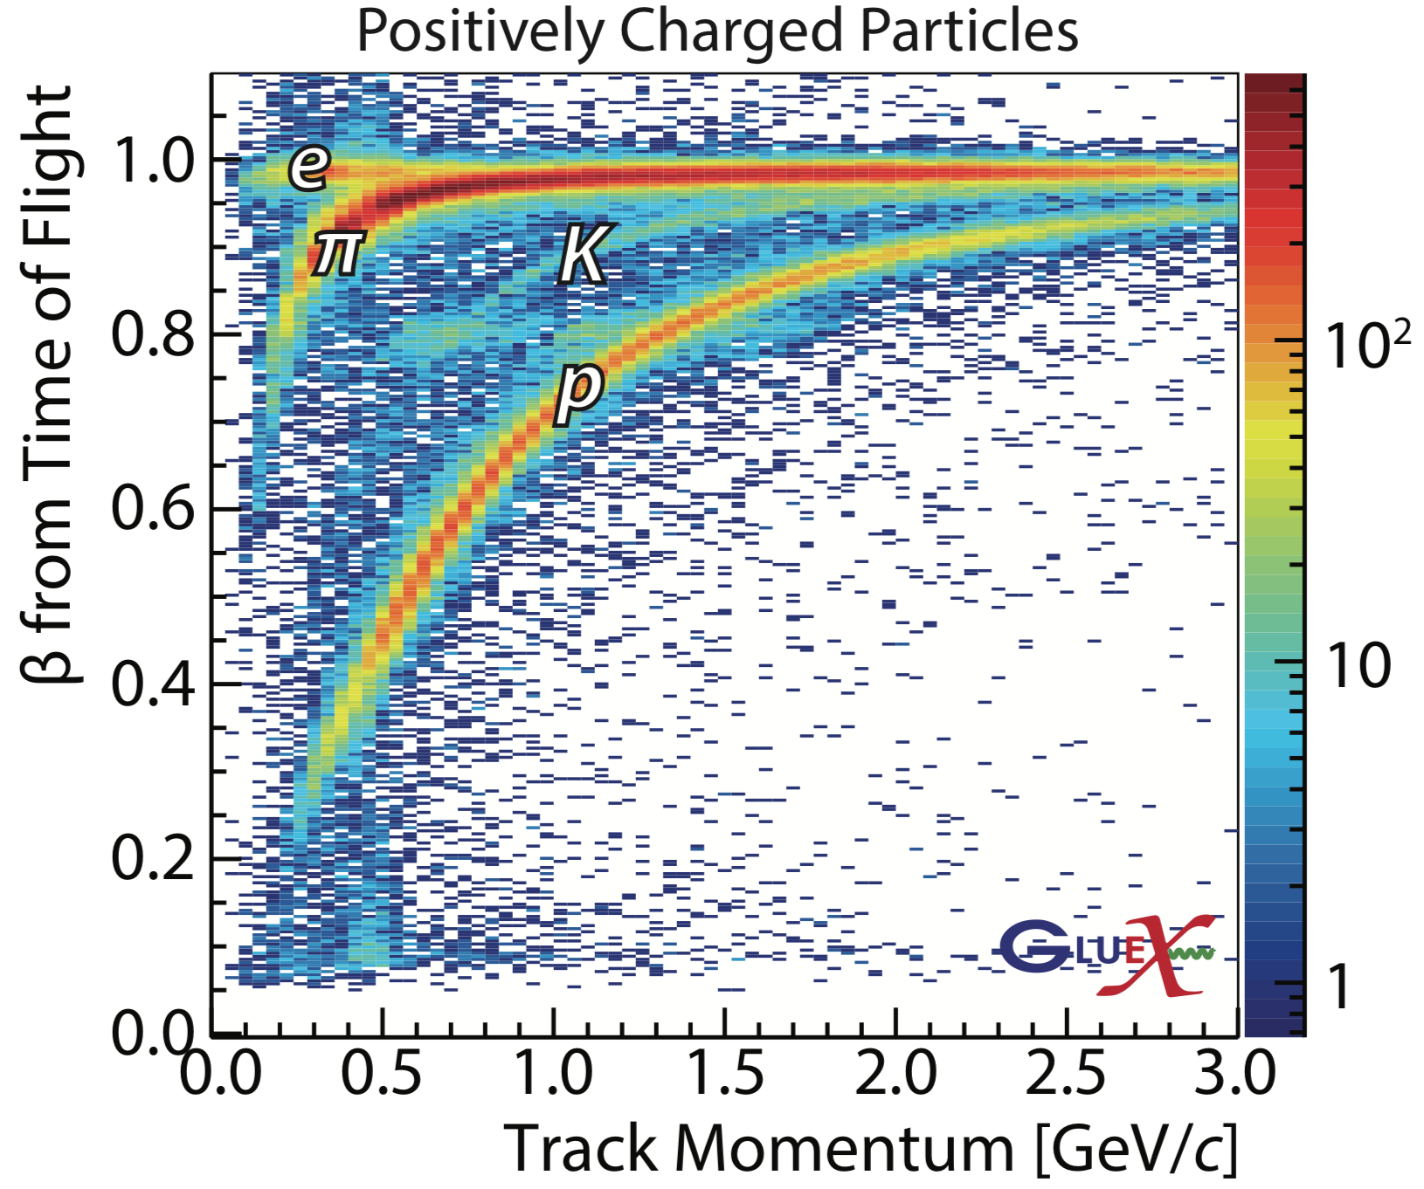
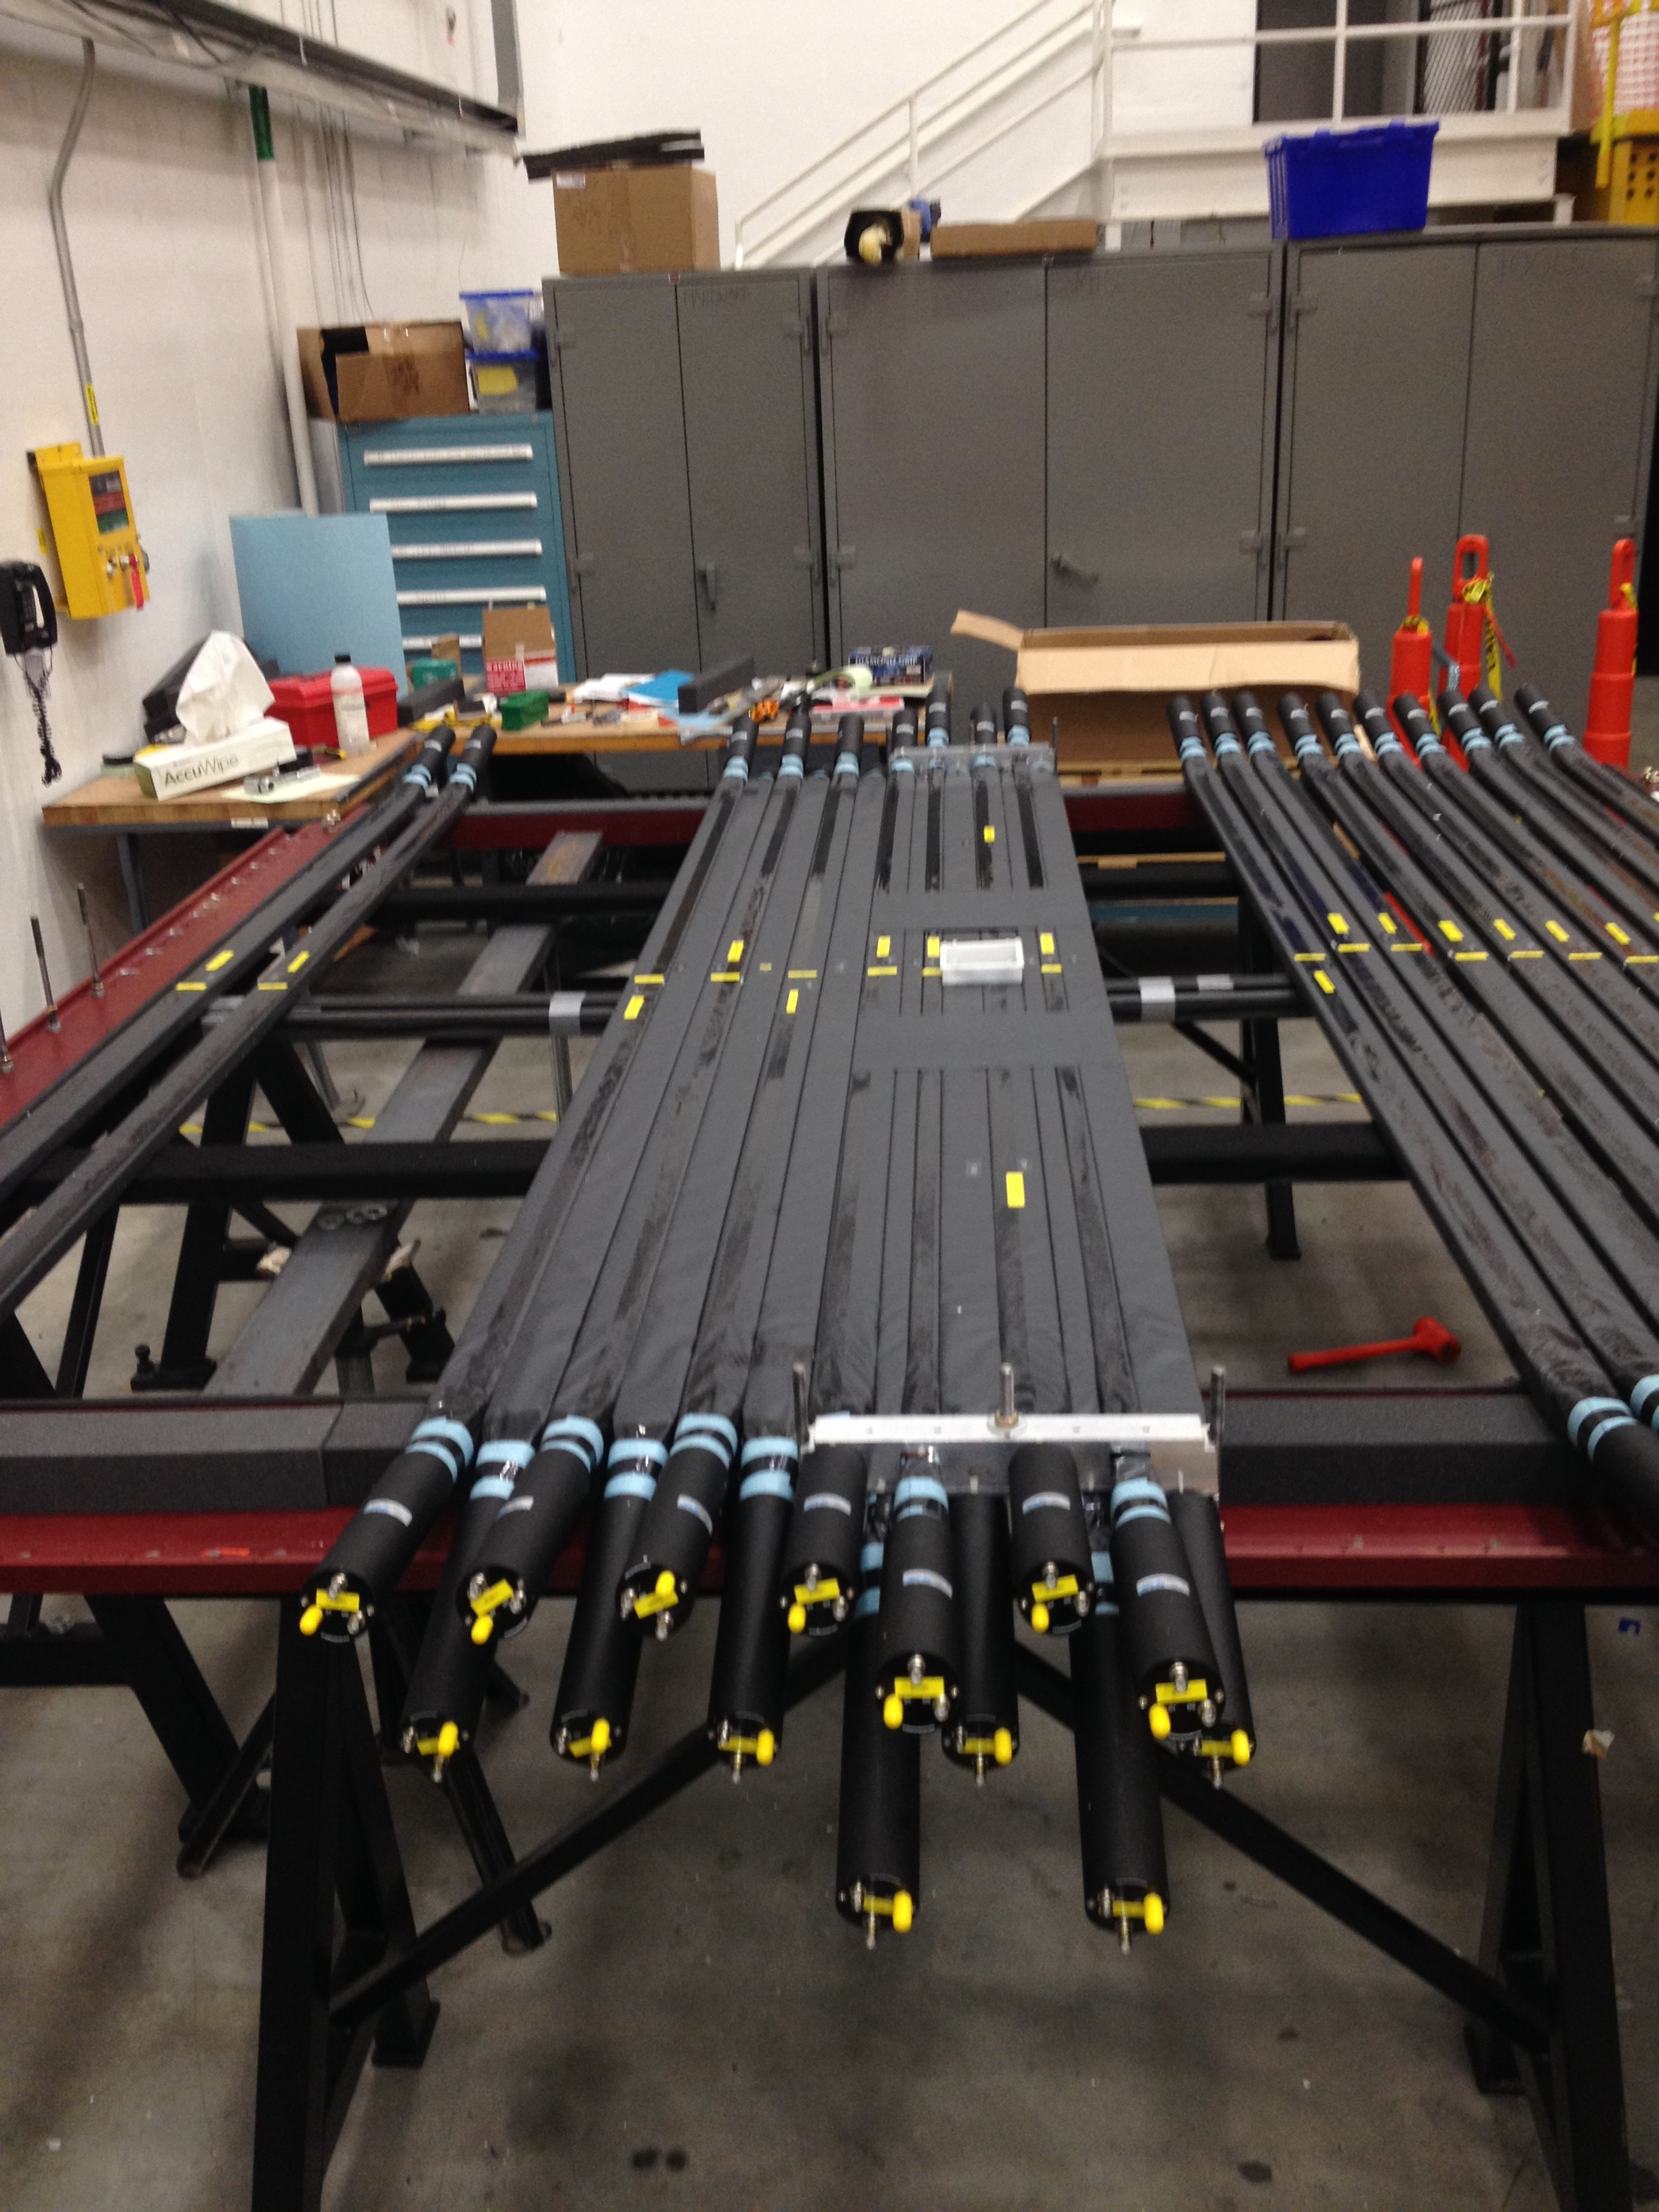
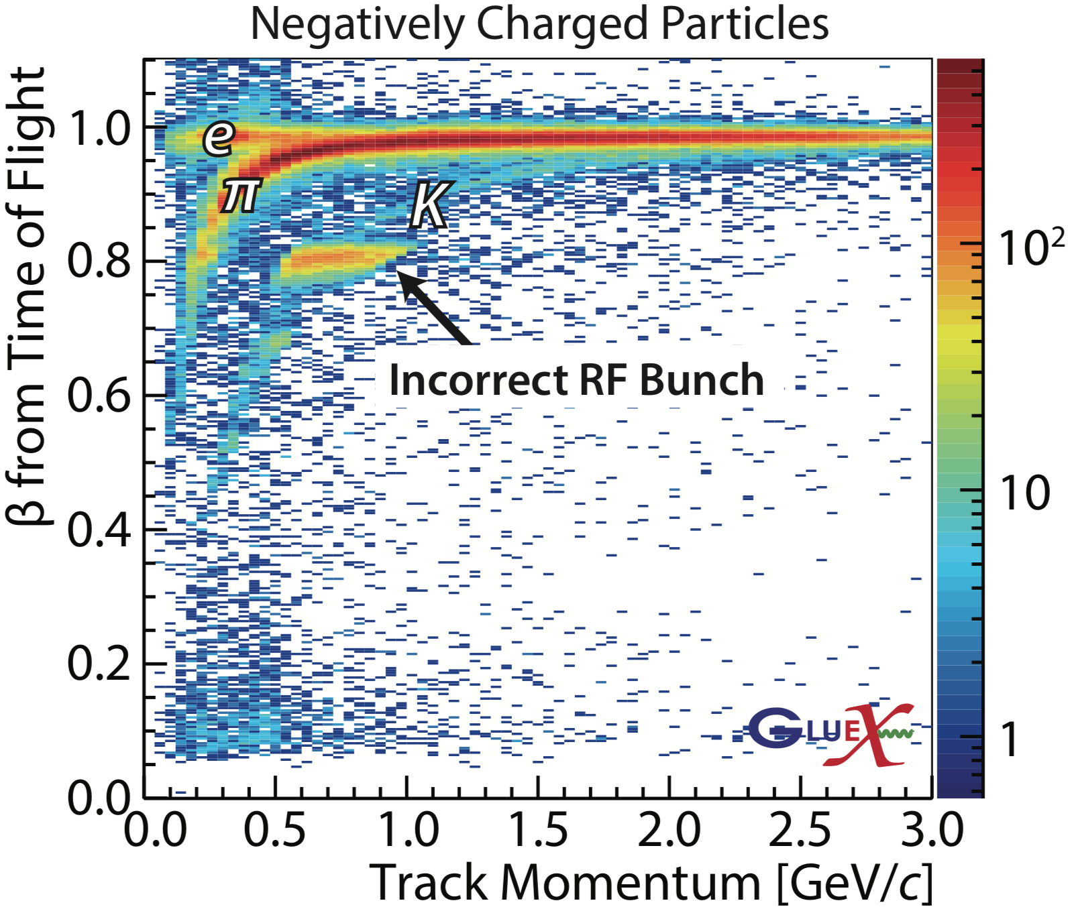
Time of Flight and PID
TOF: two planes of scintillator paddles, one stacked vertically, the other horizontally.

Slide 21
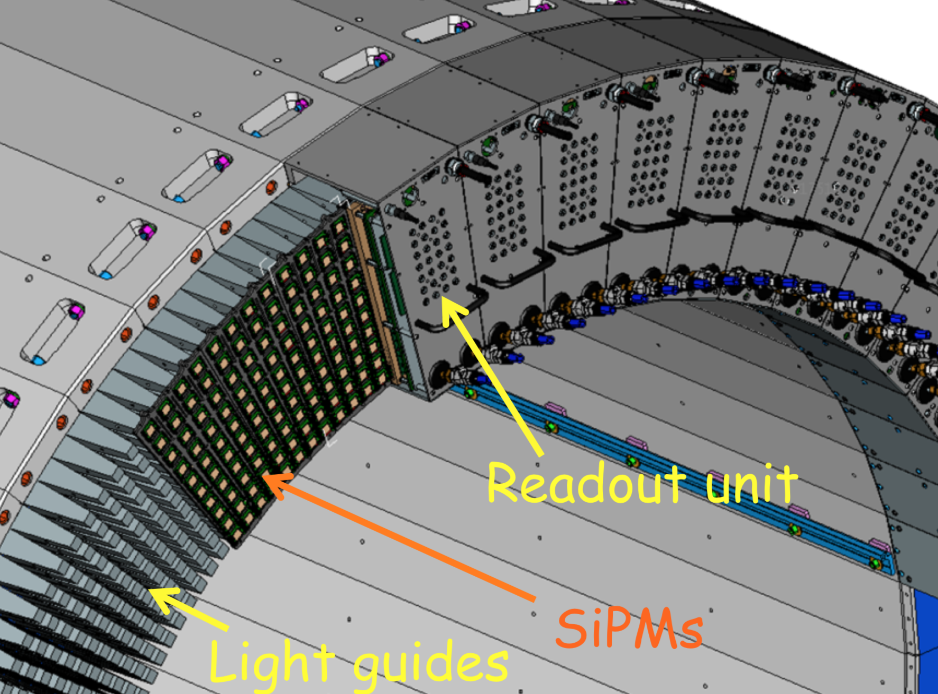
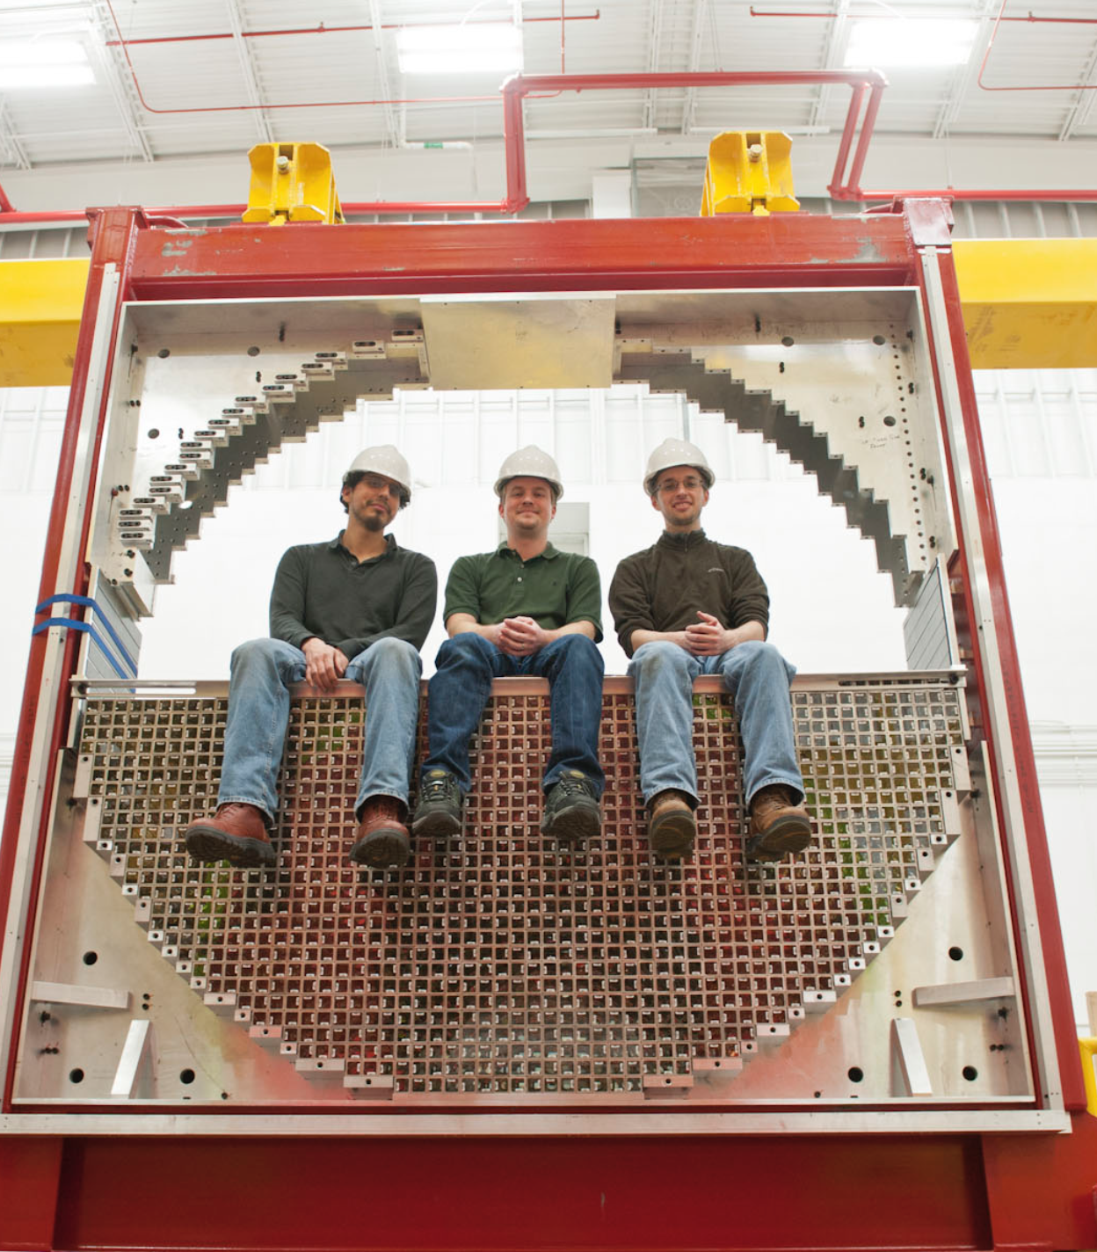
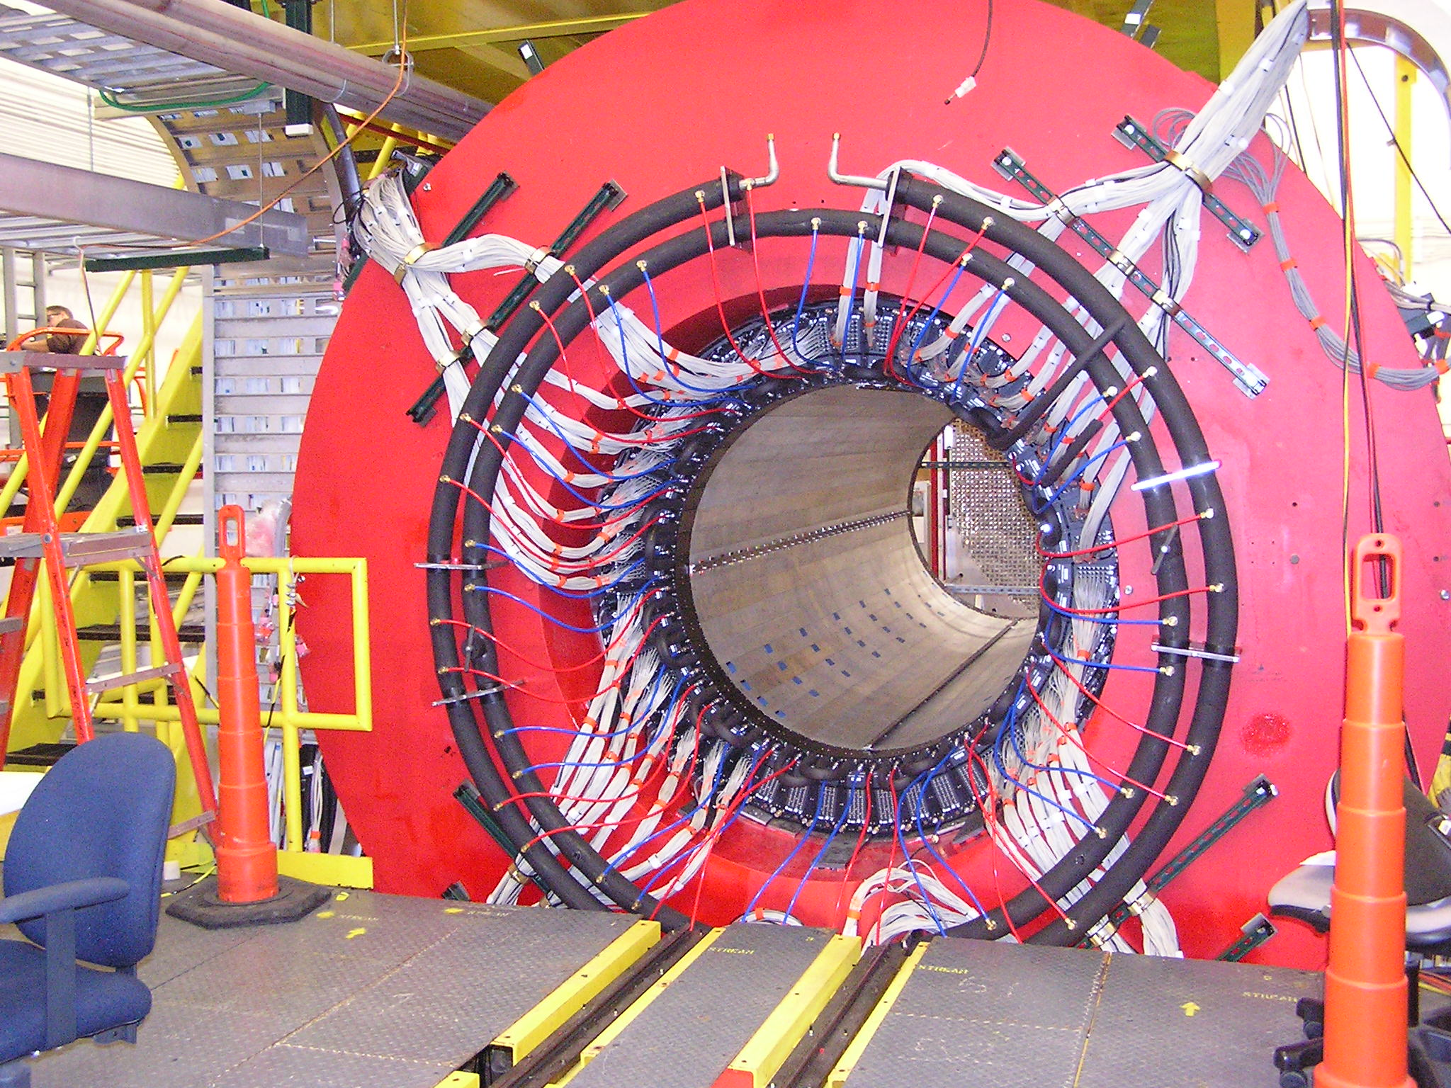
Barrel and Froward Calorimeter
Lead and scintillating Fiber matrix by Regina U
Forward Calorimeter assembling
Barrel Calorimeter installed
FCAL: consisting of 2800 element 4 x 4 x 45 cm lead glass bars, light produced is measured by PMTs

Slide 22
Performance of Calorimeter
Calorimeter approaching designed energy resolution

Slide 23

Data Sets
Initial physics data ($≈$ 80 h)
2018 low-intensity data
2014-2015: Detector Commissioning
Spring 2016: GlueX Engineering Run
Spring 2017: First Physics runs
  April 2017: First Physics Result published

Slide 24

The GlueX Collaboration
North America (17)
Arizona State Univ.
Carnegie Mellon Univ.
Catholic Univ.
Univ. of Connecticut
Florida International Univ.
Florida State Univ.
George Washington Univ.
Indiana Univ.
Jefferson Lab
Univ. of Massachusetts, Amherst
MIT
Norfolk State Univ.
North Carolina A&T State
Univ. of North Carolina, Wilmington
Northwestern Univ.
Univ. of Regina
College of William and Mary
Europe (8)
University of Athens
Univ. of Glasgow
GSI
ITEP Moscow
MEPhI
Tomsk State Univ.
Tomsk Poly. Univ.
Yerevan Physics Institute
Asia (2)
Wuhan University
IHEP
South America (1)
Santa Maria University
Wuhan University joined the GlueX Collaboration in 2016; GlueX/BESIII: A Workshop on Common Topics was held in August 2017 in Beijing; In December 2017 IHEP (CAS) was approved to be a member of the GlueX Collaboration.

Slide 25
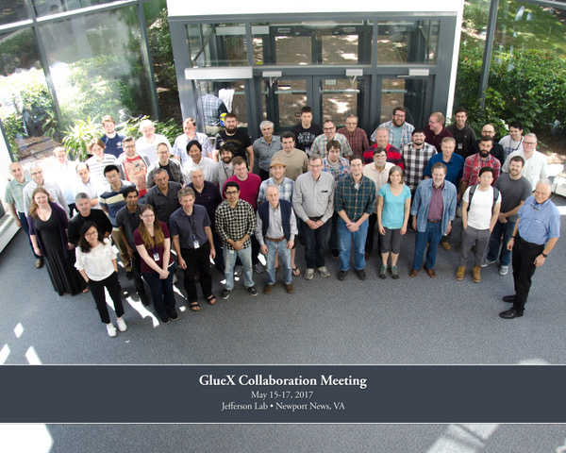
The GlueX Collaboration
North America (17)
Arizona State Univ.
Carnegie Mellon Univ.
Catholic Univ.
Univ. of Connecticut
Florida International Univ.
Florida State Univ.
George Washington Univ.
Indiana Univ.
Jefferson Lab
Univ. of Massachusetts, Amherst
MIT
Norfolk State Univ.
North Carolina A&T State
Univ. of North Carolina, Wilmington
Northwestern Univ.
Univ. of Regina
College of William and Mary
Europe (8)
University of Athens
Univ. of Glasgow
GSI
ITEP Moscow
MEPhI
Tomsk State Univ.
Tomsk Poly. Univ.
Yerevan Physics Institute
Asia (2)
Wuhan University
IHEP
South America (1)
Santa Maria University
Wuhan University joined the GlueX Collaboration in 2016; GlueX/BESIII: A Workshop on Common Topics was held in August 2017 in Beijing; IHEP (CAS) was approved to be a member of the GlueX Collaboration.

Slide 26
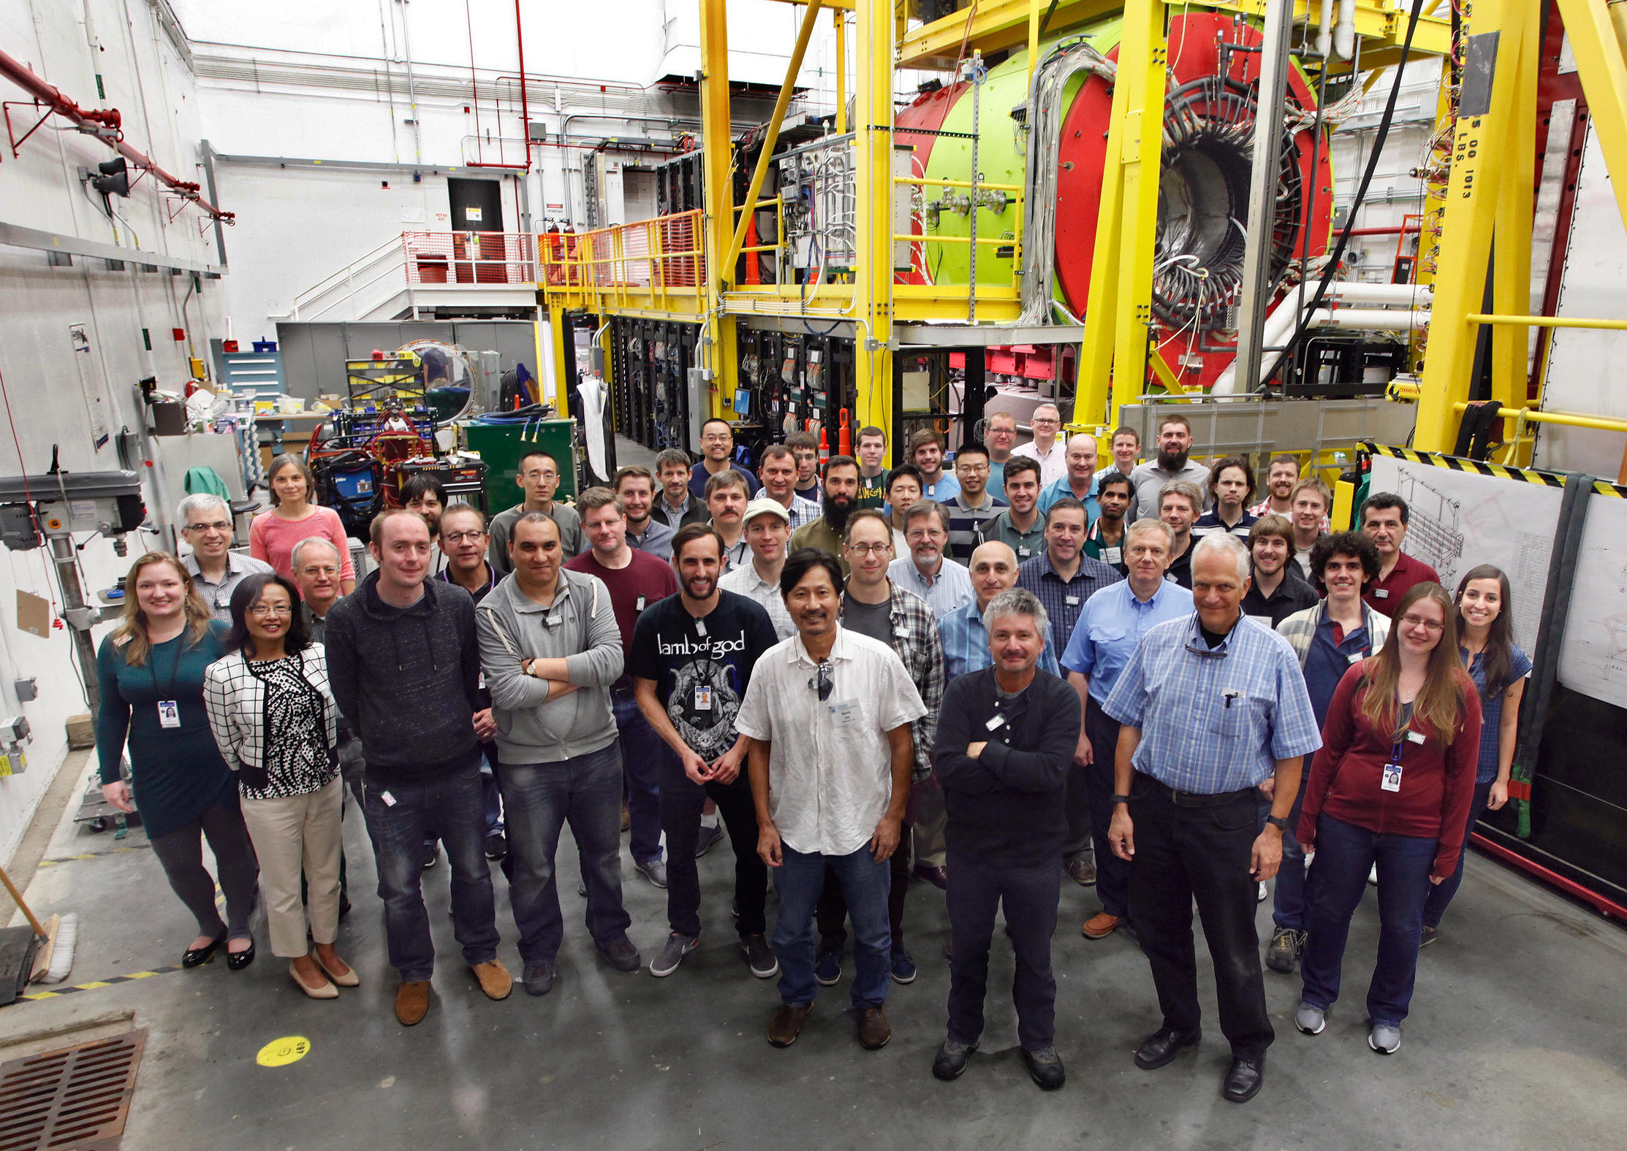
The GlueX Collaboration
North America (17)
Arizona State Univ.
Carnegie Mellon Univ.
Catholic Univ.
Univ. of Connecticut
Florida International Univ.
Florida State Univ.
George Washington Univ.
Indiana Univ.
Jefferson Lab
Univ. of Massachusetts, Amherst
MIT
Norfolk State Univ.
North Carolina A&T State
Univ. of North Carolina, Wilmington
Northwestern Univ.
Univ. of Regina
College of William and Mary
Europe (8)
University of Athens
Univ. of Glasgow
GSI
ITEP Moscow
MEPhI
Tomsk State Univ.
Tomsk Poly. Univ.
Yerevan Physics Institute
Asia (2)
Wuhan University
IHEP
South America (1)
Santa Maria University
Wuhan University joined the GlueX Collaboration in 2016; GlueX/BESIII: A Workshop on Common Topics was held in August 2017 in Beijing; IHEP (CAS) was approved to be a member of the GlueX Collaboration.

Slide 27
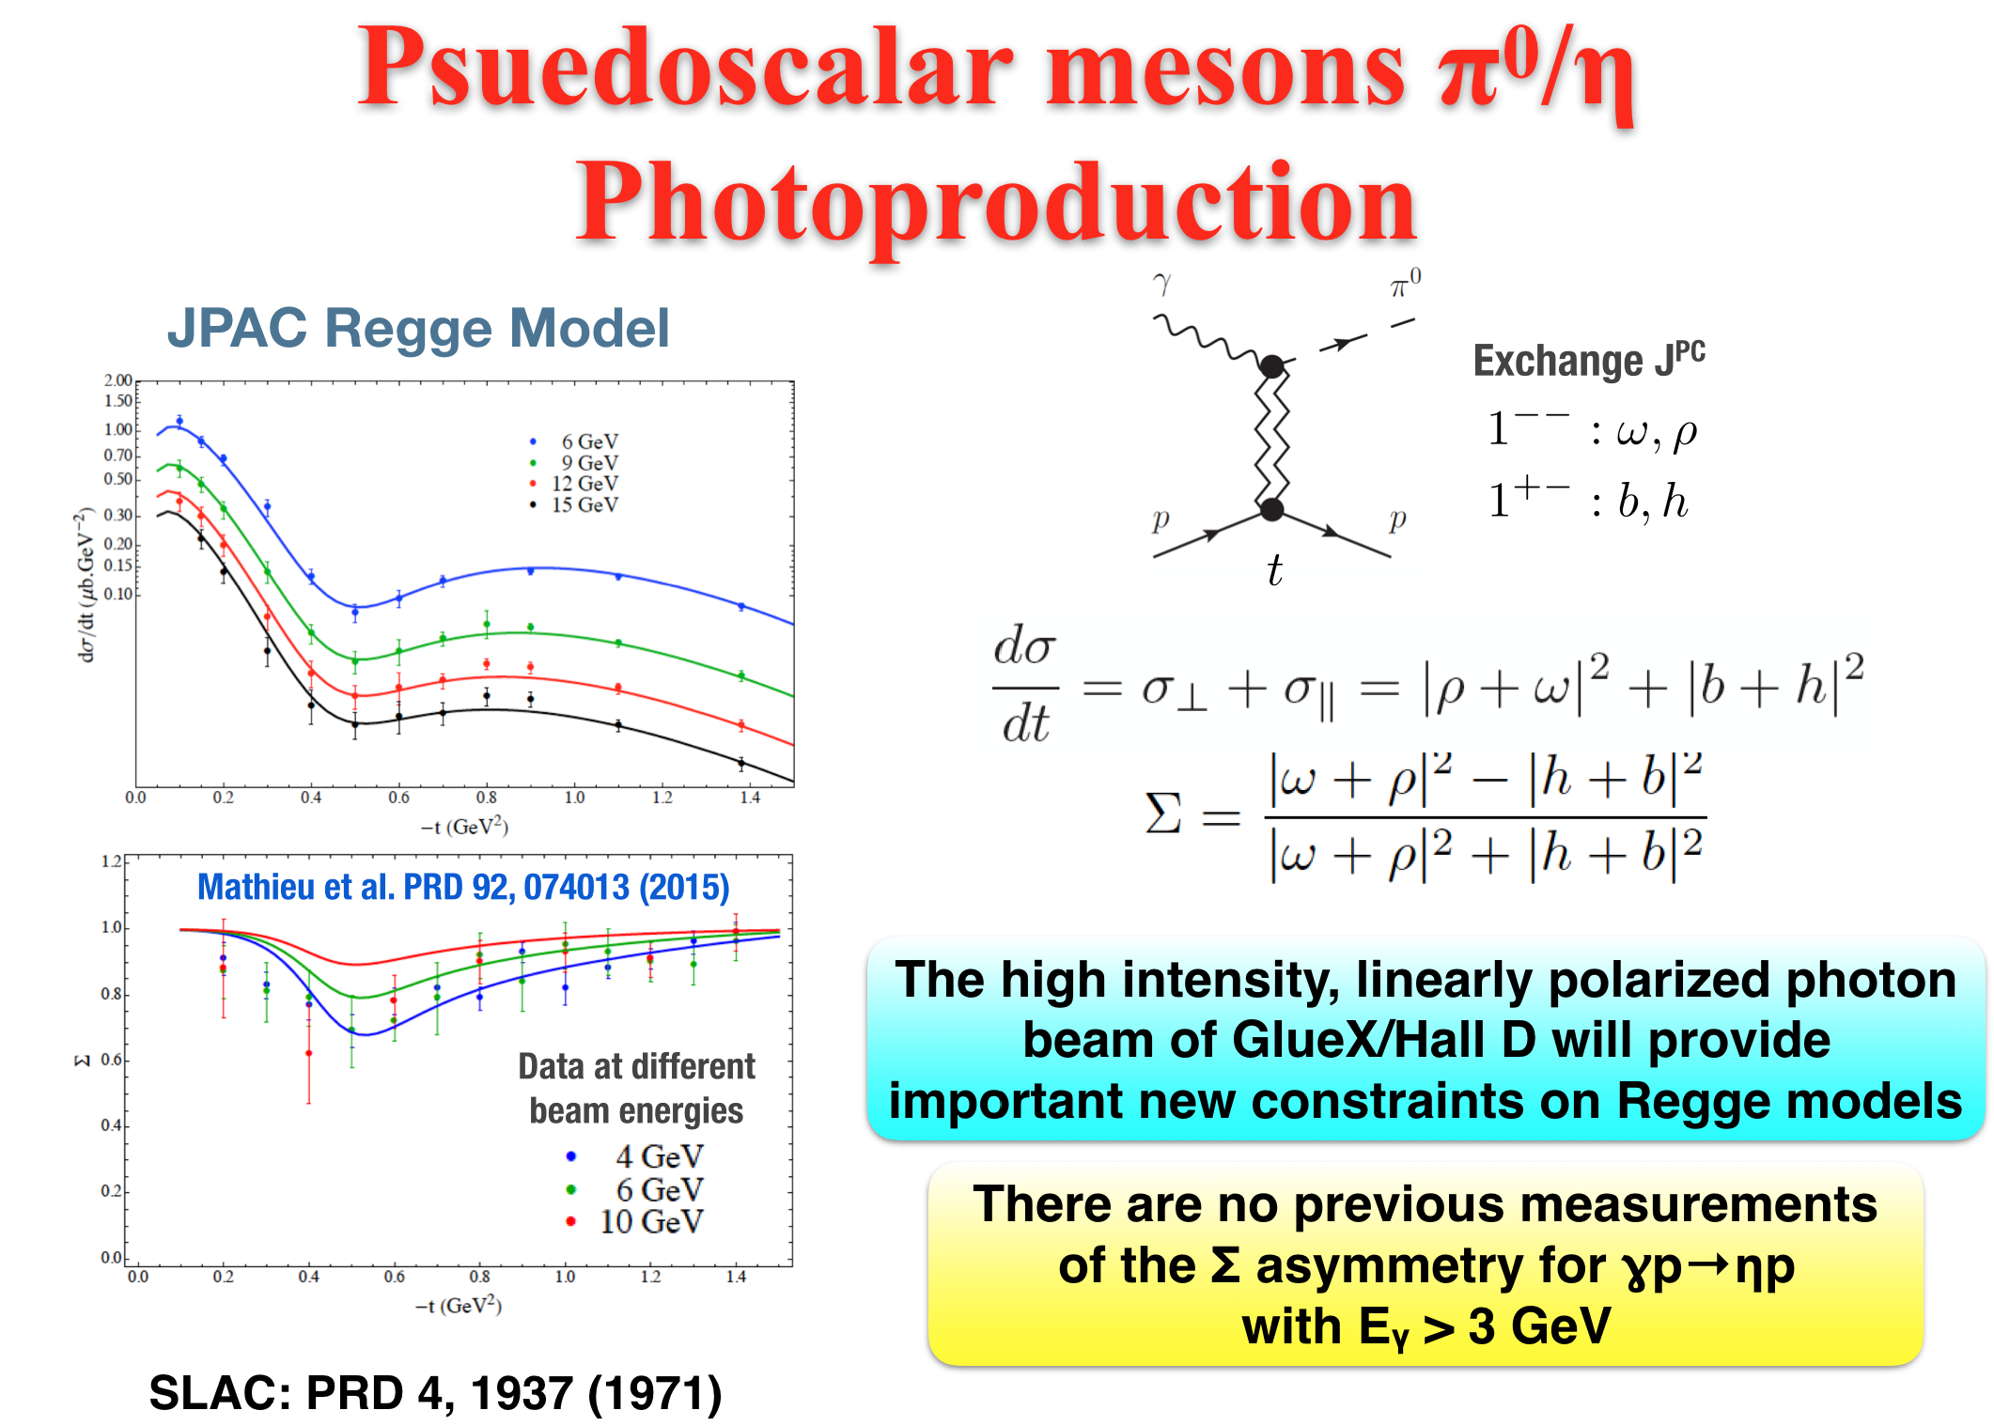
Cite from: Zhenyu Zhang EPD Seminar 6/20/2017

Slide 28
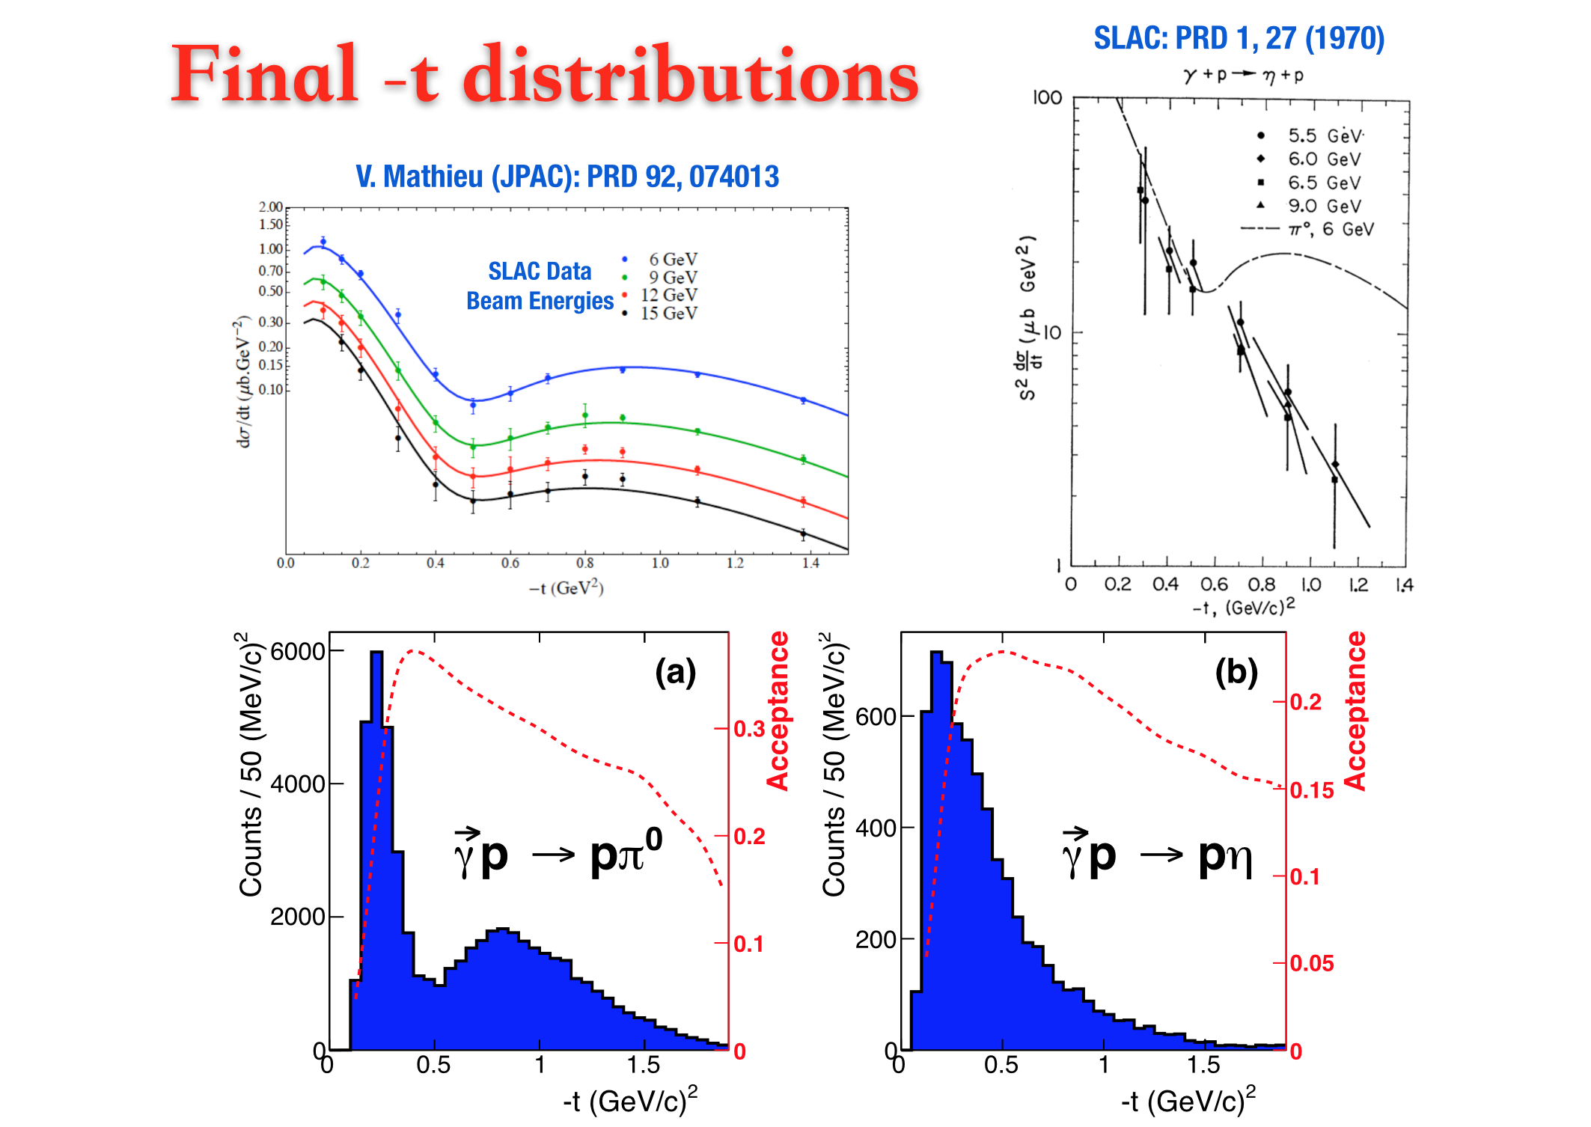
Cite from: Zhenyu Zhang EPD Seminar 6/20/2017

Slide 29
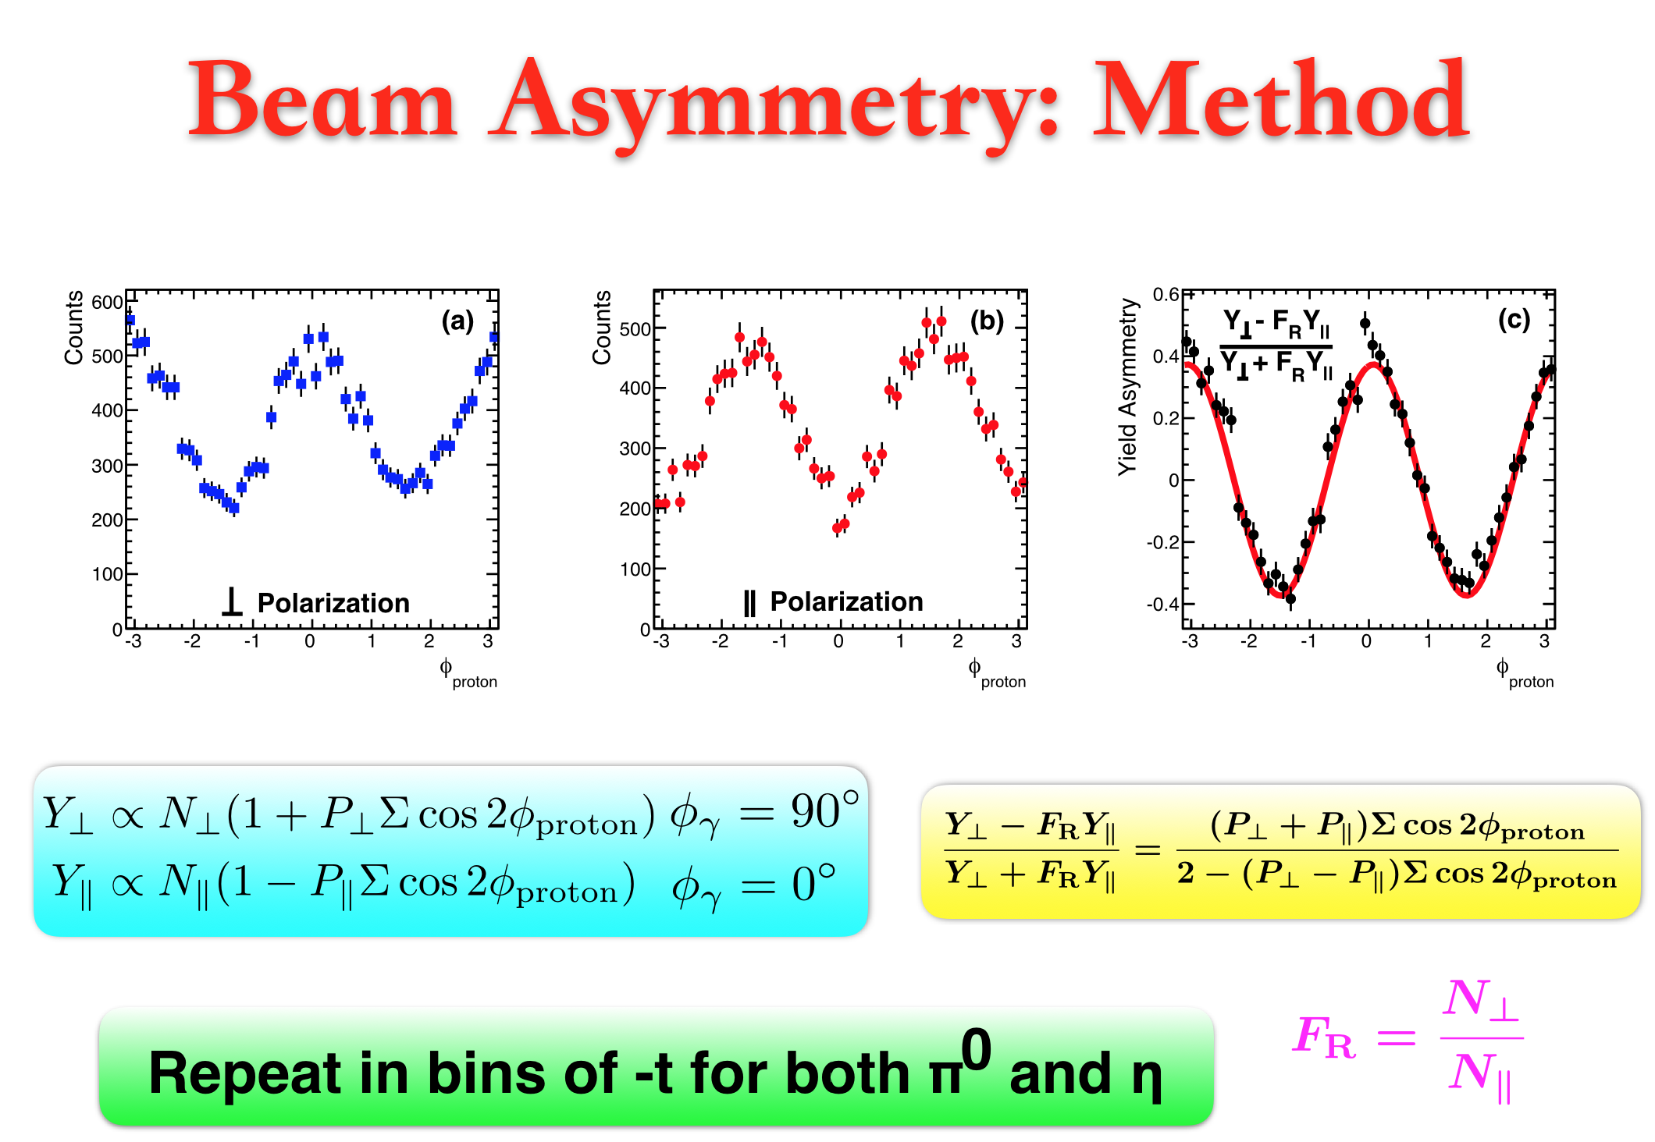
Cite from: Zhenyu Zhang EPD Seminar 6/20/2017

Slide 30
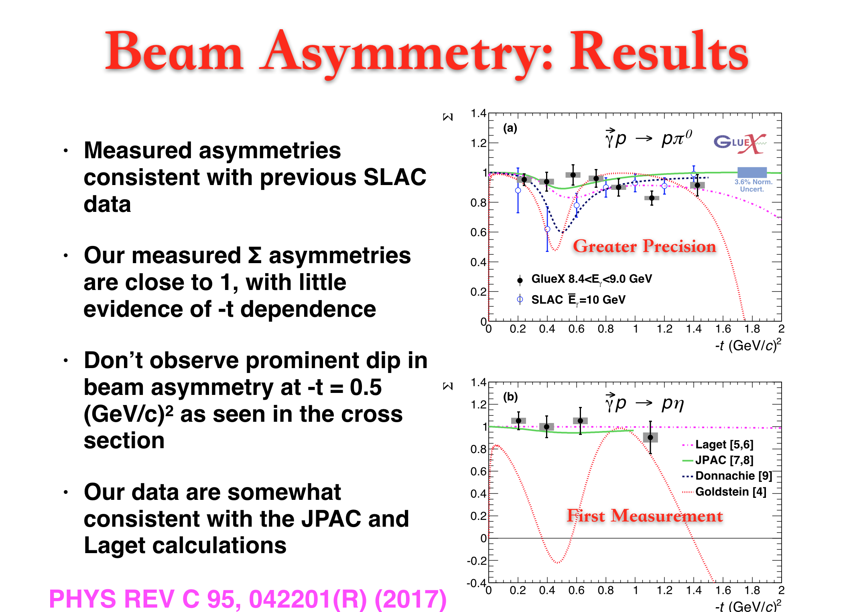
Cite from: Zhenyu Zhang EPD Seminar 6/20/2017

Slide 31
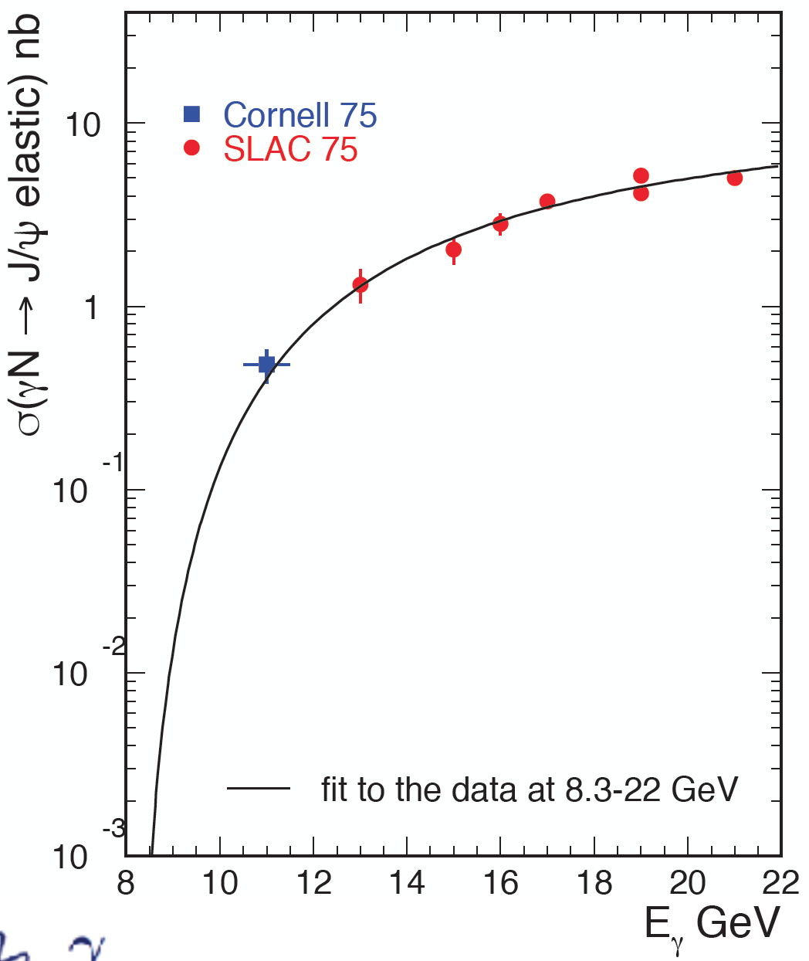
J/ψ Photoproduction Near Threshold
Threshold production is experimentally clean, ideal for studying J/ψ+N interaction
Can also study coupling of resonant J/ψ+p states to photon through s-channel production.
  Pc(4450) produced at E(ɣ) ~ 10.3 GeV
  Several existing studies: Wang, Liu, and Zhao, PRD 92, 034022 (2015). Kubarovsky and Voloshin, PRD 92, 031502 (2015). Karliner and Rosner, PLB 752, 329 (2016). Hiller Blin et al., PRD 94, 034002 (2016).
  Example: KR finds σ_{peak} ~ 12 nb assuming Br(Pc → p J/ψ)=10% Large theoretical uncertainties exist.

Slide 32
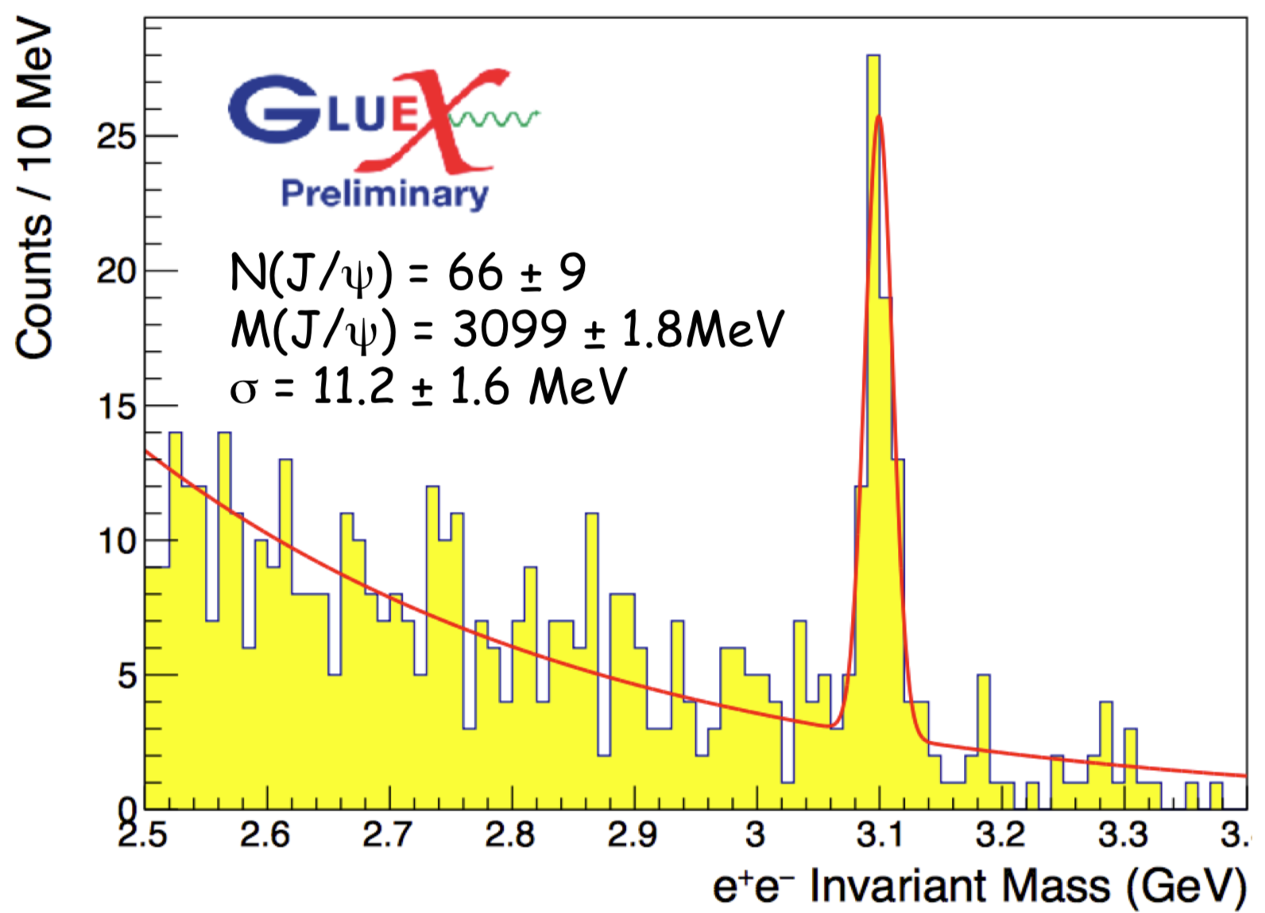
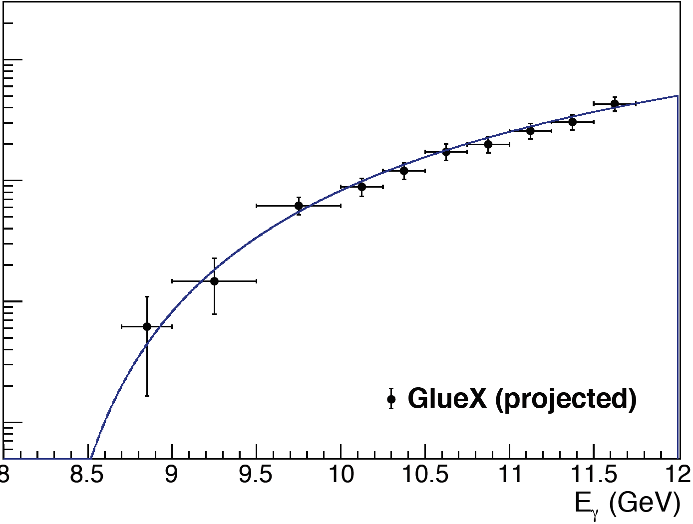
J/ψ Photoproduction Near Threshold
For initial GlueX running, expect 10 x current data, ~700 J/ψ. Allows first detailed look at cross sections near threshold, first searches for resonant states in this region.
In ~2019, high-luminosity GlueX running will begin, with updated particle identification and 10x more data. This will enable:
  Study of angular distributions in detail
  Study of polarization effects

Slide 33



Four photon final states
  The γ+p→p+4γ channel is rich in physics potential, contains a lot of channels
  The π⁰π⁰/π⁰η are dominant processes, can be used to study the properties of f₀(980) and a₀(980) mesons, hunt for exotic states, discriminate among models for scalars.

Slide 34





Four photon final states
Advantages in analyzing moments:
Can be directly and unambiguously derived from the data,
Can be expressed as bilinear in terms of the partial waves,
Show specific sensitivity to a particular subset of partial waves,
Quantitative comparisons to the same theoretical observables.
$$H_{LM}\left(E_{γ},t,M_{πη}\right)=\sqrt{4π}\int{dΩ_{π}\frac{ⅆσ}{dtⅆM_{πη}ⅆΩ_{π}} ReY_{LM}\left(Ω_{π}\right)}, (1)$$
$$H_{00}={\left|S_{0}\right|}^{2}+{\left|P_{0}\right|}^{2}+{\left|P_{−}\right|}^{2}+{\left|D_{0}\right|}^{2}$$
$+{\left|D_{−}\right|}^{2}+{\left|P_{+}\right|}^{2}+{\left|D_{+}\right|}^{2}$, $(2)$
$H_{42}=\sqrt{\frac{10}{21}}{\left|D_{−}\right|}^{2}−\sqrt{\frac{10}{21}}{\left|D_{+}\right|}^{2}$, $(3)$
E852: PRD 67, 094015 (2003)
Shuang Han DNP-2017 Pittsburgh, PA 10/27/2017

Slide 35
Outlook
The GlueX experiment has been commissioned and finished the first physics run in both low and high intensity beam status.
  An initial commissioning run in spring 2016 has yielded a data sample two order of magnitude in this energy region, and first physics results has been published early 2017.
  Several analysis of beam asymmetry are ready once the 2017 data is included.
  The upcoming run will open the door to the study of hybrid mesons.
The data has opened up the study of dilepton physics at GlueX and allow us to begin to study the J/ψ production cross section near threshold.
High luminosity GlueX running is planned to start in 2019 with upgraded detector, focusing on strange-quark states.
Several other measurements are planned: GlueX supports a rich physics program.

Slide 36

The Upgrade Proposal
2018.

Slide 37

Forward Kaon Identification
Four of the BaBar DIRC bar (quartz bar) boxes will be installed in front of the TOF wall.
Baseline GlueX provided K/p separation up to about 2GeV/c. The addition of the DIRC pushes this up to 4.5 GeV/c.
Strangeonium mesons and hybrids can be studied.
Hyperon and cascade baryons can be studied.
Expected 2018

Slide 38


Cite from: John Hardin (MIT) 2017 DNP Meeting

Slide 39

Shipping of the DIRC

Slide 40




Shipping of the DIRC

Slide 41






The End
But life is not only about physics !

Slide 42
Back up

Slide 43
Physics on GlueX

