Slide 1
Progress in timing research of XRB by Insight-HXMT Observations
QU Jinlu（屈进禄）
On behalf of insight-HXMT team
2018-06-18

Slide 2
Content
Introduction
Insight-HXMT Capabilities
Progress
future

Slide 3
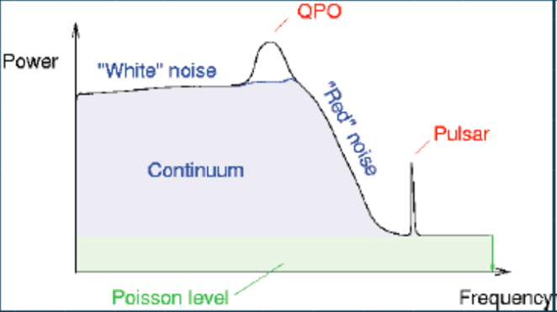
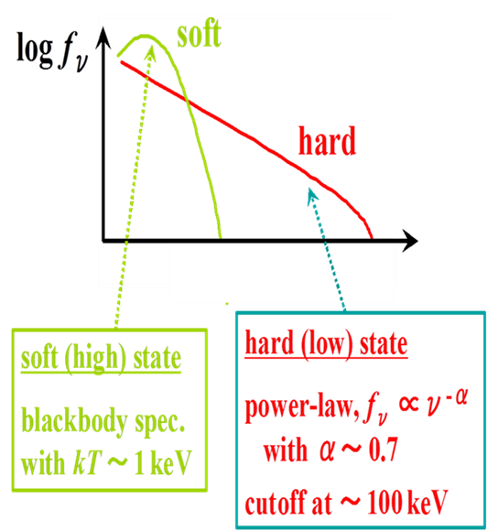
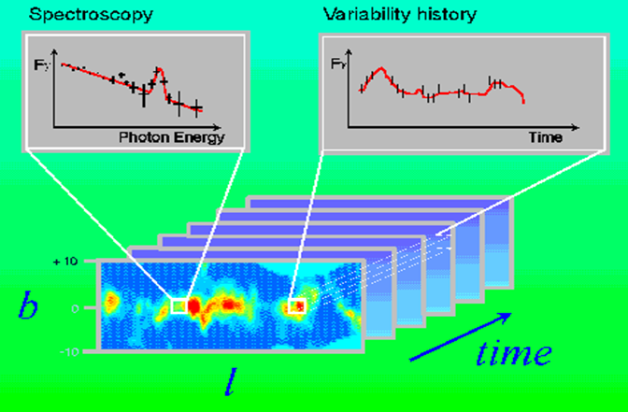
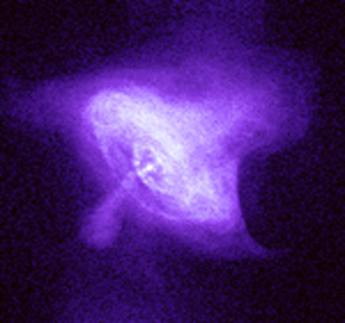
Observation & Timing
Arrival time—Timing；Energy—Spectrum；Position on detector—Image
Detect the innermost regions of XRB by X-ray
Time Domain Astrophysics is the `new frontier’!
PDS

Slide 4
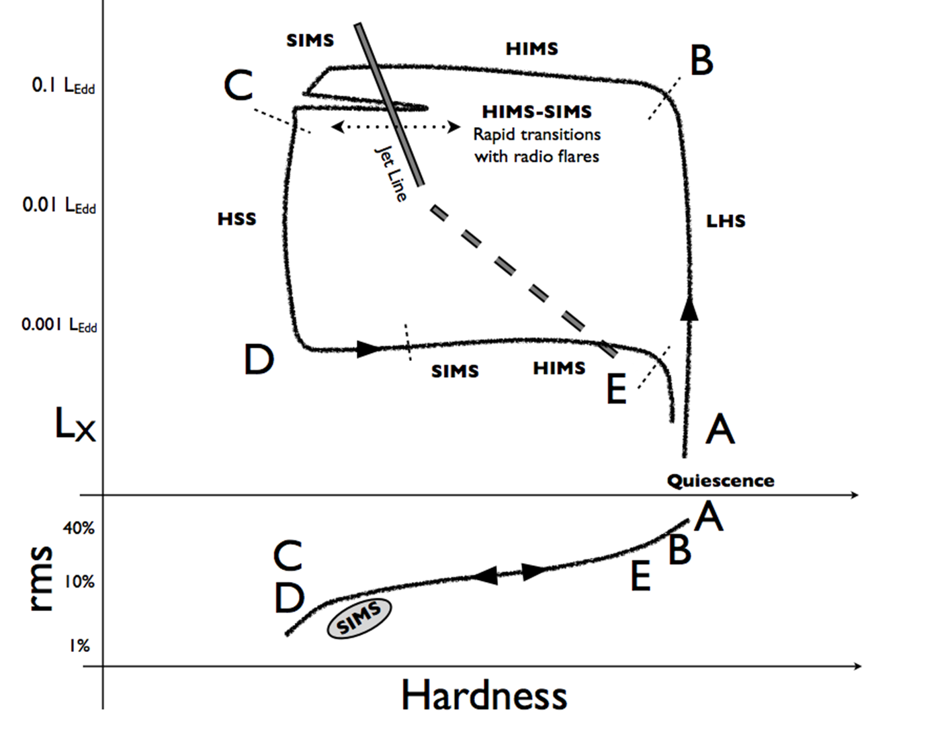
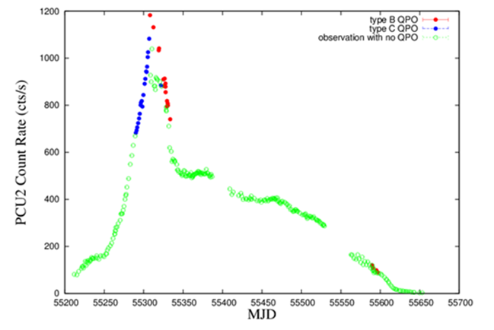
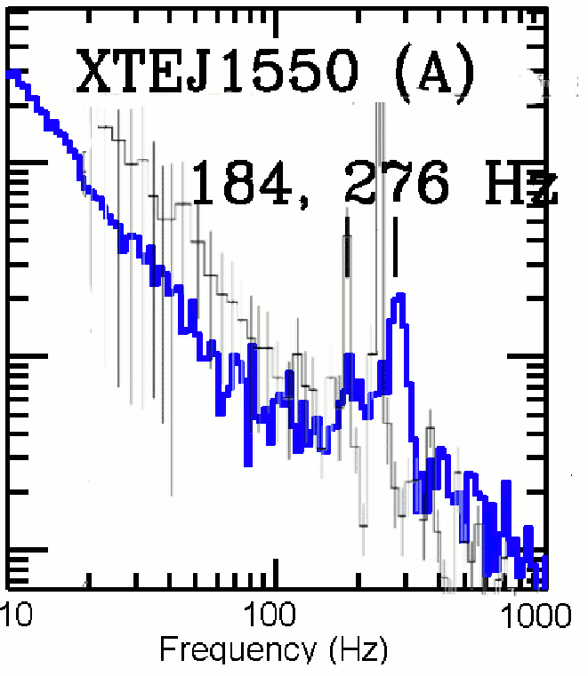
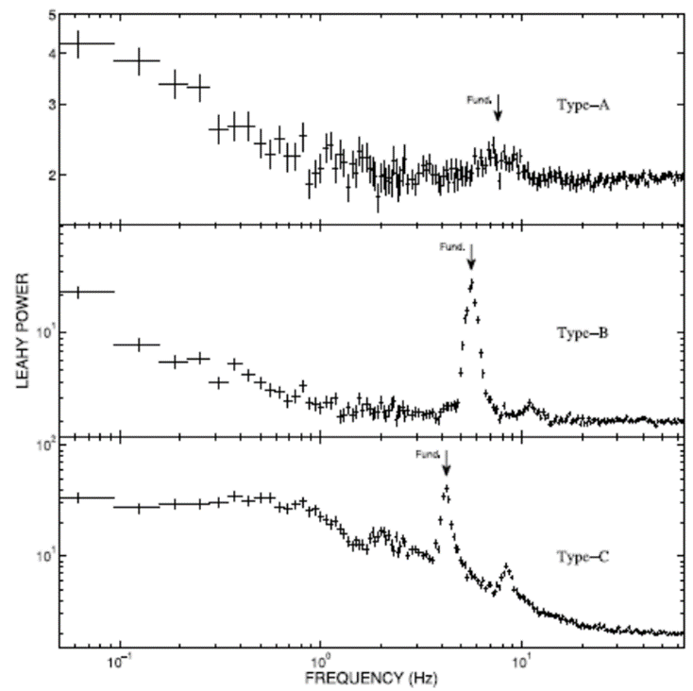
RXTE era: BH Transients
Monitoring the transients
Evolution of Timing & Spectra
  State & “q”-diagram
  High-Frequency QPO
  And so on
Motta et al. 2011, MNRAS

Slide 5
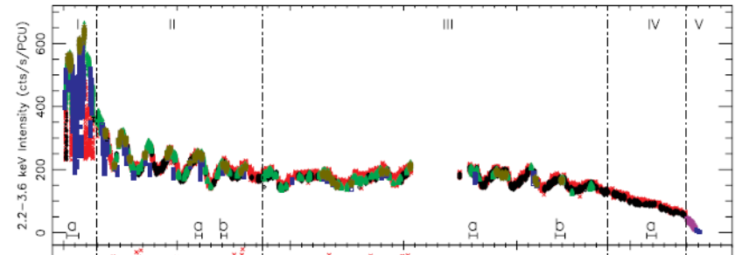
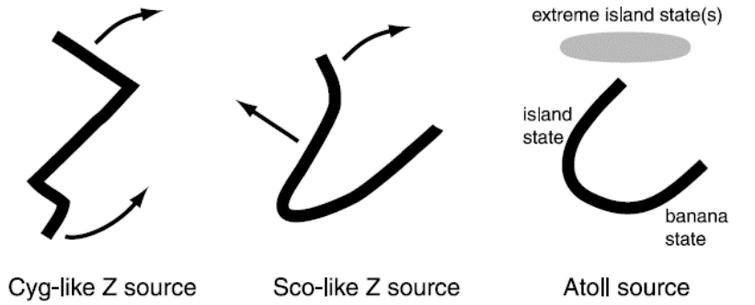
RXTE era: Neutron Star
kHz QPOs
ms Pulsar
Accretion rate and Evolution from Z (–track) to Atoll Sources for luminous NS LMXBs
And son on

Slide 6
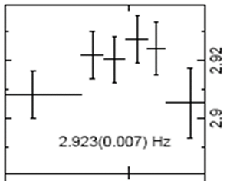
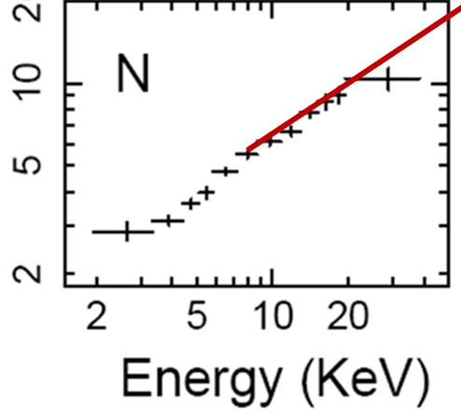
Rapid variability in accreting binaries is a powerful probe of accretion processes close to compact objects(white dwarfs, neutron stars and black holes)
But there are lot of questions, for example, what is the behavior of QPOs in high energy?
？
Frequency
？
rms
>30keV

Slide 7
Insight-HXMT Capabilities

Slide 8
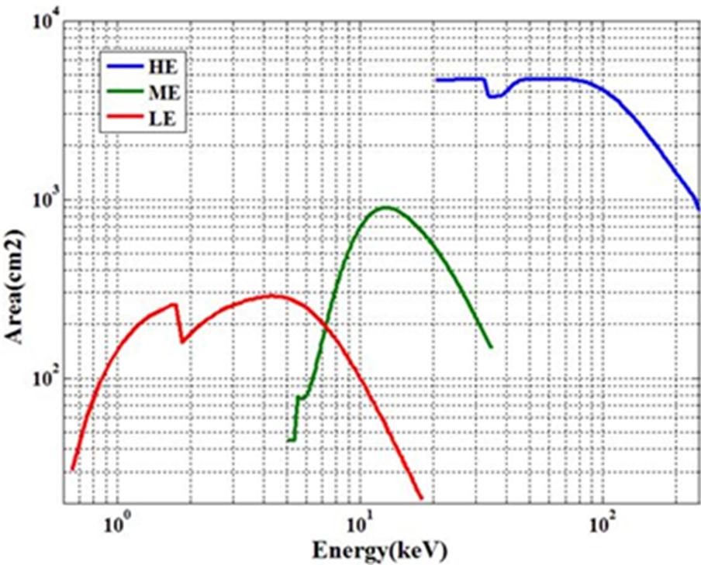
Insight-HXMT Special Features
Large Area (5000 cm²)
High time resolution (10us)
Hard X-ray Energy (~250 keV)
Low Energy (~1keV)
No PileUp
Detectors | LE: SCD, 384 cm² ME : Si-PIN, 952 cm² HE : NaI/CsI, 5000 cm²
Energy Range | LE: 1-15 keV ME: 5-30 keV HE: 20-250 keV
Time Resolution | HE: 25μs ME: 280μs LE: 1 ms(10us)
These characteristics are very useful for timing study

Slide 9
Insight-HXMT Timing: Key Science Topics
The Capability Fastly to Change/Adjust Observing Objects(Rapid Slew)
Bright Source Observing Capability (Outbursts)
Wide X-ray energy band: Extending view of the timing to higher energy and low energy bands
Monitoring different time scales outburst/burst by pointing observation
More XRB Transient Sources
State transition of transients
Spectral-timing analysis
Disk-Jet connection (Time Lags)
Long term soft/hard variability
Quasi Periodic Oscillations (QPOs)

Slide 10
Insight-HXMT Some Obs. Sources
Type | Source Name | Obs.No | Exp(ks)
LMXB NBs | Cir X-1 | 6 | 100
 | Sco X-1 | 5 | 180
 | Cyg X-2 | 11 | 320
 | GX 17+2 | 5 | 150
LMXB BHs Transients | GRS 1915+105 | 13 | 410 | High Cadence
 | H 1743-322 | 15 | 180
 | MAXI J1535-571 | 18 | 430 | High Cadence
 | MAXI J1820+070 | N | ~ | High Cadence Obs
 | MAXI J1543-564 | 1 | 80
 | MAXI J1727-203
 | SwiftJ0243.6+6124

Slide 11
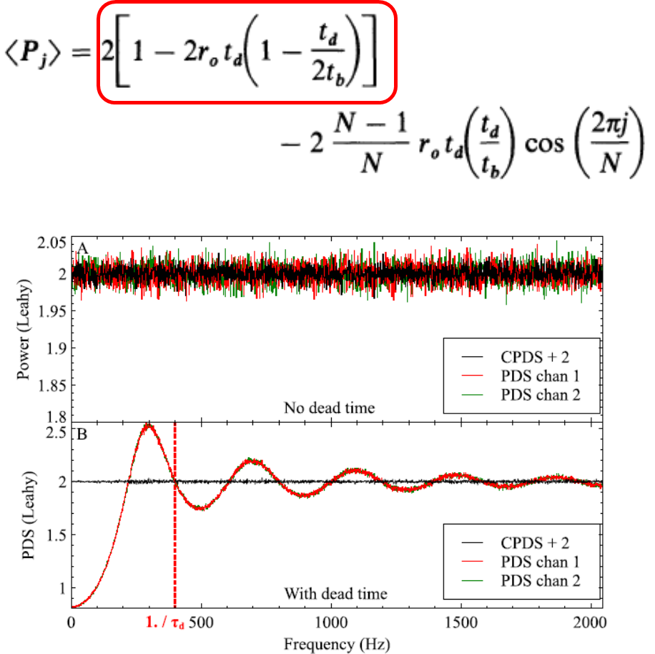
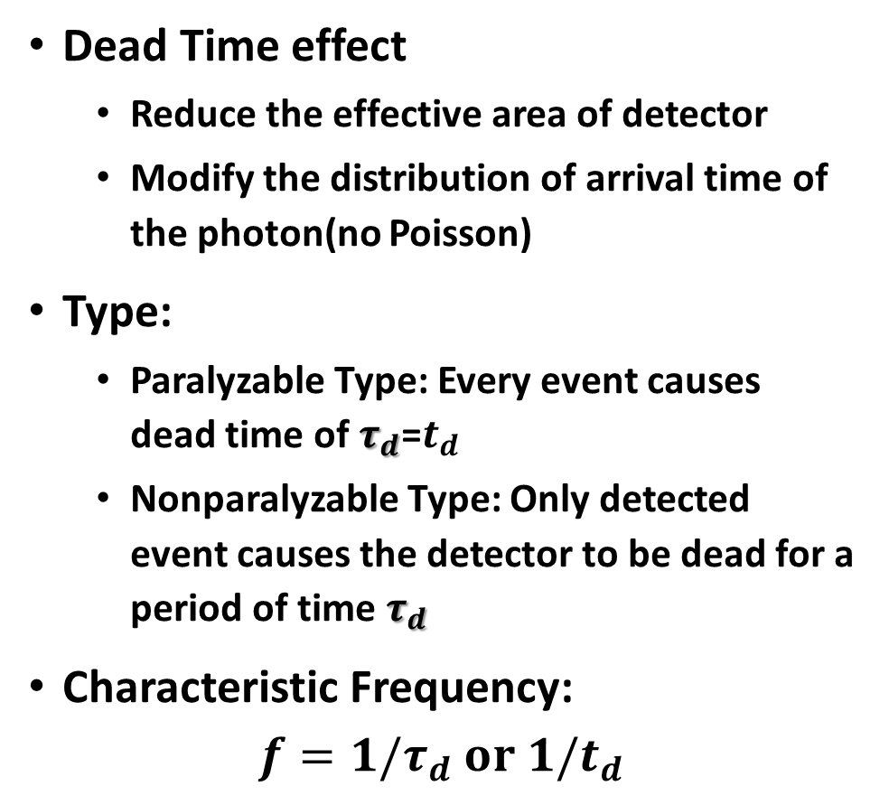
Dead Time of Insight HXMT
Dead Time effect
  Reduce the effective area of detector
  Modify the distribution of arrival time of the photon(no Poisson)
Type:
  Paralyzable Type: Every event causes dead time of $τ_{d}$=$t_{d}$
  Nonparalyzable Type: Only detected event causes the detector to be dead for a period of time $τ_{d}$
Characteristic Frequency:
$$f={1/τ}_{d} or 1/t_{d}$$
Zhang et al. 1995

Slide 12
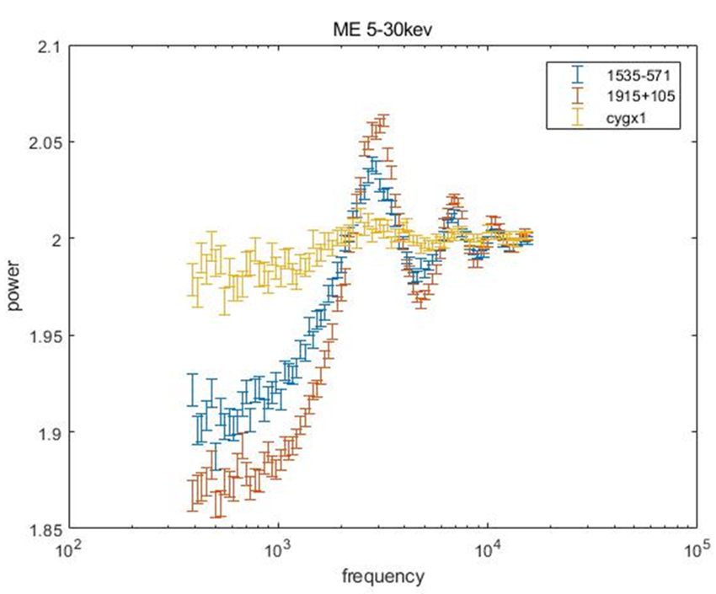
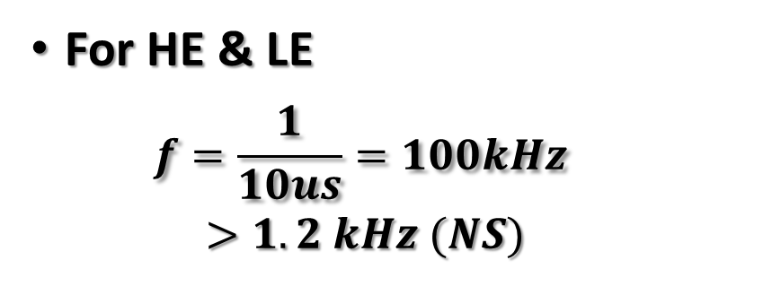
Dead Time of ME
For HE & LE
  $$f=\frac{1}{10us}=100kHz$$
  $$>1.2 kHz (NS)$$
Source | r₀ | paralyzable type |  | nonparalyzable type
 |  | t_{d} | R-s | t_{d} | R-s
MAXI1535-571 | 70.940 | 232.1±9.1 | 0.9379 | 238.0±7.5 | 0.9418
 | 74.779 | 236.3±9.6 | 0.9361 | 241.2±8.1 | 0.9513
 | 65.919 | 242.8±18.3 | 0.8439 | 246.2±16.1 | 0.8479
 | 76.053 | 239.7±7.9 | 0.9540 | 244.0±6.6 | 0.9571
Swift J0243+6124 | 80.055 | 231.2±9.7 | 0.9281 | 237.3±8.1 | 0.9319
 | 85.772 | 232.3±8.7 | 0.9423 | 238.2±7.3 | 0.9459
 | 84.966 | 231.7±8.7 | 0.9408 | 237.5±7.2 | 0.9447
 | 89.072 | 236.5±7.2 | 0.9610 | 241.7±5.9 | 0.9644
Sco X-1 | 266.970 | 238.3±5.6 | 0.9750 | 246.5±4.3 | 0.9807
 | 227.307 | 239.7±5.2 | 0.9786 | 247.0±4.3 | 0.9806
 | 293.712 | 238.5±5.6 | 0.9753 | 247.4±4.6 | 0.9782
 | 293.616 | 238.0±5.8 | 0.9742 | 246.9±4.8 | 0.9771
Characteristic frequency is not dependent X-ray Sources.
Dead Time ~ 250 us

Slide 13
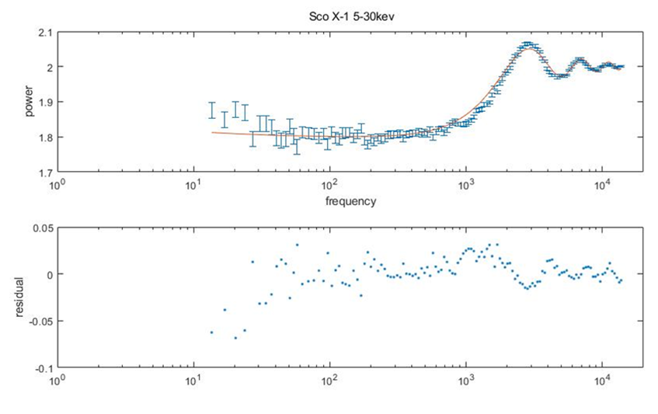
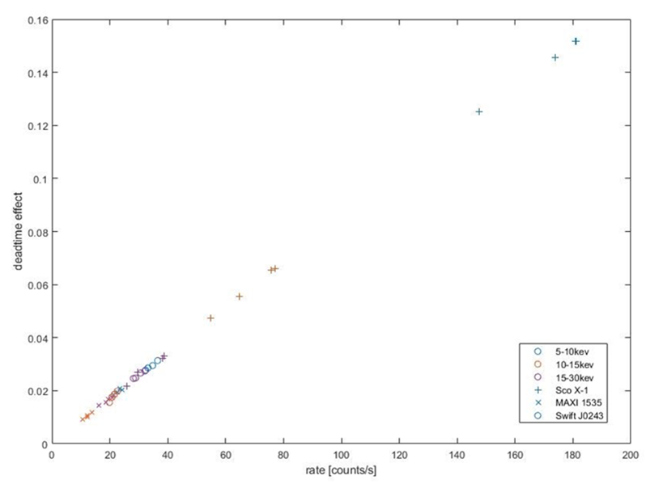
Correction & Energy Dependence of Dead Time
Two dead time type cannot fit the PDS
at high frequency (> 1kHz)
Energy non-dependence of Dead Time

Slide 14
Content
Introduction
Insight-HXMT Capabilities
Progress
future

Slide 15
BH Transients: MAXI J1535-571
Insight-HXMT
HUANG Yue

Slide 16
Q-Diagram and QPO Types

Slide 17
Energy Dependence of QPO
AstroSAT
Firstly extend energy to 100 keV

Slide 18
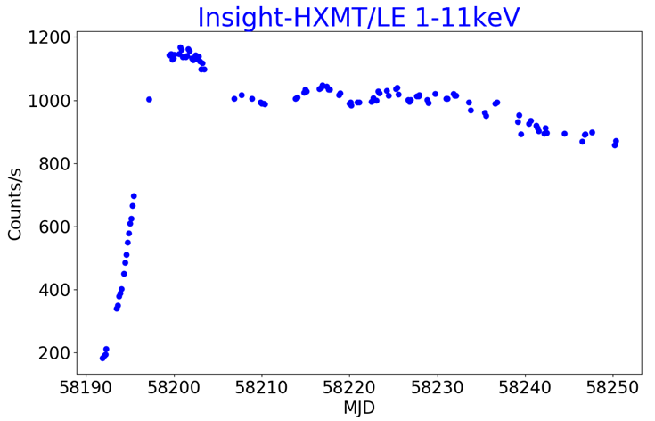
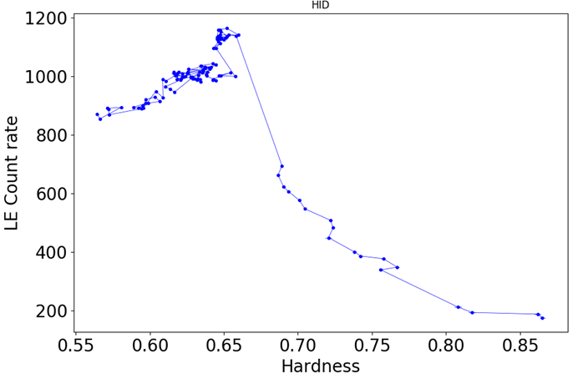
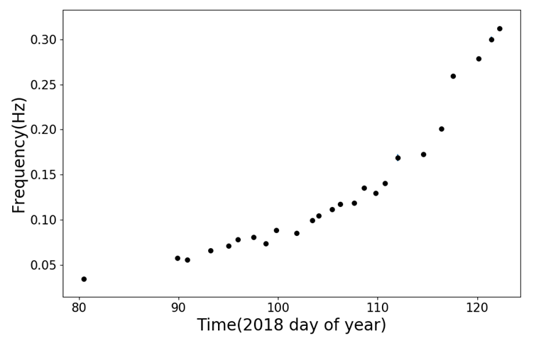
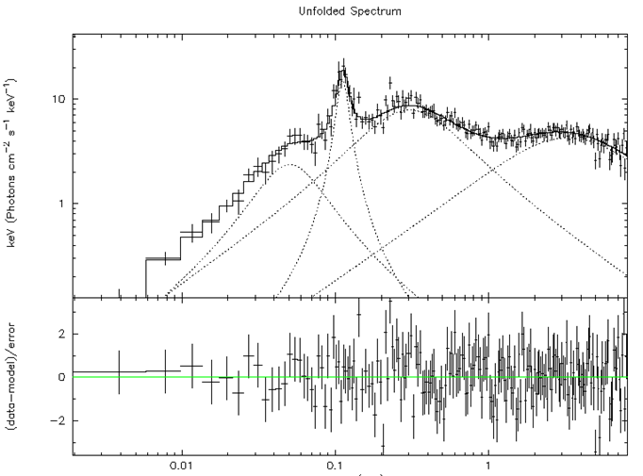
BH Transients: MAXI J1820+070:failed outburst
HID
Lightcurve
Typical PDS
QPOs
MA Xiang

Slide 19
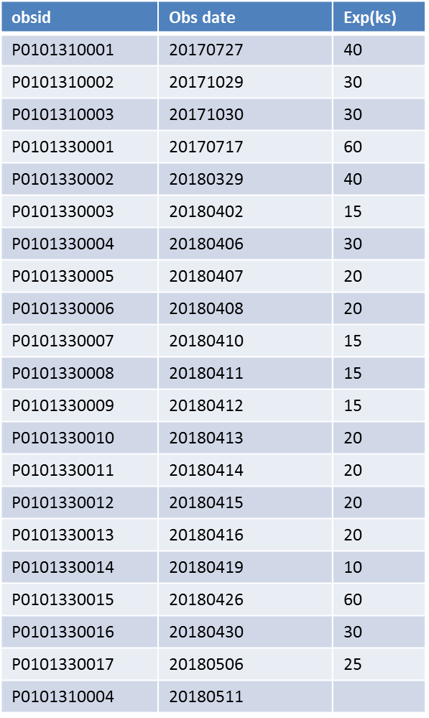
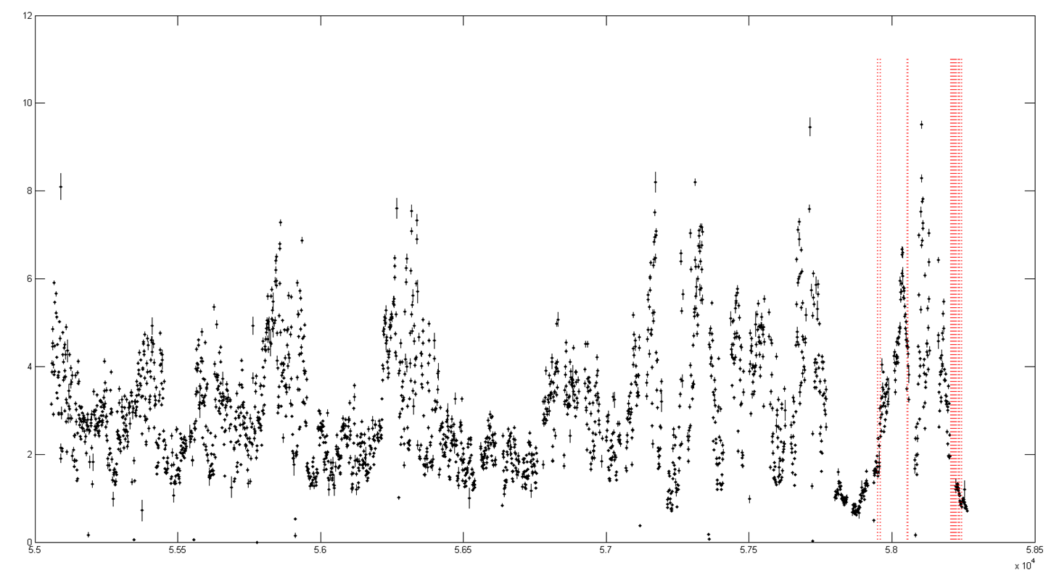
BH Transients: GRS 1915+105
BAT lightcurve
Observation Date
Partial Observations List

Slide 20
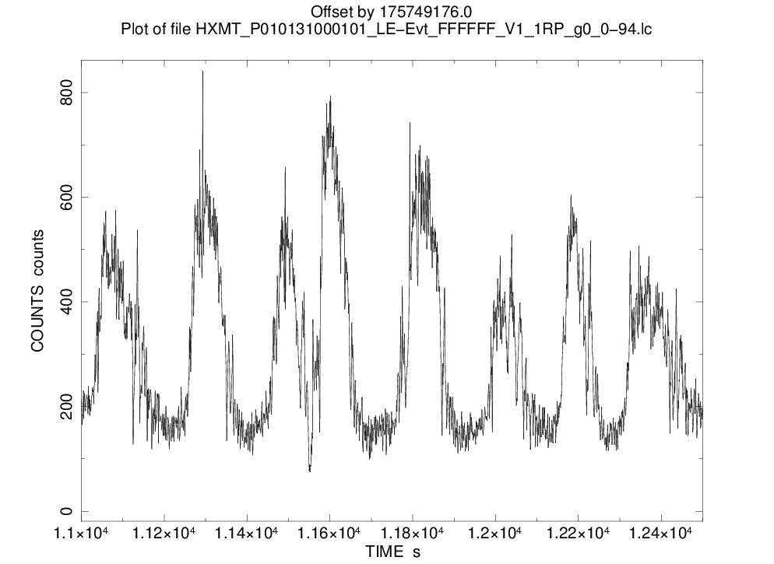
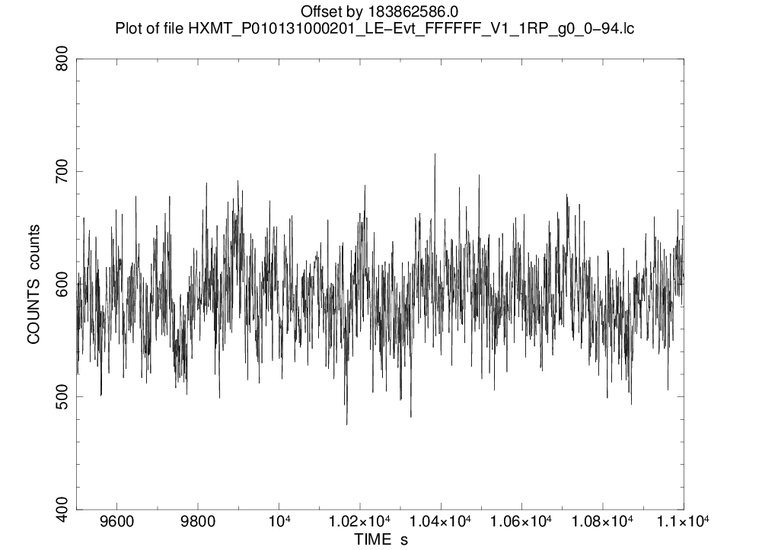
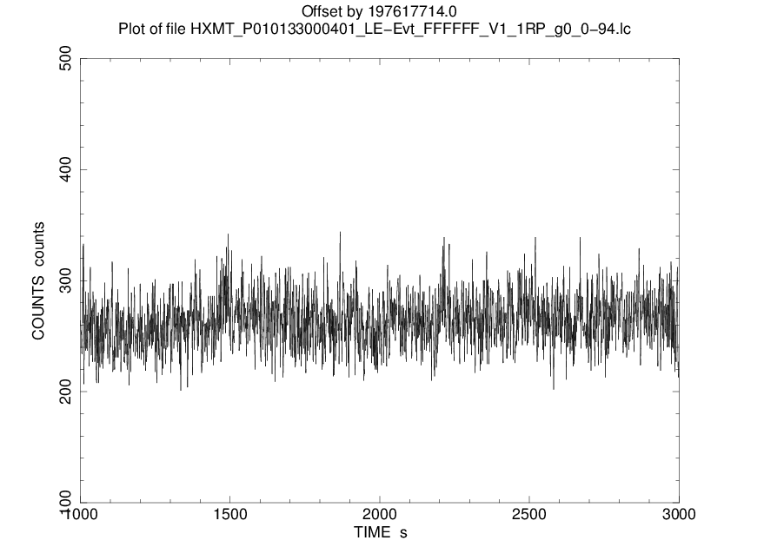
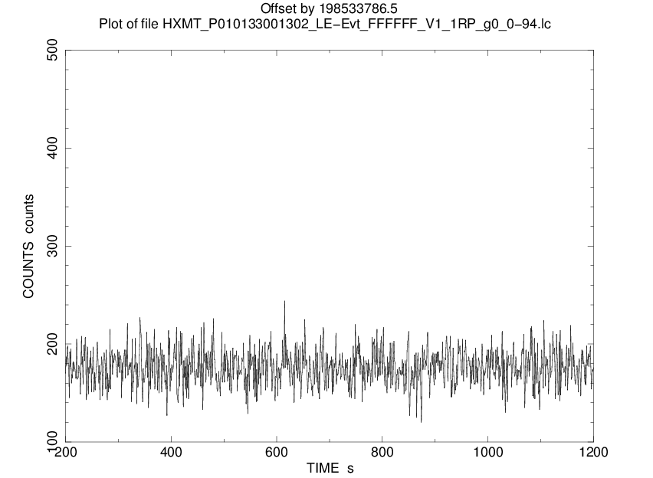
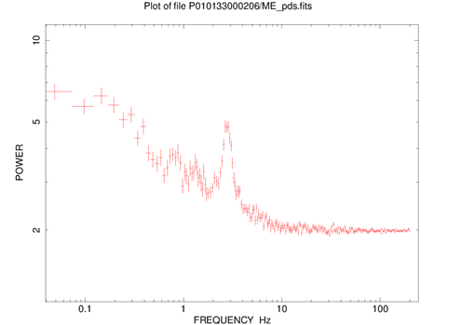
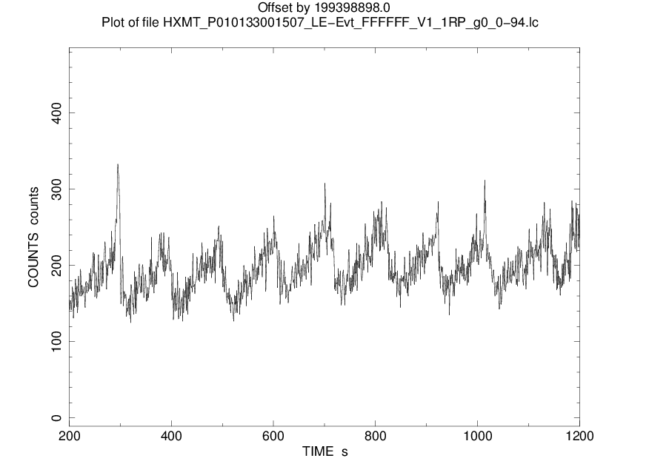
Class
κ
δ？
χ
χ
α
The analysis is in progress

Slide 21
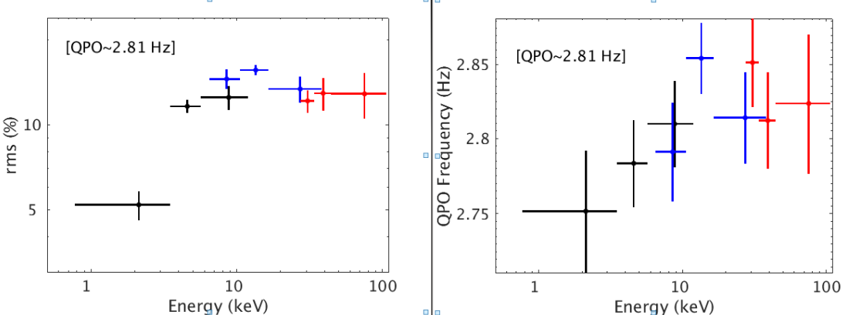
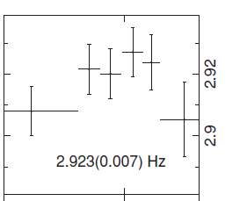
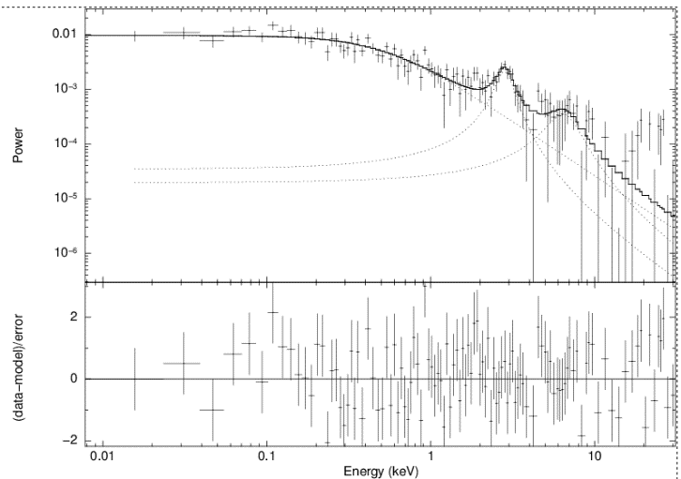

energy dependent
45-100 keV
RXTE

Slide 22
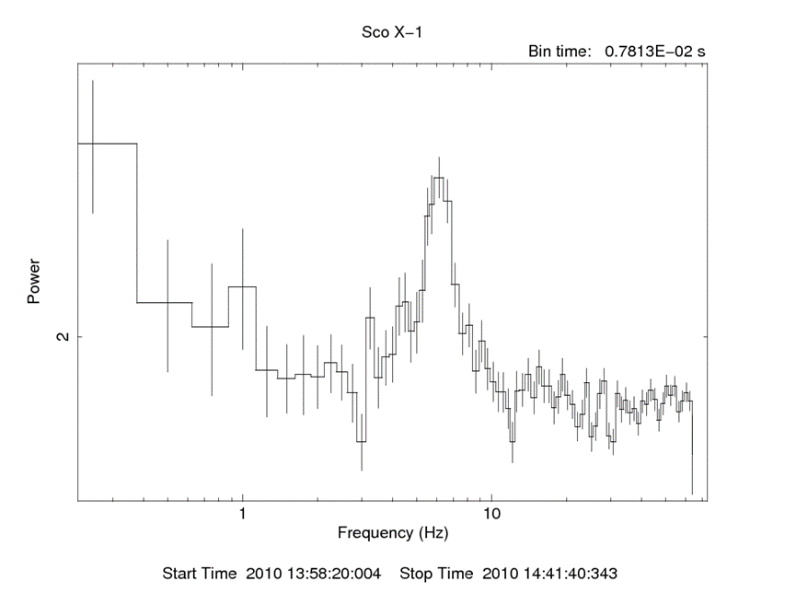
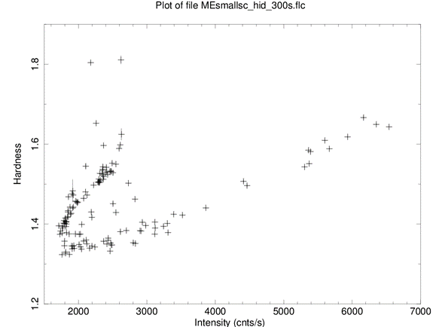
NS LMXBs
Sco X-1

Slide 23
Future
Many Achievements will be published in this year!
Also Expecting more Achievements!

