Slide 1
Background of Insight-HXMT
Speaker: Liao Jin-Yuan
Insight-HXMT background group
IHEP, CAS
2018.06.18@Chengdu

Slide 2
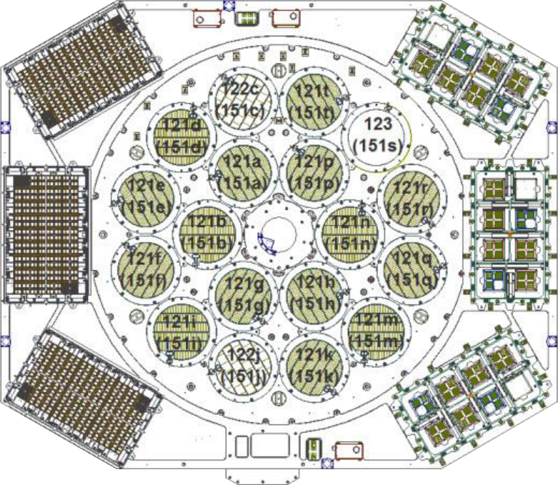
Introduction
High-Energy Telescope (20-250 keV)
Medium-Energy Telescope (5-30 keV)
Low-Energy Telescope (1-15 keV)

Slide 3
Introduction
Background Simulation
—Component
—Spectrum
—Light-curve
In-Orbit Background
—Spectrum
—Light-curve
—BKG Estimate

Slide 4
HE-Introduction
High-Energy Telescope
20 – 250 keV
18 detector
  15 small FOV
  2 big FOV
  1 blind FOV

Slide 5
Simulated Spectra and Light-Curve in 100th Day
The main contributor to the BKG
SAA: Proton in South Atlantic Anomaly
CRP_D: Cosmic-Ray Proton (Delay)
CRP_P: Cosmic-Ray Proton (Prompt)
Albedo: Gamma-Ray reflected from the Atmosphere of Earth
CXB_A: Cosmic X-ray Background (Aperture)
CXB_N: Cosmic X-ray Background (NA)

Slide 6
Simulated Spectra and Light-Curve in 100th Day
1.Every time the satellite pass the SAA, the background will rapidly rise and then slow decline. The gap is when our satellite pass SAA, it shut down.
2.Almost all the BKG components are modulated by the earth.
3.For CRP (both prompt and decay), the modulation are from the geomagnetic cutoff rigidity (COR).
4. For albedo, the modulate is from the anisotropy irradiation, because Earth radiate our satellites in only one direction.
5. For CXB, the modulate is also from the anisotropy irradiation, because Earth can block the CXB from the back.
6. We can see the continuum and some tantalum fluorescence lines and Iodine activation line.

Slide 7
In-Orbit Background
Light-curve
Spectrum
BKG estimate Method

Slide 8
Light-Curve
As expected, BKG and COR have an opposite trend

Slide 9
Spectra
The counts rate is higher as the COR is lower.

Slide 10
Spectra
The emission line with high COR is much significant.

Slide 11
On-Axis Mode
All the detectors with small and big FOVs (SRC detectors) can record the photons and BKG events simultaneously.
Detector 16 with blind FOV is covered by a Tantalum plate, so it can only record the BKG events.
We use Detector 16 as a BKG detector.
The target is located at the center of the field of view (FOV).

Slide 12
On-Axis Mode
All the detectors with small and big FOVs (SRC detectors) can record the photons and BKG events simultaneously.
Detector 16 with blind FOV is covered by a Tantalum plate, so it can only record the BKG events.
We use Detector 16 as a BKG detector.
The target is located at the center of the field of view (FOV).

Slide 13
Method to estimate the BKG
HXMT-HE has 18 detector
Detector 16 is covered by a Tantalum plate,
we use it as a BKG detector
Establish a correlation between the
BKG detector and other detectors.
In this mode, the target is located
at the center of the field of view (FOV)
Notes:
In regular observational mode (on-axis mode), the target is located at the center of the field of view (FOV).
So all the detectors can record the photons and BKG events simultaneously except the detector 16 that is covered by a Tantalum plate.

Slide 14
Method to estimate the BKG
Establish a correlation between the BKG detector and SRC detectors
August 17
Blue: DetID=16; Red: DetID=0

Slide 15
Method to estimate the BKG
x: BKG in BGK detector
y: BKG in SRC detector
Linear correlation model:
model parameters: a & b.
Every detector and every channel
Very good correlation, the validity and stability need to be confirmed
If the model parameter is stable, thus we can use it to estimate the BKG anytime!

Slide 16
Model Check
This is an observation to a blank sky in September 20, which is a month later after the BKG model parameter obtained.
The upper panel is the comparison between the observed counts rate and that inferred from the BKG detector.
We can not see obvious structure in the residual curve.
that confirm the BKG we estimated is correct and the method we use to estimate the background is effective.

Slide 17
Off-Axis Mode
A
B
C
The target will be located in only one FOV (A)
The detectors with the other two FOVs (B & C) observe the blank sky.

Slide 18
Correlation: BKG(FOV-B&C) VS. BKG(FOV-A)
Blue: FOV-A
Red: FOV-B & FOV-C
Very good correlation
The validity and stability need to be confirmed

Slide 19
ME-Introduction
Medium-Energy Telescope
5 – 30 keV
3 Box
For each Box
  15 small FOV
  2 big FOV
  1 blind FOV

Slide 20
Simulated Spectra and Light-Curve in 100th Day
The main contributor to the BKG
SAA: Proton in South Atlantic Anomaly
CRP_P: Cosmic-Ray Proton (Prompt)
Albedo: Gamma-Ray reflected from the Atmosphere of Earth
CXB_A: Cosmic X-ray Background (Aperture)
CXB_N: Cosmic X-ray Background (NA)

Slide 21
Simulated Spectra and Light-Curve in 100th Day
1. It is similar with that of HE, except the delay component caused by the cosmic-ray protons.
2. In all-energy band, the BGK is dominant by the particle, modulated by the geomagnetic cutoff rigidity (COR).

Slide 22
In-Orbit Background of ME
Light-curve
Spectrum
BKG estimate Method

Slide 23
Light-Curve of ME Background
As expected, ME BGK is mainly caused by particles,
so BKG and COR have an opposite trend.

Slide 24
Spectra of ME Background
1. The counts rate is higher as the COR is lower.
2. The spectra shape is also different, the emission line with high COR is much significant.

Slide 25
Method to estimate the BKG
HXMT-ME has 3-Box, and each box has a blind FOV detector
ME BKG is dominantly caused by particle (e.g., proton), thus the blind FOV detector is used as a BKG detector
Establish a correlation between the BKG detector and other detectors.
In this mode, the target is located at the center of the field of view (FOV)

Slide 26
On-Axis Mode
ME has 3 different small FOVs shown in red, blue, and green shadow. The FOV is 1 multiply 4 degrees.
And 3 different big FOVs shown in red, blue, and green region around with the dashed lines. The FOV is 4 multiply 4 degrees.
The target is located at the center of the field of view (FOV).

Slide 27
Correlation: BKG_Blind VS. BKG_Small
The red curve is the light-curve of 15 small FOV detector in Box-1.
The blue curve is the light-curve of the blind FOV detector in the same Box.
Observed in August 17, two month after Insight-HXMT launched.
We can see the light curve are modulated by COR (geomagnetic cutoff rigidity).
The variety of the two light-curve is consistent with each other.
Blue: Blind FOV detector; Red: Small FOV detector

Slide 28
Correlation: BKG_Blind VS. BKG_Small
This is the correlation between the BKG in Blind FOV detector and small detector in Box-1.
As we known, one Box has 15 small FOV detector and 1 blind FOV detector. However, the slope of the red line is not 15, that because some bad pixel has been shut down.
There exist the intrinsic dispersion in this figure, that tell us there exist the systematic error in the BKG estimation.

Slide 29
Model Check
This is an observation to a blank sky in November 2, which is more than two month later after the BKG model parameter obtained.
The upper panel is the comparison between the observed counts rate and that inferred from the BKG detector.
As one Box only has one BKG detector, so the statistic error is large, we can use a empirical function to fit the calculated BKG data.
We can not see obvious structure in the residual curve, that confirm the BKG we estimated is correct and the method we use to estimate the background is effective.

Slide 30
Off-Axis Mode
Blue: FOV-A
Red: FOV-B & FOV-C
A
C
B
Correlation: BKG(FOV-A) VS. BKG(FOV-B&C)
The target will be located in only one FOV
The detectors with the other two FOVs observe the blank sky.

Slide 31
Correlation: BKG(FOV-A) VS. BKG(FOV-B&C)
We also use the linear correlation model to describe the correlation between the BKG detector and the observation detector and then obtained the model parameter.
There also exist the intrinsic dispersion, but the value is less than that in on-Axis mode.
We will use the observation of the blank sky to check the model parameter in off-Axis mode.
Very good correlation
The validity and stability need to be confirmed

Slide 32
LE-Introduction
Low-Energy Telescope
1 – 15 keV
3 Box
For each Box
  20 small FOV
  6 big FOV
  1 blind FOV

Slide 33
Simulated Spectra and Light-Curve in 100th Day
SAA: Proton in South Atlantic Anomaly
CRP_P: Cosmic-Ray Proton (Prompt)
Albedo: Gamma-Ray reflected from the Atmosphere of Earth
CXB_A: Cosmic X-ray Background (Aperture)
CXB_N: Cosmic X-ray Background (NA)

Slide 34
Simulated Spectra and Light-Curve in 100th Day
1. It is similar with that of ME
2. In high-energy band, the BGK is dominant by the particle, modulated by the geomagnetic cutoff rigidity (COR)
3. In low-energy band, the BKG is dominant by the CXB.

Slide 35
In-Orbit Background
Light-curve
Spectrum
Background estimate Method

Slide 36
Light-Curve of the BKG observation of the blank sky
LC of LE is very complex， such as the ‘flares’ unexpected
The data may suffer from massive low-energy electrons.
We do the GTI selection first.
So the BKG estimation of LE is only for the data selected during the GTI phase.
As expected, BKG is modulated by COR, and they have an opposite trend.

Slide 37
Light-Curve of the BKG observation of the blank sky
In High-energy band > 7 keV,
As expected, BKG and COR have an opposite trend
In low-energy band < 7 keV, the BKG value in blind FOV detector is less than that in small FOV detector, the different between the two type detector can be explained as the CXB.

Slide 38
Spectra
Red: blind detector
Blue: small FOV detectors
Panels from top to bottom are Box 1-3 and the total.
spectra of the blind detector is multiply 20 for comparison with the spectra of the small FOV detector
This figure tell us, in high-energy band, the BKG is dominant by the particle, we can use the blind detector to estimate the BKG.
And in Low-energy band, the BKG is dominant by CXB, so we must obtain the CXB sky map to estimate the BKG.

Slide 39
Correlation: BKG_Blind VS. BKG_Small
Green: Blind FOV detector
Red: Small FOV detector
General, the correlation is well for each Box and each channel.

Slide 40
Spectra: BKG_Blind VS. BKG_Small
Green: Blind-FOV detector with Low-COR
Blue: Blind-FOV detector with High-COR
Red: Small-FOV detector with Low-COR
Orange: Small-FOV detector with High-COR
In the whole energy band, the spectra is consistent with what we expect.

Slide 41
Method
Step 1:
As the method in HE/ME, we use the blind detector as the BKG detector to estimate the BKG of the small or big FOV detectors.
This will be efficient for the sources in high Galactic Latitude, as the diffuse X-ray background is nearly uniform.
And also efficient for the sources in Galactic plane in high energy band, as the spectra of the diffuse X-ray background is too weak.
Step 2:
USE the scan data (Galactic plane scan is one of important task of Insight-HXMT) to make a sky map of the Galactic plane, thus we can estimate the diffuse background in low energy band.
This may be difficult, but it is worth studying.

Slide 42
Model Check: Step 1
In low energy band, the background has been somewhat underestimate,
that due to the different level of the diffuse X-ray emission.

Slide 43
Summary
The in-orbit background is basically consistent with the simulation, both for the light-curve or spectra.
The different BKG detectors are used to infer the background of SRC detectors for different observation mode.
We use the observation of a blank sky to test the BKG model, the systematic error < 3%.
Our BKG Model has not been completed. For HE/ME, We will make the correlation between the BKG detector and the observation detector under different conditions, and we hope the systematic error can be reduced to 1% or lower in the future. For LE, we plan to make the sky map to estimate the background in low energy.
In the future, the data will be sufficient, some interesting study can be attempt , e.g., machine learning…

