Slide 1

Hard X-Ray Modulation Telescope
(Insight-HXMT)
Science Operations
Liming Song
Institute of High Energy Physics, CAS
June. 18, 2018
11:00, June 15th, 2017,Jiuquan
Notes:
Good morning everyone.
Hard X-ray Modulation Telescope (Insight-HXMT) is the first X-ray astronomy satellite in China, which was launched on June 15, 2017.
And I am very glad to introduce the work on HXMT Science Operations.

Slide 2
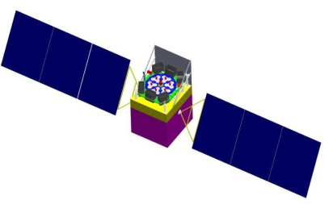
Outline
HXMT introduction
  Scientific Objectives
  Observing Modes
HXMT Ground Segment
HXMT Science Operations
  Mission planning
  Data production
  Data analysis software
  Summary
Notes:
First, I will make a brief introduction to HXMT and HXMT ground segment.
Then, I will focus on HSOC in detail, including the mission planning and the instrument operations.
Finally, I will give a summary to the science operation work since HXMT launched.

Slide 3
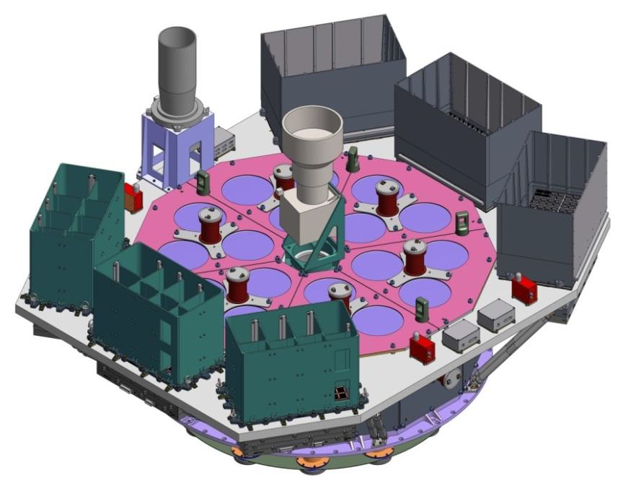
1. HXMT introduction
Launched at Jiuquan on June 15. 2017
Nominal lifetime: 4 years
Orbit: circle, 550 km
orbital period: ~96 mins
orbital inclination: 43°
Instruments:
  HE : 5000cm², 20-250keV
  NaI/CsI phoswich
  ME: 952cm², 5-30keV
  Si-Pin
  LE : 384cm², 1-15keV
  SCD
LE
HE
ME
Notes:
Insight-HXMT was launched on June 15, 2017, and it has run for more than 5 months and finished the in-orbit test.
Its nominal lifetime is 4 years.
HXMT has a circle orbit and its orbital period is about 96mins.
HXMT has 3 main instruments, the High Energy Detector, the Medium Energy Detector and the Low Energy Detector.
The energy band for HE is 20-250 keV, and its effective area is 5000 square centimeter
The energy band for ME is 5-30 keV, and its effective area is 952 square centimeter
The energy band for LE is 1-15 keV, and its effective area is 384 square centimeter

Slide 4
1.1 Field of View
Field of View
LE: 1.6 °╳6 °
Energy resolution: <192eV@5.9keV
Time resolution: 1ms
HE: 1.1 °╳5.7 °
Energy resolution: 17.3%@60keV
Time resolution: 2us
ME: 1 °╳4 °
Energy resolution: 3kev@20keV
Time resolution: 276us
Notes:
These 3 instruments have different FOVs.
The 3 black rectangles are for LE, 1.6*6 for each.
The 3 green rectangles are fro HE, 1.1*5.7 for each.
The 3 red rectangles are for ME, 1*4 for each

Slide 5
1.2 Scientific Objectives
To scan the Galactic Plane in broad energy band (1-250 keV) to find new transient sources and to monitor the known variable sources.
To perform high cadence and high statistics observations of BH and NS systems to study the dynamics and emission mechanism in strong gravitational or magnetic fields.
To find and study GRB and GW electromagnetic counterpart as the most sensitive detectors in the extension energy band (0.2-3 MeV).
Notes:
There are three main scientific objectives for Insight-HXMT.

Slide 6
1.2 Observing Modes
Pointing Observation: Observing lasted time: 96 mins~20 days
  Spectrum
  Light Curve
Small Area Scan:
A square area of 14*14~20*20
    Scan radius: 7~10 degree
    Scan velocity: 0.01, 0.03, 0.06 deg/s
    Scan step: 0.1~1 degree
    Complete scan time: 2 hours ~ 5 days
  Galactic Plane Scan
  Other interesting small areas Scan
GRB Mode: designed and implemented for HE
  In this mode, the high voltage of the photo-multiplier tube (PMT) is reduced,
  so that the measured energy range of CsI goes up to 0.2-3 MeV.
  HE: unique high-energy gamma-ray telescope to monitored the entire GW localization area and the gamma-ray counterpart, with the large collection area (~1000 cm²) and microsecond time resolution.
Scan direction
Starting Point
7~10°
Notes:
In order to achieve the scientific objectives of HXMT, 3 main observing modes were designed.
One is the pointing observation mode, and we can observe an interesting source for some time to study its spectrum and the variable properties.
The observing time should be longer than one orbital periods about 96mins and less than 18 days.
The second mode is the small area scan, that means we can scan a square area in the sky.
The radius, velocity and step can be selected, and for different selection, one scan will take about 2 hours to 5 days.
The Galactic plane is a very important area for the new transient sources monitoring, so it is one of the most important scientific objectives of HXMT.
And other interesting small areas in the sky can be scan in this mode.
The third mode is the Gamma-Ray Burst mode, this is designed and implemented for HE.
In this mode, the high voltage of the photo-multiplier tube (PMT) is reduced, so that the measured energy range of CsI goes up to 0.2-3 MeV.
So, HE becomes the unique high-energy gamma-ray telescope to monitored the entire GW localization area and the optical counterpart, with the large collection area (~1000 cm²) and microsecond time resolution.

Slide 7
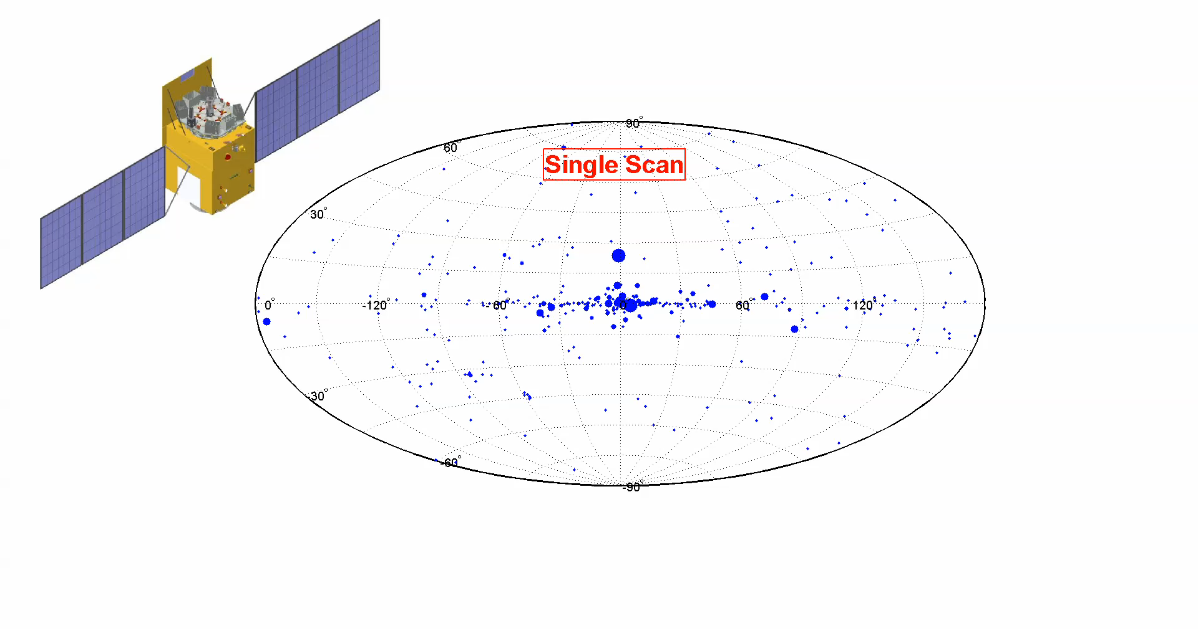
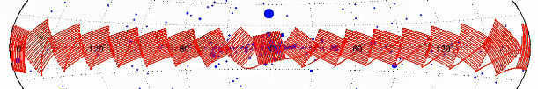
1.4 Galactic Plane Scan
Galactic Plane: (20°*20°)*18 + (20°*20°)*4
11 center regions: 90 times/year (-60°~60°)
11 outer regions: 10 times/year
Notes:
Galactic plane was divided into 18 20d*20d regions as the red areas, and for the Galactic center, we added 4 more regions to increase the exposure time as the green ones.
There’s a video for hte Galactic Plane Scan.
Here’s the scan for one region, and then for the whole Galactic Plane.
This is the simulate exposure map of Galactic Plane for one year, the 11 center regions were scanned for 90 times, and the outer regions were scanned for 10 times.

Slide 8
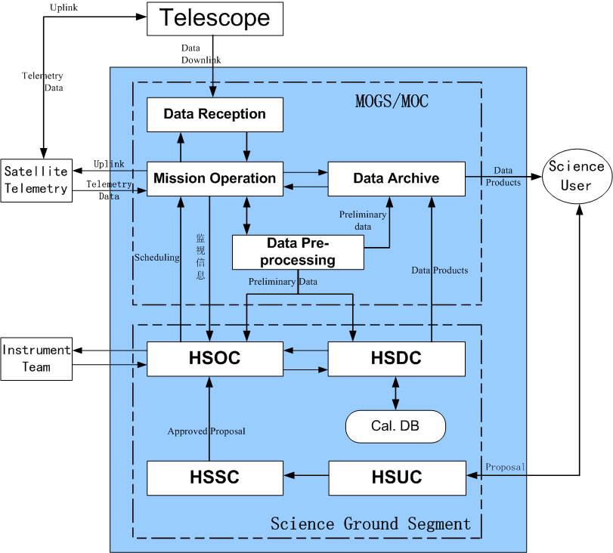
2. HXMT Ground Segment
Mission Operation Ground Segment (MOGS/MOC)
National Space Science Center, CAS
  Operation commands
  Data reception
  Data pre-processing
  Data archive after mission
Science Ground Segment (SGS)
IHEP, CAS
  Science User (HSUC)
  Science Support (HSSC)
  Science Operation (HSOC)
  Science Data (HSDC)
Configuration of HGS
Notes:
HXMT Ground Segment is responsible for the operation of the satellite.
It consists of two parts, the mission operation ground segment, MOC, and science ground segment, SGS.
MOC is built and now running on in National Space Science Center, and the main tasks include: operation commands generation, data reception, data pre-processing and data archive after the mission.
The science ground segment is built and running on in IHEP.
It contains four parts, HSOC, HSDC, HSUC and the science support center (HSSC).
First, HSUC will collect the proposals from the scientists, and HSSC together with HSOC will do the evaluation to the proposals. For the accepted proposals, HSOC will schedule the long-term and short-term observations and send the plans to MOC, MOC will turn the plan into the commands and send it to the Telemetry Center and to the satellite.
Then ,the telescope will send the obs. data down. With the data, HSOC will monitor the work status of the payloads, and HSDC will generate the science data products.
The following I will focus on the science operations.

Slide 9
3. HXMT Science Operations
Mission Planning:
* Proposal evaluation
* Long-term planning
* Short-term planning
* Target of Opportunity (ToO) planning
Instrument Operations:
* Instrument Monitoring
* Anomaly tracking
* Onboard parameters and software maintenance
Notes:
The main tasks of the Science Operations contains two parts:
One is the mission planning, including collecting and evaluating observation proposals, providing long&short-term planning, and for some burst sources, the urgent ToO observation should be scheduled.
The other part is the instrument operations, including monitoring the working status of payloads, anomaly tracking and on board parameters and software maintenance.
I will introduce these jobs respectively.

Slide 10
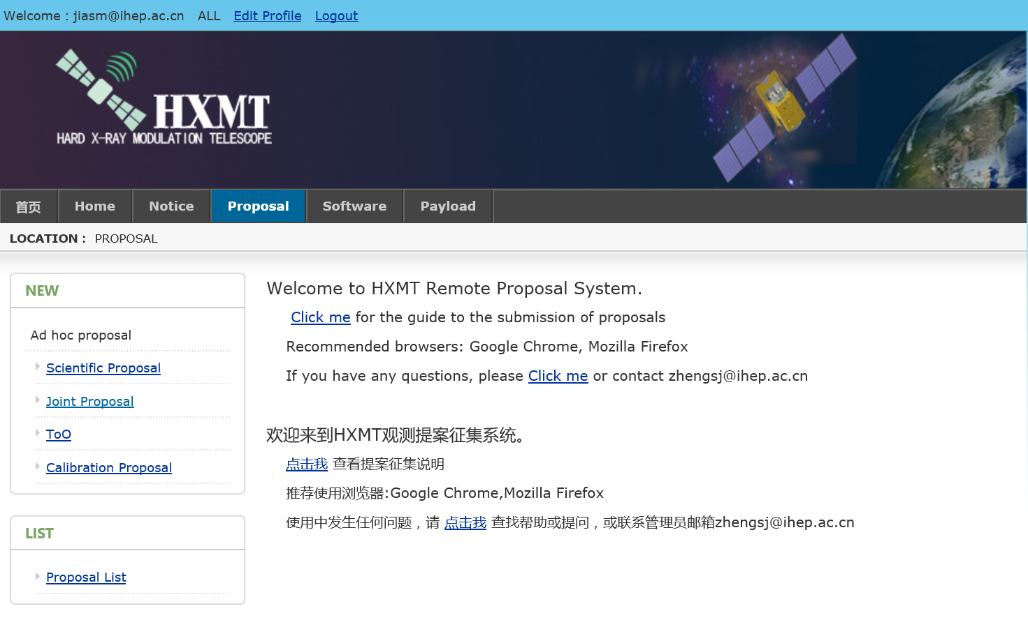
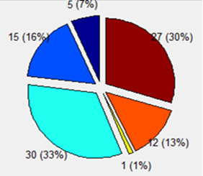
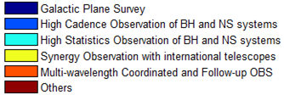
3.1 Proposals
Aug.-Sept., 2016 : Call for Proposals (AO01)
http://proposal.ihep.ac.cn
Total: 90 Proposals, 348 sources
Notes:
Aug. to Sep. last year, the first call for proposals was announced. And the proposals were submitted through the website.
Totally, we received 90 proposals involving 348 source.
This is the classify for the different types of the proposals.

Slide 11
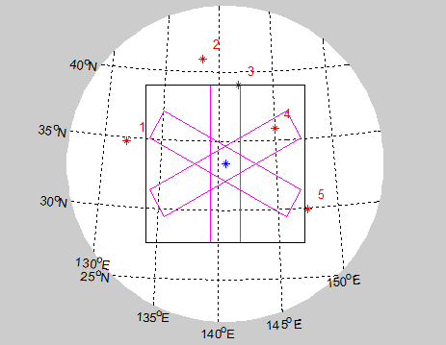
3.1 Proposals
Oct., 2016 : Technical and Scientific evaluations
Technical Evaluation: HSOC
Observation efficiency
Effected by the other sources around
Scientific Evaluation: Science Committee
Scientific goal suits HXMT
Grade |  | Mode | Number | times | Exposure time
Normal | A | Point | 42 | 290 | 5.8Ms | ~136 days | 331days
 |  | SAS | 24 | 1271 | 16.1Ms | ~195 days
 | B+C | Point | 35 | 92 | 2.7Ms | ~62 days
ToO | A | Point | 116 |  | 49Ms | 1140d ays
 | B+C |  | 65
Total |  |  | 282
Notes:
Then, we held the Technical and Scientific evaluations.
Technical evaluation is mainly made by HSOC, which considers the observation efficiency and the influence by the sources around.
And the scientific evaluation is mainly held by the science committee, and is mainly consider if its scientific goal is appropriate to HXMT.
Finally, 42 normal sources and 116 ToO sources were selected as Grade A, and the total observation time is about 1 year.

Slide 12
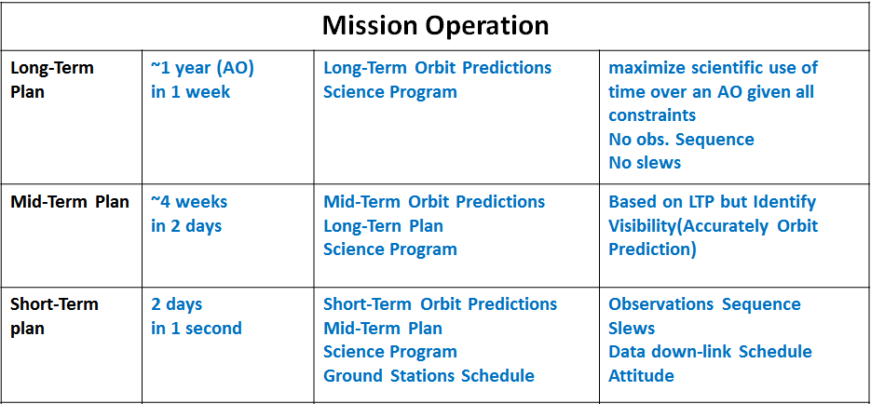
3.2 Mission Planning
Notes:
Then, based on these sources, we need to schedule the observations.
In order to schedule the observations more reasonable, and to achieve more scientific results, we defined three type of plans.
The long-term plan is scheduled the observations for the whole year to maximize the scientific use of the observation time.
The mid-term plan is about 4 weeks, its main purpose is to update the long-term planning and support the short-term plan.
The short-term plan is for 2 days, scheduling the observation sources and their sequence, the slew time, data down-link and so on.

Slide 13
Target of Opportunity (ToO)
ToO alert
* HXMT - Galactic Plan Scan
* Atel – Instant Email Notices
Check
* Is HXMT contactable? (7-8 orbit/day)
* Information in Email
* Is it approved before?
Evaluation
* Observation constrains
Project Scientist decision
Urgent re-scheduling
* Reschedule a ToO plan in 90 mins
Start observation
GW170817
ToO workflow
BJ 21:32
Project
Scientist
Uncertainty
&Constrains
observation
scheme
00:00
in 60 mins
Too Plan
01:15
> 4 hours
02:23
Notes:
For some emergency, such as a burst, the target of opportunity, we need to make a ToO plan.
Currently, we have two main ways to get the ToO alert.
One is our HXMT Galactic Plane scan, which can find a new source or a burst.
The other is that we applied for an Instant Email Notices of Atel, if there is a burst, we will get the information immediately.
And the ToO workflow will start.
Since HXMT will not pass by China for 7-8 orbits each day.
So, first we should check if it is possible to start the observation immediately.
then, we will check the Atel information and check if this source was approved before, and at the same time the technical evaluation should be made to confirm if it conform HXMT’s observation constrains.
All the jobs should be finished in 60mins.
Then we contact with the project scientist, who will make the decision if we start the corresponding observation.
If sure, the urgent re-scheduling should be started at once, and this ToO plan should be finished in 90 mins.
From the decision of Project Scientist to observation, it will take about 4 hours.
For example, for the first binary neutron star merger GW170817.
We got the alert at BJ time 21:32, the ToO workflow started at once.
Since the important of this event, the project scientist participate in and led the whole work from the begining.
Considering the uncertainty of position and the constrains of HXMT, the observation scheme was determined at midnight.
Then we finished the ToO plan in 1:15, and the observation started from 2:23.
It was about 5 hours from the alert to observation,

Slide 14
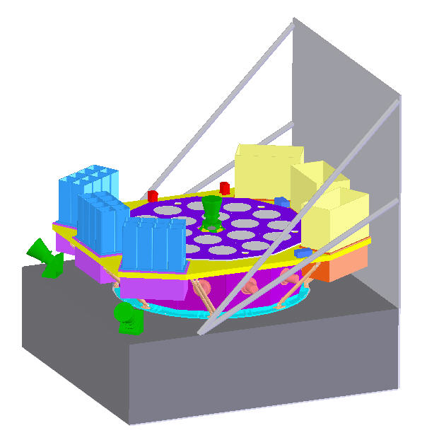
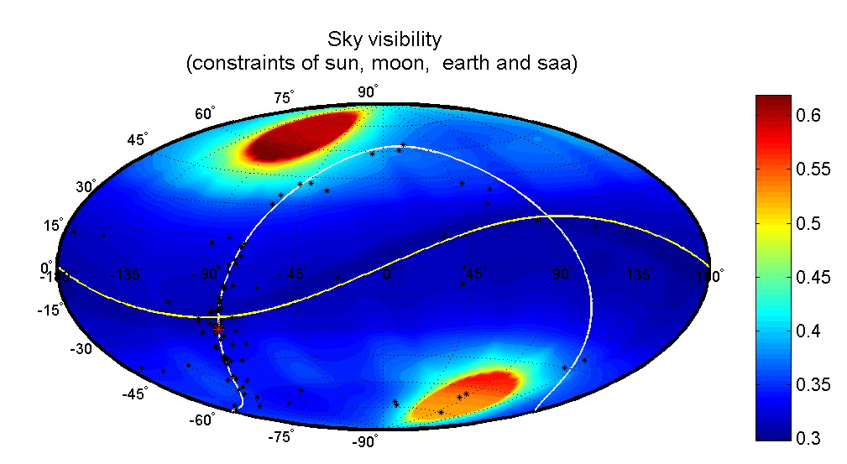
3.3 Observation Constrains
Thermal Control:
Limited FoV Orientation and
Satellite Attitude
  Solar avoidance angle > 70 °
  X-Z plane < 10 °
Earth Occultation
  Almost every orbit
  Last about 30 minutes
South Atlantic Anomaly (SAA)
  8~9 orbits per day
  Last about 15 minutes
Moon avoidance angle: > 6 °
Total efficiency: ~ 50%
X
Z
Y
Notes:
When we make the observation plan, the constraints of HXMT have to be considered.
Shown as this figure, the detectors can not be exposed to the sun directly, so HXMT designed a sunshade to protect the detectors.
The solar avoidance angle is 70 degrees.
And also the angle of the sun to the X-Z plane should be less than 10 degrees.
The observations will always be interrupted by the earth and the South Atlantic Anomaly.
Usually, the earth occultation will occur almost every orbit, and each time will last about 30 minutes.
HXMT will pass through SAA for 8-9 times everyday, and will last about 15mins.
Considering the FOV of the detector, the moon avoidance angle is about 6 degrees.
So the total observation efficiency of Insight-HXMT is about 50%

Slide 15
3.4 Schedule Submit
& Data Reception
Commands
Telemetry
Data
Obs. Data
(Beijing)
Plan Commands
(Xian)
Telemetry Data
Data
Obs. Plan
Blue: uplink
Red : downlink
(Beijing)
Notes:
After we made the short-term or ToO plan, we will submit it to MOC.
MOC will translate it into the commands and send it to telemetry center.
When HXMT pass by the Telemetry station, the commands will be uplink to the satellite.
The telemetry and the obs. data will be downlink and sent to MOC, and MOC will send it to SOC.

Slide 16
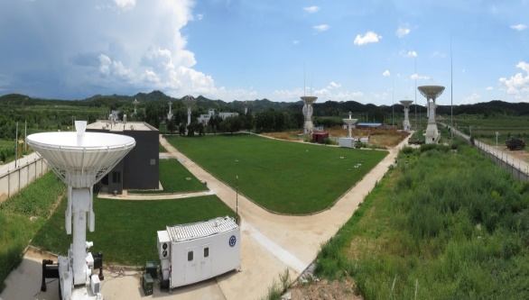
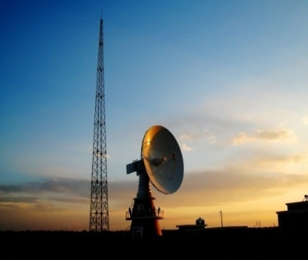

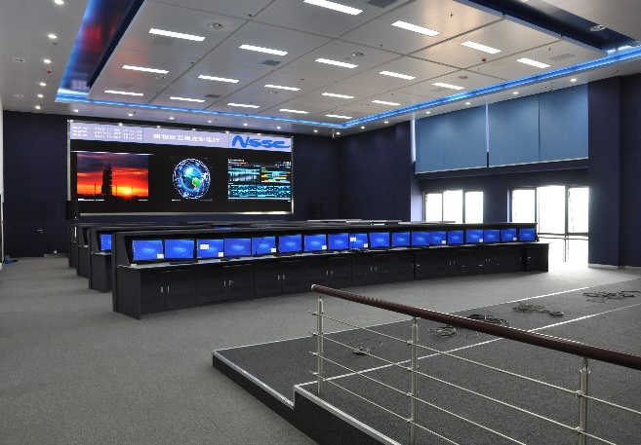
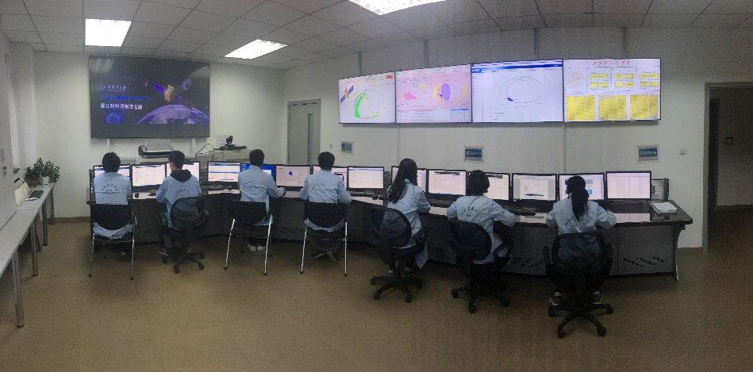
3.5 Payloads Monitoring
Data Reception
Kashgar,Xinjiang
Miyun,Beijing
Sanya,Hainan
Telemetry Data:
real time monitor for instrument safety
NSSC-MOC
Engineering Data:
work status and health of instrument
Science Data:
performance and performance trend of instrument
IHEP-SOC
Notes:
After the data reception, MOC will mainly monitor the telemetry data, it is almost the real time monitor for the instruments safety.
SOC will use the engineering data to monitor the work status and the health of instruments, and analyse the science data to monitor the performance and performance variation trend of instrument.

Slide 17
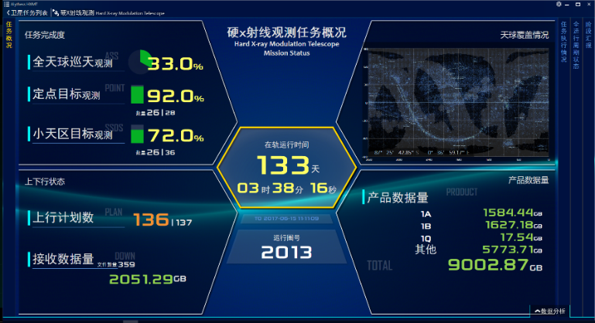
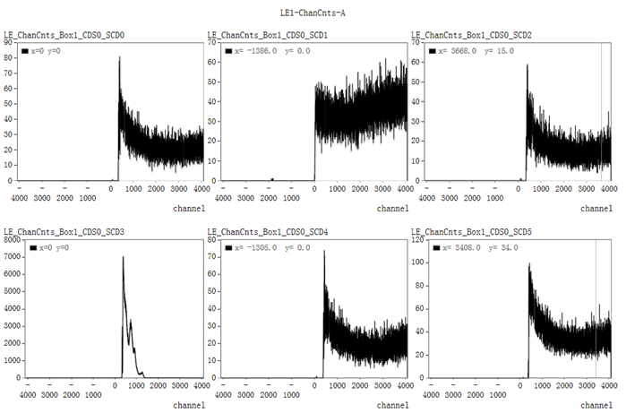
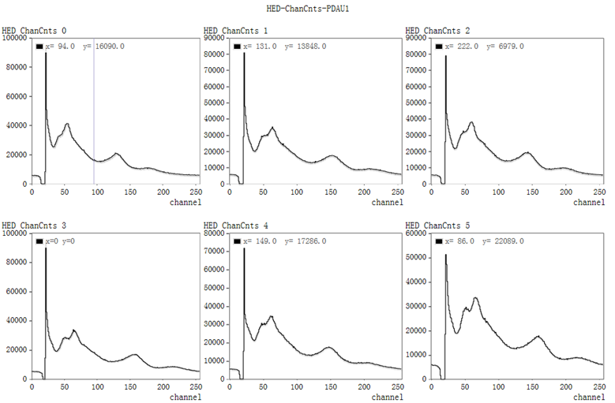
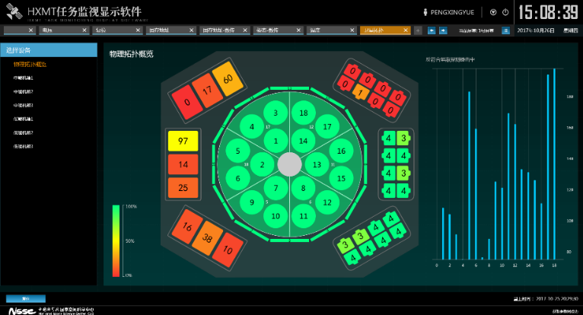
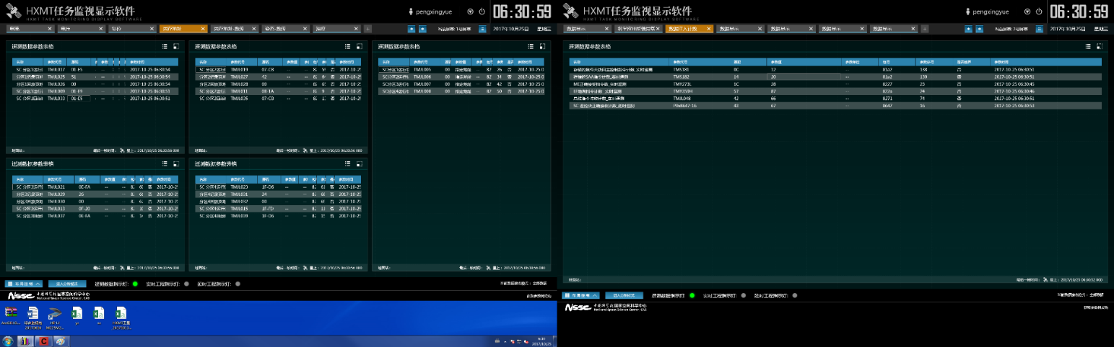
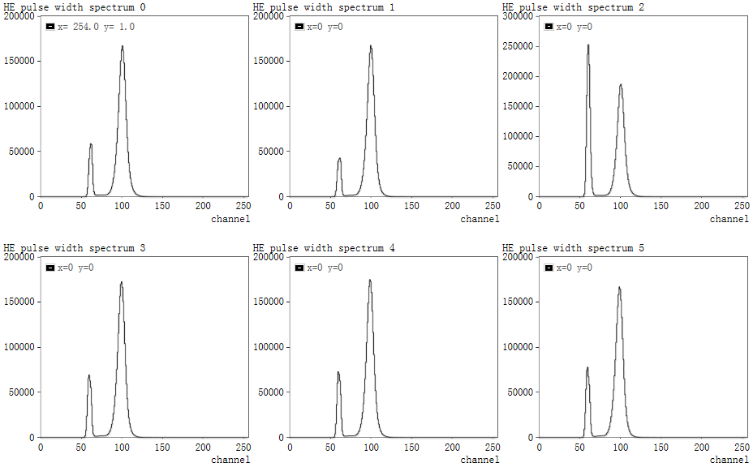
3.5 Payloads Monitoring
Light Curve
Channel-counts Spectrum
Pulse width Spectrum for HE
Notes:
Here list some interfaces for the instrument monitoring.
There are more than 1000 parameters should be monitored everyday.

Slide 18
3.6 Data products
Events information from detector:
  Photons arriving time
  Energy deposite in detector
  Incidence detector ID
  Event type, using to distinguish normal event, time event(GPS) , radioactive source event
  Other informations, such as Pulse-Width in NaI(CsI) detectors, Information of anti-coincidence detectors, Split events

Slide 19
3.6 Data products
Engineering data from payload:
  Count rate of detector/detector group/telescope
  Circuit parameters: Voltage and current of detector/electric board
  Detector status
  Command feedback
Engeering data from Platform:
  Temperature of detector/electric board
  Satellite attitude
  Orbit from GPS
  Instrument status

Slide 20
3.6 Data products
Data For Scientist (Lever 1) :
AUX（Ground Auxiliary Data）
ACS（Attitude and Orbit Data）
CRAFT（Engineering data from platform）
HE（Events and Engineering data from HE Telescope）
ME（Events and Engineering data from ME Telescope）
LE（Events and Engineering data from LE Telescope）

Slide 21
Data File List | HE | ME | LE
All Event data | √ | √ | √
Scientific Event data | √ | √ | √
In-orbit Calibration Event data | √ | √ | √
Covered detector Event data | √ | √ | √
Instrument Status data | √ | √ | √
Temperature Monitor data | √ | √ | √
Counting(Statistics on-board ) data | √ | √ | √
Deadtime | √
HV Monitor data | √
Threshold of Detectors | √ |  | √
Particitle Monitor data | √
Circuit parameter data |  | √ | √

Slide 22
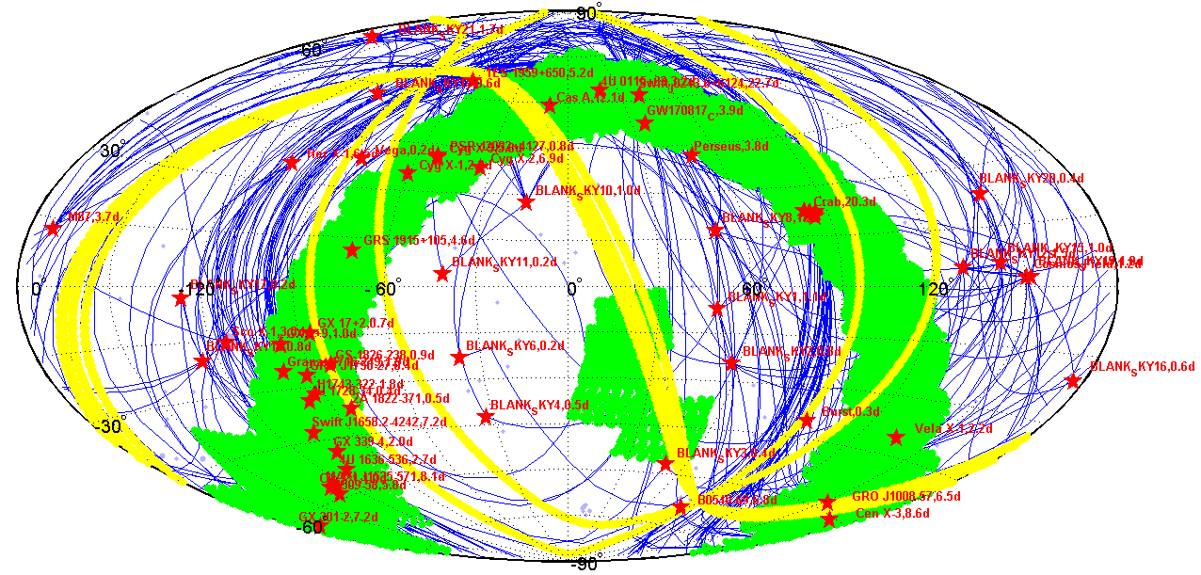
Red stars: point observation
Green regions: small area scan
Notes:
Here is the distribution of all the observed sources on the sky map.
The red stars are for the point observations, and the green regions are for the small area scan.

Slide 23
3.7 Data Analysis Software
Input: Level 1 data
Output
  RSP，background files, event files, spectra, light-curves
Data processing organized into three distinct stages
  Calibration Stage: Calibration of unfiltered event files
  Screening Stage: filtering of calibrated event files by applying conditions on specified attitude/orbital/instrument parameters
  Extraction Stage: extraction of high-level scientific products
PI conversion and response generation， see Dr. Li Xiaobo’s report
Background estimation， see Dr. Liao Jinyuan’s report

Slide 24
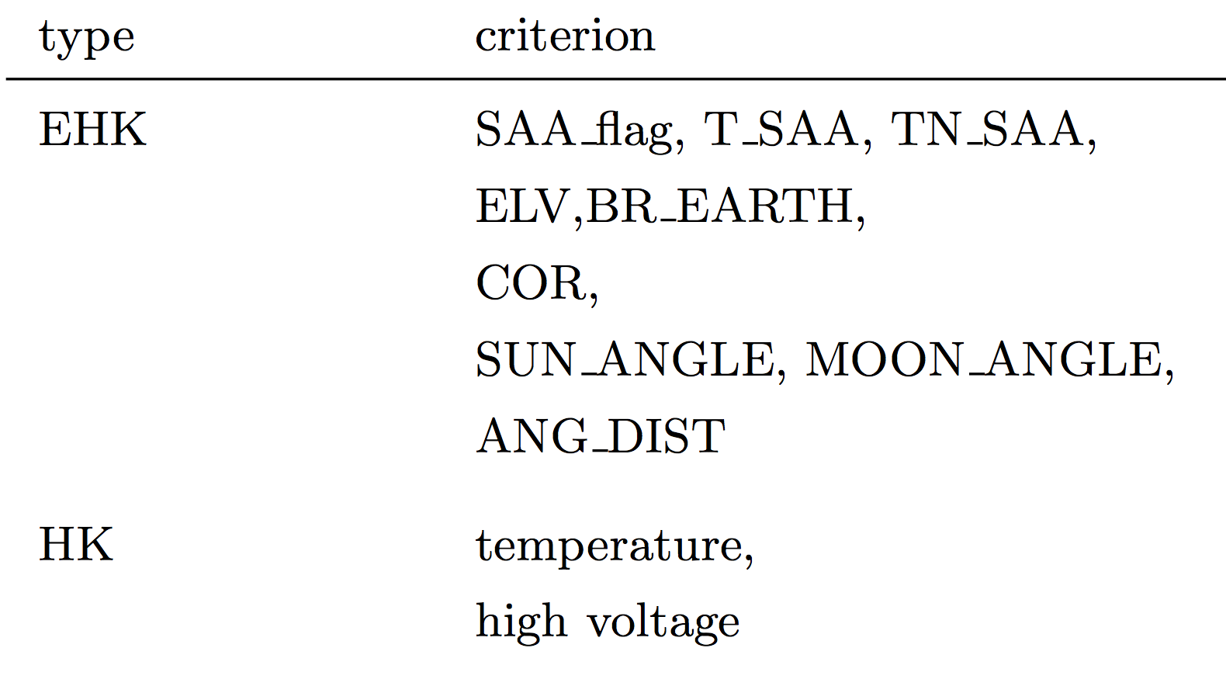
3.7 Data Analysis Software
Screening criteria for GTI:
(ELV from the day Earth’s limb)
(Cut-off rigidity, geomagnetic field)
(the angular distance between the mean pointing position and the pointing vector)
HE: particle flux (obtained by particle monitors)
LE: force trigger events (100K 1000C/S, 50K 500C/S)

Slide 25
HE Data Analysis Software
Software functions:
  Gain correction and spark identification （hepical）
    Calculates PI values, search for glitch events and remove them
  Good Time Intervals (GTI) generation (hegtigen)
    Applies cleaning criteria to the specified attitude/orbital/instrument parameters
  Event screening (hescreen)
    Event properties screening (e.g. detectors selection, exclusion of bad detectors)
  Spectra extraction (hespecgen)
    Spectra extraction from screening events file and deadtime calculation
  Light curves extraction (helcgen)
    Light curves extraction from screening events file and deadtime/fracexp calculation
  RSP files generation(herspgen)
    PSF correction, combination each detector’s rsp files
  Background files estimation (hebkgest)
    Generate background files for Spectra and light curves

Slide 26
ME Data Analysis Software
Software functions:
  Gain correction（mepical）
    Calculates PI values
  Grade assignment and deadtime calculation (megrade)
    Assigns events grade and calculates deadtime
  Good Time Intervals (GTI) generation (megtigen)
    Applies cleaning criteria to the specified attitude/orbital/instrument parameters
  Event screening (mescreen)
    Event properties screening (e.g. detectors selection, exclusion of bad detectors, grade selection)
  Spectra extraction (mespecgen)
    Spectra extraction from screening events file and deadtime correction
  Light curves extraction (melcgen)
    Light curves extraction from screening events file and deadtime correction
    RSP files generation(merspgen)
    PSF correction, combination each detector’s rsp files
  Background files estimation(mebkgest)
    Generate background files for Spectra and light curves

Slide 27
LE Data Analysis Software
Software functions:
  Gain correction（lepical）
    Calculates PI values and subtract noise
  Grade assignment and split events reconstruction (lerecon)
    Assigns events grade and reconstruct split events
  Good Time Intervals (GTI) generation (legtigen)
    Applies cleaning criteria to the specified attitude/orbital/instrument parameters
  Event screening (lescreen)
    Event properties screening (e.g. detectors selection, exclusion of bad detectors, grade selection)
  Spectra extraction (lespecgen)
    Spectra extraction from screening events file
  Light curves extraction (lelcgen)
    Light curves extraction from screening events file
  RSP files generation(lerspgen)
    PSF correction, combination each detector’s rsp files
  Background files extimation(lebkgest)
    Generate background files for Spectra and light curves

Slide 28
4. Summary
June.15, 2017 —: Instrument operation
HXMT has been running for 350 days.
Working parameters onboard the instruments (HE, ME and LE) have been adjusted according to the actual situation in orbit. Now, all the instruments work well.
The performances and the in-orbit calibration of the instruments have been preliminary confirmed.
Notes:
At last, I will give a summary to the science operation work since Insight-HXMT launched.
The first is the instruments operation.
The instruments have worked for 175 days, and the working status is well.
The performances and the on orbit calibration of the payloads have been preliminary confirmed, which will be reported following.

Slide 29
4. Summary
June.22, 2017—: Mission planning
Scientific observation has lasted for 343 days.
Short-term Plan: 173 normal & 14 ToO
Point observation: 42 sources, 1005 times
Small Area Scan:
Crab area: 9 times
Galactic Plane: 21 regions, 324 times
Data products:
Raw data: 4.1TB
Level 1: 19.0TB
Internal Level: 50.0TB
Notes:
Insight-
HXMT started the scientific observation since June 22nd, 2017.
And now it has lasted for 168 days.
In these days, we have made 73 normal plans and 9 ToO plans.
27 sources have been observed for 204 times.
The Crab area has been scanned for 9 times, and the 21 regions in Galactic plane has been scanned for 192 times.
This information is available on the website: http://hxmt.org
Some scientific results of these observations has been derived, and which also will be reported following.

Slide 30
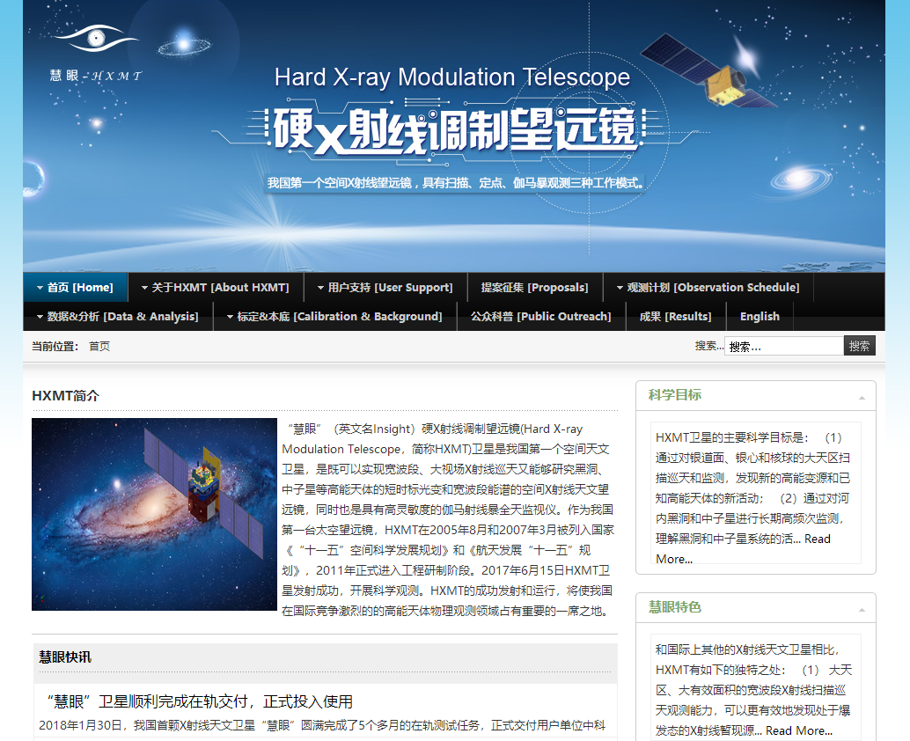
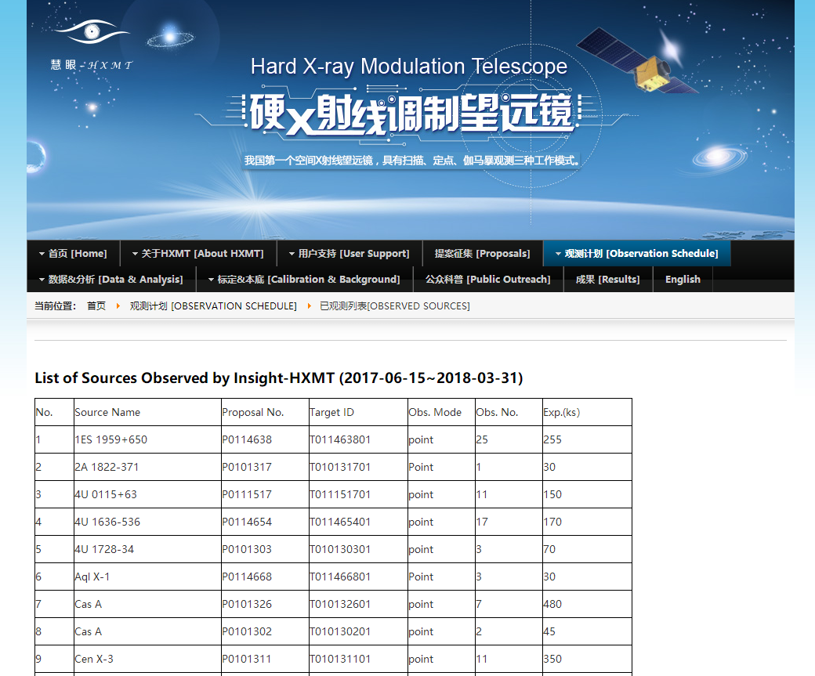
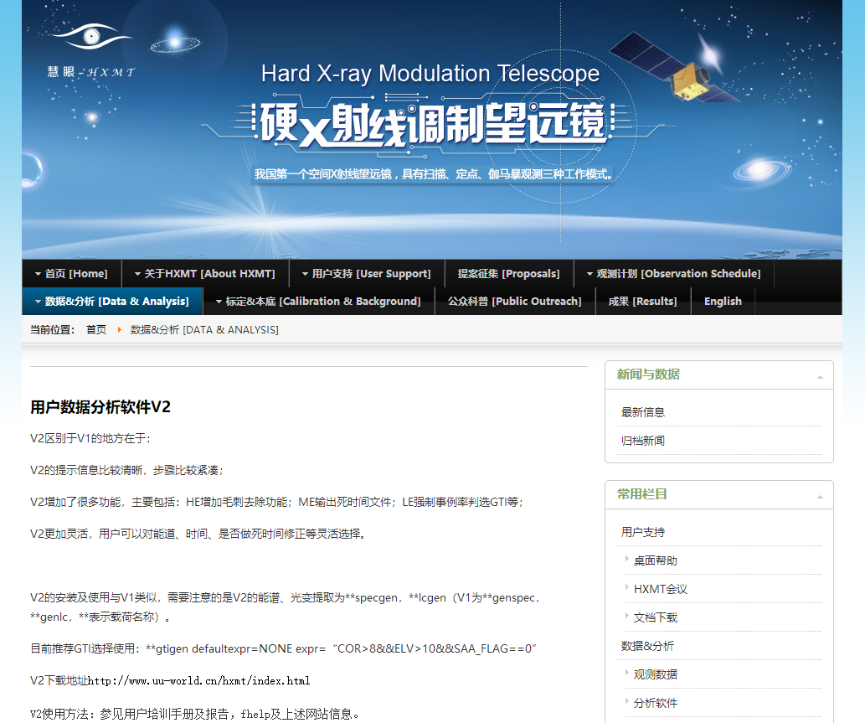
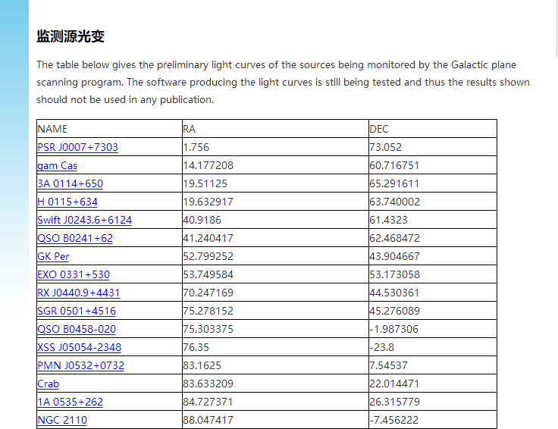
http://www.hxmt.org

Slide 31
4. Summary
HXMT Core Science Team and Data Policy have been published on Insight-HXMT homepage: http://www.hxmt.org
The Science User Conference will be held in August in IHEP
  Data Policy
  Data Release
  Data Analysis
Thank you!
Notes:
HXMT Core Science team and the Data policy have been published on the homepage of Insight-HXMT, and in the website you can get the details.
The Science User Conference will be held the next month in IHEP, and the announcement will be released soon.
If you are interested in, you can get more information about the Data policy, data release and data analysis then.

