Slide 1
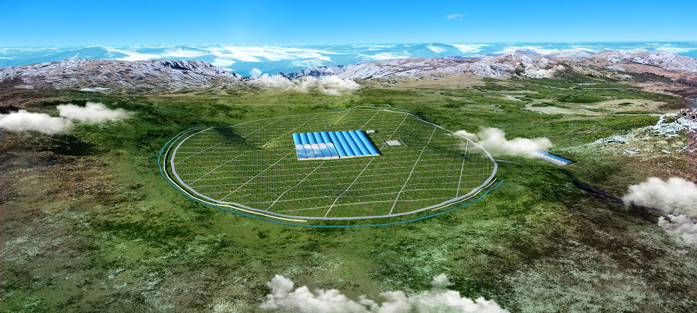
Mohsin Saeed, Min Zha
A daily WCDA sun shadow simulation
22/03/2018 – 24/03/2018
2018 LHAASO General meeting @ southwest Jiaotong university

Slide 2
outline
Physics from sun shadow study
A simulation code construction
Simulation results on daily basis

Slide 3
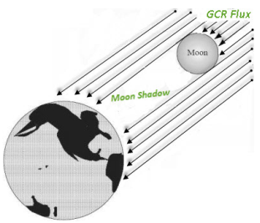
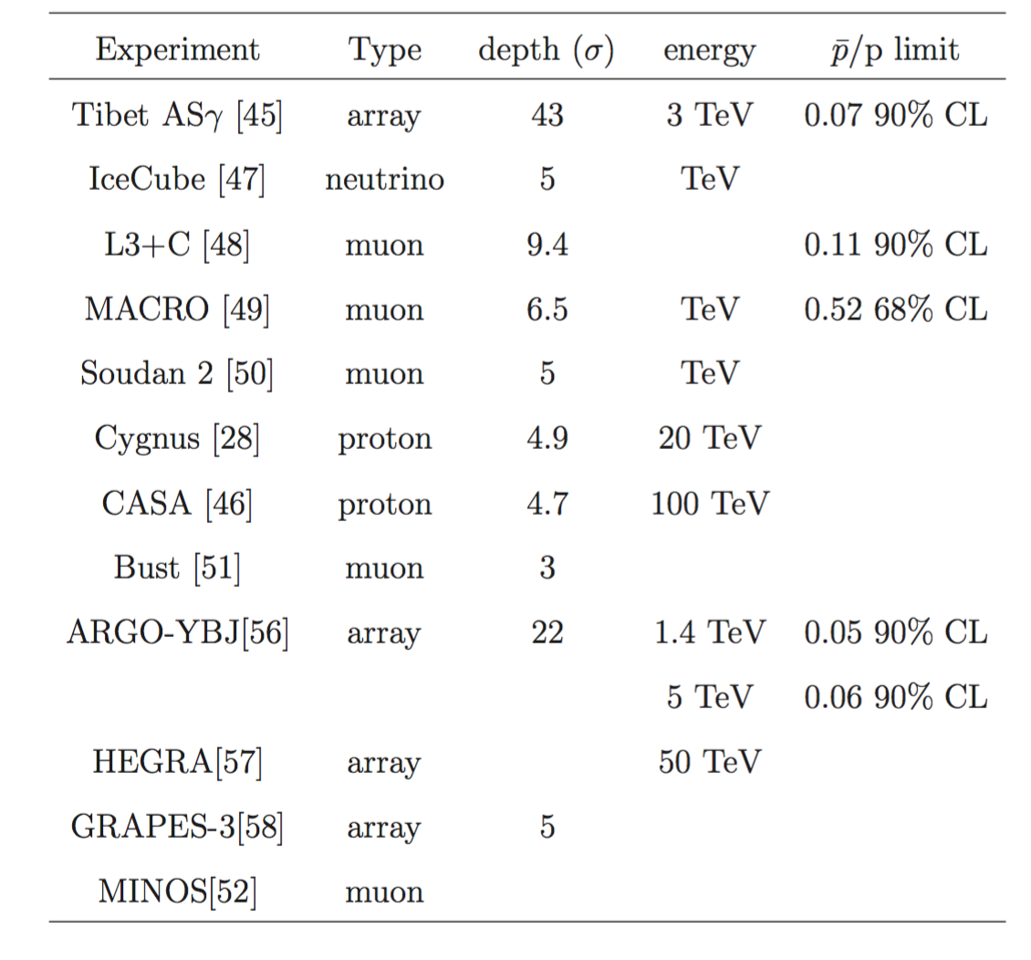
The Sun blocks Cosmic Rays
1957, Concept by Clark
1991, first Sun+Moon shadow 4.9sigma by CYGNUS
Only several σ sun shadows with CASA, Milagro, SOUDAN2, MACRO, L3+C
Further physics with ASγ, ARGO-YBJ
55
Notes:
PFSS, potential field source surface model,this model can predict the topology of solar magnetic field during the maximum and minimum of solar activity. But not give the evolution of the solar magnetic field. Magnetohydrodynamic model has some limits in propagation of the solar magnetic field and the coronal heating.

Slide 4
10TeV探测到日影随太阳活动（1996-2009）by Asr
  Conclusions:
  Sun Shadow is a power full tool for SMF
  CSSS is better in re-producing Sun Shadows
  Solar mini. (Darker)
  Solar Max. (Faint)
PRL 111, 011101 (2013)

Slide 5
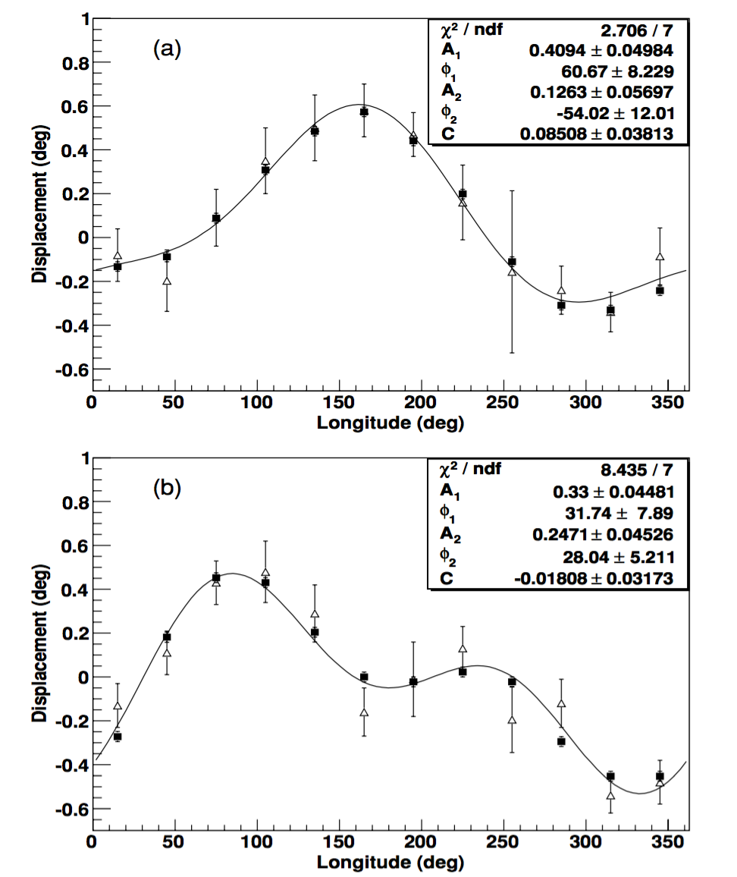
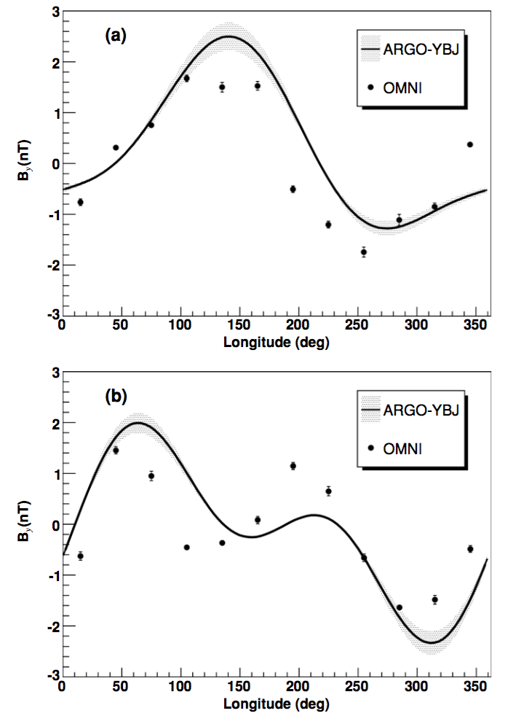
IMF measurement from ARGO-YBJ
APJ 729 (2011) 113

Slide 6
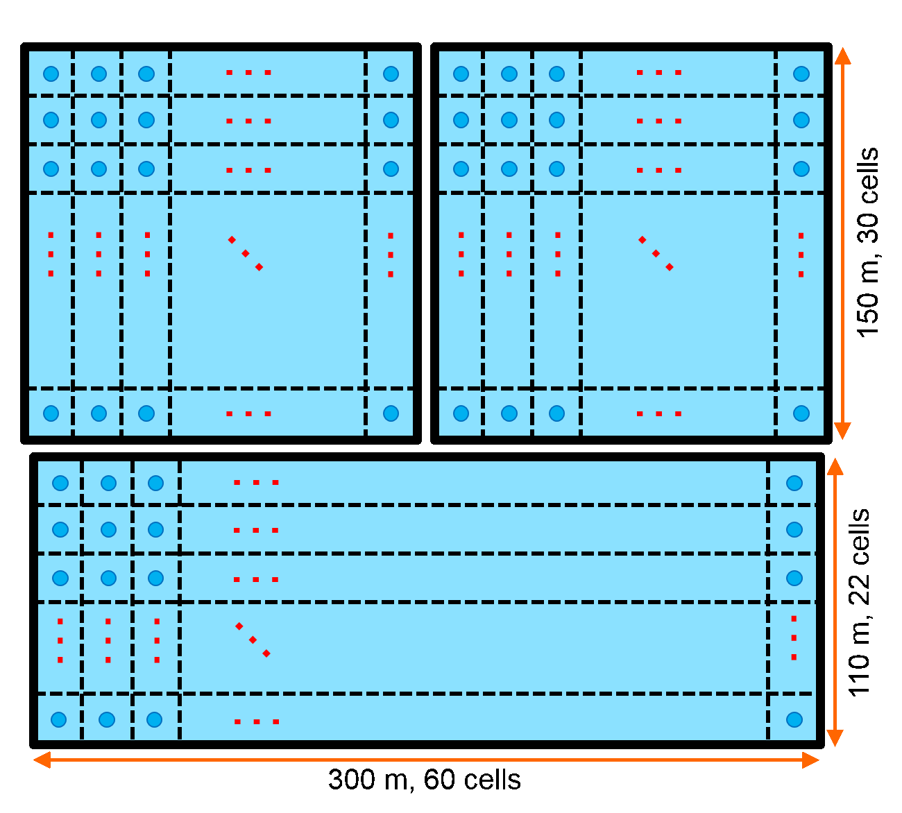
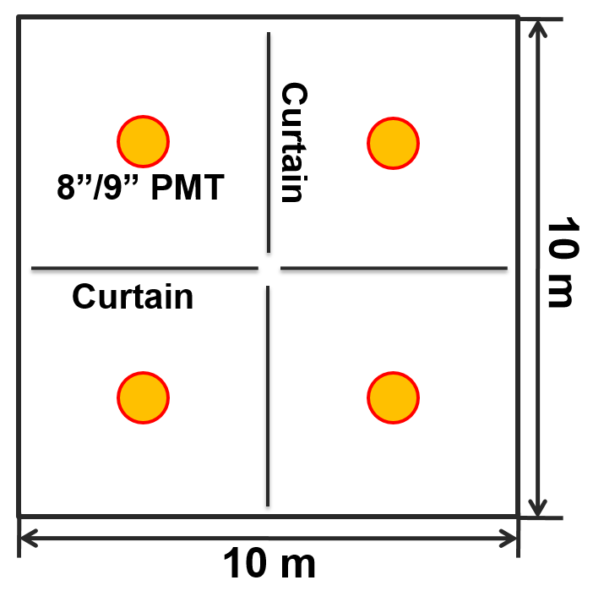
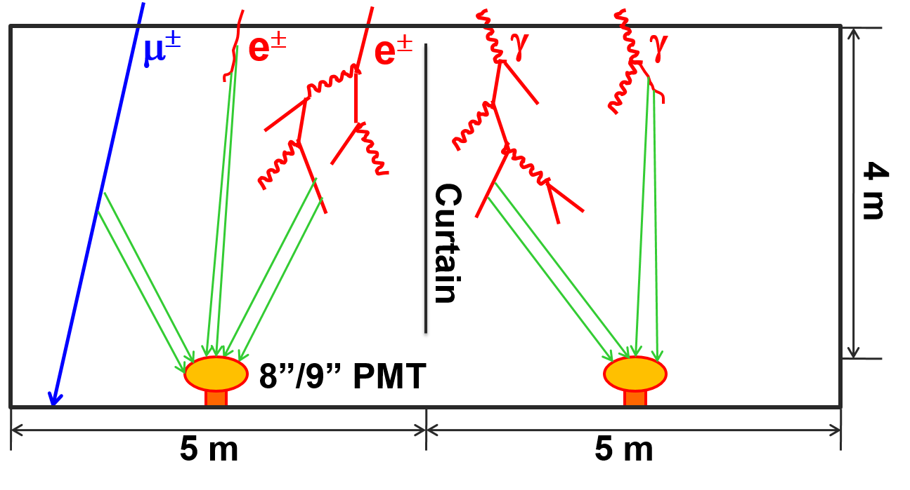
Cells of WCDA
3 water ponds:
  78,000 m² in total;
  4 m effective depth;
  3120 cells, with an 8”/9” PMT in each cell;
  Cells are partitioned with black curtains.

Slide 7
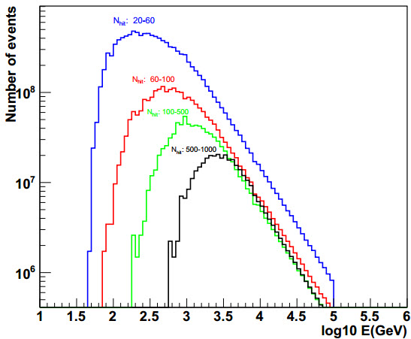
Sun shadow simulation
Magnetic field models
  Solar Magnetic Field
    PFSS-like model
  Interplanetary magnetic field
    parker spiral
  Geomagnetic field
    dipole/IGRF
particles to Sun
  May be trapped in field;
  Hit the sun disk passing through 1AU distance.
Add PFS to produce experimental angular resolution
  1.35 deg → 0.75 deg.

Slide 8
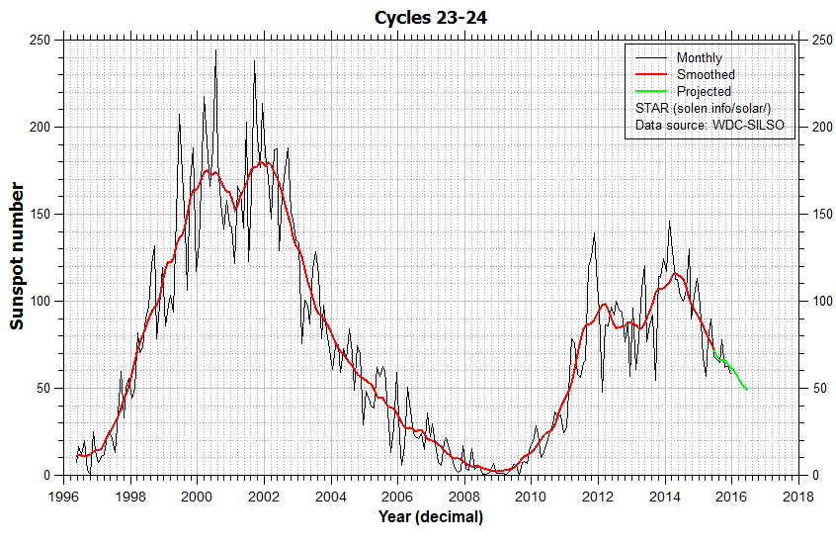
PFSS-like model
与空间中心的合作
Chaowei Jiang, Xueshang Feng, Solar physics DOI 10.1007/s11207-0120074-x

Slide 9
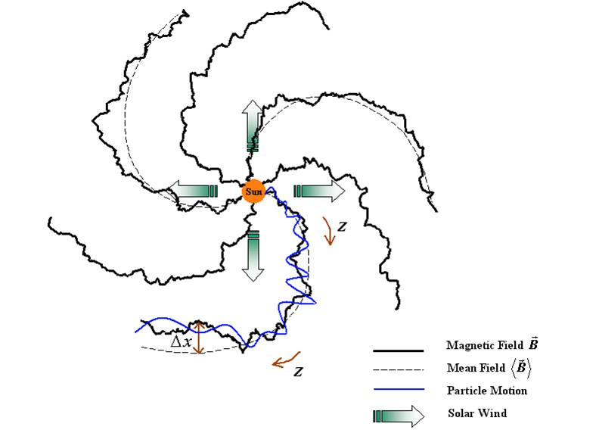
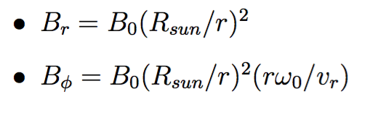

IMF: parker spiral
A steady solar wind with a constant velocity of 450 km/s

Slide 10
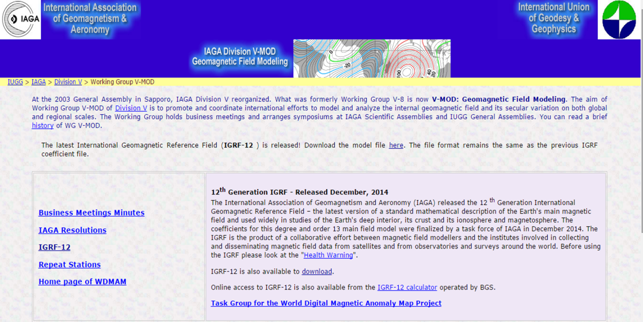
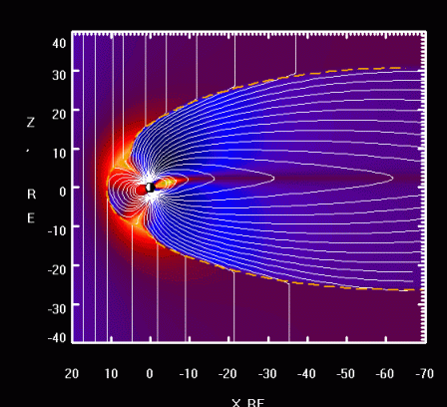
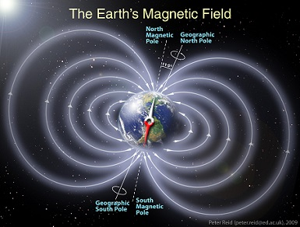

Geomagnetic field
1 TeV Proton
1 @ 20 R_{earth} B~nT gyroR 20 AU
1 TeV Proton
@ 1 R_{earth} B~0.5G gyroR 10 R_{earth}

Slide 11
Individual contributions: GMF + IMF + PFSS

Slide 12
The deficit ratio D_{ratio}
D_{ratio} = N_{sun}/N_{moon}

Slide 13
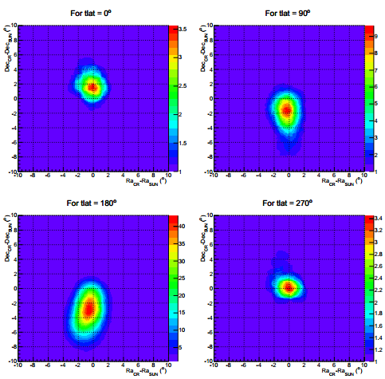
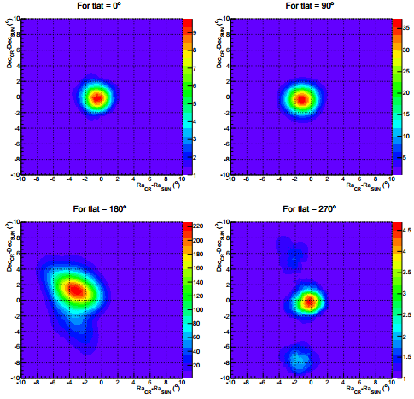
Daily map
Solar maximum (CR-1984)
Solar minimum(CR-2078)

Slide 14
Daily result on 1 full Carrington Rotation
Solar maximum (CR-1984)
Solar minimum(CR-2078)

Slide 15
Outlook
A code to study sun shadow is ready, the simulation result looks consistent with experimental observation;
Sun shadow displacement, deficit ratio as function of solar activity looks promising;
A daily sun shadow map is expected for WCDA;

Slide 16
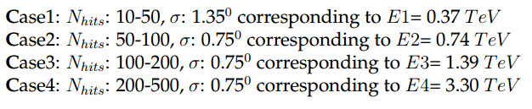
p-Energy Distributions by WCDA

Slide 17
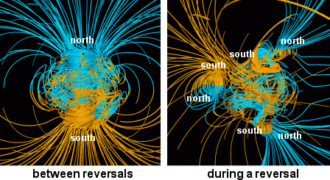
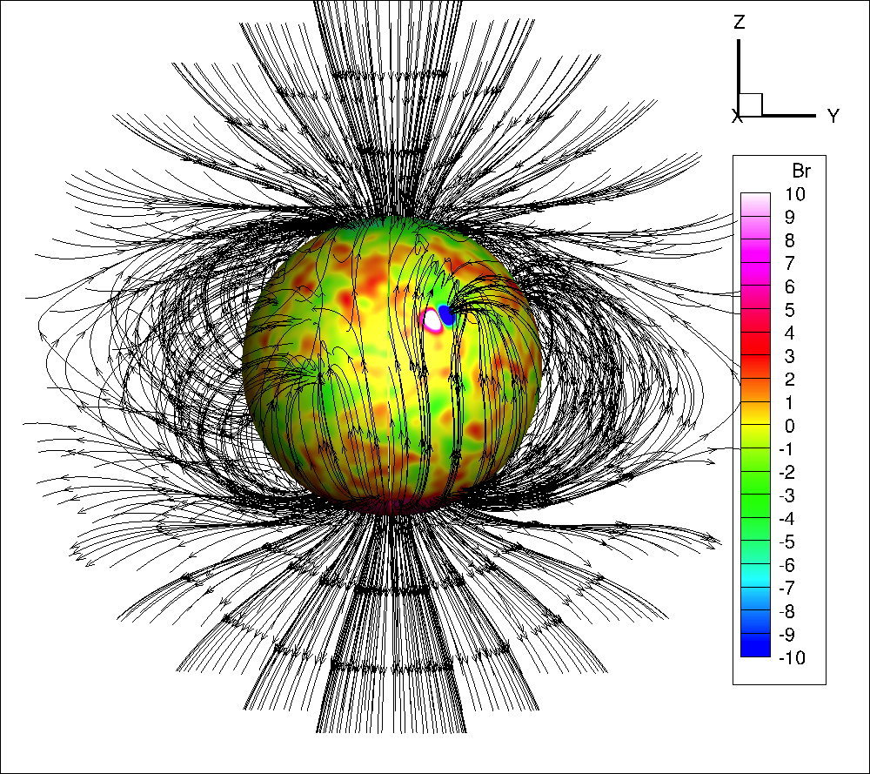
PFSS-like model (Potential Field Source Surface)
@ 10 R_{sun}
Chaowei Jiang, Xueshang Feng, Solar physics DOI 10.1007/s11207-0120074-x

Slide 18
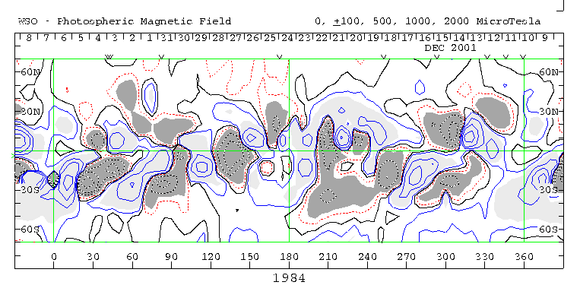
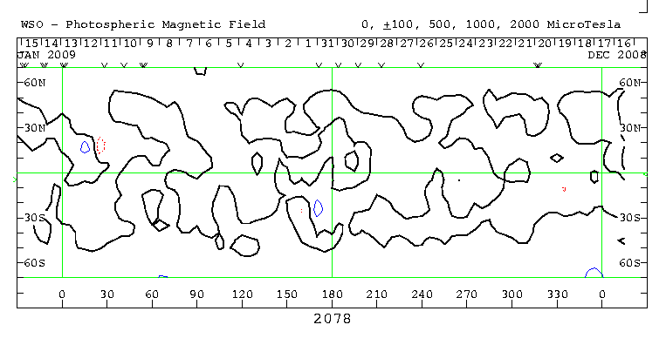
PFSS-like model

Slide 19
Accumulative result:

