Slide 1
Progress on the CEPC 650MHz/800kW klystron development
Shilun Pei, IHEP
On behalf of HERSC (High Efficiency RF Source R&D Collaboration) in China
Presentation at the CEPC CDR internal review
February 10, 2018, IHEP

Slide 2
HERSC effort
IHEP team
Yuan Chen, Yunlong Chi, Dong Dong, Shigeki Fukuda, Xiang He, Zhijun Lu, Cai Meng, Zaib Un Nisa, Guoxi Pei, Shilun Pei, Guan Shu, Ouzheng Xiao, Shengchang Wang, Fengli Zhao, Ningchuang Zhou, Zusheng Zhou, etc.
Collaborators
IE (Institute of Electronics, CAS)
Xuhua Hu, Xiuxia Li, Yan Li, Yunfeng Liao, Xiaoxia Wang, Long Yao, Xiudong Yang, Jianyong Zhou, Rui Zhang, Zhiqiang Zhang, etc.
GLVAC (GLVAC Industrial Technology Research Institute for High Power Devices)
Mingkun Cao, Zhiqiang Cai, Hao Huang, Junjie Huang, Ming Lei, Yang Shen, Shaozhe Wang, Jingui Zhang, etc.

Slide 3
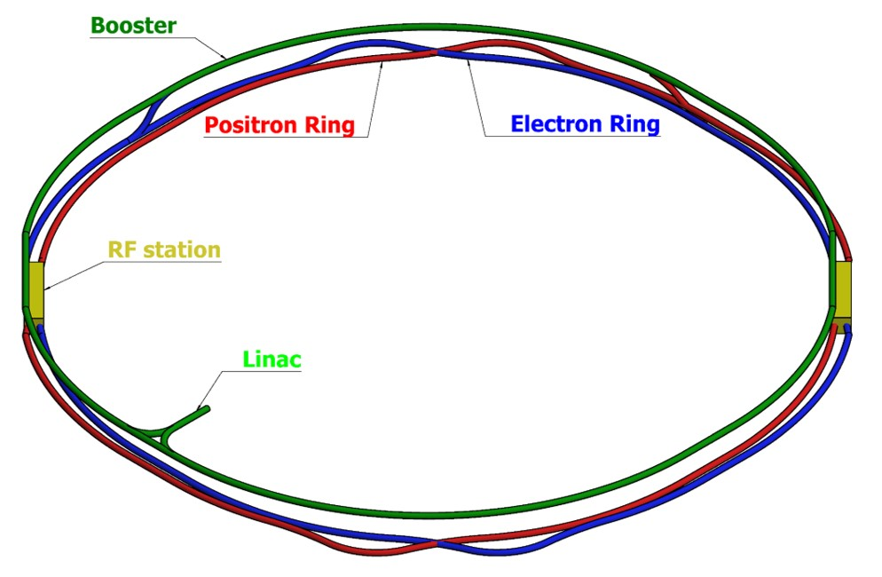
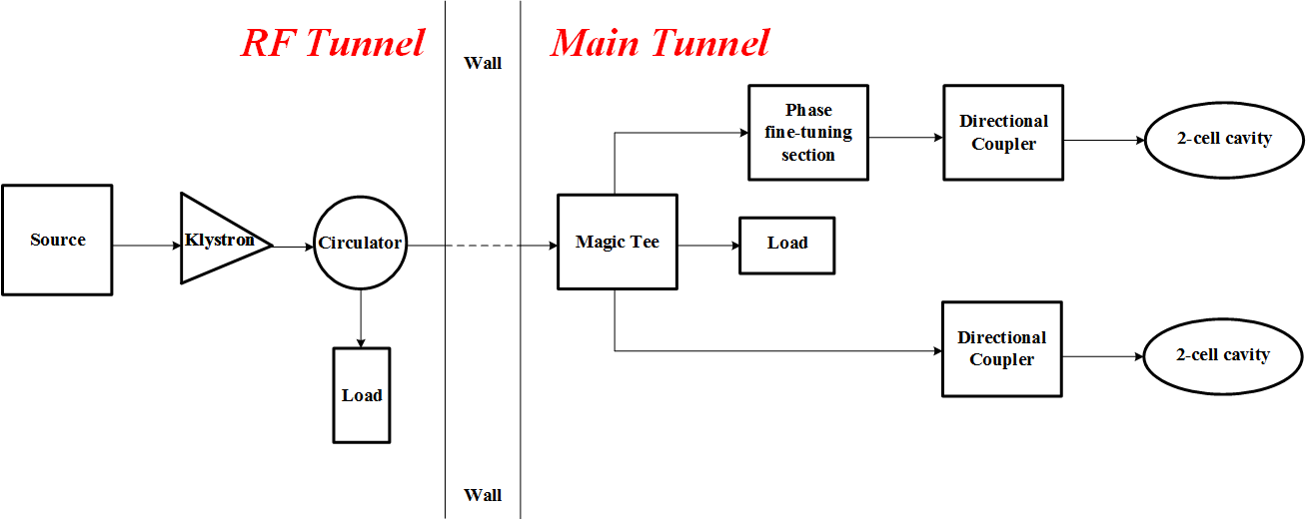
RF system for the CEPC collider
CEPC schematic layout
10GeV→45/120GeV
Parameters for the CEPC collider RF system
Parameter | Value
Frequency (MHz) | 650
Cell number per cavity | 2
Input power per cavity (kW) | 278
Total cavity number | 336
Total input power (MW) | 93.4
Cavity number per klystron | 2
Klystron number | 168
45/120GeV
45/120GeV
10GeV
800kW saturated klystron output power by taking into account the transmission loss, the power reflection caused by the cavity mismatch and the operation margin for the LLRF system
The higher the klystron efficiency, the lower the collider operation cost
>80% ultimate goal for the 650MHz/800kW klystron (needs more studies and work, long way to go)
RF unit for CEPC collider

Slide 4
R&D plan from 2016 to 2018
3 klystron prototypes in 6 FYs
FY 2016: done
Finalize the gun and the collector design of the 1st conventional klystron prototype (UHFKP8001, Ultra High Frequency band Klystron Prototype with 800kW output power)
Initialize the interaction section design of the UHFKP8001
FY 2017: done
Finalize the interaction section and the coil design of the UHFKP8001
Preliminary mechanical design of the UHFKP8001
FY 2018: being carried out
Finalize the mechanical design and the fabrication of the UHFKP8001
Infrastructure construction for the klystron brazing, baking and testing
Finalize the interaction section design of the 2nd high efficiency klystron prototype (UHFKP8002)
Initialize the design of the new gun with a lower perveance
Initialize the multi-beam high efficiency klystron study

Slide 5
R&D plan from 2018 to 2021
FY 2019
High power test of the UHFKP8001 (>60% efficiency to be expected)
Finalize the mechanical design and fabrication of the UHFKP8002
Finalize the mechanical design of the new gun with a lower perveance
Finalize the interaction section design of the 3rd high efficiency klystron prototype (UHFKP8003)
FY 2020
High power test of the UHFKP8002 (>70% efficiency to be expected)
Finalize the mechanical design and fabrication of the UHFKP8003
FY 2021
High power test of the UHFKP8003 (>80% efficiency to be expected)
More klystron prototypes or klystron industrialization

Slide 6
Parameters for the UHFKP8001
Conventional method based on the 2nd harmonic cavity to investigate the design and manufacture technologies for the high power CW klystron
Main parameter | Value
Frequency (MHz) | 650
Vk (kV) | 81.5
Ik (A) | 15.1
Perveance (µP) | 0.65
Efficiency (%) | >60
Saturated gain (dB) | >40
Output power (kW) | >800
1dB bandwidth (MHz) | ±0.5
Brillouin magnetic field (Gs) | 106.7
Reduced plasma wavelength(m) | 3.47
N cavities | 6
Normalized drift tube radius | 0.63
Normalized beam radius | 0.41
Filling factor | 0.65

Slide 7
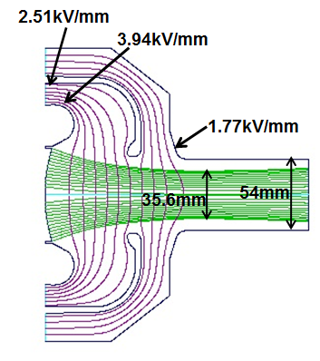
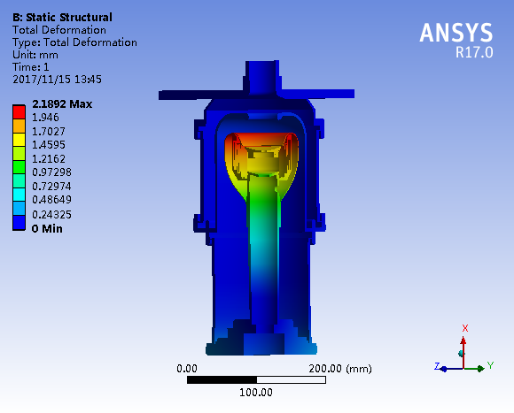
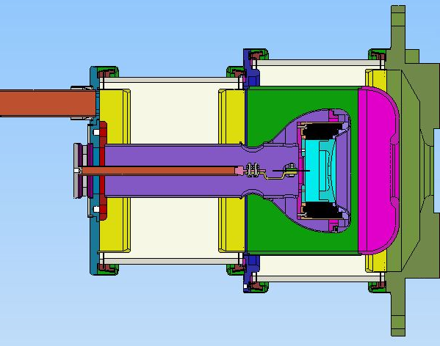
Electron gun for the UHFKP8001
Triode gun with the modulating anode for convenient adjustment of the beam perveance
Φ10 hole at the cathode center to avoid the damage by the ion bombardment
Main parameters | DGUN | EGUN | MAGIC2D | CST | Design
Beam waist radius (mm) | 17.8 | 17.48 | 17.48 | 17.64 | 17.5
Perveance (µP) | 0.64 | 0.64 | 0.65 | 0.64 | 0.65
Current density @ cathode (A/cm²) | <0.45 | 0.39~0.43 |  |  | <0.5
Current uniformity @ cathode (%) |  | 9.8% |  |  | <10%
Beam optics
Thermal deformation
Mechanical design

Slide 8
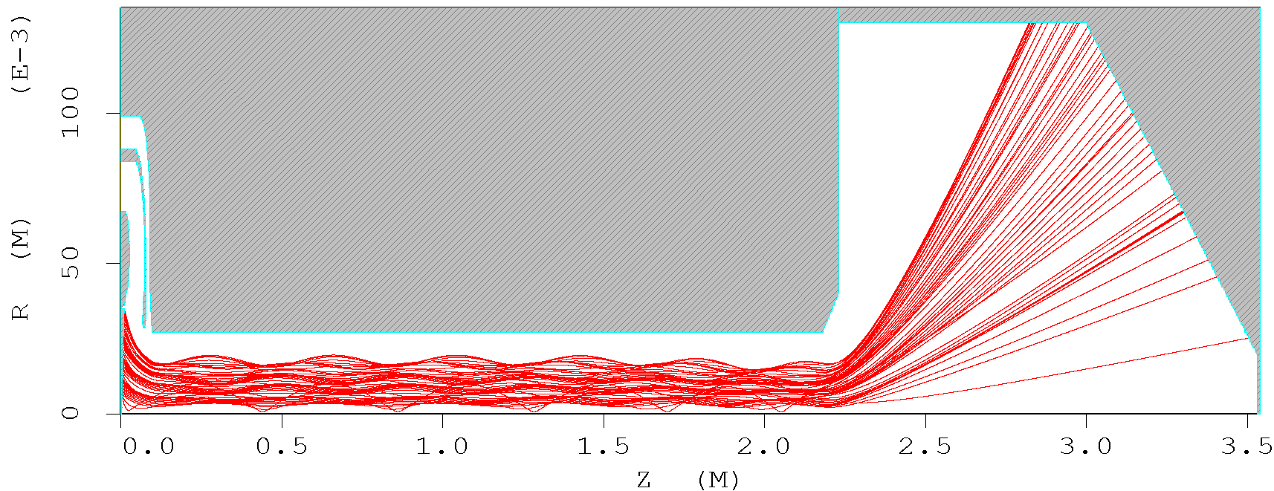
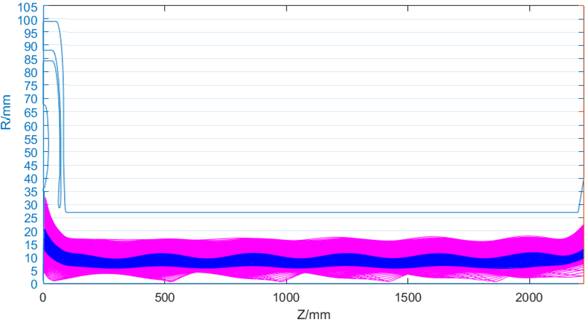
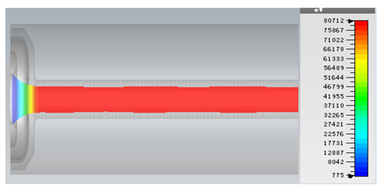
Beam optics for the UHFKP8001
Good laminarity without electron interception along the klystron
Ripple rate less than 5%
Electron beam trajectory without RF drive

Slide 9
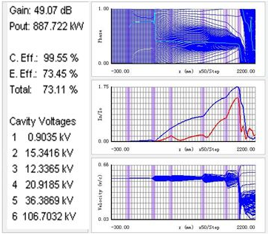
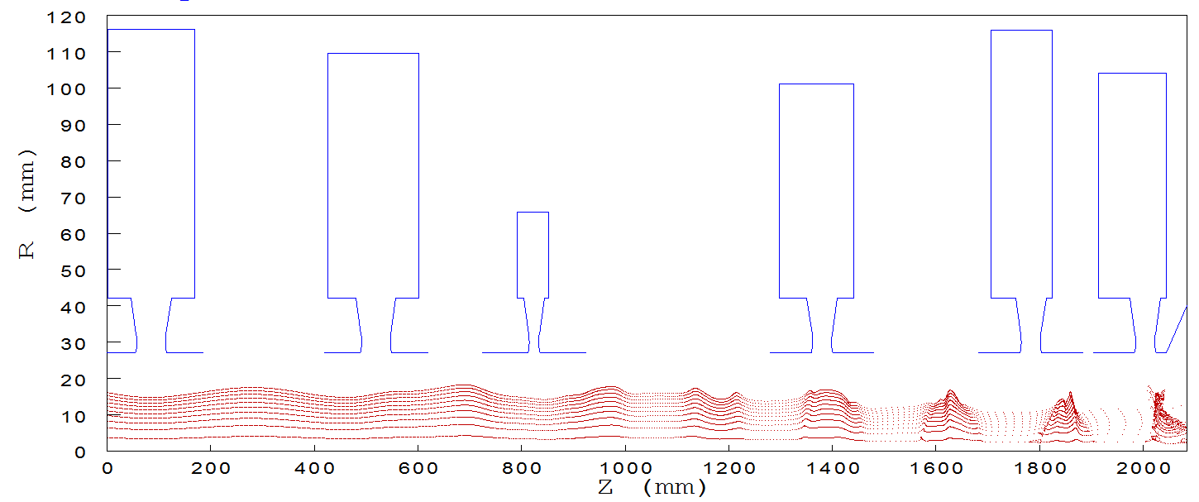
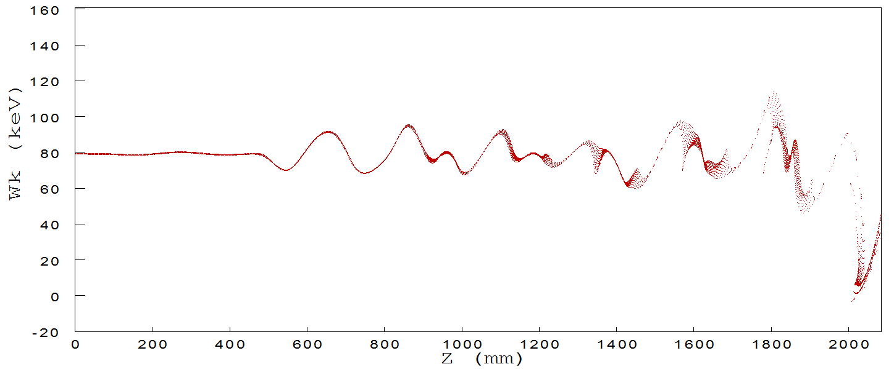
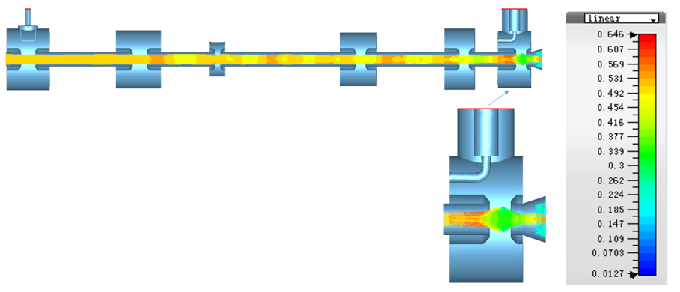
Dynamics for the UHFKP8001
1D optimization on the dynamics and crosschecked by 2D&3D
73%/68%/65% efficiencies for 1D/2D/3D respectively
888kW/827kW/790kW output power for 1D/2D/3D respectively
1D dynamics
2D dynamics
3D dynamics

Slide 10
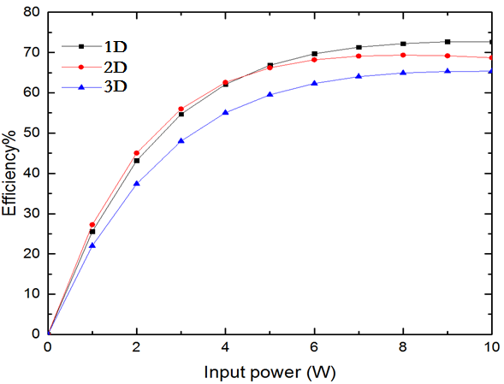
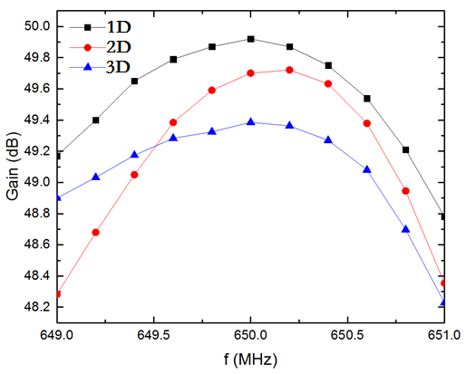
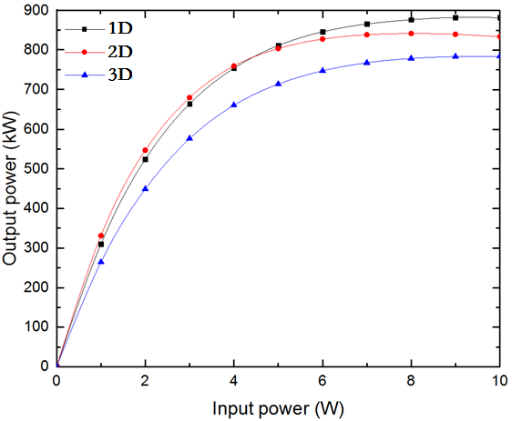
Dynamics for the UHFKP8001
1dB bandwidth larger than ±0.5MHz, Saturated gain around 48dB
Klystron efficiency curve
Klystron gain curve
Klystron transfer curve

Slide 11
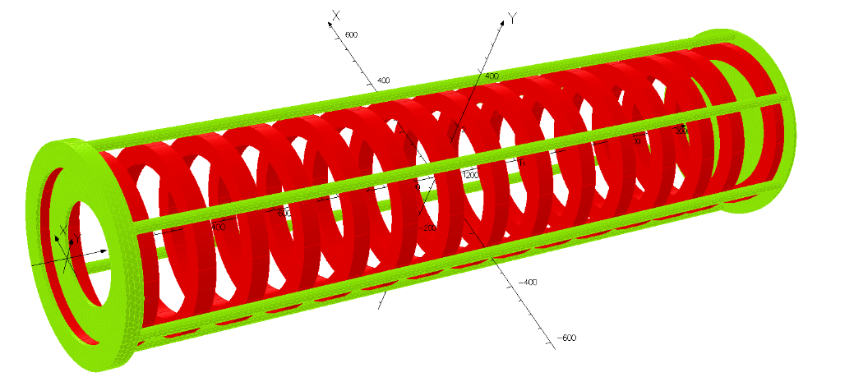
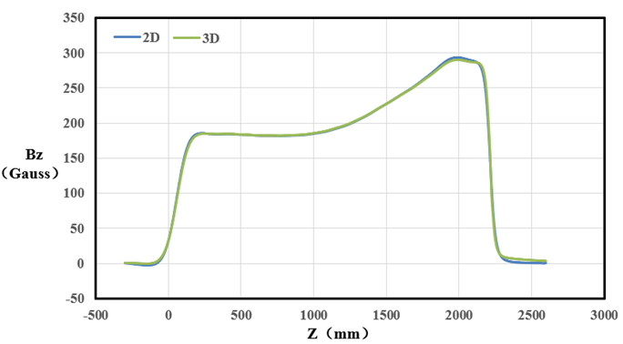
Coils for the UHFKP8001
Designed by 2D and crosschecked by 3D, very good consistency
15 regular coils with 1 bucking coil near the gun
Cathode: 32 Gauss, Gain cavity: 180 Gauss, Output cavity: 270 Gauss
2D solenoid model
3D solenoid model
On-axis magnetic field

Slide 12
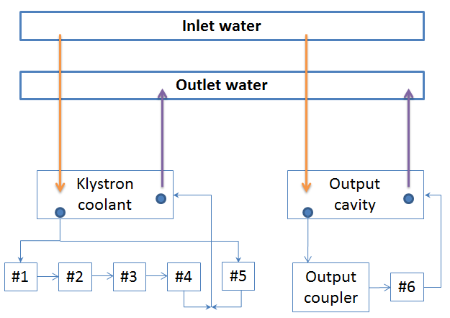
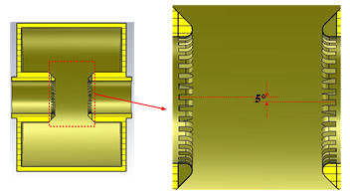
Cavity chain for the UHFKP8001
RF design and cooling analysis conducted
Grooved nose cone for each cavity to suppress the multipacting effect
Cavity chain
Grooved nose cone for each cavity
Klystron cavity chain cooling scheme

Slide 13
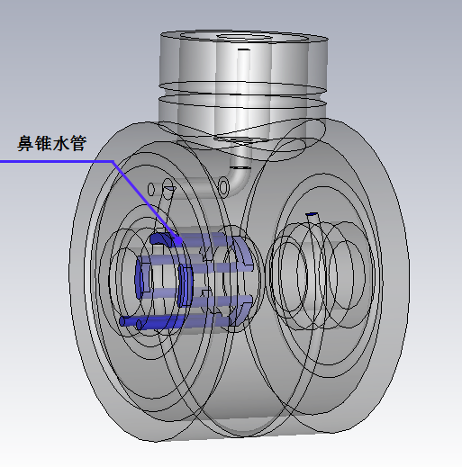
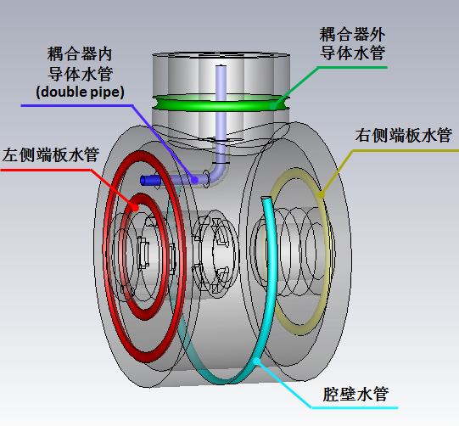
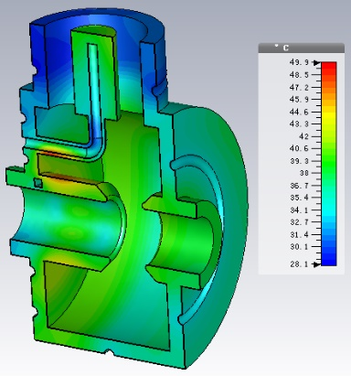
Output cavity cooling for the UHFKP8001
87% of the total power loss for the cavity chain located at the output cavity
Efficient cooling needed to guarantee the klystron operation stability
Theoretical power loss around 3.9kW, cooling capability designed to be 8kW
Cooling pipes distribution
Temperature distribution

Slide 14
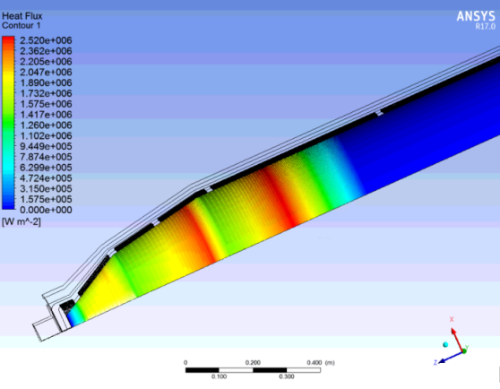
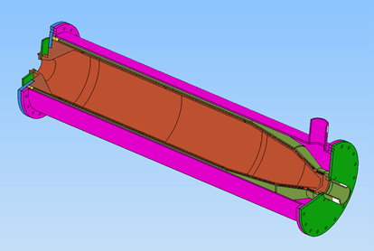
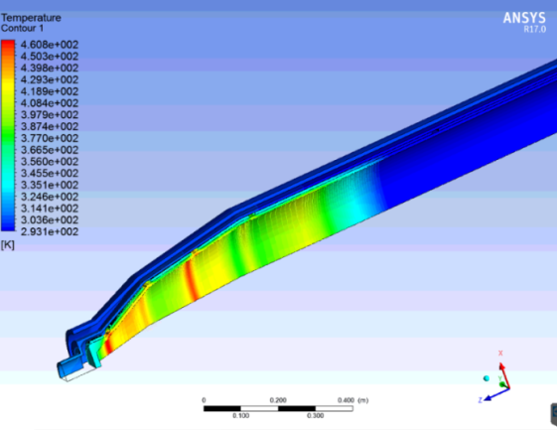
Collector for the UHFKP8001
~2m long collector to sustain 1.23MW full beam power
Thermal load distribution
Mechanical design
Temperature distribution
Duty factor (%) | Max. heat flux (W/cm²) | Max. stress (Mpa) | Max. temperature (ºC)
100 | 210 | 158 | 187

Slide 15
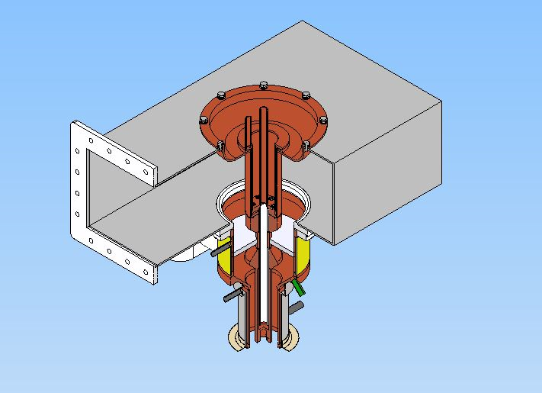
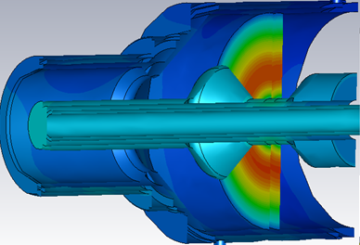
Output window for the UHFKP8001
Relatively simple design with door knob to facilitate the fabrication, two windows to be tested at the high power
>800kW capacity of CW RF power @ 650MHz
<1.05 VSWR @ 650±0.5MHz
Temperature distribution
Mechanical design

Slide 16
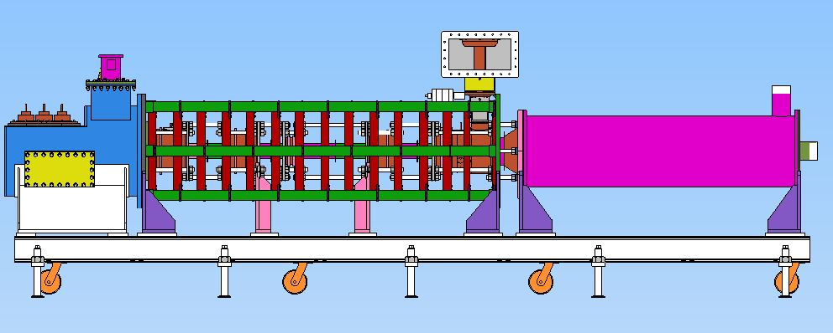
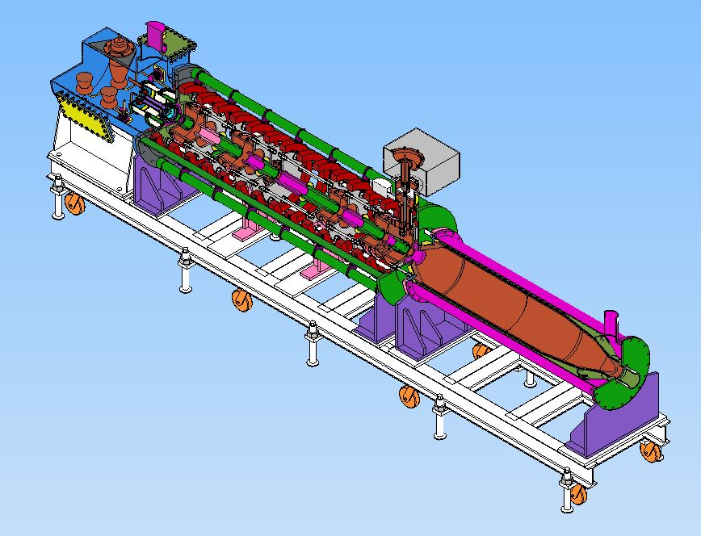
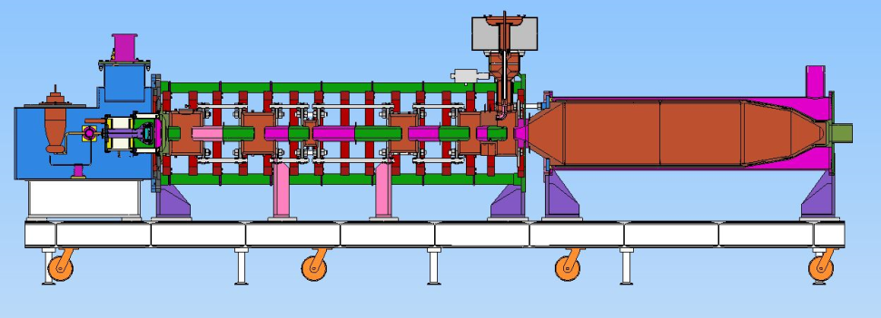
Mechanical design for the UHFKP8001
China consortium HERSC (High Efficiency RF Source R&D Collaboration) established in 2017 for 650MHz/800kW klystron design and fabrication
Preliminary mechanical design achieved (L×W×H: 5.12m×0.87m×1.56m)
Discussion on the manufacturing details being conducted
Preliminary mechanical design for UHFKP8001

Slide 17
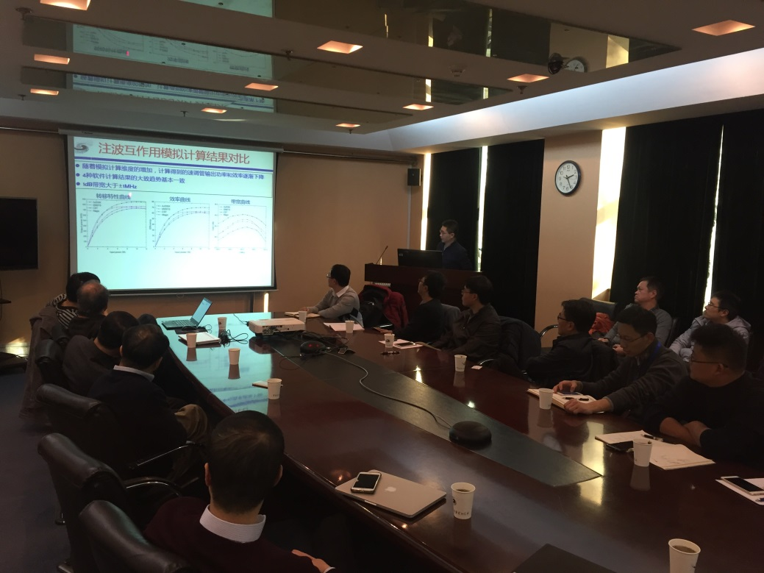
HERSC quarterly meeting
Physical design report for UHFKP8001 released in October, 2017, currently being updated
Quarterly meeting held inside HERSC, 1st in November, 2017, 2nd to be in March, 2018
Physical design report for UHFKP8001
1st HERSC meeting

Slide 18
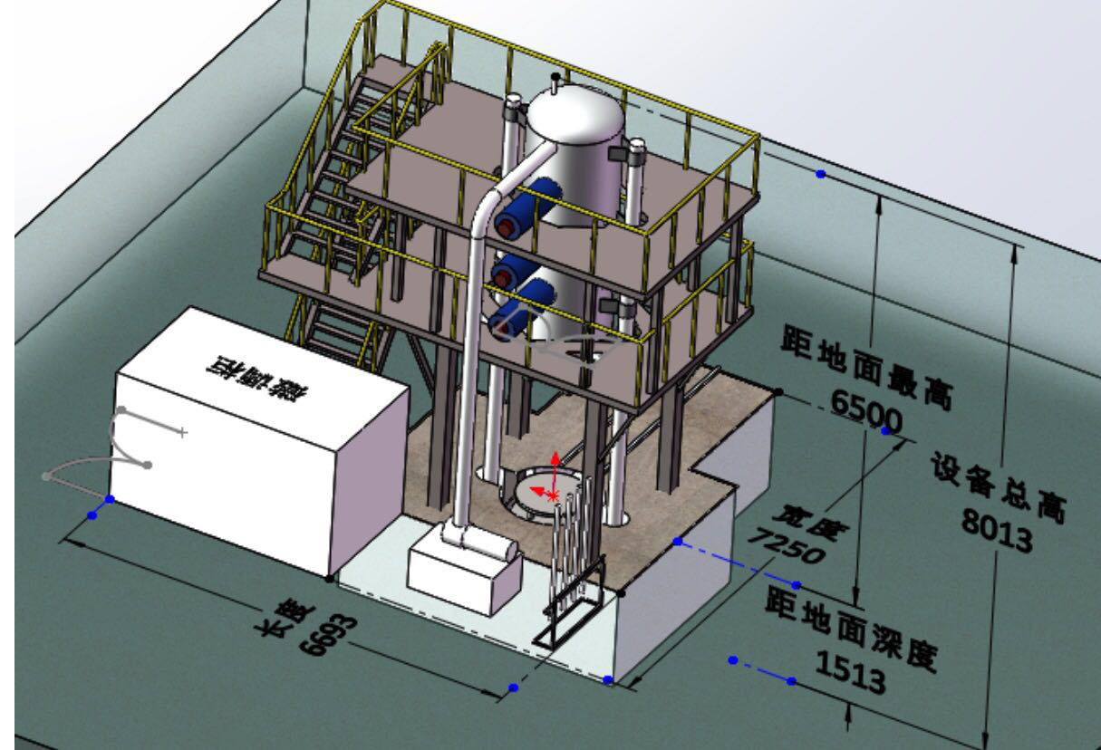
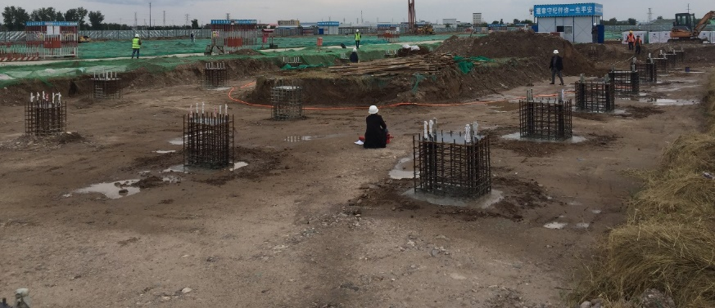
Infrastructure construction
GLVAC Industrial Technology Research Institute established in 2016 for large baking furnace construction (expect to put into use at end of 2018), supported by the local government
Klystron high power testing stand construction being conducted, supported by the PAPS project in Beijing
PAPS project being constructed
Sketch for the large baking furnace

Slide 19
Parameters for the UHFKP8002 baseline
To develop the high efficiency klystron steadily, the UHFKP8001 will be retrofitted by only replacing the cavity chain in the baseline
3rd harmonic cavities will be introduced to increase the efficiency
Main parameters | UHFKP8001 | UHFKP8002 baseline
Frequency (MHz) | 650 | 650
Vk (kV) | 81.5 | 81.5
Ik (A) | 15.1 | 15.1
Perveance (µP) | 0.65 | 0.65
Efficiency (%) | >60 | >70
Saturated gain (dB) | >40 | >40
Output power (kW) | >800 | >800
1dB bandwidth (MHz) | ±0.5 | ±0.5
Brillouin magnetic field (Gs) | 106.7 | 106.7
Reduced plasma wavelength(m) | 3.47 | 3.47
N cavities | 6 | 7
Normalized drift tube radius | 0.63 | 0.63
Normalized beam radius | 0.41 | 0.41
Filling factor | 0.65 | 0.65

Slide 20
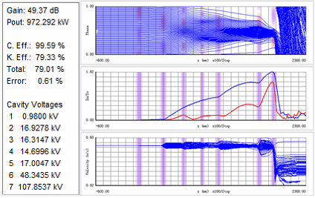
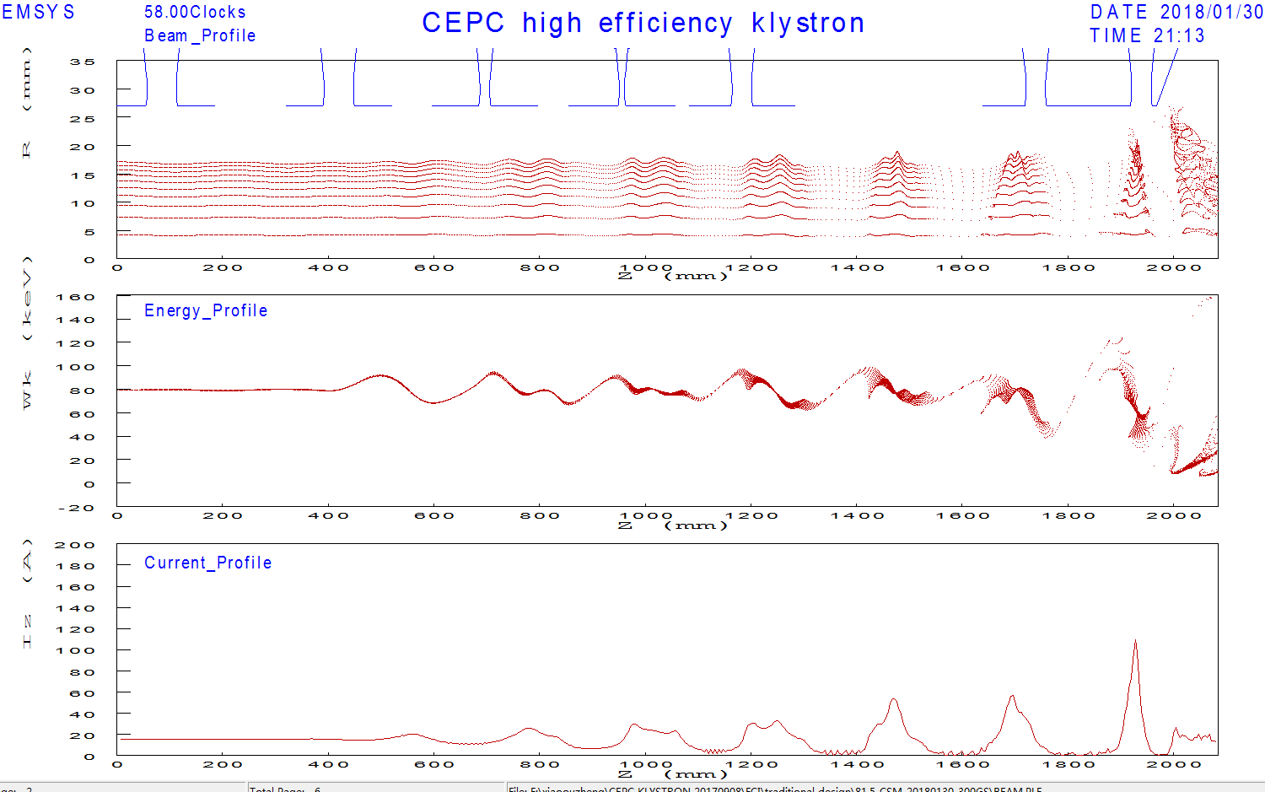
Dynamics for the UHFKP8002 baseline
79.3%/72.3% efficiencies for 1D/2D respectively
972kW/878kW output power for 1D/2D respectively
1D dynamics
2D dynamics

Slide 21
Parameters for the UHFKP8002 alternative
To develop the high efficiency klystron aggressively, the UHFKP8001 will be retrofitted by replacing both the electron gun and the cavity chain
The gun perveance will be further lowered, 3rd harmonic cavities will also be introduced to increase the efficiency
Main parameters | UHFKP8001 | UHFKP8002 baseline | UHFKP8002 alternative
Frequency (MHz) | 650 | 650 | 650
Vk (kV) | 81.5 | 81.5 | 110
Ik (A) | 15.1 | 15.1 | 9.1
Perveance (µP) | 0.65 | 0.65 | 0.25
Efficiency (%) | >60 | >70 | >70
Saturated gain (dB) | >40 | >40 | >40
Output power (kW) | >800 | >800 | >800
1dB bandwidth (MHz) | ±0.5 | ±0.5 | ±0.5
Brillouin magnetic field (Gs) | 106.7 | 106.7 | 115.8
Reduced plasma wavelength(m) | 3.47 | 3.47 | 6.46
N cavities | 6 | 7 | 7
Normalized drift tube radius | 0.63 | 0.63 | 0.38
Normalized beam radius | 0.41 | 0.41 | 0.23
Filling factor | 0.65 | 0.65 | 0.6

Slide 22
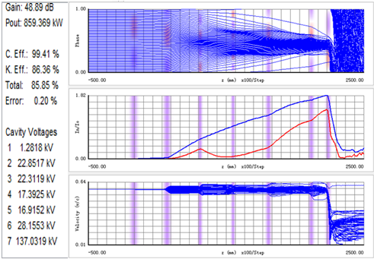
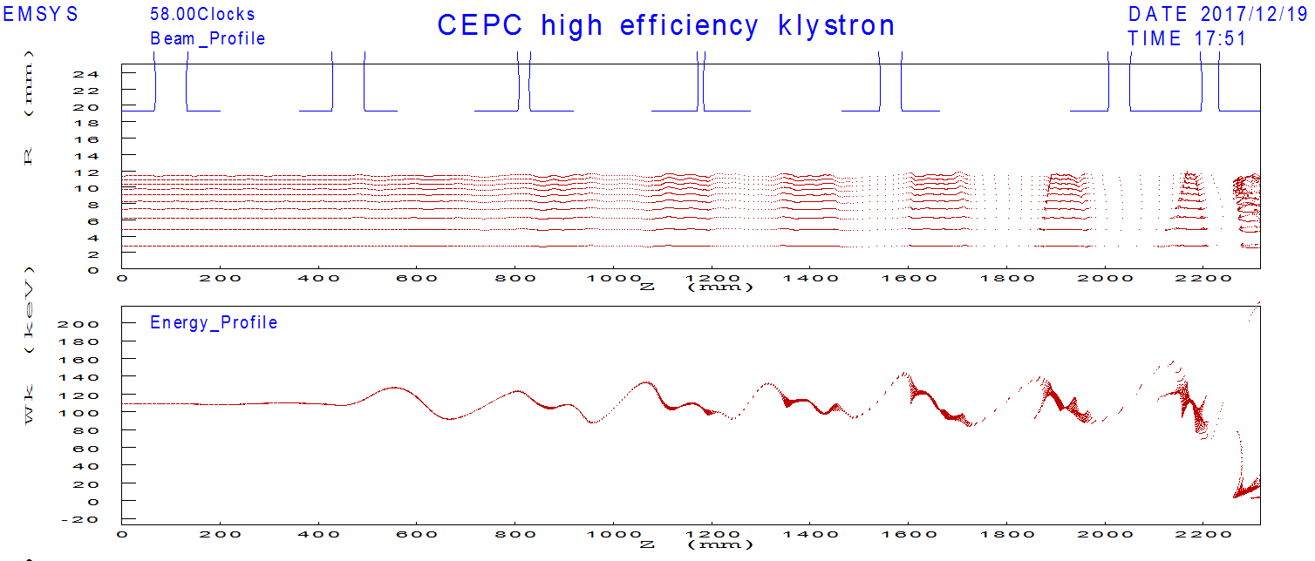
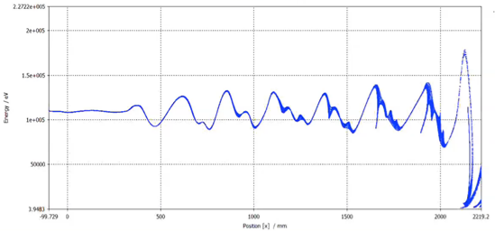
Dynamics for the UHFKP8002 alternative
1D dynamics
2D dynamics
3D dynamics

Slide 23
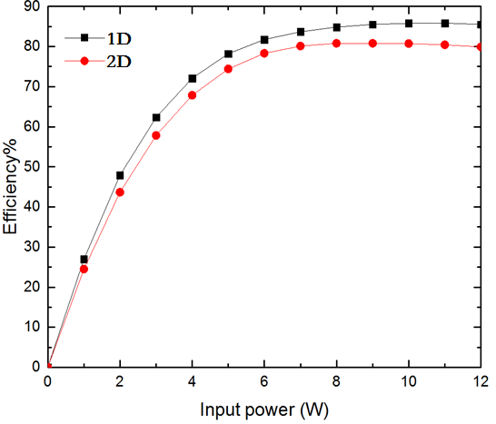
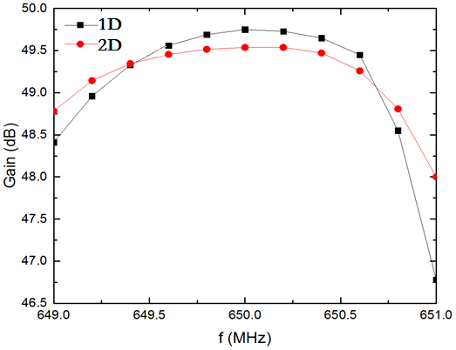
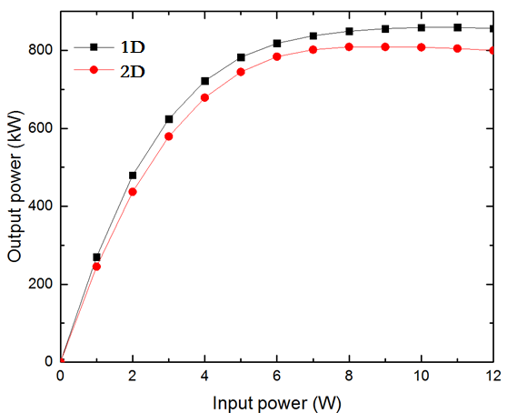
Dynamics for the UHFKP8002 Alternative
85.9%/81.2%/76.5% efficiencies for 1D/2D/3D respectively
859kW/812kW/765kW output power for 1D/2D respectively
Klystron efficiency curve
Klystron gain curve
Klystron transfer curve

Slide 24
Summary
Based on the current mature technologies (low perveance electron gun and 2nd harmonic bunching), the physical design of the 1st klystron prototype UHFKP8001 has been finalized, the mechanical design is being carried out, the high power test is expected to be in 1 year later.
The physical design of the high efficiency klystron prototype UHFKP8002 is being conducted, both the conservative baseline and the alternate aggressive design are presented, new design is still being searched.
China consortium HERSC was established, infrastructure for UHF band klystron brazing and baking is being constructed.
Due to the unsubstantial technology strength, the professionals shortage, the progressive infrastructure construction and the limited budget in the area of the high efficiency klystron development technology at China, more studies and work need to be done to increase the klystron efficiency to 80%, there is still a long way to go.

Slide 25
Thanks for your attention!

