Slide 1
CEPC accelerator physics
Chenghui Yu
for CEPC team
Feb.10, 2018

Slide 2
Outline
Physics goals and collider parameters
Physics design of CEPC
Linac → Booster → Collider ring
Summary

Slide 3
Physics goals of CEPC
Electron-positron collider (45.5, 80, 120 GeV)
  Higgs Factory
    Precision study of Higgs (m_{H}, J^{PC}, couplings)
    Looking for hints of new physics
    Luminosity > 2.0×10³⁴cm⁻²s⁻¹
  Z & W factory
    Precision test of standard model
    Rare decays
    Luminosity > 1.0×10³⁴cm⁻²s⁻¹

Slide 4
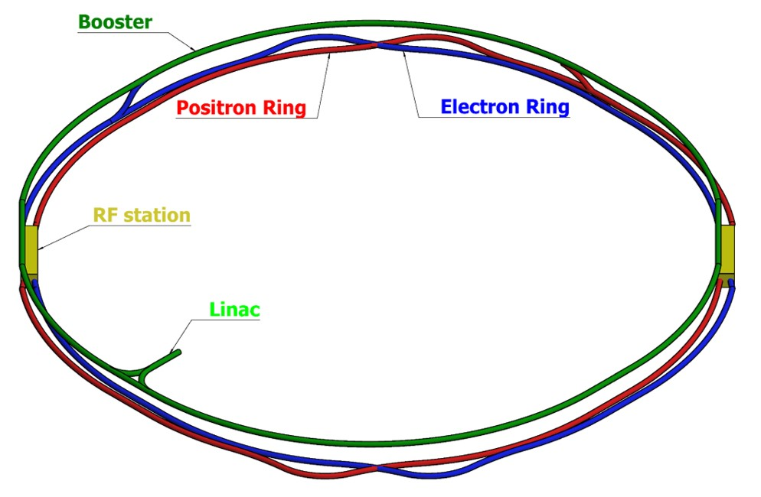
Physics design of CEPC Linac → Booster → Collider ring
100km circumference, double ring collider with 2 IPs
Matching the geometry of SPPC as much as possible
Adopt twin-aperture quadrupoles and dipoles in the ARC

Slide 5
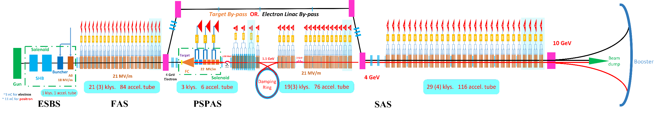
Physics design of CEPC Linac
1200m
Parameter | Symbol | Unit | Baseline | Designed
e⁻ /e⁺ beam energy | E_{e-}/E_{e+} | GeV | 10 | 10
Repetition rate | f_{rep} | Hz | 100 | 100
e⁻ /e⁺ bunch population | N_{e-}/N_{e+} |  | > 9.4×10⁹ | 1.9×10¹⁰ / 1.9×10¹⁰
 |  | nC | > 1.5 | 3.0
Energy spread (e⁻ /e⁺ ) | σ_{e} |  | < 2×10⁻³ | 1.5×10⁻³ / 1.6×10⁻³
Emittance (e⁻ /e⁺ ) | ε_{r} | nm⋅ rad | < 120 | 5 / 40 ~120
Bunch length (e⁻ /e⁺ ) | σ_{l} | mm |  | 1 / 1
e⁻ beam energy on Target |  | GeV | 4 | 4
e⁻ bunch charge on Target |  | nC | 10 | 10

Slide 6
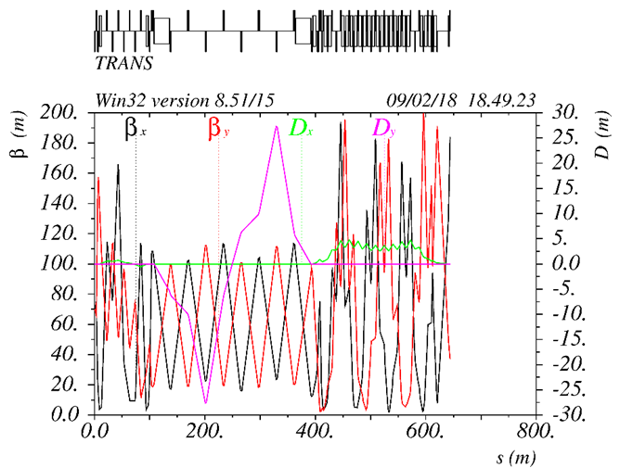
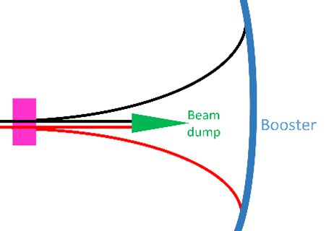
Physics design of CEPC Transport Line 1
~650m
0 ~ -100m
Transfer efficiency 99%

Slide 7
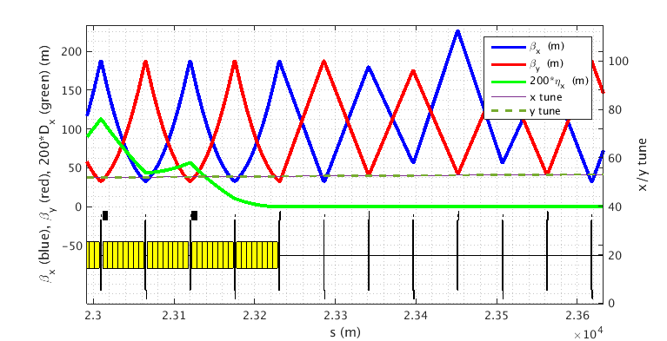
Physics design of CEPC Booster
Injection energy 10GeV
FODO cells with 90 degrees phase shift
The diameter of the inner aperture is selected as 55mm due to limitation of impedance.
The beam lifetime should be higher than 14min (3% particle lose) according to the duration before extraction.

Slide 8
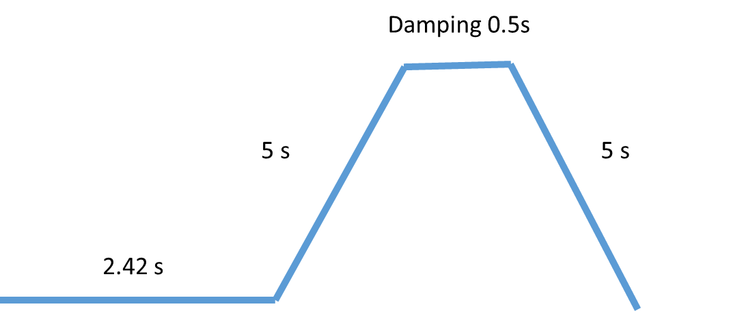
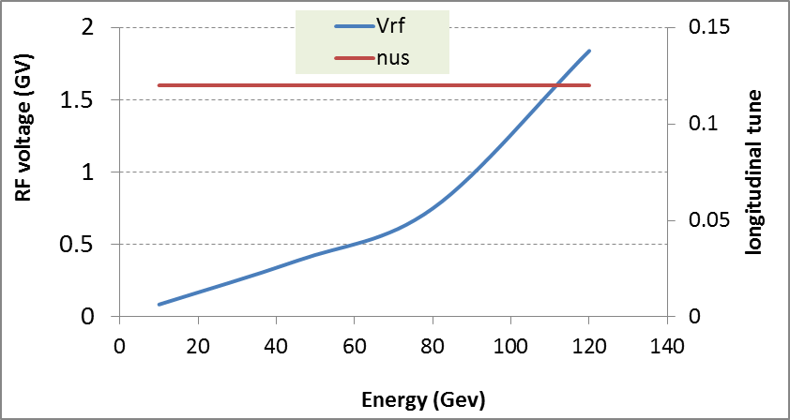
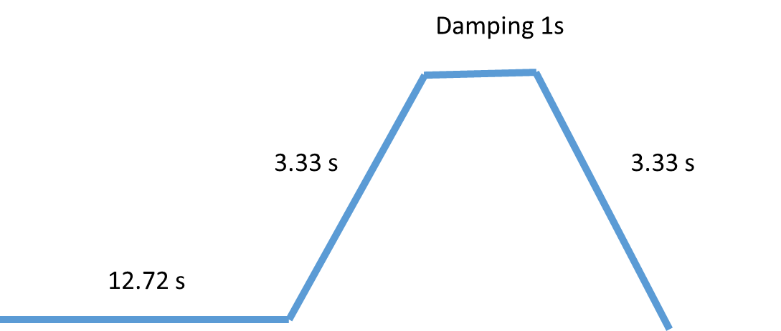
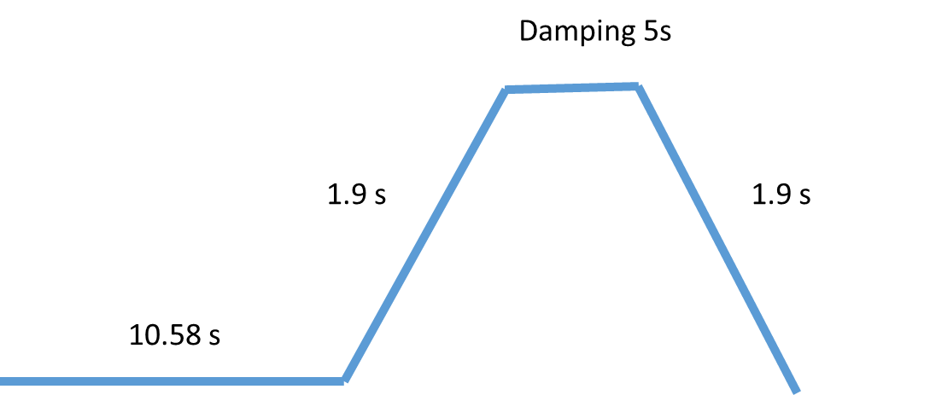
Physics design of CEPC Booster
Injection time structure
1 cycle
4 cycles
30Gauss @ 10GeV
Eddy current effect
9 cycles

Slide 9
Physics design of CEPC Booster
 | Higgs | W | Z
Injection Energy (GeV) | 120 | 80 | 45.5
Bunch number | 242 | 305 | 600
Bunch Charge (nC) | 0.72 | 0.72 | 0.38
Beam Current (mA) | 0.52 | 0.66 | 0.69
Beam current threshold due to TMCI (mA) | 0.803
Number of Cycles | 1 | 4 | 20
Current decay | 3% | 3% | 3%
Ramping Cycle (sec) | 10.0 | 6.6 | 3.8
Injection time (sec) | 26 | 86 | 592
Collider Lifetime (hour) | 0.33 | 3.5 | 7.4
Injection frequency (sec) | 37 | 383 | 811
Transfer efficiency is 92% if beam lifetime is 14min.

Slide 10
Errors Setting
Physics design of CEPC Booster
Error studies
 | Dipole | Quadrupole | Sextupole | Corrector
Transverse shift X/Y (μm) | 100 | 100 | 100 | 100
Longitudinal shift Z (μm) | 150 | 150 | 150 | 150
Tilt about X/Y (mrad) | 0.1 | 0.2 | 0.2 | 0.2
Tilt about Z (mrad) | 0.05 | 0.2 | 0.2 | 0.2
Nominal field | 1e-3 | 1e-3 | 1e-3 | 1e-2
 | Accuracy (m) | Tilt (mrad) | Gain | Offset after BBA(mm)
BPM | 1e-5 | 10 | 5% | 1e-3

Slide 11
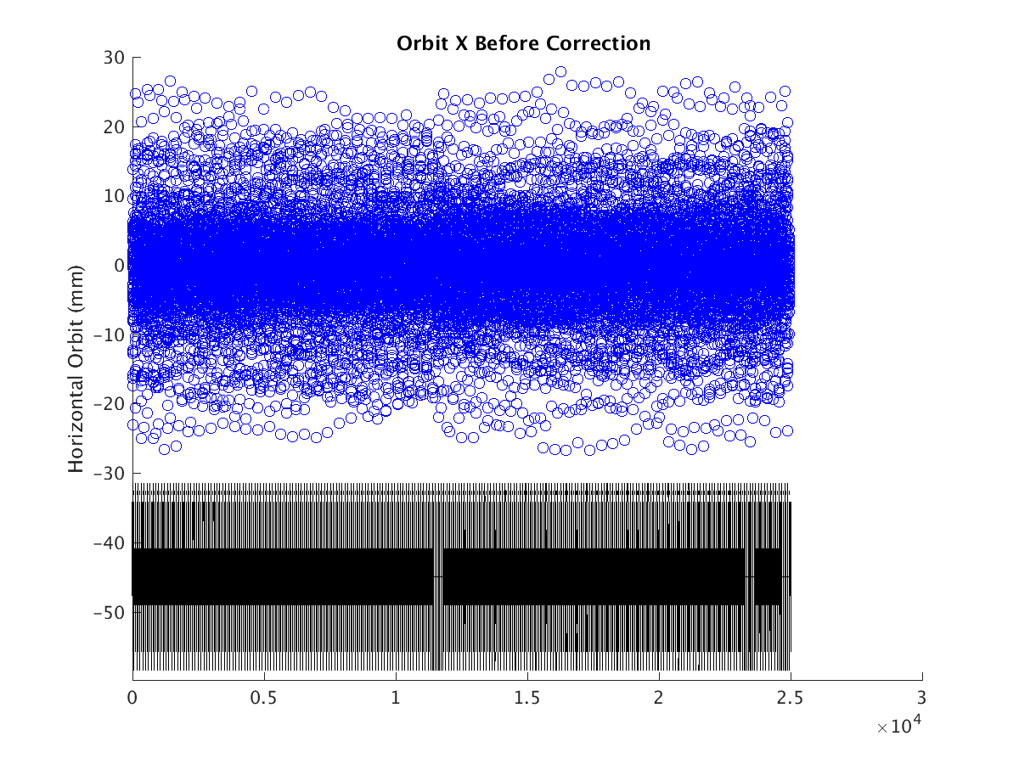
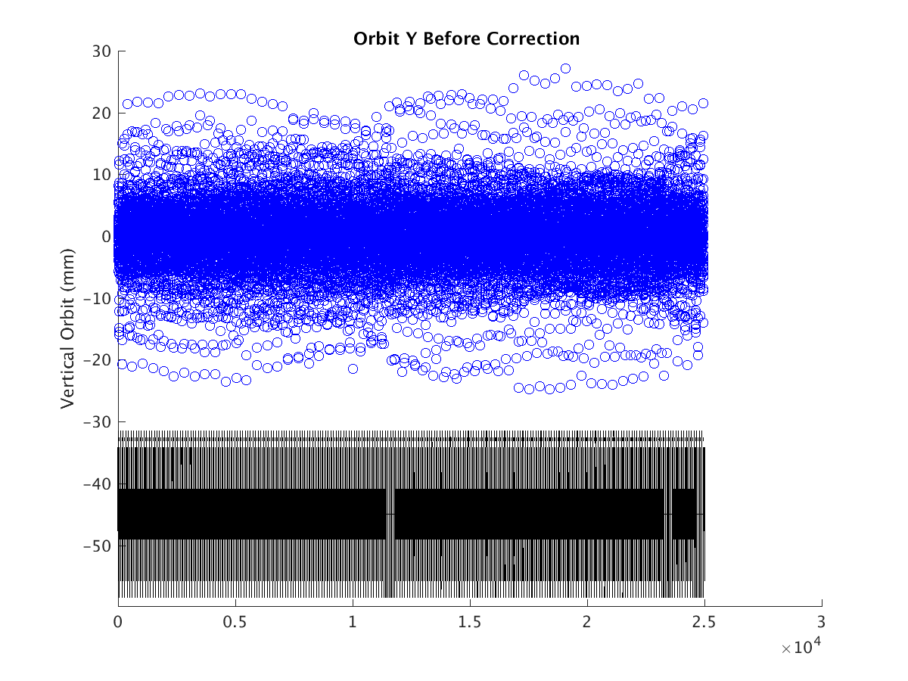
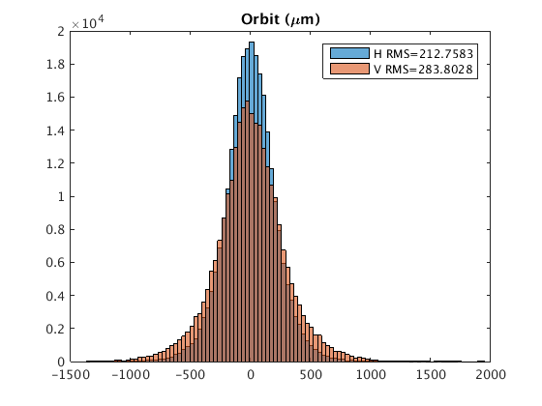
Orbit with errors
Physics design of CEPC Booster
Horizontal Corrector: 48 correctors +856 BTs
Vertical Corrector : 904 correctors
BPM : 904*2
Orbit within the beam stay clear
“First turn trajectory” is not necessary
Hor. 0.2mm Ver. 0.3mm

Slide 12
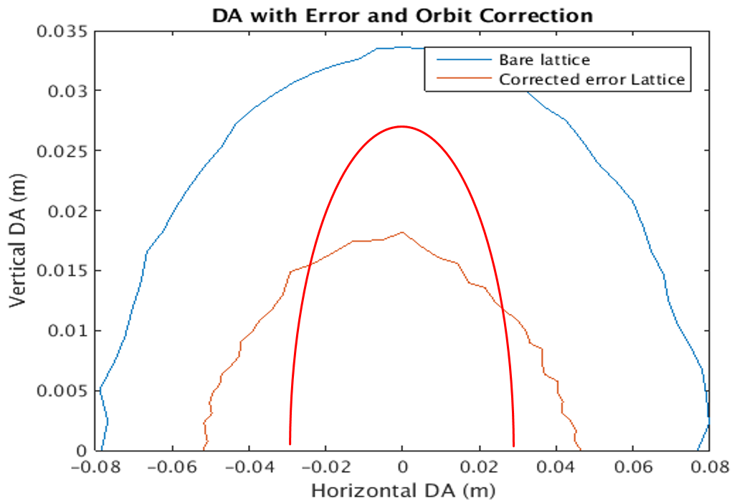
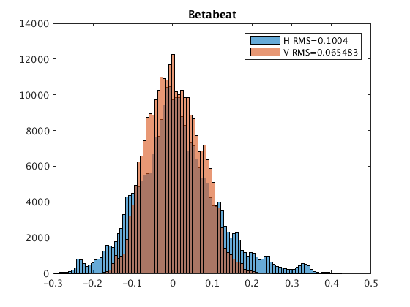
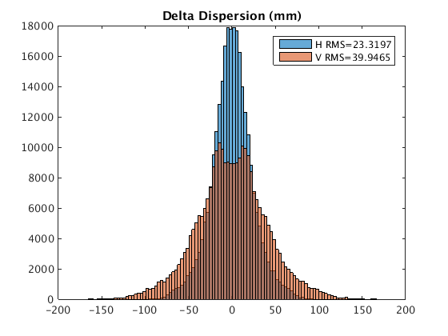
Beta Beating, Emittance and Dynamic Aperture with errors
Physics design of CEPC Booster
  Nearly half of bare lattice, ±50mm* ±18mm, without optics correction, satisfy requirement
  Emittance growth is less than 10% for the simulation seeds
Satisfy the requirement of injection and beam lifetime
Skew quadrupoles are needed to control the coupling
βx/βy=188/33m
ε=120nm : 2(9σ_{x} +5mm) / 2(6σ_{y} +5mm)
Hor. 10% Ver. 6.5% Hor. 0.023m Ver. 0.04m

Slide 13
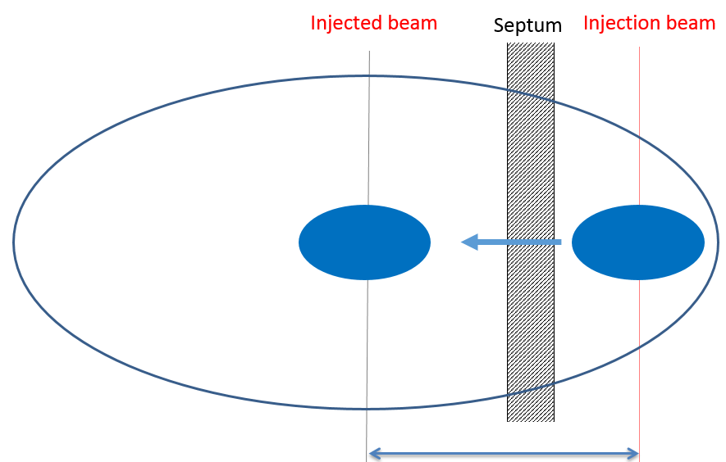
Physics design of CEPC Booster
On-axis injection and extraction
Damping time 87s
e+ and e- beams are injected from outside of the booster ring
Horizontal septum is used to bend beams into the booster
A single kicker downstream of injected beams kick the beams into the booster orbit
Extraction is the opposite procedure

Slide 14
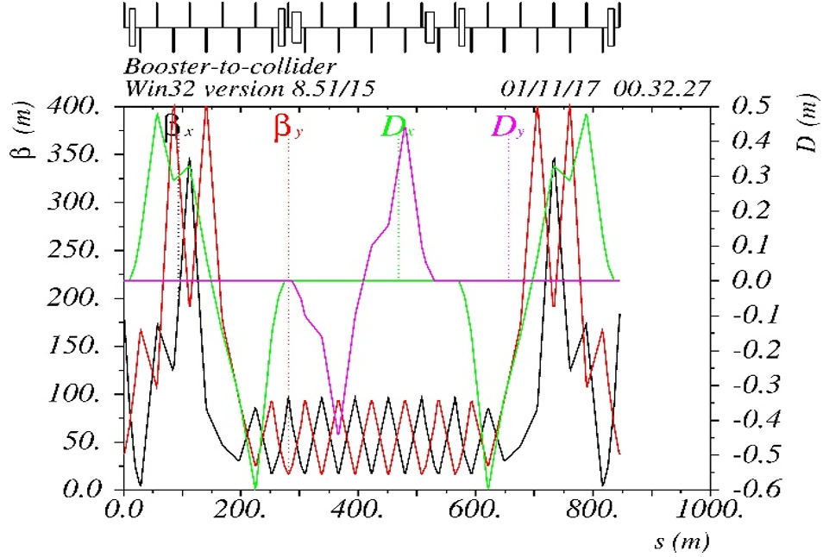
Physics design of CEPC Transport Line 2
~ 850m
1.5m
Transfer efficiency 99%
The total transfer efficiency > 90% (99%*92%*99%)
Satisfy the requirement of topup operation for H, W and Z

Slide 15
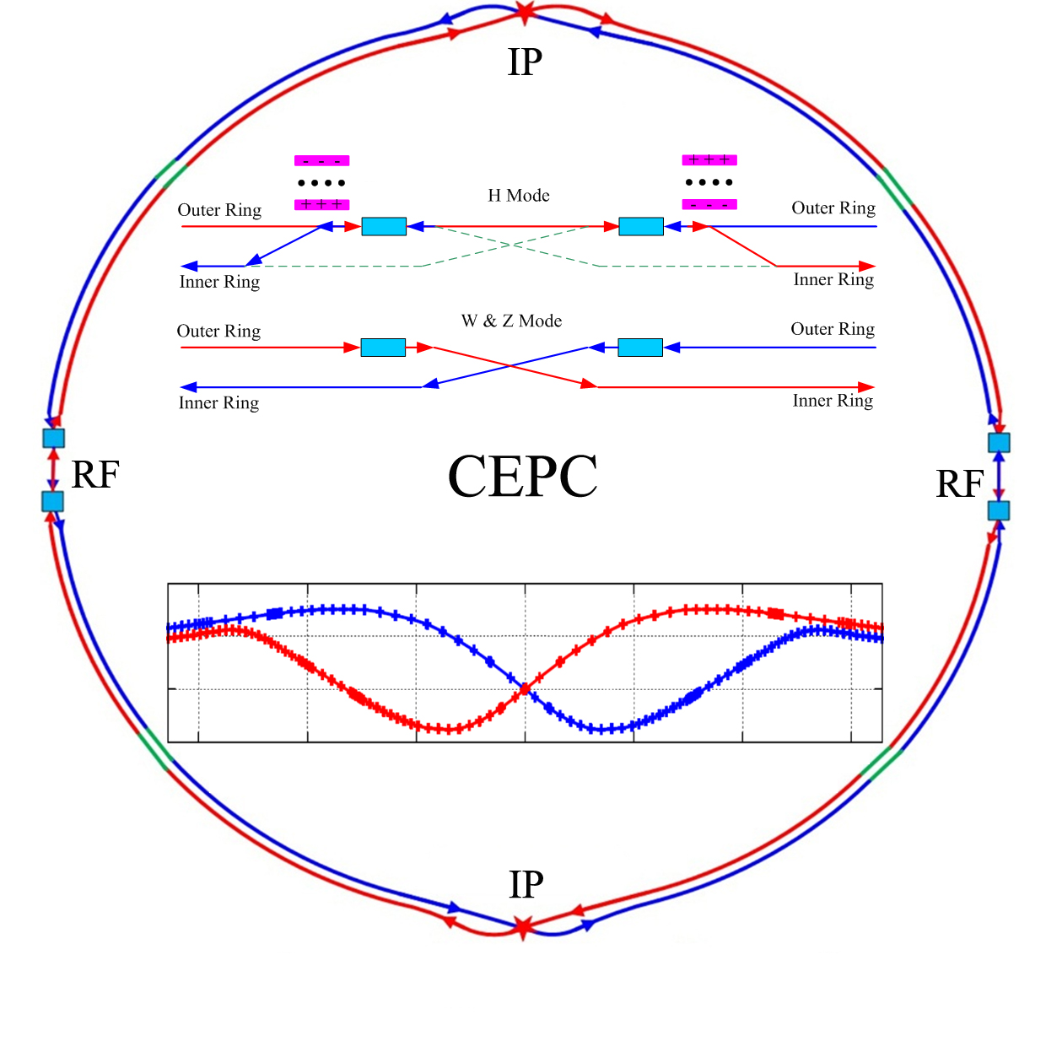
Physics design of CEPC Collider ring
The geometry of CEPC is compatible with the SPPC as much as possible

Slide 16
Parameters of CEPC collider ring
 | Higgs @ 3T | W @ 3T | Z @ 2T
Number of IPs | 2
Energy (GeV) | 120 | 80 | 45.5
Circumference (km) | 100
SR loss/turn (GeV) | 1.73 | 0.34 | 0.036
Half crossing angle (mrad) | 16.5
Piwinski angle | 2.58 | 7.74 | 23.8
N_{e}/bunch (10¹⁰) | 15 | 15 | 8.0
Bunch number (bunch spacing) | 242 (0.68us) | 1220 (0.27us) | 12000 (25ns+10%gap)
Beam current (mA) | 17.4 | 87.9 | 461
SR power /beam (MW) | 30 | 30 | 16.5
Bending radius (km) | 10.6
Momentum compaction (10⁻⁵) | 1.11
β_{IP} x/y (m) | 0.36/0.0015 | 0.36/0.0015 | 0.2/0.001
Emittance x/y (nm) | 1.21/0.0031 | 0.54/0.0016 | 0.17/0.0016
Transverse σ_{IP} (um) | 20.9/0.068 | 13.9/0.049 | 5.9/0.04
ξ_{x}/ξ_{y}/IP | 0.031/0.109 | 0.013/0.12 | 0.0041/0.072
V_{RF} (GV) | 2.17 | 0.47 | 0.1
f _{RF} (MHz) (harmonic) | 650 (216816)
Nature bunch length σ_{z} (mm) | 2.72 | 2.98 | 2.42
Bunch length σ_{z} (mm) | 3.26 | 6.53 | 8.5
HOM power/cavity (kw) | 0.54 (2cell) | 0.87(2cell) | 1.94(2cell)
Energy spread (%) | 0.1 | 0.066 | 0.038
Energy acceptance requirement (%) | 1.35 | 0.4 | 0.23
Energy acceptance by RF (%) | 2.06 | 1.47 | 1.7
Photon number due to beamstrahlung | 0.29 | 0.44 | 0.55
Lifetime _simulation (min) | 100
Lifetime (hour) | 0.67 (40 min) | 2 | 4
F (hour glass) | 0.89 | 0.94 | 0.99
L_{max}/IP (10³⁴cm⁻²s⁻¹) | 2.93 | 11.5 | 32.1
2T→3T
0.2/0.0015
0.17/0.004
5.9/0.078
16.6

Slide 17
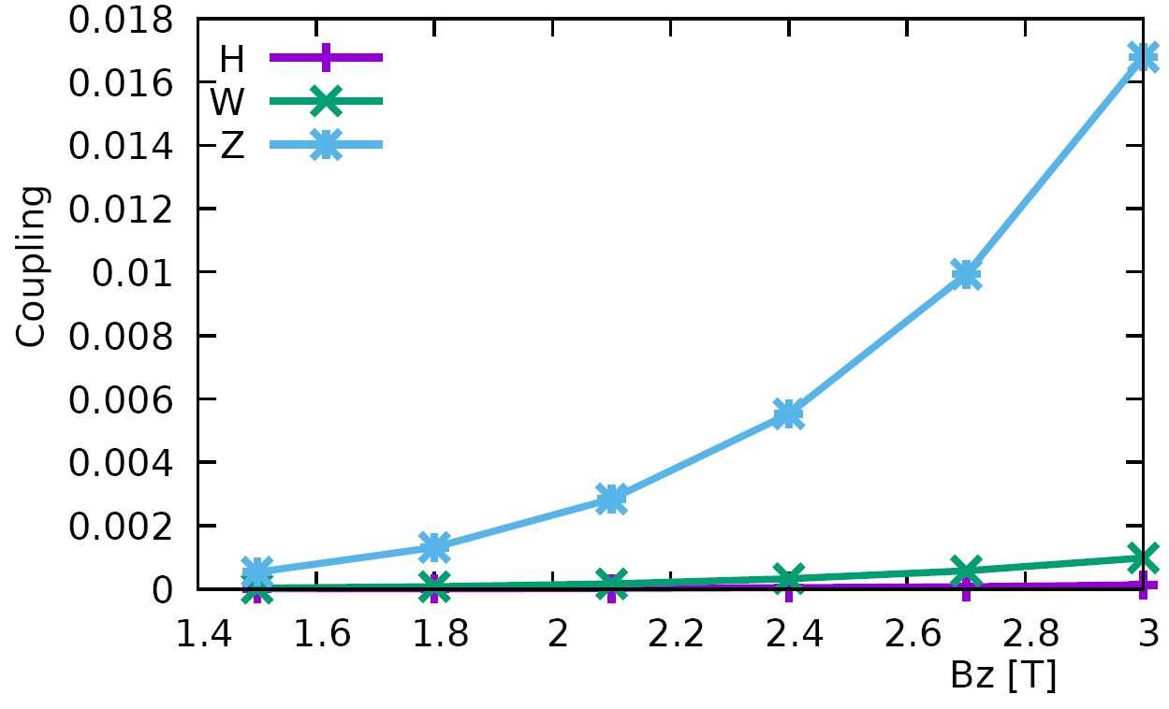
Start from detector solenoid 3.0T
Emittance growth caused by the fringe field of solenoids
Design emitY/emitX expected contribution real contribution
H: 3.6pm/1.21nm (0.3%) 0.36pm 0.14pm (0.01%)
W: 1.6pm/0.54nm (0.3%) 0.16pm 0.47pm (0.09%)
Z: 1.0pm/0.17nm (0.5%) 0.09pm 2.9pm (1.7%)

Slide 18
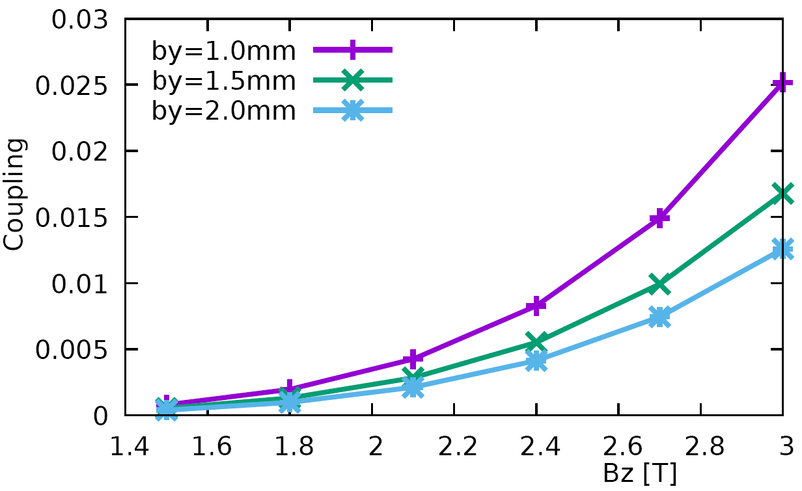
Start from detector solenoid 3.0T
β_{y}* Vs. coupling @ Z
Limitation of the luminosity improvement by reducing the β_{y}*

Slide 19
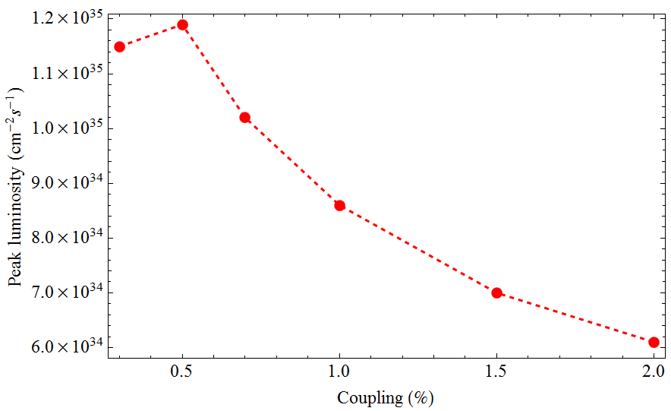
Start from detector solenoid 3.0T
Coupling=1.7% + 0.3~0.5%
Large beam size
&
serious bunch lengthening
Set the detector solenoid at 2T
Higher luminosity & Lower difficulty of SC magnet & More free space nearby IP
Only set the detector solenoid at 2T or < 2T during Z operation
Only higher luminosity @ Z

Slide 20
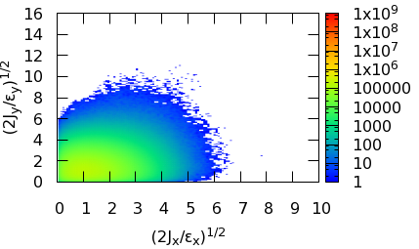
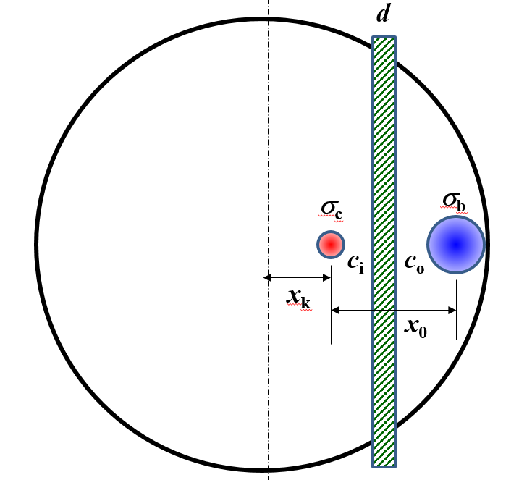
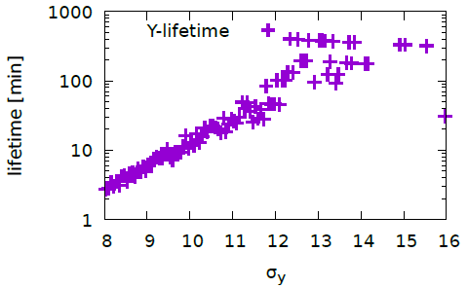
The design of interaction region
The definition of beam stay clear
To satisfy the requirement of injection: BSC > 13 σ_{x}
To satisfy the requirement of beam lifetime after collision BSC > 12σ_{y}
BSC_x =±(18σ_{x} +3mm), BSC_y =±(22σ_{y} +3mm), While coupling=1%
Beam tail distribution
with full crab-waist
BSC>13 σ_{x}
BSC>12 σ_{y}

Slide 21
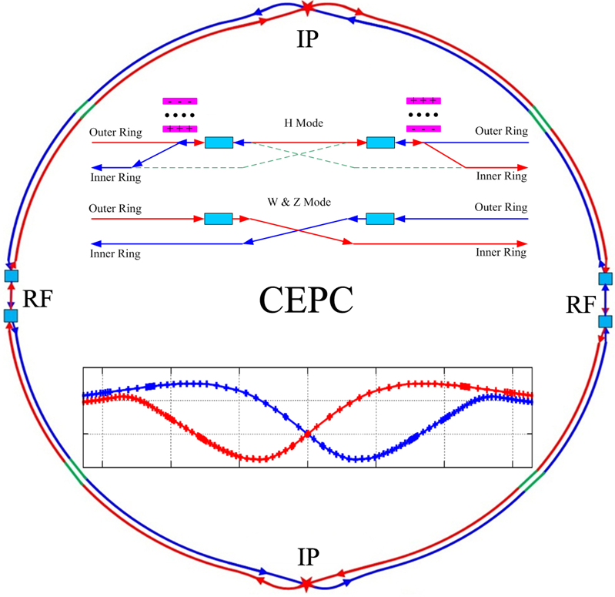
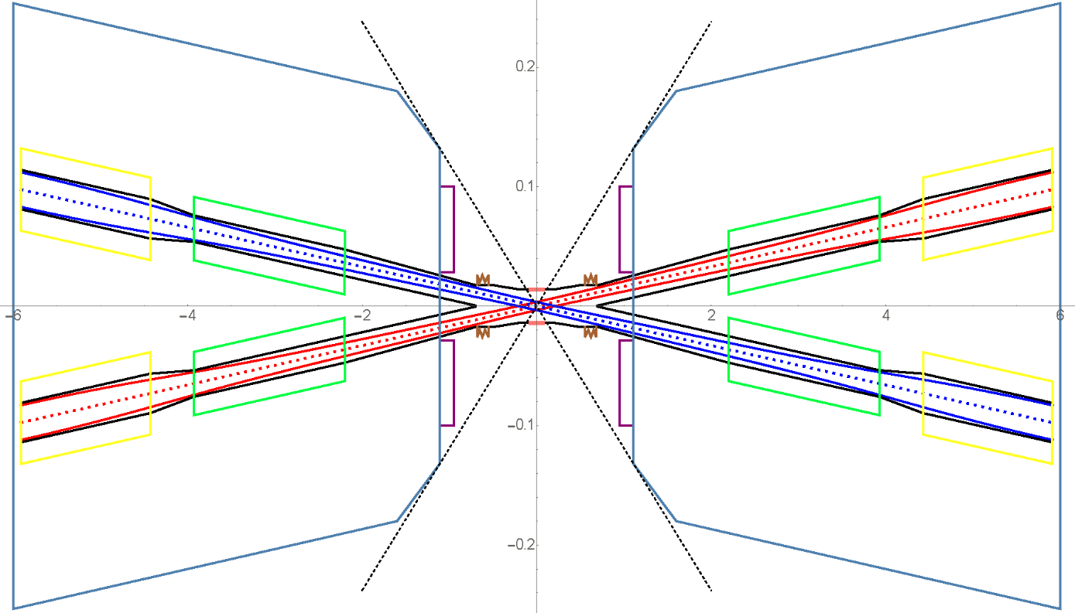
The design of interaction region
✓ L*=2.2m, θc=33mrad, βx*=0.36m, βy*=1.5mm, Detector solenoid=3.0T
  Lower strength requirements of anti-solenoids (~7.2T)
  Enough space for the SC quadrupole coils in two-in-one type (Peak field 3.8T & 136T/m) with room temperature vacuum chamber.
  The control of SR power from the superconducting quadrupoles.

Slide 22
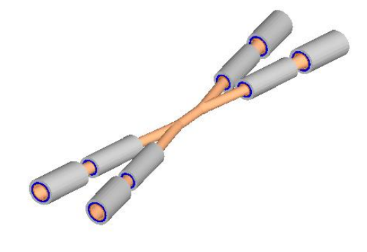
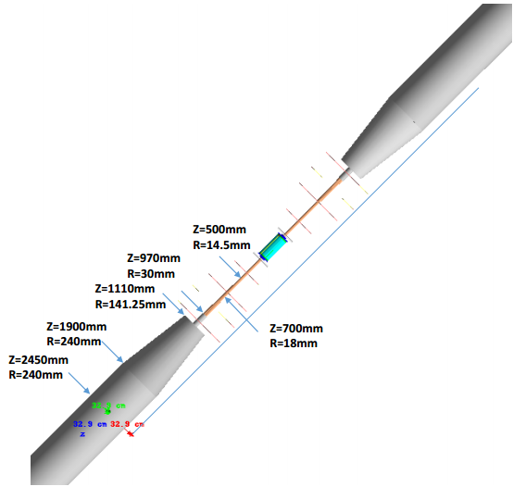
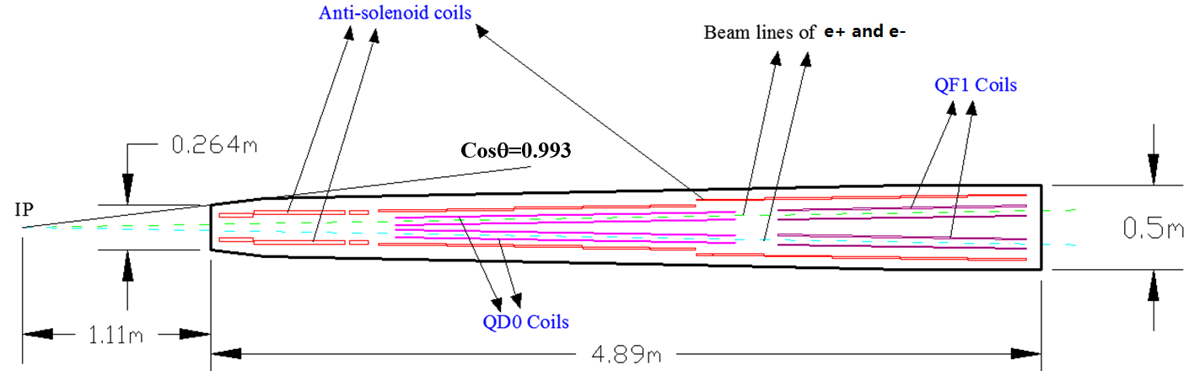
The design of interaction region
The inner diameter of the beryllium pipe is 28mm with the length of ±7cm.
Without tungsten shield.

Slide 23
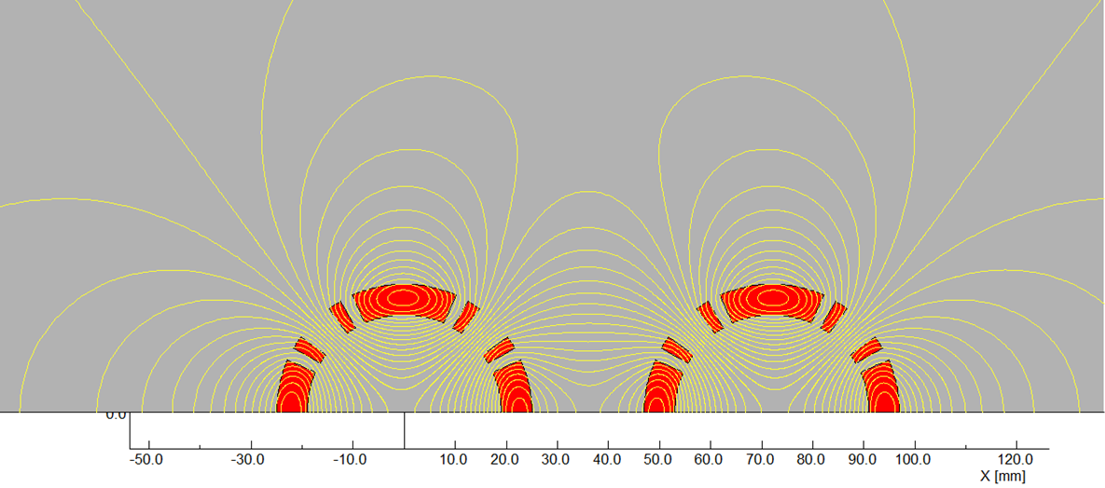
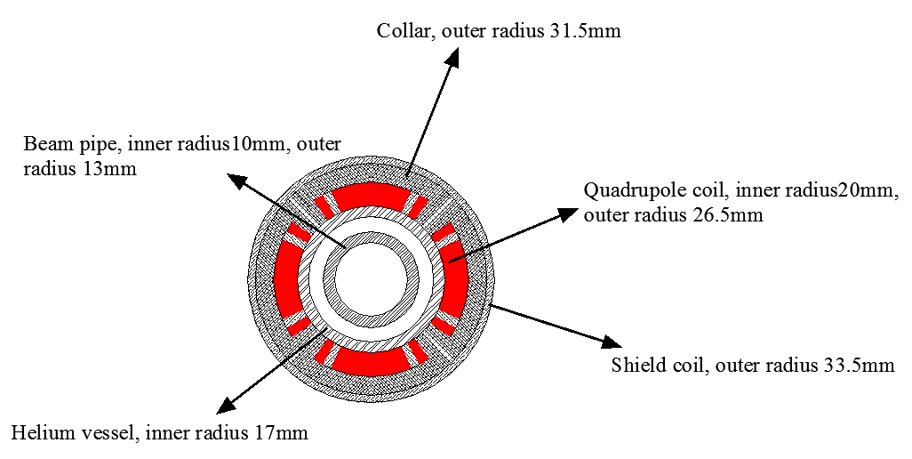
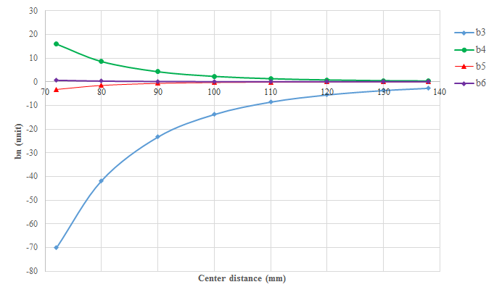
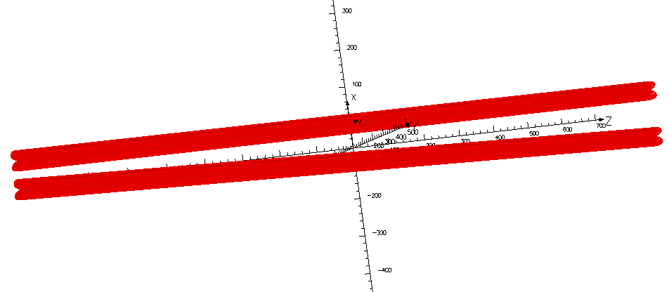
The design of interaction region
Superconducting QD coils
Rutherford NbTi-Cu Cable
Field cross talk of two coils
Single aperture of QD0
(Peak field 3.2T)
Room-temperature vacuum chamber with a clearance gap of 4 mm
*10⁻⁴
Magnet | Central field gradient (T/m) | Magnetic length (m) | Width of Beam stay clear (mm) | Min. distance between beams centre (mm)
QD0 | 136 | 2.0 | 19.51 | 72.61

Slide 24
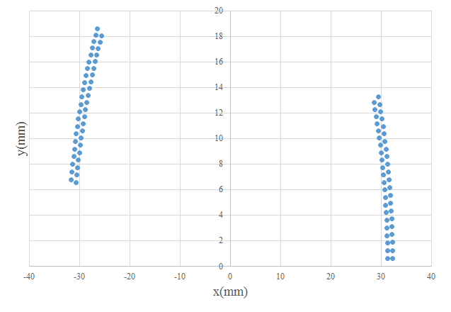
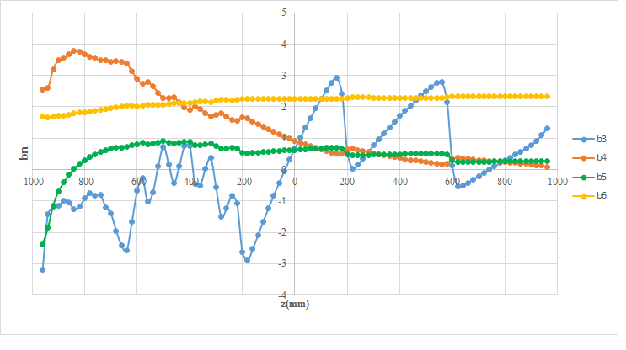
The design of interaction region
Superconducting QD coils
Two layers of shield coil are introduced outside the QD coil to improve the field quality.
The conductor for the shield coil is round NbTi wire with diameter of 0.5mm. There are 44 turns in each pole with different length to optimize the field harmonics along the QD coil.
*10⁻⁴
Integral field harmonics with shield coils（×10⁻⁴）
n | B_{n}/B₂@R=9.8 mm
2 | 10000
3 | -0.57419
4 | 1.525573
5 | 0.375555
6 | -0.13735
7 | 0.015413
8 | -0.03117
9 | -1.70E-03
10 | -0.05809

Slide 25
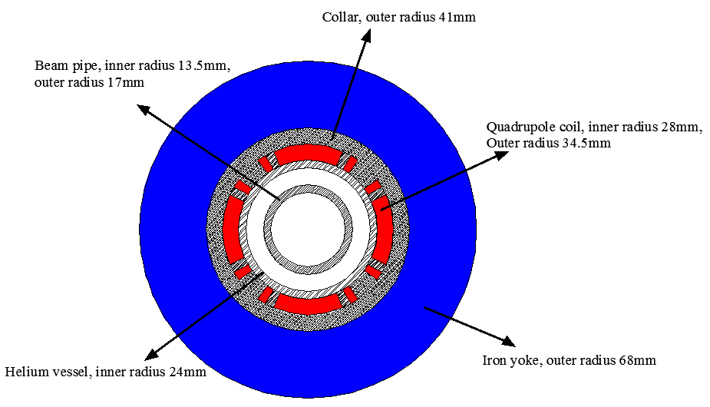
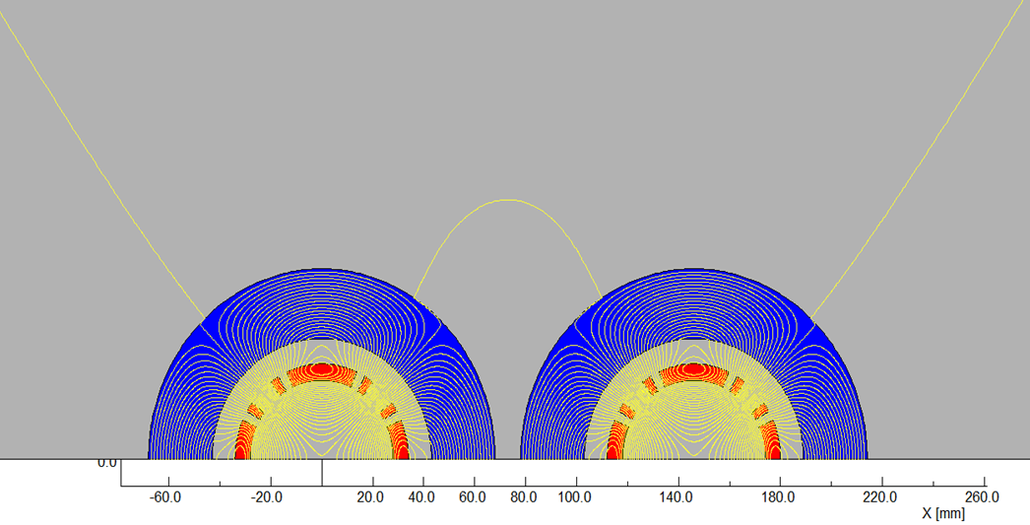
The design of interaction region
Superconducting QD coils
There is iron yoke around the quadrupole coil for QF1. Since the distance between the two apertures is larger enough and the usage of iron yoke, the field cross talk between two apertures of QF1 can be eliminated.
One of QF1 aperture
(Peak field 3.8T)
Rutherford NbTi-Cu Cable
Room-temperature vacuum chamber with a clearance gap of 7 mm
Integral field harmonics with shield coils（×10⁻⁴）
n | B_{n}/B₂@R=13.5mm
2 | 10000
6 | 1.08
10 | -0.34
14 | 0.002
Magnet | Central field gradient (T/m) | Magnetic length (m) | Width of Beam stay clear (mm) | Min. distance between beams centre (mm)
QF1 | 110 | 1.48 | 27.0 | 146.20

Slide 26
The design of interaction region
Magnet name | QD0
Field gradient (T/m) | 136
Magnetic length (m) | 2.0
Coil turns per pole | 21
Excitation current (A） | 2400
Shield coil turns per pole | 44
Shield coil current (A） | 126
Coil layers | 2
Conductor size (mm) | Rutherford NbTi-Cu Cable, width 3 mm, mid thickness 0.95 mm, keystone angle 1.6 deg
Stored energy (KJ) | 19.0
Inductance (H） | 0.007
Peak field in coil (T) | 3.2
Coil inner diameter (mm) | 40
Coil outer diameter (mm) | 53
X direction Lorentz force/octant (kN) | 54
Y direction Lorentz force/octant (kN) | -112
Magnet name | QF1
Field gradient (T/m) | 110
Magnetic length (m) | 1.48
Coil turns per pole | 29
Excitation current (A） | 2250
Coil layers | 2
Conductor size (mm) | Rutherford NbTi-Cu Cable, width 3 mm, mid thickness 0.95 mm, keystone angle 1.6 deg
Stored energy (KJ) | 30.5
Inductance (H） | 0.012
Peak field in coil (T) | 3.8
Coil inner diameter (mm) | 56
Coil outer diameter (mm) | 69
X direction Lorentz force/octant (kN) | 110
Y direction Lorentz force/octant (kN) | -120
Specification of QD0 and QF1

Slide 27
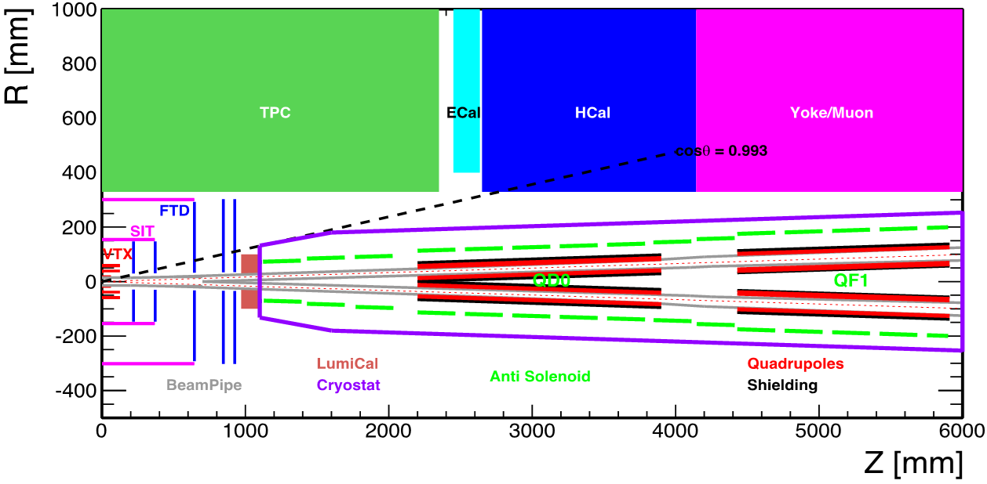
The design of interaction region
3T & 7.6m
Specification of Anti-Solenoid
Anti-solenoid | Before QD0 |  | Within QD0 |  | After QD0
Central field（T） | 7.2 |  | 2.8 |  | 1.8
Magnetic length（m） | 1.1 |  | 2.0 |  | 1.98
Conductor (NbTi-Cu, mm) | 2.5×1.5
Coil layers | 16 | 8 |  | 4/2
Excitation current（kA） | 1.0
Inductance（H） | 1.2
Peak field in coil (T) | 7.7 | 3.0 |  | 1.9
Number of sections | 4 | 11 |  | 7
Solenoid coil inner diameter (mm) | 120
Solenoid coil outer diameter (mm) | 390
Total Lorentz force F_{z} (kN) | -75 | -13 |  | 88
Cryostat diameter (mm) | 500
22 anti-Solenoid sections with different inner coil diameters
∫B_{z}ds within 0~2.12m. Bz < 300Gauss away from 2.12m with local cancellation structure
The skew quadrupole coils are designed to make fine tuning of Bz over the QF&QD region instead of the mechanical rotation.

Slide 28
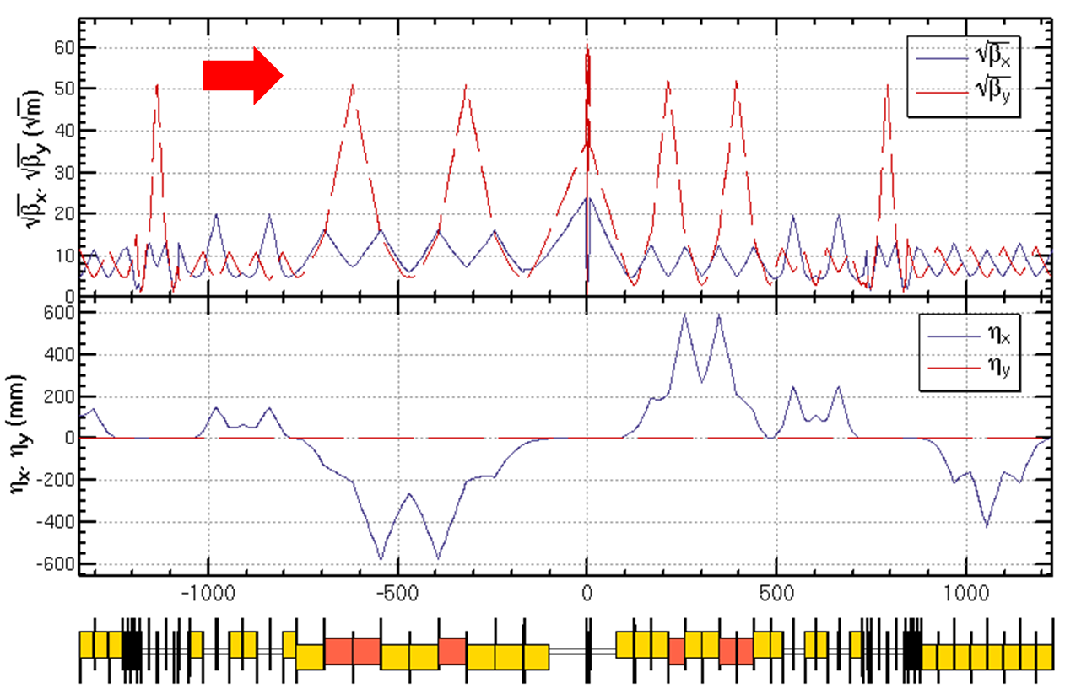
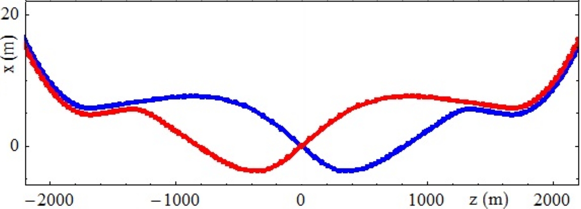
The design of interaction region
Geometry and Lattice
Crab-waist scheme with local chromaticity correction

Slide 29
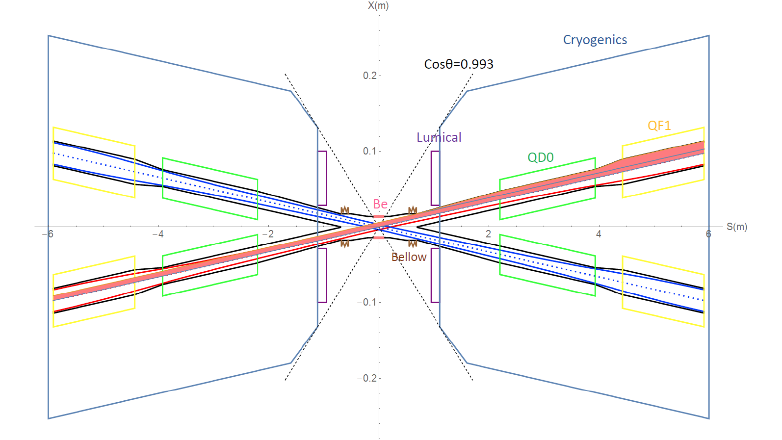
The design of interaction region
The central part is Be pipe with the length of 14cm and inner diameter of 28mm.
IP upstream: Ec < 120 keV within 400m. Last bend(66m)Ec = 45 keV
IP downstream: Ec < 300 keV within 250m, first bend Ec = 97 keV
Reverse bending direction of last bends
Background control & SR protection

Slide 30
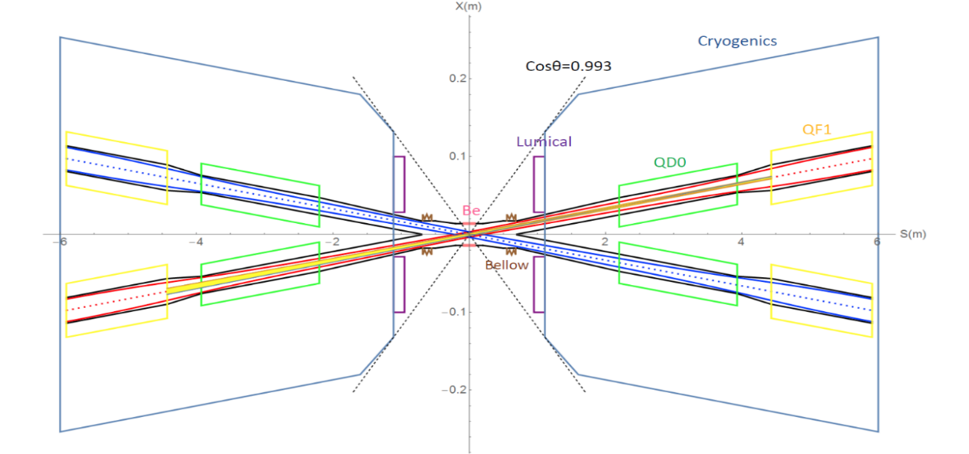
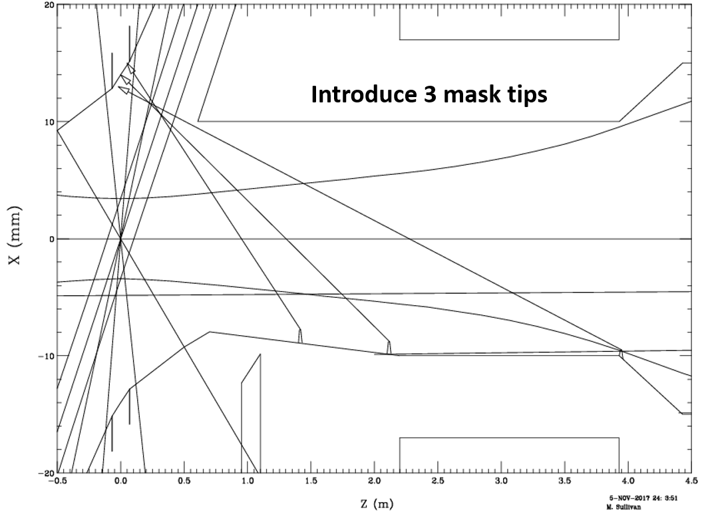
The design of interaction region
The total SR power generated by the QD magnet is 639W in horizontal and 166W in vertical. The critical energy of photons are about 1.3 MeV and 397keV in horizontal and vertical.
The total SR power generated by the QF1 magnet is 1567W in horizontal and 42W in vertical. The critical energies of photons are about 1.6MeV and 225keV in horizontal and vertical.
No SR hits directly on the beryllium pipe. SR power contributed within ±6σ_{x} will go through the IP.
3 mask tips are added to shadow the beam pipe wall from 0.7 m to 3.93 m reduces the number of photons that hit the Be beam pipe from 2×10⁴ to about 200 (100 times lower).

Slide 31

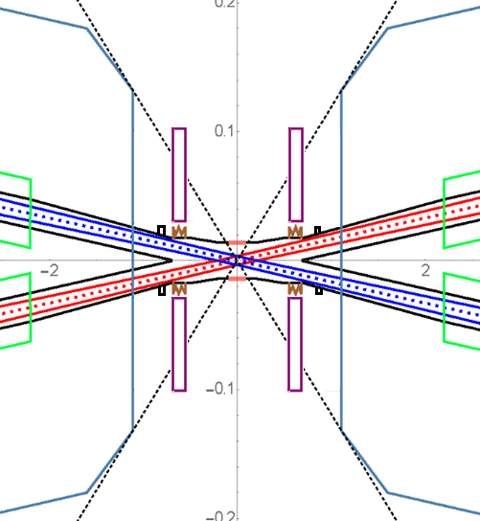
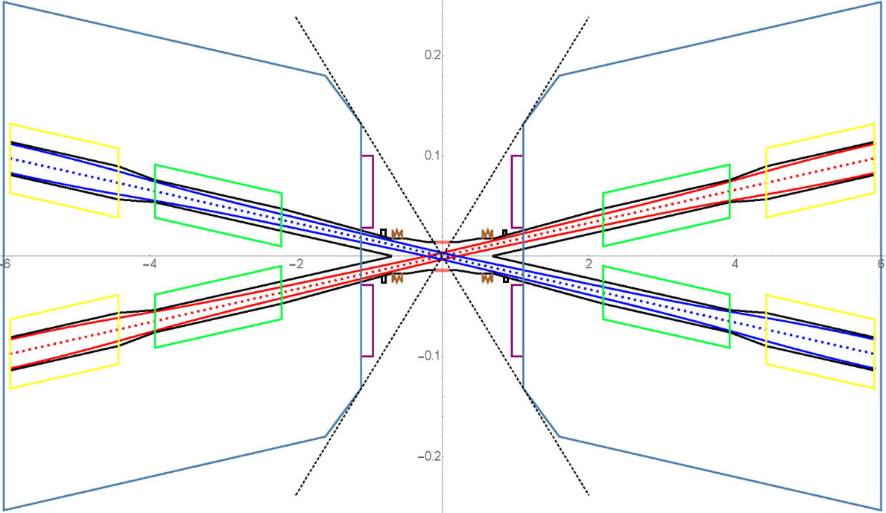
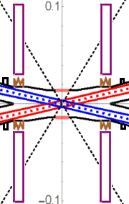
Assembly nearby the IP
1, IP Chamber
(supporting)
3, SC Magnet and Vacuum chamber (remotely)
4, Move Lumical back and attach to the cover of cryostat by alignment holes (remotely)
2, Bellows and Lumical (remotely)
(supporting system)

Slide 32
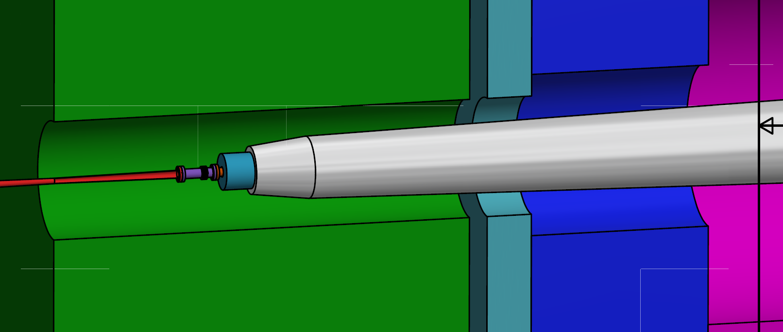

Slide 33
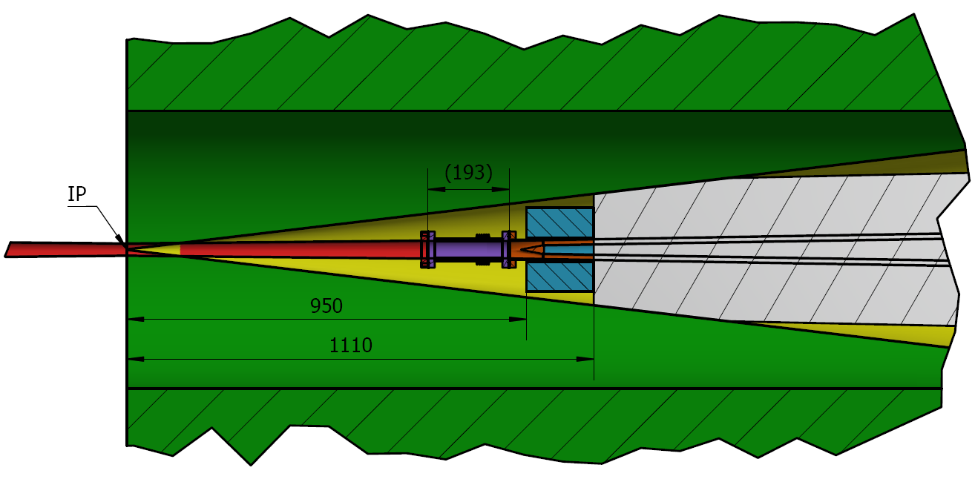

Slide 34
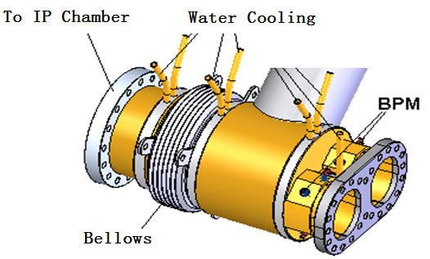
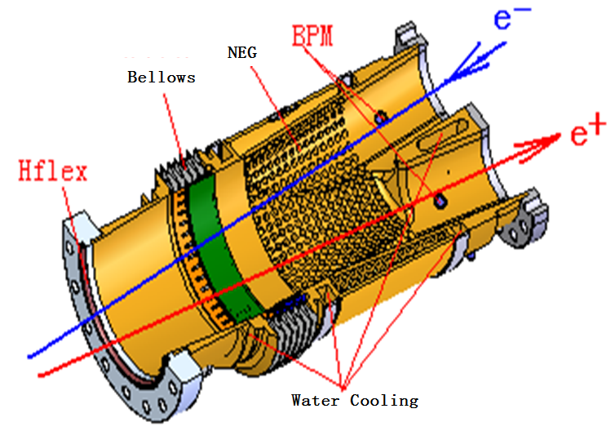
Assembly nearby the IP
Crotch region
Helicoflex

Slide 35





Physics design of CEPC Collider ring
The ARC region
  Distance of two ring is 0.35m to adopt twin-aperture Q & B magnets.
  FODO cell, 90°/90°, non-interleaved sextupole scheme

Slide 36

Physics design of CEPC Collider ring
The RF region
  Common cavities for Higgs mode, bunches filled in half ring for e+ and e-.
  Independent cavities for W & Z mode, bunches filled in full ring.
  The outer diameter of RF cavity is 1.5m. Distance of two ring is 1.0m.
Z mode:
Bunch spacing > 25ns

Slide 37

Physics design of CEPC Collider ring
The RF region
  Low beta functions in the RF region to reduce the instabilities caused by RF cavities. For Z mode, due to the limitation of HOM 466mA can be chosen before the installation of the dedicated RF cavity.
~2.0km
RF cavities RF cavities
Esep=1.8 MV/m , Lsep=50m

Slide 38

Physics design of CEPC Collider ring
The injection region
  Independent magnets for two rings
  0.3m of longitudinal distance between two quadrupoles of two rings.
Phase tuning
Injection
Phase tuning
βx=600 m at injection point，Injection section 66.7 m

Slide 39

Physics design of CEPC Collider ring
The injection
For Higgs:
ε_x = 1.21 nm.rad; ε_inject = 3.58 nm.rad
σx = 0.85 mm, σ_inject = 0.94 mm
Septum = 2 mm
Acceptance > 13 σ
For Z:
ε_x = 0.17 nm.rad; ε_inject = 0.51 nm.rad
σx = 0.32 mm, σ_inject = 0.357 mm
Septum = 2 mm
Acceptance > 17 σ
Acceptance >4σ_{xc} + 6σ_{xi} + S

Slide 40

Physics design of CEPC Collider ring
The injection
Injected Beam
Circulating Beam
Local bump kickers
Off-axis injection

Slide 41





Code: MODE
Physics design of CEPC Collider ring
Dynamic aperture optimization
Crab waist=100%
SAD is used
200 turns tracked
100 samples
IR sextupoles + 50 arc sextupoles
(Max. free various=254)
Damping at each element
RF ON
Radiation fluctuation ON
Sawtooth on with tapering
The requirements
Minimum DA of 100 samples. 0.26% coupling. 200 turns.
$$13σ_{x}×12σ_{y} \& 0.0135$$
$16σ_{x}×15σ_{y} \& 0.016$@ Higgs without errors
Dynamic Aperture of on-momentum particles

Slide 42




Z mode
Physics design of CEPC Collider ring
Dynamic aperture optimization
Crab waist=100%
SAD is used
3000 turns tracked
IR sextupoles + arc sextupoles
(Max. free various=254)
Damping at each element
RF ON
Radiation fluctuation ON
Sawtooth on with tapering
The requirements
30$σ_{x}×25σ_{y} \& 0.01$@ Z
Minimum DA of 100 samples. 2.4% coupling. 3000 turns.
17$σ_{x}×12σ_{y}$ & 0.0023
All effects (exception: errors and solenoid) is included in the dynamic aperture survey.

Slide 43
Physics design of CEPC Collider ring
Beam performance with errors
Component | Δx (mm) | Δy (mm) | Δθ_{z} (mrad)
Dipole | 0.05 | 0.05 | 0.1
Quadrupole w/o FF | 0.03 | 0.03 | 0.1
Sextupole | 0.03 | 0.03 | 0.1
LOCO based on AT is used to correct COD, beta, dispersion and coupling.
Tracking DA by SAD.
About 1500 BPMs, 1500 horizontal correctors and 1500 vertical correctors are placed in the storage ring. (4 per betatron wave)
Component | Field error
Dipole | 0.01%
Quadrupole (w/o FF) | 0.02%

Slide 44
Physics design of CEPC Collider ring
Beam performance with errors
Residue σ_{COD} ≈ 40 um (x) after orbit correction
Residue σ_{COD} ≈ 75 um (y) after orbit correction
(β_{xy_err}/β_{xy})_{max} =0.01 after optics correction
Coupling=0.08% after coupling correction
1/5 quadrupole (~600 of 3000 quadrupoles) are tuned to restore beta functions. It’s important to modify LOCO script to make the optics correction efficient and more parameters fitting possible.
Skew-Quads are installed in the sextupoles. About 200 Skew-quads(1/5 sextupoles) are used in the coupling correction

Slide 45


Physics design of CEPC Collider ring
The impedance and instabilities
Components | Number | R, kΩ | L, nH | Z||/n, mΩ | k_{loss}, V/pC | ky, kV/pC/m
Resistive wall | - | 15.3 | 866.8 | 16.3 | 432.3 | 23.0
RF cavities | 336 | 11.2 | -72.9 | -1.4 | 315.3 | 0.41
Flanges | 20000 | 0.7 | 145.9 | 2.8 | 19.8 | 2.8
BPMs | 1450 | 0.53 | 6.38 | 0.12 | 13.1 | 0.3
Bellows | 12000 | 2.3 | 115.6 | 2.2 | 65.8 | 2.9
Pumping ports | 5000 | 0.01 | 1.3 | 0.02 | 0.4 | 0.6
IP chambers | 2 | 0.2 | 0.8 | 0.02 | 6.7 | 1.3
Electro-separators | 22 | 1.5 | -9.7 | 0.2 | 41.2 | 0.2
Taper transitions | 164 | 1.1 | 25.5 | 0.8 | 50.9 | 0.5
Total |  | 32.9 | 1079.7 | 20.6 | 945.4 | 32.1
At the design bunch intensity, the bunch length will increase 30% and 40% for H and Z respectively. Bunch spacing >25ns will be needed to eliminate the electron cloud instability.

Slide 46

Physics design of CEPC Collider ring
 | tt @ 3T
Number of IPs | 2
Energy (GeV) | 175
Circumference (km) | 100
SR loss/turn (GeV) | 7.61
Half crossing angle (mrad) | 16.5
Piwinski angle | 0.91
N_{e}/bunch (10¹⁰) | 24.15
Bunch number | 34
Beam current (mA) | 3.95
SR power /beam (MW) | 30
Bending radius (km) | 10.9
Momentum compaction (10⁻⁵) | 1.14
β_{IP} x/y (m) | 1.2/0.0037
Emittance x/y (nm) | 2.24/0.0068
Transverse σ_{IP} (um) | 51.8/0.16
ξ_{x}/ξ_{y}/IP | 0.077/0.105
V_{RF} (GV) | 8.93
f _{RF} (MHz) (harmonic) | 650 (217500)
Nature bunch length σ_{z} (mm) | 2.54
Bunch length σ_{z} (mm) | 2.87
HOM power/cavity (kw) | 0.53 (5cell)
Energy spread (%) | 0.14
Energy acceptance requirement (%) | 1.57
Energy acceptance by RF (%) | 2.67
Photon number due to beamstrahlung | 0.19
Lifetime due to beamstrahlung (hour) | 1.0
Lifetime (hour)
F (hour glass) | 0.89
L_{max}/IP (10³⁴cm⁻²s⁻¹) | 0.38
@ 175GeV
@ 50MW
1$8σ_{x}×30σ_{y} \& 0.024$ @ tt
Without changing the specification of hardware
QF1→ QD1
Large β*
Relatively lower luminosity
Ability of PS, KLY and magnets
Enough length of RF region
Ability of booster design

Slide 47
Summary
Detector solenoid 3.0T is a relatively hard start point for the accelerator design. The finalization of the beam parameters and the specification of special magnets have been finished. The hardware devices are all reasonable.
DA @ Higgs is the bottleneck of the design especially with errors.
  A preliminary procedure for the IP elements installation was studied. The boundary between detector and accelerator is still not clear.
  The design of a backup injection chain to avoid low field issues has already been finished with slight higher budget.
  4GeV&100Hz→Booster1 to 36GeV →Booster2 to 120GeV→Collider Ring

