Slide 1
RF issues for Z
Jiyuan Zhai
CEPC CDR Internal Review
Feb 10, 2018, IHEP

Slide 2
Outline
CEPC RF design requirement
RF parameters and challenges of Z
Beam cavity interaction issues
Conclusions

Slide 3
CEPC RF Design Requirement
New CDR goals and RF related parameter changes from CDR mini review:
H: L = 3E34 cm⁻²s⁻¹ → No RF related change
W: L (x 1.7) = 12E34 cm⁻²s⁻¹ → 2.8 x bunch charge, same beam current, longer bunch length, higher HOM power
Z: L (x 8) = 32E34 cm⁻²s⁻¹ → 2 x bunch charge, 1.4 x bunch number, 2.8 x beam current, longer bunch length, higher RF voltage
Potential for operating at ttbar → longer RF and klystron tunnel, Higgs RF configuration and cavity suitable for ttbar
High priority Higgs long run first (avoid new RF hardware for HL-Z):
Install all Higgs cavities in one time
Use part of the Higgs cavities for W and Z (but separate for two rings to reduce current)
Park the idle cavities rather than push them off beamline (turn-key switch)

Slide 4
CEPC Collider Ring SRF Parameters
Collider parameters: 20180109 & 20180207 | H | W | W-new | Z | Z-new
SR power / beam [MW] | 30 | 30 | 30 | 5.7 | 16.6
RF voltage [GV] | 2.17 | 0.47 | 0.47 | 0.054 | 0.1
Beam current / beam [mA] | 17.4 | 87.7 | 87.7 | 160 | 460
Bunch charge [nC] | 24 | 8.6 | 24 | 6.4 | 12.8
Bunch number / beam | 242 | 3390 | 1220 | 8332 | 12000
Bunch length [mm] | 3.26 | 3.43 | 6.53 | 6 | 8.5
Cavity number (650 MHz 2-cell) | 336 | 2 x 108 | 2 x 108 | 2 x 24 | 2 x 60
Idle cavities on line / ring | 0 | 60 | 60 | 144 | 108
Cavity gradient [MV/m] | 14 | 9.5 | 9.5 | 4.9 | 3.6
Input power / cavity [kW] | 179 | 278 | 278 | 239 | 276
Klystron power [kW] (2 cavities / klystron) | 800 | 800 | 800 | 800 | 800
HOM power / cavity [kW] | 0.57 | 0.5 | 0.86 | 0.45 | 1.94
Optimal Q_{L} | 1E6 | 3.2E5 | 3.2E5 | 1E5 | 4.7E4
Optimal detuning [kHz] | 0.22 | 1.0 | 1.0 | 3.7 | 17.8
Max relative voltage drop for 1 us gap |  |  |  | 4.2 % | 12 %
Max bunch train phase shift for 1 us gap |  |  |  | 2.6 | 7.4
Optimized for the Higgs mode of 30 MW SR power per beam, with enough operating margin and flexibility.
FM and HOM impedance and power, heat load
Gradient (stored energy) as high as possible
Input coupler power limit 300 kW (high risk)
Keep power level and RF distribution
HOM power per cavity limit 2 kW
Input coupler variable range: 5E4-5E6 (H/tt)
Revolution frequency: 3 kHz (FM CBI)
Longitudinal dynamics, LLRF control
Longitudinal dynamics, LLRF control

Slide 5
RF Challenges for CEPC HL-Z
Large ring, low energy, high current, high charge, low voltage → prefer low impedance and high stored energy (small beam loading): smallest number of single cell cavities in separate cryomodule with large input coupler and RT HOM damper power, BEPCII type. But CEPC will use Higgs cavities for HL-Z, thus several beam-cavity interaction problems will happen and have severe effects:
HOM CBI
HOM power
Fundamental mode CBI
Parking cavity
Beam gap transient

Slide 6
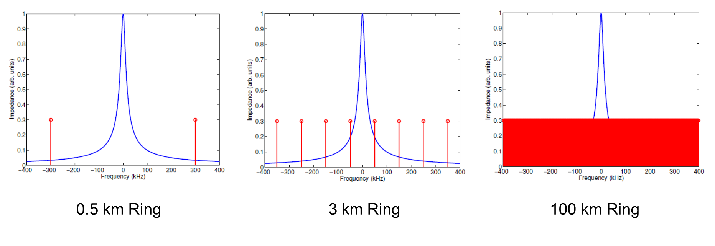
Large Ring Issues
Impossible to avoid beam spectrum and HOM impedance line up because of dense spectrum
Detuning easily exceeds revolution frequency, causing fundamental mode CBI

Slide 7
HOM Damping Requirement for HL-Z
Monopole mode | f (MHz) | R/Q (Ω) | Q_{e} (with feedback) | Q_{e} (without feedback)
TM011 | 1165.574 | 65.2 | 6.56×10³ | 1.19×10²
TM020 | 1383.898 | 1.29 | 2.79×10⁵ | 5.07×10³
TM021 | 1717.475 | 19.88 | 1.46×10⁴ | 2.65×10²
TM012 | 1832.801 | 17.26 | 1.58×10⁴ | 2.86×10²
Dipole mode | f (MHz) | R/Q (Ω/m) | Q_{e} (with feedback) | Q_{e} (without feedback)
TE111 | 844.738 | 279.82 | 2.84×10⁴ | 1.11×10²
TM110 | 907.592 | 420.05 | 1.89×10⁴ | 7.39×10¹
TE121 | 1475.553 | 125.79 | 6.31×10⁴ | 2.47×10²
TM120 | 1662.599 | 18.80 | 4.22×10⁵ | 1.65×10³
Z: 168 2-cell cavity
Average beta_x,y in RF cavity ~ 30 m
No frequency spread included
Shortest longitudinal feedback time: 11.9 ms (synchrotron oscillation period)
Feedback time for transverse mode: 3.3 ms (10 turns), could be shorter.
Cut off frequency: 1471MHz
Cut off frequency:1126 MHz

Slide 8
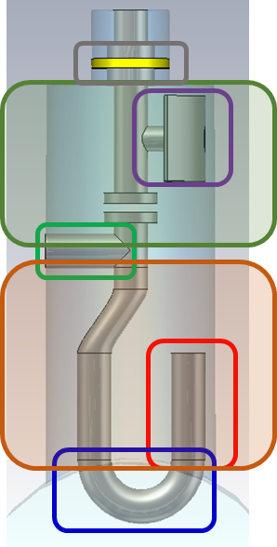
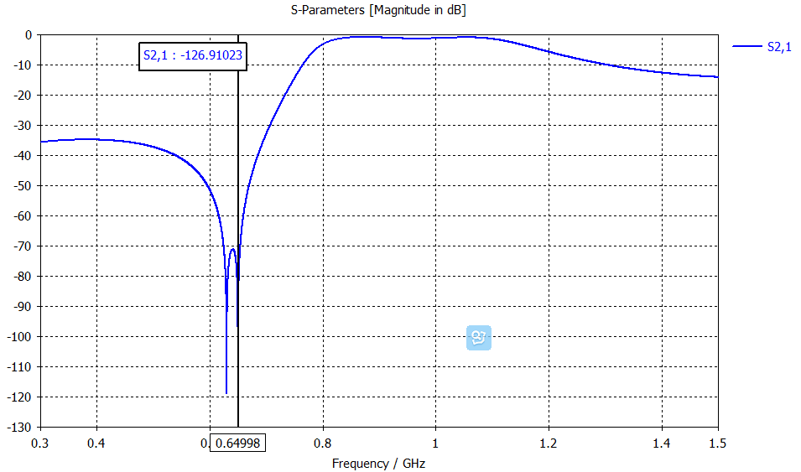
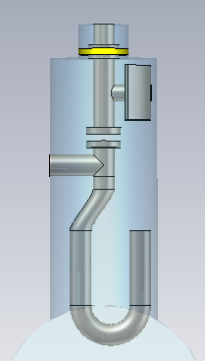
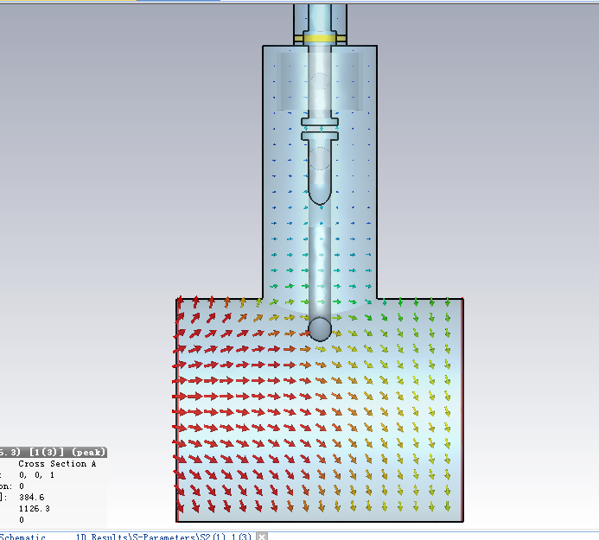
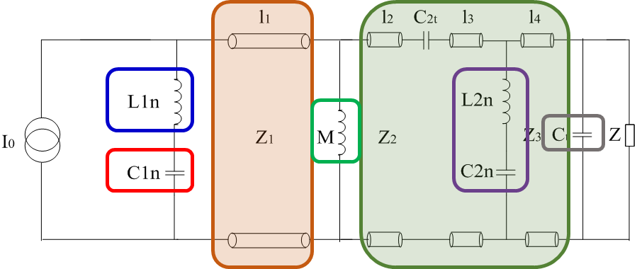
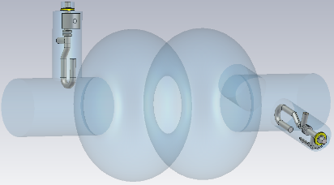
HOM Coupler Damping
equivalent circuit (transmission line model) → optimize each part according to S21 curve
→ change to 3D model → electromagnetic optimization
Port2
Port1
Port3
Modes | f (GHz) | R/Q (monopole Ω, dipole Ω/m) | Q_{e} simulation
TM011 | 1165.574 | 65.2 | 2.46E+05
TM020 | 1383.898 | 1.3 | 1.55E+05
TE111 | 844.738 | 279.8 | 1.50E+04
TM110 | 907.592 | 420.1 | 4.58E+02
Use 5E4 as further optimization goal and impedance calculation

Slide 9
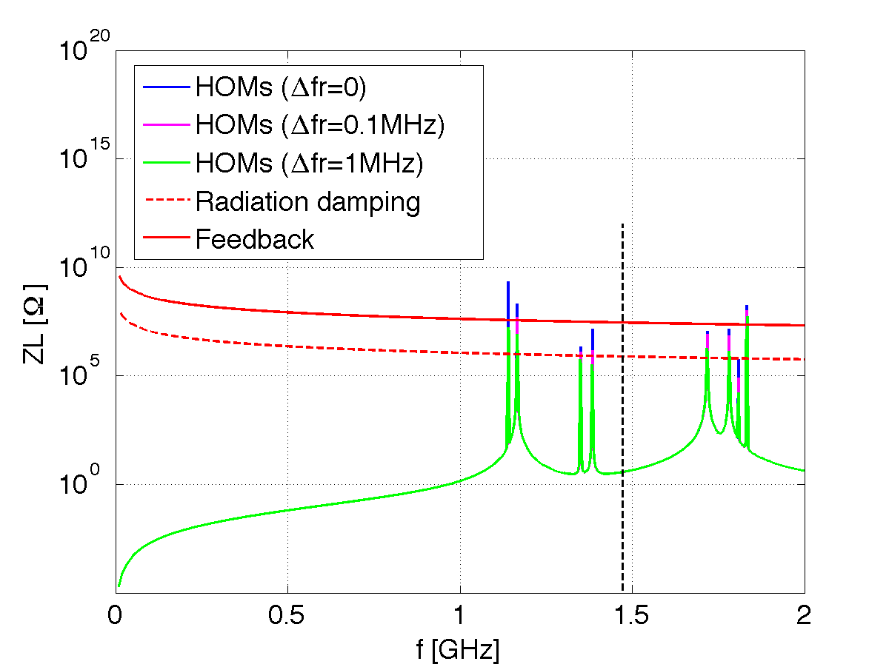
HOM Impedance (Wang Na)
Optimize HOM coupler geometry
Larger beam pipe
Two more HOM couplers dedicated for monopole modes damping (as LHC)
Increase TM011 field in one side and reduce Qext by asymmetric end cells
Push idle cavities off-line.
Monopole modes impedance (idle cavities online)

Slide 10
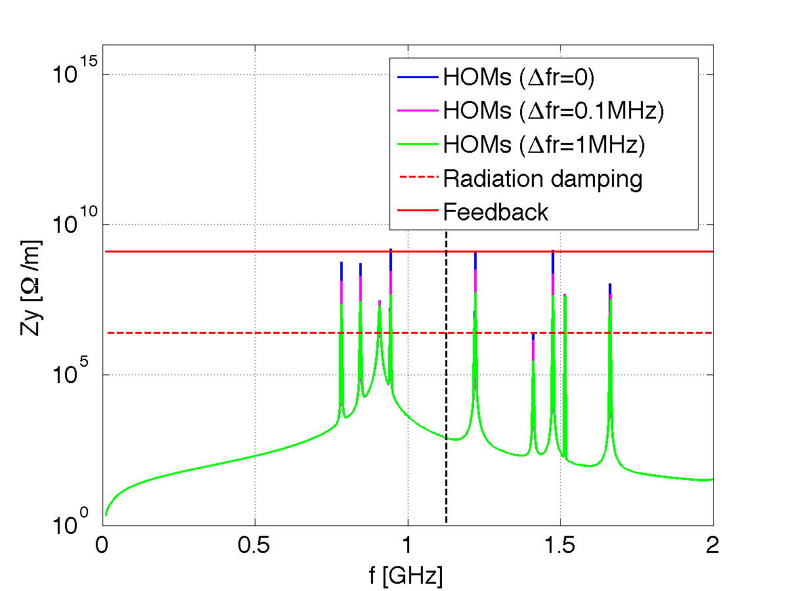
HOM Impedances (Wang Na)
Dipole modes impedance (idle cavities in beamline)

Slide 11
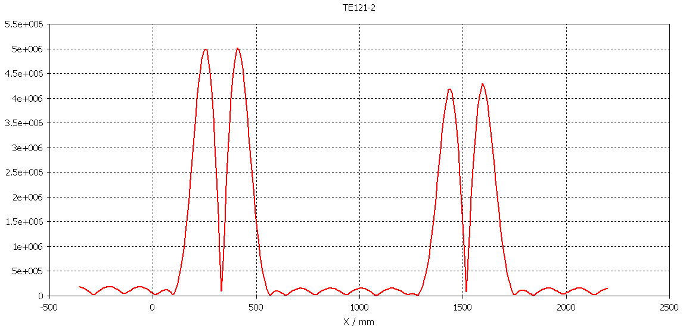
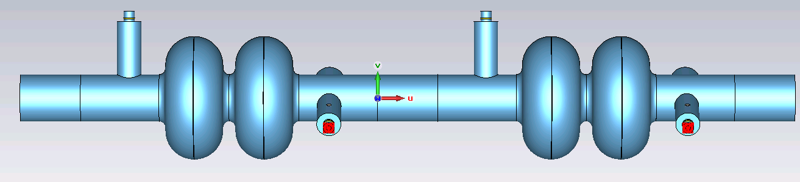
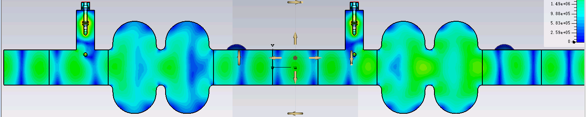
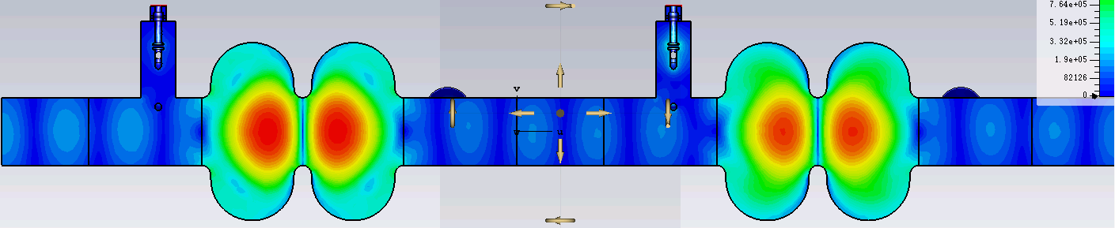
TE121
f (MHz) | R/Q (Ω/m) | Qe (4 ports) | Qe (6 ports)
1476.923 | 126 | 5441 | 19
1514.663 | 13 | 3.75e+6 | 2E+4
1
3
EB
4
EB
2
3
1
5
4
6
2
f=1476.923MHz
For TE121-2 mode, only a small amount of HOM power come out from HOM coupler.
A large amount of stored energy concentrate in the middle cell. The field values in the beam pipe is low. Even so it can meet the CBI requirement.
f=1514.663MHz

Slide 12
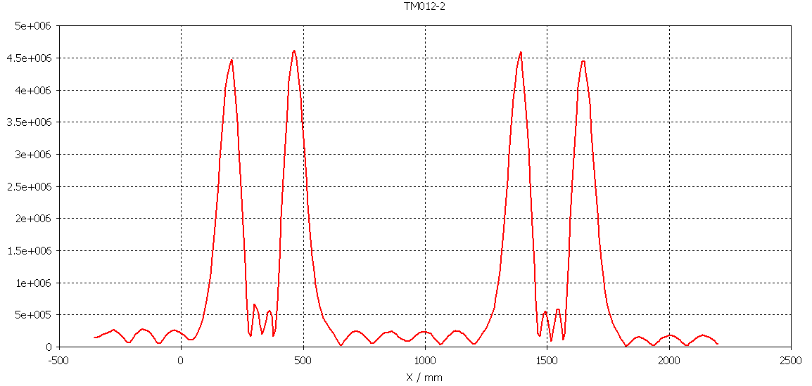
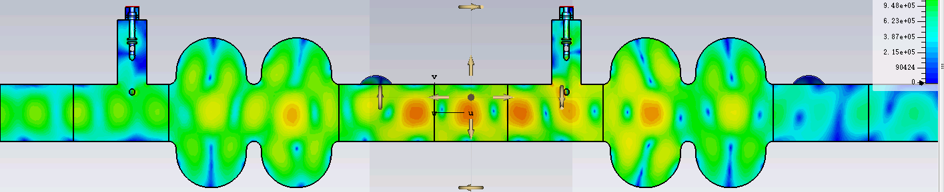
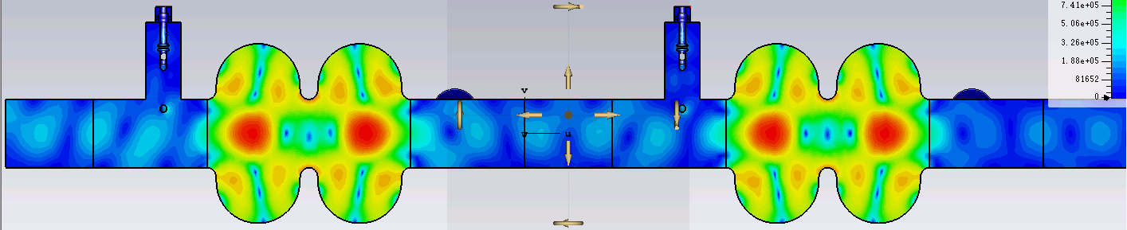
TM012
f (MHz) | R/Q (Ω) | Qe (4 ports) | Qe (6 ports)
1814.447 | 0.07 | 3.07e+4 | 1095
1832.825 | 17 | 2.14e+7 | 2.8E+4
f=1814.447 MHz
f=1832.825 MHz
For TM012-2 mode, a large amount of stored energy concentrate in the middle cells.
Both end cells are distorted by the presence of the beam pipe on either end of the cavity.
Tuning the end cells for the "trapped modes" is one way to improve the field profile.
Compared with the symmetric end cell design, an asymmetric end cell design is better.
Modify the curve from equator to iris, the iris ellipsis to untrap the TE121 and TM012 mode, but still have the TM010 flat.
Even so it can meet the CBI requirement.

Slide 13
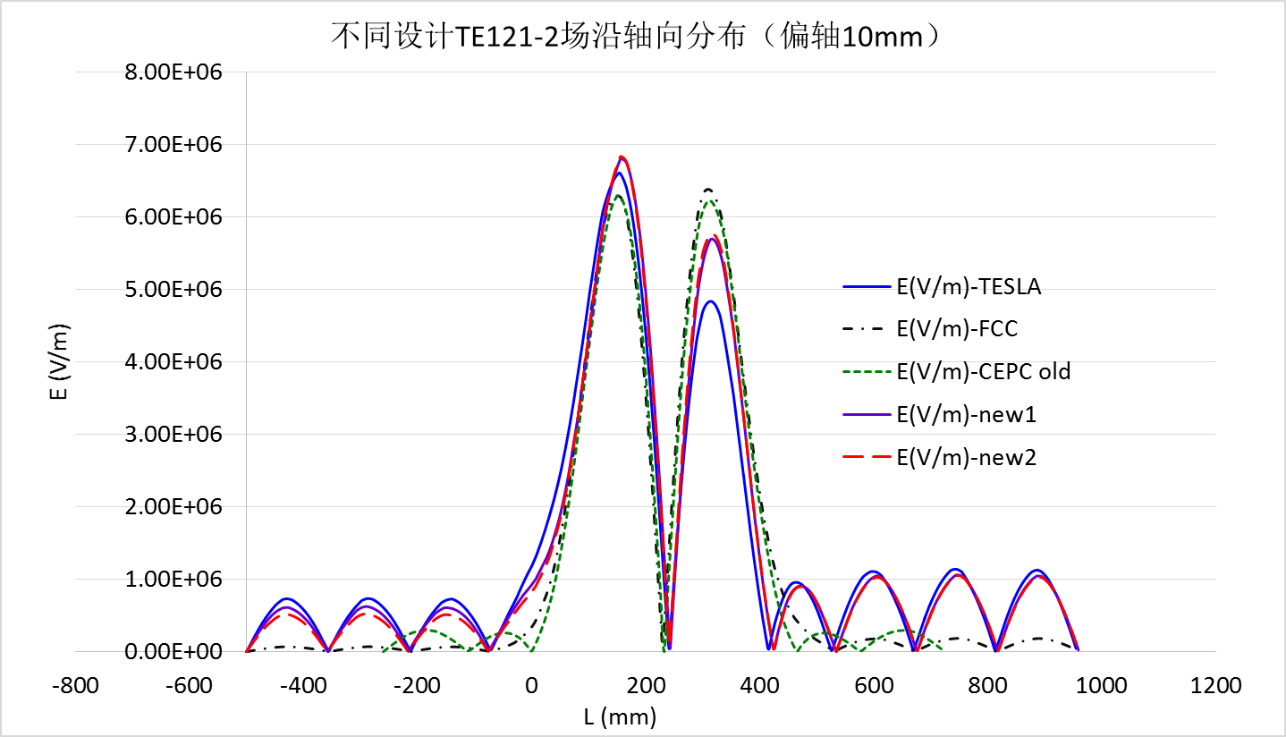
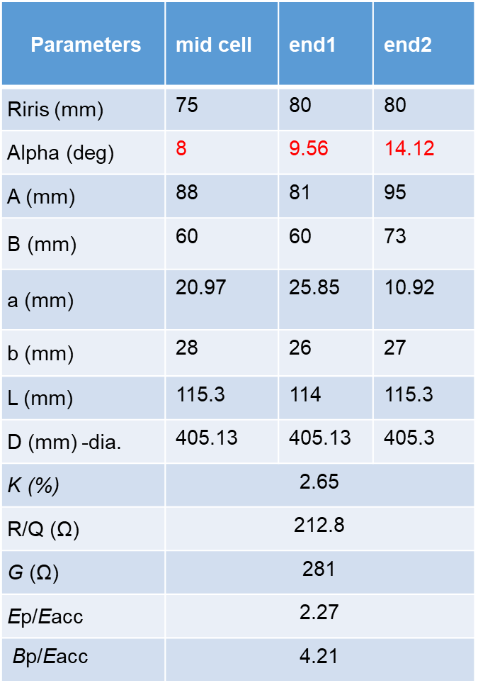
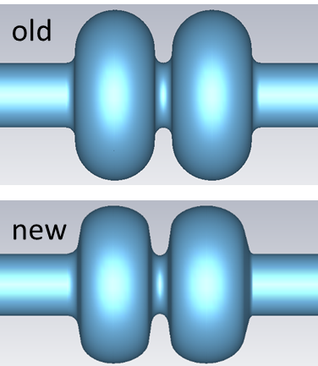
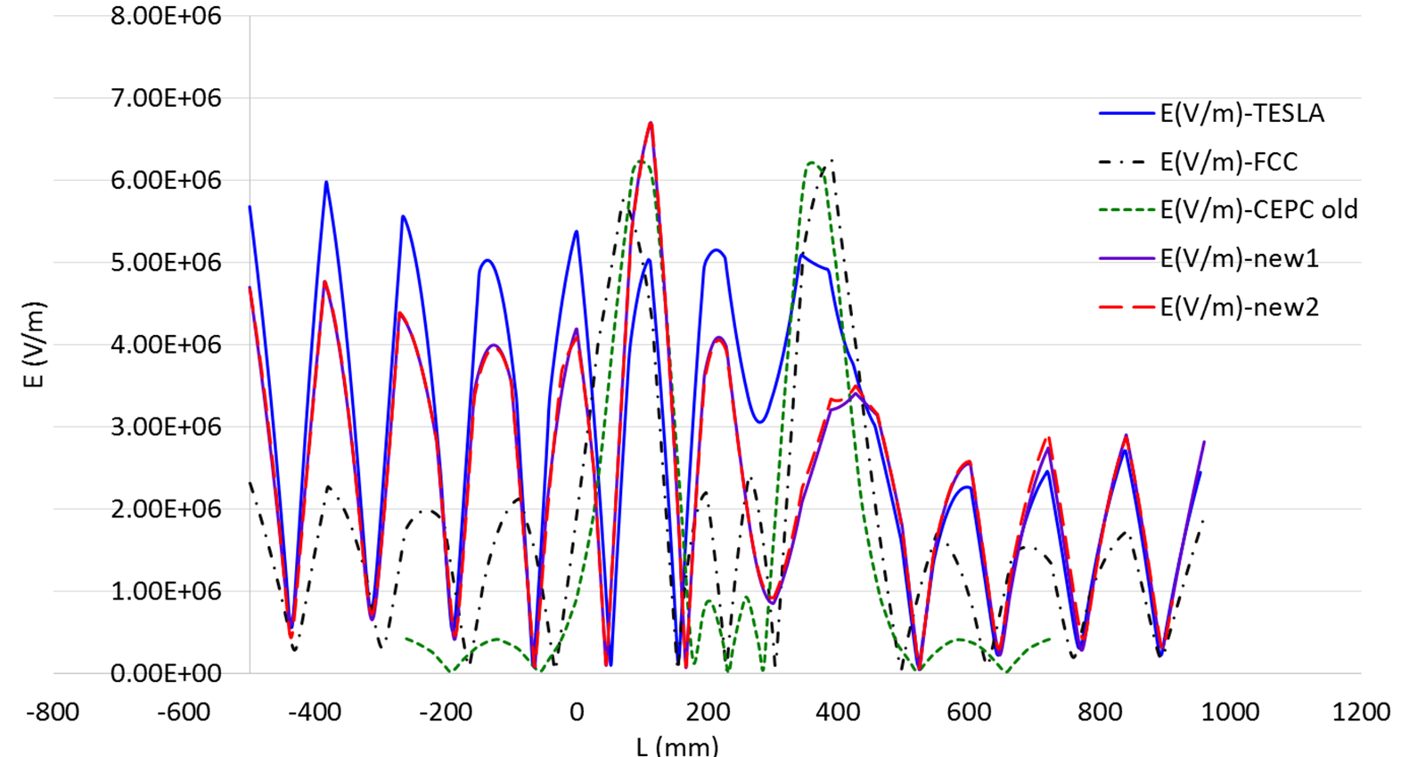
New Cavity Design with Asymmetry End Cell
To untrap TE121 and TM012 mode, as well as TM011
Larger wall angle for mechanical stability and cleaning
TE121 (10 mm off-axis)
TM012 (on-axis)

Slide 14
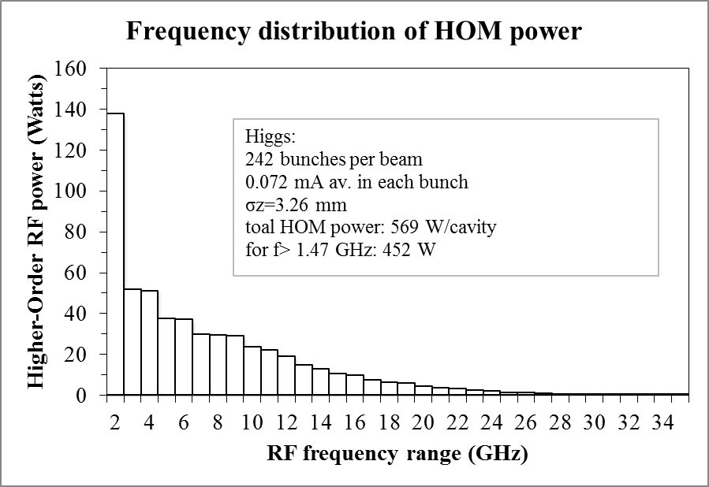
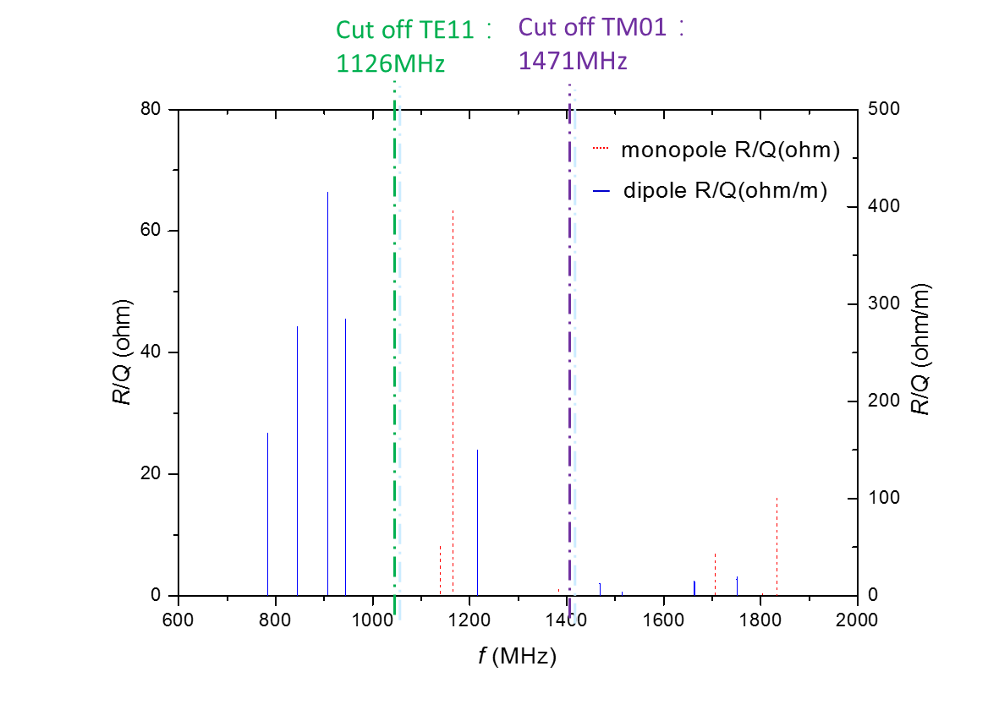
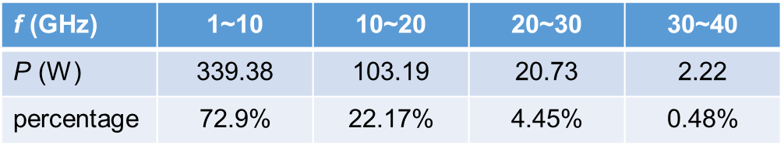
HOM Power Spectrum (Higgs)
Dangerous monopole: aroud 1200MHz
Dangerous dipole: 800 MHz ~ 900 MHz, 1200 MHz
HOM coupler: 800~1400 MHz
HOM absorber: operating frequency＞1.4 ~ 20 GHz

Slide 15
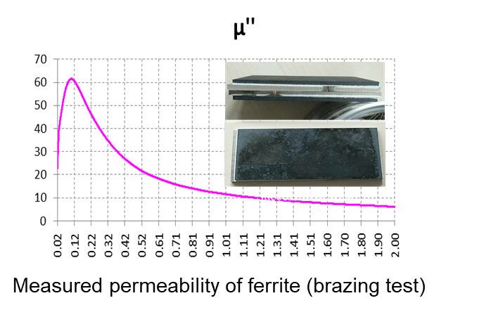
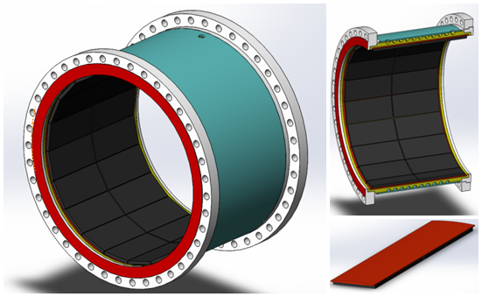
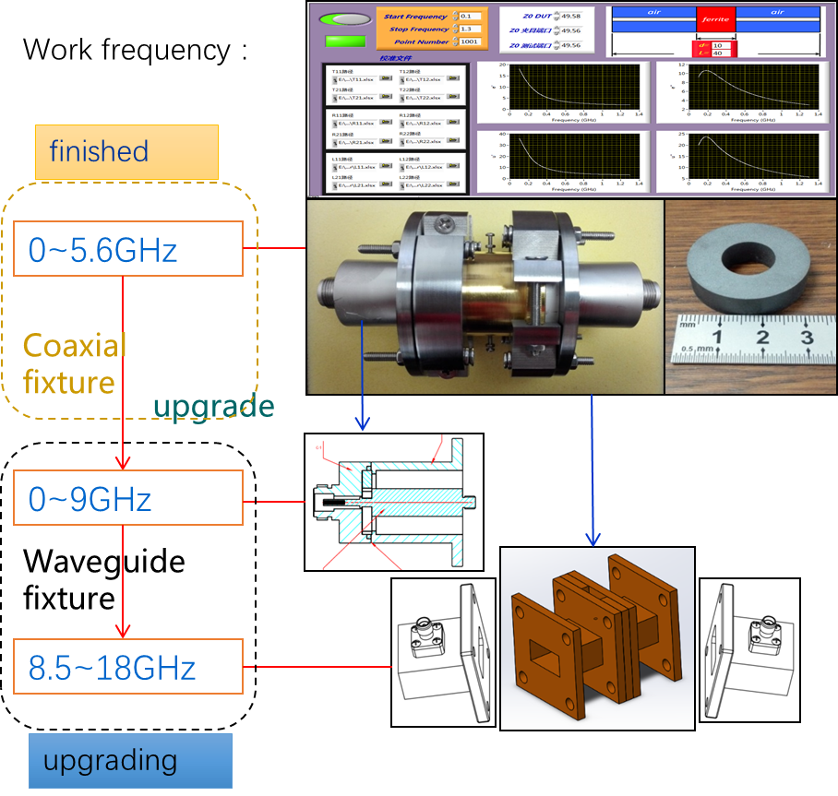
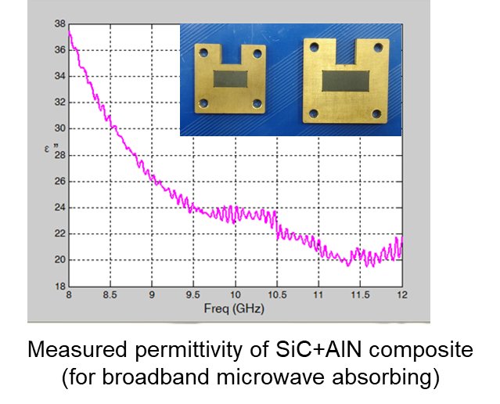
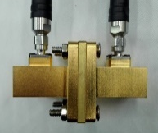
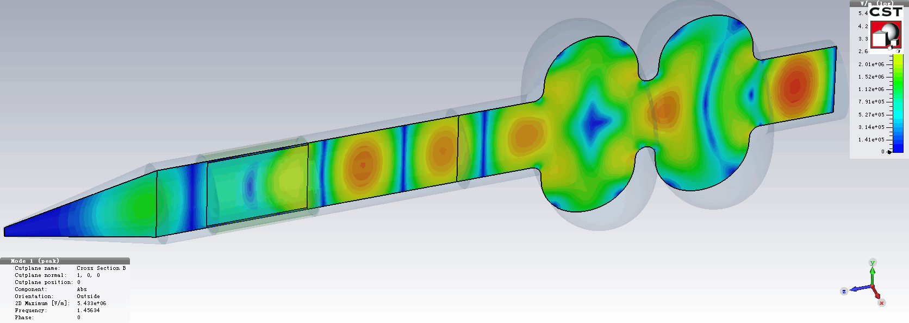
HOM Absorber (Ferrite and SiC)
Brick structure to reduce the fabrication cost
Microwave absorbing material test system

Slide 16
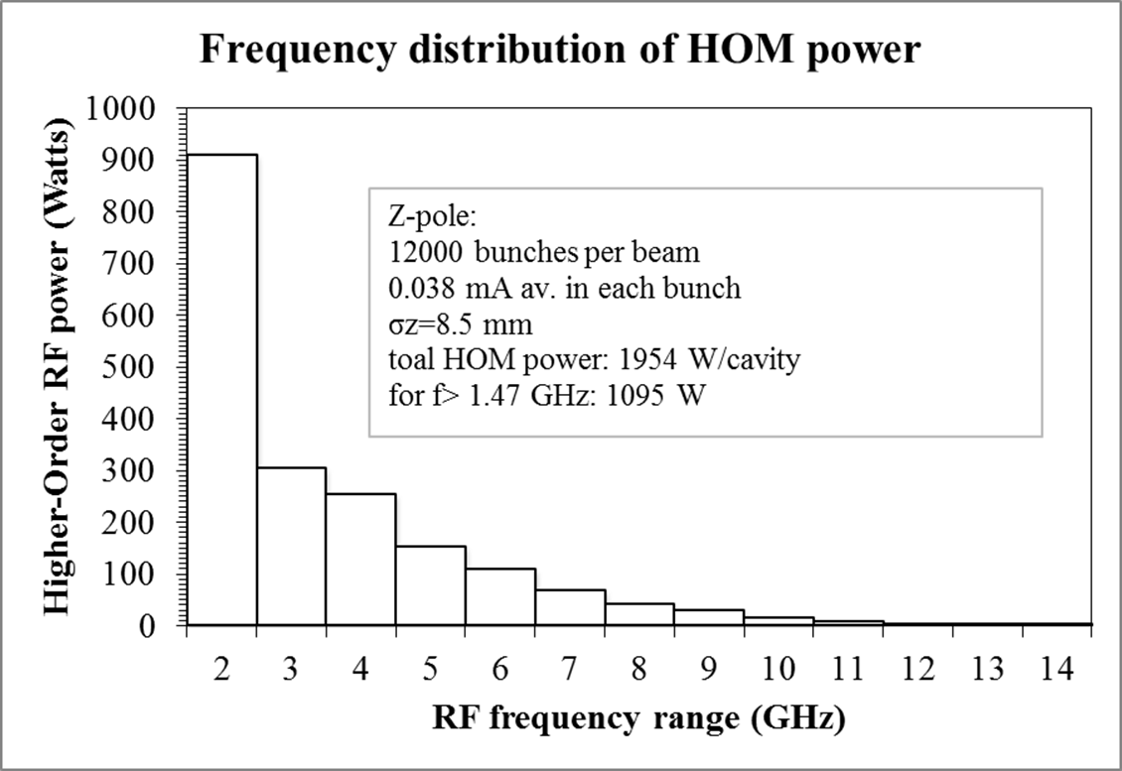
HOM Power Spectrum (HL-Z)
Average HOM power: 2 kW per cavity. Avoid resonance by tuning or fill pattern change.
900 W below cut-off, two HOM couplers per cavity, 450 W per HOM coupler.
HOM coupler design power: 1 kW with margin.
Special coaxial line and feedthrough needed with appropriate cooling.
Long bunch length important (also for the other parasitic loss and instability).

Slide 17
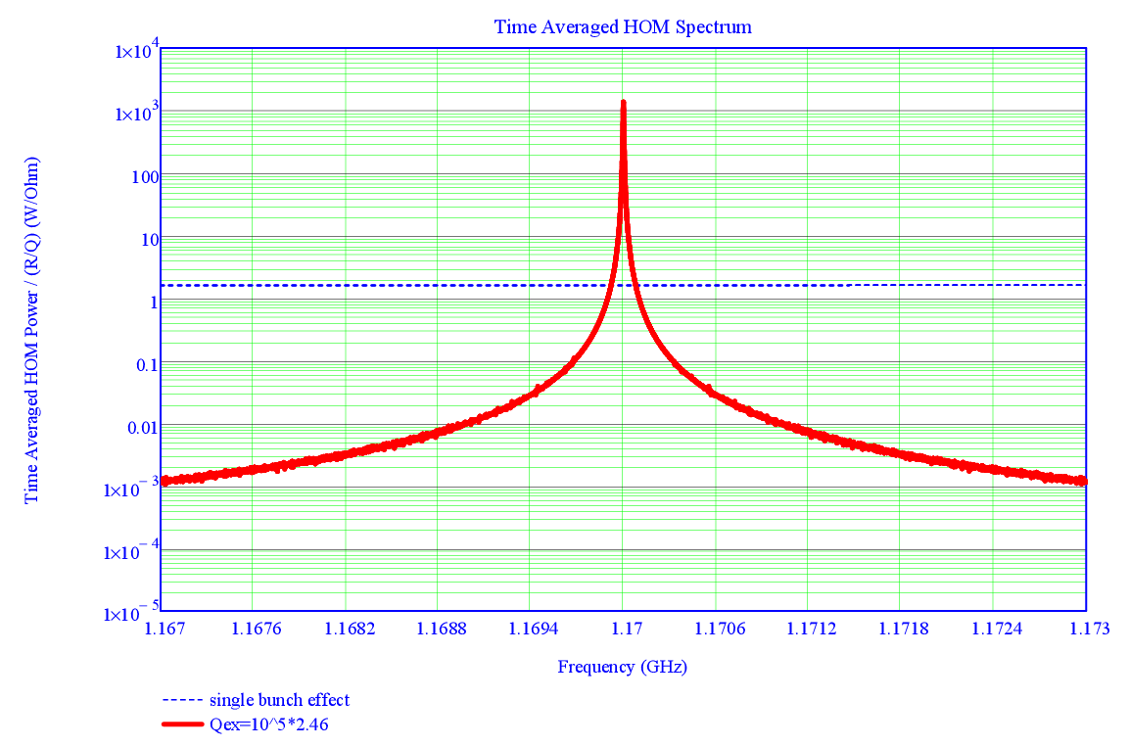
HOM power-resonant case (mini-review)
Take TM011 mode for example
R/Q = 65.2 Ω, the most dangerous monopole mode
Qe=2.46E+5
Resonant case | H | W | Z
HOM power (kW) | 20.1 | 130.5 | 112.4
If the HOM frequency is 26 kHz away from the beam spectrum for Z running, the HOM power will be less than 1 kW, while only 11 kHz for H running.
Time average HOM spectrum for Z
17

Slide 18
Fill Pattern and Beam Power Spectrum
Normalized beam power spectrum in terms of the fill pattern parameters:
h (f [frequency], n_{t} [number of bunch trains], n_{b} [bucket number between bunch], M_{b} [number of bunches in one train])
Train repetition: n_{t} f₀
Fine structure repetition: f₀
Bunch repetition: f_{rf} / n_{b}
Fine structure repetition: f_{rf} / n_{b} / M_{b}
Amplitude ~ 1 / (M_{b} n_{t})²
Bunch structure dominates when M_{b} >> n_{t}
Train structure dominates when n_{t} >> M_{b}
Red: h (1, 1, 10900)
Blue: h (10, 19, 1090)
Green: h (1, 19, 10900)
Pink: h (1090, 4, 10)
Detuned cavities are not always safe. Different fill pattern will move the beam spectrum peaks to generate large power. Slightly change the detune of each cavity to avoid resonance. Same attention should be paid to HOMs.
162.5 MHz
3.3 MHz
h
16.25 MHz
60 kHz
Frequency (MHz)

Slide 19
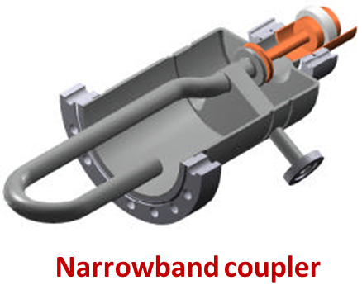
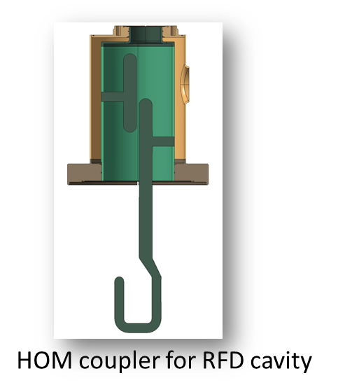
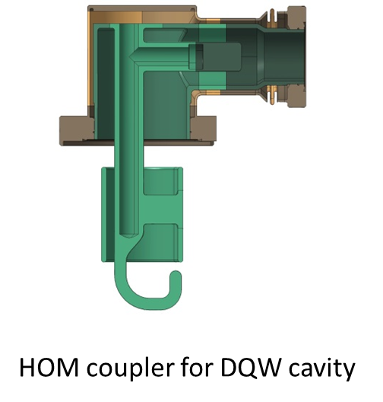
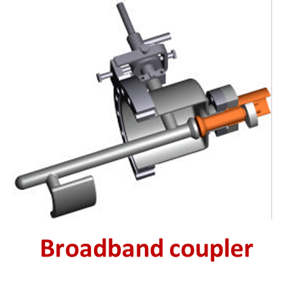
High Power HOM Coupler
All designed for 1 kW, tested up to 800 ~ 1000 W, operation at 300 ~ 500 W
LEP
LHC
HL-LHC

Slide 20
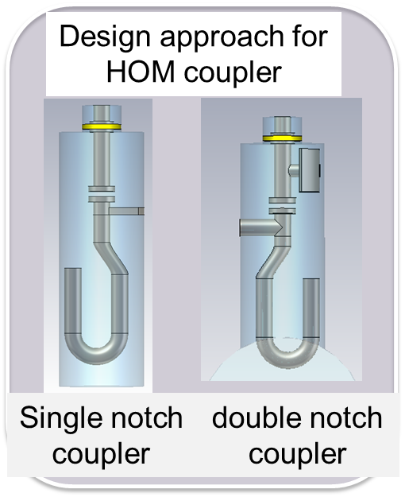
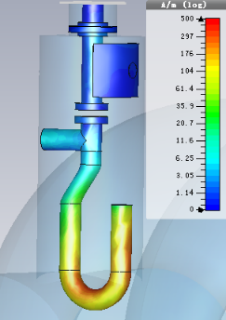
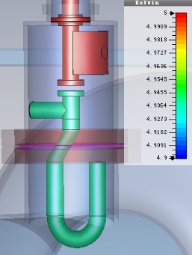
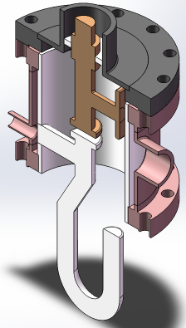
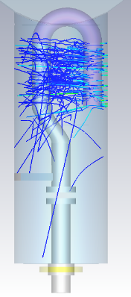
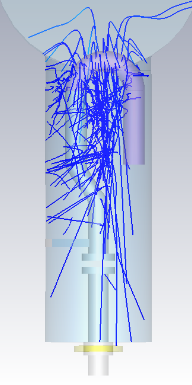
650 MHz Cavity HOM Coupler Design
RF design
Thermal Design
Mechanical designs
Multipacting analysis
Five-pages report from the International Review Committee of the CEPC HOM Coupler Design chaired by Bob Rimmer (JLAB), July 18, 2017.
> 1 kW power

Slide 21
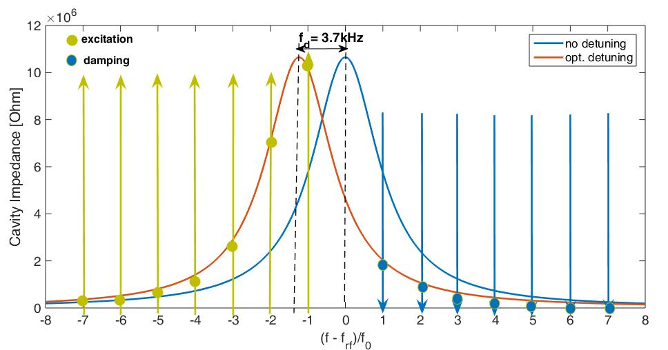
Fundamental Mode Instability (mini-review)
Mode number | Impedance / cavity (Ω) | Growth Time (ms) | Growth Time / Damping Time | Growth Rate/ Syn. Freq.
W / -1 | 5.50E+06 | 16.6 | 0.21 | 0.72
Z / -7 | 1.83E+05 | 322.7 | 0.77 | 0.06
Z / -6 | 2.92E+05 | 202.5 | 0.48 | 0.09
Z / -5 | 5.07E+05 | 116.7 | 0.28 | 0.16
Z / -4 | 9.91E+05 | 59.6 | 0.14 | 0.30
Z / -3 | 2.29E+06 | 25.8 | 0.06 | 0.70
Z / -2 | 6.12E+06 | 9.7 | 0.02 | 1.87
Z / -1 | 8.05E+06 | 7.3 | 0.02 | 2.46
CEPC baseline Z FM-CBI (without parked cavities)
Mitigation methods:
Less running cavities (pushing the coupler power limit)
Higher total RF voltage (also good for e-cloud, but beam-beam instability)
Direct (and comb) RF feedback loops to decrease the fundamental-mode impedance and the growth rates at least to the manageable level of the longitudinal bunch-by-bunch feedback system.

Slide 22
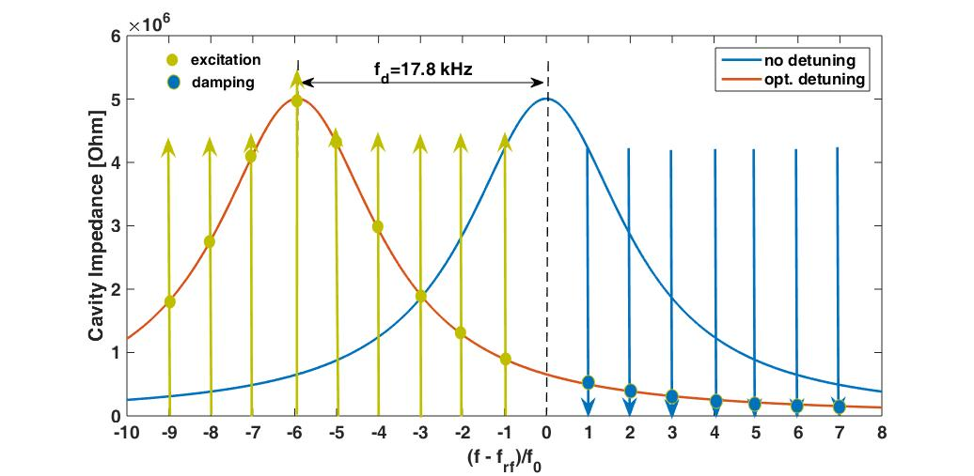
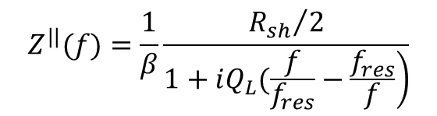
FM CBI of HL-Z
Mode number | Impedance / cavity (Ω) | Growth Time (ms) | Growth Time/ Damping Time | Growth Rate/ Syn. Freq.
-28 | 3.11E+04 | 411.3 | 0.98 | 0.03
-27 | 3.49E+04 | 366.6 | 0.87 | 0.03
-26 | 3.94E+04 | 325.2 | 0.77 | 0.04
-25 | 4.46E+04 | 286.9 | 0.68 | 0.04
-24 | 5.08E+04 | 251.7 | 0.60 | 0.05
-23 | 5.83E+04 | 219.5 | 0.52 | 0.05
-22 | 6.74E+04 | 190.0 | 0.45 | 0.06
-21 | 7.84E+04 | 163.2 | 0.39 | 0.07
-20 | 9.21E+04 | 139.0 | 0.33 | 0.09
-19 | 1.09E+05 | 117.2 | 0.28 | 0.10
-18 | 1.31E+05 | 97.8 | 0.23 | 0.12
-17 | 1.59E+05 | 80.5 | 0.19 | 0.15
-16 | 1.96E+05 | 65.3 | 0.16 | 0.18
-15 | 2.45E+05 | 52.1 | 0.12 | 0.23
-14 | 3.14E+05 | 40.8 | 0.10 | 0.29
-13 | 4.11E+05 | 31.1 | 0.07 | 0.38
-12 | 5.55E+05 | 23.1 | 0.05 | 0.52
-11 | 7.75E+05 | 16.5 | 0.04 | 0.72
-10 | 1.13E+06 | 11.4 | 0.03 | 1.05
-9 | 1.71E+06 | 7.5 | 0.02 | 1.59
-8 | 2.67E+06 | 4.8 | 0.01 | 2.49
-7 | 4.01E+06 | 3.2 | 0.01 | 3.73
-6 | 4.82E+06 | 2.7 | 0.01 | 4.49
-5 | 4.05E+06 | 3.2 | 0.01 | 3.77
-4 | 2.65E+06 | 4.8 | 0.01 | 2.46
-3 | 1.57E+06 | 8.1 | 0.02 | 1.46
-2 | 8.74E+05 | 14.6 | 0.03 | 0.81
-1 | 3.87E+05 | 33.1 | 0.08 | 0.36
Longitudinal coupling-impedance
$$Z^{||}(f)=\frac{1}{β}\frac{{R_{sh}}/2}{\left.1+iQ_{L}(\frac{f}{f_{res}}−\frac{f_{res}}{f}\right)}$$
Cavity resonance frequency

Slide 23
Simulation of Growth Rate and Direct RF Feedback
D. Teytelman.
3 ms growth time (1/4 synchrotron period)
Optimal direct loop gain of 14 the growth rates are reduced to a very reasonable 7.2 1/s (139 ms growth time, 11.6 synchrotron periods). That residual growth rate should be easy to control with standard bunch-by-bunch feedback.

Slide 24
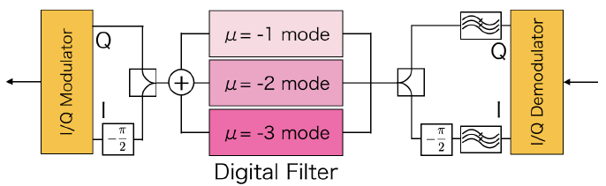
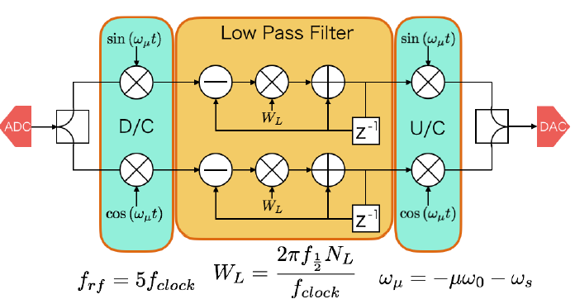
RF Feedback Hardware
Use the mode by mode damper system with digital filters to suppress (SuperKEKB)
Damper system for SuperKEKB:
Kouki Hirosawa. Development of a coupled bunch instability damper caused by the acceleration mode for SuperKEKB. PASJ2016 TPU012
Functional block diagram of digital filter for SuperKEKB

Slide 25
FM CBI and Power of Parked Cavities (mini-review)
Radiation damping time
Large detuning and narrow BW to reduce FM power excited by the beam (limit?), but fast-growing CBI modes. symmetric detuning (positive and negative detuned cavities cancel each other) will mitigate the instabilities.
Small input power is required to have the signal to detune the cavity (?). Circulators and loads should keep working for the excited FM power. Cavities should be kept at 2 K to extract HOM power.
Power increases with square of the beam current. Different fill pattern will change the exited power.
Better to move the large number of idle W and Z cavities off the beamline (in the empty place of the future SPPC magnets) or with multi-by-pass (but needs lattice change and longer straight section), rather than parking (detune) them. Similar for the Booster. This will also reduce the HOM impedance significantly.
Sync. oscillation period
Beam excited FM power
-1 -2 -3 -4 -5 -6 -7 -8 -9 - 10 -11 -12
CBI mode No.
CEPC baseline Z mode FM CBI and beam excited power per cavity of the 156 parked cavities (reduce FM coupling to Q_{e} = 2E6)

Slide 26
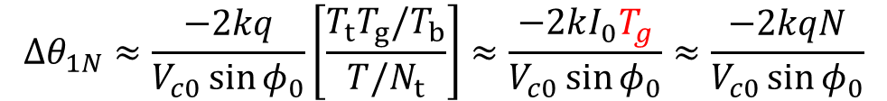
Beam Gap Transient
Phase shift caused by beam gaps, results in less longitudinal focusing, smaller energy acceptance, lifetime and luminosity, and possible other dynamical problem. Small phase shift can be estimated by (K. Bane, etc., EPAC96):
  Phase Shift Correction Methods
Increase cavity stored energy (less cell number, higher RF voltage, low RF freq)
More uniform distribution (increase bunch train number or length)
Pulsed power (power source hardware limit and low RF-to-beam efficiency)
Klystron phase modulation
Beat cavity (small frequency shift of part of RF sources and cavities, beating)
$$Δθ_{1N}≈\frac{−2kq}{V_{c0}\sin{φ_{0}}}\left[\frac{T_{t}T_{g}/T_{b}}{T/N_{t}}\right]≈\frac{−2kI_{0}T_{g}}{V_{c0}\sin{φ_{0}}}≈\frac{−2kqN}{V_{c0}\sin{φ_{0}}}$$
Max phase variation proportional to number of bunches in a bunch train, or number of bunch trains (for fixed total bunch number) or the gap length.

Slide 27
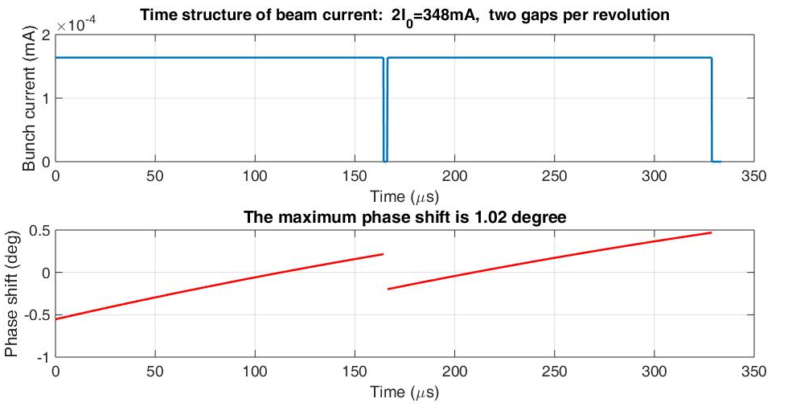
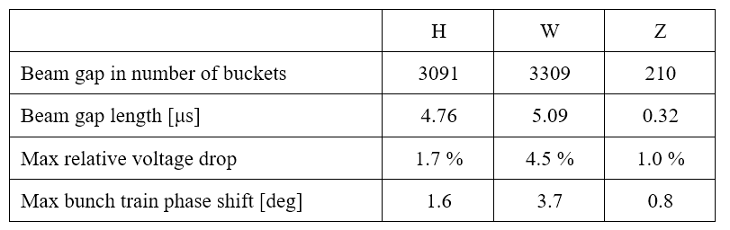
Beam Gap Phase Shift (mini-review)
Gap for beam abort and mitigate ion-trapping and fast beam ion instability (FBII).
~ 10 % total gap needed for HL-Z. But one gap will have too large phase shift and beam loss. Use many bunch trains with short gaps (0.5 ~ 1 us)
Phase shift for Higgs end cavity
Simulation based on D. Teytelman’s code with transfer functions.

Slide 28
Phase Shift of HL-Z
D. Teytelman.
Transfer functions (Pedersen Model)
48 trains of 250 bunches located symmetrically in the ring. Bunch spacing is 24.6 ns (16 RF buckets), gaps are 820 ns.

Slide 29
Conclusions and Further Studies
New CEPC CDR Z (HL-Z) is challenging for RF hardware and beam operation with Higgs cavity, but feasible:
HOM CBI is OK with deeper TM011 mode damping (and large cavity frequency spread and fast bunch-by-bunch feedback), but critical. Better to have idle cavities off-line.
HOM power is within the current coaxial HOM coupler technology reach.
FM CBI is manageable by direct RF feedback.
Phase shift is moderate for small gaps (what is the beam dynamics limit?)
Parking cavities FM CBI can be mitigated by symmetry detuning.

Slide 30
Conclusions and Further Studies
Push RF limitation beyond Z baseline for higher current and luminosity:
Novel HOM coupler design with larger power capacity.
Very high power input coupler ( > 500 kW) and wide variable range (or two couplers per cavity)
BEPCII type cryomodules (but cost …)
…
Another important issue:
Parasitic loss (significant luminosity loss for high current, reduce by longer bunch length, see Wang Na’s talk)

Slide 31
Back-up

Slide 32
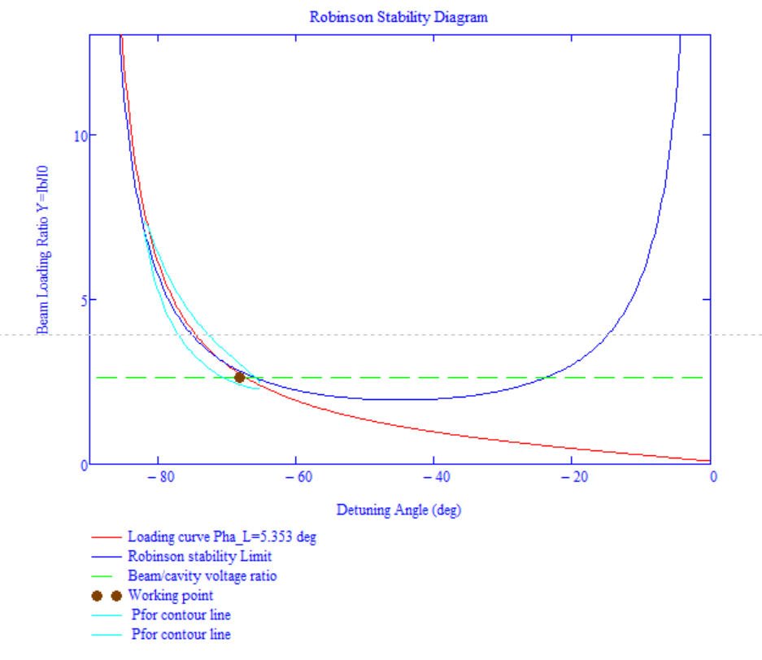

Second Robinson Stability (CEPC Z old)
Fast direct feedback (group delay 2 us, loop gain 22).
~ 10 % more power to have Robinson stable operation of high current Z-pole.

Slide 33
Parasitic Loss of High Current Z
Beam energy loss by the cavity fundamental mode is compensated by input RF power
Parasitic loss: cavity HOM loss + other ring components loss. Energy loss should be compensated by increasing RF voltage. Parasitic power loss should be compensated by increasing the total RF power. A significant beam current and luminosity reduction for high luminosity Z if keep the 50 MW “SR” power per beam.
CEPC Z-pole baseline:
  loss factor ~ 688 V/pC (bunch length dependent), beam current 160 mA, bunch charge 6.4 nC
  parasitic energy loss: 4.4 MV (8 % of the RF voltage, increase cavity gradient by 8 %)
  parasitic power loss: 0.7 MW (12 % of the SR power, increase input power per cavity by 8 %)
High current Z (with nominal 50 MW SR power per beam) :
  e.g. bunch charge x 4, beam current x 9 → energy loss x 4, power loss x 36 (25 MW !)
  total RF AC power and input coupler power per cavity will exceed the design.

Slide 34

CEPC Input Coupler Challenges
  High power handling capability: CW, 300 kW ( > 400 kW, update).
  Wide-range variable coupler with low heat load to save power.
  Clean assembled with cavity in class 10 clean room
  Balance coupler vacuum part length (cryomodule diameter size) and heat load.
Frequency (GHz) | 0.65
Power (kW) | 300
Coupling (Qext) | Variable: 1E5~2E6
Heat load spec (dynamic 300 kW, TW, CW) | Dynamic: 1 W / 6 W / 10 W @ 2 K / 5 K / 80 K Static: 0.3 W / 3 W / 6 W @ 2 K / 5 K / 80 K

Slide 35




CEPC Variable 650 MHz Input Coupler Design
RF design complete, thermal and mechanical design ongoing.
Thermal anchor or helium gas cooling of outer conductor. Water or gas cool of inner conductor.
Start fabrication in end 2017.

Slide 36




Input Coupler Heat Load
Water cooling of the outer bellow is a must.
RF shielding of the gap between the coupler and cavity connecting flange is very important, since which made great contributions to the 2K heat load.
Try helium gas cooling for next step

Slide 37



Coupling Adjusting Mechanism
Two bellows on outer or inner conductor.
Method other than changing the penetration depth of the antenna tip : RF short plunger on the doorknob waveguide (standing wave, frequency change, adjusting range …)

Slide 38

Variable Coupling and Power Saving
Variable coupling (Qe: 1E5 ~ 2E6) of power coupler is necessary especially with “high efficiency klystron”:
Collider Ring: same mode, different beam current
  Not so significant, but 10 % is ~ 20 MW AC power (and lower efficiency for lower klystron operation power)
  Compensate Qext scattering
  Enable matching for higher current
Collider Ring: different modes at max design current
  46 % and 32 % more RF power for W and Z with fixed H coupling. Under coupling not good for stability
  Booster
  cavity BW change (easy control or power saving)

