Slide 1
CEPC Injector
Damping Ring
Cai Meng, Dou Wang, Jingru Zhang,
Dianjun Gong, Jiyuan Zhang, Jie Gao
CEPC CDR internal review, Feb 10, 2018 . A415, IHEP.

Slide 2
Outline
Introduction of CEPC linac
  Parameters
  layout
Damping Ring design
  Why
  Parameters and layout
  ECS/BCS
Summary

Slide 3
Introduction
CEPC linac
Linac design principles
  Simplicity
  High Availability (necessary hot-standby backups,10%-20%) and Reliability
  meet requirements of Booster
Parameter | Symbol | Unit | Value
e⁻ /e⁺ beam energy | E_{e-}/E_{e+} | GeV | 10
Repetition rate | f_{rep} | Hz | 100
e⁻ /e⁺ bunch population | Ne-/Ne+ |  | >9.4×10⁹
 |  | nC | >1.5
Energy spread (e⁻ /e⁺ ) | σ_{E} |  | <2×10⁻³
Emittance (e⁻ /e⁺ ) | ε_{r} | nm | < 120
e⁻ beam energy on Target |  | GeV | 4
e⁻ bunch charge on Target |  | nC | 10
Length
R&D
Positron source
ECS/ shorter bunch length
Positron source/DR

Slide 4
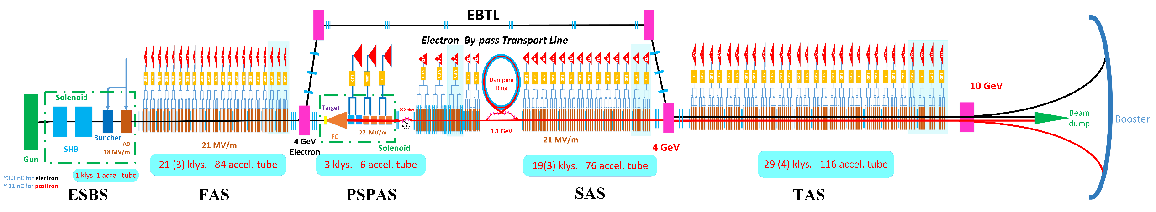
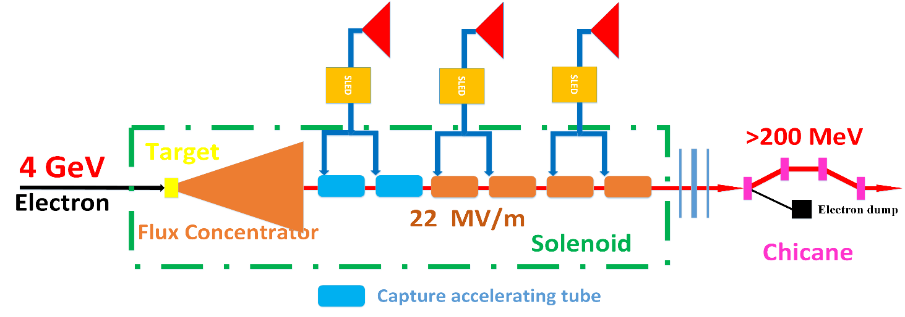
Introduction
CEPC linac
Emittance: RMS
  300 nm@6GeV → 300nm@10GeV → 120nm@10GeV → ? @10GeV
  3500mm-mrad 5800mm-mrad 2350 mm-mrad
Positron source
  Capture emittance

Slide 5

Introduction
CEPC linac
Accelerating tube
  Aperture: 25 mm
Norm. RMS. Emittance
  2500 mm-mrad
Energy: >200 MeV
Positron yield
  Ne+/Ne- ~=0.55 [-6°,14°,235 MeV,265 MeV]
Emittance
  Bunch charge
  Collimation
  120 nm
A1
D1
Acceleration
Deceleration
SuperKEKB
SuperKEKB commissioning results
Only energy cutoff $∆E<15 MeV$

Slide 6
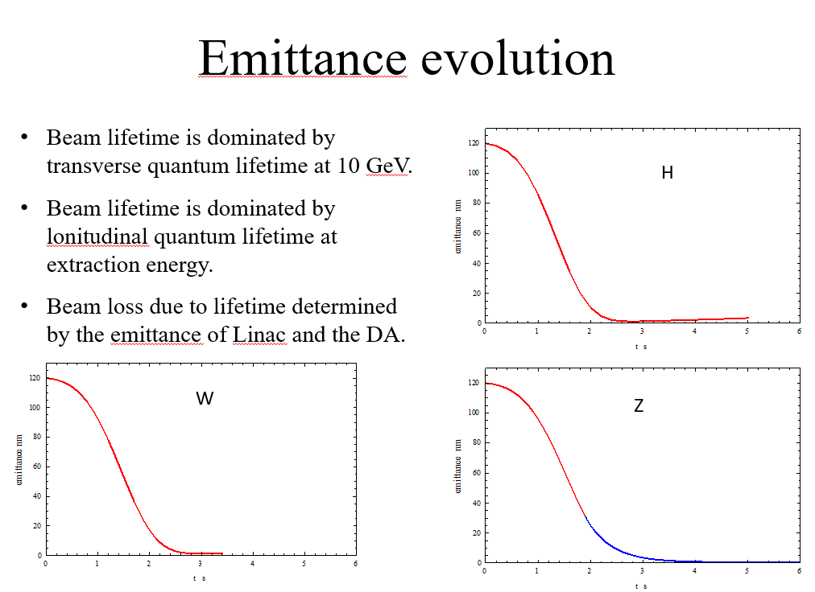
Damping Ring
Why
Smaller emittance requirement possibility and update potential
  Damping Ring for positron linac
Emittance budget for Linac: One-bunch-per-pulse
  Enough margin with high transmission efficiency
  Decrease beam loss at low energy part (collimation)
  100 Hz kicker? → Reliability
Emittance for booster
  Easy injection design and high efficiency
  Beam lifetime
  Damping time at high energy(?)
CEPC Accelerator CDR mini-review
  Strongly Suggesttion @ Katsunobu Oide
@Dou Wang

Slide 7
Damping Ring
Preliminary design
DR V1.0 | Unit | Value
Energy | GeV | 1.1
Circumference | M | 58.5
Repetition frequency | Hz | 100
Bending radius | M | 3.6
Dipole strength B₀ | T | 1.01
U₀ | keV | 35.8
Damping time x/y/z | Ms | 12/12/6
δ₀ | % | 0.049
ε₀ | mm.mrad | 302
Nature σ_{z} | mm | 7 (23ps)
Extract σ_{z} | mm | 7 (23ps)
ε_{inj} | mm.mrad | 2500
ε_{ext x/y} | mm.mrad | 716/471
δ_{inj} /δ_{ext} | % | 0.5/0.07
Energy acceptance by RF | % | 1.0
f_{RF} | MHz | 650
V_{RF} | MV | 1.8
Energy
  1.1 GeV
  SuperKEKB DR: CSR
Repetition frequency
  100 Hz→ 10ms
  One bunch

Slide 8
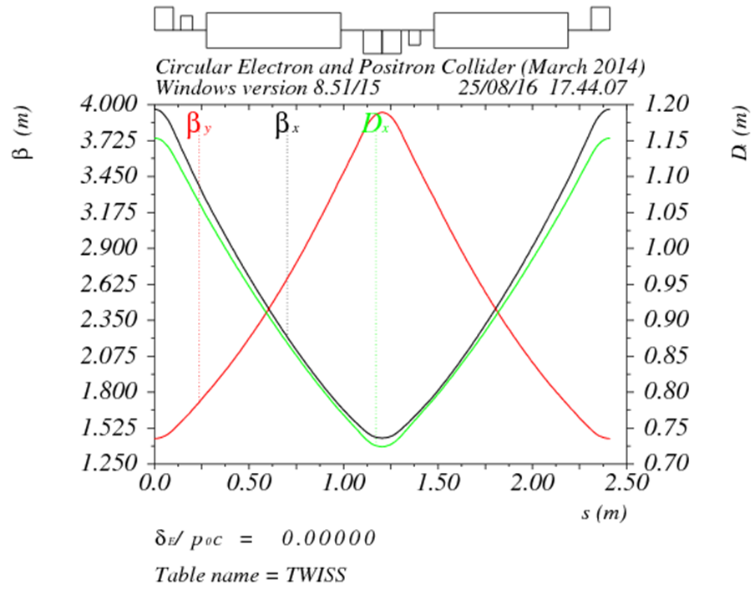
Damping Ring
Lattice
@Dou Wang
FODO length (m) | 2.4
Phase per cell | 60°
Dipole length (m) | 0.71
Dipole strength (T) | 1.0
Quadrupole length (m) | 0.2
Quadrupole strength (m⁻²) | 4.1
Sextupole length (m) | 0.06

Slide 9
Damping Ring
Lattice

Slide 10
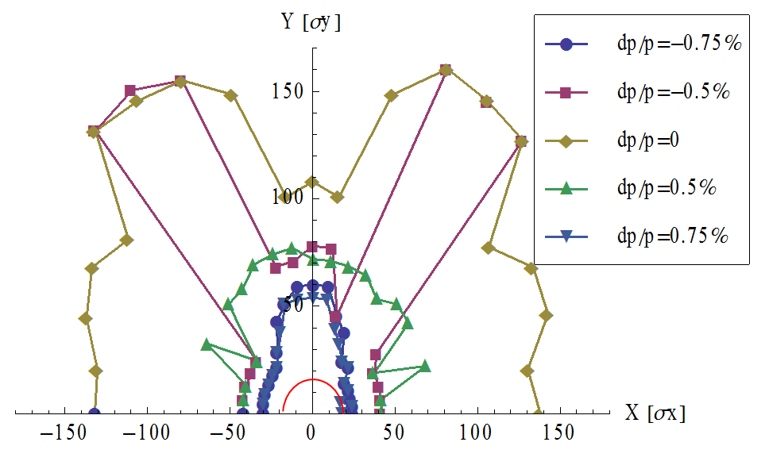
Damping Ring
DA
@Dou Wang
Red：7 times injected beam size (rms)

Slide 11
Damping Ring
RF parameters
@Dianjun Gong
 | SCRF | NCRF
Circumference [m] | 58.5 | 58.5
Beam energy [GeV] | 1.1 | 1.1
SR loss/ turn [keV] | 35.8 | 35.8
Revolution frequency [MHz] | 5.12 | 5.12
SR power / beam [W] | 550.4 | 550.4
Momentum compactor | 7.82E-02 | 7.82E-02
Beam current [mA] | 15.4 | 15.4
Bunch charge [nC] | 3 | 3
Number of bunches per revolution | 1 | 1
RF voltage [MV] | 1.8 | 1.8
RF frequency [MHz] | 650 | 650
RF wave length [m] | 0.461 | 0.461
Bucket length [ns] | 1.538 | 1.538
Harmonic number | 127 | 127
Revolution time [ns] | 195.1 | 195.1
Bunch population [1E10] | 1.88 | 1.88
Bunch charge [nC] | 3 | 3
Natrue Bunch length [mm] | 7 | 7
RF energy acceptance [%] | 1 | 1
Acc. Phase [deg] | 88.86 | 88.86
Syn. Tune | 0.010 | 0.010
Synchrotron oscillation period [us] | 19.3 | 19.3
Longitudinal damping time [ms] | 6.0 | 6.0
SC cavity and NC cavity
  Because of the small beam current and beam power, choose 4-cell 650MHz NC cavity.
  This cavity is scaled from 5-cell 500MHz HERA-type cavity.

Slide 12
Damping Ring
RF parameters
@Dianjun Gong
 | SCRF | NCRF
Type of Cavity | SCRF | NCRF(HERA-type)
number of cell/ cavity | 1 | 4
Cavity effective length [m] | 0.23 | 0.92
RF section length [m] | 1 | 1
Cavity number | 1 | 2
Cavity voltage [MV] | 1.8 | 0.9
Cavity Acc. Gradient [MV/m] | 7.83 | 0.98
Q0 | 1.00E+10 | 29500
R/Q [Ohm] | 103 | 440
Input power/ cavity [W] | 550 | 62679
Pb [W] | 550 | 550
Pc/ cavity [W] | 3 | 62404
Coupling Coefficient | 176 | 1.01
Optimal Q_{L} | 5.68E+07 | 2.92E+04
Cavity bandwidth at optimal Q_{L} [Hz] | 11 | 2.2E+04
Detuning angle [deg] | -88.86 | -12.45
Filling time [us] | 2.78E+04 | 14.3
Optimal detuning at optimal Q_{L} [Hz] | -287.49 | -2452.99
Cavity stored energy [J] | 7.7 | 0.5
Damping ring lattice
  4 1m-long spaces for RF
  2 4-cell NC cavity.
  Acc. gradient is 1MV/m
  Input power is 63kW

Slide 13
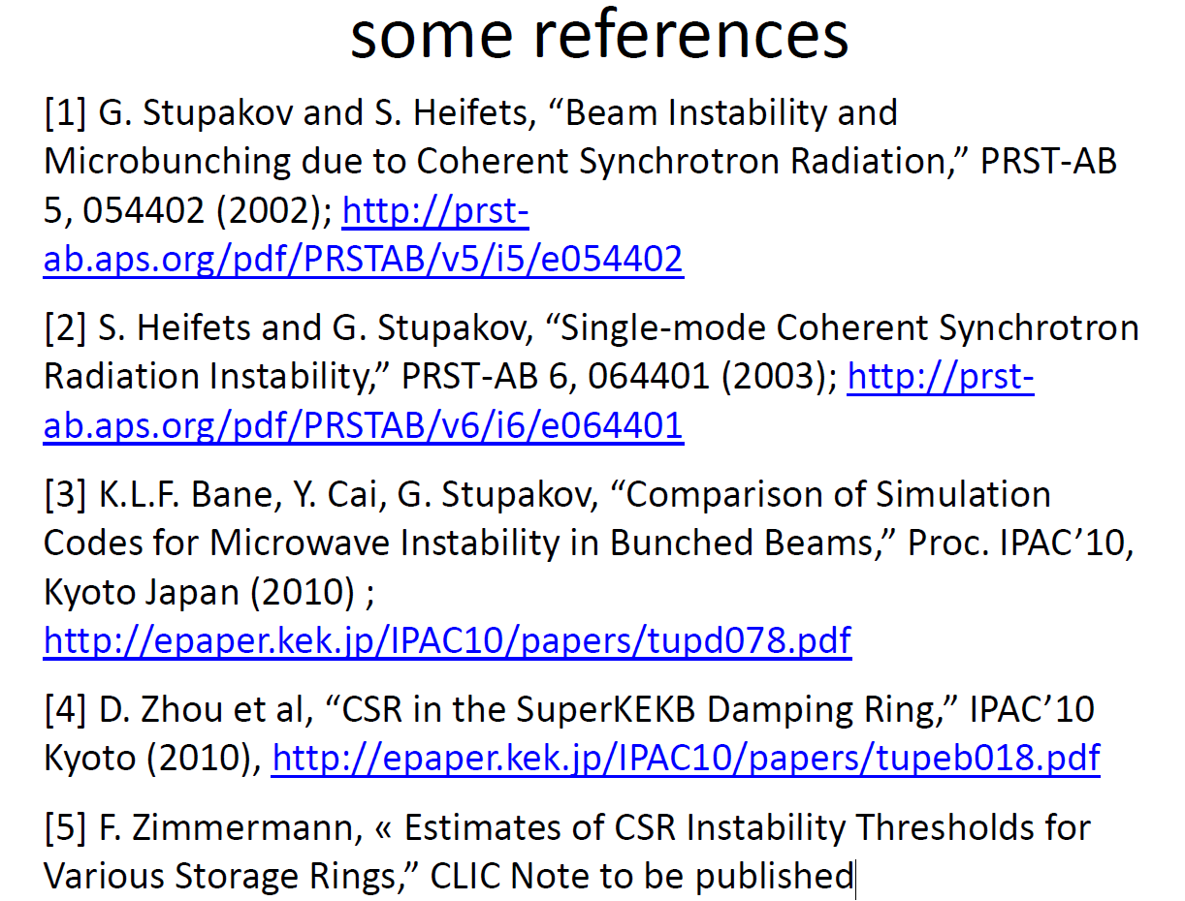
Damping Ring
Instability
Coherent synchrotron radiation
  High energy
  Larger momentum compaction
  Longer bunch length
Electron Cloud Instability

Slide 14
Damping Ring
ECS/BCS
Injection (DR)
  Small energy spread
  Large bunch length
  Energy compression system (ECS)
Extraction (Linac)
  small bunch length: 7mm→ 1 mm
    Energy spread <1%
    R56: -600mm
  Bunch compression system (BCS)

Slide 15
Damping Ring
Chicane
C-Chicane
  Rectangular dipole
  Bending angle: θ
  Bend radius: ρ
  Length: a, b

Slide 16
Damping Ring
Chicane
 | Unit | Value
bend radius ρ | m | 3.7
bending angle | degree | 25
a | m | 0.5
b | m | 0.6
Dx | mm | 1049
R₅₆ | mm | -684
H | m | 0.926
L | m | 7.855

Slide 17
Positron Linac

Slide 18
Summary
Damping ring is new addition in injector for smaller emittance requirement possibility and update potential.
Preliminary damping ring design is proposed.
ECS and BCS is considered.
Further study is necessary and needed.

