Slide 1
Machine Learning in SUSY Exploration
杨 金 民
ITP，Beijing
1708.06615 J Ren, L Wu, JMY, J Zhao
1807.09088 M Abdughani, J Ren, L Wu, JMY
丹东 2018.8.24

Slide 2
Contents
Introduction
Machine learning scan in SUSY
Graph neural network in SUSY
Conclusion

Slide 3
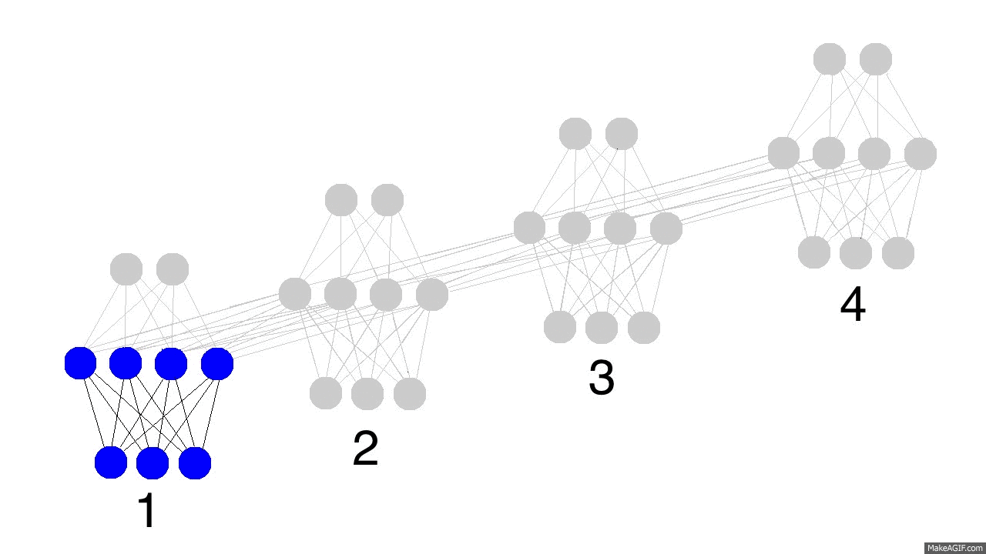
1 Introduction
Machine learning
-- a subset of artificial intelligence

Slide 4
04/35
Machine Learning in HEP
Several advanced machine learning (computer learns from data) and data mining (knowledge learning from data) techniques are applied
Signal-background discrimination
Jet tagging
Pileup mitigation
………

Slide 5
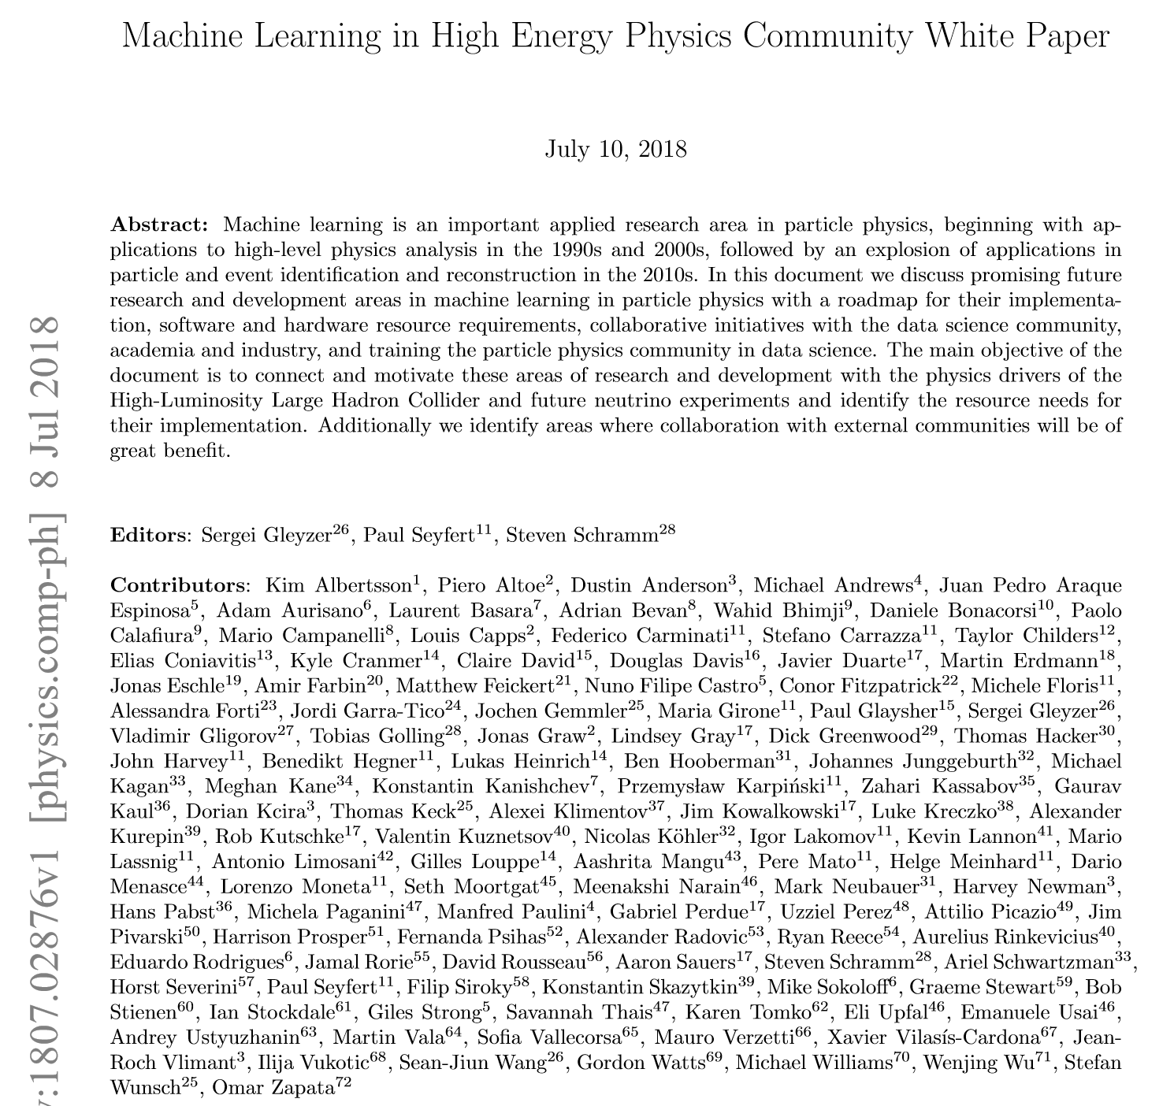
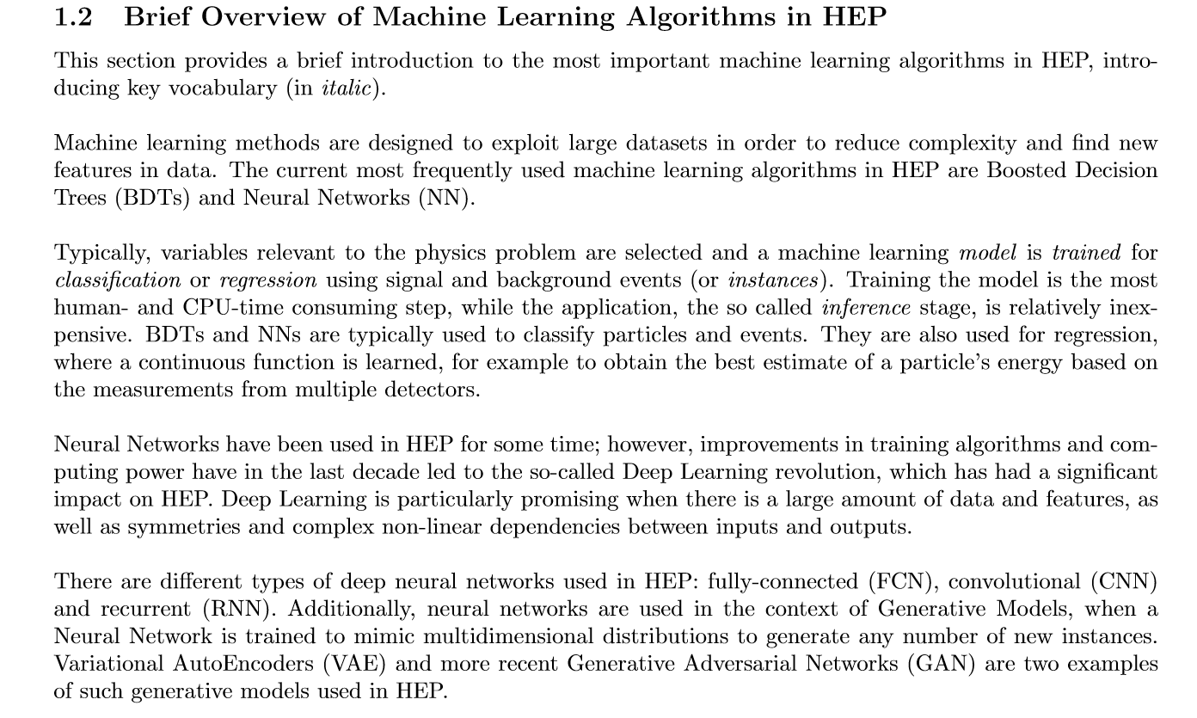
05/35

Slide 6
06/35
Our Works
Machine learning in SUSY parameter space exploration
1708.06615 J. Ren, L. Wu, JMY, J. Zhao
Graph neural network for SUSY search
1807.09088 Abdu, J. Ren, L. Wu, JMY
Graph neural network for $H\overline{tt}$ search at LHC
1809.????? J. Ren, L. Wu, JMY

Slide 7
07/35
2 Machine Learning Scan in SUSY
1708.06615 J Ren, L Wu, JMY, J Zhao

Slide 8
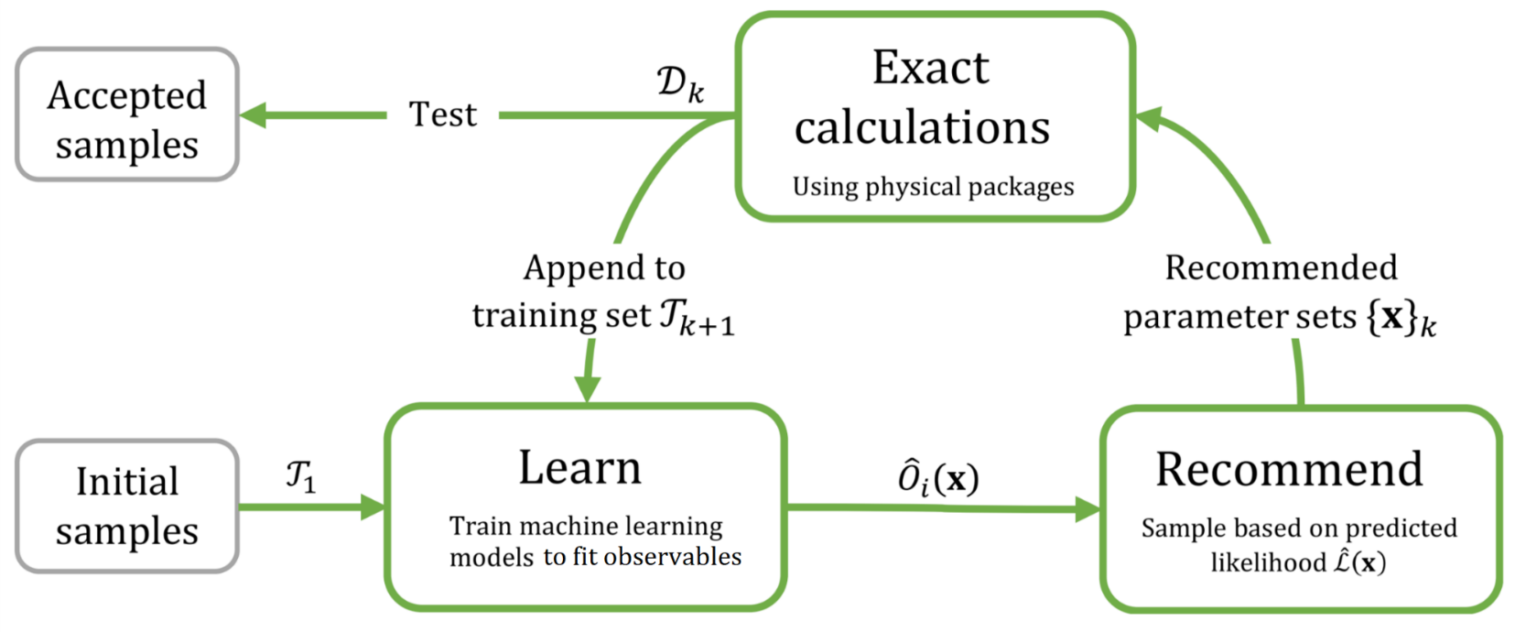
08/35

Slide 9
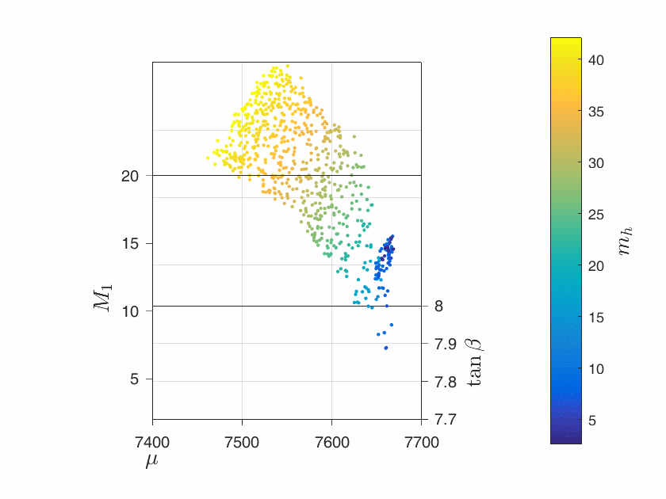
09/35
MSSM alignment limit

Slide 10
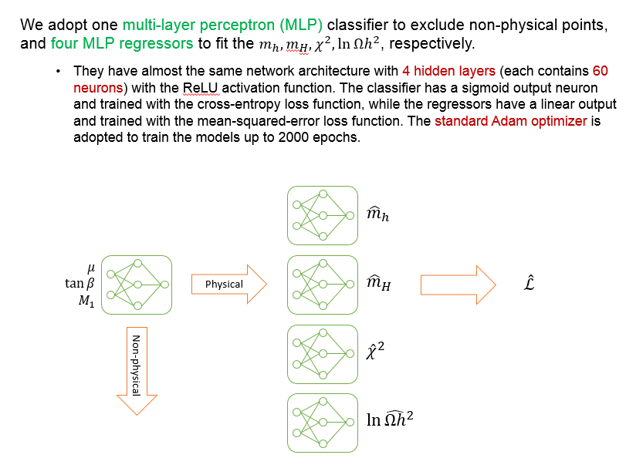
10/35

Slide 11
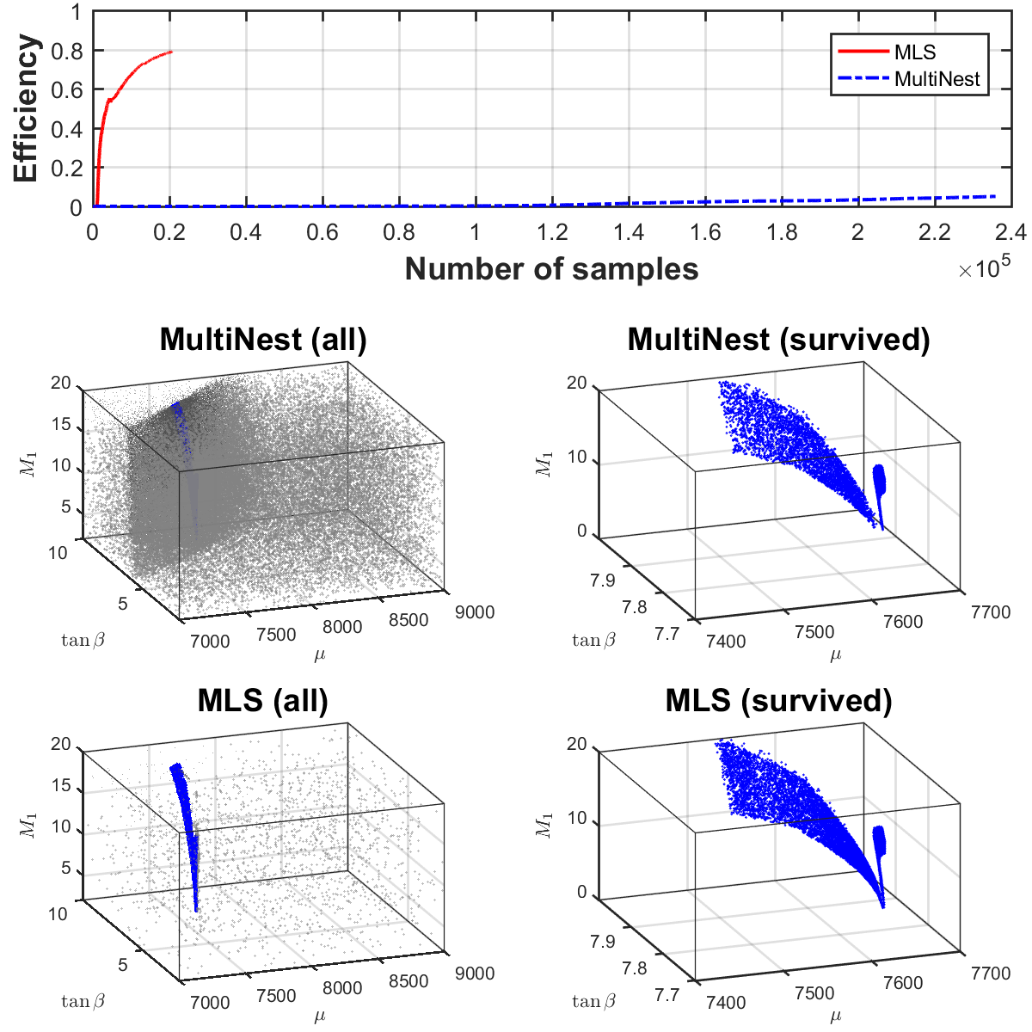
11/35
Gray points—wasted
Blue points --survived

Slide 12
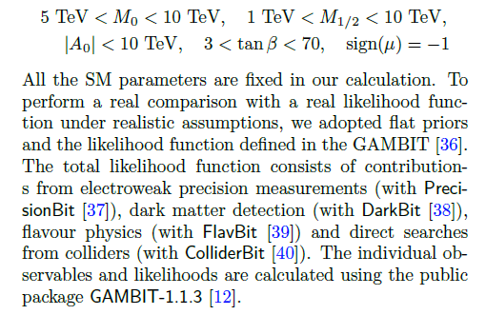
12/35
MSSM/mSUGRA

Slide 13
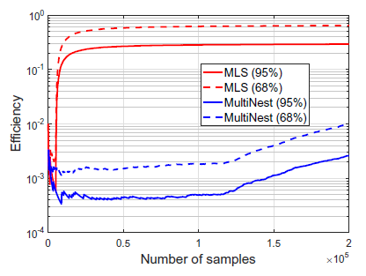
13/35

Slide 14
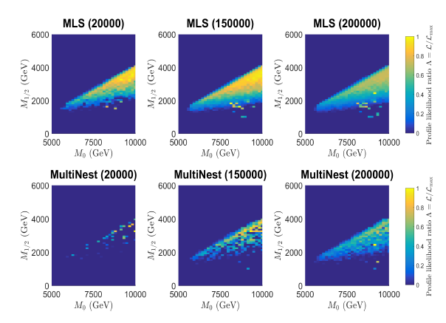
14/35

Slide 15
3 Graph Neural Network for SUSY
15/35
1807.09088 M Abdu, J Ren, L Wu, JMY
An event is a signal or background ?

Slide 16
Methods for Event Selection
16/35
B
Cut-flow
S
Control Region
Signal Region

Slide 17
Methods for Event Selection
17/35
Cut-flow
Machine Learning
Boosted Decision Tree (BDT)
a lot of trees → a forest
When an event comes, it passes each tree and is valued 1(signal) or 0(background). Finally, these values are averaged.

Slide 18
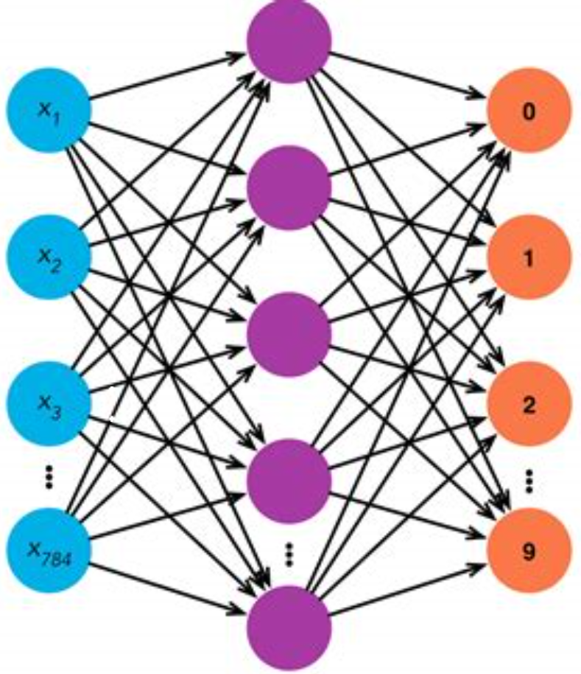
Methods for Event Selection
18/35
Cut-flow
Machine Learning
Boosted Decision Tree (BDT)
Neural Networks
Shallow Neural Network (NN)

Slide 19
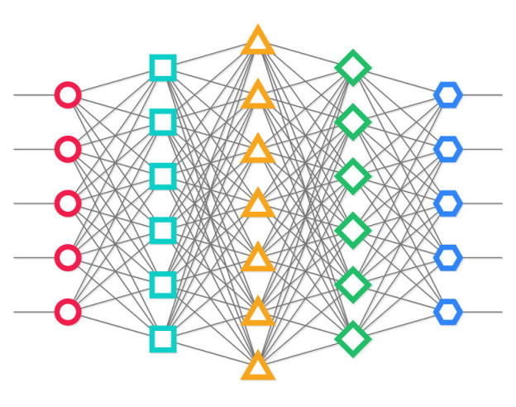
Methods for Event Selection
19/35
Cut-flow
Machine Learning
Boosted Decision Tree (BDT)
Neural Networks
Shallow Neural Network (NN)
Deep Learning
Deep Neural Network (DNN) 1410.3469, 1402.4735, 1803.01550

Slide 20
Methods for Event Selection
20/35
Cut-flow
Machine Learning
Boosted Decision Tree (BDT)
Neural Networks
Shallow Neural Network (NN)
Deep Learning
Deep Neural Network (DNN) 1410.3469, 1402.4735, 1803.01550
Convolutional Neural Network (CNN) 1708.07034
$$η$$
$$φ$$
color$−$particle type
size $—$energy or tansverse momentum

Slide 21
Pros and Cons
21/35
Cut-flow is simple but coarse, hurts signal events.
BDT can be viewed as an optimized version of cut-flow.
BDT is explainable, while NNs are hard to explain.
NNs are more powerful than BDT for non-linear mapping.
Most machine learning methods use fixed-length of inputs.

Slide 22
Event as Graph
22/35
Our Idea
Represent an event as a graph $G=\left(V, E\right)$
Encode each vertex into a state vector
Message passing between vertices
Each vertex votes the signal/background
Average the votes as the final result
$$E:$$
$V:$ $(0,0,1,0,m, E, P_{T})$
$$j$$
$$s_{2}$$
MP
$$s_{2}^{t}$$
encode
$$s_{1}$$
$$s_{1}^{t}$$
$$l$$
$$s_{3}$$
$$/$$
$$s_{3}^{t}$$
$$E$$
$$b$$
$$s_{4}$$
$$s_{4}^{t}$$
$$j$$
$$s_{5}$$
$$s_{5}^{t}$$
vote
S
average
S
signal or background
S
S
B

Slide 23
Graph Classification as Event Selection
23/35
The output value is called Score, which can be understood as the likeliness of the event being a signal.
Apply a cut on the score:
If $y≥θ_{y}$, keep the event.
If $y<θ_{y}$, drop the event.
As a result, most signal events and some background events are selected.
S
B
number of events
score
filtered out
selected
$$θ_{y}$$

Slide 24
Performance Index
24/35
Expected discovery significance is
$$\frac{S}{\sqrt{B}}=\frac{σ_{S}Lε_{S}^{0}}{\sqrt{σ_{B}Lε_{B}^{0}}}⋅\frac{ε_{S}}{\sqrt{ε_{B}}}$$
$S\text{, }B$: the number of selected signal and background events
$σ$: cross section
$L$: integrated luminosity
$ε^{0},ε$: efficiencies of preselection cuts and classifier
We define the expected relative discovery significance as ${ε_{S}}/{\sqrt{ε_{B}}}$

Slide 25
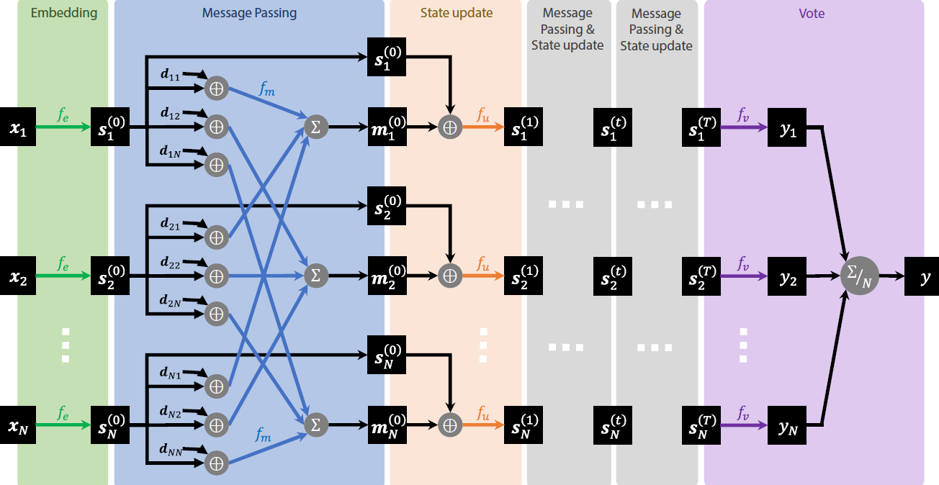
25/35
具体的操作（1）
Message Passing Neural Network

Slide 26
Neural Network Model
26/35
具体的操作（2）
Use one-hot-like encoding for object identity.
30-dim feature vectors
Distance measure using $ΔR=\sqrt{Δη^{2}+Δφ^{2}}$
Pair distances are expanded in a Gaussian basis (linearly distributed in [0, 5]) as vectors of length 21.
Use separate message and update functions for each iteration.
$f_{e}\left(\text{id},E,p_{T}\right)=\operatorname{relu}\left(W_{e}\left[\begin{aligned}\text{onehot}\left(\text{id}\right) \\ p_{T} \\ E\end{aligned}\right]+b_{e}\right)$
$f_{m}^{\left(t\right)}\left(s,d\right)=\operatorname{relu}\left(W_{m}^{\left(t\right)}\left[\begin{aligned}s \\ \text{e}\text{x}\text{pand}\left(d\right)\end{aligned}\right]+b_{m}^{\left(t\right)}\right)$
$f_{u}^{\left(t\right)}\left(s, m\right)=\operatorname{relu}\left(W_{u}^{\left(t\right)}\left[\begin{aligned}s \\ m\end{aligned}\right]+b_{u}^{\left(t\right)}\right)$
$f_{v}\left(s\right)=σ\left(W_{v}s+b_{s}\right)$
Training
relu: rectified linear unit (non linear trans)
计算速度快，广泛应用于深度学习中
Binary Cross-Entropy (BCE) as loss function.
Calculate gradients using error back-propagation.
Optimize network parameters using Adam algorithm.
Training with mini-batch of examples.
Adopt early stopping to prevent overfitting.
expand: 把距离展开到多个高斯基底上，
形成一个向量表示
$b_{e}$, $b_{m}$, $b_{u}$,${ b}_{s}$ : parameters
$W_{e}$, $W_{m}$, $W_{u}$,${ W}_{v}$ : linear transformations

Slide 27
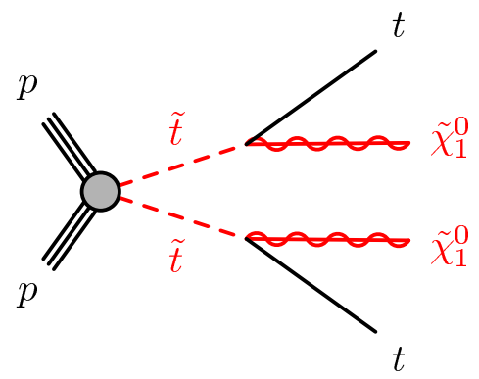
Search for stop-pair signal
27/35
The diagonal region of phase space ($m_{{\tilde{t}}_{1}}≈m_{{\tilde{χ}}_{1}^{0}}+m_{t}$) is hard to hunt
The momentum transfer from ${\tilde{t}}_{1}$ to ${\tilde{χ}}_{1}^{0}$ is small.
The stop signal is kinematically very similar to $t\overline{t}$ process.

Slide 28
Search for stop-pair signal
28/35
Generate events with ATLAS detector
MadGraph5 + Pythia8 + Delphes3 + CheckMate2
Signal events
$pp→{\tilde{t}}_{1}\overline{{\tilde{t}}_{1}}$
Background events
$pp→t\overline{t}$
Object reconstruction
Electron and muon
$p_{T}>10 \text{GeV}, \left|η\right|<2.5$
Jet
Anti-kt clustering ($R=0.4$)
$p_{T}>25 \text{GeV}, \left|η\right|<2.5$
B-tagging
80% efficiency
Preselection criteria
$N\left(l\right)=1$
$N\left(j\right)≥4$
$N\left(b\right)=2$
$\text{MET}>150 \text{GeV}$

Slide 29
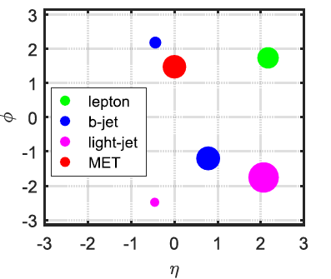
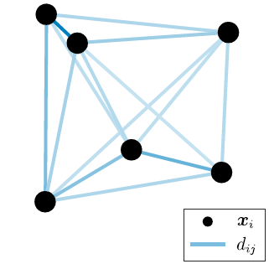
Search for stop-pair signal
29/35
encoding

Slide 30
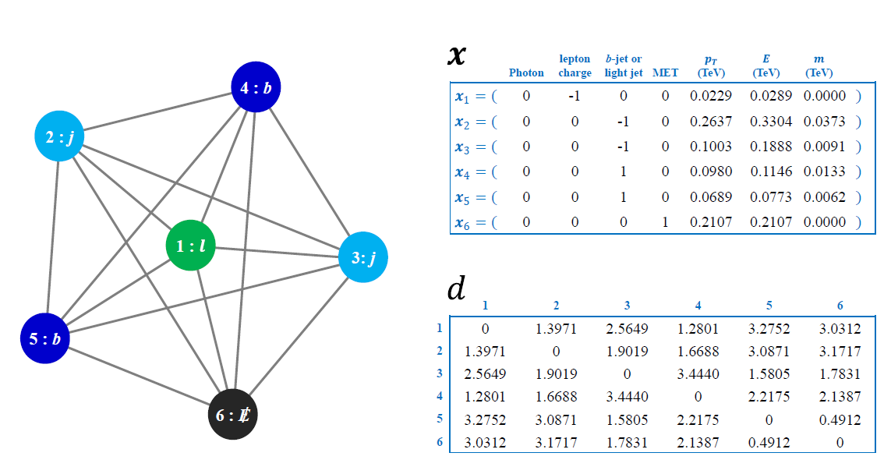
30/35
An event graph with detailed node features and distance
matrix, built from a Monte Carlo simulated event

Slide 31
Search for stop-pair signal
31/35
Training set
300,000 signal events and 300,000 background events
Validation set
100,000 signal events and 100,000 background events
Tools
BDT: scikit-learn
NN/DNN/MPNN: pytorch

Slide 32
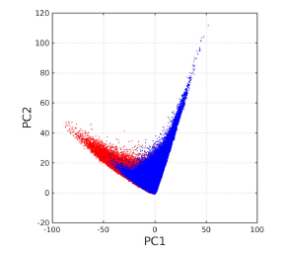
32/35
$$m_{{\tilde{t}}_{1}}=508 \text{GeV}$$
$$m_{{\tilde{χ}}_{1}^{0}}=330 \text{GeV}$$
The first two principle components of node state vectors $s_{i}^{T}$ of signal (red) and background (blue) events.

Slide 33
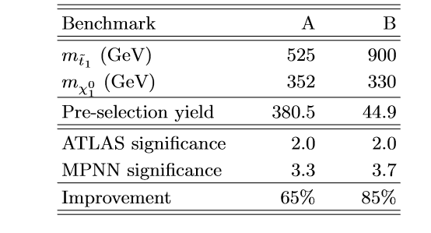
33/35
systematical uncertainty of backgrounds：10%

Slide 34
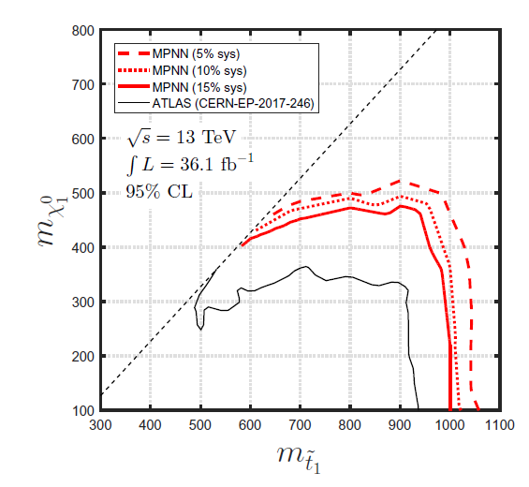
34/35

Slide 35
Conclusion
We propose to use machine learning for SUSY:
Machine learning scan in SUSY
Graph neural network in SUSY
$⋯⋯$
Thanks for your attention !

