Slide 1
Using hydrogen and helium isotopes to constrain CR propagation models
吴娟
中国地质大学（武汉）
第十五届粒子物理、核物理和宇宙学交叉学科前沿问题研讨会@Dandong 2018/08/21-2018/08/27

Slide 2
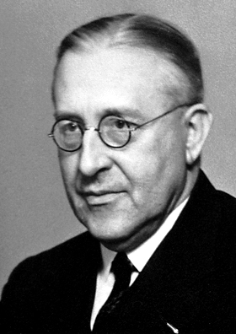
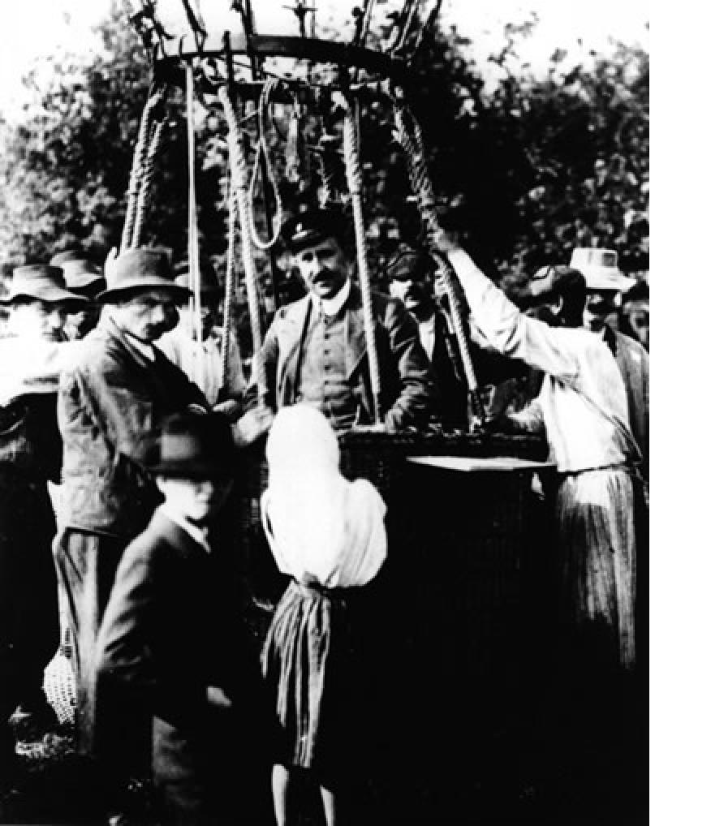
Victor Hess discovered cosmic rays in 1912 and won Nobel Prize in 1936.

Slide 3
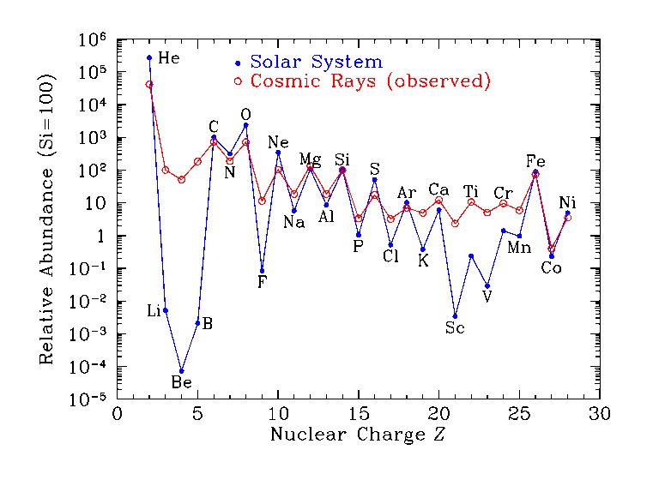
The CR composition
Primaries+Secondaries

Slide 4
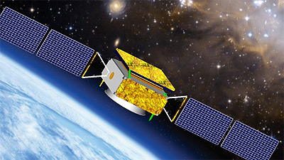
A picture of CR propagation
DAMPE

Slide 5
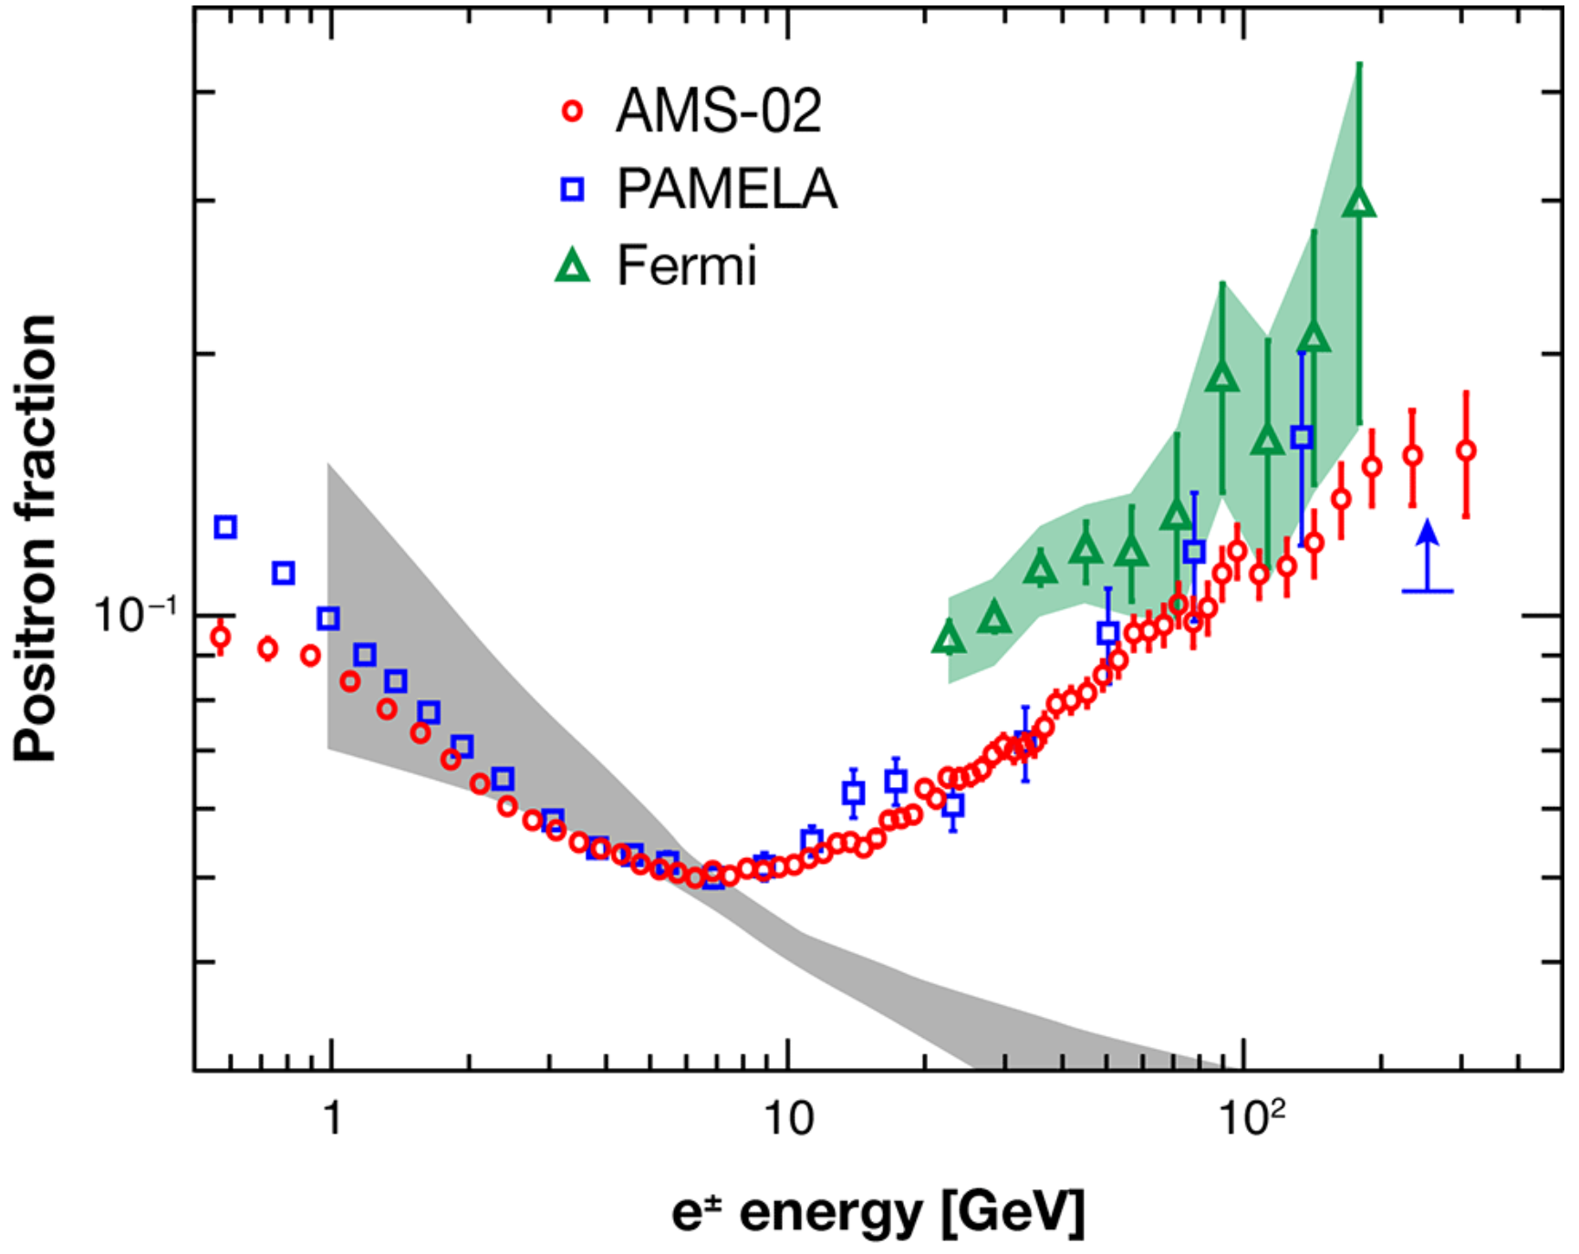
Positron excess
Taken from Coutu, Physics:Viewpoint 6, 40 (2013)

Slide 6
A picture of CR propagation
DAMPE

Slide 7
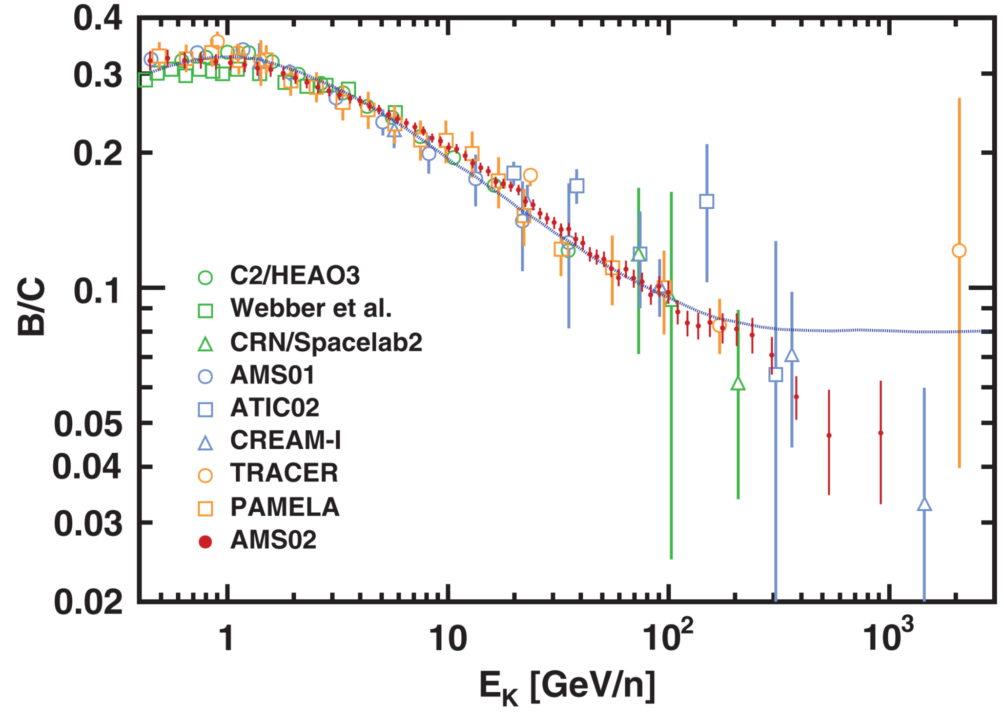
The S/P ratios
S/P ratios infer the CR propagation mechanisms
S/P+P allow a simultaneous scan on both transport and source parameters
The most commonly used one is the B/C ratio
The diffusion reacceleration model can naturally explain the peak around 1 GeV
Difficulties: antiproton discrepency
Johannesson et al. 2016: Z ≤ 2 CR species (p, pbar, He) might suffer different propagation mechanisms as heavier elements (Be, B, C, N, O)
PhysRevLett.117.231102
it is very important and necessary to use S/P other than B/C, such as ²H/⁴He and ³He/⁴He to investigate CR propagation processes.

Slide 8
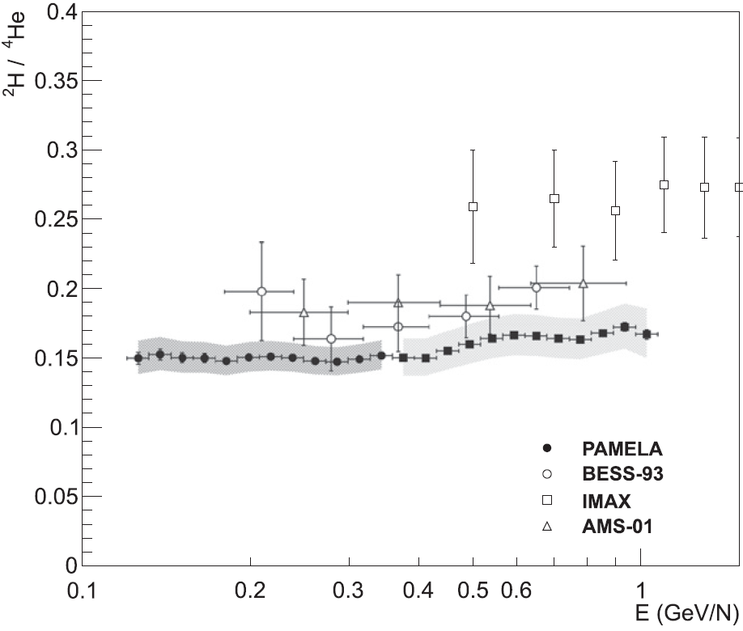
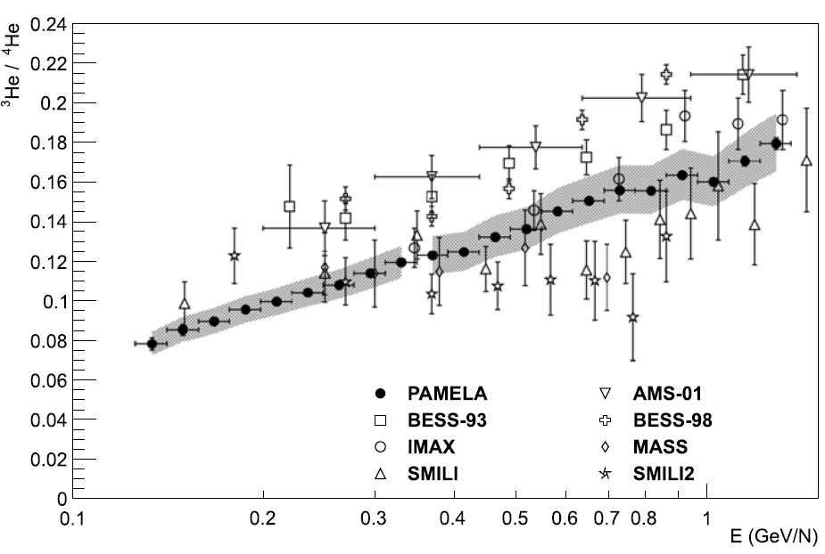
Data observed on Earth
Adriani et al., ApJ 818, 68 2016
Adriani et al., Science, 332, 69, 2011
Proton
Helium
Adriani et al., ApJ 818, 68 2016
Notes:
加点实验介绍

Slide 9
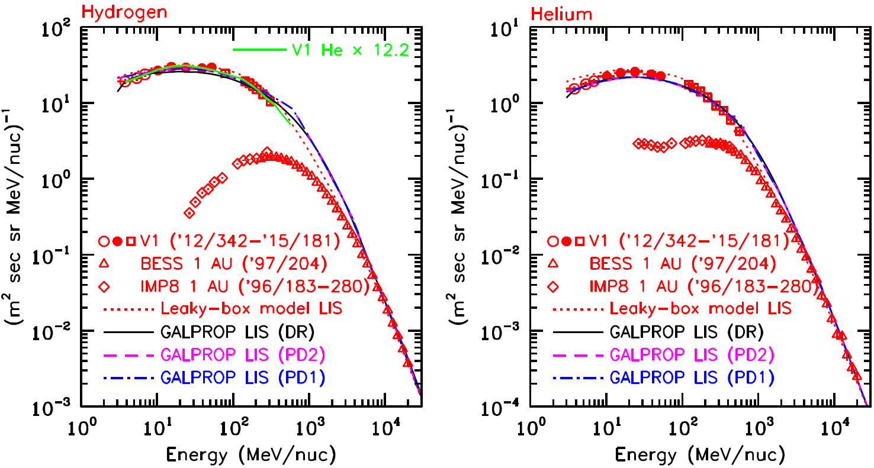
Data measured out of Solar System

Slide 10
Solar modulation
A most frequent used model: the force-field approximation
FF model: depend on a potential parameter Φ
A more physically motivated model: proposed in Cholis et al. 2016
CM model:
polarity of HMF
magnitude of HMF
related with time scale for CR drift
tilt angle of HCS
based on solar observations;
consider the charge-sign dependency
…
Notes:
加个solar wind的图，22年周期和11年周期的图

Slide 11
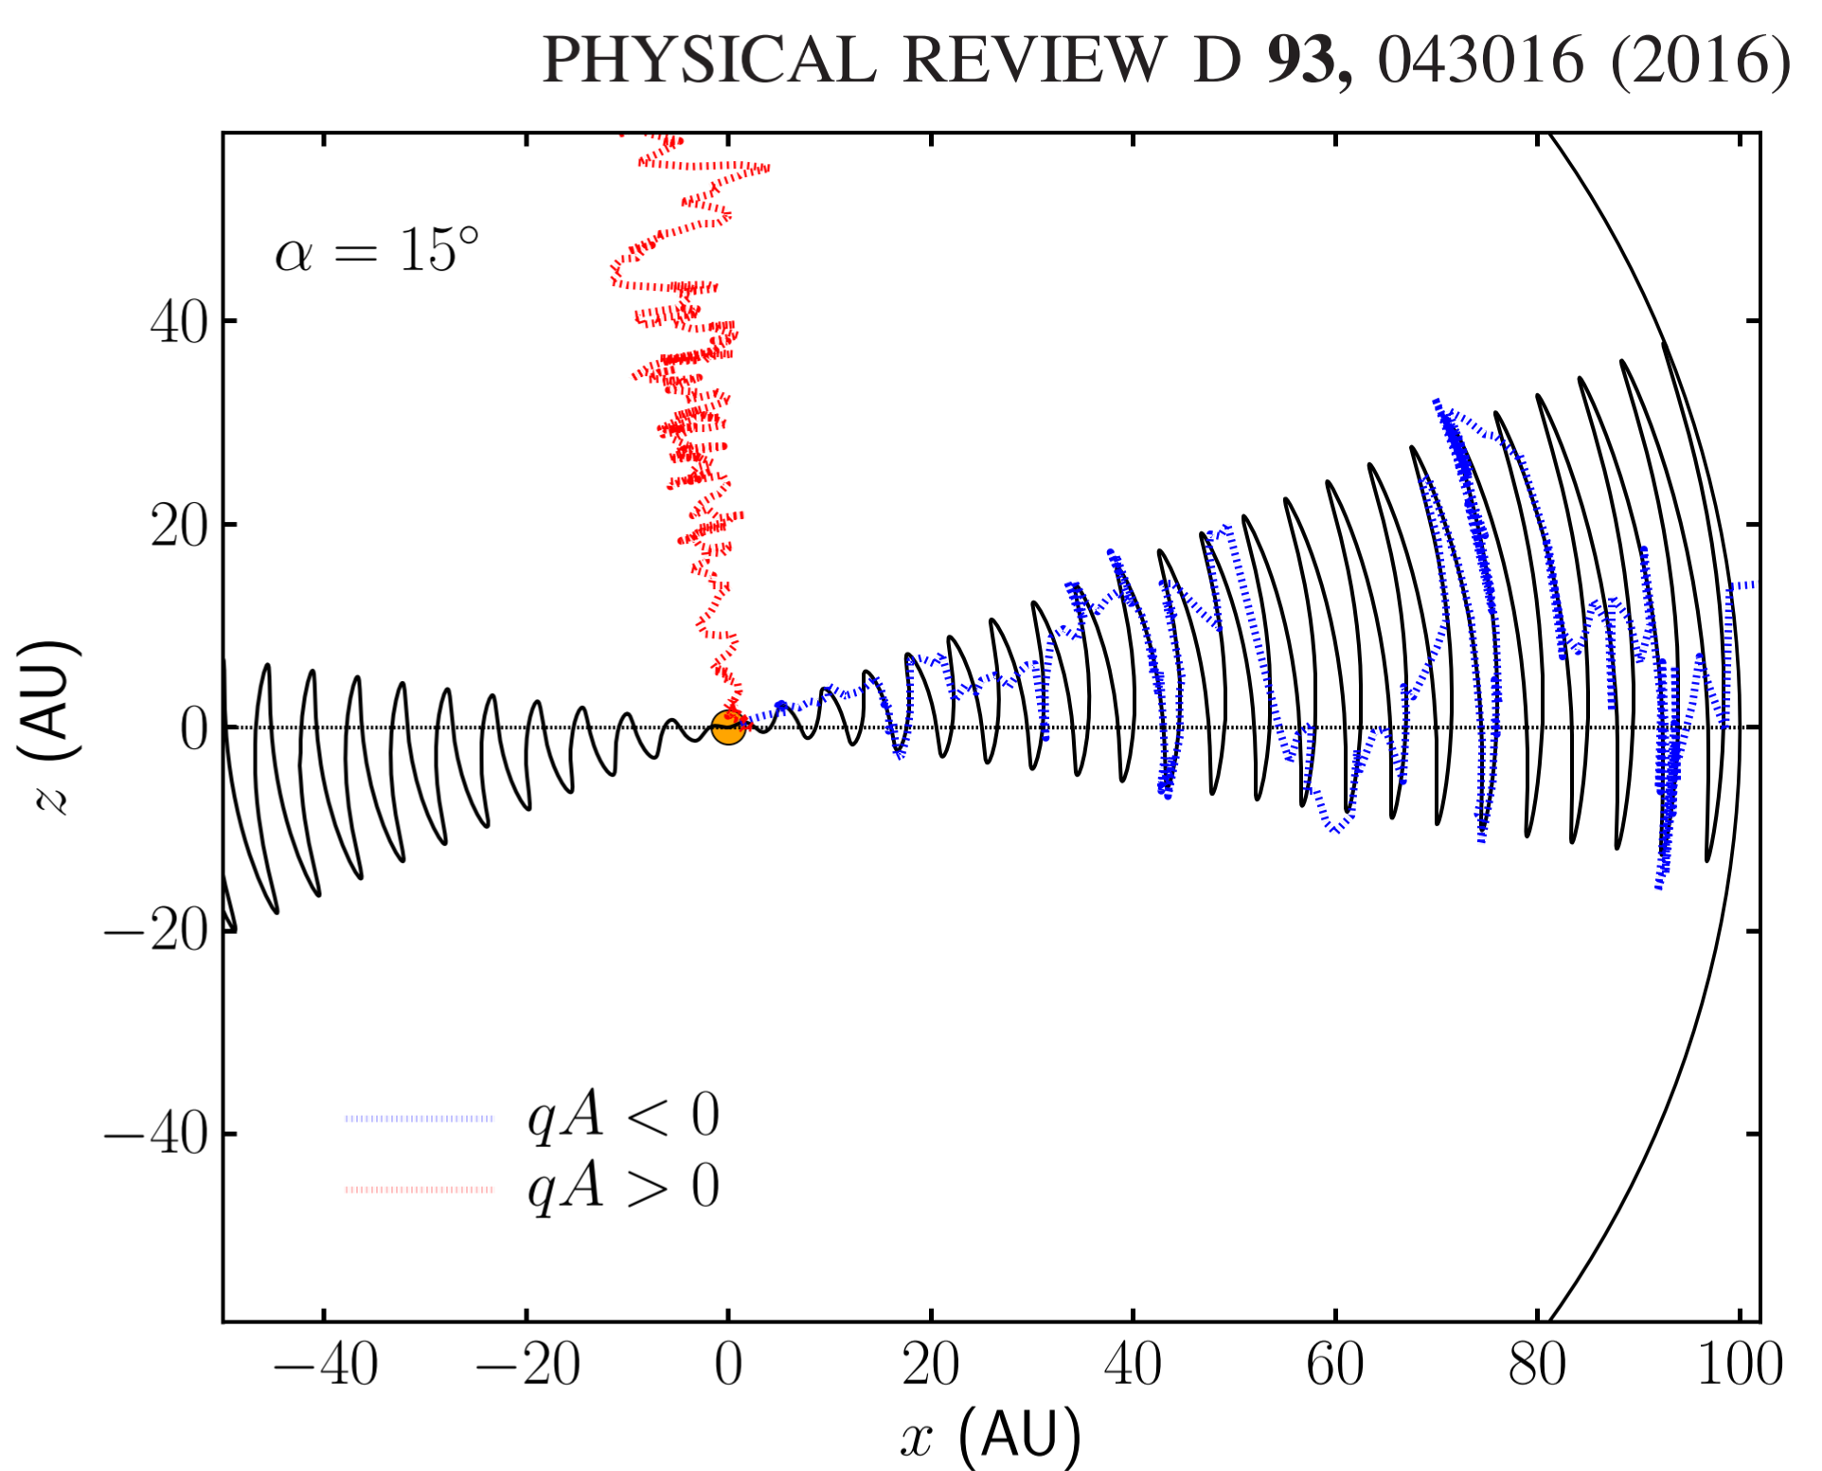
charge-sign dependency

Slide 12
Solar modulation
A most frequent used model: the force-field approximation
FF model: depend on a potential parameter Φ
A more physically motivated model: proposed in Cholis et al. 2016
CM model:
polarity of HMF
magnitude of HMF
related with time scale for CR drift
tilt angle of HCS
based on solar observations;
consider the charge-sign dependency
…
Notes:
加个solar wind的图，22年周期和11年周期的图

Slide 13
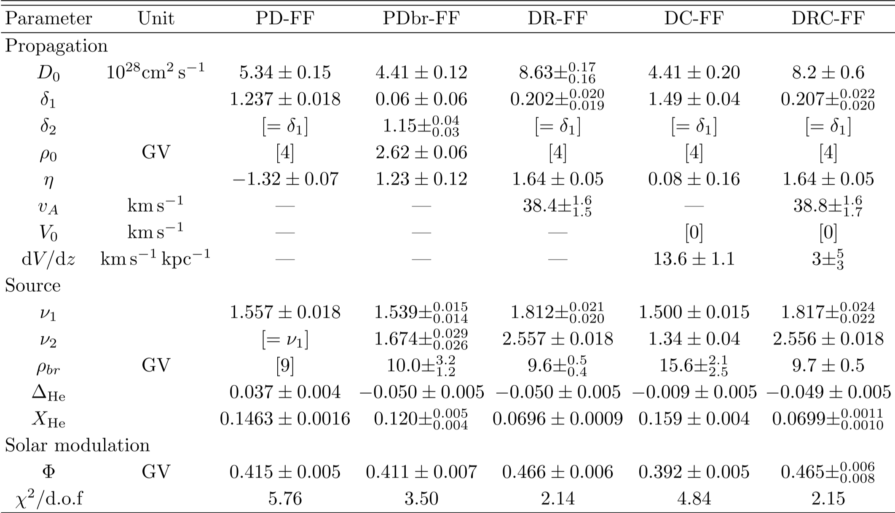
χ² minimization – GALPROP+FF
χ² not good!
Reacceleration fits better!
No convection is favored!

Slide 14
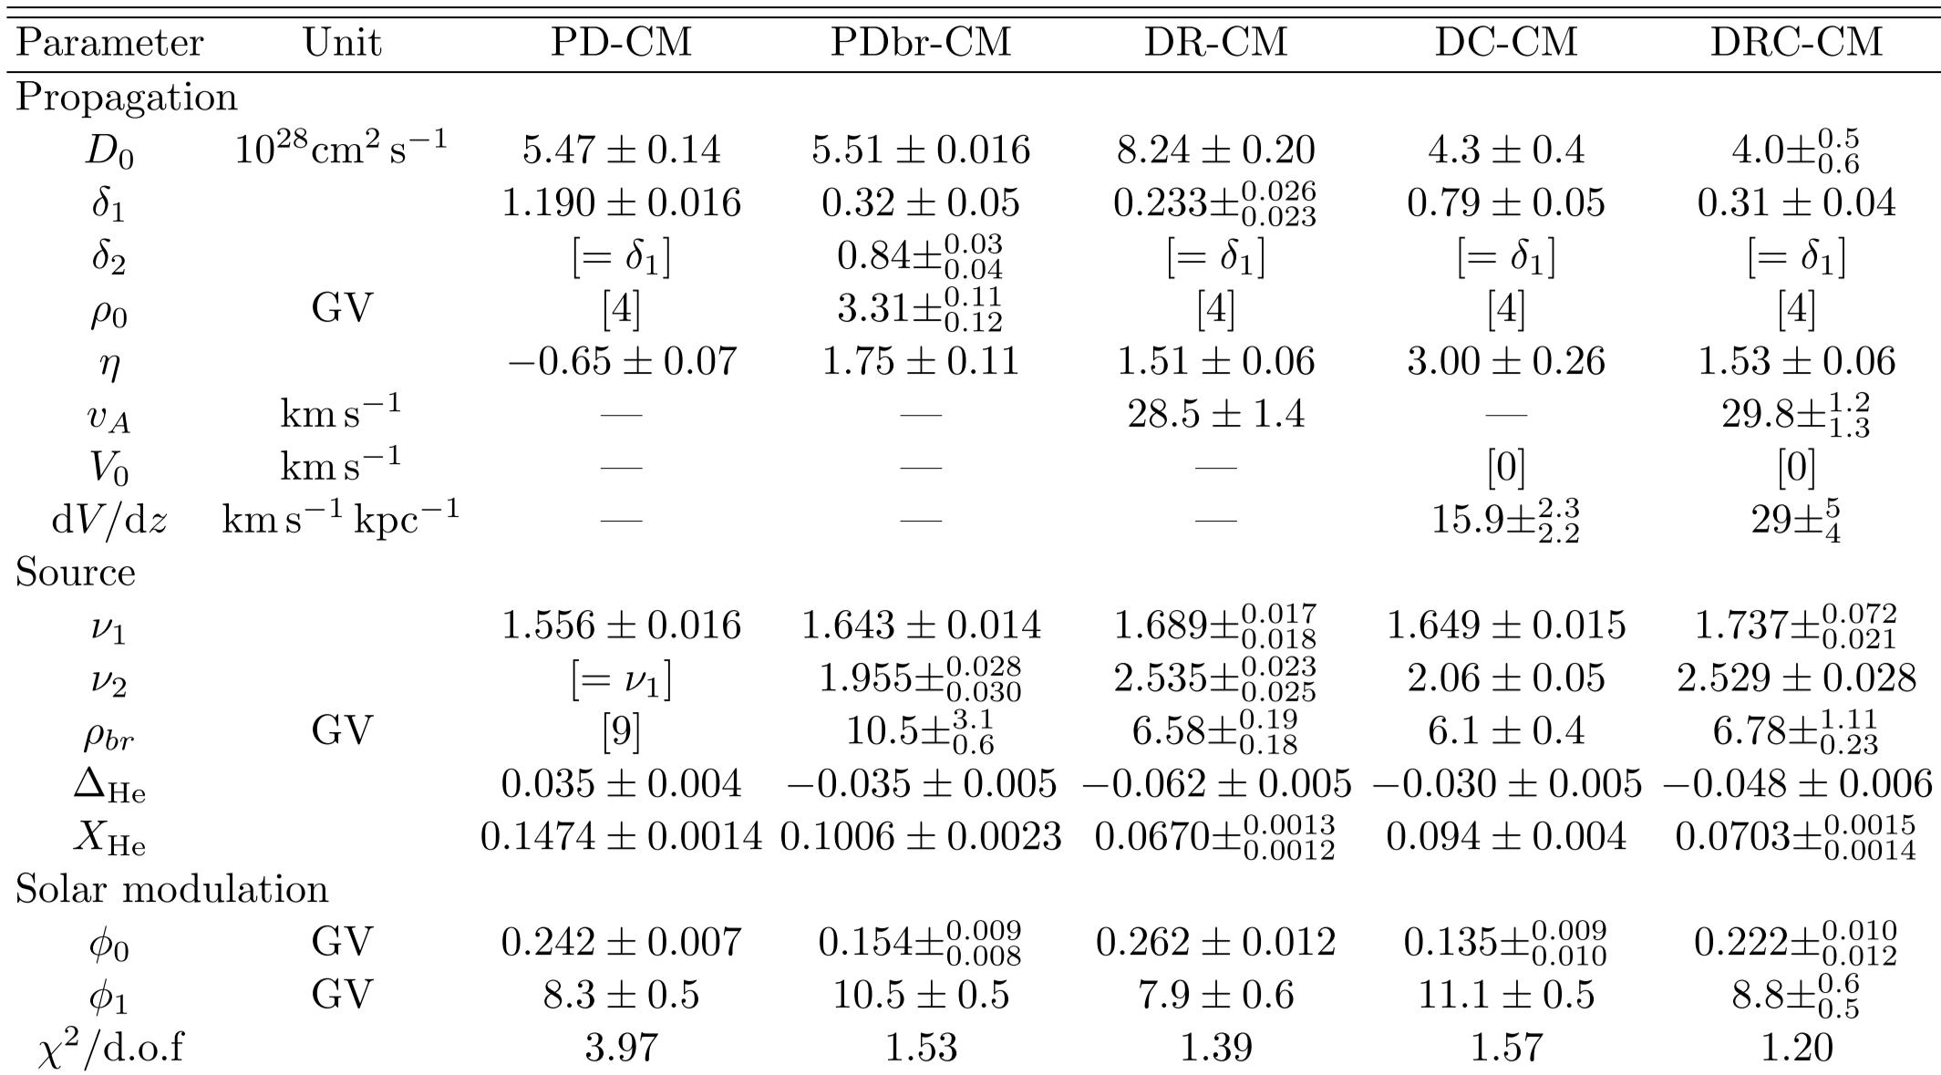
χ² minimization – GALPROP+CM
DRC give the best χ²
Kolmogorov-type turbulence is favored

Slide 15
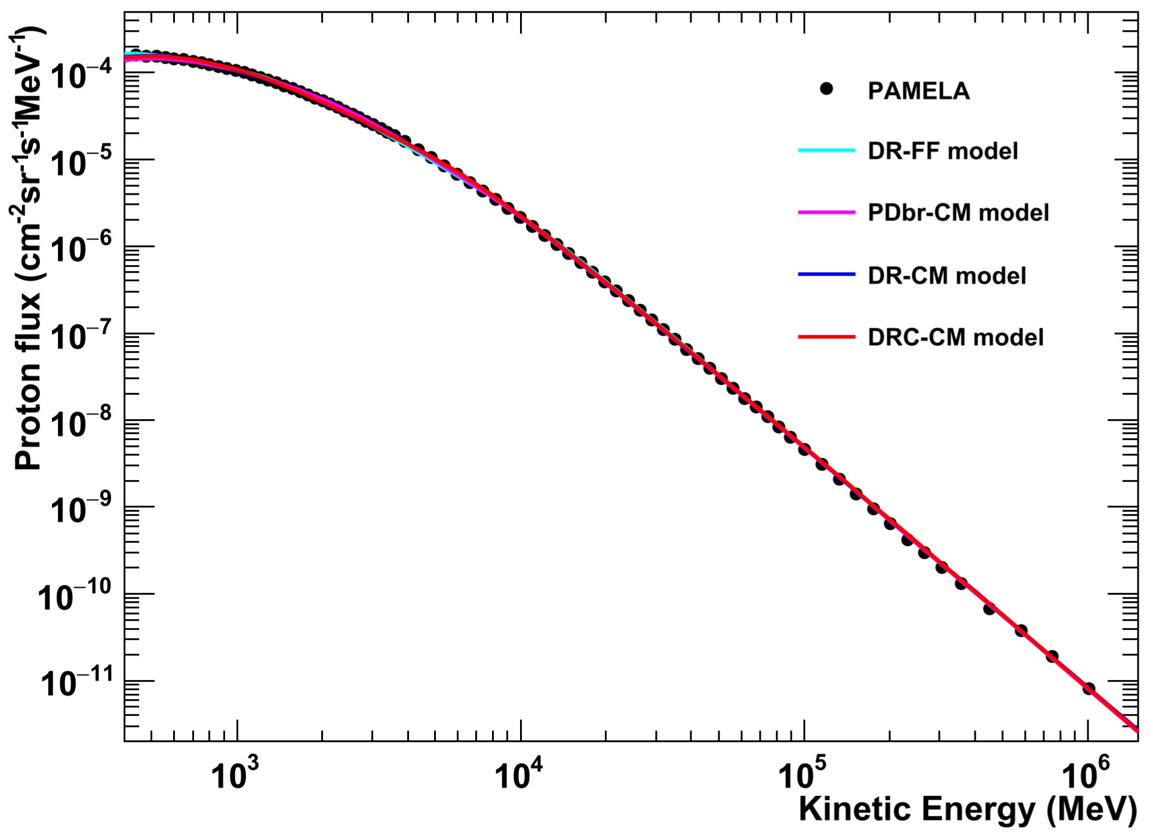
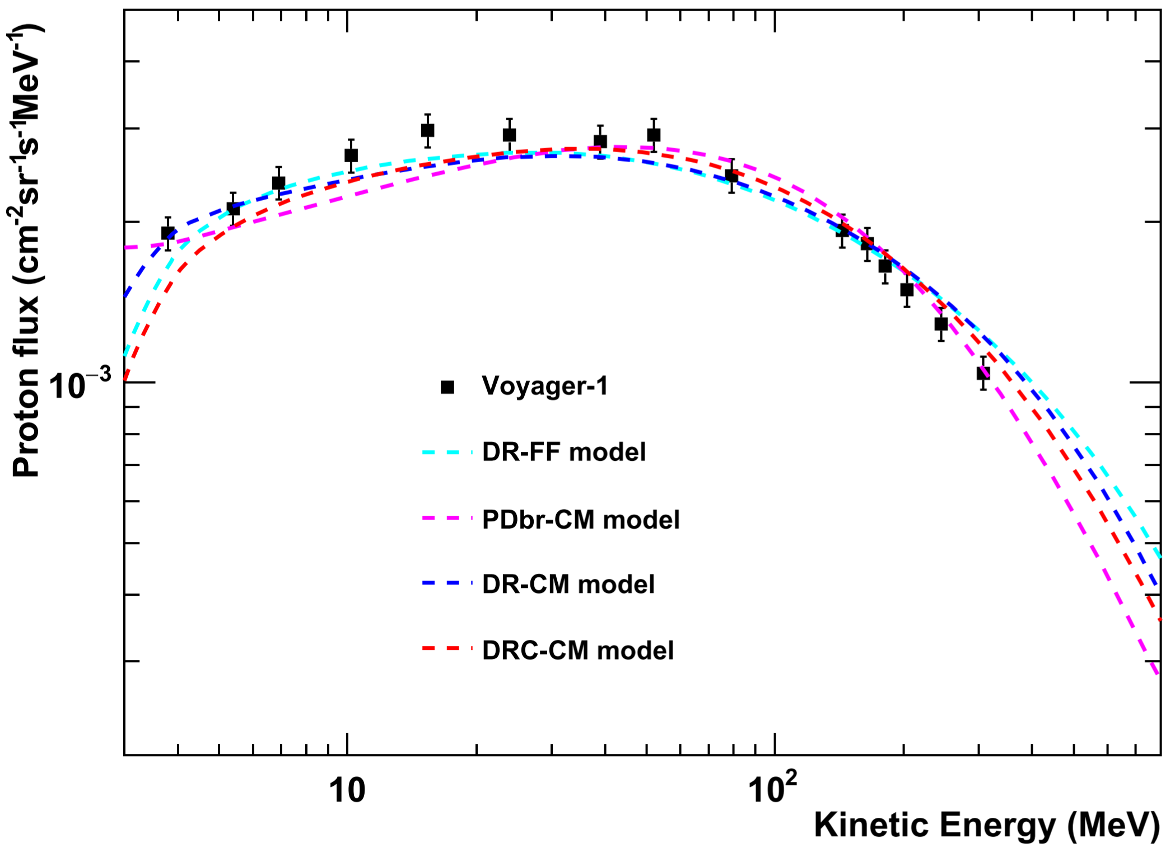
The proton flux
All the models list here can generally fit both the modulated and unmodulated proton fluxes

Slide 16
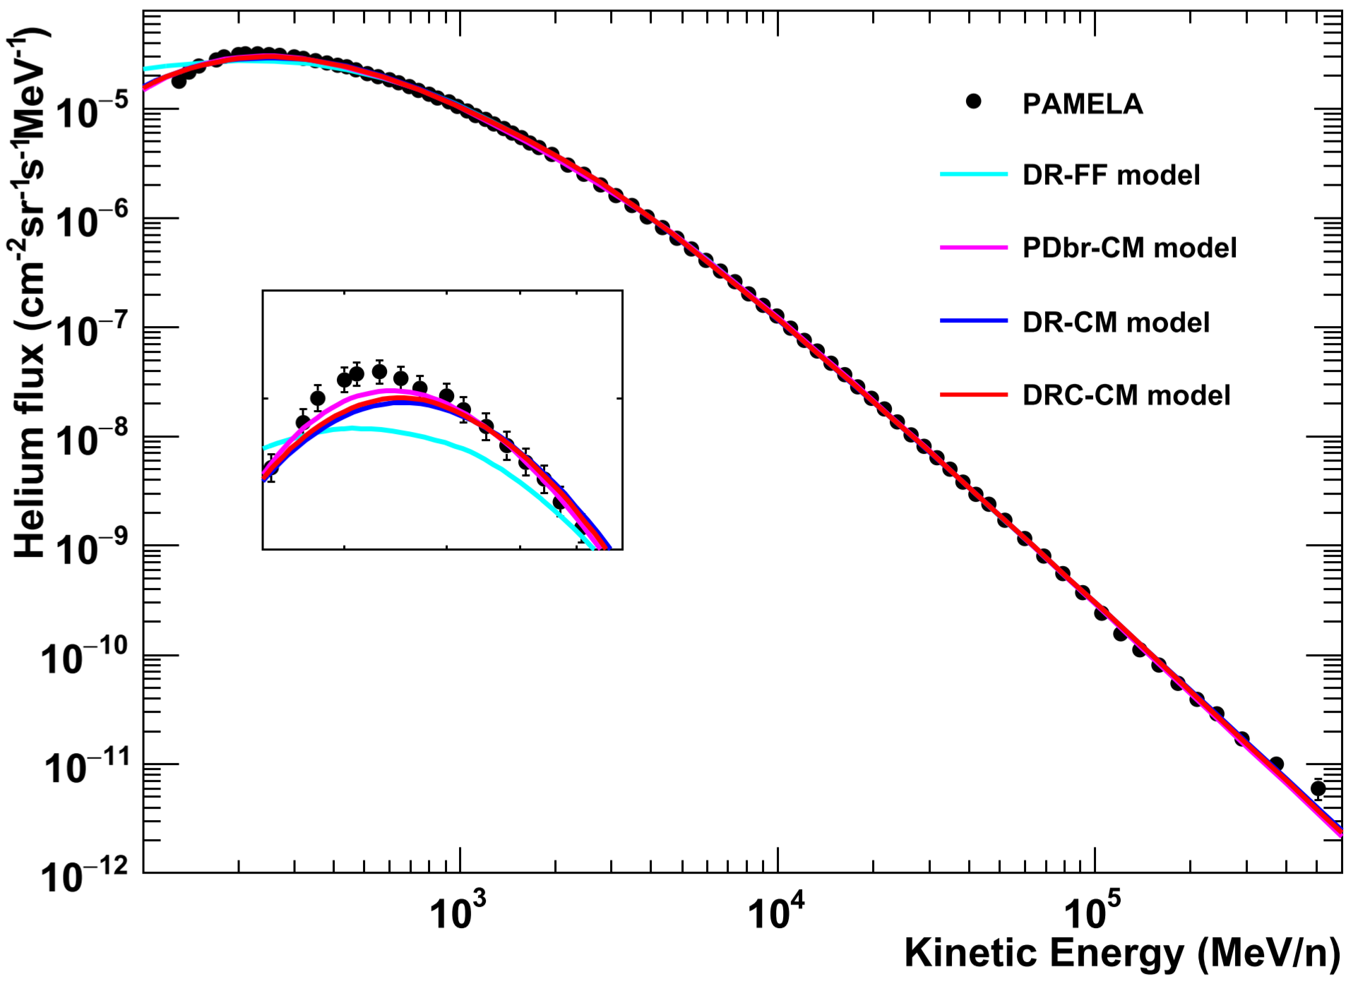
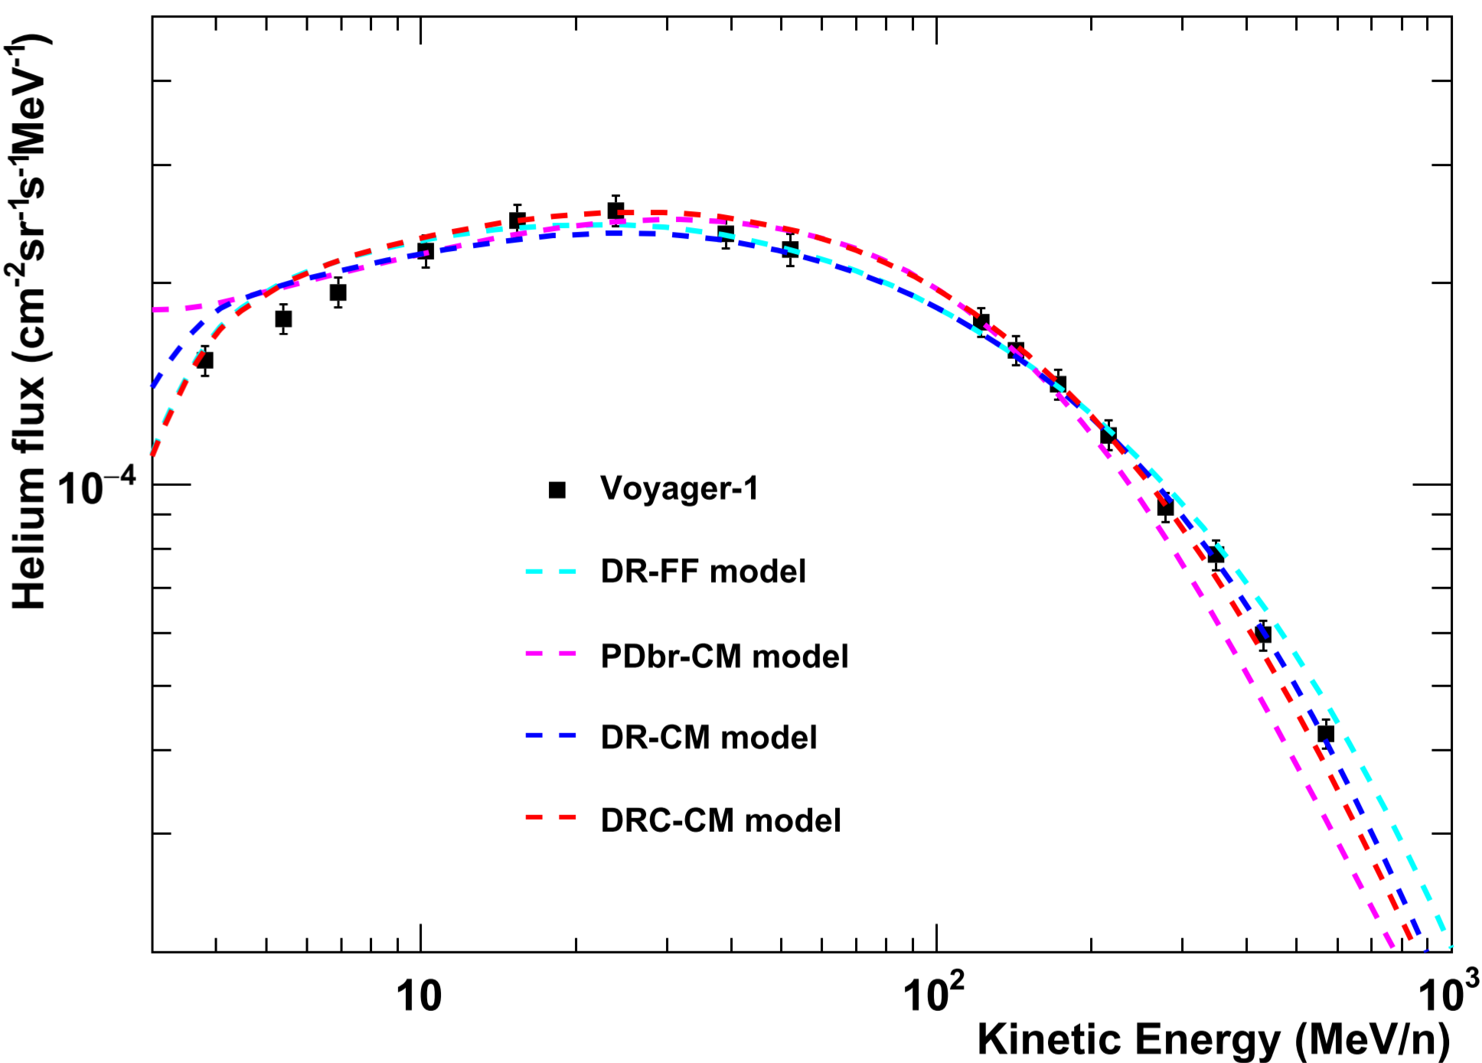
The helium flux
DR-FF does not fit PAMELA helium data well
PDbr-CM & DC-CM do not fit Voyager helium data well

Slide 17
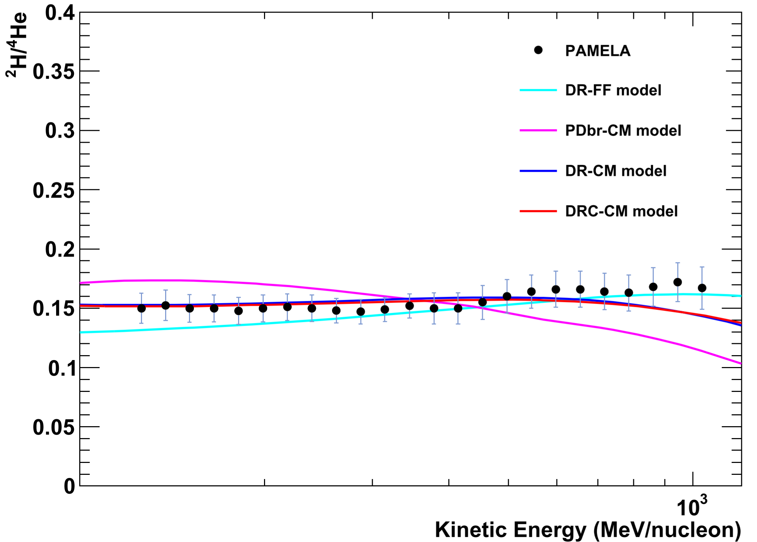
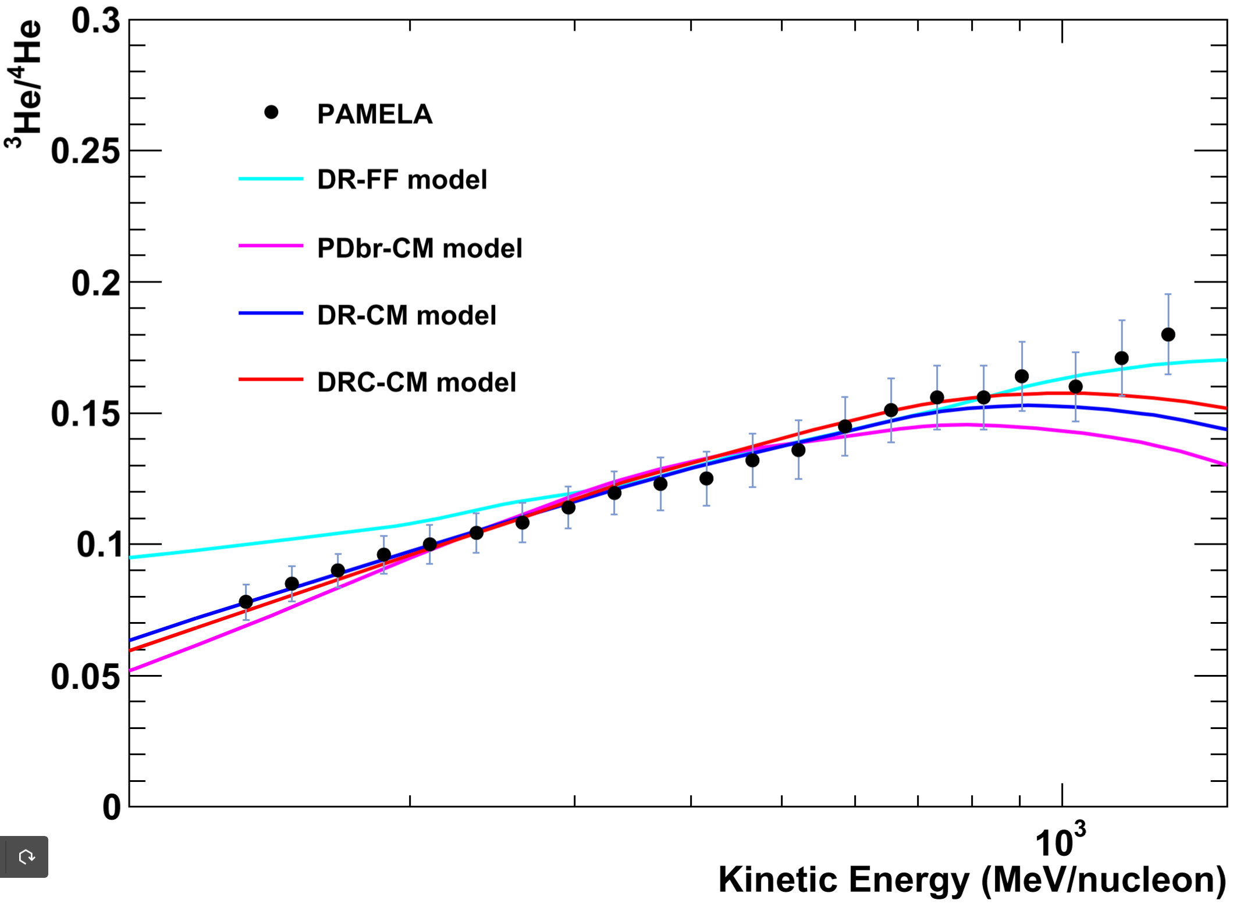
The ²H/⁴He and ³He/⁴He ratios
Only DR-CM &DRC-CM can generally reproduce the ²H/⁴He and ³He/⁴He ratios
²H/⁴He and ³He/⁴He data place strong constraints on CR propagation models

Slide 18
The Bayesian analysis
Motivation:
Correlations between parameters can be studied
Credible intervals on parameters and on fluxes can be produced efficiently.
Models under studied can be compared by the Bayesian evidences.
Studied models:
DR-CM and DRC-CM models which can describe the Z<=2 data well as shown in χ² study

Slide 19
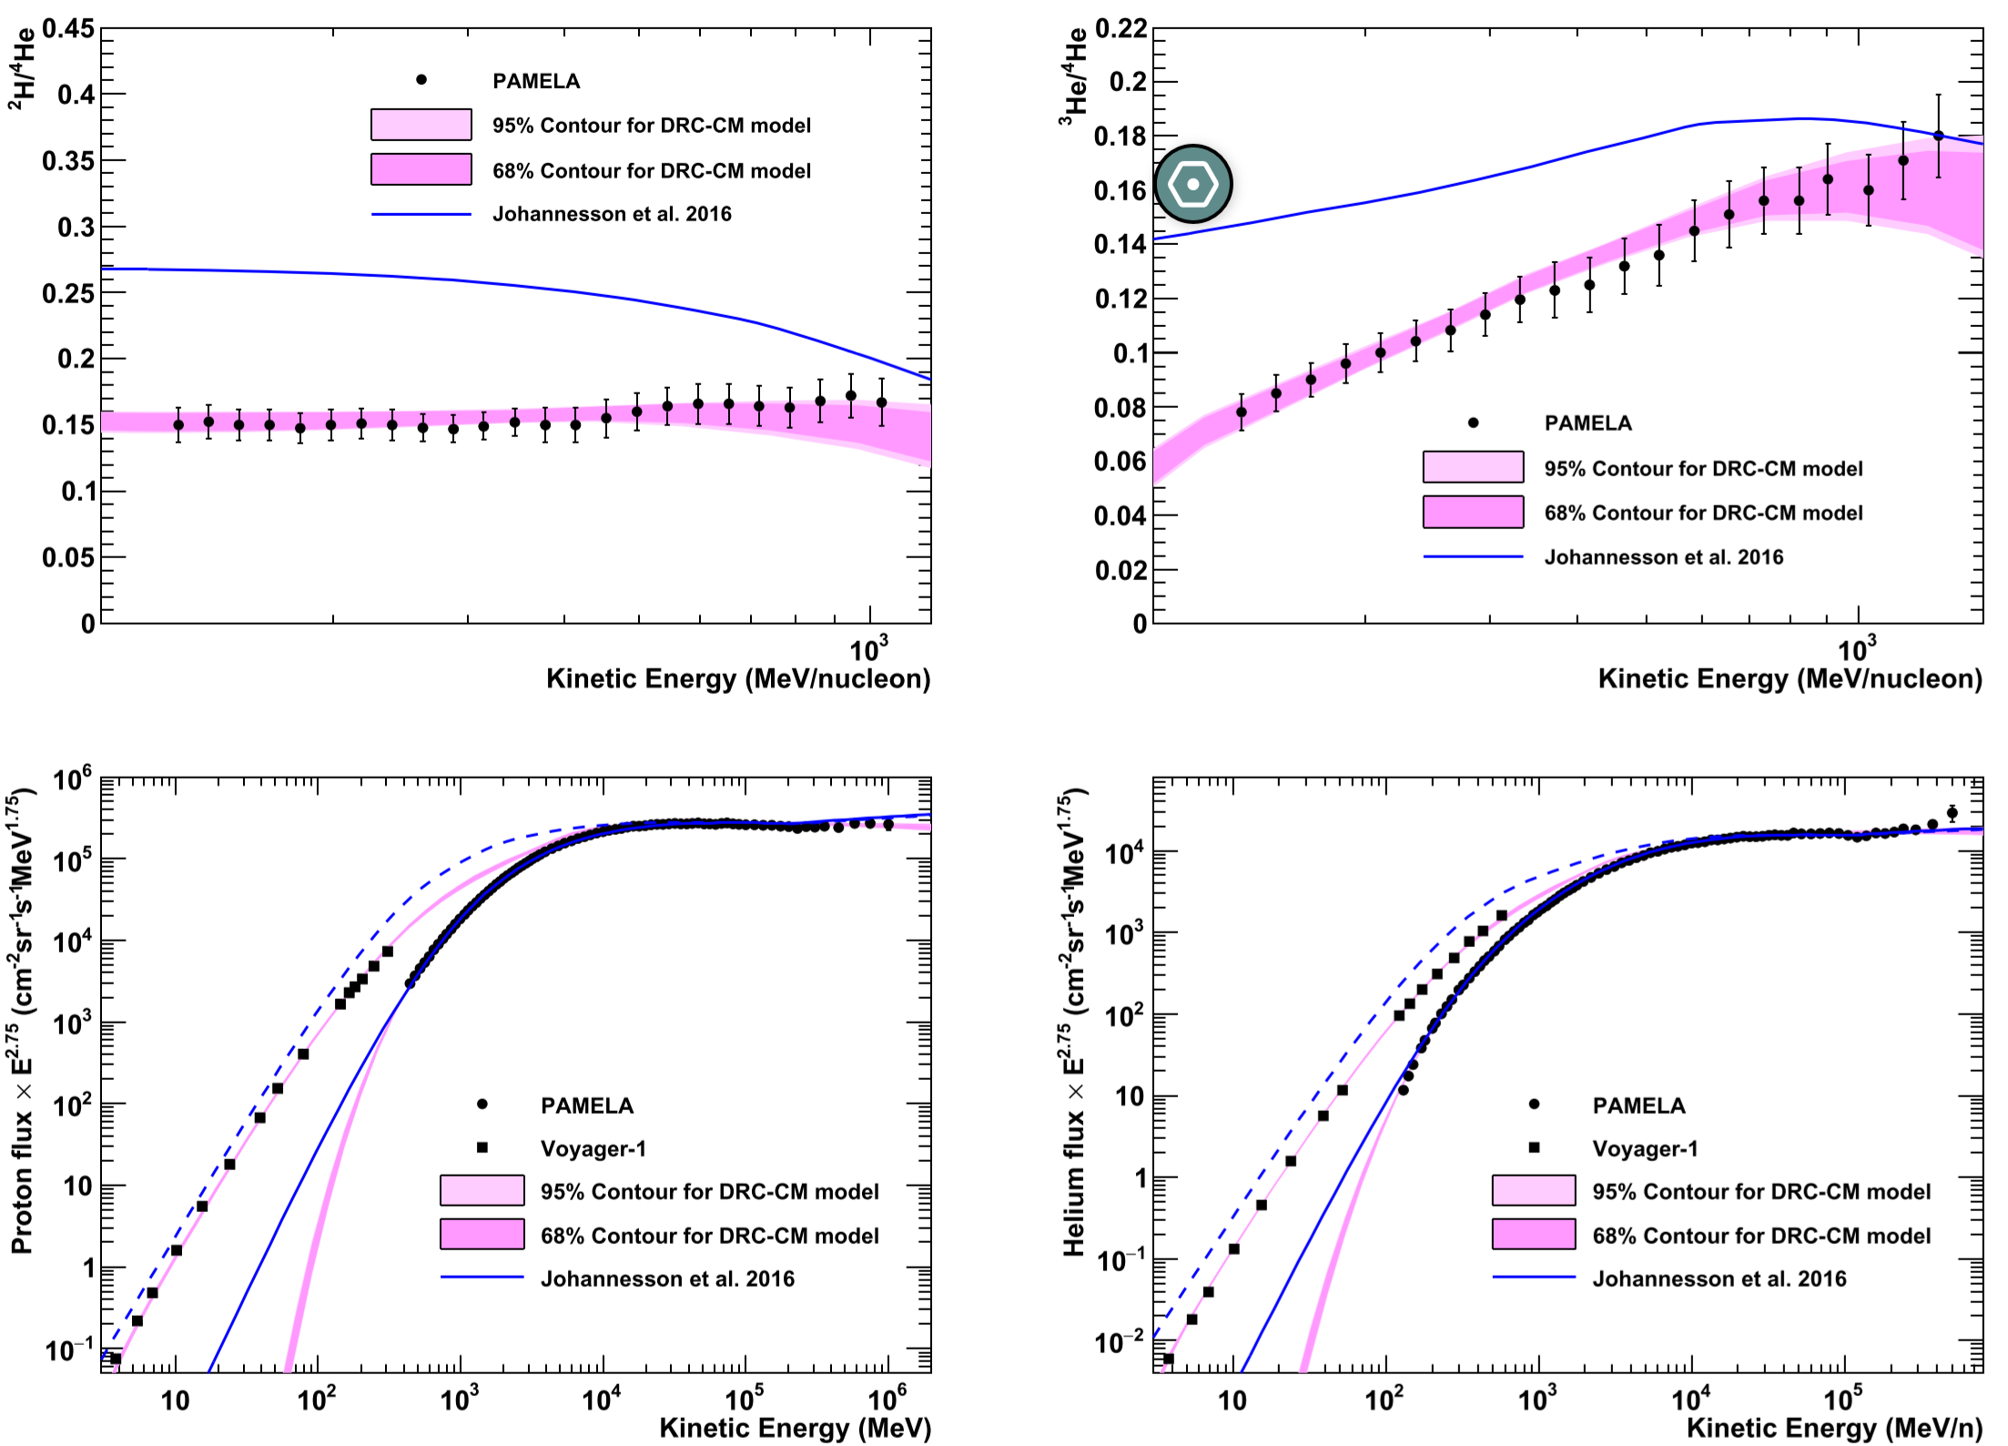
The Bayesian analysis
: DRC-CM is the best model

Slide 20
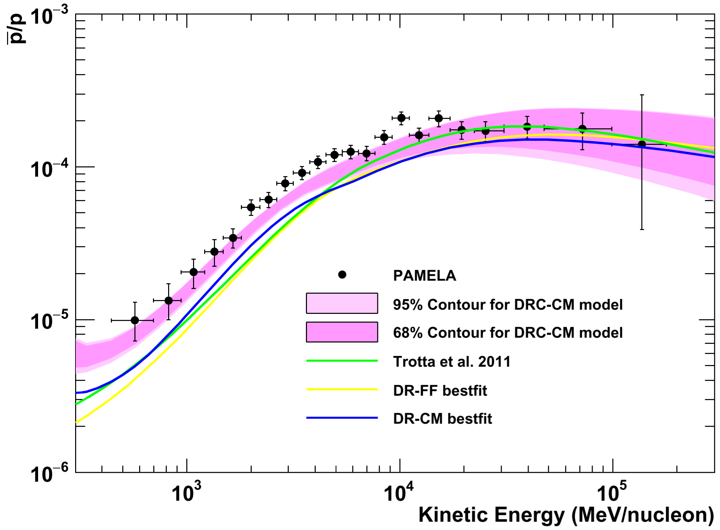
The antiproton prediction
All the DR models underpredict the pbar/p ratio.
Though the antiproton data was not involved in the fitting procedure, the DRC-CM model can describle the antiproton data well.

Slide 21
Summary and outlook
The cosmic ray propagation models were tight constrained by using the ²H/⁴He and ³He/⁴He data.
The CM solar modulation model can explain the data better than the FF model.
The DRC model is the best model to explain the Z<=2 data, especially this model can generally describe the pbar/p ratio not involving in the fitting procedure.
The Kolmogorov-type of interstellar magnetic is favored, while the Kraichnan-type is excluded.
AMS-02 measurements cover a HMF reversal period, for which the solar modulation should be treat more carefully. These data will be further studied in future.

Slide 22
SPARES

Slide 23
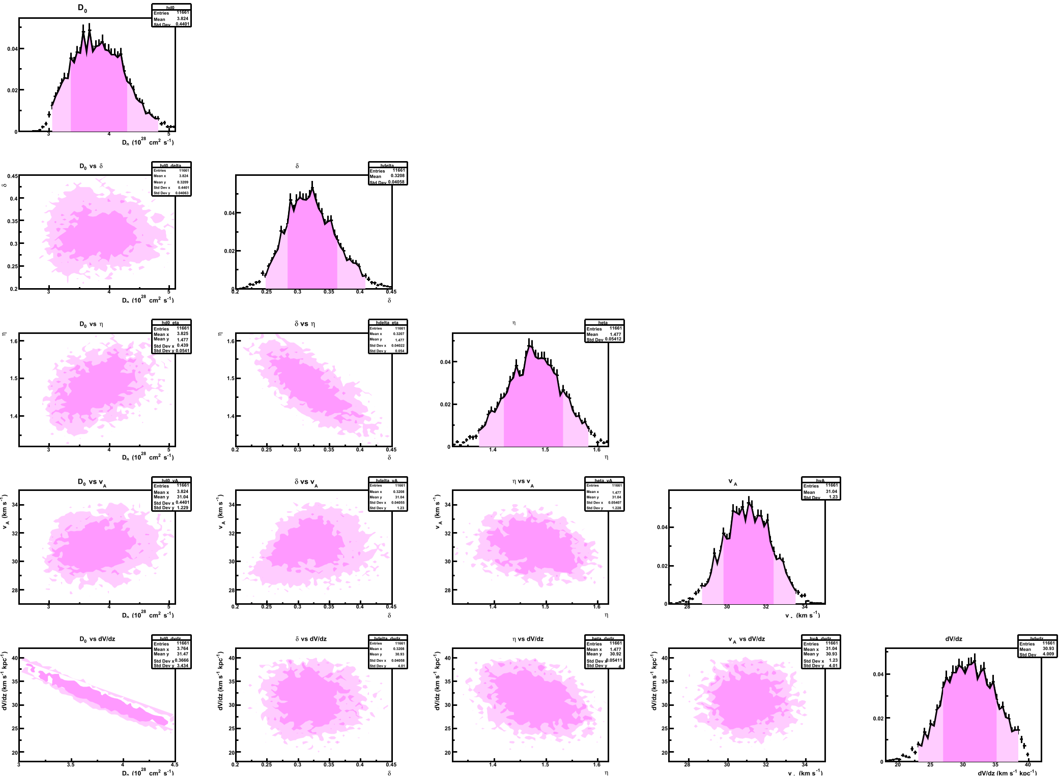
Parameter correlation

Slide 24
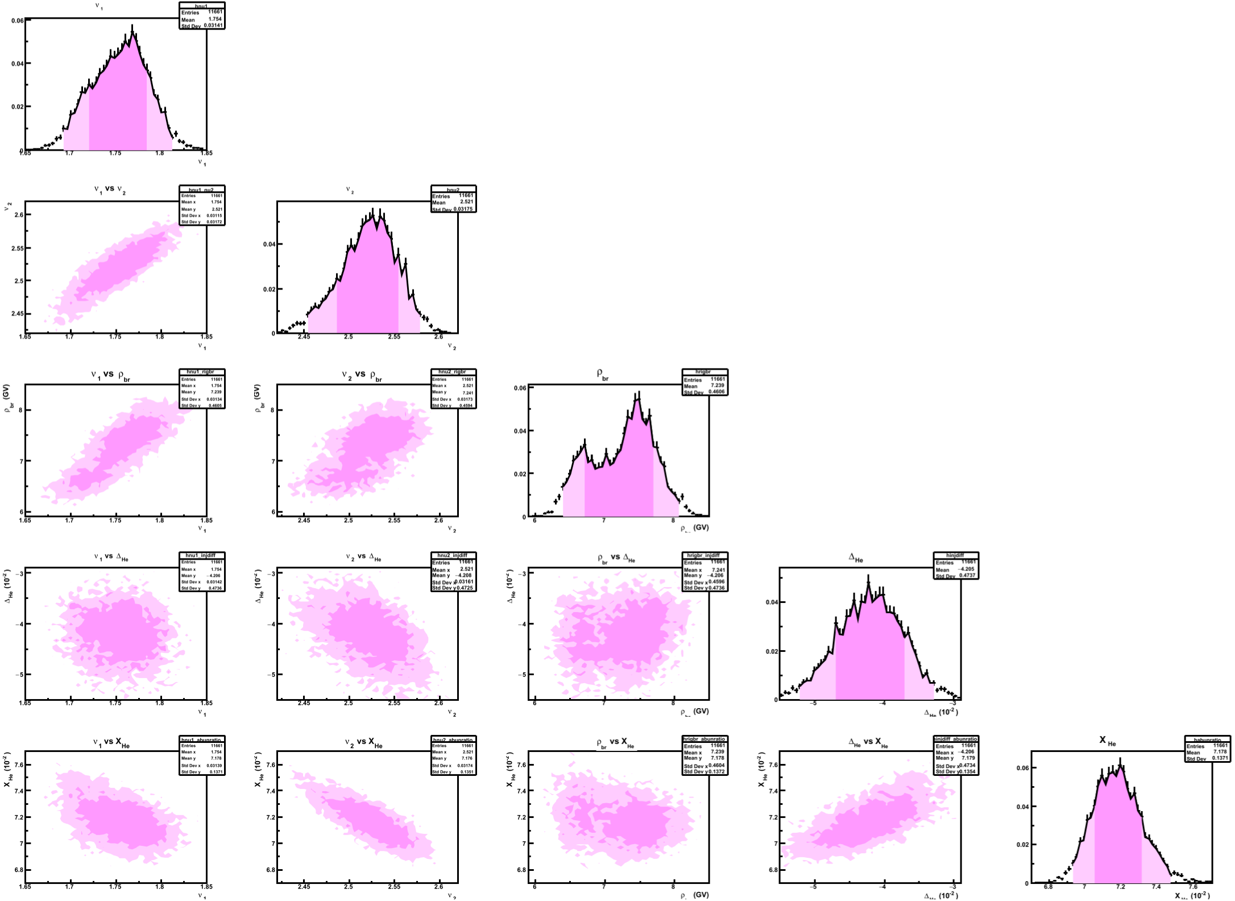
Parameter correlation

Slide 25
Propagation equation
Basic mechanisms: diffusion, convection, diffusive reacceleration
spallation and decay of heavier nuclei
q_{A}(p)=N_{A}(ρ/ρ_{br})^{-ν}
D_{xx}=D₀β (ρ/ρ₀)^{δ}
V_{c} (z) = V (0) + z*dV/dz
sources: SNRs
diffusion
convection
nuclear destruction &
radioactive decay
diffusive reacceleration
energy losses: ionization, Coulomb scattering
adiabatic loss
D_{pp}D_{xx}~p²v_{A}²
parameters under study: D₀, δ, dV/dz, v_{A}, ν,N_{A}

