Slide 1

A divergent volume
for black hole
implicates no firewall
张 保 成
2018年粒子物理、核物理和宇宙学交叉学科前沿问题研讨会 辽宁丹东

Slide 2
Outline
Information loss paradox
Black hole interior
Entropy associated with interior
No firewall for infinite interior

Slide 3
Information loss paradox

Slide 4

A black hole
A black hole is often defined as an object whose gravity so strong that the light can not escape. This is a classical description.

Slide 5

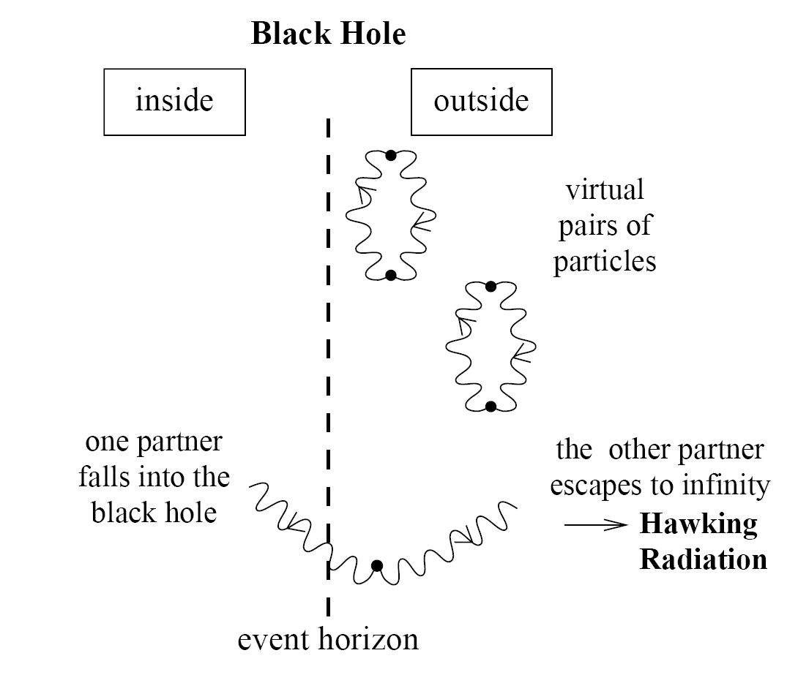

Black hole radiation
Classical black hole
Quantum black hole
Physical explanation
This picture leads to some severe problems!

Slide 6
Information loss paradox
Irrespective of what initial state a black hole starts with before collapsing, it will evolves eventually into a thermal state after being completely exhausted into emitted radiations.
Fuzzballs; Firewalls; Remnants; AdS/CFT;
Baby universe; Final State Projection; ……
S. W. Hawking, Phys. Rev. D 14, 2460 (1976).

Slide 7
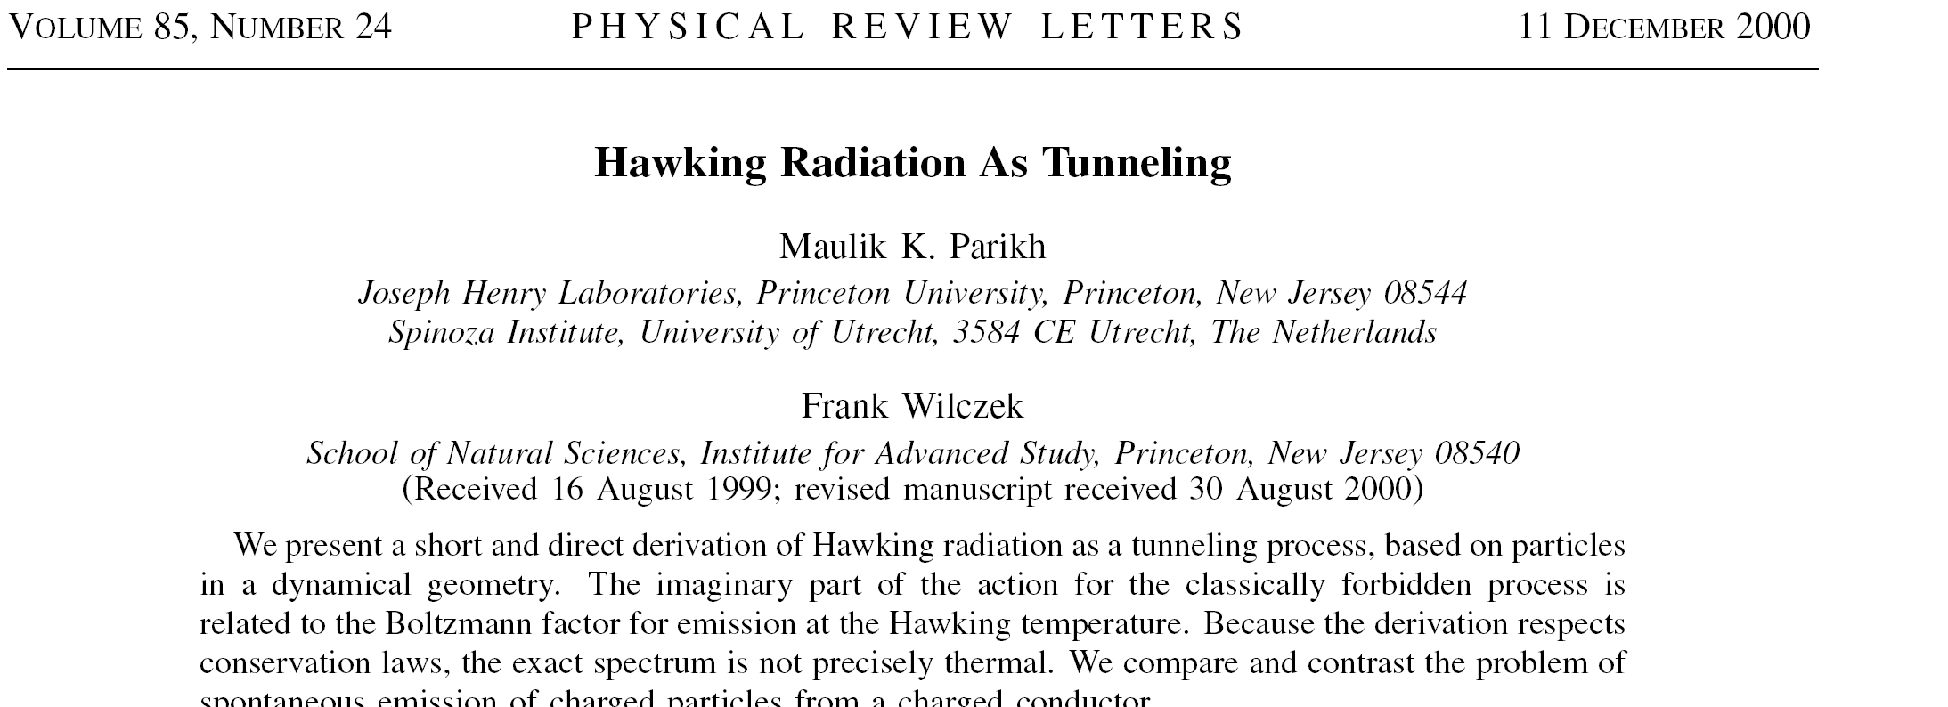
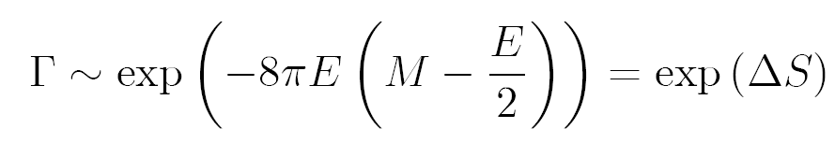
Hawking radiation as tunneling
Departing from thermal spectra!

Slide 8
The non-thermal spectrum
It recovered Hawking’s original result in leading order
and gave a consistent temperature expression.
It gave a direct relation between tunneling
probability and black hole entropy. It implies the
relation between tunneling and thermodynamics.
The non-thermal spectrum open the window to discuss the possibility of information-carrying correlation.
B. Zhang, et al., PLB 671, 310 (2009)
B. Zhang et al., Phys. Lett. B 665, 260 (2008)；B. Zhang et al., EPJC 68 561 (2010)

Slide 9
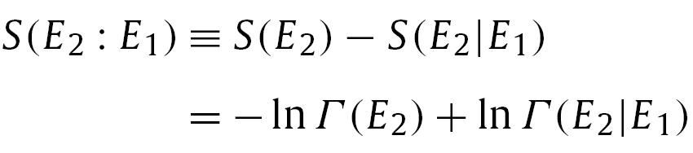




A non-thermal spectrum
Is there correlation existed in the non-thermal spectrum?
Could the correlation carry away information about the in-fallen matter?
Could the correlation cancel the entropy increase or the entropy is conserved in the radiation process?
B. Zhang et al., PLB 675, 98 (2009); Annals of Physics 326 350 (2011); EPL 94, 20002 (2011); PRD 87, 044006 (2013);
B. Zhang et al., IJMPD 22, 1341014 (2013); First Prize in 2013 Easy Competition of Gravity Research Foundation

Slide 10


Physical picture
……
Number of microstates
Define a microstate
Microcanonical ensemble: all microstates of an isolated system are equally likely, so the number of microstates of black hole are
Thus non-thermal spectrum accords with quantum interpretation！
B. Zhang et al., GRG 43, 797 (2011)

Slide 11
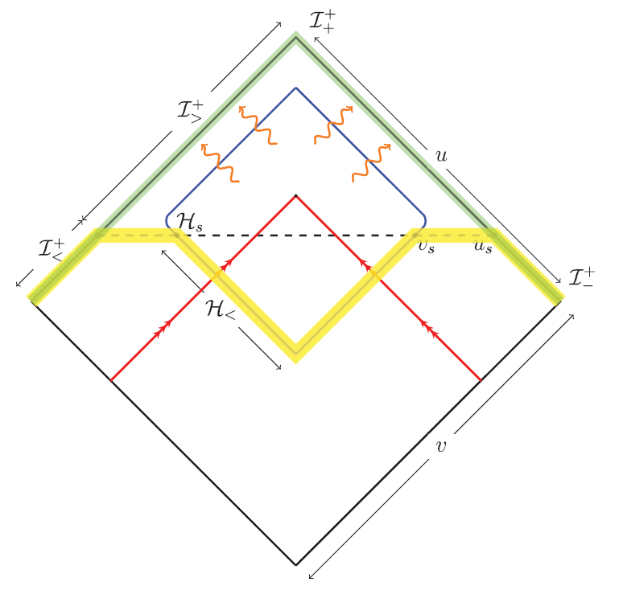

When the radiation could begin
In semi-classical limit, the formation process is essentially complete long before the evaporation turn on.
Hawking, Perry, and Strominger,
PRL 116, 231301 (2016)
A potential problem is that when a black hole forms but the radiation does not begin, where the information should stay in?

Slide 12
Black hole interior

Slide 13


Black hole interior
There exists a transformation that tranferrs the inside metric of a Schwarzschild BH into that similar to collapsing universe
That black hole radiation can be considered as equilibrium state implies that a volume can exist thermodynamically and mathematically.
FRW metric
S. M. Carroll, et al, J. High Energy Phys. 11 (2009) 094

Slide 14




Volume of black holes
There are some slicing invariant definition
Recently, an interesting definition for collapsed BH: The volume inside a two-sphere S is the volume of the largest spacelike spherically-symmetric surface bounded by S. Its expression (CR volume)
M. K. Parikh, Phys. Rev. D 73, 124021 (2006) and others
M. Christodoulou and C. Rovelli, Phys. Rev. D 91, 064046 (2015)

Slide 15
CR Volume
The volume for collapsing black holes
For Schwarzschild black holes, it is a very large volume, so is there enough degrees of freedom in such space for the interpretation of BH entropy?

Slide 16
Entropy associated with the interior

Slide 17



Asymptotic static
The inner metric which is not static
Is it possible to describe quantum states inside?
Thus it makes sense for entropy in the volume

Slide 18






Entropy in the volume
Due to uncertainty relation, one quantum state corresponds to a “cell” of volume, so the number of quantum states in the phase space labeled by
Consider scalar fields, a constraint from Klein-Gordon Eq.
The number of quantum states with energy less than E is

Slide 19
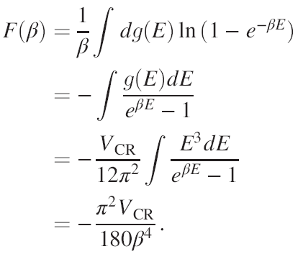

Entropy in the volume
Ignore the exotic feature of CR volume, and the free energy
Then the entropy is obtained as

Slide 20




Entropy in the volume
The volume for Schwarzschild black holes
The loss mass rate and Stefan-Boltzmann law
For a black hole with mass M, we have
Thus the entropy is
It is surprised that the entropy associated with the CR volume is proportional to the surface area!
No sufficient d.o.f for black hole entropy!
B.Zhang, Phys. Rev. D 92, 081501(R) (2015); Phys. Lett. B 773, 644 (2017)

Slide 21

Final stage of evaporation
The earlier estimation depends on Stefan-Boltzmann law
It was shown that SB law holds so long as the mass of black hole is much greater than Planck mass.
Thus need to investigate the final stage of evaporation, which can be described well in the noncommutative spacetime.

Slide 22
A simple history
1930s, Heisenberg put forward this thought at first.
Then, Peierls tried to applied it to Landau energy level.
In 1947, Snyder constructed the first example explicitly.
In 1947 later, Yang extended Snyder’s work.
In 1948, Moyal found the Moyal product.
Until 1980s, SNC was again paid attention due to France’s Mathematicians Connes et al.
In 1986, Witten linked SNC with string theory.
In 1989, Seiberg-Witten map was put forward. Since then, SNC entered into different fields of physics, including black hole, condensed matter, high-energy physics, QM, et al.

Slide 23
There are many proposals for how this may be achieved, none of which are entirely conclusive. Of course, much of the issue concerns the magnitude of the effects of noncommutativity, and the hope is that there exist physical processes for which the effective scale of noncommutativity lies within the present day experimental energy range.

Slide 24



Experimental constraint
In some estimates for violations of Lorentz invariance, the NC parameter is constrained in the range
NC parameter is constrained by observational data from blazars or cosmic microwave background radiation
Phys. Rev. Lett. 87, 141601 (2001).
J. High Energy Phys. 0401, 037 (2004); Phys. Rev. D 79, 063004 (2009).

Slide 25







Noncommutativity in gravity
Einstein field equation,
Solving this equation with matter of mass M, but its position Dirac-delta function is replaced everywhere with a Gaussian distribution, and thus, one can choose the mass density of a static, spherically symmetric, smeared, particle-like gravitational source as,
This shows that the energy-momentum tensor is taken as
S. Ansoldi, et al, PLB 645, 261 (2007).

Slide 26
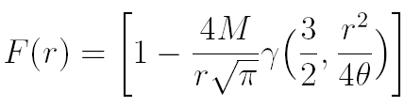

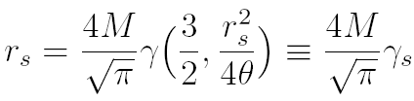

NC black holes
Solving the Einstein equation with the description above,
The horizon is calculated at
Compared with the Schwarzschild black holes,
which is the commutative limit of the NC solution.
S. Ansoldi, et al, PLB 645, 261 (2007).

Slide 27
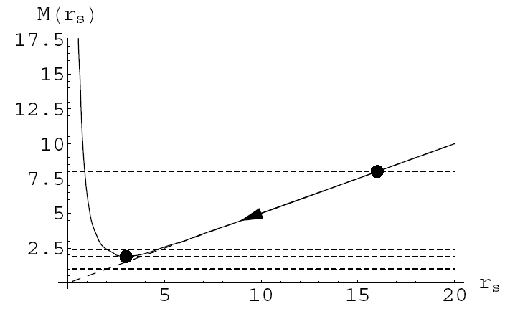


Mass in evaporation
The ending point occurs in
Y. S. Myung, et al, JHEP 02, 012 (2007).

Slide 28
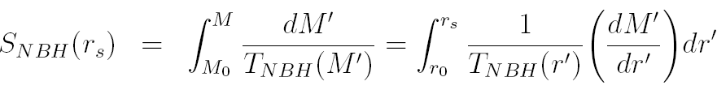
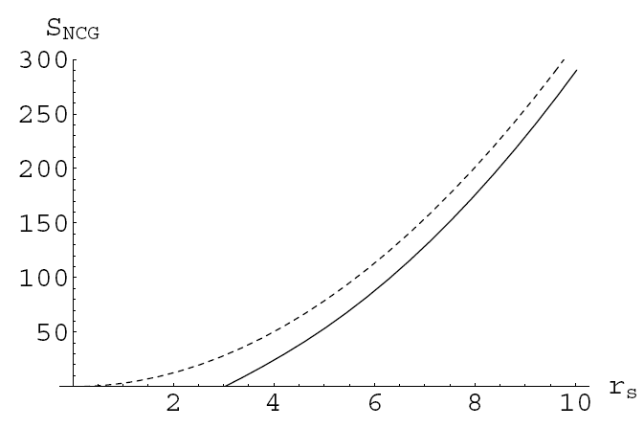
Entropy in evaporation
No conflict for NC black holes in the end.
Y. S. Myung, et al, JHEP 02, 012 (2007).

Slide 29
NC black holes
All those above showed that NC black hole can provide a nice description for the final stage of evaporation, and in what follows, I will see what changes it can bring for the discussion of black hole volume.

Slide 30




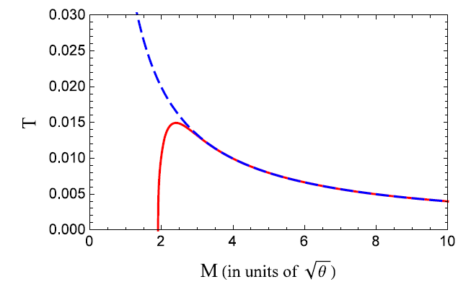
NC black hole entropy
Since only spatial NC is considered, the statistics in phase space is similar to earlier ones,
Standard statistical method gives the entropy
In what follows, we divide the evaporation into two stages

Slide 31
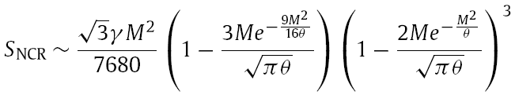

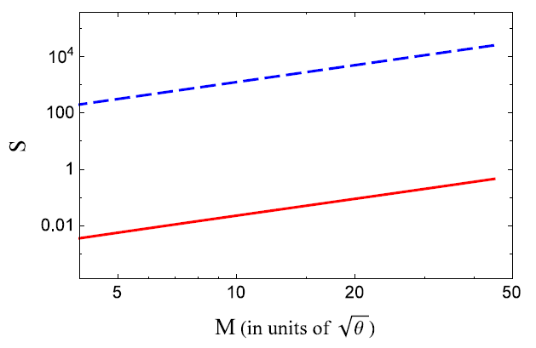
First stage of evaporation
Still the entropy associated with NC volume cannot interpret NCBH entropy!

Slide 32

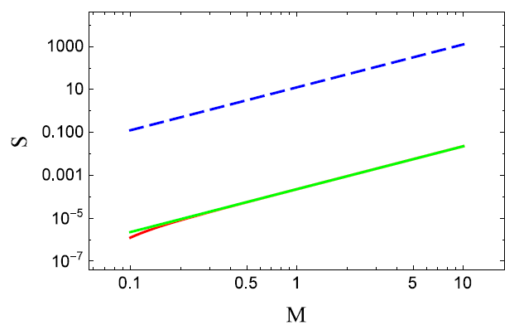
First stage of evaporation
Back reaction is considered with Vaidya metric, and the volume is modified
The entropy is presented in the picture
Back reaction doesn’t change the earlier conclusion!

Slide 33
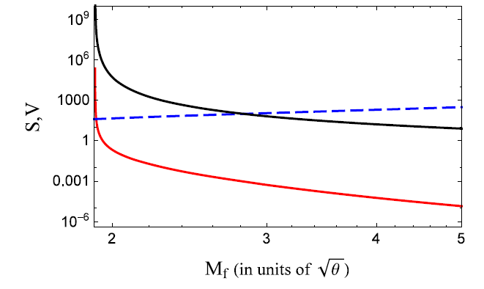



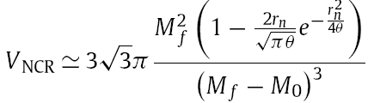

Second stage of evaporation
With the modified parameters
B.Zhang and L. You, Phys. Lett. B 765, 226 (2017)

Slide 34
Actually, the insufficient d.o.f. for the semi-classical consideration or excessive d.o.f. for the case with spatial noncommutativity shows that the black hole entropy is not dependent on black hole interior.
But is it helpful to relieve the black hole information loss paradox?

Slide 35
No firewall for infinite interior

Slide 36
Information loss revisited
Entanglement/quantum correlations should exist near the black hole that is vacuum;
Black hole radiations should basically be thermal at least for semi-classical theory
To some extent, the information loss paradox derives from the conflict of the two properties

Slide 37
Black hole complementarity
The information is not lost but no any exotic phenomena occurs with a set of postulates:
P1—Unitarity of black hole evaporation
P2—Validity of effective field theory
P3—Microscopic black hole entropy
P4—Equivalence principle
L. Susskind, et al, Phys. Rev. D 48 (1993) 3743.

Slide 38






Firewall suggestion
P1, P2, P3 are consistent with P4 by violating
where A is earlier Hawking radiation, B is the present outgoing Hawking radiation and C is its interior partner
The thermal radiation implies
P1, P2, P3 implies
P4 implies or
The violation means
AMPS suggested the horizon should be a firewall but not a vacuum!
A. Almheiri, et al, JHEP 02, 062 (2013).

Slide 39
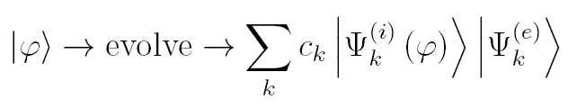
No firewall is needed
Firewall suggestion required that GR should be modified at a fundamental level, so this is also called firewall paradox.
Such evolution
Only if the interior is large enough, no firewall is needed to preserve the unitarity.

Slide 40
Comments for remnants
Remnants with infinite d.o.f.
If the black holes don’t have infinite d.o.f in their interior, how to realize the unitary evolution?
If the remnants drop into the black hole, what happened if it is finite for its interior?
So, infinite interior for black hole is necessary if the remnant should be left at the end.
Review for remnant see P. Chen, et al, Physics Reports 603 (2015) 1–45.

Slide 41
Summary and discussion
The investigation of black hole interior is helpful to understand the origin of black hole entropy.
Infinite black hole interior is helpful to understand information loss problem. Compare with AdS/CFT?
Furthermore, what is the information and its relation to statistical interpretation for black hole entropy?
Although the recent suggestion that the information should be stored at the horizon by Hawking, et al, it is still not closed for this problem.

Slide 42

Thank you!

