Slide 1
WW Threshold scan runs and Z pole runs in CEPC
Zhijun Liang
IHEP,CAS

Slide 2
Introduction
Some discussion about CEPC Z pole running .
http://indico.ihep.ac.cn/event/7709/
Two possibility:
L=1.6 X 10³⁵ cm⁻²s⁻¹, solenoid field = 3T
L=3.2 X 1035 cm⁻²s⁻¹, solenoid field = 2T
Two year running proposed by accelerator team
WW threshold scan
Proposal from accelerator team
One year running, Total luminosity 3.2 ab⁻¹

Slide 3
WW threshold scan Vs luminosity
WW threshold scan need to scan 3~5 mass points
Especially need to cover 158.5GeV, 161.2GeV, 162.4 GeV
In CEPC Pre-CDR, we assume 0.5ab⁻¹ for W threshold scan
W width measurement is totally limited by statistics
W mass measurement suffers a bit from statistics
Assume we run one year WW threshold to collect 3.2 ab⁻¹ data.
W width measurement is still limited by statistics, but much better than pre-CDR
If running for two years with 6.4 fb⁻¹
W width measurement is not limited by statistics any more
Observable | Systematics | L=0.5 ab⁻¹ (3 points scan, 0.16 ab⁻¹ per run) | L=3.2 ab⁻¹ (3 points scan, 1 ab⁻¹ per run) | L=6.4 ab⁻¹ (3 points scan, 2 ab⁻¹ per run) | Major uncertainty
M_{w} | 2 MeV | 2 MeV | 0.8 MeV | 0.6 MeV | E beam cali. ΔE < 1 MeV
Γ_{W} | 2 MeV | 6 MeV | 2.4 MeV | 1.7 MeV | Statistics

Slide 4
The parameters of CEPC
 | Higgs | W | Z
Number of IPs | 2
Energy (GeV) | 120 | 80 | 45.5
Circumference (km) | 100
SR loss/turn (GeV) | 1.73 | 0.34 | 0.036
Half crossing angle (mrad) | 16.5
Piwinski angle | 2.58 | 7.74 | 23.8
N_{e}/bunch (10¹⁰) | 15 | 15 | 8.0
Bunch number (bunch spacing) | 242 (0.68us) | 1220 (0.27us) | 12000 (25ns+10%gap)
Beam current (mA) | 17.4 | 87.9 | 461
SR power /beam (MW) | 30 | 30 | 16.5
Bending radius (km) | 10.6
Momentum compaction (10⁻⁵) | 1.11
β_{IP} x/y (m) | 0.36/0.0015 | 0.36/0.0015 | 0.2/0.0015
Emittance x/y (nm) | 1.21/0.0031 | 0.54/0.0016 | 0.17/0.004
Transverse σ_{IP} (um) | 20.9/0.068 | 13.9/0.049 | 5.9/0.078
ξ_{x}/ξ_{y}/IP | 0.031/0.109 | 0.013/0.12 | 0.0041/0.056
V_{RF} (GV) | 2.17 | 0.47 | 0.1
f _{RF} (MHz) (harmonic) | 650 (216816)
Nature bunch length σ_{z} (mm) | 2.72 | 2.98 | 2.42
Bunch length σ_{z} (mm) | 3.26 | 6.53 | 8.5
HOM power/cavity (kw) | 0.54 (2cell) | 0.87(2cell) | 1.94(2cell)
Energy spread (%) | 0.1 | 0.066 | 0.038
Energy acceptance requirement (%) | 1.35
Energy acceptance by RF (%) | 2.06 | 1.47 | 1.7
Photon number due to beamstrahlung | 0.29 | 0.44 | 0.55
Lifetime _simulation (min) | 100
Lifetime (hour) | 0.67 (40 min) | 2 | 4
F (hour glass) | 0.89 | 0.94 | 0.99
L_{max}/IP (10³⁴cm⁻²s⁻¹) | 2.93 | 11.5 | 16.6
3T→2T
0.2/0.001
0.17/0.0015
32

Slide 5
Z pole electroweak physics Vs lumiosity
Assuming Z pole runs last for 180 days, Z cross section 60 nb
L=1e³⁴, about 10¹⁰ Z
Observable | Systematics | L=1e³⁴ (stat unc.) | 3T, L=1.6e³⁵ (stat unc.) | L=3.2e³⁵ (stat unc.) | Key
M_{z.} Γ_{Z} | 0.5 MeV | 0.2MeV | 0.05 MeV | 0.035 MeV | E beam cali. ΔE < 500keV
R _{l} =Γ_{h}/Γ_{l} | 0.01% | 0.01% | 0.0025% | 0.0018% | Statistics
R_{b} | 0.05% | 0.04% | 0.01% | 0.007% | Statistics + small Rin
A_{LR} | NA | NA | NA | NA | Beam polarization
A_{FB} ^{lept.} | 0.1% | 0.08% | 0.02% | 0.014% | Forward acceptance
From 1e³⁴ to 1.6e³⁵ , large improvement in stat. uncertainty
From 1.6e³⁵ to 3.2 e³⁵ , improvement is not big
From 3T to 2T, Momentum resolution degraded to 50%, higher BkG. (no major impact )
Key issue for Z pole physics, beam momentum systematics need to be smaller than 500keV
Beam polarization is needed for beam momentum measurement and ALR

Slide 6
backup

Slide 7
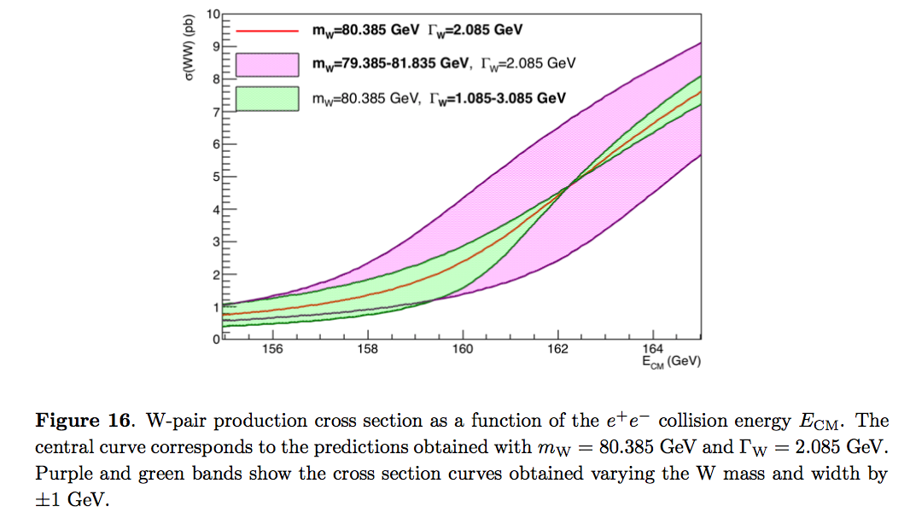
Cross section Vs W mass or W width
df

Slide 8
W mass stat uncertainty single energy point (500 fb⁻¹)
df
From Peixun and Gang

Slide 9
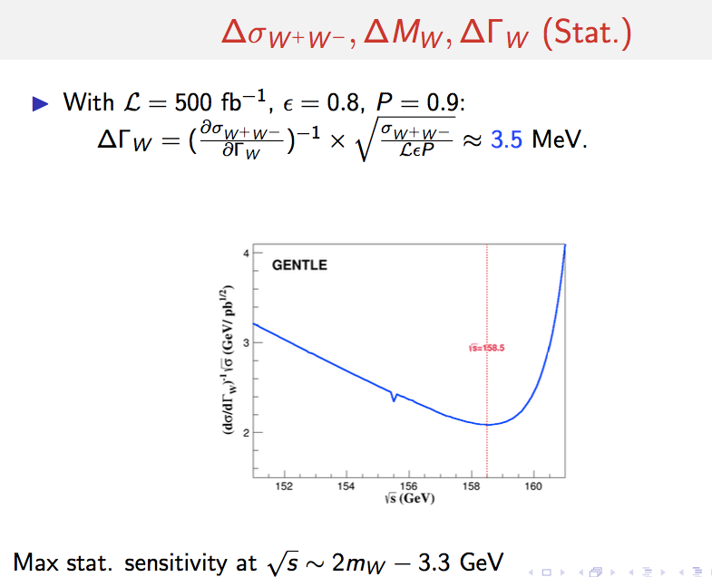
W width stat uncertainty single energy point (500 fb⁻¹)
df
From Peixun and Gang
width

Slide 10
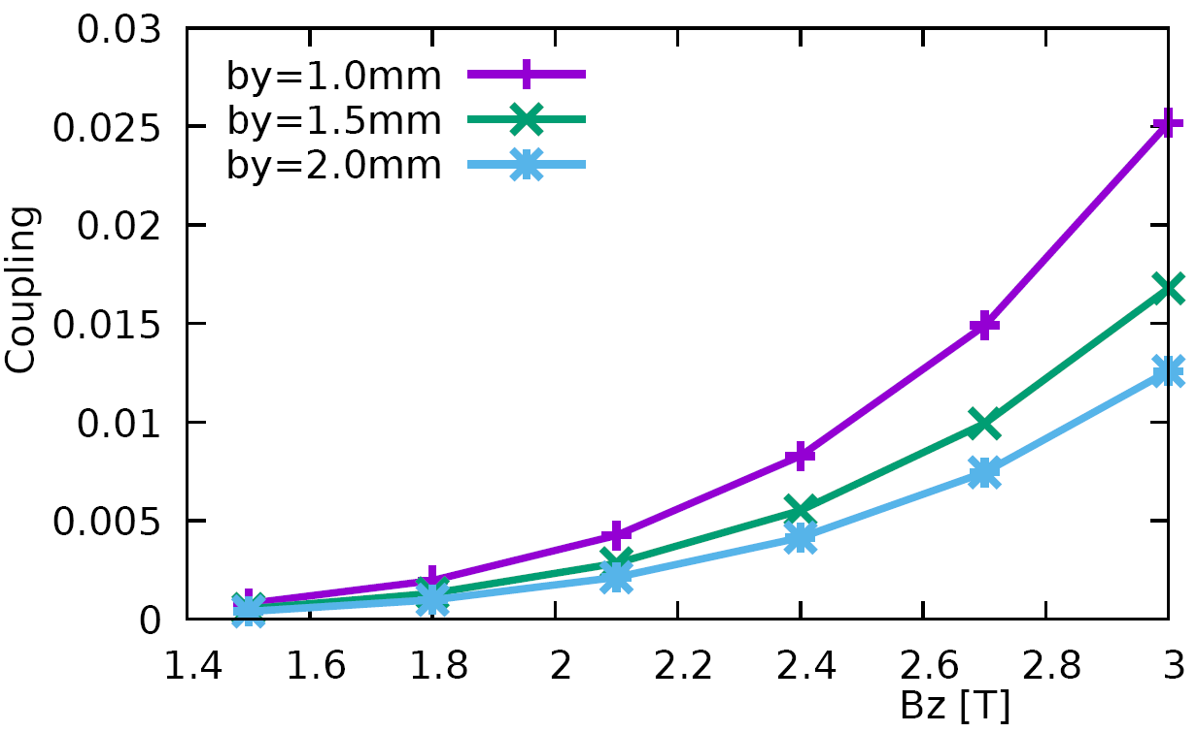
Start from detector solenoid 3.0T
From Chenghui
β_{y}* Vs. coupling @ Z
Limitation of the luminosity improvement by reducing the β_{y}*

Slide 11
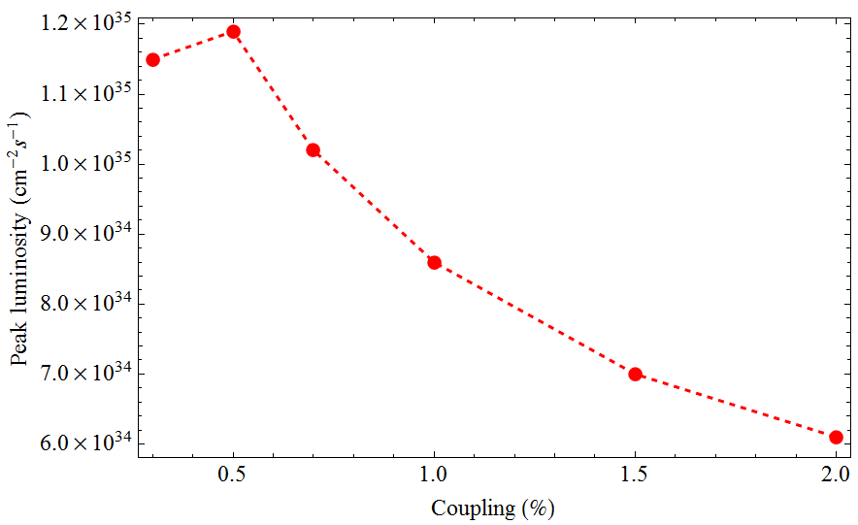
Start from detector solenoid 3.0T
Coupling=1.7% + 0.3~0.5%
Large beam size
&
serious bunch lengthening
From Chenghui
Coupling Vs. Luminosity @ Z
For the 2Cell cavity operation, if the coupling lose control L ≈ L₀/2 ~ L₀/4

