Slide 1
Observation of VBF Higgs with the ATLAS Detector
Yquan Fang (方亚泉)
Institute of High Energy Physics, Beijing
18-21 August, 2018
13th TeV Physics Working Group Workshop
Nankai University

Slide 2
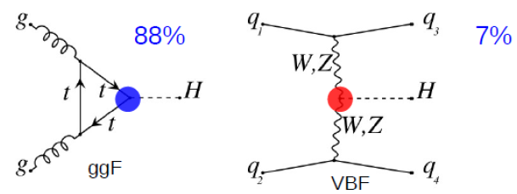
Introduction
Gluon-gluon fusion
Vector Boson Fusion (VBF)
W/ZH
ttH
After the Higgs discovery, it is important to study the Higgs property according to its production, decays, coupling, spin….
VBF provides us an opportunity to understand:
Higgs production mode
Electro-weak production
Search for new physics.

Slide 3
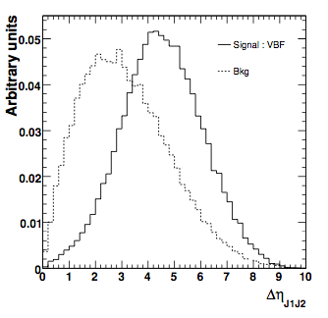
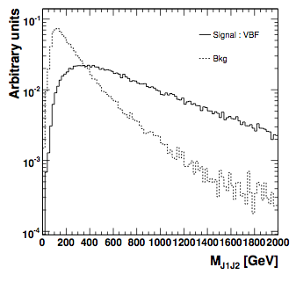
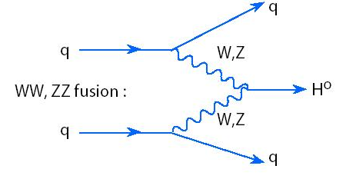
Event signature of Vector Boson Fusion (VBF) Higgs
Wisconsin Pheno. Group:
T. Han, D.L. Rainwater, D. Zeppenfeld……
Two forward highly boosted jets.
High invariant mass of the di-jet M_{jj},
No much jet activities in the
center region of the detector.
Central jet veto…
feasible to play
with Multivariate
analysis (MVA).
Forward jets
φ
Higgs Decay
η

Slide 4
Example: discriminating variables used in ATLAS for H->γγ analysis
variables used
Separation power
two forward jet → large Δη_{jj}
high pT and large Δη_{jj} → large m_{jj}
central diphoton and forward dijet → large ΔR^{min}_{γ,j}, low η^{Zepp}
two balance high pT jet → high pTt

Slide 5
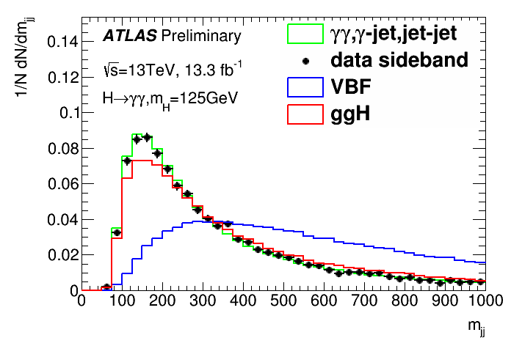
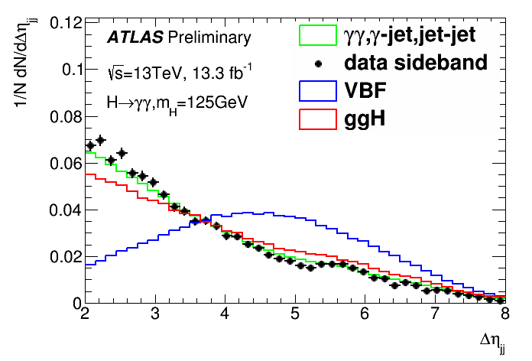
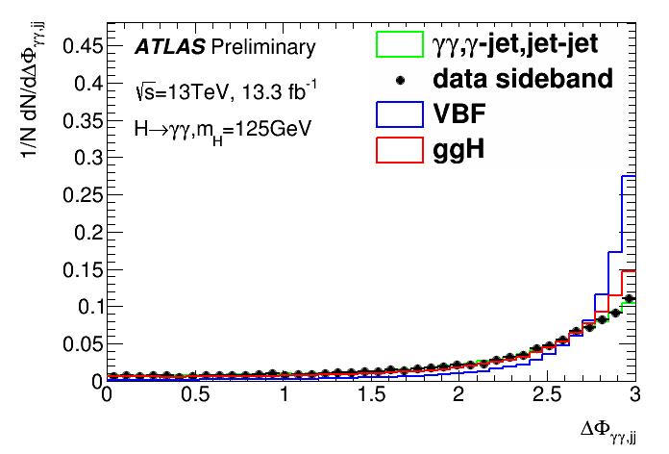
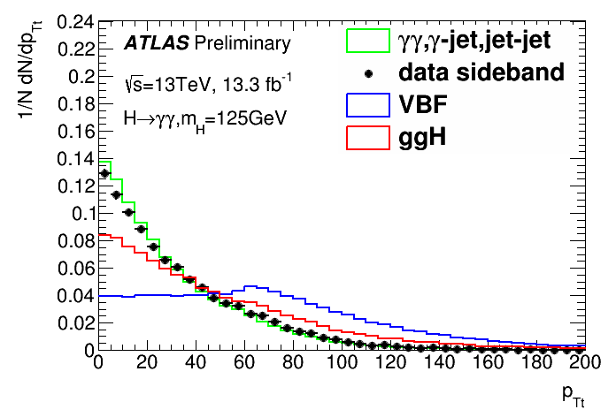
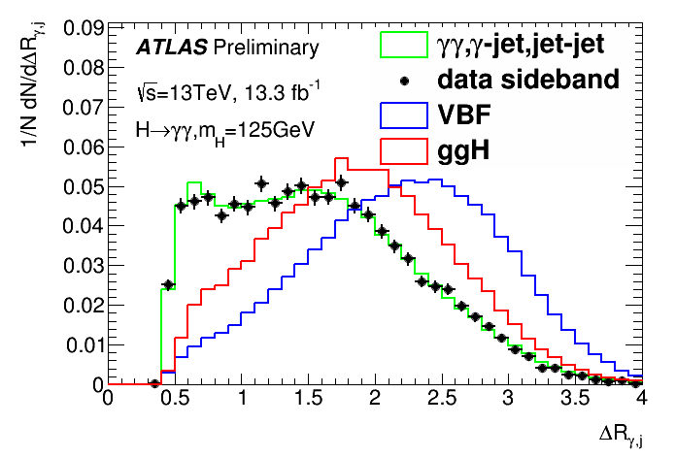
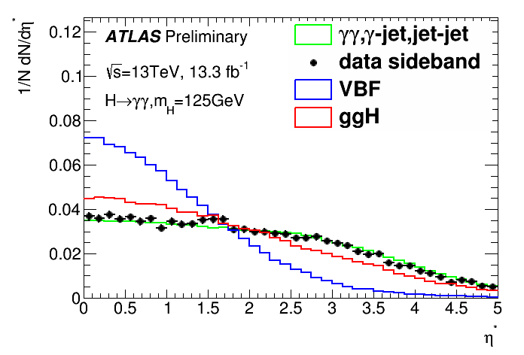
Distributions of the discriminating variables
data sideband (exculde 120-130GeV ) is consistent with γγ+γj+jj background
these variables show good separation power
they are used in category optimization

Slide 6
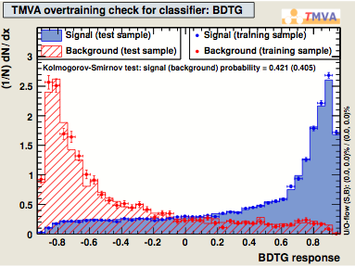
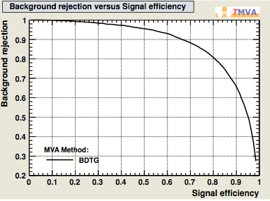
MVA method: Training/optimization the MVA
[120,130] GeV window is blinded during the
process for data.
Signal : VBF 125 GeV.
Background :
ϒϒ : SHERPA Monte-Carlo normalized to
4 fb⁻¹.
ϒjet+jets : data with at least
one photon not isolated.
The components are normalized
to the fraction from data-driven method.
Other samples such as revIso,
MC+revID, sideband were tried as well.
The performances are worse than
the first one.
For the optimization, both sideband fit
from data and MC+revIso are tested.
MC+revIso is used as the baseline
(no bias)
example
example

Slide 7
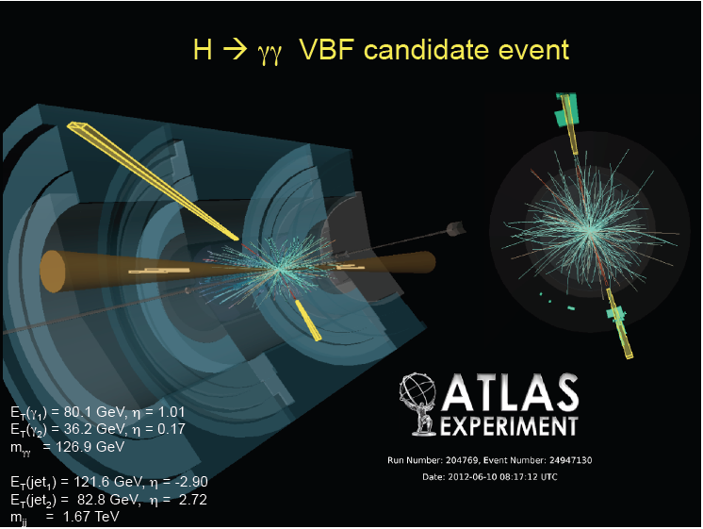
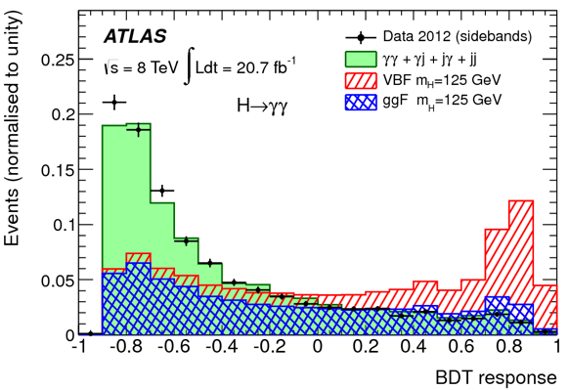
Selection on BDT response
MVA can maximize the discriminating power of the signal from the backgrounds
Improvement is above 10-20% w.r.t cut based one.

Slide 8
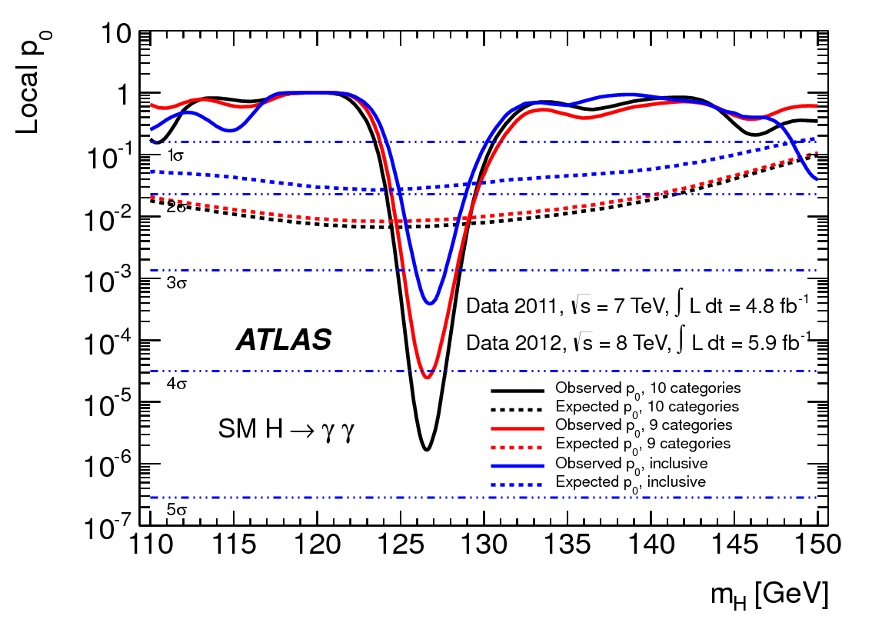
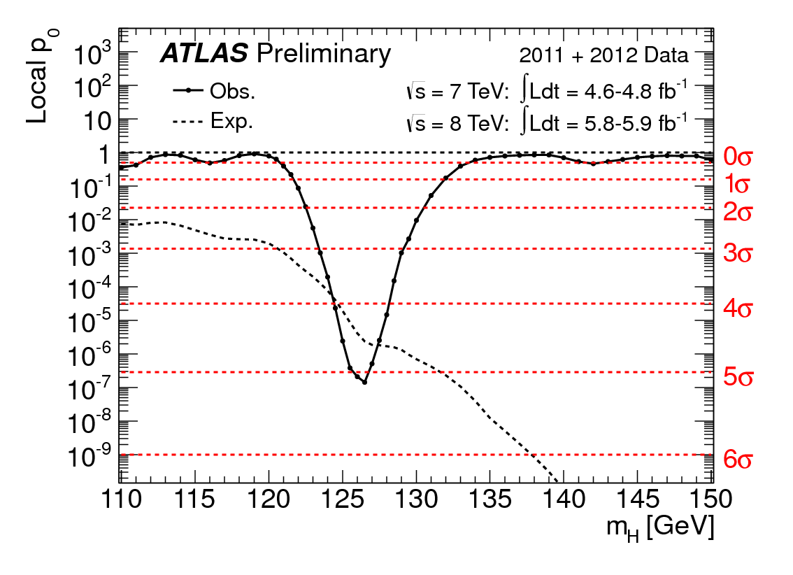
Contribution of VBF production for Higgs discovery
For the di-photon channel, ATLAS includes VBF Higgs process for the result on July 4, 2012.
The improvement of the signal significance is from 4σ to 4.4σ (from red curve to black curve for the right plot)
Together with ZZ channel, we can achive 5 σ.

Slide 9
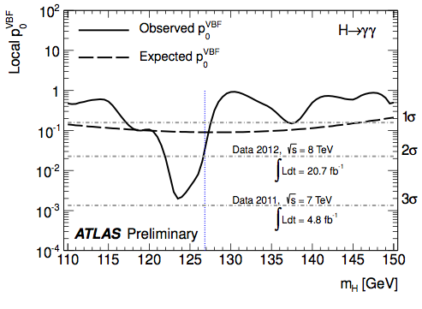
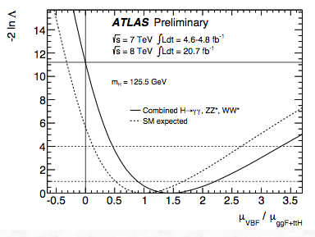
ATLAS RUN1 results
3.3σevidence
3.3σ VBF Higgs evidence has been seen with ATLAS detector.
The most important contribution to the 125.5 GeV VBF Higgs is from H→ γγ

Slide 10
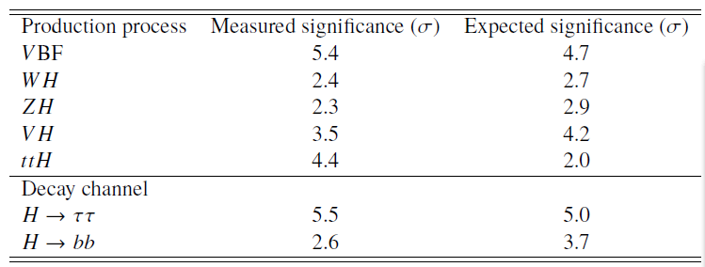
Combination between ATLAS and CMS for VBF search with RUN1 data
ATLAS-CONF-2015-044
CMS-PAS-HIG-15-002
The combined significance for VBF Higgs is 5.4σ
Highlighted RUN1 result at LHCC on Sep 24th,2015.
http://indico.cern.ch/event/443017/session/1/contribution/3/attachments/1158507/1667223/ATLASReport_Polifka_LHCC230915Final.pdf

Slide 11
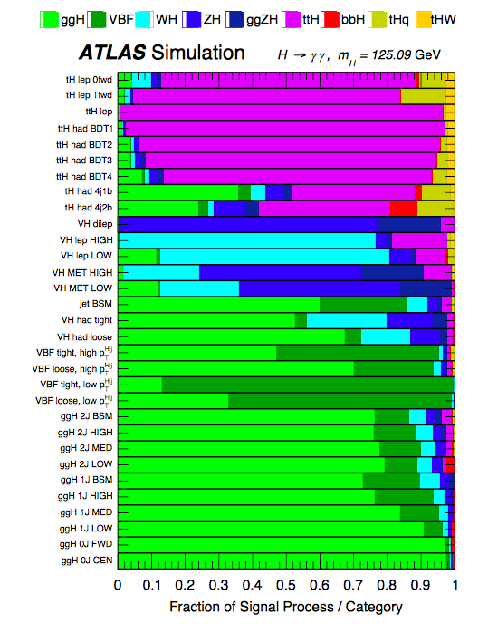
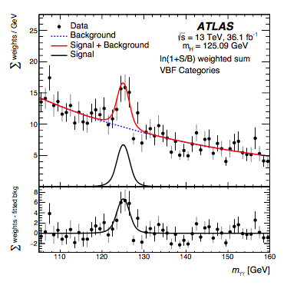
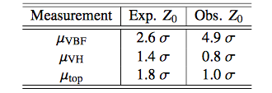
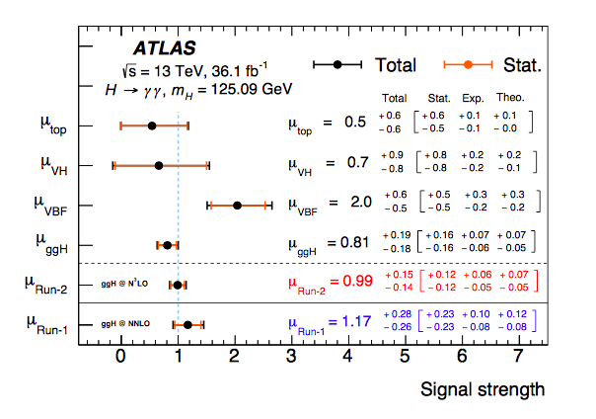
ATLAS RUN2 VBF H->γγ results (36.1 fb⁻¹)
First observation of
~5σ VBF signal from one
experiment。
The signal strength is ~2XSM, which is still consistent with SM prediction within uncertainties.
Submitted to P.R.D. (arXiv:1802.04146)

Slide 12
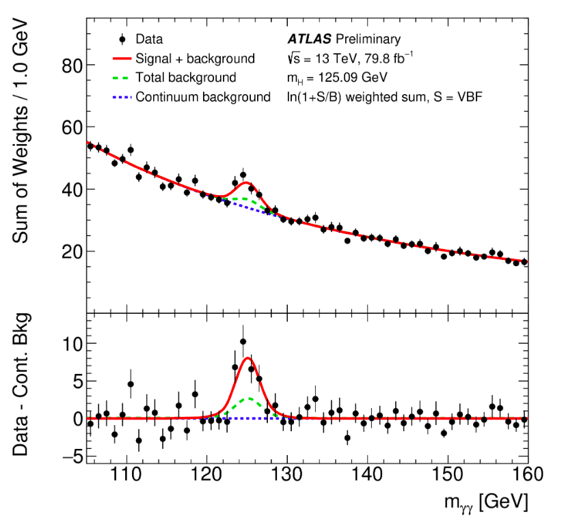
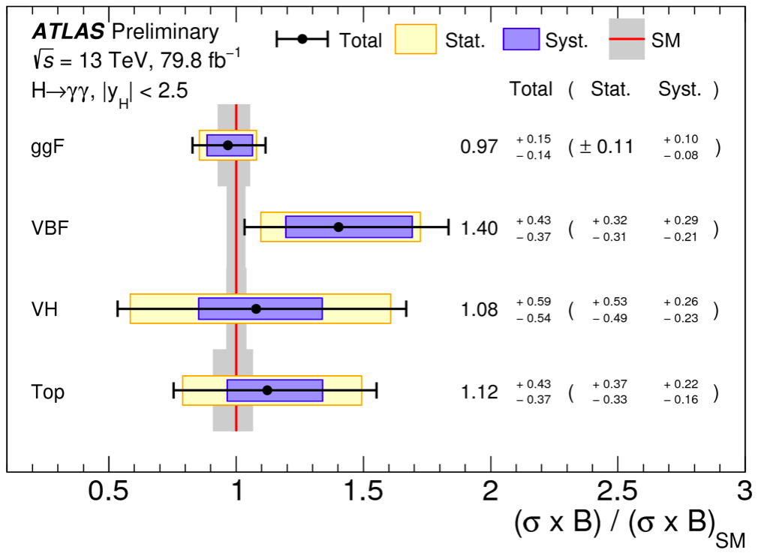
ATLAS RUN2 VBF H->γγ results (79.8 fb⁻¹)
ATLAS-CONF-2018-028
The signal strength is well consistent with SM prediction within uncertainties

Slide 13
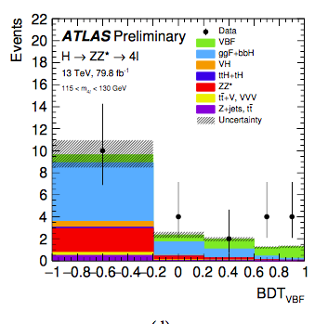
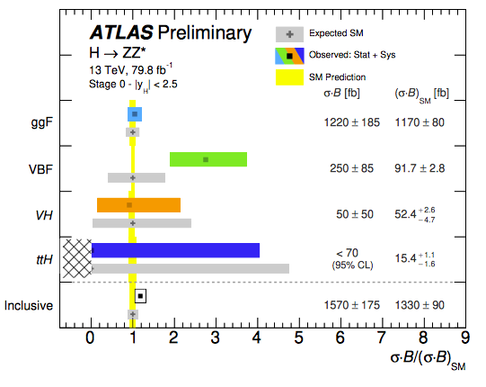
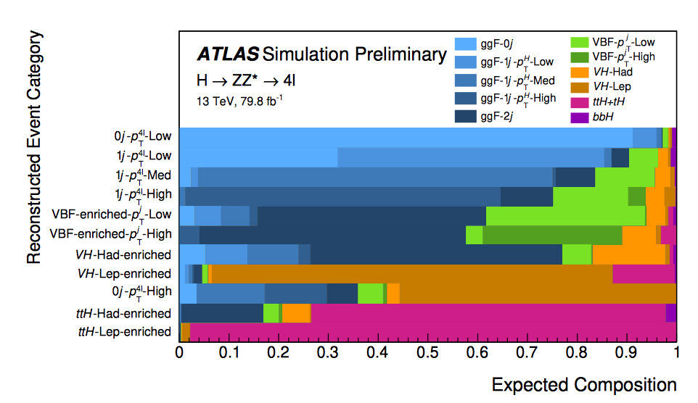
ATLAS VBF H->ΖΖ∗
ATLAS-CONF-2018-018
VBF is around 2.5XSM prediction for ATLAS VBF H->ZZ which is still consistent with SM prediction considering
the larger statistical uncertainty.

Slide 14
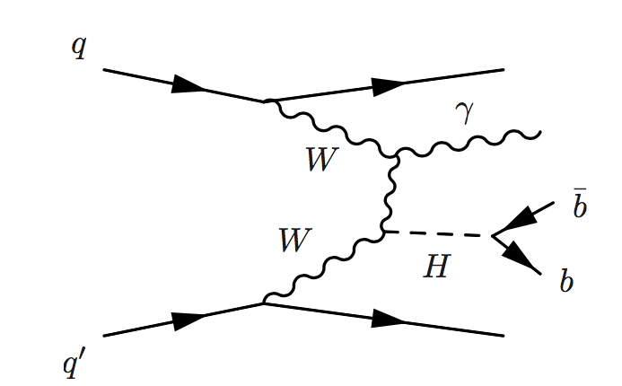
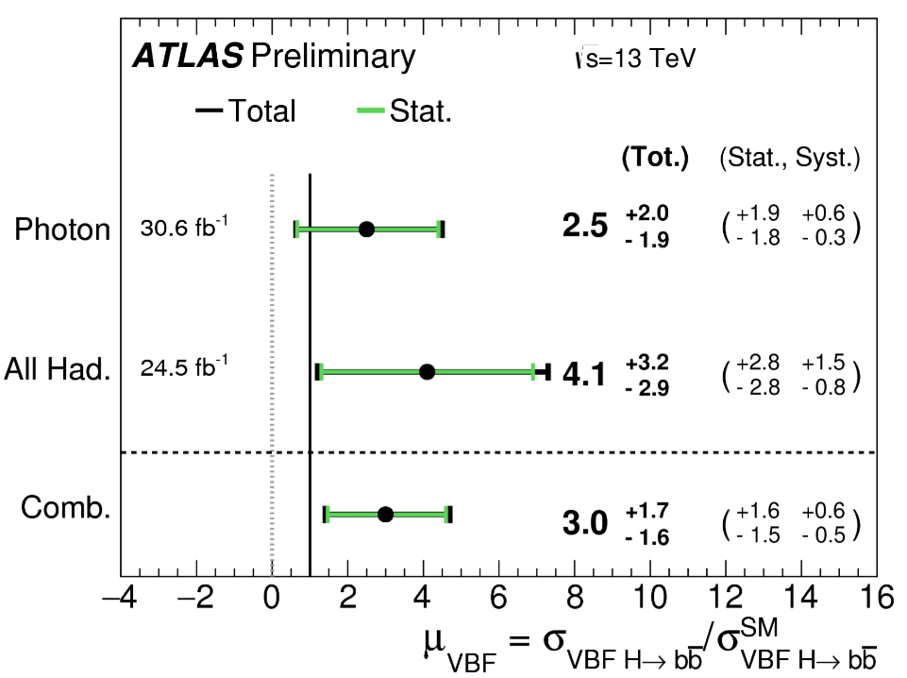
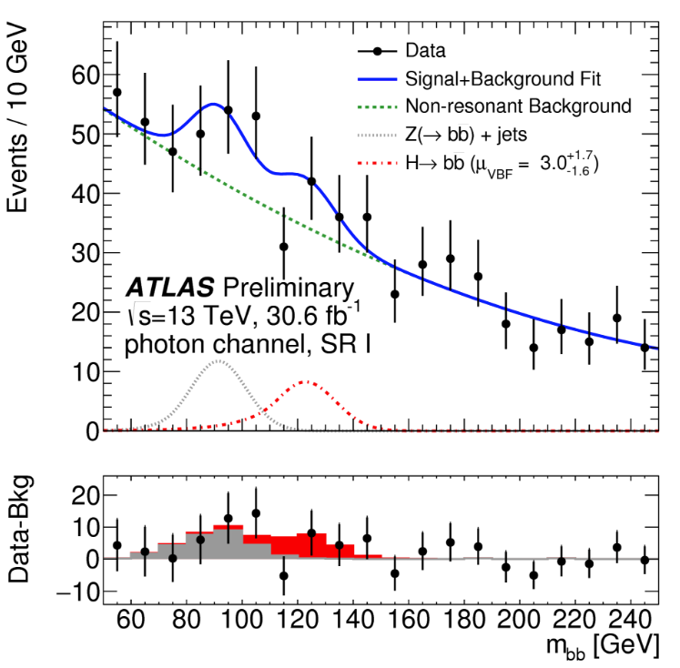
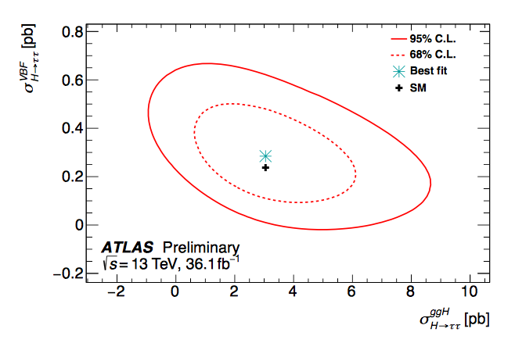
VBF H->bb,ττ
The analyses of VBF H->bb are divided into two categories (tagging or non-tagging photon)
The tagging of one photon is efficent to suppress QCD backgroud.
The signal strength for VBF H->bb
analyses
M_{bb} mass distribution
CERN-EP-2018-140
ATLAS-CONF-2018-021
The observed signal strength for VBF H->bb is ~3XSM, which is still consistent with SM within the error bar.
For the VBF H->ττ, the observed signal strength is slightly higher than the SM prediction.

Slide 15
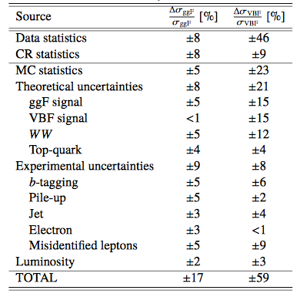
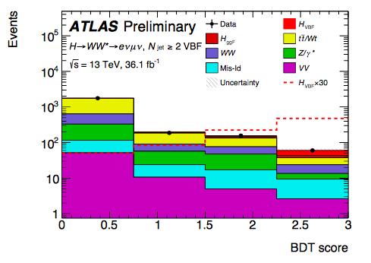
ATLAS VBF H->WW*
ATLAS-CONF-2018-004
VBF is around 0.6XSM prediction which is still consistent with SM prediction considering
the large statistical uncertainty.

Slide 16
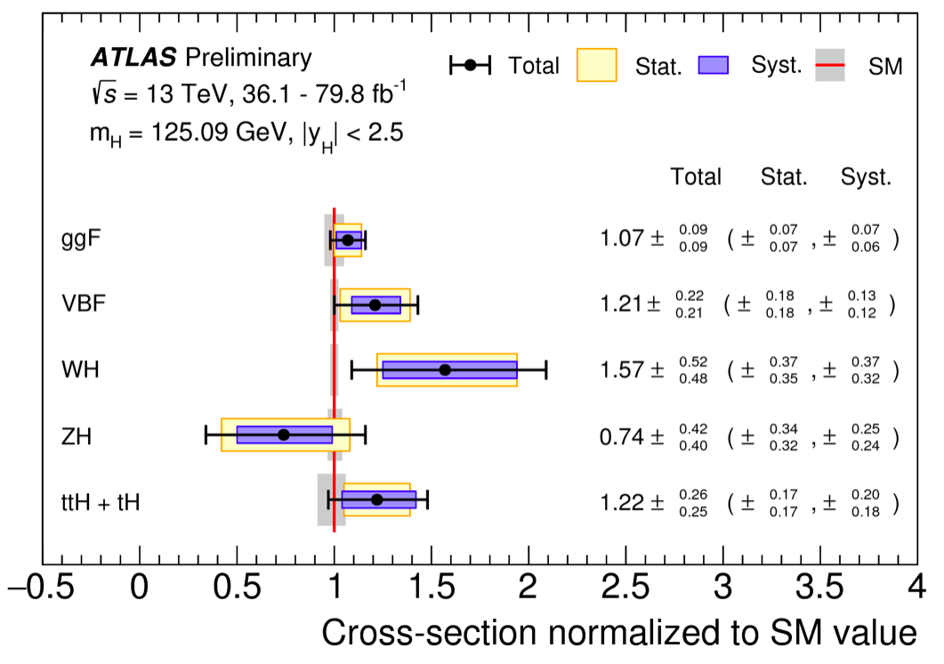
Combination of different channels
ATLAS-CONF-2018-031
Combining H->γγ, ZZ, WW, one can achieve 5.3σ/6.5σ (observed/expected) for VBF Higgs.
The dominant contribution is form H->γγ.
The result is well consistent with SM prediction.

Slide 17
Conclusion
The analyses VBF Higgs have obvious event signatures and can be studied with MVA method.
ATLAS H->γγ first observed 4.9σ VBF signal with 36 fb⁻¹ RUN2 data.
Results from the channels (H->ZZ*,WW*,ττ, bb) have been shown.
The combined result achieve 5.3σ/6.5σ (observed/expected)
H->γγ makes a leading contribution.
Chinese colleagues (γγ,WW*,bb)play leading roles in the observation of VBF Higgs

Slide 18
backup slides

Slide 19
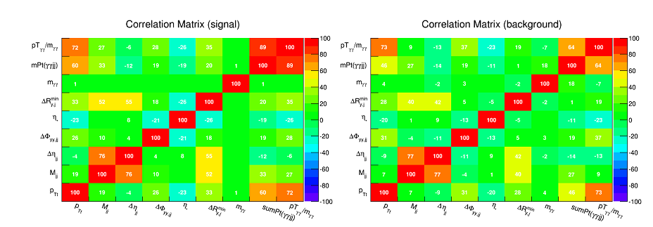
correlation to m_{H}
the used variables should not be correlated to m_{γγ}

Slide 20
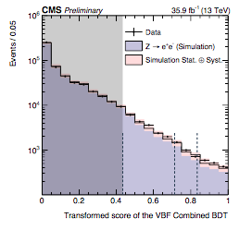
CMS VBF H->γγ strategy
BDT training :
VBF Higgs vs ggH+jets
Divided into 3 cats.
Validated with Z->ee events
Selections:

Slide 21
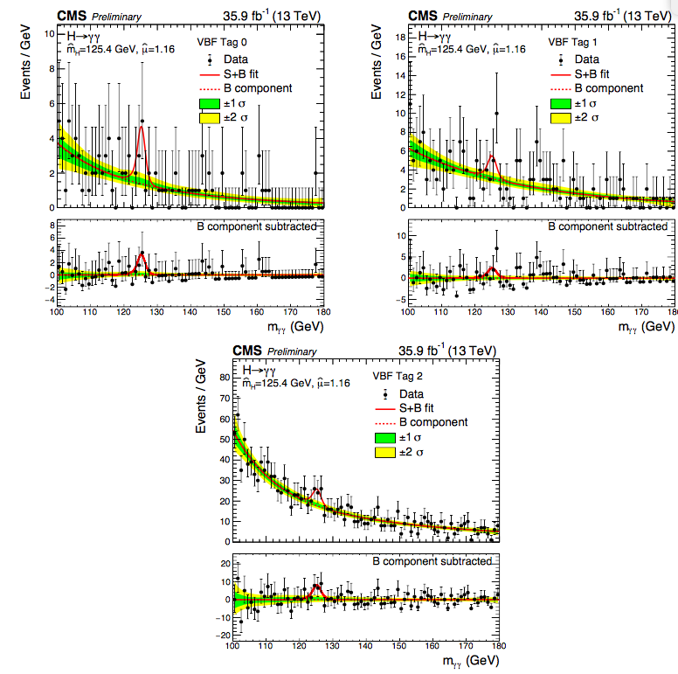
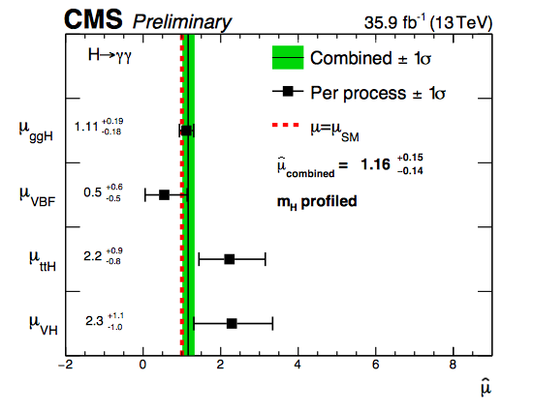
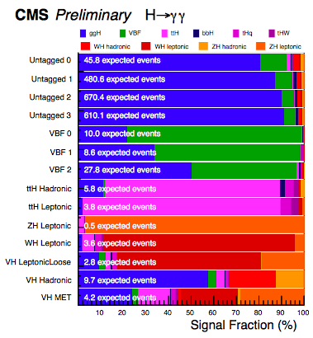
CMS VBF H->γγ
Observed (expected) Significance =
1.1σ/1.9σ

Slide 22
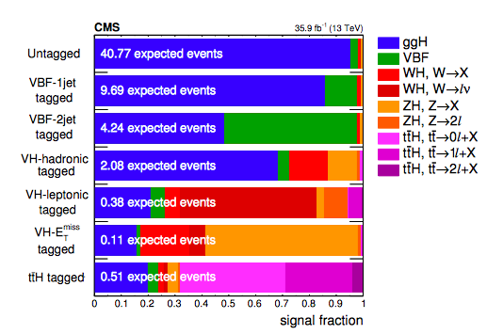
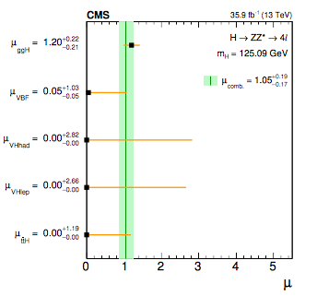
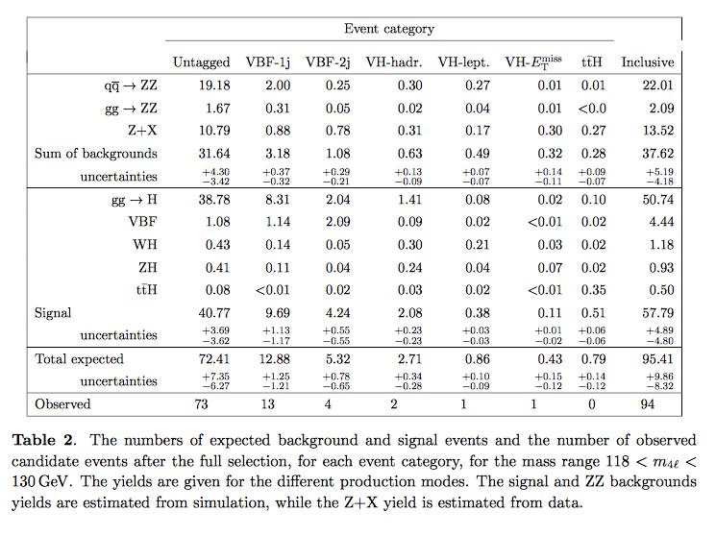
CMS VBF H->ΖΖ

