Slide 1

Chengping Shen
Heavy quark spectroscopy
第五届手征有效场论
吉林大学，8月29日, 2018年

Slide 2
Outline
Challenges in Hadron Spectroscopy
XYZ states
  The X states — whatever is leftover
  The Y states — J^{PC}=1⁻⁻
  The Z_{c} states — I=1 & decays into‾cc
Upgrade and prospects
Summary
Notes:
In this talk, we present the most recent study of the X(3872) from Y(4260) radiative decay, the Y states from Initial state radiation and from electron positron collision, as well as the charged Z states.

Slide 3
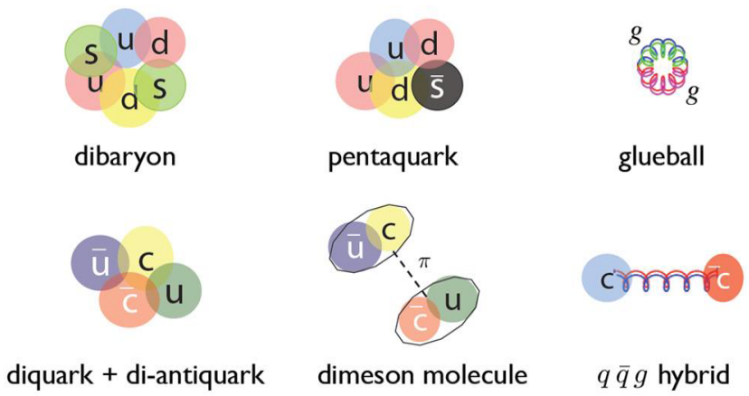
Hadrons: normal & exotic
Quark model: hadrons are composed from 2 (meson) quarks or 3 (baryon) quarks
QCD does not forbid hadrons with N_{quarks}≠2, 3
  Glueball： N_{quarks} = 0 (gg, ggg, …)
  Hybrid： N_{quarks} = 2 (or more) + excited gluon
  Multiquark state： N_{quarks} > 3
  Molecule： bound state of more than 2 hadrons
  …

Slide 4
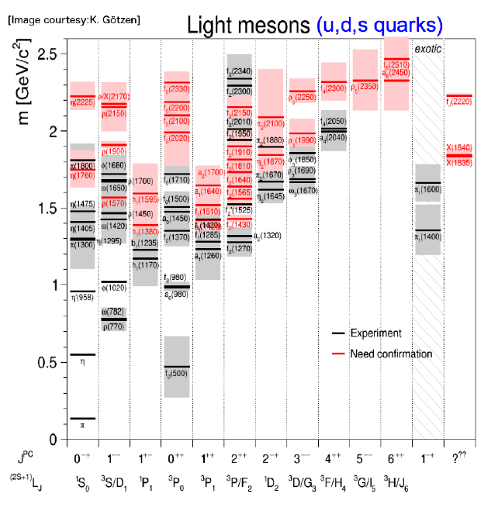
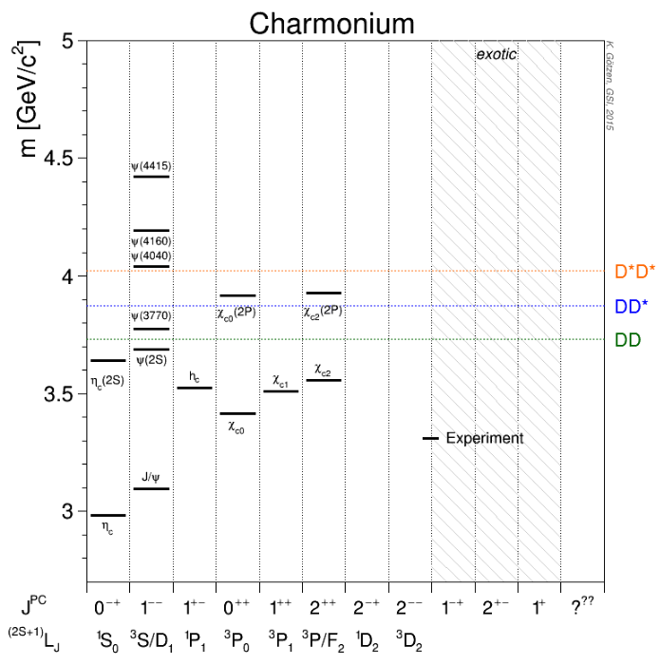
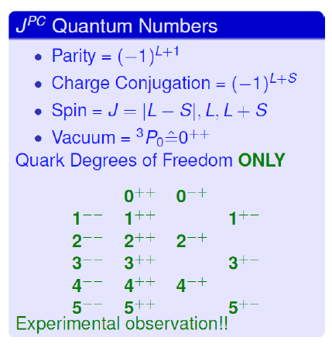
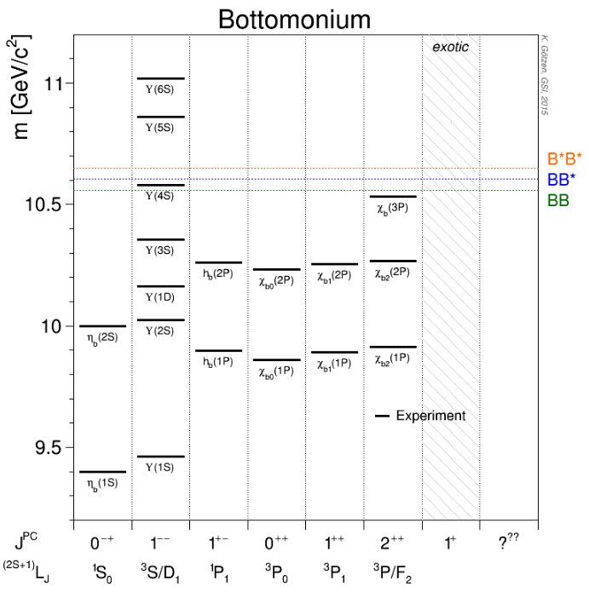
Hadron spectra: normal
Light hadron spectroscopy is complicated
Many broad and overlapping states discovered, some not yet – need complicated PWA technology
Below open-charm/bottom threshold: good agreement between experiments and theoretical predictions
Above open-charm/open-bottom threshold: some expected states not discovered yet

Slide 5
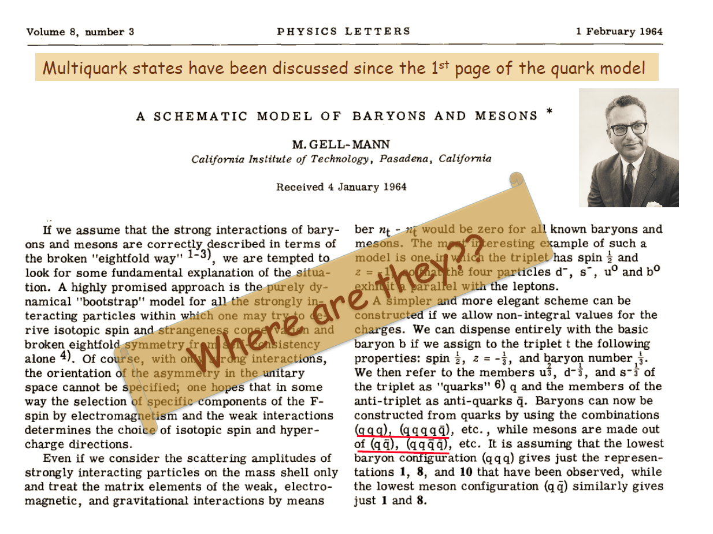
M. Gell-Mann, Phys. Lett. 8, 214 (1964)
5

Slide 6
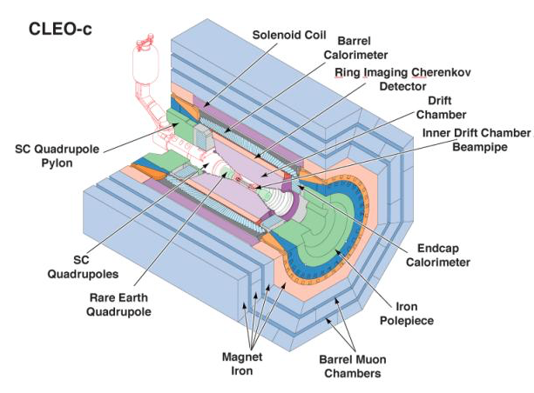
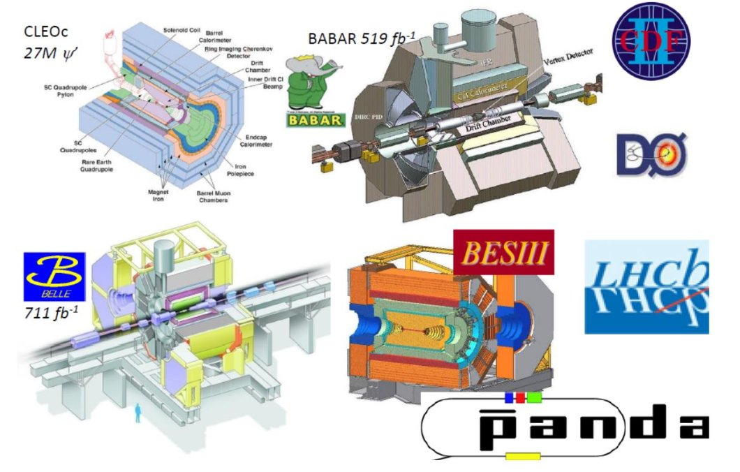

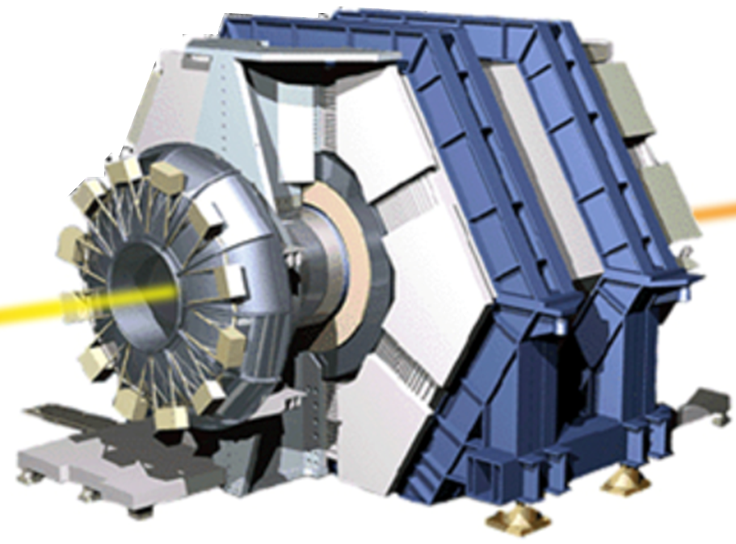

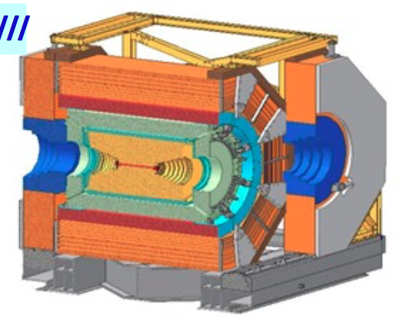

Main Suppliers of Exotics

Slide 7
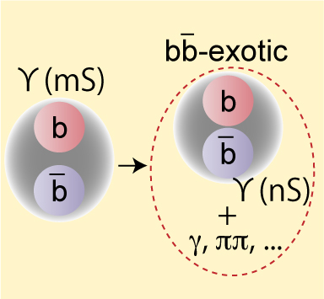
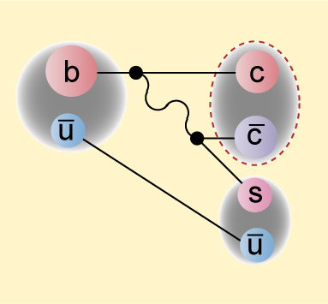
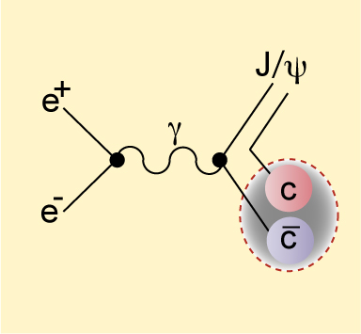
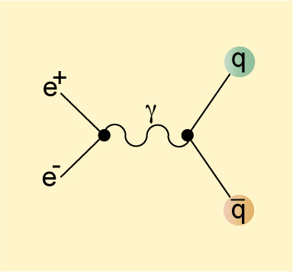
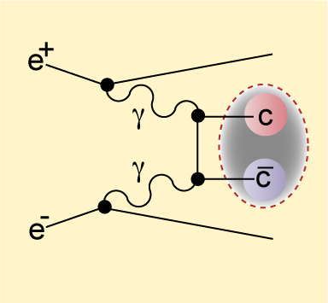
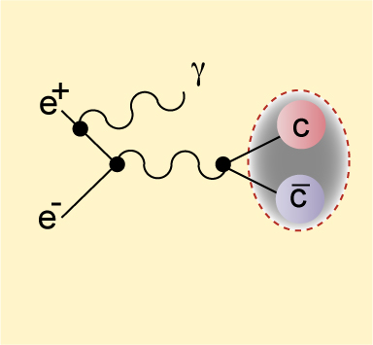
Variety of recorded reactions
Υ decay
B decay
J^{PC}=0⁻⁺, 1⁻ ⁻, 1⁺⁺ in factorization limit.
Double chamonia production
C=+1.
Continuum
γγ collision
Initial state radiation
J^{PC}=0⁻⁺, 2⁺⁺.
J^{PC}=1⁻ ⁻.

Slide 8
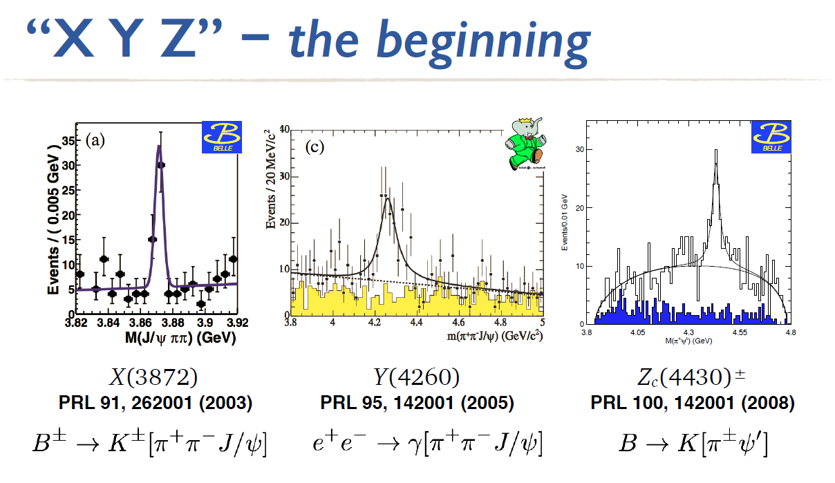
~20 multi-quark states are observed since 2003 with high significance
  BES, Belle, Babar, CDF, D0, LHCb, Atlas, CMS
Some examples of multi-quark states
  Tetraquarks candidates X(3782)→J/ψπ⁺π⁻, Z⁺(4430)→Ψ’π⁺, X(4140)→J/ψφ, Z_{b}⁺(10610)→Υπ⁺, Z_{b}⁺(10650) → Υπ⁺
  Pentaquarks candidates P_{c}⁺(4450) → J/ψp, P_{c}⁺(4380) → J/ψp

Slide 9
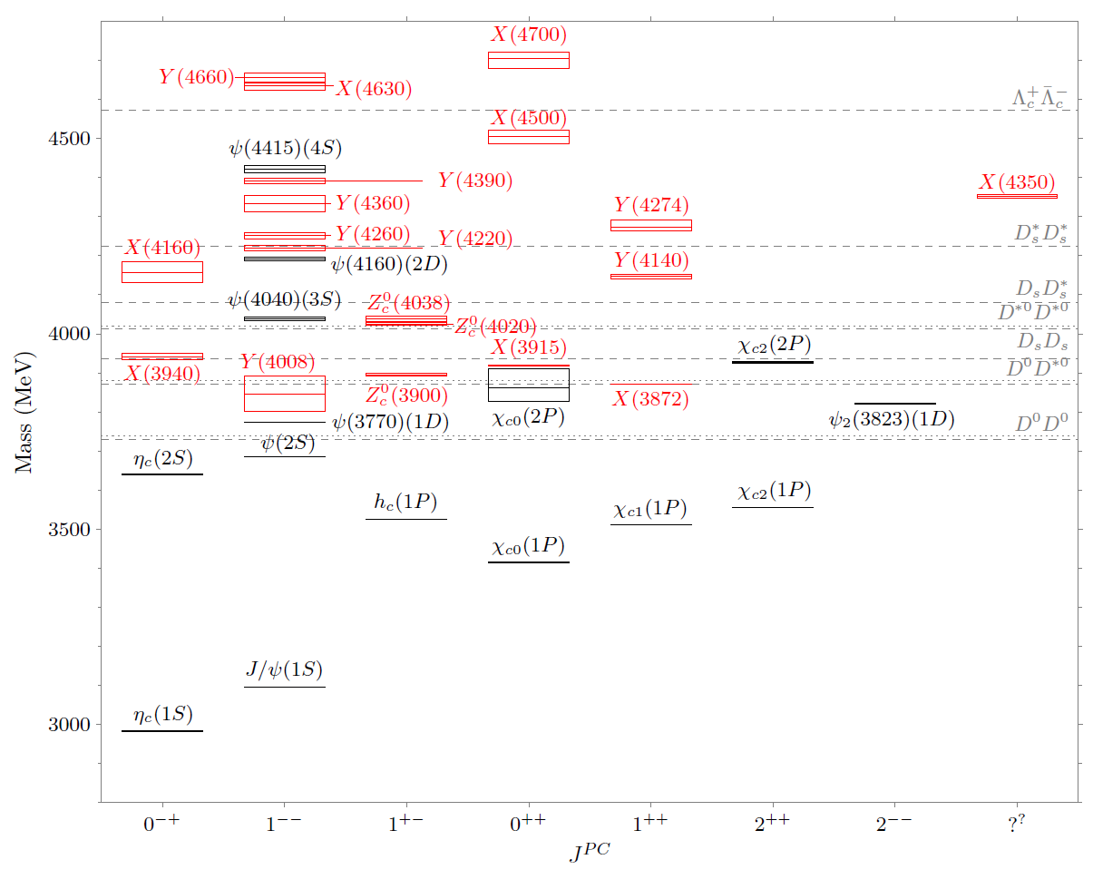


XYZ particles
Charmonium-like (XYZ) particles
New type of hadron (multi-quark …)?
n^{(2S+1)}L_{J}
n radial quantum number
S total spin of c & cbar
L orbital angular momentum
L = 0, 1, 2 ... correspond to S, P, D, …
J = S + L
P = (–1)^{L+1} parity
C = (–1)^{L+S} charge conj.
Prog. Part. Nucl. Phys 93 (2017) 143
Particle “Zoo” again !
9

Slide 10
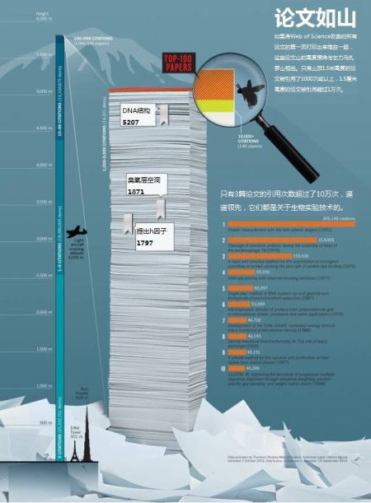
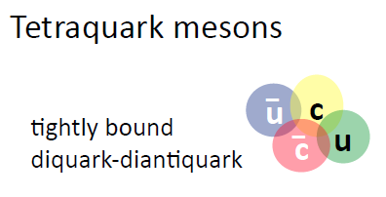
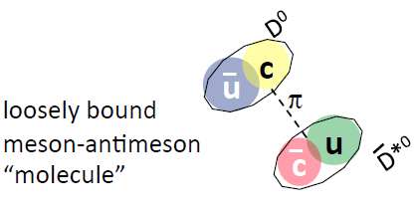
Too many models !
  Theory 1: screened potential
  Theory 2: hybrids with excited gluons
  Theory 3: tetraquark states
  Theory 4: meson molecules
  Theory 5: cusps effect
  Theory 6: final state interaction
  Theory 7: coupled-channel effect
  Theory 8: mixing of normal quarkonium and exotics
  Theory 9: mixture of all these effects
  Theories …
We need clear features to identify exotic hadronic states !
Notes:
10

Slide 11
The X state

Slide 12
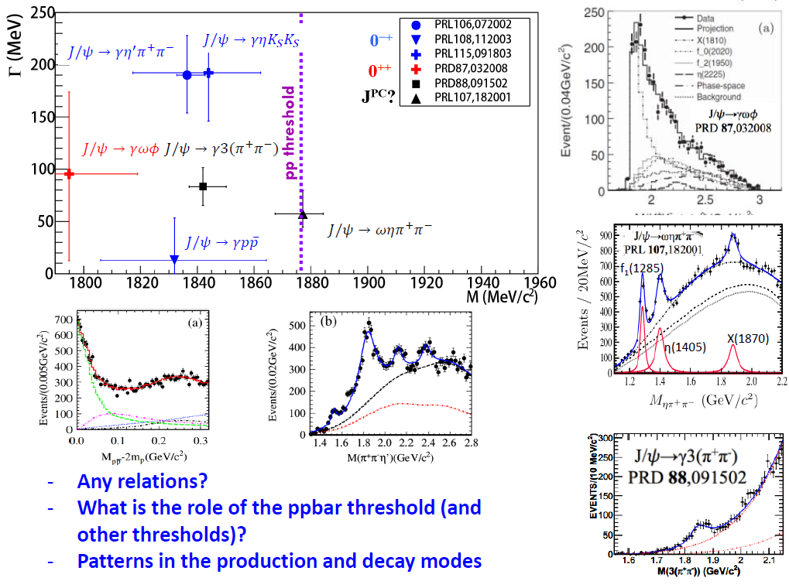

X(18??) at BESIII

Slide 13
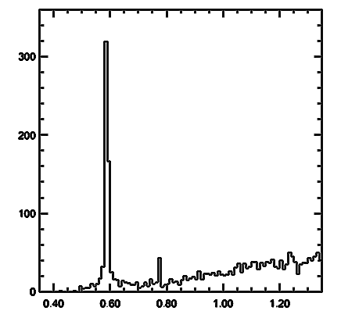
What is the X(3872)?
Belle, 2003
140 fb⁻¹
Mass: Very close to D⁰D^{*0} threshold
Width: Very narrow, < 1.2 MeV
J^{PC}=1⁺⁺
Production
  in ‾pp/pp collision – rate similar to charmonia
  In B decays – KX similar to ‾cc, K*X smaller than ‾cc
  Y(4260)→γ+X(3872)
Decay BR: open charm ~ 50%, charmonium~O(%)
Nature (very likely exotic)
  Loosely ‾D⁰D^{*0} bound state (like deuteron)?
  Mixture of excited χ_{c1} and ‾D⁰D^{*0} bound state?
M(ππJ/ψ) –M(J/ψ) [GeV]
Notes:
The X(3872) was first observed by Belle ten years ago, then confirmed by other experiments[CDF, D0 BaBar], its mass is very close to neutral DD* threshold and its width is very narrow. Since its observation, it has stimulated special interests on its nature. In both Belle and BaBar, its decay to gamma Jpsi has been observed, which supports it being a C-even state. The angular distribution study from CDF and most recently from LHCb determined it being a 1++ state. In the theoretical side, it was interpreted as a good candidate for a hadronic molecule or a tatrequark state. Currently, X(3872) was only observed in B decays, proton proton collision. Since its quantum number is determined to be 1++, it could be produced trough radiative transition of a vector charmonium or charmonium-like states, such as excited psi or Y states.

Slide 14
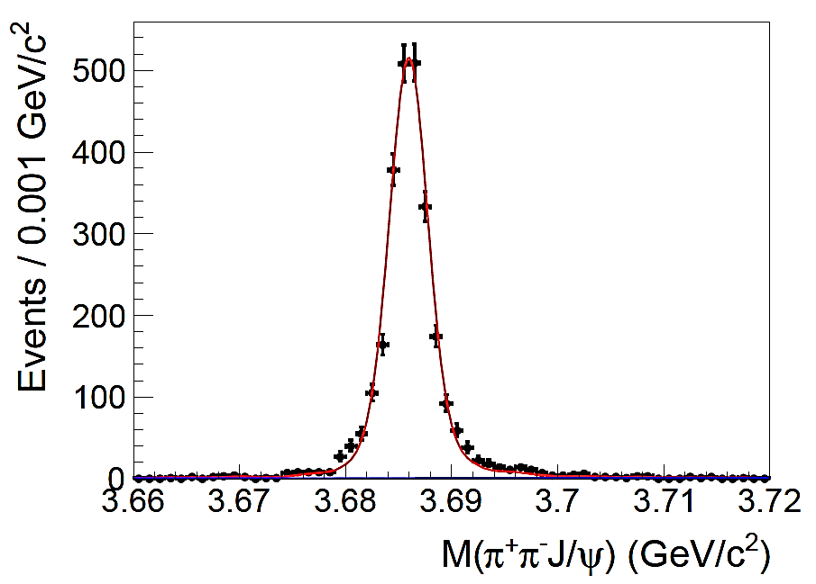
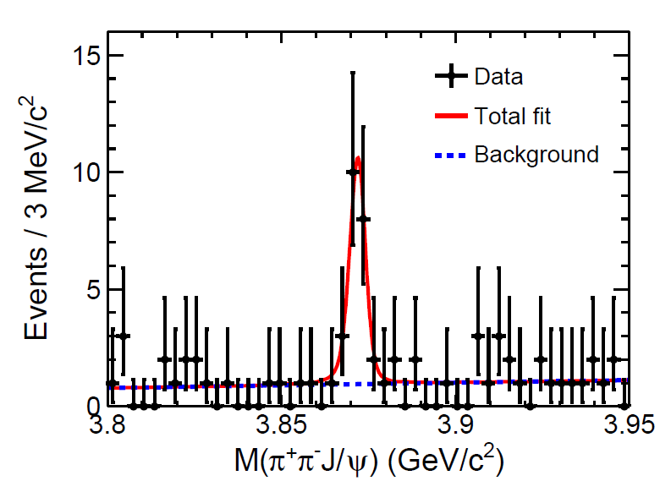
Observation of e⁺e⁻ →γX(3872)
ISR ψ’ signal is used for mass, and mass resolution calibration.
N=1818; ΔM=0.34±0.04 MeV; Δσ_{M}=1.14 ±0.07 MeV
N(X(3872)) = 20.1±4.5 6.3σ
M(X(3872)) = 3871.9±0.7±0.2 MeV [PDG: 3871.68 ±0.17 MeV]
PRL 112, 092001 (2014)
Notes:
The pipijpsi mass distribution summed over all the energy points is fitted to extract the mass and signal yields of the X(3872). The X(3872) signal is described by a MC simulated signal shape convolving a Gaussian function which represents the difference between data and MC, while the background events are described by a linear function. The mass resolution difference between data and MC simulation, the absolute mass and the cross section calibration are obtained using the ISR psip signal. The fit yields 20 X(3872) signal events with a mass consistent with the PDG value. The statistical significance of X(3872) is estimated to be 6.3 Gaussian standard deviation.

Slide 15
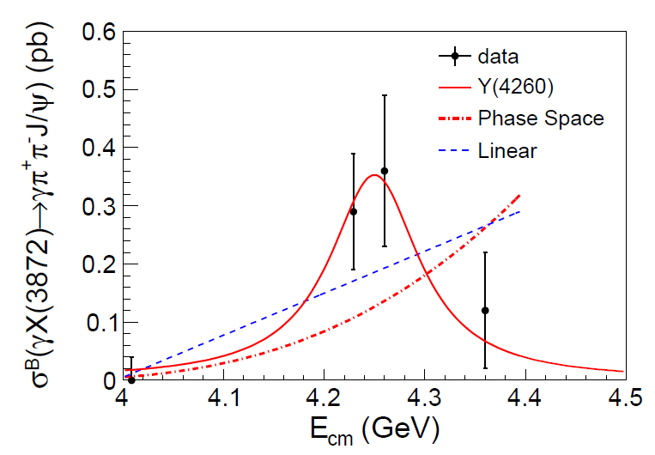
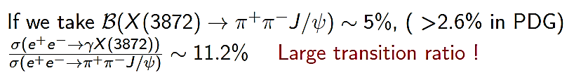
Observation of Y(4260)→γX(3872)
PRL 112, 092001 (2014)
A new Y(4260)
decay mode
A new X(3872)
production mode
10%
Notes:
Using the signal events observed, the Born cross section times the branching fraction of X(3872) decays into pipijpsi are calculated as listed in this table. For 4009 data and 4360 data, since the signals are not significant, upper limits on the production rates at 90% confidence level are set. The observation suggests that the X(3872) might be from the radiative transition of the Y(4260). Combining the cross section of electron positron goes to pi pi jpsi measured by BESIII and take the branching fraction of X(3872) decays to pi pi jpsi as 5 percent, the cross section ratio of Y(4260) decays into gamma X(3872) to Y(4260) decays into pipijpsi is about 11 percent, which is a relatively large transition ratio.

Slide 16
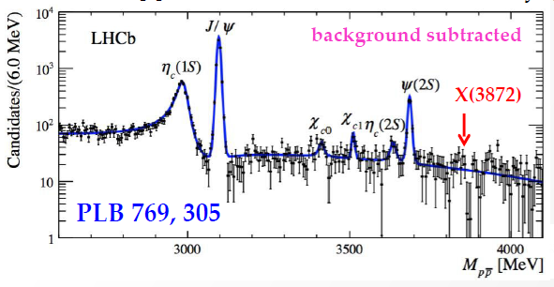


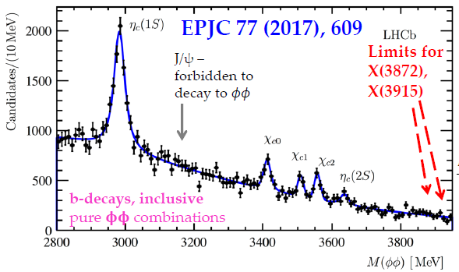


Search for X(3872)→$p\overline{p}$ and $φφ$
Upper limits at 95%(90%) C.L.

Slide 17
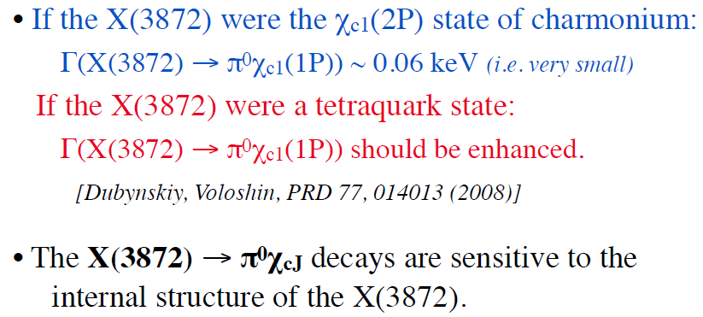
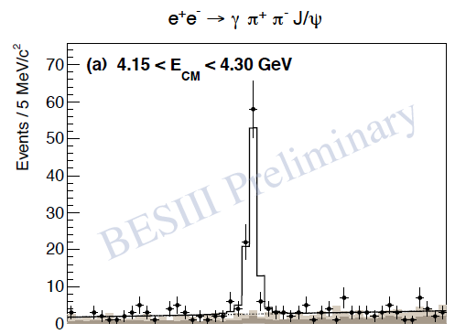


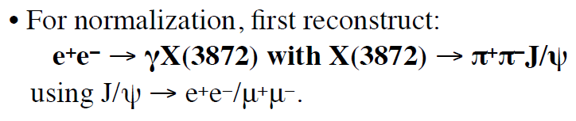

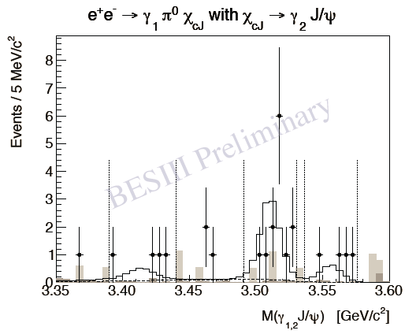
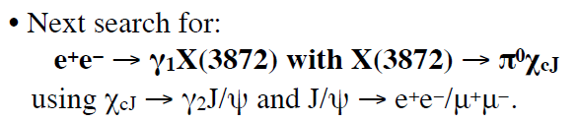
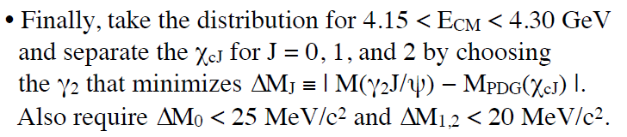

Observation of X(3872)→$π^{0}χ_{c1}$
New

Slide 18
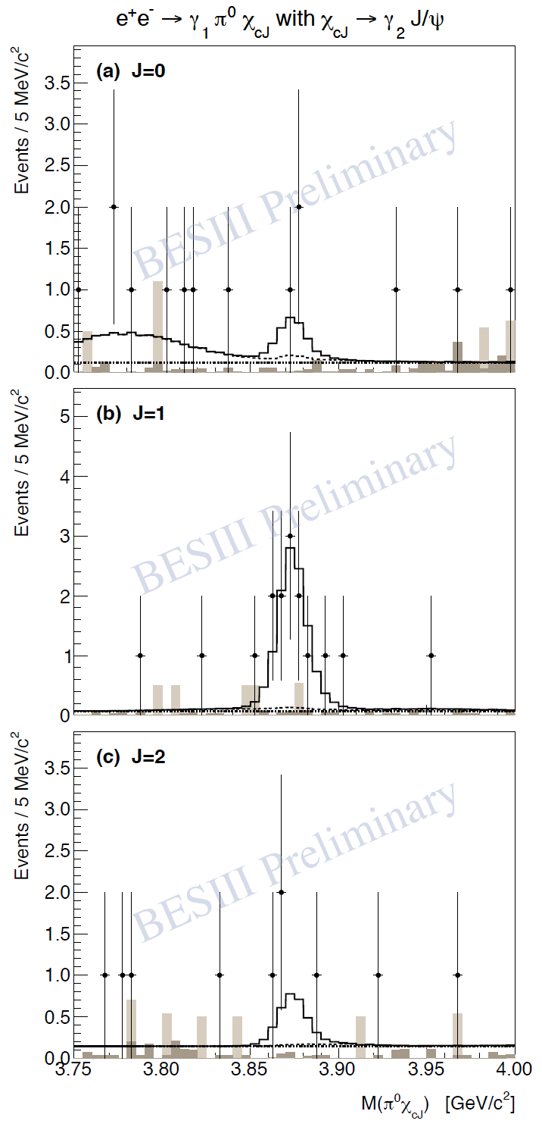

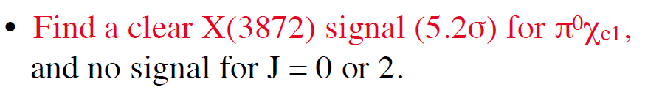
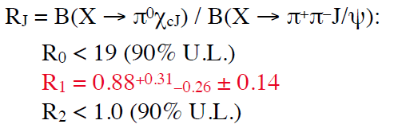





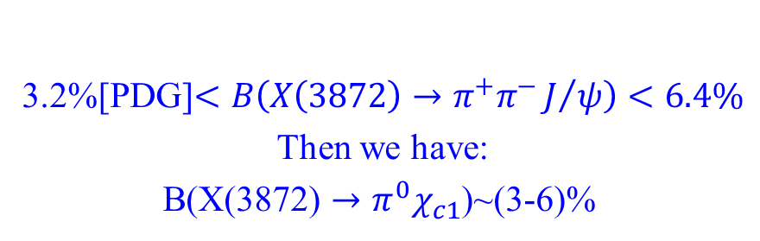
New
Observation of X(3872)→$π^{0}χ_{c1}$
3.2%[PDG]$<B\left(X\left(3872\right)→π^{+}π^{−}J/ψ\right)<6.4\%$
Then we have:
B(X(3872) $→π^{0}χ_{c1}$)~(3-6)%
  Loosely ‾D⁰D^{*0} bound state ?
  Mixture of excited χ_{c1} and ‾D⁰D^{*0} bound state?
  Tetraquark state ?

Slide 19
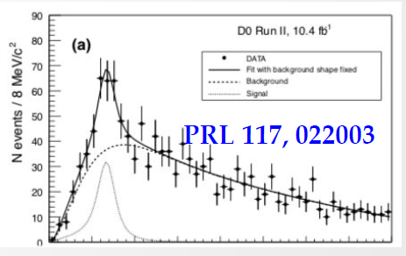
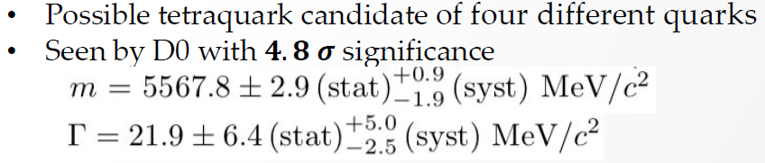
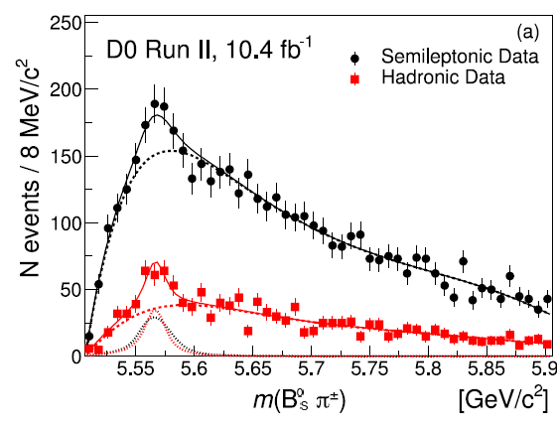
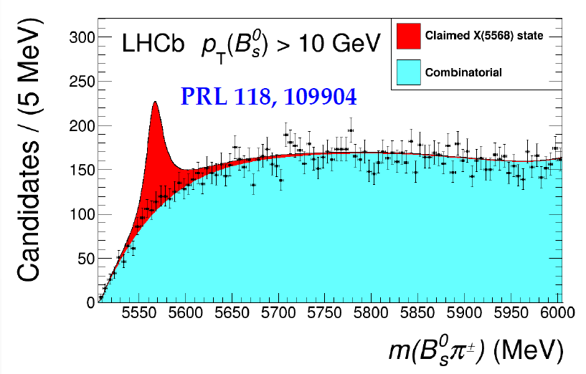
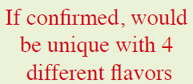
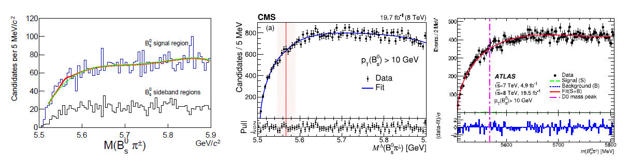



X(5568) – puzzle ?
PRL120,202006
CDF
CMS
ATLAS
19

Slide 20
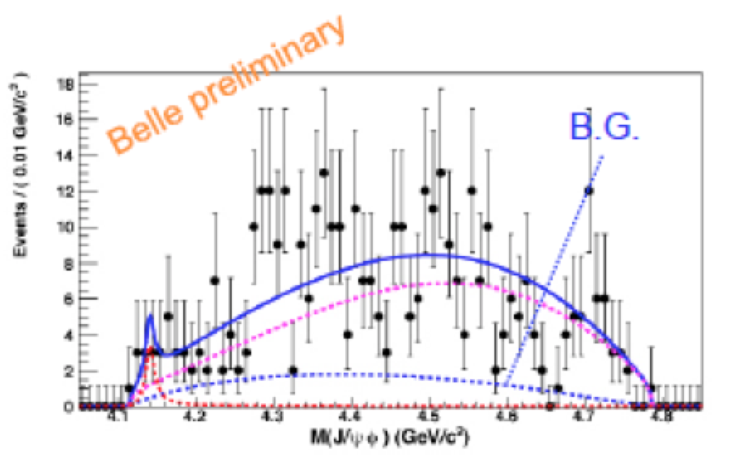
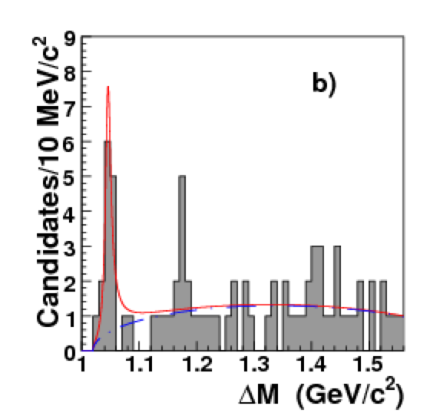
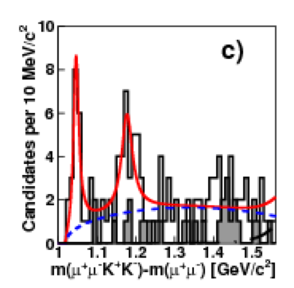
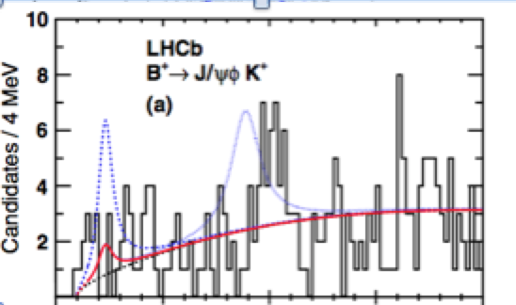

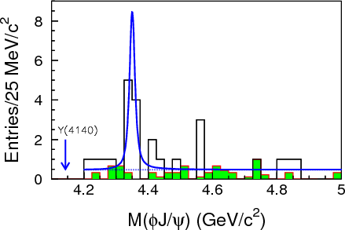
The Story of X(4140)—(2009-2011)
PRL102, 242002 (2009)
MPRA 32, 1750139 (2017)
PRD 85 091103 (2012)
CDF
CDF
Belle
CDF (2009) found evidence of Y(4140), now called X(4140)
Belle (2010) cannot confirm or deny the existence of X(4140)
LHCb(2011) confirms neither of the structures, 2.4sigma disagreement with CDF
Belle found evidence of X(4350) in ˠˠ process
Belle
PRL104, 112004 (2010)
20

Slide 21







The Story of X(4140)—(2012-2016)
CMS
CDF: Y(4140)
Local: 5.3σ?
Global: 4.3σ ➔ 3.8σ
PLB 734 261 (2014)
PRD 89, 012004 (2014)
PRD 91, 012003 (2015)
PRL118:022003 (2017)
BES
LHCb
PRD 91, 032002 (2015)
D0
PRL115:232001 (2015)
CMS, D0, LHCb finally confirm the existence of X(4140) with >5sigma significance
LHCb also confirms the existence of Y(4274) with >5sigma significance
LHCb found two more structures: X(4500) & X(4700)
21

Slide 22




Search for $X_{bb\overline{b}\overline{b}}$
CMS has observed double upsilons
(JHEP 1705 013 (2017)
should check mass spectrum?
22

Slide 23




The Y states measurements of more final states for the Y and ψ states
23

Slide 24




The Y states
Belle: PRL99,142002, 670/fb
BaBar: PRD89, 111103, 520/fb
PRL110,252002
967/fb
PRL101,172001
695/fb
PRD86,051102
454/fb
M(Λ_{c}⁺Λ_{c}⁻)
Notes:
Recently, BaBar updated their analysis of ISR pi pi psip with the full data sample, and confirmed the existence of the Y(4660), while the the update of the ISR pi pi jpsi analysis from both Belle and BaBar experiments still show difference around the 4008 mass region. The data taken at BESIII and the line-shape study using the pi pi jpsi final states may help to clarify this discrepancy between the two B-factories.

Slide 25




Search for Y$(4660)$and its spin part in
$$B^{+}→K^{+}Λ_{c}^{+}{\overline{Λ}}_{c}^{−} at Belle$$
Belle reported a structure, called X(4630), in the $Λ_{c}^{+}{\overline{Λ}}_{c}^{−}$ invariant mass distribution in $e^{+}e^{−}→γ_{ISR}Λ_{c}^{+}{\overline{Λ}}_{c}^{−}$ PRL 101, 172001
Also, some theory explained that Y(4660) has a large partial decay width to $Λ_{c}^{+}{\overline{Λ}}_{c}^{−}$ and it’s spin partner Y(4616) is predicted. PRD 82, 094008; PRL102, 242004
EPJC 78, 252 (2018)
No Y(4660) and its spin partner $Y_{η}$ were observed. in the $Λ_{c}^{+}{\overline{Λ}}_{c}^{−}$ invariant mass distribution
90% C.L. upper limits of $B^{+}→K^{+}Y(4660)→K^{+}Λ_{c}^{+}{\overline{Λ}}_{c}^{−}$ and $B^{+}→K^{+}Y_{η}→K^{+}Λ_{c}^{+}{\overline{Λ}}_{c}^{−}$ are 1.2$×{10}^{−4} and 2.0{×10}^{−4}$.
25

Slide 26


e⁺e⁻→π⁺π⁻J/ψ cross section
PRL118, 092001 (2017)
data
data
8.2 fb⁻¹
19 points
0.8 fb⁻¹
103 points
Most precise cross section measurment to date from BESIII
Fit I =|BW₁+BW₂*e^{iφ2}+BW₃*e^{iφ3}|² or Fit II =|exp+BW₂*e^{iφ2}+BW₃*e^{iφ3}|² (other fits ruled out)
M = 4222.0±3.1±1.4 MeV (lower)
Γ = 44.1±4.3±2.0 MeV (narrower)
A 2nd resonance Y₂ with M=4320.0±10.4±7.0 MeV/c²
Γ=101.4^{+25.3}_{-19.7}±10.2 MeV
Observed for the first time, significance > 7.6σ

Slide 27





Y(4260)➔Y(4220): what is it?
    Hybrid?
    ‾D₁D molecule?
    ψ(4S) state?
    ‾D_{s}*D_{s}* molecule?
    ωχ_{c0} molecule?
More data and more
theoretical work needed
Y(4220) appeared in $ωχ_{c0}$, $π^{+}π^{−}J/$, $π^{+}π^{−}′$, $π^{+}π^{−}h_{c}$, $D^{0}D^{∗−}π^{+}$
Mass~4220 MeV, Width~ 60 MeV!

Slide 28
The Z_{c} states

Slide 29




Observation of Zc(3900)
PRL110, 252002 (2013)
PRL110, 252001 (2013)
M = 3899.0±3.6±4.9 MeV
Γ = 46±10±20 MeV
307 ± 48 events
>8σ

Slide 30

Spin-parity of Z_{c}(3900)
PRL 119, 072001 (2017)
Asymmetric line shape
JP=1+ preferred over 0-, 1-, 2-, 2+ by at least 7σ.
Significant f₀(980) contribution
ππ D-wave fraction increases as E_{cm} increases
4.23 GeV
1092/pb
4.26 GeV
826/pb
May any model calculate the s-dependent Dalitz plot? [large data samples at 4.18-4.28 every 0.01 GeV, 4.36, and 4.42 GeV]
Notes:
BESIII observed the production of pi+pi-h_c with the data samples at a few energy points. Here, hc is reconstructed with its E1 transition to eta_c, and eta_c is reconstructed with its 16 hadronic decay modes. From the plot we can see very clear eta_c signal in the invariant mass of the hadronic system, and very clear h_c signal at gamma and eta_c invariant mass. If we select only the events in the eta_c mass region, we get …

Slide 31





Search for Z_{c}→ ρη_{c}
New
Search for new decay mode of Z_{c}(3900) and Z_{c}(4020)
The ratios of $Z_{c}^{(′)}→ρηc$to $Z_{c}^{(′)}→πJ/ψ({πh}_{c})$ may discriminate the tetra-quark and molecule models.
$$Rz= \frac{B(Z_{c}→ρηc)}{B(Z_{c}→πJ/ψ)}$$
$$R_{z′}= \frac{B(Z_{c}^{′}→ρηc)}{B(Z_{c}^{′}→πh_{c})}$$
A.Esposito, A.L.Guerrieri, A.Pilloni, Phys. Lett. B 746, 194 (2015)
Type II tetraquark model:
neglect the spin-spin interaction outside the diquarks

Slide 32





Evidence for Z_{c}→ ρη_{c}
New
preliminary
Strong evidence for e⁺e⁻→$πZc , Zc→ρ ηc$ at $\sqrt{s}=$ 4.23,
240±56 events
statistical significance is 4.3σ.
e⁺e⁻→$πZ_{c}^{′},Z_{c}^{′}→ρ ηc$ not seen
21±13 events (1σ)
$e^{+}e^{−}→π^{+}π^{−}π^{0}η_{c}$
$ηc$→9 hadronic decays
Decay mode | BR
η_{c}→ $p\overline{p}$ | ~0.13%
η_{c} → 2(K⁺K⁻) | ~0.15%
η_{c} → π⁺π⁻K⁺K⁻ | ~1.50%
η_{c} → K⁺K⁻π⁰ | ~1.20%
η_{c} → $p\overline{p}$π⁰ | ~0.18%
η_{c} → K_{S}Kπ | ~1.80%
η_{c} → π⁺π⁻η | ~1.60%
η_{c} → K⁺K⁻η | ~0.57%
η_{c} → π⁺π⁻π⁰π⁰ | ~2.40%
preliminary
preliminary
e⁺e⁻→$πZc ,Zc→ρ ηc$ @ 4.23 GeV

Slide 33






Evidence for Z_{c}→ ρη_{c}
preliminary
New
Measure Born cross section at 4.23 GeV:
${{ σ}^{B}(e}^{+}e^{−}→π^{+}π^{−}π^{0}η_{c})=(\text{46 ± 12 ± 10 })$ pb
${{ σ}^{B}(e}^{+}e^{−}\text{→} πZc ,Zc→ρ ηc)=\left(\text{47}\text{±}\text{ 1}\text{1} \text{±}\text{ 1}\text{1} \right)$ pb
Also calculations predict very different values:
R_{z}=10⁻³~10² !
arXiv:1806.05651
arXiv:1512.01938
PRD 91, 034032 (2015)
PRD 90, 054006 (2014)
EPJC 73, 2561 (2013)
$$Rz= \frac{B(Z_{c}→ρηc)}{B(Z_{c}→πJ/ψ)}$$
$$R_{z′}= \frac{B(Z_{c}^{′}→ρηc)}{B(Z_{c}^{′}→πh_{c})}$$
A.Esposito et al, Phys. Lett. B 746, 194 (2015)

Slide 34





Production of Z_{c}±(3900) in b-hadron Decays
Search for the Z_{c}⁺(3900) production in H_{b} decays via the following decays:
H_{b} → Y(4260) + anything
Y(4260) → Z_{c}±(3900)π∓
Z_{c}±(3900) → J/ψπ±
where H_{b} is any b-ﬂavored hadron
arXiv:1807.00183
1.96 TeV
4.6 σ
M = 3895.0±5.2 (stat)^{+4.0}_{−2.7} (syst) MeV
Y(4260)

Slide 35


Observation of Z_{c}(4020)⁺
BESIII: PRL111, 242001
Simultaneous fit to 4.23/4.26/4.36 GeV data, 16 η_{c} decay modes. 8.9σ
M(Z_{c}(4020)) =
4022.9±0.8±2.7 MeV; Γ(Z_{c}(4020)) =
7.9±2.7±2.6 MeV
Close to‾D*D* threshold
σ(e⁺e⁻→ πZ_{c}→π⁺π⁻h_{c}) :
8.7±1.9±2.8±1.4 pb @ 4.230 GeV
7.4±1.7±2.1±1.2 pb @ 4.260 GeV
10.3±2.3±3.1±1.6 pb @ 4.360 GeV
Significance: 8.9σ [Z_{c}(4020)]
No significant Z_{c}(3900) (2.1σ)

Slide 36





Z_{c} in e⁺e⁻→ π⁺π⁻ψ’ ?
PRD 96, 032004 (2017)
Stat. err. ONLY!
Lum.=1073.56 pb⁻¹

Slide 37

A toy fit by Alex Bondar @ Charm2018
Probably this is a new Zc(4020) decay mode.
37

Slide 38
X, Y, Z particles are correlated
Whatever they are, they are very similar.
Molecule? Compact tetraquark? Kinematic effect?
Y(4220)
Z_{c}(3900)
X(3872)
?

Slide 39

Upgrade and Prospects

Slide 40
BEPCII Upgrade
Increase of beam energy
  E_{beam}=2.30→2.35→2.45 GeV
  Plan:
    Get to 2.35 GeV in 2019
    Get to 2.45 GeV in 2020-21, change ISPB (Interaction region SePtum Bending) magnet, big challenge
Top-up injection
  Data taking efficiency increases by 20∼30%

Slide 41




SuperKEKB
Expected data sample @ full luminosity
2018.4. start of the collisions
2019 physics running
Assumptions:
  same commission time to reach design lum. as KEKB
  9 months/year running
  20 days/month
The target integrated luminosity will be 50-100 ab⁻¹
41
Notes:
The plot on the right shows the luminosity profile of SuperKEKB, assuming the same commissioning time to reach nominal luminosity as in KEKB, 9 months/year of running time and 20 days/month of physics operations.
With this assumption the goal of 50 ab-1 will be reached in the year 2025.

Slide 42

LHCb upgrade

Slide 43
Summary
Lots of progress in the study of exotic states at experiments
Some new (charm-)baryons were found recently （see backup）
More experimental and theoretical efforts are needed to understand heavy flavor spectroscopy
BESIII, Belle II, LHC, … will take more data and continue the study
Thanks a lot!

Slide 44

Baryon Spectroscopy

Slide 45










Observation of an excited $Ω^{−}$ baryon
Only one excited $Ω^{−}$ states, $Ω$(2250), was confirmed until now.
The evidence for two other states of $Ω^{−}$ were reported.
Observation $Ω^{−}(2012)$ with a significance of 8.3$σ$ in Y(1,2,3S) data
- $M=(2012.4±0.7±0.6)$ MeV/c² & $Γ$ $=({6.4}_{−2.0}^{+2.5}±1.6)$MeV
$Ω^{−}(2012)$
$$Ξ^{0}+K^{−}$$
A measurement of the three-body decay, e.g., Ω(2012) $→ΞπK$, is crucial to identify the nature of this hyperon.
arXiv:1805.09384
Accepted by PRL
$$Ξ^{−}+K_{S}^{0}$$
Y. H. Lin and B. S. Zou, arXiv:1807.00997
M. V. Polyakov, arXiv:1806.04427
M. P. Valderrama, arXiv:1807.00718
45

Slide 46





$Ξ_{c}{(2930)}^{0}$in $B^{+}→K^{+}Λ_{c}^{+}{\overline{Λ}}_{c}^{−}$
Belle reported a structure, called X(4630), in the $Λ_{c}^{+}{\overline{Λ}}_{c}^{−}$ invariant mass distribution in $e^{+}e^{−}→γ_{ISR}Λ_{c}^{+}{\overline{Λ}}_{c}^{−}$ PRL 101, 172001
BarBar once studied $B^{+}→K^{+}Λ_{c}^{+}{\overline{Λ}}_{c}^{−}$ and found two small peaks in $M_{Λ_{c}^{+}{\overline{Λ}}_{c}^{−}}$ spectrum and a vague structure named $Ξ_{c}\left(2930\right)$is seen in the distribution of $M_{K^{ }Λ_{c}^{ }}$. Larger data is needed to verify them. PRD 77, 031101
Also, some theory explained that Y(4660) has a large partial decay width to $Λ_{c}^{+}{\overline{Λ}}_{c}^{−}$ and it’s isospin partner Y(4616) is predicted. PRD 82, 094008; PRL102, 242004
PRL 101, 172001
PRD 77, 031101
46

Slide 47

Observation of $Ξ_{c}{(2930)}^{0}$in $B^{+}→K^{+}Λ_{c}^{+}{\overline{Λ}}_{c}^{−} at Belle$
Eur. Phys. J. C78, 252 (2018)
47

Slide 48





Evidence of charged $Ξ_{c}(2930)$ in $B^{0}→K_{ }^{0}Λ_{c}^{+}{\overline{Λ}}_{c}^{−}$
arXiv:1806.09182
Based on full $Υ(4S)$ data set (772 M $B\overline{B}$ pairs) at Belle
Three $Λ_{c}^{ }$ decay channels:
$Λ_{c}^{+}→{pK}^{−}π^{+}$, $Λ_{c}^{+}→pK_{s}(π^{+}π^{−})$and $Λ_{c}^{+}→Λ\left({pπ}^{−}\right)π^{+}.$
$B$ candidates extracted via 2D fit to $M_{bc}$ and $ΔM_{B}$
48

Slide 49



Evidence of charged $Ξ_{c}(2930)$ in $B^{0}→K_{ }^{0}Λ_{c}^{+}{\overline{Λ}}_{c}^{−}$
Charged $Ξ_{c}(2930)$ extracted by fitting $M_{K_{s}^{0}Λ_{c}}$
4.1σ
49

Slide 50





Exicted $Ω_{c}$ at LHCb and Belle
PRD97, 051102 (2018)
50

Slide 51







Observation of a new $Ξ_{b}^{∗∗−}$ state
Hadronic $Λ_{b}^{0}→Λ_{c}^{+}π^{−}$:
  Resolution: 2 MeV
  − Μ=6226.9$±2.0±0.3±0.2$ MeV
  − $Γ=18.1±5.4±1.8$MeV
arXiv:1805.09418, submitted to PRL
  7.9σ
Semileptonic (SL)
$Λ_{b}^{0}→Λ_{c}^{+}μ^{−}X{\overline{ν}}_{μ}$
  Resolution: ~18 MeV
  Yields ~15 larger
  25σ
Semileptonic (SL)
$Ξ_{b}^{0}→Ξ_{c}^{+}μ^{−}X{\overline{ν}}_{μ}$
  9.2σ
Many states are predicted at ~6230 MeV To distinguish them further information needed (e.g. J^{P}, $ℬ$)

Slide 52













Observation of $Ξ_{cc}^{++}$at LHCb
Decay: $Ξ_{cc}^{++}→Λ_{c}^{+}K^{−}π^{+}π^{+}$, $ℬ$ could be
as large as 10% [Yu et al., CPC 42 (2018) 051001]
LHCb run II at $\sqrt{s}=13$ TeV, $\sim 1.7$ fb⁻¹
arXiv:1807.01919, submitted to PRL
  $313±33$, $12σ$
$$N_{sig}=91±20$$
PRL 119 (2017) 112001
new decay mode $Ξ_{cc}^{++}→Ξ_{c}^{+}π^{+}$
$${Ξ_{cc}^{++}→K^{−}π^{+}π^{+}Λ}_{c}^{+}\left(→pK^{−}π^{+}\right)$$
$Ξ_{c}^{+}\left(→pK^{+}π^{−}\right)π^{+}$
$$Ξ_{cc}^{++}$$
$$Λ_{c}^{+}$$
PV
$τ_{Ξ_{cc}^{++}}={256}_{−22}^{+24}±14$ fs
$$m\left(Ξ_{cc}^{++}\right)=3621.40±0.72±0.27$$
$±0.14(Λ_{c}^{+})$ MeV/c²
arXiv:1806.02744, accepted by PRL

Slide 53

Belle II vs. BESIII
ISR produces events at all CM energies BESIII can reach
At 4.26 GeV for π⁺π⁻J/ψ
ε_{BESIII} = 46%
ε_{Belle} = 10%

Slide 54

Fit of intermediate state
Interference not considered & fits cannot describe data well!
PRD 96, 032004 (2017)

Slide 55



$e^{+}e^{−}→π^{+}D^{0}D^{∗−}$+c.c.
Reconstruct $D^{0}→K^{−}π^{+}$
Select the combination closest to $D^{0}$ mass (m($D^{0}$))
Find an additional $π^{+}$;
1.9 < $M(D^{∗−})$ (RM$\left(D^{0}π^{+}\right)+M\left(D^{0}\right)−m\left(D^{0}\right)$) < 2.1 GeV/$c^{2}$
select the candidate closest to $D^{∗−}$ mass
An un-binned maximum likelihood fit
Signal shape: MC convolved with a Gaussian;
The isospin partner background (dotted line) is parameterized with MC;
A linear function for other bkg
Preliminary

Slide 56



Fit to the dressed Xsection of $e^{+}e^{−}→π^{+}D^{0}D^{∗−}$+c.c.
$$σ_{dress}=\frac{N^{obs}}{ℒ\left(1+δ^{r}\right)B\left(D^{0}→K^{−}π^{+}\right)ε}$$
Preliminary
Fit with a constant (pink dashed triple-dot line) and two constant width relativistic BW functions (green dashed double-dot line and aqua dashed line).

Slide 57


Resonant parameters
The error are statistical only.
Preliminary
Statistical significance is greater than 10σ.
Consistent with those of Y(4220) and Y(4390) in $e^{+}e^{−}→π^{+}π^{−}h_{c}$.

Slide 58
e⁺e⁻→ π⁺π⁻h_{c}(1P)
h_{c}→γη_{c}, η_{c} →hadrons [16 exclusive decay modes]
  pp, π⁺π⁻K⁺K⁻, π⁺π⁻pp, 2(K⁺K⁻), 2(π⁺π⁻), 3(π⁺π⁻)
  2(π⁺π⁻)K⁺K⁻, K_{S}⁰K⁺π⁻+c.c., K_{S}⁰K⁺π⁻π⁺π⁻+c.c., K⁺K⁻π⁰
  ppπ⁰, K⁺K⁻η, π⁺π⁻η, π⁺π⁻π⁰π⁰, 2(π⁺π⁻)η, 2(π⁺π⁻π⁰)
E_{cm}=4.415 GeV
E_{cm}=4.415 GeV
Method same as in PRL111, 242001 (2013)
Notes:
BESIII observed the production of pi+pi-h_c with the data samples at a few energy points. Here, hc is reconstructed with its E1 transition to eta_c, and eta_c is reconstructed with its 16 hadronic decay modes. From the plot we can see very clear eta_c signal in the invariant mass of the hadronic system, and very clear h_c signal at gamma and eta_c invariant mass. If we select only the events in the eta_c mass region, we get …

Slide 59
e⁺e⁻→π⁺π⁻h_{c} cross section
PRL118, 092002 (2017)
~6 fb⁻¹
First precise cross section measurement from threshold to 4.6 GeV
Fit with |BW₁+BW₂*e^{iφ2}|² , two resonant structures are evident

Slide 60
e⁺e⁻→π⁺π⁻h_{c} cross section
PRL118, 092002 (2017)
~6 fb⁻¹
M₁=4218.4^{+5.5}_{-4.5}±0.9 MeV/c², Γ₁= 66.0^{+12.3}_{-8.3}±0.4 MeV → Y(4220)
M₂=4391.5^{+6.3}_{-6.8}±1.0 MeV/c², Γ₂=139.5^{+16.2}_{-20.6}±0.6 MeV → Y(4390)

Slide 61

Improvement of e⁺e⁻→ π⁺π⁻ψ’
PRD 96, 032004 (2017)
Notes:
Here we show the Dalitz plot of the 1600 pi+pi-J/psi events selected at 4.26 GeV in the 525 inverse pico barn BESIII data. We can see very clear bands in pipi and piJ/psi invariant masses, which are the known pipi resonances such as sigma, f0(980), and a structure in piJ/psi, at 3900 MeV. In fact there is another peak in the piJ/psi invariant mass distribution, from the MC study, we know it is the reflection of the same Zc state in a wrong piJ/psi combination.

Slide 62


Signals at Ecm=4.416 GeV
PRD 96, 032004 (2017)
Mode I
Mode II
Number of signals are extracted from π⁺π⁻J/ψ invariant mass (mode I) and π⁺π⁻ recoiled mass spectrum (mode II).
Signals are described with MC simulated shape convolved with a Gaussian function.

Slide 63

The Ys in e⁺e⁻→ π⁺π⁻ψ’
arXiv:1703.08787,
PRD 96, 032004 (2017)
The Y(4220) is necessary
(significance = 5.8σ)
Fix parameters of the Y(4660) to Belle results

Slide 64
Summary of the Z_{c} states at BESIII
Decay Modes | Z_{c}(3900) | Z_{c}(4020)
I^{G}(J^{PC}) | 1⁺(1⁺ ⁻) | 1⁺(?^{? −})
πJ/ψ | Discovery mode | No
πh_{c} | 2.1σ | Discovery mode
‾D*D | Yes | No
‾D*D* | No | Yes
πψ’ | No | Yes?
ρη_{c} | 4.3σ | No

Slide 65

Results from Five Collider Experiments on X(5568)
LHC experiments do not observe X(5568) at higher collisions energy
CDF result is in ~2σ tension with DØ studies in hadronic decay channel
  Kinematic selections vary substantially
  Ratio to B_{s}⁰ production might not be the best metric
Without theoretical model of X(5568) production and decays it is hard to compare various experiments quantitively

