Slide 1
Understanding X(3872) and other XYZ states in Friedrichs model
Zhi-Yong Zhou
Southeast University
周智勇
东南大学
With Zhiguang Xiao
2018.8.30 吉林大学

Slide 2
motivation
Properties of X(3872)
See Rev.Mod.Phys. 90 (2018) no.1, 015004
Prog.Part.Nucl.Phys. 93 (2017) 143-194
Just below the D⁰D⁰ threshold
Very narrow width
Decay to jpsi rho
J^{PC}=1⁺⁺
Radiative decay

Slide 3
Motivation
“Exotic” X(3872)
X(3872)
From chengping
3

Slide 4
Gamow state
Energy eigenfunction with a complex eigenvalue, proposed by G.Gamow to understand alpha decay.
G.Gamow , Z.Phys. 51 (1928) 204-212
However, in Hilbert space, a self-adjoint operator can only admit real eigenvalues. A rigorous treatment to Gamow state require an extension of Hilbert space to Rigged Hilbert space(RHS).
A.Bohm, M.Gadella, Dirac kets, Gamow vectors, and Gelfund Triplets,
Springer Lectures Notes in Physics Vol.348, Springer, Berlin
Plane wave is also not in Hilbert space but in RHS.

Slide 5
Rigged hilbert space
I.M. Gel’fand, N.Ya. Vilenkin, Generalized Functions, Vol. IV, Academic Press, New York, 1964
Gel’fand triplet space
the space of the anti-linear continuous functionals on the nuclear space
Nuclear space , dense in H
Hilbert space of normalizable state
The space of Gamow states
More mathematical background :
A. Bohm, J. D. Dollard, and M. Gadella, Dirac Kets,
Gamow Vectors and Gel’fand Triplets, Lecture Notes in Physics, Vol. 348
O. Civitaresea, M. Gadella ,Physics Reports 396 (2004) 41–113

Slide 6
Friedrichs model
A solvable model to demonstrate the properties of Gamow state.
K. O. Friedrichs,
Communications on Pure and Applied Mathematics 1, 361 (1948).
Several variants:
Lee model
Fano model
Anderson model
T. D. Lee, Phys. Rev. 95, 1329 (1954),
U. Fano, Phys. Rev. 124, 1866 (1961).
P. W. Anderson, Phys. Rev. 124, 41 (1961).

Slide 7
Simplest Friedrichs model
Free Hamiltonian with a simple continuous spectrum , and a discrete eigenstate with the eigenvalue .
Then the free Hamiltonian is
Normalization :

Slide 8
Simplest Friedrichs model
Suppose there is an interaction between the continuous and discrete parts
where represent the interaction strength.
We can solve the eigenstate of the full Hamiltonian with eigenvalue .
Since the and form a complete set, could be
expressed as

Slide 9
Solution
Using
We have
For Eigenvalue

Slide 10
solution
Define
Thus,
Choose normalization:
Solution:

Slide 11
solution
For eigenvalue
For to be nonzero, should vanish.

Slide 12
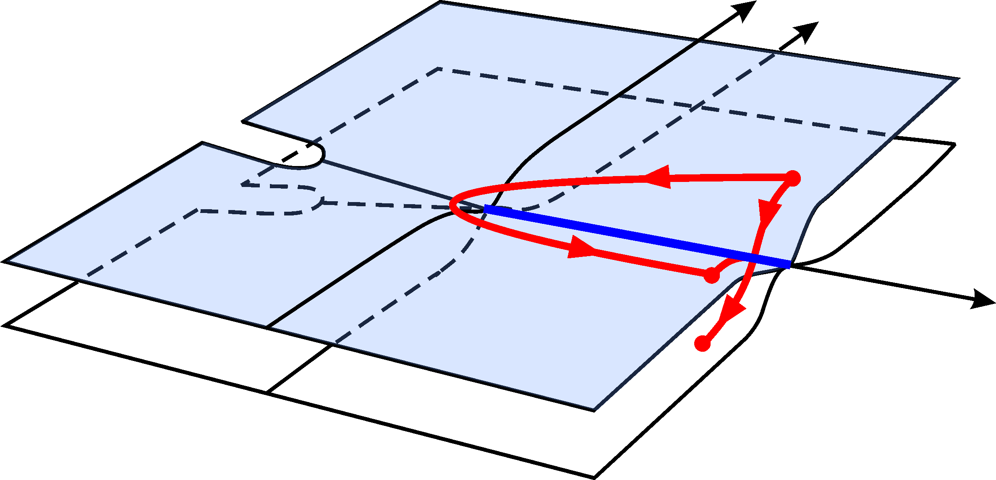
properties of function
A complex analytic function with no singularities on the complex plane other than a branch cut coinciding with the positive semi-axis R+ provided that . It admits analytic continuations through the cut , from above to below from below to above. The continuation has a zero at z₀ with Im[z₀]<0, which is an analytic function. Analogously, has a zero at z∗₀, which is also an analytic function.
Real-analytic
Anti-real-analytic

Slide 13
Bound state
Solutions on the first sheet real axis below the threshold
If , there could be a bound state.
where
Such that

Slide 14
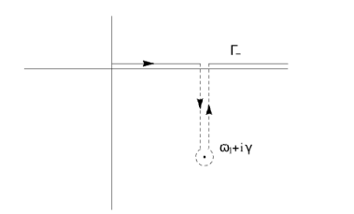
Resonance --------”Gamow vector”
For , a pair of solutions and on the second sheet.
decaying state
growing state

Slide 15
Resonance --------”Gamow vector”
Normalization
A simple argument:
Since
So
is not a state in Hilbert space, need Rigged Hilbert space description.

Slide 16
Norms of gamow states
Left eigenvector
Right eigenvector
Normalization:
is complex.

Slide 17
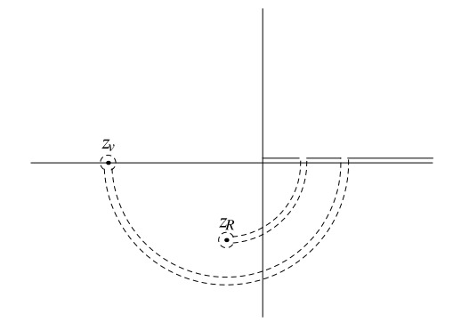
virtual state
on the second sheet real axis below the threshold
Normalization constant:

Slide 18
main results by extending Friedrichs model
(1)Mostly generalized completeness relation with higher-order
virtual poles, bound-states, and resonances.
Different origins of virtual states.
Zhiguang Xiao, ZYZ,arXiv:1608.00468, Phys. Rev. D 94, 076006
(2) Find the solutions in multichannel case. The wave functions of Gamow states in different Riemann sheets.
The compositeness relations of multi-channel case.
Zhiguang Xiao, ZYZ , arXiv:1608.06833,
J.Math.Phys. 58 (2017) no.6, 062110
(3) Partial wave decomposition for non-relativistic in extended Friedrichs model with self-interacting continua.
Probability explanations for bound states.
But for resonance the “compositeness” and “elementariness” are complex. Probability explanation?
Zhiguang Xiao, ZYZ , arXiv:1610.07460 J.Math.Phys. 58 (2017) no.7, 072102

Slide 19
X(3860),X(3872),X(3930),X(3940)
Suppose a discrete state |0;JM> with spin J, coupled to a continuum composed of two hadrons |p; JM;LS>. The free Hamiltonian is
The matrix elements of the interaction potentials can be expressed as
By finding the zeros of the resolvent( on complex energy plane)
Use Godfrey-Isgur model and QPC model to represent the bare masses and the coupling functions.

Slide 20
Predictions of poles
The quark pair creation strength
$$γ≈4.0$$
The χ_{c2}(2P)
Two poles related to χ_{c1}(2P)
χ_{c0}(2P) is a narrow state
Predicted h_{c}(2P)
Phys.Rev. D96 (2017) no.5, 054031

Slide 21
X(3872) and its compositeness
Wave function of X(3872)
Compositeness of X(3872)
where
normalization

Slide 22
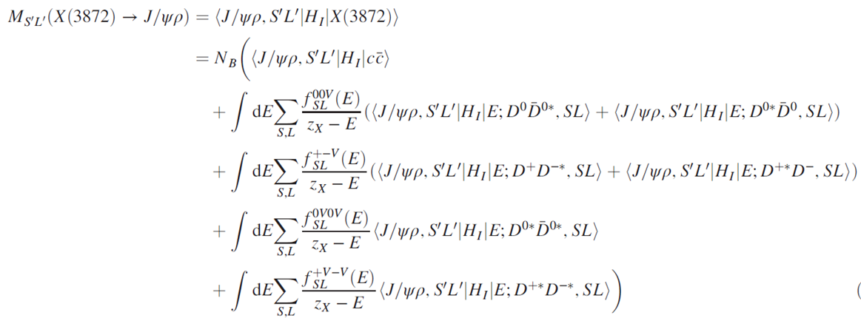
Transition amplitude to J/ψ$ρ,ω$
To calculate its decay widths to $J/\text{ψ}ππ$and $J/\text{ψ}πππ$
Similarly for J/ψ$ω$
Phys.Rev. D97 (2018) no.3, 034011

Slide 23
Barnes-swanson model
T. Barnes and E. S. Swanson, Phys. Rev. D 46, 131 (1992).
Interaction between quark or antiquark among different mesons
Four kinds of scattering amplitudes
scattering amplitudes can be expressed as products of signature, flavor, color, spin, and space overlap factors.
$$T=I_{sign}I_{flavor}I_{color}I_{spin}I_{space}$$

Slide 24
Barnes-swanson model
Space overlap factors
The meson wave functions are those Godfrey-Isgur solution, and the coefficients are also obtained from Godfrey-Isgur model. Thus there is no free parameters adopted.

Slide 25
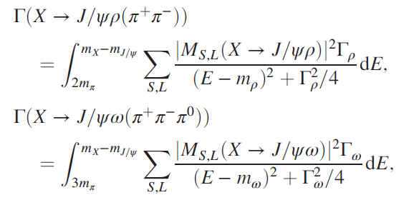
results
Omitted due to small elementariness and OZI suppression

Slide 26
result

Slide 27
${\overline{D}}^{0}D^{0∗}$ scattering amplitude
${\overline{D}}^{0}D^{0∗}$ mass distributions in $B→X\left({\overline{D}}^{0}D^{0∗}\right)K$decays

Slide 28
Summary
Extend the Friedrichs model to general cases.
General properties of Gamow states in Friedrichs-like model are obtained.
It could help us to understand the wave functions of unstable states.
Applications of the Friedrichs-like model in hadron physics.
It could be used to understand the properties of X(3872), when a quark rearrangement model is adopted.

Slide 29
Thanks for your patience!

