Slide 1
Gluon mass generation and the critical phenomena
Lei Chang(常雷)
leichang@nankai.edu.cn
Nankai University
2018手征有效场论研讨会，2018年8月30日

Slide 2

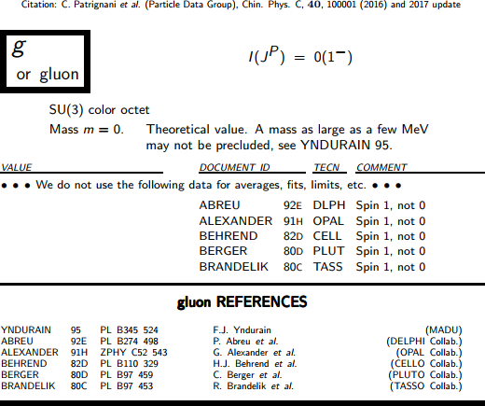
Particle Data Group

Slide 3
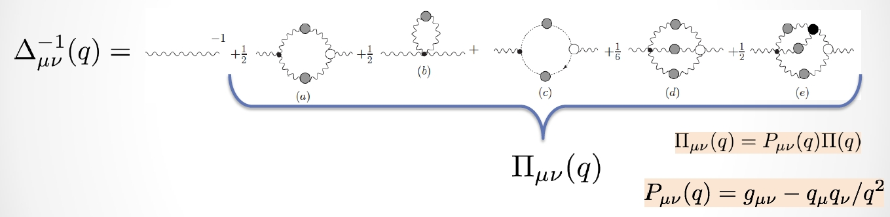
In QCD: Gluons become massive!
Schwinger
1962
Cornwall
1982
Binosi & Papavassiliou
Phys. Rept. 479 (2009)1-152
Pinch Technique: Theory and Applications

Slide 4
On the Lattice
a) SU(3) b)SU(2)

Slide 5
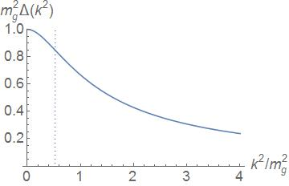
胶子传播子
目前，所有DSE和格点QCD关于Landau规范下的胶子传播子的计算表明胶子传播子在红外会出现拐点；
拐点的出现表明谱正定性的破坏= 禁闭的充分条件
m_{g} ≈ 0.5 GeV
r_{C} ≈ 0.5 fm附近出现拐点:
r<r_{c} 类部分子，没有质量粒子之传播;
r>r_{c} 大距离传播行为发生极大改变，不再具有传播子信息。
谱表示
如果
谱不正定
胶子=汉尼拔

Slide 6
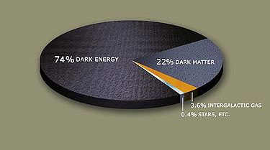
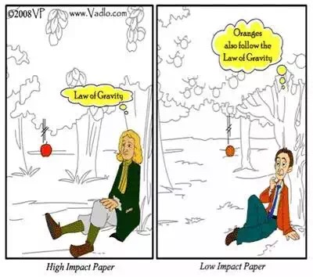
…...
Can we quantitatively understand quark and gluon confinement in quantum chromodynamics and the existence of a mass gap?
Quantum chromodynamics, or QCD, is the theory
describing the strong nuclear force. Carried by
gluons, it binds quarks into particles like protons
and neutrons. Apparently, the tiny subparticles
are permanently confined: one can’t pull a quark
or a gluon from a proton because the strong force
gets stronger with distance and snaps them right
back inside.

Slide 7
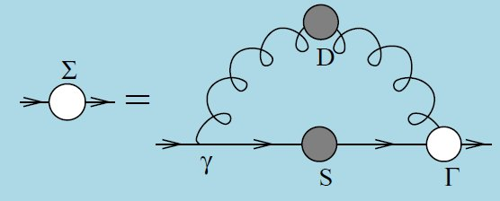
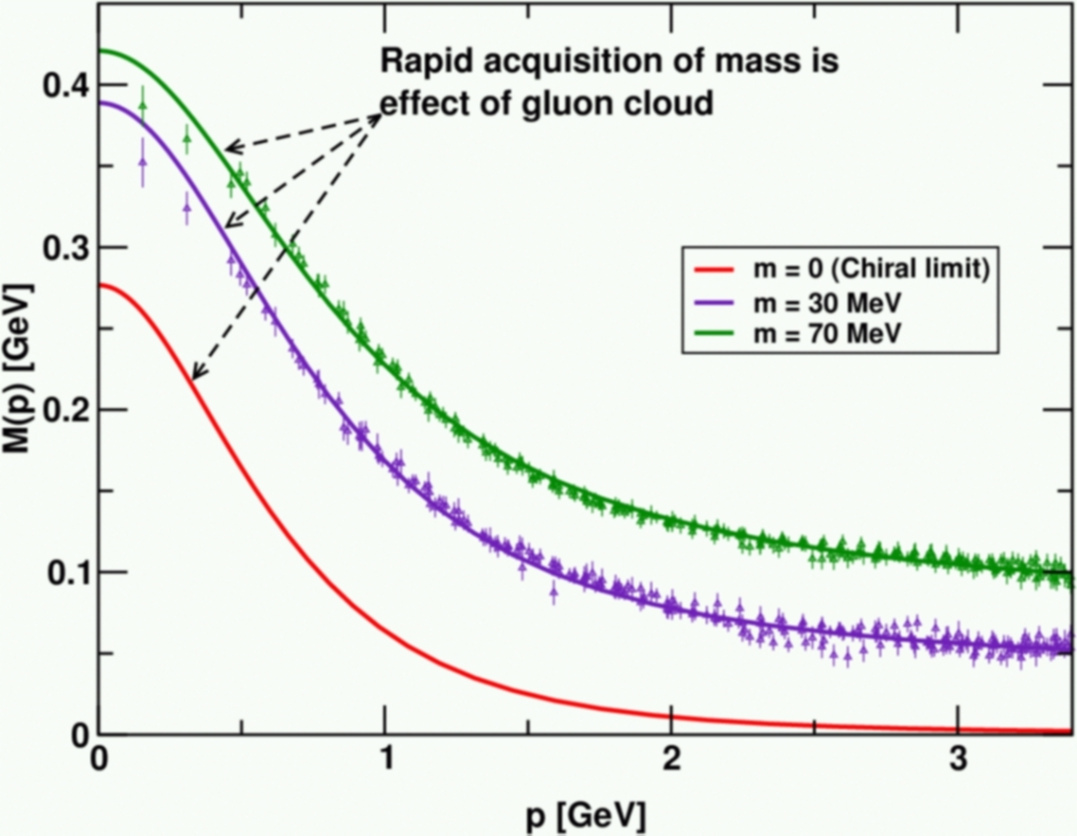
Dynamical Chiral Symmetry Breaking
Is a crucial emergent phenomenon in QCD
Expressed in hadron wave functions not in vacuum condensates
Contemporary theory indicates that it is responsible for more than 98% of the visible mass in the Universe; namely, given that classical massless-QCD is a conformally invariant theory, then DCSB is the origin of mass from nothing.
Dynamical, not spontaneous
  Add nothing to QCD ,
  No Higgs field, nothing!
  Effect achieved purely
  through quark+gluon
  dynamics.

Slide 8
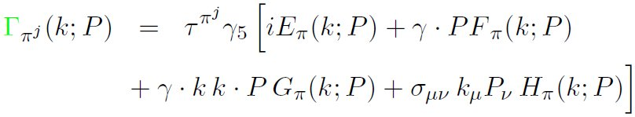

Pion’s dichotomy
Goldstone boson and Bound State
Maris, Roberts and Tandy, Phys. Lett. B420(1998) 267-273
Pion’s Bethe-Salpeter amplitude
Solution of the Bethe-Salpeter equation
Dressed-quark propagator
Axial-vector Ward-Takahashi identity entails(chiral limit)
Given the dichotomy of pion the fine-tuning should not play any role in an explanation of pion properties;
Descriptions of pion within frameworks that cannot faithfully express symmetries and their breaking patterns(such as constituent-quark models) are unreliable;
Hence, pion properties are an almost direct measure of the dressed-quark mass function.

Slide 9
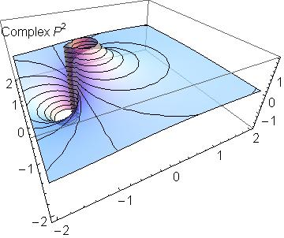
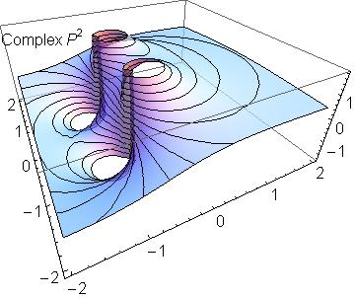
k²≈ 0.5 mg²附近出现拐点:
0th Chebyshev
2nd Chebyshev
输入特征胶子传播子；
求解Pion的BSE；
利用Chebyshev多项式表征波函数；
在大动量区域，波函数具有传统的Nakanishi表示，部分子图像；
拐点的出现（禁闭特征）使红外区域波函数不具有Nakanishi表示，需要引入准粒子图像（同夸克传播子）

Slide 10
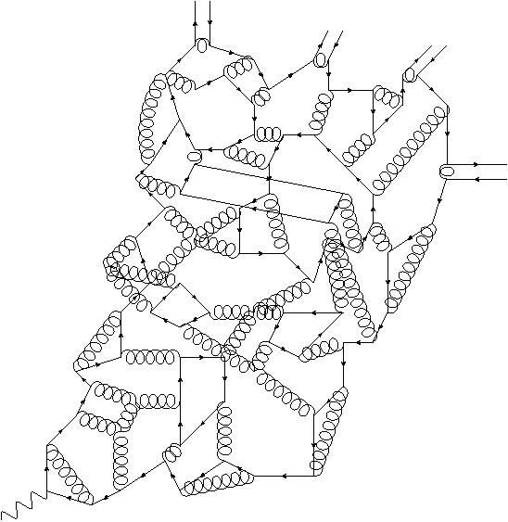
胶子质量
m_{g} ≈ 0.5 GeV 一个动力学质量标度
r_{C} ≈ 0.5 fm 胶子夸克传播的最大波长
介子BS波函数的特征体现
可观测量？？？

Slide 11

从手征动力学破缺到硬破缺
拉氏量中显含的能标，由Higgs玻色子耦合获得；
手征极限，手征对称性动力学破缺，mg能标动力学产生；
随Higgs玻色子耦合增加，硬破缺逐渐发挥作用；
讨论动力学破缺到硬破缺的过渡，与m_{g}标度的关系

Slide 12
夸克方程多解特点和临界质量
Dynamical chiral symmetry breaking and a critical mass
Lei Chang, et.al, PRC 75 (2007) 015201
临界质量（对应赝标介子质量）大约0.4GeV；
之下多解，之上唯一解，解的特征是？
相对对于Taylor序列展开的收敛半径，不考虑由于Goldstone圈导致的非解析项，m的分数幂次或log项。

Slide 13
Pion’s dichotomy
Goldstone boson and Bound State----On the light front
equal-time dynamics vs light-front dynamics
Dirac 1949
Valence quark picture
Definitive of a hadron – it’s how we tell a proton from a neutron
Expresses charge; flavour; baryon number; and other Poincaré-invariant macroscopic quantum numbers
Parton physics involves time-dependent dynamics

Slide 14
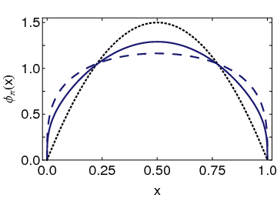
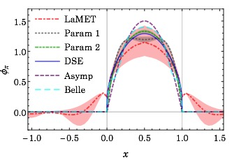
Pion PDA——动力学破缺特征
Conformal QCD
Continuum-QCD prediction:
marked broadening of φ_{π}(x), which owes to DCSB
Scale evolution quite slow
DB
RL
Real-world PDAs are squat and fat
Imaging dynamical chiral symmetry breaking:
pion wave function on the light front,
Lei Chang, et al.,
Phys. Rev. Lett. 110 (2013) 132001
格点模拟；arxiv: 1702.00008
季向东方法；
DSE & lQCD predictions are practically indistinguishable;
Favor no-humped behavior

Slide 15
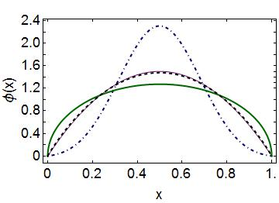
Emergent Mass vs. Higgs Mechanism
Parton distribution amplitudes of S-wave heavy-quarkonia
Minghui Ding, et al, Phys. Lett. B 753 (2016) pp. 330-335
When does Higgs mechanism begin to influence mass generation?
limit m_{quark}→ ∞
φ(x) → δ(x-½)
limit m_{quark} → 0
φ(x) ∼ (8/π) [x(1-x)]^{½}
Transition boundary lies just above m_{strange}
Comparison between distributions of light-quarks and those involving strange-quarks is obvious place to find signals for strong-mass generation
conformal
c+c_{bar}: Higgs
s+s_{bar}:
on the border
q+q_{bar}: Emergent

Slide 16
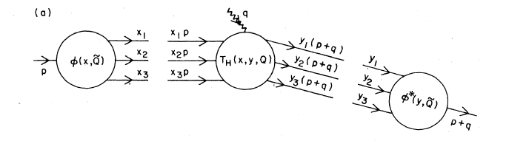
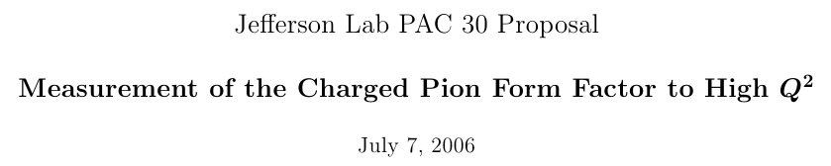
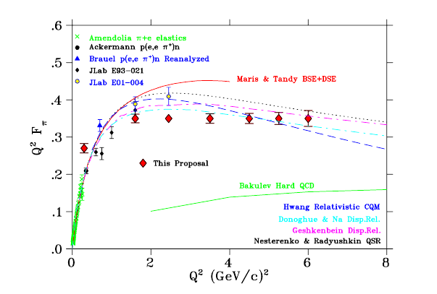
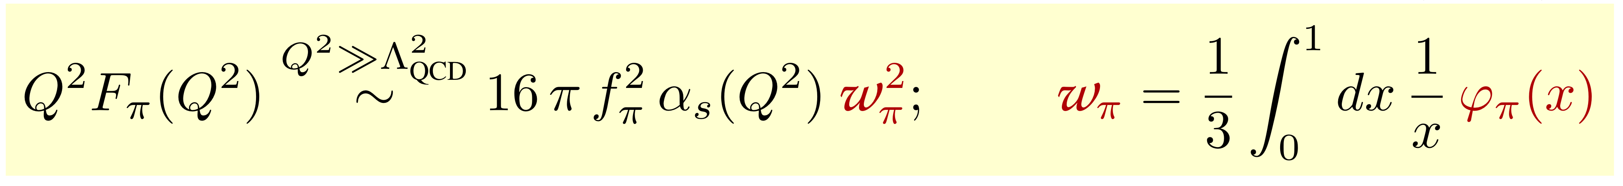
Measure pion elastic form factor in space-like region
Parton Distribution Amplitude
Hard scattering amplitude
(G.R. Farrar and D.R.Jackson, PRL43 (1979) 246;
P. Lepage and S. Brodsky, PLB 87 (1979) 359)
Performing asymptotic valence-quark distribution amplitude 6x(1-x)
Q²F=0.15 at Q²=4GeV²
A factor 2.7 smaller than the empirical value 0.41GeV² quoted at Q²=2.45GeV²
A factor 3 smaller than the case of BSE

Slide 17
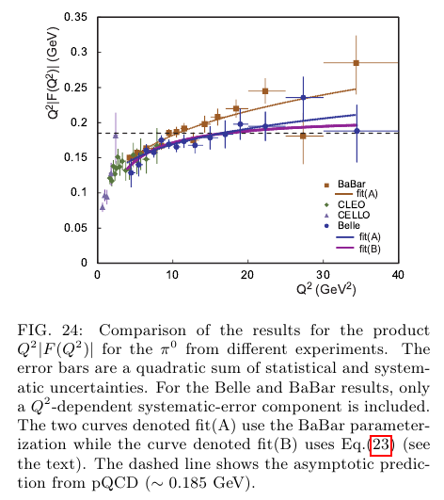
Messure π₀-γ transition form factor
in space like region
Ultraviolet scale---pion gamma transition form factor at lowest-order pQCD and leading twist 2

Slide 19
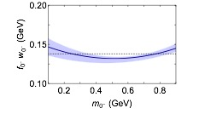
Mass-dependence of pseudoscalar meson elastic form factors
Muyang Chen, et.al, in preparation
彩虹梯子近似之计算
赝标质量大约等于胶子质量处出现极小值

Slide 20
临界现象？？
手征展开收敛半径；
Fw极小点；
Asymptotic PDA对应点。

Slide 21
Gluon mass generation…
QCD is well-defined at UV momenta owing to asymptotic freedom; QCD is IR finite, owing to dynamical generation of gluon mass-scale;
Maximum wavelength for gluon/quark;
Critical behavior for the wave function…
Transition from dynmaical breaking to explicit prekaing.

Slide 22
Gluon mass generation…
QCD is well-defined at UV momenta owing to asymptotic freedom; QCD is IR finite, owing to dynamical generation of gluon mass-scale;
Maximum wavelength for gluon/quark;
Critical behavior for the wave function…
Transition from dynmaical breaking to explicit prekaing.
Thanks for your attention

