Slide 1
W/Z physics in CDR
Zhijun Liang
IHEP,CAS

Slide 2
News
Some discussion about CEPC Z pole running .
http://indico.ihep.ac.cn/event/7709/
Two possibility:
E=90 GeV, L=1.6 X 10³⁵ cm⁻²s⁻¹, solenoid field = 3T ( new default )
Two year running proposed by accelerator team
WW threshold scan
Proposal from accelerator team
One year running about 160GeV , 3T
Total luminosity 3.2 ab⁻¹

Slide 3
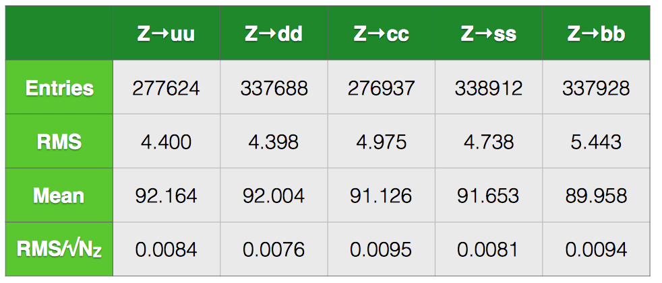
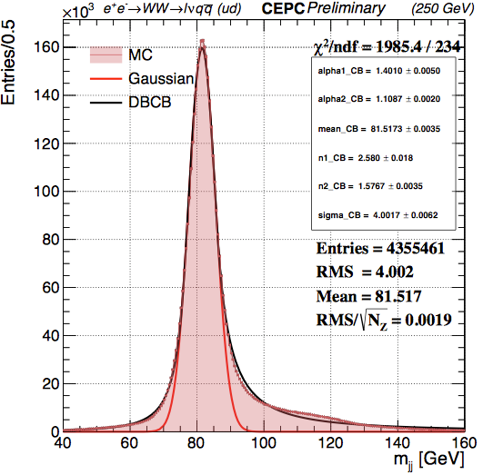
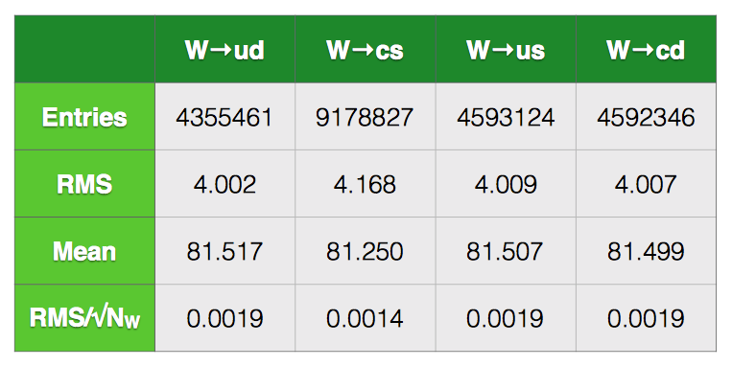
W mass (direct method)
With Maarten Boonekamp’s help, Peizhu Lai and Bo Liu and working on evaluation jet energy scale systematics ( eg: jet flavor dependence)
Plan to implement heavy flavor jet veto in Z->jj sample

Slide 4
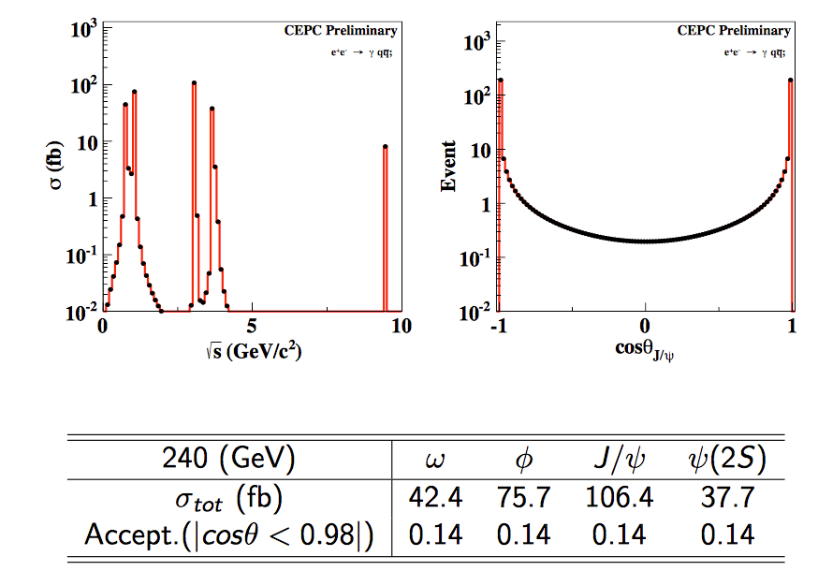
W mass (direct method)
Bo Liu is looking into PFA object energy scale calibration
One idea from Maarten and Manqi is that to use J/pi sample
Peixun Shen has calculated the production cross section for J/psi in Z pole and ZH runs.

Slide 5
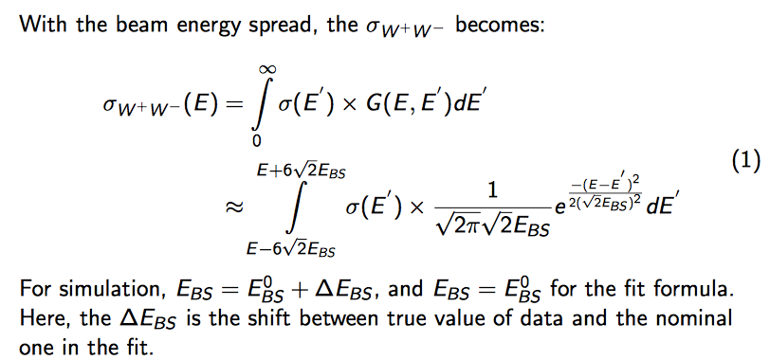
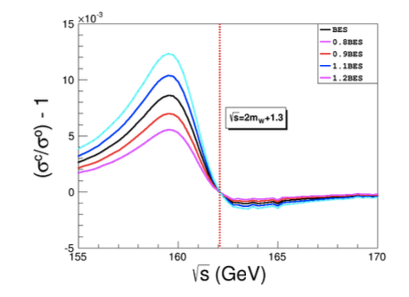
W mass measurement (WW threshold scan)
Peixun Shen is optimizing the WW scan runs
Considering the beam energy uncertainty, energy spread, theory unc.

Slide 6
CEPC W/Z physics Plan for CDR
Plan to cover the prospects of 6-7 key parameters.
Text for CDR is going to commit into git this weekend
Contributions are welcome
Some study need to be done with new MC simulation
New detector geometry, B field
This study will not change the text, just change some number in CDR.
Eg: jet energy resolution, lepton resolution, acceptance uncertainty …

Slide 7
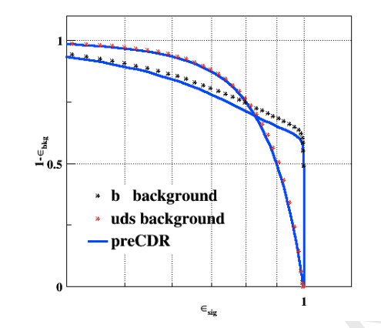
Performance input
Identify some performance input needed to support the W/Z physics prospect study
May need to repeat some study with 3T magnetic field and new detector geometry
Afb(l): lepton angular resolution
R_b: “B jet efficiency” vs “cjet/light rejection “
W mass (direct approach)： jet energy resolution
W mass (threshold scan): ?
N_v : photon energy resolution

Slide 8
MC Production plan for W/Z physics
Afb(l):
100k Z->ll full simulation for angular resolution study
10M ~ 100M Z->ll and Z->tautau fast simulation for background study and event-by-event fitting.
W mass (direct measurement)：
1M WW->lvqq fullsim in ZH run ?
R(b) :
200k fullsim Z->bb, Z->cc , Z->qq at Z pole ?
Could we use fast sim for b tagging ?

