Slide 1
EMuS beamline design
Yu Bao
CSNS Annual meeting 2018
@huizhou
2018.9.12

Slide 2
Outlines
Layout of EMuS beamlines
Proton beamline
Target station
Full scheme:
  surface muon beam
  decay muon beam
Simplified scheme
Muon moderation demonstration

Slide 3
Staging Strategy of EMuS
First funding 100M
Second funding +100M
CDR
Simplified Scheme
Full Scheme
Verticle beamline
World leading muon beams
High polarization surface muon
First beam for muSR

Slide 4
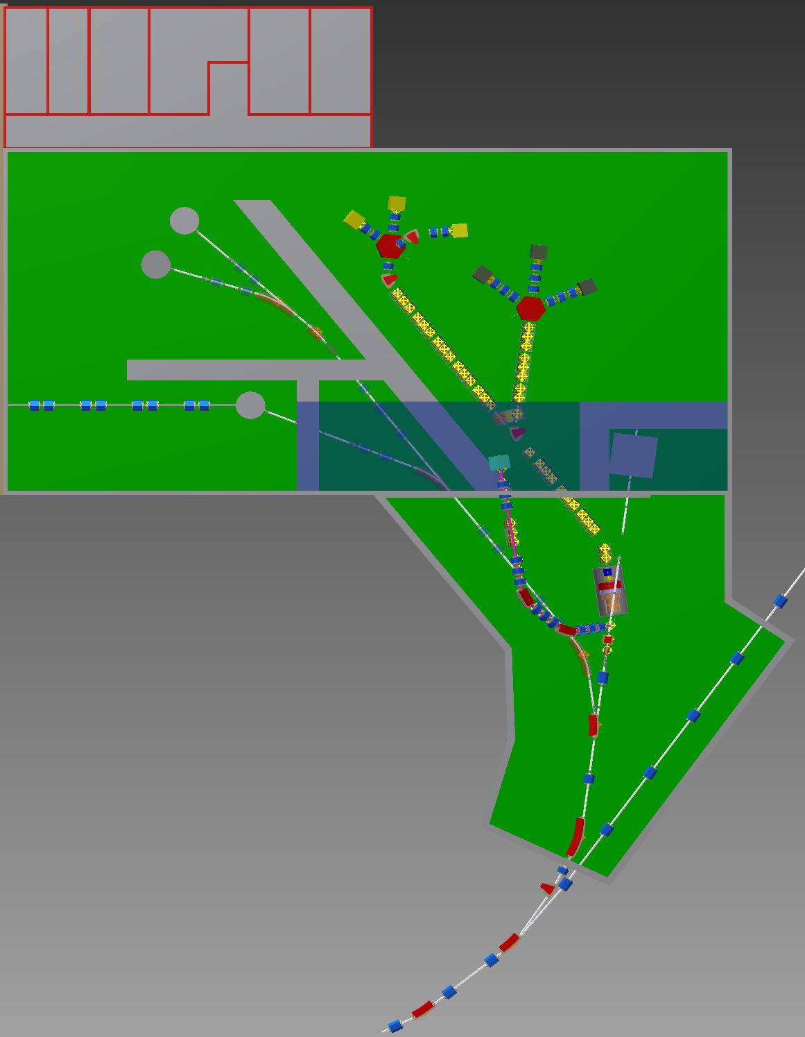
Layout of EMuS beamlines
Proton beamline
  Baseline design completed.
  Beam dump designed for different modes.
Superconducting beamlines
  Surface muon beamline designed for 3 experimental area – septum section on-going
  Decay muon beamline designed for muon momentum up to 450 MeV/c
Room temperature surface muon beamline
  Thin target in front of the main target station
  Beamline perpendicular to the proton beamline

Slide 5
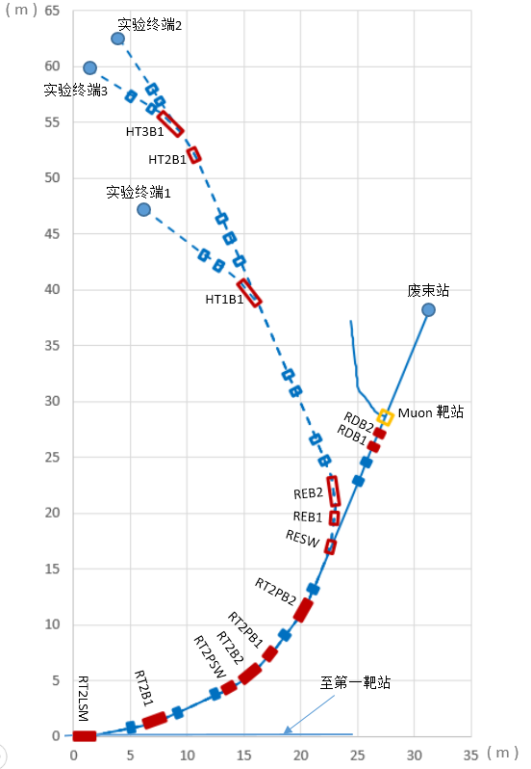
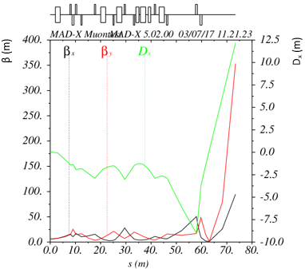
Proton beamline optics
Muon target

Slide 6
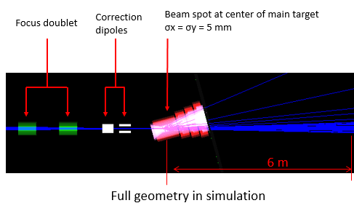
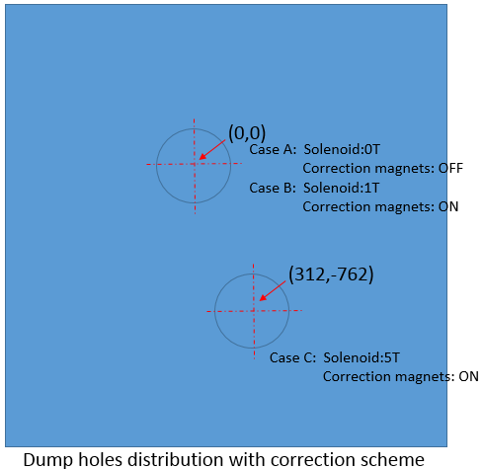
Proton beam dump
Distance between beam dump and target center: 6 m
Dump size: 2m*2m
Hole size: 400mm
Distance between holes: 832mm

Slide 7
Proton beam parameters
Energy: 1.6 GeV
Power: 5kW
Repetition rate: 2.5Hz
Emittance: 150 π mm mrad
Physical aperture: 150 mm
Beam size at target: 5mm (rms)
Beam size at dump: <400mm

Slide 8
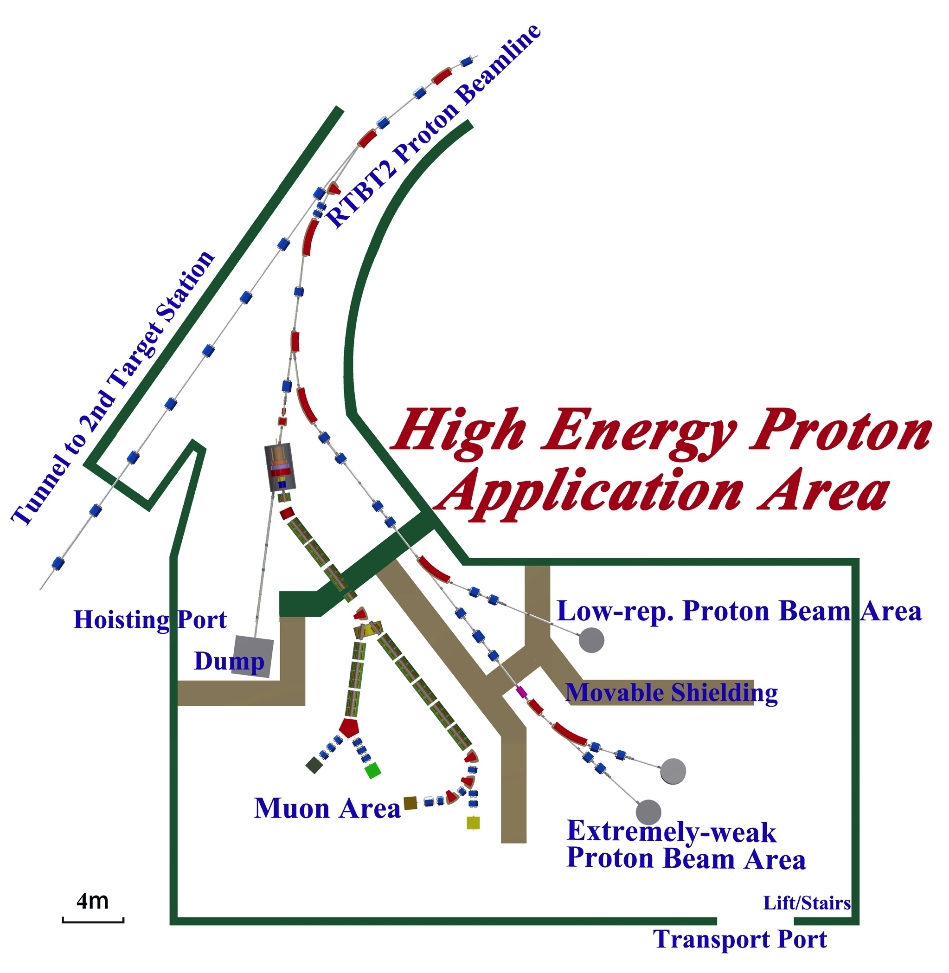
Muon beamlines
Surface muon beam
  For muSR applications
  Momentum: 29.8MeV/c
  Polarization>70%
Decay muon beam
  For muSR and muon imaging (high-energy)
  Momentum range 20~450MeV/c
  Polarization up to 75% depends on different mode

Slide 9
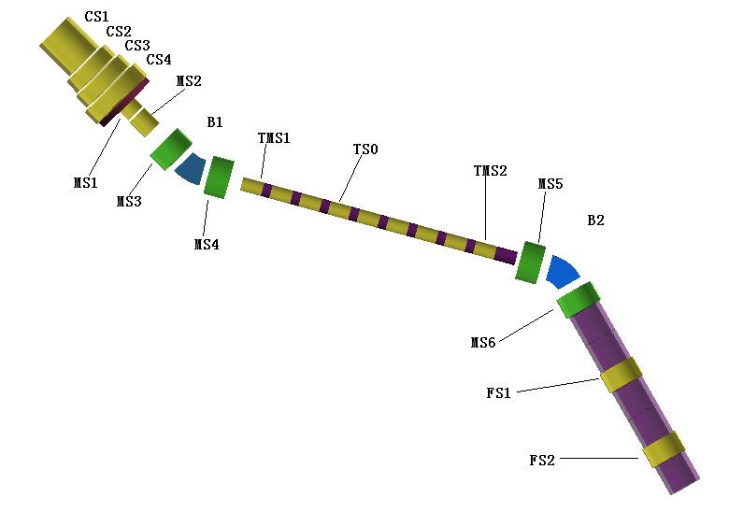
Superconducting surface muon beamline
Goal: high intensity surface muon for muSR research
Approach: superconducting solenoids to increase the beam acceptance.

Slide 10
Surface muon parameters
solenoid | 1T | 2.5T
Intensity (1E6/s) | 37.2 (20.0) | 82.8 (47.0)
Polarization | -0.62 (-0.63) | -0.45 (-0.44)
IP2 (1E6/s) | 14.5 (7.9) | 16.9 (9.17)
dp/p (FWHM) | 12.4% | 12.4%
x (FWHM) | 112mm | 112mm
y (FWHM) | 92mm | 104mm
Positron contamination | 1.1% | 0.8%
Beam intensity is relatively high.
1T mode can reach a relatively high polarization
Polarization needs to be improved.
Beam size at sample is large.

Slide 11
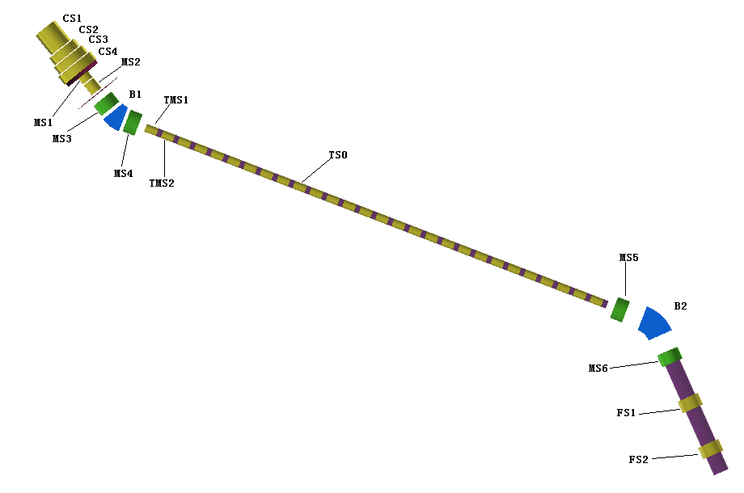
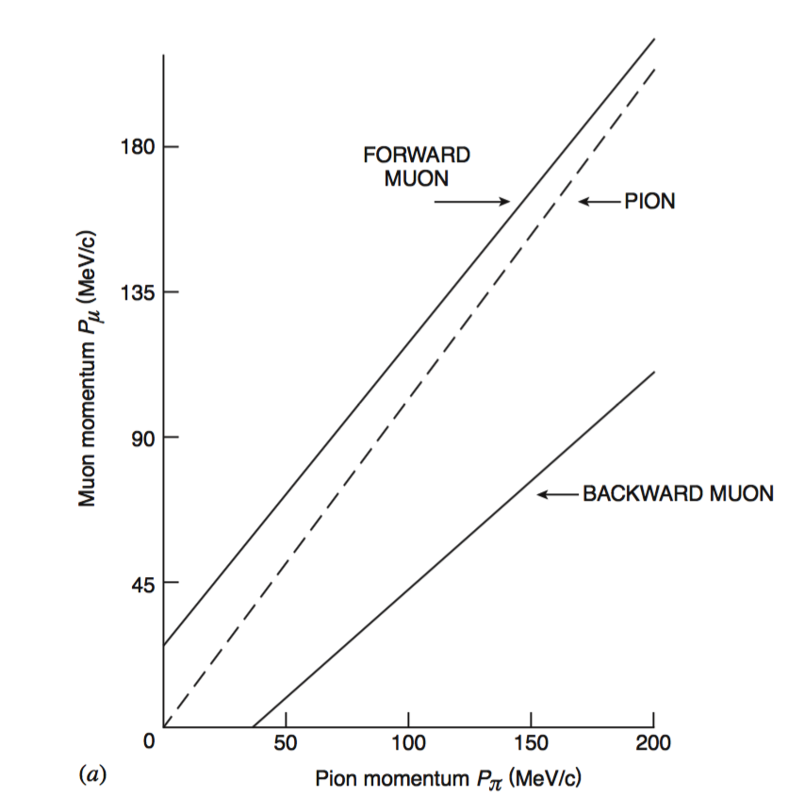
Decay muon beamline
Select pions for a certain momentum at the first bend.
Select muons from pions decay in backward direction
Two modes are designed for high intensity and high polarization beams at 130MeV/c (for the first design).
Goal : provide the highest energy muon beam (up to 450 MeV/c) with the highest intensity.

Slide 12
Decay muon parameters
 | EMuS | μE1@PSI | RIKEN-RAL | D-Line@J-PARC | M9B@TRIUMF
Proton beam power (MW) | 0.005 | 1.3 | 0.16 | 1.0 | 0.075
μ momentum range (MeV/c) | 50-130 | 85-125 | 65-120 | 33-250 | 20-100
Intensity (1E6/s) | 40 | 240 | 1 | 10 | 0.0014
Polarization | 0.70 | ~0.75 | ≥0.8 | ~0.8
IP2 (1E6/s) | 20 | 180 | 0.8 | 8
dp/p (FWHM) | 15% | 3% | 10% | 15%
x (FWHM) | 72mm | 39mm | ~30mm | ~35mm
y (FWHM) | 84mm | 25mm | ~30mm | ~35mm

Slide 13
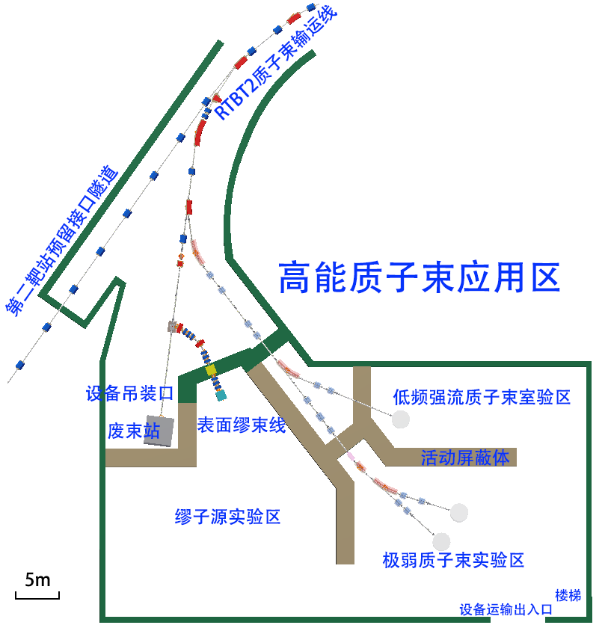
Simplified scheme
Only build a short surface muon beamline with RT magnets.
One spectrometer is planned which is under studying at USTC.
Whole system should reach the basic requirements of muSR users.

Slide 14
Simplified muon beam parameters
Intensity : 1.2E6 /s
Polarization: 98%
Beam spot at sample: 48(H)*59(V)mm
  Need to be improved
Momentum dispersion: 11%

Slide 15
Muon moderation
High intensity muon beams are the most useful for producing slow muons because of limits of spectrometers.
Currently only PSI can provide slow muons for users, based on surface muon beam of 1E8 /s.
The moderation efficiency is the key.
We are investigating the possibility of using frictional cooling method to produce slow muons.

Slide 16
Frictional cooling
Slow down surface muons by materials.
Restore muon energy by electric field.
At low energy range the high-energy muon losses more energy than low-energy muons, so that they reach an equilibrium energy.
Stopping power of muon in Helium: energy loss from different processes

Slide 17
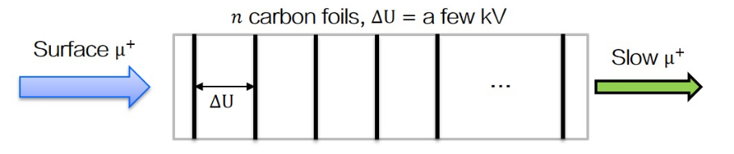
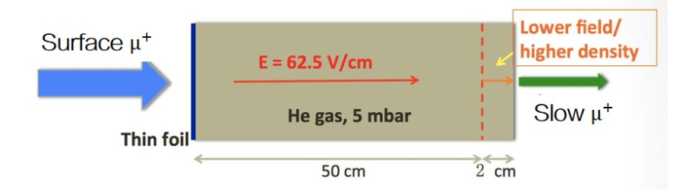
Two schemes
Using foils
Using helium gas

Slide 18
International collaborations
RIKEN/RAL: spectrometer design and tests, consultation on beamline design. (Watanabe, Ishida)
ISIS: spectrometer design, consultation on beamline design. (James Lord)
PSI: spectrometer, beamline, and moderation. (Thomas Prokcha, Aldo Antognini)

Slide 19
Summary and further works
Proton beamline has been designed.
Target station has been designed for several operation modes.
Full scheme reaches most of the requirements, excepts:
  Surface muon polarization needs to be improved.
  Decay muon beam size needs to be reduced.
Simplified scheme has been designed.
  Beam size needs to be reduced.
Muon moderation demonstration experiment is going on…

