Slide 1
Status of MFT Disks
Ni Fang, Dong Wang, Jun Liu – CCNU
The 5th China LHC Physics Workshop
– 2019, October 26th

Slide 2
Outline
Motivation
ALICE MFT upgrade
-- Electronic readout board(disk0~disk4)
-- Other components(Support & Heat Exchangers & Ladders)
-- DISKs Performance test (Power dropout & High speed signal)
Summary

Slide 3
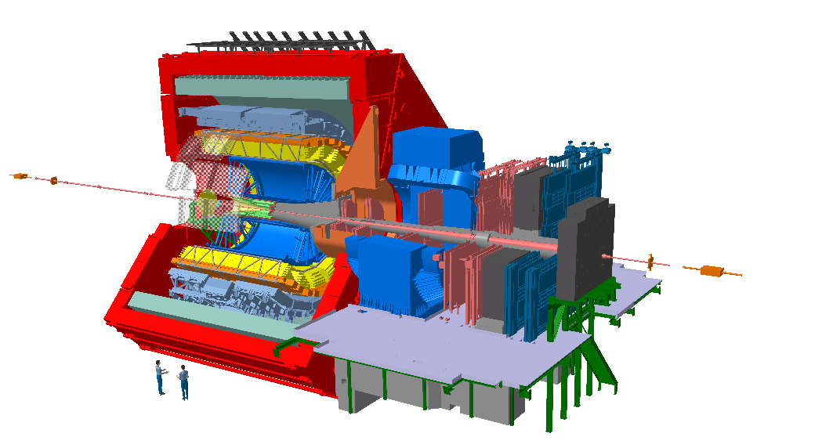
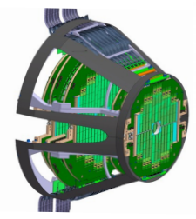
Briefly introduce ALICE
ALICE (A Large Ion Collider Experiment) detects quark-gluon plasma, a state of matter thought to have formed just after the big bang
stuides properties of strongly interacting matter (quark-gluon plasma)
MFT
（Muon Forward Tracker）

Slide 4
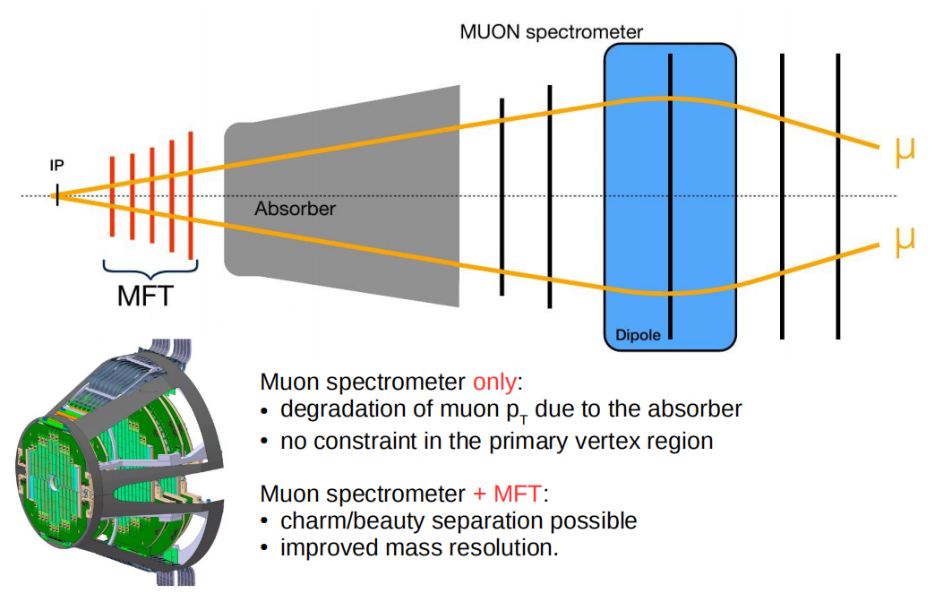
Motivation

Slide 5
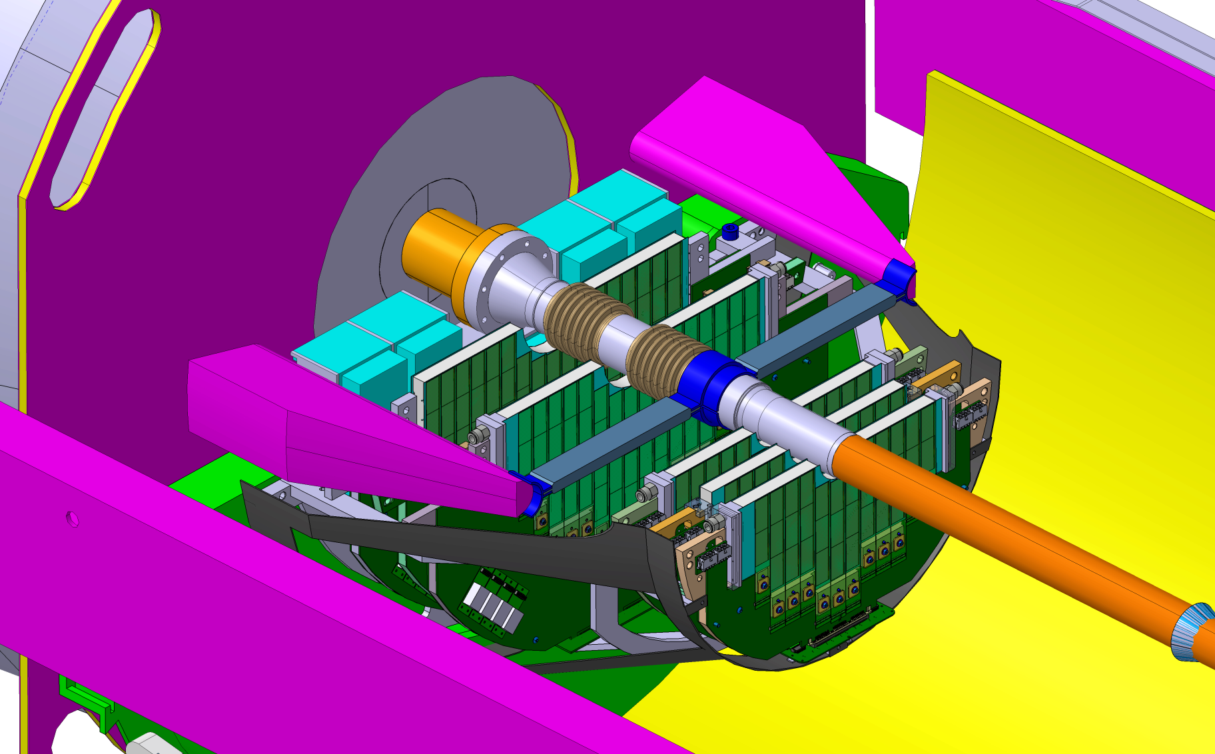
The MFT Detector
Zoom out
General layout of the MFT half-barrel and its environment
Zoom out of the MFT half-barrel
MFT is a sub detector of ALICE in front of the FIT and absorber
MFT is composed by 5 disks
Each disk is a couple of front and back PCB fixed on a mechanical support
Several FPC with detection sensors are connected on each PCB(front & back)

Slide 6
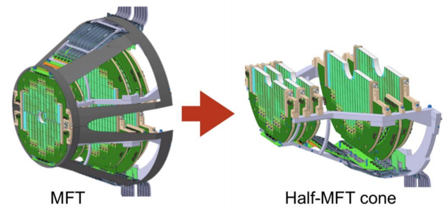
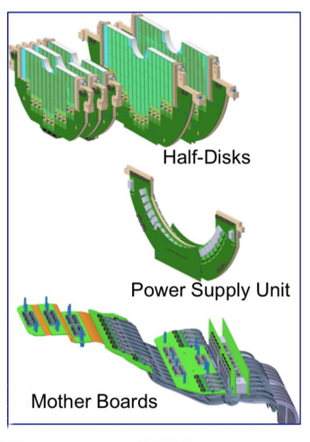
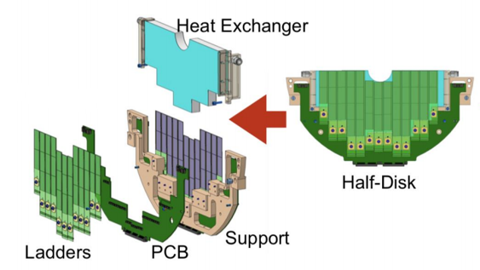
MFT Mechanical Structure Breakdown
920 silicon pixel sensors (0.4 m²) in 280 ladders of 2 to 5 sensors each.
Sensor
(2 to 5)
DISK0~DISK4

Slide 7
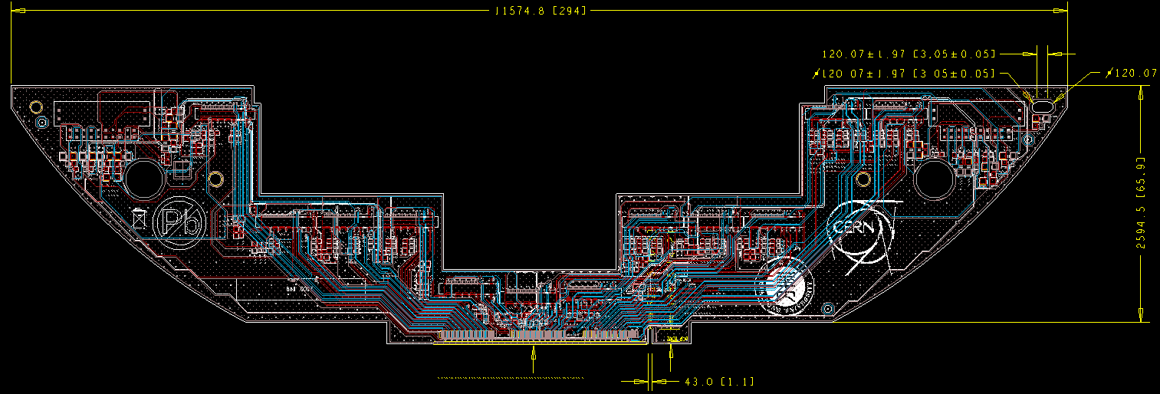
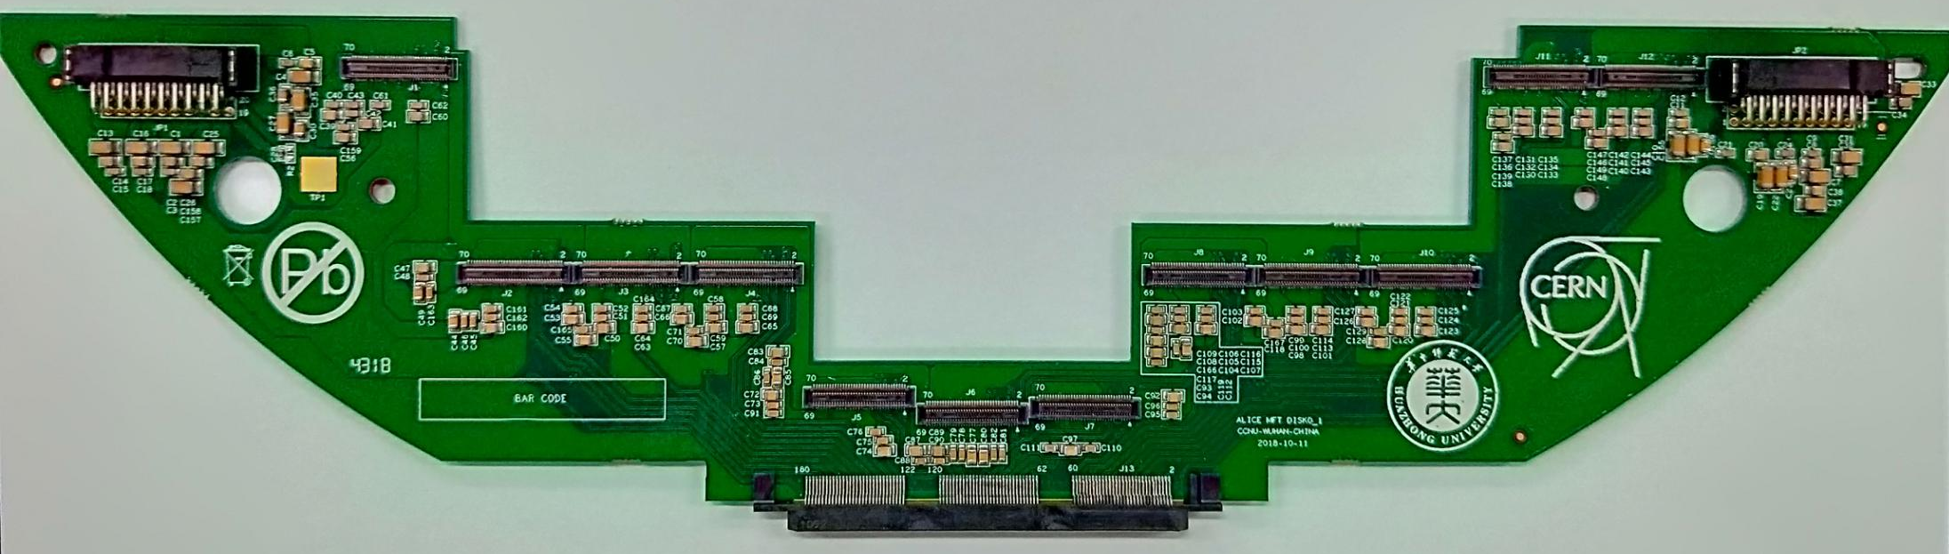
Disk0/1
Electronic board layout and physical map
Layout
Four-layer board design
Length : 29.4cm
Width : 7.2cm
Physical map
This is the fourth（Final）
vision of disk0/1
This prototype has been
produced in May,2019
We have sent 16 pieces
to France for test.
support high-speed signals of 1.6Gb/s

Slide 8
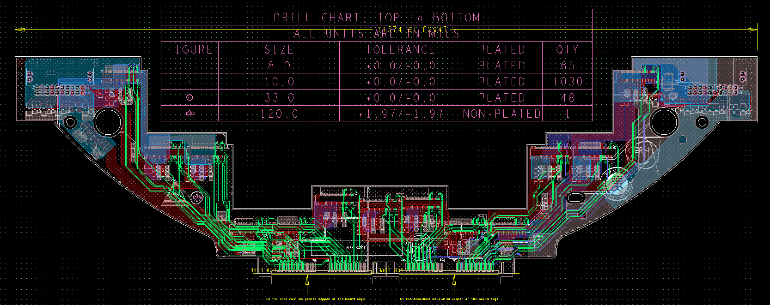
Electronic board physical map and layout
Disk2
Layout
Six-layer board design
Length : 29.4cm
Width : 8.5cm
Physical map
This prototype has been
produced in June,2019
We have sent 8 pieces
of PCB to France
support high-speed signals of 1.6Gb/s

Slide 9
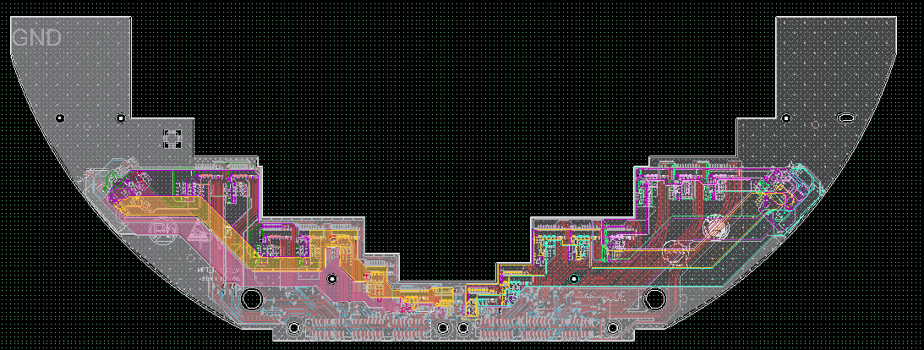
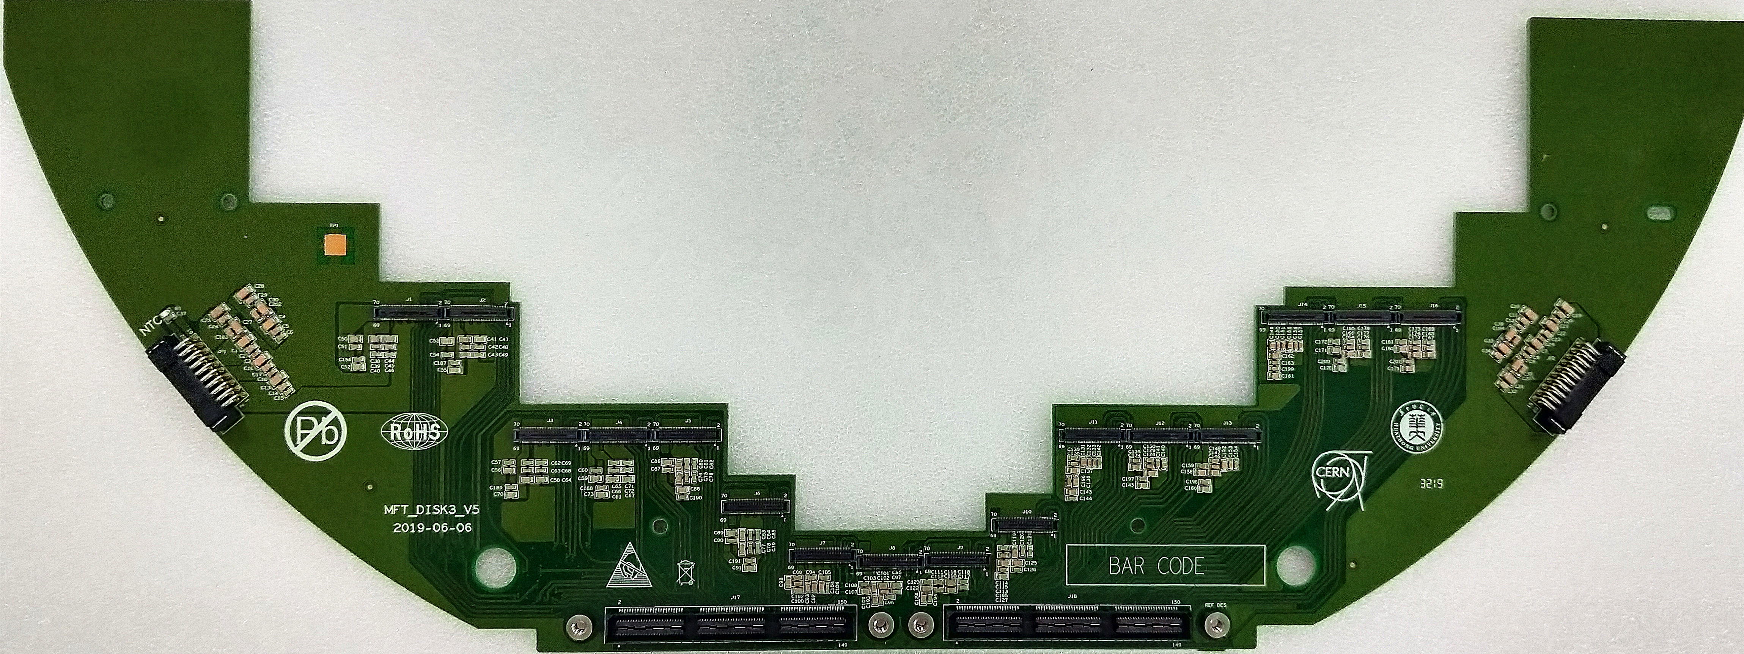
Disk3
Electronic board physical map and layout
Layout
Four-layer board design
Length : 44.0cm
Width : 16.1cm
Physical map
This prototype has been
produced in September,2019
We have sent 8 pieces
of PCB to France
support high-speed signals of 1.6Gb/s

Slide 10
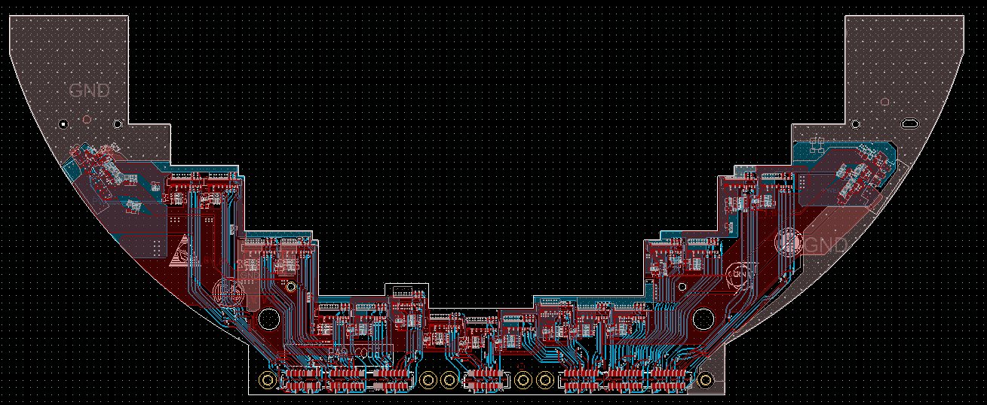
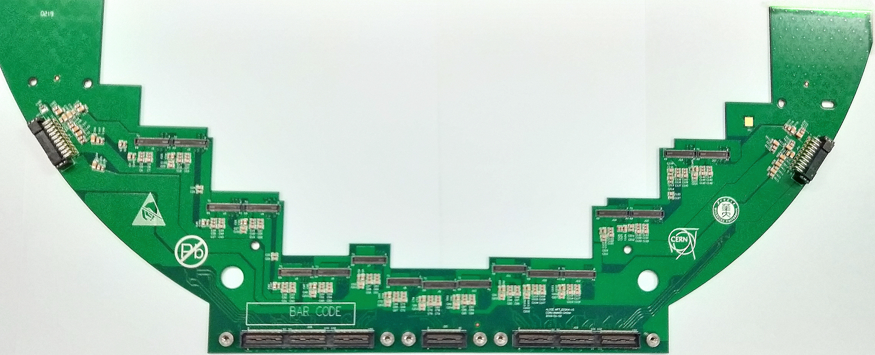
Electronic board physical map and layout
Disk4
Layout
Four-layer board design
Length : 44.0cm
Width : 17.5cm
Physical map
This prototype has been
produced in July,2019
We have sent 8 pieces
of PCB to France
support high-speed signals of 1.6Gb/s

Slide 11
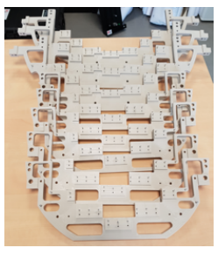
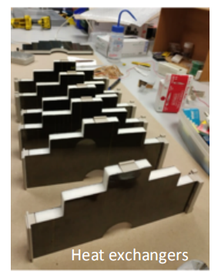
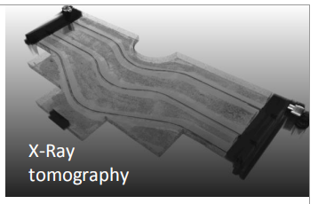
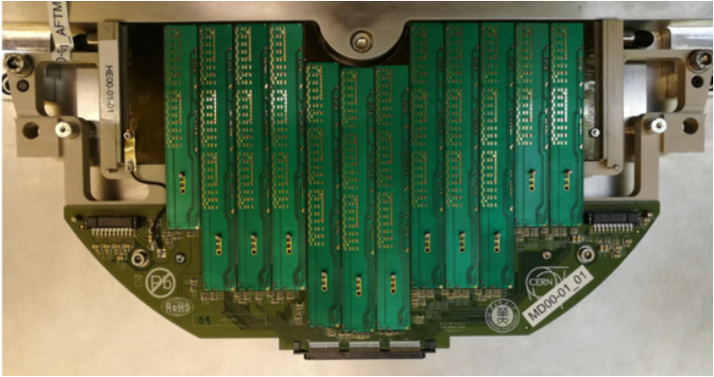
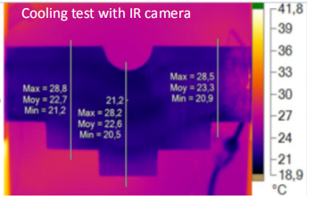
Physical map of other brackets and heat sinks
Ladder
Disk support
Assembled
Thermal performance results
PCB
(DISK0-DISK4)
Ladder
Heat exchangers
Support

Slide 12
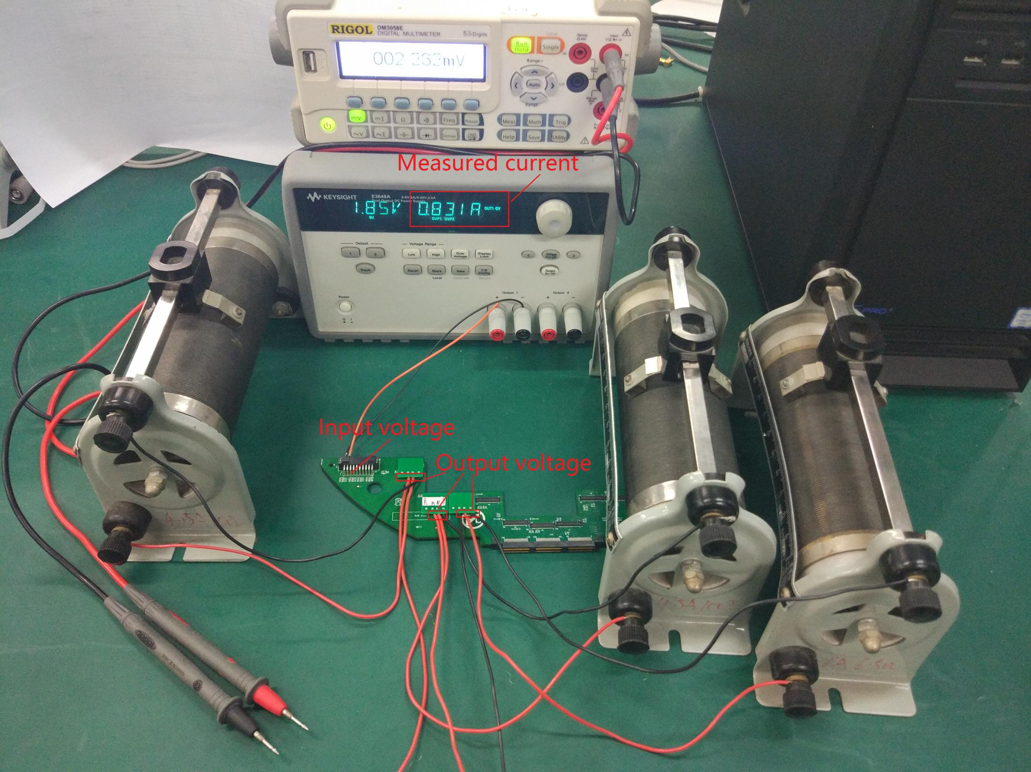
Disk Power dropout testing
This shows a test for the second vision of disk0/1.
We use this power to provide power, and a Sliding resistance as load.
The difference between Actual input and Actual output should be smaller than 5 percent of Actual input.

Slide 13
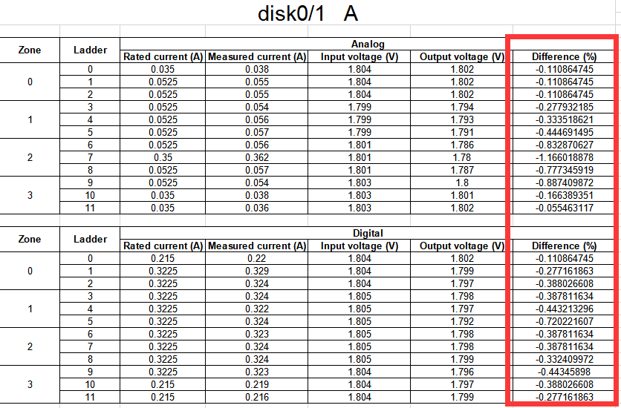
Disk Power dropout testing

Slide 14
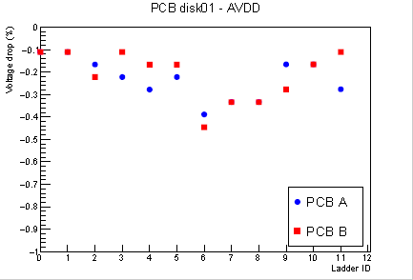
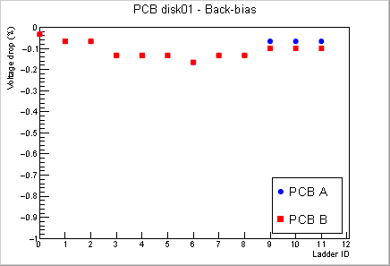
Disk Power dropout testing
This is the Power dropout reasult for disk01.
The power for every zone is different and they have different shape copper on the layers, which reasults the Irregularity between zones.
In fact, Power dropout is required to be below 5%.

Slide 15
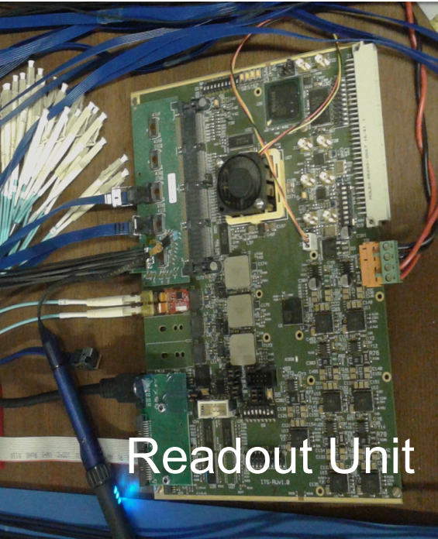
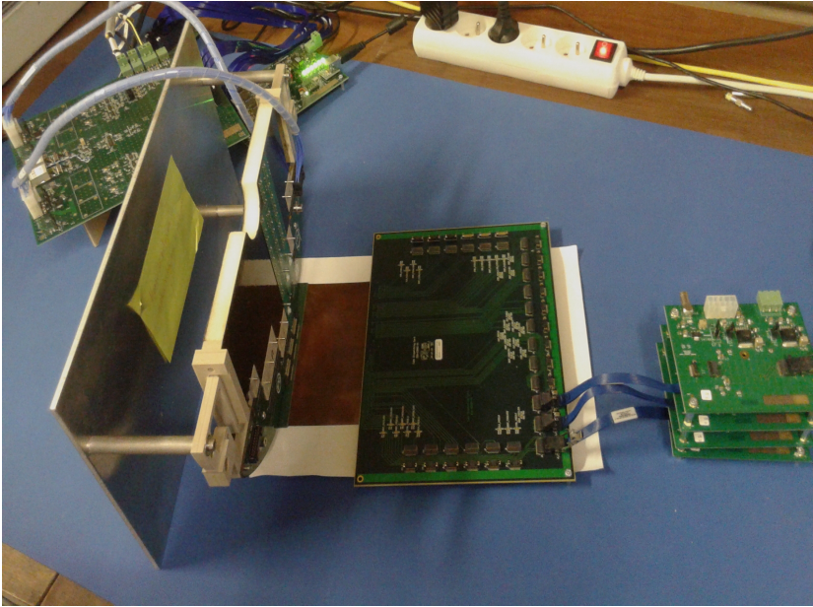
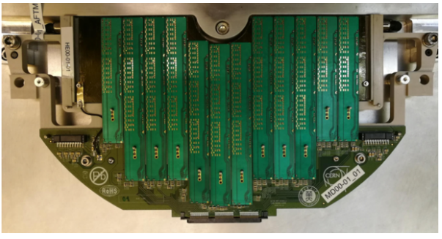
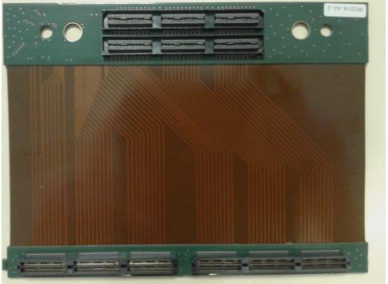
Disk High speed signal test
Zoom out
Zoom out
Full scale setup
-- Using most of pre-prod elements
-- BER measurements in PRBS mode at 1.2Gb/s
-- 68 hours without errors ; BER = 1.5 10⁻¹⁴

Slide 16
Status
Electronic Boards | Waiting | Schematic Under design | PCB layout Under design | Prototype Produced
disk0/1 PCB--version 1
…
disk0/1PCB--Final version |  |  |  | Produced 16 blocks
disk2 PCB--version 1
…
disk2 PCB--Final version |  |  |  | Produced 8 blocks
disk3 PCB--version 1
…
disk3 PCB--Final version |  |  |  | Produced 8 blocks
disk4 PCB--version 1
…
disk4 PCB--Final version |  |  |  | Produced 8 blocks
The electronic interconnect board has been fully produced and tested well.

Slide 17
Summary
All current electronic board designs are completed including spare boards
Cooperate with partners for assembly and testing
Thanks for your attention

