Slide 1


HGTD activities at USTC
Chihao Li
on behalf of USTC HGTD Group
Oct 26th, 2019

Slide 2
Overview
Introduction to HGTD
Sensor simulation and design
  TCAD simulation
  Sensor design
Sensor test
  I-V & C-V measurement
  Beta scope test
HGTD electronics
Other work on HGTD

Slide 3
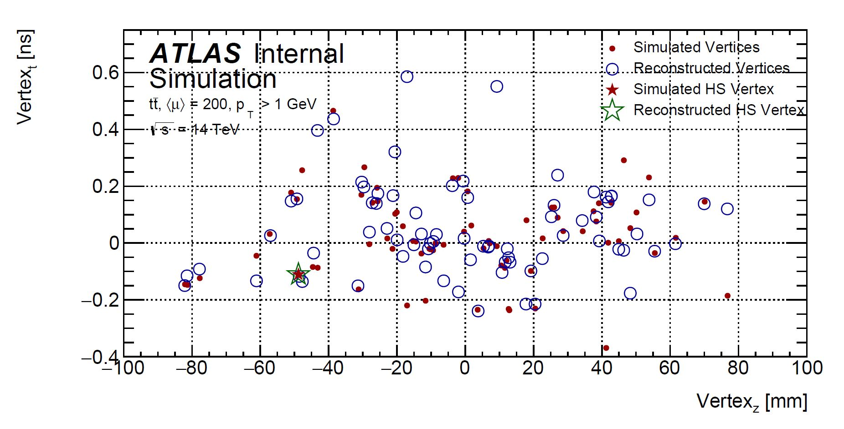
HGTD motivation
At high luminosity, pile up is one of the most difficult challenges.
Adding time information to trackers in forward regions to resolve pile up interactions.
A High Granularity Timing Detector (HGTD) is proposed in the forward regions.

Slide 4
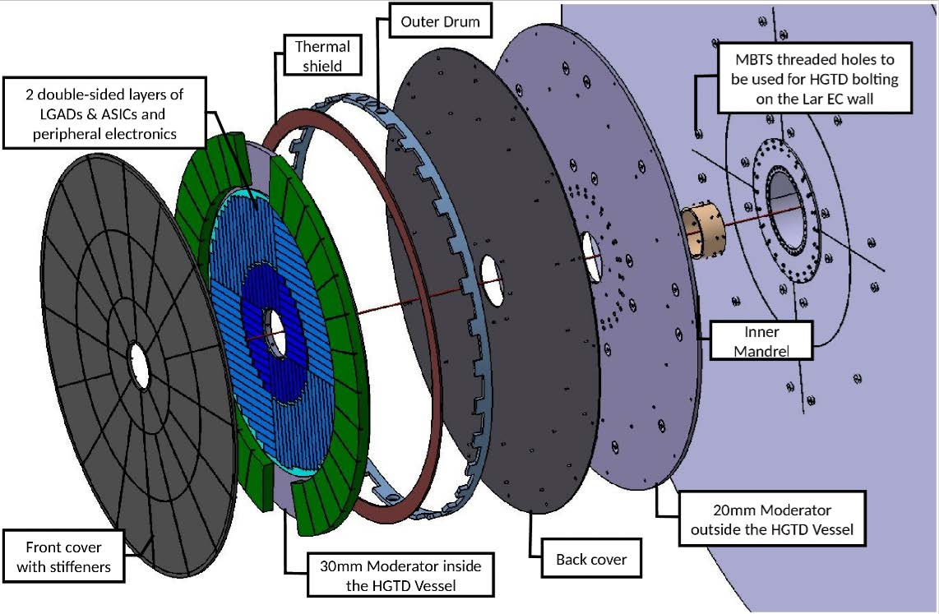
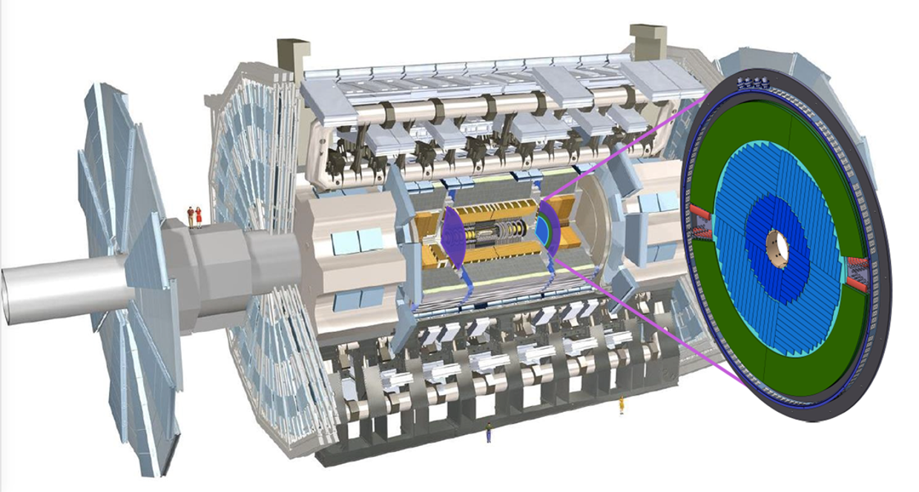
ATLAS HGTD project
High Granularity Timing Detector
Two double-sided disks at each endcap
At 3435 mm < |z| < 3485 mm
Coverage: 2.4 < |η| < 4.0
110 mm < R < 1000 mm
Pixel size: 1.3 x 1.3 mm²
Number of channels : 3.54 M
Active area: 6.3 m²
Time resolution per track: 30 ps

Slide 5
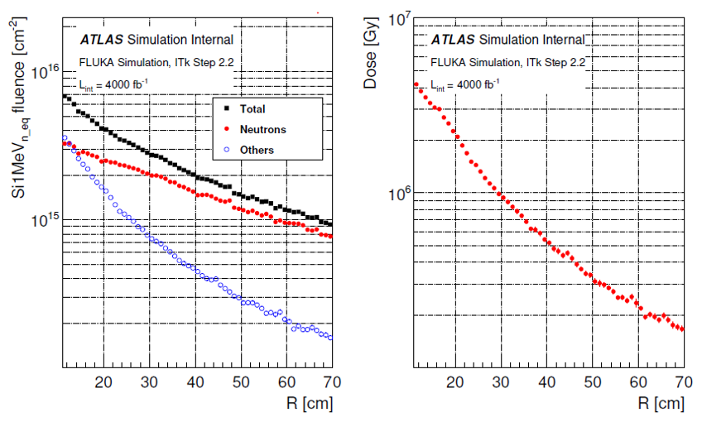
Radiation tolerance (TDR draft 2019)
At the end of the HL-LHC (4000 fb⁻¹), the detector should withstand the maximum neutron-equivalent fluence of ~ 6*10¹⁵ 1MeV neqcm⁻² and the total ionising dose (TID) of ~ 4.2MGy at a radius of 120 mm.

Slide 6
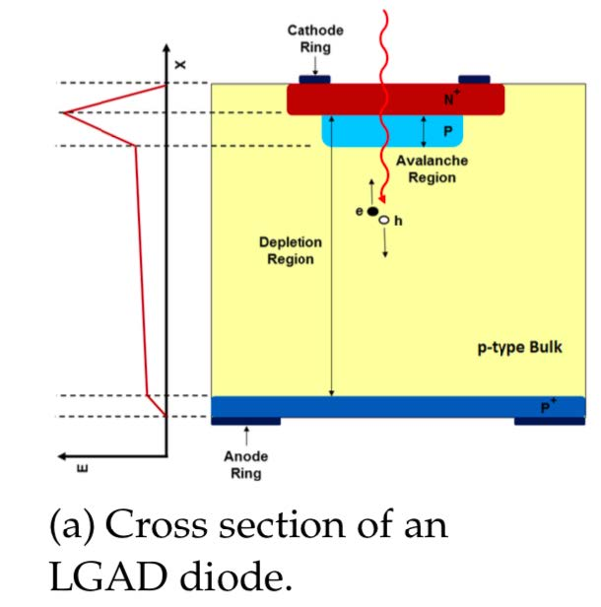
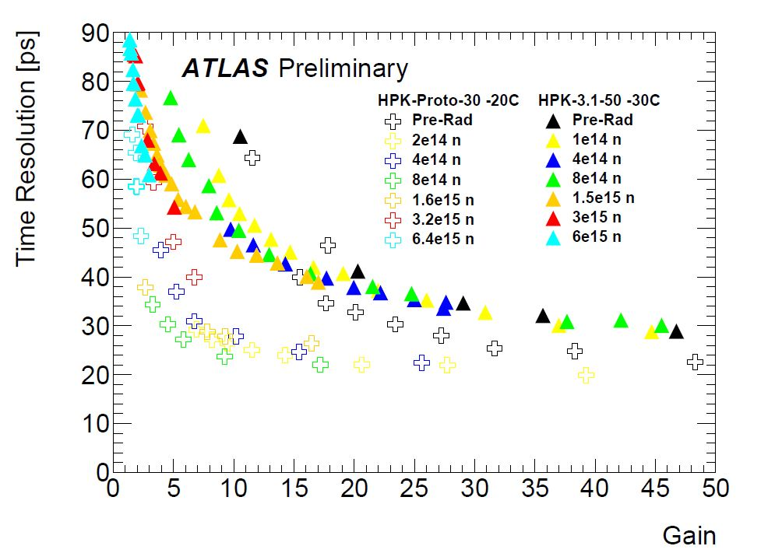
Introduction to LGAD
The technology chosen for the HGTD sensors is Low Gain Avalanche Detector (LGAD).
LGADs are planar silicon detectors with internal gain depending on the doping profile of the multiplication layer.
For the low-noise, low-power operation required in a tracking system, gain of ~20 would be an optimum choice for LGAD.

Slide 7
USTC HGTD group
USTC joined the ATLAS HGTD project in January 2019.
Have a long-term involvement in the gaseous detectors field, now take HGTD a starting point to develop semiconductor detectors.
Current interests
  Sensor design and tests
  ASIC RD
  Digitization software
  Test beam analysis

Slide 8
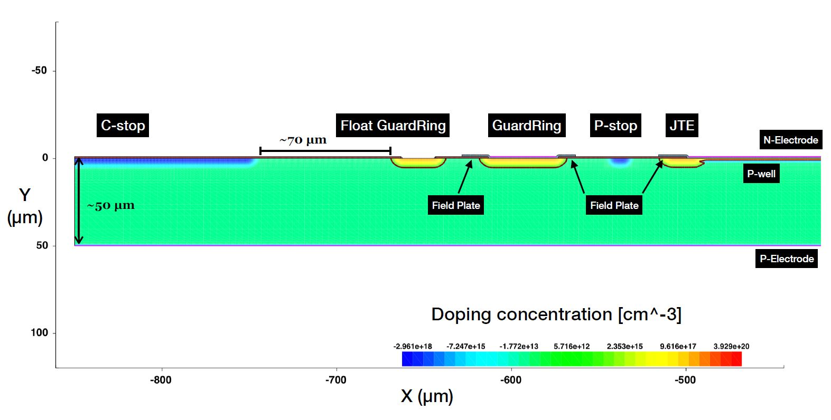
Xiao Yang yxflight@mail.ustc.edu.cn
Sensor simulation and design
Based on the simulation tools for semiconductors, such as WeightField2, TCAD
Study the leakage current, breakdown voltage and radiation hardness of LGAD sensors.
Optimize the parameters of sensor with the simulation results.
Periphery
Core region
Sensor simulation in TCAD

Slide 9
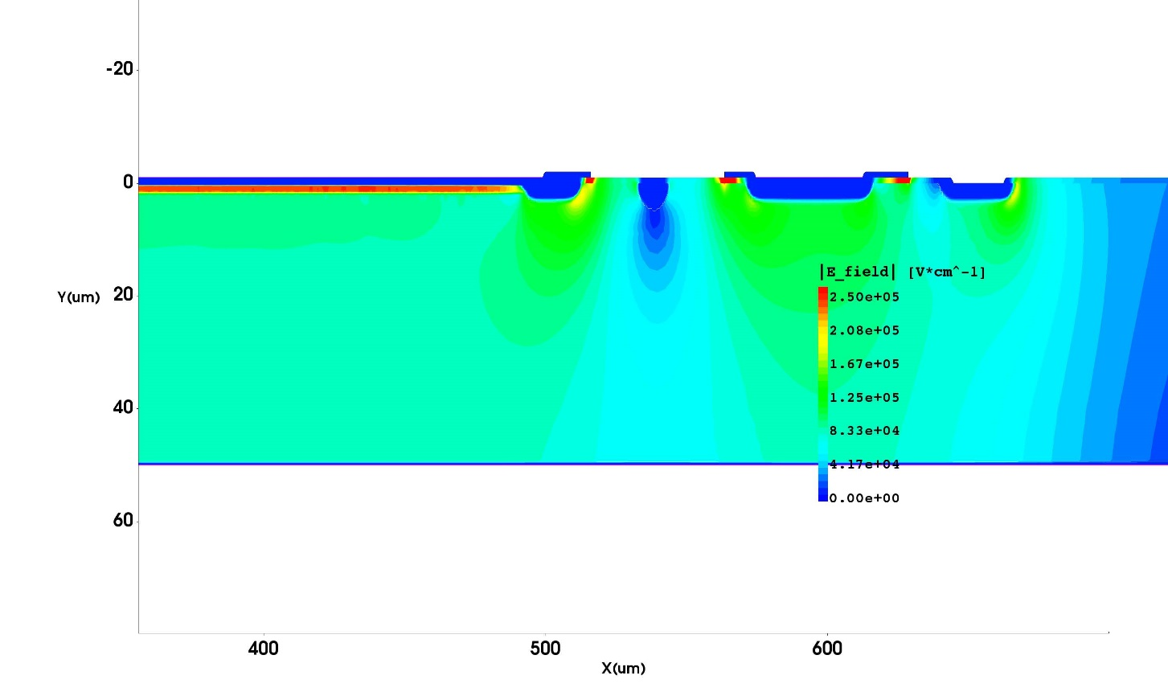
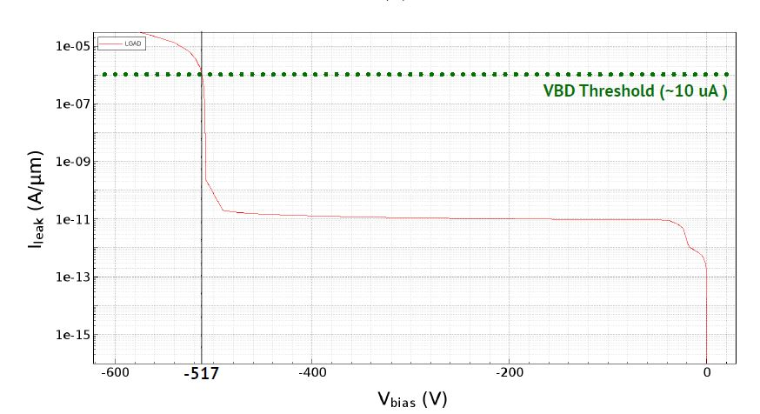
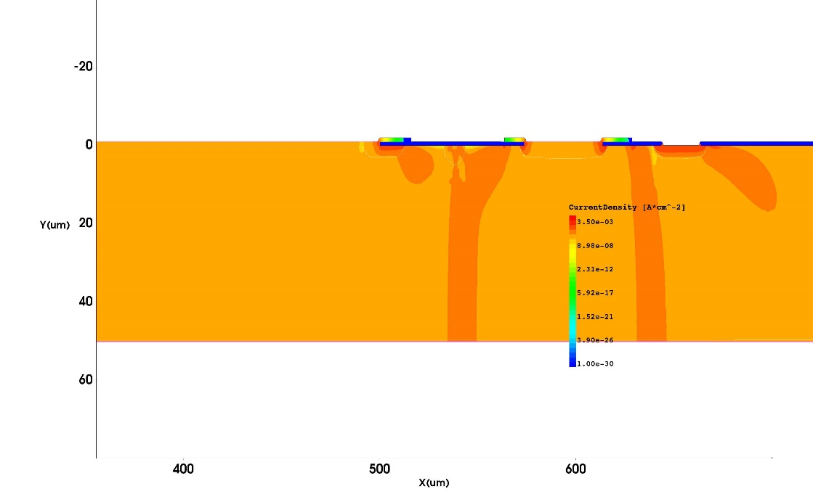
Results with bias application
Central electrode
Guard ring
E-Field distribution
Central electrode
Guard ring
Current distribution after break down
Parameter optimization based on I-V, Gain-V performance

Slide 10
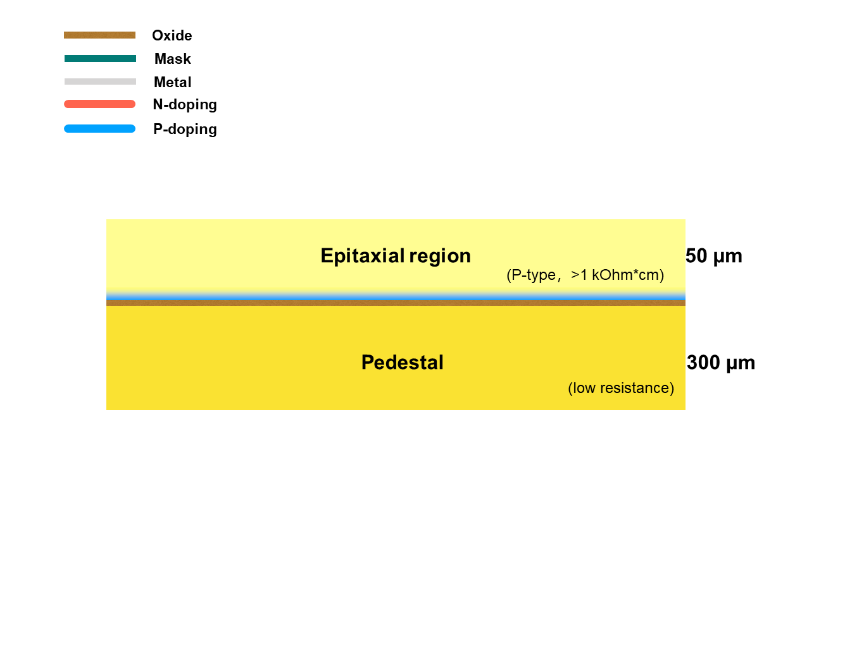
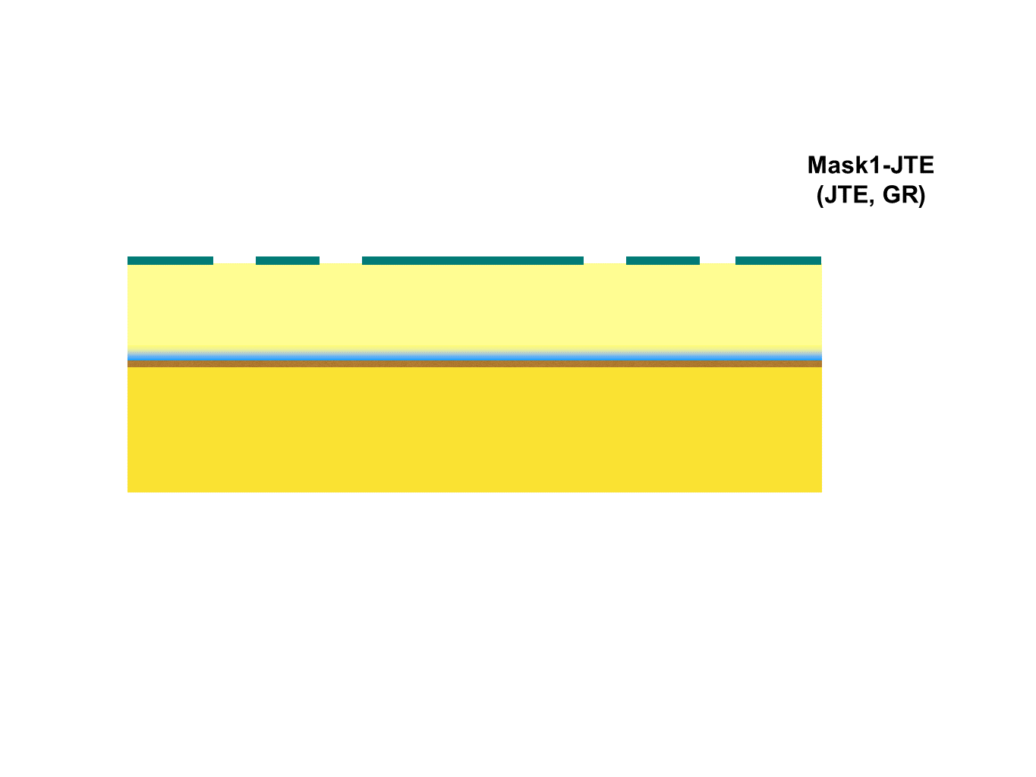
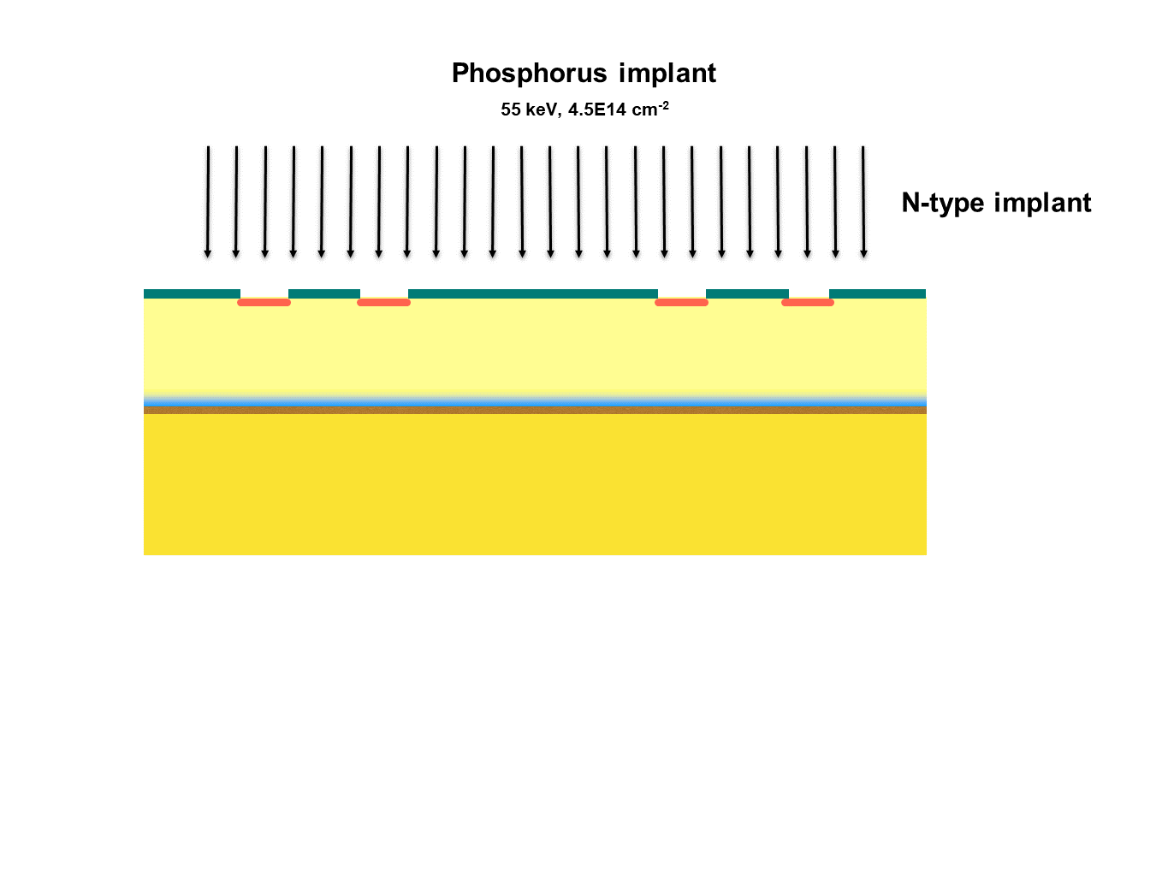
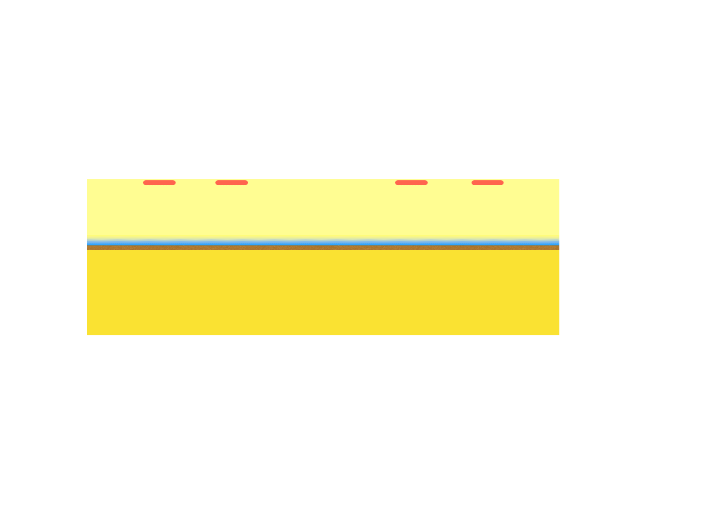
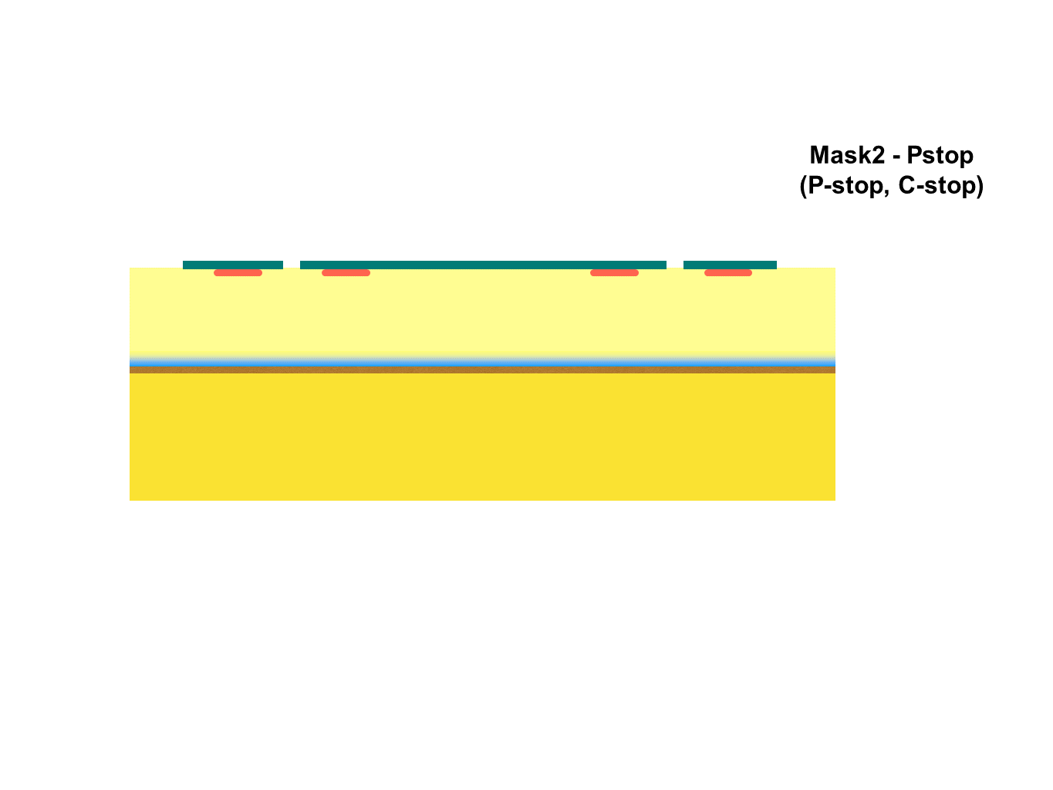
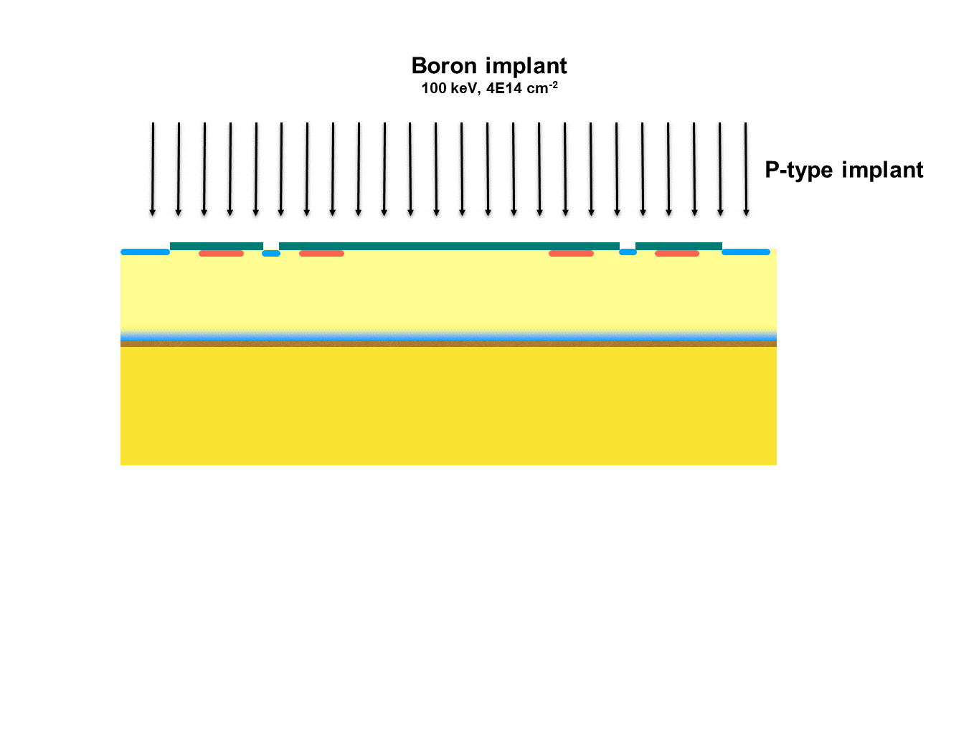
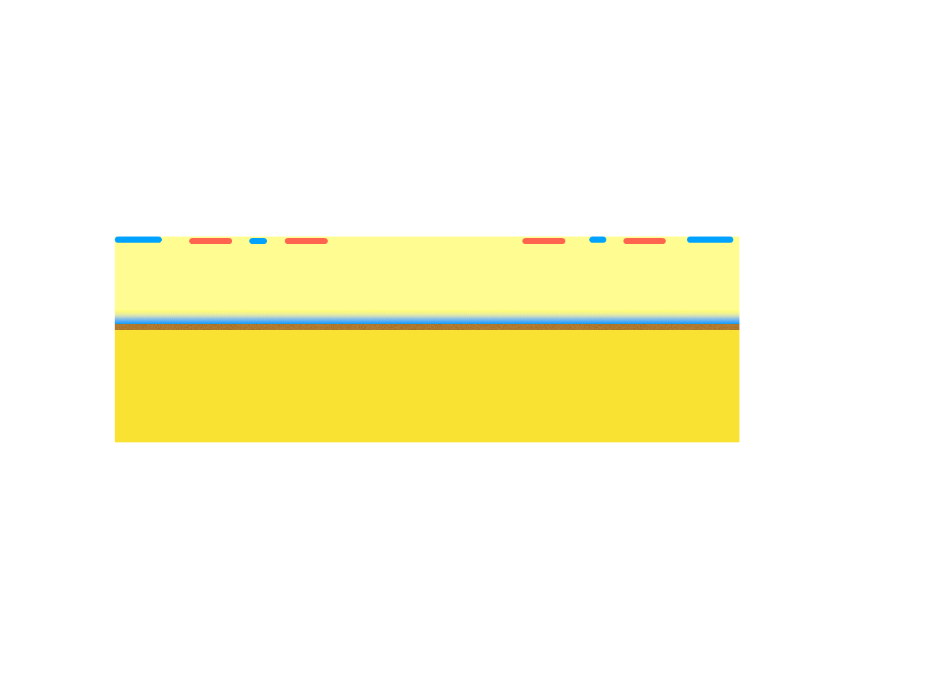
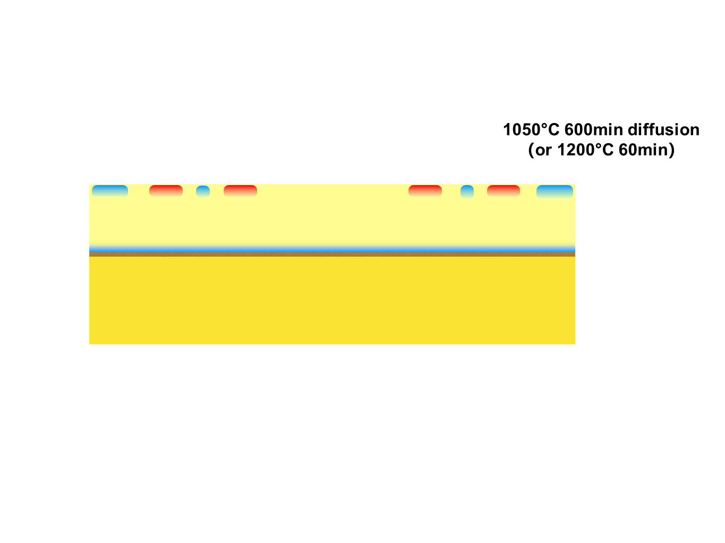
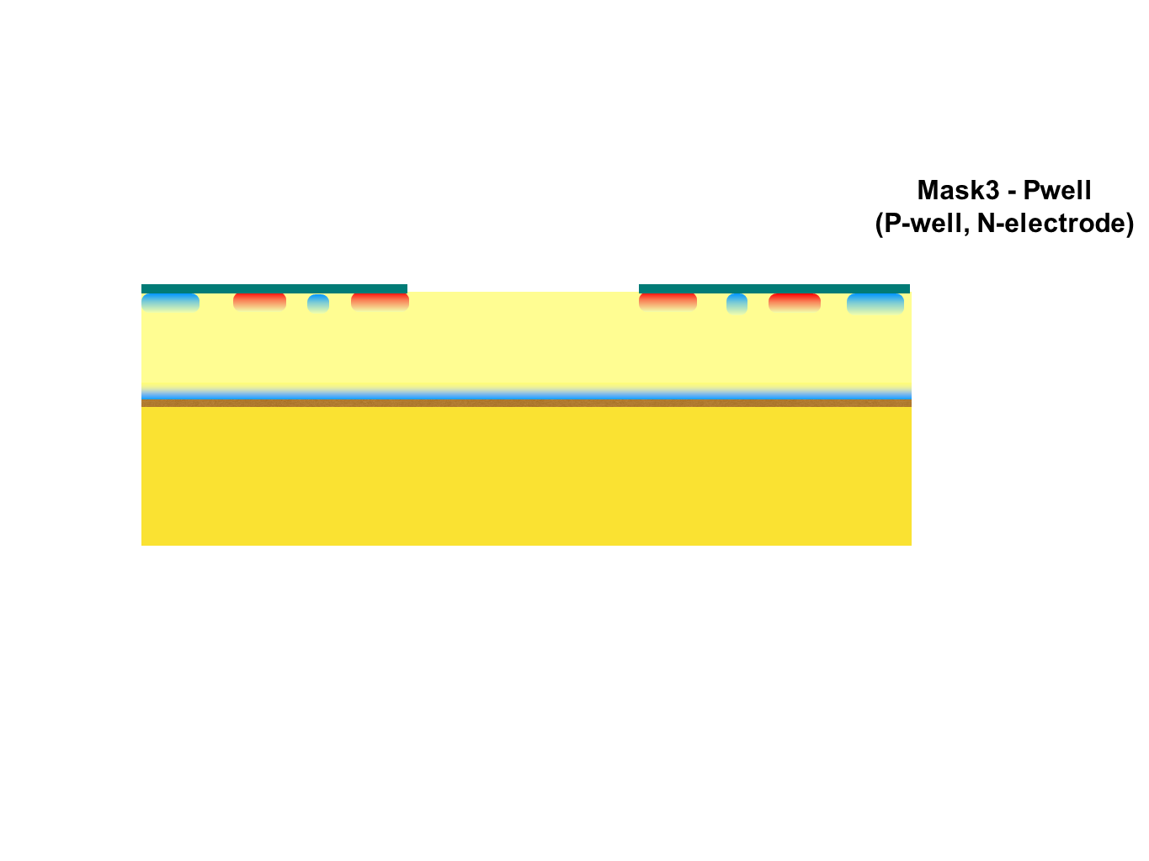
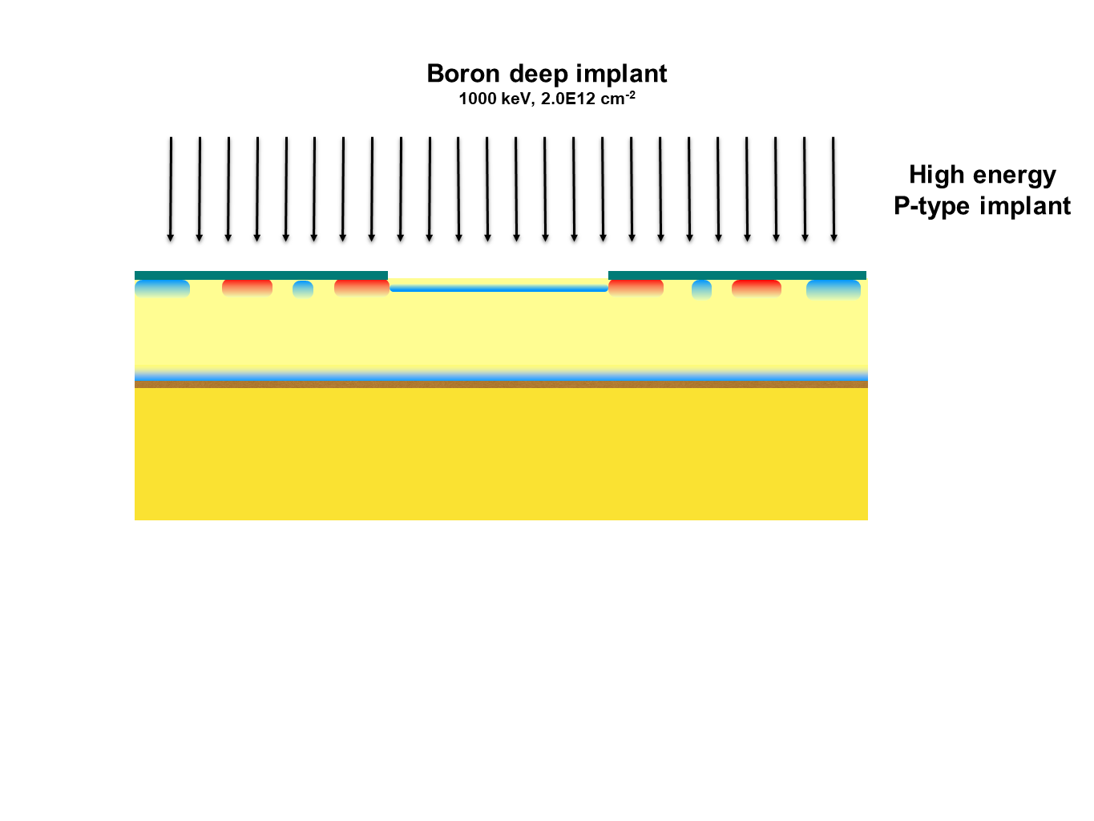
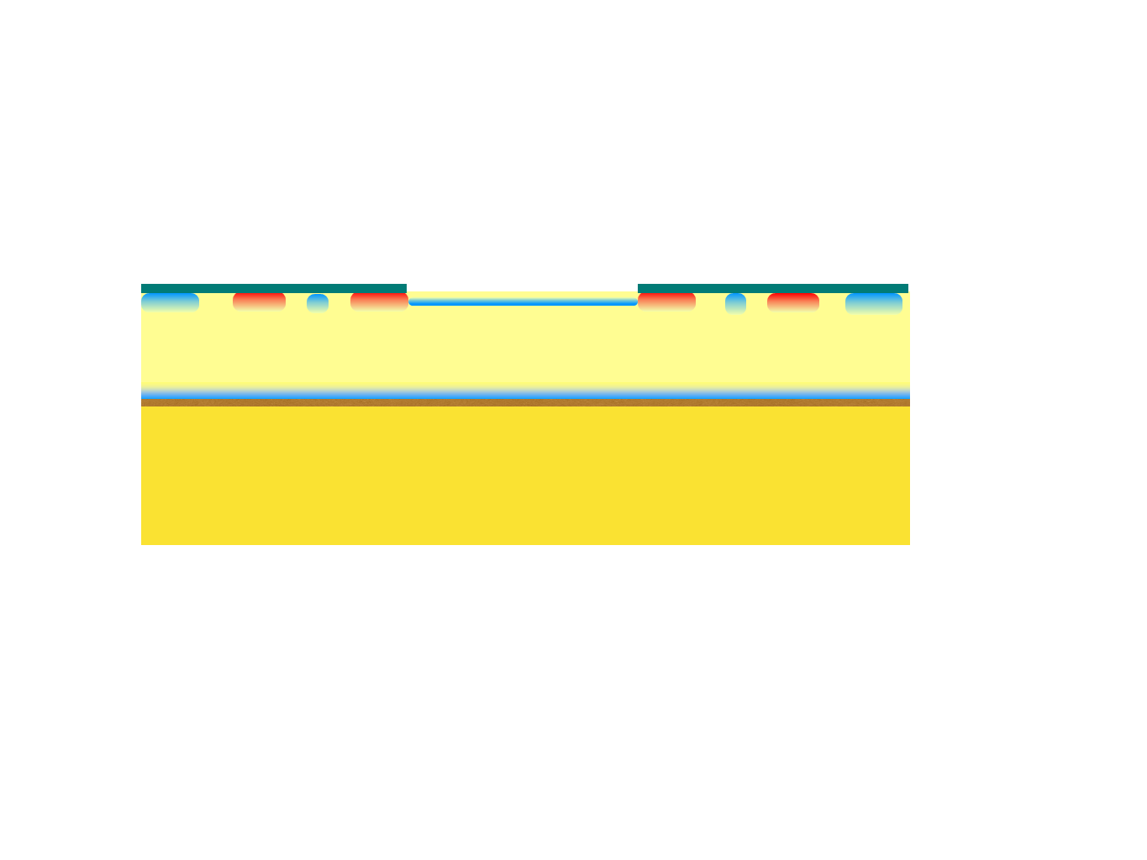
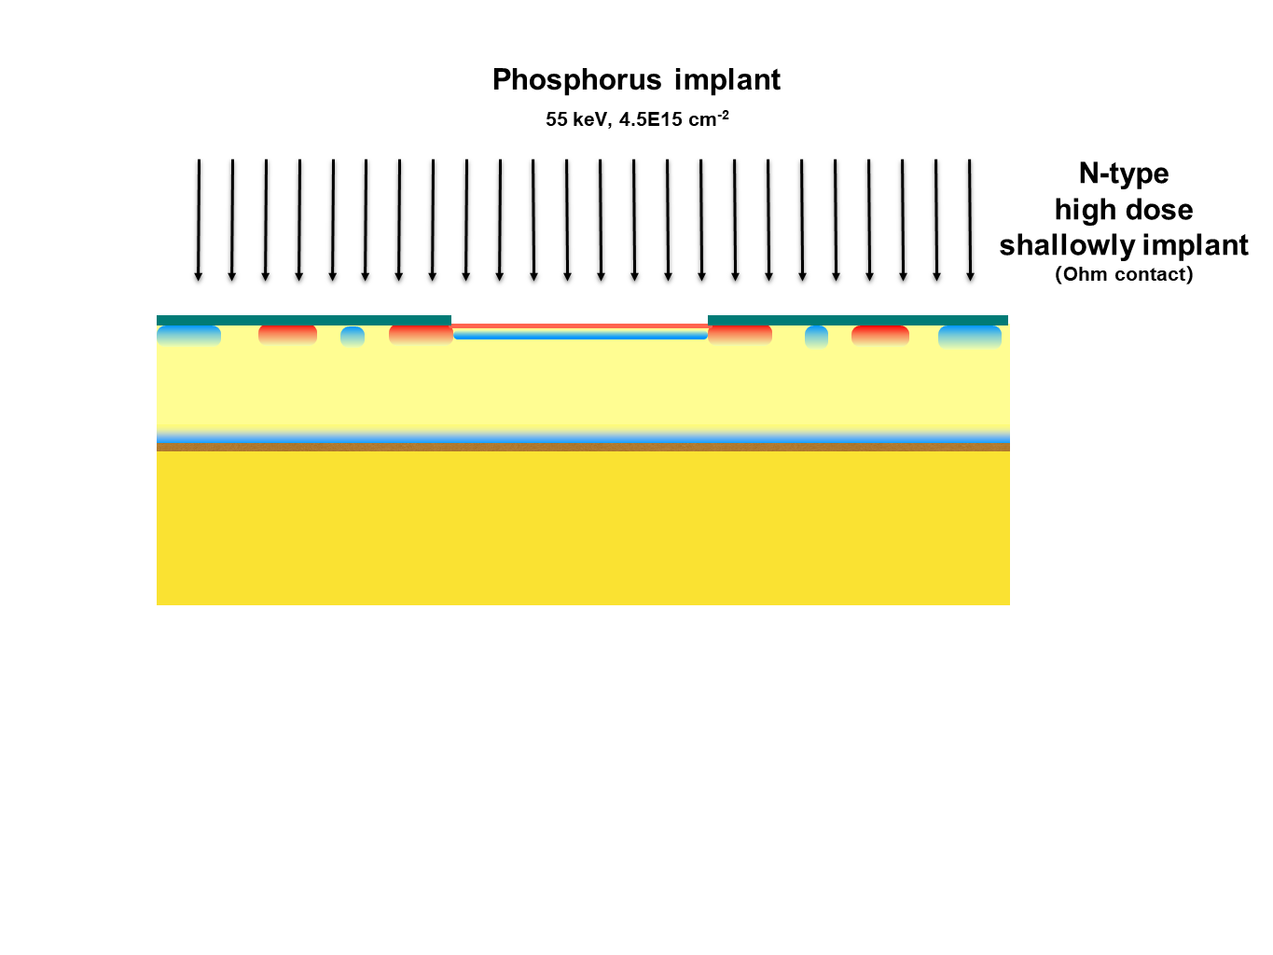
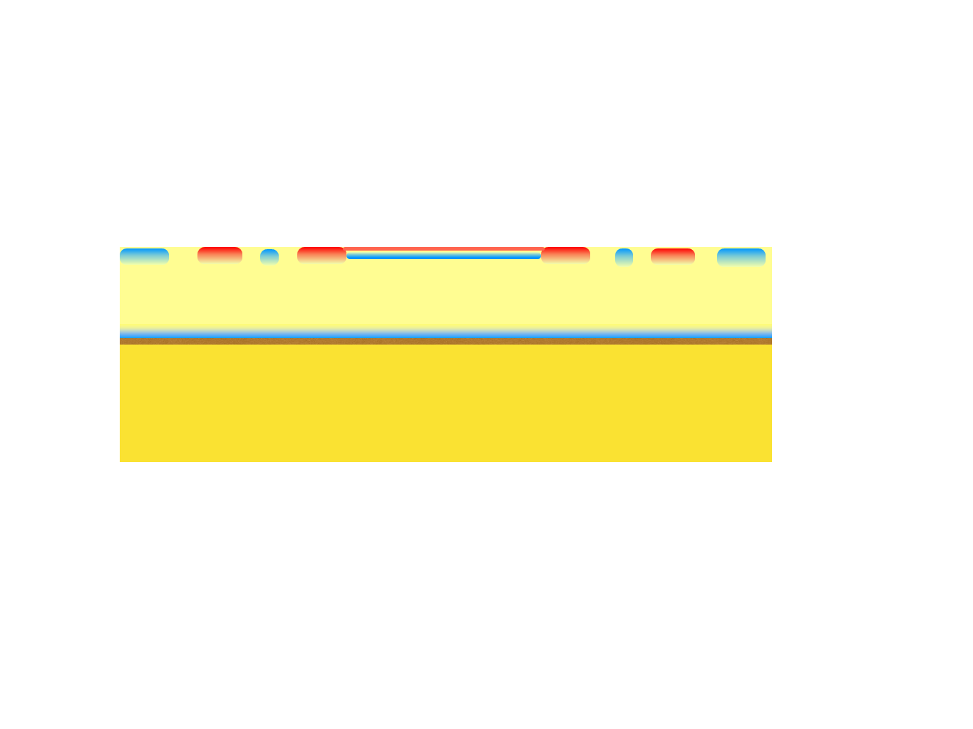
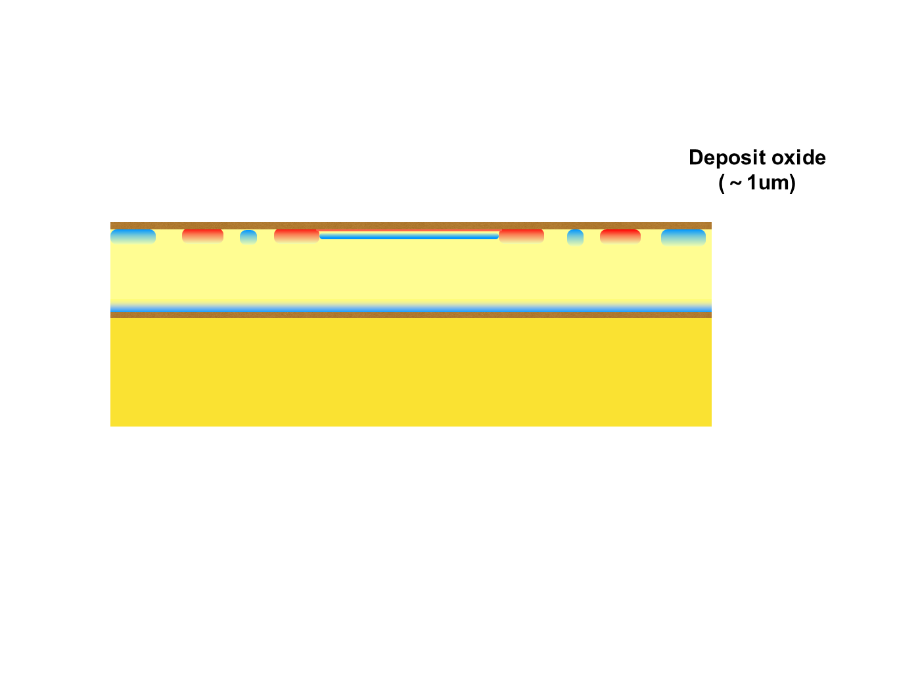
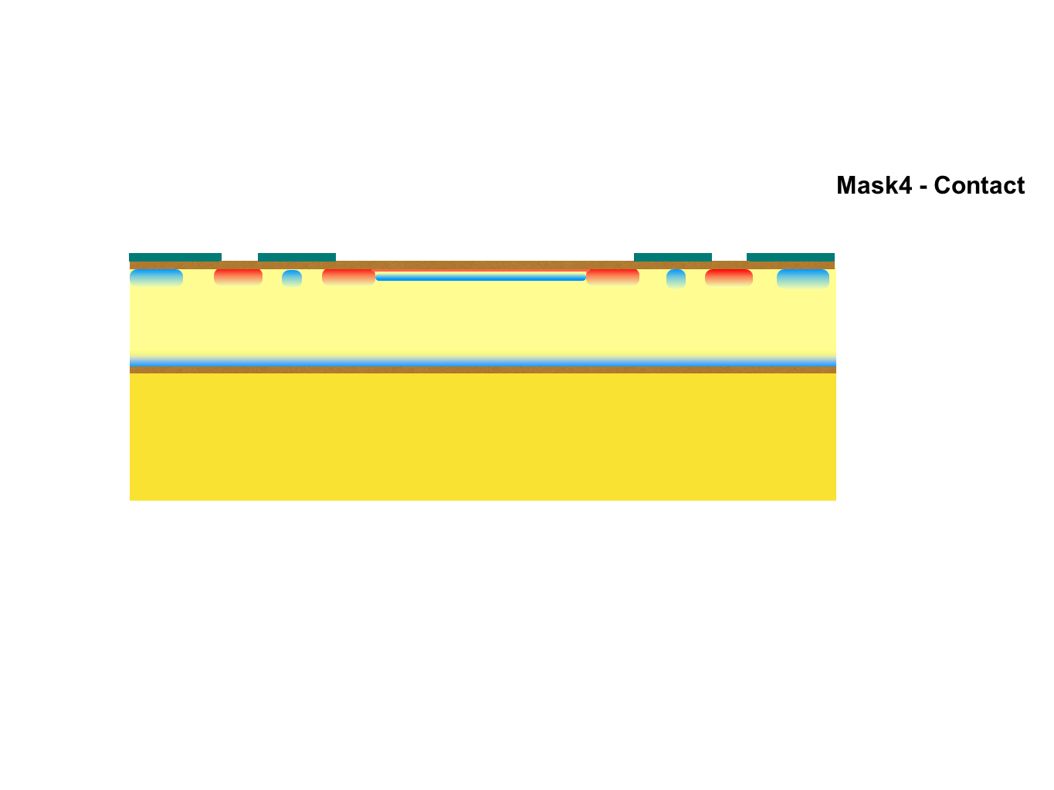
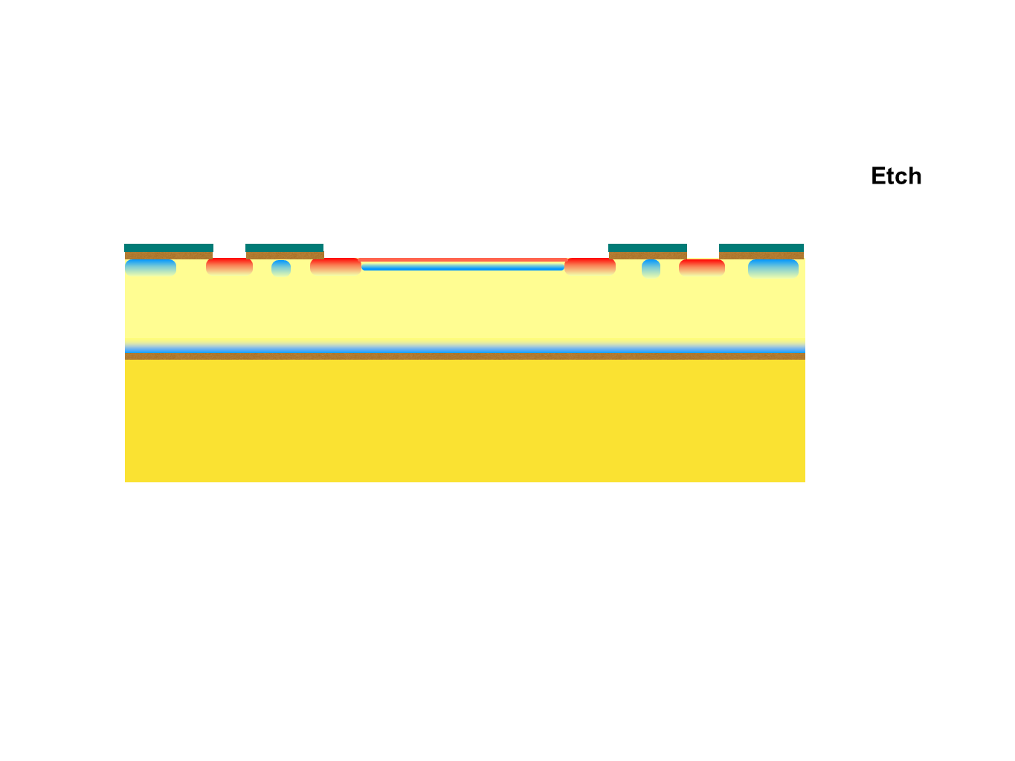
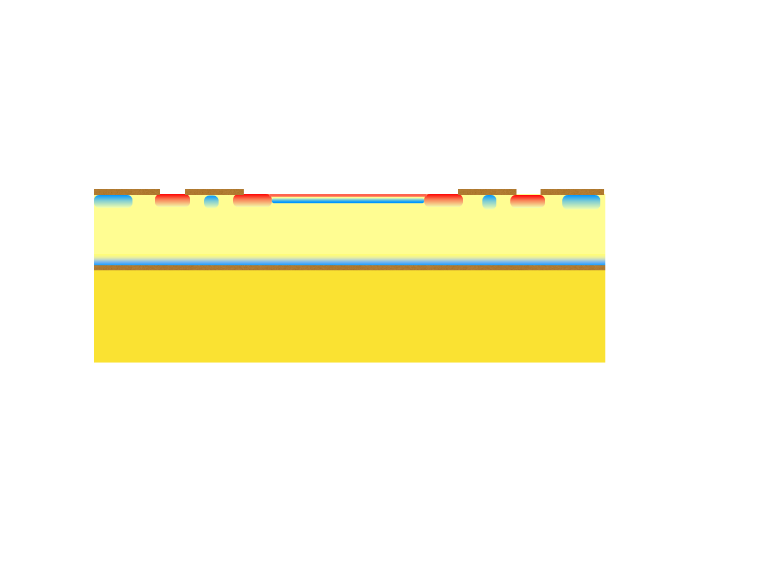
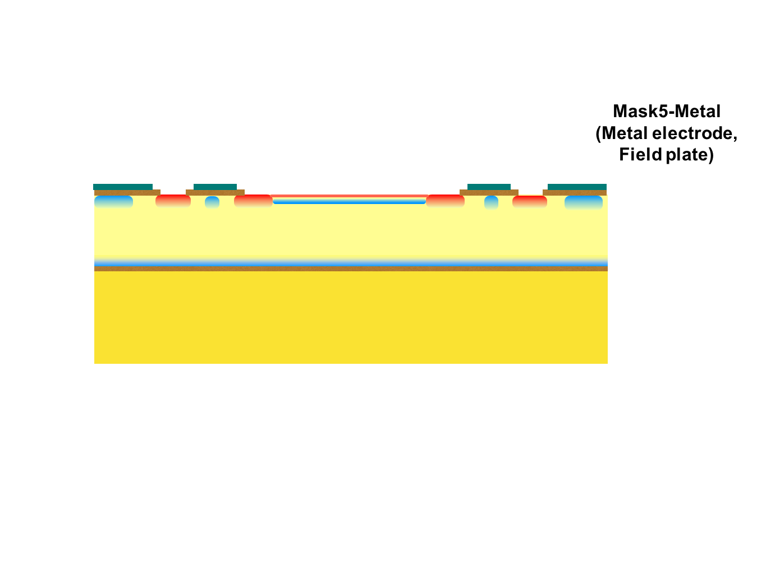
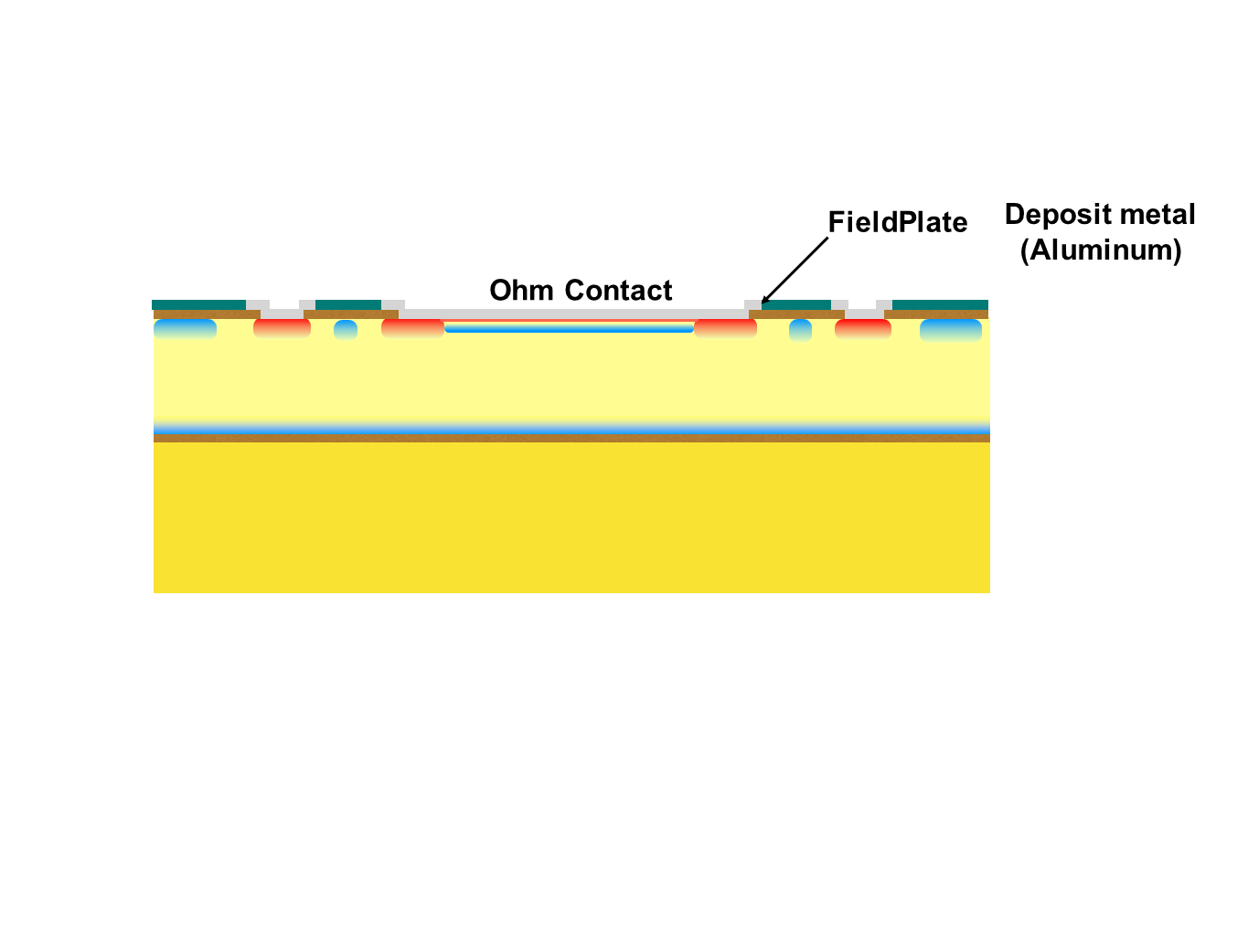

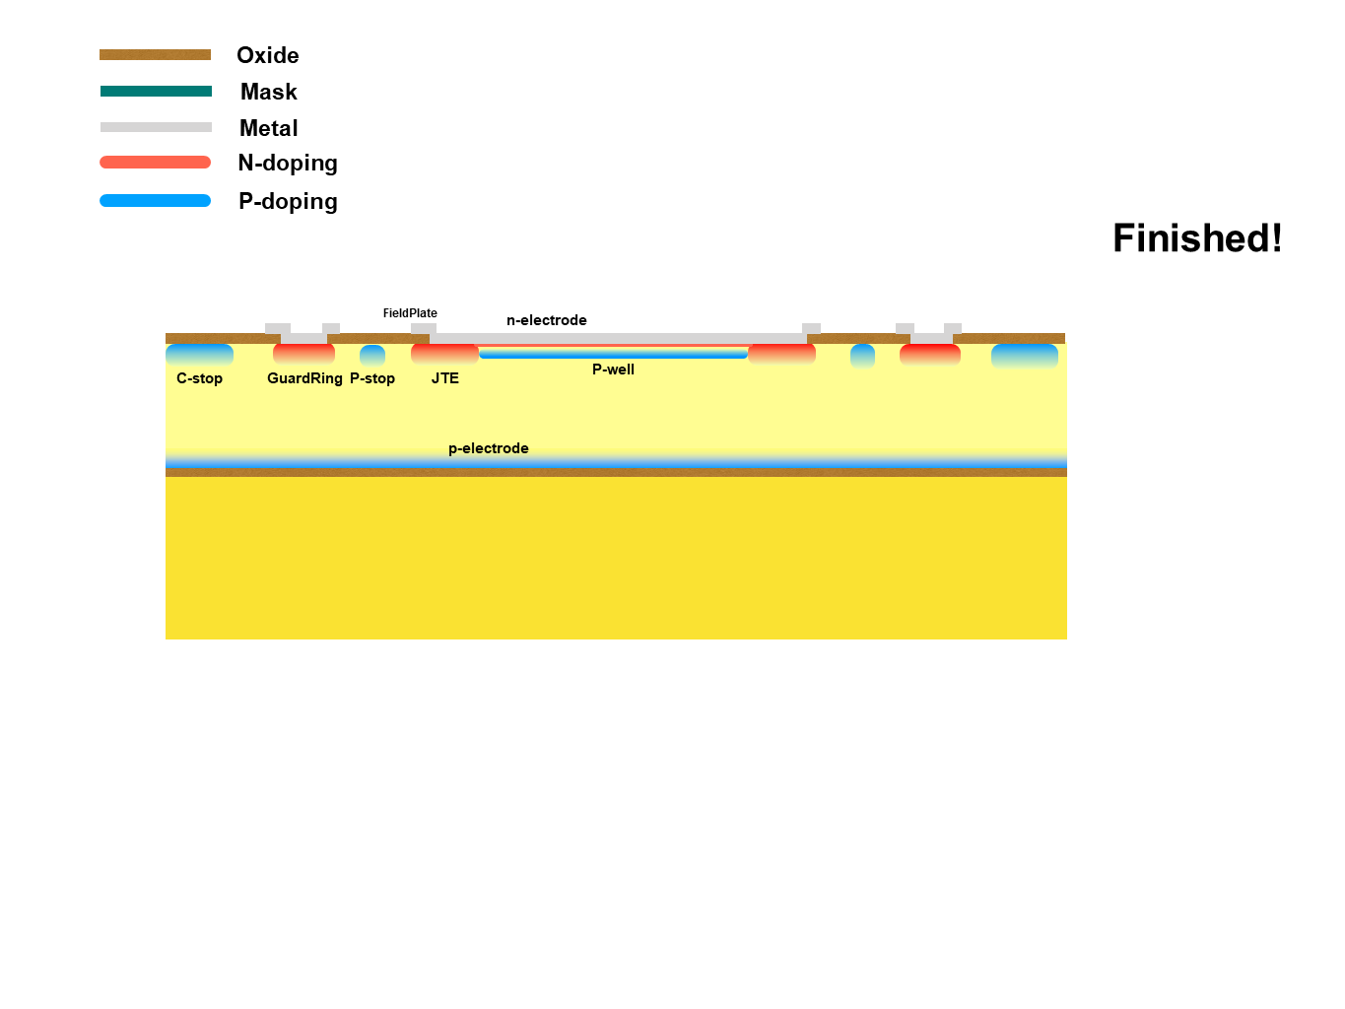

Slide 11
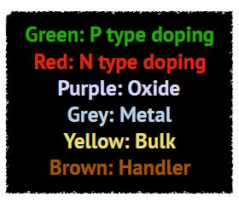
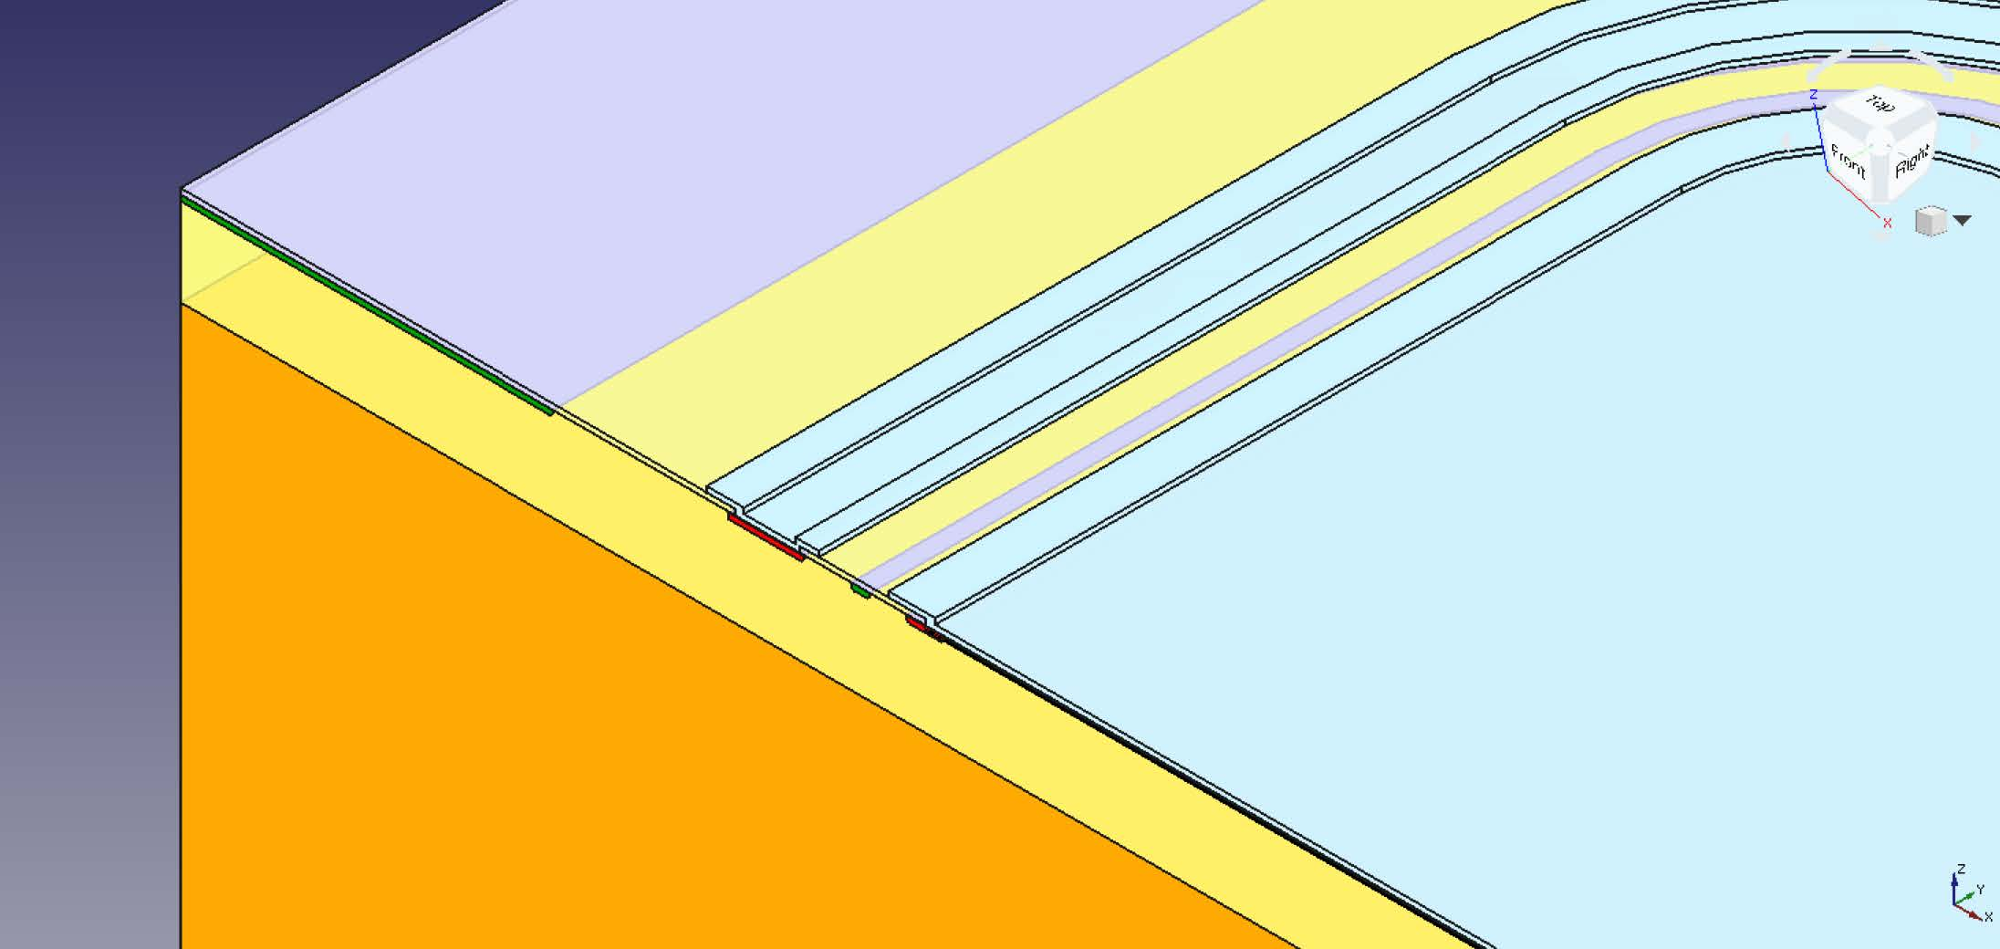
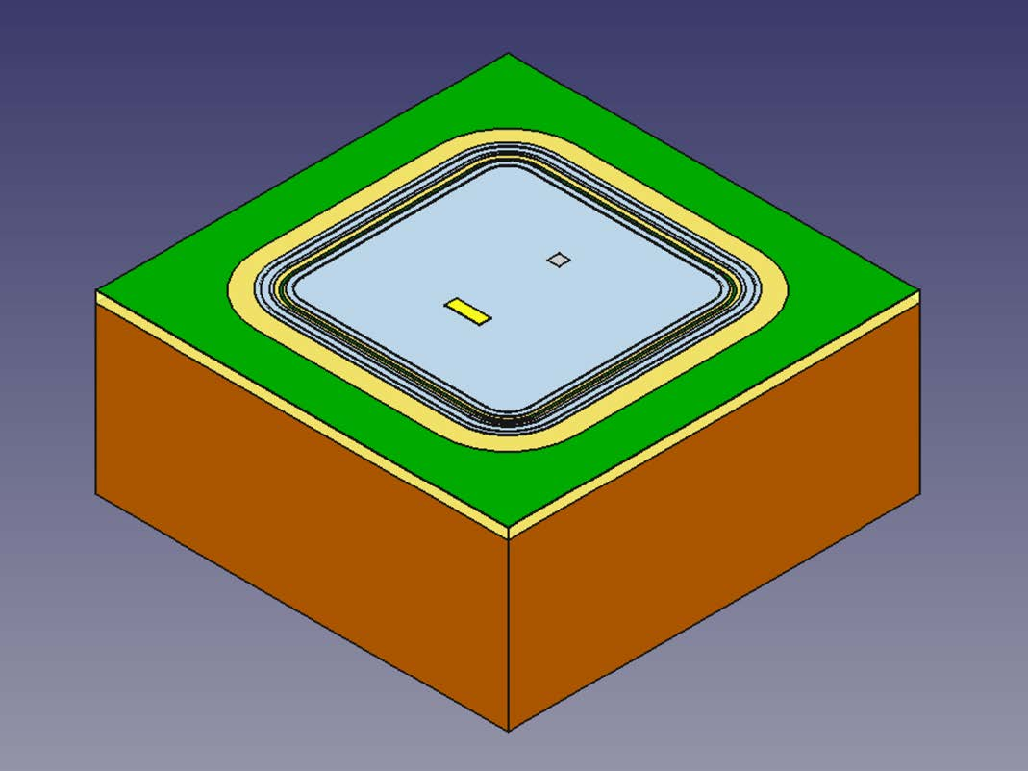
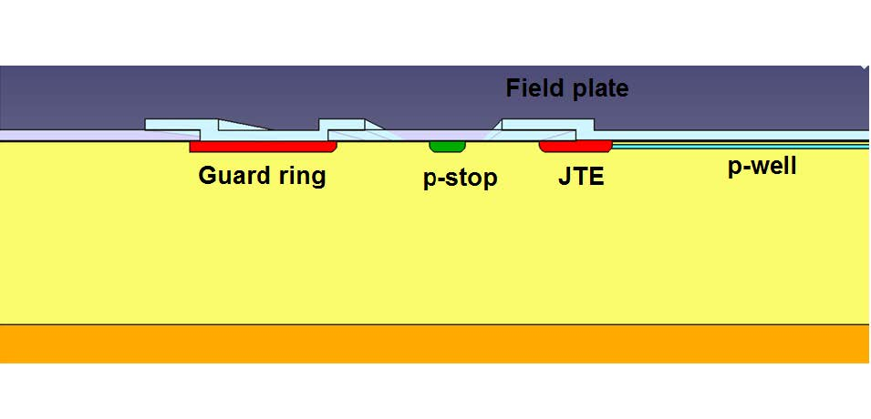
3D model of USTC sensor
Cross section
(Oxide removed)

Slide 12
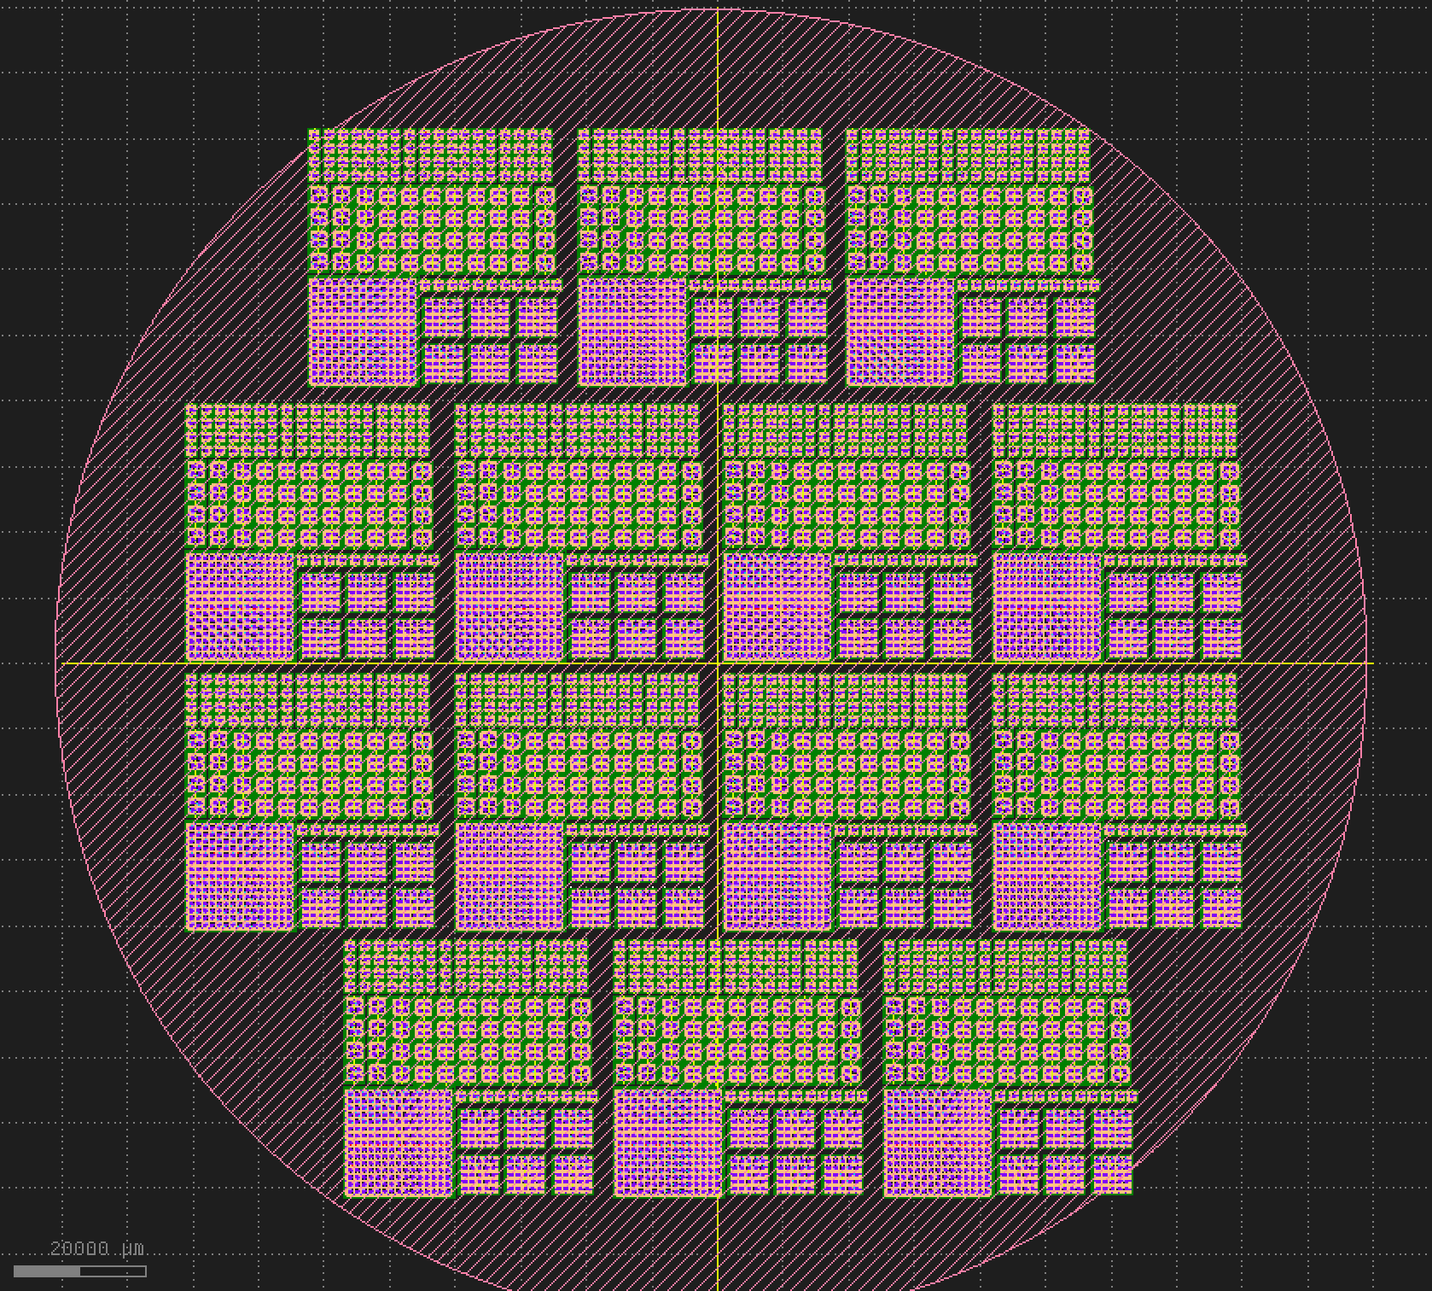
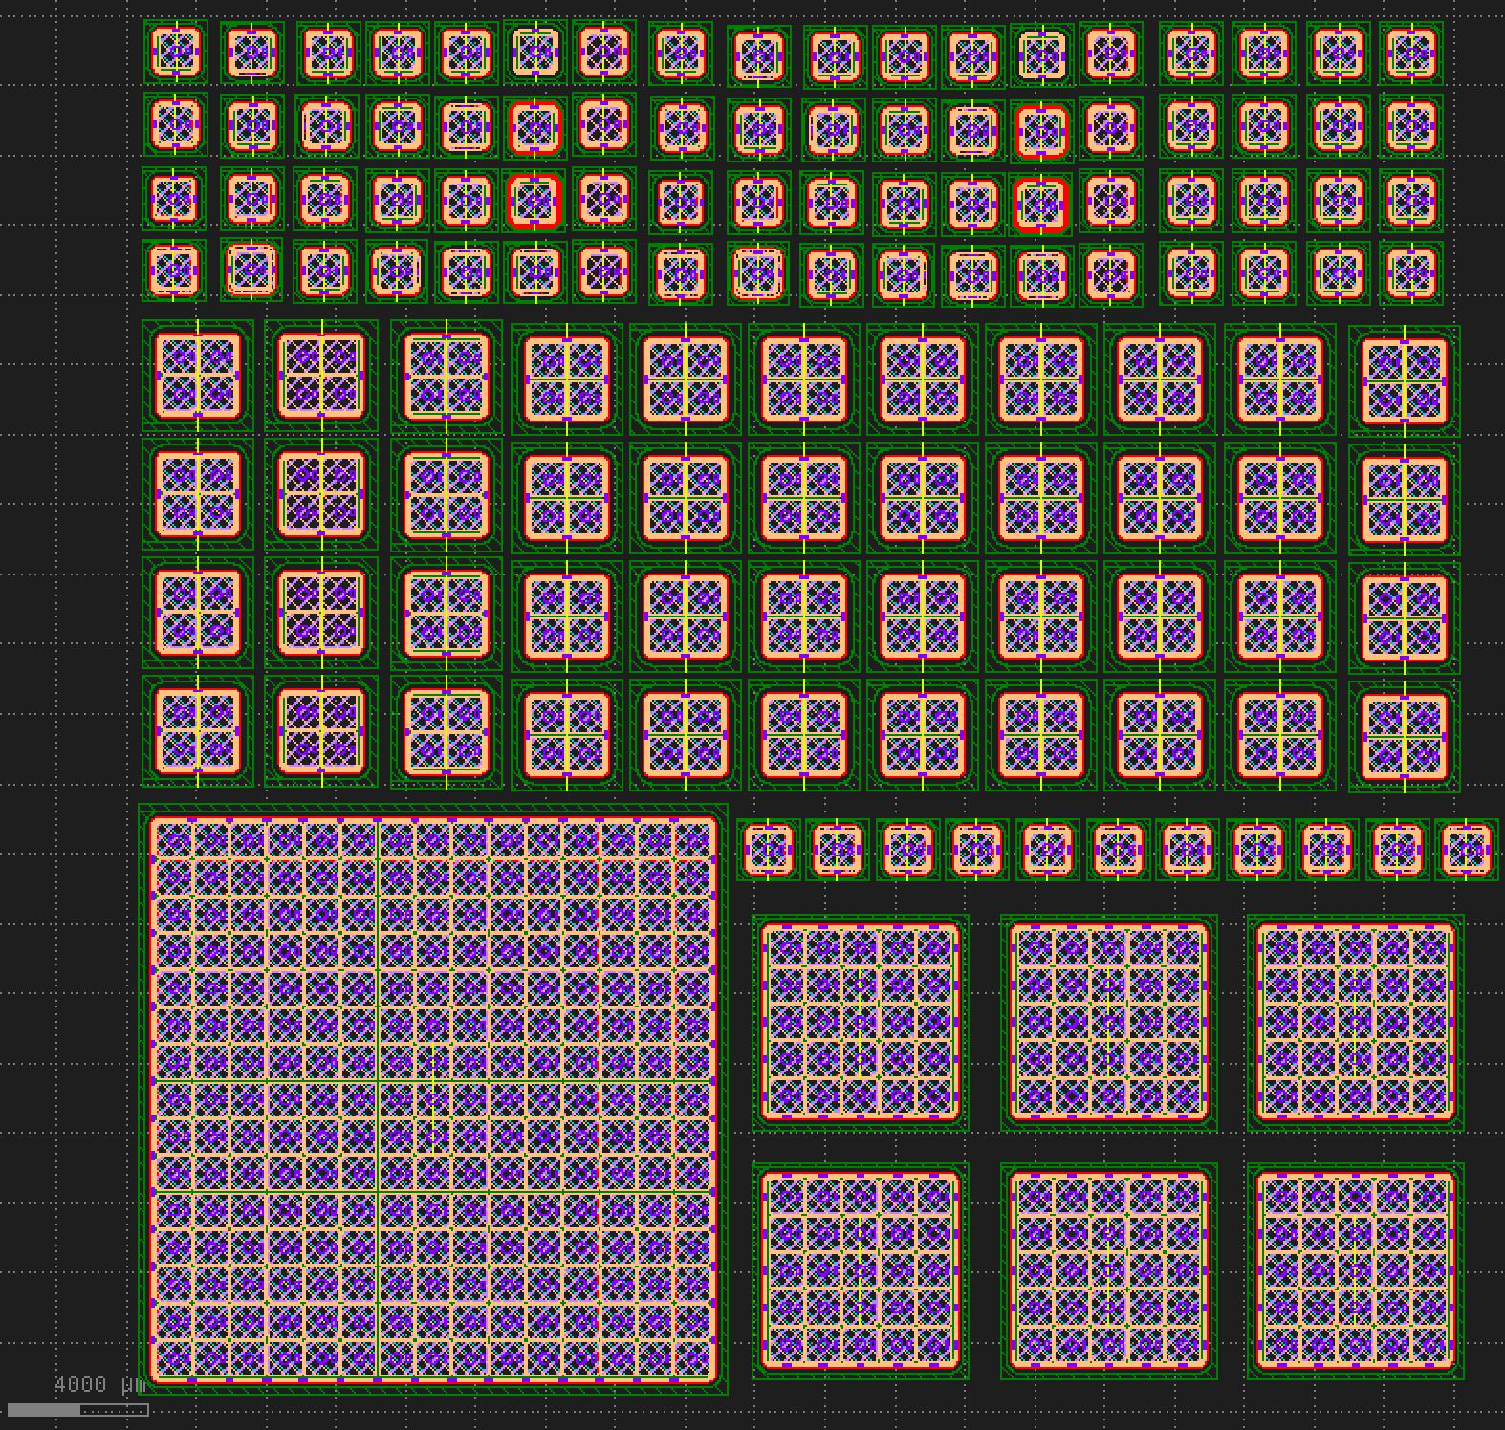
USTC batch layout
20000um
4000um
Sensor size | 1×1 | 2×2 | 5×5 | 15×15
Num. in each stepper | 83 | 44 | 6 | 1
Total | 1162 | 616 | 84 | 14
Ready for fabrication

Slide 13
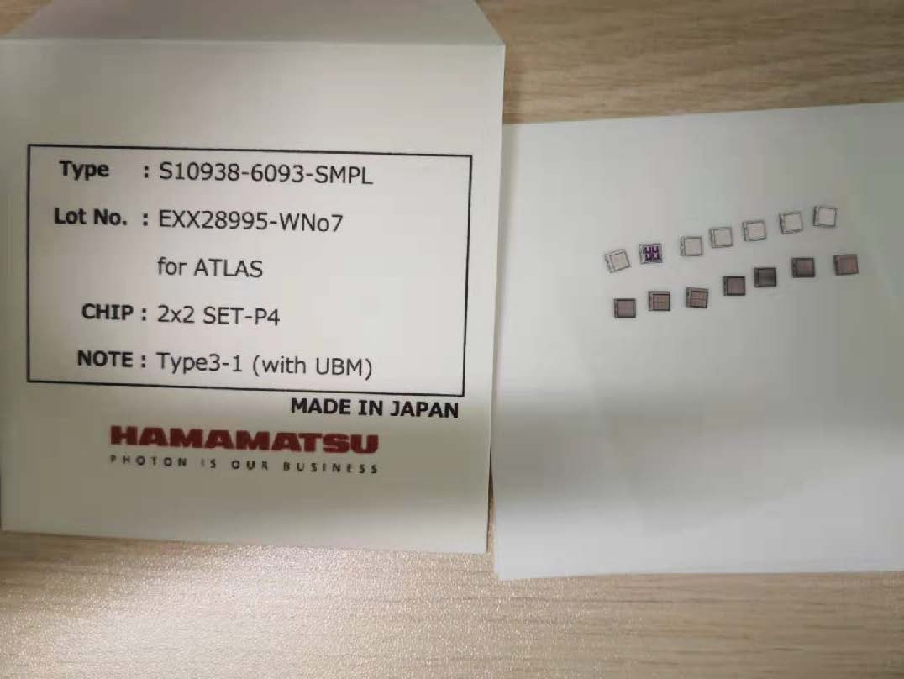
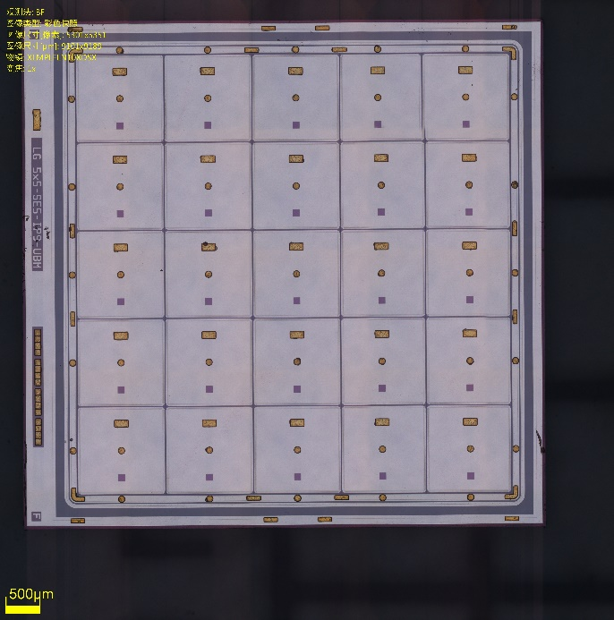
Chihao Li hcl2014@mail.ustc.edu.cn
Sensor test
Study the LGAD performance before and after irradiation at laboratory
Electrical measurements at probe station and the measurements of the dynamic properties of LGAD with beta scope or laser
USTC is one of the test sites of LGADs
Received from UCSC

Slide 14
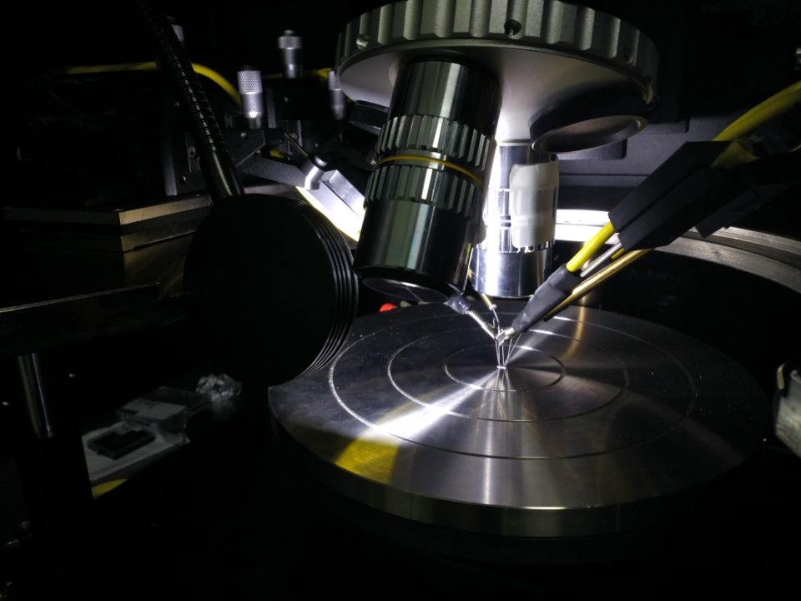
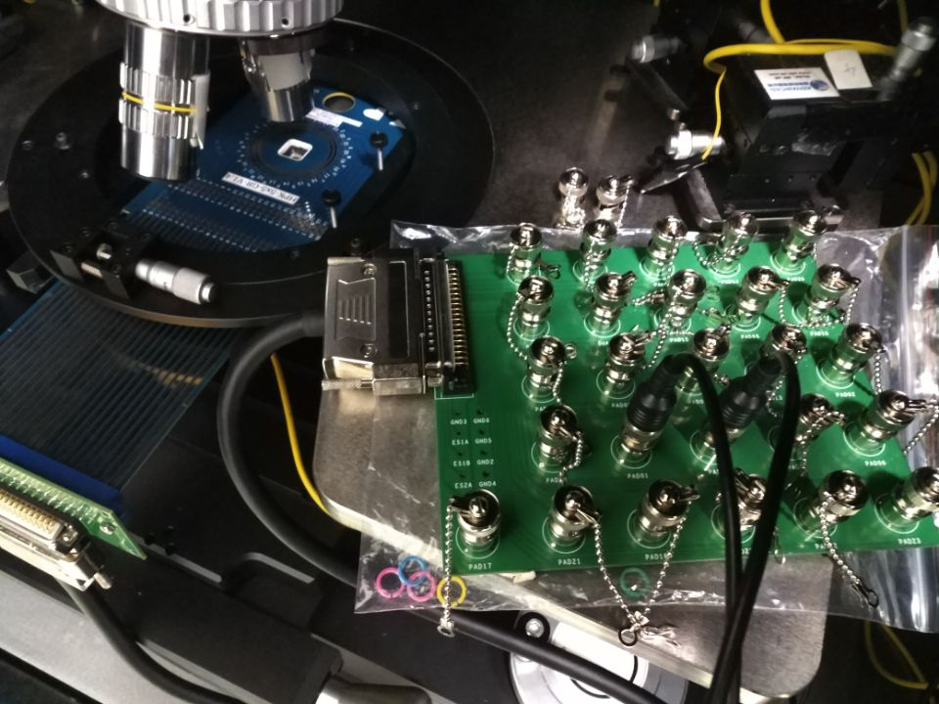
I-V & C-V measurement
Electrical measurements including current-voltage (I-V) and capacitance-voltage (C-V) characteristics performed at room temperature
Probe card with switch board used in 5×5 measurements

Slide 15
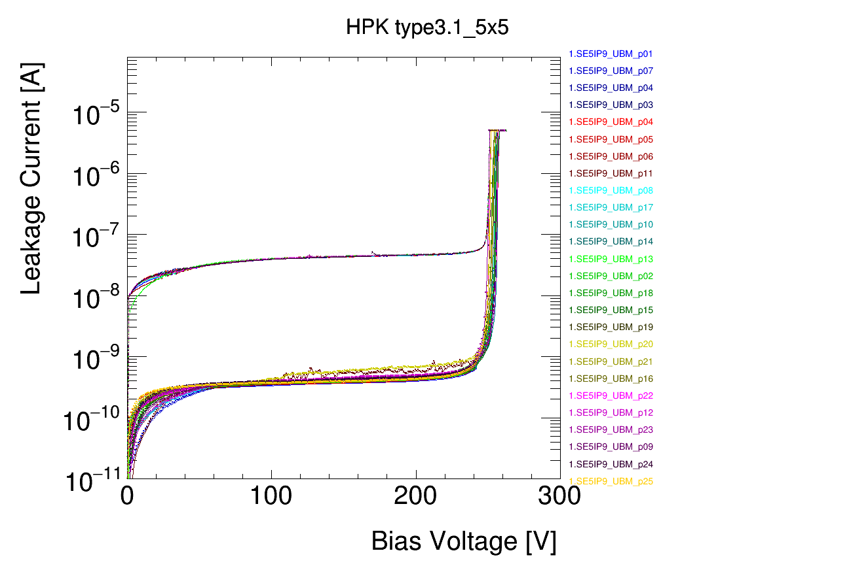
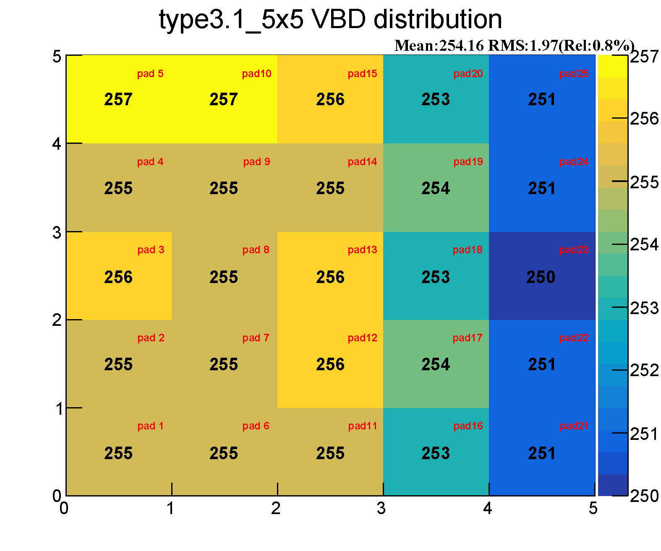
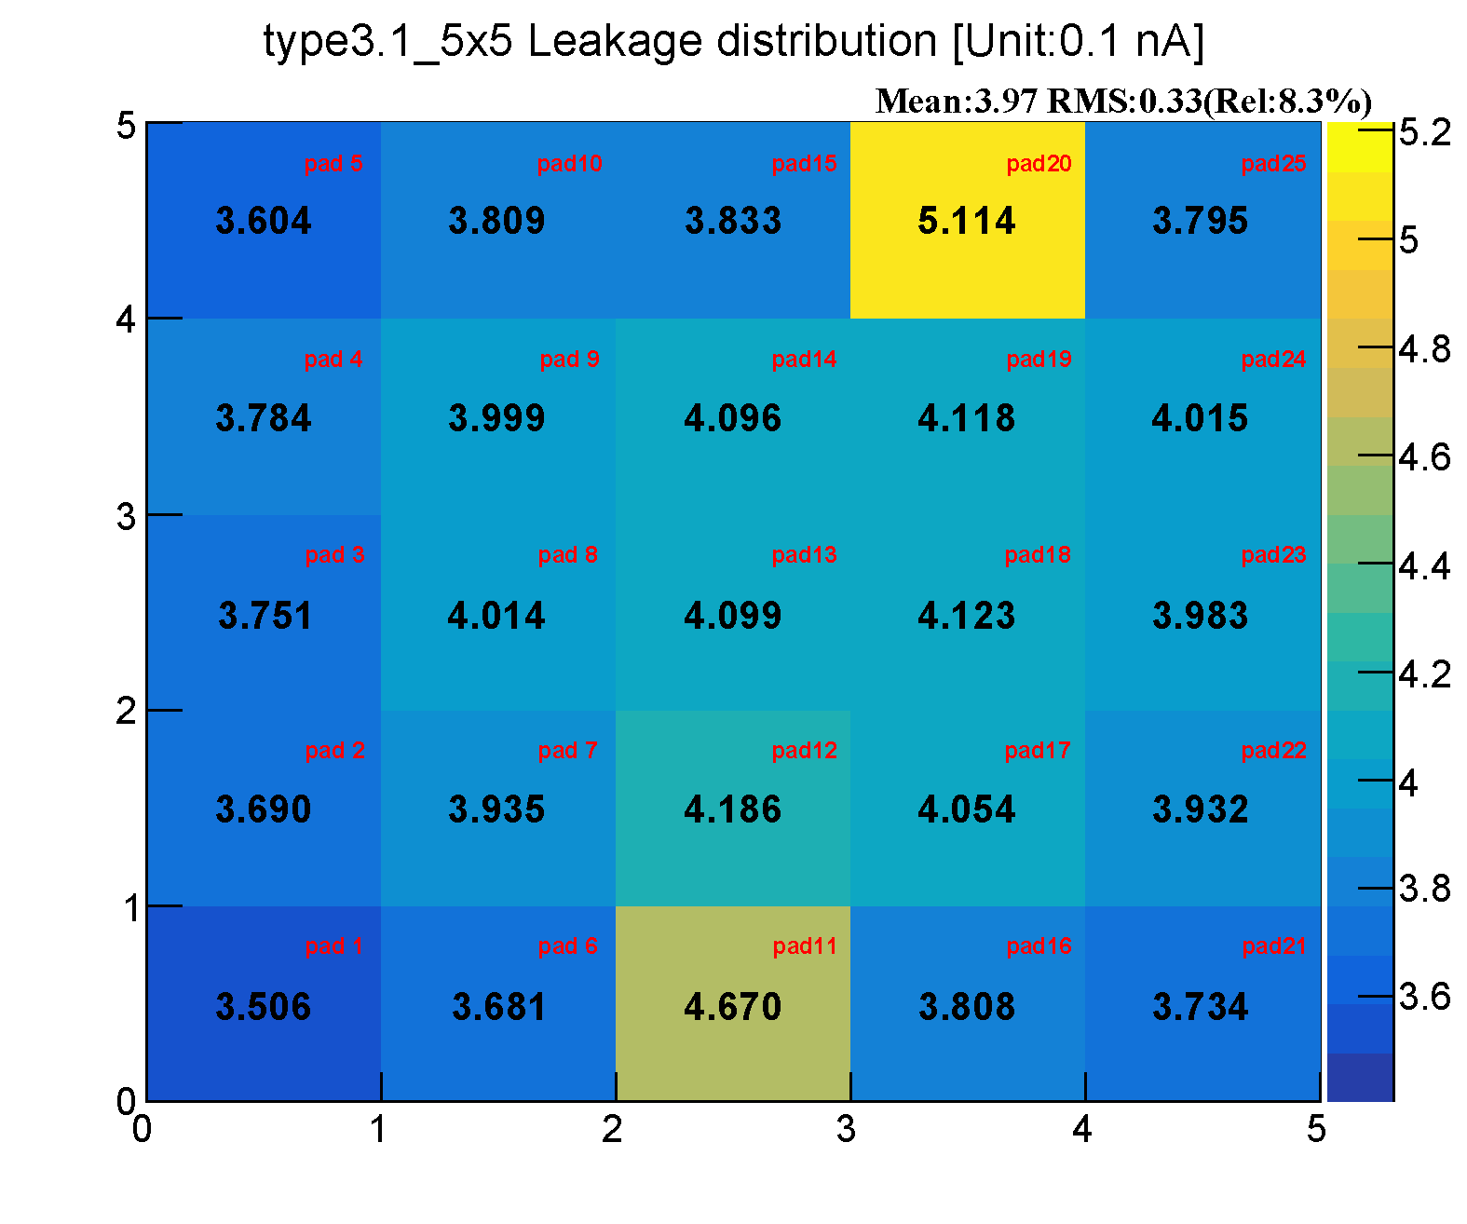
I-V results
Breakdown voltage
Average leakage current
Leakage
VBD
Sensor | Type 1-1 |  |  | Type 1-2 |  |  | Type 2 |  |  | Type 3-2 |  |  | Type 3-1
 | Single | 2×2 | 5×5 | Single | 2×2 | 5×5 | Single | 2×2 | 5×5 | Single | 2×2 | 5×5 | Single | 2×2 | 5×5
VBD/V | 216.2 | 201.1 | 206.9 | 272.3 | 277.9 | 281.4 | 255.9 | 245.0 | 251.2 | 130.3 | 126.8 | 118.6 | 245.5 | 259.8 | 254.2
Leakage/nA | 0.45 | 0.69 | 0.12 | 1.18 | 1.11 | 0.18 | 1.41 | 2.41 | 0.05 | 0.79 | 1.27 | 1.17 | 0.75 | 0.58 | 0.40
Type3.1 sensors perform well

Slide 16
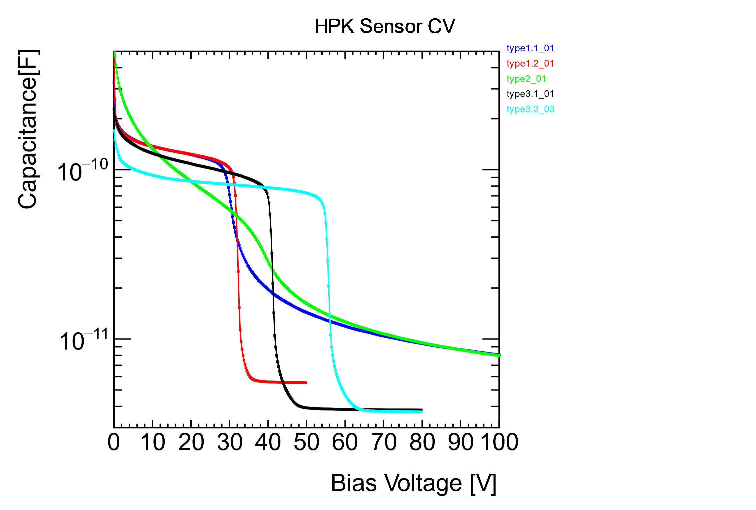
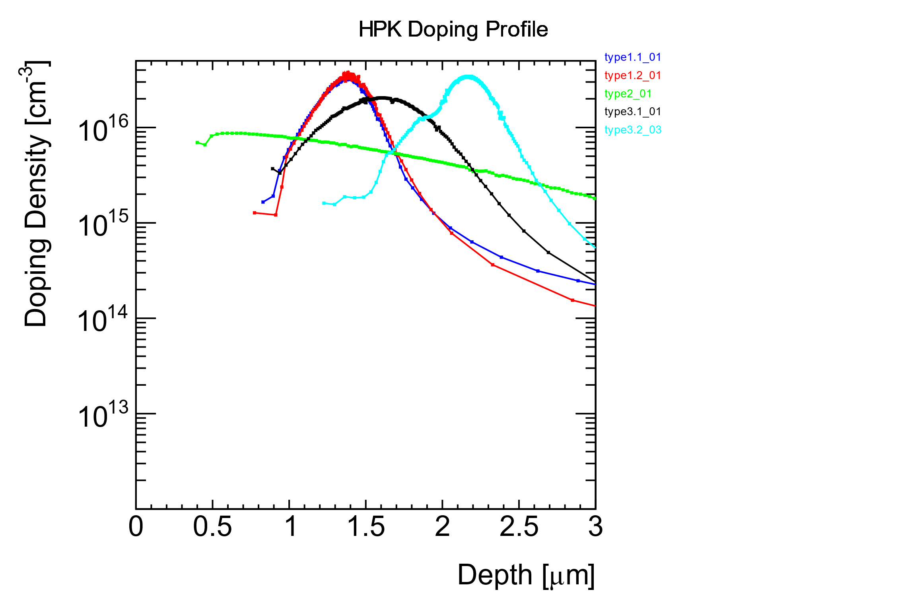

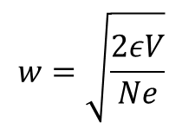
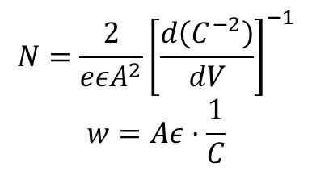
C-V results & Doping profile
$$w=\sqrt{\frac{2εV}{Ne}}$$
$$N=\frac{2}{eεA^{2}}{\left[\frac{d\left(C^{−2}\right)}{dV}\right]}^{−1}$$
$$w=Aε⋅\frac{1}{C}$$
N: Doping density
w: Depletion zone depth
A: Active area
$$C=\frac{ε}{Aw}$$

Slide 17
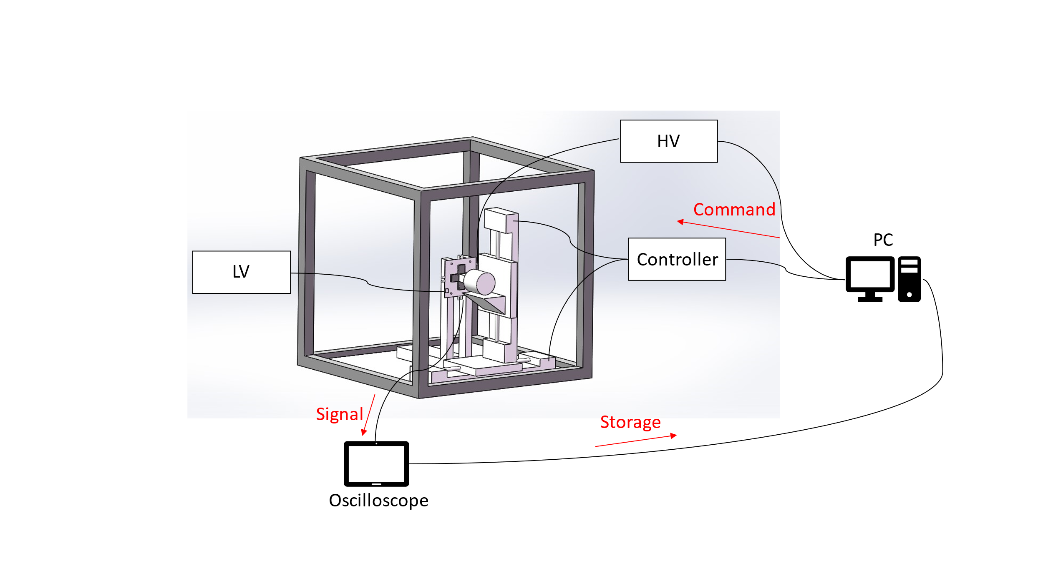
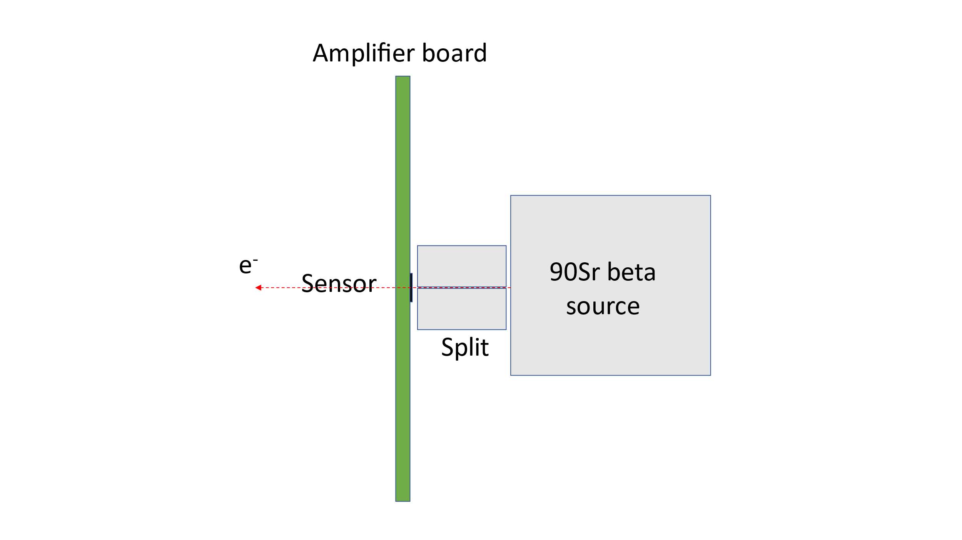
Beta scope setup
To study the dynamic properties of LGADs, such as charge collection, gain, gain uniformity, and time resolution, Sr90 beta source is used for test now and infrared laser is coming into use in future.
Two orthogonal guide rails are used to scan on the surface of sensor, and splits are used for collimation.

Slide 18
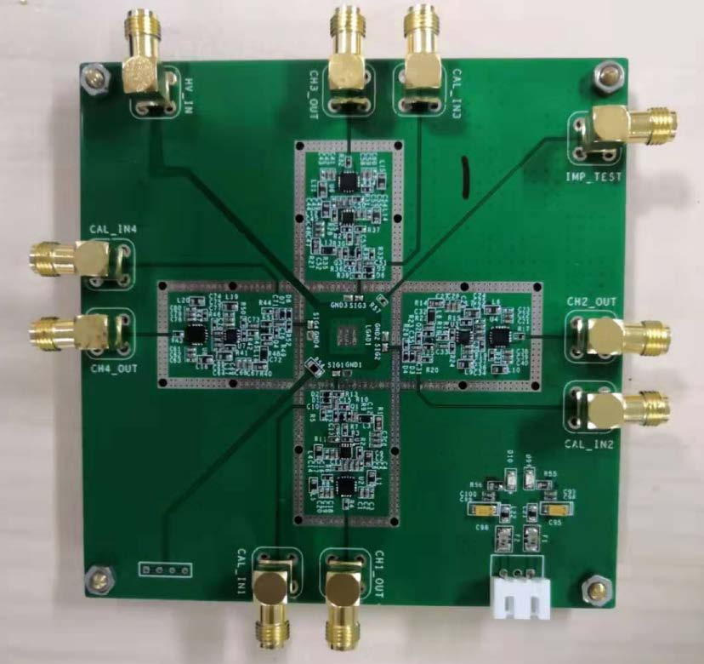

Jiajin Ge gejiajin@mail.ustc.edu.cn
USTC amplifier board
4 channels for 2×2 sensor test
Voltage gain: 240
Bandwidth: 1.1 GHz
Output dynamic range: -1.3 V ~ +1.3 V

Slide 19

Amplifier board calibration
Q_inj[fC] | V_integral[mV*ns]
25 | 175.68
30 | 212.67
35 | 249.67
40 | 313.68
45 | 329.55
50 | 371.04
Calibration with the injected voltage signal

Slide 20




Results with beta source
Charge distribution
Need to compare with the results of no-gain sensors to obtain the absolute value of the gain
Peak integral
MPV of Landau fitting

Slide 21

Han Chen han2013@mail.ustc.edu.cn
HGTD electronics
Study on the prototype of the ASIC chip, Altiroc
Pixel ASIC used in HGTD, consists of pre-amplifier, discriminator, TDC and digital parts
Version ALTIROC1 used for test
TDC
AMP
DISC

Slide 22
Altiroc test
Scan test on discriminator threshold, injected charge and input signal delay, to get the performance and its mismatch among channels and chips. Also, the data will be a reference for the next version ASIC.
Some issues are exposed during the test: such as cross talk form digital controller to analog input, oscillation in analog front-end in some of channels, inconsistency among ASICs.

Slide 23


Other work
HGTD digitization software
  Implement a more realistic digitization of HGTD hits in “PixelDigitizationTool” with release 20.20.
  The new method will be used to update the TDR samples for later performance and physics studies.
HGTD beam test
  Participated in the beam test at DESY in March 2019
  Analysis work with the test beam data
Tao Wang wt1949@mail.ustc.edu.cn
Xiao Yang yxflight@mail.ustc.edu.cn

Slide 24
Summary
LGAD sensor simulation and design are in progress. The USTC batch layout is ready for the sensor fabrication.
Sensors received from other institutes are under test. Effective electrical measurements system has been set up at USTC. To study the dynamic properties of LGADs, a beta scope is under construction.
The threshold, charge and delay scan have been taken on the Altiroc. More tests on the ASIC are ongoing.
Work on the digitization software goes well. Some results are produced to compare with the results in TDR.
Participated in the beam test at DESY and did some analysis with the test beam data.

Slide 25
Plan of USTC HGTD Group
Measure C-V, I-V, charge collection, timing resolution, efficiencies and uniformities of sensors from different vendors (HPK,CNM, FBK, NDL - both irradiated and un-irradiated)
Intensive study on sensor design: study both structure and fabrication process, target replacement of inner ring(s) of HGTD, focusing on improvement of radiation tolerance
Study module assembly and integration techniques to prepare for the construction of HGTD
Contribute to HGTD simulation and reconstruction software and expected performance studies
Long-term project : RD on ASIC (amplifier + discriminator + TDC)

Slide 26
Thank you!

Slide 27
Back up

Slide 28
3 rings radiation level
Inner ring
Middle ring
Outer ring

Slide 29

LGAD fabrication process
 | Process | Mask | Ion | Energy (keV) | Dose(cm^-2)
1 | Implant | JTE,Guard Ring | Phosphorus | 55 | ~4.5E+14
2 | Implant | C-stop, P-stop/P-spray | Boron | 55 | ~4.0E+14
 | Diffusion | 1050 ℃, 900 min (or 1200 ℃, 60 min)
3 | Implant | P-well | Boron | >1000 | *1.8-2.2 E+12
4 | Implant | N-electrode | Phosphorus | 55 | ~4.5E+15
 | Anneal | ~1050℃, 20s
 | Deposit | Surface Oxide | SiO2 |  | 0.5 - 2$μm$
 | Deposit | Ohm Contact & Field Plate | Aluminum |  | 1$μm$

Slide 30
Un-irradiated sensor information
HPK Type1.1, 1.2, 2, 3.1, 3.2
Envelope Label | Contents |  |  | Total number
Single SET | LG1-SE3 x2 | LG1-SE5 NM | LG1-SE5 x4 | 11
 | PIN1-SE5 | PIN1-SE5 NM | LG1-SE2 x2
2x2 SET | LG 2x2-SE3-IP9 | LG 2x2-SE5-IP9 NM | LG 2x2-SE5-IP9 x4 | 14
 | PIN 2x2-SE5-IP9 | LG 2x2-SE2-IP9 | LG 2x2-SE5-IP7
 | LG 2x2-SE5-IP5 | LG 2x2-SE5-IP3 | LG 2x2-SE3-IP7
 | LG 2x2-SE3-IP5 | LG 2x2-SE5-IP5-IP9 UBM
LG 5x5-SE5-IP9 | LG 5x5-SE5-IP9 UBM |  |  | 1

Slide 31

Irradiated sensor information
HPK Type1.2

Slide 32


Electrical measurements

Slide 33

Switch board for 5×5 sensors
Manual switch board
Matched with HPK-5x5-GR-1.4 version probe card
Need some developments for the digital board
Digital switch board
HV
LGAD
Analogue switch controlled by micro controller
PC
Picoammeter/GND
LCD

Slide 34

VBD & Leakage extraction
VBD: voltage where leakage current reaches 1 μA
Leakage: average current from 1/3 VBD to 2/3 VBD
GR current
1/3 VBD
2/3 VBD
Pad current
GR current
VBD
Pad current

Slide 35

VGL & VFD extraction
VGL: Gain layer full depletion voltage
VFD: Bulk full depletion voltage
VFD
VGL
Type | 1-1 | 1-2 | 2 | 3-2
VGL/V | 23.7 | 31.7 | 32.2 | 54.8
VFD/V | 183.3 | 35.4 | 141.2 | 62.9

Slide 36


Beta scope setup

Slide 37
Some issues in Altiroc test
INL: Integral nonlinearity
DNL: Differential nonlinearity

Slide 38

Timing performance simulation
Result from TDR
Result generated by new software

