Slide 1
ttH multi-lepton studies at CMS
Chaochen Yuan（IHEP）
CLHCP，10.24-27，Dalian 1

Slide 2
Higgs
Bosons
Discovered in 2012
Higgs itself
Not yet
The only scalar boson in SM
Fermions
ttH process was discovered in 2018
Higgs: the mass origin of fundamental particle
The fifth force
2

Slide 3
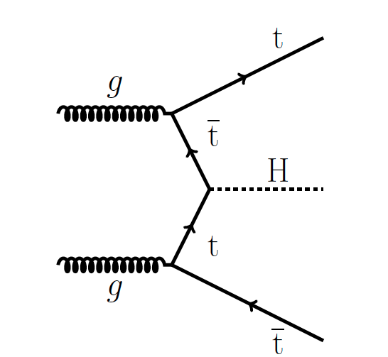
ttH analysis
HIG-18-019-pas
The strength of Higgs-Fermion interactions, Higgs-Top coupling is the largest
𝑡𝑡𝐻 provides the best sensitivity to probe Higgs-top Yukawa coupling 𝑦𝑡
Focus on three H decay mode(expect for H->ZZ*->4l)
WW*(21.5%)
ZZ*(2.6%)
ττ(6.3%)
direct detection in production
3

Slide 4
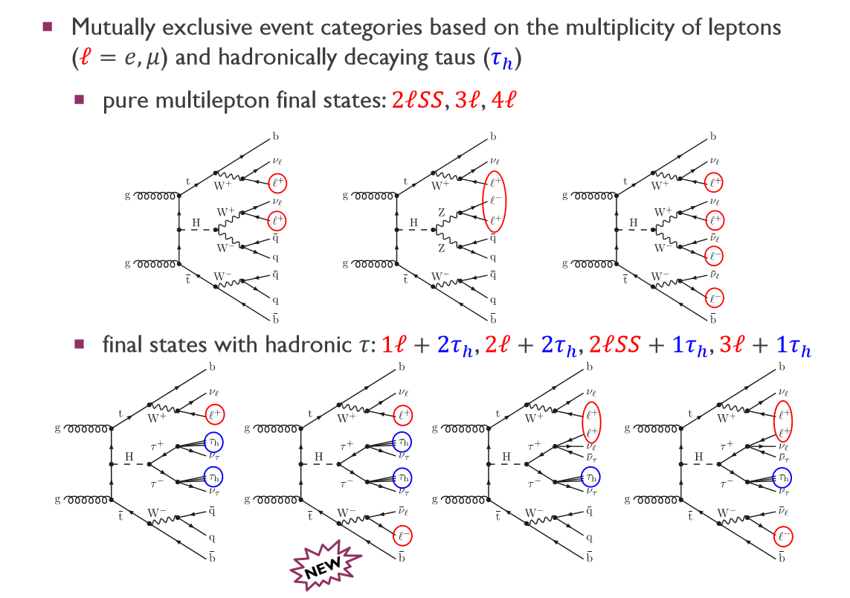
ttH analysis
Event selection：
contain at least two jets of pT > 25 GeV and |η| < 2.4
contain a loosely-selected lepton pair with an invariant mass mll < 12 GeV are rejected
ttH signal events are expected to contain two b-jets.
these events are not well modeled by the simulation
4

Slide 5
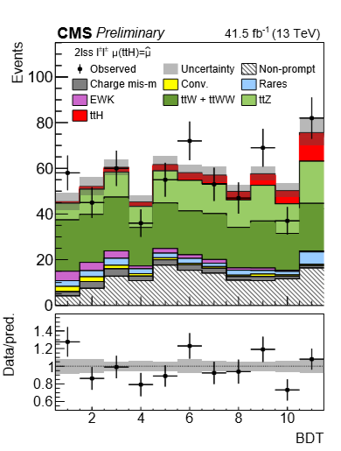
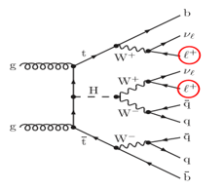
2lss category
Two BDTs are used
Event selection:
Contain two leptons with same charge pt>25Gev and 15Gev, respectively.
Contain at least four jets
LD>30Gev
rejects most of the otherwise large tt+jets background
In case both leptons in the event are electrons
5

Slide 6
2lss category
Dominant background:
ttW : studied in ttW CR
ttZ : studied in ttZ CR
reduced by rejecting events with |mee−mZ| < 10 GeV
Non-prompt : From b decay but pass the selection criteria -> be regarded as V decay.
Reduced by specific isolation criteria(important contribution from IHEP )
BDT are used for the separation of the signal and background
IHEP provide the most sensitive variable->Hj tagger
Tagging jets from Higgs decay
Aim to extract ttH from ttV
6

Slide 7
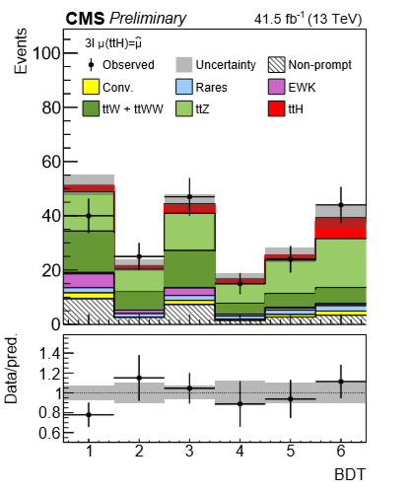
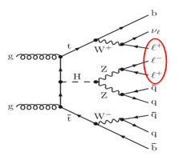
3l category
matrix element methods are used
ttZ production background:
Vetoing events contain a pair of SFOC leptons with
$$\left|M_{ll}−M_{z}\right|<10Gev$$
Event selection:
Contain three leptons with highest pt>25Gev, second and third pt>15Gev
Charge sum +1 or -1
Fewer than 4 jets
->LD>45Gev
Contain two lepton pairs with SFOC and M4l<140Gev vetoed
Two BDTs are used
Avoid a pair of lepton with SFOC, and LD>30 if no such lepton pair
Avoid H->ZZ->4l
7

Slide 8
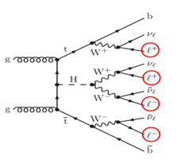
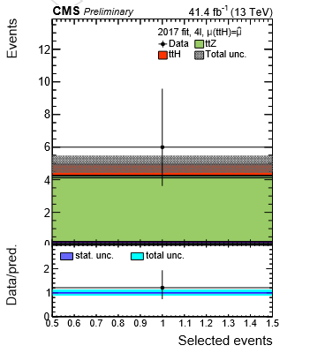
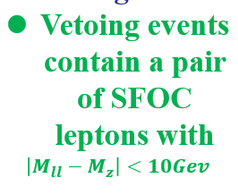
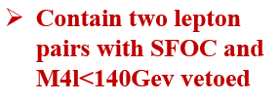
4l category
Event selection:
Similar as 3l category expect:
Contain 4 leptons
Pt thresholds is 25Gev,15Gev,15Gev,10Gev for the highest, second, third, fourth
Due to low event statistics, no shape analysis is performed in this category.
8

Slide 9
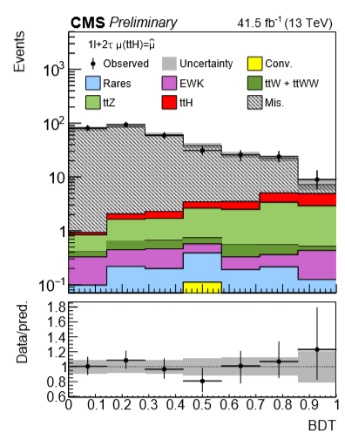
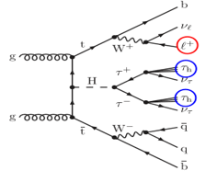
1l+2τh category
dominant background :
tt+jets
one or two jets are misidentiﬁed as τh
reduced by demanding that the τh of higher pT satisﬁes the condition pT > 30 GeV and the event contains at least three jets of pT > 25 GeV and |η| < 2.4
Event selection:
Contain one e/μ and two τh.
For e(μ),|η|<2.1,
Pt>30Gev(pt>25Gev)
Two τh opposite charge
More than one e/μ vetoed
9

Slide 10
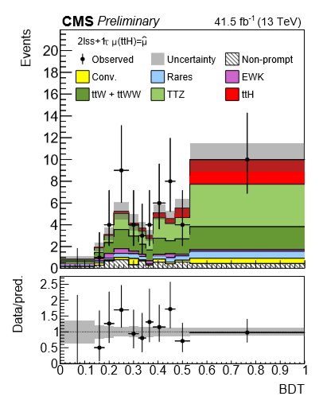
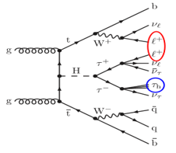
2lss+1τh category
Event selection:
Similar to 2l category expect :
Contain a τh
Pt>10Gev for μ if μ lepton has the second highest pt
Jets from 4 to 3
Opposite charge for τh and lepton
Contain two τh vetoed
10

Slide 11
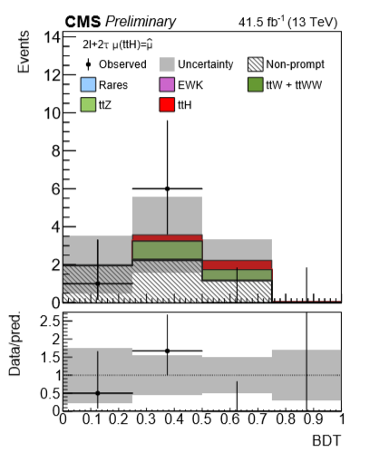
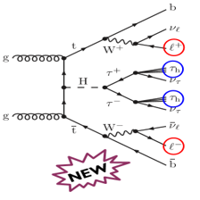
2l+2τh category
ttZ process background:
Event selection:
For the two lepton, higher pt>25Gev, lower pt>10Gev(15Gev) for μ(e)
Charge sum of leptons and τh->0
Avoid a pair of lepton with SFOC, and LD>30 if no such lepton pair
11

Slide 12
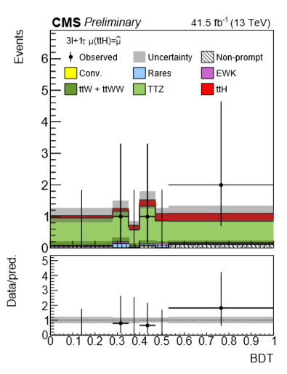
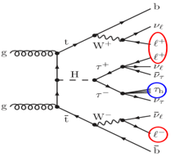
3l+1τh category
Increasing ttH signal:
highest pt>20Gev, second and third pt>10Gev
Event selection:
Same as 3l category expect:
Contain a τh
Charge sum of leptons and τh ->0
12

Slide 13
Background estimation
dominant contributions
Minor contributions
Irreducible background
modeled using the MC simulation
ttW
ttZ
WZ+jets
triboson production
production of single top quarks in association with W or Z bosons
The modeling of the data by the simulation is validated in speciﬁc control regions
13

Slide 14
Background estimation
Reducible background | estimation
misidentiﬁed leptons and τh | fake-factor(FF)method
lepton charge mismeasurement(mainly for 2lss and 2lss+1τh) | Similar to fake-factor(FF)method
ttγ/γ* | MC simulation
Irreducible background
14

Slide 15
systematic uncertainty
15

Slide 16
Event yields
The event yields in each category after the ML ﬁt are summarized
16

Slide 17
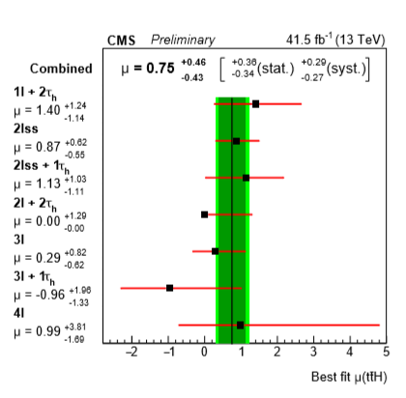
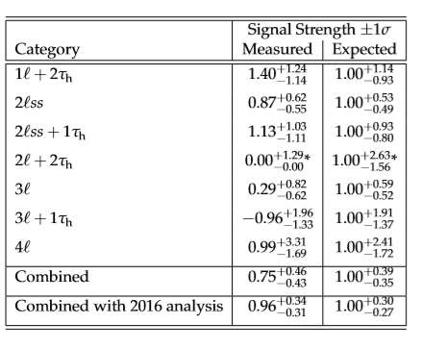
Result
for the measured and expected signal rates
$$μ=σ/{σ_{SM}}$$
17

Slide 18
Summary
ttH->ML final states has been presented
Events from the sample of pp collisions recorded by the CMS experiment in 2017 are categorized according to the number of leptons and τh.
BDT and matrix element methods are used to optimize the analysis sensitivity.
A ttH production rate of ${0.75}_{−0.43}^{+0.46}$($1_{−0.35}^{+0.39}$)times the SM expectation is observed(expected), corresponding to a significance of 1.7σ(2.9σ).
Combine with 2016 data, the observed(expected) signal rate of ${0.96}_{−0.31}^{+0.34}$(${1.00}_{−0.27}^{+0.30}$) times the SM expectation, corresponds to a significance of 3.2σ (4.0σ).
All results are consistent with the SM expectation.
Data from RUN2 is being analyzed.
http://cds.cern.ch/record/2649199?ln=en
18

Slide 19
Thanks
19

Slide 20
Back-up
Samples for signal and background processes
20

Slide 21
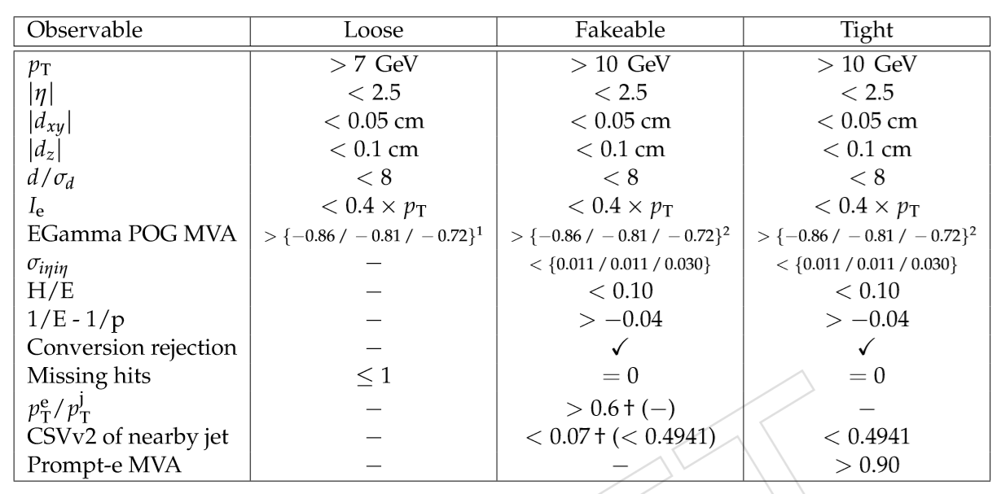
Back-up
Loose, fakeable, and tight selection criteria for electrons
21

Slide 22
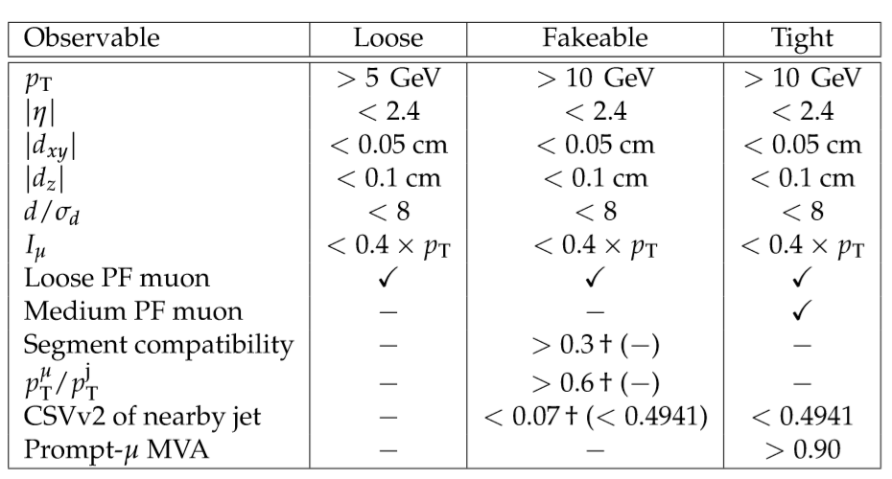
Back-up
Loose, fakeable, and tight selection criteria for muons
22

Slide 23
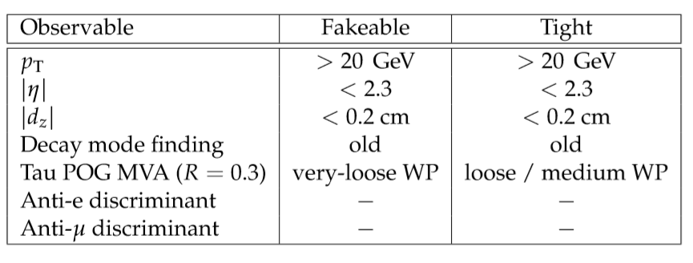
Back-up
Fakeable and tight selection criteria for hadronic τ decays. The loose WP is used in the 2lss + 1τh and 3l+ 1τh channels, while the medium WP is used in the 1l +2τh and 2l +2τh channels.
23

Slide 24
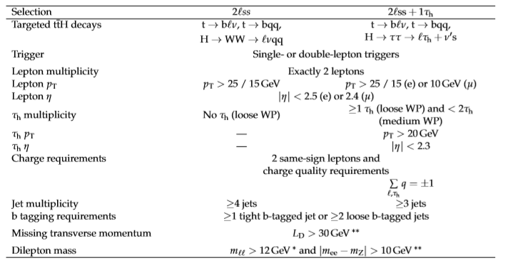
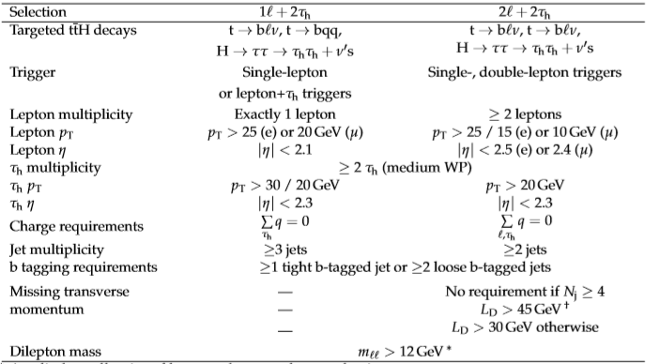
Back-up
24

Slide 25
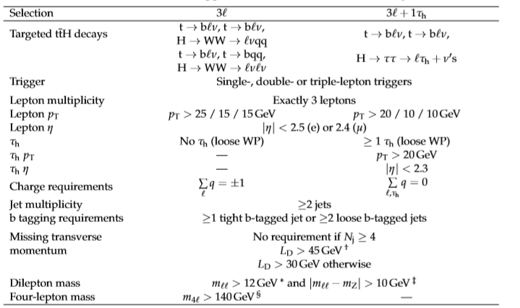
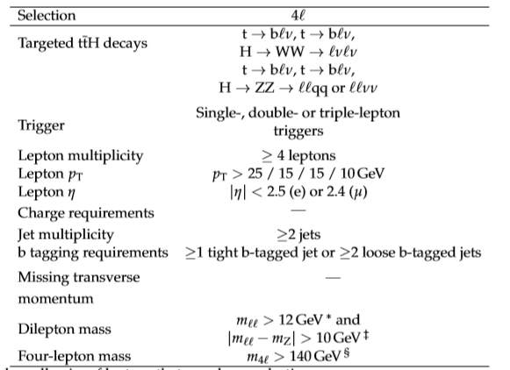
Back-up
25

Slide 26
Back-up
reducible: not prompt leptons or τh.
Mainly for e in 2lss and 2lss+1τh
small additional reducible background:
ttγ/γ*
Background from misidentiﬁed leptons and τh
Background from lepton charge mismeasurement
fake-factor(FF)method
Similar to FF method
contribution of this background is modeled using the MC simulation.
Estimation of the non-prompt background in the SR is obtained by applying weights to the events in the AR
Estimation of the non-prompt background in the SR is obtained by applying weights to the events in the AR
Weights : Z/γ∗ → ee sample
AR: pass the relaxed, fall the tight
AR: except that the two leptons are required to be of opposite charge
weights :multi-jet control regions for electrons and muons, and tt+jets for τh.
26

Slide 27
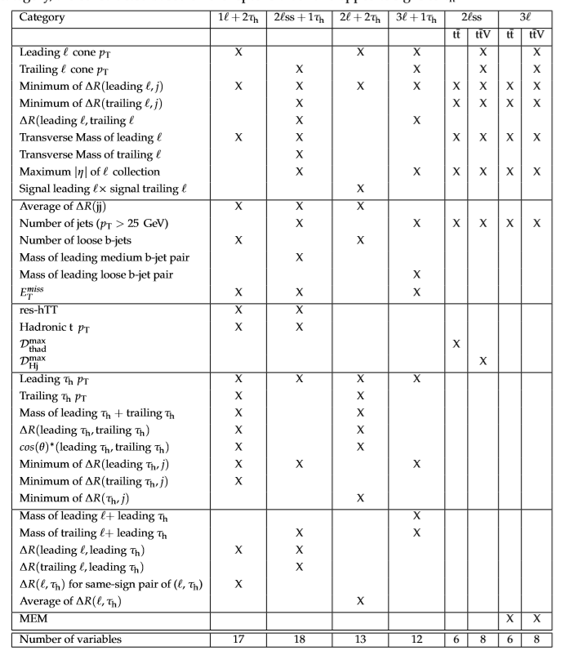
Back-up
Variables used in the multivariate discriminators for the channels with and without taus.
27

Slide 28
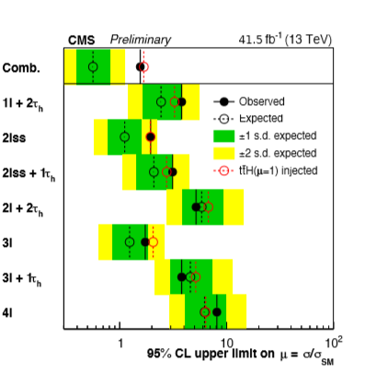
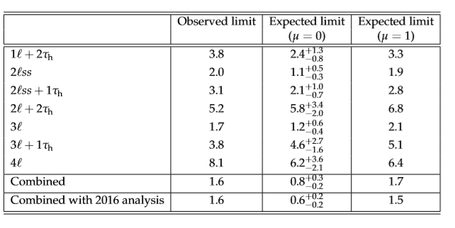
Back-up
95% CL upper limits on µ, The observed limit is compared to the expected limits for the background-only hypothesis (µ = 0) and for the hypothesis where the SM ttH process is expected (µ = 1).
28

