Slide 1
Ghost rate study of the tracking at LHCb
Menglin Xu
Central China Normal University
The 5th China LHC Physics Workshop
24 Oct 2019, Dalian
1

Slide 2
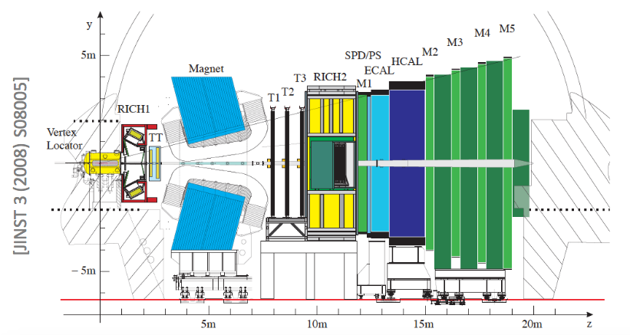
LHCb detector
Single arm forward spectrometer: $2<η<5$
Excellent detector performance:
Track reconstruction efficiency >95%
Momentum resolution $dp/p$ ~[0.5%-1%]
Excellent particle identification

Slide 3
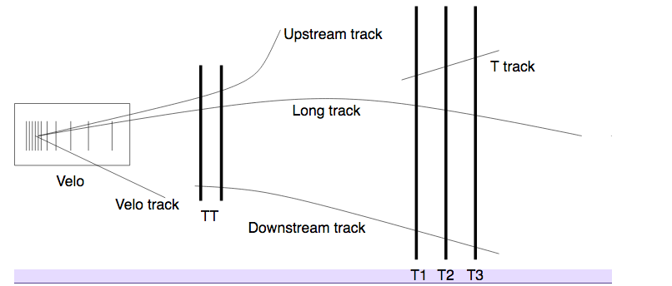
Track reconstruction
The LHCb tracking reconstruction contains two steps:
Track finding - pattern recognition algorithm
Track fitting - Kalman filter
Track types in LHCb

Slide 4
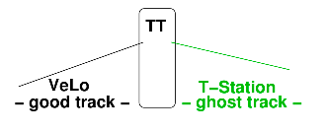
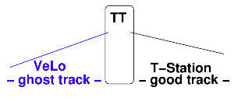
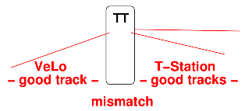
Ghost sources
Long tracks mis reconstruction:
Hadronic interaction with detector material– main sources
T station segments mis-reconstruction
VELO segments mis-reconstruction
mis-matched between VELO and T-station
Ghost tracks: Low probability of $χ^{2}$ from the track fit and missing hits

Slide 5
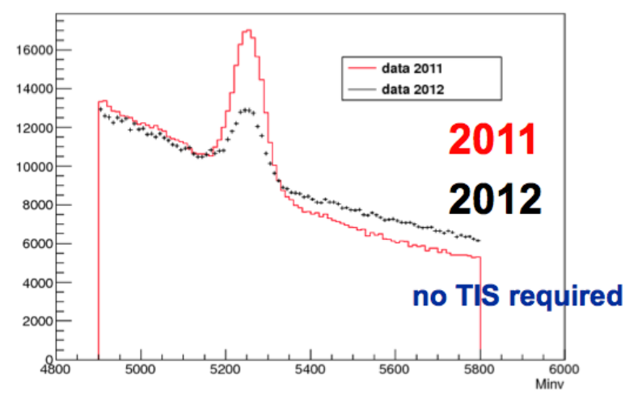
Motivation
2012 data show more noise and worse S/B ratios than 2011 data
Problems are caused by background from mis-reconstructed ghost tracks
$B→hh$ channel in $B_{s}→μμ$ analysis

Slide 6
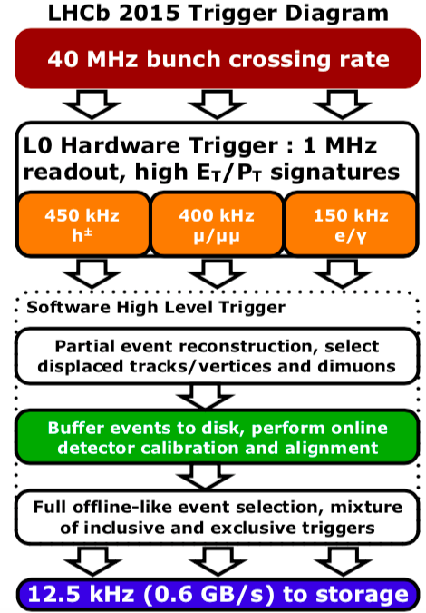
Reconstruction sequence in Run II
Reconstruction in two stages
Fast stage (HLT1): partial event reconstruction
Full stage (HLT2): full offline-like selection
The majority of the LHCb tracking algorithms efficiency is limited by the ghost rate
Need to make track reconstruction faster with low fake rate

Slide 7
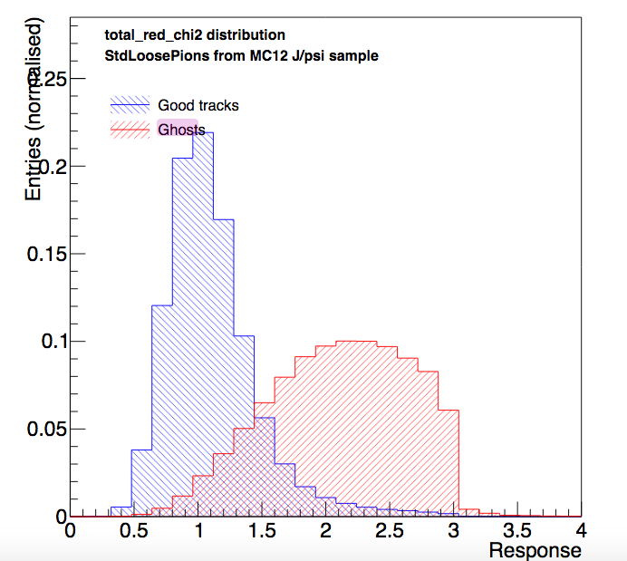
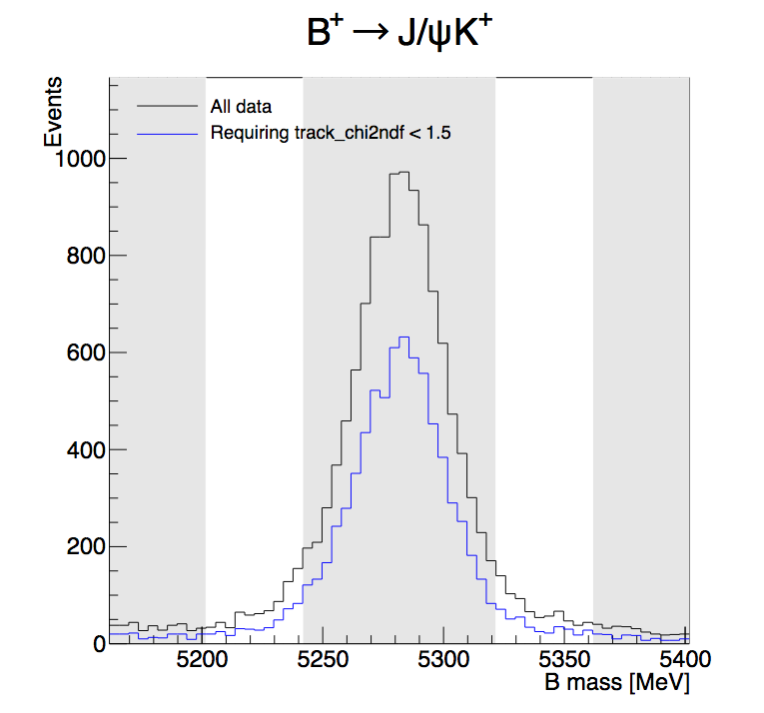
Previous method: cut on track $χ^{2}/ndof$
Quality of fit is generally worse for ghosts than for real tracks
Require $χ^{2}/ndof<1.5$
Improves S/B ratio
Signal efficiency of 63.3%, Signal loss too high
Need something more efficient to suppress ghost tracks

Slide 8
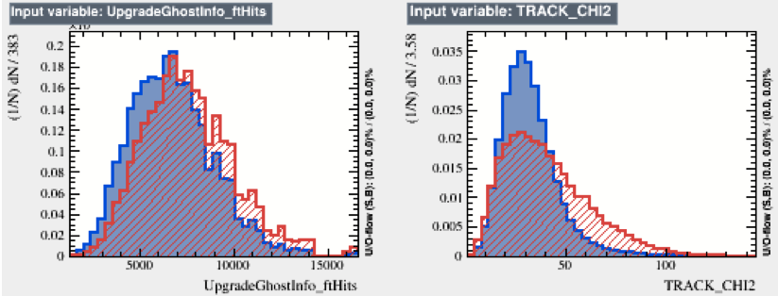
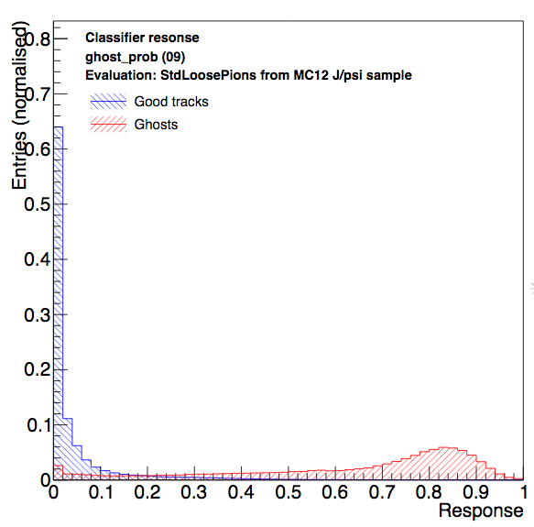
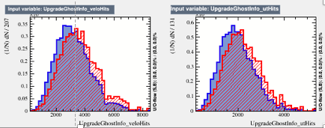
New algorithm: multivariate method
Multivariate classifier: MLP neural network combines several weak discriminants into one strong classifier discriminate between ghost and good tracks
Input files(B inclusive MC):
Signal: good tracks (>70% hits matched to a MC particle)
Background: ghost tracks (<70% hits matched to a MC particle)
Ghost probability
FT hits
Track_CHI2
Neural network
Velo hits
UT hits

Slide 9
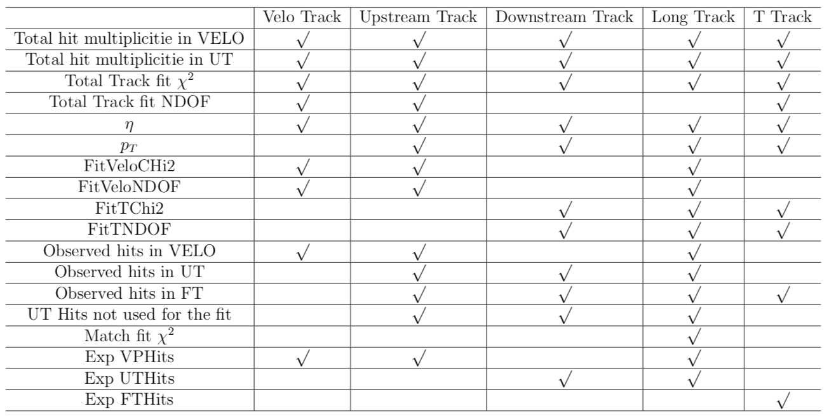
Variable Selection
Various tracking variables, no PID
Track fit quality, number of hits, momentum, detector occupancies

Slide 10
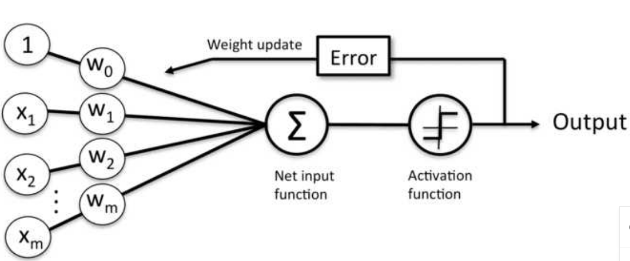
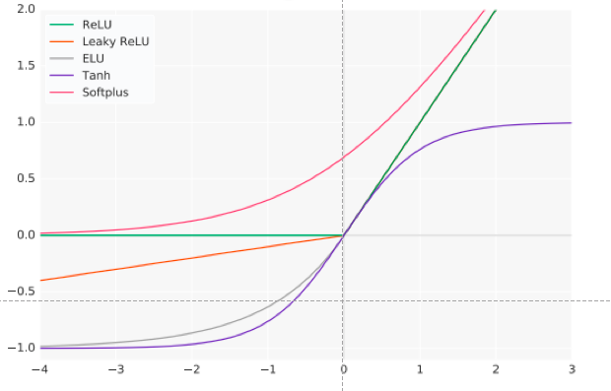
Activation function
Introduces non-linear factors to compute nontrivial problems using only a small number of nodes
Hidden layer: Tanh(RunI) $→$Sigmoid(RunII)
Last layer: exponential function(RunI+RunII)
Tanh: $f\left(x\right)=\frac{e^{x}−e^{−x}}{e^{x}+e^{−x}}$
Sigmoid: $f\left(x\right)=\frac{1}{1+e^{−x}}$
Simple-Sigmoid: $f\left(x\right)=\frac{1}{1+x^{2}}$
ReLu: $f\left(x\right)=$max(0,x)

Slide 11
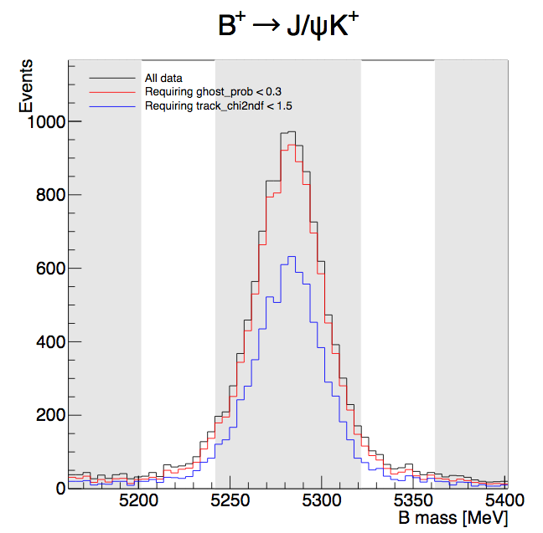
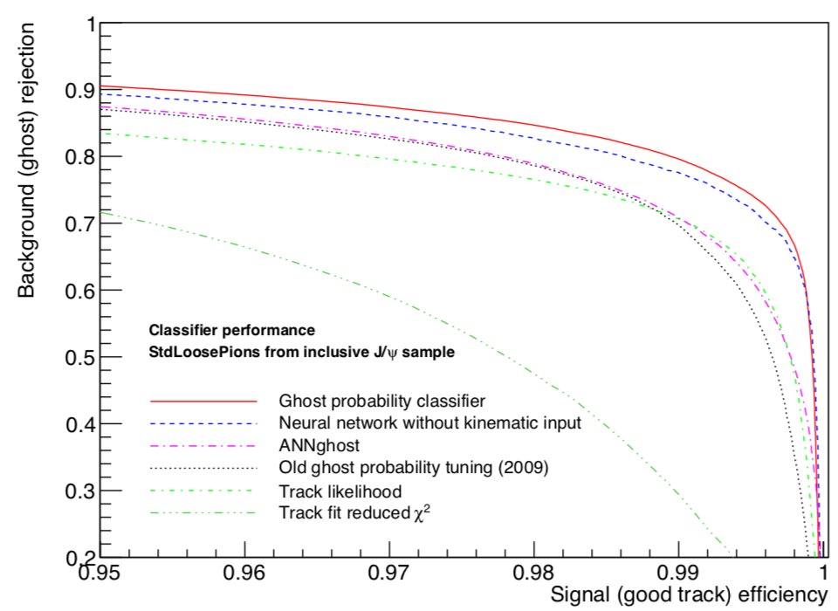
Discrimination power
Good performance
For the same signal efficiency, cutting on ghost probability is most efficient
With similar ghost rejections, the signal efficiency of the ghost prob cut is much better
$χ^{2}/ndof<1.5$: 63.3%
Ghost prob $<3$: 96.1%

Slide 12
Impact on trigger CPU consumption
offline$→$online quantity:
RunI+2015(50ns) : offline quantity
2015(25ns): all tracks in HLT2 had to pass ghost probability selection, speed-up by a factor ~90
Since 2016: processing in HLT1+HLT2, HLT2 input rate reduced by 4%
CPU consumption decreased
ghost probability computation itself is 0.2% of HLT CPU budeget
22% fewer tracks, 23% less CPU time in RICH PID
Overall saving of 16% entire HLT CPU
Ghost probability can not only suppress background but also decrease CPU consumption

Slide 13
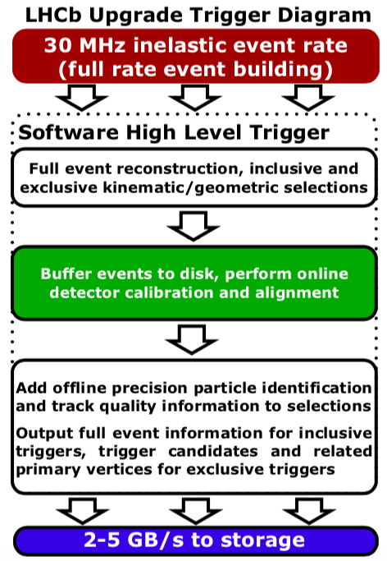
LHCb Upgrade
CPU timing decreased is expected
Detector upgrades to copy with increased luminosity
Run III: $2×{10}^{33} cm^{−2}s^{−1}$(~5 factor larger than RunII)
Remove hardware trigger, increase output rate to storage
Integrated luminosity
LHC era |  | HL_LHC era
Run2 (2015-18) | Run3 (2021-24) | Run4 (2027-30) | Run5+ (2031+)
9 $fb^{−1}$ | 23 $fb^{−1}$ | 46 $fb^{−1}$ | >300 $fb^{−1}$ ??

Slide 14
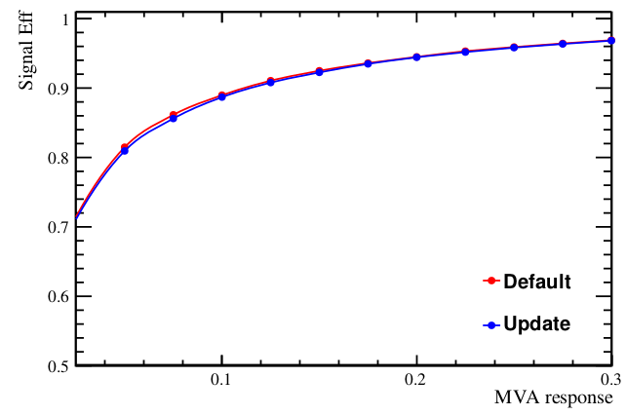
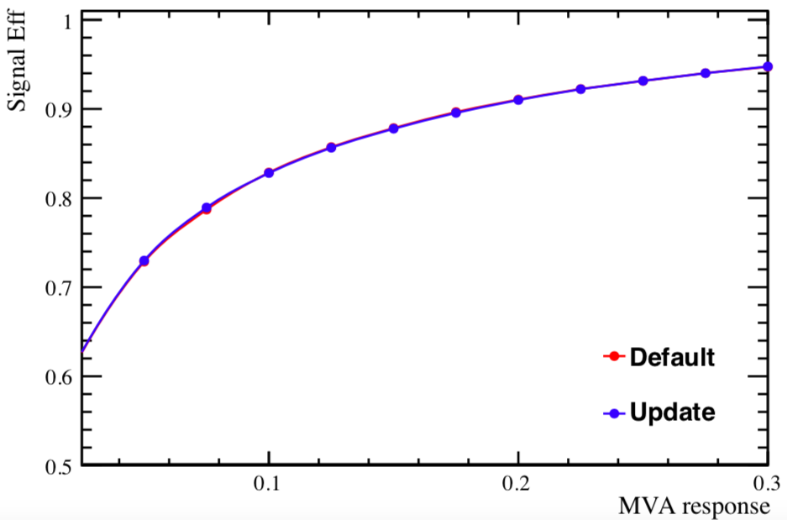
Improvements in the upgrade
Upgrade:
Removed time-consuming variables(hit estimation)
Activation functions at hidden layer: Sigmoid$→$ ReLU
Efficient gradient propagation
Fast computation: Only comparison, addition and multiplication
Activation functions at Last layer: exponential $→$finite exponential
Replace the exponential operation with the finite number of multiplications
The efficiency performance is almost the same
Reduced timing of ghost probability algorithm by 97%
Long Track
Downstream Track

Slide 15
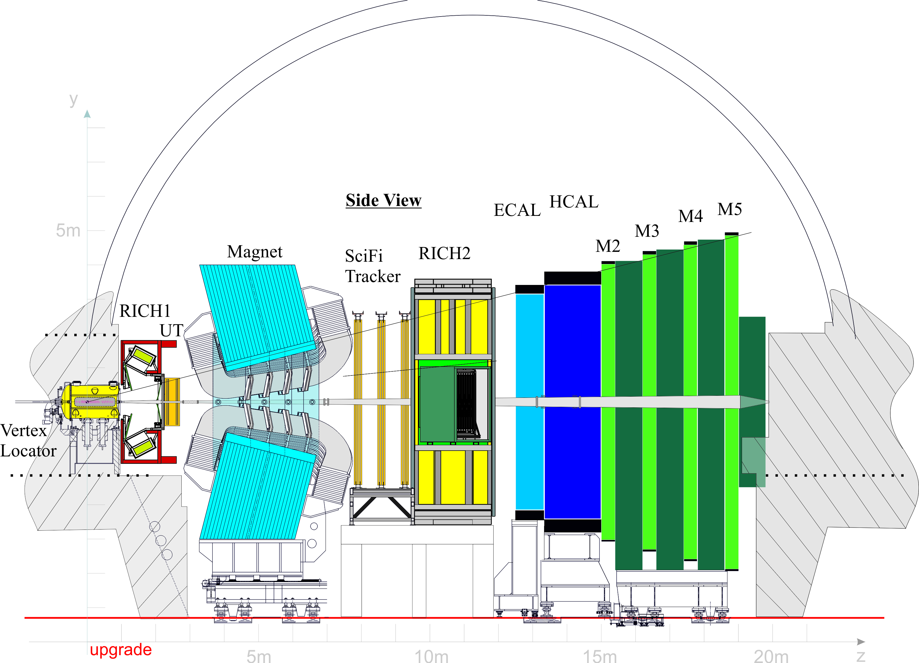
Conclusion
Ghost tracks are a significant source of background
Ghost probability: important part online reconstruction
excellent ghost reduction with minor signal loss
Highly decrease the CPU timing
Room for improvement
fast VDT-like implementations for SIMD types
add Scifi track position information in neural work

Slide 16
Backup

Slide 17
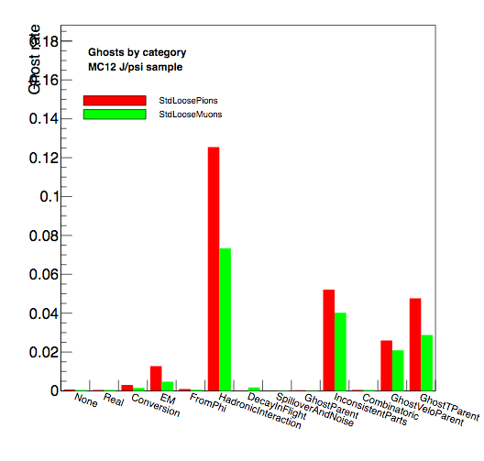
Ghost types

