Slide 1

Recent results of charm meson spectroscopy at LHCb
陈 晨(Chen Chen)
Center for High Energy Physics, Tsinghua University
On behalf of the LHCb collaboration
CLHCP 2019, Da Lian
24 October 2019

Slide 2
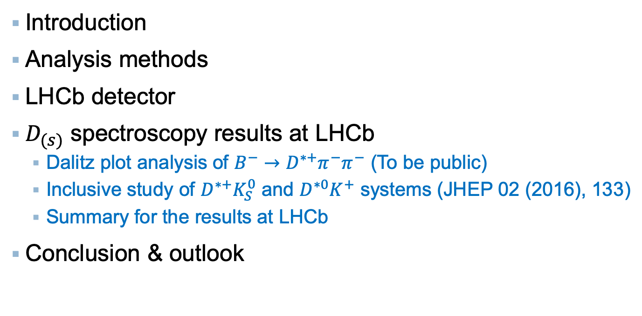
Outline
Introduction
Analysis methods
LHCb detector
$D_{(s)}$ spectroscopy results at LHCb
  Dalitz plot analysis of $B^{−}→D^{∗+}π^{−}π^{−}$ (To be public)
  Inclusive study of $D^{∗+}K_{S}^{0}$ and $D^{∗0}K^{+}$ systems (JHEP 02 (2016), 133)
  Summary for the results at LHCb
Conclusion & outlook

Slide 3
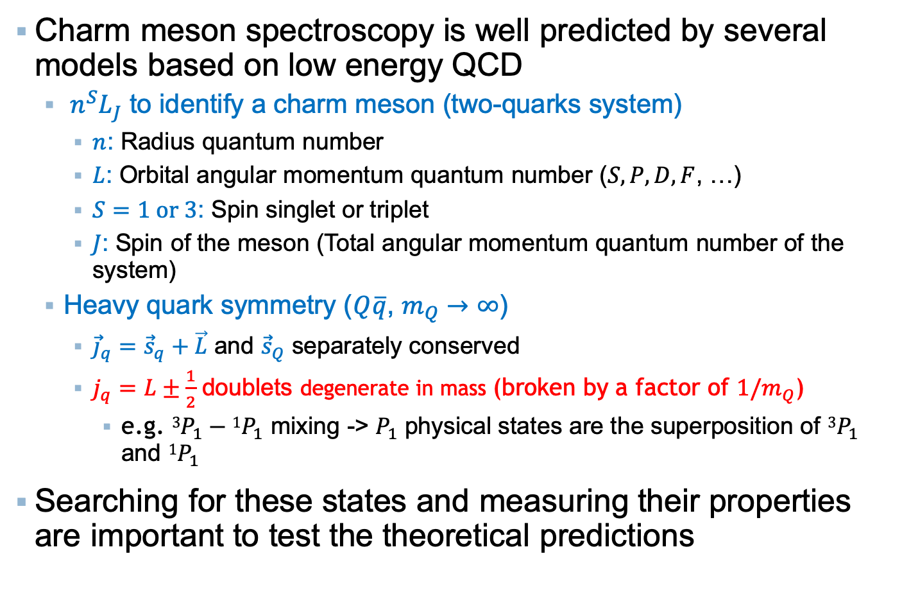
Introduction
Charm meson spectroscopy is well predicted by several models based on low energy QCD
  $n^{S}L_{J}$ to identify a charm meson (two-quarks system)
    $n$: Radius quantum number
    $L$: Orbital angular momentum quantum number ($S, P, D, F$, …)
    $S=1 or 3$: Spin singlet or triplet
    $J$: Spin of the meson (Total angular momentum quantum number of the system)
  Heavy quark symmetry ($Q\overline{q}$, $m_{Q}→∞$)
    ${\vec{j}}_{q}={\vec{s}}_{q}+\vec{L}$ and ${\vec{s}}_{Q}$ separately conserved
    $j_{q}=L±\frac{1}{2}$ doublets degenerate in mass (broken by a factor of ${1/m}_{Q}$)
      e.g. $3P_{1}−1P_{1}$ mixing -> $P_{1}$ physical states are the superposition of $3P_{1}$ and $1P_{1}$
Searching for these states and measuring their properties are important to test the theoretical predictions

Slide 4
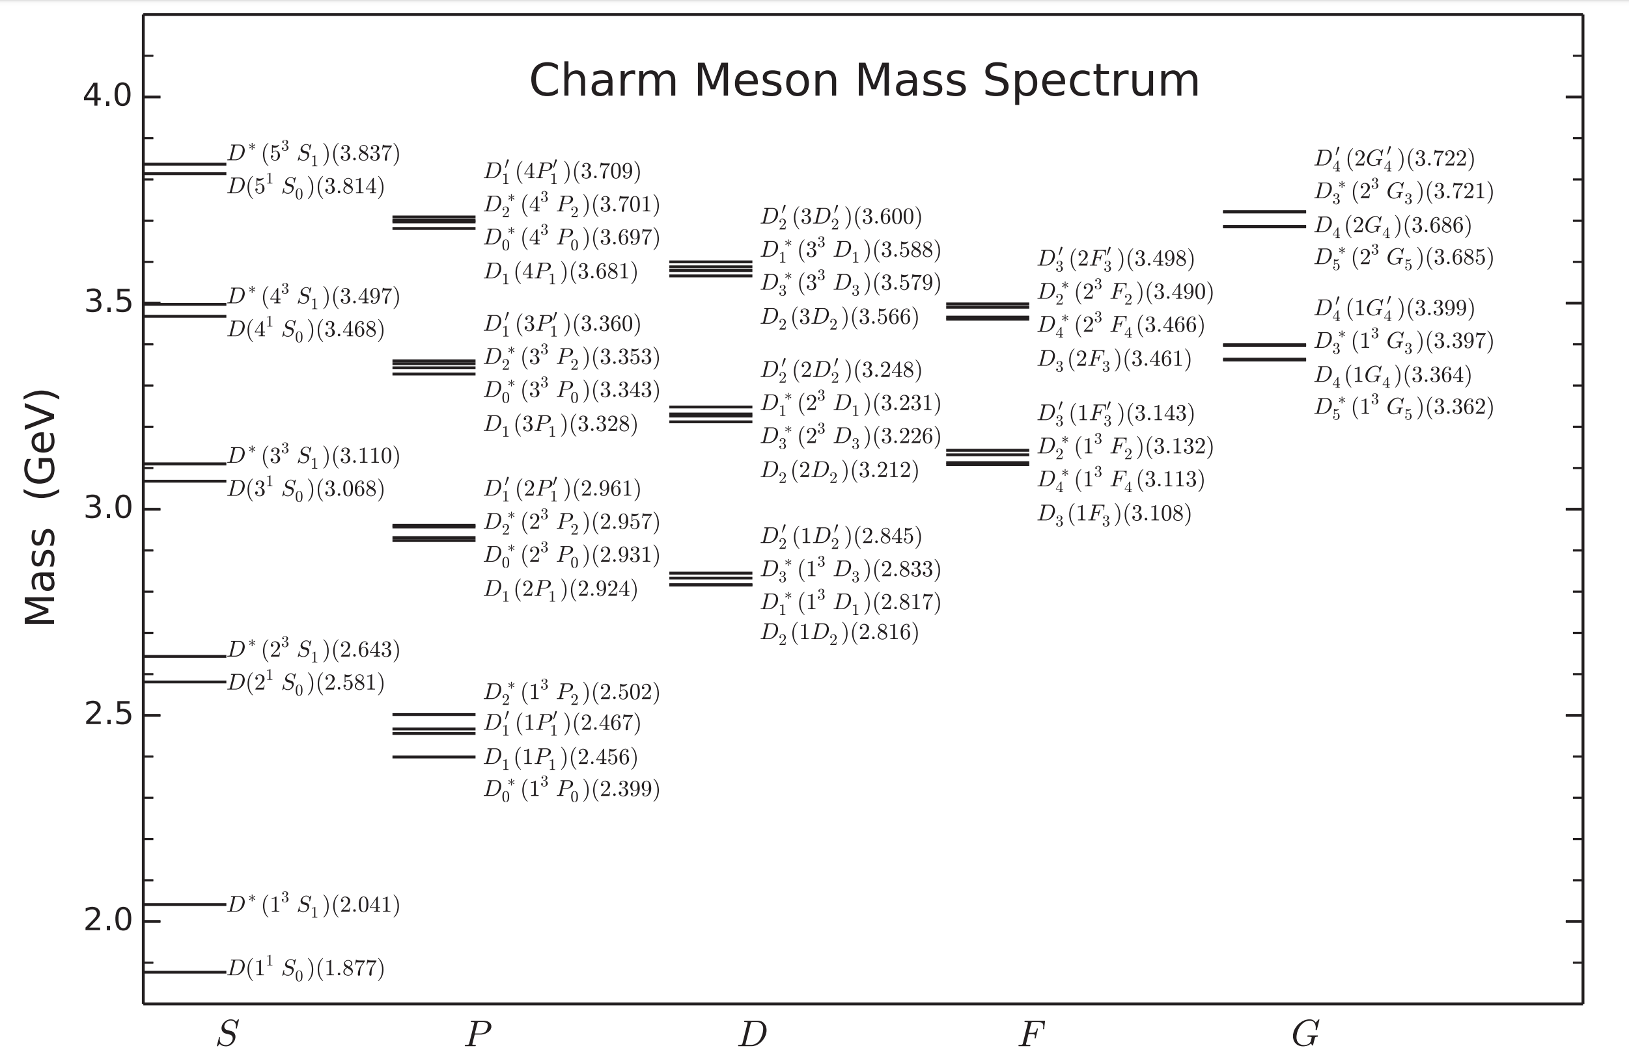


Introduction
  Observed states without spin-parity assignment!
$$D{\left(3000\right)}^{0}$$
$$D^{∗}{\left(2640\right)}^{± }$$
  Observed states with spin-parity determined!
(Phys. Rev. D 93, 034035)
Many states have been observed in various experiments. However
  Still many not found
  Still spin-parity of several states not determined

Slide 5
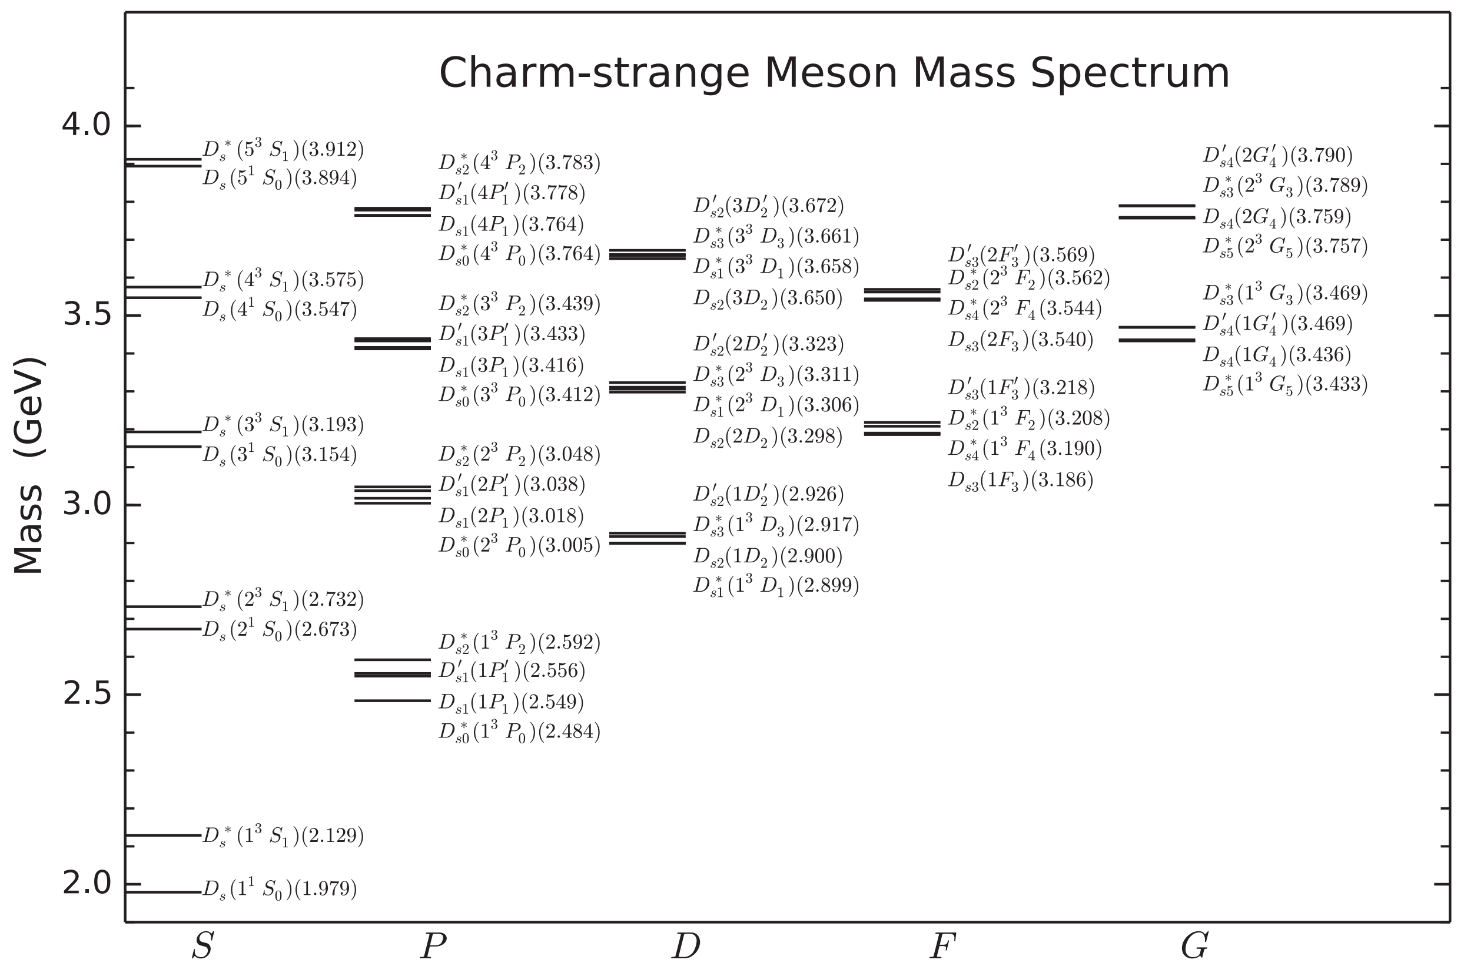



Introduction
$$D_{sJ}{\left(3040\right)}^{±}$$
  Observed states without spin-parity assignment!
$D_{s}{\left(2317\right)}^{+}$ Mass tension
  Observed states with spin-parity determined!
  Should be $D_{s}^{∗}$
(Phys. Rev. D 93, 034035)
Many states have been observed in various experiments. However
  Still many not found
  Still spin-parity of several states not determined
  Still some interesting tensions between theory and experiment

Slide 6
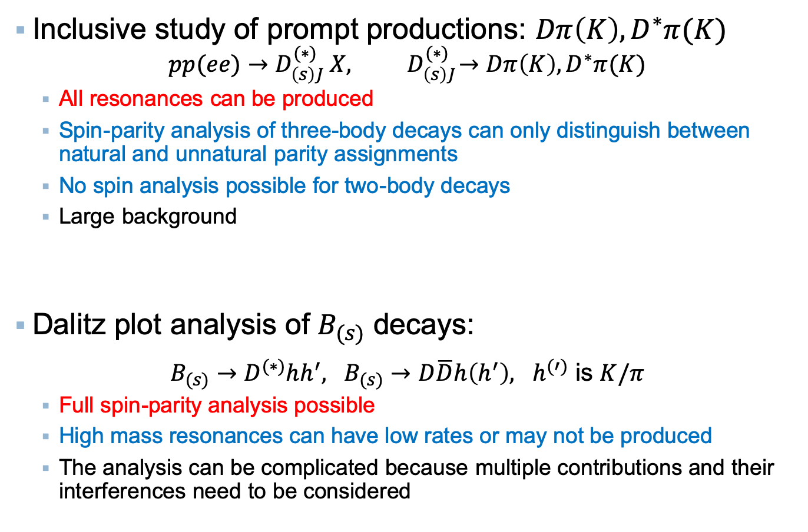

Analysis methods
Inclusive study of prompt productions: $Dπ\left(K\right), D^{∗}π(K)$
$$pp(ee)→D_{\left(s\right)J}^{(∗)} X,{ D}_{\left(s\right)J}^{(∗)}→Dπ\left(K\right),D^{∗}π(K)$$
  All resonances can be produced
  Spin-parity analysis of three-body decays can only distinguish between natural and unnatural parity assignments
  No spin analysis possible for two-body decays
  Large background
Dalitz plot analysis of $B_{(s)}$ decays:
$B_{(s)}→D^{(∗)}hh^{′}, {B_{(s)}→D\overline{D}h\left(h^{′}\right), h}^{(′)}$ is $K/π$
  Full spin-parity analysis possible
  High mass resonances can have low rates or may not be produced
  The analysis can be complicated because multiple contributions and their interferences need to be considered
Natural parity & unnatural parity
  Natural parity states can decay strongly into two pseudo scalars ($J^{P}=0^{+}, 1^{−}, 2^{+}$, etc.), labeled as $D_{(s)J}^{∗}$
  Unnatural parity states are not natural parity states ($J^{P}=0^{−}, 1^{+}, 2^{−}$, etc.), labeled as $D_{(s)J}$

Slide 7
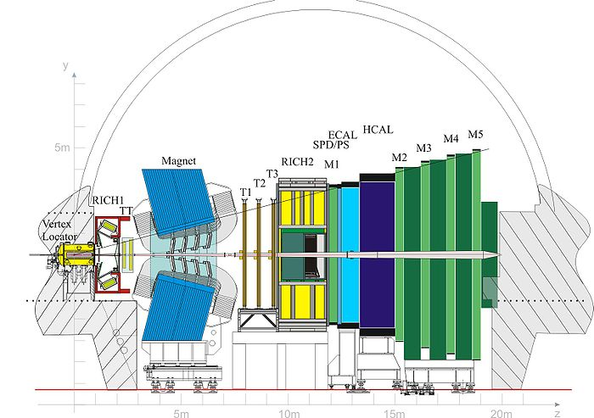
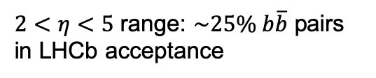


LHCb detector
JINST 3 (2008) S08005
Int.J.Mod.Phys. A30 (2015) 1530022
Single-arm $(2<η<5)$ spectrometer, designed for precision flavour measurements
Excellent vertex, IP and decay-time resolution
  $σ\left(IP\right)≈20 μm$ for high-$p_{T}$ tracks
  $σ\left(τ\right)≈45 fs$ for $B_{s}^{0}→J/ψφ$ and $B_{s}^{0}→D_{s}^{−}π^{+}$ decays
Good momentum resolution
  $δp/p≈0.5\%−1\%$ for $p∈\left(0,200\right)GeV$
  $σ\left(m_{B}\right)≈24 MeV$ for two-body decays
Hadron and Muon identification
  $ε_{K→K}≈95\%$ for $ε_{π→K}≈5\%$ up to 100 $GeV$
$2<η<5$ range: $\sim 25\% b\overline{b}$ pairs in LHCb acceptance

Slide 8
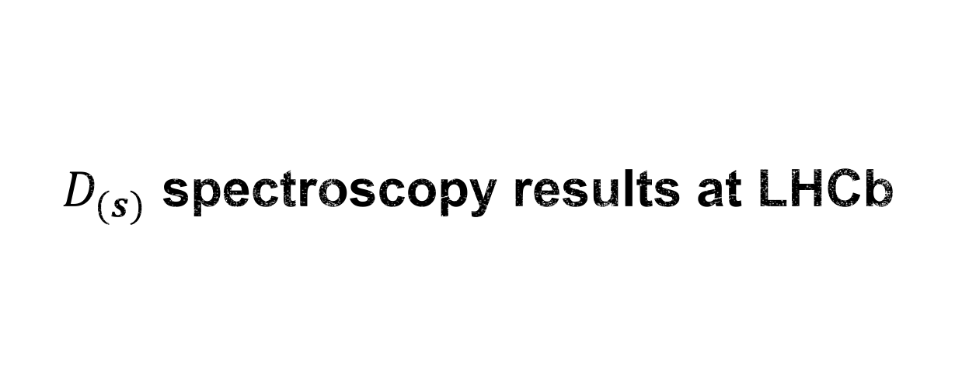
$D_{(s)}$ spectroscopy results at LHCb

Slide 9
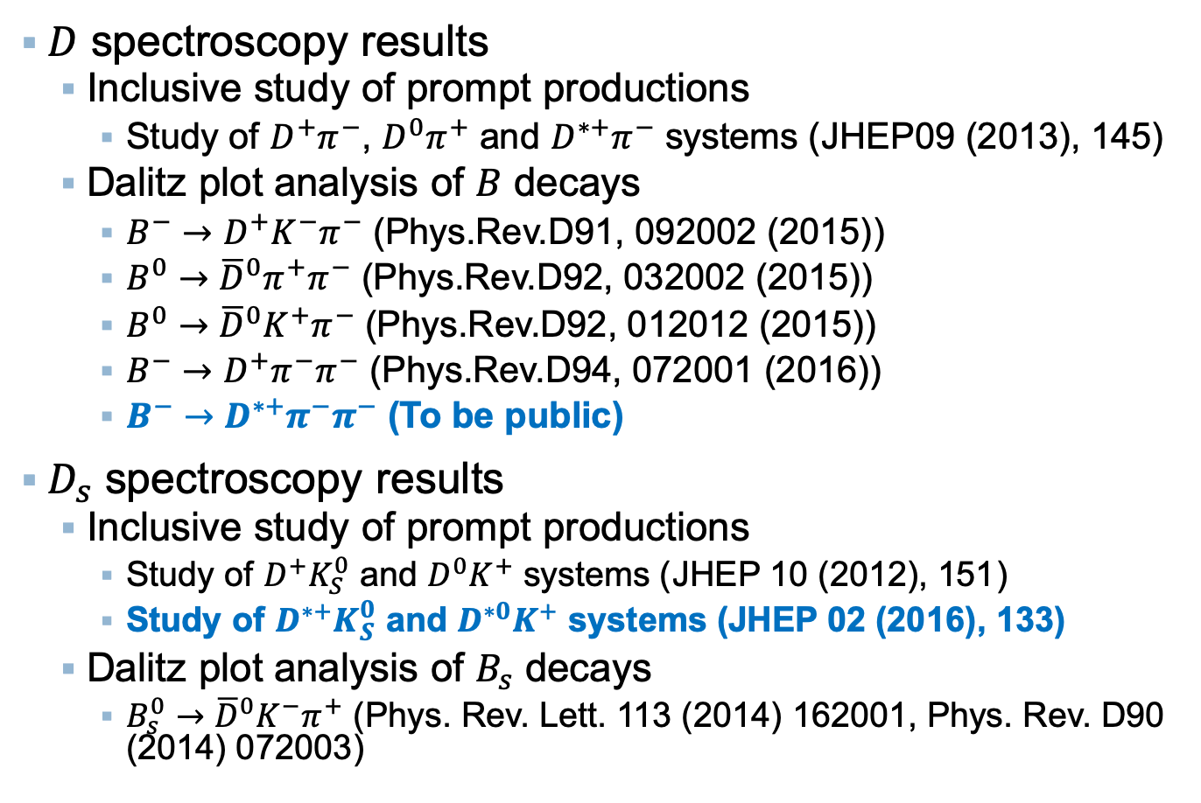
$D_{(s)}$ spectroscopy analyses at LHCb
$D$ spectroscopy results
  Inclusive study of prompt productions
    Study of $D^{+}π^{−}$, $D^{0}π^{+}$ and $D^{∗+}π^{−}$ systems (JHEP09 (2013), 145)
  Dalitz plot analysis of $B$ decays
    $B^{−}→D^{+}K^{−}π^{−}$ (Phys.Rev.D91, 092002 (2015))
    $B^{0}→{\overline{D}}^{0}π^{+}π^{−}$ (Phys.Rev.D92, 032002 (2015))
    $B^{0}→{\overline{D}}^{0}K^{+}π^{−}$ (Phys.Rev.D92, 012012 (2015))
    $B^{−}→D^{+}π^{−}π^{−}$ (Phys.Rev.D94, 072001 (2016))
    $B^{−}→D^{∗+}π^{−}π^{−}$ (To be public)
$D_{s}$ spectroscopy results
  Inclusive study of prompt productions
    Study of $D^{+}K_{S}^{0}$ and $D^{0}K^{+}$ systems (JHEP 10 (2012), 151)
    Study of $D^{∗+}K_{S}^{0}$ and $D^{∗0}K^{+}$ systems (JHEP 02 (2016), 133)
  Dalitz plot analysis of $B_{s}$ decays
    $B_{s}^{0}→{{\overline{D}}^{0}K}^{−}π^{+}$ (Phys. Rev. Lett. 113 (2014) 162001, Phys. Rev. D90 (2014) 072003)

Slide 10

Dalitz plot analysis of $B^{−}→D^{∗+}π^{−}π^{−}$
(To be public)

Slide 11
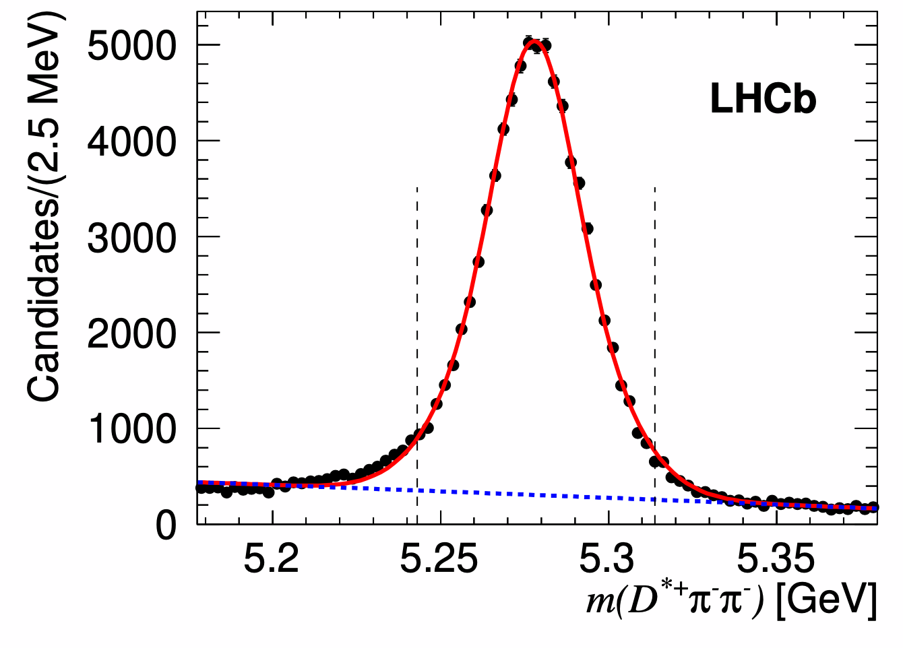

$B^{−}$ signals after all the selections
(To be public)
Run1&$2016$, $4.7 {fb}^{−1}$
79120 signals with a purity of 90%
Preliminary

Slide 12
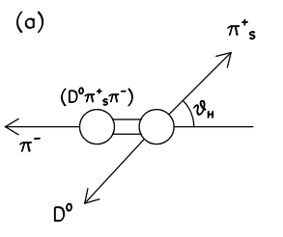
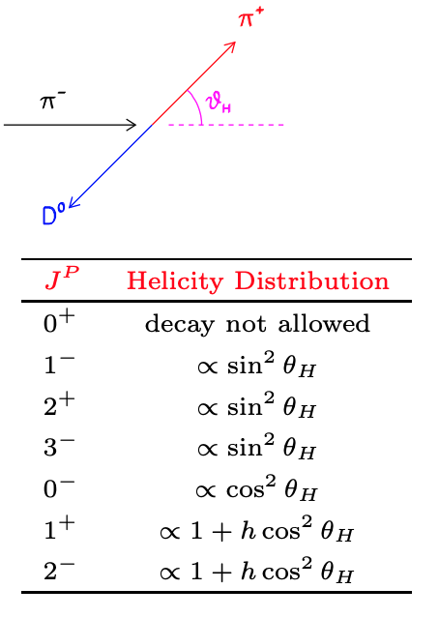
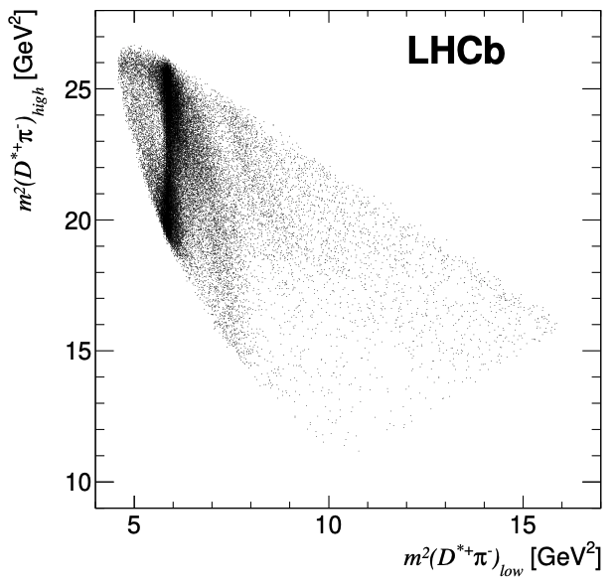
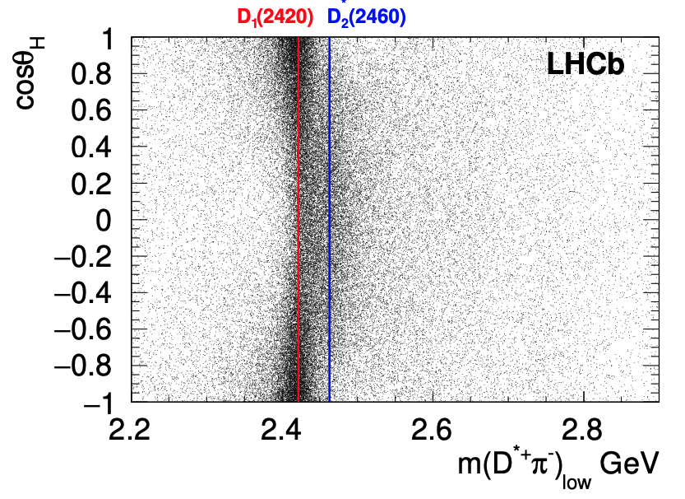
Dalitz plot of $B^{−}→D^{∗+}π^{−}π^{−}$
(To be public)
Clear band in low $D^{∗}π^{−}$ mass combination
Preliminary
Preliminary

Slide 13
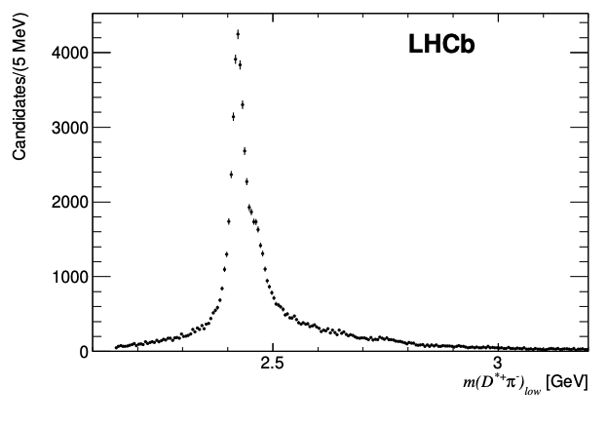
Mass distribution of ${\left(D^{∗+}π^{−}\right)}_{low}$
(To be public)
Clear contributions from $D_{1}\left(2420\right)$ and $D_{2}^{∗}(2460)$
Preliminary
Some activities at high mass region
Dalitz plot analysis is needed to separate different contributions!!

Slide 14
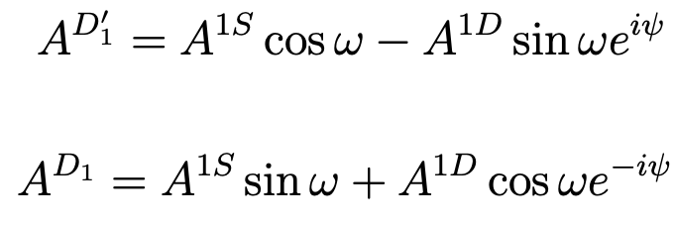
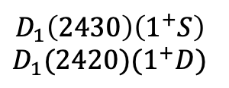
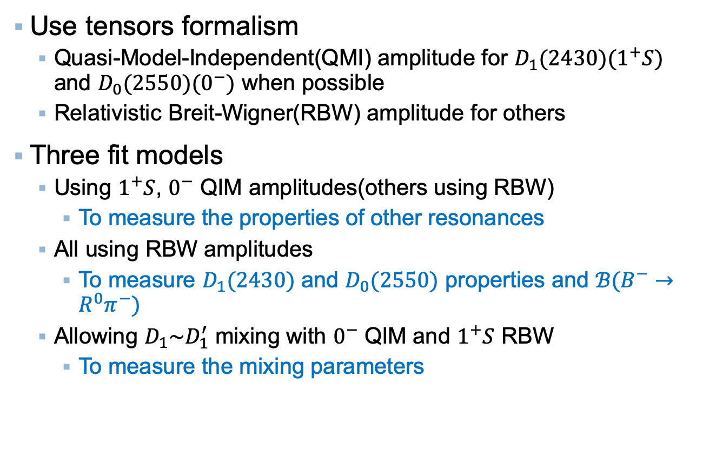
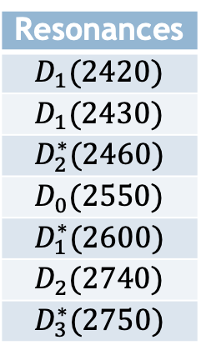
Dalitz plot analysis of $B^{−}→D^{∗+}π^{−}π^{−}$
(To be public)
Resonances
$$D_{1}(2420)$$
$$D_{1}(2430)$$
$$D_{2}^{∗}(2460)$$
$$D_{0}(2550)$$
$$D_{1}^{∗}(2600)$$
$$D_{2}(2740)$$
$$D_{3}^{∗}(2750)$$
Use tensors formalism
  Quasi-Model-Independent(QMI) amplitude for $D_{1}(2430)(1^{+}S)$ and $D_{0}(2550)(0^{−})$ when possible
  Relativistic Breit-Wigner(RBW) amplitude for others
Three fit models
  Using $1^{+}S$, $0^{−}$ QIM amplitudes(others using RBW)
    To measure the properties of other resonances
  All using RBW amplitudes
    To measure $D_{1}(2430)$ and $D_{0}(2550)$ properties and $ℬ(B^{−}→R^{0}π^{−})$
  Allowing $D_{1}\sim D_{1}^{′}$ mixing with $0^{−}$ QIM and $1^{+}S$ RBW
    To measure the mixing parameters
$$D_{1}\left(2430\right)\left(1^{+}S\right)$$
$$D_{1}(2420)(1^{+}D)$$

Slide 15
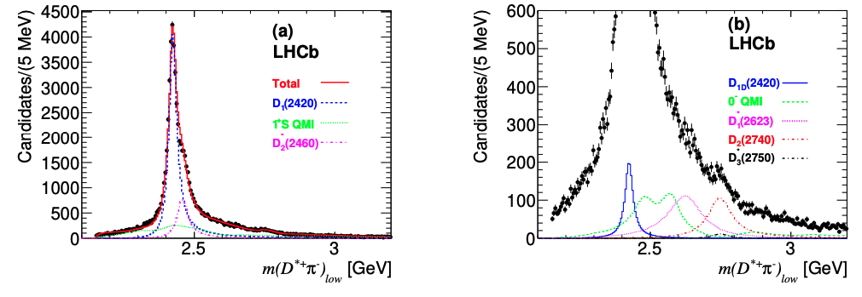
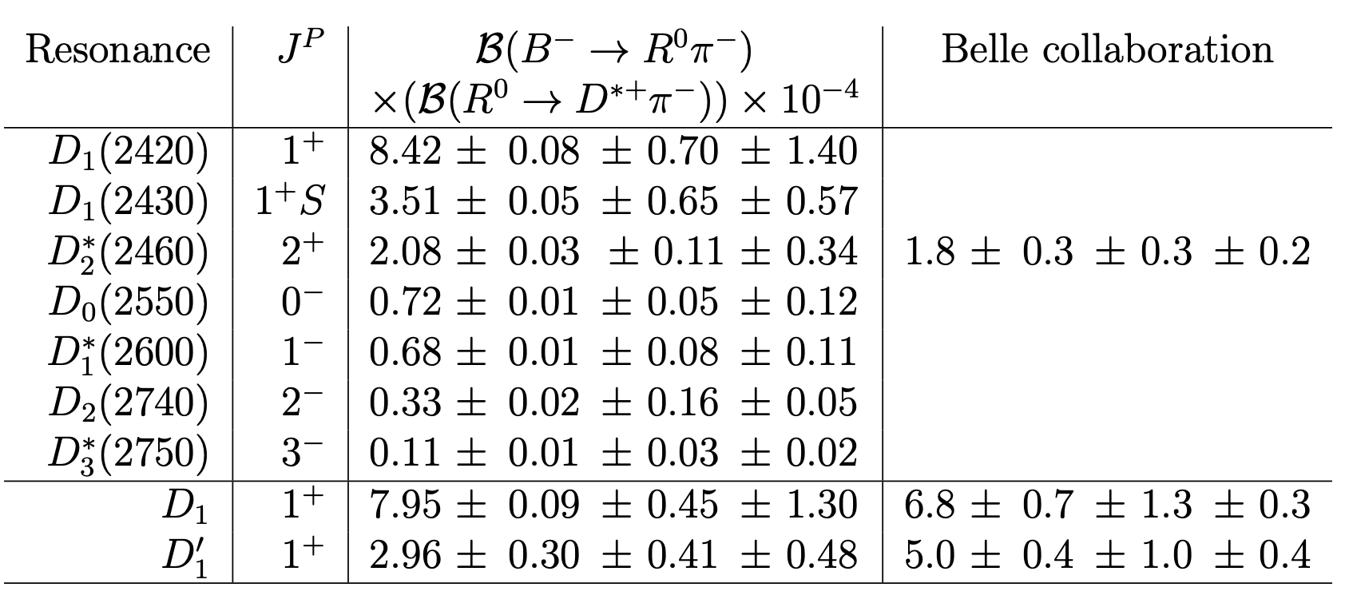
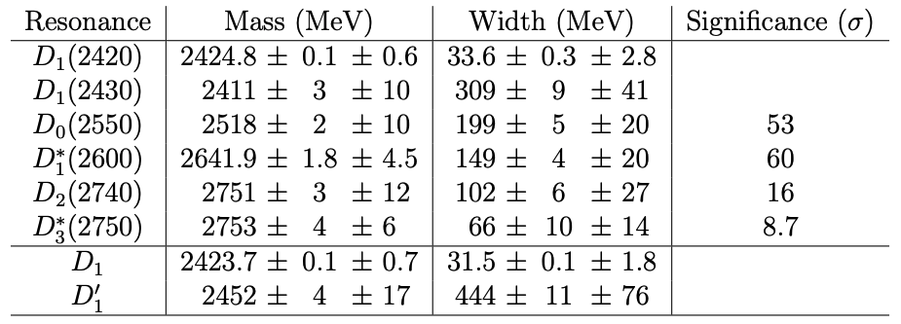
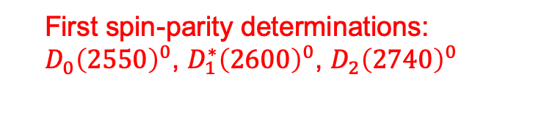
Fit results
(To be public)
Preliminary
Preliminary
  First spin-parity determinations:
  $D_{0}{\left(2550\right)}^{0}$, $D_{1}^{∗}{\left(2600\right)}^{0}$, ${D_{2}\left(2740\right)}^{0}$
Preliminary
Preliminary
  Mixing parameters

Slide 16
  Inclusive study of $D^{∗+}K_{S}^{0}$ and $D^{∗0}K^{+}$ systems
(JHEP 02 (2016), 133)

Slide 17
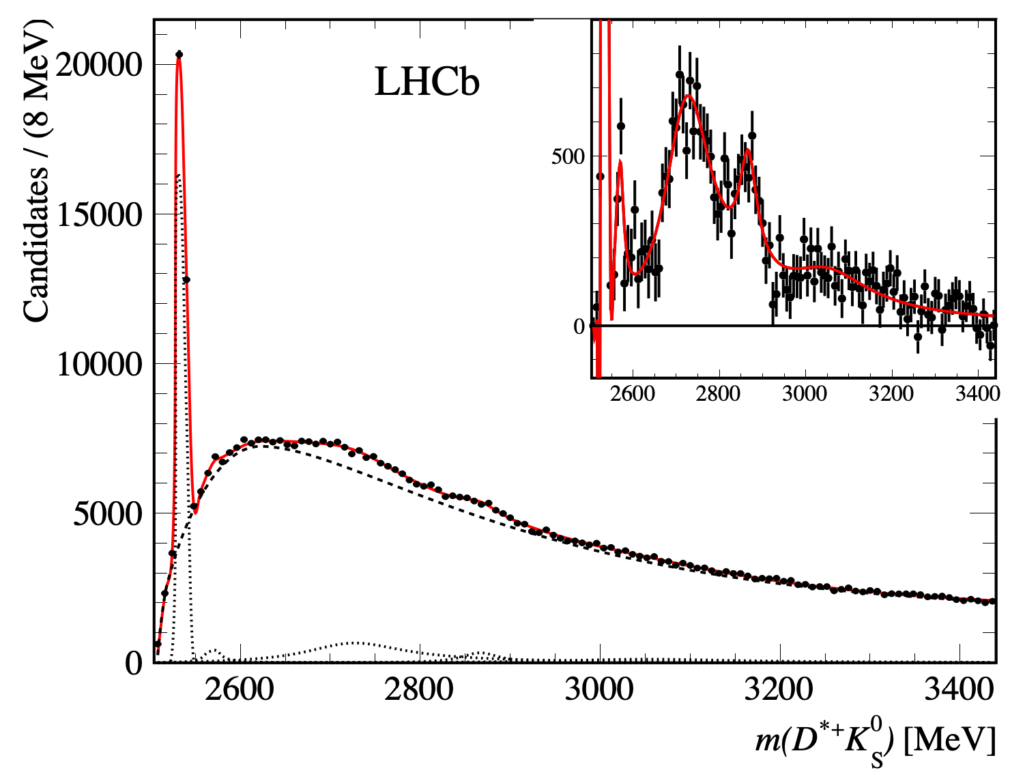
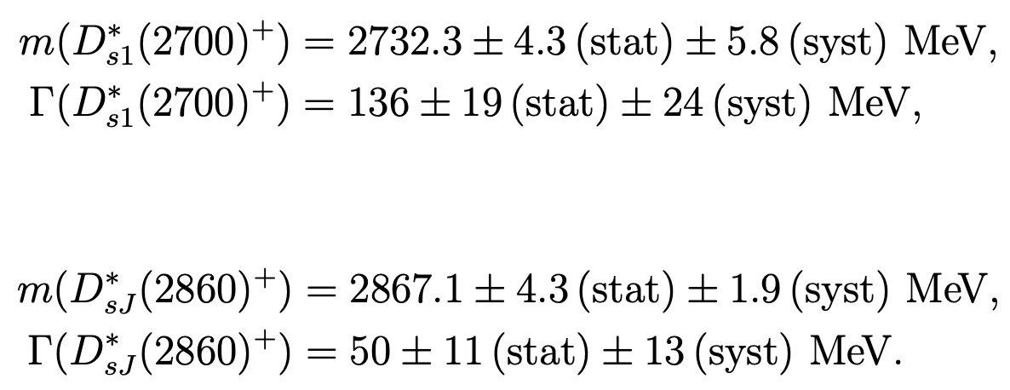

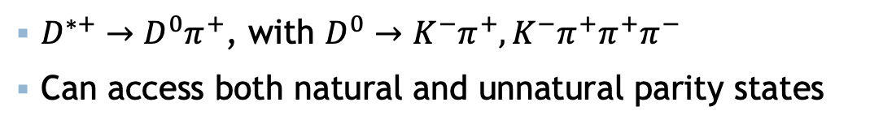




$D^{∗+}K_{S}^{0}$mass spectrum
  (JHEP 02 (2016), 133)
Run 1, $3.0 {fb}^{−1}$
$D^{∗+}→D^{0}π^{+}$, with $D^{0}→K^{−}π^{+}, K^{−}π^{+}π^{+}π^{−}$
Can access both natural and unnatural parity states
$$D_{s1}^{∗}(2700)$$
$$D_{s3}^{∗}(2860)$$
$$D_{s1}(2536)$$
$$D_{s2}^{∗}(2573)$$

Slide 18
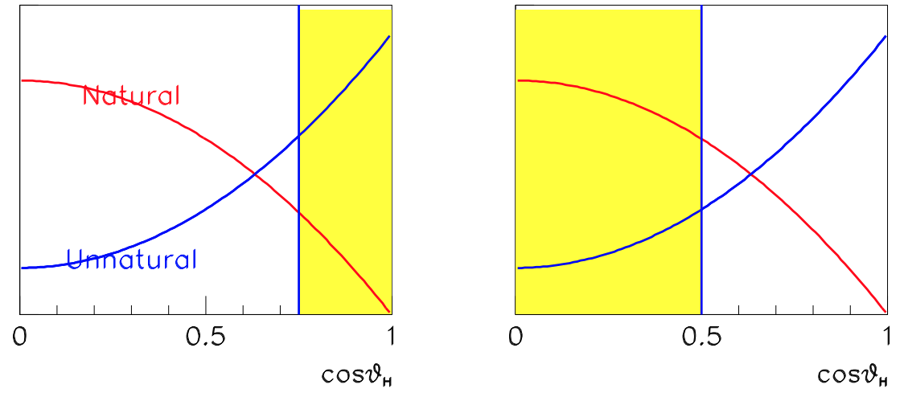
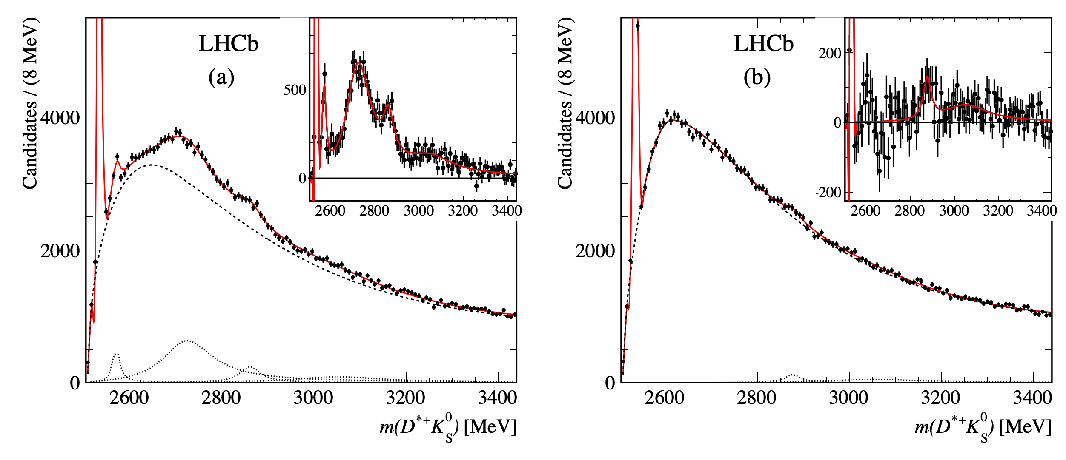






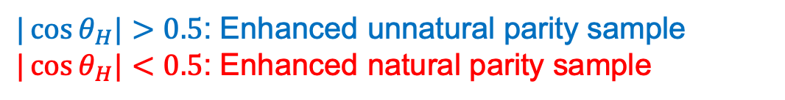



$D^{∗+}K_{S}^{0}$mass spectrum(2)
  (JHEP 02 (2016), 133)
$|\cos{θ_{H}|}>0.5$: Enhanced unnatural parity sample
$|\cos{θ_{H}|}<0.5$: Enhanced natural parity sample
$$D^{∗+}$$
$D_{sJ}(3040)$ excess
$$D_{s1}^{∗}(2710)$$
$$D_{s1}(2536)$$
$$D_{s3}^{∗}(2860)$$
$$D_{s1}(2536)$$
$$D_{s2}^{∗}(2573)$$
Possible $D_{sJ}(2860)$ excess
Natural Parity
Unnatural Parity
$D^{0}→K^{−}π^{+}$ result

Slide 19
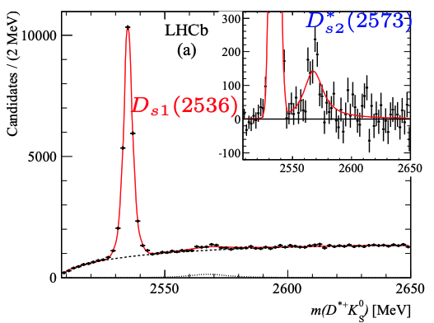


Branching fraction of $D_{s2}^{∗}{\left(2573\right)}^{+}→D^{∗+}K_{S}^{0}$
  (JHEP 02 (2016), 133)
First observation of the decay $D_{s2}^{∗}{\left(2573\right)}^{+}→D^{∗+}K_{S}^{0}$
  Fit to the $D^{∗}K$mass spectrum in the threshold region to get yields
Consistent with theoretical calculation: 0.058 (Phys.Rev.D93 (2016), 034035)

Slide 20
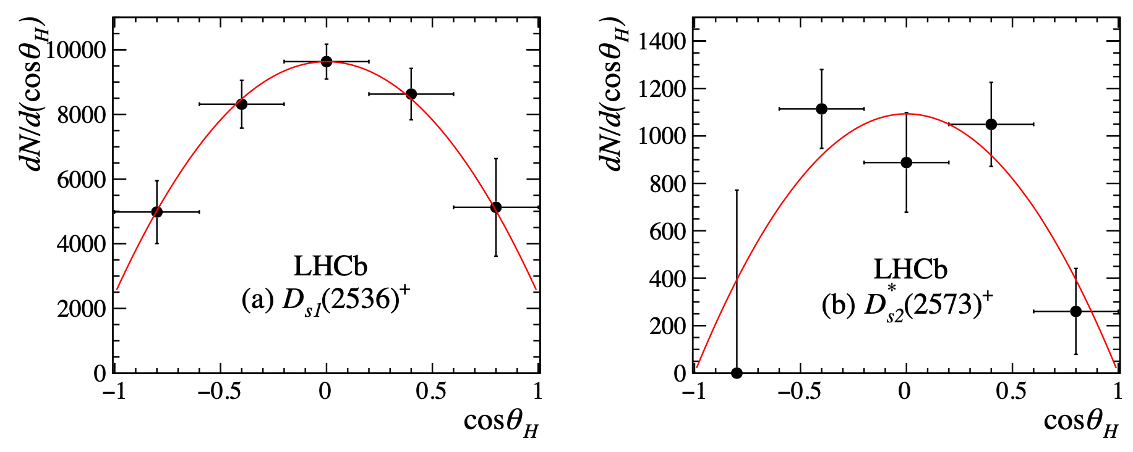
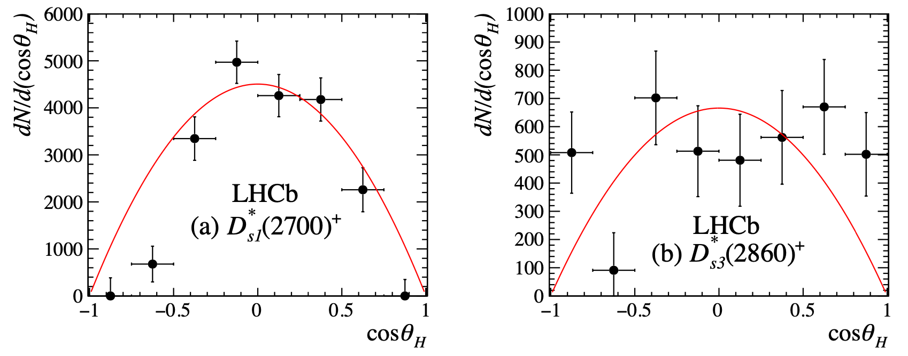
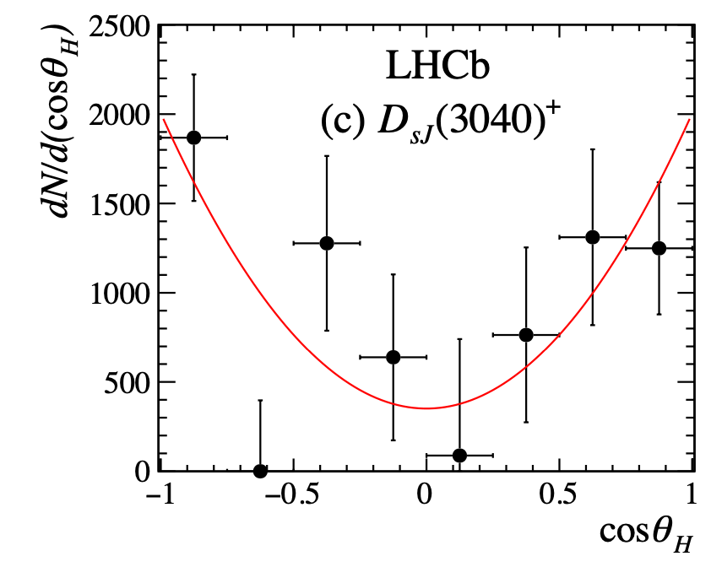


Spin-parity analysis
  (JHEP 02 (2016), 133)
Fit $D^{∗+}K_{S}^{0}$mass in each $\cos{θ_{H}}$ bin to get the yields
All consistent with their parity assignments
Possibility for the unnatural parity of $D_{s3}^{∗}(2860)$ due to the poor quality of the angular distribution

Slide 21
  $D_{(s)}$ spectroscopy results summary

Slide 22
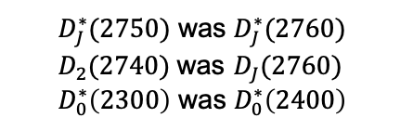
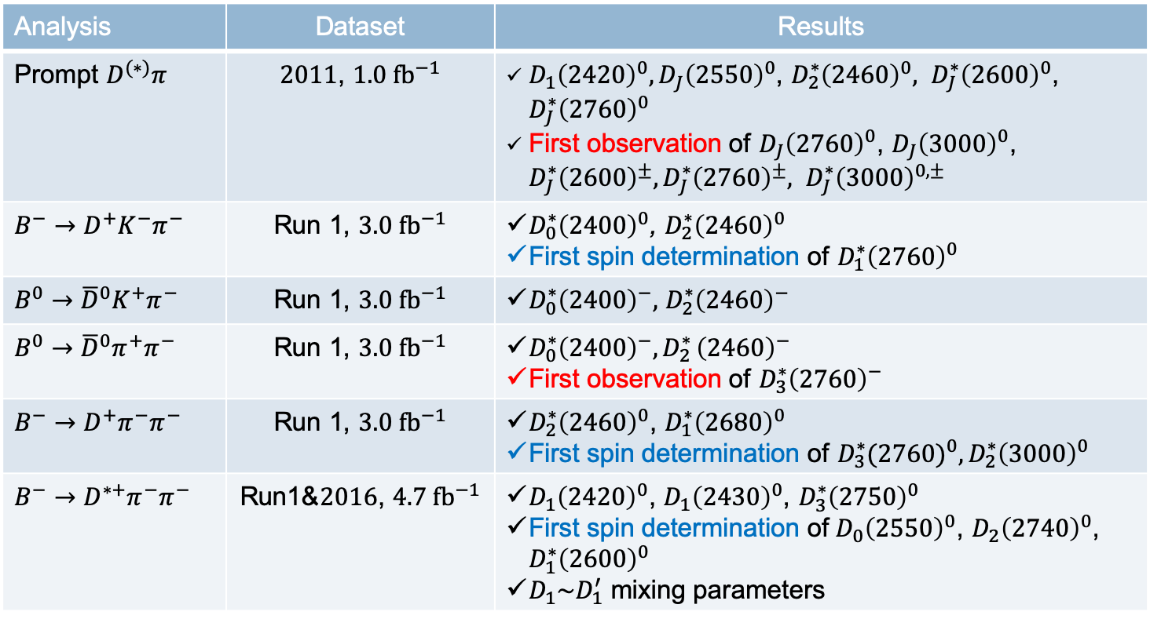
$D$ spectroscopy results summary
Analysis | Dataset | Results
Prompt $D^{(∗)}π$ | $2011$, $1.0 {fb}^{−1}$ | $D_{1}{\left(2420\right)}^{0}, D_{J}{\left(2550\right)}^{0}$, $D_{2}^{∗}{\left(2460\right)}^{0}, D_{J}^{∗}{\left(2600\right)}^{0}$, $D_{J}^{∗}{\left(2760\right)}^{0}$ First observation of $D_{J}{\left(2760\right)}^{0}$, $D_{J}{\left(3000\right)}^{0}$, $D_{J}^{∗}{\left(2600\right)}^{±}, D_{J}^{∗}{\left(2760\right)}^{±},$ $D_{J}^{∗}{\left(3000\right)}^{0,±}$
$B^{−}→D^{+}K^{−}π^{−}$ | Run 1, $3.0 {fb}^{−1}$ | $D_{0}^{∗}{\left(2400\right)}^{0}$, $D_{2}^{∗}{\left(2460\right)}^{0}$ First spin determination of $D_{1}^{∗}{\left(2760\right)}^{0}$
$B^{0}→{\overline{D}}^{0}K^{+}π^{−}$ | Run 1, $3.0 {fb}^{−1}$ | $D_{0}^{∗}{\left(2400\right)}^{−},$ $D_{2}^{∗}{\left(2460\right)}^{−}$
$B^{0}→{\overline{D}}^{0}π^{+}π^{−}$ | Run 1, $3.0 {fb}^{−1}$ | $D_{0}^{∗}{\left(2400\right)}^{−}{, D}_{2}^{∗}{\left(2460\right)}^{−}$ First observation of $D_{3}^{∗}{\left(2760\right)}^{−}$
$B^{−}→D^{+}π^{−}π^{−}$ | Run 1, $3.0 {fb}^{−1}$ | $D_{2}^{∗}{\left(2460\right)}^{0}$, $D_{1}^{∗}{\left(2680\right)}^{0}$ First spin determination of ${D_{3}^{∗}(2760)}^{0}, D_{2}^{∗}{\left(3000\right)}^{0}$
$B^{−}→D^{∗+}π^{−}π^{−}$ | Run1&$2016$, $4.7 {fb}^{−1}$ | $D_{1}{\left(2420\right)}^{0}$, $D_{1}{\left(2430\right)}^{0}$, $D_{3}^{∗}{\left(2750\right)}^{0}$ First spin determination of${ D}_{0}{\left(2550\right)}^{0}$, ${D_{2}\left(2740\right)}^{0}$, $D_{1}^{∗}{\left(2600\right)}^{0}$ $D_{1}\sim D_{1}^{′}$ mixing parameters
  World-leading mass & width measurements
  Branching fractions of the decays
  Fit fractions of the resonances
  $D_{J}^{∗}(2750)$ was $D_{J}^{∗}(2760)$
  $D_{2}(2740)$ was $D_{J}(2760)$
  $D_{0}^{∗}\left(2300\right)$ was $D_{0}^{∗}\left(2400\right)$

Slide 23
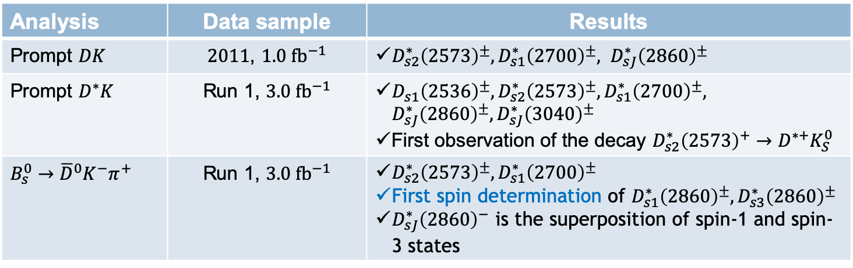
$D_{s}$ spectroscopy results summary
Analysis | Data sample | Results
Prompt $DK$ | $2011$, $1.0 {fb}^{−1}$ | $D_{s2}^{∗}{\left(2573\right)}^{±}, D_{s1}^{∗}{\left(2700\right)}^{±}, D_{sJ}^{∗}{\left(2860\right)}^{±}$
Prompt $D^{∗}K$ | Run 1, $3.0 {fb}^{−1}$ | $D_{s1}{\left(2536\right)}^{±}, D_{s2}^{∗}{\left(2573\right)}^{±}, D_{s1}^{∗}{\left(2700\right)}^{±}, D_{sJ}^{∗}{\left(2860\right)}^{±},D_{sJ}^{∗}{\left(3040\right)}^{±}$ First observation of the decay $D_{s2}^{∗}{\left(2573\right)}^{+}→D^{∗+}K_{S}^{0}$
$B_{s}^{0}→{{\overline{D}}^{0}K}^{−}π^{+}$ | Run 1, $3.0 {fb}^{−1}$ | $D_{s2}^{∗}{\left(2573\right)}^{±},D_{s1}^{∗}{\left(2700\right)}^{±}$ First spin determination of $D_{s1}^{∗}{\left(2860\right)}^{±}, D_{s3}^{∗}{\left(2860\right)}^{±}$ $D_{sJ}^{∗}{\left(2860\right)}^{−}$ is the superposition of spin-1 and spin-3 states
  World-leading mass & width measurements
  Branching fractions of the decays
  Fit fractions of the resonances

Slide 24
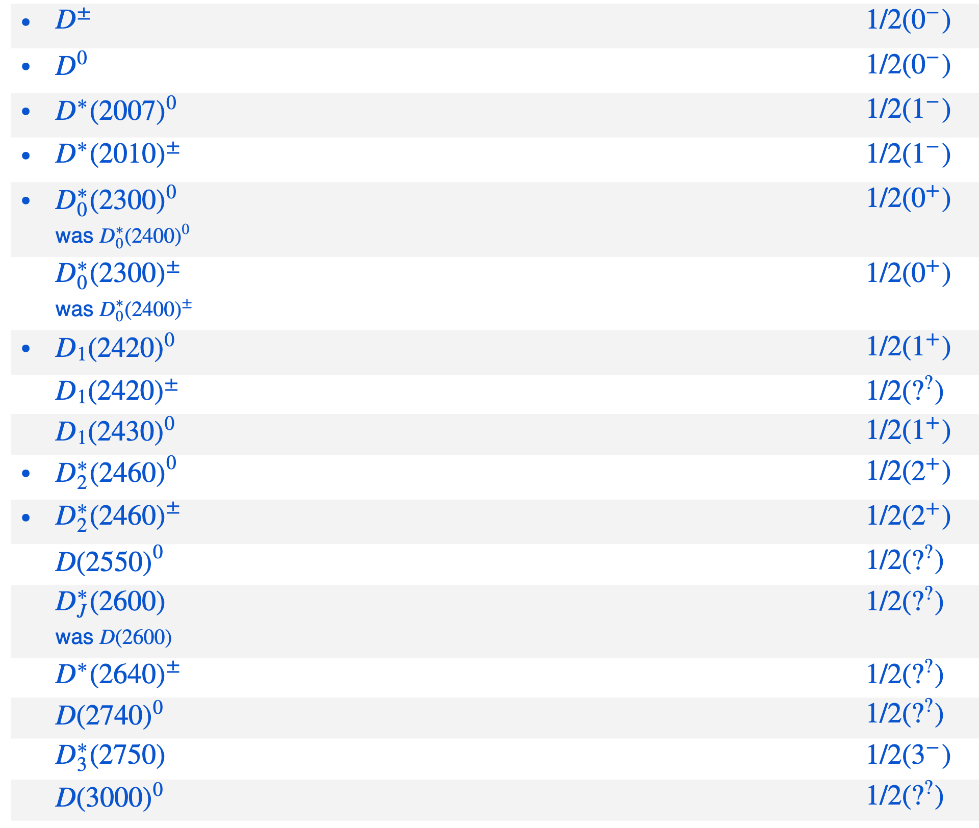



$D$ spectroscopy status
  Still a lot of states missing
    Provide opportunities to find them
  The spin-parity of several observed states not determined
    Provide opportunities to determine them
  Observed states without spin-parity assignment!
$$D{\left(3000\right)}^{0}$$
$$D^{∗}{\left(2640\right)}^{± }$$
  Observed states with spin-parity determined!
Should be $1^{+}$
LHCb observation
LHCb contribution
(Phys. Rev. D 93, 034035)
Spin-parity determined recently
  Explore the full run 1&2 LHCb data!!
2019 Review of Particle Physics.
M. Tanabashi et al. (Particle Data Group), Phys. Rev. D 98, 030001 (2018) and 2019 update.

Slide 25
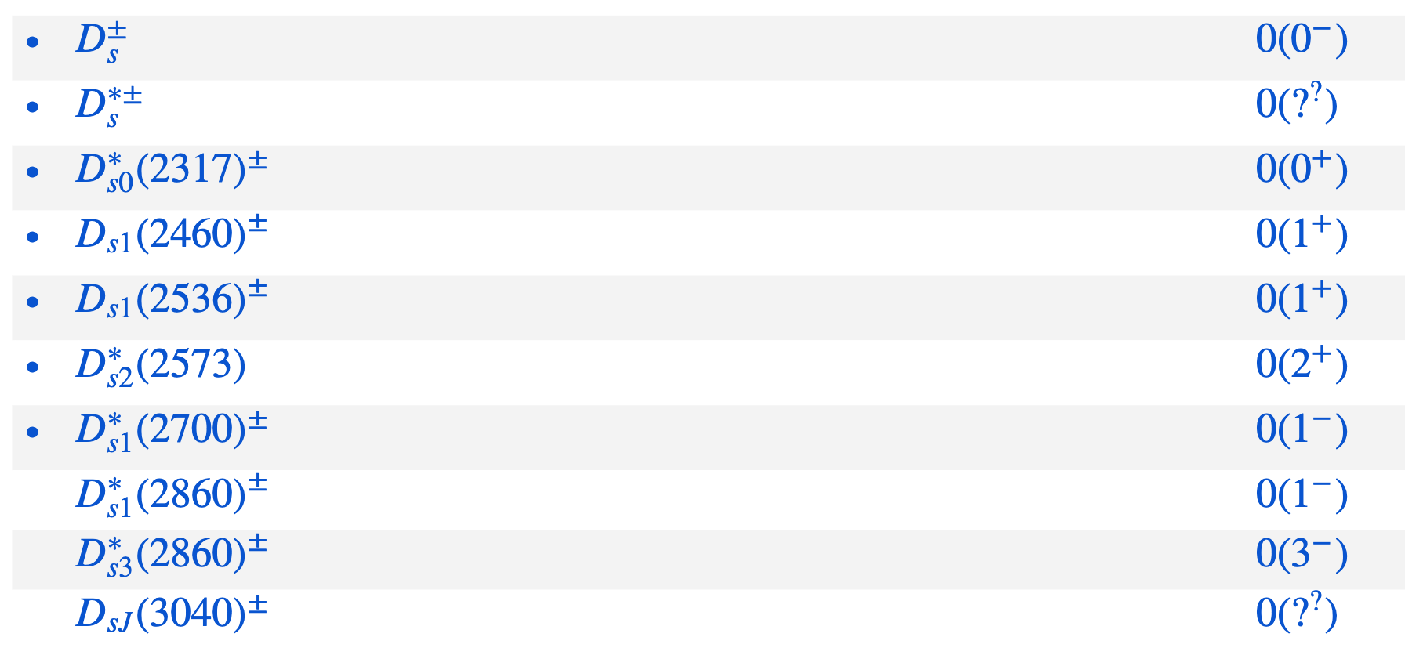


$D_{s}$ spectroscopy status
  Still a lot of states missing
    Provide opportunities to find them
  The spin-parity of several observed states not determined
    Provide opportunities to determine them
$$D_{sJ}{\left(3040\right)}^{±}$$
  Observed states without spin-parity assignment!
  Observed states with spin-parity determined!
(Phys. Rev. D 93, 034035)
  Should be $D_{s}^{∗}$
LHCb observation
LHCb contribution
Should be $1^{−}$
  Explore the full run 1&2 LHCb data!!
2019 Review of Particle Physics.
M. Tanabashi et al. (Particle Data Group), Phys. Rev. D 98, 030001 (2018) and 2019 update.

Slide 26
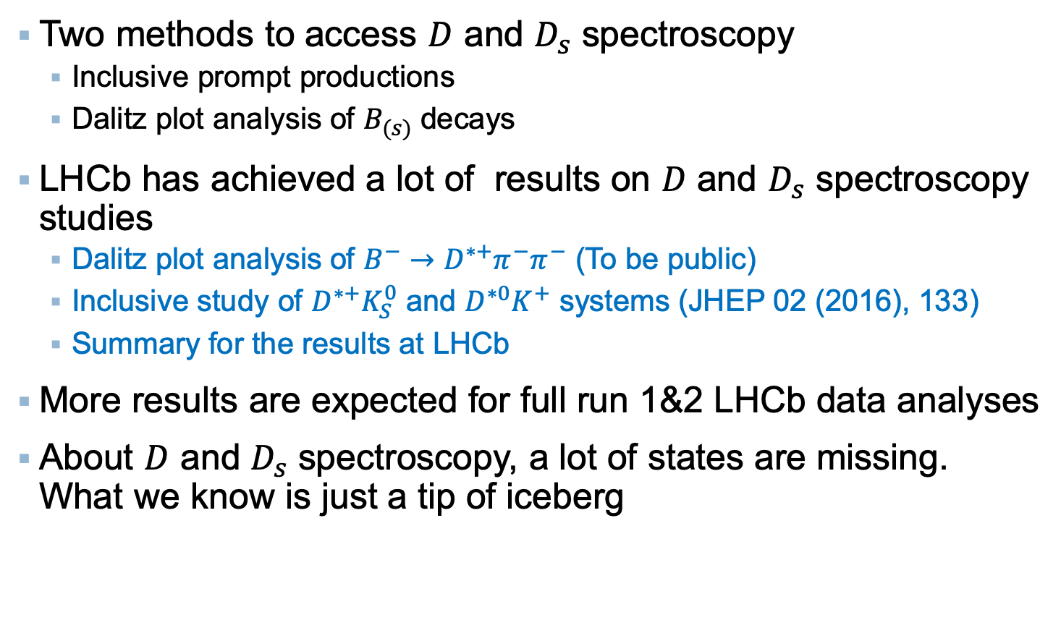
Conclusion & outlook
Two methods to access $D$ and $D_{s}$ spectroscopy
  Inclusive prompt productions
  Dalitz plot analysis of $B_{(s)}$ decays
LHCb has achieved a lot of results on $D$ and $D_{s}$ spectroscopy studies
  Dalitz plot analysis of $B^{−}→D^{∗+}π^{−}π^{−}$ (To be public)
  Inclusive study of $D^{∗+}K_{S}^{0}$ and $D^{∗0}K^{+}$ systems (JHEP 02 (2016), 133)
  Summary for the results at LHCb
More results are expected for full run 1&2 LHCb data analyses
About $D$ and $D_{s}$ spectroscopy, a lot of states are missing. What we know is just a tip of iceberg
Thanks for your attention!
Any questions or comments?

Slide 27
Backup slides

Slide 28
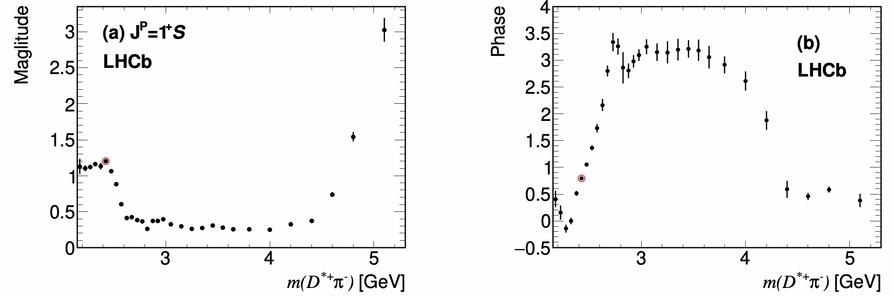

Quasi-Model-Independent amplitude
To modelled the resonance which can’t be well described by RBW
  A certain spin-parity
  Too broad
  Additional contributions from higher mass region
Parameterized as a complex histogram of $D^{∗+}π^{−}$ mass
  The complex amplitude for each bin is a fit parameter in amplitude fit
Preliminary

Slide 29
$D$ spectroscopy results at LHCb

Slide 30
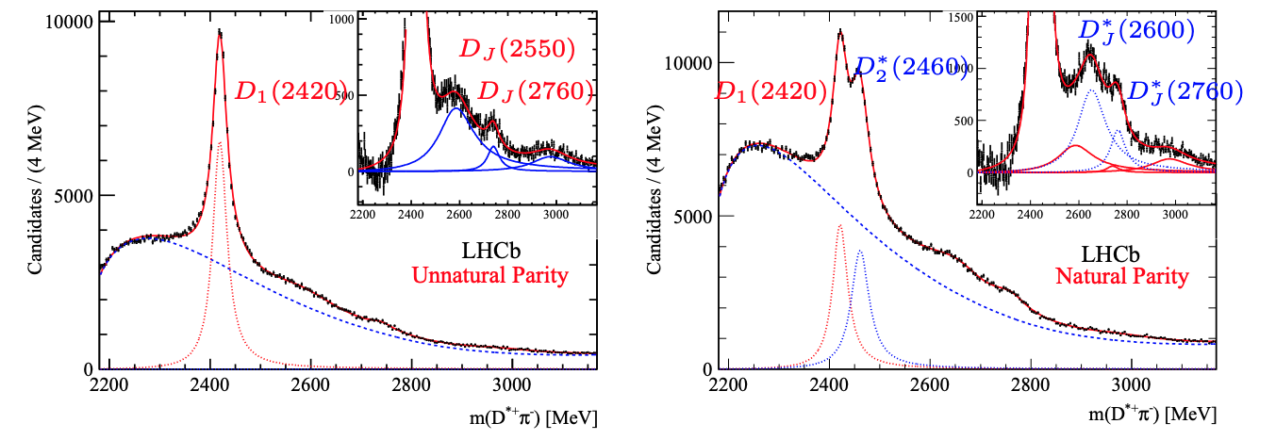
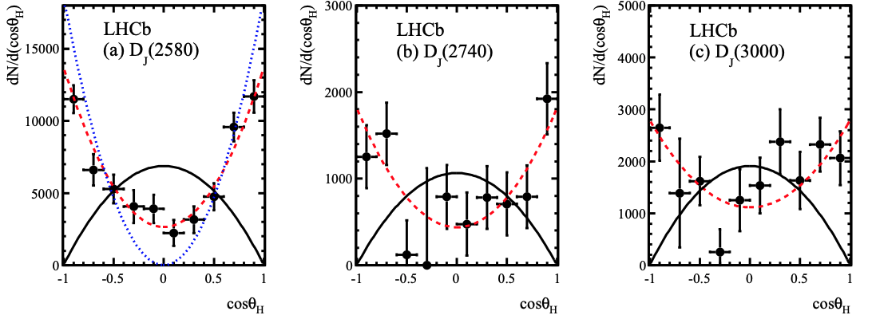
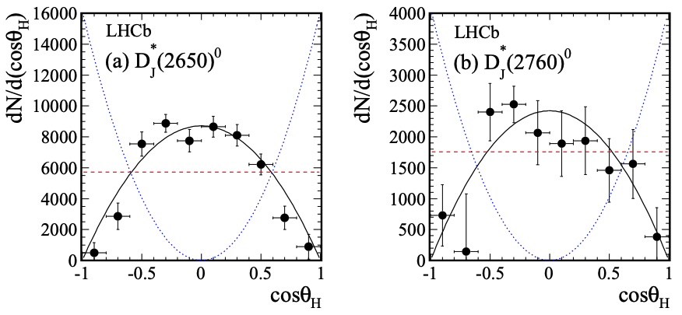
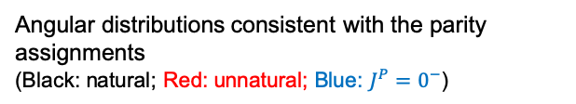




Study of $D^{+}π^{−}$, $D^{0}π^{+}$ and $D^{∗+}π^{−}$ systems
(JHEP09 (2013), 145)
$2011$ data, $1.0 {fb}^{−1}$
$D^{∗+}π^{−}$ system
  Can access both natural and unnatural parity states
$|\cos{θ_{H}|}>0.75$: Enhanced unnatural parity sample (Natural Parity suppressed by a factor 11.6)
$|\cos{θ_{H}|}<0.50$: natural parity sample (Unnatural Parity suppressed by a factor 1.5)
3 unnatural parity states observed:
  $D_{J}{\left(2550\right)}^{0}$, $D_{J}{\left(2760\right)}^{0}$, $D_{J}{\left(3000\right)}^{0}$
2 natural parity states observed:
  $D_{J}^{∗}{\left(2600\right)}^{0}$, $D_{J}^{∗}{\left(2760\right)}^{0}$
Angular distributions consistent with the parity assignments
(Black: natural; Red: unnatural; Blue: $J^{P}=0^{−}$)

Slide 31




Study of $D^{+}π^{−}$, $D^{0}π^{+}$ and $D^{∗+}π^{−}$ systems
(JHEP09 (2013), 145)
$2011$ data, $1.0 {fb}^{−1}$
$D^{+}π^{−}$ and $D^{0}π^{+}$ system
  Can access natural parity states
Partially reconstructed $D^{∗+}π^{−}$
Confirm the $D^{∗+}π^{−}$ observations:
  $D_{J}^{∗}{\left(2600\right)}^{0}$, $D_{J}^{∗}{\left(2760\right)}^{0}$
Two charged states found:
  $D_{J}^{∗}{\left(2600\right)}^{+}$, $D_{J}^{∗}{\left(2760\right)}^{+}$
A broad structure at 3.0 GeV:
  $D_{J}^{∗}\left(3000\right)$

Slide 32







Dalitz plot analysis of $B^{0}→{\overline{D}}^{0}π^{+}π^{−}$
(Phys.Rev.D92, 032002 (2015))
Run1 data, $3.0 {fb}^{−1}$
Several $π^{+}π^{−}$ and ${\overline{D}}^{0}π^{−}$ contributions considered
Two models used: Isobar model and K-matrix model
The precision of mass & width of $D_{0}^{∗}\left(2400\right)$ and $D_{2}^{∗}\left(2460\right)$ improved
Observation of a $J^{P}=3^{−}$resonance

Slide 33








Dalitz plot analysis of $B^{0}→{\overline{D}}^{0}K^{+}π^{−}$
(Phys.Rev.D92, 012012 (2015))
Run1 data, $3.0 {fb}^{−1}$
Several $K^{+}π^{−}$ and ${\overline{D}}^{0}π^{−}$ contributions considered
  No evidence is found for additional spin-1 or spin-3 $D_{J}^{∗}$ resonances.

Slide 34








Dalitz plot analysis of $B^{−}→D^{+}K^{−}π^{−}$
(Phys.Rev.D91, 092002 (2015))
Run1 data, $3.0 {fb}^{−1}$
Several $D^{+} π^{−}$contributions considered in Isobar model
$$ℬ(B^{−}→D^{+}K^{−}π^{−}) =(7.31±0.19±0.22 ±0.39)×{10}^{−5}$$
  $D_{J}^{∗}{\left(2760\right)}^{0}$ is determined to be spin-1

Slide 35









Dalitz plot analysis of $B^{−}→D^{+}π^{−}π^{−}$
(Phys.Rev.D94, 072001 (2016))
Run1 data, $3.0 {fb}^{−1}$
Several $D^{+}π^{−}$ contributions considered
$$D_{2}^{∗}{\left(2460\right)}^{0}$$
  First observation of ${D_{3}^{∗}(2760)}^{0}$
  First spin determination of $D_{2}^{∗}{\left(3000\right)}^{0}$

Slide 36
$D_{s}$ spectroscopy results at LHCb

Slide 37








Study of $D^{+}K_{S}^{0}$ and $D^{0}K^{+}$ systems
  (JHEP 10 (2012), 151)
$2011$, $1.0 {fb}^{−1}$
Confirmation of $D_{s1}^{∗}{\left(2700\right)}^{+}$ and $D_{sJ}^{∗}{\left(2860\right)}^{+}$ in hadronic interactions for the first time
$D_{s1}^{∗}{\left(2700\right)}^{+}$
$D_{s1}^{∗}{\left(2700\right)}^{+}$
$D_{sJ}^{∗}{\left(2860\right)}^{+}$
$D_{sJ}^{∗}{\left(2860\right)}^{+}$

Slide 38














Dalitz plot analysis of $B_{s}^{0}→{{\overline{D}}^{0}K}^{−}π^{+}$
(Phys. Rev. Lett. 113 (2014) 162001, Phys. Rev. D90 (2014) 072003)
Run 1, $3.0 {fb}^{−1}$
Several $K^{−}π^{+}$ and ${\overline{D}}^{0}K^{−}$ contributions considered using tensor formalism
$$D_{s2}^{∗}{\left(2573\right)}^{−}$$
$$D_{s1}^{∗}{\left(2860\right)}^{−}$$
$$D_{s3}^{∗}{\left(2860\right)}^{−}$$
Signal present in the 2860 MeV ${\overline{D}}^{0}K^{−}$ mass region described by a superposition of a spin-1 and a spin-3 resonance.
$$D_{s3}^{∗}{\left(2860\right)}^{−}$$
$$D_{s1}^{∗}{\left(2860\right)}^{−}$$

Slide 39


LHCb dataset
JINST 3 (2008) S08005
Int.J.Mod.Phys. A30 (2015) 1530022
Single-arm $(2<η<5)$spectrometer, designed for precision flavour measurements
$$ℒ=9 fb^{−1}$$

