Slide 1
A new set of CMS Pythia8 tunes from underlying-event measurements
Efe Yazgan
CLHCP2018

Slide 2
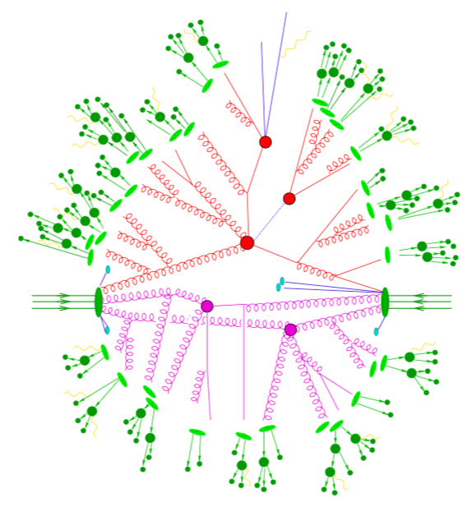
Underlying Event
decays
Hadronization
Fragmentation/
Parton shower
Hard process
Beam remnants
Underlying event/
Multi-parton interactions
Gleisberg et al. JHEP02 (2004) 056
CMS, EPJ C 79 (2019) 123
UE: activity in addition to the hard process
  Consists of beam-beam remnants and multi-parton interactions + some contribution from the hard process
  Requires modeling of BBR, MPI, hadronization, ISR, FSR.
  Need to tune the adjustable parameters in MCs.
2

Slide 3
Comparisons of predictions for UE observables from previous tunes to 13 TeV data
arXiv:1903.12179
Main CMS tune (CUETP8M1 based on Monash tune) used until 2017 analyses does not describe well the central values of the data at 13 TeV.
CUETP8M1: α_{s} and shower parameters kept as in Monash → α_{s}^{ISR/FSR}=0.1365 despite the prefered values of 0.130 in LO and 0.118 in NLO matrix elements/ PDF sets.
  α_{s}^{FSR} in Monash → by fitting Pythia8 predictions to LEP event shapes and α_{s}^{ISR} is just assumed to be the same as α_{s}^{FSR}.
  α_{s}^{MPI} = 0.130 set to the value prefered in the LO PDF set.
EP JC 76 (2016) 155

Slide 4
Revisiting Shower Parameters and Tunes
  Starting from parton shower in ttbar events
  → CUETP8M2T4 tune (α_{s}^{ISR} ~ 0.11)
  UE in ttbar events at 13 TeV
  → α_{s}^{FSR}~0.118 agrees better with data.
  Jet substructure in ttbar events at 13 TeV
  → α_{s}^{FSR}~0.115.
  New CMS tunes using (N)(N)LO PDF sets in PS
  → CPX tunes (consistent treatment of PDF+α_{s} in matrix element and
  parton shower)
  UE in Z+jets events at 13 TeV
CMS-PAS-TOP-16-021
EPJC 79 (2019) 123
PRD98 (2018) 092014
arXiv:1903.12179
JHEP07 (2018) 032
and
arXiv:1903.12179

Slide 5
α_{s} Consistency in ME and PS and PDF Choices
PDF and α_{s}(M_{Z}) appear in ME, PS, and MPI models.
α_{s}(M_{Z}) at (N)NLO = 0.118 (=world average) and LO = 0.130
Different strategies are adopted
  CMS & ATLAS tunes traditionally based on LO PDFs.
  PYTHIA tunes are mostly based on LO PDFs.
  Sherpa tunes are based on NNLO PDFs.
  HERWIG7 provide tunes based on NLO PDFs (in which MPI is still based on LO PDF).
Using the same PDF set and α_{s}(M_{Z}) value in the ME and in the simulation of the PS components in matched configurations advocated
  i.e. If ME is at NLO, then use N^{≥1}LO PDF in ME and PS.
  Effect depends on the configuration and process.
Cooper et al. EPJC72 (2012) 2078

Slide 6
New CMS Tunes using LO PDF
arXiv:1903.12179
Fixed
inputs
Fitted
parameters

Slide 7
New CMS Tunes using (N)NLO PDFs
arXiv:1903.12179
Fixed
inputs
Fitted
parameters

Slide 8
New CMS Tunes using (N)NLO PDFs
arXiv:1903.12179
Fixed
inputs
Fitted
parameters
The overlap between two protons modelled by a double-gaussian --> better reproduces 7 TeV CMS data
CMS-PAS-FSQ-12-020
Data used for the fits:
charged particle and p_{T}^{sum} densities in transMIN, transMax vs p_{T}^{max} at √s = 1.96, 7 and 13 TeV.
+ charged-particle multiplicity vs η at √s=13 TeV.

Slide 9
α_{s} Consistency in ME and PS and PDF Choices – MinBias
arXiv:1903.12179
(N)NLO
LO
Central values of min-bias data are described within ~5% of uncertainties by tunes with LO, NLO, and NNLO NNPDF3.1 sets.
  Central values of the LO-PDF-tunes worse description of data for |η|>1.5

Slide 10
α_{s} Consistency in ME and PS and PDF Choices –Underlying Event
arXiv:1903.12179
13 TeV UE data are described at the same level by tunes with LO, NLO, and NNLO NNPDF3.1 sets.

Slide 11
CPX and UE
arXiv:1903.12179
SISCone0.5 jet
Lower pT better described by (N)NLO PDF tunes.

Slide 12
CPX and Collision Energy Dependence
arXiv:1903.12179
√s=1.96 TeV
√s=7 TeV
√s=13 TeV
LO
LO
LO
(N)NLO
(N)NLO
(N)NLO
All predictions reproduce well the central values of UE observables at 1.96, 7, and 13 TeV.
LO-PDF tunes slightly better in describing the energy dependence.

Slide 13
CPX and ttbar
arXiv:1903.12179
Matrix elements:
POWHEG: inclusive ttbar at NLO, additional jet at LO
  hdamp tuned using 8 TeV data and CP5 tune
MG5_aMC[FxFx]: ≤ 2 parton at NLO 3rd at LO
NNPDF3.1 NNLO α_{s}(m_{Z})=0.118 for both cases
CP5 (and CUETP8M2T4) → RapidityOrdering for ISR = on
  Makes a big difference in POWHEG+PYTHIA8
All predictions equivalently good for MG5_aMC+PYTHIA8 [FxFx]

Slide 14


CPX and double parton scattering
arXiv:1903.12179
DPS effective cross sections from the individual measurements and different tunes compatible within ~1σ.
(N)NLO PDF tunes or RapidityOrdering gives worse predictions for DPS sensitive observables for CPX tunes.
CUETP8M1 already not good (although LO and even w/o rapidity ordering)

Slide 15
CPX and Z+Jets
arXiv:1903.12179
Matrix elements:
LO: ≤ 3 partons
NLO: ≤ 2 parton at NLO 3rd at LO
NNPDF3.1 NNLO α_{s}(m_{Z})=0.118 for both cases
LO
NLO
Little sensitivity to the tune for low multiplicities.
All tunes describe the central values of Njets reasonably well.
CP2 has a slightly better description of the central values.
CUETP8M1 and CP5 undershoot the data at the PS dominated region with at least 4 jets.

Slide 16
CPX and Z+Jets
arXiv:1903.12179
MLM: poor agreement with data
FxFx: all tunes give reasonable agreement for p_{T}(Z)> ~5 GeV
p_{T}(Z)<10 GeV: description by CUETP8M1 is better

Slide 17
UE in Z+Jets Events
arXiv:1903.12179
~ 1 GeV
~ 7 GeV
Central values of the UE observables are, in general, well described by all tunes.
Away region dominated by hadronic recoil system correlated with p_{T}(µµ)
UE≠0 when p_{T}(µµ)→0 because of the large initial scale in Z boso events → significant overlap between transverse parton densities of the colliding protons → Larger # MPI
UE activity becomes similar in different regions with p_{T}(µµ)~0 ← activity in the three regions mostly due to varying ISR/FSR contributions.

Slide 18
Summary - 1
New CMS tunes CUETP8M2T4 and CP1-5 describe the central values of the data better than CUETP8M1.
None of the tunes prior to CPX describe the ttbar jet sub-structure data.
Tunes are tested for which α_{S}(M_{Z}) used for the hard scattering, ISR, FSR, and MPI are chosen consistently with the order of the PDF used.
For the first time, predictions from PYTHIA8 with (N)NLO-PDF-based tunes are shown to reliably describe the central values of min-bias and underlying event data with similar or better level agreement to predictions from LO-PDF tunes.
Irrespective of the order of NNPDF3.1 PDF order, predictions from CPX tunes reproduce the UE from 1.96-13 TeV reasonably well (and better than CUETP8M1).
CPX tunes simultaneously describe the N_{ch} in diffractive and inelastic collisions.
CPX tunes describe the min-bias data up to |η| < 4.7.
No tune describes the very forward region (-6.6 < η < -5.2).
New tunes tested against min-bias, UE, ttbar, DY, dijet, V+jets, DPS data.

Slide 19
backups
MC
components
hard scattering
BBR
hadronization of partons
partons from initial-state radiation (ISR) and final-state radiation (FSR)
underlying event (UE)
multiple-parton interactions (MPI)
MEs
showering algorithm

Slide 20
