Slide 1
Open charm and beauty states production in proton-lead collisions with LHCb
杨迪（清华大学）
Di Yang (Tsinghua University)
On behalf of the LHCb Collaboration
October 24th 2019

Slide 2
Outline
Physics motivation
The LHCb detector
Analysis strategy
LHCb $p$Pb data samples
Prompt open charm production at $\sqrt{s_{NN}}=$ 5.02 TeV $p$Pb collisions
Open beauty production at $\sqrt{s_{NN}}=$ 8.16 TeV $p$Pb collisions
Summary and outlook
LHCb. JHEP 10 (2017) 090
LHCb. JHEP 02 (2019) 102
LHCb. Phys. Rev. D99 052011 (2019)

Slide 3
Physics motivation
Heavy flavor states are good probes in heavy-ion collisions
$m_{c, b}≫Λ_{QCD}$: $g+g\underset{→}{pertubative QCD}c,b quark$
$t_{prod}≪t_{QGP}$: experience whole time evolution of collisions
proton
gluon in p
$f_{gluon}^{p}\underset{→}{pQCD}f_{c,b quark}^{pp}\underset{→}{hadronization no medium }σ_{c,b hadon}^{pp}$
$f_{gluon}^{Pb}\underset{→}{pQCD}f_{c,b quark}^{pPb}\underset{→}{hadronization \& medium}σ_{c,b hadon}^{pPb}$
c,b hadron
c,b quark
gluon in p
proton
Cold nuclear matter effects:
Modification of parton distribution functions: nPDF and CGC: $R_{gluon}^{pPb}=f_{gluon}^{Pb}$/$f_{gluon}^{p}$
Hadronization with medium
Energy-loss in medium and so on
proton
gluon in p
c,b hadron
gluon
c,b quark
Observables:
Nuclear modification factor $R_{pPb}$: modification of PDF, $hadronization$ mechanism, medium effects
Forward-backward ratio $R_{FB}$: modification of PDF
Particle ratios: $hadronization$ mechanism
gluon in Pb
Medium(QGP?)
lead

Slide 4
Analysis strategy
Nuclear modification factor $R_{pPb}=\frac{1}{A}\frac{dσ_{pPb}\left(p_{T},y^{∗},\sqrt{s_{NN }}\right)/dp_{T}(dy)}{dσ_{pp}\left(p_{T},y^{∗},\sqrt{s_{NN }}\right)/dp_{T}(dy)}$, $A=208$
Forward-backward ration $R_{FB}= \frac{dσ_{pPb}\left(p_{T},+\left|y^{∗}\right|\right)/dp_{T}(dy^{∗})}{dσ_{Pbp}\left(p_{T},−\left|y^{∗}\right|\right)/dp_{T}(dy^{∗})}$
Particle ratio $R_{particle 1/particle 2}=\frac{dσ_{particle 1}\left(p_{T},y^{∗}\right)/dp_{T}(dy^{∗})}{dσ_{particle 2}\left(p_{T},y^{∗}\right)/dp_{T}(dy^{∗})}$
Prompt open charm cross section $\frac{d^{2}σ_{prompt charm}}{dy^{∗}dp_{T}}=\frac{N_{prompt charm}\left({ p}_{T},y^{∗}\right)}{ℒ×ε(p_{T},y)×ℬ×Δy^{∗}×Δp_{T}}$
Open beauty cross section $\frac{d^{2}σ_{beauty}}{dy^{∗}dp_{T}}=\frac{N_{beauty}({ p}_{T},y^{∗})}{ℒ×ε(p_{T},y)×ℬ×Δy^{∗}×Δp_{T}}$
$ℒ$: luminosity
$ε(p_{T},y)$: effeciency estimated from simulation samples
$ℬ$: branch ratio of decay channel
$Δy^{∗}, Δp_{T}$: width of rapidity and transvers momentum bins
Notes:
FOREWARD 和BACKWARD 加框强调对应

Slide 5
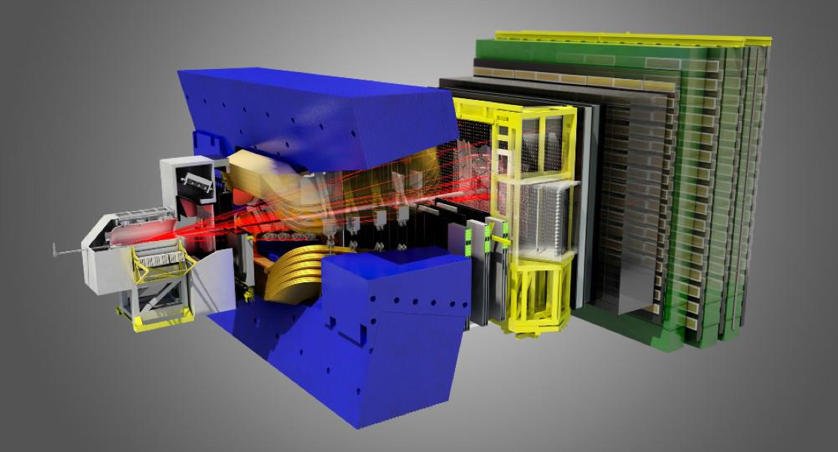
The LHCb detector
A single-arm general purpose detector at forward rapidity !
pseudorapidity acceptance $2<η<5$
$p_{T}$ down to 0
Muon system: $μ$ identification: $ε$ ($μ→μ$) ~ 97%
Mis-ID:$ε$ ($π→μ$) ~ 1$−$3%
RICH: K/$π$/$p$ separation
$ε$(K$→$K) ~ 95%
Mis-ID: $ε$ ($π→$ K) ~ 5%
Vertex detector: IP resolution ~ 20 $μ$m
Decay time resolution ~ 45 fs
Dipole magnet Bending power 4 Tm
Electromagnetic + hadronic calorimeters
Tracking system: $Δp/p$ = 0.5$−$1.0%
(5$−$200 GeV/c)
LHCb. JINST 3 (2008) S08005
LHCb. IJMPA 30 (2015) 1530022

Slide 6
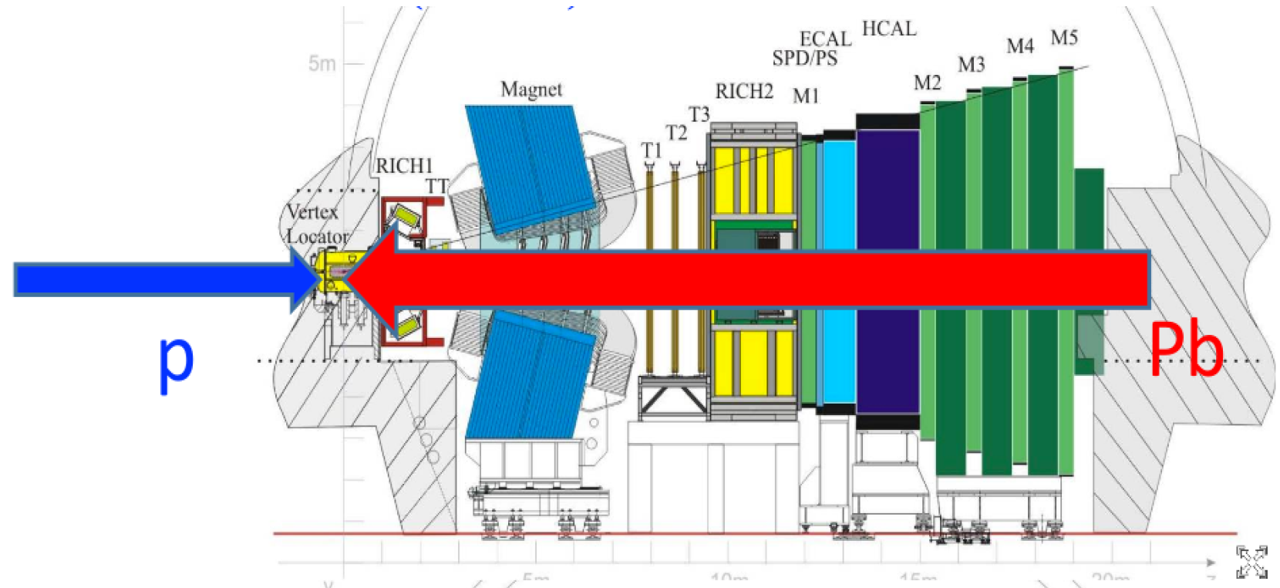
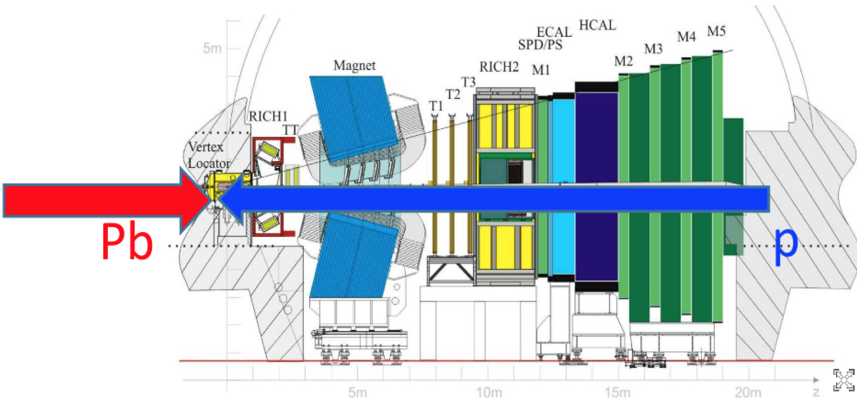
LHCb $p$Pb data samples
Forward: $p$Pb
$\sqrt{s_{NN}}=5.02$ TeV (2013)
$p$Pb $\left(ℒ=1.06 {nb}^{−1}\right)$+ Pb$p\left(ℒ=0.52 {nb}^{−1}\right)$
$\sqrt{s_{NN}}=8.16$ TeV (2016)
$p$Pb $\left(ℒ=12.2 {nb}^{−1}\right)$+ Pb$p\left(ℒ=18.6 {nb}^{−1}\right)$
Rapidity coverage
$y^{∗}=y_{lab}−y_{cms}$
rapidity in nucleon-nucleon cms
$y_{cms}=±0.465$
Forward ($p$Pb): $1.5<y^{∗}<4.0$
Backward (Pb$p$): $−5.0<y^{∗}<−2.5$
Common region: $2.5<{|y}^{∗}|<4.0$
z axis
Backward: Pb$p$
z axis

Slide 7
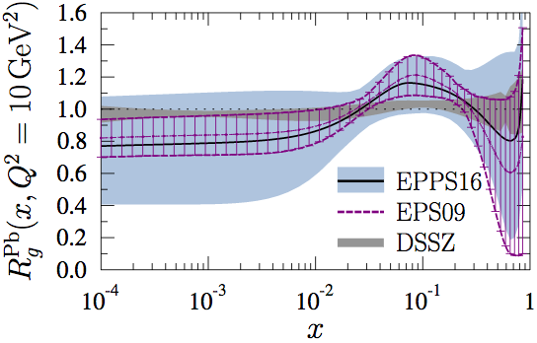
LHCb $p$Pb data samples
Forward: $p$Pb
Eur. Phys. J. C (2017) 77:163
anti-shadowing
shadowing
z axis
Backward: Pb$p$
z axis
Zenaiev, Oleksandr, et al. Eur. Phys. J. C (2015) 75: 396
Forward: sensitive to small-$x$ region
Backward: sensitive to mid-$x$ region
Notes:
FOREWARD 和BACKWARD 加框强调对应

Slide 8
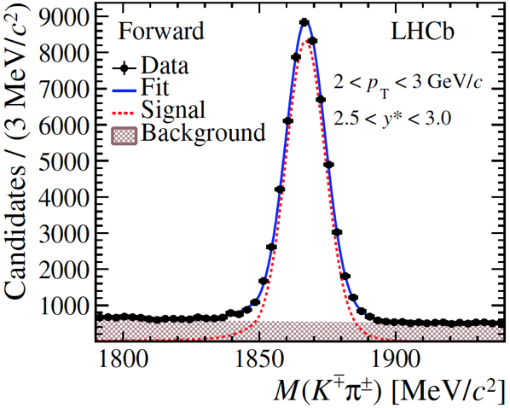
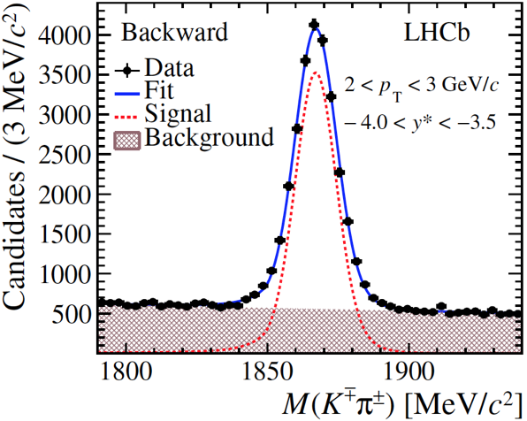
Open charm: signals
Forward
Backward
Reconstructed through decay channels: $D^{0}→K^{−}π^{+}$,
$$Λ_{c}^{+}→pK^{−}π^{+}$$
$$D^{0}→K^{−}π^{+}$$
$$D^{0}→K^{−}π^{+}$$
Forward
Backward
$$Λ_{c}^{+}→pK^{−}π^{+}$$
$$Λ_{c}^{+}→pK^{−}π^{+}$$
Extract $N_{charm}$ by fitting invariant mass distributions
LHCb. JHEP 10 (2017) 090
LHCb. JHEP 02 (2019) 102

Slide 9
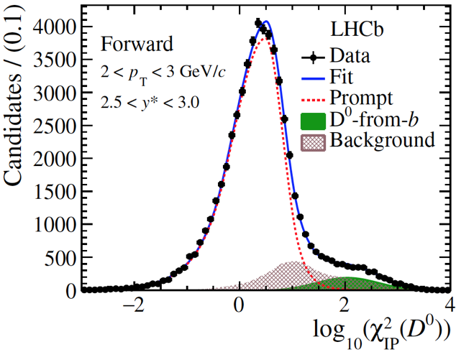
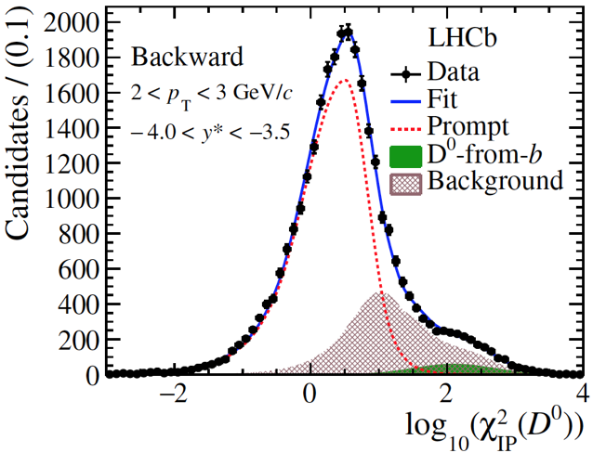
Prompt and non-prompt charm
Distinguish prompt and non-prompt by fitting impact parameter (IP) distributions
$$p\left(K^{−}\right)+p(π^{+})$$
$$D^{0}$$
$$D^{0}$$
Forward
Backward
$$π^{+}$$
$$K^{−}$$
$$D^{0}$$
$$PV$$
others
Prompt : charm produced directly in collisions (IP$\sim$0)
$$p\left(K^{−}\right)+p(π^{+})$$
$$Λ_{c}^{+}$$
$$Λ_{c}^{+}$$
$$π^{+}$$
Forward
Backward
$$K^{−}$$
$$D^{0}$$
b hadron
others
$$PV$$
$$IP$$
Non-prompt: charm produced from b decay (IP>0)
Extract $N_{prompt charm}$
LHCb. JHEP 10 (2017) 090
LHCb. JHEP 02 (2019) 102

Slide 10
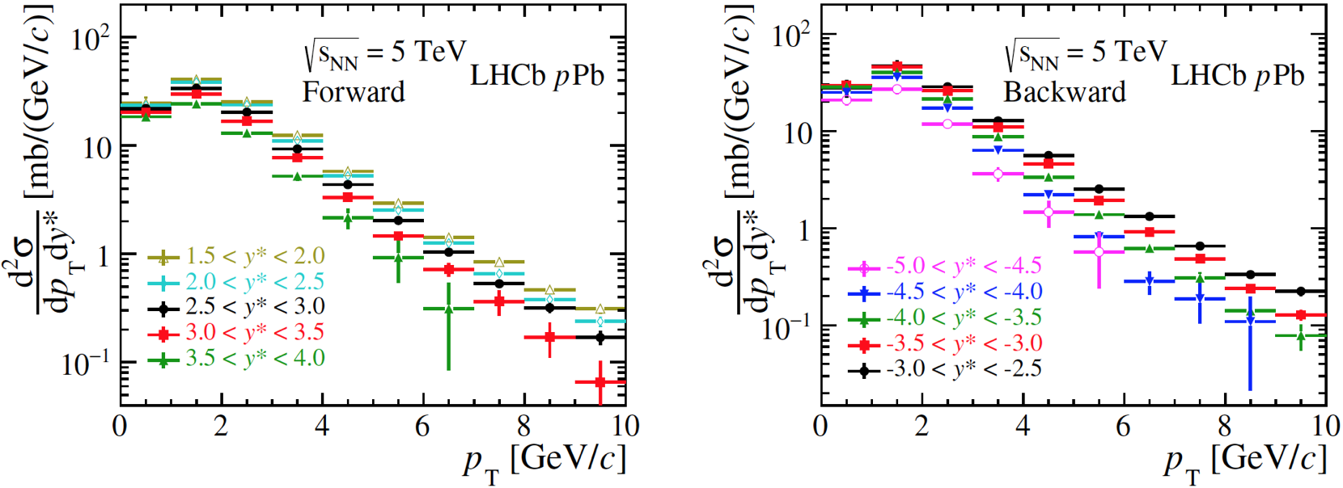
Prompt open charm: cross section
Forward
Backward
$$D^{0}$$
$$D^{0}$$
Forward
$$Λ_{c}^{+}$$
Backward
$$Λ_{c}^{+}$$
stat.+sys.
stat.+sys.
LHCb. JHEP 10 (2017) 090
LHCb. JHEP 02 (2019) 102

Slide 11
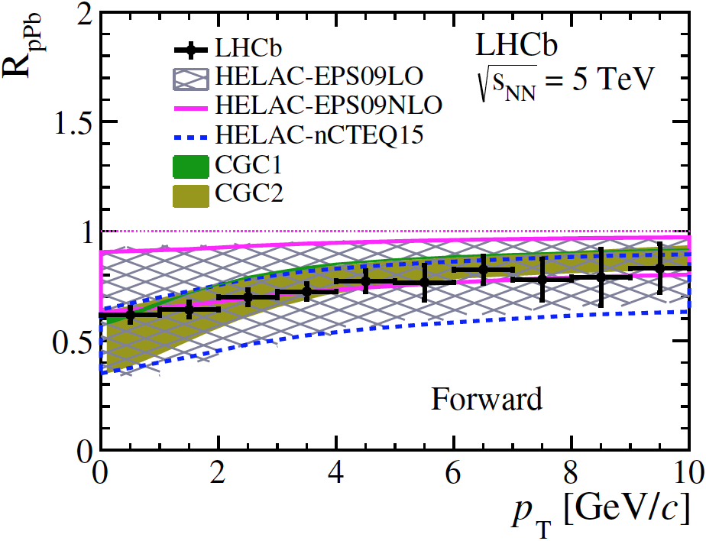
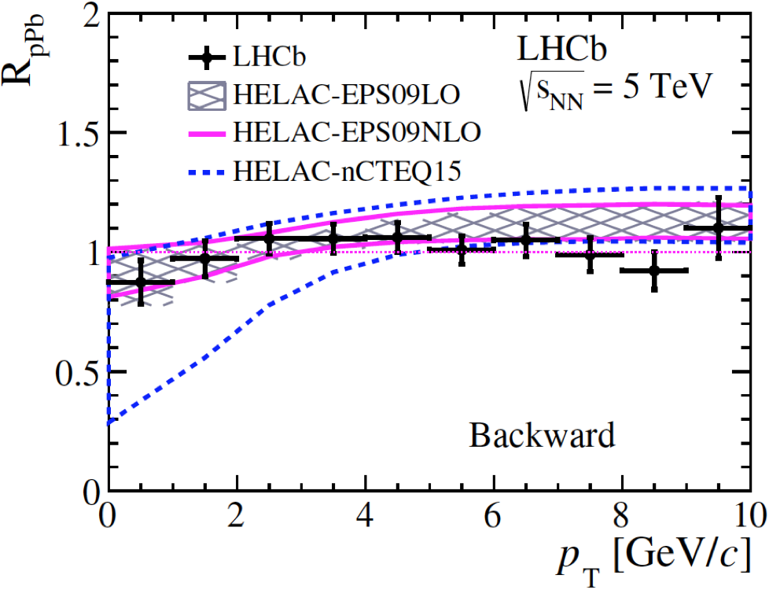
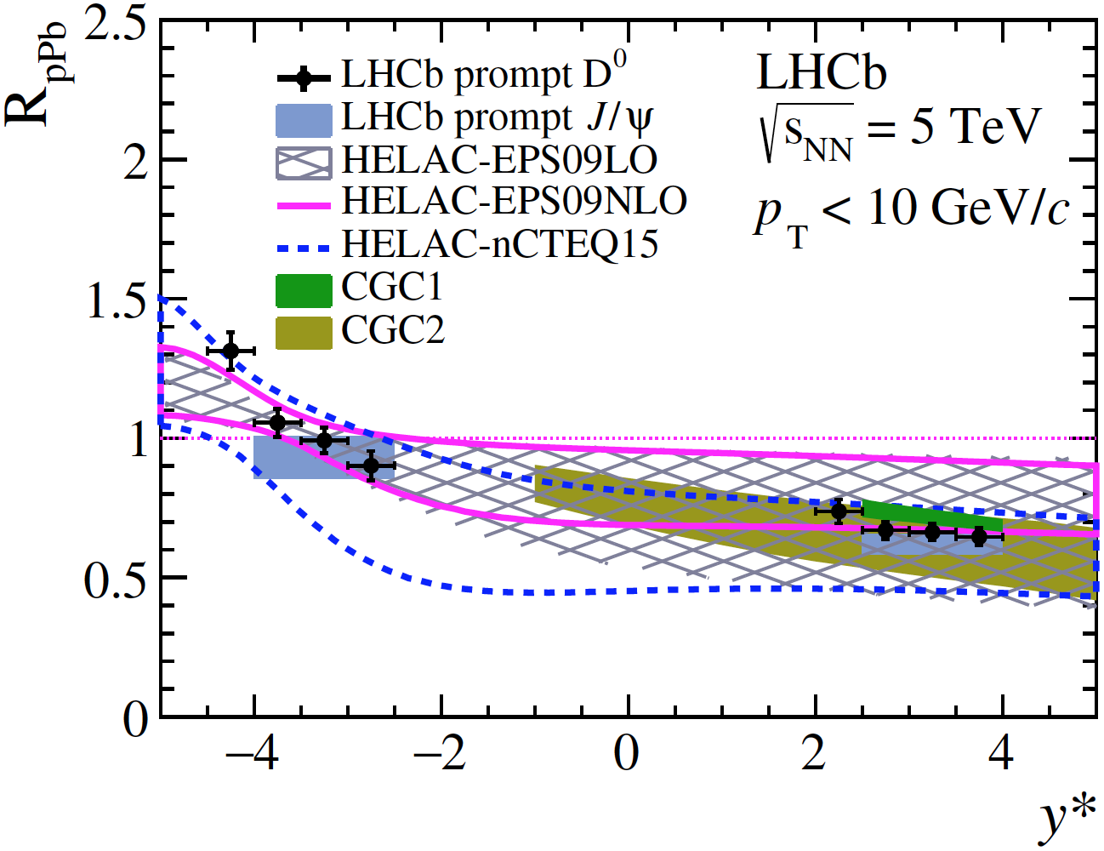
Prompt open charm: nuclear modification factor
$$D^{0}$$
$$D^{0}$$
LHCb. JHEP 10 (2017) 090
Forward
Backward
$pp$ reference measured by LHCb
$R_{pPb}$ suppressed at forward rapidity
Slight increase with increasing $p_{T}$
$R_{pPb}$ close to 1 at backward rapidity
Data are consistent with models with nPDF, CGC
Data have smaller uncertainties than theory
$$D^{0}$$

Slide 12
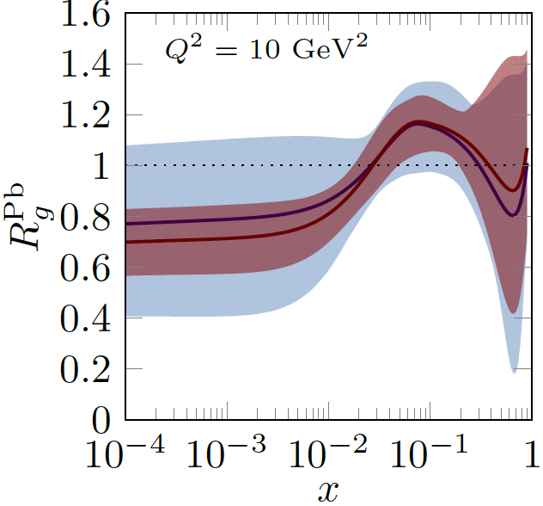
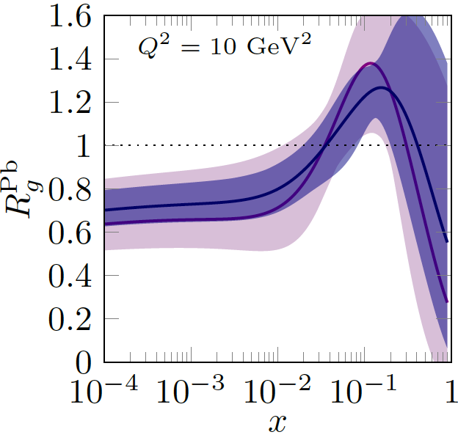
Prompt open charm: PDF modification
Eskola, Kari J., et al. arXiv:1906.02512v1
EPPS16
nCTEQ15
$$D^{0}$$
LHCb. JHEP 10 (2017) 090
Blue: without LHCb $D^{0}$ data
Red: reweighted with LHCb $D^{0}$ data
Purple: without LHCb $D^{0}$ data
Blue: reweighted with LHCb $D^{0}$ data
$D^{0}$ data have small uncertainties and are used to reduce uncertainties of $R_{g}^{Pb}$ in some nPDF models

Slide 13
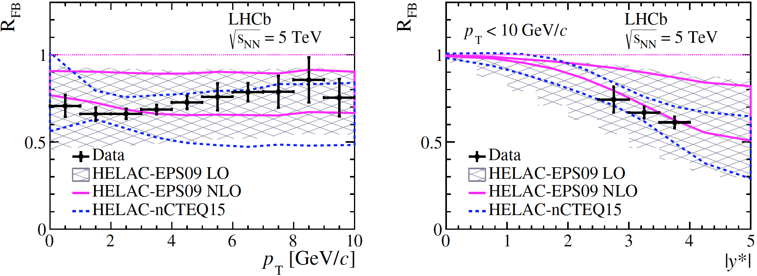
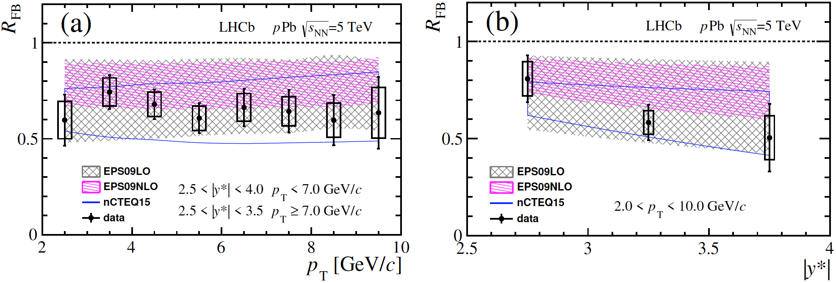
Prompt open charm: forward-backward ratio
$$D^{0}$$
$$D^{0}$$
$R_{FB}= \frac{dσ_{pPb}\left(p_{T},+\left|y^{∗}\right|\right)/dp_{T}(dy)}{dσ_{Pbp}\left(p_{T},−\left|y^{∗}\right|\right)/dp_{T}(dy)}$ $R_{FB}<1$ and decreases with rapidity
$$Λ_{c}^{+}$$
$$Λ_{c}^{+}$$
sys.
sys.
total.
total.
Data agree with calculations using various nPDF sets
$D^{0}$ data have smaller uncertainties than theory
LHCb. JHEP 10 (2017) 090
LHCb. JHEP 02 (2019) 102

Slide 14
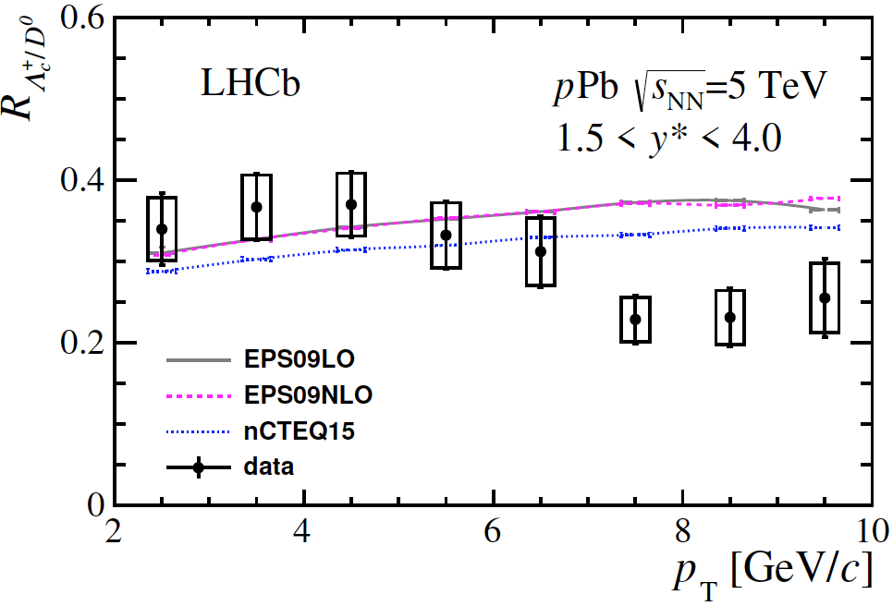
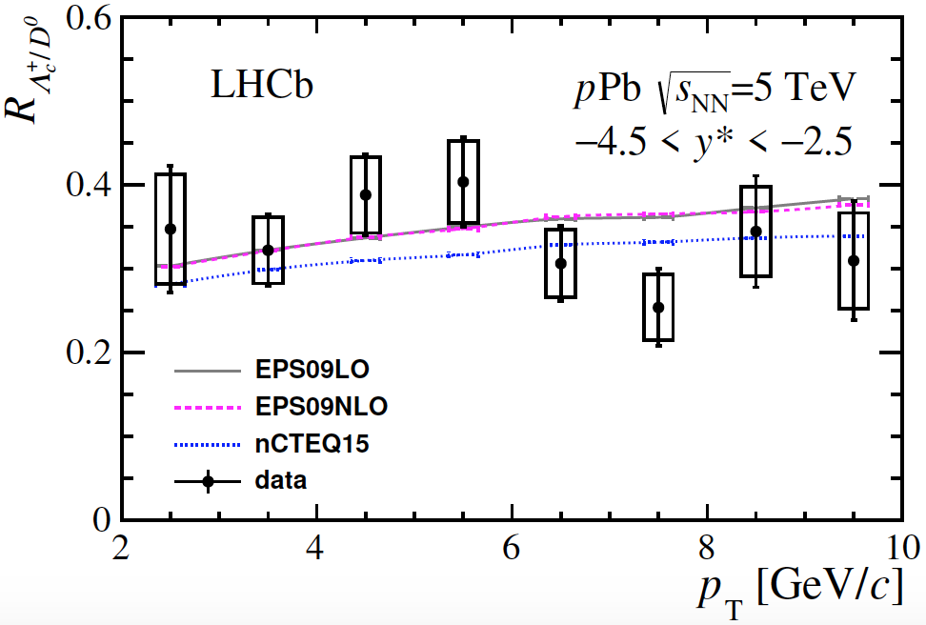
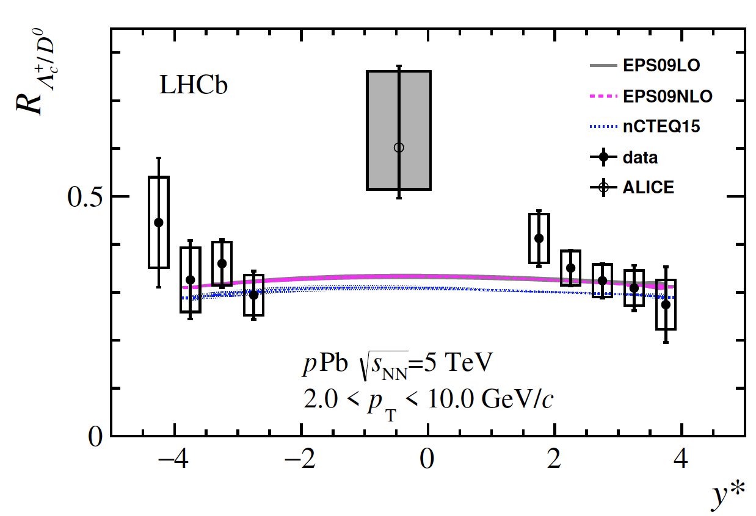
Prompt open charm: particle ratio
Forward
Backward
$R_{Λ_{c}^{+}/D^{0}}=\frac{d^{2}σ_{Λ_{c}^{+}}\left(p_{T},y^{∗}\right)/dp_{T}(dy)}{d^{2}σ_{D^{0}}\left(p_{T},y^{∗}\right)/dp_{T}(dy)}$
Theoretical calculations is based on measured $pp$ results from LHCb
nPDF effects cancel in baryon/meson ratios
Forward: consistent with theory in lower $p_{T}$ and below theory in higher $p_{T}$
Backward: consistent with theory for all $p_{T}$ and $y^{∗}$
LHCb. JHEP 02 (2019) 102

Slide 15
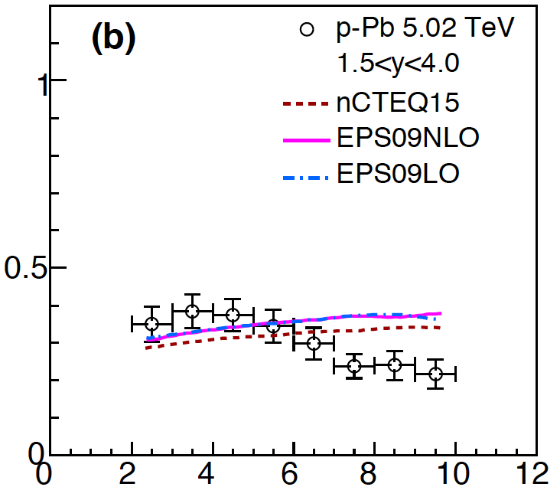
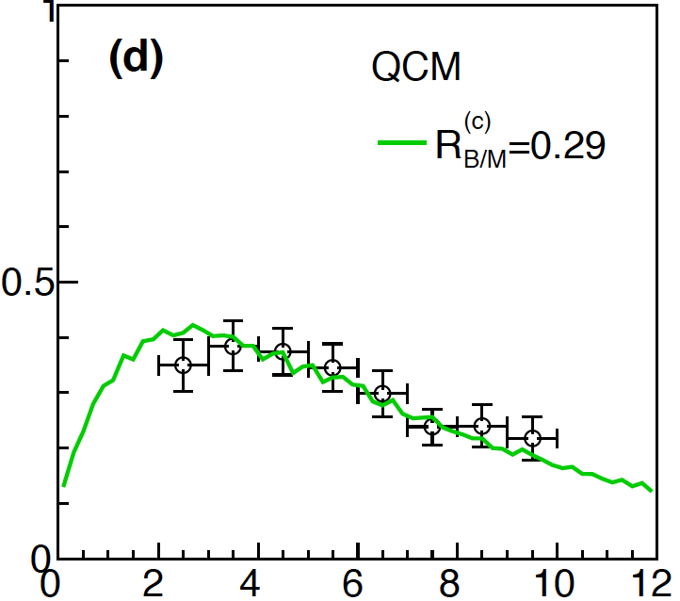
Prompt open charm: hadronization mechanics
Forward
Forward
$$Λ_{c}^{+ }/D^{0}$$
$$Λ_{c}^{+ }/D^{0}$$
Fragmentation
Combination
Li, Hai-hong, et al. PhysRevC.97.064915
b,c hadron
b,c hadron
$Λ_{c}^{+ }/D^{0}$ is consistent with both models with fragmentation and model with combination within uncertainties
light quark fragmented from b,c quark
gluon
light quark in medium
b,c quark
b,c quark
Fragmentation
Combination

Slide 16
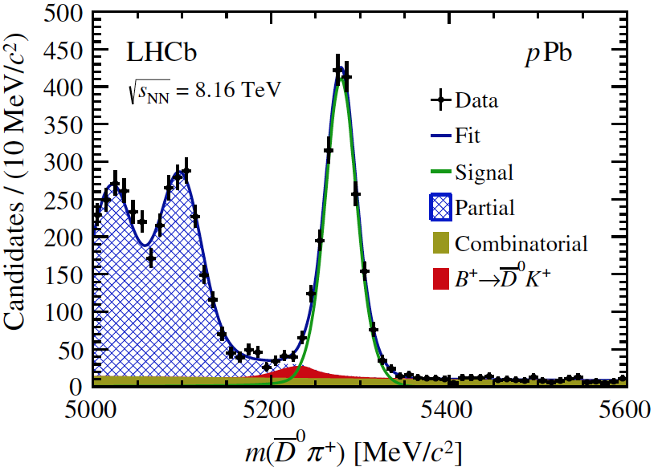
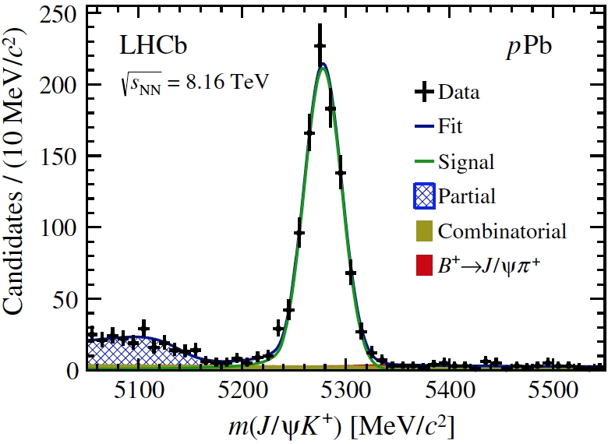
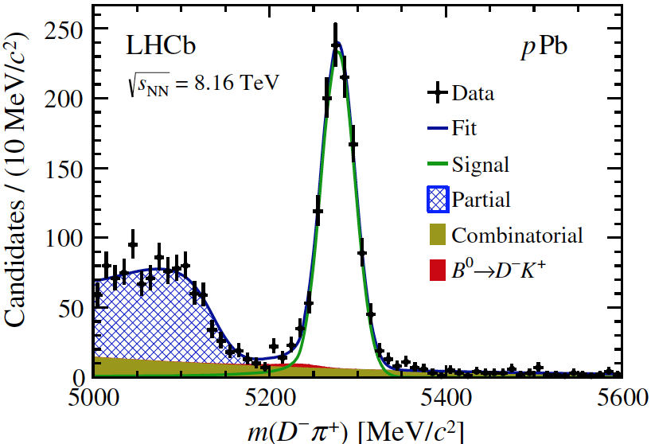
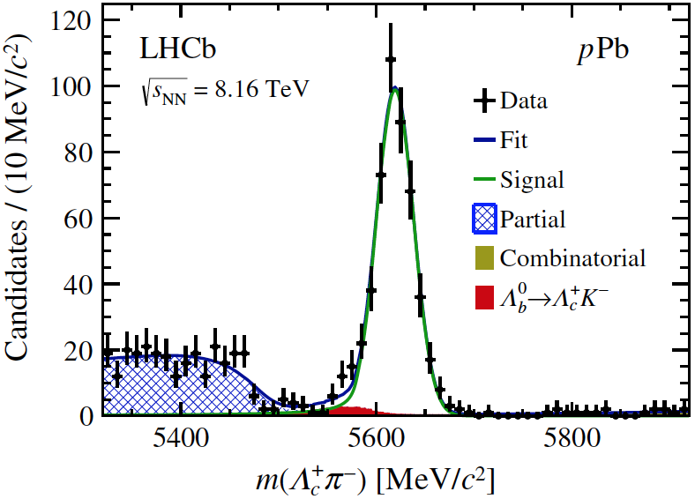
Open beauty: signals
$$B^{+}→\overline{D^{0}}π^{+}$$
$$B^{+}→J/ψK^{+}$$
Reconstructed through decay channels:
$B^{+}→\overline{D^{0}}π^{+}$;
$B^{+}→J/ψK^{+}$ ;
$B^{0}→D^{−}π^{+}$;
$Λ_{b}^{0}→Λ_{c}^{+}π^{−}$
Forward
Forward
$$B^{0}→D^{−}π^{+}$$
$$Λ_{b}^{0}→Λ_{c}^{+}π^{−}$$
Forward
Forward
LHCb. Phys. Rev. D99 052011 (2019)
Extract $N_{beauty}$ by fitting invariant mass distribution

Slide 17
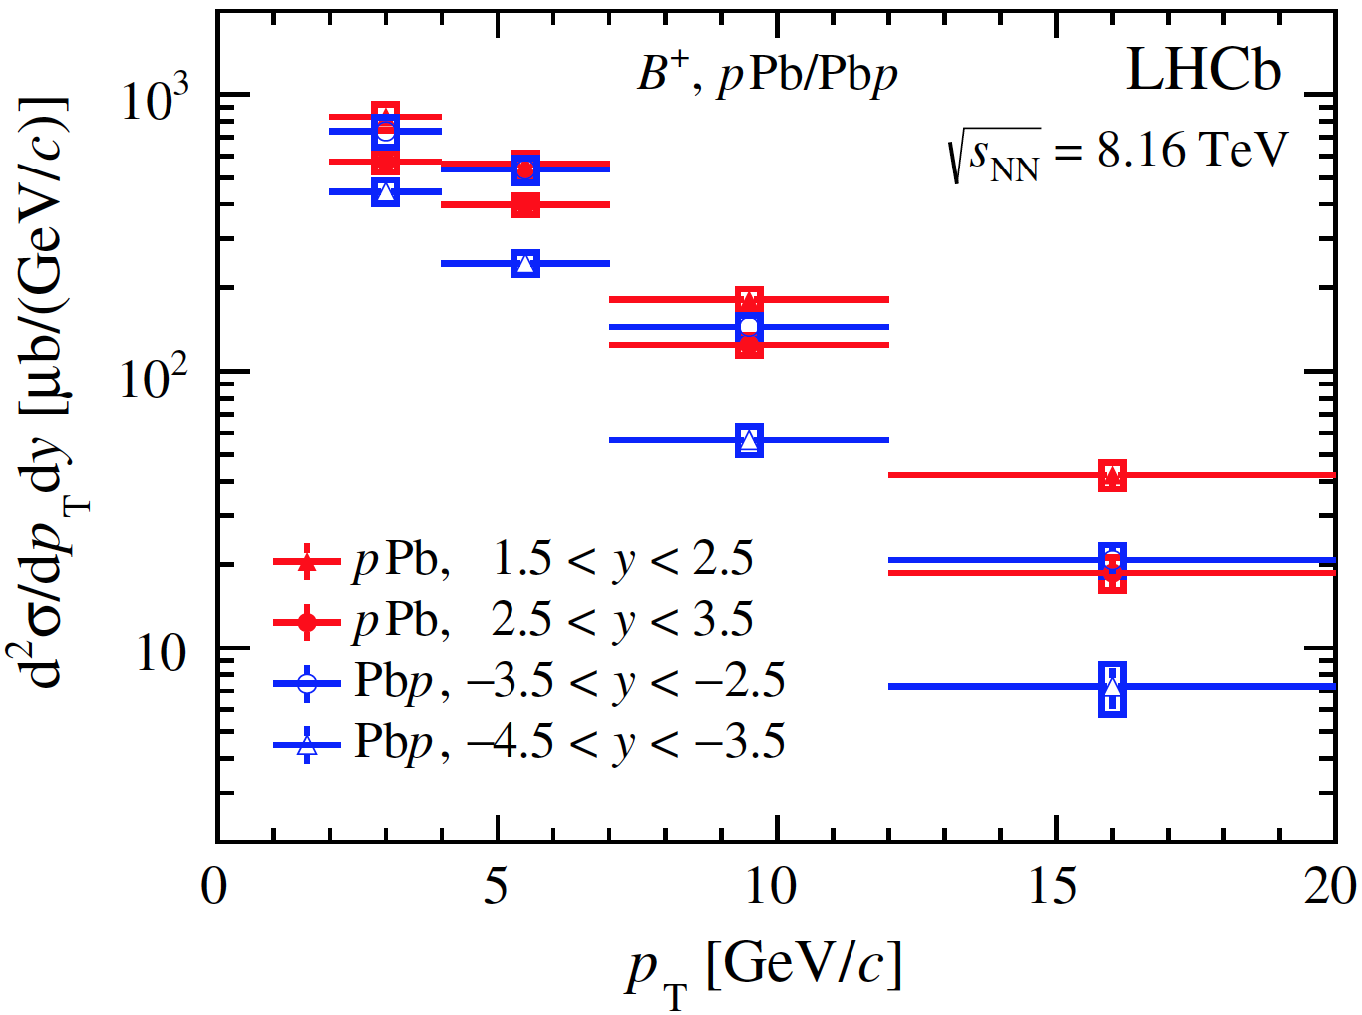
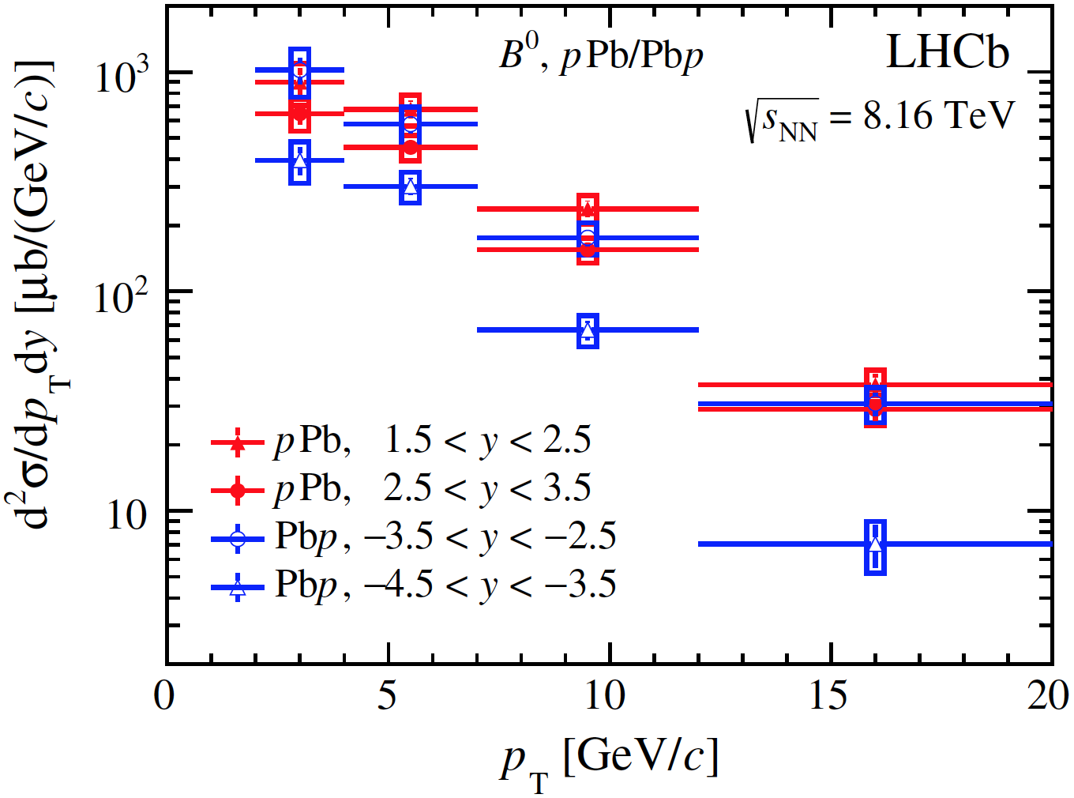
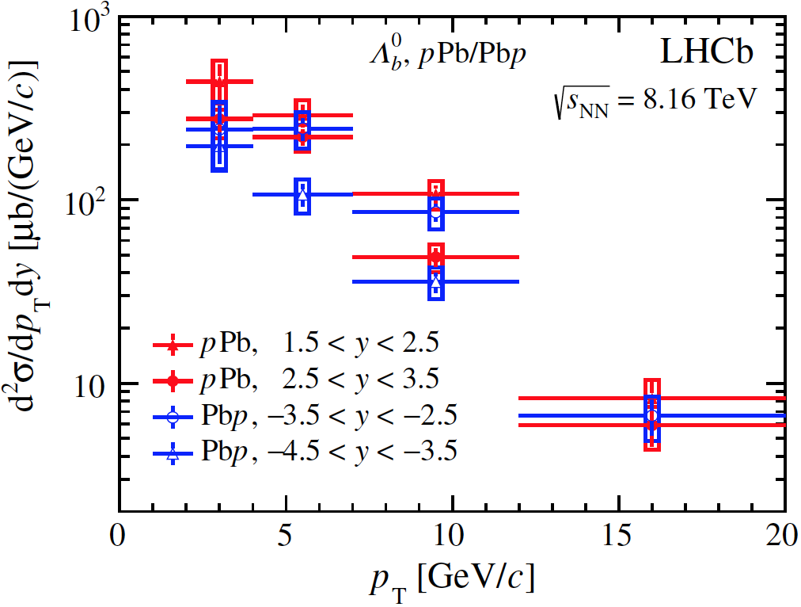
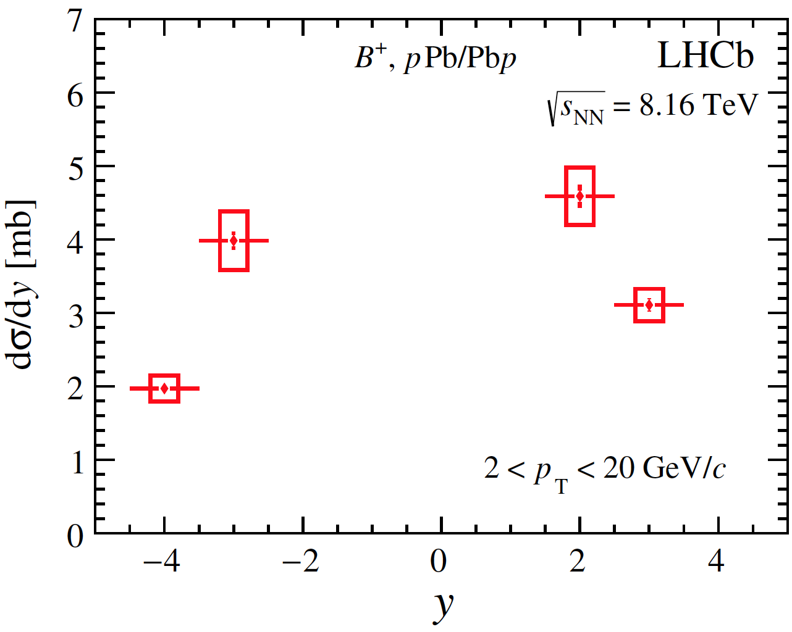
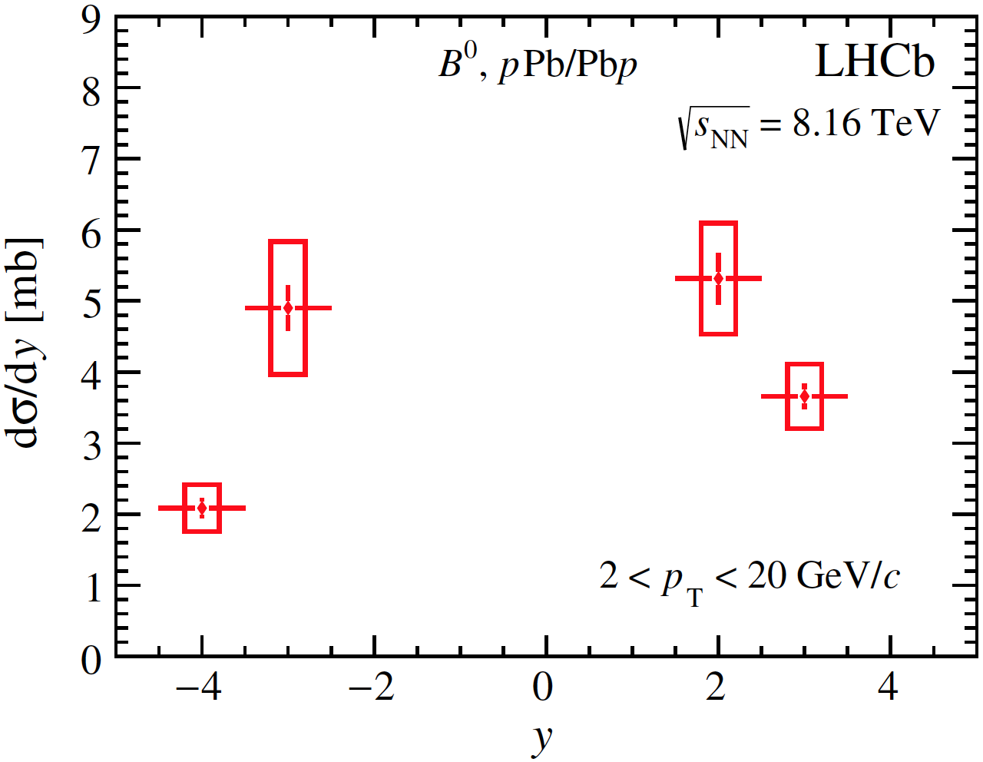
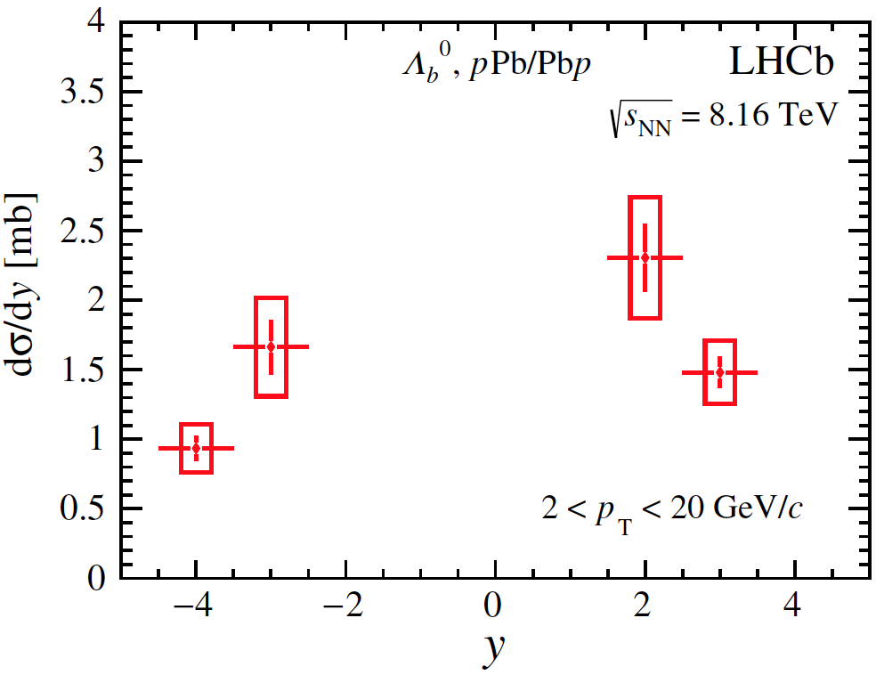
Open beauty: cross sections
tot.
tot.
tot.
stat.
stat.
stat.
tot.
tot.
tot.
stat.
stat.
stat.
LHCb. Phys. Rev. D99 052011 (2019)

Slide 18
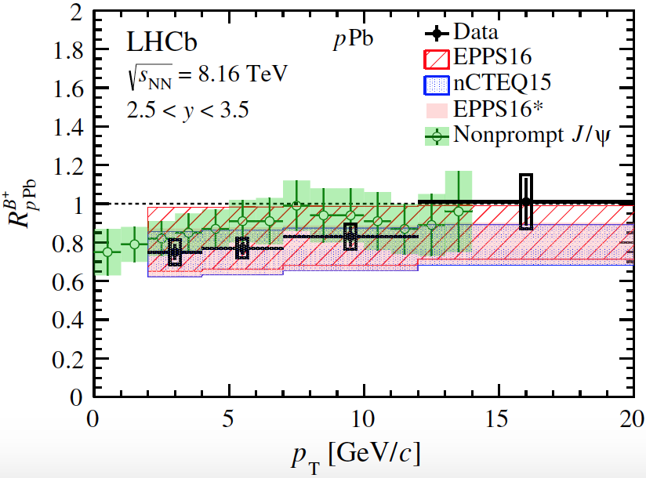
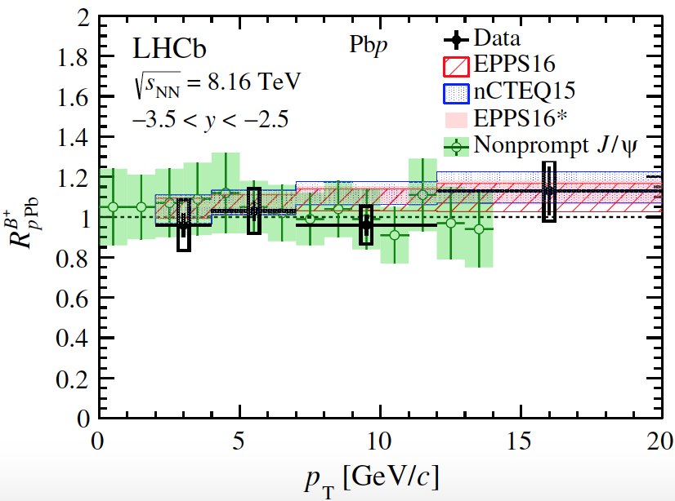
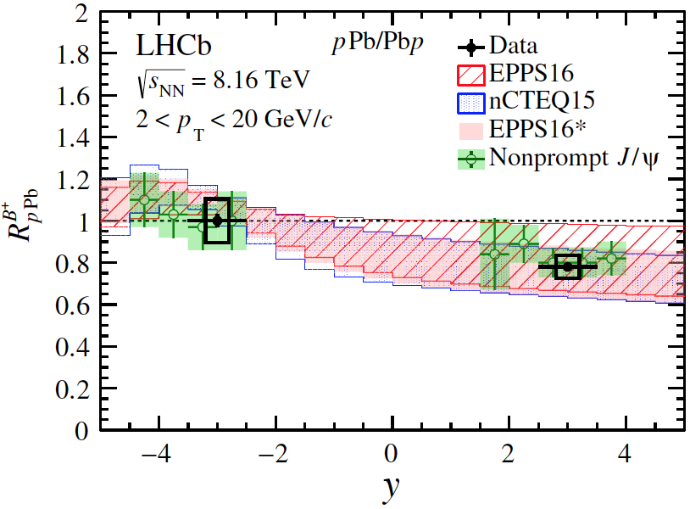
Open beauty: nuclear modification factor
Forward
Backward
tot.
tot.
stat.
stat.
Forward: suppressed, increases with $p_{T}$
Backward: no obvious suppression
Data are consistent with nPDF calculations and $J$/$ψ$ from b decay
tot.
stat.
LHCb. Phys. Rev. D99 (2019) 052011

Slide 19
Open beauty: nuclear modification factor
tot.
stat.
$$D^{0}$$
Eur. Phys. J. C (2017) 77:163
$R_{pPb}^{B^{+}}$ is suppressed at forward, no suppression at backward
Suppression-enhancement pattern predicted by nPDFs
$R_{pPb}^{B^{+}}$ suppression is compatible to $R_{pPb}^{D^{0}}$
LHCb. JHEP 10 (2017) 090
LHCb. Phys. Rev. D99 (2019) 052011

Slide 20
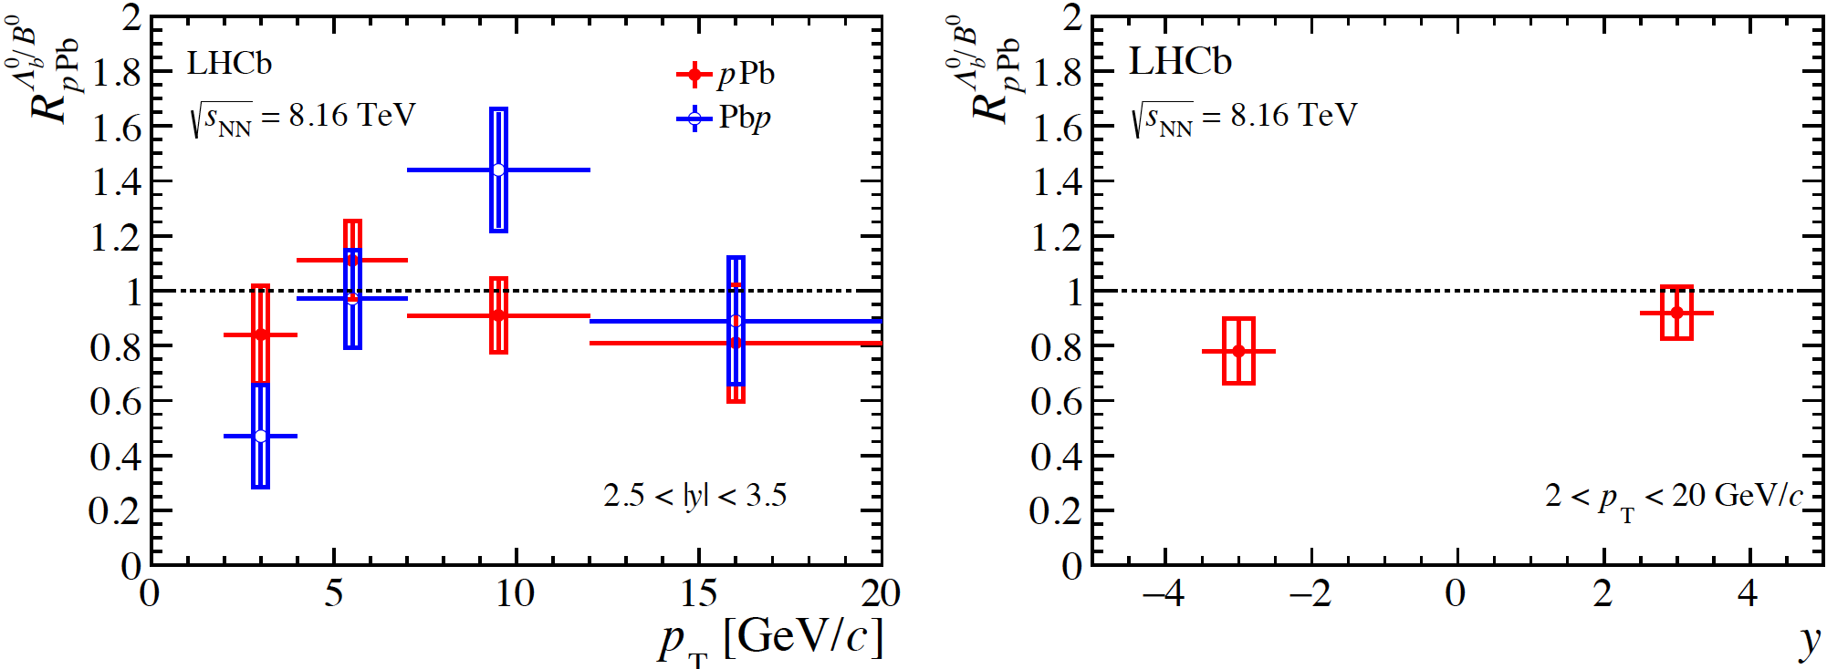
Open beauty: nuclear modification factor
tot.
stat.
tot.
stat.
$$R_{pPb}^{Λ_{b}^{0}/B^{0}}=R_{pPb}^{Λ_{b}^{0}}/R_{pPb}^{B^{0}}$$
Nuclear modification factor ratio of $Λ_{b}^{0}$ and $B^{0}$ is close to unity at forward
Suffer large uncertainty at backward due to limited sample size
LHCb. Phys. Rev. D99 052011 (2019)

Slide 21
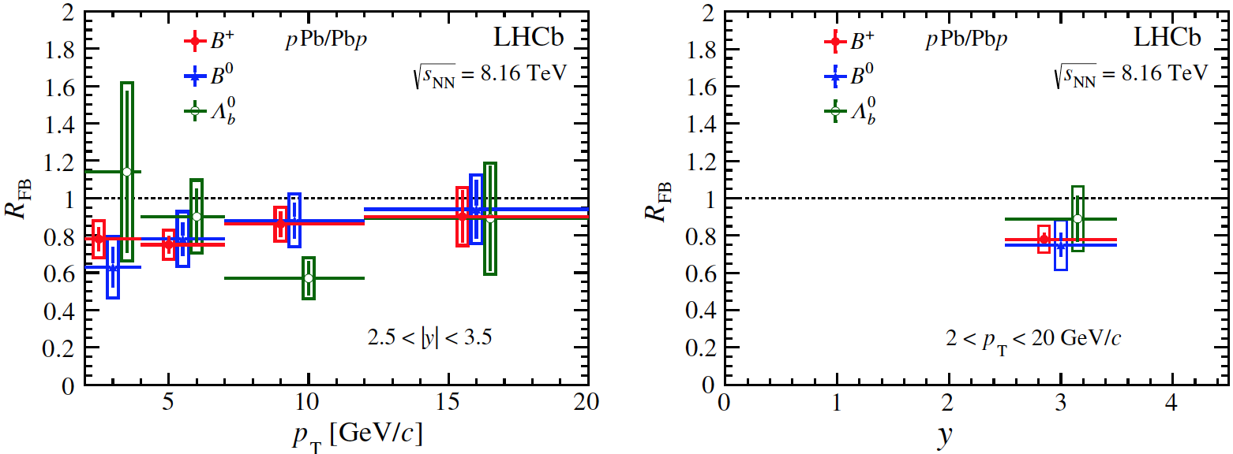
Open beauty: forward-backward ratio
tot.
tot.
stat.
stat.
$R_{FB}$ for $B$ mesons $<1$
No strong dependence on $p_{T}$ is observed
Consistent with nPDF calculations
$R_{FB}$ for $B^{0}$ and $B^{+}$ are similar
$R_{FB}$ for $Λ_{b}^{0}$ suffers large statistical uncertainty
LHCb. Phys. Rev. D99 052011 (2019)

Slide 22
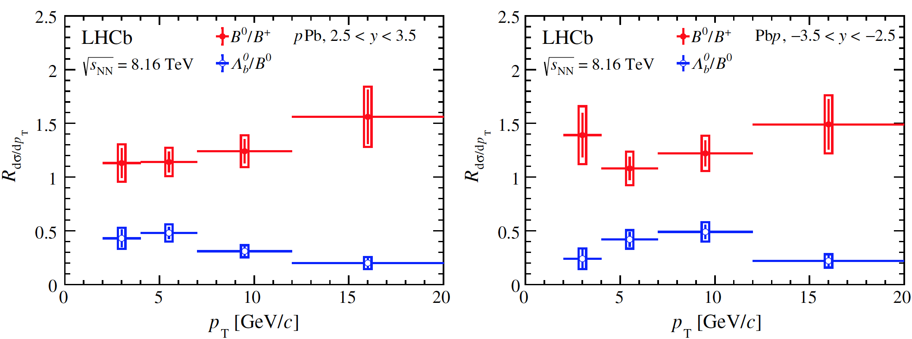
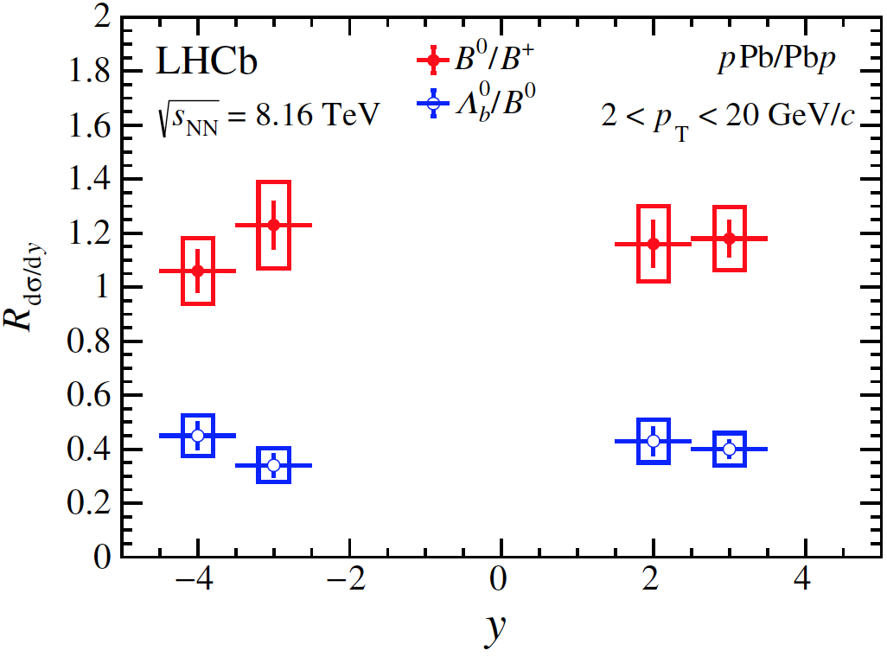
Open beauty: particle ratio
Forward
Backward
tot.
tot.
stat.
stat.
$$\frac{dσ_{B^{0}}/dy(dp_{T})}{dσ_{B^{+}}/dy(dp_{T})}$$
$$\frac{dσ_{Λ_{b}^{0}}/dy(dp_{T})}{dσ_{B^{0}}/dy(dp_{T})}$$
tot.
$B^{0}$/$B^{+}$ about 1$σ$ from 1, explained by systematic uncertainties
$Λ_{b}^{0}\text{/}B^{0}≈0.4$, decreases at high $p_{T}$, and is compatible to $Λ_{c}^{+}/D^{0}$ in the same region
stat.
LHCb. Phys. Rev. D99 052011 (2019)

Slide 23
Summary and outlook
LHCb has excellent capabilities to study heavy flavor in heavy ion studies
Production of $D^{0}$ and $Λ_{c}^{+}$ measured in 5.02 TeV $p$Pb collisions by LHCb
$R_{pPb}^{D^{0}}$ is significantly suppressed in the forward and more precise than theory and is used to constrain models
$R_{FB}^{D^{0}}$ and $R_{FB}^{Λ_{c}^{+}}$ agree with QCD models and $R_{FB}^{D^{0}}$ has smaller uncertainties than theory
$R_{Λ_{c}^{+}/D^{0}}$ agrees with model except in forward high $p_{T}$ bins
Production of $B^{+}$, $B^{0}$ and $Λ_{b}^{0}$ measured in 8.16 TeV $p$Pb collisions by LHCb
$R_{pPb}^{B^{+}}$ agrees with QCD theory and $J$/$ψ$ from b decay
$R_{pPb}^{Λ_{b}^{0}}$/$R_{pPb}^{B^{0}}$ $≈1$at forward rapidity
Production of open charm in 8.16 TeV and more species in 5.02 TeV $p$Pb collisions are under study
Multiplicity dependence

Slide 24
Thank you!

Slide 25
Back up slides

Slide 26
Open charm production: prompt $D^{0}$
Reconstructed through decay channel: $D^{0}→K^{−}π^{+}$
Obtain $D^{0}$ yields $N(D^{0}→K^{−}π^{+})$ by fitting invariant mass distribution:
Signal: Crystal Ball + Gaussian
Background: linear
JHEP 10 (2017) 090

Slide 27
Open charm production: prompt $D^{0}$
$$p\left(K^{−}\right)+p(π^{+})$$
Extract prompt $D^{0}$ by fitting $χ_{IP}^{2}$ distribution
Prompt: simulation
from $b$: simulation
Background: sideband in data
$$π^{+}$$
$$K^{+}$$
$$D^{0}$$
$$PV$$
others
$$IP$$
JHEP 10 (2017) 090

Slide 28
Prompt $D^{0}$: cross section
Double-differential Cross section: $\frac{d^{2}σ}{dydp_{T}}=\frac{N(D^{0}→K^{−}π^{+};{ p}_{T},y)}{ℒ×ε(p_{T},y)×ℬ(Λ_{c}^{+}→pK^{−}π^{+})×Δy×Δp_{T}}$
The uncertainty is the quadratic sum of the statistical and systematic components
$ε(p_{T},y)$: effeciency estimated from simulation sample
$σ(p_{T}<10 GeV/c$ $, 1.5<y^{∗}<4.0)=230.6±0.5(stat)±13.0(sys)$ mb
$σ(p_{T}<10 GeV/c$ $, −5.0<y^{∗}<−2.5)=252.7±1.0(stat)±20(sys)$ mb
JHEP 10 (2017) 090

Slide 29
Open charm production: prompt $Λ_{c}^{+}$
Reconstructed throught decay channel:$Λ_{c}^{+}→pK^{−}π^{+}$
Obtain $Λ_{c}^{+}$ yields $N(Λ_{c}^{+}→pK^{−}π^{+})$ by fitting invariant mass distribution:
Signal: Gaussian
Background: linear
JHEP 02 (2019) 102

Slide 30
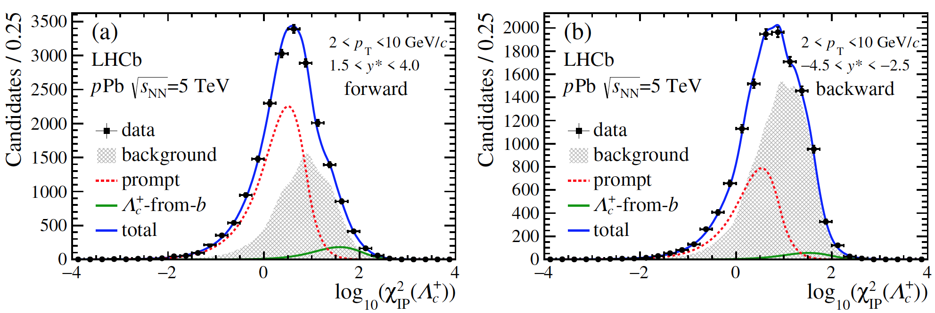
Open charm production: prompt $Λ_{c}^{+}$
Extract prompt $Λ_{c}^{+}$ by fitting $χ_{IP}^{2}$ distribution
Prompt: simulation
from $b$: simulation
Background: sideband in data
$$p\left(K^{−}\right)+p\left(π^{+}\right)+p\left(p^{+}\right)$$
$$p^{+}$$
$$π^{+}$$
$$K^{+}$$
$$Λ_{c}^{+}$$
others
$$PV$$
$$IP$$
JHEP 02 (2019) 102

Slide 31
Prompt $Λ_{c}^{+}$: cross section
stat.+sys.
stat.+sys.
Double-differential Cross section: $\frac{d^{2}σ}{dydp_{T}}=\frac{N(Λ_{c}^{+}→pK^{−}π^{+};{ p}_{T},y)}{ℒ×ε(p_{T},y)×ℬ(Λ_{c}^{+}→pK^{−}π^{+})×Δy×Δp_{T}}$
$ε(p_{T},y)$: effeciency estimated from simulation sample
$σ(2<p_{T}<10 GeV/c$ $, 1.5<y^{∗}<4.0)=32.1±1.1(stat)±3.2(sys)$ mb
$σ(2<p_{T}<10 GeV/c$ $, −5.0<y^{∗}<−2.5)=27.7±1.8(stat)±3.8(sys)$ mb
JHEP 02 (2019) 102

