Slide 1
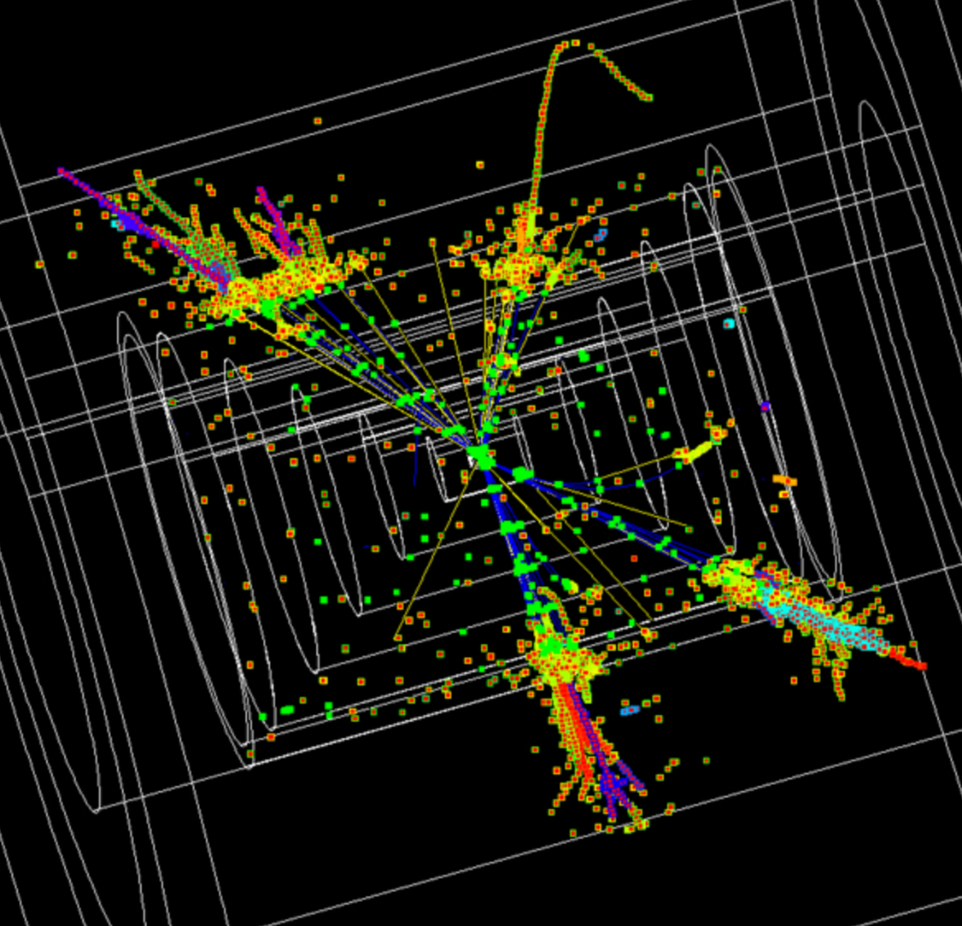

QCD opportunities at future e⁺e⁻ colliders
Andrea
Banfi
CEPC Physics Workshop - 3 JuLY 2019 – Beijing

Slide 2
Outline
Personal selection of theoretically intriguing problems, whose solution would greatly benefit from future electron-positron colliders (FEPC)
Hadronisation corrections (and a bit of EW effects)
Hadronic decays of heavy objects
Top mass determinations
Ultimately, our success is solving those problems will be reflected in more accurate measurements of the short-distance parameters of QCD, the strong coupling and the top mass

Slide 3
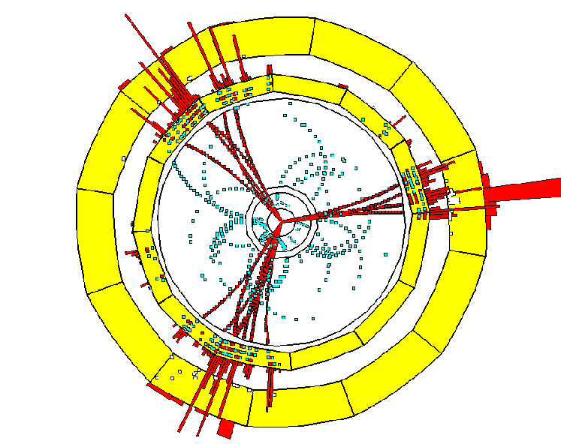
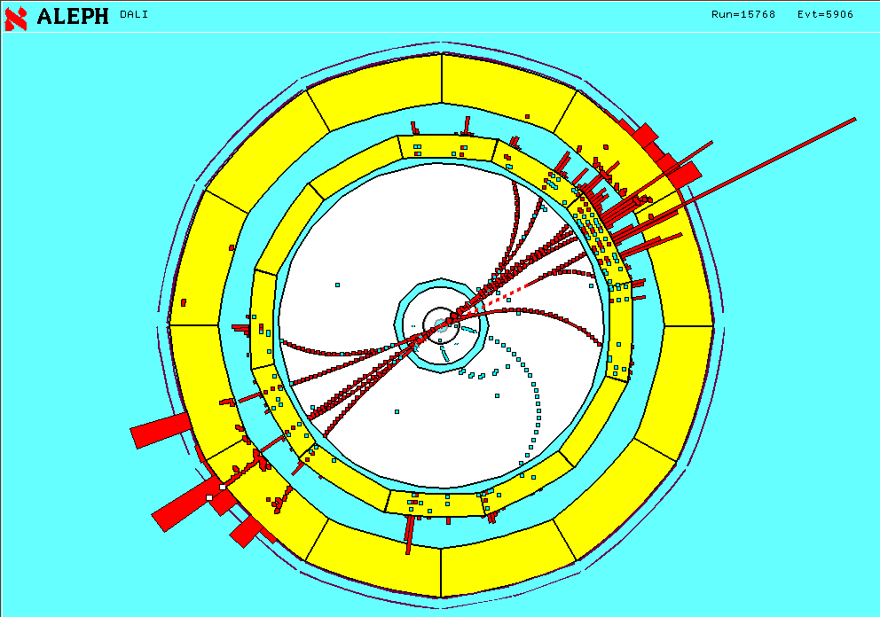
Jet observables in QCD
Jet observables (e.g. event-shape distributions and jet rates) are powerful probes of QCD dynamics from high to low scales

Slide 4
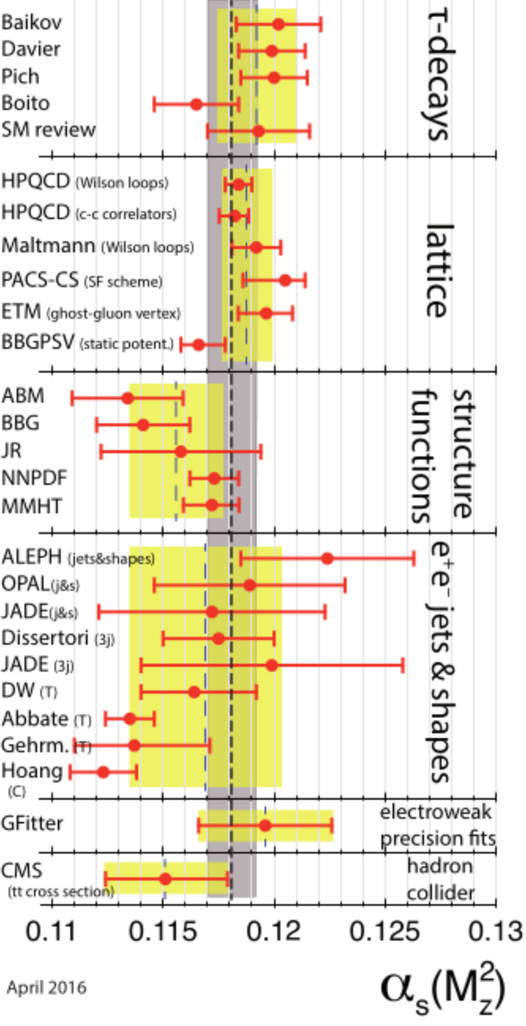

Strong coupling with jets
Jet observables constitute an important means of determination of the strong coupling
Currently, tension between determinations with different jet observables
What is the main difference between various approaches?
Event shapes and jet-rates (NLL+NNLO)
Thrust and C-parameter ((N)NNLL+NNLO)
[PDG 2019]

Slide 5
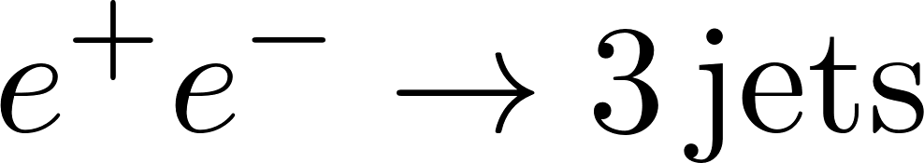
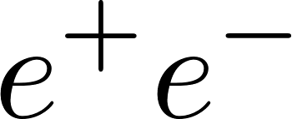
Progress in PT calculations
The last ten years have been characterised by an impressive progress in perturbative calculations for jet observables
NNLO calculation of
NNLL resummation of factorisable observables (e.g. thrust, broadening) in SCET
General NNLL resummation of event shapes in annihilation with the ARES method
First-ever NNLL resummation of a jet-rate with ARES
Given this precision, the relevant question is how to estimate non-perturbative corrections due to hadronisation
[Gehrmann-De Ridder Gehrmann Glover Heinrich 0711.4711]
[Becher Schwartz 0803.0342]
[Becher Bell 1210.0580]
[AB Monni McAslan Zanderighi 1412.2126]
[AB Monni McAslan Zanderighi 1607.03111]

Slide 6
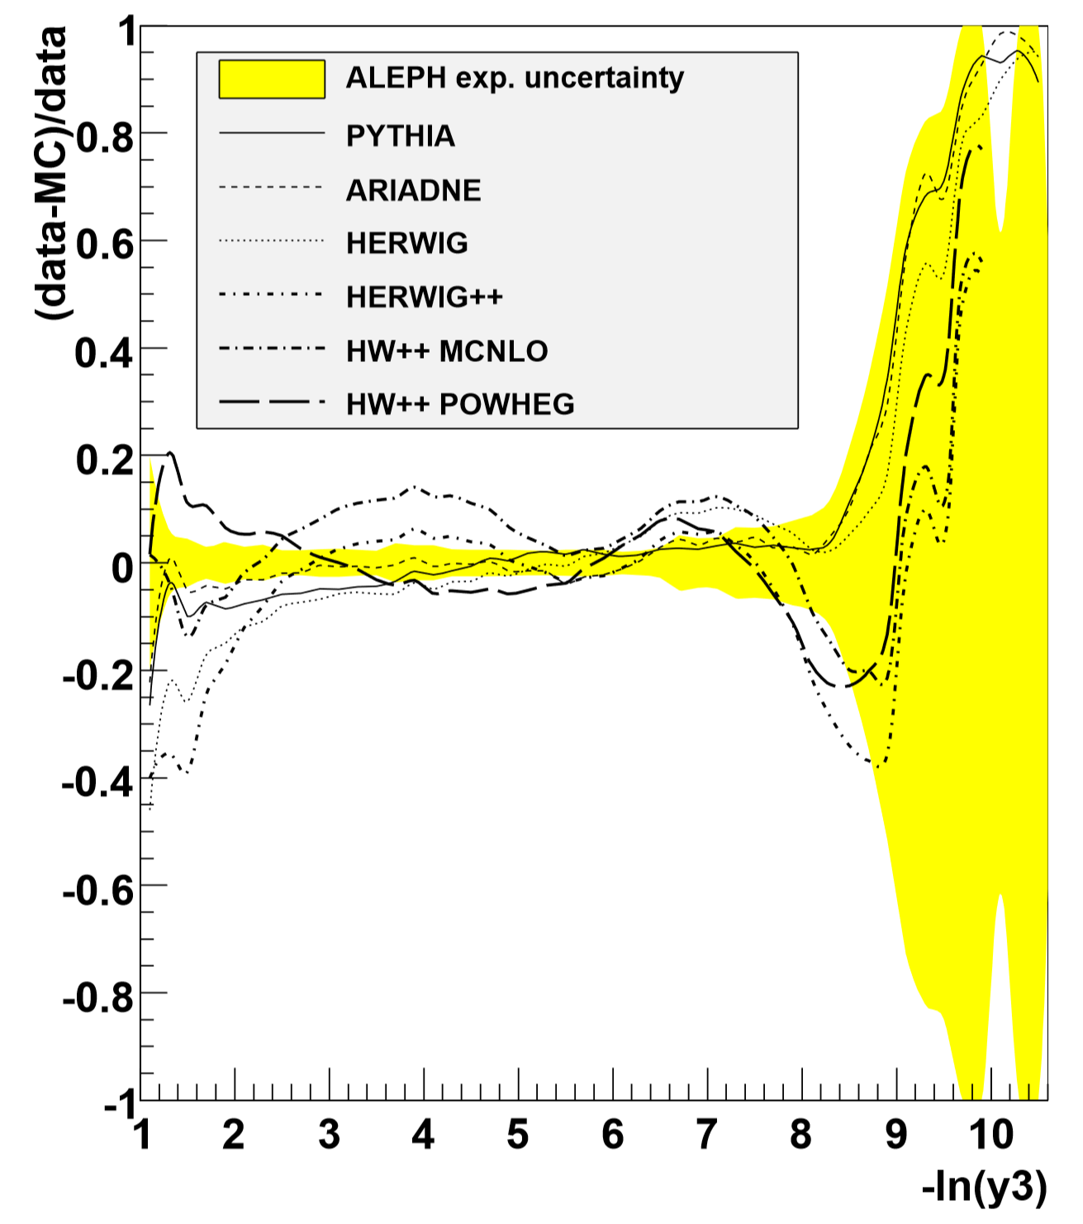

Hadronisation corrections
Most analyses determine hadronisation corrections using Monte Carlo event generators, as the ratio between hadron- and parton-level results
[Dissertori et al 0906.3436]
Hadronisation uncertainty
Perturbative QCD uncertainty
This approach is sensible as long as perturbative QCD uncertainties dominate
Recent calculations have pushed to accuracy of QCD calculations to NNLL hadronisation main source of uncertainty!
[Verbytskyi et al 1902.08158]

Slide 7
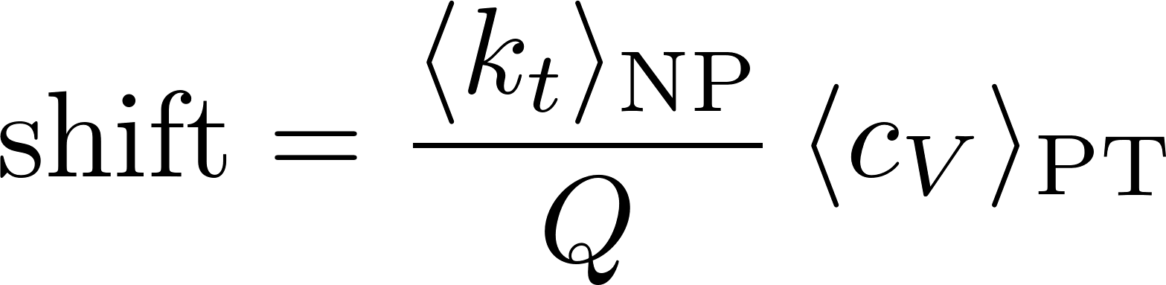
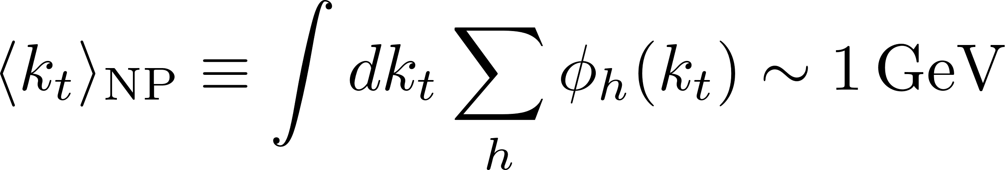
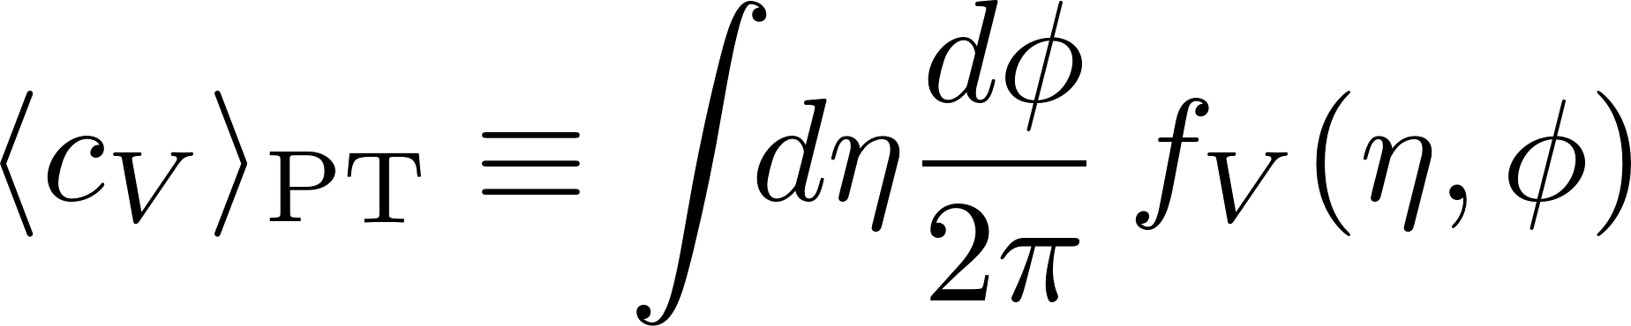
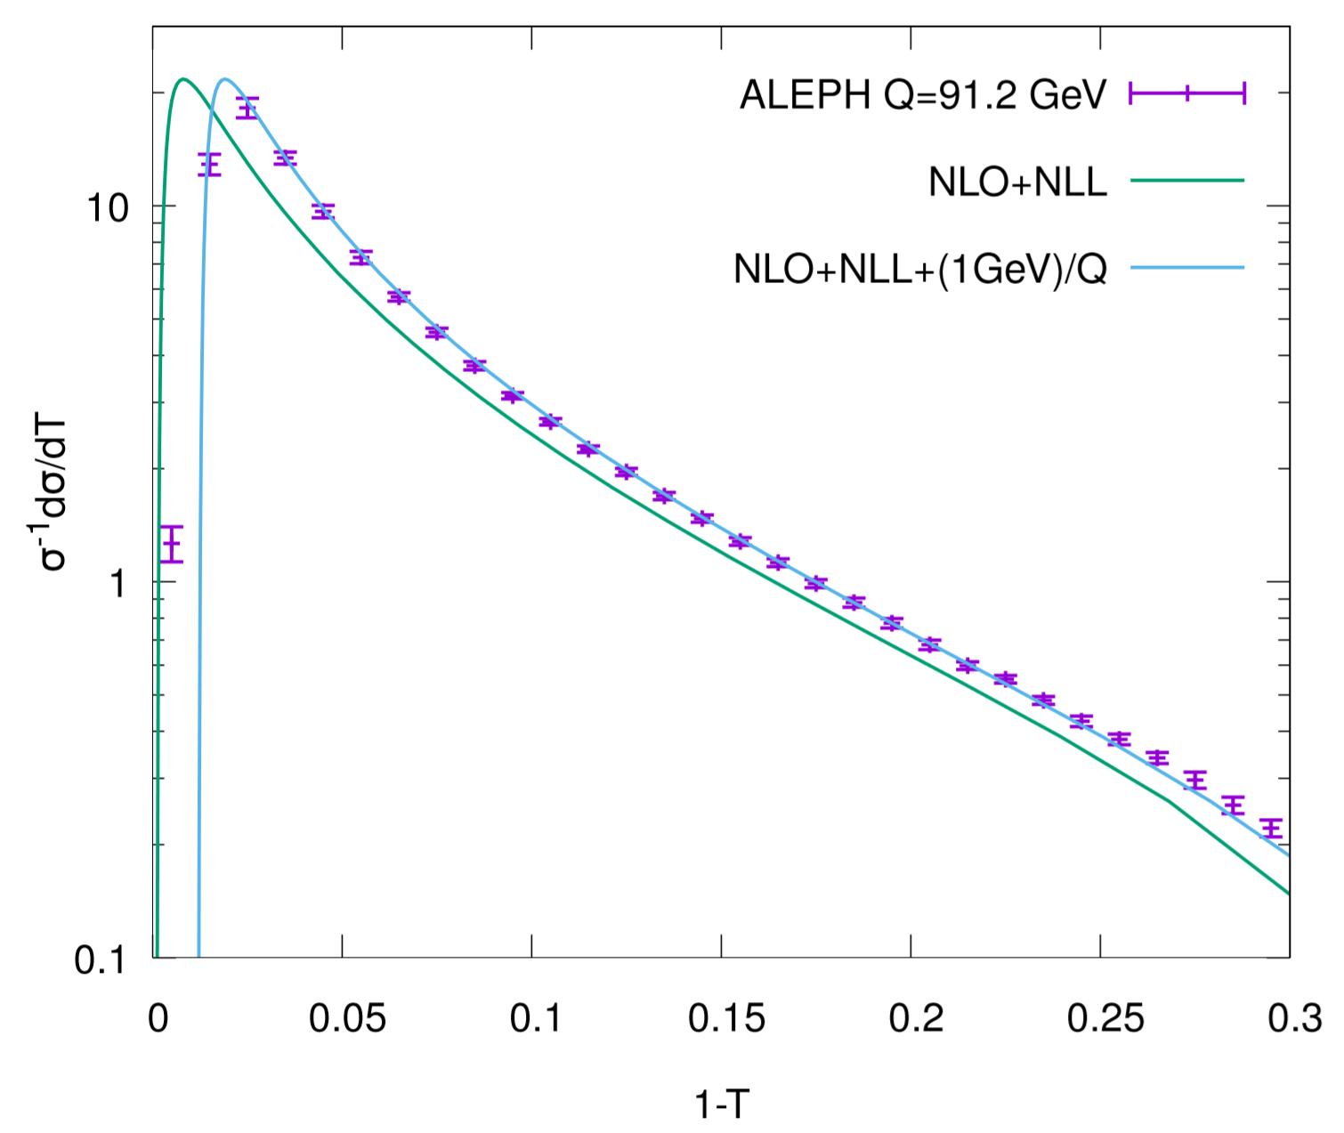
Leading hadronisation effects
Central hadrons with momenta ~1GeV give rise to shift of perturbative distributions of jet observables
[Dokshitzer Webber hep-ph/9704298]
Average over PT configurations
Universal (?) NP parameter
Observable dependent but calculable

Slide 8



Simultaneous PT-NP fits
Most accurate determinations of thrust and C-parameter arise from simultaneous fits of 1/Q hadronisation corrections
Such fits give values of the strong coupling below the world average
Thrust (NNLL+NNLO)
C-parameter (NNNLL+NNLO)
[Gehrmann Luisoni Monni 1210.6945]
[Hoang Kolodubrez Mateu Stewart 1501.04111]
Both Monte-Carlo and analytic determinations of hadronisation corrections are challenged by the precision of perturbative QCD calculations
Monte Carlo event generators have the correct kinematics, but predictions are too dependent on the hadronisation model
Using just leading hadronisation corrections might be an oversimplification in the fit region, what is the impact of neglected effects?

Slide 9
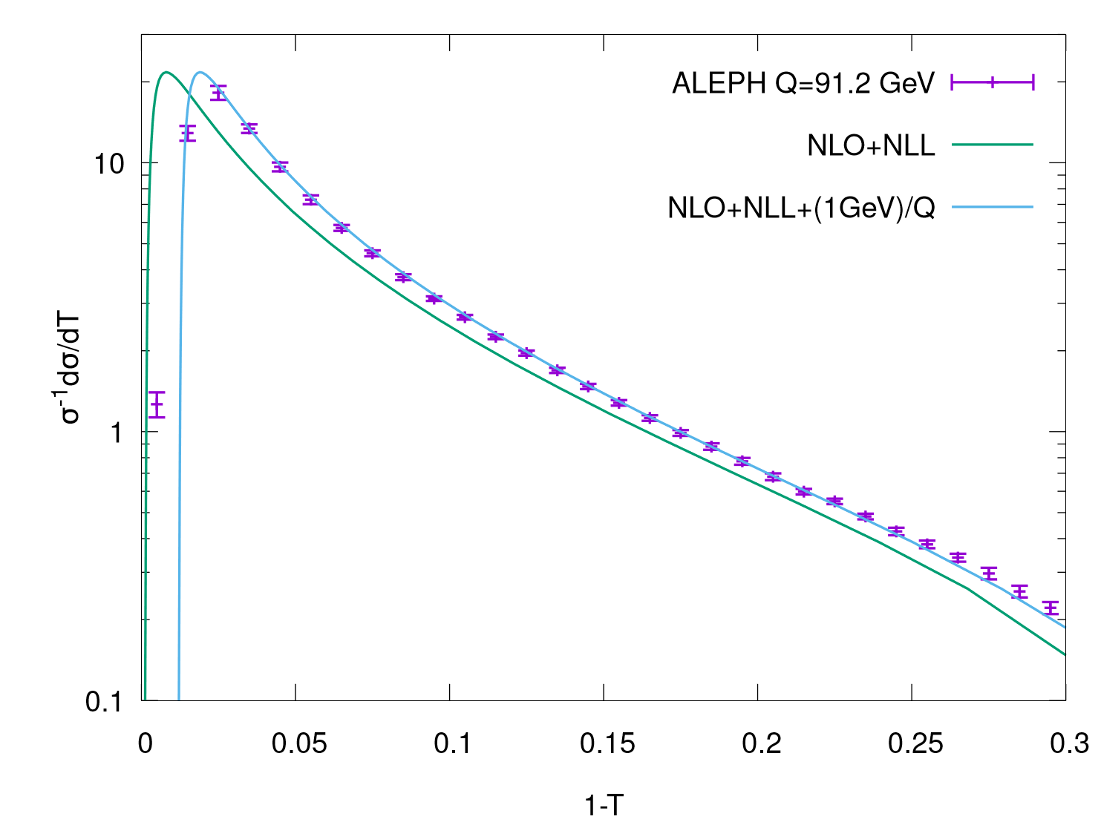
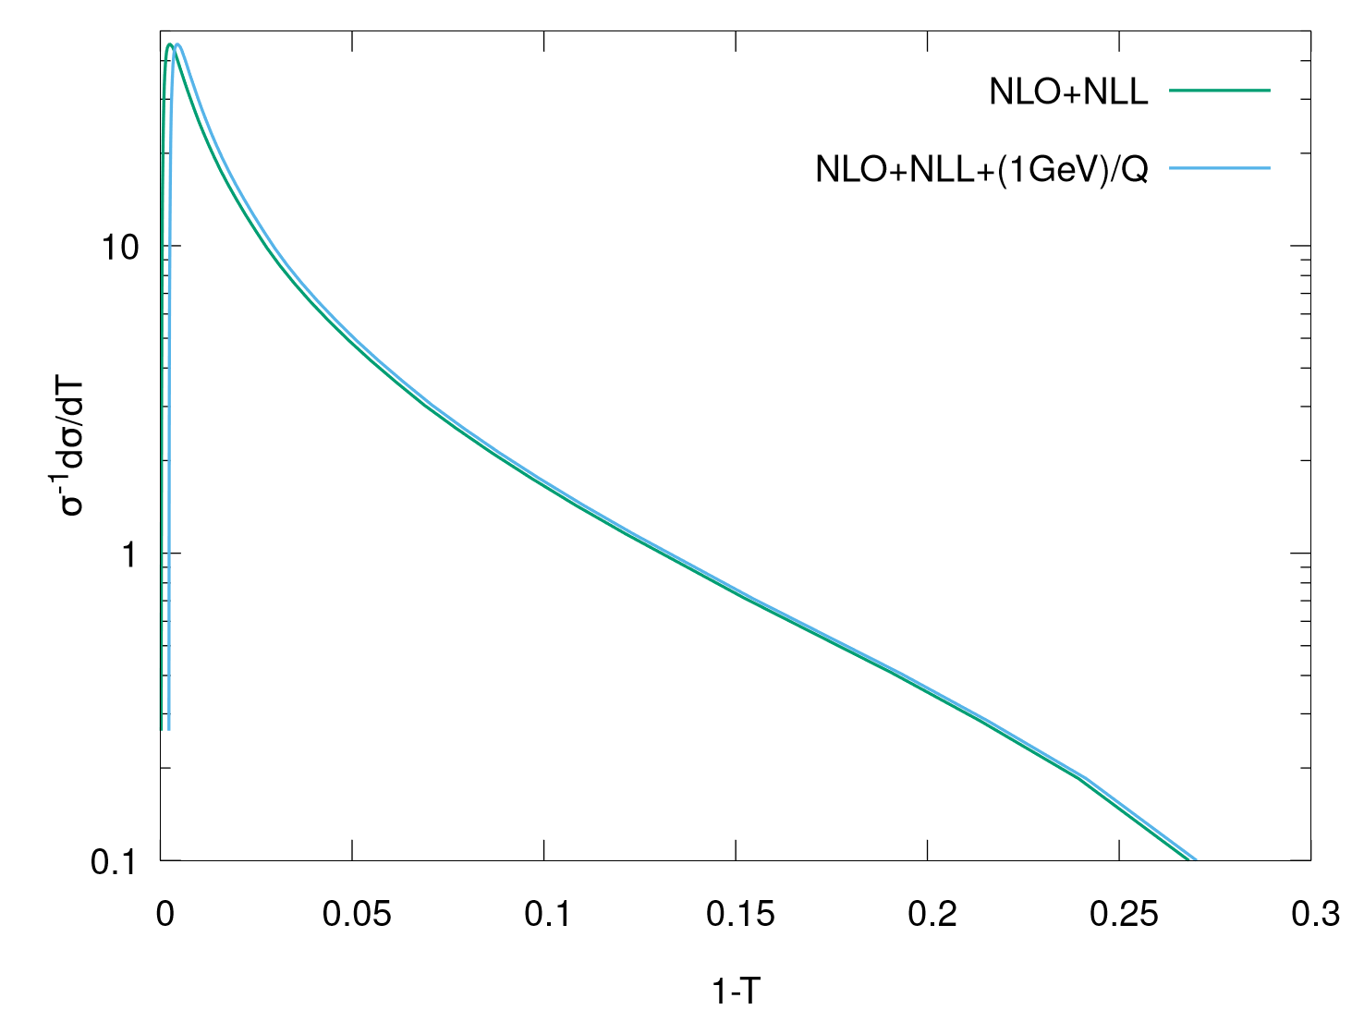


Hadronisation at FEPC
At future colliders, hadronisation corrections to two-jet observables are smaller than at LEP1 1 jet ~ 1 parton
Two-fold advantage for fits of the strong coupling
Monte-Carlo hadronisation corrections will have a reduced impact in the error on perturbative uncertainties (now ~0.1%) dominant
Negligible impact of subleading hadronisation corrections more reliable determination of NP parameter(s) of leading 1/Q corrections

Slide 10
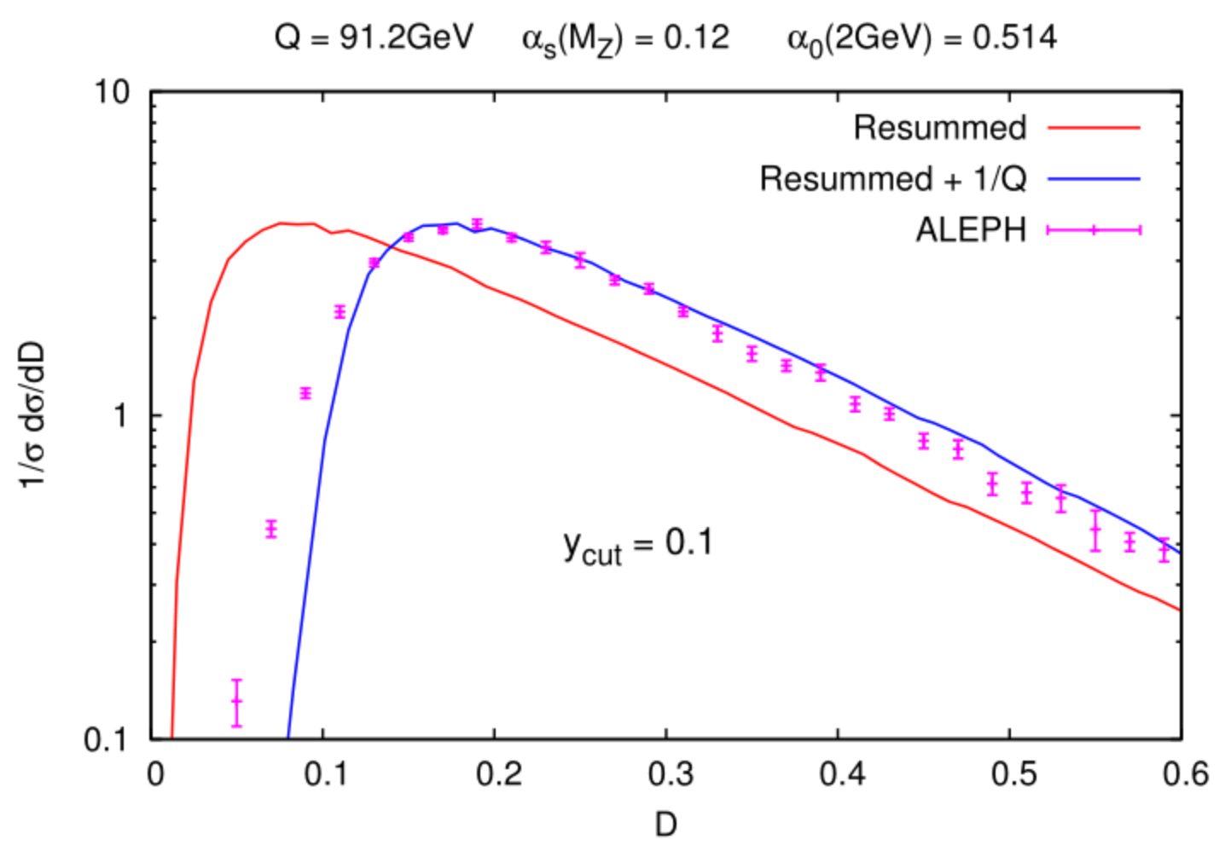
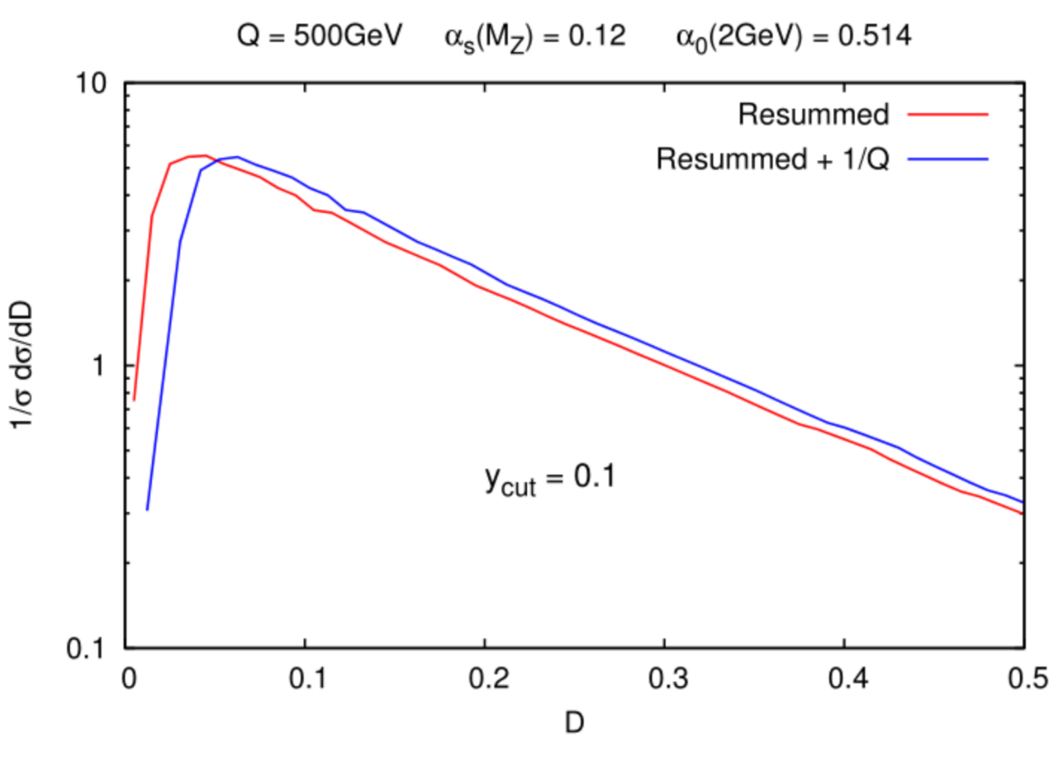
multi-jet opportunities
Near-to-planar three-jet event shapes (e.g. D-parameter) could be used to probe hadronisation effects in gluon jets
Hadronisation corrections in three-jet events are very large at LEP (twice as large as in two-jet events due to radiating gluon) fits of leading hadronisation corrections problematic
Hadronisation effects in three-jet observables at future colliders are as large as those for two-jet event shapes at LEP new tests of leading hadronisation corrections
[AB Dokshitzer Marchesini Zanderighi hep/ph 0104162]
[AB 0706.2722]

Slide 11
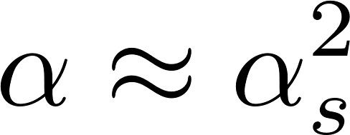
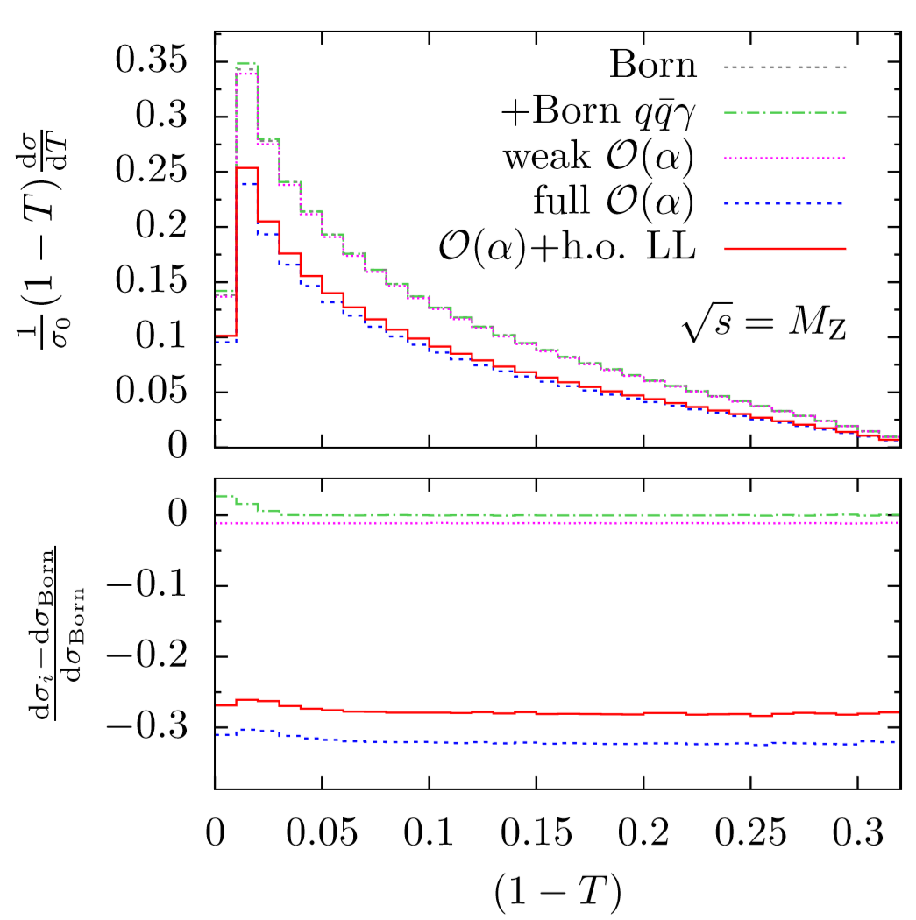
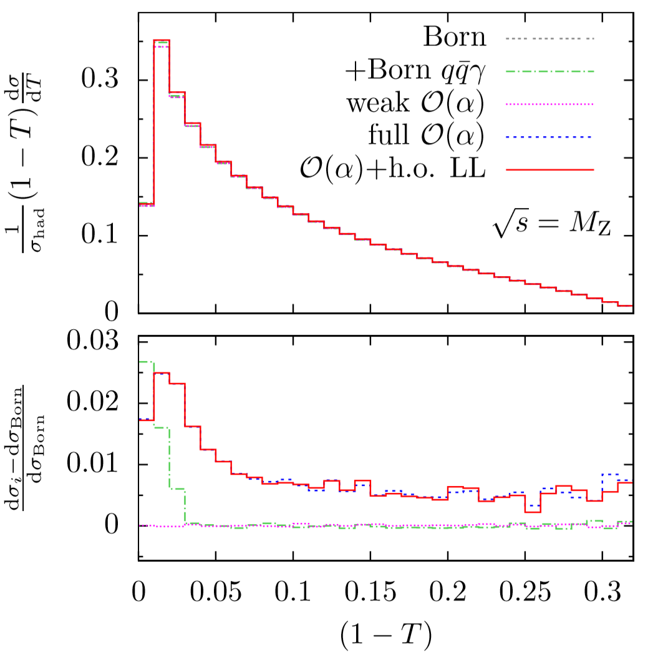
Electroweak corrections
NLO EW effect potentially as large as NNLO
Photon ISR effects largely cancel when taking ratios with total cross sections, yet results depend largely on photon isolation cuts
EW loop effects contribute at the per-mille level
Under control no need to correct for photons or separate WW
[Denner Dittmaier Gehrmann Kurz 1003.0986]

Slide 12
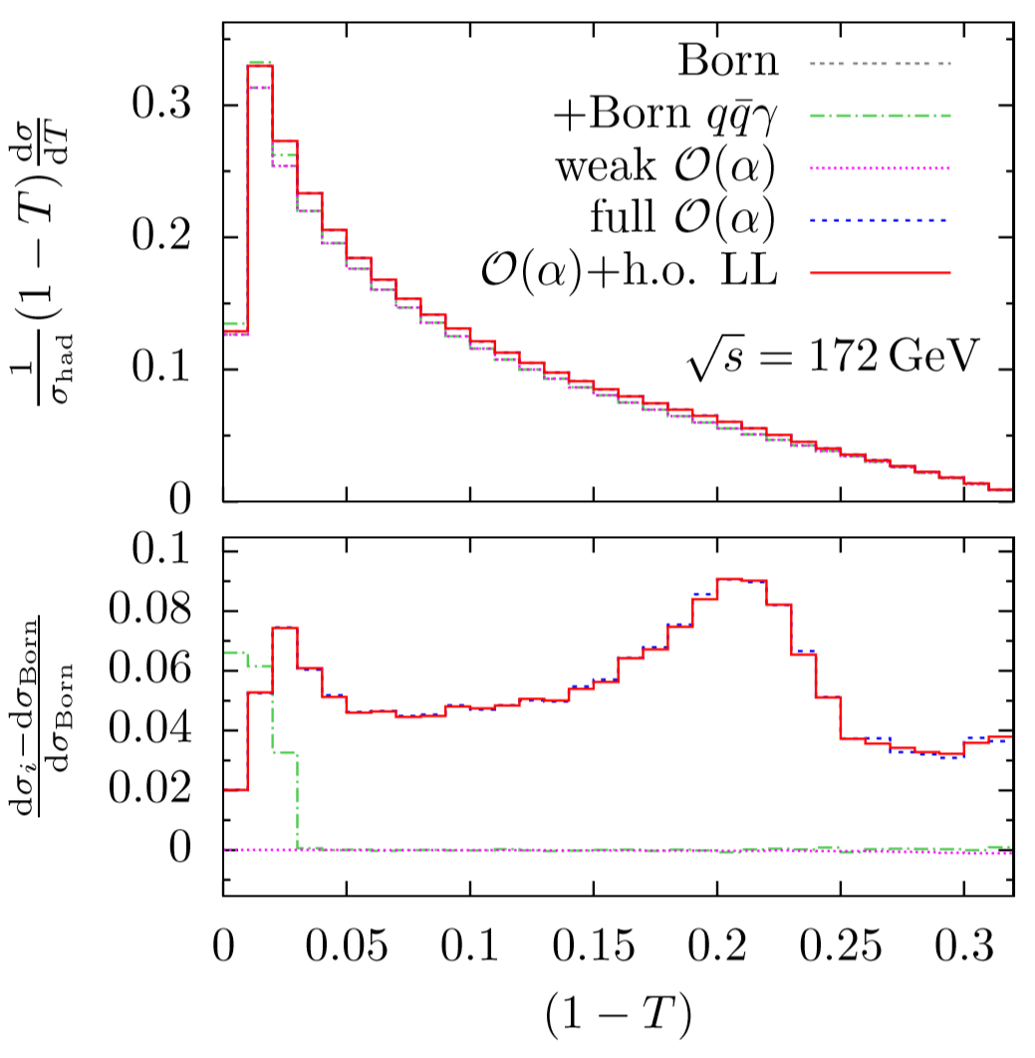
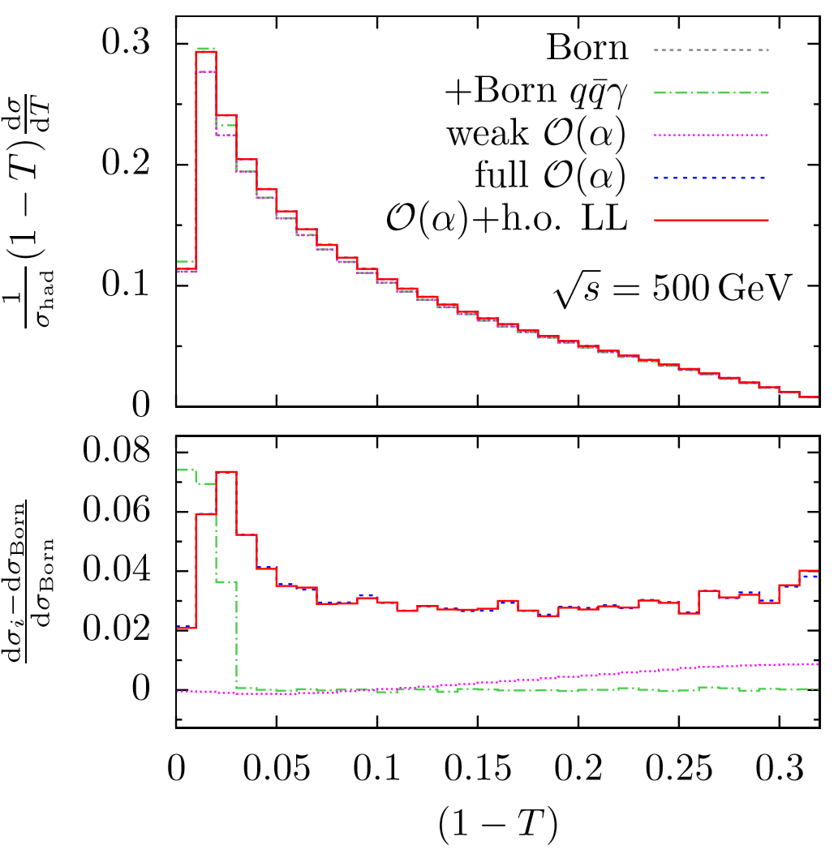
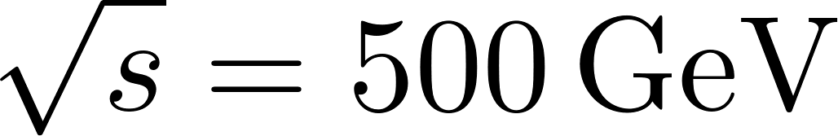
Electroweak corrections
NLO EW effect potentially as large as NNLO
Additional peaky structure due to radiative return + clustering of a soft gluon with the hard photon
The additional peak moves to lower values of the observables with incearsing energy and disappears at
[Denner Dittmaier Gehrmann Kurz 1003.0986]

Slide 13
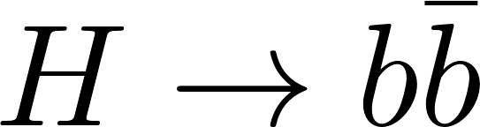
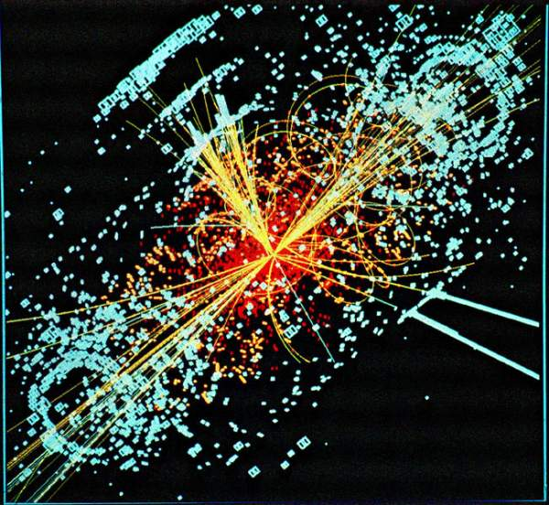
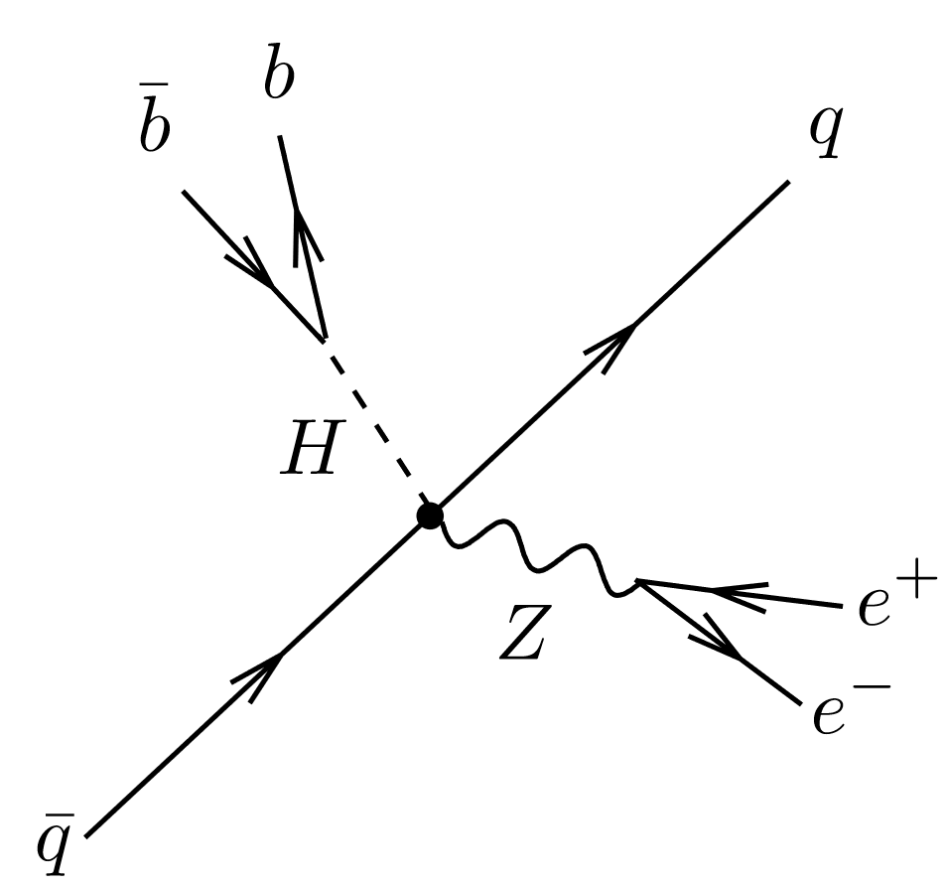
Hadronic decays at the LHC
The Higgs decay mode with the largest branching ratio is hadronic
General strategy to look for hadronic decays of (boosted) heavy objects
[Butterworth Davison Rubin Salam 0802.2470]
Cluster events into large-radius “fat” jets, and impose that these have a substructure corresponding to the hadronic decay “prongs”
Clean jets to avoid contamination from ISR and underlying event

Slide 14

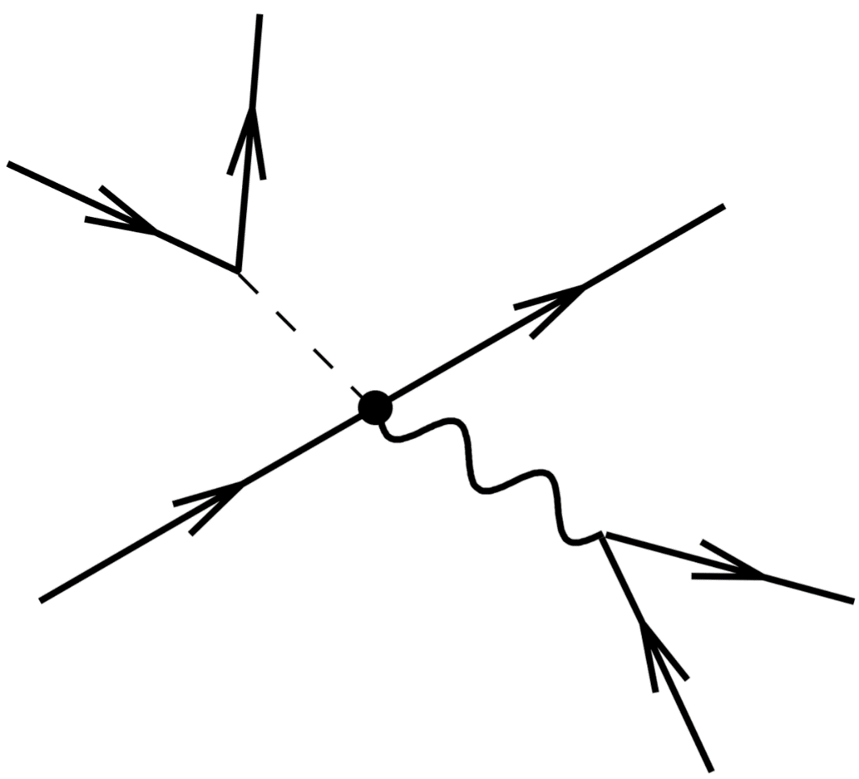





Hadronic decays at FEPC
Future colliders will greatly benefit from our improved understanding of the difference between QCD jets and those originating from hadronic decays of heavy objects
Some change of strategies required when moving from hh to
Grooming procedures do not need to bother about ISR and underlying event (but maybe could be used for photons?)
Consider a mixture of boosted and “resolved” decays
[Gouzevitch Oliveira Rojo Rosenfeld Salam Sanz 1303.6636]

Slide 15
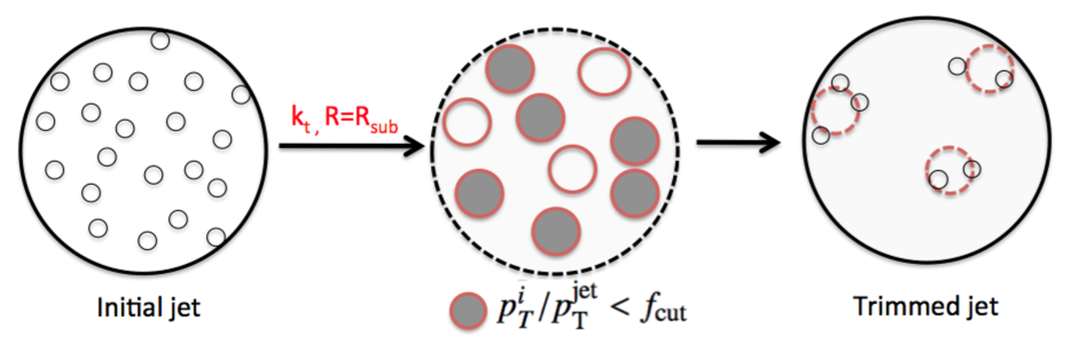
Boosted objects
Both LHC and future colliders will produce boosted heavy objects, whose decay products fall in the same jet (e.g. boosted Higgs or tops)
[Butterworth Davison Rubin Salam 0802.2470]
hadronic top candidate
[ATLAS 1306.4945]
Key feature of boosted object taggers are groomers, procedures that clean jets from soft constituents irrelevant for mass reconstruction
Relevant: how to assess the performance of different groomers?

Slide 16
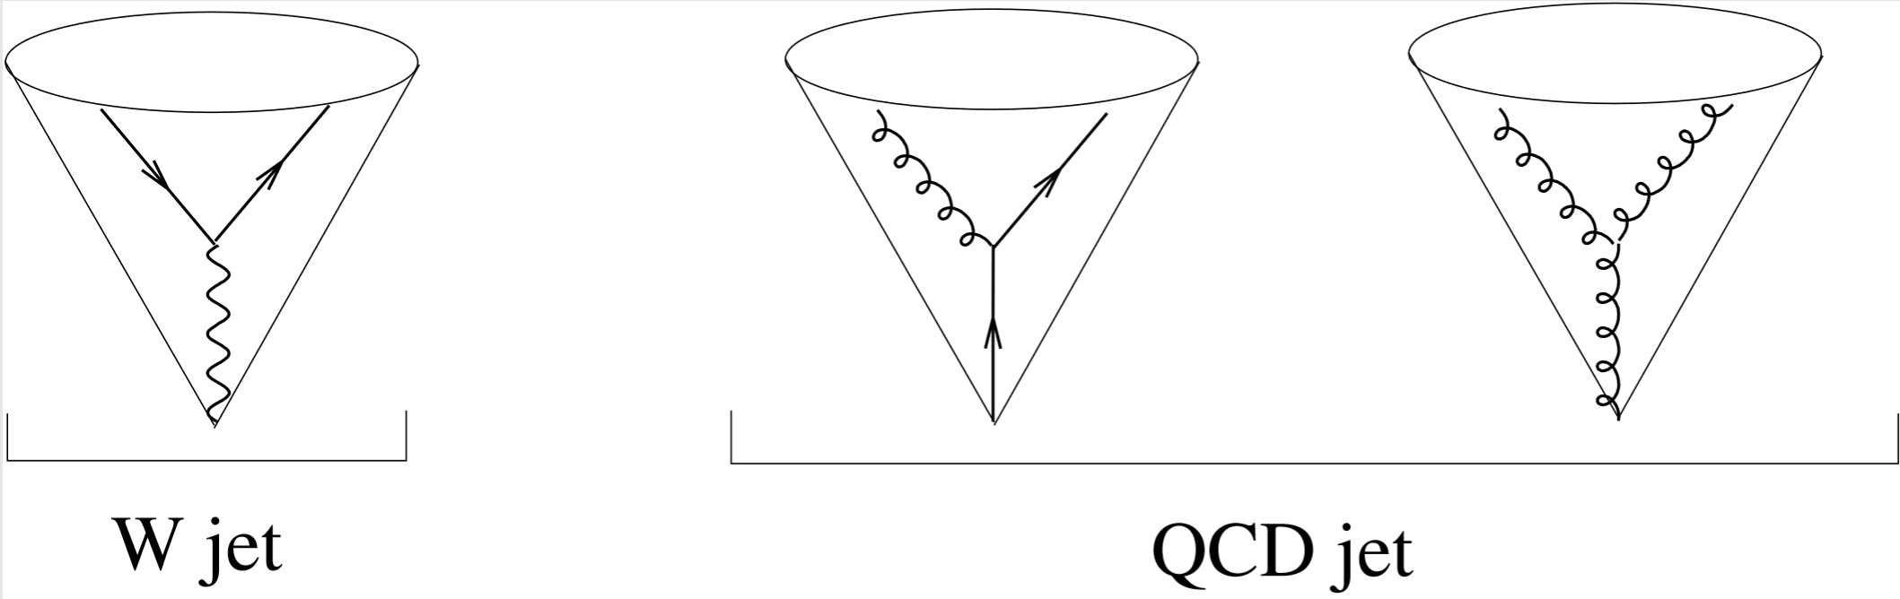
Jet-substructure revolution
It is possible to quantitatively assess the performance of different groomers by computing the distribution in the invariant mass of a QCD jet
[Dasgupta Fregoso Marzani Salam 1307.0007]

Slide 17
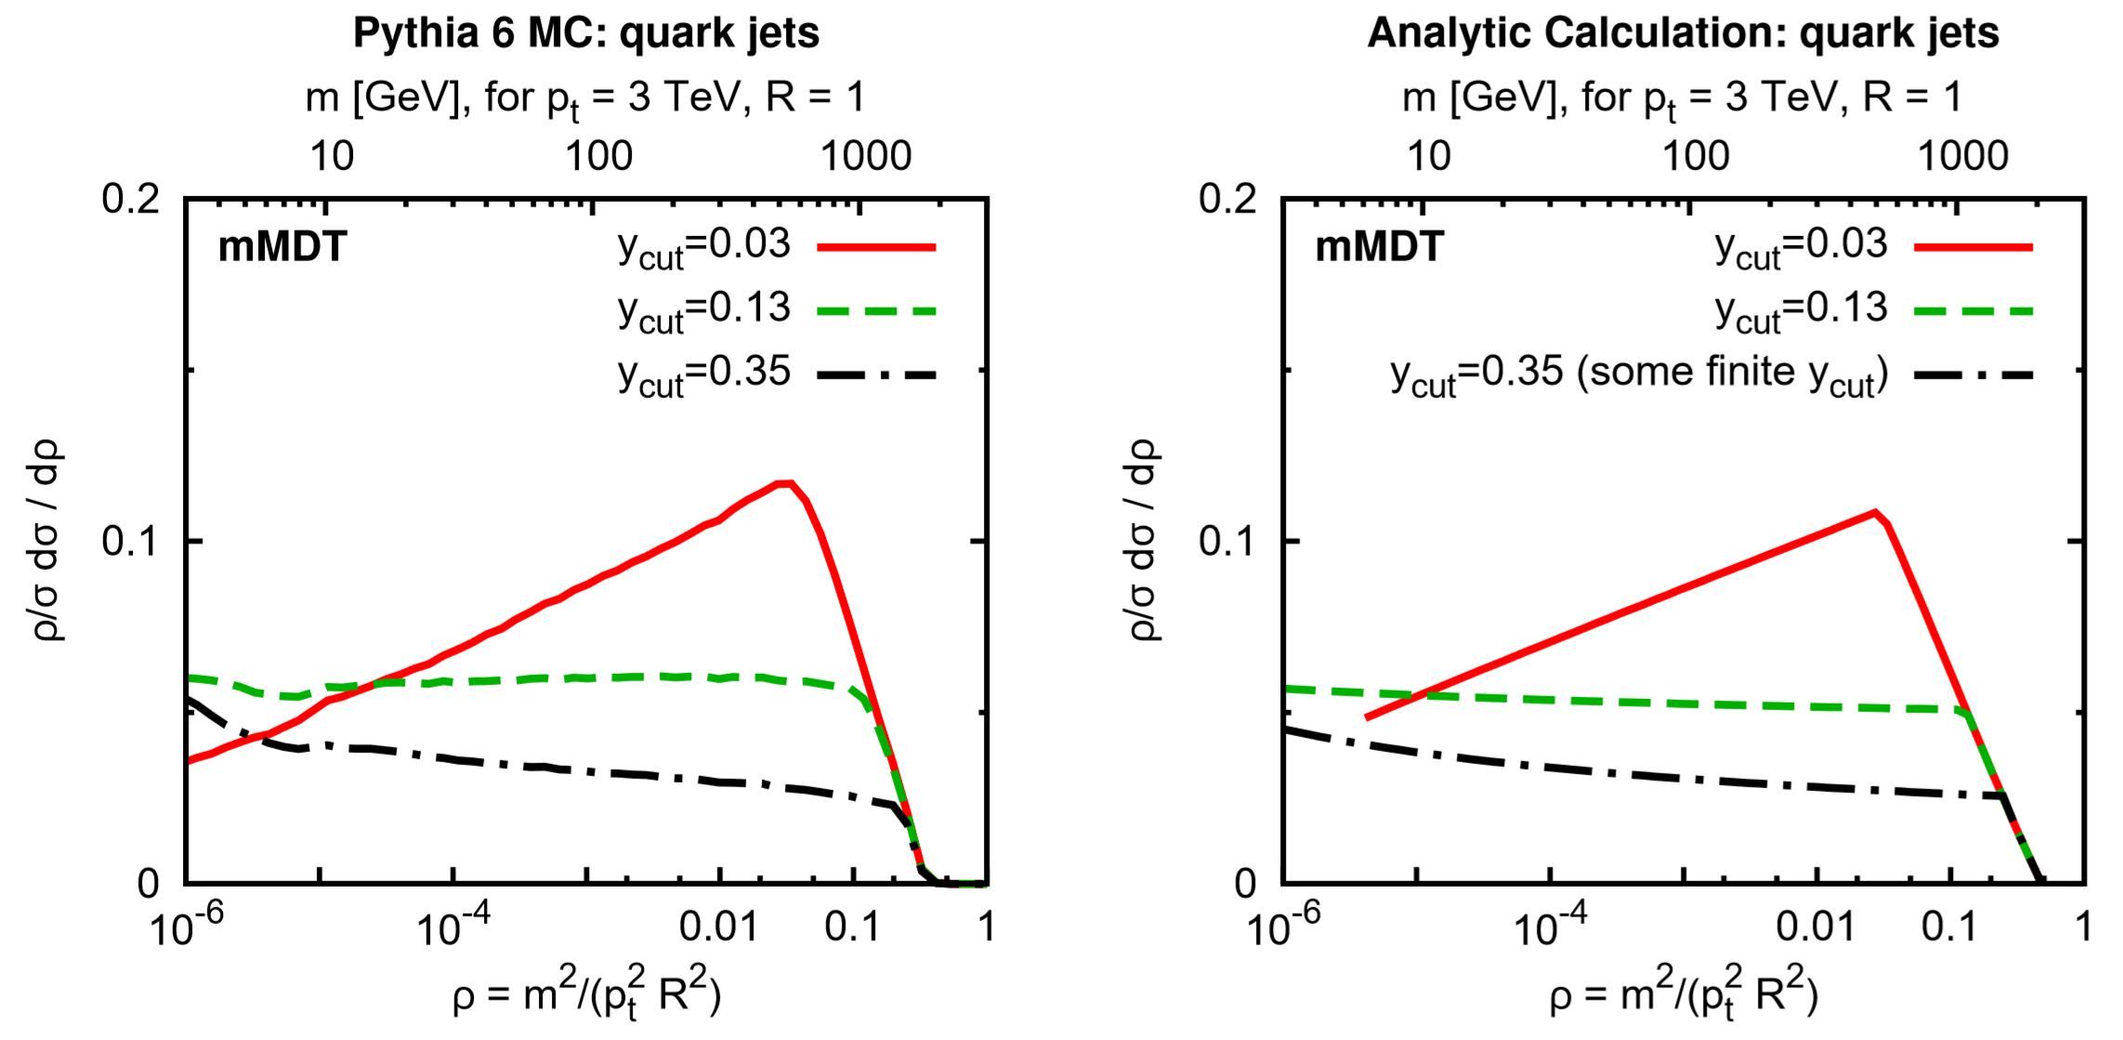
Jet-substructure revolution
It is possible to quantitatively assess the performance of different groomers by computing the distribution in the invariant mass of a QCD jet
The analytical calculation reproduces the features of the Monte Carlo
It is possible to quantitatively control the shape of the background
[Dasgupta Fregoso Marzani Salam 1307.0007]

Slide 18
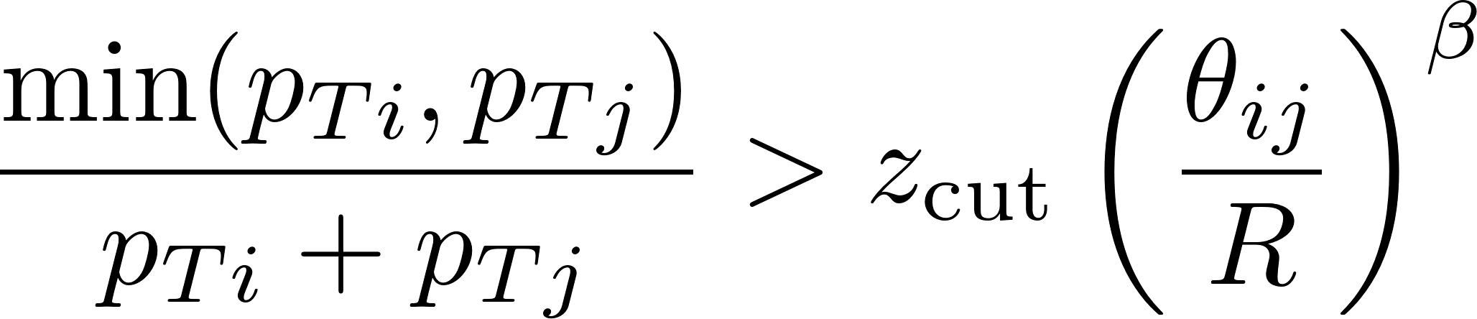

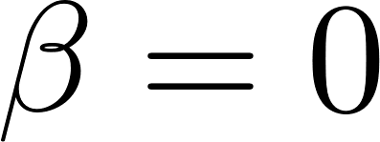
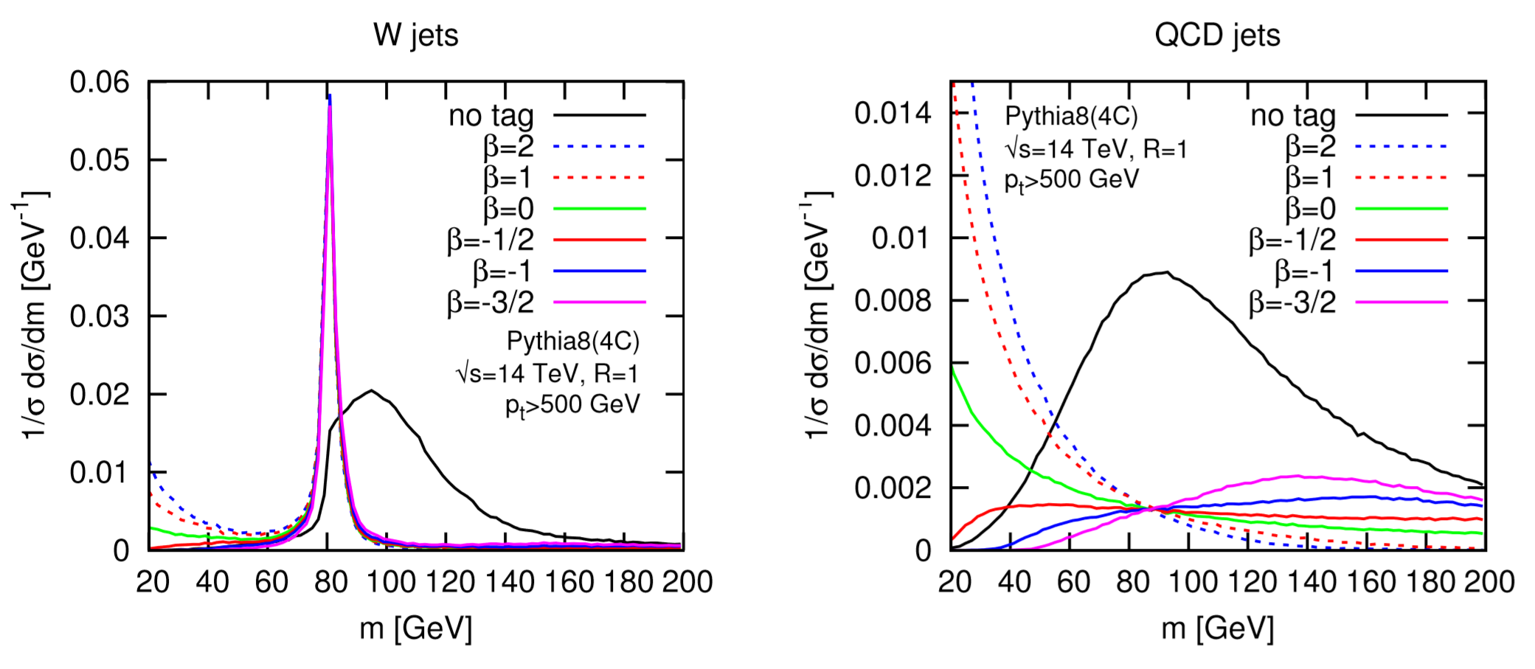
Innovative groomers: soft drop
New groomers (mMDT, soft drop) allow the calculation of the jet mass distribution at high logarithmic accuracy reliable analytical modelling of different taggers
[Larkoski Marzani Soyez Thaler 1402.0007]
fail
pass
: mMDT

Slide 19
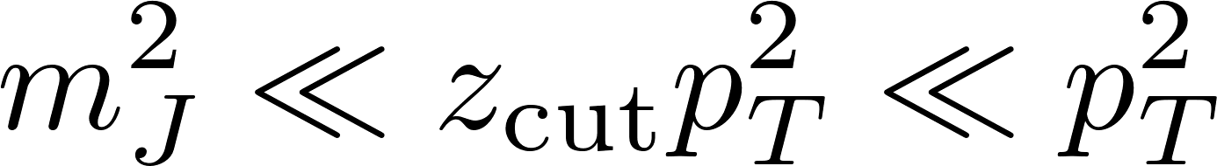
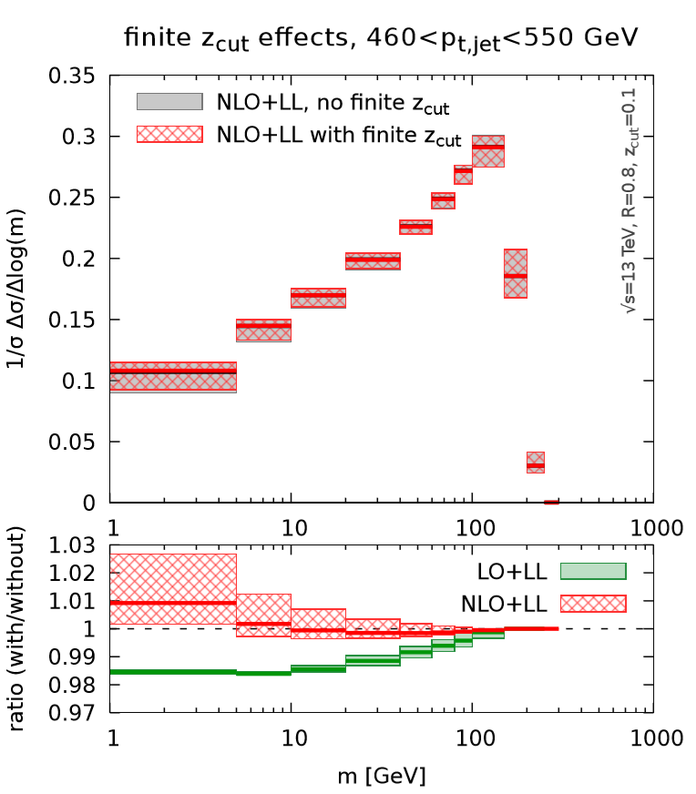

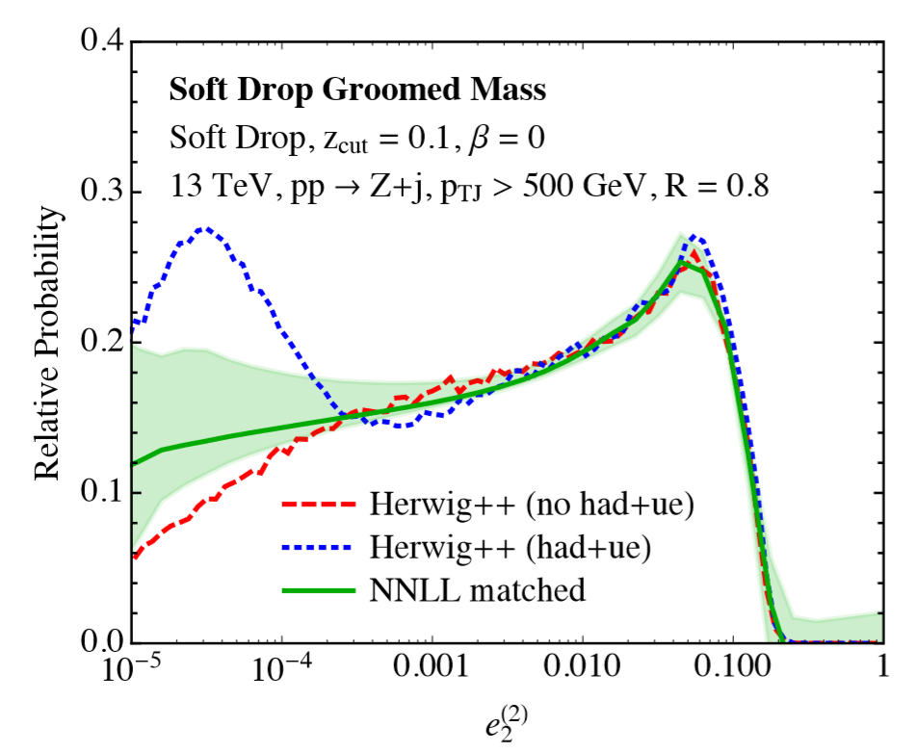
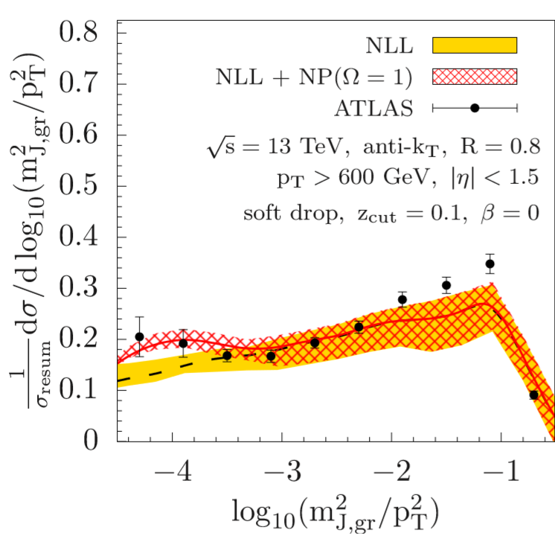
Innovative groomers: soft drop
New groomers (mMDT, soft drop) allow the calculation of the jet mass distribution at high logarithmic accuracy reliable analytical modelling of different taggers
[Larkoski Marzani Soyez Thaler 1402.0007]
fail
pass
: mMDT
NLL resummation for
Resummation of
[Frye et al 1603.09338]
[Marzani et al 1704.02210]
[Kang et al 1803.03645]

Slide 20
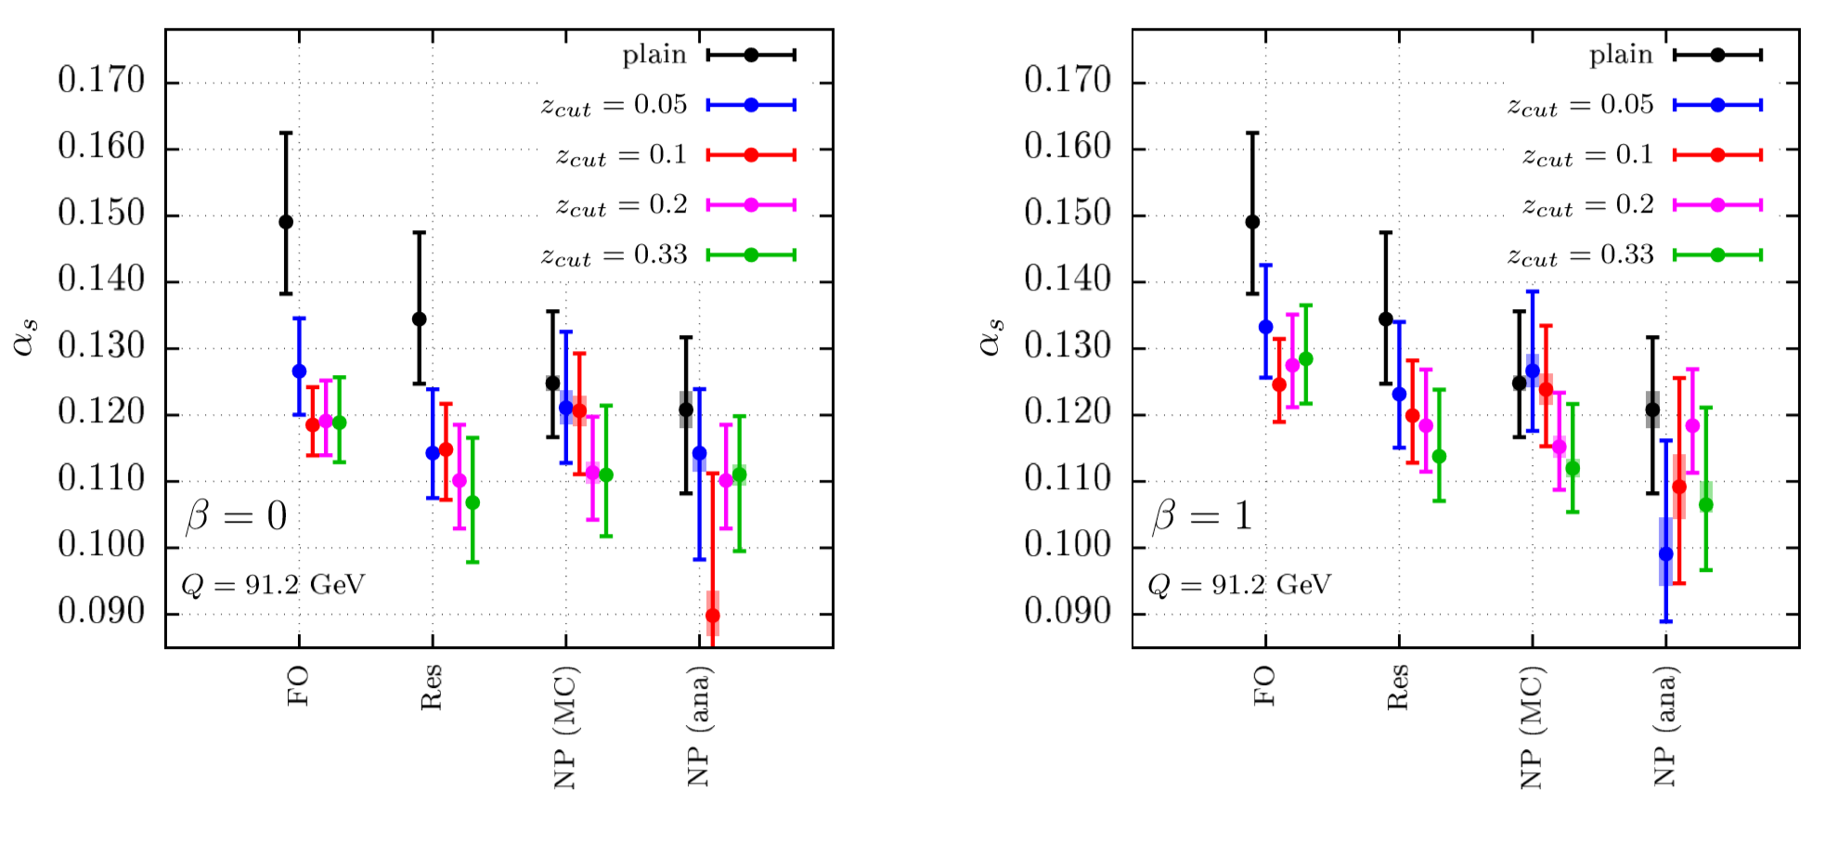
Grooming for precision
Grooming procedures can be applied to jet observables in to reduce the impact of hadronisation corrections
Example: soft-drop thrust, computed on hadrons that survive a soft-drop procedure
Problem: at LEP1 not enough jet constituents survive grooming clear gain from raising the collider energy
[Marzani Reichelt Schumann Theeuwes 1906.1504]

Slide 21
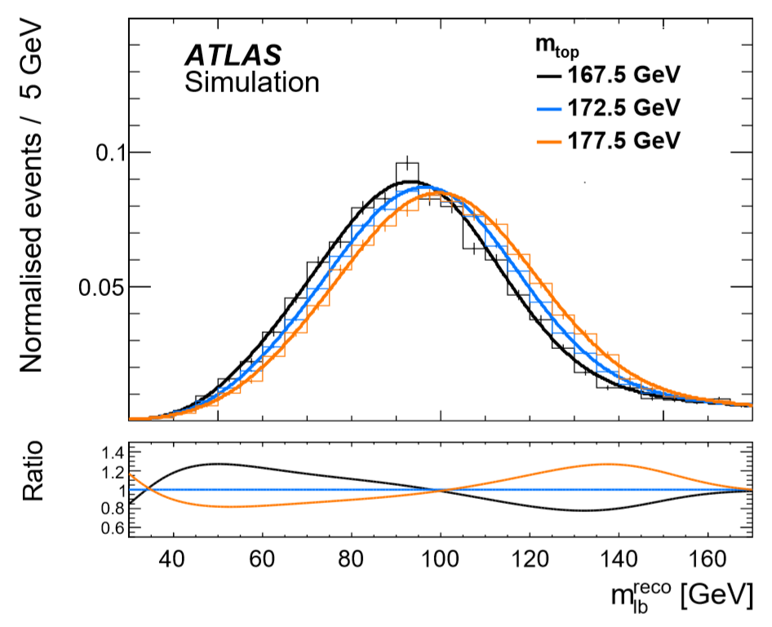
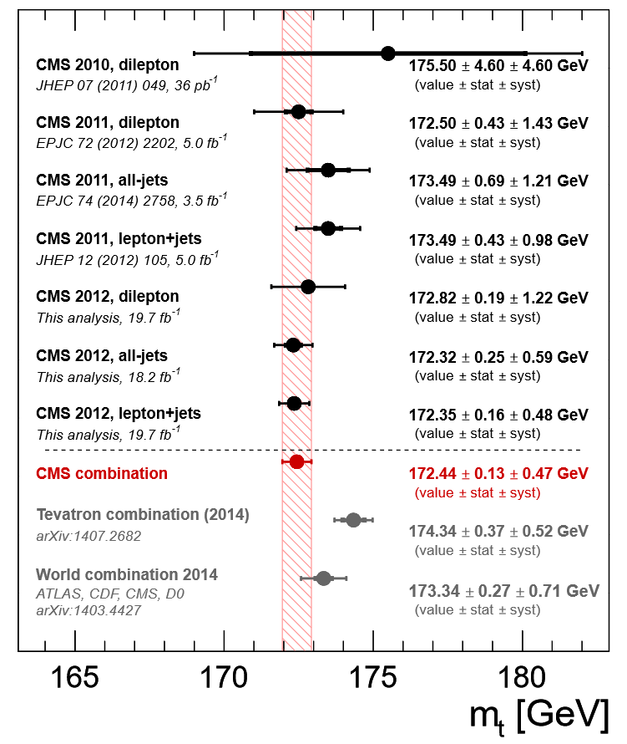
Top-mass measurements
At the LHC, the top mass is determined by fitting suitable distributions with templates obtained by varying the Monte Carlo input top mass
Uncertainties on the top mass below 1 GeV we cannot ignore any more the difference between the MC mass and the “actual” top mass
Observables in hh collisions are too complicated to be modelled analytically
[ATLAS 1606.02179]
[CMS 1509.04044]

Slide 22
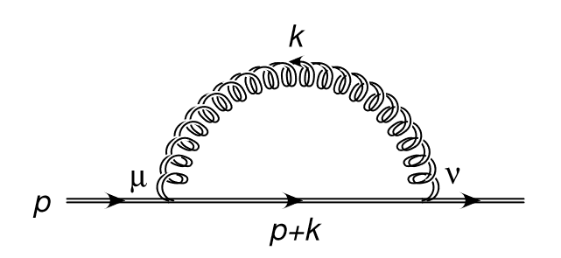
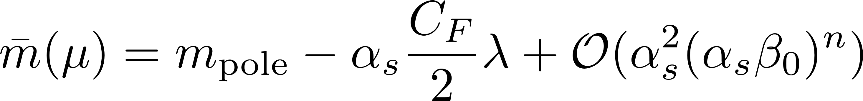

Top-mass renormalons
It is well known that the top pole mass is related to a short-distance mass (e.g. MS) through a divergent PT series (renormalon)
This divergence reflect the sensitivity of the pole mass to NP physics
Observables that are sensitive to the top mass can also have a renormalon ambiguity, which needs to be considered on a case-by-case basis
Example: the position of the peak in event-shape distributions is linear in , which indicates the need of 1/Q hadronisation corrections
[Ravasio Nason Oleari 1810.10931]
gluon mass, triggers the divergence

Slide 23
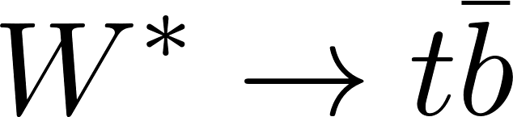
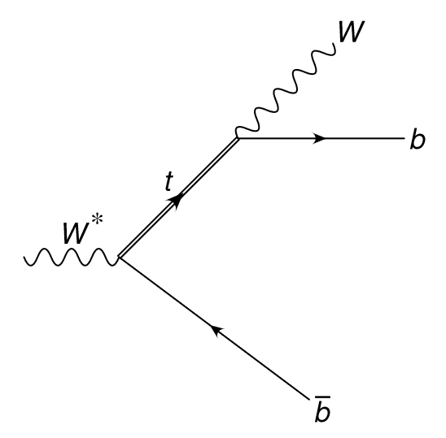
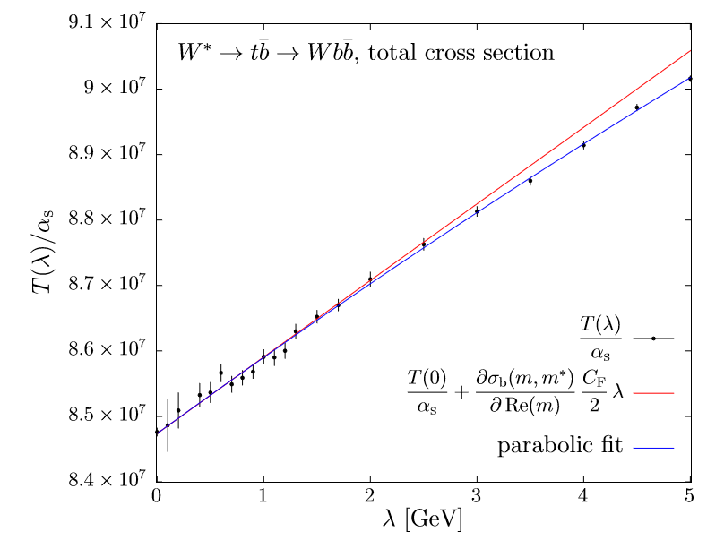
Observable renormalons
Toy model: , with various observables related to the top mass
In terms of a short-distance mass, the total cross section is free of (leading) renormalons
[Ravasio Nason Oleari 1810.10931]

Slide 24
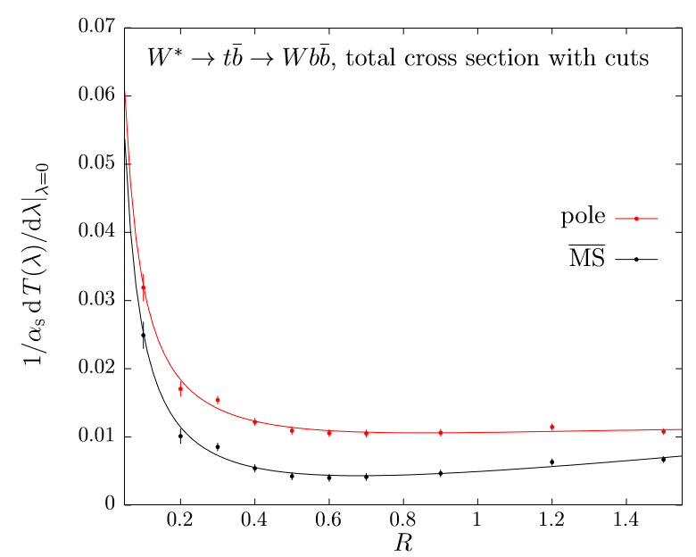
Observable renormalons
Toy model: , with various observables related to the top mass
In the presence of cuts in the final state (e.g. clustering into jets of radius R), non-cancelling renormalons survive
These effects could be actually probed at a future collider
[Ravasio Nason Oleari 1810.10931]

Slide 25
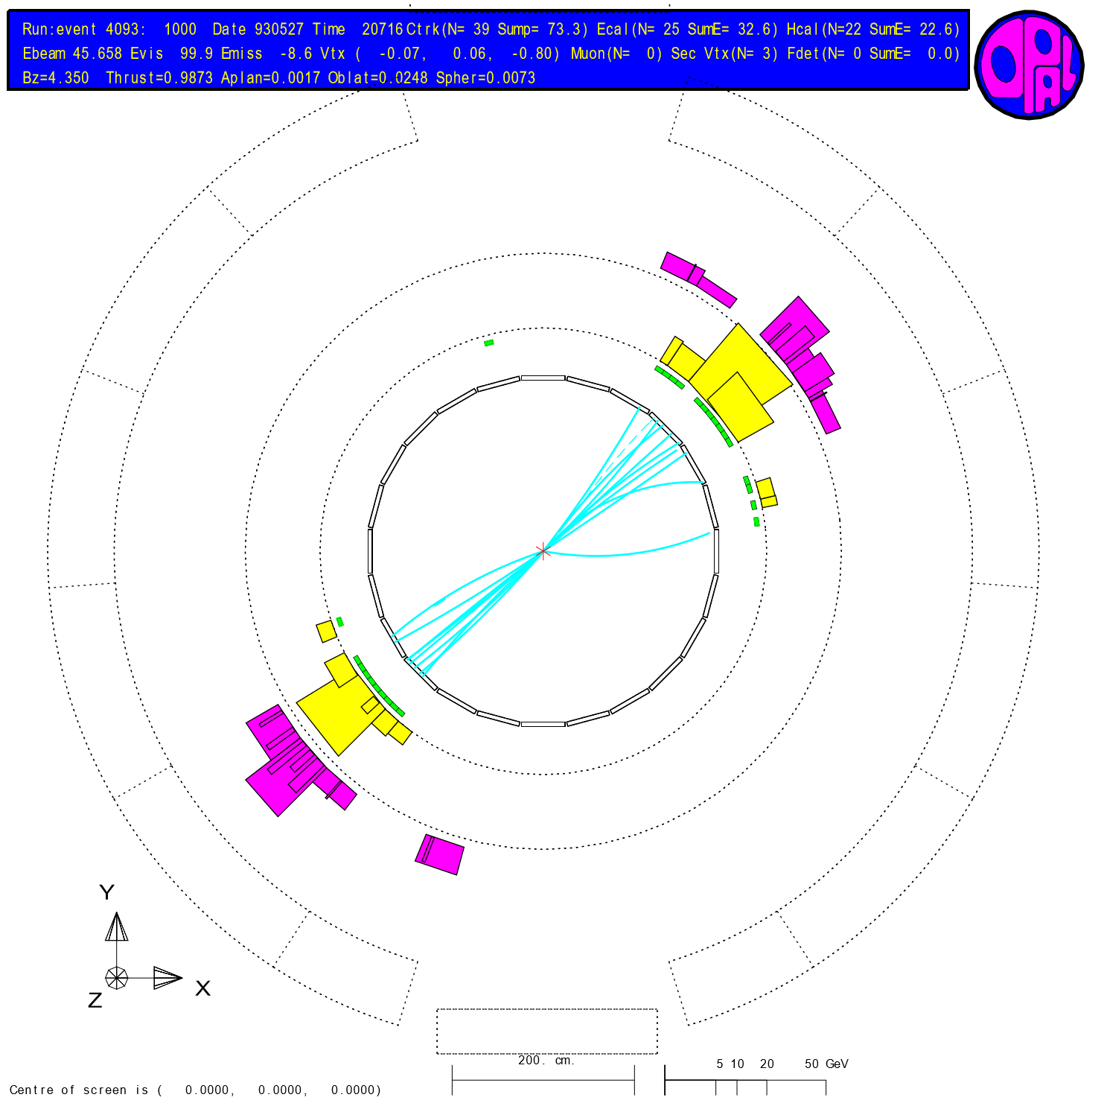
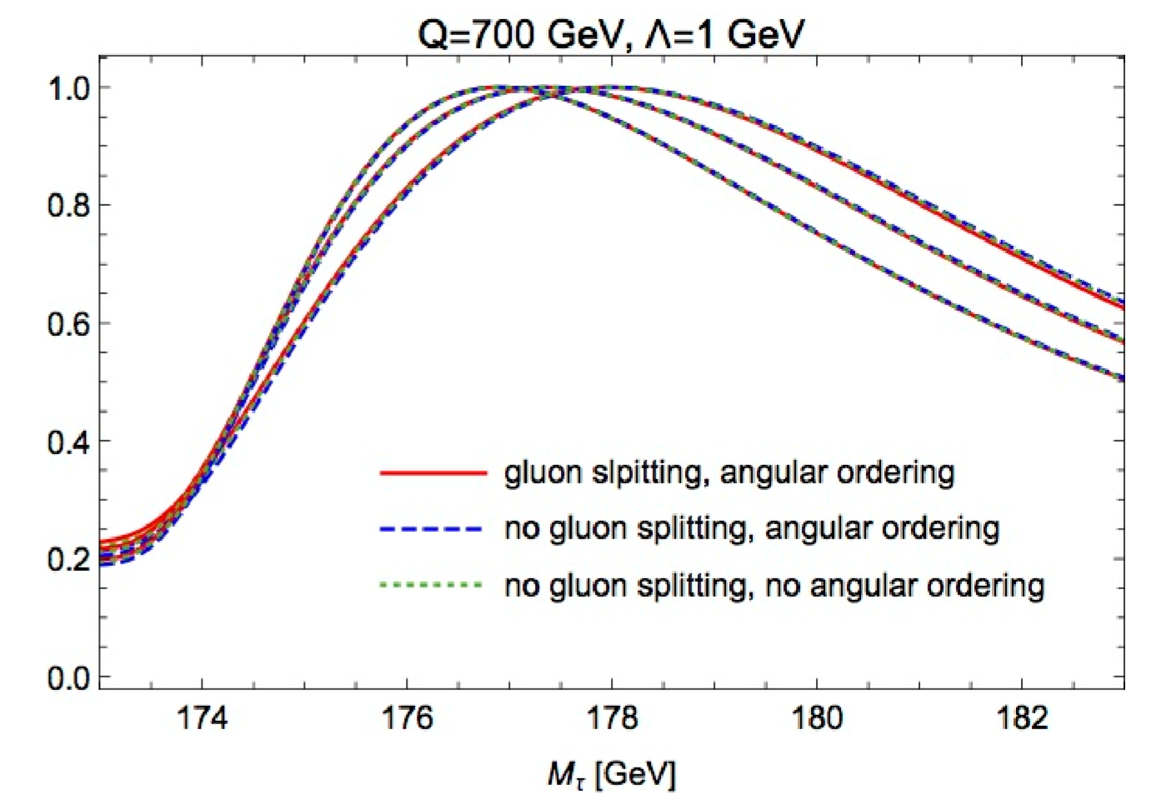

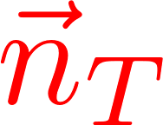

Boosted top mass
An alternative study considers an observable at colliders that is theoretically very well understood, the peak in the distribution of the total mass of two hemisphere in boosted top-antitop events
The relevant question is the relation between the MC and the pole masses
[Hoang Plaetzer Samitz 1807.06617]

Slide 26

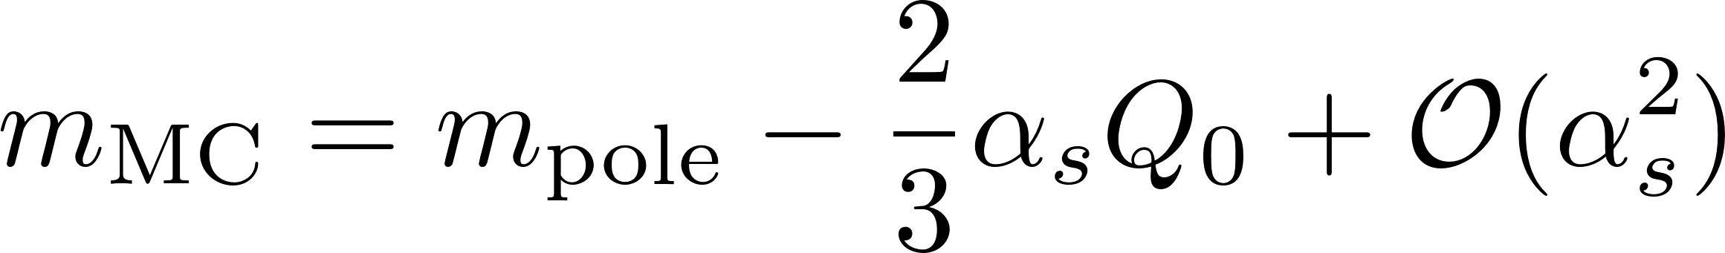

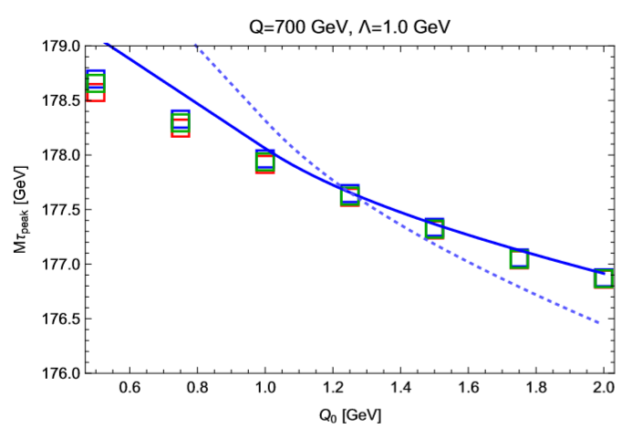
Monte Carlo top mass
At parton-level, any Monte Carlo has an IR cut-off
For a parton shower based on angular ordering, it is possible to compute the relation between the MC and the pole mass as a function of
For finite , the MC mass is a short-distance mass, and reduces to the pole mass for
[Hoang Plaetzer Samitz 1807.06617]
It is possible to compute the dependence of the position of the peak as a function of
This requires control over 1/Q corrections induced by soft radiation at large angle, which do not contribute to the top mass definition

Slide 27
Concluding remarks
Future electron-positron colliders offer the possibility to answer a number of general theoretical questions
Smaller hadronisation corrections pave the way to very precise determination of the strong coupling with jet observables
New possibilities to test universality of leading hadronisation corrections
Boosted object techniques could be used to devise novel observables for precision studies
Toy observables for precision determination of the top mass could be actually measured

Slide 28
Concluding remarks
Future electron-positron colliders offer the possibility to answer a number of general theoretical questions
Smaller hadronisation corrections pave the way to very precise determination of the strong coupling with jet observables
New possibilities to test universality of leading hadronisation corrections
Boosted object techniques could be used to devise novel observables for precision studies
Toy observables for precision determination of the top mass could be actually measured
Thank you for your attention!

Slide 29
Extra

Slide 30

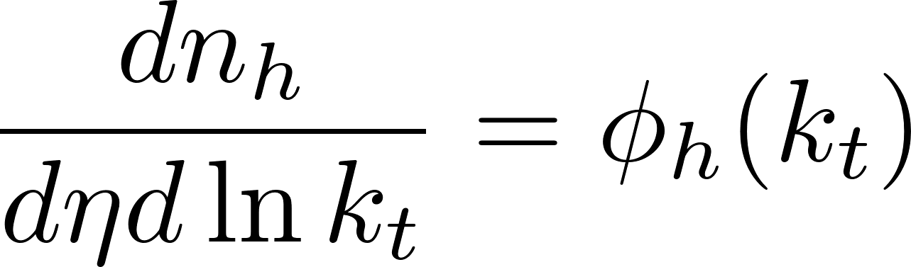

Leading hadronisation effects
Leading hadronisation corrections are triggered by central hadrons ( ) distributed uniformly in rapidity

