Slide 1
Introduction and Plans for CEPC Higgs physics
Yaquan Fang (IHEP)
CEPC Higgs workshop at Peking University

Slide 2
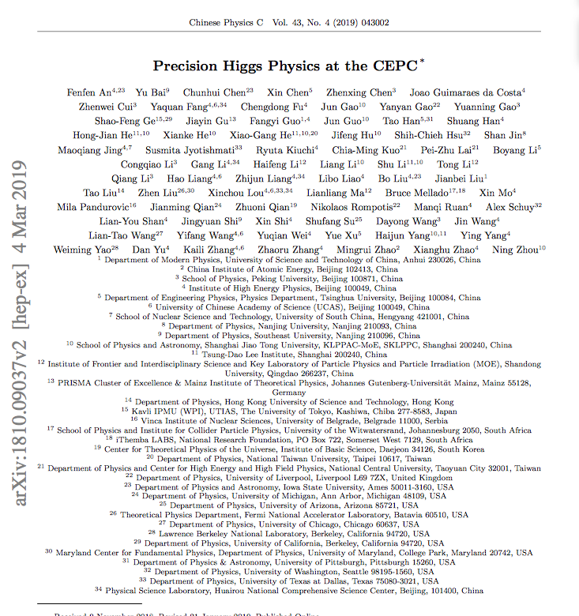
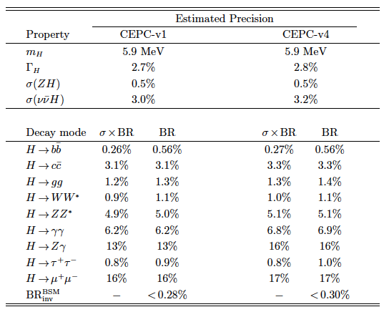
Higgs white paper @ CDR
V2 is at arxiv.
CPC : Vol 43, No.4 (2019) 043002
Thanks to those colleagues for great efforts.
Welcome to new colleagues to join in.
Mailing list: cepc-physics@maillist.ihep.ac.cn

Slide 3
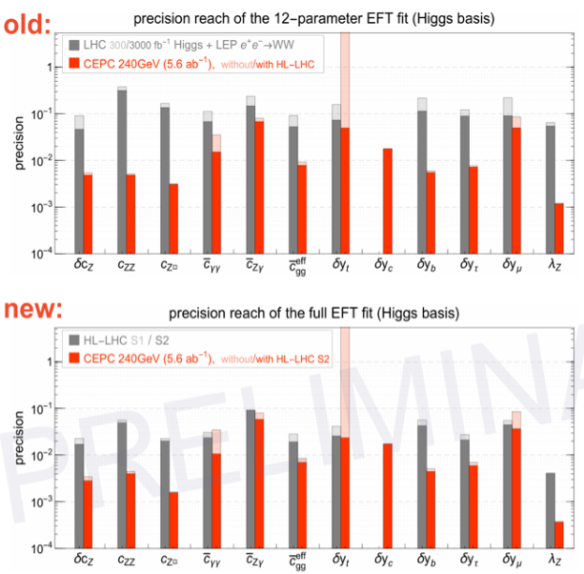
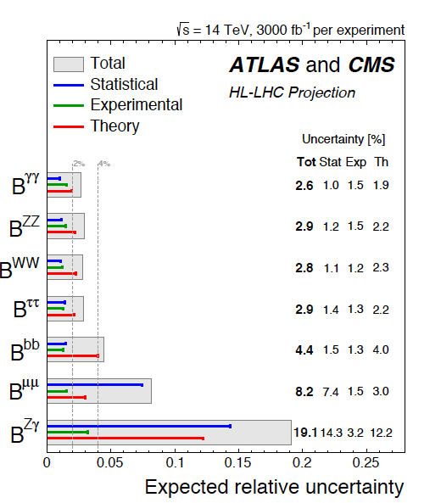
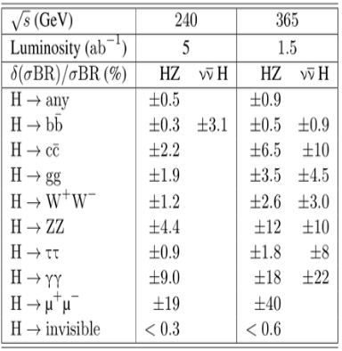
Recent news
CDR vs HL-LHC 2014
Fcc-ee 240 GeV/365 GeV:
CERN-ACC-2018-0057
arxiv: 1902.00134
CDR vs HL-LHC 2019
Width: ${{4.1}_{−0.8}^{+0.7} \text{MeV}. }_{}^{}$
Precision mass of 10-20 MeV plausible
Width : ~1.3%
LHC updated their projected results based on current Run 2 studies and possible improvements on uncertainties :
theory ½ and experimental systematics 1/sqrt(L) of current ones (check talk at CEPC workshop in Oxford)
Fcc-ee has similar results as CEPC but including a 365 GeV run improving the measurement of Higgs width.

Slide 4
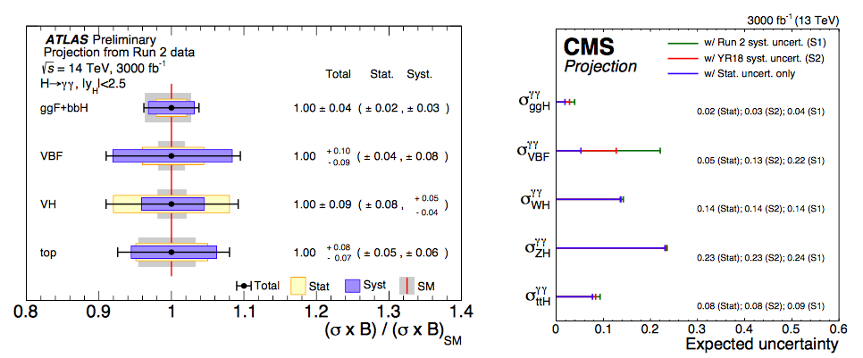
HL-LHC H->γγ: one example
S2 scenario
Scenario S1: Total uncertainty is half of the one used for the result of 80 fb⁻¹.
Scenario S2: Total uncertainty is 1/3 of the one for 80 fb⁻¹.

Slide 5
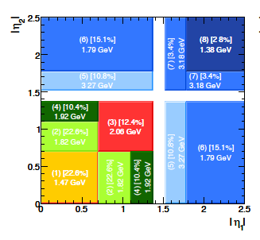
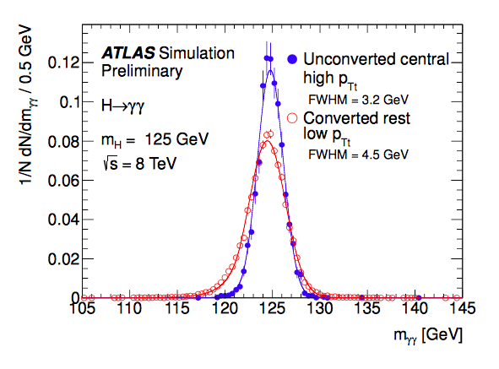
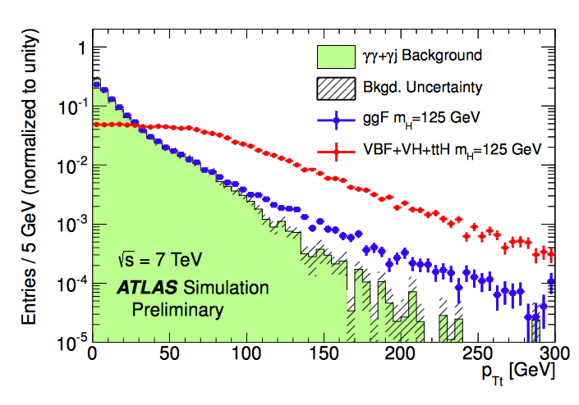
HL-LHC H->γγ: very advanced analyses (example)
The inclusive analysis is very simple :
Photon ID, Isolation, Kinematic cuts on leading/subleading photon.
Explore other possible improvements ?
Divide events into different categories.
P_{T} of Higgs (P_{Tt} is perpendicular to the thrust direction of two photon)
Divide different eta regions for two photons
Conversion of the photons

Slide 6
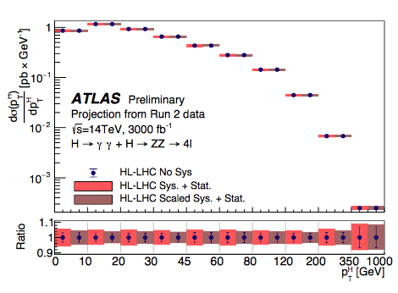
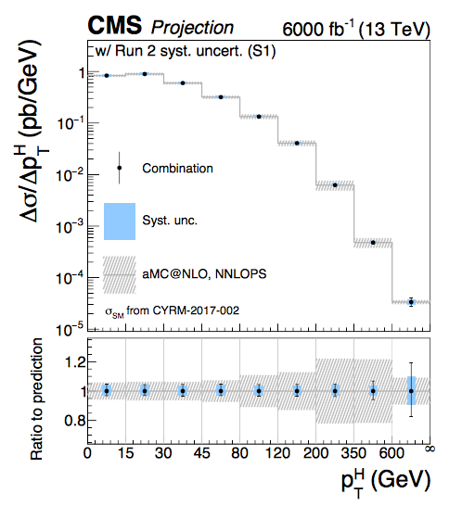
HL-LHC: Differential xsection measurement
The precision can reach a few percent for different p_{T} bins.

Slide 7
Plan for CEP Higgs physics
Improve the analyses with different technologies:
MVA, multi-dim fit.
Improve the performance b-tagging, photon ID/conversion etc.
Test different setup-of the detectors
Test the analyses with different colliding energy
Benchmark : 360 GeV/1.5(2.0) ab⁻¹
Improvement of ww fusion on the Higgs width as well as the precision measurement.
ttbar run
Differential xsection measurements
Start to do that.
Interpretation on the results
Further cooperation with theorists (in particular the domestic theorists)
Wrap up with a post CDR Higgs paper.

Slide 8
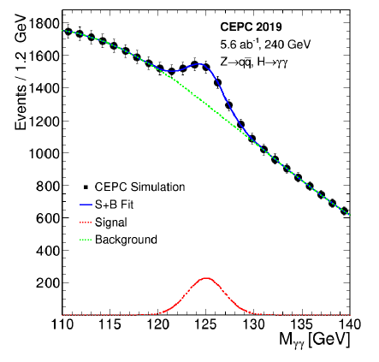
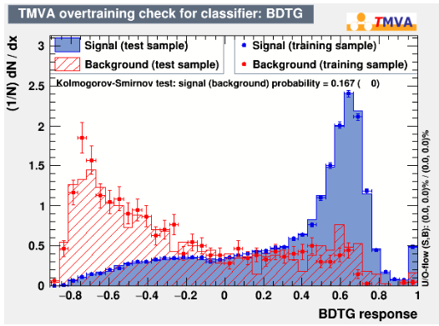
Some preliminary progresses (H->γγ)
Variables having low correlations with Mγγ are chosen as inputs to MVA
Two dimensional fit is implemented to extract the precision of the measurement.
The improvement is ~30% in the channel of Z(->qq)H->γγ for the precision measurment.
See more in Fangyi Guo’s talk.

Slide 9
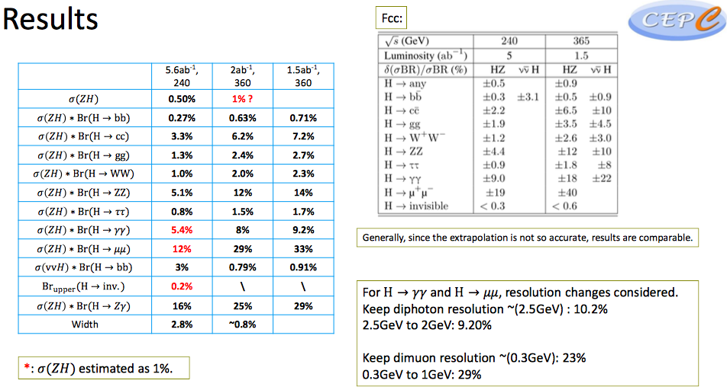
High energy (360 GeV) Run
Kaili’s talk
Mostly from WW fusion
(Hao Liang’s talk)

Slide 10
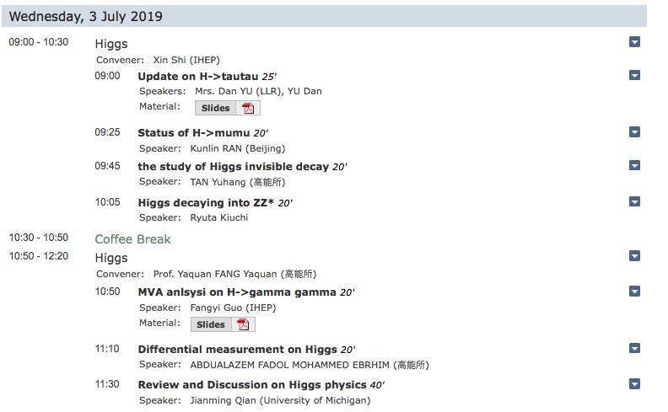
Talks in Higgs section

Slide 11
Conclusion
The Higgs CDR is done and the studies post CDR toward TDR start
Different topics will be addressed (page 7).
Manpower needed (welcome to join)

Slide 12
backup slides

Slide 13
One example
ATLAS-CONF-2016-017
The improvement of significance w.r.t. inclusive one is from 4.0 to 4.6, corresponding 13% improvement on the
precision.

Slide 14
Measurement of Higgs width
Method 1: Higgs width can be determined directly from the measurement of σ(ZH) and Br. of (H->ZZ*)
But the uncertainty of Br(H->ZZ*) is relatively high due to low statistics.
Method 2: It can also be measured through:
These two orthogonal methods can be combined to reach the best precision.
Precision : 5.1%
3.0%
Precision : 3.5%
Precision : 2.8%

