Slide 1
Transverse polarization for energy calibration at Z-peak
M. Koratzinos
With valuable input from
Alain Blondel
ICFA HF2014, Sunday, 12/10/2014

Slide 2
Other talks in this workshop
Please also see the following talks in this workshop:
Ivan Koop, “Polarization issues and schemes for energy calibration”
Eliana Gianfelice, “Polarization issues in FCC-ee collider”
Ivan Koop “Maintaining polarization in synchrotrons”
More talks follow in this session…

Slide 3
This talk
I will try not to repeat what others have so eloquently reported in this conference
I will make a suggestion for a possible strategy for depolarization measurements
This is work in progress!

Slide 4
Why?
Transverse depolarization is unique to circular machines and an extremely accurate method to measure the beam energy
The beam energy in a large circular collider changes continuously by many times the desired accuracy (fewX100keV)
Important to monitor this change continuously
(at LEP we used this method only at the end of a fill and only for some fills)

Slide 5
The bottom line
I cannot resist to give it all away:
The good news for CEPC: polarization at the Z should be easier than at FCC-ee
The bad news for CEPC: cannot guarantee polarization at the W threshold (80GeV beam energy)

Slide 6
Polarization vs energy and ring circumference
Theory says the energy spread goes like
σ_{E} ∝ E_{b}² / √ρ
Polarization levels are inversely proportional to the energy spread
So a ring with 16 times the diameter will have the same polarization level at twice the beam energy
Data exists for LEP at different energies (only optimised for 45 and 60 GeV)

Slide 7
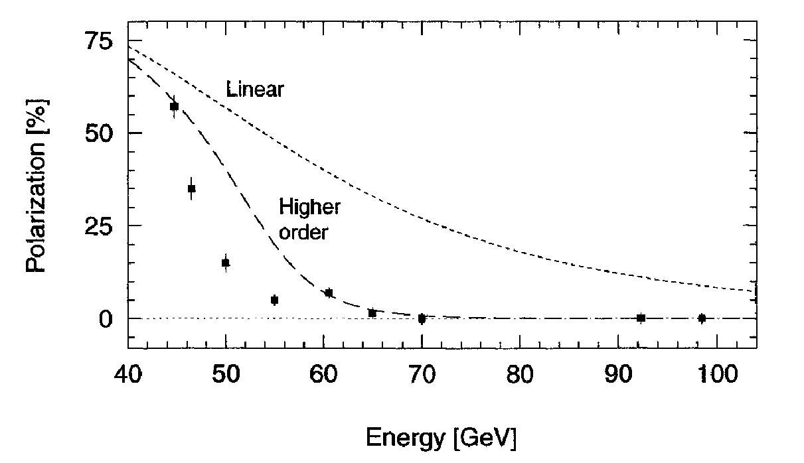
Measurements from LEP
: Not optimized
CEPC
47.6 59.5 71.4 83.2 95.1 107.0 118.9
TLEP
55.5 69.4 83.2 97.1 111.0 124.9 138.7

Slide 8
CEPC polarization at 80GeV
If the amount of effort to reduce depolarizing effects is like at LEP, no polarization will be seen at 80GeV
This is in contrast to FCC-ee, where 80GeV is (just) possible (always extrapolating from the LEP experience)

Slide 9
Z running: the problem
At the Z peak we need extremely accurate beam energy knowledge all the time
There exists a method that gives excellent instantaneous accuracy: resonant depolarization. Error is 100KeV (a big chunk of it is arguably a ‘statistical’ type error, going down with the number of measurements)
Environmental parameters change the energy by many times this amount in the space of minutes/hours:
Tides: time constant of 1h
Trains: time constant of few mins
Water level: time constant a few months
Temperature: few hours
Other parameters that change the energy is the RF system (standard offsets plus corrections for changing running conditions. This can give also differences between the energy of electrons and positrons)

Slide 10
Z energy calibration
The solution (brute-force if you want) if one needs ultimate precision is to
Measure resonant depolarization every few minutes
Measure independently electrons and positrons
Measure continuously from the beginning of physics to the end of physics

Slide 11
Resonant depolarization measurement
The measurement consists of measuring the spin precession frequency by introducing a resonance in a ‘random walk’ fashion.
Failure: nothing observed, the frequency used not the correct one
Success: the bunch depolarizes, the frequency corresponds to the exact energy at that moment
For the measurement one needs levels of polarization of 5-10% (the better the polarimeter, the smaller the value) – I hope we will have a good polarimeter!
One bunch is targeted at a time
This bunch should be a non-colliding bunch

Slide 12
The problem
Polarization times at FCC-ee and CEPC are very large:
TLEP-45GeV: 250 hours
CEPC-45GeV: 42 hours
(TLEP 80GeV: 9 hours)
As we only need polarization levels of 5-10%, you can divide the above numbers by 10 to 20. But this is still too long.
One solution is to use wigglers to decrease polarization time to something manageable.

Slide 13
Wigglers – the flip side
Wigglers have two undesired effects:
They increase the energy spread
They contribute to the SR power budget of your machine
Strategy is to use them is such a way that
The energy spread is less than some manageable number (so that no resonances are encountered). This number was determined by A. Blondel to be between 48MeV and 58MeV, say 52MeV “for the sake of discussion”, judging from the LEP experience
Switch them on only where necessary

Slide 14
LEP wigglers
As proof of concept, A. Blondel has suggested the use of the old LEP wigglers to decrease polarization time
B-
B+
B-
Quick and dirty design, troublesome operationally
(B-=B+/6.25)

Slide 15
Polarization time vs induced energy spread
Using the equations of LEP note 606 “Dedicated wigglers for polarization” by Blondel/Jowett:
52MeV
By using wiglers we can decrease polarization time to 23 hours (TLEP) and 7.5 hours (CEPC).
This means that useful polarization levels (5-10%) are reached after 70-140 mins (TLEP) and 22-45 minutes (CEPC).
Interestingly, this does not depend on the number of wigglers installed (just need a higher field per wiggler)

Slide 16
SR budget
Work in progress!
Machine | Energy | No. of wigglers | B+ | Polarization time | Energy spread | Wiggler SR power
TLEP | 45 | 0 | 0 | 253 hours | 17MeV | 0
TLEP | 45 | 12 | 0.62T | 21 hours | 52MeV | 20MW
TLEP | 45 | 1 | 1.35T | 24 hours | 52MeV | 9MW
CEPC | 45 | 0 | 0 | 41 hours | 23MeV | 0
CEPC | 45 | 12 | 0.72T | 7 hours | 52MeV | 17MW
CEPC | 45 | 1 | 1.58T | 7 hours | 52MeV | 7
The SR budget for a single wiggler looks manageable, especially considering that they can be switched off after a short period of time
Wigglers introduce more damping and might help to achieve higher beam-beam parameters partly compensating the loss due to wiggler SR power– to be investigated

Slide 17
Duration of wiggler operation
The wigglers need to be on just enough time to polarise enough non-colliding bunches:
TLEP: 250 non-colliding bunches
CEPC: 40 non-colliding bunches
They can be switched on as soon as the machine starts filling up (which takes ~30 mins)
They can be switched off when 5% polarization is achieved
TLEP: 40 minutes after filling is completed
CEPC: ready after filling has been completed
Using and replacing 5 bunches for 5 depolarization measurements per hour, the machine will have naturally polarized to 5% by the time the last non-colliding bunches are exhausted.

Slide 18
Future work
Check the toy model to optimise wiggler size/magnetic field
Simulate! (and to simulate, one needs a code…)

Slide 19
End

Slide 20
Backup slides

Slide 21
Fill-up time (TLEP)
According to our recent parameter document (EDMS 1346082):
“The required flux of e⁺ and of e⁻ is currently estimated to ≥2x10¹² particles/s for each species.”
I have used 2E12 particles/s and a bhabha lifetime of 200 mins. This results in a fill up time at the Z of 28 minutes:

