Slide 1
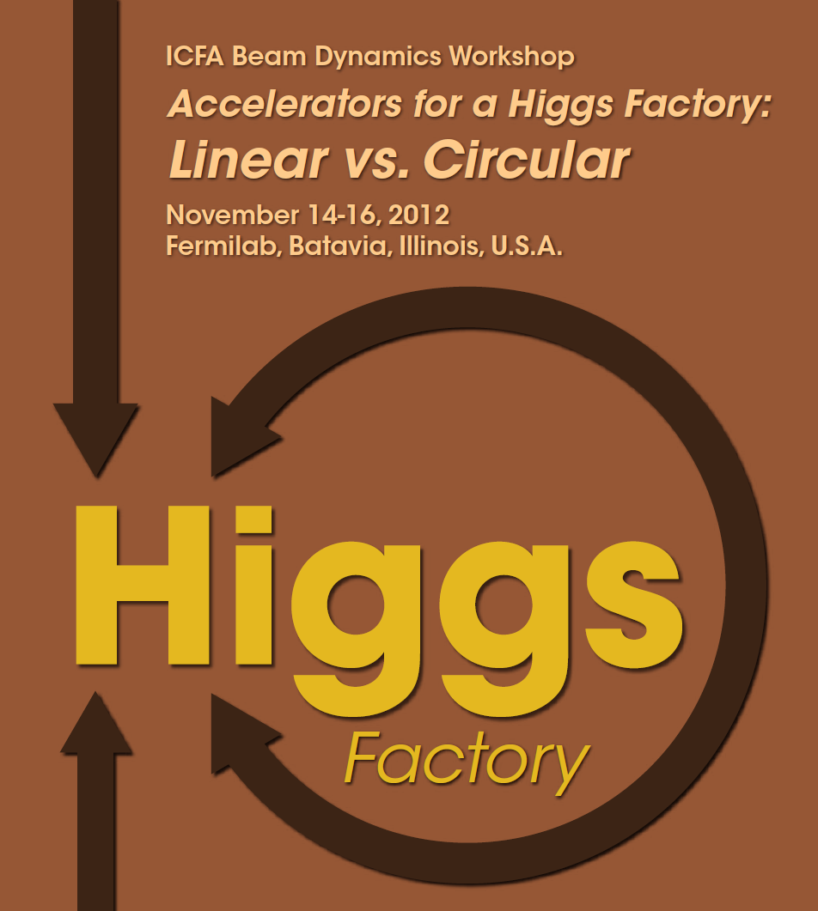
Higgs Factory Workshop
Fermilab, 14-16 2012

Slide 2
ICHEP’14:
“ICFA supports studies of energy frontier circular colliders and encourages global coordination“

Slide 3
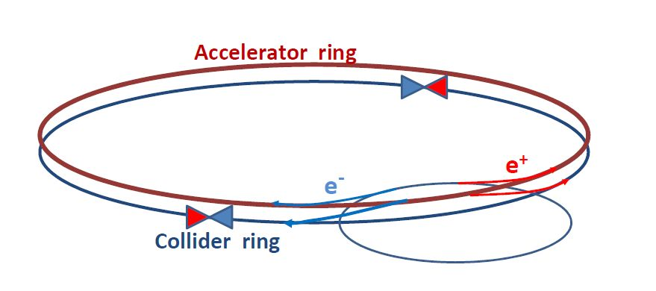
Dec. 2011:

Slide 4
http://cern.ch/fcc and
http://cern.ch/fcc-ee
first
2014 F. Gianotti, LHCP2014
NB (AB): time scale for FCC-ee similar to CLIC (2030++)

Slide 5
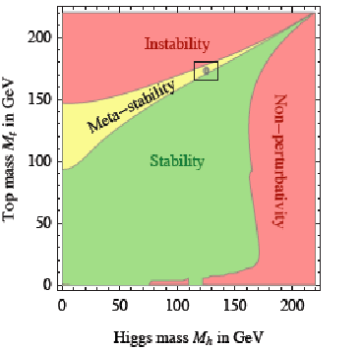
Is it the end?

Slide 6
Is it the end?
Certainly not!
-- Dark matter
-- Baryon Asymmetry in Universe
-- Neutrino masses
are experimental proofs that there is more
to understand.

Slide 7
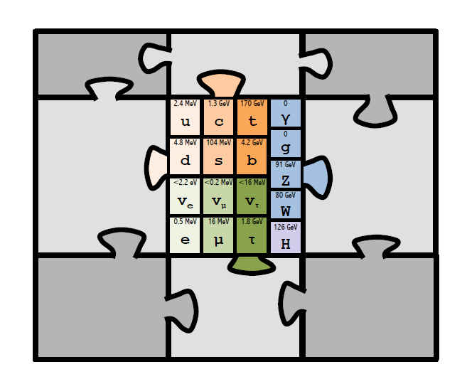
perhaps new world(s) of SM replicas?
Extra-dimensions
Super
Symmetry
you
Funny
Higgses
name
it
or perhaps only right handed ‘sterile’ neutrinos.....

Slide 8
Nima

Slide 9
Nima
At higher masses -- or at smaller couplings?

Slide 10
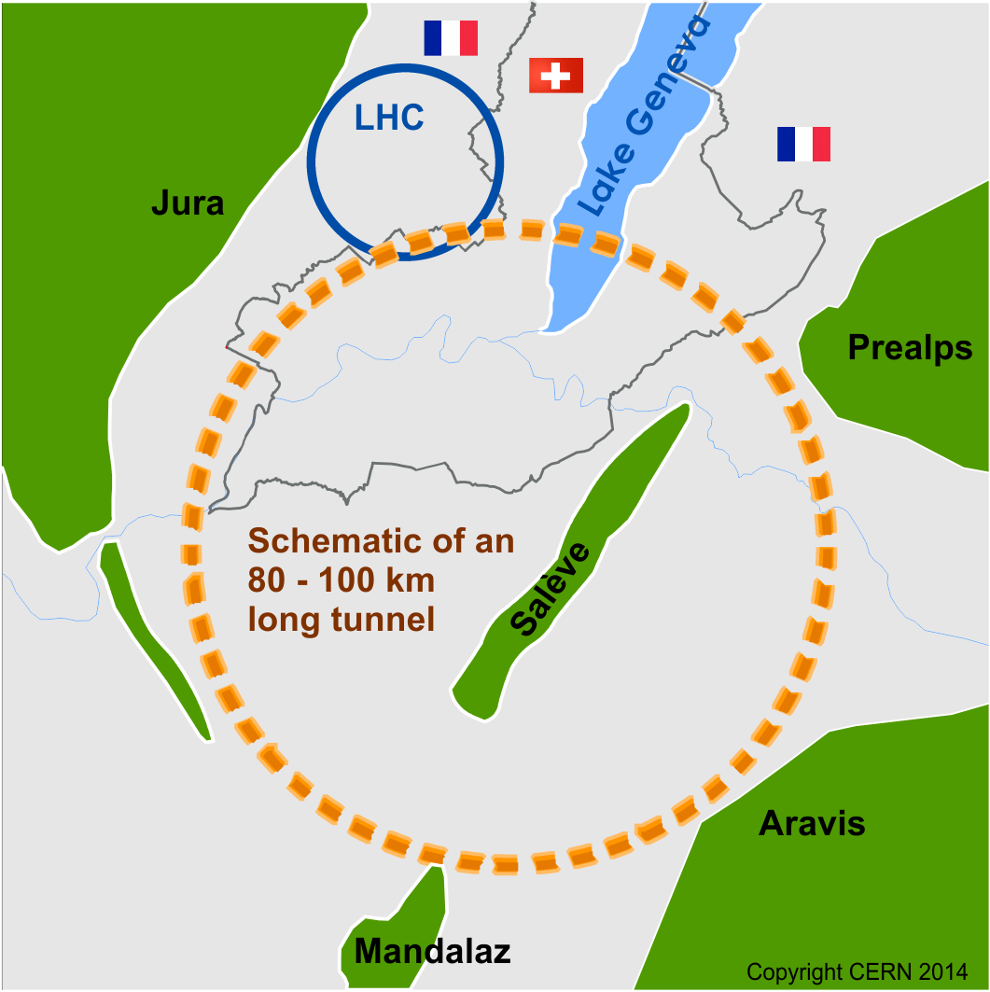
Future Circular Collider Study - SCOPE
CDR and cost review for the next ESU (2018)
Forming an international collaboration to study:
pp-collider (FCC-hh) → defining infrastructure requirements
ultimate goal: 100 TeV pp collisions
e⁺e⁻ collider (FCC-ee) as potential intermediate step
p-e (FCC-he) option
80-100 km infrastructure in Geneva area

Slide 11
possible long-term strategy
FCC-ee (80-100 km,
e⁺e⁻, 90-350 GeV
Interm. step
LEP
PSB
PS (0.6 km)
LHC (26.7 km)
HL-LHC
SPS (6.9 km)
FCC-hh
(pp, up to
100 TeV c.m.)
Ultimate goal
& e± (120 GeV)–p (7, 16 & 50 TeV) collisions FCC-eh)
≥50 years of e⁺e⁻, pp, ep/A physics at highest energies

Slide 12
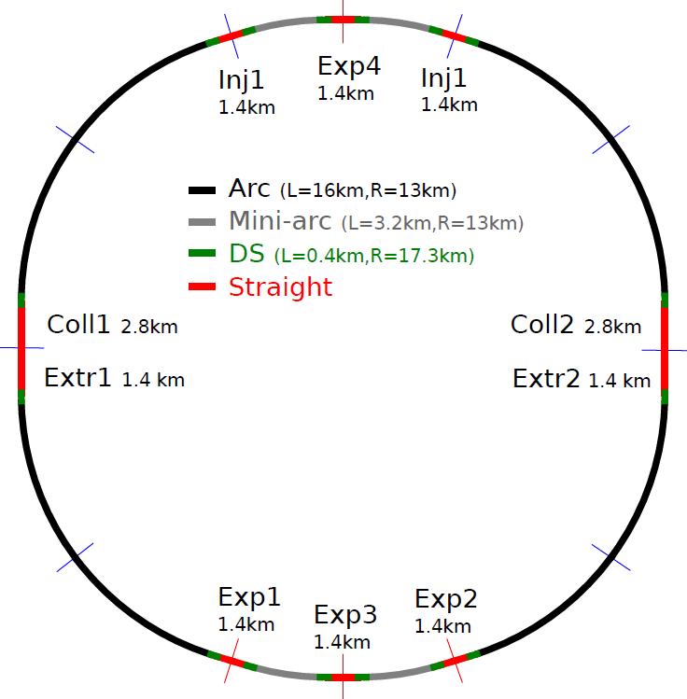
FCC-ee physics studies
one of the possible
layouts of the FCC
with 4 IPs.

Slide 13
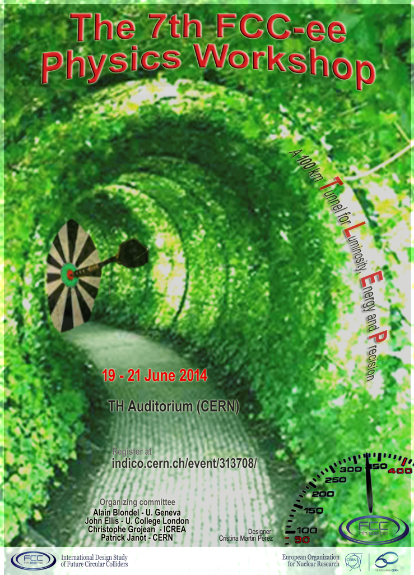
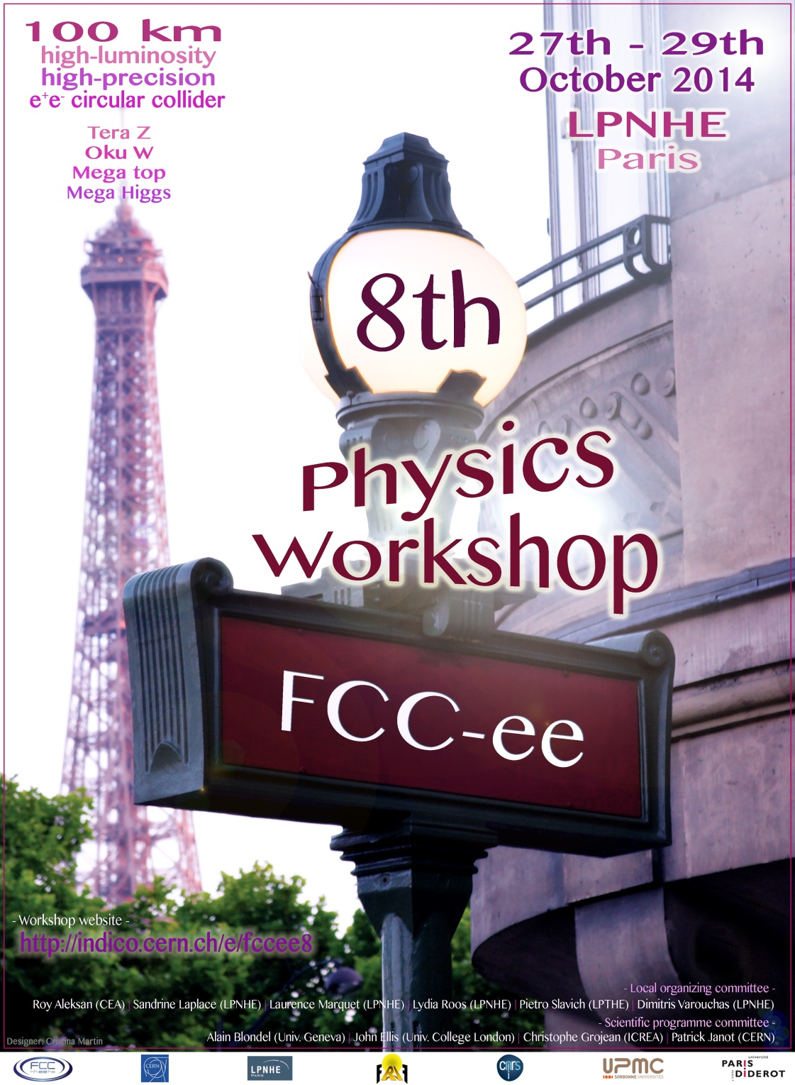

Slide 14
Successes of 7th FCC-ee Physics workshop
-1- All top level conveners are nominated and engaged!
congratulations to Patrick Janot and to the conveners!
-2- Software effort is underway
big thanks to Benedikt Hegner et al!
-3- Nice participation by e+e- Linear collider colleagues
part of FCC-ee mandate. We all agree that the next machine should be an e+e- collider.
(Thanks to Simon, Wilson, Sailer, Mele, Heinemeyer, Grojean, Brient, Haddad, etc...)
We re-invented the wheel (circle) but we do not need to re-invent the electron!
-4- Complementarity with hadron machine is not just words
ttH coupling is a good example
-5- Reaching out to dark matter, BAU and neutrinos
invisible widths, direct search for rare Z,H, W ... decays
-6- We are discovering the immense potential offered by the high luminosity e+e-
Z,W,H,t factory

Slide 15
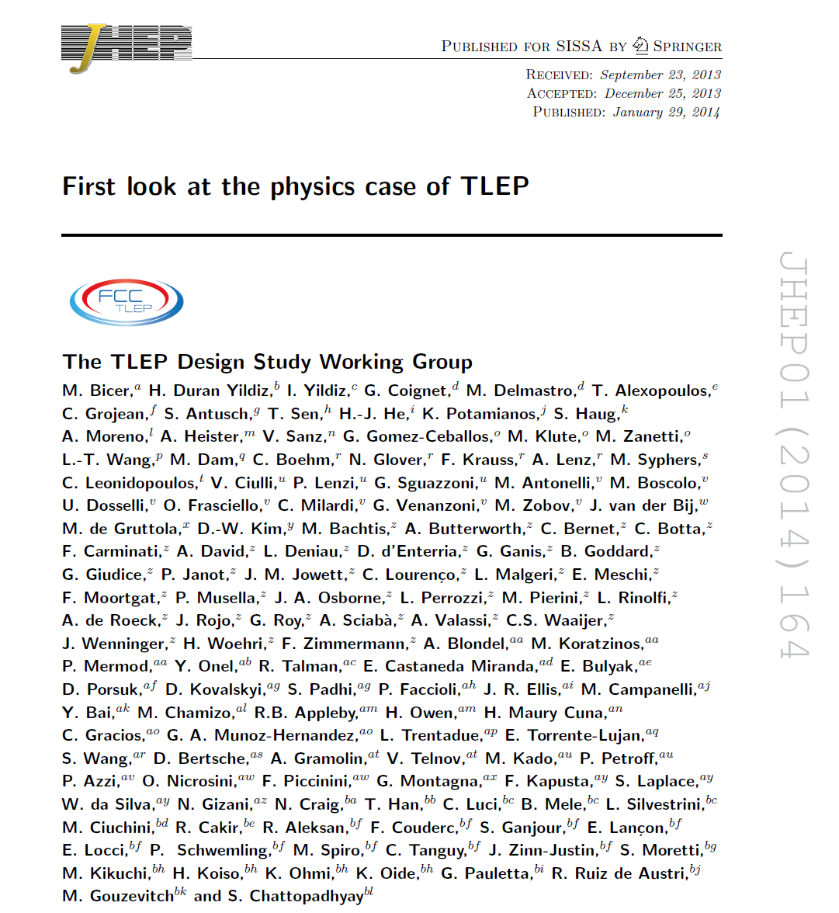
A lot is published in JHEP:
I will insist on new things

Slide 16
First phase until March 2015:
SCOPING the physics panorama and the main technical issues
Establish collaboration and reach out to interested groups
Get things started.

Slide 17
FCC-ee experiments
Experimental Studies: A. Blondel, P. Janot
Discovery through precision measurements, rare, or invisible processes.
Develop the necessary tools Understand the experimental conditions
Set constraints (specifications) on possible detector designs to match statistical precision
Electroweak Physics at the Z pole
R. Tenchini
F. Piccinini
Di-boson Physics m_{W} measurement
R. Tenchini
H(126) Properties
M. Klute
K. Peters
Top Quark Physics
P. Azzi
QCD and γγ Physics
D. d’Enterria
P. Skands
Flavour Physics
S. Monteil
J. Kamenic
New Physics
M. Pierini
C. Rogan
Offline Software
B. Hegner
C. Bernet
Online Software
C. Leonidopoulos
Experimental Environment
N. Bacchetta
common across FCC
Detector Designs
A. Cattai
G. Rolandi
Synergy with linear collider detectors:
ILD proposed as benchmark, SID (CERN group)
both require L* modifications!
Several detectors possible:
lots of space for new ideas!
NB Conveners have mission for one year to assemble group and find co-conveners

Slide 18
FCC-ee Phenomenology Studies
Phenomenology Studies: J. Ellis, C. Grojean
Match theory predictions to FCC-ee experimental precisions
How to discover new physics in precision measurements, in rare decays (Z, W, t, H, b, c, τ, …) in rare or invisible processes (Right Handed neutrinos etc.. )
Set up the framework for global fits and understand the complementarity with other colliders (LHC, FCC-hh, in particular)
QCD and γγ Physics
(Joint exp/th)
P. Skands
Precision EW calculations
S. Heinemeyer
Flavour Physics
(Joint exp/th)
Jernej Kamenik
Model Building and New Physics
Andreas Weiler
Synergy with
FCC-hh physics
Linear collider physics,
LEP physics
HF physics
:
Global Analysis, Combination, Complementarity
John Ellis

Slide 19
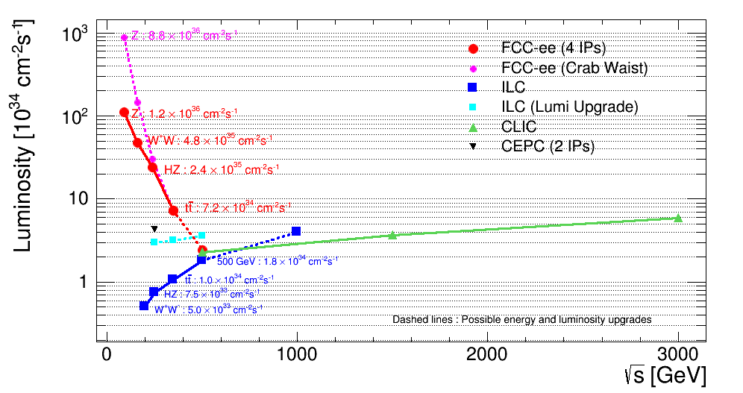
This tells the story:
FCC-ee as Z factory: 10¹² Z/few years
(possibly 10¹³ with crab-waist)
complementarity
ww
NB: ideas for lumi upgrades:
-- ILC arxiv:1308.3726 (not in TDR). Upgrade at 250GeV by reconfiguration after 500 GeV running
-- FCC-ee (crab waist) see Zimmermann’s talk

Slide 20
1 Precision measurements
-- EW observables Z, W, top
-- Higgs boson
2. Search for rare processes
-- neutrinos

Slide 21
1. ELECTROWEAK PRECISION TESTS (EWPT)
Due to the non-abelian Gauge theory, Electroweak observables offer sensitivity to
electroweakly coupled new particles ...
-- if they are nearby in Energy scale
or
-- if they violate symmetries of the Standard Model (in which case, no «decoupling»)
Higgs boson and top-bottom mass splitting constitute such symmetry violations
2. TESTS OF ELECTROWEAK SYMMETRY BREAKING (EWSB)
Is the H(125) a Higgs boson?
→ couplings proportional to mass?
if not: could be more complicated EWSB e.g. more Higgses
→ Higgs supposed to cancel WW scattering anomalies at TeV scale: does this work?

Slide 22
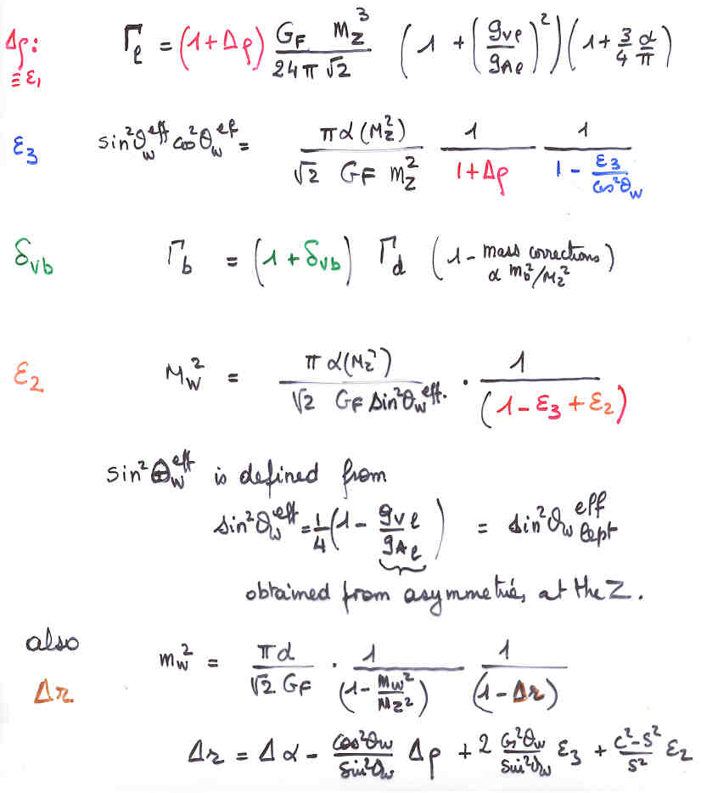
EWRCs
relations to the well measured
G_{F} m_{Z} α_{QED}
at first order:
Δρ = α /π (m_{top}/m_{Z})²
- α /4π log (m_{h}/m_{Z})²
ε₃ = cos²θ_{w} α /9π log (m_{h}/m_{Z})²
δ_{νb} =20/13 α /π (m_{top}/m_{Z})²
complete formulae at 2d order
including strong corrections
are available in fitting codes
e.g. ZFITTER , GFITTER

Slide 23
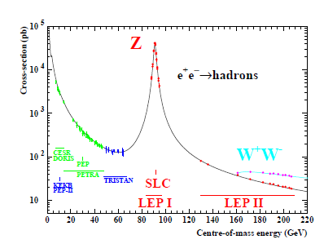

Slide 24
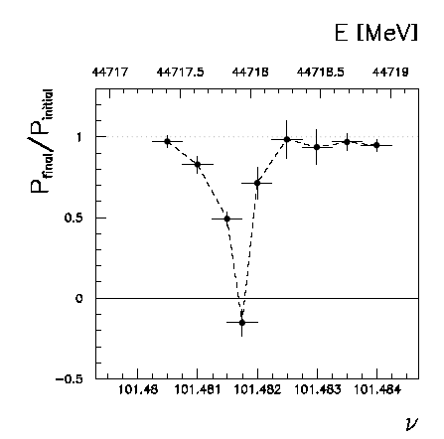
Beam polarization and E-calibration @ FCC-ee
Precise meast of E_{beam} by resonant depolarization
~100 keV each time the meast is made
At LEP transverse polarization was achieved routinely at Z peak.
instrumental in 10⁻³ measurement of the Z width in 1993
led to prediction of top quark mass (179+- 20 GeV) in March 1994
Polarization in collisions was observed (40% at BBTS = 0.04)
At LEP beam energy spread destroyed polarization above 60 GeV
σ_{E} ∝ E²/√ρ ➔ At FCC-ee transverse polarization up to at least 80 GeV
to go to higher energies requires spin rotators and siberian snake
FCC-ee: use ‘single’ bunches to measure the beam energy continuously
no interpolation errors due to tides, ground motion or trains etc…
<< 100 keV beam energy calibration around Z peak and W pair threshold.
Δm_{Z} ~0.1 MeV, ΔΓ_{Z} ~0.1 MeV, Δm_{W} ~ 0.5 MeV

Slide 25
A Sample of Essential Quantities:
X | Physics | Present precision |  | TLEP stat Syst Precision | TLEP key | Challenge
M_{Z} MeV/c2 | Input | 91187.5 ±2.1 | Z Line shape scan | 0.005 MeV <±0.1 MeV | E_cal | QED corrections
Γ_{Z} MeV/c2 | Δρ (T) (no Δα!) | 2495.2 ±2.3 | Z Line shape scan | 0.008 MeV <±0.1 MeV | E_cal | QED corrections
R_{l} | α_{s ,} δ_{b} | 20.767 ± 0.025 | Z Peak | 0.0001 ± 0.002 - 0.0002 | Statistics | QED corrections
N_{ν} | Unitarity of PMNS, sterile ν’s | 2.984 ±0.008 | Z Peak Z+γ(161 GeV) | 0.00008 ±0.004 0.001 | ->lumi meast Statistics | QED corrections to Bhabha scat.
R_{b} | δ_{b} | 0.21629 ±0.00066 | Z Peak | 0.000003 ±0.000020 - 60 | Statistics, small IP | Hemisphere correlations
A_{LR} | Δρ, ε_{3 ,}Δα (T, S ) | 0.1514 ±0.0022 | Z peak, polarized | ±0.000015 | 4 bunch scheme | Design experiment
M_{W} MeV/c2 | Δρ, ε_{3 ,} ε_{2,} Δα (T, S, U) | 80385 ± 15 | Threshold (161 GeV) | 0.3 MeV <1 MeV | E_cal & Statistics | QED corections
m_{top} MeV/c2 | Input | 173200 ± 900 | Threshold scan | 10 MeV | E_cal & Statistics | Theory limit at 100 MeV?

Slide 26
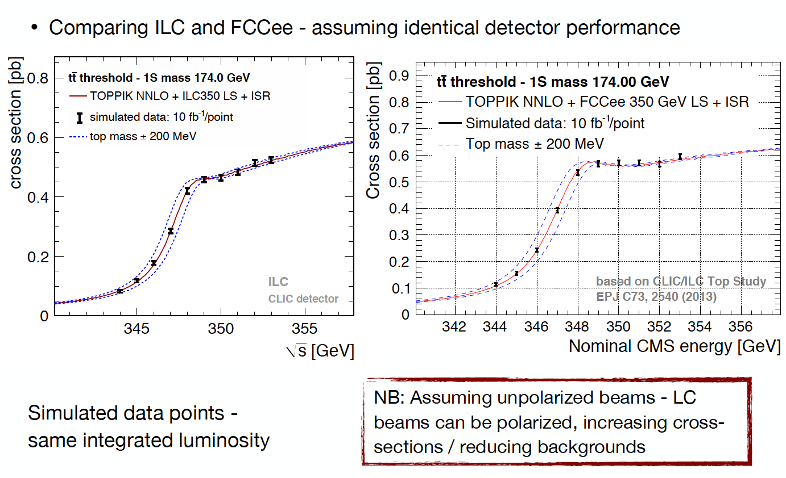
350 GeV: the top mass
Advantage of a very low level of beamstrahlung
Could potentially reach 10 MeV uncertainty (stat) on m_{top}
From Frank Simon, presented at 7th TLEP-FCC-ee workshop, CERN, June 2014

Slide 27
The Higgs

Slide 28
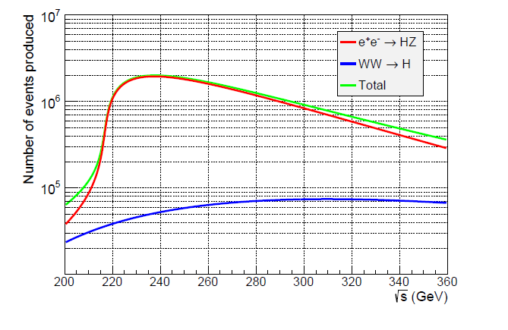
Higgs Production Mechanism in e+ e- collisions
Light Higgs is produced by “Higgstrahlung” process close to threshold
Production xsection has a maximum of ~200 fb
TLEP: 2. 10³⁵/cm²/s ➔ 400’000 HZ events per year (2 million Higgses in 5 years)
Z – tagging by missing mass
e⁻
H
Z*
e⁺
Z
For a Higgs of 125GeV, a centre of mass energy of 240GeV is sufficient
➔ kinematical constraint near threshold for high precision in mass, width, selection purity

Slide 29
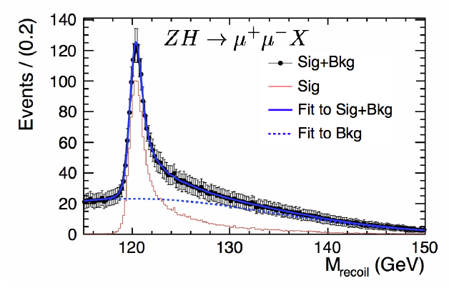
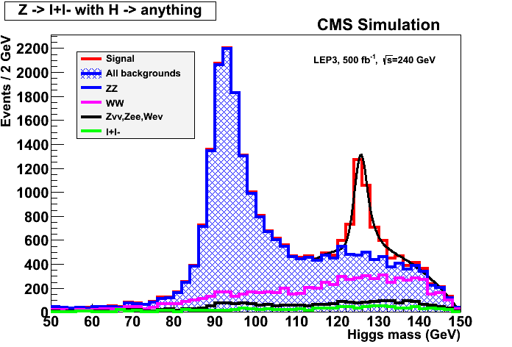
ILC
Z – tagging
by missing mass
total rate ∝ g_{HZZ}²
ZZZ final state ∝ g_{HZZ}⁴/ Γ_{H}
➔ measure total width Γ_{H}
empty recoil = invisible width
‘funny recoil’ = exotic Higgs decay
easy control below theshold
e⁻
H
Z*
e⁺
Z

Slide 30
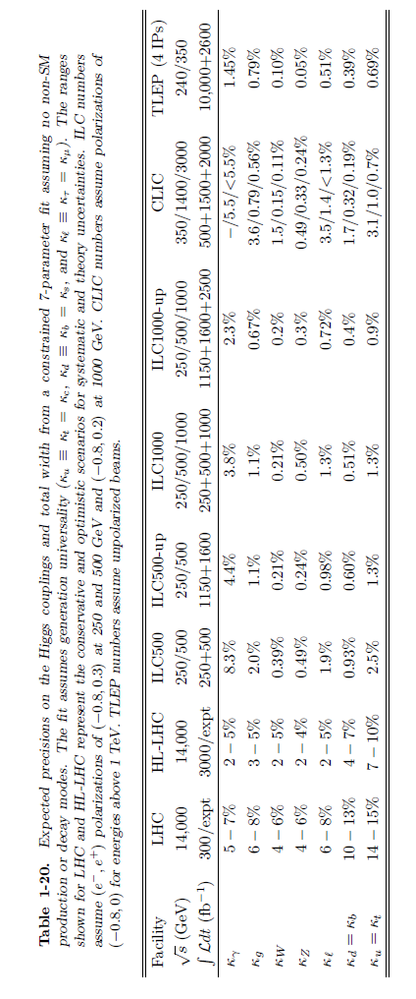
many comparisons in Snowmass report.
bottom line: FCC-ee + FCC-hh (for ttH, ttZ and HHH) cover couplings very well!

Slide 31
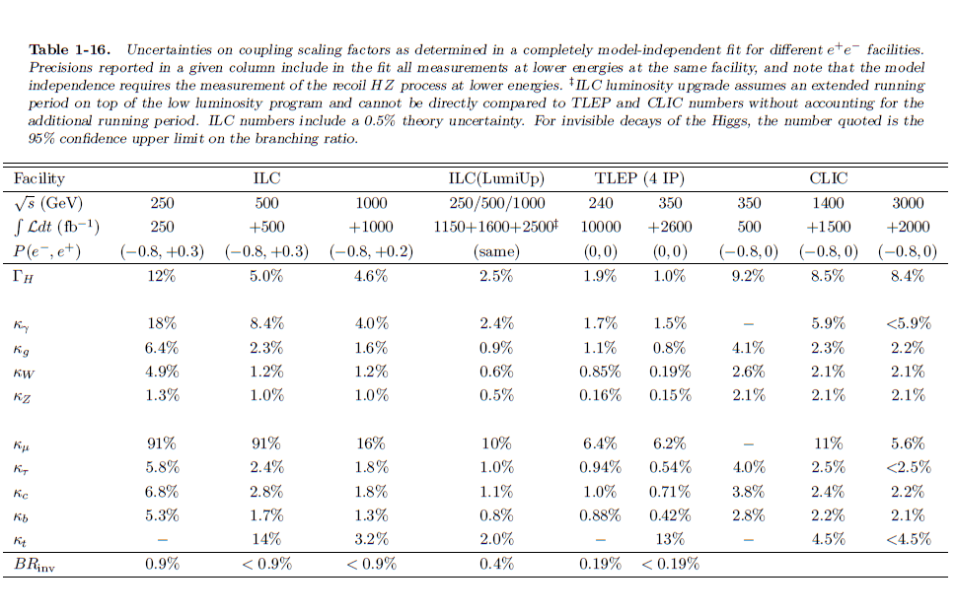
baseline
ILC
Invisible width is unique feature of lepton collider at 240 GeV
HIGH LUMINOSITY + PRECISE KNOWLEDGE OF SPECTRUM

Slide 32
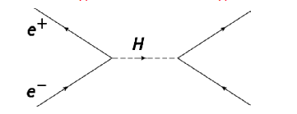
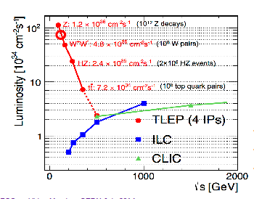
For those who like challenges:
Higgs s-channel production at √s = m_{H}
In theory, with L_{int}~6 ab-1 (4 exps./year)
FCC-ee running at H pole mass
➔ 10⁴ events per year.
Very difficult because huge background
and beam energy spread ~ 10 x Γ_{H}
limits or signal? monochromators?
Aleksan, D’Enterria, Woijcik

Slide 33
need to gain a factor of ~8
➔ monochromator?

Slide 34
Search for Rare Processes
the example of right-handed neutrinos

Slide 35
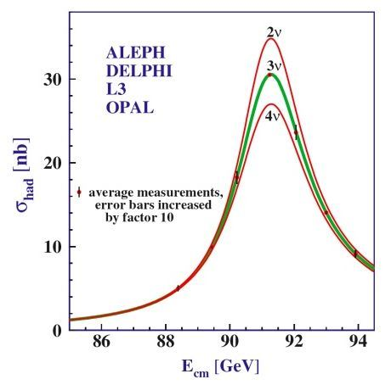
At the end of LEP:
Phys.Rept.427:257-454,2006
N_{ν} = 2.984 ±0.008
- 2 σ :^) !!
This is determined from the Z line shape scan
and dominated by the measurement of the
hadronic cross-section at the Z peak maximum ➔
The dominant systematic error is the theoretical
uncertainty on the Bhabha cross-section (0.06%)
which represents an error of ±0.0046 on N_{ν}
Improving on N_{ν} by more than a factor 2 would require a large effort
to improve on the Bhabha cross-section calculation!

Slide 36
Neutrino counting at FCC-ee
given the very high luminosity, the following measurement can be performed
above Z peak
(105-160 GeV Ecm)

Slide 37
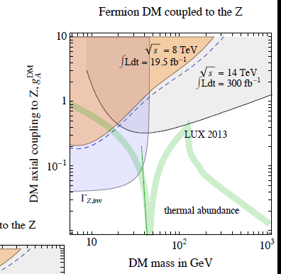
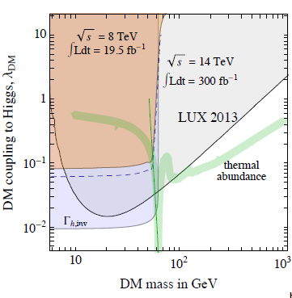
(Giudice)
Will improve these by large factors!
ΔN_{ν} = 0.0004?
from e+e-→Zγ
ΔΓ_{h,inv} /Γ_{tot} <0.19%

Slide 38
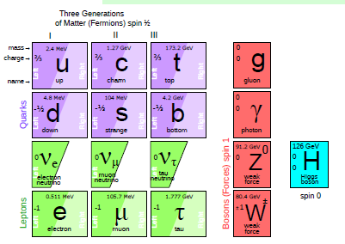
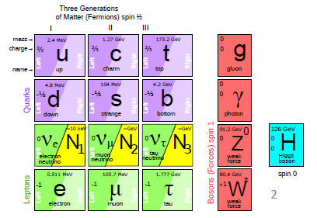
SM is NOT complete!
at least 3 pieces are still missing
neutrinos have mass...
and this very probably implies new degrees of freedom
➔ Right-Handed, almost «Sterile» (very small couplings) Neutrinos
completely unknown masses (meV to ZeV), nearly impossile to find.
.... but could perhaps explain all: DM, BAU,ν-masses

Slide 39
See-saw in a general way :
M_{R} ≠ 0
m_{D} ≠ 0
Dirac + Majorana
mass terms
see-saw
M_{R} = 0
m_{D} ≠ 0
Dirac only, (like e- vs e+):
ν_{L} ν_{R} ‾ν_{R} ‾ν_{L}
½ 0 ½ 0
4 states of equal masses
M_{R} ≠ 0
m_{D} = 0
Majorana only
ν_{L} ‾ν_{R}
½ ½
2 states of equal masses
M_{R} ≠ 0
m_{D} ≠ 0
Dirac + Majorana
ν_{L} N_{R} ‾ν_{R} ‾N_{L}
½ 0 ½ 0
4 states , 2 mass levels
m
m
m
I_{weak}=
I_{weak}=
I_{weak}=
Some have I=1/2 (active)
Some have I=0 (sterile)
All have I=1/2 (active)
m1 have I=1/2 (~active)
m2 have I=0 (~sterile)

Slide 40
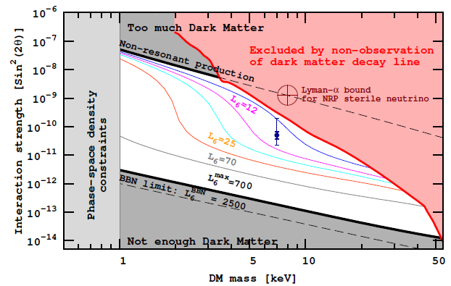
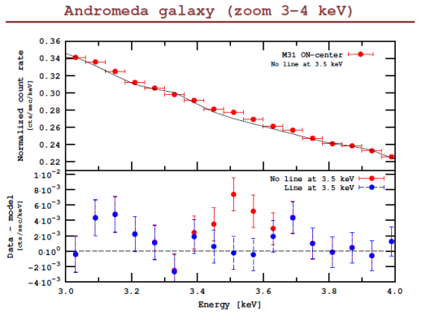
There even exists a scenario that explains everything: the νMSM
Shaposhnikov et al
TeV
N₂, N₃
can generate Baryon Asymmetry of Universe
if m_{N2,N3} > 140 MeV
GeV
MeV
constrained:
mass: 1-50 keV
mixing :
10⁻⁷ to 10⁻¹³
N₁
keV
eV
decay time:
τ_{N1} > τ_{Universe}
ν₃
ν₂
meV
ν₁
N₁→ v γ
may have been seen:
arxiv:1402:2301
arxiv:1402.4119

Slide 41
Manifestations of right handed neutrinos
$v$ = light mass eigenstate
N = heavy mass eigenstate
≠ $vL$ , active neutrino
which couples to weak inter.
and ≠ N_{R}, which does’nt.
one family see-saw :
θ ≈ (m_{D}/M)
$mv$ ≈ $\frac{mD2}{M}$
m_{N} ≈ M
|U|² ∝ θ² ≈ $mv$/ m_{N}
$v= vL$ cosθ - ${Nc}_{R }^{} sin$θ
$N=N_{R}^{} \text{cos}\text{θ}+ vL$ ^{c} sinθ
what is produced in W, Z decays is:
$vL= v$ cosθ + $N_{ }^{}sin$θ
-- mixing with active neutrinos leads to various observable consequences
-- if very light (eV) , possible effect on neutrino oscillations
-- if in keV region (dark matter), monochromatic photons from galaxies with E=m_{N}/2
-- possibly measurable effects at High Energy
If N is heavy it will decay in the detector (not invisible)
➔ PMNS matrix unitarity violation and deficit in Z «invisible» width
➔ Higgs and Z visible exotic decays H→ ν_{i}‾Ν_{i} and Z→ ν_{i}‾Ν_{i} , W-> l_{i} ‾Ν_{i}
➔ also in charm and b decays via W*-> l_{i} ‾Ν_{i}
➔ violation of unitarity and lepton universality in Z, W or τ decays
-- etc... etc...
-- Couplings are small ($mv$/ m_{N}) (but who knows?) and generally out of reach of hadron colliders (but this deserves to be revisited for detached vertices @LHC, HL-LHC, FCC-hh)

Slide 42
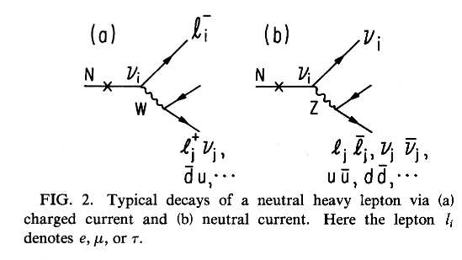
Direct RH nu’s production in Z decays
Production:
multiply by 2 for anti neutrino and add contributions of 3 neutrino species (with different |U|² )
Decay
Decay length:
cm
NB CC decay always leads to
≥ 2 charged tracks
Backgrounds : four fermion: e+e- → W*⁺ W*⁻ e+e- → Z*(vv) + (Z/γ)*

Slide 43
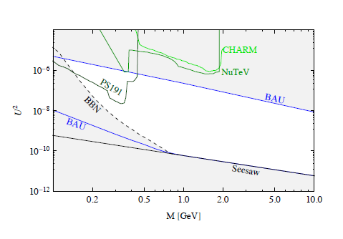
Decay length
Interesting region
|U|² ~ 10⁻⁹ to 10⁻¹² @ 50 GeV
L=1mm
L=1m
L=10m
~1 evt with 10¹³Zs
20 50 100
heavy neutrino mass ~ M
a large part of the interesting region will lead to detached vertices
... ➔very strong reduction of background!
μ⁺
N
W⁻→qq
Exact reach domain will depend on detector size
and details of displaced vertex efficiency & background
ν

Slide 45
Complementarity
Proposed physics topics to be used in the study of synergy/complementarity among experiments at FCC-hh/ee/eh
Subject |  | ee | hh | he
Higgs Physics | precision studies higher dimension operators composite Higgs rare and exotic decays multiple Higgs production extra Higgs bosons
Interface with Cosmology | Dark matter baryogenesis right-handed/(almost) sterile neutrinos
Electroweak Sym. Breaking | WW scattering supersymmetry extra dimensions composite models
Flavour Changing | rare H,Z,W,top decays lepton flavor violation
Extensions of the SM | extra vector-like fermions SU(2)_{R} models leptoquarks
QCD | Perturbation theory, structure functions Modelling final states
EW/SM precision issues | precision measts (m_{Z},m_{W},m_{t},α,α_{s}(m_{Z}),sin²θ_{W}.R_{b}... higher-order EW corrections W,Z triple and quadruple couplings top (anomalous) couplings charm/bottom flavor studies

Slide 46
What we believe now and hope to demonstrate in a few years:
The combination of the FCC machines offers outstanding discovery potential by exploration of new domains of
-- precision
and
-- direct search, both at high energy and at very small couplings

Slide 47
CONCLUSIONS
-- FCC-ee physics studies are in construction phase
for software, event generators, etc.. no results yet.
-- contacts with linear collider groups positive
-- high luminosity FCC-ee offers real opportunities for
discovery
-- precision measurements
-- rare processes (FCNCs, LFV, heavy neutrinos, etc..)
-- Circular Collider complex (ee, hh, eh) is a fantastic
story in the making!

Slide 48
Let’s go for it!

Slide 49
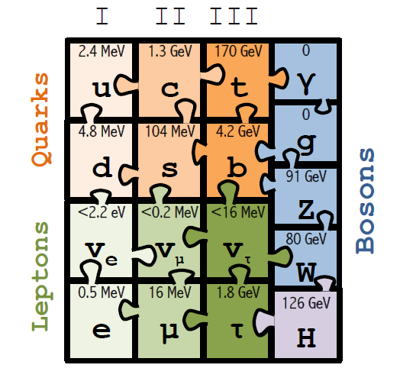
1964-2013 Higgs boson predicted,
mass cornered (LEP direct, indirect M_{Z} etc +Tevatron m_{t} , M_{W})
Higgs Boson discovered (LHC)
Englert and Higgs get Nobel Prize
(c) Sfyrla

Slide 50
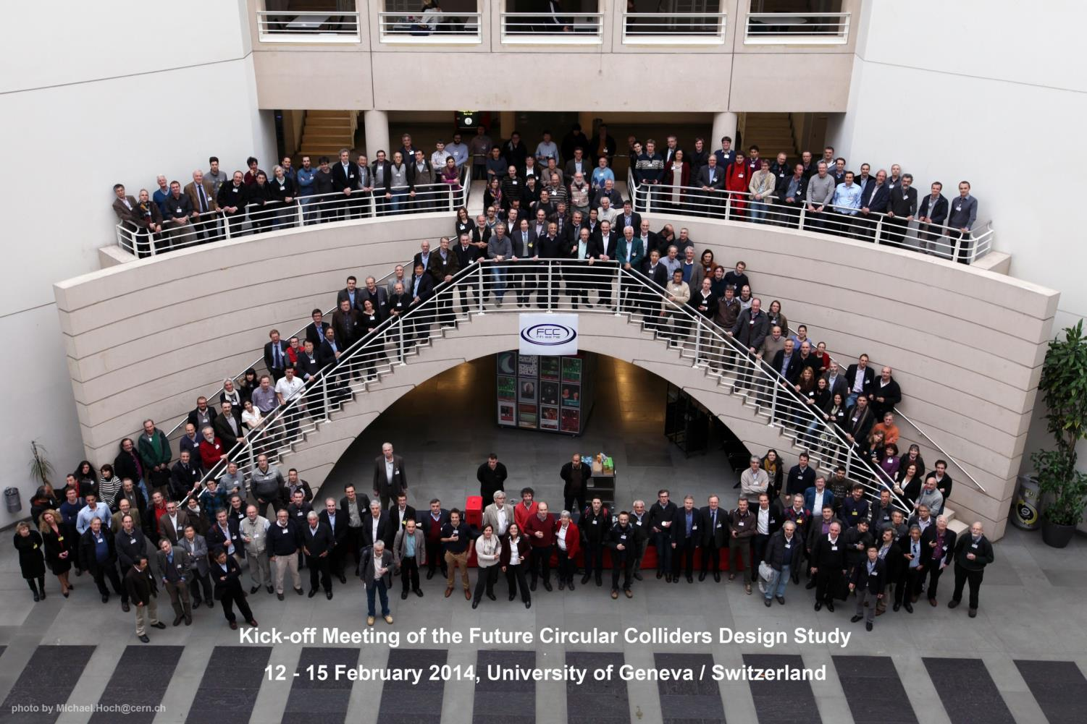
FCC Kick-off Meeting
341 registered participants

Slide 51
FCC Coordination Team
Future Circular Colliders - Conceptual Design Study
Study coordination, M. Benedikt, F. Zimmermann
Hadron collider
D. Schulte
Hadron injectors
B. Goddard
e+ e- collider and injectors
J. Wenninger
Infrastructure, cost estimates
P. Lebrun
Technology
High Field Magnets
L. Bottura
Supercon-ducting RF
E. Jensen
Cryogenics
L. Tavian
Specific Technologies
JM. Jimenez
Physics and experiments
Hadrons
A. Ball, F. Gianotti,
M. Mangano
e+ e-
A. Blondel
J. Ellis, P. Janot
e- p
M. Klein
e- p option
Integration aspects O. Brüning
Operation aspects,
energy efficiency, safety, environment P. Collier
Planning (Implementation roadmap, financial planning, reporting)
F. Sonnemann, J. Gutleber

Slide 52
FCC-PHYSics-COordination-group
FCC-ee
Alain Blondel
John Ellis
Christophe Grojean
Patrick Janot
FCC-hh
Austin Ball
Fabiola Gianotti
Michelangelo Mangano
FCC-he
Max Klein
Monica d’Onofrio

Slide 53
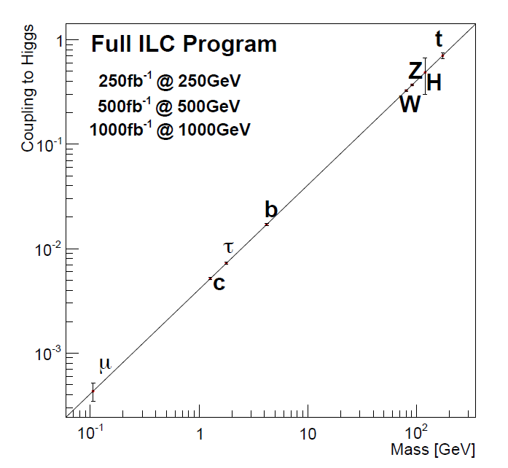
t
Full HL-LHC
H
Z
W
b
τ
μ

Slide 54
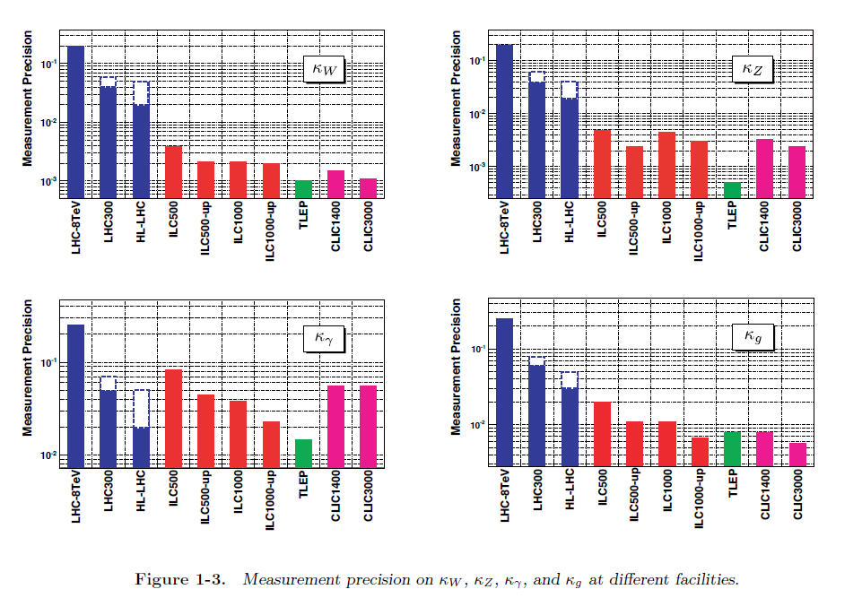

Slide 55
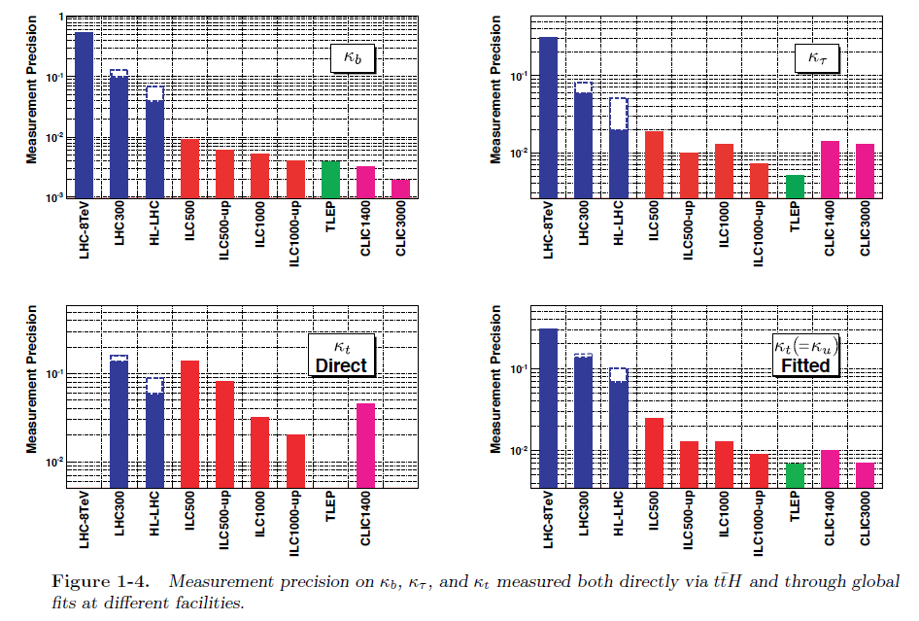

Slide 56
This will remain the reserved domain of the hadron colliders with HL-LHC and FCC-hh!

Slide 57
The main players
Inputs:
G_{F} = 1.1663787(6) × 10⁻⁵ /GeV² from muon life time 6 10⁻⁷
M_{Z} = 91.1876 ± 0.0021 GeV Z line shape 2 10⁻⁵
α = 1/137.035999074(44) electron g-2 3 10⁻¹⁰
EW observables sensitive to new physics:
M_{W} = 80.385 ± 0.015 LEP, Tevatron 2 10⁻⁴
sin²θ_{W}^{eff =} 0.23153 ± 0.00016 WA Z pole asymmetries 7 10⁻⁴
Nuisance paramenters:
α (M_{Z}) =1/127.944(14) hadronic corrections 1.1 10⁻⁴
to running alpha
α_{S} (M_{Z}) =0.1187(7) strong coupling constant 7 10⁻³
m_{top} = 173.34 ± 0.76 GeV from LHC+Tevatron 4 10⁻³
combination
m_{H} = ATLAS 125.36 ± 0.37 (stat) ± 0.18 (syst) GeV 125.17 ± 0.25 2 10⁻³
CMS 125.03 ± 0.26 (stat) ± 0.14 (syst) GeV

Slide 58
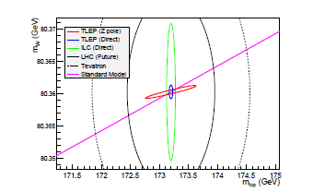
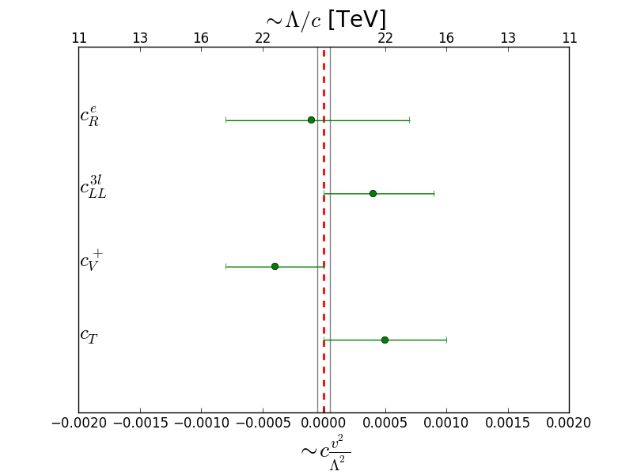
present
Precision measurements as tests of existence
of weakly coupled new physics
⬅ ‘classical’ precision measurements
+ flavour physics + Higgs precision measts
Thickness of SM line
is given by error on m_{Z}:
precise measurements of m_{Z} and m_{W}
➔ Energy calibration by resonnant depolarization

Slide 59
Theoretical limitations
FCC-ee
R. Kogler, Moriond EW 2013
SM predictions (using other input)
0.0005
0.0001
0.0005?
0.0005
- 0.001
0.0005?
0.0000
0.000003
0.000001
0.000003?
0.000002
0.000001?
0.000000
Experimental errors at FCC-ee will be 20-100 times smaller than the present errors.
BUT can be typically 10 -30 times smaller than present level of theory errors
Will require significant theoretical effort and additional measurements!

Slide 60
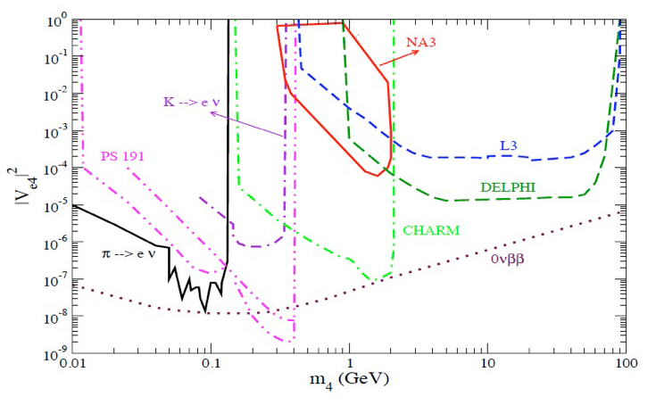
Order-of-magnitude extrapolation of existing limits
4 10^6 Z decays
BAU
maybe achievable with
10¹⁰ ⁻ 10¹³ Z decays?
see-saw

Slide 61
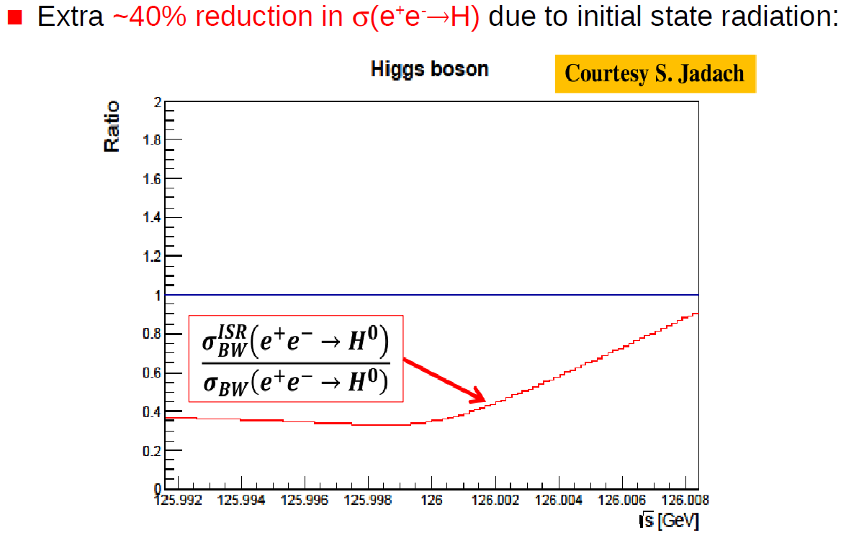
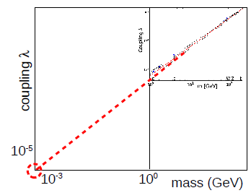
Thanks to high FCC-ee luminosity at low energies:
Preliminary event selections lead to sensitivity at ~ x SM cross-section
linearity test of H→ ff couplings extended by doubling the orders of magnitude
study on-going: monochromators, better selections, etc...

Slide 62
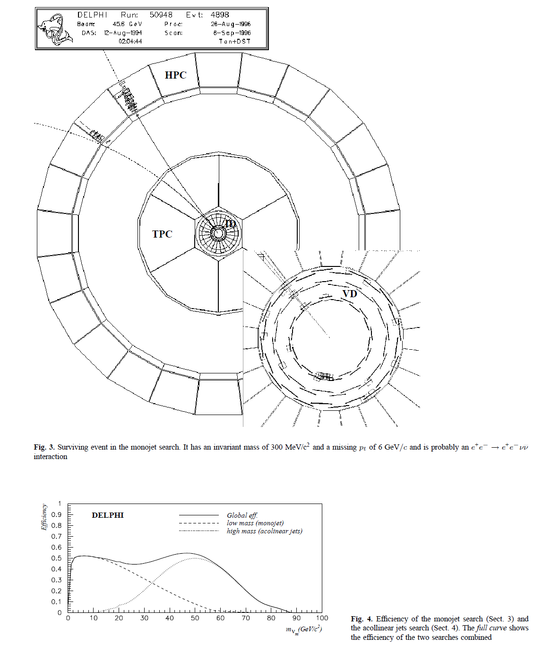
Search for heavy neutral leptons
search e⁺ e⁻→ v N
N→ v(γ/Z)*_{→ monojet}
Find: one event
in 4x10⁶Z:
e⁺e⁻
e⁺
γ*
Z*
e⁻

Slide 63
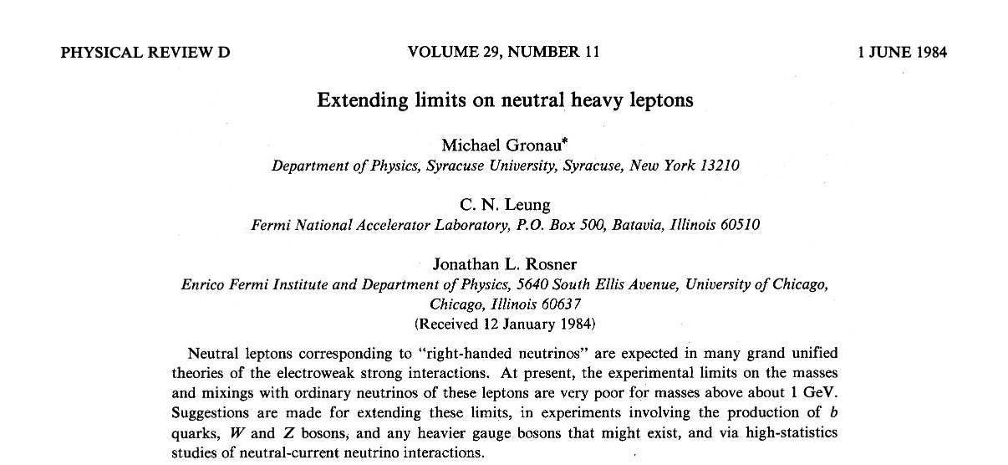
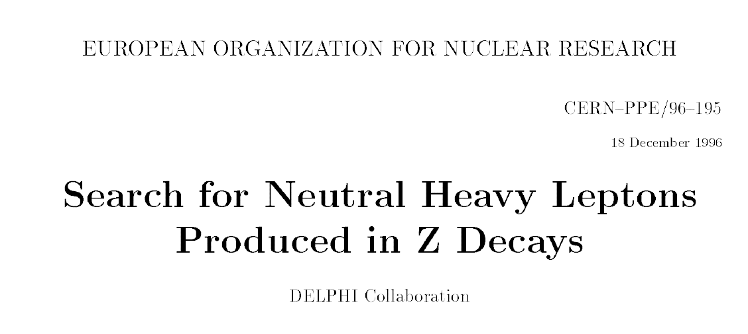
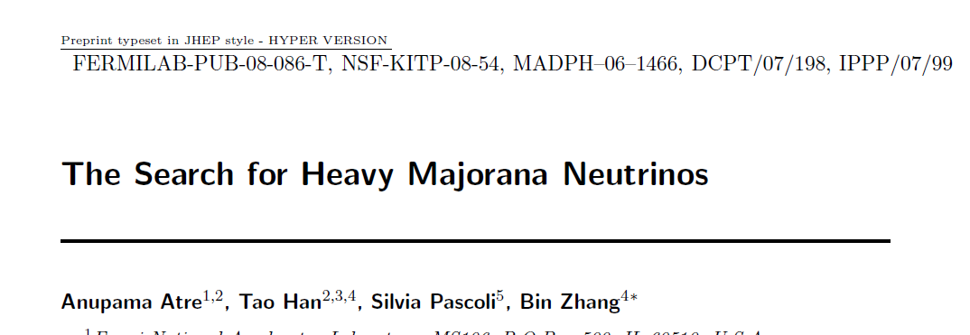
some REFERENCES
arxiv:1308.6176
arxiv:1208.3654
FCC design study and FCC-ee http://cern.ch/fcc-ee
and presentations at FCC-ee physics workshop
http://indico.cern.ch/event/313708/
Phys.Lett.B631:151-156,2005
arXiv:hep-ph/0503065
talks by Maurizio Pierini (BSM), Manqi Ruan (Higgs)
Roberto Tenchini (Top & Precision) tomorrow,
posters tonight at Future accelerator session

Slide 64
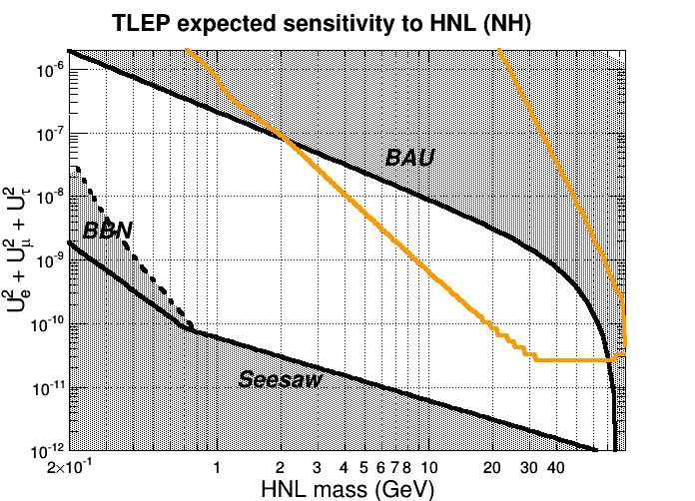
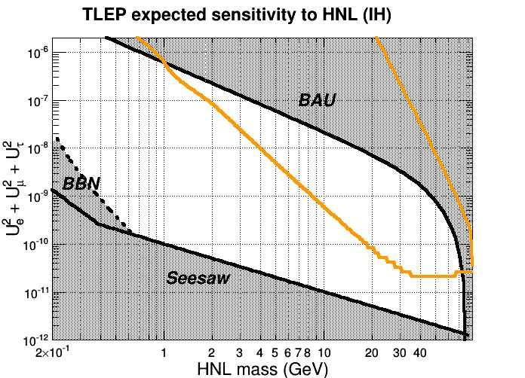
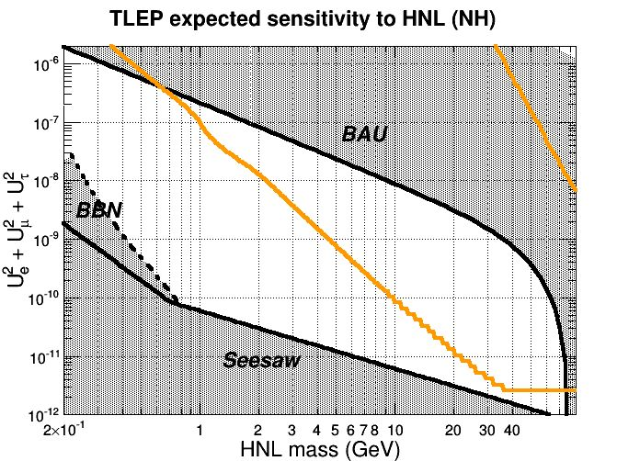
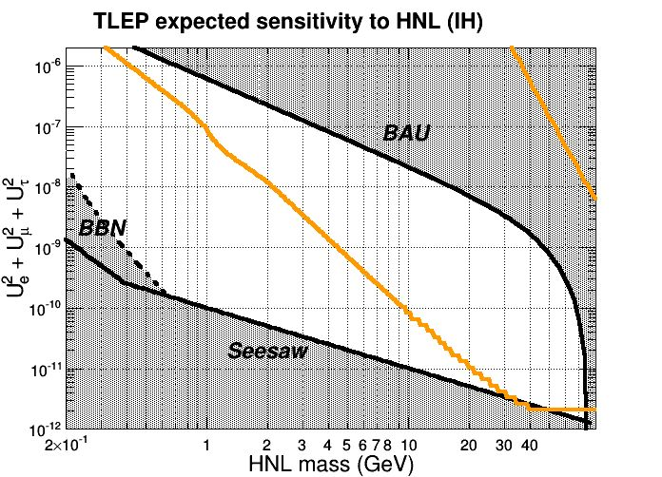
SHIP
N_{Z} = 10¹² 1mm<L<1m
N_{Z} = 10¹³ 100$m$ <L<5m
Elena Graverini, Nicola Serra

