Slide 1
CEPC SCRF System and R&D Progress
Jiyuan Zhai, Peng Sha on behalf of CEPC SRF team
CEPC Work Day, May 31, 2019

Slide 2
CEPC New Parameters @Z
20190226 | Z（2T）- CDR W/O ante-chamber | Z（2T）- new1 W/O ante-chamber | Z（2T）- new2 W ante-chamber | Z（2T）- new3 W ante-chamber
Beam energy (GeV) | 45.5
Synchrotron radiation loss/turn (GeV) | 0.036
Crossing angle at IP (mrad) | 16.5×2
Piwinski angle | 23.8 | 27.9 | 27.9 | 33.0
Number of particles/bunch N_{e} (10¹⁰) | 8.0 | 12.0 | 12.0 | 15.0
Bunch number (bunch spacing) | 12000 (25ns+10%gap) | 8570 (35ns+10%gap) | 14564 (20.6ns+10%gap) | 11682 (26ns+10%gap)
Beam current (mA) | 461.0 | 494.3 | 839.9 | 842.2
Synchrotron radiation power /beam (MW) | 16.5 | 17.7 | 30 | 30
Bending radius (km) | 10.7
Momentum compact (10⁻⁵) | 1.11
β function at IP β_{x}* / β_{y}* (m) | 0.2/0.001
Emittance ε_{x}/ε_{y} (nm) | 0.18/0.0016
Beam size at IP σ_{x} /σ_{y} (μm) | 6.0/0.04
Beam-beam parameters ξ_{x}/ξ_{y} | 0.004/0.079 | 0.004/0.093 | 0.004/0.093 | 0.004/0.098
RF voltage V_{RF} (GV) | 0.10
RF frequency f _{RF} (MHz) (harmonic) | 650 (216816)
Natural bunch length σ_{z} (mm) | 2.42
Bunch length σ_{z} (mm) | 8.5 | 10.0 | 10.0 | 11.8
HOM power/cavity (kw) | 1.94 (2cell) | 1.35 (1cell) | 2.29 (1cell) | 2.45 (1cell)
Energy spread (%) | 0.080 | 0.1 | 0.1 | 0.115
Energy acceptance requirement (%) | 0.49 | 0.6 | 0.6 | 0.7
Energy acceptance by RF (%) | 1.7
Photon number due to beamstrahlung | 0.023 | 0.03 | 0.03 | 0.032
Lifetime (hour) | 2.5 | 2.0 | 2.0 | 1.8
F (hour glass) | 0.99 | 0.97 | 0.97 | 0.97
Luminosity/IP L (10³⁴cm⁻²s⁻¹) | 32.1 | 43.9 | 74.5 | 79.2
Choose Z(2T) - new2 to explore the high current potential (~ 800 mA) of CEPC SRF system with 1-cell cavities (this talk) or other better schemes (to be studied in the future).

Slide 3
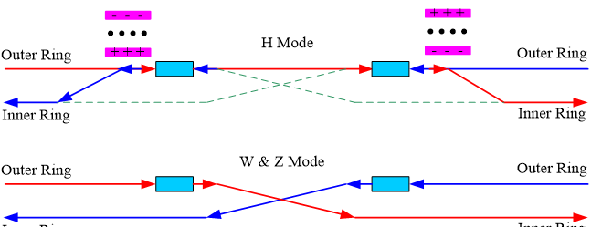
CEPC Collider Ring SRF Parameters
New machine parameters 20190226 SRF parameters 20190301 | CDR (2-cell) |  |  | HL-Z (new2) (1-cell) |  |  |  | HL-Z (2-cell) | Performance Limits & Risks
 | H | W | Z | H | W | Z (a) | Z (b) | Z
Luminosity / IP [10³⁴ cm⁻²s⁻¹] | 2.93 | 10.1 | 32.1 | 2.93 | 10.1 | 74.5 | 74.5 | 74.5
SR power / beam [MW] | 30 | 30 | 16.5 | 30 | 30 | 30 | 30 | 30
RF voltage [GV] | 2.17 | 0.47 | 0.1 | 2.17 | 0.47 | 0.1 | 0.1 | 0.1
Beam current / beam [mA] | 17.4 | 87.7 | 460 | 17.4 | 87.7 | 838 | 838 | 838
Bunch charge [nC] | 24 | 19.2 | 12.8 | 24 | 19.2 | 19.2 | 19.2 | 19.2
Bunch number / beam | 242 | 1524 | 12000 | 242 | 1524 | 14564 | 14564 | 14564
Bunch length [mm] | 3.26 | 5.9 | 8.5 | 3.26 | 5.9 | 10 | 10 | 10
Cavity number (650 MHz) | 240 | 2 x 108 | 2 x 60 | 240 | 2 x 120 | 2 x 120 | 2 x 60 | 2 x 120 | Smart by-pass could be a better approach than 1-cell.
Cell number / cavity | 2 | 2 | 2 | 1 | 1 | 1 | 1 | 2 | Common 1-cell for Z & H/W necessary or different cavity?
Idle cavities on line / ring | 0 | 12 | 60 | 0 | 0 | 0 | 60 | 0 | Z 2x60 symmetry detune parked half cavities for FM CBI
Cavity gradient [MV/m] | 20 | 9.5 | 3.6 | 40 | 17 | 3.6 | 7.2 | 1.8 | Current status: ~ 10 MV/m in storage ring. Field emission
Q₀ for long term operation | 1.5E10 | 1.5E10 | 1.5E10 | 3E10 | 3E10 | 3E10 | 3E10 | 1.5E10 | ~ 1E9 in storage ring. Field emission. Magnetic shield
Input power / cavity [kW] | 250 | 278 | 275 | 250 | 250 | 250 | 500 | 250 | ~ 300 kW in storage ring. Window events and damages
Klystron max power [kW] | 800 | 800 | 800 | 800 | 800 | 800 | 1400 | 800 | Klystron max power limit: 1200 kW? KLY # & $
Number of cavities / klystron | 2 | 2 | 2 | 2 | 2 | 2 | 2 | 2 | Avoid RF power source reconfiguration
HOM power / cavity [kW] | 0.57 | 0.75 | 1.94 | 0.29 | 0.37 | 2.28 | 2.28 | 4.57 | HOM coupler capacity (not HOM power per cavity) : 1 kW
Optimal Q_{L} | 1.5E6 | 3.2E5 | 4.7E4 | 3.1E6 | 5.8E5 | 2.6E4 | 5.2E4 | 1.3E4 | Coupler variation range, coupler kick to beam
Optimal detuning [kHz] | 0.2 | 1.0 | 17.8 | 0.1 | 0.5 | 32.3 | 16.1 | 64.6 | Fundamental mode coupled bunch instability
Wall loss / cavity @ 2 K [W] | 25.6 | 5.9 | 0.9 | 25.6 | 4.8 | 0.2 | 0.9 | 0.2 | Field emission will drastically increase the cryogenic load.
Total cavity wall loss [kW] | 6.1 | 1.3 | 0.1 | 6.1 | 1.2 | 0.05 | 0.05 | 0.05 | (cryogenic wall loss in two rings)

Slide 5
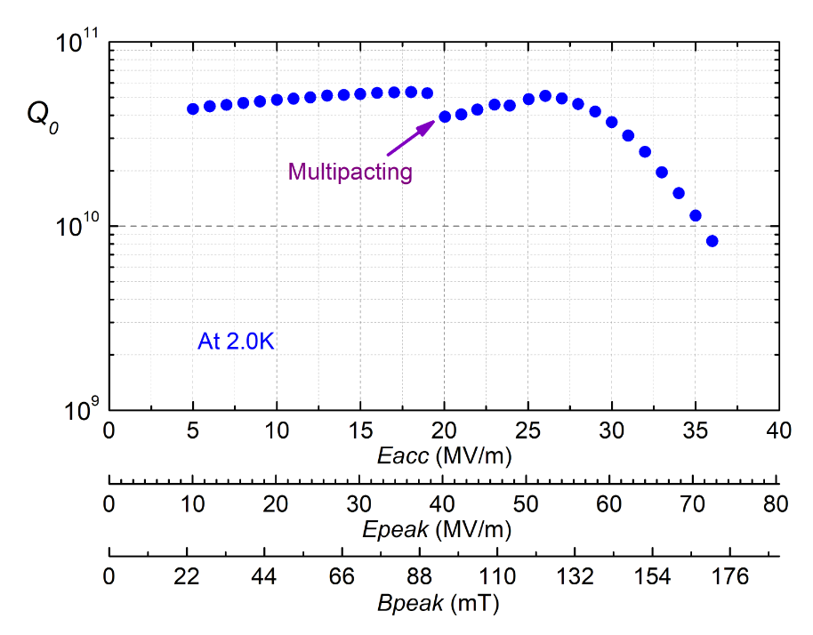
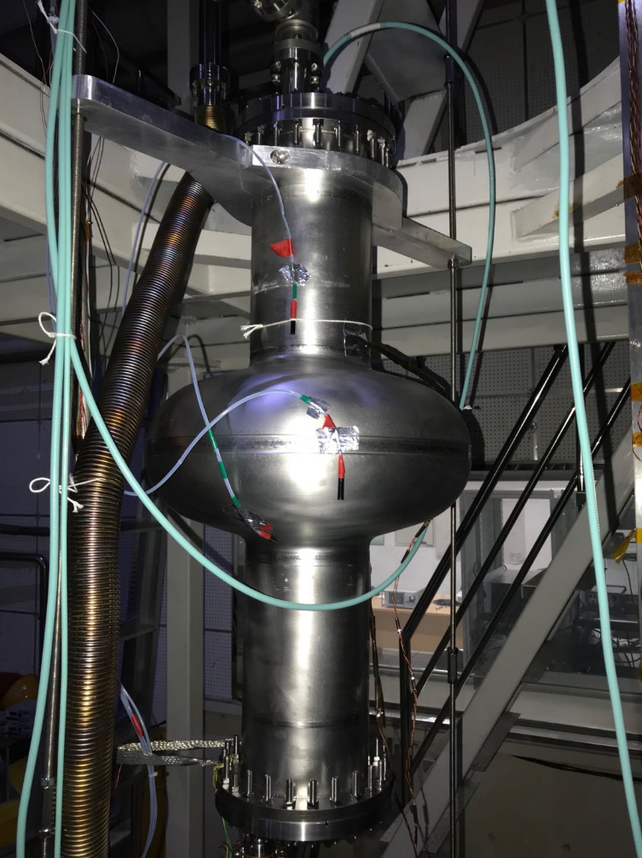
High Q and High Gradient R&D (650 MHz FG)
Accelerating gradient (Eacc) reach 36.0 MV/m，Q = 5.1E10 @ Eacc = 26 MV/m。
Next, increase the Q and Eacc through N-doping, EP, etc. Target: 5E10@42MV/m for vertical test.
Record highest Q-factor in China
CEPC spec
(1-cell)
CEPC spec
(2-cell)
only BCP, no EP or N-doping
650 MHz 1-cell cavity
N-doping + EP will increase the 650 MHz cavity performance in near future

Slide 6
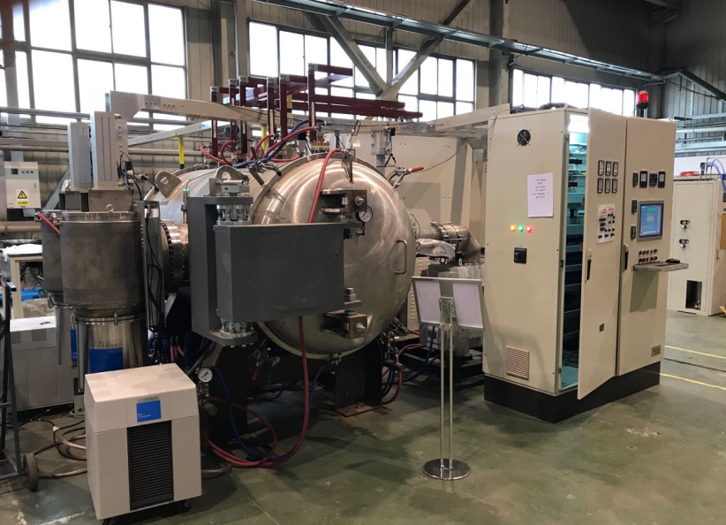
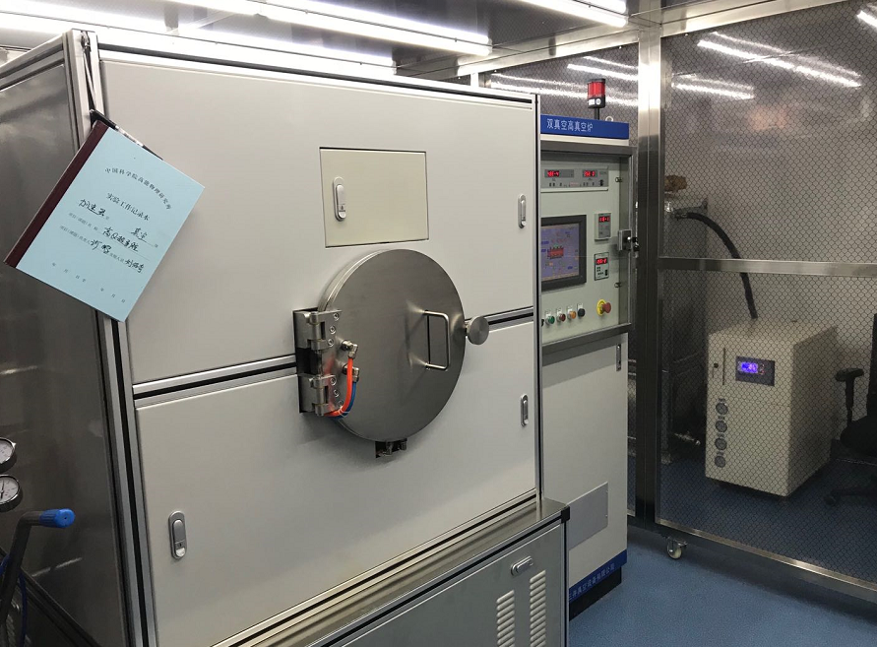
IHEP N-doping Furnaces

Slide 7
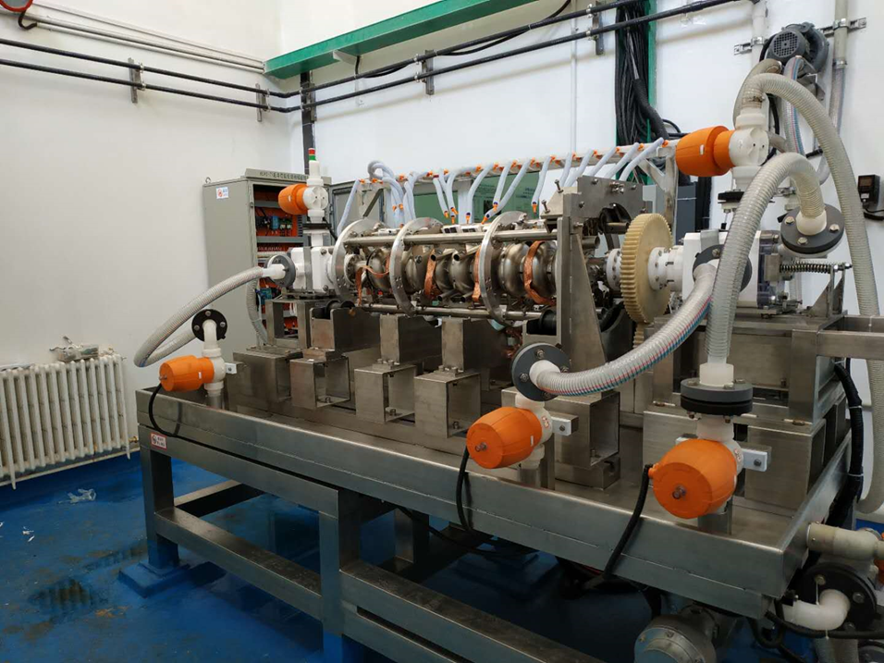
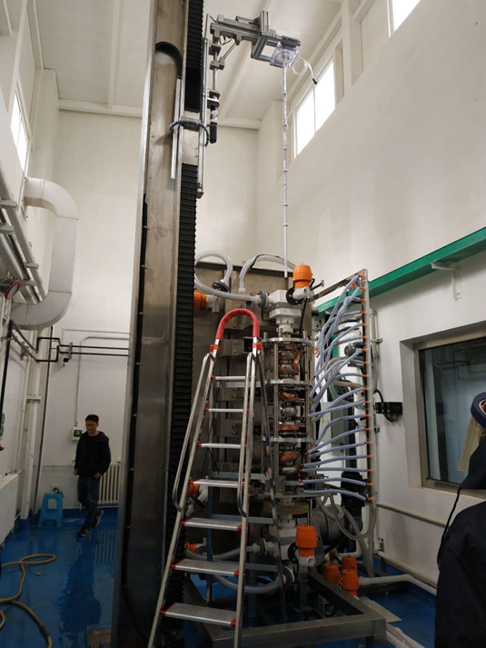
EP facility
First acid commissioning with 1.3 GHz 9-cell was finished at May 12th, 2019.
All the processes with acid were tested for the first time to expose the problems. Modification scheme were made.
It is expected that the formal EP process study with 1-cell cavity can be started in June this year.

Slide 8
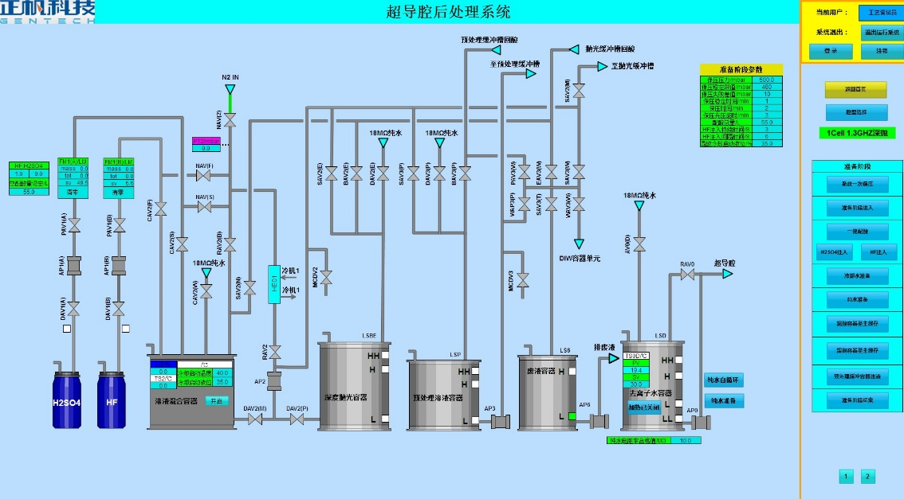
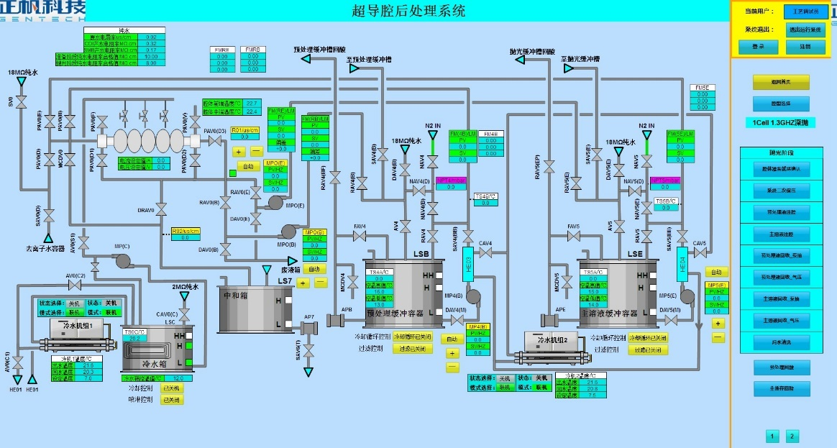
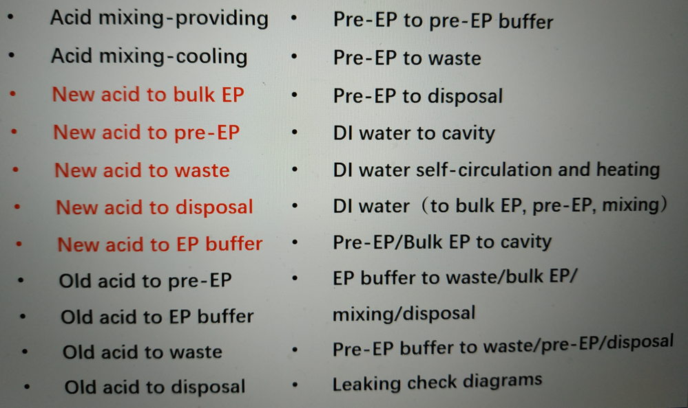
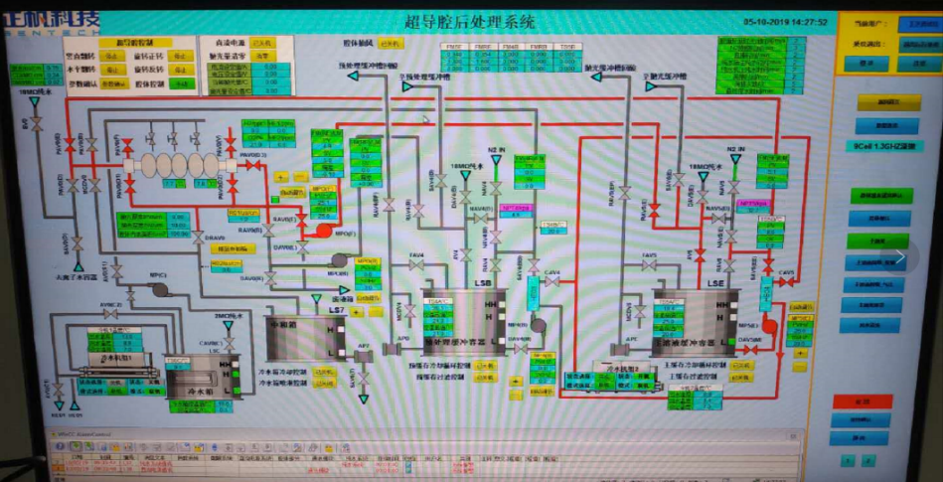
Water commissioning with model-cavity was finished on March 22nd, 2019
Water commissioning with 1.3GHz 1-cell and 9-cell were finished on April 30th ，2019

Slide 9
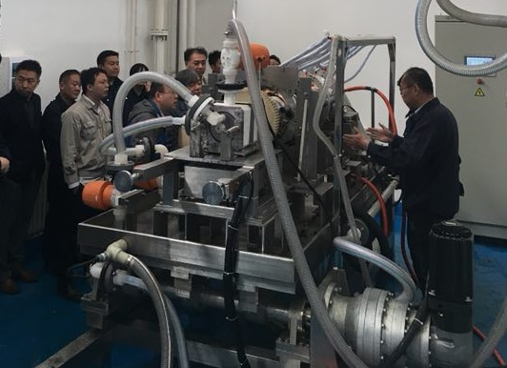
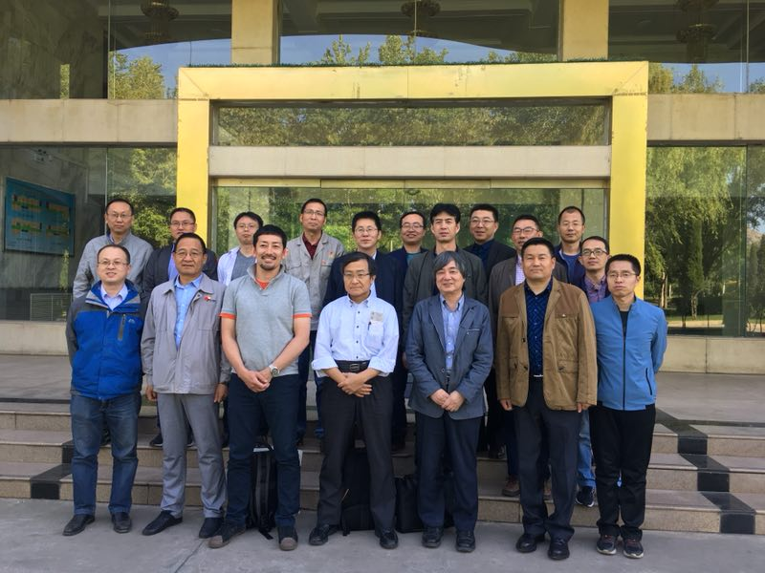
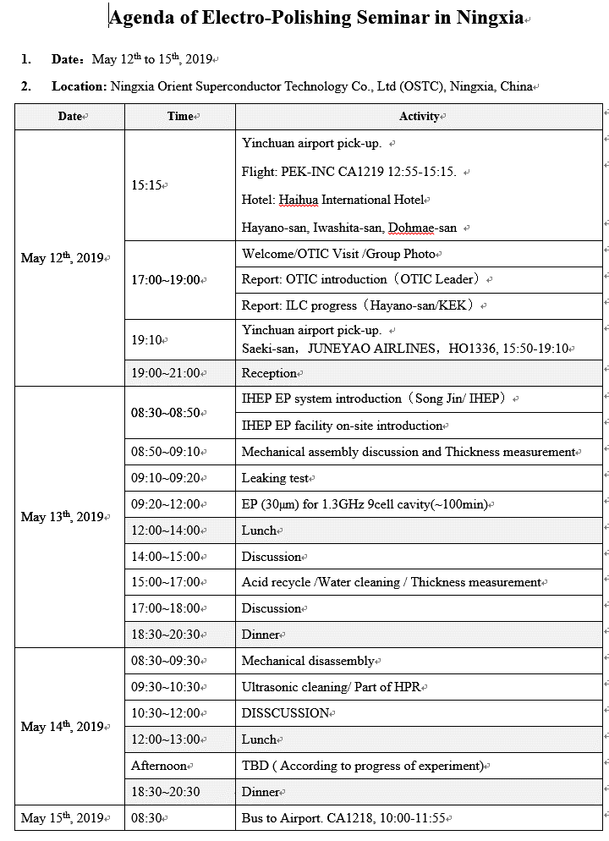
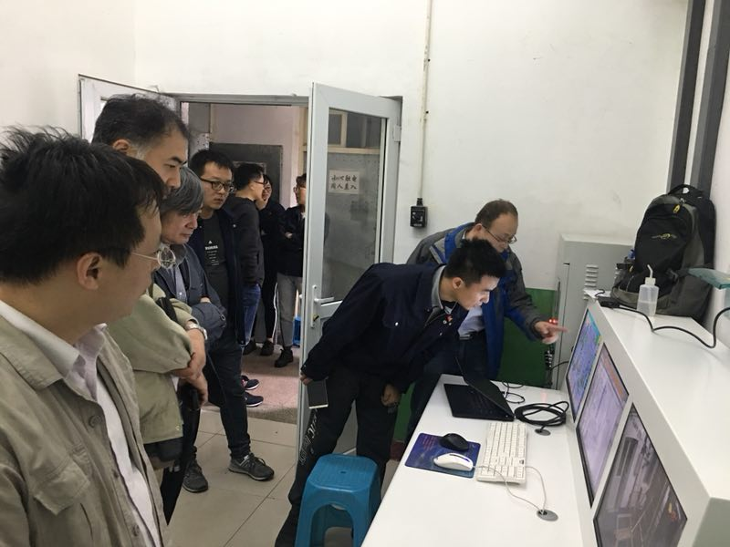
A EP seminar were hold at Ningxia. Four Japan SRF experts consulted the work on site.

Slide 10
Fermilab PIP-II 650 MHz 5-cell Cavity

Slide 11
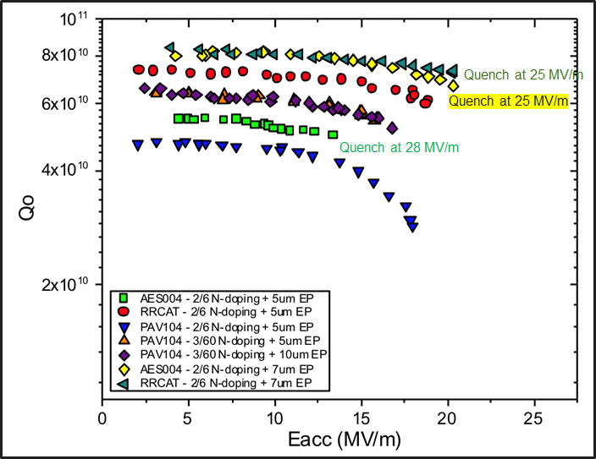
Fermilab 650 MHz 1-cell Cavity

Slide 12
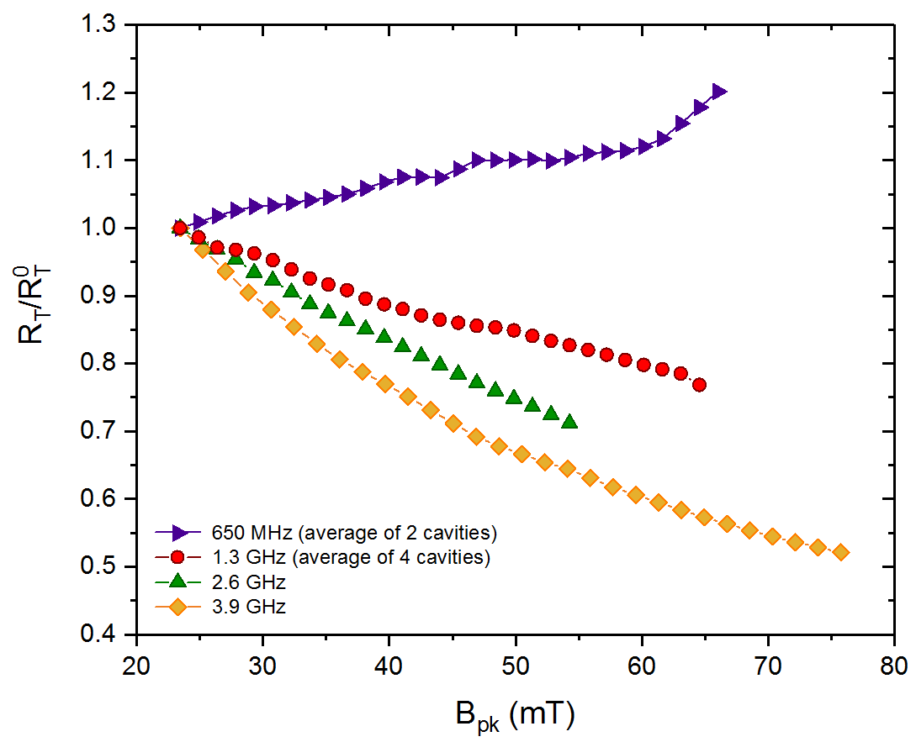
Normalized $R_{T}\left(2 K\right)$ for N-doping
M. Martinello et al., Phys. Rev. Lett. 121, 224801 (2018)

Slide 13
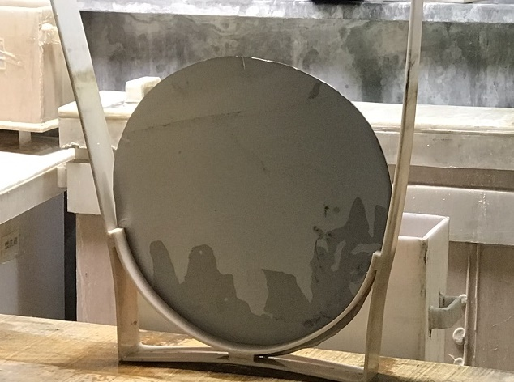
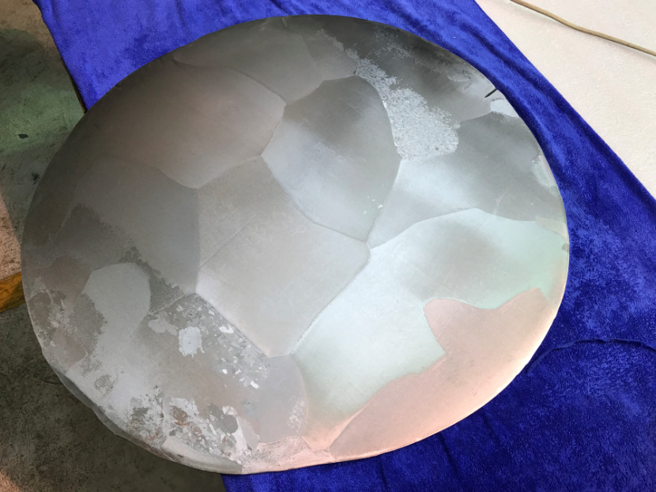
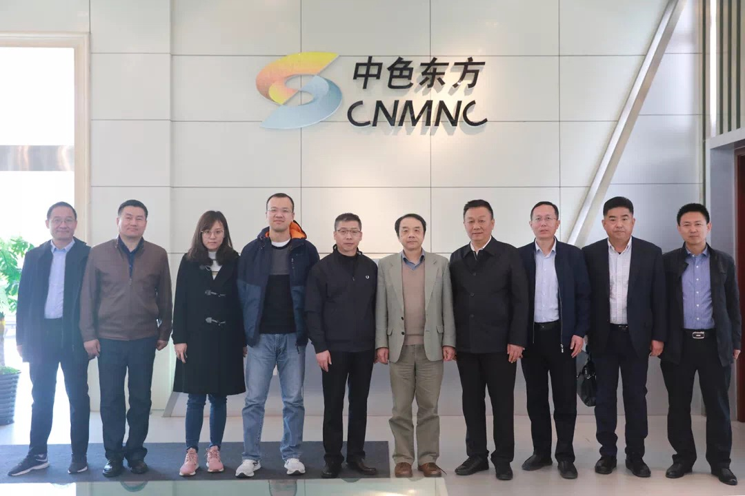
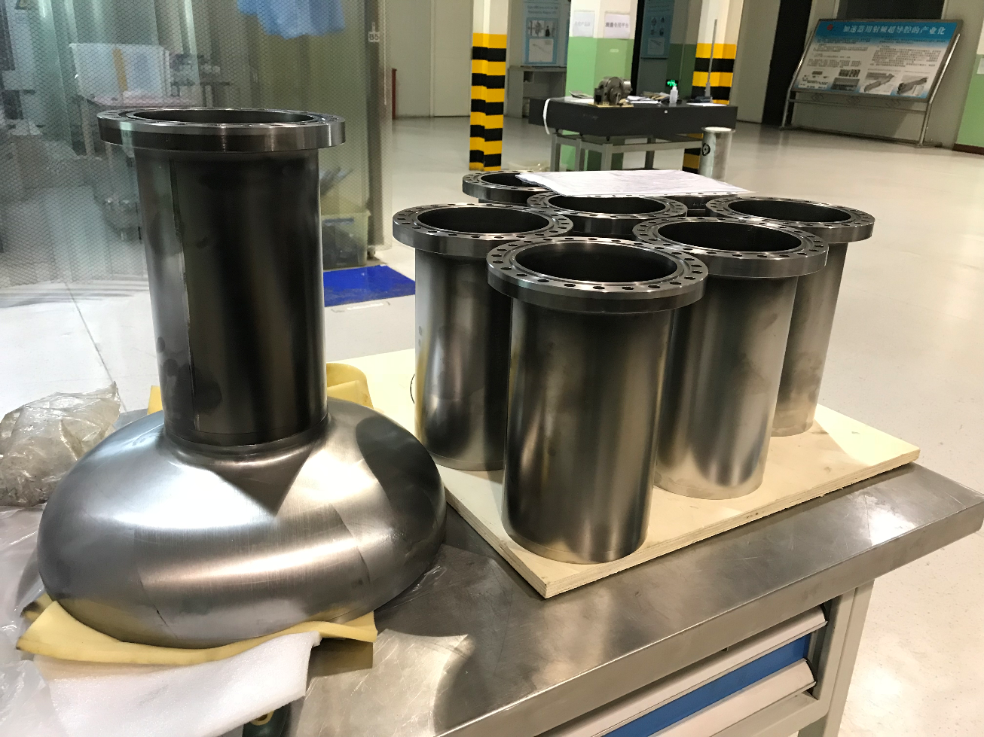
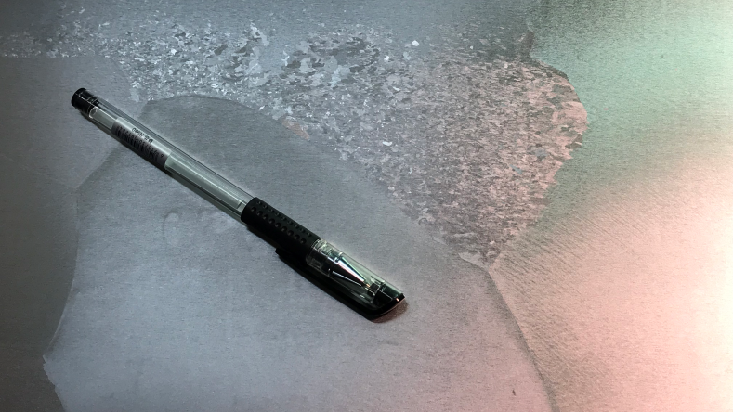
High Q and High Gradient R&D (650 MHz LG)
东方钽业大晶粒铌板的生产工艺还在摸索中，仅有一片合格（完成了半碗的冲压），其余多片均发生了晶粒破碎的现象，无法用于冲压。
5月27日，赴宁夏与厂家讨论后，预计6月份能够完成大晶粒铌板的生产。已完成4只大晶粒铌腔所需束管和法兰的焊接。
酸洗前的大晶粒铌板
2019年3月31日，王所长访问东方钽业公司，推进 650 MHz 大晶粒腔的研制。
650 MHz 大晶粒超导腔部件
铌板四周的晶粒破碎

Slide 14
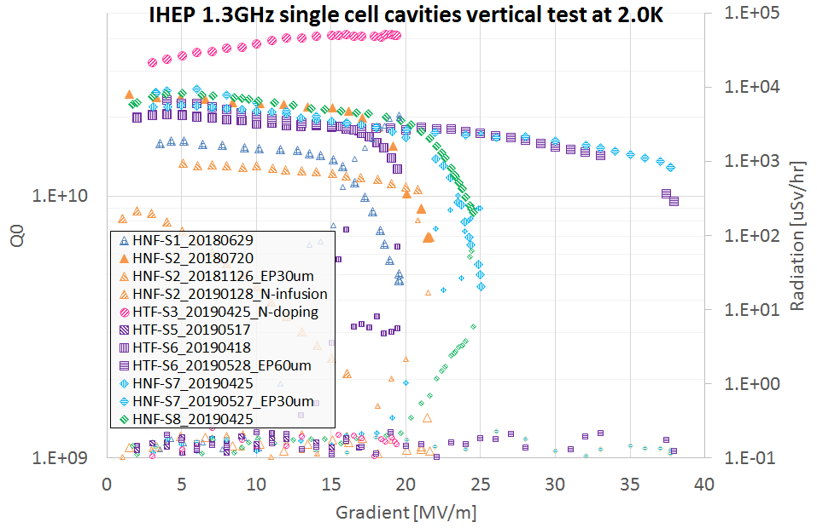
IHEP High Q and High Gradient R&D (1.3 GHz FG)
All IHEP-made 1.3 GHz 1-cell cavities.
All vertical tests at IHEP.
Highest Q (4E10 at 16 MV/m) achieved by EP and N-doping at KEK.
Highest gradient (38 MV/m) achieved by improving (but not optimized) OTIC’s simple EP and post-EP cleaning and improving clean assembly at IHEP.
Aiming for gradient frontier (1-cell > 45 MV/m and 9-cell > 40 MV/m) by optimizing cavity EBW and IHEP’s new EP tool, and using Kyoto camera and TMAP.
Aiming for Q frontier (with high gradient) by N-doping with IHEP’s new furnaces and new recipe, and fundamental mechanism research.
4.1E10@19.3/m——国内Q值最高的细晶1.3GHz超导腔

Slide 15
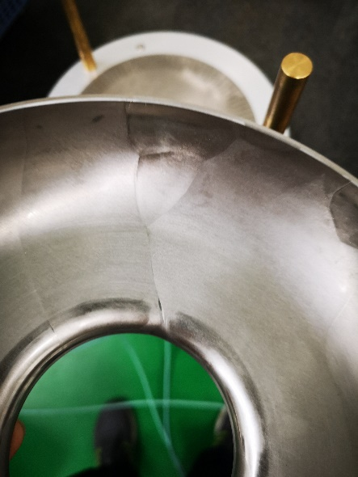
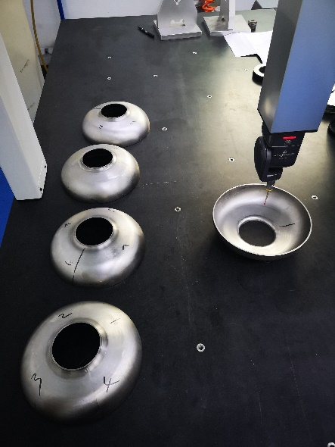
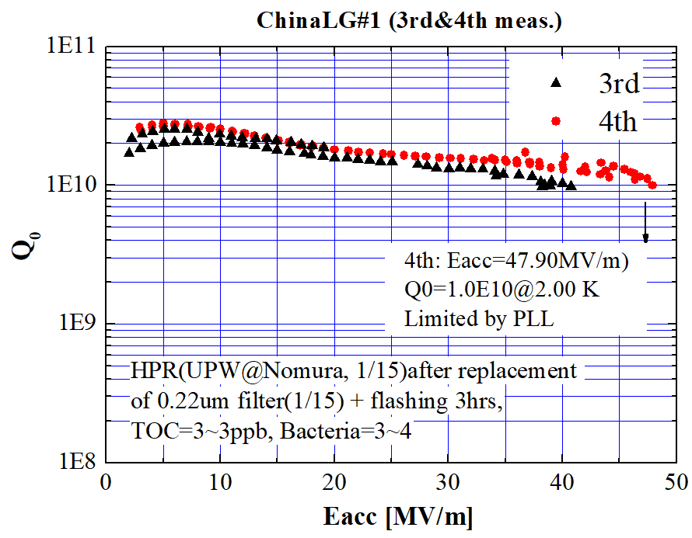
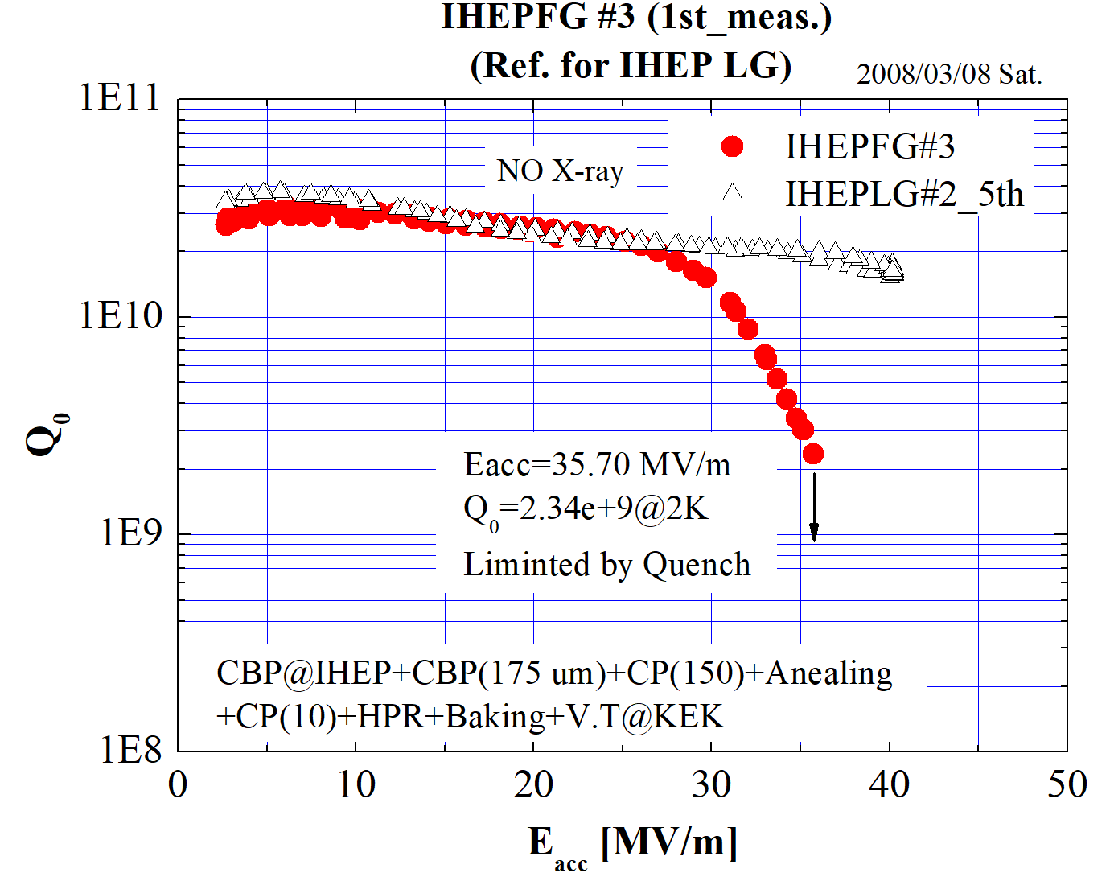
IHEP High Q and High Gradient R&D (1.3 GHz LG)
Alternative cavity material for SHINE project. N-doping on LG shows promising results. Three LG single cell cavities in fabrication.
All previous IHEP 1.3 GHz single cell cavities were CBP treated and got very high gradient. We have many experience. 9-cell large grain Pi mode ~ 20 MV/m with several cells exceeds 35 MV/m.
Try high gradient without CBP first. And recover CBP machine and recipe in the same time.

Slide 16
1.3 GHz N-doping Frontier

Slide 17
Flux Trapping by Magnetic Field

Slide 18
Nb₃Sn Frontier

Slide 23
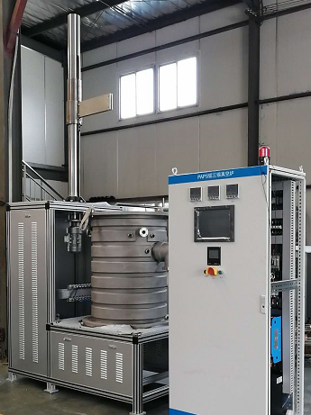
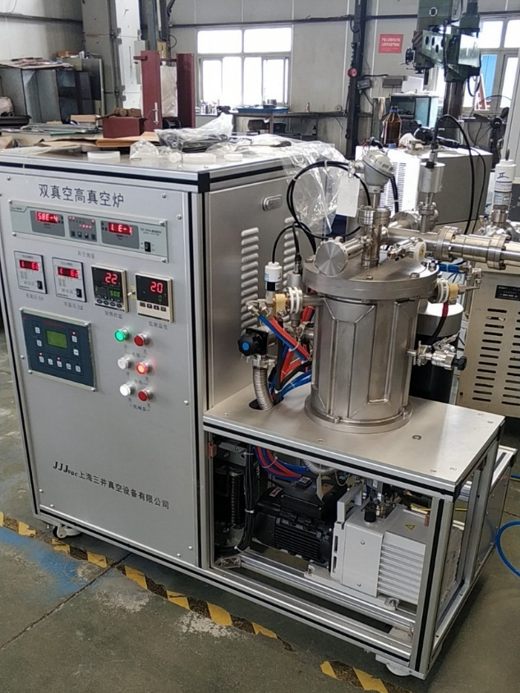
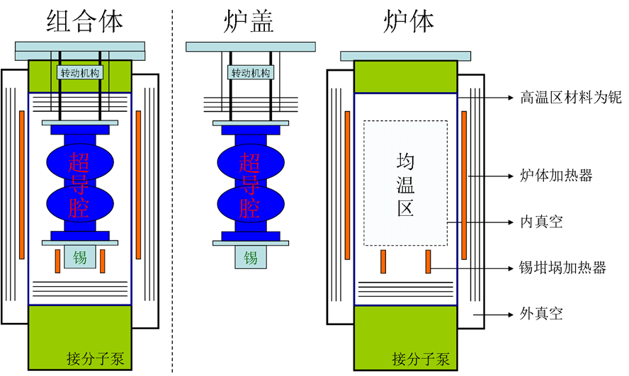
IHEP Nb₃Sn Furnaces

Slide 24
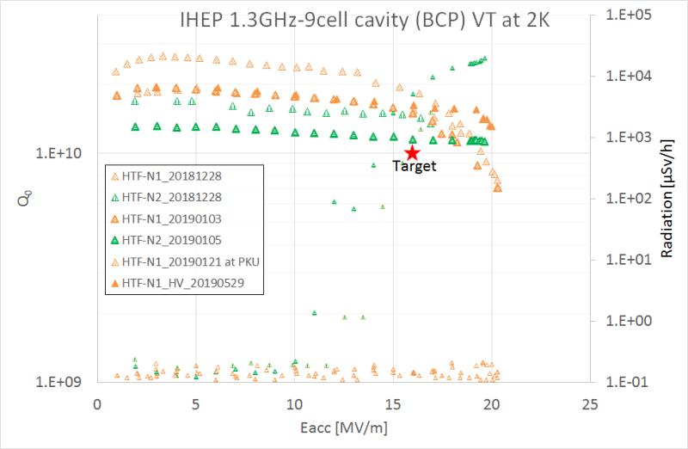
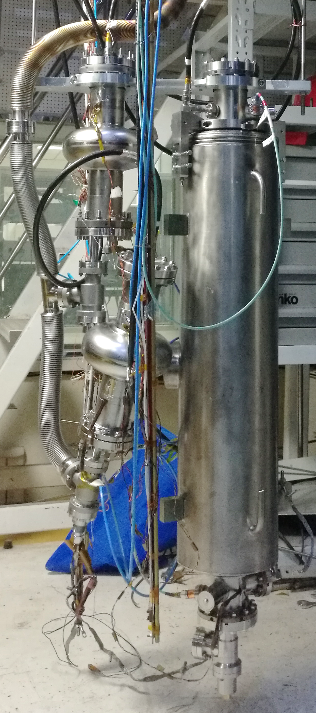
IHEP SHINE 1.3 GHz 9-cell Cavities (BCP)

Slide 25
9-cell样腔基本达到SHINE技术指标
指标 | 数值 | PAPS-HTF-1300-N001 | PAPS-HTF-1300-N002
哑铃零部件形状偏差 | ≤ +/- 0.5 mm | 合格 | 合格
裸腔长度 (预调谐后) | 1283.40+/- 3.0 mm | 1284.55 mm | 1283.19 mm
槽腔长度 | 1283.40+/- 3.0 mm | 待测 | 待测
裸腔同心度 | ≤ 0.4 mm | 未达到（可调同心度的预调谐机正在调试）
裸腔频率 (室温真空) | 1298.2 +/- 0.1 MHz | 1298.210 MHz | 1298.160 MHz
裸腔频率 (2K垂测) | 1300.2 +/- 0.1 MHz | 1300.252 MHz | 1300.199 MHz
槽腔频率 (2K垂测) | 1300.2 +/- 0.1 MHz | 1299.870 MHz (垂测后酸洗及氦槽收缩） | 待测 （室温真空1298.080 MHz）
裸腔场平坦度 | ≥ 95 % | 95 % | 98 %
槽腔场平坦度 | ≥ 90 % | 85 % (运输及氦槽收缩） | 94 %
裸腔及液氦槽漏率 | ≤ 1.0e-8 Pa l/s | 合格 | 合格
高次模耦合器notch Qe (2K垂测) | > 2.7E11 | 1.5E12, 3.5E13 | 待测 (常温真空 > 1E12)
槽腔加速梯度 (化学抛光、非掺氮) | > 19 MV/m | 20 MV/m | 待测 (裸腔19.5 MV/m)
槽腔 Q₀ (化学抛光、非掺氮) | > 1.0×10¹⁰ @16 MV/m | 1.5E10 | 待测 (裸腔1.1E10)

Slide 26
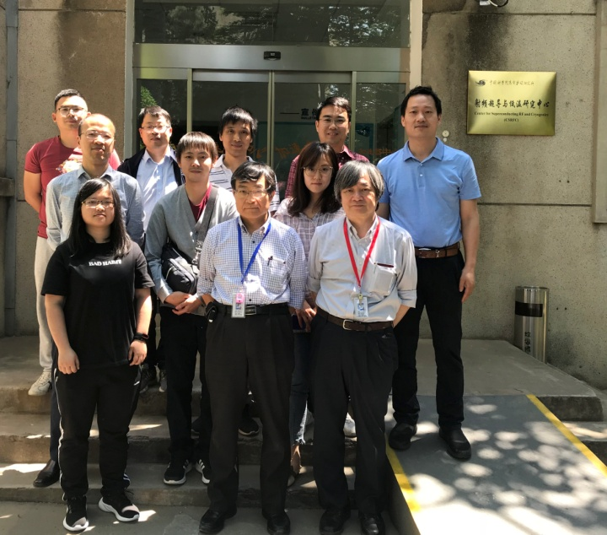
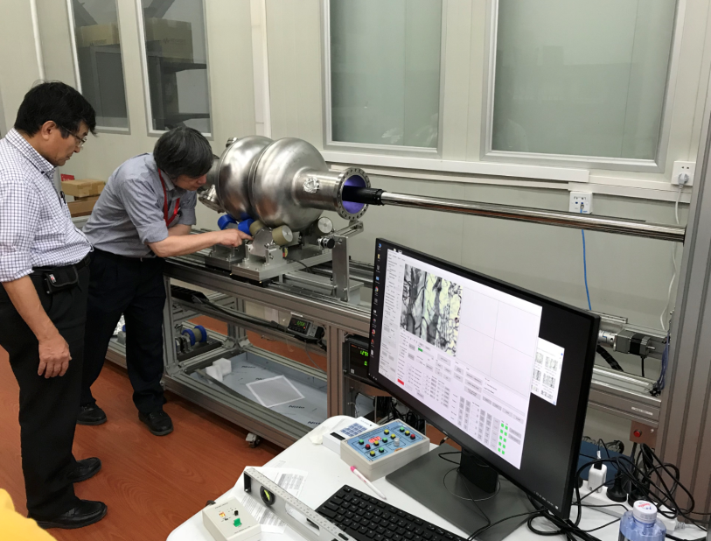
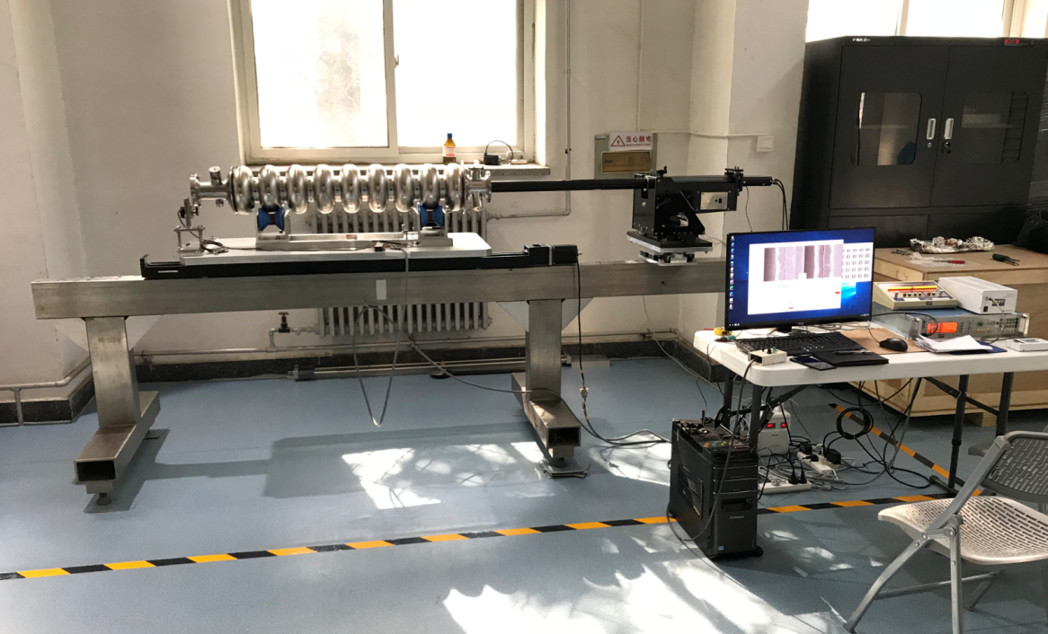
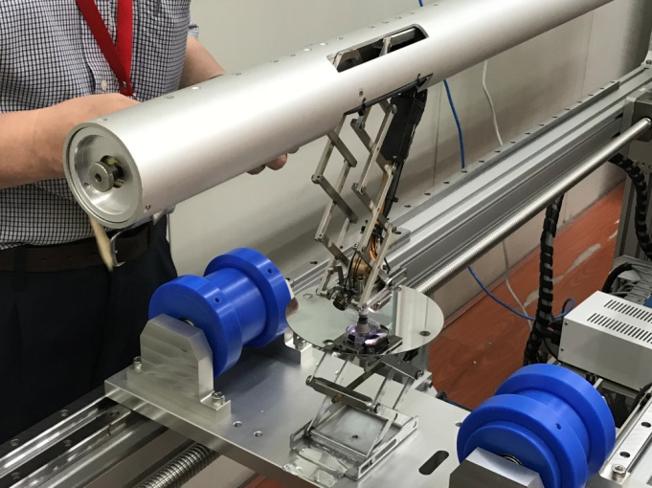
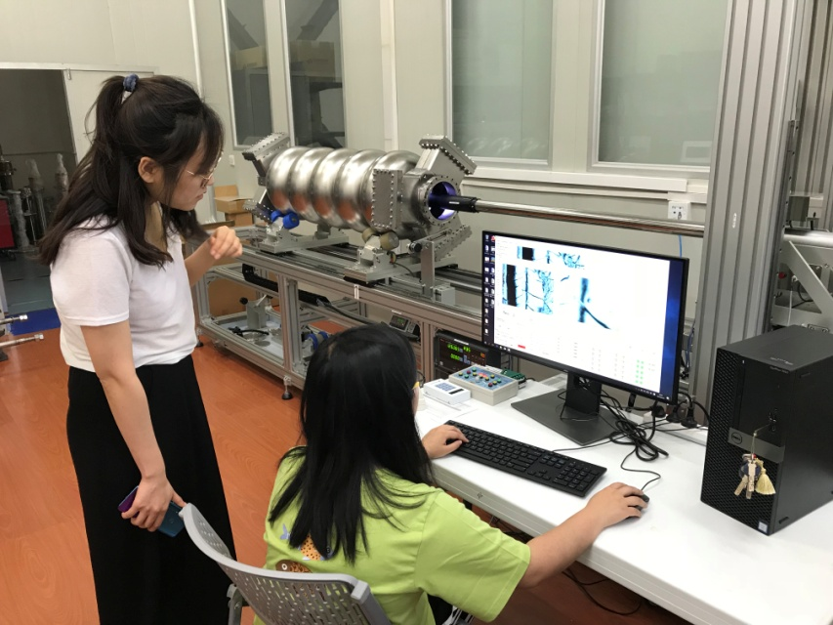
超导腔高分辨率内窥镜
借KEK的1.3GHz内窥镜已用于1.3 GHz 9-cell和1.3 GHz 1-cell的表面检查
PAPS购买的650 MHz 内窥镜调试完成，可替换1.3GHz镜头和研磨头
内窥镜调试和培训
（IHEP、KEK、京都大学）
调试650MHz内窥镜
1.3GHz 9-cell腔内窥镜
缺陷研磨功能调试
CEPC 650 MHz 5-cell超导腔内窥镜检查

Slide 27
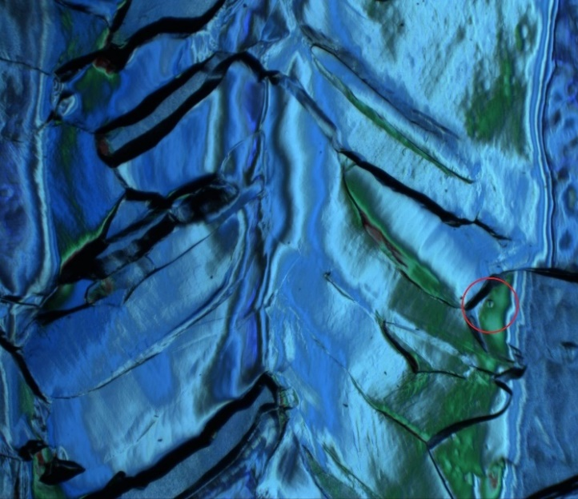
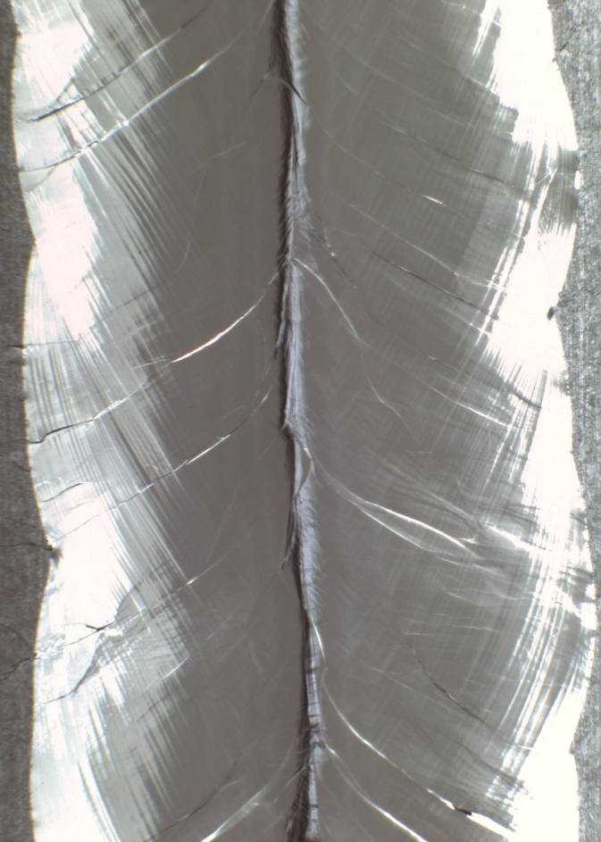
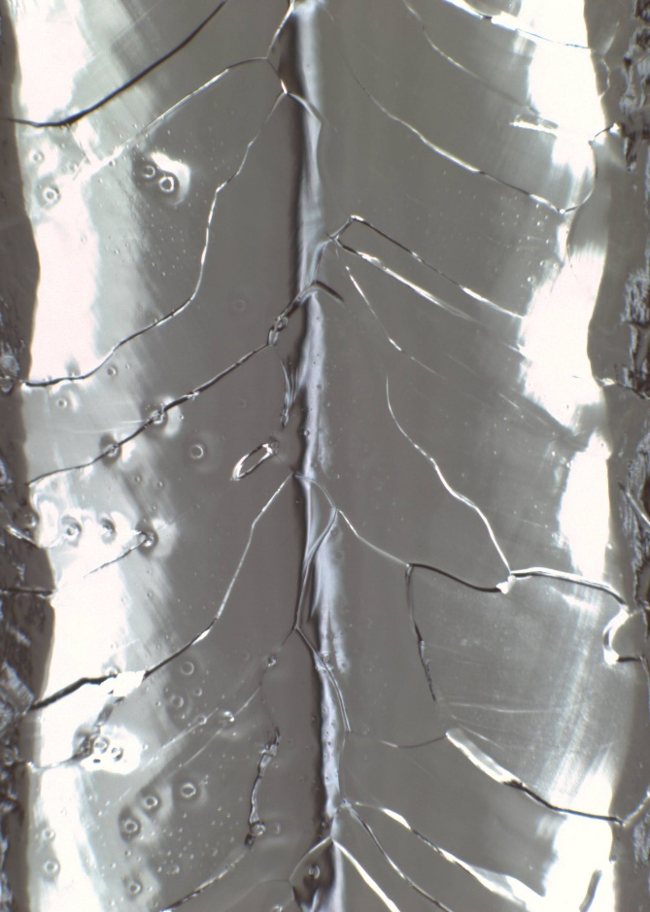
超导腔焊缝内窥镜图像
After EBW
After BCP
650 MHz
1.3 GHz

Slide 28
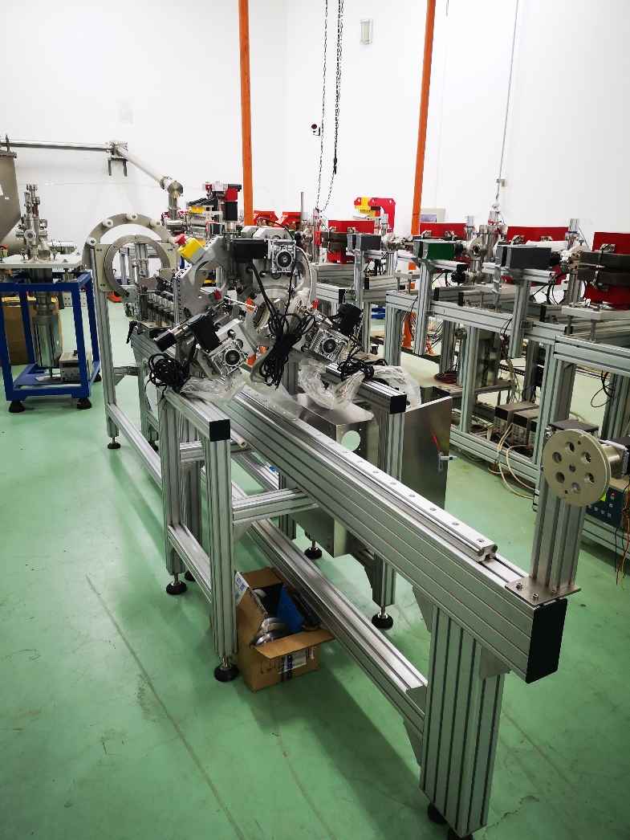
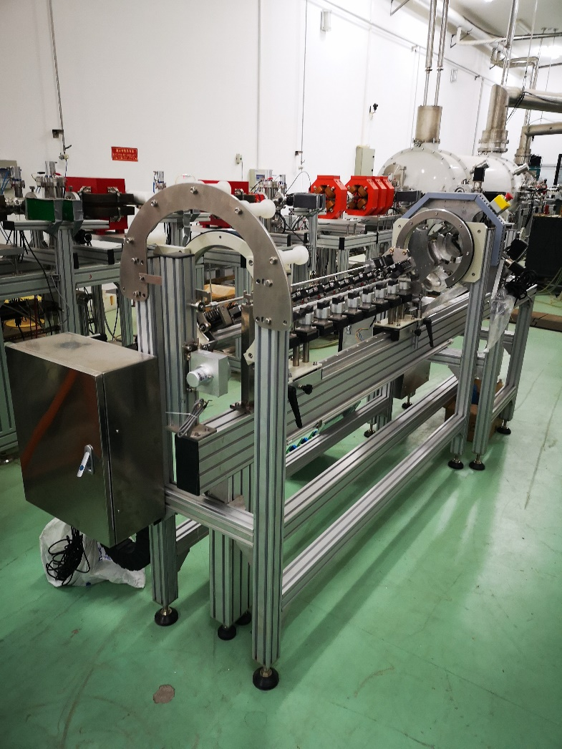
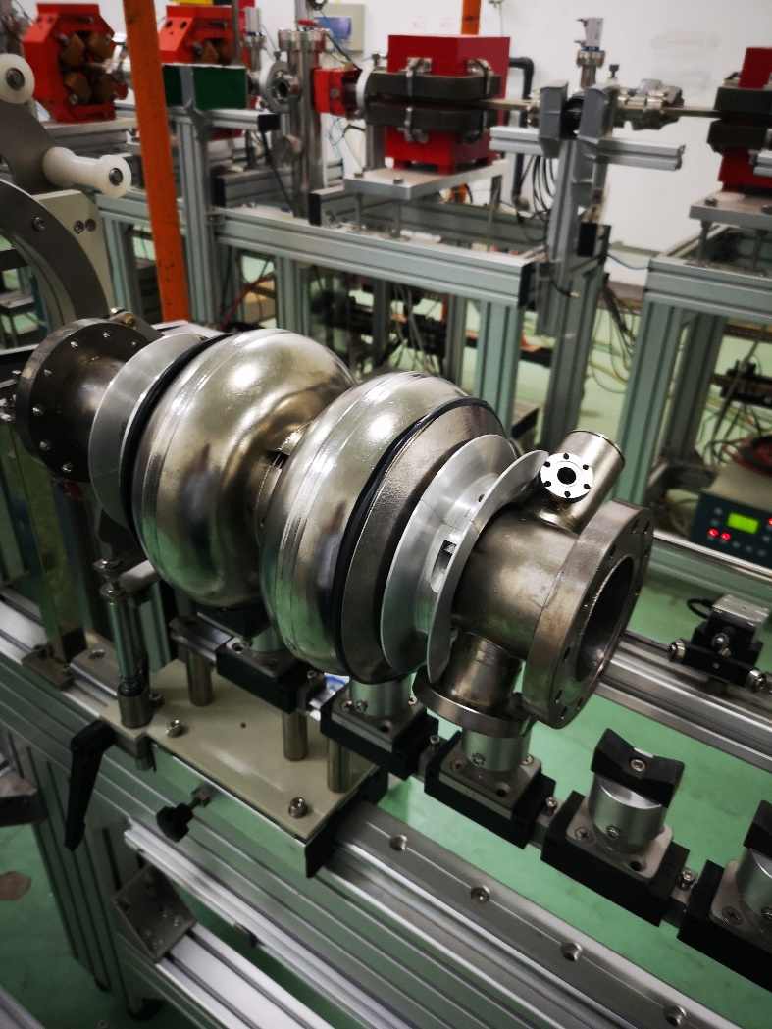
Cavity Pre-Tuning Machine

Slide 29
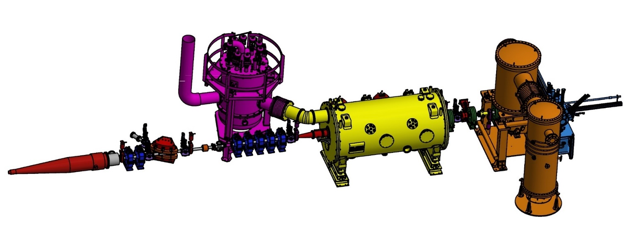
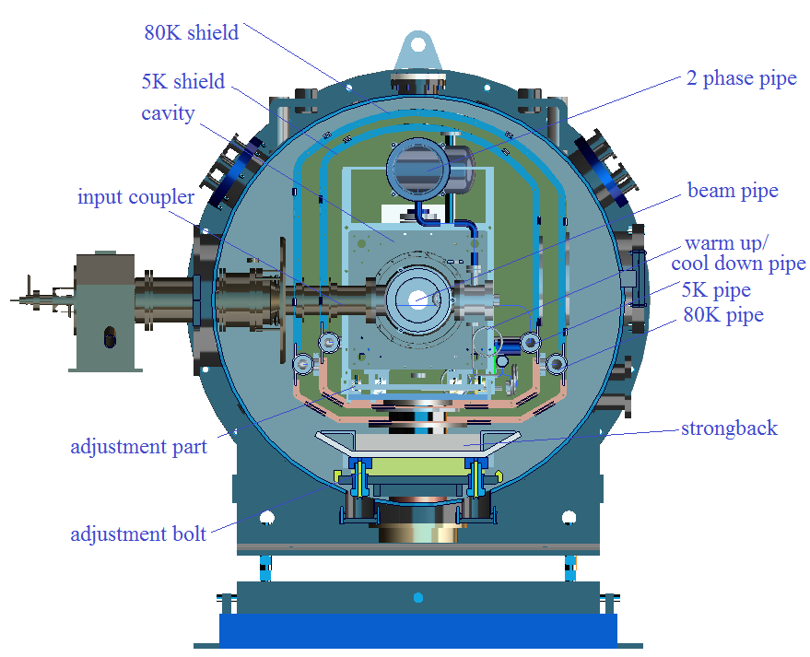
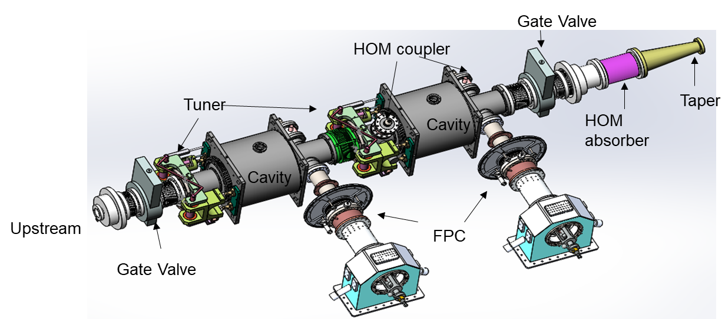
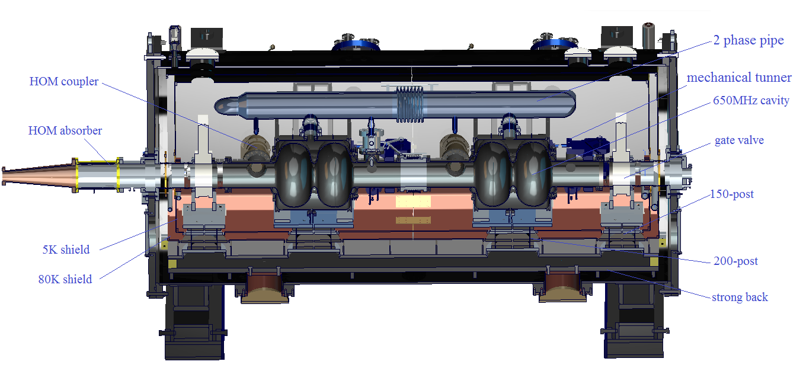
CEPC 650 MHz Test Cryomodule with Beam

Slide 30
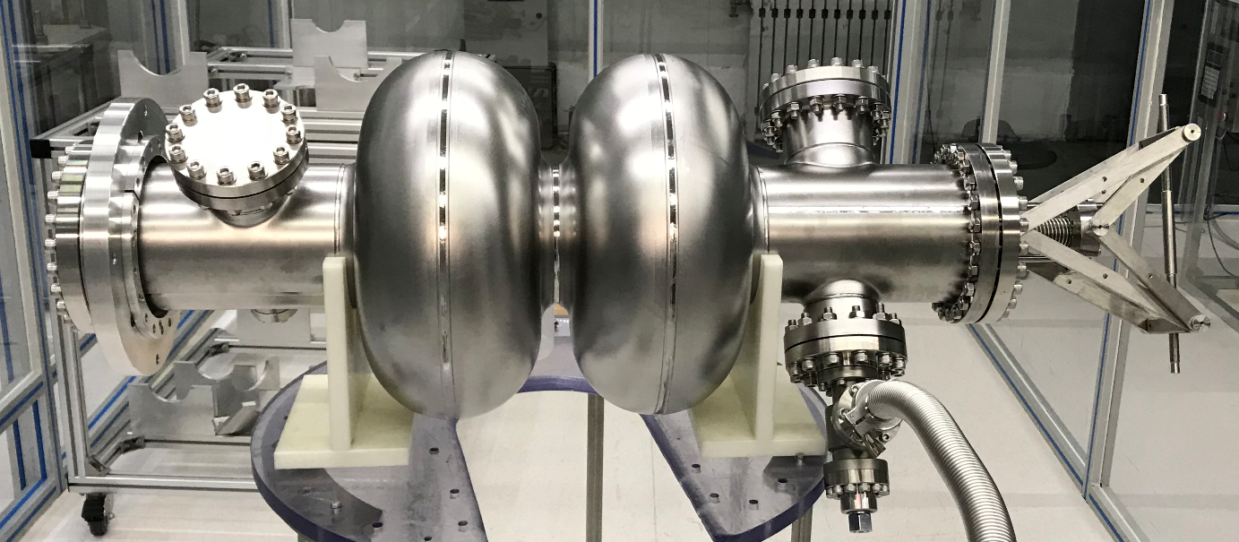
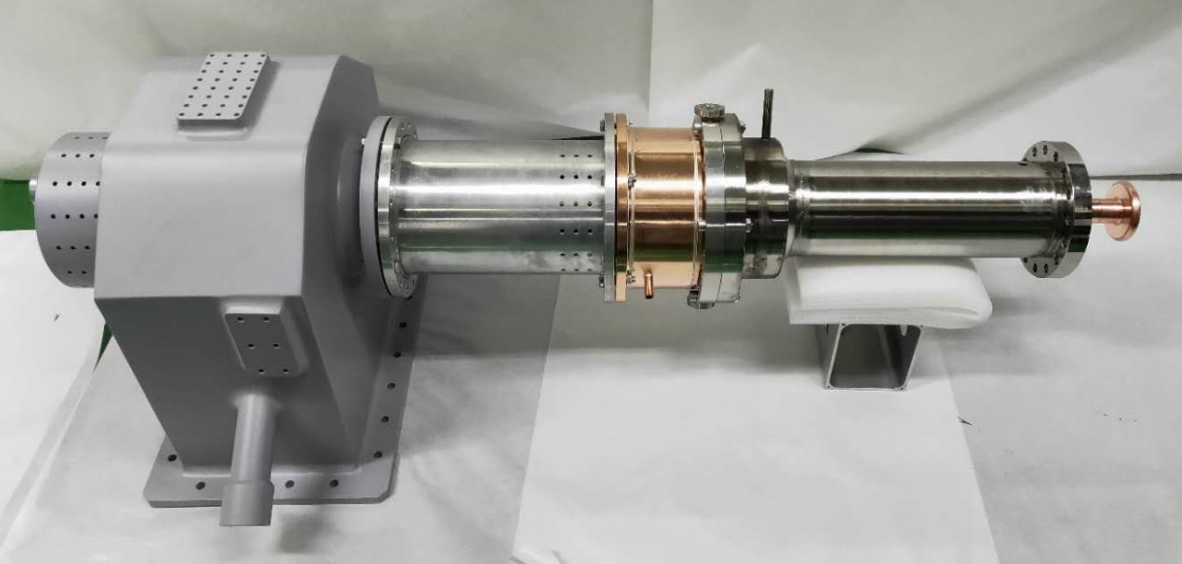
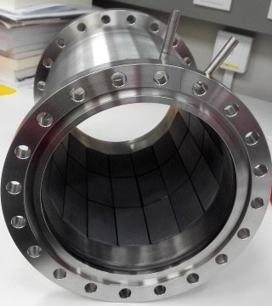





650 MHZ SRF Key Components
Cavity
High power coupler
HOM absorber
HOM coupler
Cryomodule vacuum vessel
Valve box

Slide 31



与CIPC相关企业的合作深入开展
高能锐新
  1.3 GHz 1-cell、1.3 GHz 9-cell、650 MHz 2-cell超导腔及液氦槽
  1.3 GHz、650 MHz 高功率耦合器
东方钽业
  高纯铌板（细晶、大晶）
  650MHz 1-cell大晶粒超导腔
  高阶模耦合器
华东光电
  1.3GHz、650MHz 高功率耦合器
  高阶模耦合器，高阶模吸收器
  超导腔真空部件
  高频功率源
  计划下一步开展超导腔的制造，并尝试整套超导高频系统的集成

Slide 32
TDR Plan of CEPC SRF System
Time | TDR R&D Plan | Resources (in CNY)
2018-2020 | System design and optimization Key technology R&D 650 MHz test cryomodule | MOST CEPC 7 M (650 MHz, IHEP & PKU) PAPS 20 M (650 MHz & 1.3 GHz) SHINE R&D 13 M (1.3 GHz cavity and coupler) 4 FTEs now, 2 more FTEs needed
2020-2022 | Cryomodule prototyping | 80 M (one 650 MHz & one 1.3 GHz module with power sources) SHINE pre- and mass production ? M (1.3 GHz) 12 FTEs
2022-2023 | Industrialization and pre-production Cryomodule beam test | 90 M (three 650 MHz modules + two 1.3 GHz modules） SHINE mass production ? M (1.3 GHz) 18 FTEs

Slide 33
Summary
1.3 GHz and 650 MHz 1-cell > 35 MV/m (w/o CBP) → 45 MV/m, and with large grain
N-doped 1.3 GHz cavity Q₀ > 4E10 at 19 MV/m → 6E10. 650 MHz as well.
1.3 GHz 9-cell cavity > 20 MV/m, most parameters qualified for SHINE (except Q₀)
→ more improvements, quality control of mass production
Newly developed facilities (EP, N-doping, T-MAP, Inspection, Pre-tuning etc.) will be the cornerstones.
SRF key components will soon be ready to integrate into CEPC test cryomodule.
Join in center of the next battle: Nb₃Sn. And lead Fe-based SRF material research.

