Slide 1
CEPC booster magnet R&D progress
Wen Kang
CEPC Day, May 31, 2019

Slide 2
Contents
CEPC增强器二极磁铁技术指标
铁芯方案二极磁铁样机研制进展
CCT空芯线圈方案二极磁铁样机研制进展
CT空芯线圈方案二极磁铁样机研制进展
高精度低场磁场测量系统进展
真空盒涡流问题研究
总结

Slide 3
技术指标及其挑战
 | BST-63B
Quantity | 16320
Minimum field (Gs) | 29
Maximum field (Gs) | 338
Gap (mm) | 63
Magnetic Length (mm) | 4700
Good field region (mm) | 55
Field uniformity | 0.1%
Field reproducibility | 0.05%
Challenges
Total length of the dipoles ~75km how to reduce cost
Field error <29Gs*0.1%=0.029Gs how to design
Field reproducibility<29Gs*0.05%=0.015Gs how to measure
Magnet length ~4700mm how to fabricate

Slide 4
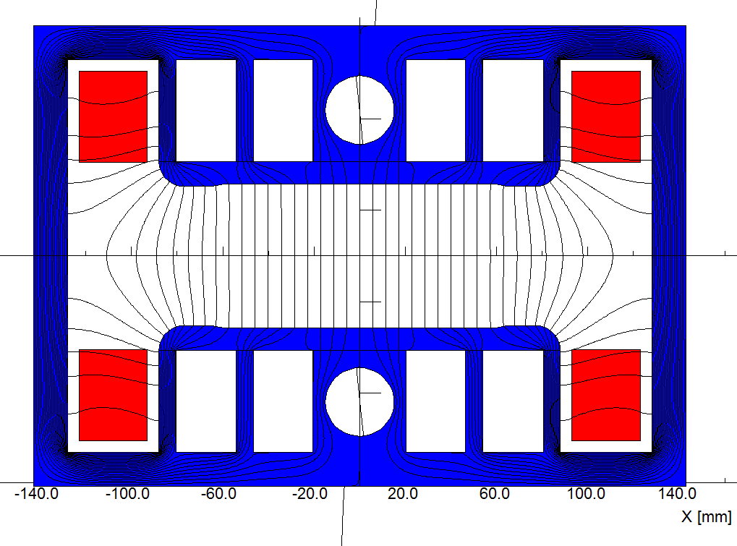
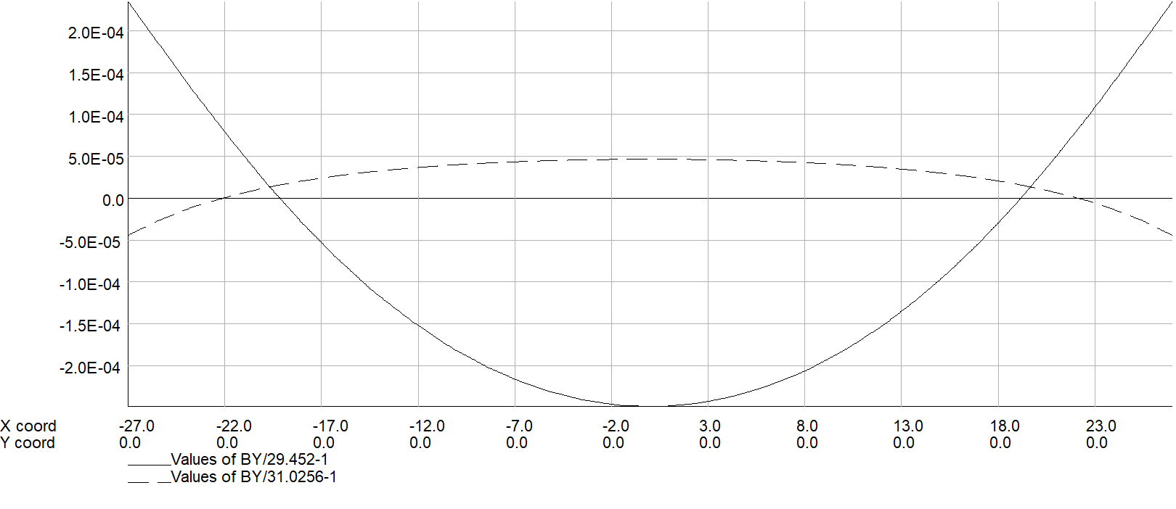
铁芯磁铁样机研制进展
The grain-oriented silicon steel laminations produced by Wuhan steel company were investigated, BH curves and coecive of the oriented and non-oriented steel laminations have an obvious difference.
By using the two kinds of BH curves, the performance of the dipole magnet at low field level were simulated, the results showed that the magnet with the oriented steel laminations had a better field quality.
 | Hc// | Hc┴
Conventional low carbon steel | 56A/m | 56A/m
Grain oriented steel | 4A/m | 12A/m

Slide 5
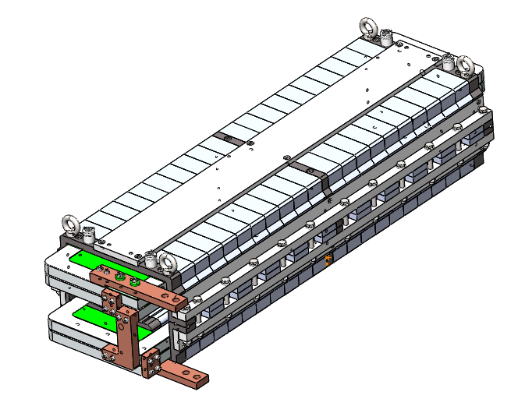
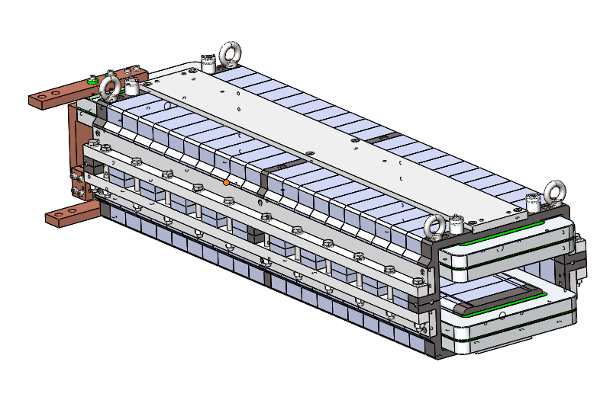
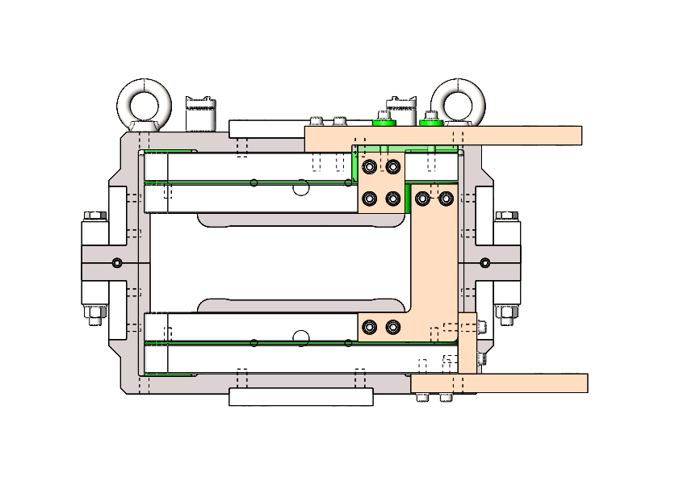
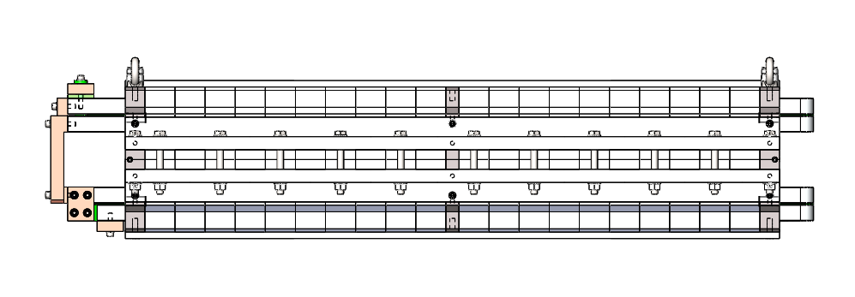
铁芯磁铁样机研制进展
At present, the mechanical design of a subscale prototype magnet was finished, the oriented steel laminations will be bought and the prototype magnet will be developed to verify the design.

Slide 6
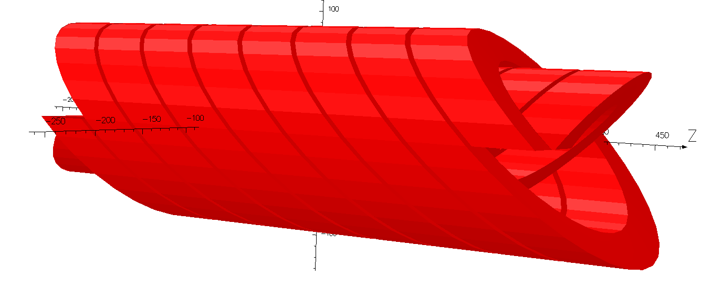
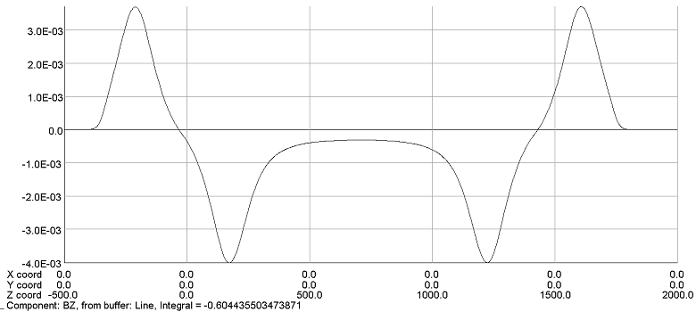
Dipole magnet without iron cores
The dipole magnet with CCT coils is composed of two or four canted solenoids, of which the excited currents have different direction. The By field in the magnet center is By=μ₀I/(w*tan(α)), in which w is the distance between two turns, α is canted angle. The Bz field is compensated to nearly zero.
The main advantage of CCT design is that it can get a good field quality in its 80% aperture without any field shimming, it means the field quality will not very sensitive to the mechanical errors of the coils.

Slide 7
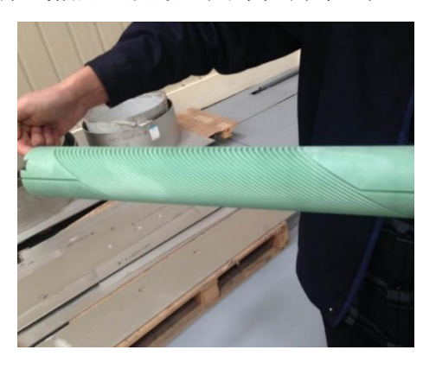
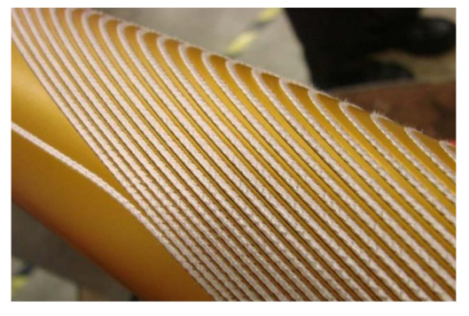
Dipole magnet without iron cores
In the case of superconducting magnets, the CCT coils are made by insert the conductors into the grooves that are fabricated on the surfaces of the supporting cylinders.
The paths of the grooves on the cylinders are precisely determined by the equations of CCT’s curves so that the conductors in the groove can produce the expected field.

Slide 8
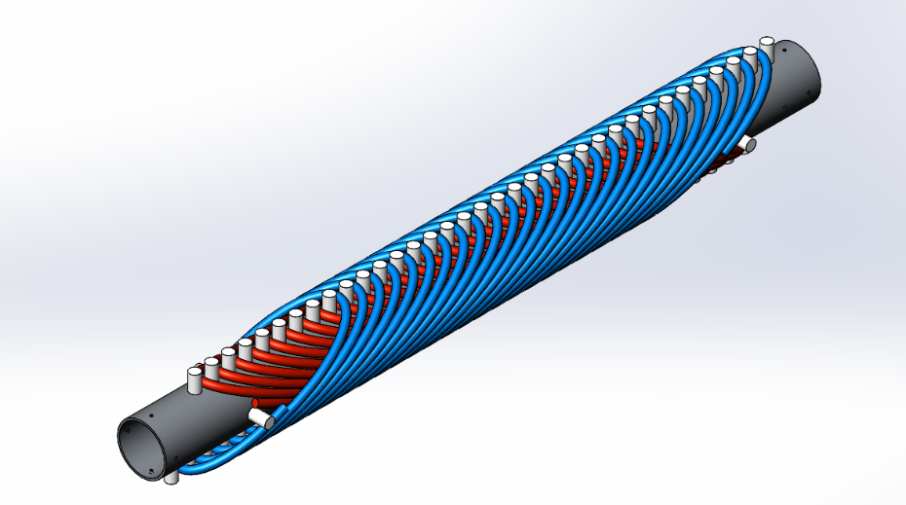
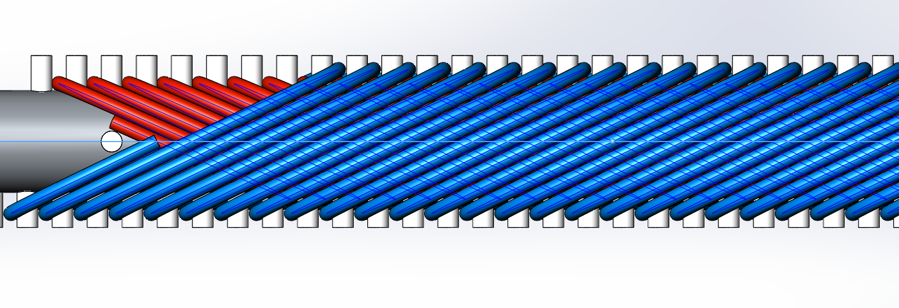
Dipole magnet without iron cores
In the case of the dipole magnets of CEPCB, to reduce the cost of the magnet production, one simple way is to directly wind the conductor on the supporting cylinders.
To fix the conductors in their right position, some small positioning cylinders are made on the surface of the supporting cylinder according to the equations of CCT’s curves.

Slide 9
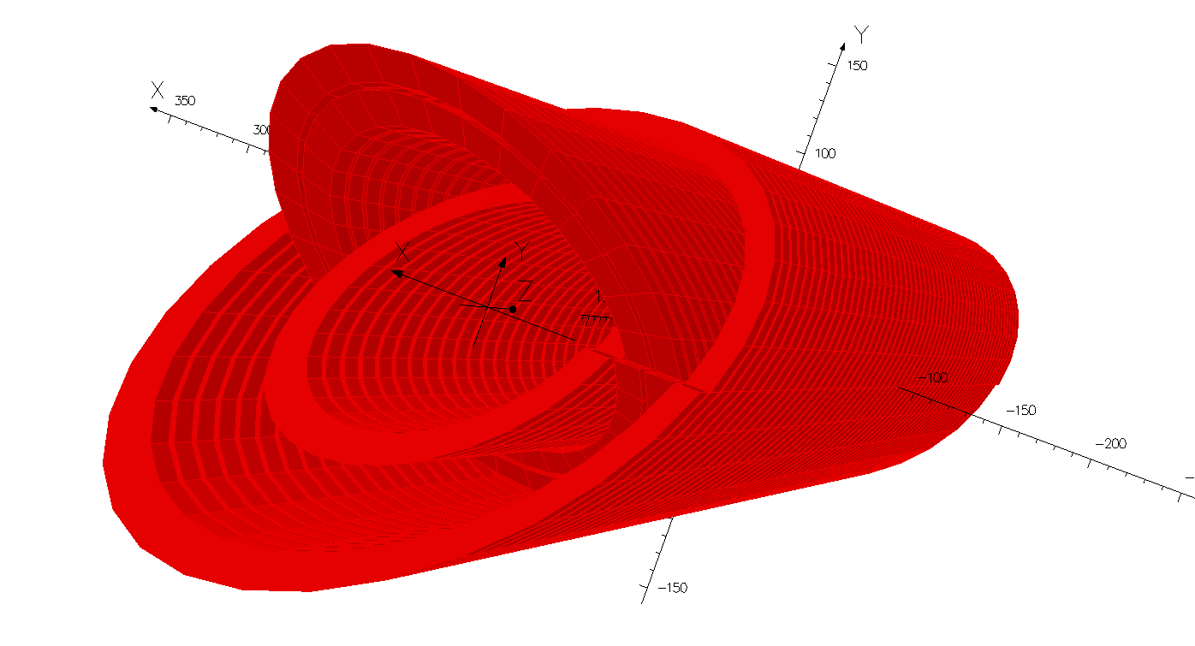
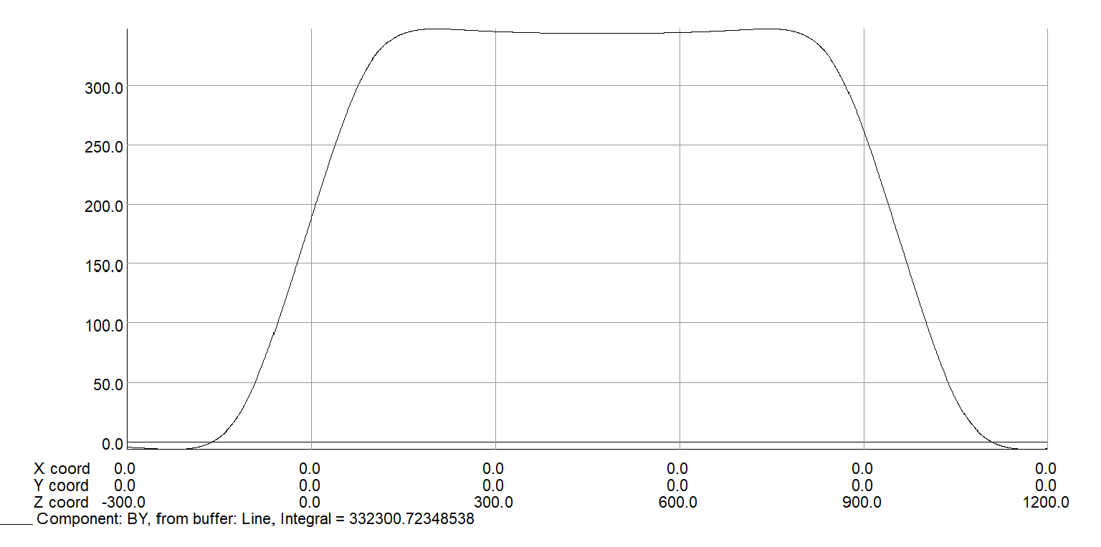
Dipole magnet without iron cores
However, the position errors directly winding the conductor on the supporting cylinders are probably not small enough to meet the field precision requirement.
To ensure the field precision, the alternative way to make CCT coils is to directly fabricate them from the aluminum tubes.
The CCT coils of the dipole magnet have four layers, so four aluminum tubes with the different diameters are used to fabricate the CCT coils.
To improve the excitation efficiency, the canted angle of the CCT is 25 degree instead of 30 degree as in superconducting magnet case.

Slide 10
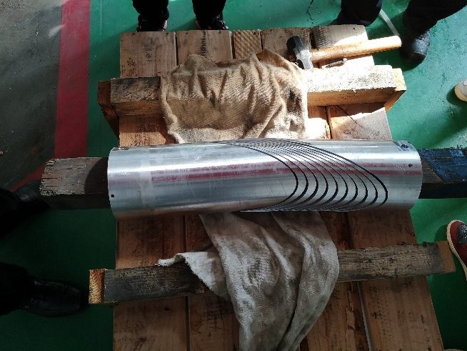
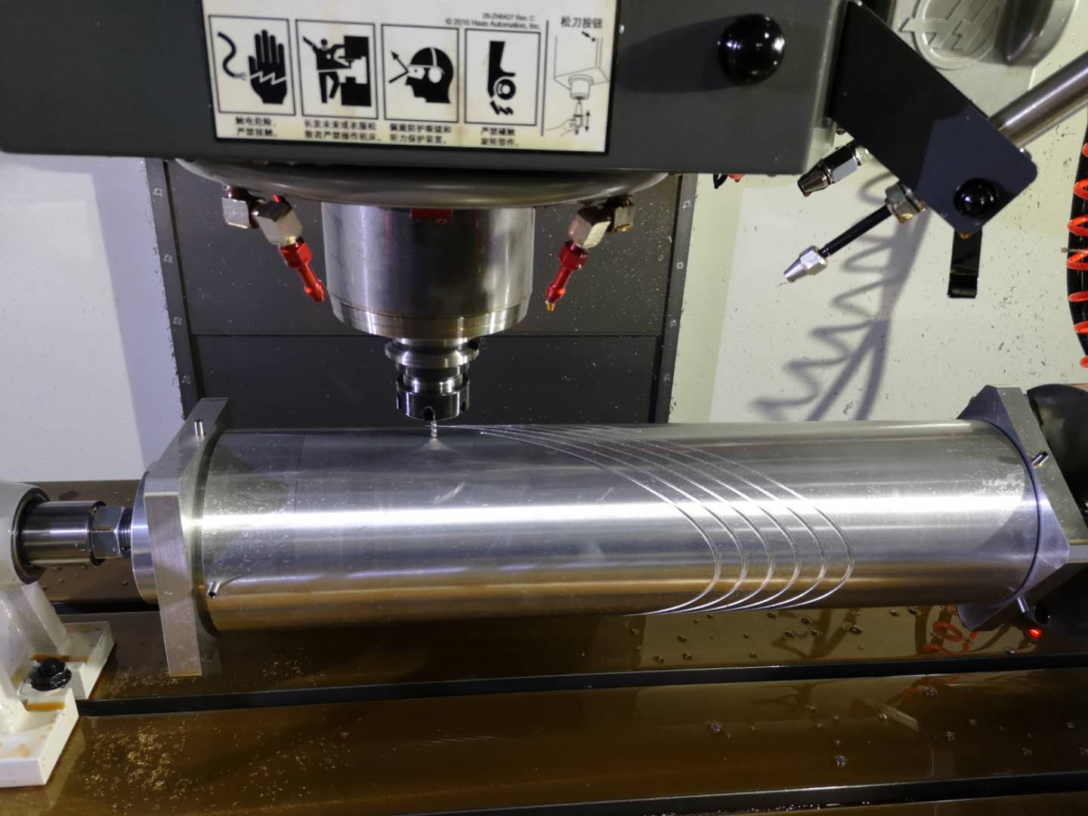
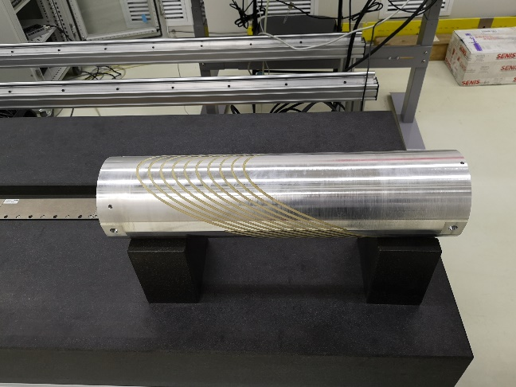
Dipole magnet without iron cores
To investigate the procedures of fabrication, one part layer of CCT was produced from an aluminum tube.
It is not easy to fabricate the coil and the mechanical precision is out of control after the fabrication is finished.
After some insulation epoxy resin was carefully inserted in the gaps, each turn of the coil was restored to it right position. It will be tested on the bench of the Hall probe field measurement system in the lab.

Slide 11
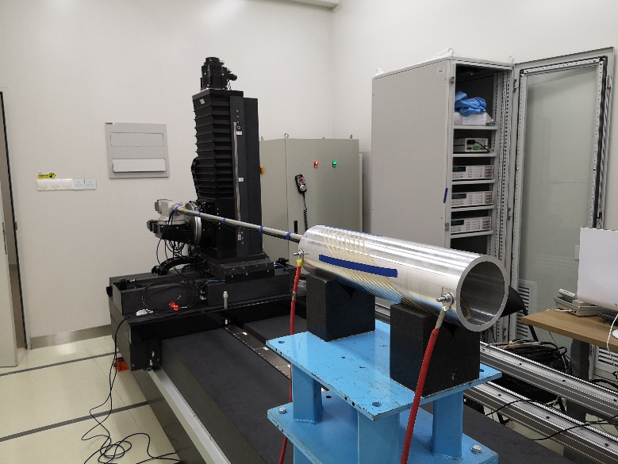
CCT空芯线圈磁铁样机研制进展
The test part of CCT coil was measured in the field measurement lab.
At the excited current of 60A, the central field reached to 33Gs as expected, and the field distribution also had a good agreement with the simulated ones.
The field reproducibility at 30Gs was better than 2E-4, which was satisfied with the requirements.

Slide 12
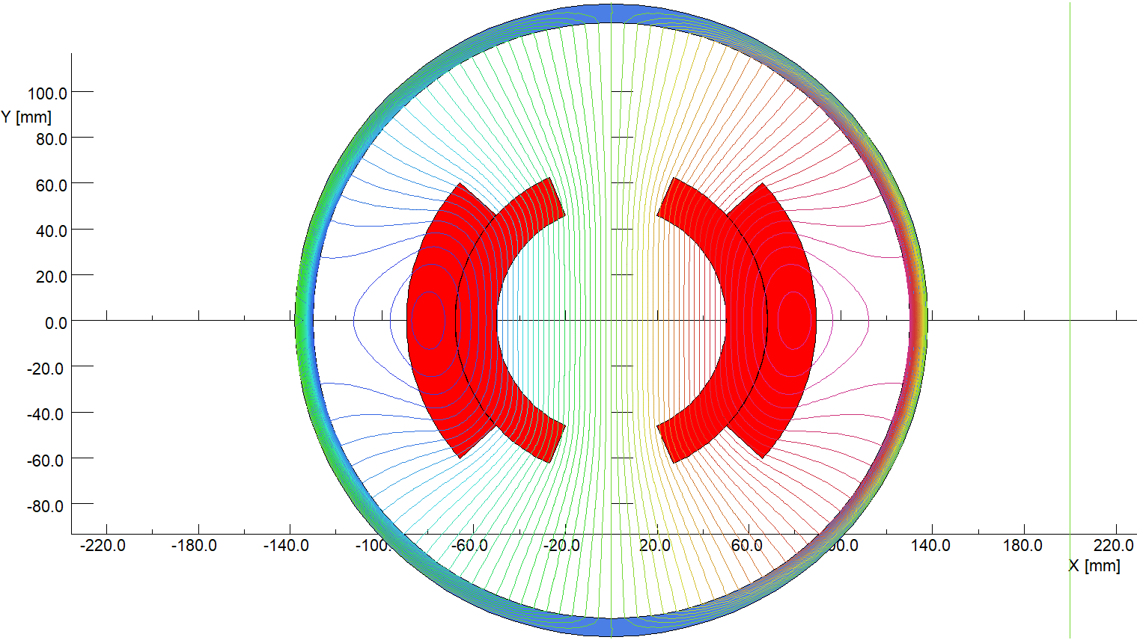
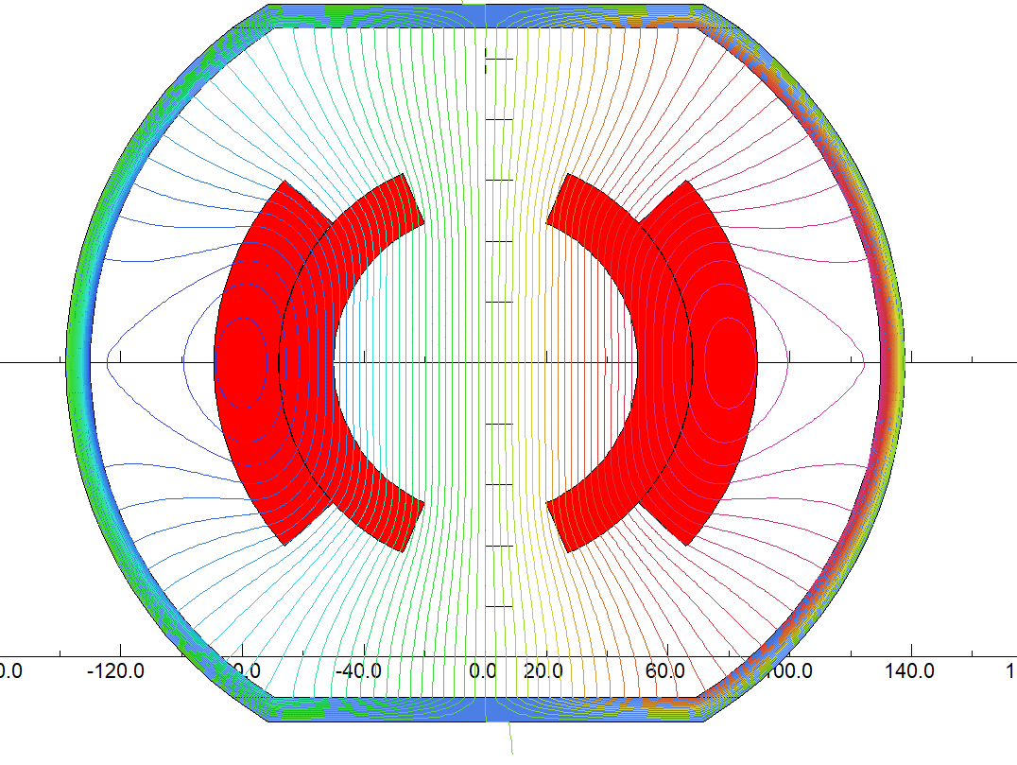
CT空芯线圈磁铁样机研制进展
The main advantage of Cosθ (CT) coil is that it have a higher efficiency than other air core magnets. By flatting the top and bottom of the shielding, the efficiency be increased by 5%.
The disadvantage is that its field quality is sensitive to the mechanical errors of the coils, which is required to be less than 20 microns.
To reduce the production cost, the structure of the CT coils is designed as simple as possible. The magnet have two coils, each coil has two layers and two turns, which are formed by aluminum bars with the same cross section areas.

Slide 13
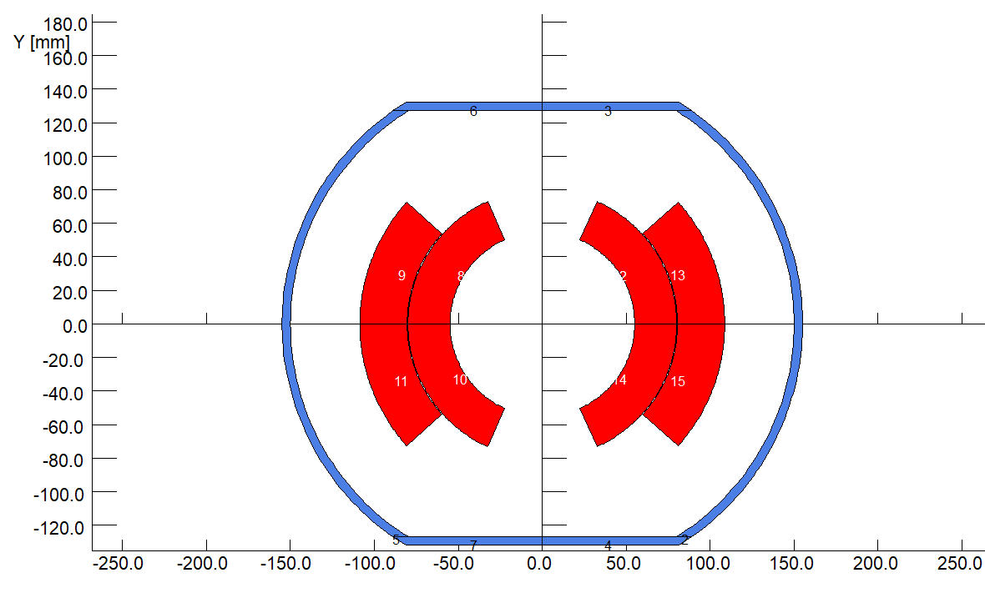
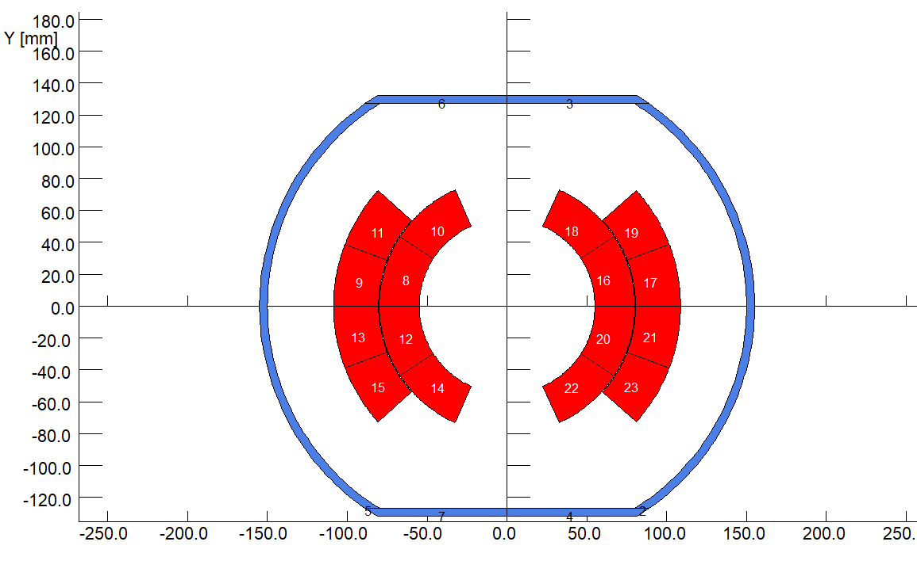
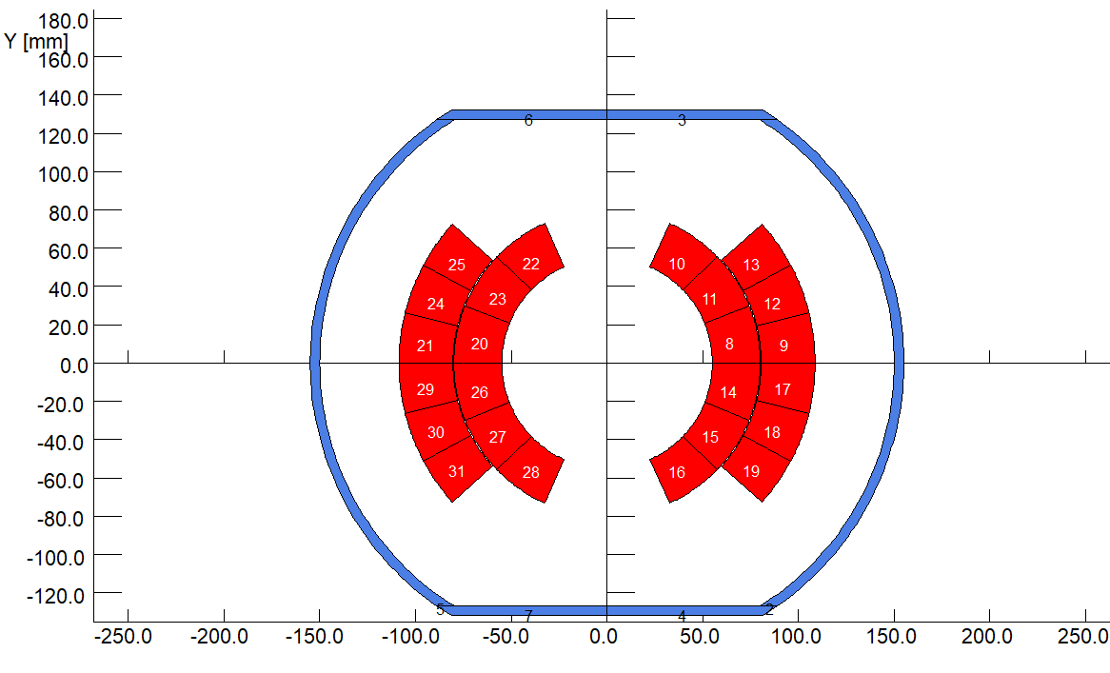
Dipole magnet without iron core
Since the field of the dipole magnets for CEPCB will ramp with the beam energy, eddy current will be induced in the coil conductors.
To study the influence of the eddy current on the field quality of the magnet, the field of the CT coils with different turns were simulated
2 turn per coil
4 turn per coil
6 turn per coil

Slide 14
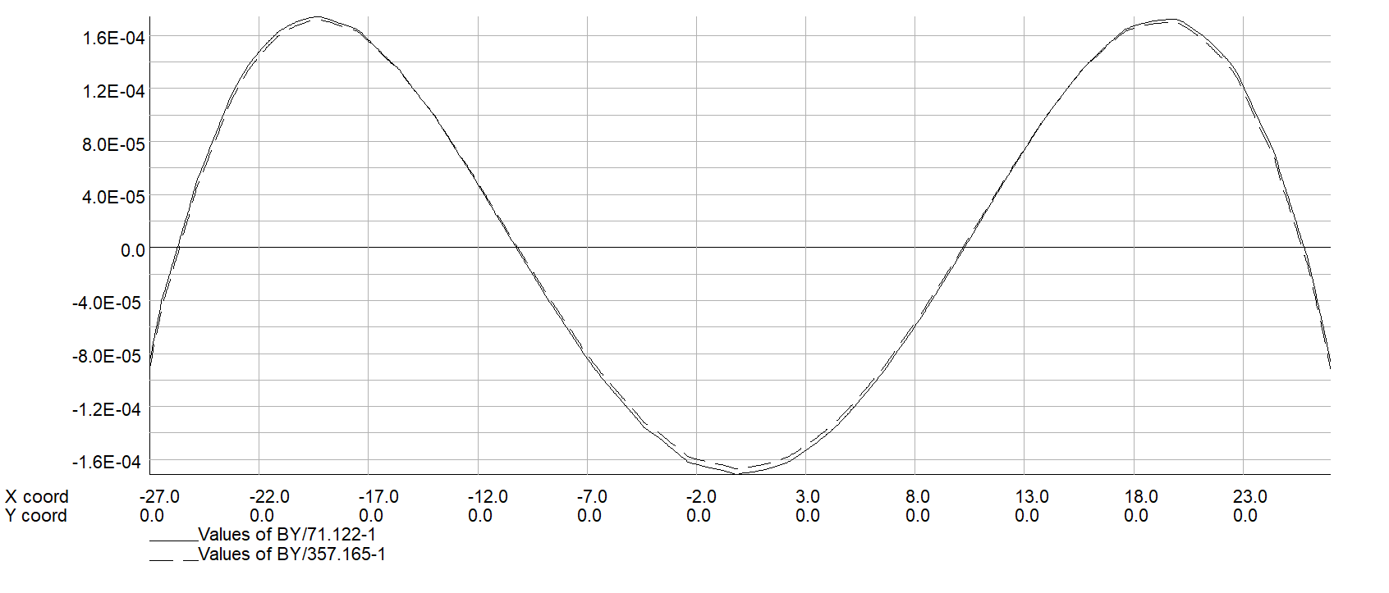
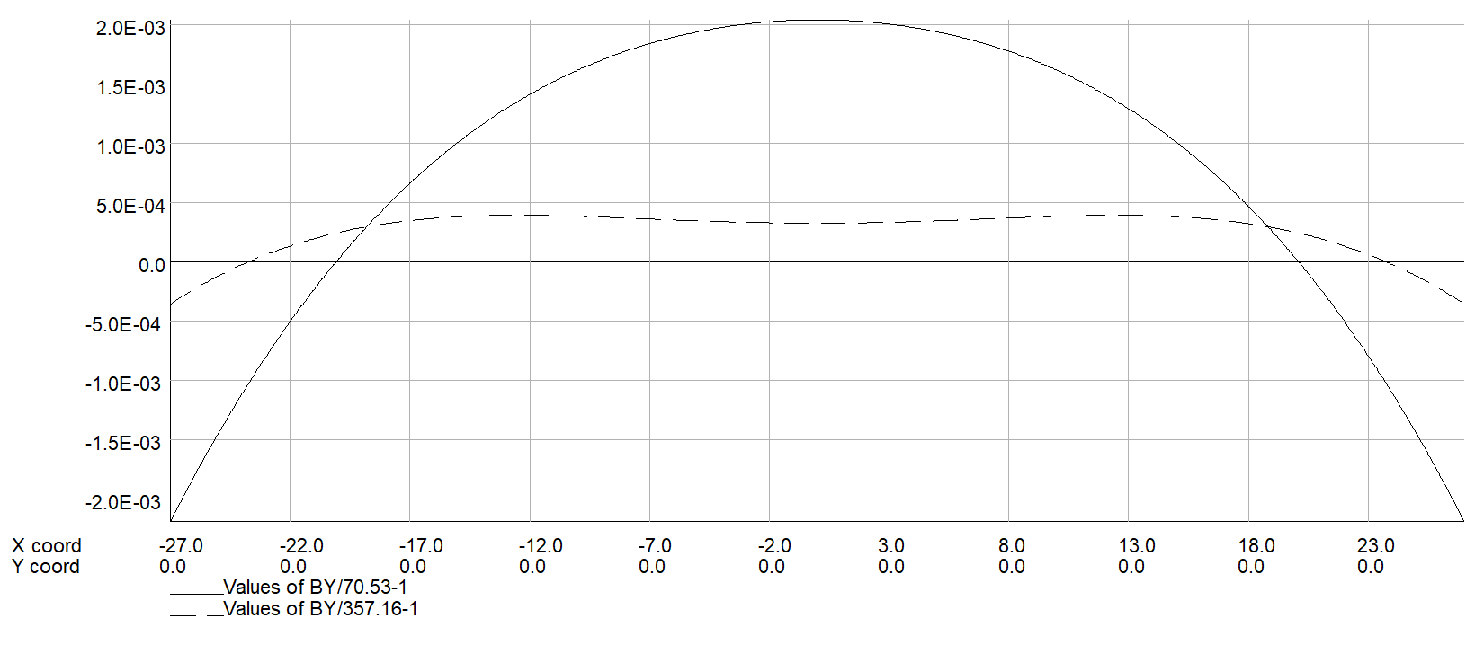
Dipole magnet without iron core
The field ramping curve is shown on the right, the field of the dipole magnet is ramped to the max. in 2.5s.
For comparison, the DC field uniformity is simulated, it can be seen that the field distributions at low and high levels have no difference.
However, when the field is ramping, the field distributions at low and high levels have large difference in the case of 2 turn per coil.
DC case
2 turn AC case

Slide 15
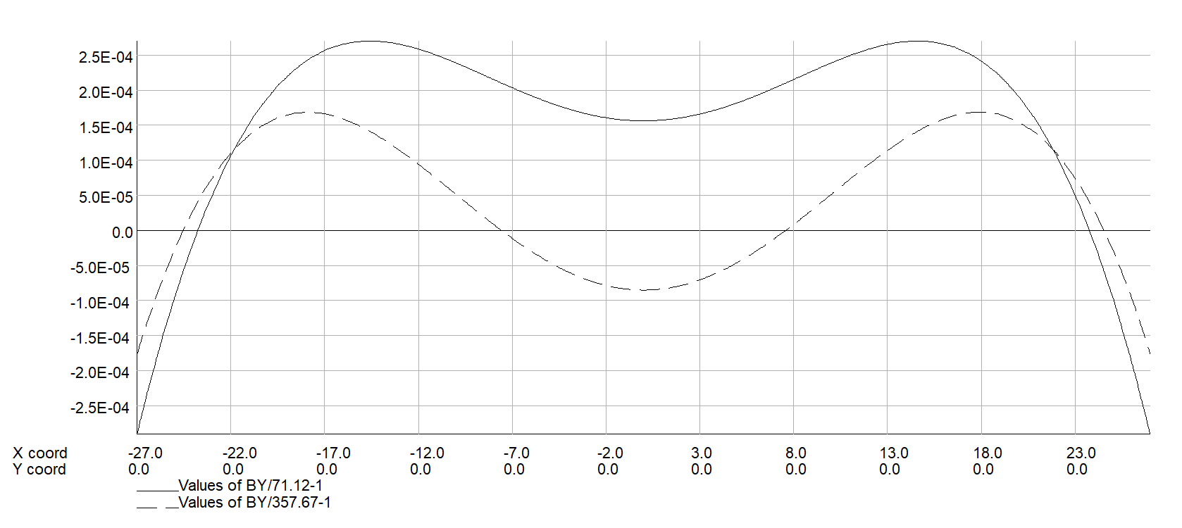
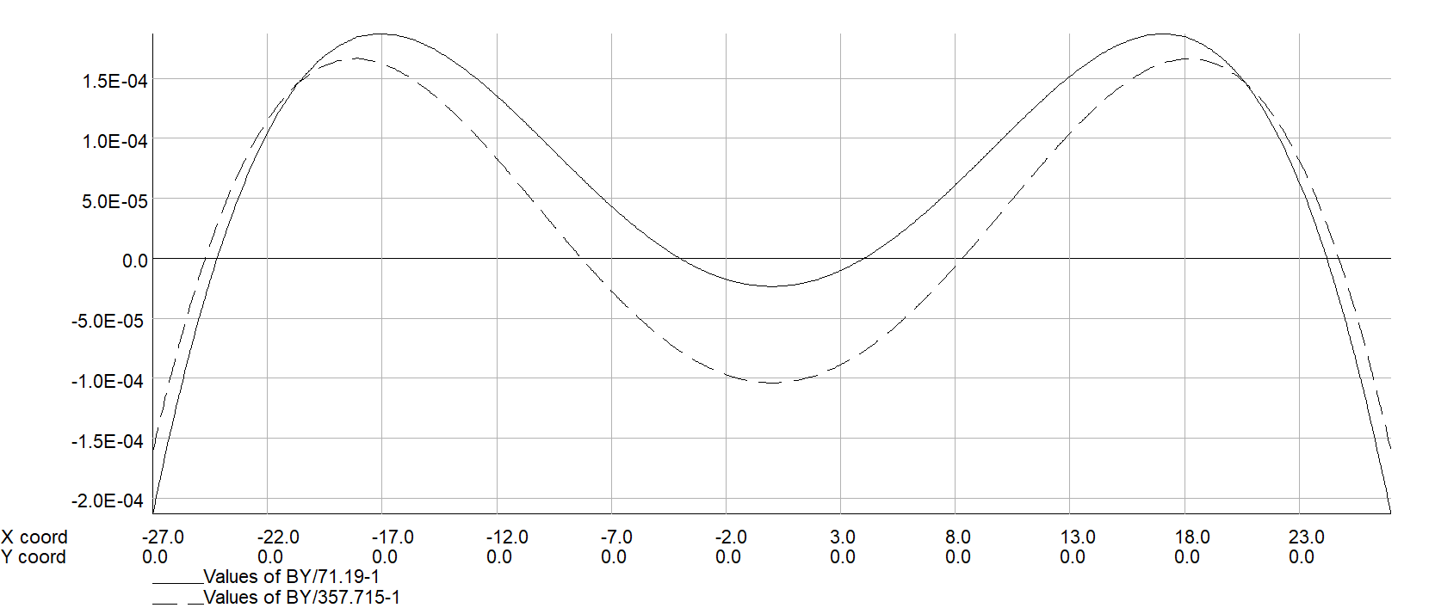
Dipole magnet without iron core
In order to reduce the eddy current in the coil conductors, the turns of the coils are increased and the cross sections of the conductors per turn are reduced.
The cases of 4 turns and 6 turns per coil are considered, the field simulations shows that the more turns per coil are, the better field quality at low level is.
Although the AC field distribution of the 6 turn per coil is much closer to the DC field distribution, the structure of the 4 turn per coil is preferred because it is easier to be produced.
4 turn AC case
6 turn AC case

Slide 16
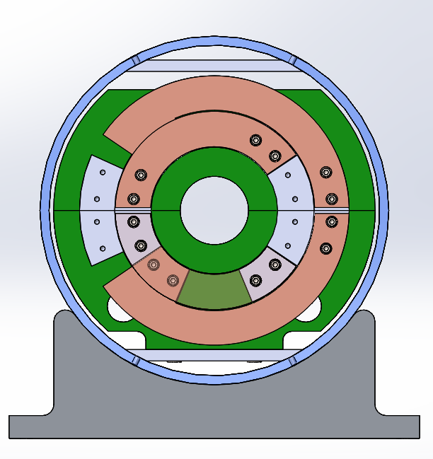
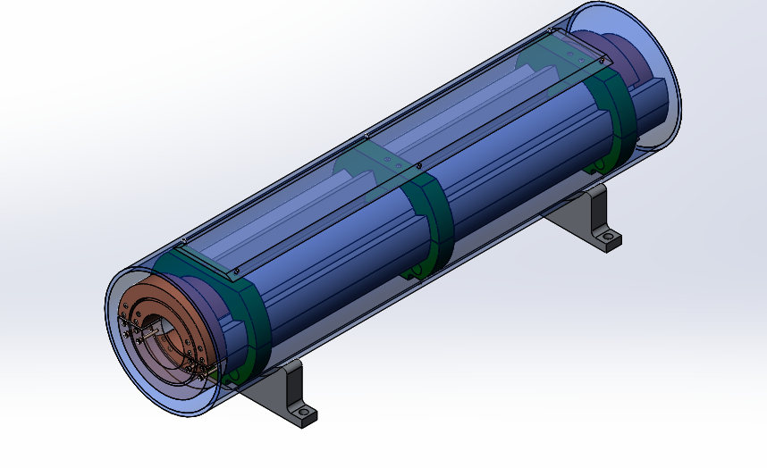
CT空芯线圈磁铁样机研制进展
在结构上，磁铁由上下两个线圈组成，每个线圈有3匝，由6个圆弧型导体拼装而成，导体空间位置由精确加工的支撑件保证；
线圈导体材料为铝，因此可以通过表面阳极化实现匝间绝缘；
磁铁本体部分在专用平台上装配完成后，整体推入磁屏蔽筒完成总装；
由于导体形状及磁铁总体装配相对都比较简单，不仅能够保证线圈形位公差，而且可以降低磁铁制作成本。

Slide 17
三种设计方案磁铁参数对比
 | Iron Yoke | CT | CCT
Max. field [Gs] | 338 | 338 | 338
Min. field [Gs] | 29 | 29 | 29
Good field region (mm) | 55 | 55 | 55
Field uniformity | 0.1% | 0.1% | 0.1%
Turns per magnet | 2 | 4 | 234
Max.current (A) | 856 | 1275 | 481
Min.current (A) | 73 | 109 | 41
Conductor area (mm²) | 1200 | 1945 | 900
Max.current density(A/mm²) | 0.71 | 0.66 | 0.53
Max. power loss (W) | 425 | 1320 | 1665
Avg. power loss (W) | 170 | 528 | 666
Inductance (mH) | 0.08 | 0.36 | 1.5
Magnet size（mm） | 330 | 300 | 360
Magnet length (mm) | 4650 | 4632 | 4865
Magnet weight (ton) | 1.4 | 0.6 | 0.65

Slide 18
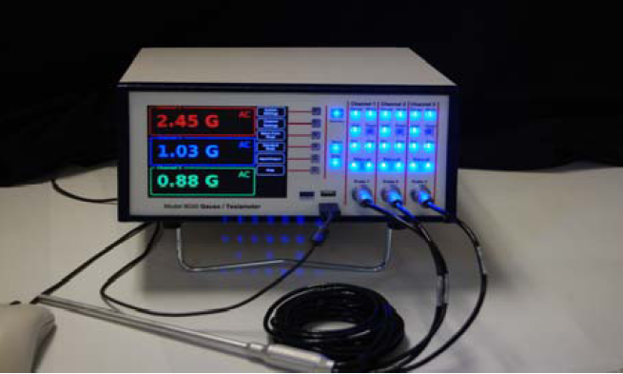
High precision field measurement system
By exploring several international companies that can produce Hall probe field measurement systems, we found one set of high precision system that could meet the requirements of the low field measurement.

Slide 19
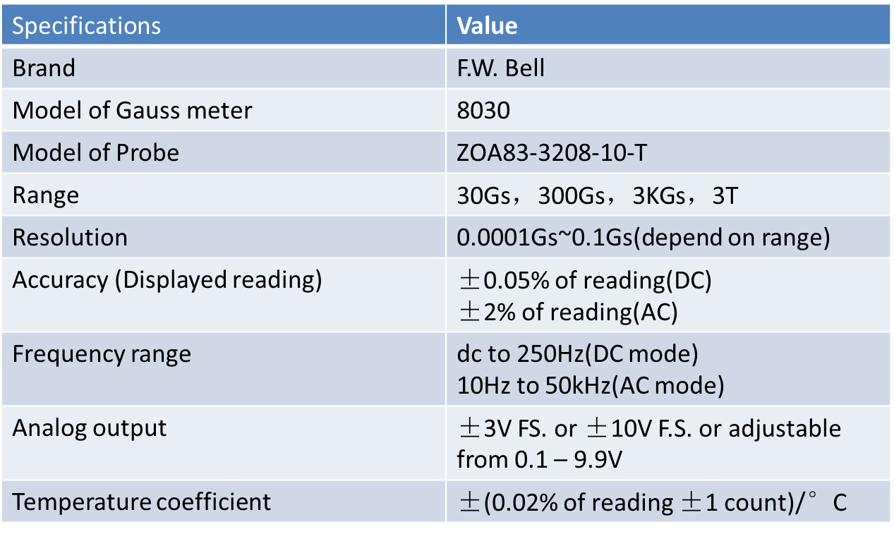
High precision field measurement system
The specifications of the measurement system (@F.W. Bell)

Slide 20
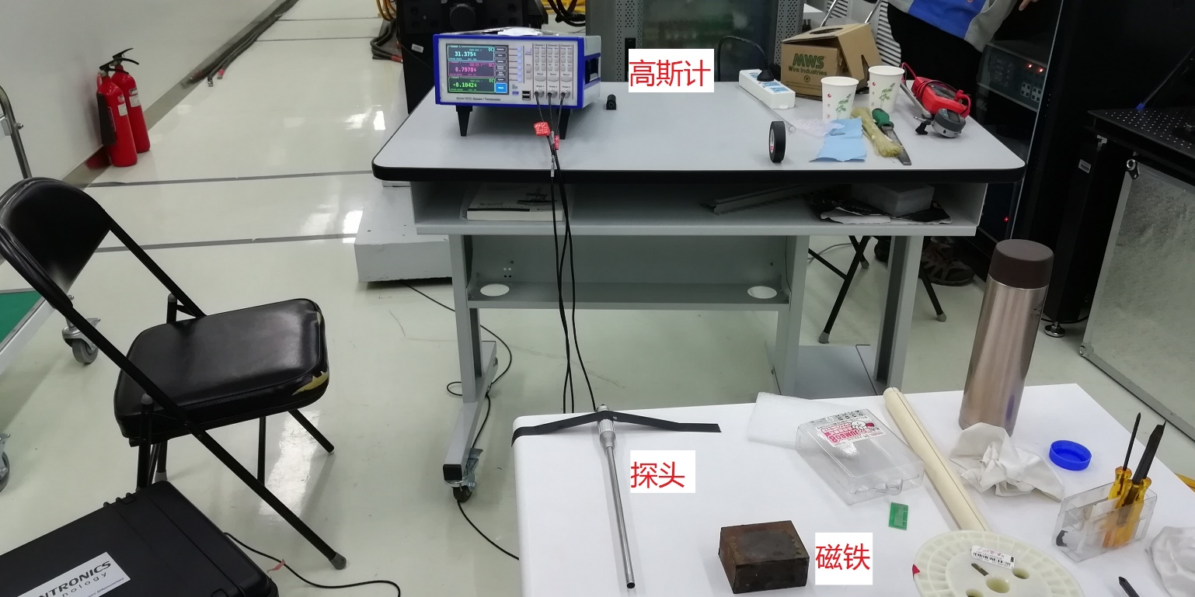
High precision field measurement system
The performance of the Hall probe field measurement system was tested in the lab of IHEP.
The low field of 30Gs was produced by a permanent magnet that is absolutely stable.

Slide 21
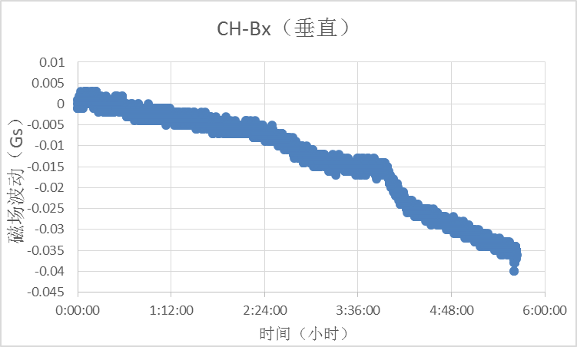
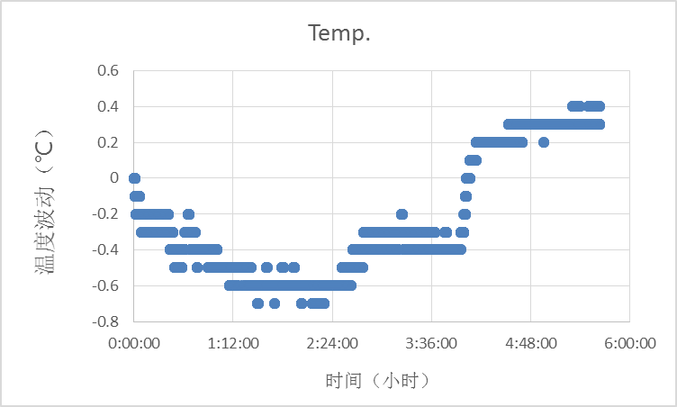
High precision field measurement system
The test results of 5 hours
The precision of the system is 0.006Gs in the first hour and 0.01Gs in the second hour.
The precision is very sensitive to the temperature change of the lab. From the third hour, the temperature of the lab changed 1ºC, the precision became 0.035Gs.
To realize the precision of 0.01Gs, the temperature change in the lab should be controlled within 0.5ºC

Slide 22
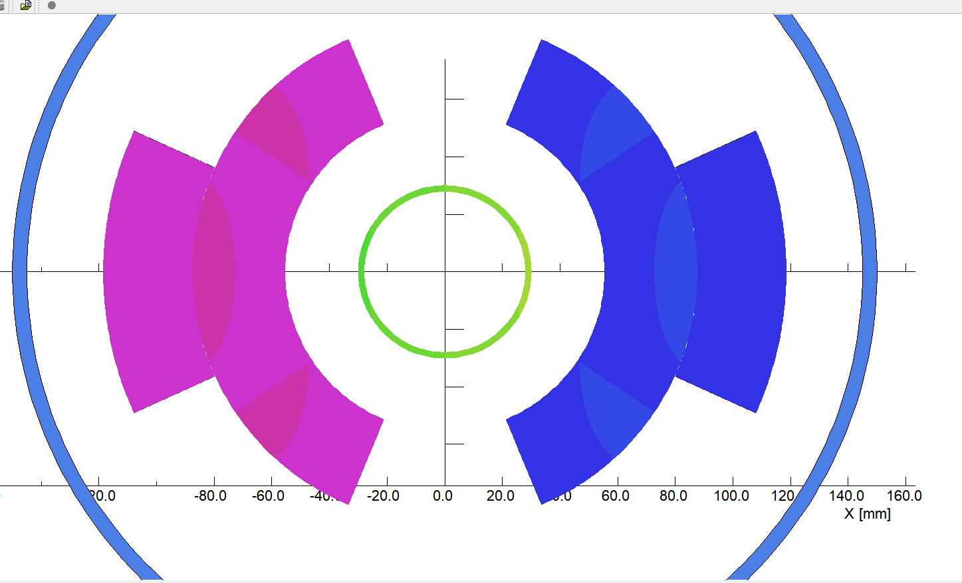
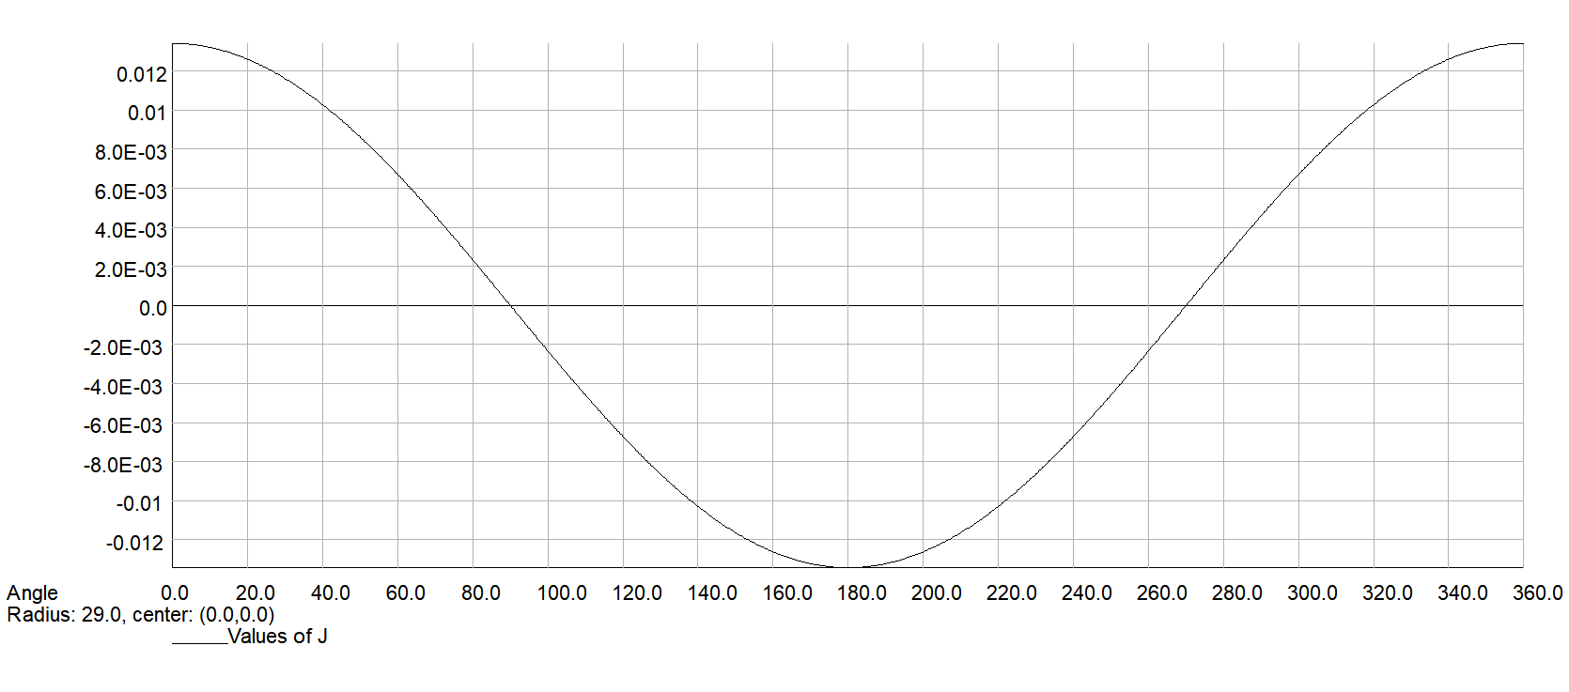
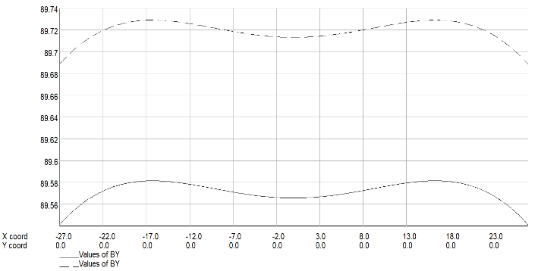
真空盒涡流问题研究
增强器磁铁的磁场随真空盒内束流能量的增大而增大，变化的磁场会在金属真空盒壁上感应出涡流，涡流产生的磁场会改变励磁电流产生的磁场。
由于二极磁铁很长，端部效应可以忽略，真空盒涡流的三维问题可以简化为二维问题，因此采用二维计算机程序精确计算真空盒壁上的涡流及其产生的磁场。
从模拟计算结果看，真空盒壁上的涡流沿方位角的分布是标准的cosθ分布，这种涡流分布产生的磁场是纯的二极磁场，没有六极场分量。
从空芯线圈磁铁模拟结果看，真空盒涡流确实只产生很小的二极场，六极场分量为3E-6Gs，几乎为0。

Slide 23
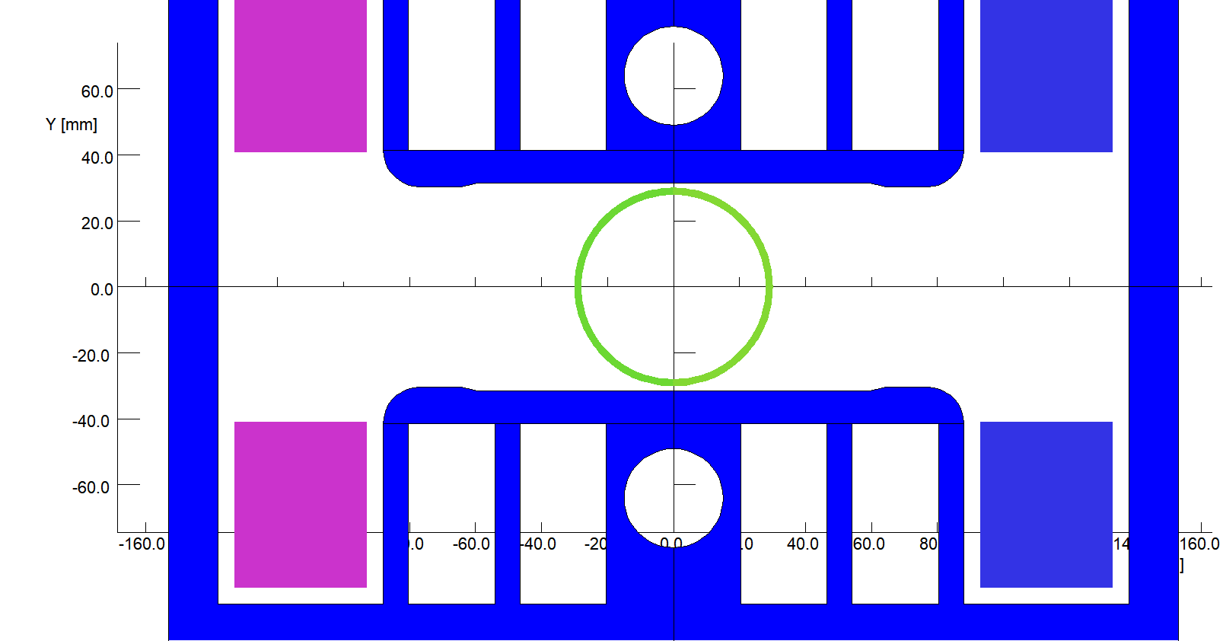
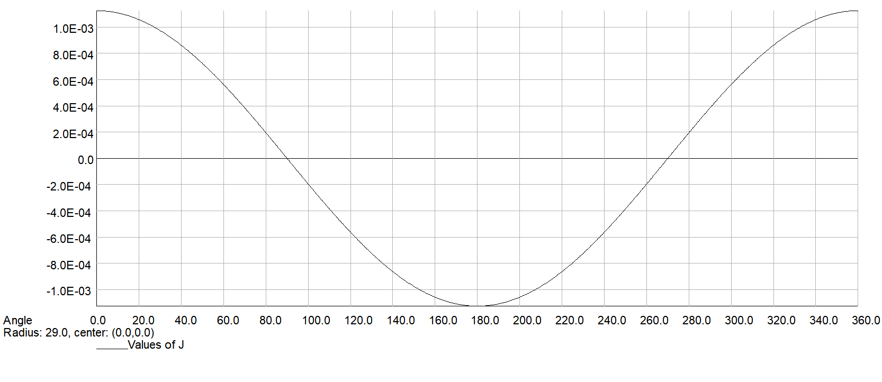
真空盒涡流问题研究
从铁芯磁铁模拟结果看，真空盒涡流除了产生一个很小的二极场外，还产生幅度为0.0035Gs的六极场分量，约占二极场的1E-4，可以忽略不计。
真空盒壁内的涡流分布虽然还是纯正的cosθ分布，但是铁芯磁性材料的存在使涡流产生的磁场分布发生了改变，产生了一个很弱的六极场分量。
模拟结果基于理想的梯形变化磁场，实际的磁场波形在梯形起始处和末了处都是圆滑过渡，磁场变化速率小，因此产生的涡流会更小一点。

Slide 24
Summary
From the view of the excitation efficiency at high field level, the design of the dipole magnet with iron cores is the best. To reduce the influence of the remnant field on the field quality at low field level, grain oriented silicon steel laminations will be used to stack the cores.
The two designs (CT and CCT) of the dipole magnets without iron cores can meet the requirement of the field uniformity at low field level, they will consume more electricity power due to lower excitation efficiency at high field level .
A set of Hall probe field measurement system with high precision was investigated and tested, it might reach the precision less than 0.01Gs in the case that the temperature change in the lab could be controlled within 0.5ºC

Slide 25
总结
从高场励磁效率的角度考虑，铁芯二极磁铁应该是最佳方案。为了减小铁芯剩磁对低场精度的影响，拟采用矫顽力小很多的取向钢制造磁铁铁芯，进行小型实验样机研制。
CCT空芯线圈二极磁铁方案优点是线圈形位公差要求较低，但是通过工艺实验件的加工发现，加工时间和成本太高，不适合CEPC增强器大量二极磁铁的加工制造。
CT空芯线圈方案的缺点是线圈形位公差要求较高，但是通过优化设计，可以简化磁铁的结构和工艺，有可能满足所需的公差要求，需要进一步通过小型实验样机研制进行验证。
通过调研，我们发现一款Hall点测系统能够满足高精度30Gs低场的测量要求，但是实验室温度必须控制在0.5ºC。
通过模拟计算，增强器二极磁铁真空盒壁内的涡流会产生一个很小的二极场，产生的六极场分量可以忽略不计。

Slide 26
谢谢大家！

