Slide 1
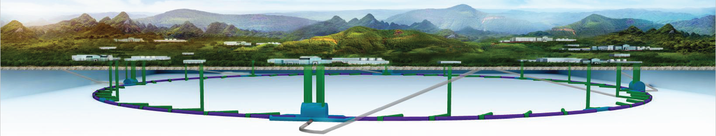
CEPC injection and extraction Septa and kickers R&D progress
Jinhui Chen
Injection group
2019-05-31

Slide 2
Overview of CEPC injection and extraction systems

Slide 3
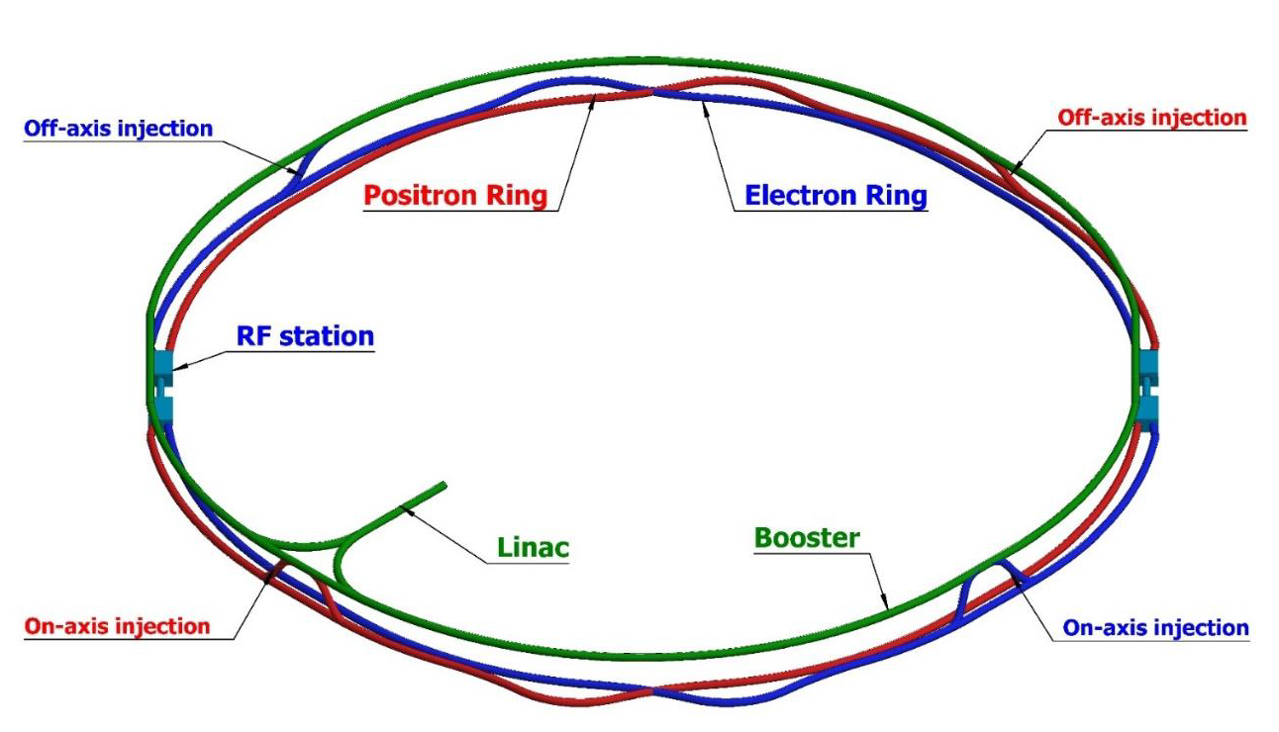
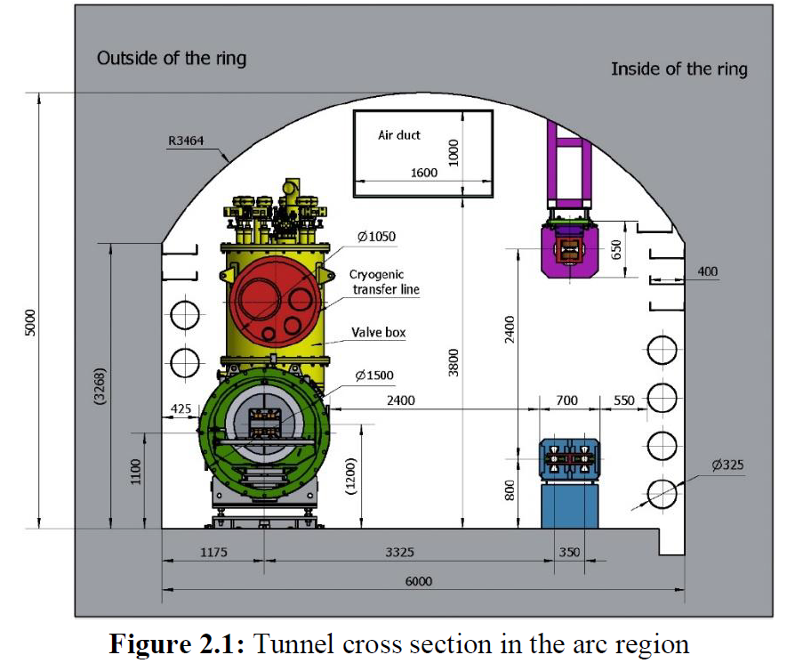
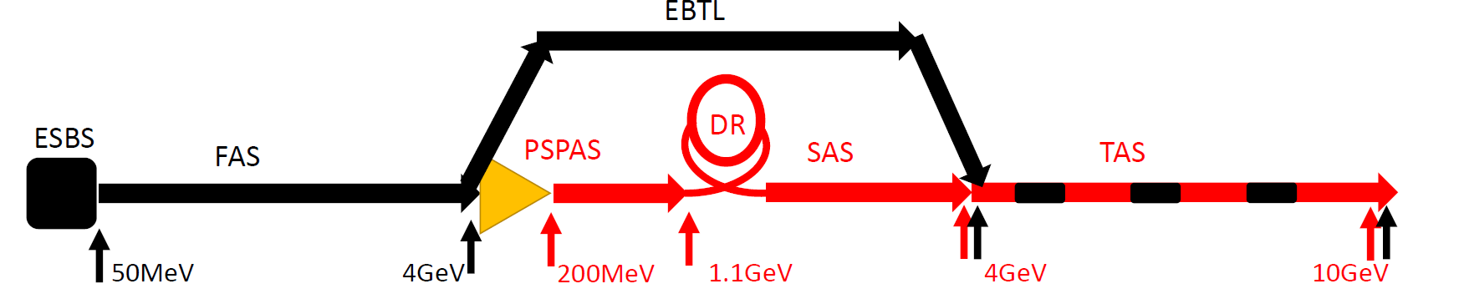
Layout of the accelerators
120GeV
120GeV
e+
e-
100km
10-120GeV
1.2km

Slide 4
CEPC injection and extraction systems
DR injection and Extraction system(e+)
Booster LE injection system (e+,e-)
Booster Extraction system1 (e+,e-)
Collider off-axis injection system (e+,e-)
Booster Extraction system2 (e+,e-)
Booster HE injection system (e+,e-)
Collider swap out injection system (e+,e-)
Collider swap out extraction system (e+,e-)
Collider beam dump system

Slide 5
Parameters of the Linac and DR
75.4m
Bunch spacing of the Linac=10ms
10ms
How long are the straight sections for inj.&ext.?
Damping ring energy=1.1GeV
Circumference=75.4m，Revolution period=251.4ns
Filling mode：2 bunches, uniform
Bunch spacing=125ns
Bunch spacing of the Linac and the DR are different. So， bunch by bunch injection and extraction is necessary for the DR.
Lambertson: length=0.5m, deflection angle=100mrad, B=0.72T
thickness of septum sheet? Leakage field=?
Fast kicker: pulse width<250ns, repetition rate=100Hz, length=0.25m, deflection angle=1.5mrad, B=0.02T
125ns

Slide 6
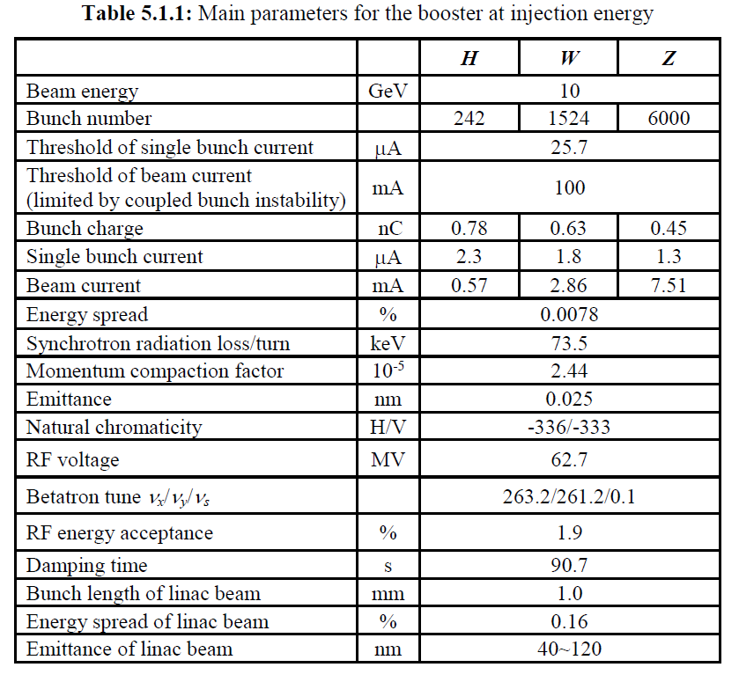
Parameters of the booster-Low energy
3 operation mode：Higgs，W，Z
Circumference=100km，Revolution period=333.6us
Filling mode：uniform?
242 bunches
1524 bunches
6000 bunches
680ns
210ns
25ns？
Higgs
W
Z
Bunch spacing of the Linac and the booster are different. So， it has to be bunch by bunch injection for the booster at low energy.
The damping time of the booster at low energy is 90.7s. So，it is impossible to approach beam accumulate in low energy booster. On-axis injection based on fast kicker is reasonable scheme for low energy beam injection from the Linac.
fast kicker : pulse width<50ns?, repetition rate=100Hz
Magnet aperture=40mm(round diameter? Quadrupole?)
Kicker aperture(H×V)=? good field region(H×V)=? Length=0.3m, deflection=0.25mrad, B=0.028T
Lambertson: length=1m, deflection=22mrad, B=0.72T
leakage field?

Slide 7
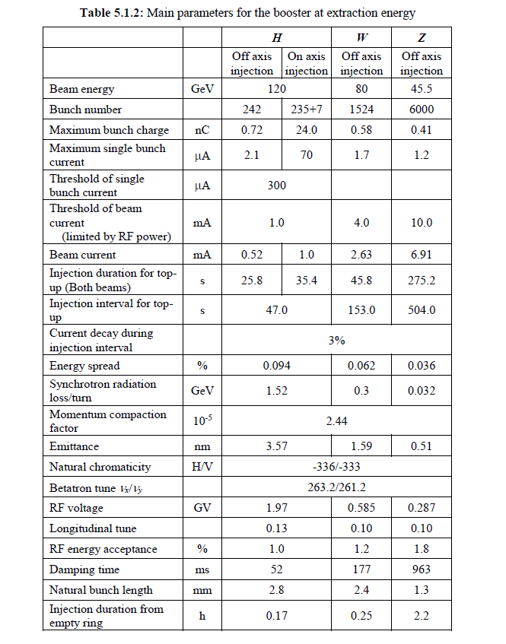
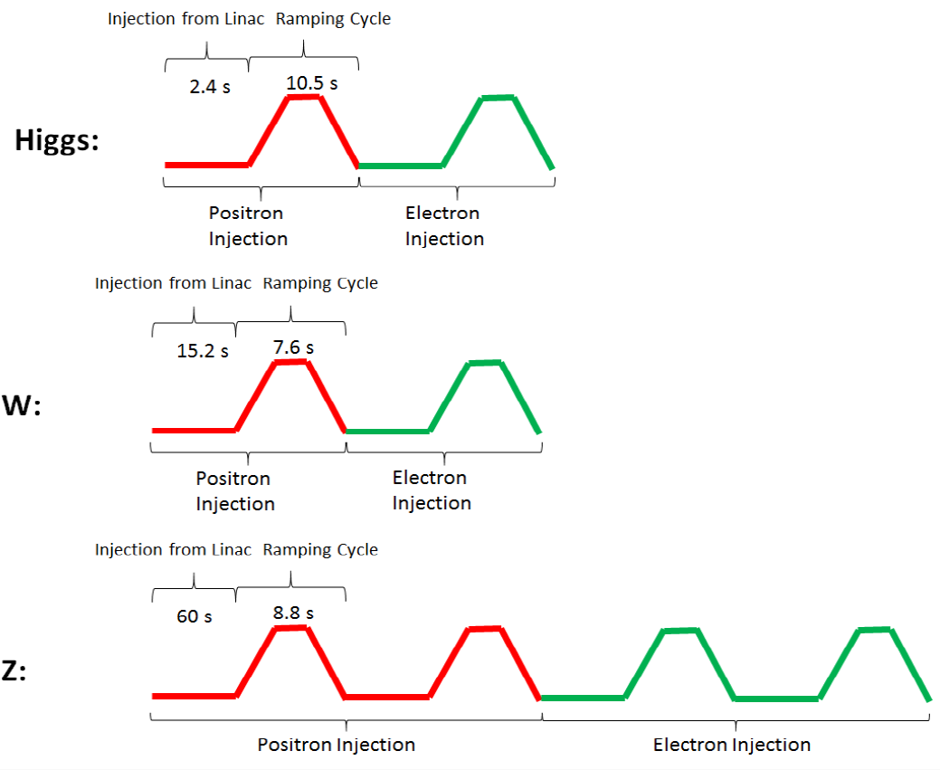
Parameters of the booster-High energy
reinjection?

Slide 8
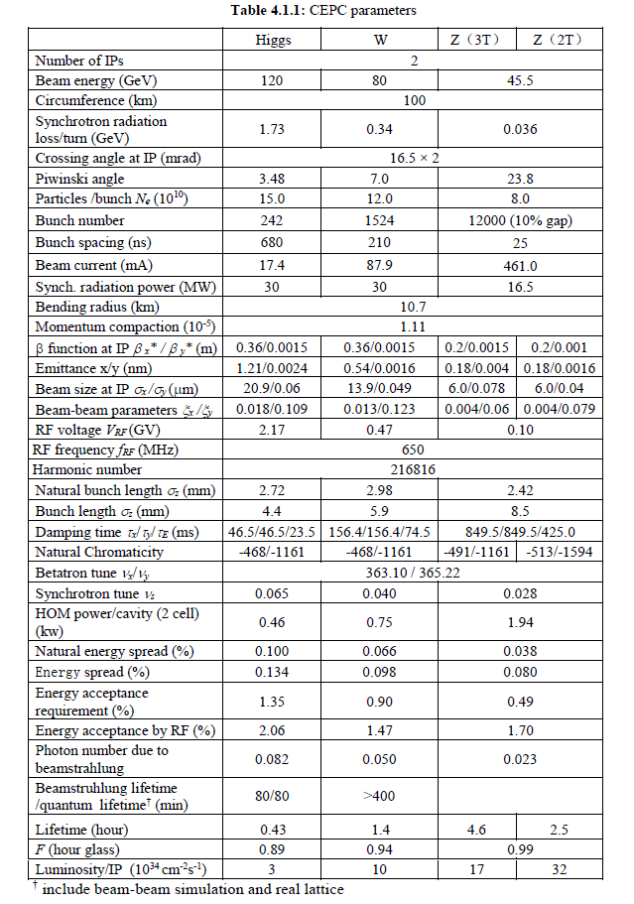
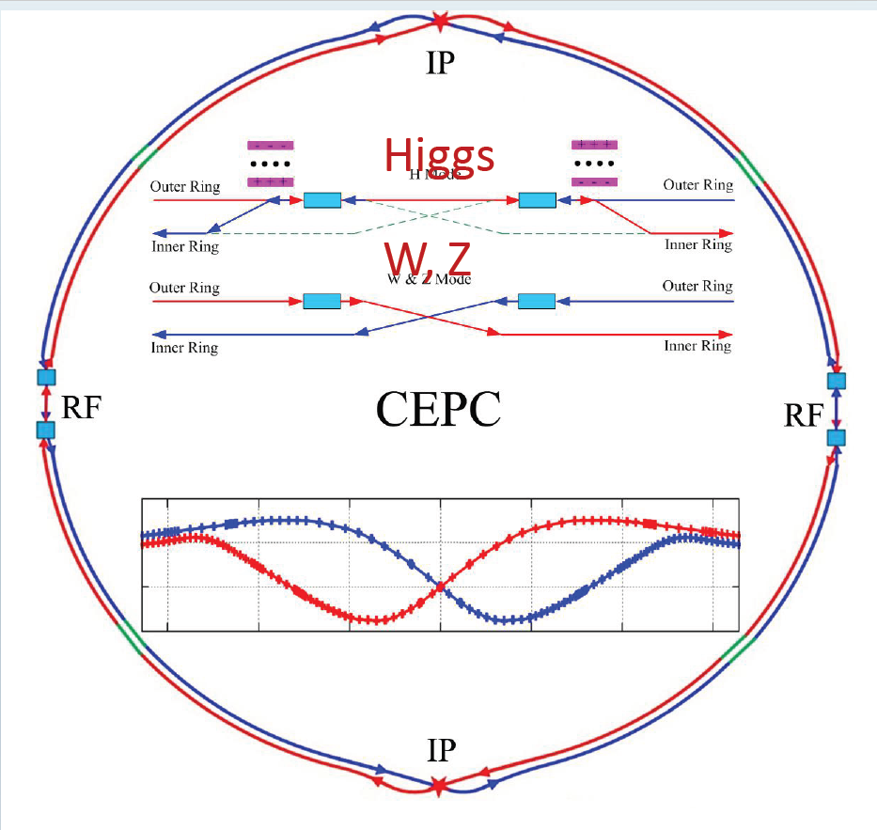
Parameters of the collider
Where is the beam dump system?
3 operation mode：Higgs，W，Z
Circumference=100km，Revolution period=333.6us
Filling mode：uniform?
242 bunches
1524 bunches
12000 bunches
680ns?
210ns
25ns
Higgs
W
Z

Slide 9
Booster Extraction
242 bunches
1524 bunches
6000 bunches
680ns?
210ns
25ns?
booster
Higgs
W
Z
Uniform??
242 bunches
1524 bunches
12000 bunches
680ns?
210ns
25ns
collider
Higgs
W
Z
Bunch by bunch extraction or bunch train fast extraction?
It would take long time for bunch by bunch extraction because long damping time of around 50ms in the collider.
Bunch train extraction required the both rings have the same filling pattern.
300us
200ns
200ns
Single turn extraction?? Be difficult for kicker pulser.
平顶宽度=300us，如果采用脉冲形成线PFL储能的话需要30km长，阻抗5欧姆，10根50欧姆的电缆并联，总计电缆长度为300km。

Slide 10
MR Off-axis injection for the W and Z mode
Bunch by bunch extraction or bunch train injection?
It would take long time for bunch by bunch extraction because long damping time of around 50ms in the collider.
Bunch train extraction required the both rings have the same filling pattern.
stored bunch train
Septum sheet
Injected bunch train
300us
200ns
200ns
Single turn injection?? Be difficult for kicker pulser.

Slide 11
MR On-axis swap out injection for the Higgs mode
242 bunches
680ns?
The beam is kicked bunch by bunch?? Repetition rate=??
Higgs

Slide 12
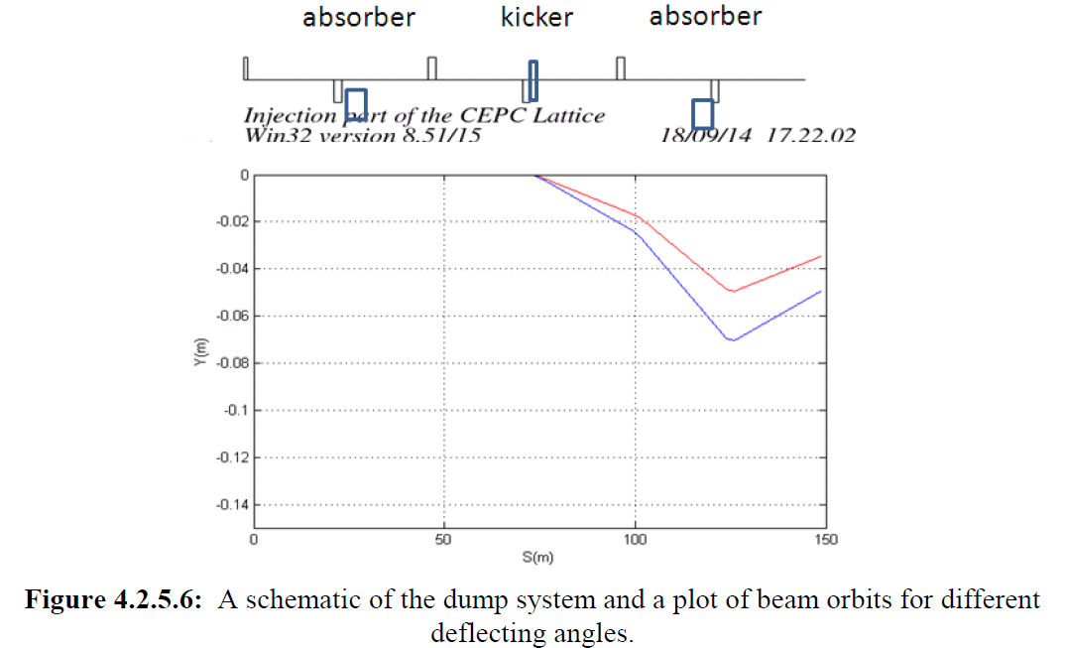
Beam dump system
Fast kicker Location: between IP3 and IP4?
Fast kicker: Tr=35ns?(bunch spacing=27.5ns in Z mode)
Fast kicker: Tf=330us?
Kick angle?.........
330us

Slide 13
Important parameters input
Injection & extraction schemes
Filling pattern
Injection & extraction section layout, including injection and extraction direction
Beam stay clearance of Kickers and septums
Strength of kickers and septums，some input parameters are not reasonalble
Thickness of septum
Parameters of kicker pulse: waveform ? rise/fall time(?%-?%), flat-top( duration, flatness), repetition rate.
Magnet type? Beam impedance budget.
Another potential new technology? Non-linear kicker, puled sextupole (trapezoid waveform?)

Slide 14
Hardware designs for CEPC injection and extraction systems
Contributed by Kang Wen

Slide 15
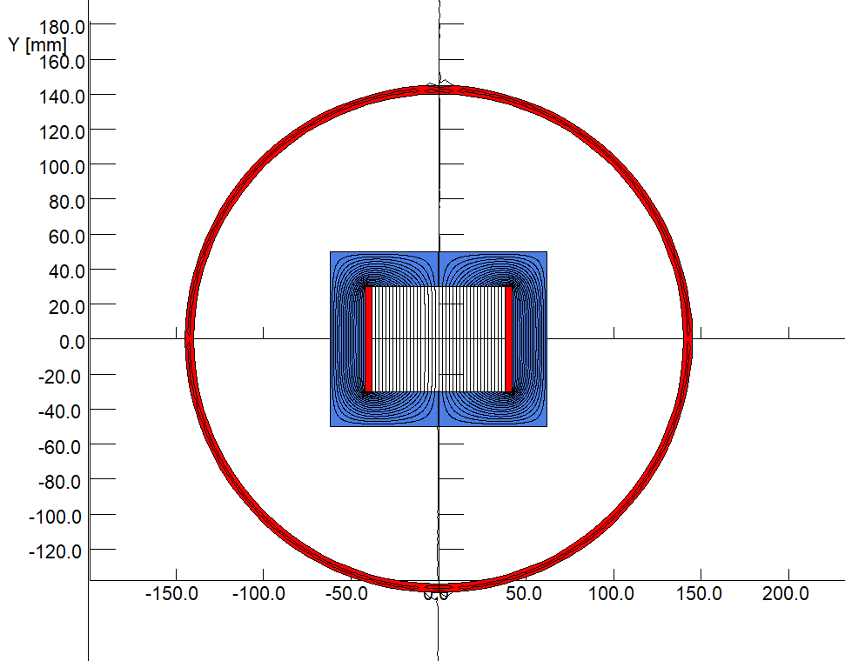
Preliminary design of kicker magnets
To get an high excitation efficiency, all the kicker magnets will have a window type cores made by two C-type ferrite blocks.
All the kicker magnets will be put inside the vacuum tanks so that the fast pulsed field can directly kick the beam without time delay and amplitude attenuation.
To avoid the coupling between particle beam and the ferrite blocks, two thin copper plates will be inserted between the touched surfaces of two C-type blocks.

Slide 16
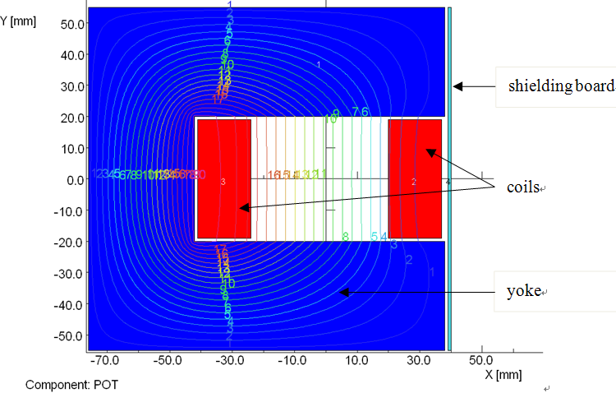
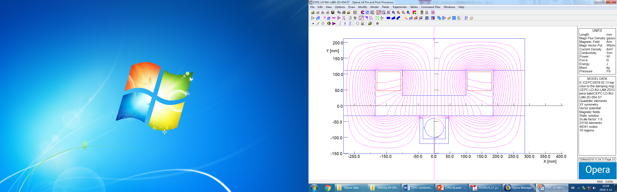
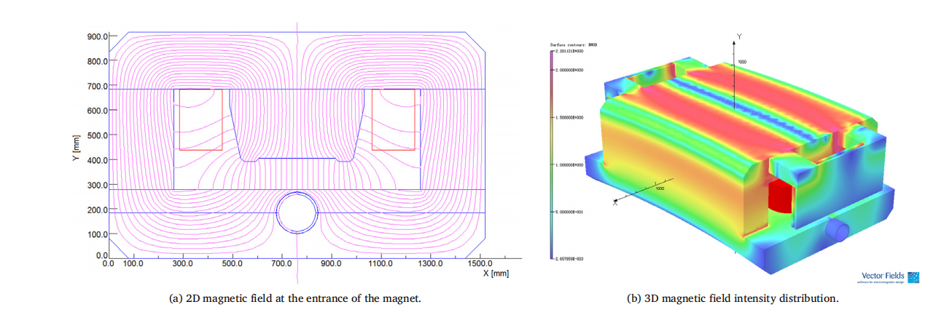
Preliminary design of septum magnets
There are two types of septum magnets often used for beam injection and extraction of accelerators. One is C-type septum magnet, another is Lambertson type septum magnet.
Due to high reliability and stability, Lambertson magnets are selected as the septum magnet for the beam injection and extraction of all the CEPC accelerators.
By using several shielding measures, the leakage field along the orbit of the circulating beam can be reduced down to 5E-4 of the main field in the magnet gap.

Slide 17
Preliminary design of septum magnets
The main parameters of the Lambertson magnets
 | DR-INJ-EXT-LAM | BST-INJ-EXT-LAM | BST-EXT-LAM | MR-EXT-LAM-01 | MR-EXT-LAM-02
Number | 2 | 2 | 16 | 20 | 20
Eff. length（m） | 2 | 2 | 1.875 | 1.75 | 1.75
Max. field（T） | 0.18 | 0.366 | 0.58 | 0.64 | 0.32
Septa thick(mm) | 10 | 10 | 10 | 10 | 4
Gap（mm） | 64 | 44 | 44 | 24 | 24
GFR（mm） | 60 | 40 | 40 | 20 | 20
Leakage field | ＜0.001 | ＜0.001 | 0.1% | 0.1% | 0.1%
Amp. turns（AT） | 9442 | 13200 | 20917 | 12590 | 6295
Current (A) | 472 | 440 | 581 | 420 | 393
Jc（A/mm2） | 3.27 | 3.04 | 4.02 | 2.9 | 2.72
Resistance（Ω） | 0.011 | 0.016 | 0.019 | 0.014 | 0.007
Voltage（V） | 5.26 | 7.16 | 10.8 | 5.9 | 2.9
Power loss（kW） | 2.48 | 3.15 | 6.30 | 2.47 | 1.15
ΔP（kg/cm2） | 6 | 6 | 6 | 6 | 6
Water flow（l/s） | 0.52 | 0.79 | 0.73 | 0.86 | 0.66
ΔT（℃） | 1.13 | 1 | 2 | 1 | 1
L/W/H（m） | 2.2/0.7/0.4 | 2.2/0.5/0.4 | 2.1/0.5/0.4 | 2.0/0.4/0.3 | 1.9/0.3/0.3
Weight（t） | 2.9 | 2.5 | 2.5 | 1.7 | 1.0

Slide 18
END

Slide 19
