Slide 1
Toward Track segment in HGTD
Lianyou SHAN
June 10, 2019, IHEP

Slide 2
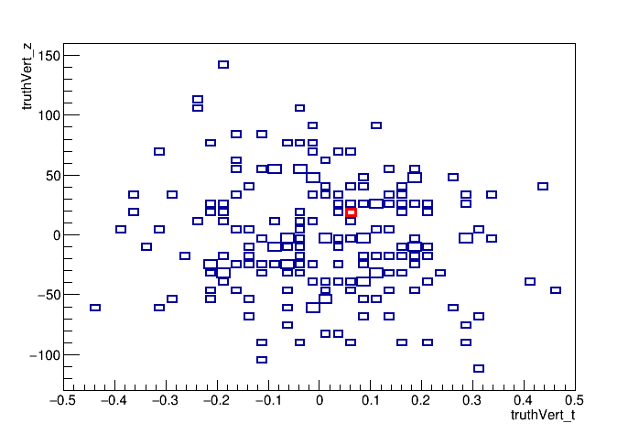
Pileup in HL run
$μ=200$
Time window should shrink to 0.25 ns
Then 0.175 as core part
HGTD is expect to mitigate
by a time-slice
Time resolution is important
$t_{0}$ determination will be crucial

Slide 3
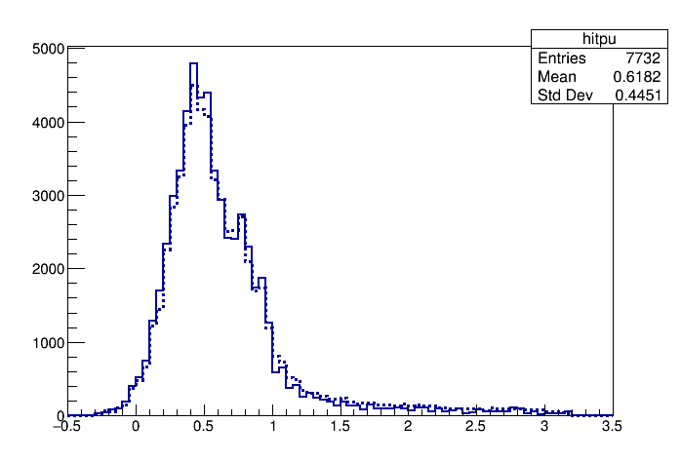
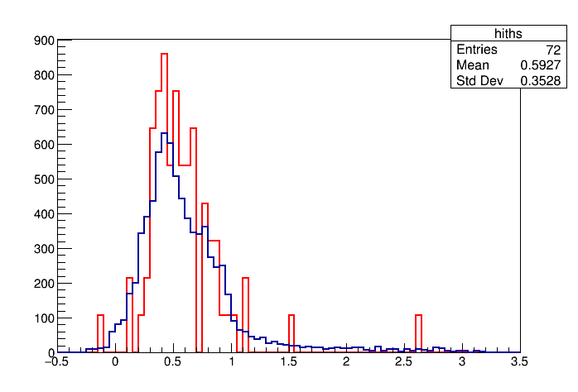
HGTD measurements
20.20.14 G4 FullSimul at 1.3*1.3 config
Plus pulse re-sampling with $σ_{t}=30 ps$
Too many pixel readout
72 phys hits from 7732 Pileup, then from 58332 total per event
Resort to ITK or something else ?

Slide 4
TrkSegment in HGTD
A bunch of pixels in HGTD
An HGTD reconstruction output with $\left( t, X, Y, nL \right)$ defined
Connected pixels per layer
Time cut inside
Connect hit along $\left(η,φ\right)$ between layers
Again time cut inside
Association to ITK track
Pattern recognition
Time coincident along adjacent pixels
Filter the (time)disconnected hits

Slide 5
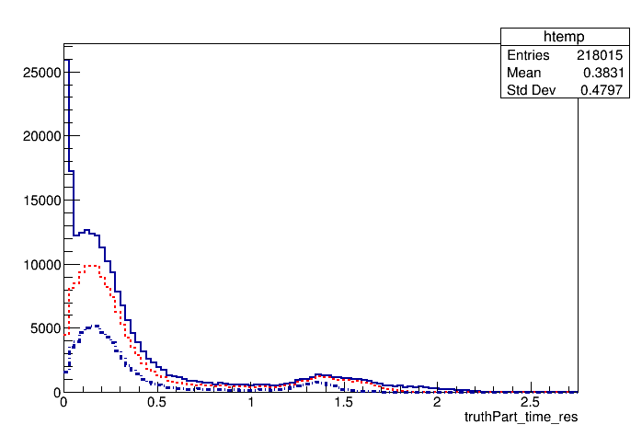
Clues from Truth MC

Slide 6
Connected Pixels per layer

Slide 7
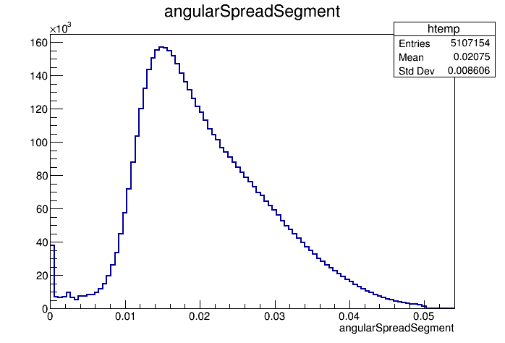
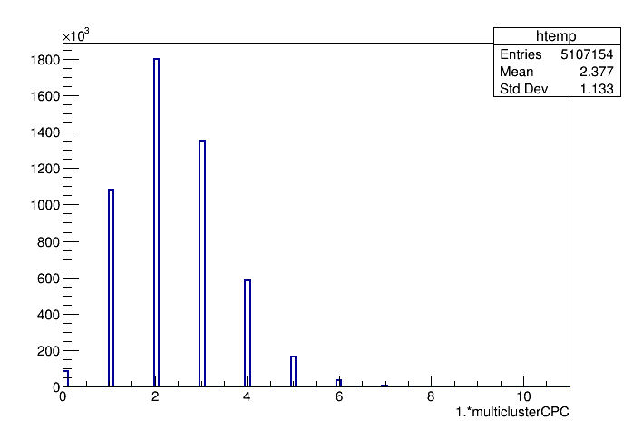
coincidentness along layers

Slide 8
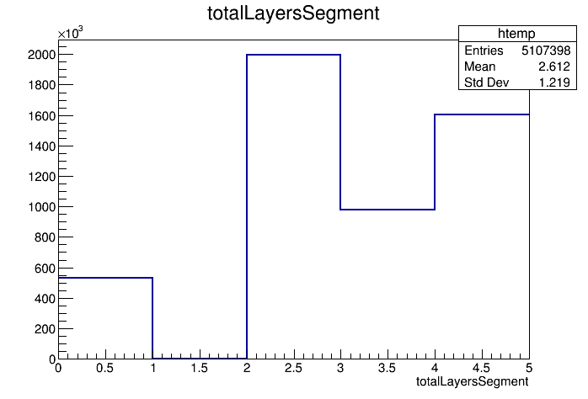
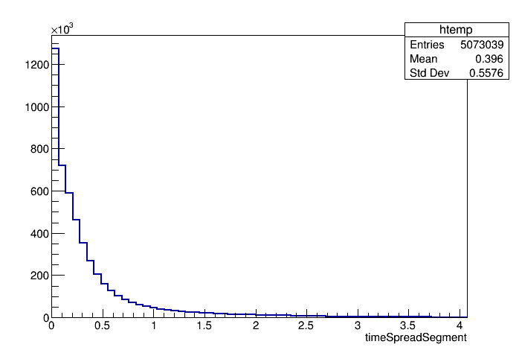
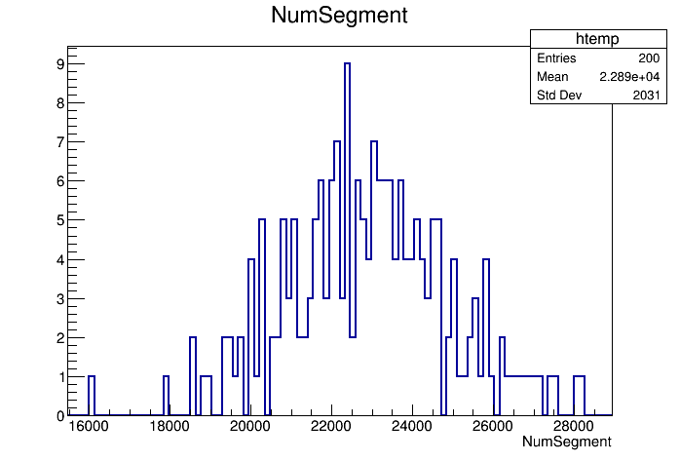
TrkSegment : preliminary observation
Crucial cut to tune

Slide 9
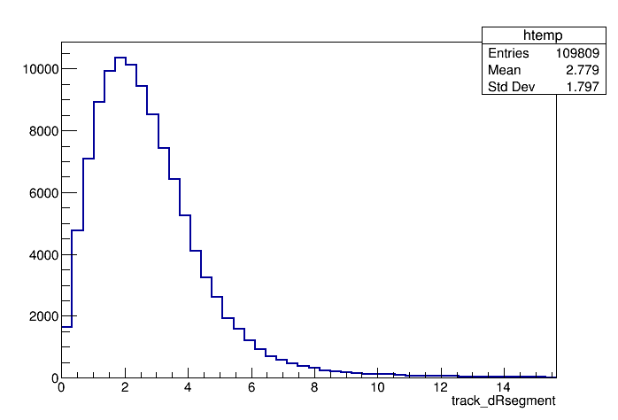
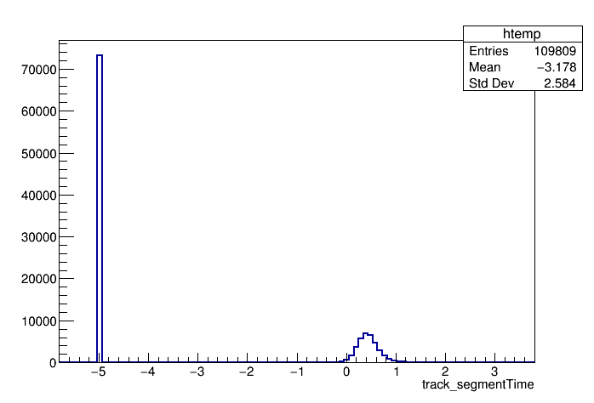
Association to ITK tracks
Eventhough most of tracks came from unexpected, one needs optimization !
Track (pseado-)extrapolation to Segment on going

Slide 10
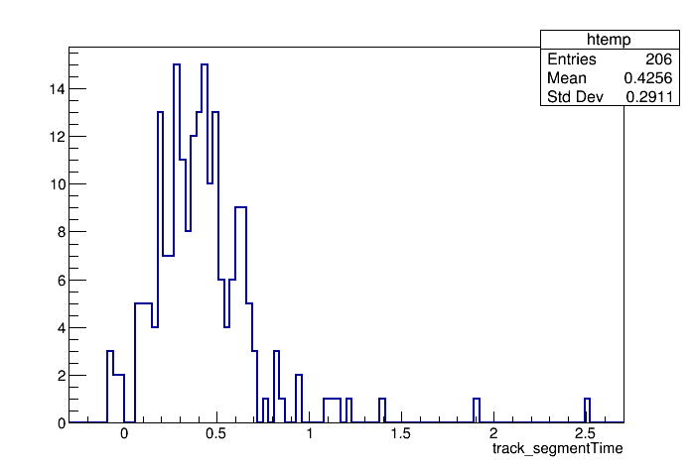
Determination $t_{0}$ ?
Need some novel ideas : thanks if any suggestions !
Need some optimization/iterations

Slide 11
Summary
HGTD TrkSegment defined
At least a working code
At least a way to understand current configurations&simulations
Still chasing the physics performance
$t_{0}$ determination
So that Pileup mitigation
Thanks !

