Slide 1
Contents
1. Root files to be the input for the fitting code
“llhzz-merged-signal-background-files.tar.gz ” -- Ζ(μ⁺μ⁻)Η(Ζ→νν, Ζ*→jj)
mzvj-sig.root , mzvj-sm.root , mzvj-az.root , mzvj-zz.root , mzvj-ww.root , mzvj-tt.root
“nnhzz-merged-signal-background-files.tar.gz ” -- Ζ(νν)Η(ΖΖ∗→μ⁺μ⁻jj+jjμ⁺μ⁻)
vzmj-vzjm-sig.root , vzmj-vzjm-sm.root , vzmj-vzjm-az.root , vzmj-vzjm-zz.root , ....
2. Signal-background histogram (@ pre-fitting ) and the cutflow
Page 2 -- Ζ(μ⁺μ⁻)Η(Ζ→νν, Ζ*→jj)
Page 3 -- Ζ(νν)Η(ΖΖ∗→μ⁺μ⁻jj+jjμ⁺μ⁻)
3. the code is under ( this version is under merging stage ) /cefs/higgs/kiuchi/Higgs2zz/ana_2019/YanxiG_20191018version/hig2zz
and will be merged into the central one , https://github.com/cepc/hig2zz

Slide 2
Ζ(μ⁺μ⁻)Η(Ζ→νν, Ζ*→jj)

Slide 3
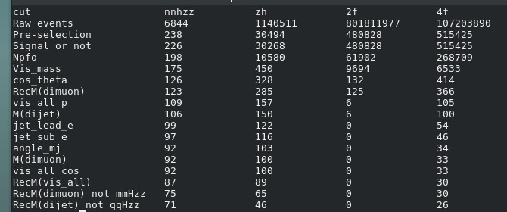
Ζ(νν)Η(Ζ→μ⁺μ⁻, Ζ*→jj)
Ζ(μ⁺μ⁻)Η(Ζ→jj, Ζ*→μ⁺μ⁻)

