Slide 1
HH->yy+multilepton
Kaili Zhang
kazhang@cern.ch
²⁰¹⁹⁻⁰⁷⁻¹⁵

Slide 2
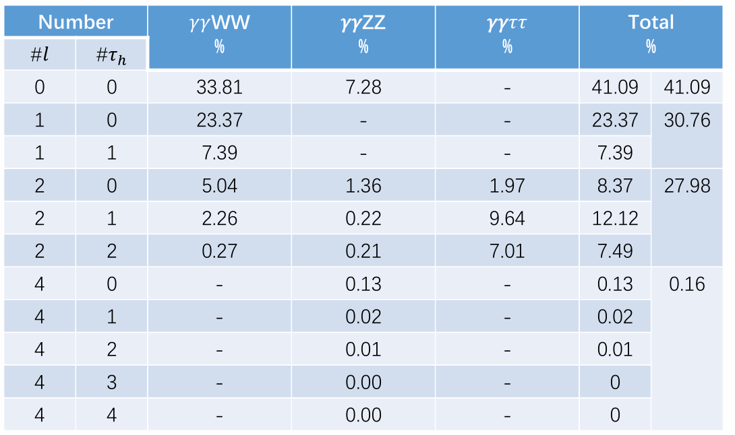
HH->yy+multilepton Samples
Environment: Hgam Framework
AnalysisBase 21.2.72 and HGamCore tag v1.8.33-h024
Samples: non-resonance, MC16a/d/e, 1M in total, (12:17:21)
mc16_13TeV.450697.aMcAtNloHerwig7EvtGen_UEEE5_CTEQ6L1_CT10ME_hh_yyXX1L.deriv.DAOD_HIGG1D1
mc16_13TeV.450698.aMcAtNloHerwig7EvtGen_UEEE5_CTEQ6L1_CT10ME_hh_yyXX2L.deriv.DAOD_HIGG1D1
WWyy+ZZyy+$ττyy$
No available $τ$ information yet. Currently focus on lepton (e/$μ$).
Would try $τ$ veto cut to avoid the overlap with Lei’s group.

Slide 3
Selections
Good Event
Derivation; Duplicate; GRL; Trigger; DQ; Vertex……
B veto: WP: MV2c10_FixedCutBEff_70
2 Tight photons
Trigger: HLT_g35_loose_g25_loose/ HLT_g35_medium_g25_medium_L12EM20VH
Tight PID, Isolation
$\frac{pT_{y1}}{m_{yy}}>0.35,\frac{pT_{y2}}{m_{yy}}>0.25$
$pT_{y1}>35GeV, pT_{y2}>25GeV$
TMW(Tight Mass Window): $\left|m_{yy}−125.09\right|<5GeV$

Slide 4
Selections
$≥1$ Good leptons
IP: $z_{0}<0.5mm$; $e:\frac{d_{0}}{σd_{0}}<5, μ:\frac{d_{0}}{σd_{0}}<3,$
e: HV, OQ; $μ:$ Not Bad;
Isolation;
Tight PID
$η_{μ}<2.7$, $η_{e}<1.37 or 1.52<η_{e}<2.47.$
Pt: 10 GeV
Overlap removal
e, $μ$, $γ$, jets.
If 2 lepton:
Opposite sign. Very rare for good leptons>2, so usually compare the largest 2 leptons
Z veto if ${ee}/{μμ\left(not eμ\right)}$, $\left|m_{ll}−91.09\right|>10 GeV$
All are Hgam default selections.
Not apply lepton trigger yet.

Slide 5
Lepton Filter
MultiElecMuTauFilter are applied to generate the sample.
Filter weighted efficiency: #𝑙 = 1(17.1%), #𝑙 >= 2(10.0%). (Here $l:e, μ, τ_{Had}$.)
Fliter lepton ${p_{T}}_{vis}$ cut 7GeV; different with Hgam 10GeV configuration.
Even for 2l sample, 1l events are dominant.

Slide 6
General Cutflow
$${Eff}_{com}$$ | 16a 1l | 16d 1l | 16e 1l | 16a 2l | 16d 2l | 16e 2l
Total | 100.00% | 100.00% | 100.00% | 100.00% | 100.00% | 100.00%
Good event | 82.58% | 82.42% | 82.36% | 86.38% | 86.31% | 86.19%
B veto | 76.78% | 76.50% | 76.38% | 79.69% | 79.48% | 79.31%
2 good photons | 49.24% | 47.24% | 47.07% | 50.50% | 48.59% | 48.42%
$≥1$ good leptons | 16.90% | 15.94% | 15.92% | 21.28% | 20.09% | 19.90%
$≥2$ good leptons |  |  |  | 5.87% | 5.41% | 5.29%
OS&Z Veto |  |  |  | 5.81% | 5.36% | 5.24%
TMW |  |  |  | 5.61% | 5.16% | 5.04%
Final | 16.90% | 15.94% | 15.92% | 5.61% | 5.16% | 5.04%
Generally mc 16a/d/e have no significant difference.
Here lepton effiencicy is calculated by N_passed/N_tot_sample.
Actually as the sample is not pure 1l/2l sample, would be underestimated.

Slide 7
Photon Selections
Effiencicy | 1l 16a | 1l 16d | 1l 16e | 2l 16a | 2l 16d | 2l 16e
Total | 100.00% | 100.00% | 100.00% | 100.00% | 100.00% | 100.00%
Good Event | 82.58% | 82.42% | 82.36% | 86.38% | 86.31% | 86.19%
B veto | 76.78% | 76.50% | 76.38% | 79.69% | 79.48% | 79.31%
2 Loose Photons | 62.40% | 61.75% | 61.53% | 64.27% | 63.59% | 63.37%
Photon Trigger | 61.26% | 56.10% | 55.95% | 63.12% | 57.74% | 57.50%
Tight ID | 52.63% | 51.09% | 50.90% | 54.04% | 52.48% | 52.33%
Isolation | 49.00% | 46.99% | 46.81% | 50.12% | 48.14% | 48.00%
Relative Pt | 48.64% | 46.66% | 46.51% | 49.61% | 47.61% | 47.47%
105<m_yy<160 | 48.32% | 46.34% | 46.15% | 48.80% | 46.80% | 46.68%
2 Tight Photos | 48.32% | 46.34% | 46.15% | 48.80% | 46.80% | 46.68%
120<m_yy<130 | 46.95% | 44.91% | 44.69% | 47.48% | 45.40% | 45.26%
Generally, select 2 good tight photons around 45%.
Major selection is based in Photon Trigger. 16a a little bit better.

Slide 8
$N_{truth}^{lep}$ and $N_{rec}^{lep}$
 | $$N_{truth}^{lep}=0$$ | $$N_{truth}^{lep}=1$$ | $$N_{truth}^{lep}>1$$
$$N_{rec}^{lep}=0$$ | 29.0% | 27.8% | 4.0%
$$N_{rec}^{lep}=1$$ | 0.4% | 25.9% | 6.8%
$$N_{rec}^{lep}>1$$ | 0.0% | 0.2% | 5.8%
Total | 29.4% | 54.0% | 16.6%
mc16a/d/e has no significant difference here.
would separate by $N_{truth}^{lep}$ to calculate the effiencicy.

Slide 9
Lepton Selections
Major drop is the tight lepton PID selection.
Crucial for this study, would have further check.
Other selections, like lepton pt cut, not so important.
$${Eff}_{com}$$ | $$N_{truth}^{lep}=0$$ | $$N_{truth}^{lep}=1$$ | $$N_{truth}^{lep}>1$$
Total | 100.00% | 100.00% | 100.00%
Good event+B veto | 77.99% | 77.99% | 77.99%
>=1 loose leptons | 75.15% | 75.60% | 76.56%
Pt>10 GeV | 74.00% | 74.96% | 76.18%
IP Cut | 64.12% | 69.86% | 71.81%
Isolation | 59.32% | 68.17% | 71.19%
PID: Medium | 13.14% | 57.78% | 68.76%
PID:Tight : >=1 good leptons | 0.84% | 34.69% | 55.74%
2 good leptons |  |  | 25.86%
Opposite Sign+Z veto |  |  | 25.12%
Final | 0.84% | 34.69% | 25.12%
Change PID working point, or apply soft lepton trigger would increase the yields a lot. But need further check.

Slide 10
Cutflow(2): yy+multilepton
$${Eff}_{com}$$ | $$N_{truth}^{lep}=0$$ | $$N_{truth}^{lep}=1$$ | $$N_{truth}^{lep}>1$$
Total | 100.00%
Good event+B veto | 77.99%
2 good photons | 45.57%
$≥1$ good leptons | 0.10% | 15.80% | 25.40%
$≥2$ good leptons |  |  | 11.44%
$>2$ good leptons |  |  | 0.08%
For $N_{truth}^{lep}=0$, the lepton could be decayed from tau.
For $N_{truth}^{lep}=1,$ about 16% events could be tagged.
For $N_{truth}^{lep}=2$, 11% would be tagged as 2 lepton events, and 14% would be tagged as 1 lepton events.
Very rare to see >2 lepton events. ($ZZγγ?$)
Combination Strategy to be discussed.

Slide 11
Distributions
Different peak.
Explained by Huirun in the previous talk.

Slide 12
Particle numbers

Slide 13
Lepton
Start at 10GeV

Slide 14
Following feedback
Lei, Huirun, Tau Handler
Ask Hgam convenor for help, add tau to framework
Need to migrate to latest release
Validation

