Slide 1
AHCAL cellsize optimization
石禹坤

Slide 2
OutLine
Outline
Background and setup
Marlin arbor and Cluster building
Pion and KLong separation
Simple PFA method
Conclusion and plan

Slide 3
Background and setup
PFA
The optimal detector to detect different kinds of particle
Match or dismatch particle cluster with track is very important
Cellsize is crucial for particle identification
Charged particle
65%
photon
25%
Neutral hadron
10%

Slide 4
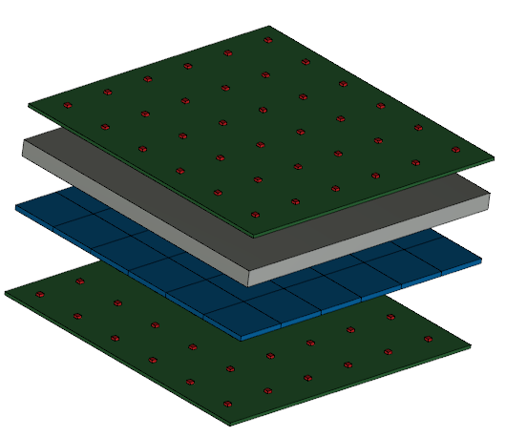
Background and setup
Geometry Setup
ECAL
30 layers
Absorber:2.8mm tungsten
SI:10×10×0.5mm³
PCB:2mm
AHCAL
40 layers
Absorber:20mm Fe
Scintillator:10×10×3mm³
PCB:2mm
Notes:
Fe λ=168mm X0=17.7mm Rm=16.8mm tungsten X0=3.5mm

Slide 5
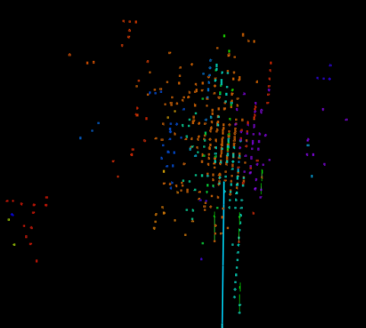
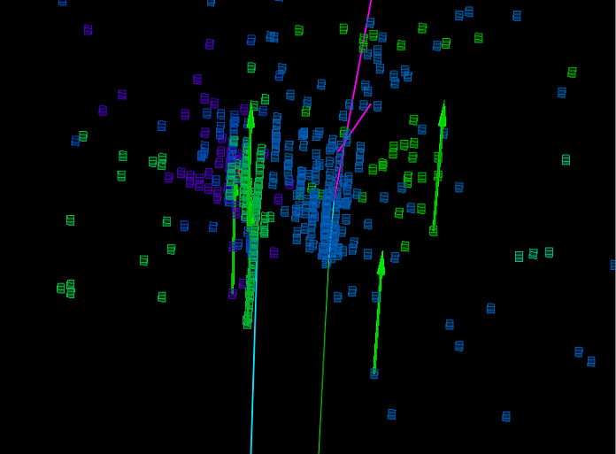
Background and setup
Incident particle
10 Gev pion-
10 GeV KLong: abundant in H-gg event
Feature of KLong
KLong usually doesn’t deposit significant energy in ECAL so that it doesn’t have a ‘stick’ in the front
KLong is fatter than pion
pion
KLong
Single KLong event
Overlay particle event

Slide 6
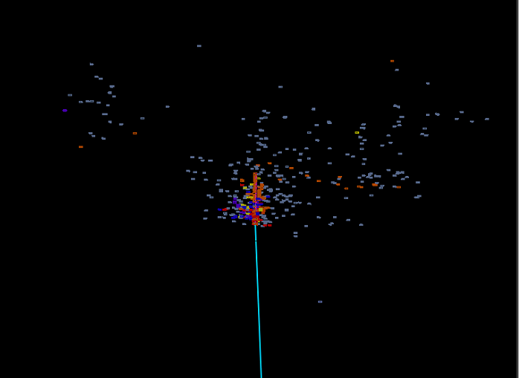
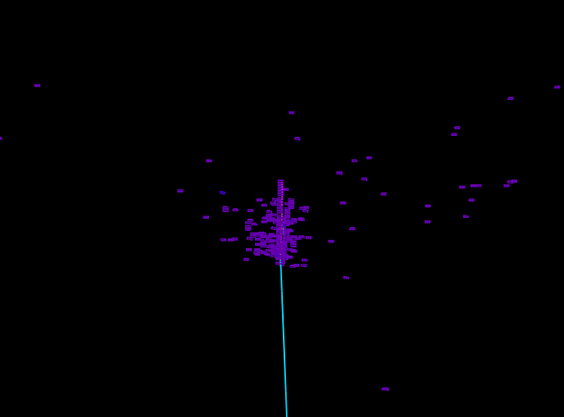
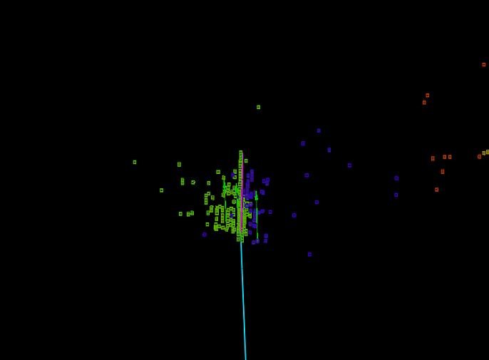
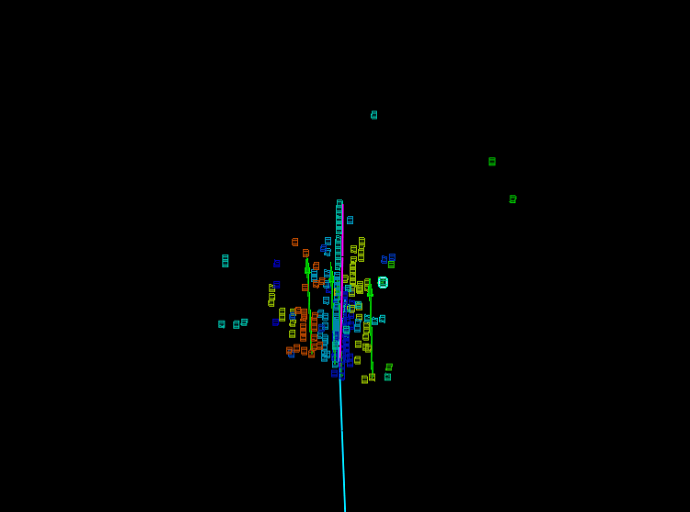
Marlin arbor and Cluster building
digitization
SimuCalorimeter Hit
Calorimeter Hit
arbor
Bush merge
ClusterAB1st
EHBushes

Slide 7
Marlin arbor and Cluster building
Digitization
Combine small cell into the size we want
arbor
6 parameter in total
EE connection(xy direction and z direction)
EH connection
HH connection(xy direction and z direction)
EE Seed connection

Slide 8
Marlin arbor and Cluster building
Bush merge
Merge small cluster into core and fragment
Cluster Seed:hit closest to origin point in cluster
Cluster COG:center of energy gravity
Joint:close hits from different cluster
Cluster depth:distance from cluster Seed to ECAL surface
Connection of EE,EH,HH clusters has different cut on cluster Seed difference,COG difference,number of joints,transSeed difference
Only deeper cluster can be merge into shallower cluster

Slide 9
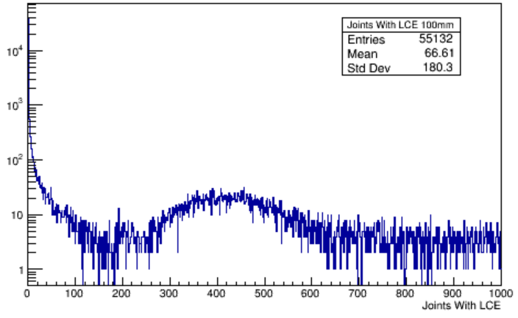
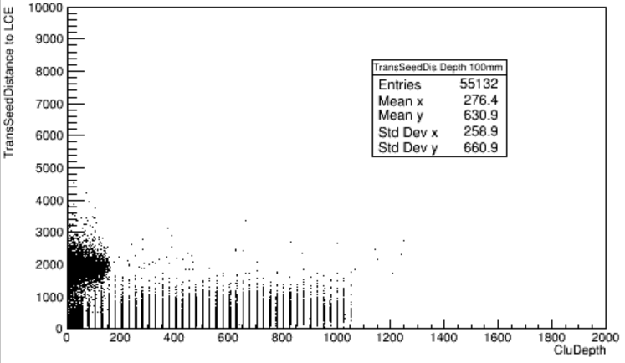
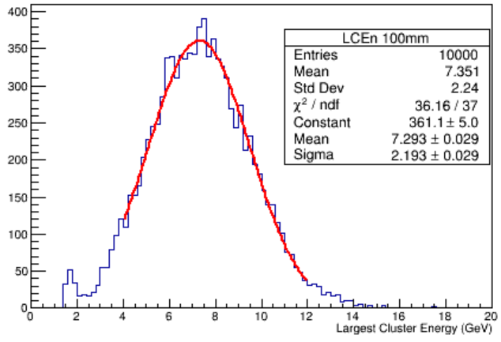
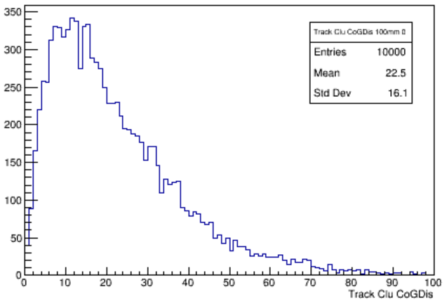
Marlin arbor and Cluster building
For single pion event in 10mm cellsize
transSeeddistance
Number of Joint
with largest energy cluster
Distance between
Cluster COG and
track
Largest cluster
energy

Slide 10
Pion and KLong separation
Real situation
Charged particle: track can provide energy and direction
Uncharged particle: even don’t know the number of them
Strategy for pion, K in MC
Assume that the incident direction is the track in Simplified geometry
Pion, K candidate selection
Pion candidate: cluster closet to track and energy >mean - 3σ
K candidate: cluster doesn’t match pion track with largest cluster energy
Efficiency for pion, K
Pion:| energy pion_{candidate} – mean_{pion}| <3σ && distance(COG) to track<80mm
K::|energy K_{candidate} – mean_{K}| <3σ && distance to track<80mm
Apply selection and calculate efficiency for both single particle and di particle event

Slide 11
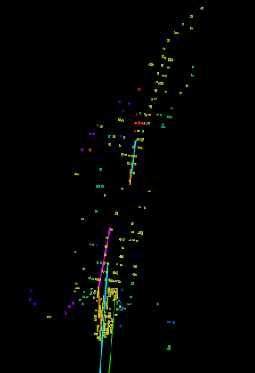
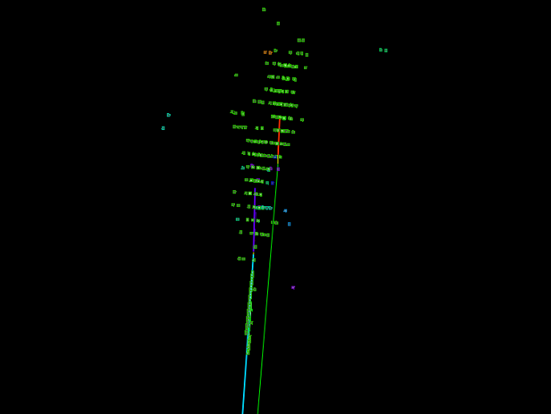
Pion and KLong separation
Fail events
Head and tail
confusion
confusion
Head and tail

Slide 12
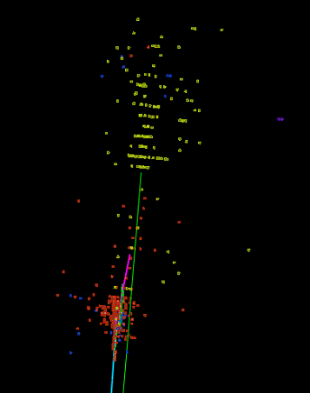
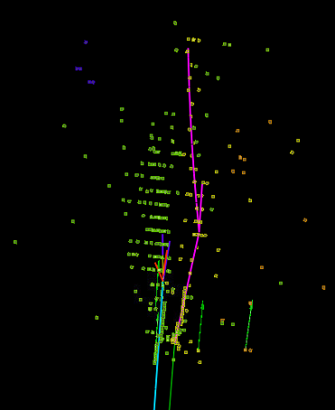
Pion and KLong separation
Successful event
Pion K distance 30mm
KLong 13.2GeV
Pion 8.3GeV
Pion 12.8GeV
KLong 5.3GeV

Slide 13
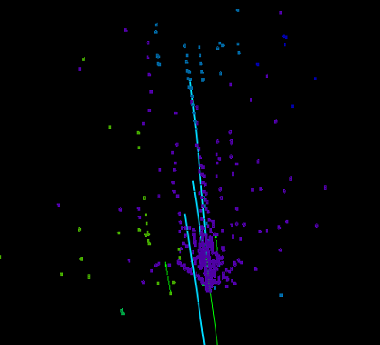
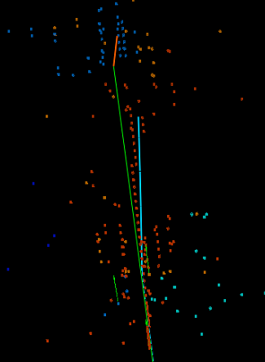
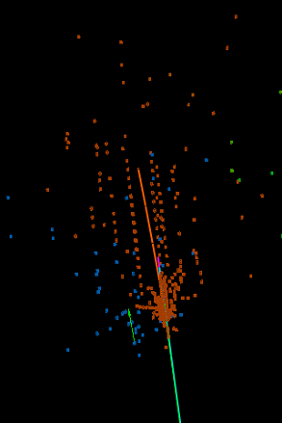
Pion and KLong separation
70mm cellsize
Incident position
pion:0mm
Klong:0mm
fail
KLong 8.4GeV
fail
Pion 7.8GeV

Slide 14
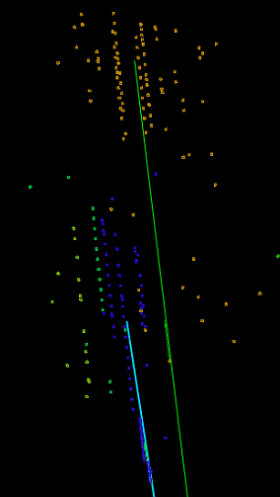
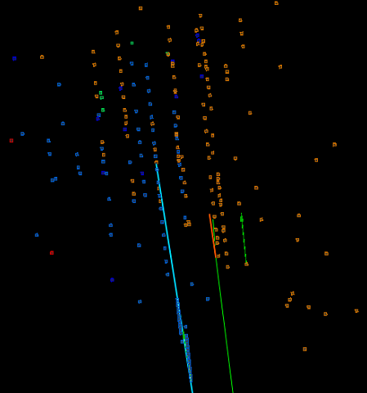
Pion and KLong separation
70mm cellsize
Incident position
pion:75mm
Klong:0mm
Klong 11.8GeV
Klong 14.4GeV
Pion 11.7GeV
Pion 9.9GeV

Slide 15
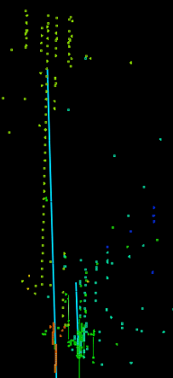
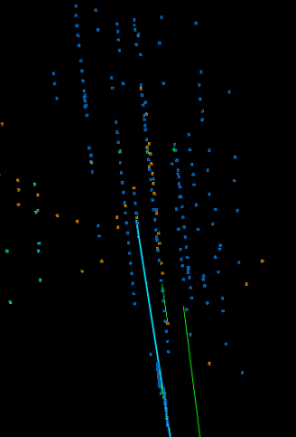
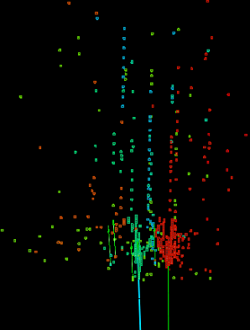
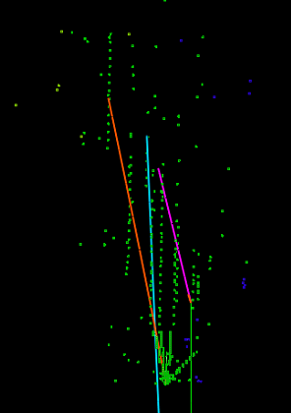
Pion and KLong separation
fail
Pion 11.3GeV
Klong 5.1GeV
fail
Pion 4.5GeV
Klong 11.2GeV

Slide 16
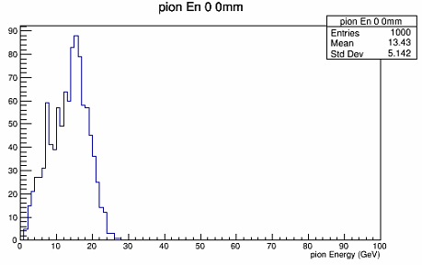
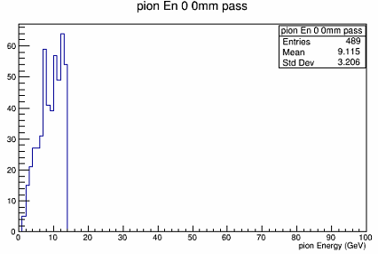
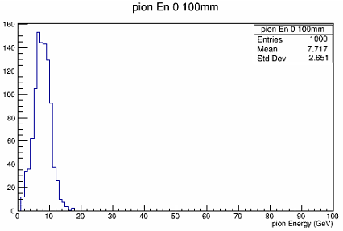
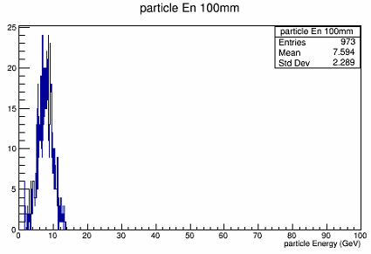
Pion and KLong separation
Pion energy distribution
Pion candidate energy
K(0mm)-pion(0mm)
Real pion energy
K(0mm)-pion(0mm)
Pion candidate energy
K(0mm)-pion(100mm)
Real pion energy
Single pion event

Slide 17
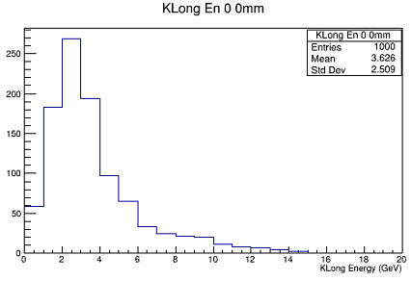
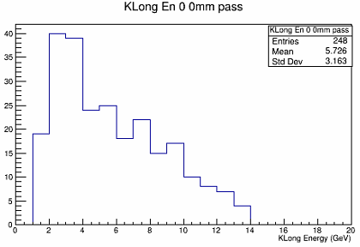
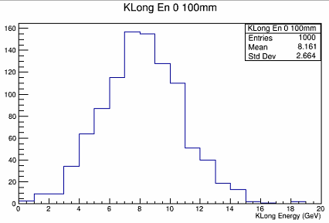
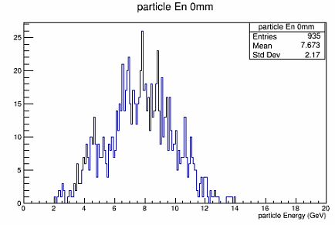
Pion and KLong separation
KLong energy distribution
Real KLong energy
K(0mm)-pion(0mm)
KLong candidate energy
K(0mm)-pion(0mm)
Real KLong energy
Single Klong event
KLong candidate energy
K(0mm)-pion(100mm)

Slide 18
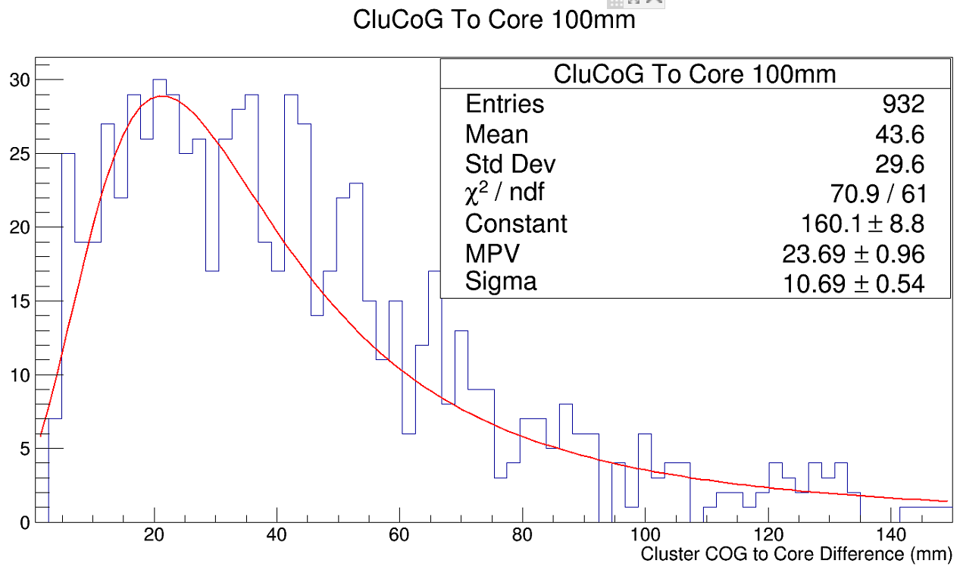
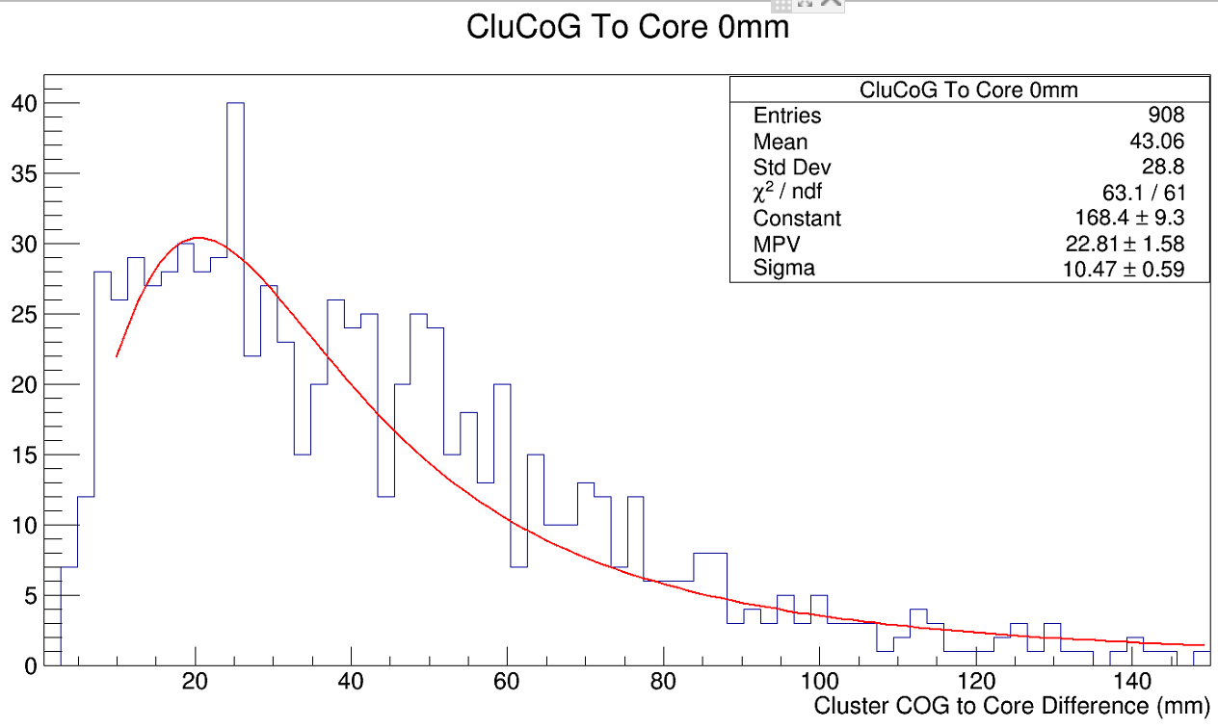
Pion and KLong separation
The cluster chose as particle is called as ‘core’
Distance between Cluster COG and Core
Distance is calculated with energy weight and threshold 0.5GeV for a single event
Reflect the size of core to some extent
Pion single event
MPV:23.69mm
KLong single event
MPV:22.81mm

Slide 19
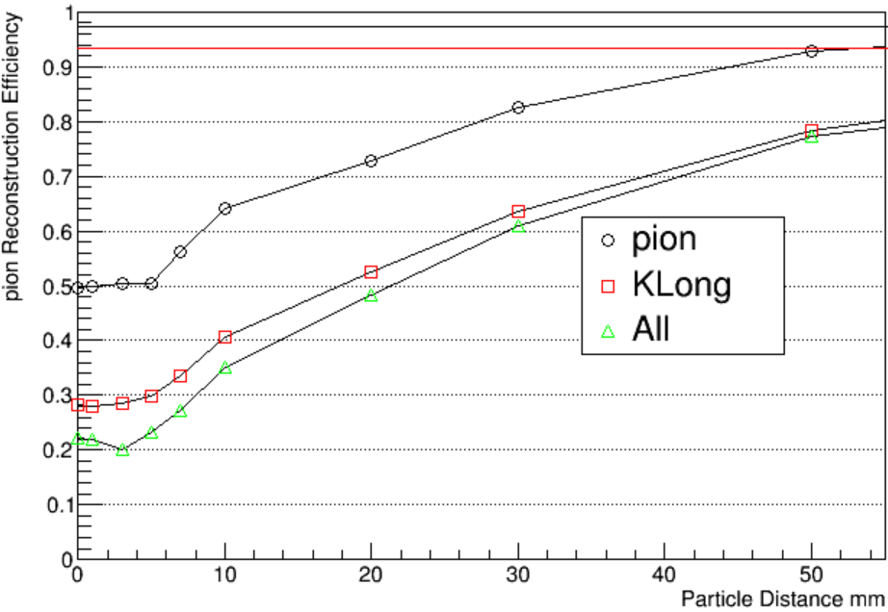
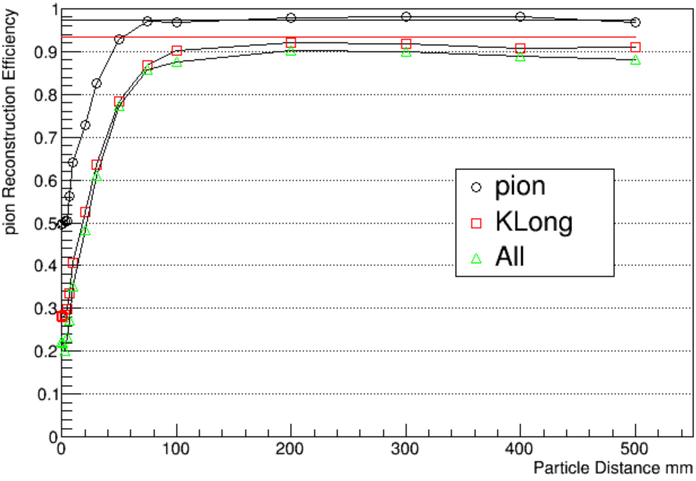
Pion and KLong separation
Straight Line is efficiency of single particle
Marker is efficiency of di particle event
particle distance is the distance of 2 particle on ECAL surface
10mm cellsize

Slide 20
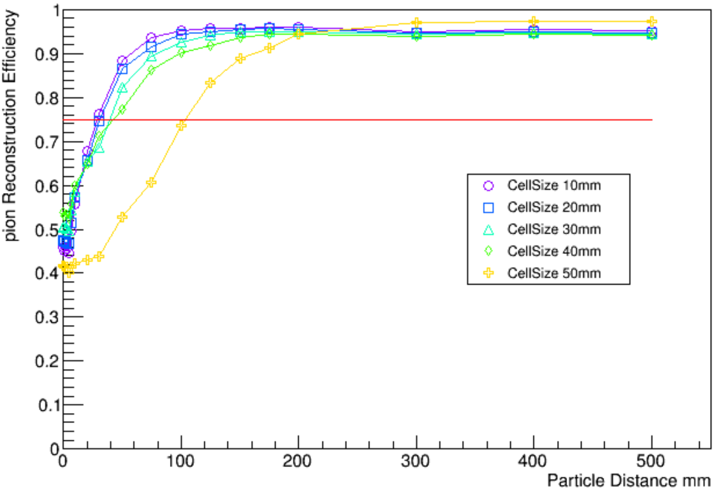
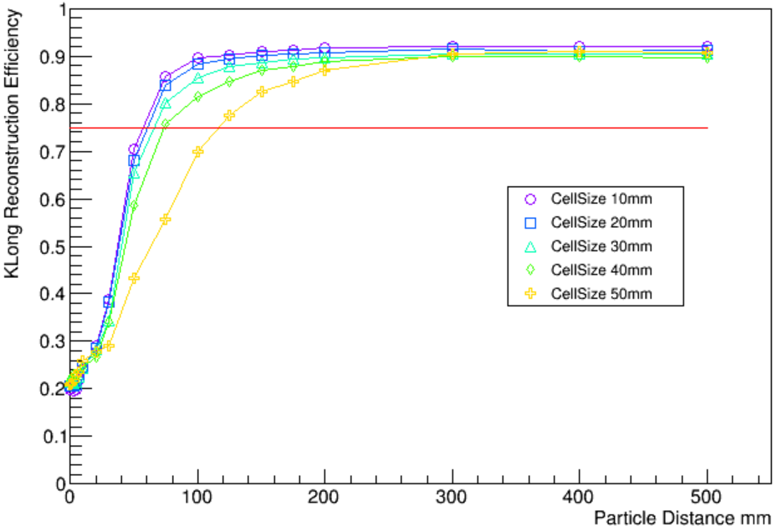
Pion and KLong separation
Different cellsize
Keep the energy mean of single particle similar, apply different energy mean for different cellsize
Energy sigma stays unchanged as 10mm cellsize situation
Pion reconstruction efficiency
KLong reconstruction efficiency

Slide 21
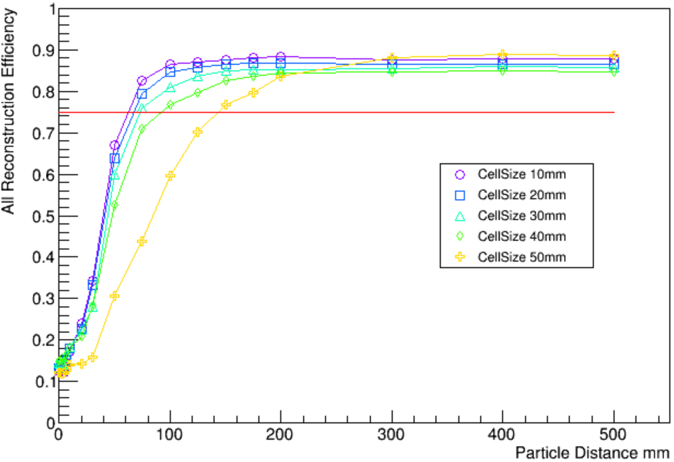
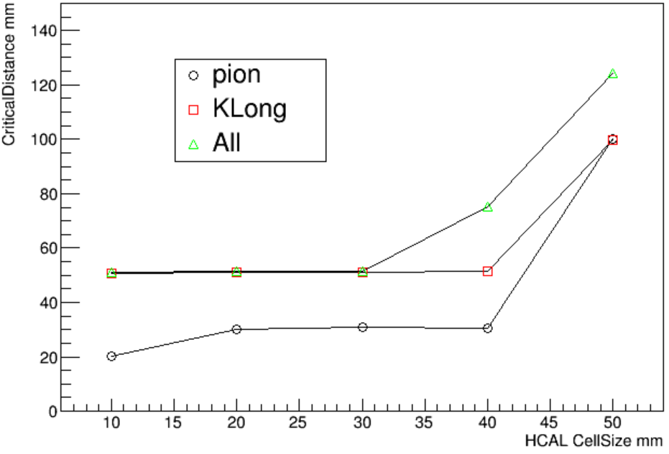
Pion and KLong separation
Critical Distance
The distance which has 80% efficiency is define as critical distance
Since core size is about 23mm,such result seems reasonable
Pion and K reconstruction efficiency
Critical distance – HCAL cellsize

Slide 22
Simple PFA method
Simple PFA method
PFA:E = pion track + KLong
Real situation:E = pion track + part of pion fragment + KLong
pion
fragment
KLong
Pion core
Pion fragment
KLong fragment
KLong core

Slide 23
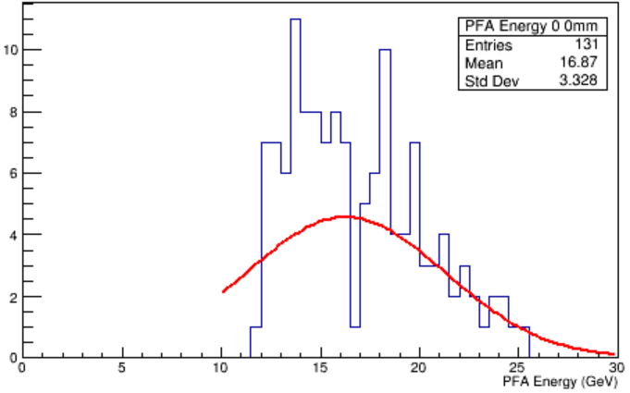
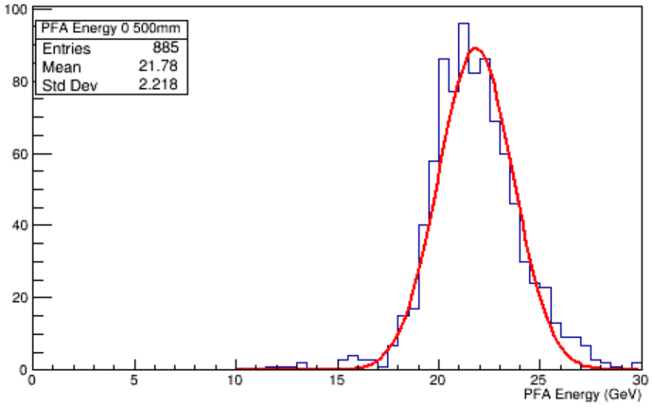
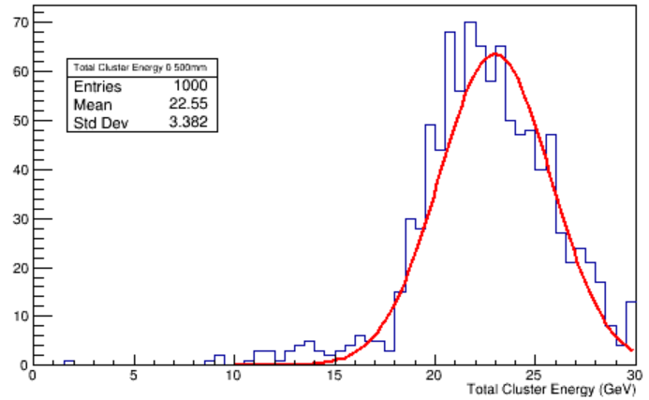
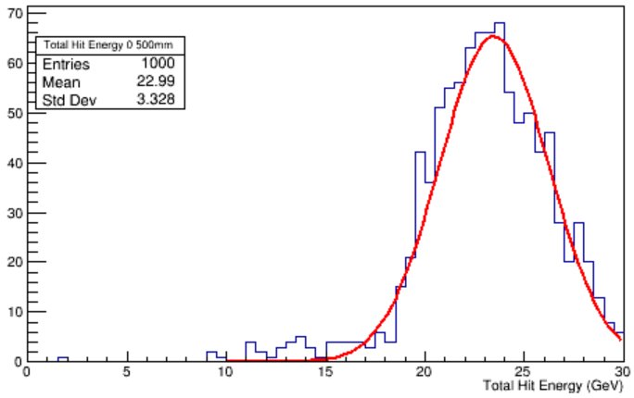
Simple PFA method
PFA energy
K(0mm)-pi(0mm)
PFA energy
K(0mm)-pi(500mm)
Total Cluster energy
Total Hit energy

Slide 24
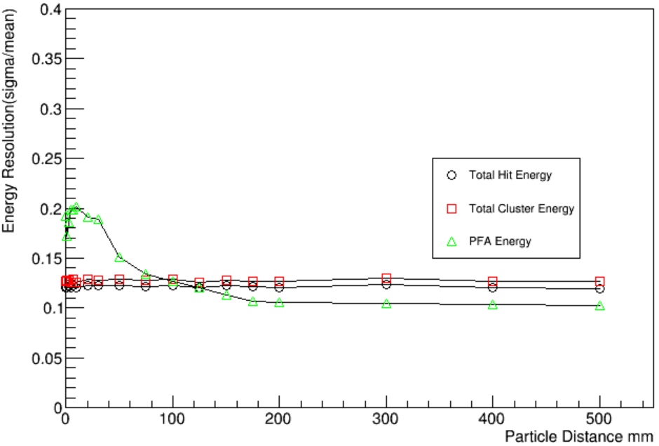
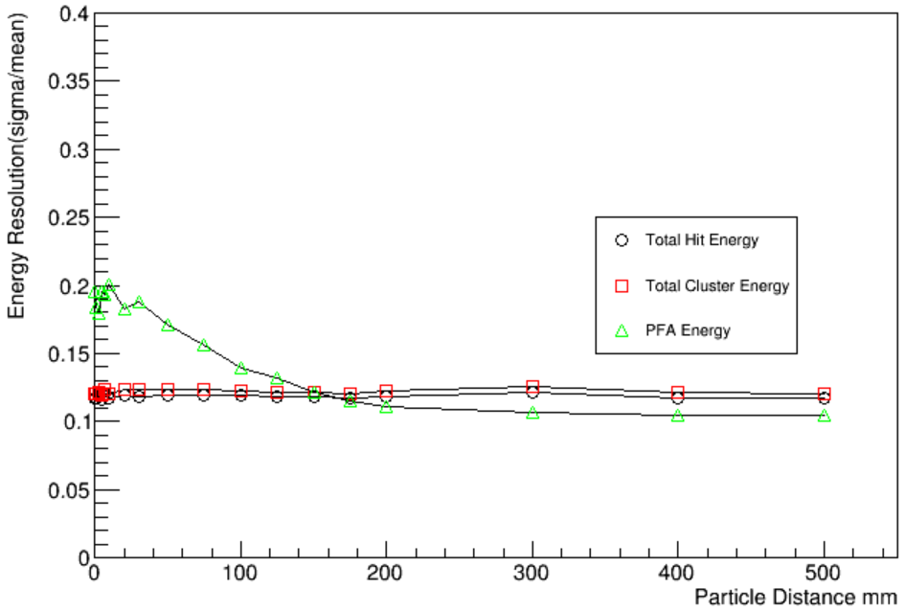
Simple PFA method
Energy resolution
Total Hit energy resolution
Total cluster energy resolution
PFA method:pion fragment has ~25% of total pion energy which makes a big trouble
10mm cellsize
50mm cellsize
Critical distance

Slide 25
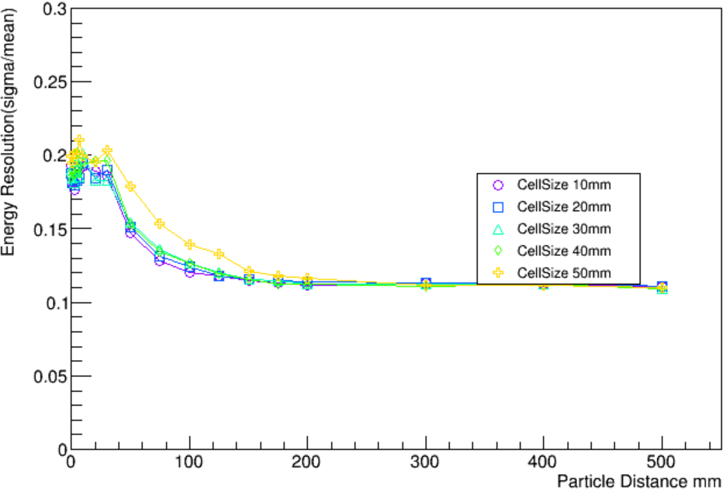
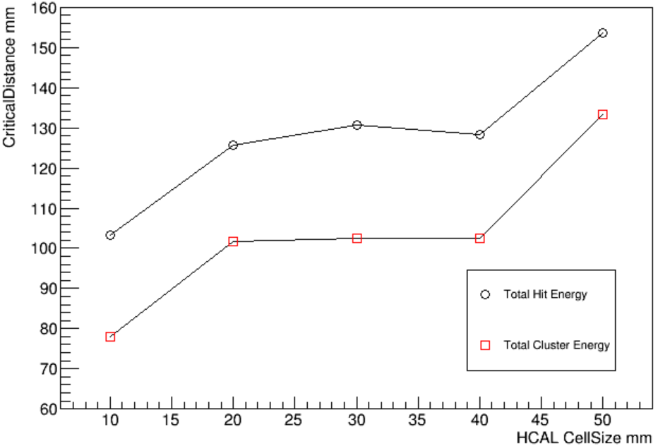
Simple PFA method
CellSize doesn’t have significant influence on energy resolution
30mm seems to be a good choice

Slide 26
Cellsize optimization
Conclusion
30mm cellsize seems reasonable but the difference between 2 kinds of critical distance should be figure out
Plan
Find the reason why 2 kinds of critical distance behave unlikely
Full PFA with AHCAL on baseline(jet energy resolution, particle separation)

Slide 27
backup

Slide 28
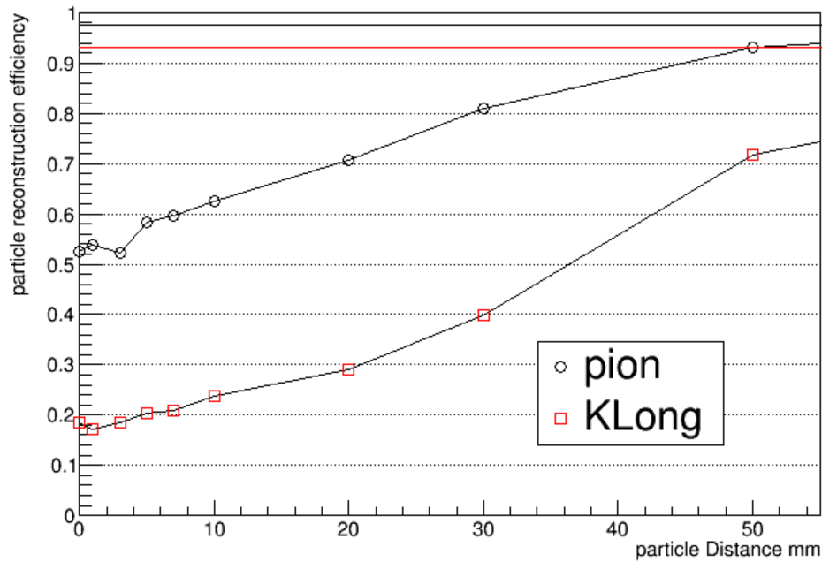
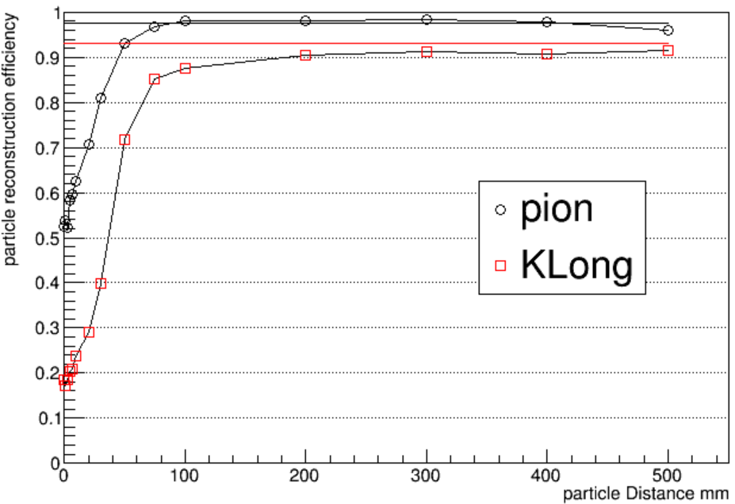
Cellsize optimization
Other cell size
Adjust single particle event energy mean similar to 10mm cellsize
20mm cellsize

Slide 29
Cellsize optimization
30mm cellsize
40mm cellsize

Slide 30
Cellsize optimization
50mm cellsize
70mm cellsize

Slide 32
70%
80%

