Slide 1
Cosmic ray reconstruct
王宏鹏
618
2019 -1-17

Slide 2
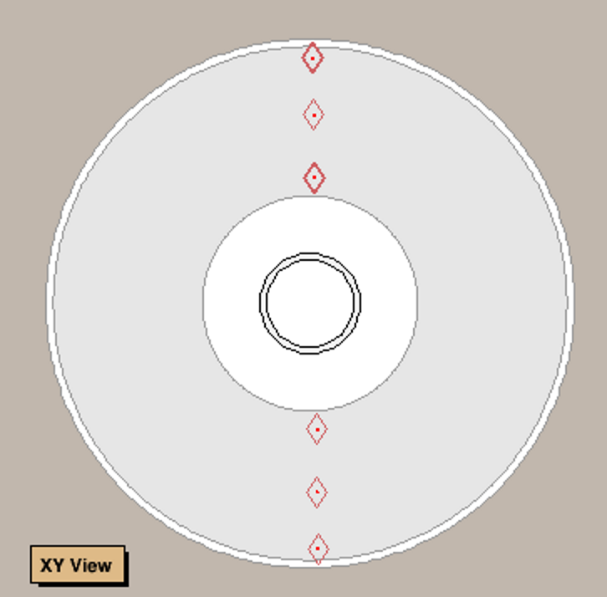
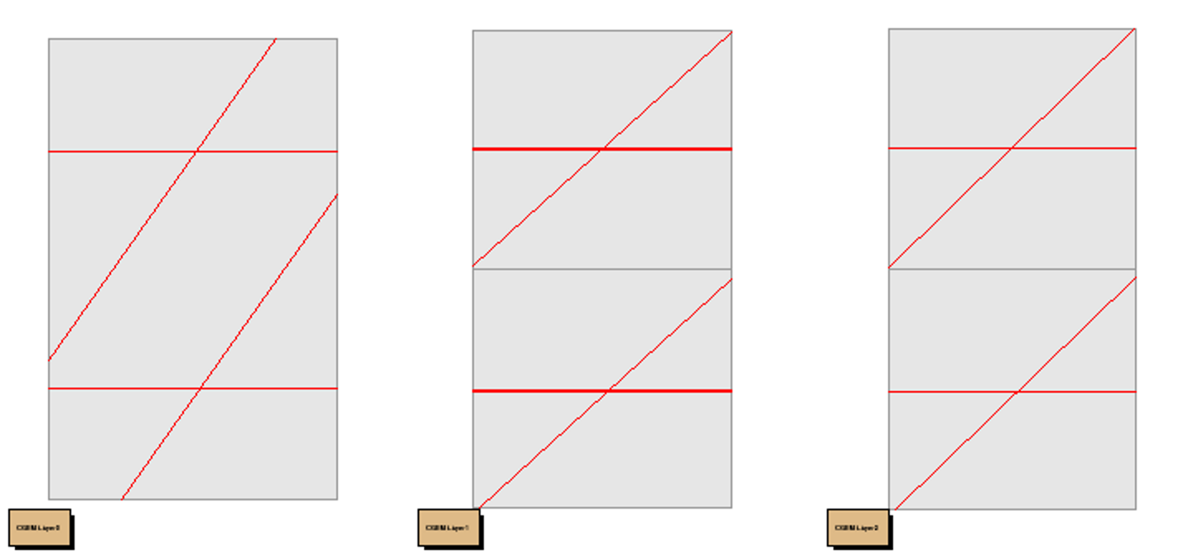
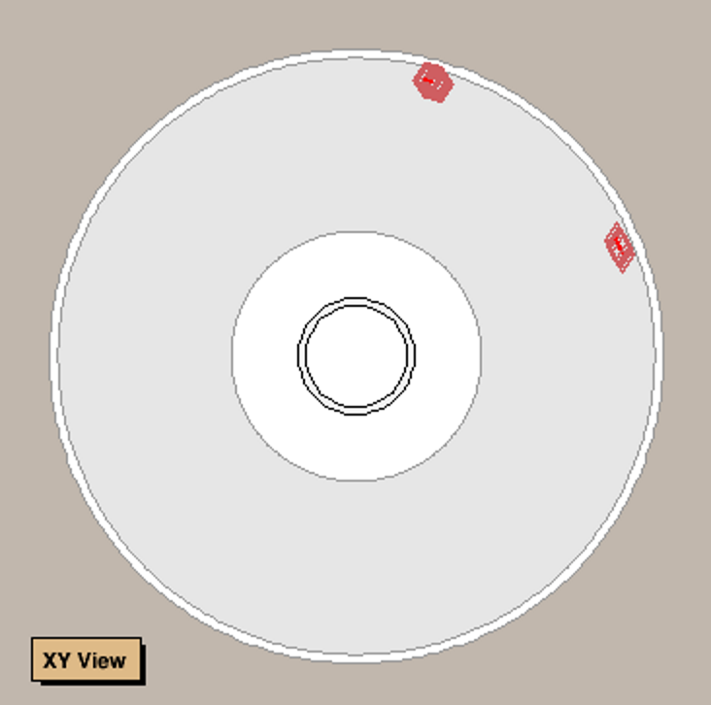
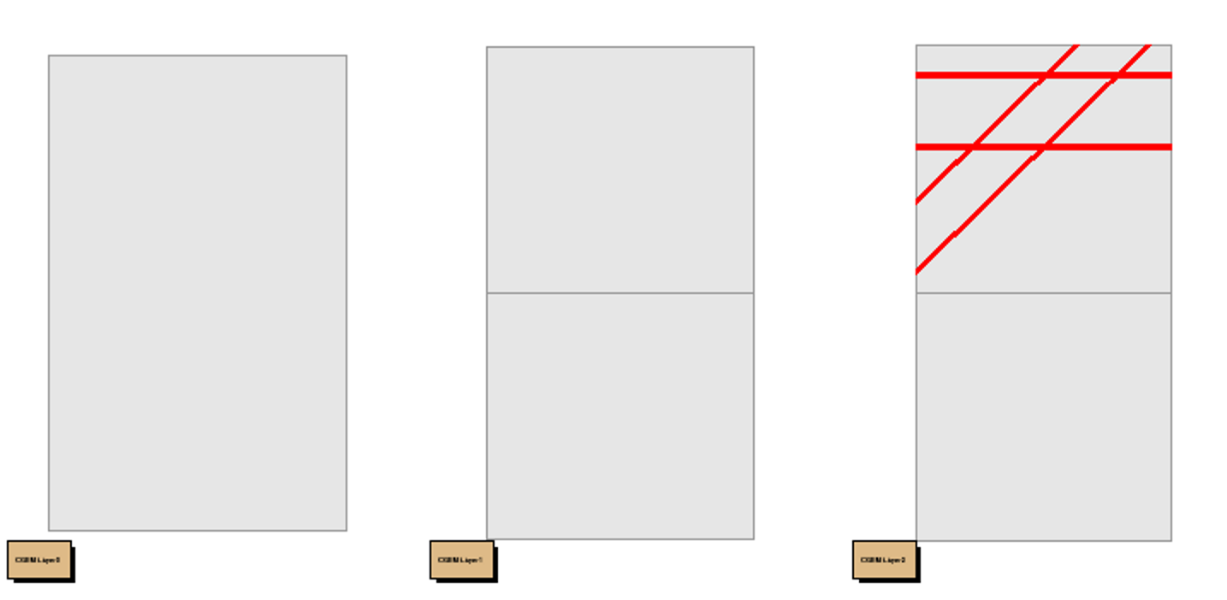
Simulation
X-Y plane
Inner middle outer
200000 samples
Single $μ^{+}$ from (0,20cm,0)
Angles cover outer barrel

Slide 3
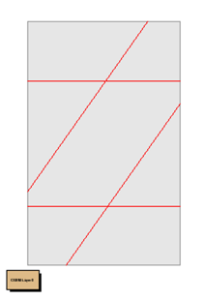
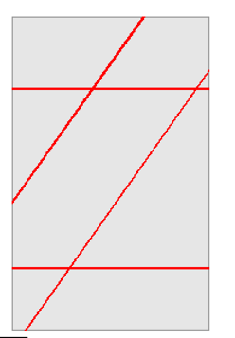
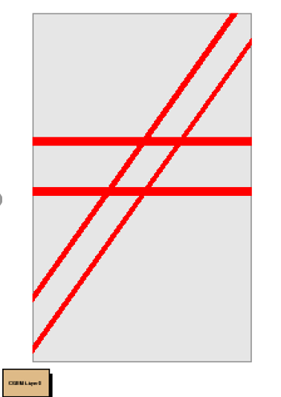
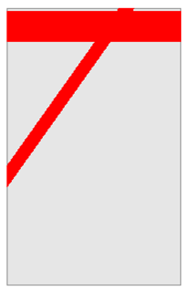
Cluster
RecCgemCluser
X cluster
…..
V cluster
….
Z cluster
…..
2+2+2=6 clsuters
2+2+3=7 clsuters
2+2+4=8 clsuters
1+1+1=3 clsuters

Slide 4
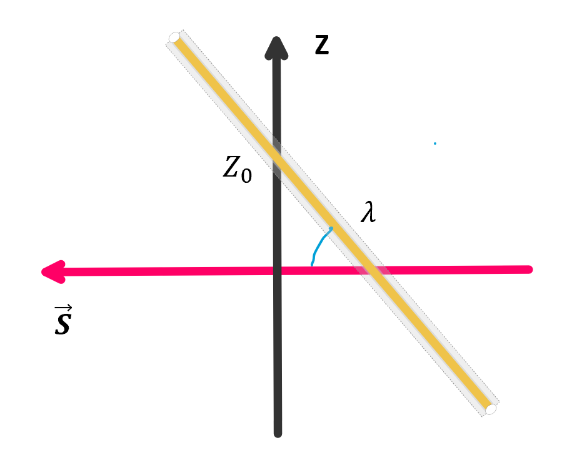
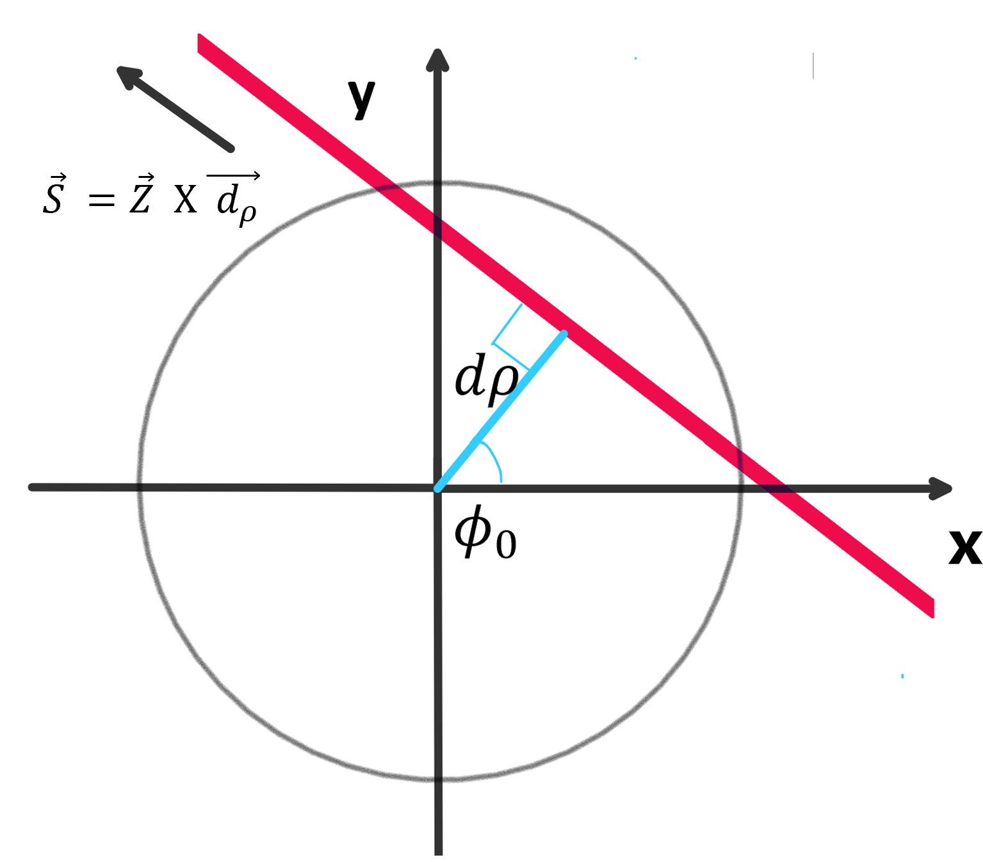
Parameter $d_{ρ} φ_{0} Z_{0} tgλ$

Slide 5
Parameter $d_{ρ} φ_{0} Z_{0} tgλ$
$$d_{ρ}>0$$
$φ_{0}:(0,2π)$

Slide 6
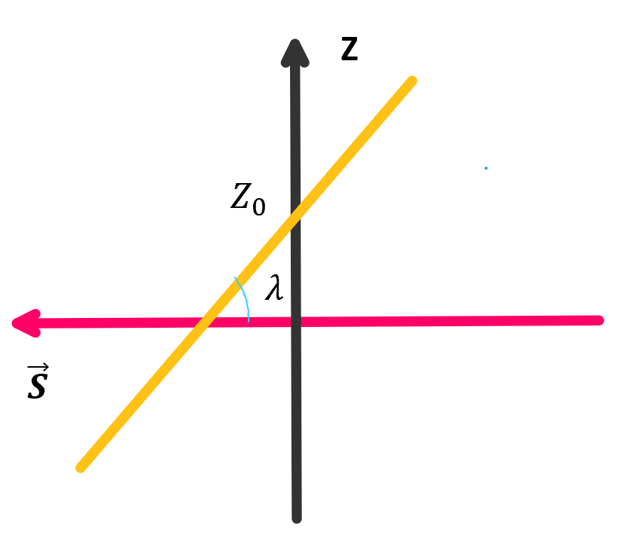
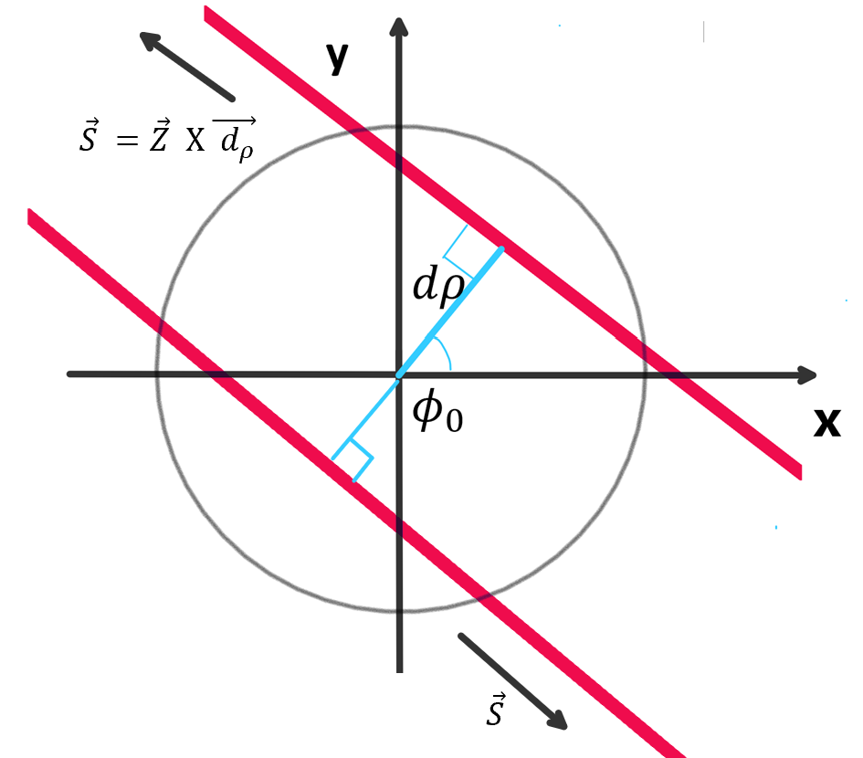
When $d_{ρ}→0$
$$l(d_{ρ},φ_{0},Z_{0},tgλ)$$
$$l′(d_{ρ}′,φ_{0}+π,Z_{0},−tgλ)$$

Slide 7
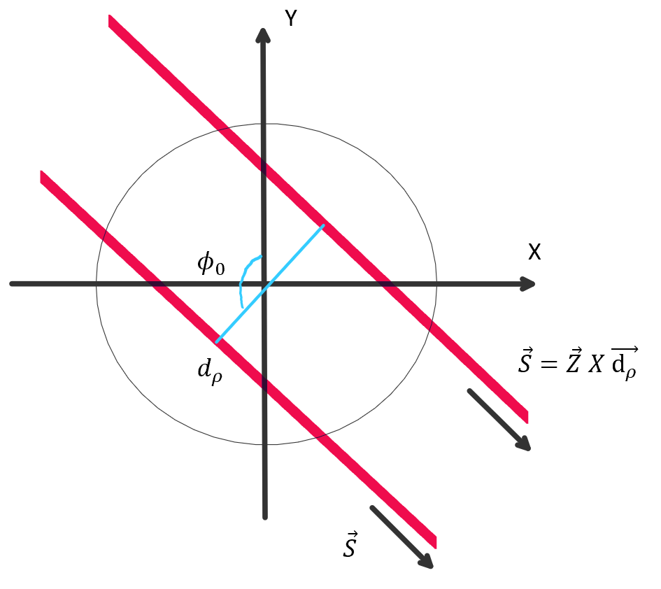
$d_{ρ}>0$
$φ_{0}:\left(0,2π\right)$
Polar axis: $\vec{X}$
$d_{ρ} : ±$
$φ_{0}:(0,π)$
Polar axis : $\vec{Y}$
$$l(d_{ρ},φ_{0},Z_{0},tgλ)$$
$l′(d_{ρ}′,φ_{0}+π,Z_{0},−tgλ)$
$$l(d_{ρ},φ_{0},Z_{0},tgλ)$$
$$l′(−d_{ρ}′,φ_{0},Z_{0},tgλ)$$

Slide 8
FCN
$χ_{1}^{2}={\left(\frac{φ−φ^{′}}{\frac{σ}{R_{n}}}\right)}^{2}$ $χ_{2}^{2}={\left(\frac{V−V′}{σ}\right)}^{2}$
$φ=φ\left(d_{ρ},φ_{0}\right) V=V(d_{ρ},φ_{0},Z_{0},tgλ)$
$σ=130 um$ deviation of cluster
$R_{n}:radius of layer$

Slide 9
Z CLUSTER = 2
34500 EVENTS

Slide 10
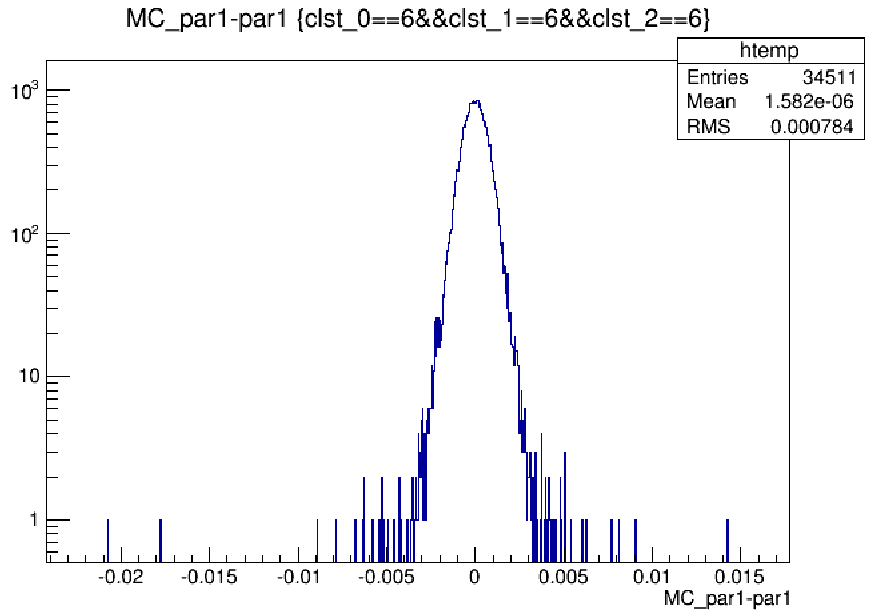
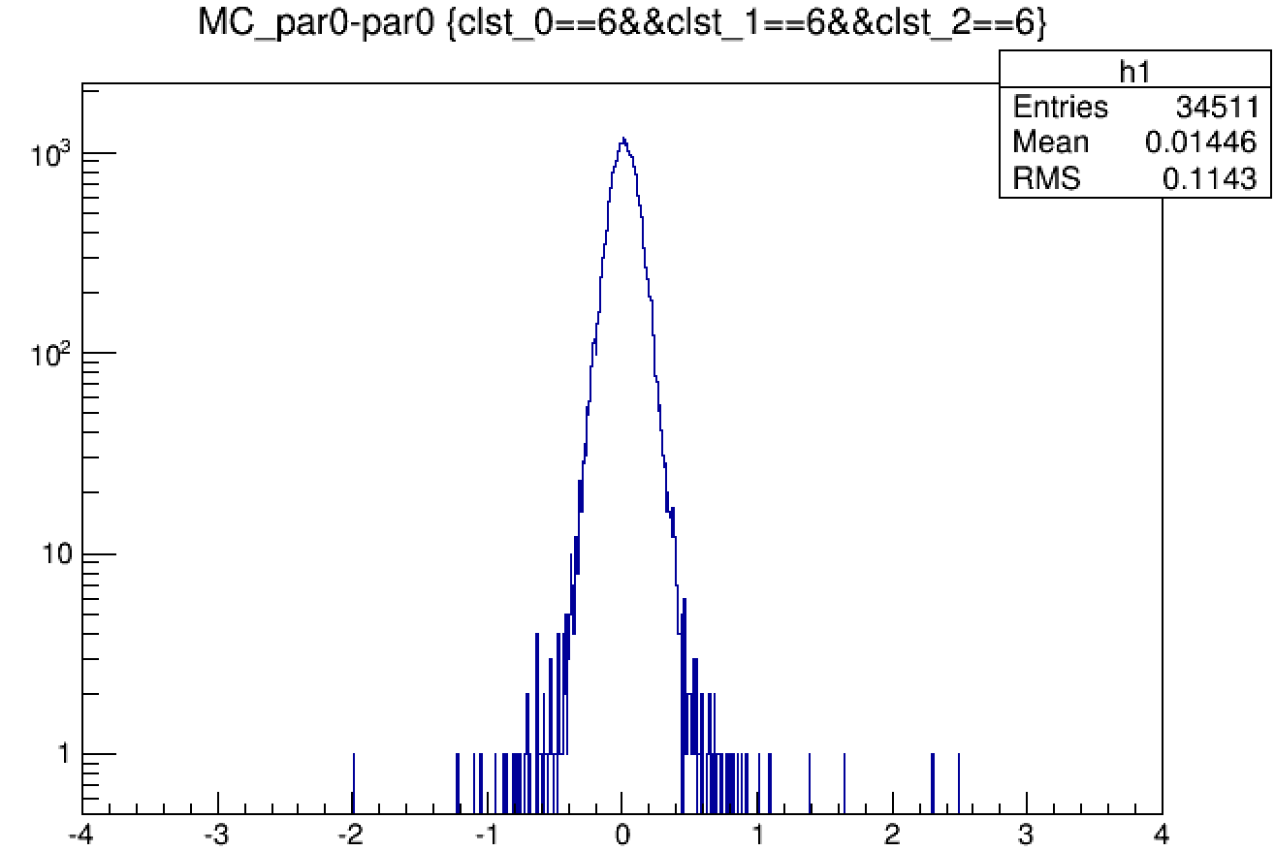
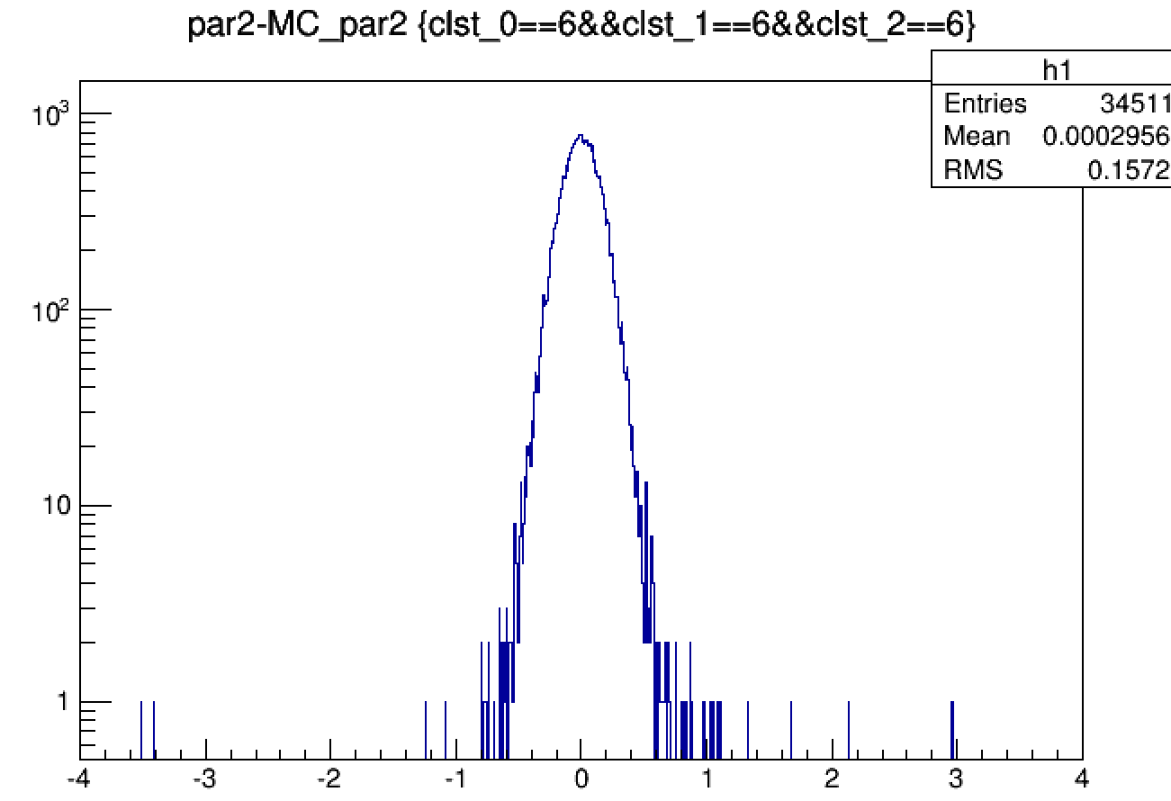
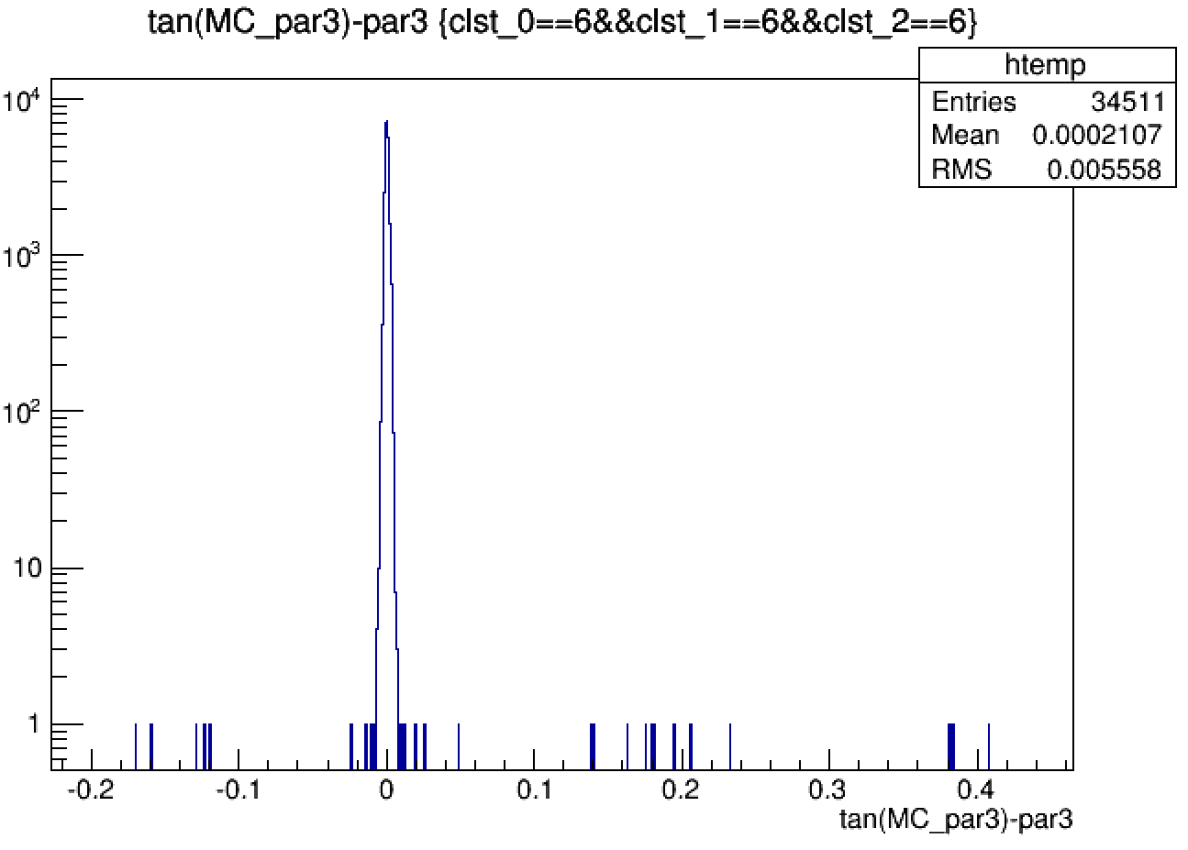
$$d_{ρ}:mm$$
$${ φ}_{0}:rad$$
$Z_{0}:mm$
$$tgλ$$

Slide 11
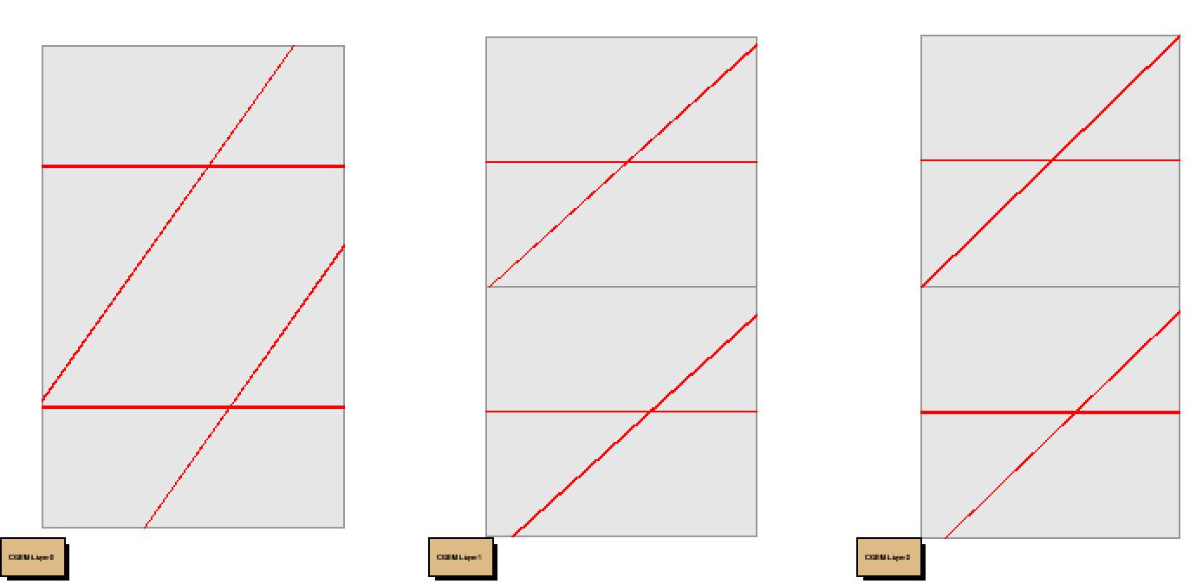
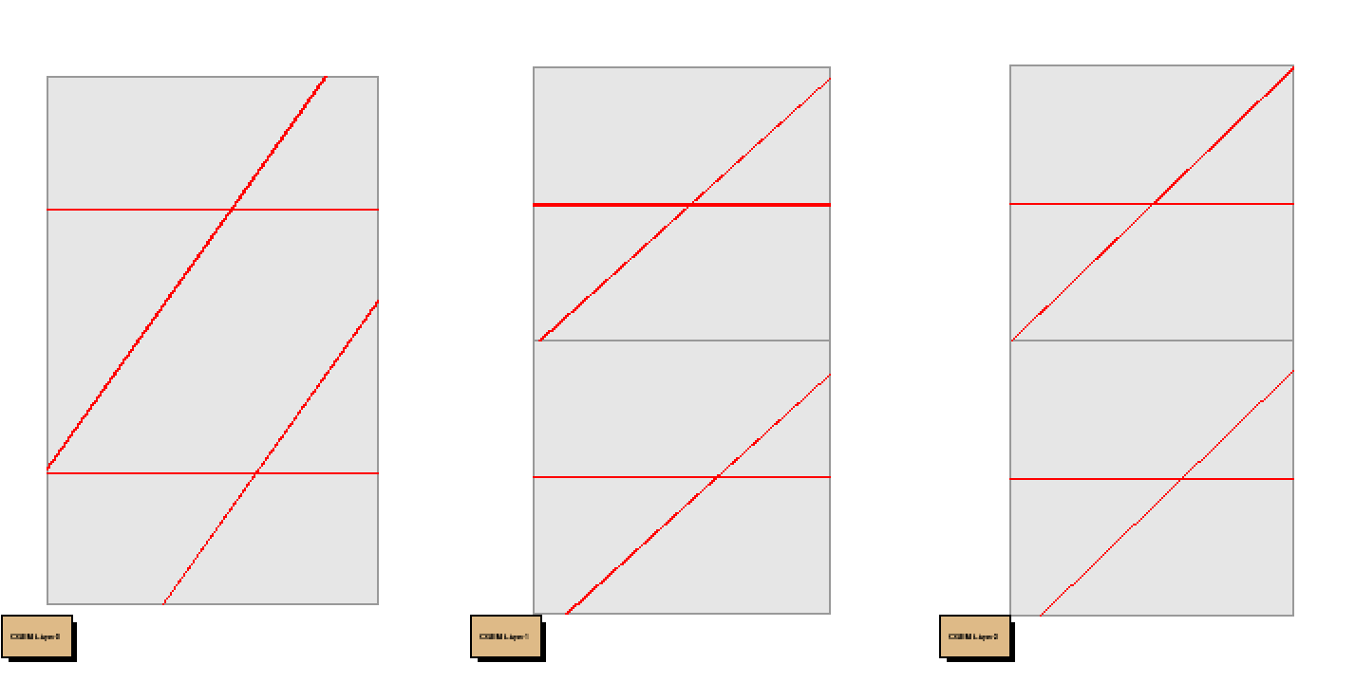
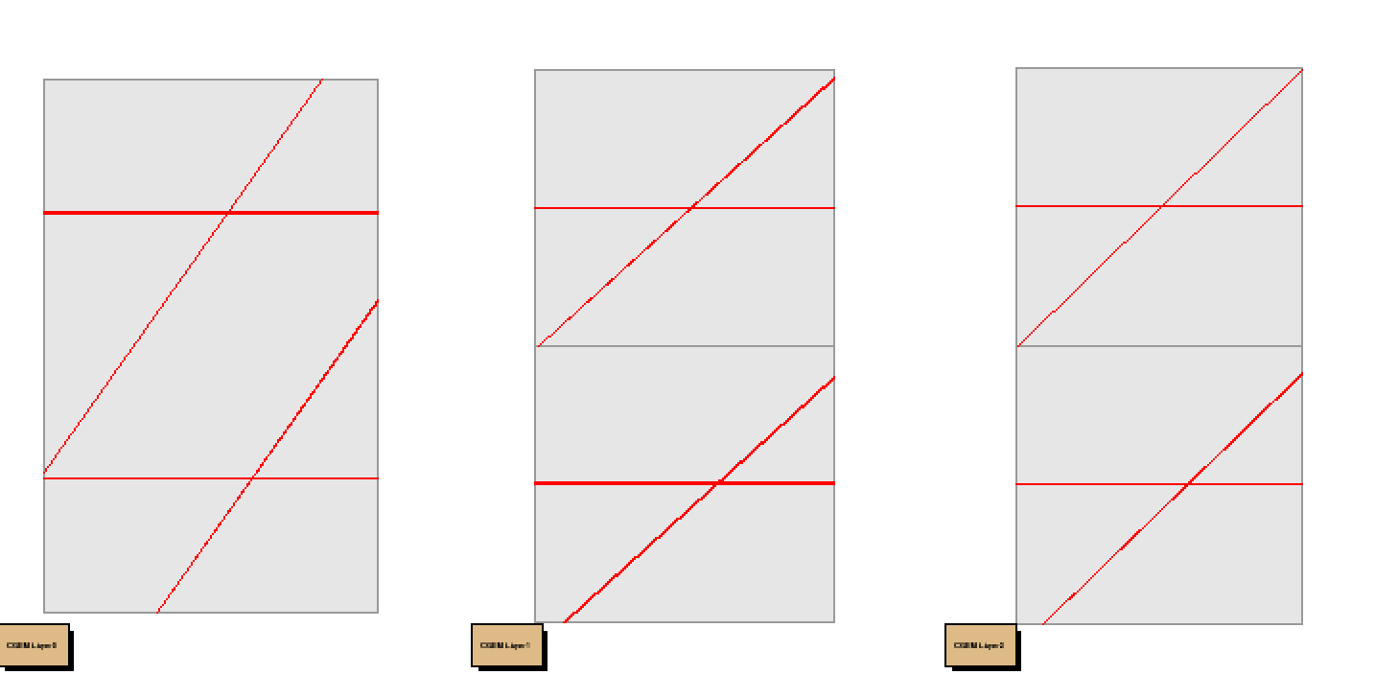
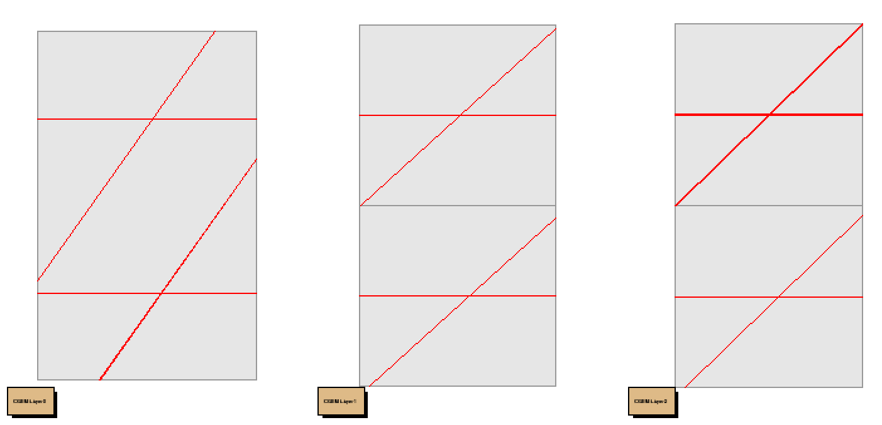

Slide 12
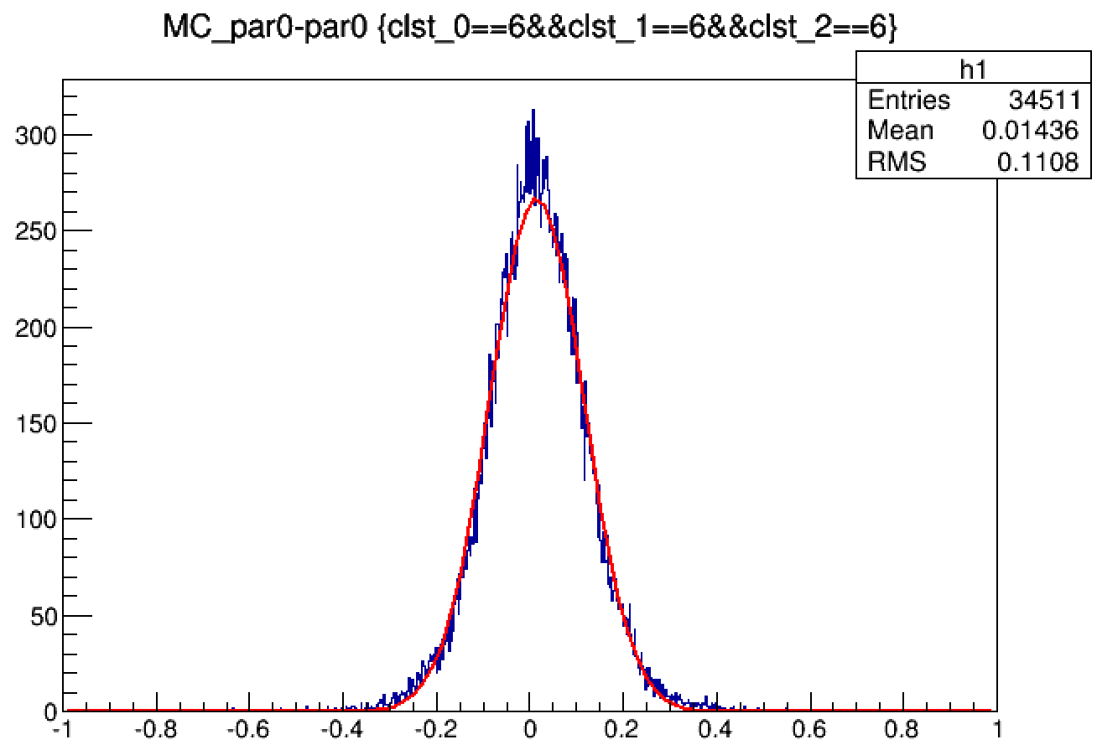
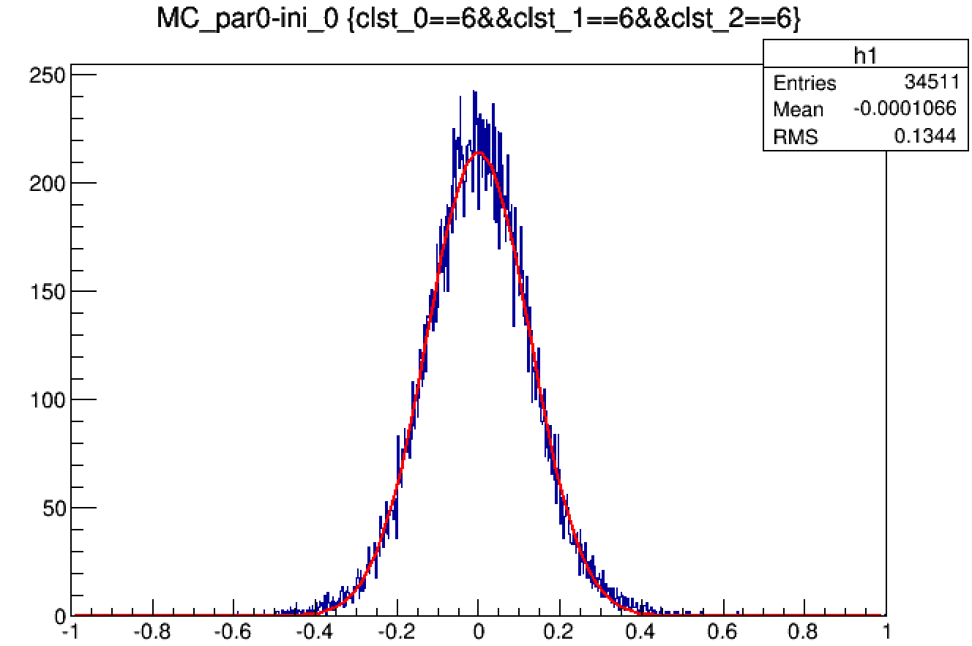
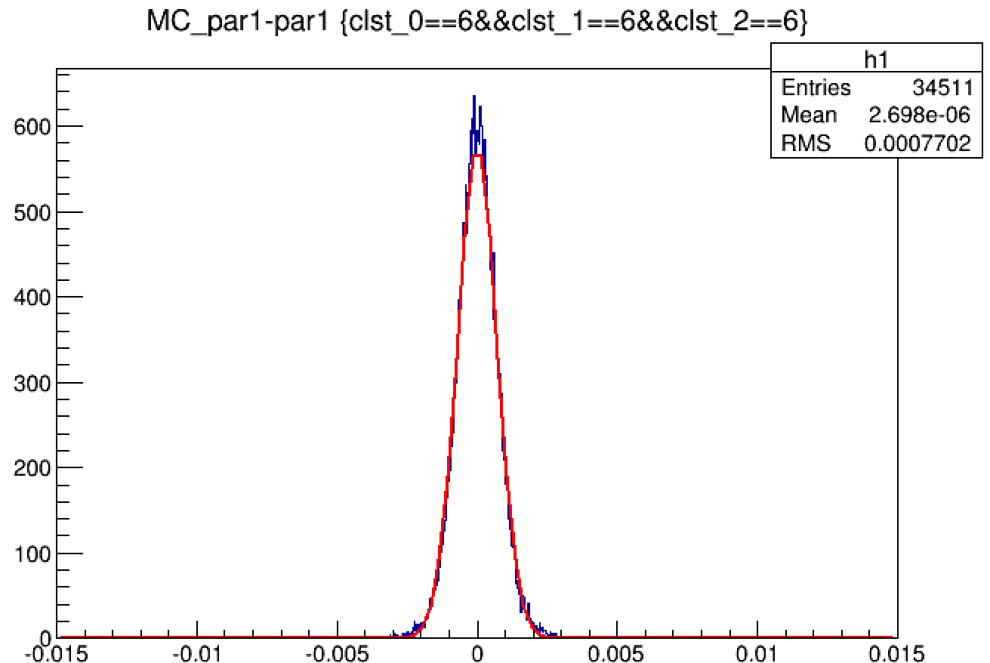
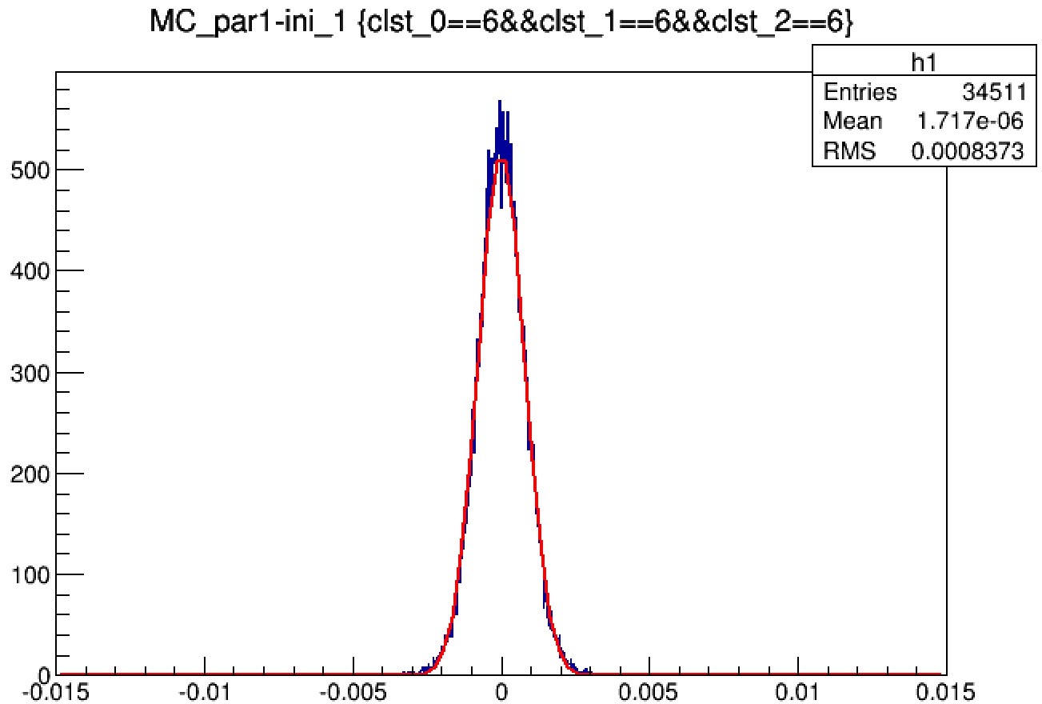
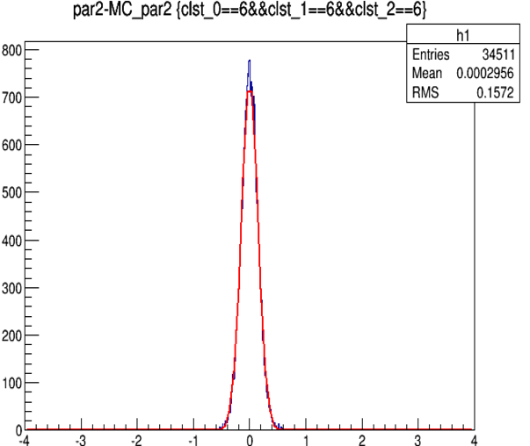
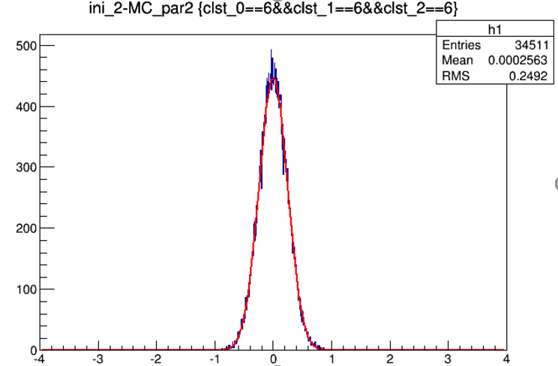
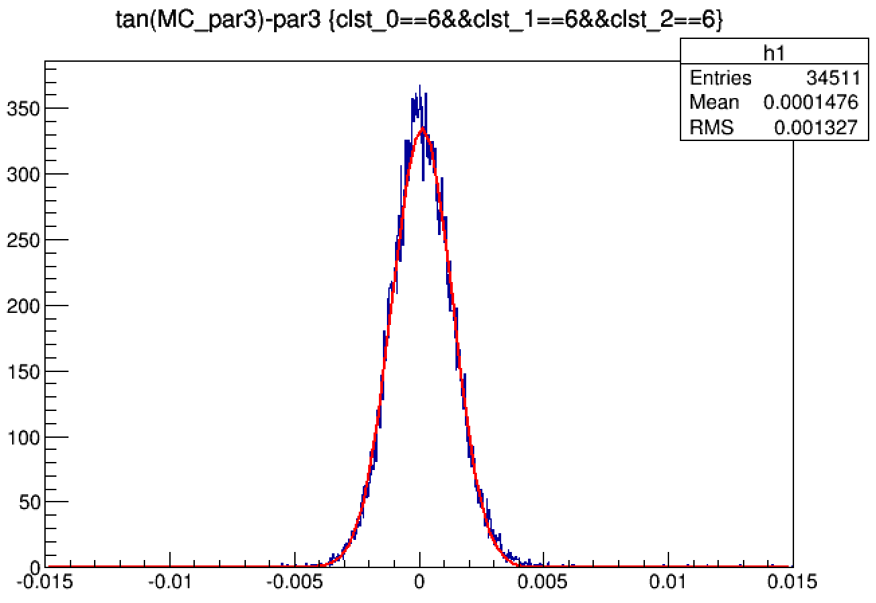
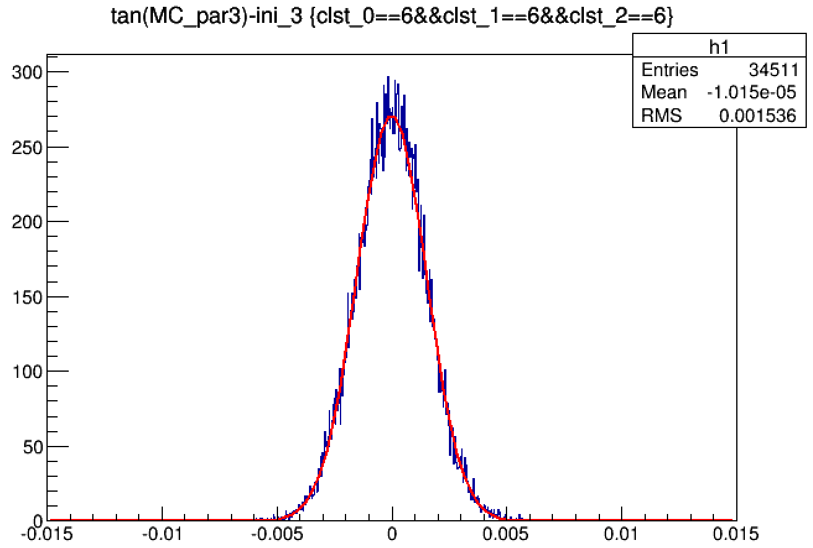
fit vers initial
$σ_{fit}/ σ_{ini}$=0.61
$$d_{ρ}:mm$$
$σ_{fit}/ σ_{ini}$=0.801
$$φ_{0}:rad$$
$σ_{fit}/ σ_{ini}$=0.893
$Z_{0}:mm$
$σ_{fit}/ σ_{ini}$=0.616
$$tgλ$$
$σ_{fit}/ σ_{ini}$=0.804

Slide 13
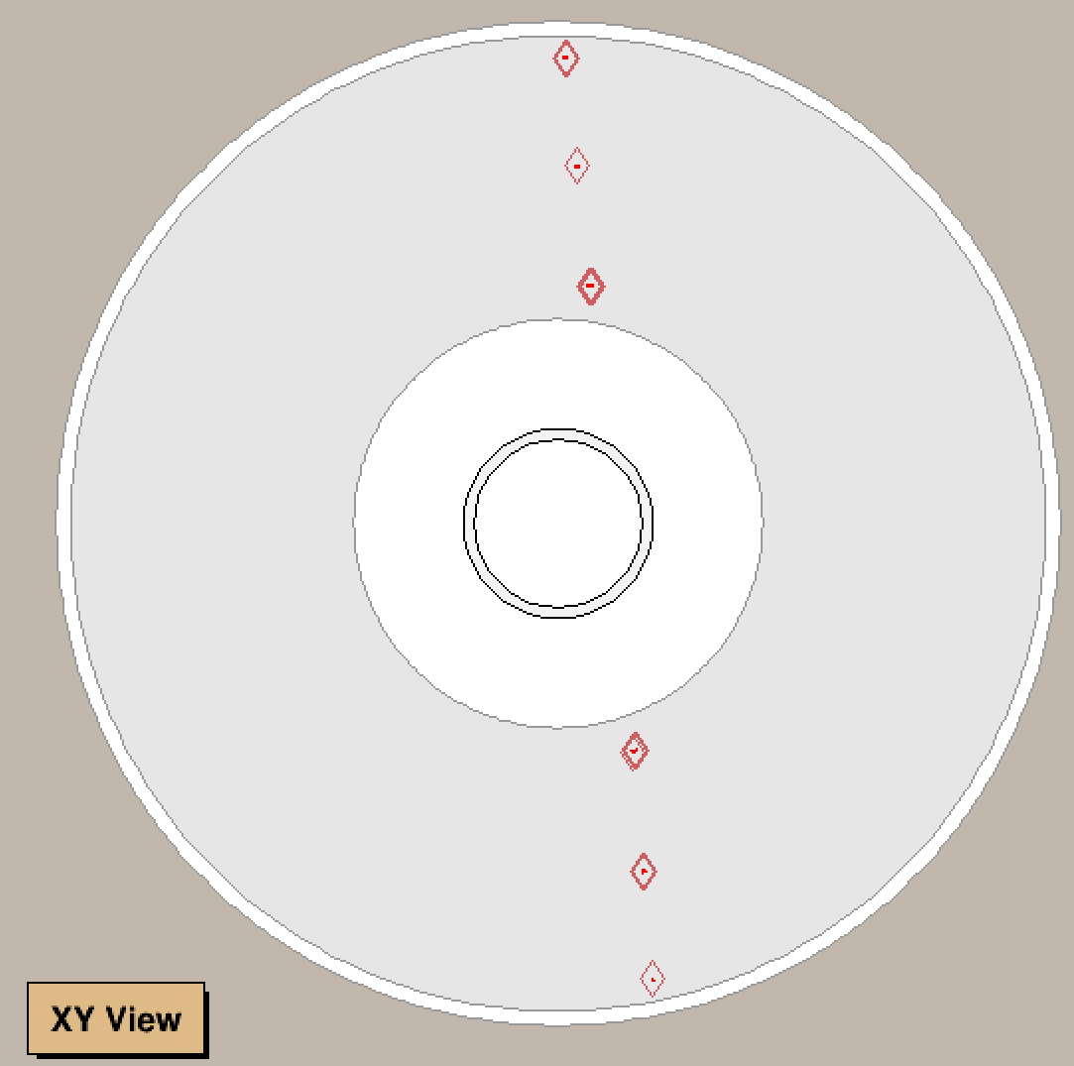
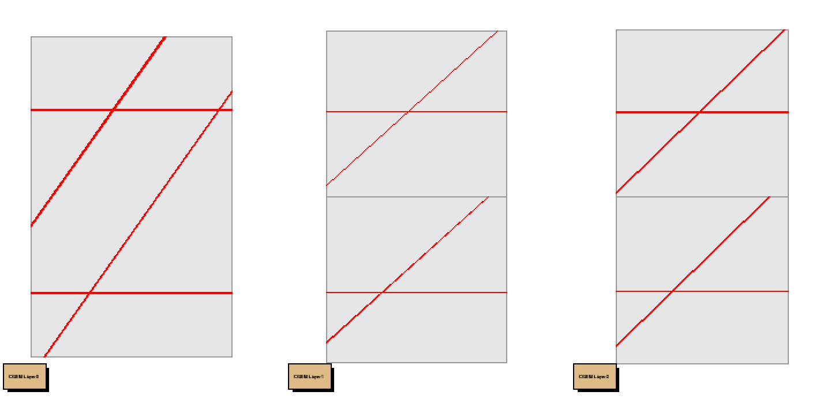
Z cluster =3

Slide 14
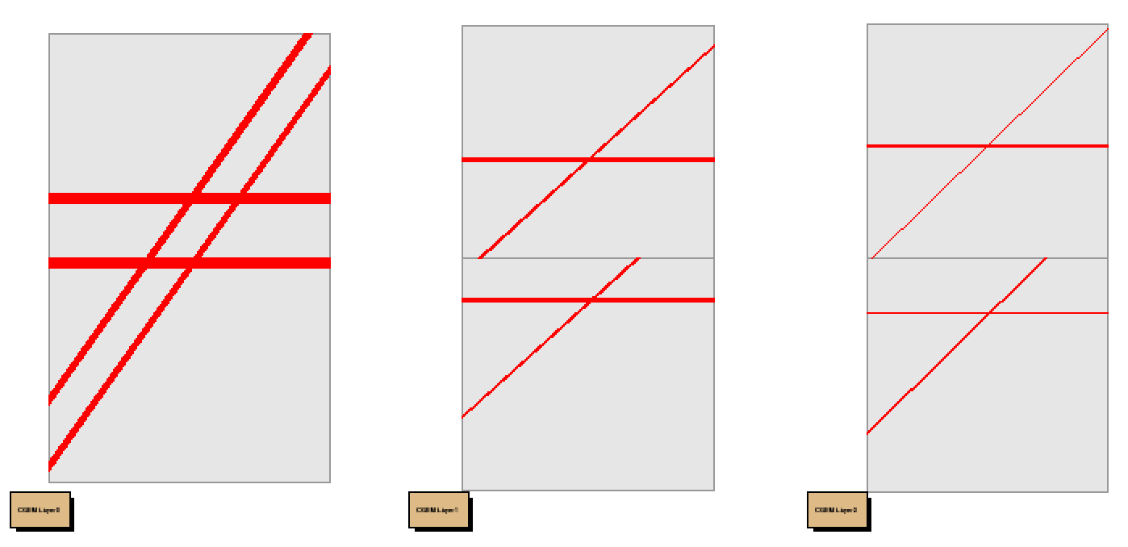
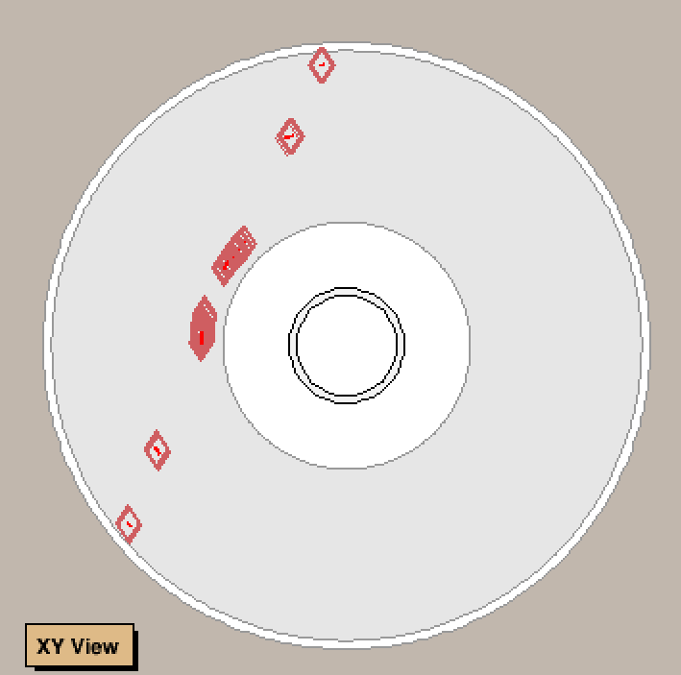
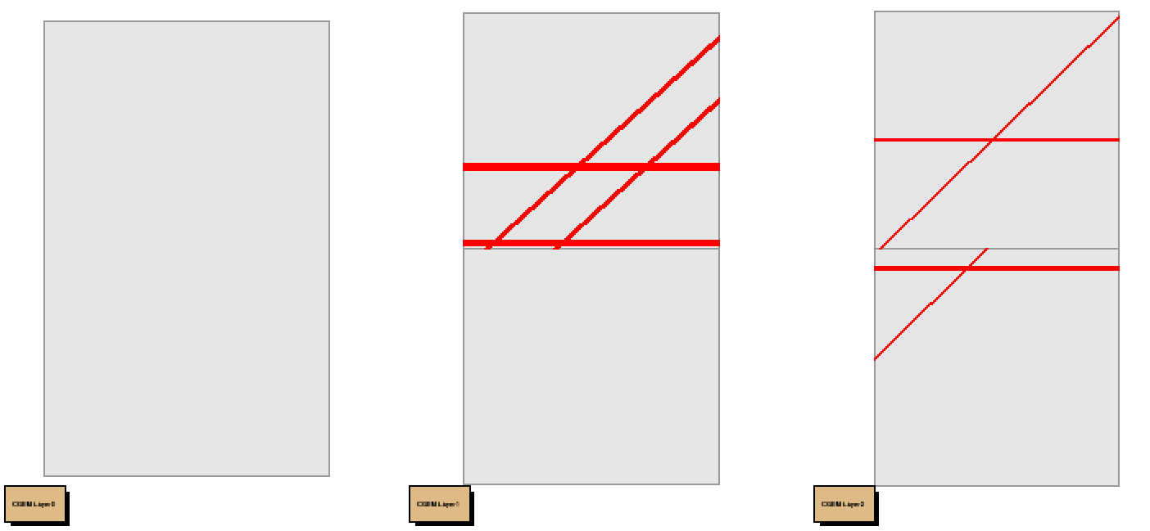
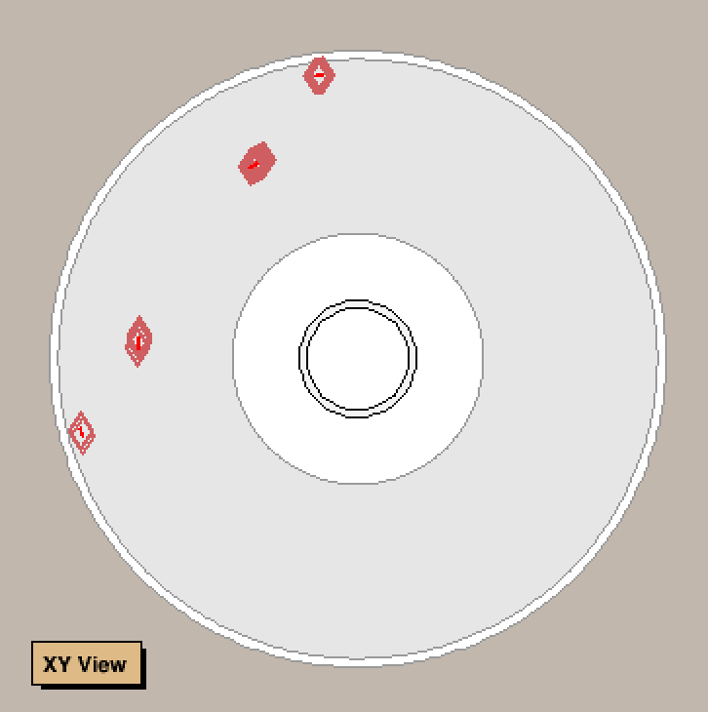
Z cluster =4

Slide 15
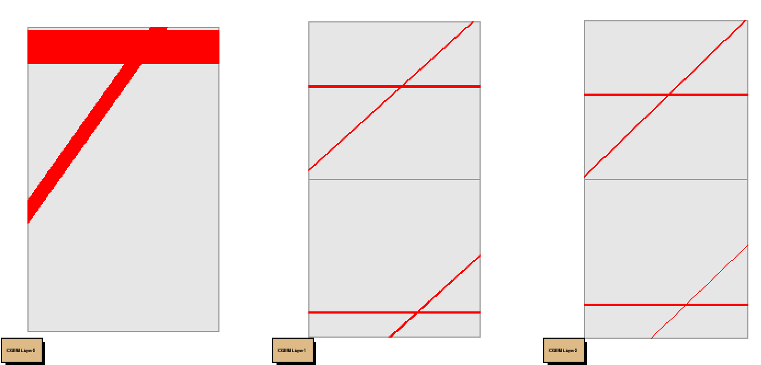
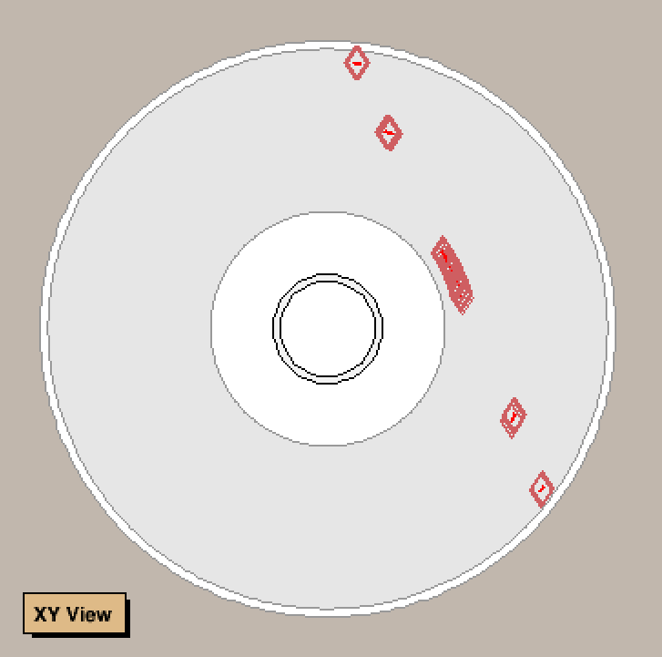
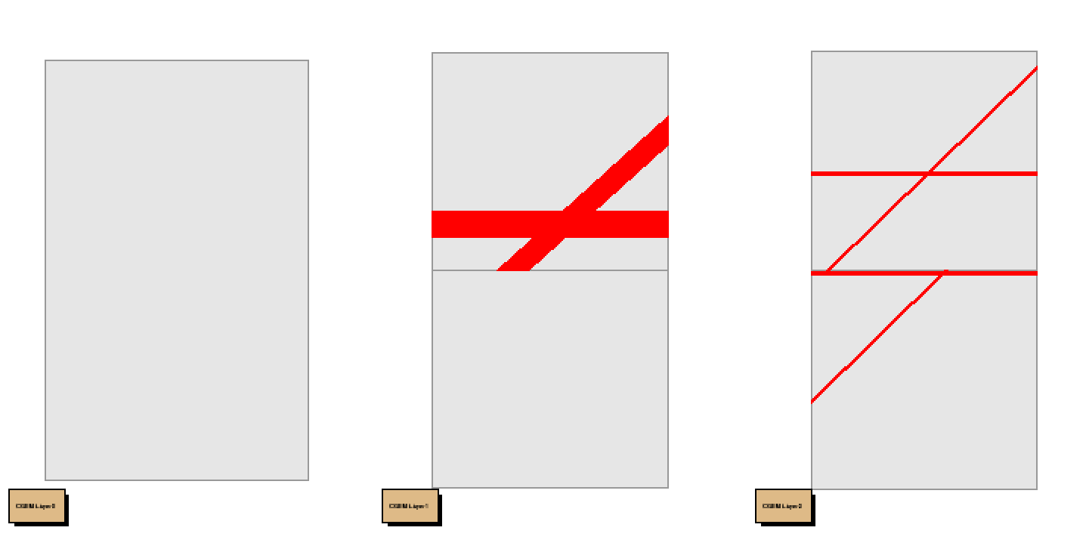
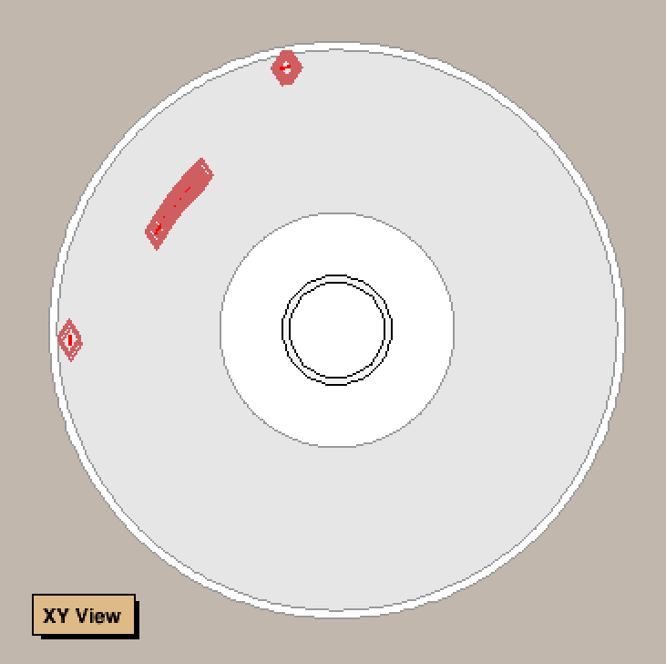
Z cluster =1

Slide 16
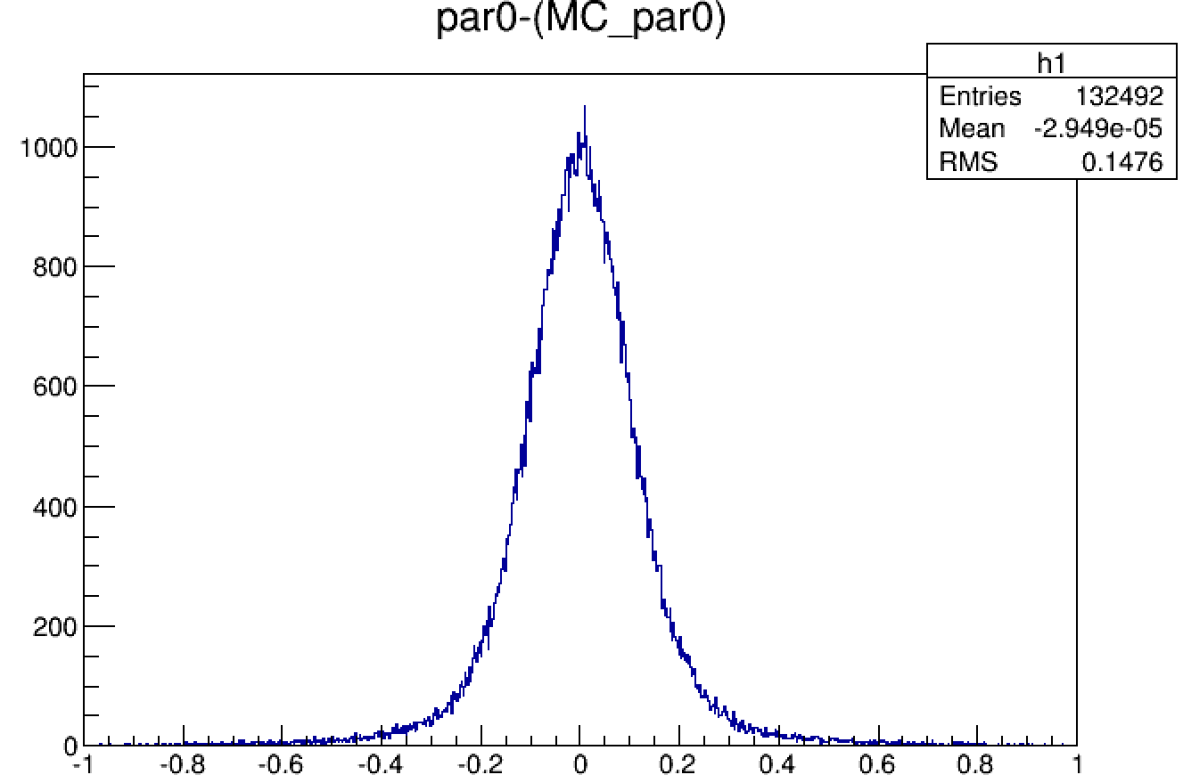
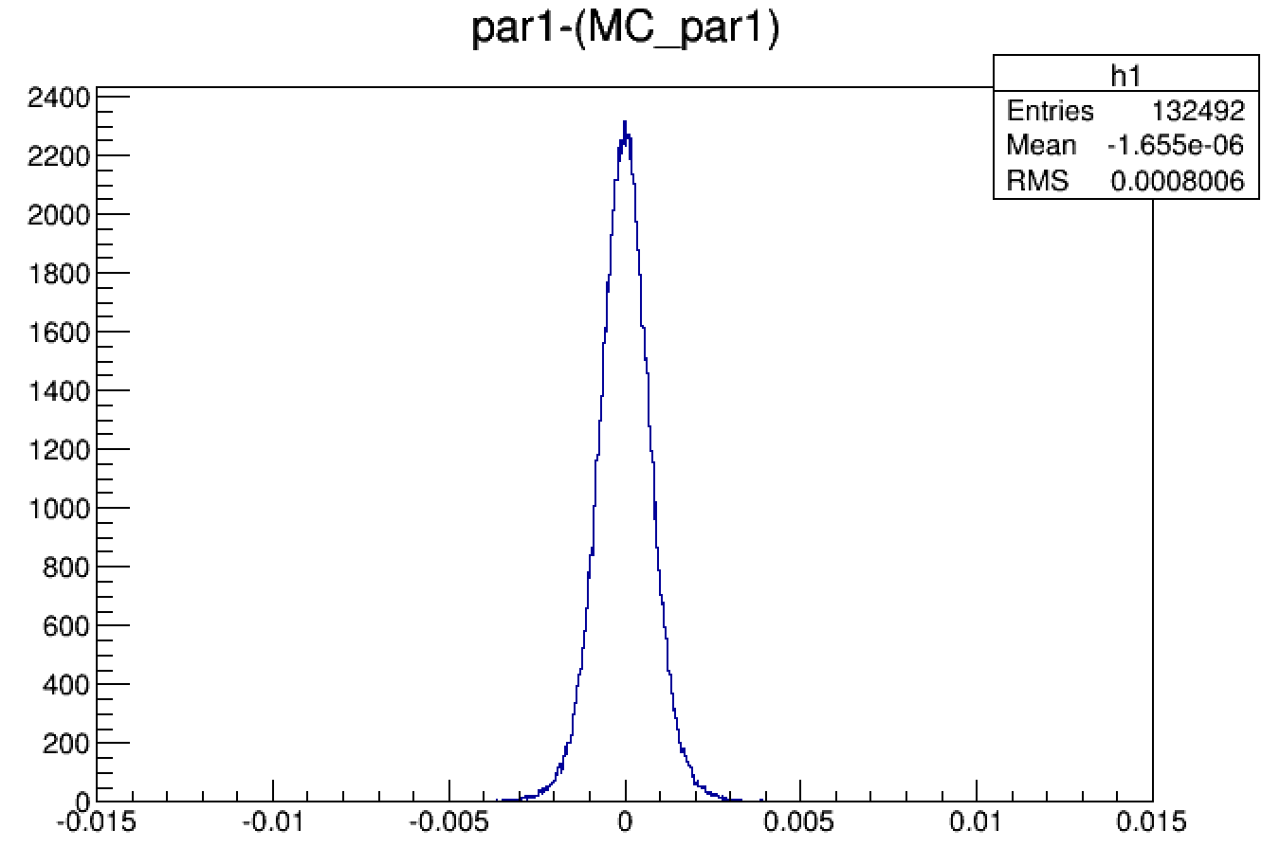
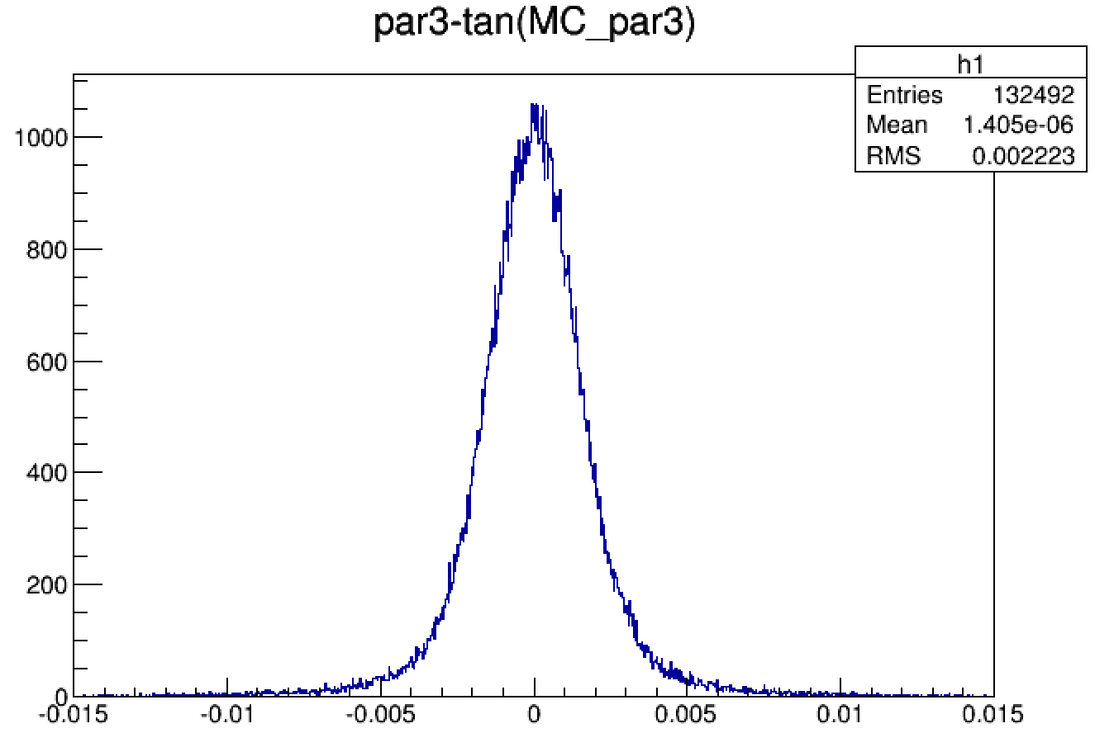
132492 events
$$φ_{0}:rad$$
$$d_{ρ}:mm$$
$$tgλ$$
$Z_{0}:mm$

Slide 17
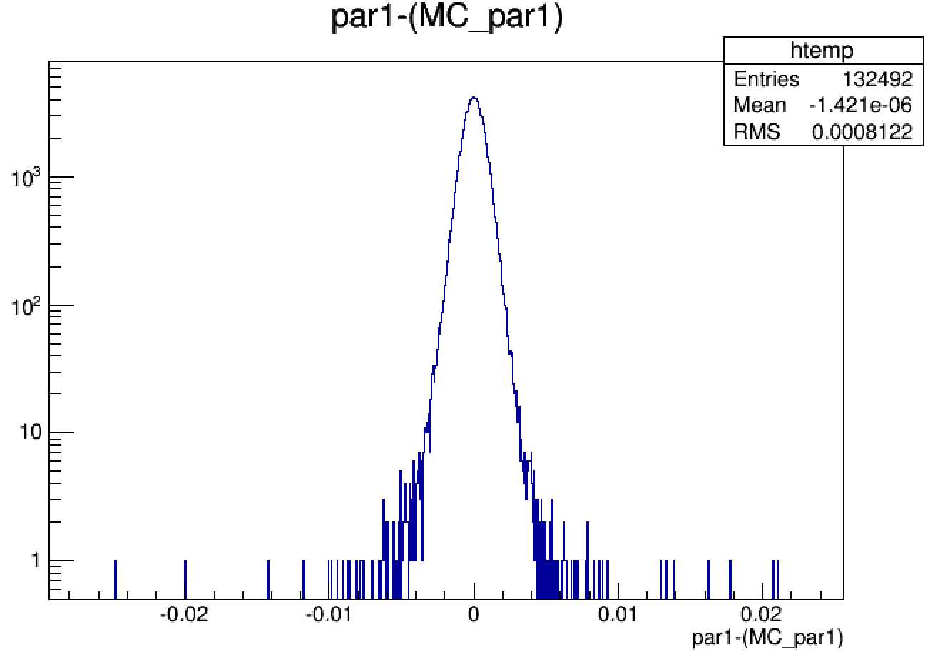
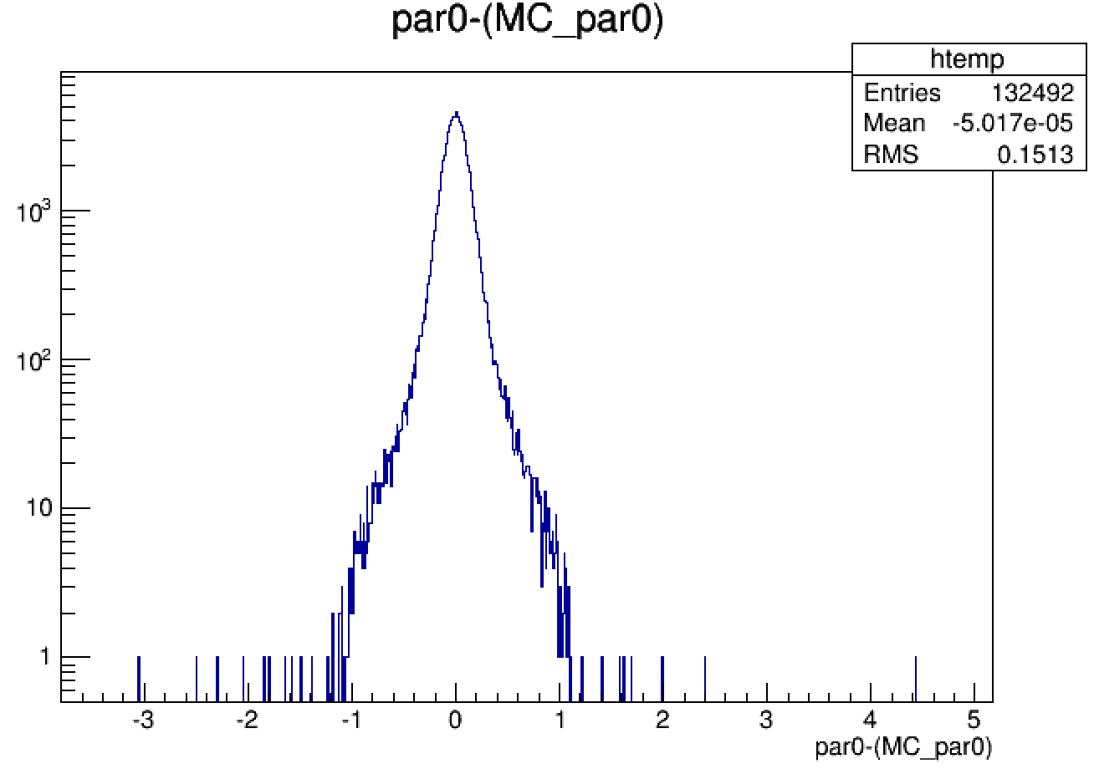
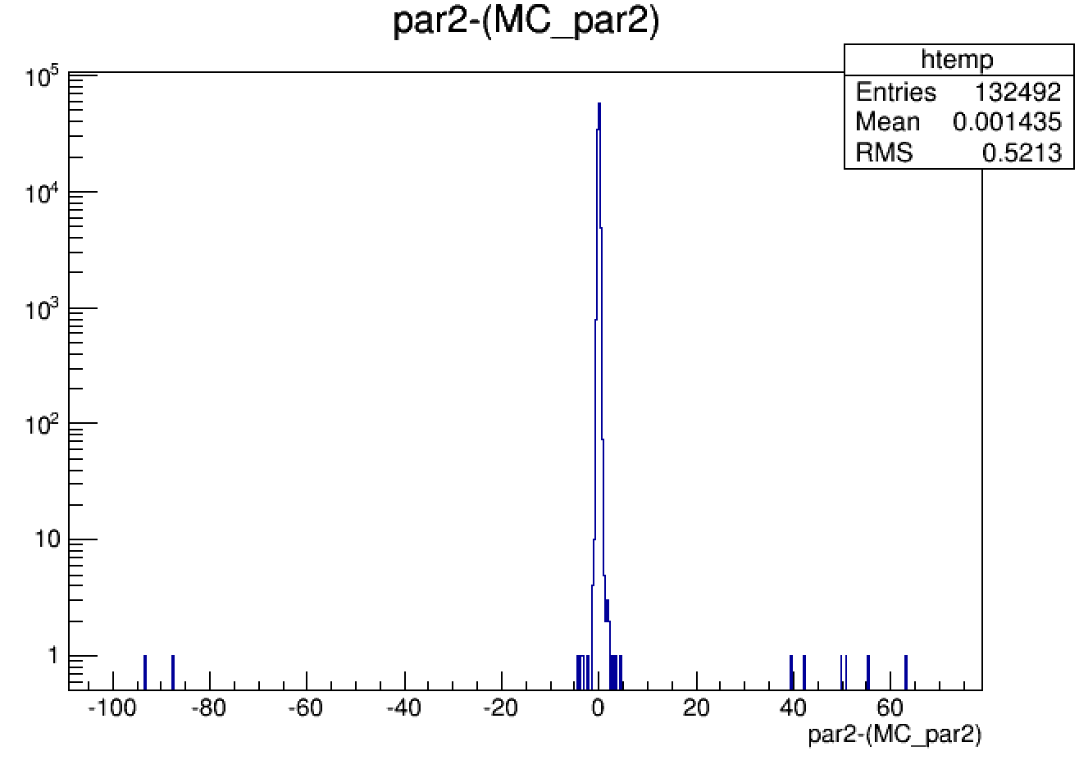
132492 events

Slide 18
CGEM straight line fit
王宏鹏
618
2019 .2.21

Slide 19
FCN
$χ_{1}^{2}={\left(\frac{φ−φ^{′}}{\frac{σ}{R_{n}}}\right)}^{2}$ $χ_{2}^{2}={\left(\frac{V−V′}{σ}\right)}^{2}$
$χ_{3}^{2}=χ_{1}^{2}$+ $χ_{2}^{2}$

Slide 20
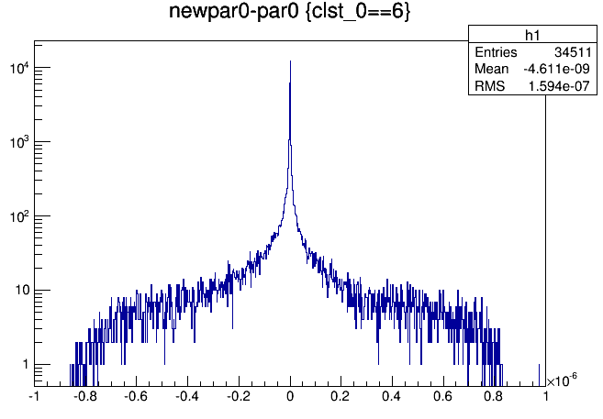
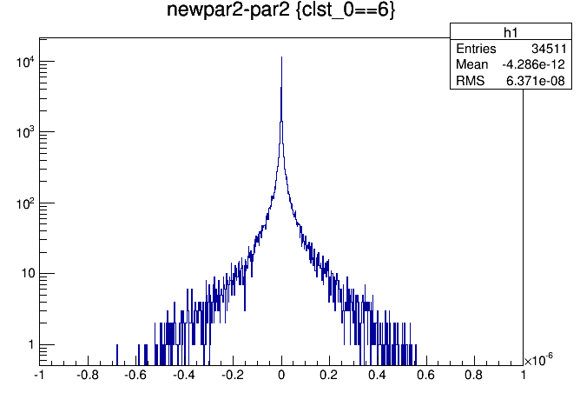
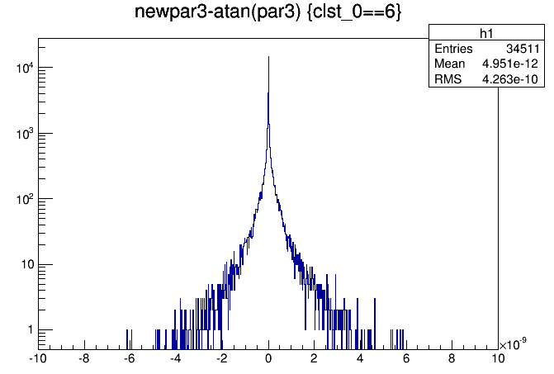
after Fit3 VS after Fit2 $\frac{Δpar}{par}≈{10}^{−6}$
$${Δd}_{ρ}:mm$$
$${Δφ}_{0}:rad$$
${ΔZ}_{0}:mm$
$$Δtgλ$$

Slide 21
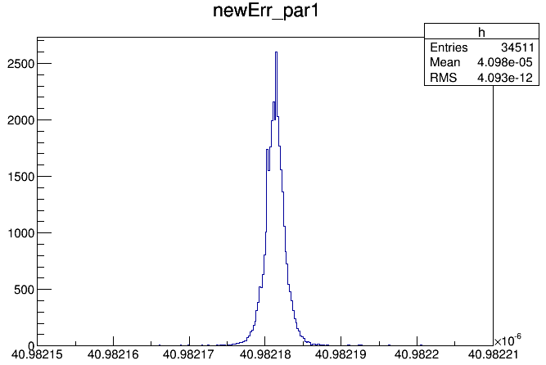
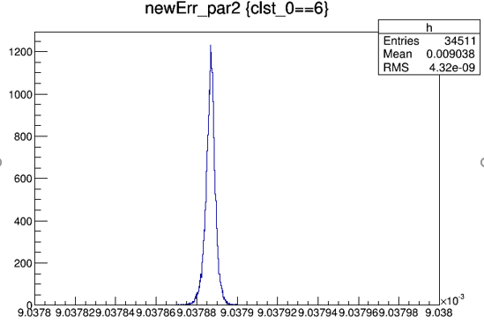
Parameter Fit Error $\frac{par}{E_{par}} ≈{10}^{−4}$
$$d_{ρ}:mm$$
$$φ_{0}:rad$$
$Z_{0}:mm$
$$tgλ$$

Slide 22
Deviation of Cluster
Inner
Middle
Outer
$σ_{Δφ}$
$σ_{Δφ}=$1.30e-03
$σ_{Δφ}=$8.29e-04
$σ_{Δφ}=$5.90e-04
$σ_{ΔV}$
$σ_{ΔV}=\text{1.1}\text{7}\text{e}\text{−01 }$
$σ_{ΔV}=\text{1.1}\text{2}\text{e}\text{−01 }$
$σ_{ΔV}=\text{1.}\text{01}\text{e}\text{−01 }$

Slide 23
Check class StraightLine

Slide 25
1.01434e-01
1.16761e-01
1.12039e-01

Slide 26
1.31557e-03
8.35256e-04
5.89628e-04

Slide 27
2.45115e-01
2.46710e-01

Slide 30
CGEM straight line fit
王宏鹏
618
2019 .4.18

Slide 33
Add new CgemGeomSvc-00-00-19

Slide 34
CgemGeomSvc-00-14-p03
王宏鹏
618
2019 .6.20

Slide 35
CgemGeomSvc-00-14-p03
14 $→$ 18 $→$ 14-p03
更新:
几何更新
增加了直线求交点的功能
可以设置为非理想几何

Slide 36
编译
CgemGeomSvc
$→$BESSim$→$CgemSim
$→$CgemClusterCreate$→$CgemLineFit
删除 x86* $→$ cmt config $→$ source setup.sh $→$make
将其它版本加前缀
总结:
更新Svc 需要重新编译底层算法
Make会根据文件修改时间选择性编译
非编译文件会根据CMTPATH 读取

Slide 37
CgemClusterCreate
新几何下,有些读出条不存在,导致程序中断
GetVfromXZ/GetZfromXV 变成local函数,直接用会出错

Slide 38
参数残差 14 VS 14-p03
$$d_{ρ}$$
$$φ_{0}$$
$Z_{0}$
$$tgλ$$

Slide 39
FCN
$χ_{1}^{2}={\left(\frac{φ−φ^{′}}{\frac{σ}{R_{n}}}\right)}^{2}$ $χ_{2}^{2}={\left(\frac{V−V′}{σ}\right)}^{2}$
$φ=φ\left(d_{ρ},φ_{0}\right) V=V(d_{ρ},φ_{0},Z_{0},tgλ)$
$σ=130 um$ deviation of cluster
$R_{n}:radius of layer$

Slide 40
GetV( ) in 14 VS 14-p03
几何计算更新前后(OnthePlane(),GetVfromPhiZ() )

Slide 41
StraightLine

Slide 42
2交点

Slide 43
3交点

Slide 44
4交点

Slide 45
GetX() GetV() in straigtline VS old Alg.

