Slide 1
IHEP activity in module assembly
Feng Lv, Liaoshan Shi, Lianyou Shan,
JinYu Fu, Joao Guimaraes da Costa,
Mei Zhao ,Mingyi Dong,YunPeng Lu,
Yunyun Fan, Zhijun Liang
Institute of High Energy Physics ,
Chinese Academy of Science

Slide 2
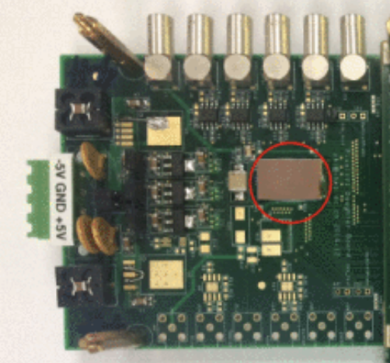
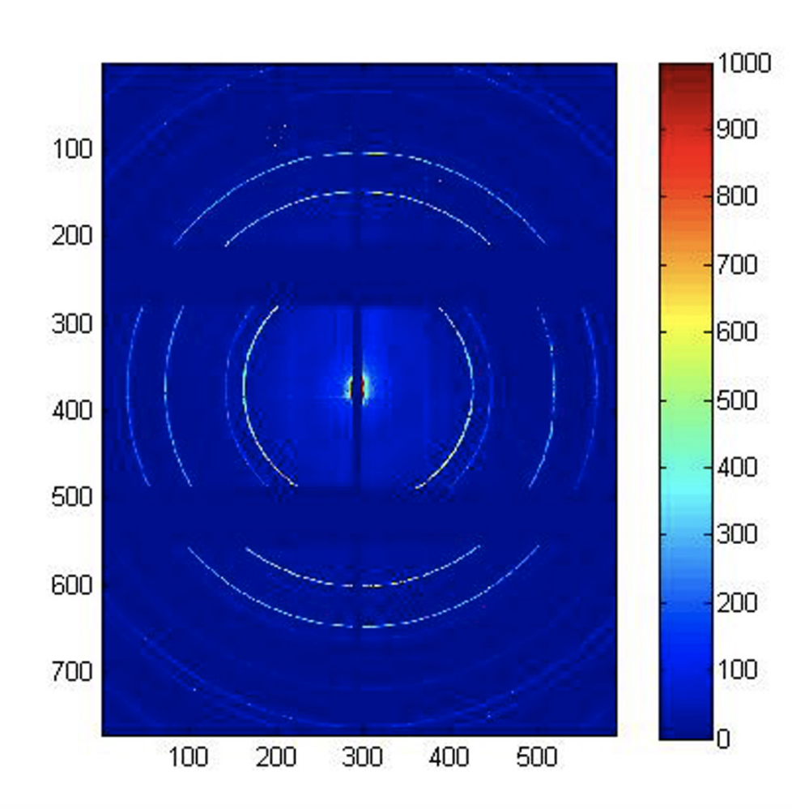
Bump bonding foundry in China
Two company identified （both are top 10 packaging company )
Tianshui Huatian Technology Co., LTD (TSHT, China)
http://en.tshtkj.com/index.html
The National Center for Advanced Packaging (NCAP China)
http://www.ncap-cn.com/en/index.aspx
IHEP has tested bump bonding by NCAP before on pixel detector project for light source (HEPS-BPIX)
HEPS-BPIX, a hybrid pixel detector system for the High Energy Photon Source in China,
Journal of Instrumentation, 12(01):C01041

Slide 3
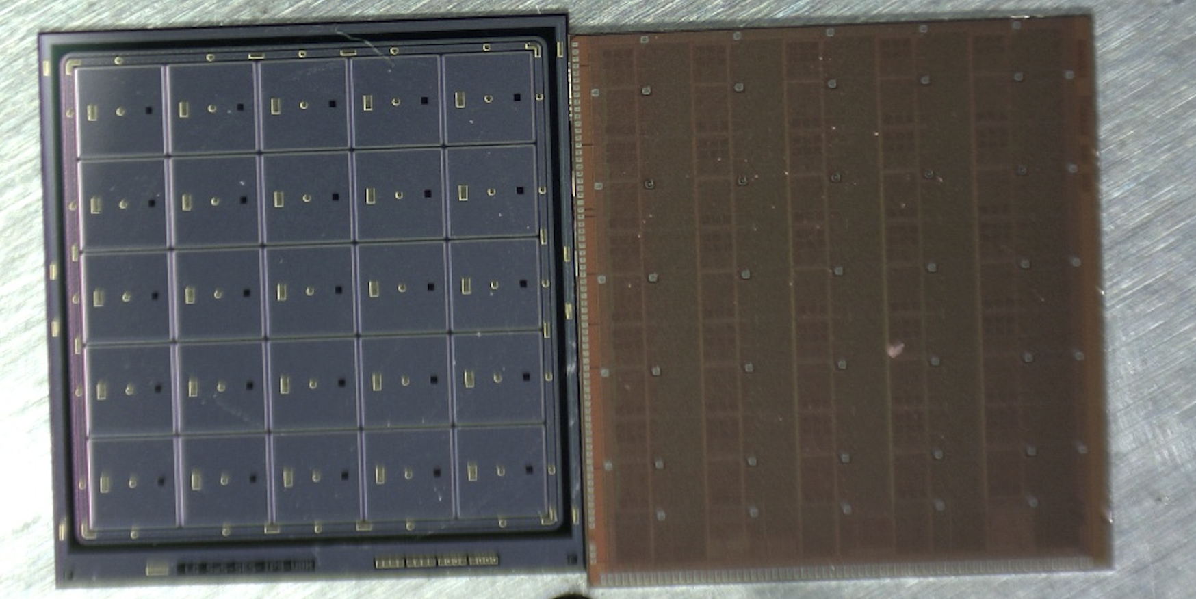
Bump bonding study
Identify two company identified （both are top 10 packaging company )
The National Center for Advanced Packaging (NCAP，华进)
http://www.ncap-cn.com/en/index.aspx
HPK 5x5 Sensors and Altirco1 chip in IHEP
5x5 sensor and ASIC
Bare module

Slide 4
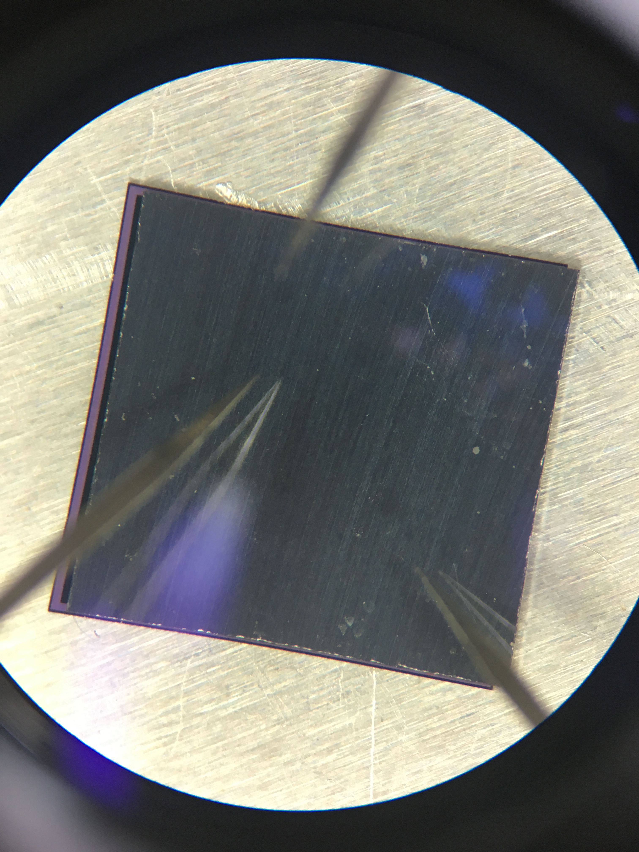
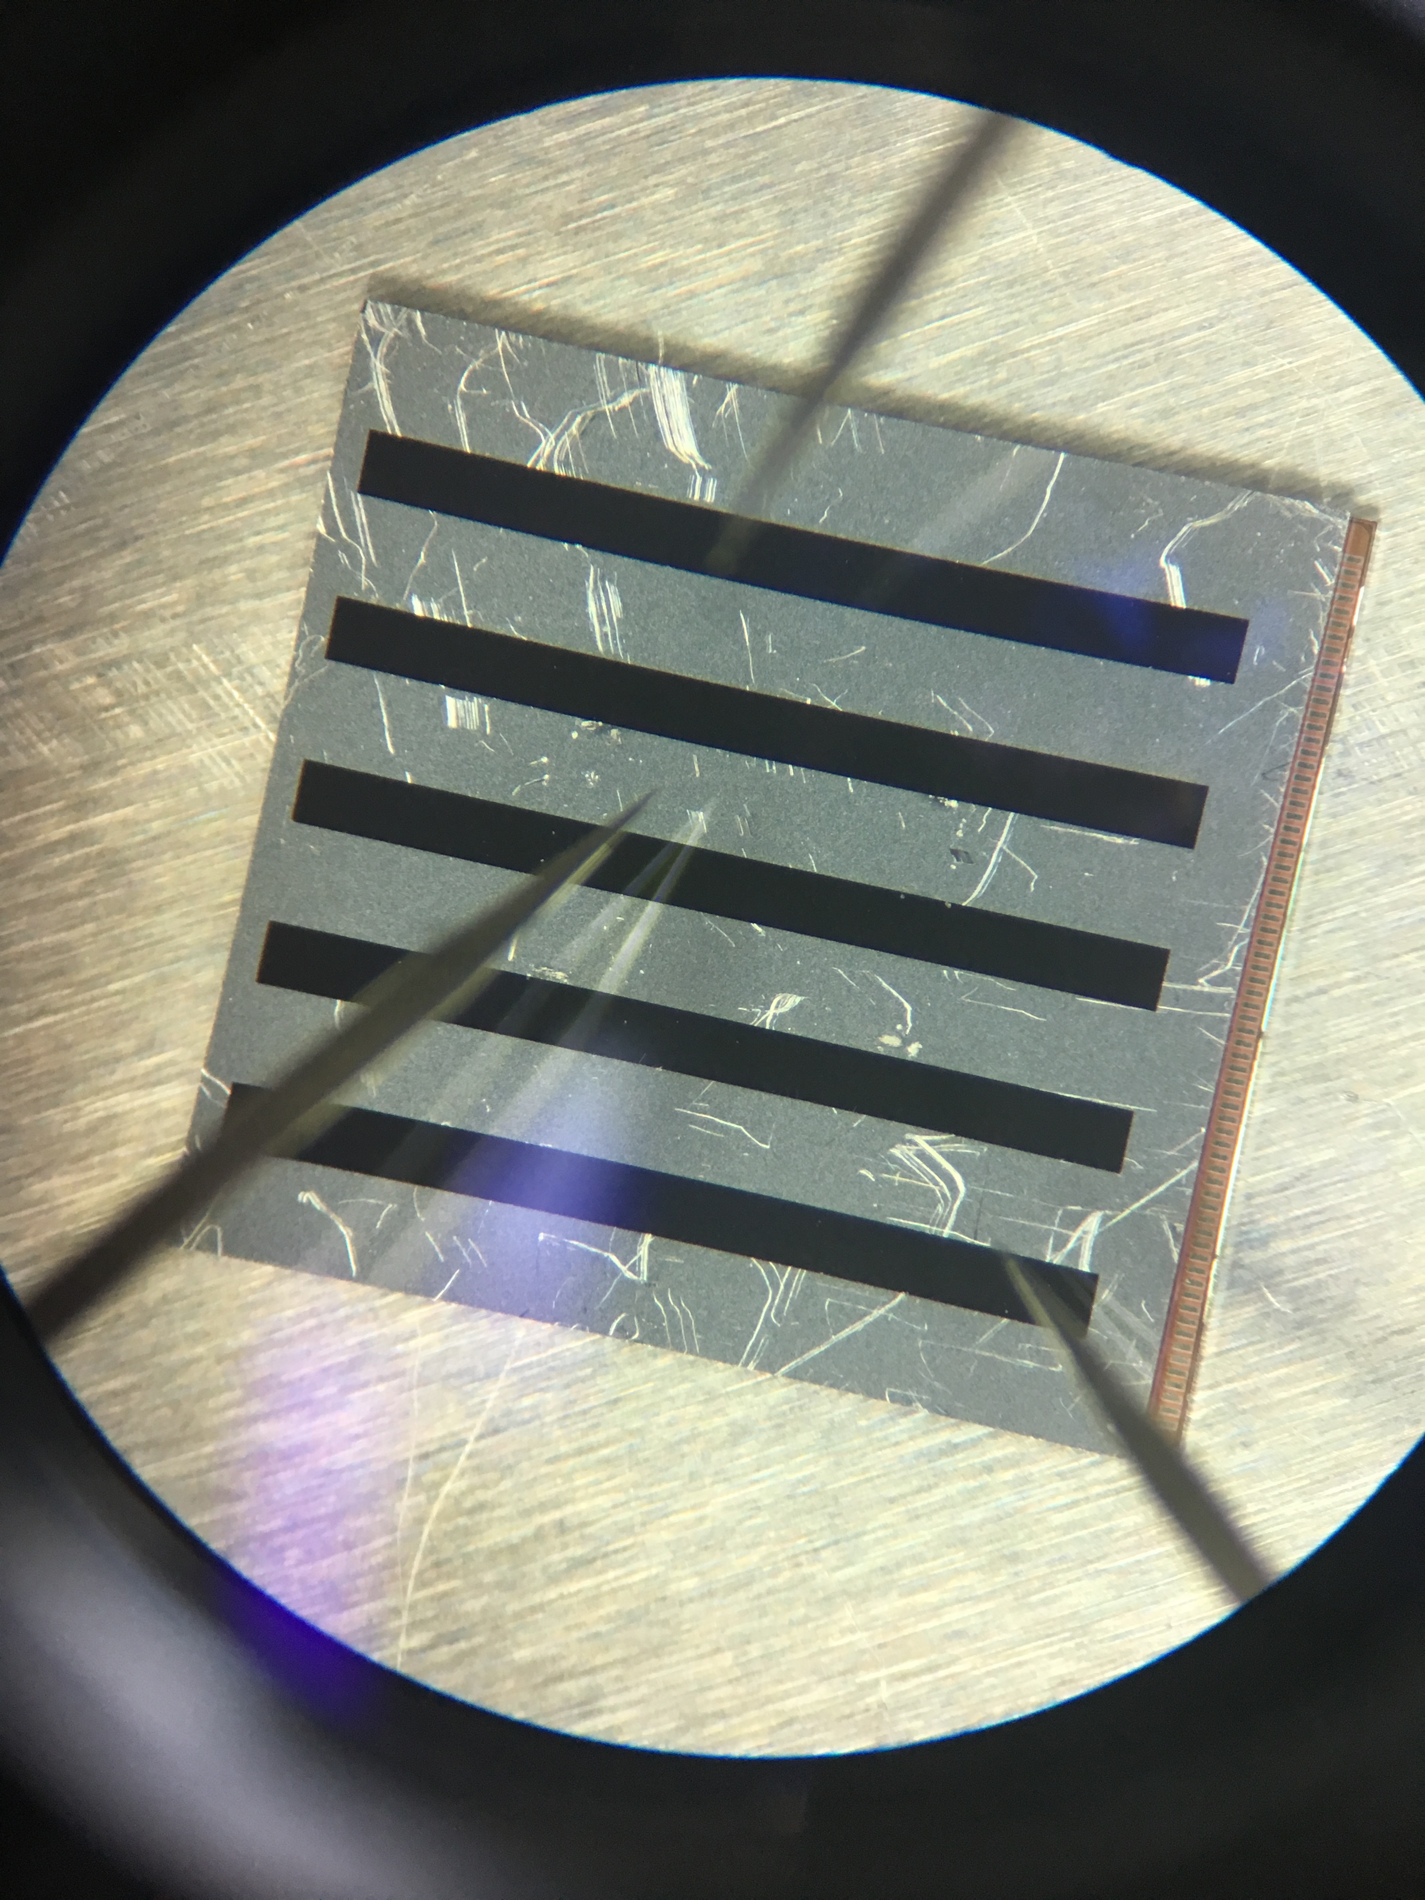
Bump bonding for 5x5 bare module
Two ASIC and two HPK 5x5 sensors (with UBM) sent to NCAP
Bump bonded in next day. (photo below)
ASIC chip is without UBM.
It is not easy to implement UBM in chip level (usually in wafer level)
They implant gold ball in ASIC for this bare module bonding.
suggest to use copper pillar instead of SnAg Solder bump for production
Will use ultrasonic imaging to evaluate the bonding quality (to be done)
Sensor side
ASIC side
Bare module

Slide 5
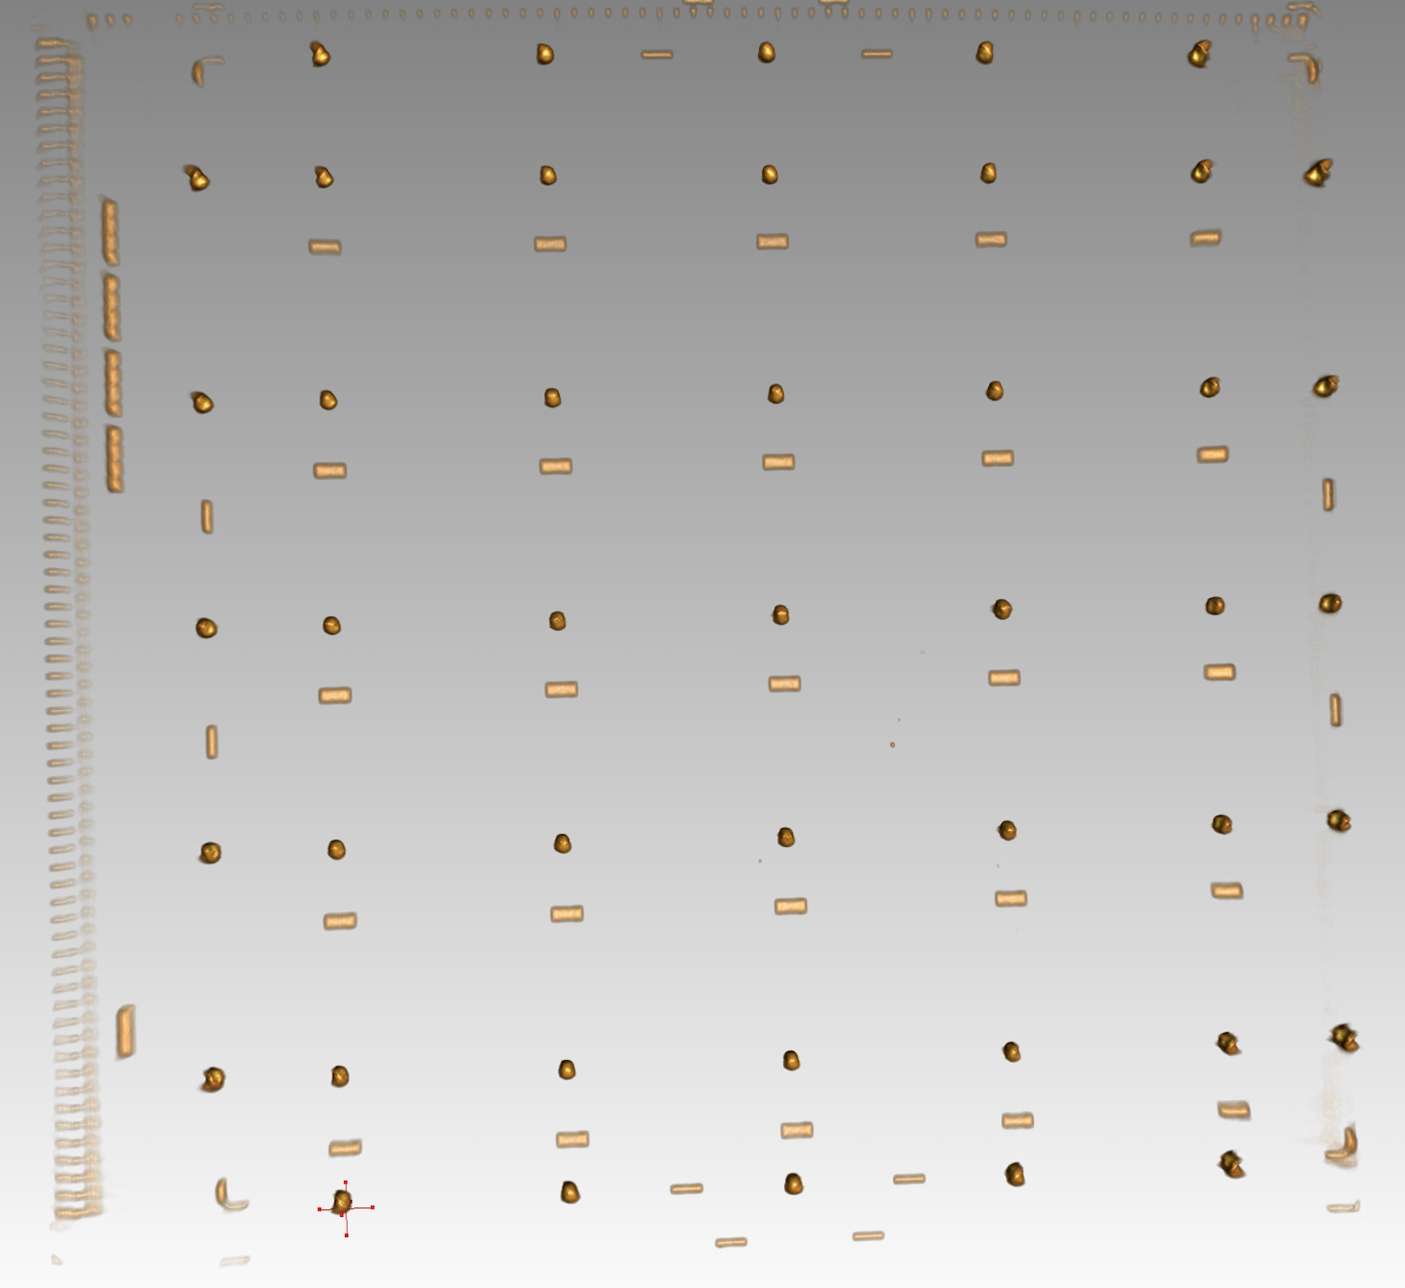
Bump bonding study (3)
Bump bonding quality is good according to 3D X ray imaging.
Pull testing in next step to check bump quality.
3D profile
X ray photo
3D X ray photo

Slide 6
Shear testing
df

Slide 7
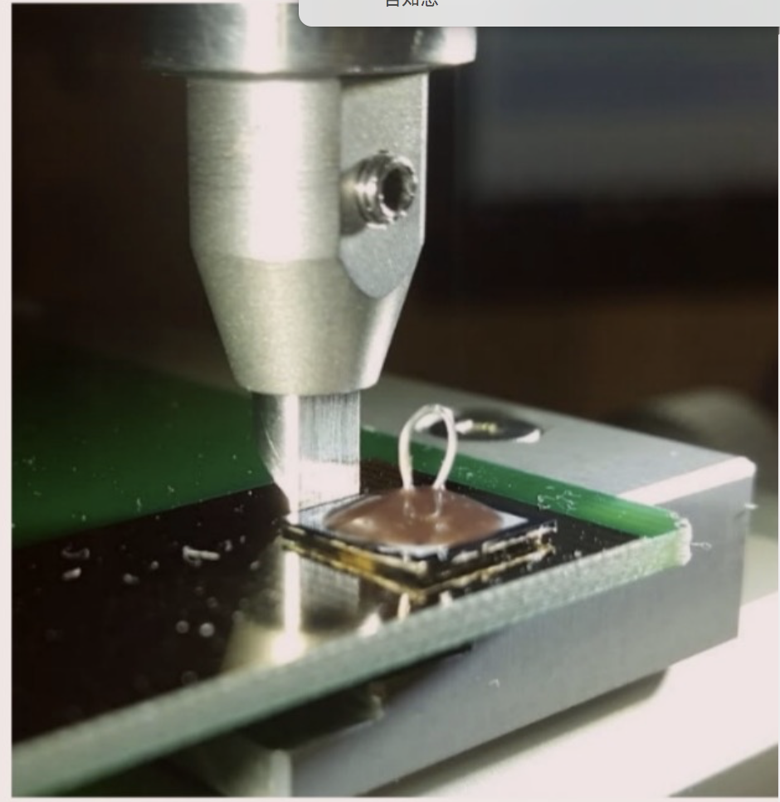
Shear testing

Slide 8
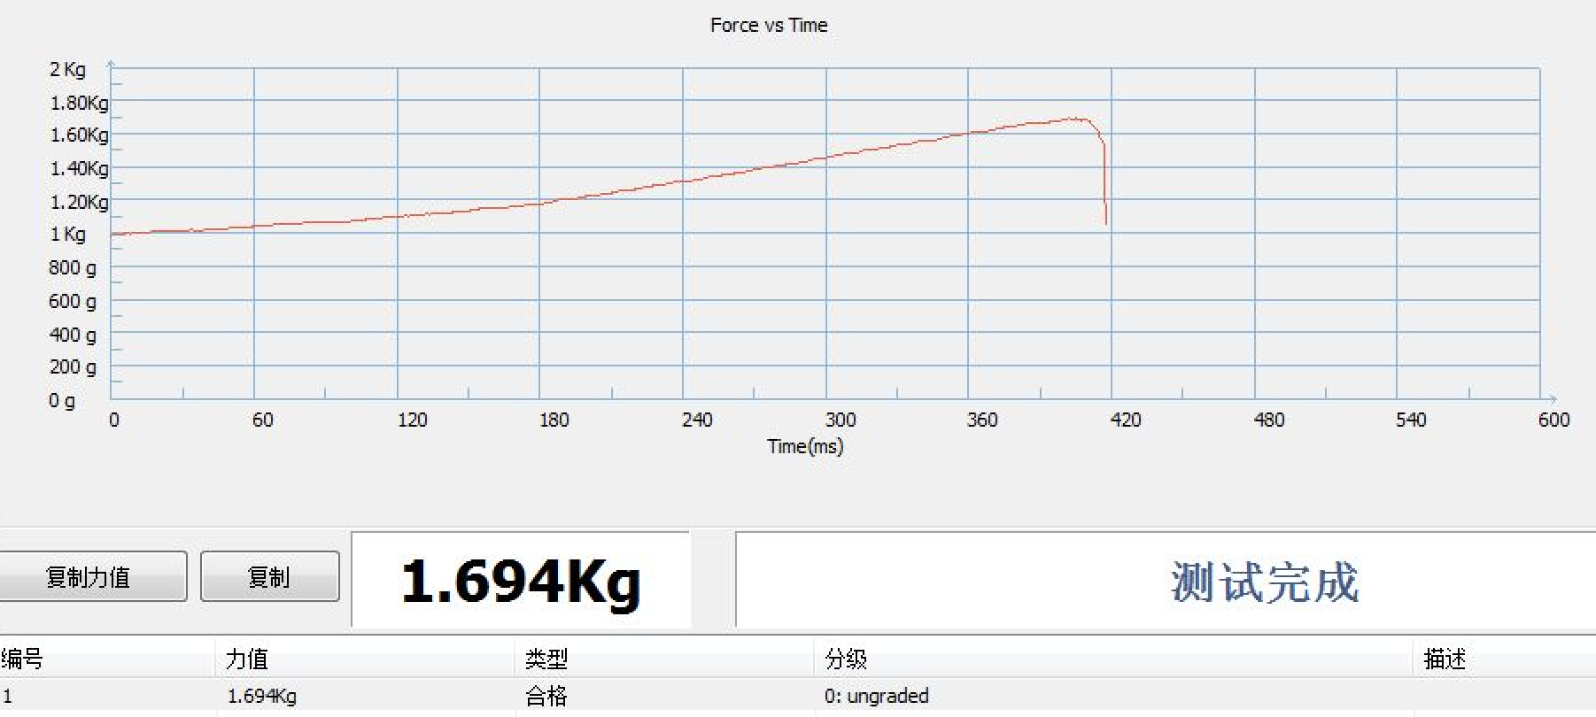
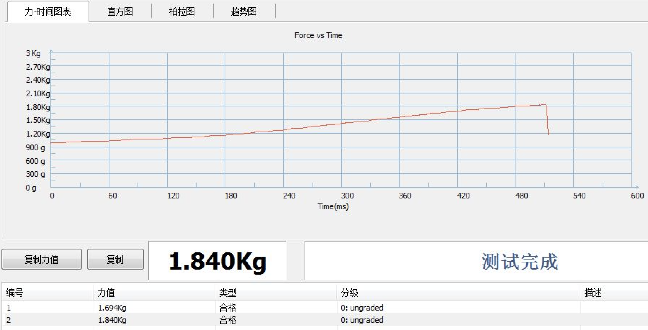
Shear test for bond quality
Shear test result
1.694Kg
1.840Kg
Both >1Kg

Slide 9
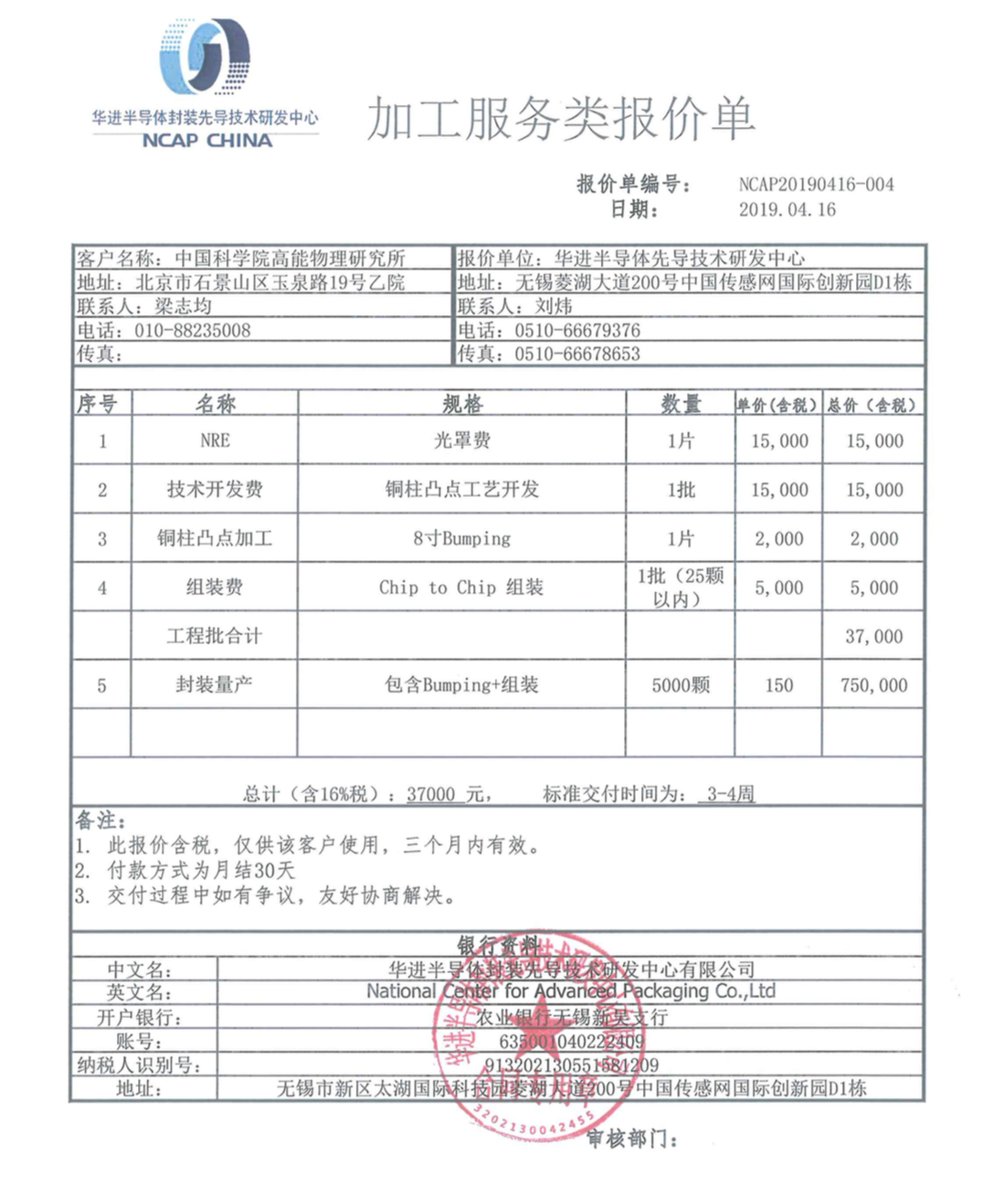
Quotation
In R & D phase, they offer 37000 RMB (~5.5kUSD) for bump bonding one wafer of ASIC and making 25 bare modules.
In production phase, they offer 750k RMB(~108k USD) for producing 5000 bare modules.
UBM for sensors not in quotation yet ( estimated <100k RMB, to be confirmed)
 | No. | Cost per item (RMB) | Total of the item (RMB)
Mask | 1 | 15000 | 15000
R & D fee | 1 | 15000 | 15000
8 inch wafer Bumping | 1 | 2000 | 2000
Chip to chip Assembly | 1 | 5000 ( 25 modules) | 5000
Engineering run in total |  |  | 37000
Massive production | 5000 | 150 | 750000
Quotation

