Slide 1
CEPC beam energy calibration with compton scattering method
Yongsheng Huang
CEPC energy calibration working group

Slide 2
Working group and collaborations
IHEP: Xinchou Lou, Yongsheng Huang, Guangyi Tang,Manqi Ruan, Jianyong Zhang, Guangpeng An, Yuan Chen(Magnetic design), Yiwei Wang(extration system), Zhe Duan, Guanglei Xu(timing comtrol), Gang Wu(spatial alignment), Hongbo Zhu (Si detector), Shanhong Chen
CIAE: Naiyan Wang(Compton scattering system design), Baozhen Zhao(laser system), Xiaofeng Xi (time synchronization)
China West Normal University: Xiaofei Lan, Meiyu Si(simulation of the Cherenkov radiation, the simulation of new fiber detector)
University of Science and Technology of China: Shubin Liu, Changqing Feng( electronic system and test)
CERN factory & CIVIDEC: CEO, CVD diamond detector and test

Slide 3
Outline
Physics requires and system design
Beam Extraction
Compton scattering
Analytic magnetic field and the drift segment
The detection system: CVD diamond+ Silicon pixel detector; the new Cherenkov fiber detector;
The simulation and data processing

Slide 4
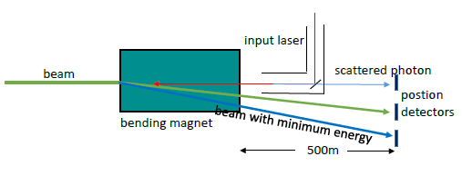
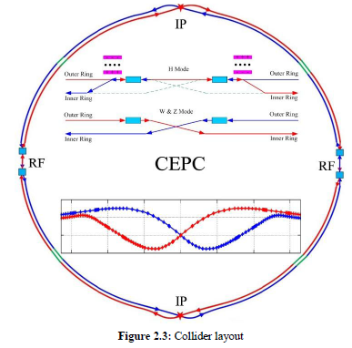
Physics requires and system design
Higgs mass measurement: 1MeV@120GeV
Compton
Scattering region
Calibration system
Calibration system
detection
extraction
Compton scattering
Magnetic &drift
Calibration system
Calibration system

Slide 5
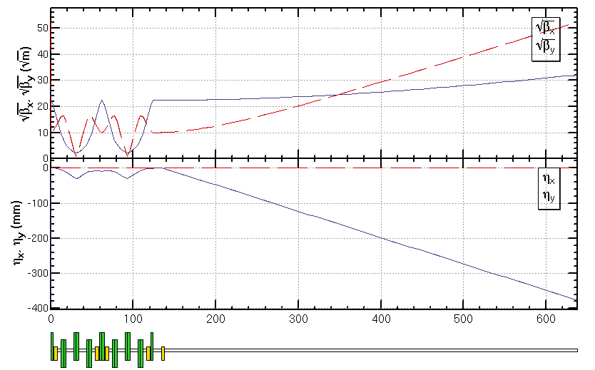
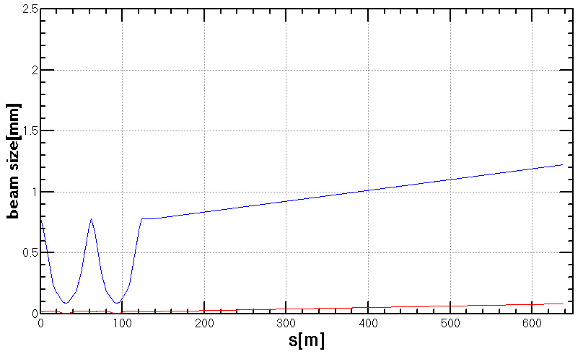
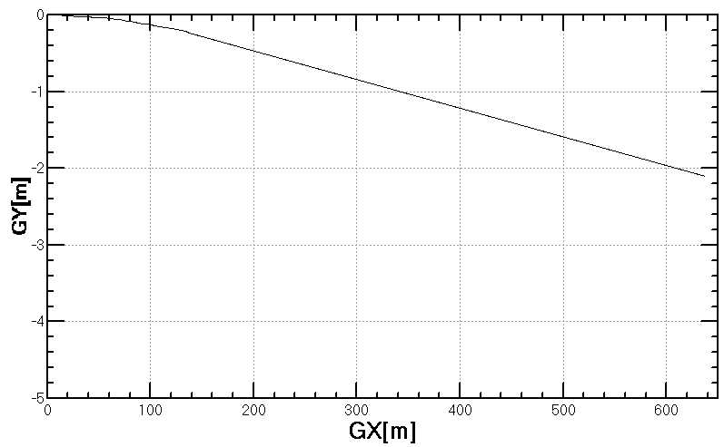
Beam Extraction(Yiwei Wang, Yuan Chen)
Design requirement
beam at the interaction point of beam and laser
beam at the end (for $σ_{E}<0.1$% )
$∆\left({E_{IP}−E_{ENT}}/{E_{IP}}\right)<{10}^{−5}$, ${∆x}_{jitter}<50μ$m, $σ_{x}<0.5$ mm, $σ_{y}<0.02$ mm
$σ_{x}<1$ mm, $σ_{y}<1$ mm
Preliminary design
Dispersion suppressed before the IP in order to reduce the beam size
Strong quadrupoles are used to get a short extraction line
Work to be done
Optimization of the beam line to get softer magnets
tracking in main ring to get realistic extracted beam including aberration, radiation, beam-beam
tracking including aberration, radiation, static and dynamic errors of the transport line
$$σ_{x}$$
$$σ_{y}$$

Slide 6
Compton scattering (Yongsheng Huang,Guangyi Tang,Guangpeng An, et al. IHEP& CIAE)
Parameters:
Cross section:600mbar
Scattered photon: ${10}^{7−8}/pulse$
Time synchronization:
1ns is OK !
Spatial alignment: 10μm is OK！
The scattered electrons:
From 36GeV---120GeV
Note：The LCS gamma ray from Tsinghua University can realize：
216fs time synchronization between the electron beam and the laser beam（30fs）
Beam spot size： 10micrometers
In 10Hall， we are doing the experiment：10ns laser+electron beam（10ps）.

Slide 7
Analytic magnetic field and the drift segment (Yuan Chen)
Magnetic field:
0.5T,3m,${5×10}^{−4}$
The bending angle:
The energy VS the position on the detection:
The beam energy:

Slide 8
The detection
Three positions:
The center of the gamma ray:Xγ
The center position of the main beam， Xbeam
The edge of the scattered electron beam，Xedge
Strip detector: 1D, 10micrometer per strip
Pixel detector: 100micrometer @ 500m drift length; 10micro@50m
number
Electron distribution after compton scattering
36GeV
120GeV

Slide 9
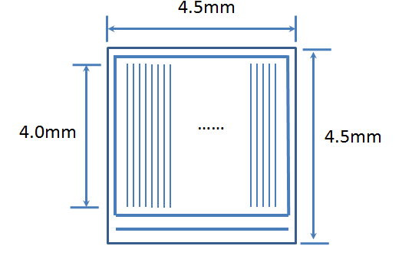
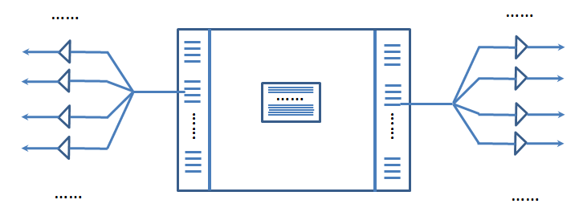
The detectors (Jianyong Zhang)
CVD strip diamond detector+Si pixel detector
Radiation resistance:
CVD diamond ${10}^{17}/cm^{2}$
Si detector: ${10}^{15}/cm^{2}$
4.5m*1cm:
so large detector
CVD
number
Electron distribution after compton scattering
Si detector

Slide 10
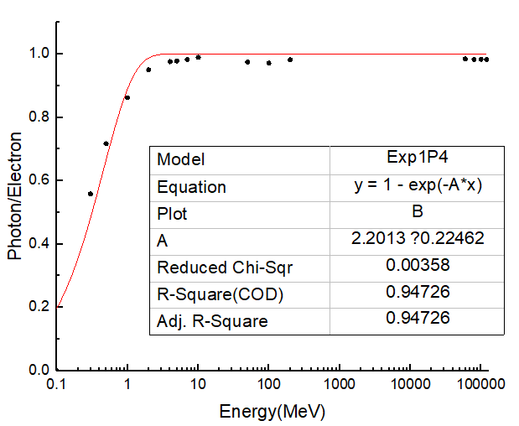
The Cherenkov fiber detector(Xiaofei Lan, Meiyu Si, Jianyong Zhang): 3micrometers-16micrometers available
Cherenkov radiation in the fiber :
The Cherenkov photon number/electron number satisfies: ( the new simulation results)
$$y=1−e^{−\frac{E}{0.45}}$$
C
particle momentum direction
$$θ$$
A
$$Φ$$
$$M_{1}$$
$$M_{2}$$
B
y
x
Z
Z
$$y^{′}=\frac{L}{10μm}∙(1−e^{− \frac{E_{k}}{0.45MeV}})$$
E_e=120GeV
R=5$μm$，L=40$μm$ fiber。

Slide 11
Simulation results
Systematical errors for 1MeV@120GeV:
$δE_{beam}=1.2MeV$ for 10$μm$ of $δX_{beam}$
From synchrotron radiation and magnetic field：
With the correction (the energy loss can be calculated): 0.1MeV
The uncertainty of the angle between the detector place and the incident beam: 0.5mrad--------0.9MeV
The derivation of the calculated energy with the truth:11.5MeV,
which can be corrected back.
Statistical errors： 0.5MeV
Scattered electrons:
The function to sim.：
The main beam：

Slide 12
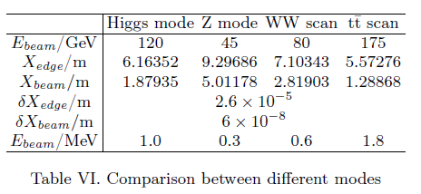
For other energy modes

Slide 13
We need to do:
Test the compton scattering in 10Hall: time synchronization and spatial alignment
Design and Test the CVD diamond detector and Si detector in 10Hall
Design and Test the gamma-ray detector
Design and Test the new Cherenkov fiber detector: flux of photon and the position uncertainty
To make sure the extraction works

Slide 14
Thanks for your attentions!

