Slide 1
Report on the Future Collider
Software Workshop in Bologna
Weidong Li
Computing Center, IHEP
2019-06-28

Slide 2

Motivations of the workshop
A common software framework would have to be versatile as to encompass the different needs of the various experiments
It should take into account the use of new processors (parallel processing, GPUs, FPGAs, etc.)
It should allow to “simply” define different detector geometries
Could we have a common event data model?
We are here to discuss these things and more and possibly come out of the workshop with a working plan on how to develop together a common solution

Slide 3
Workshop Agenda
https://agenda.infn.it/event/19047/
  Introduction and motivation (Paolo Giacomelli, INFN Bologna)
  Software status of the LHC experiments (Tommaso Boccalli, CERN)
  ILC software (Frank Gaede, DESY)
  FCC software (Gerardo Ganis, CERN)
  CEPC software framework (Xingtao Huang, SDU)
  Common software tools (Graeme Stewart, CERN)
  Turkey software stack vision (Andre Sailer, CERN)
Round table discussions
  General discussion on a common software framework
  Towards a common software stack

Slide 6
FCC Software

Slide 7
Detector Description (FCC)

Slide 8
Event Model: PodIO (FCC)

Slide 9
CEPC SW Framework Needs
Huge Data Volume
  O(~EB) for CEPC running at Z pole
  Management of Event Data and even non-Event Data
Parallelization
  Levels: algorithm, intra-event and inter-event
  Technologies: OpenCL, CUDA, TBB, MPI…
  Re-use of existing and successful serial algorithms
Heterogeneous Architectures
  CPU,GPU, FPGA, HPC, Cloud…
  Portable and flexible
Interfaces to novel tools and software
  Application of Machine learning, Deep Learning and Big Data into HEP
Friendly user interfaces
  Hiding new techniques from physicists
  Support flexible analysis with/without framework , interactive web analysis

Slide 10
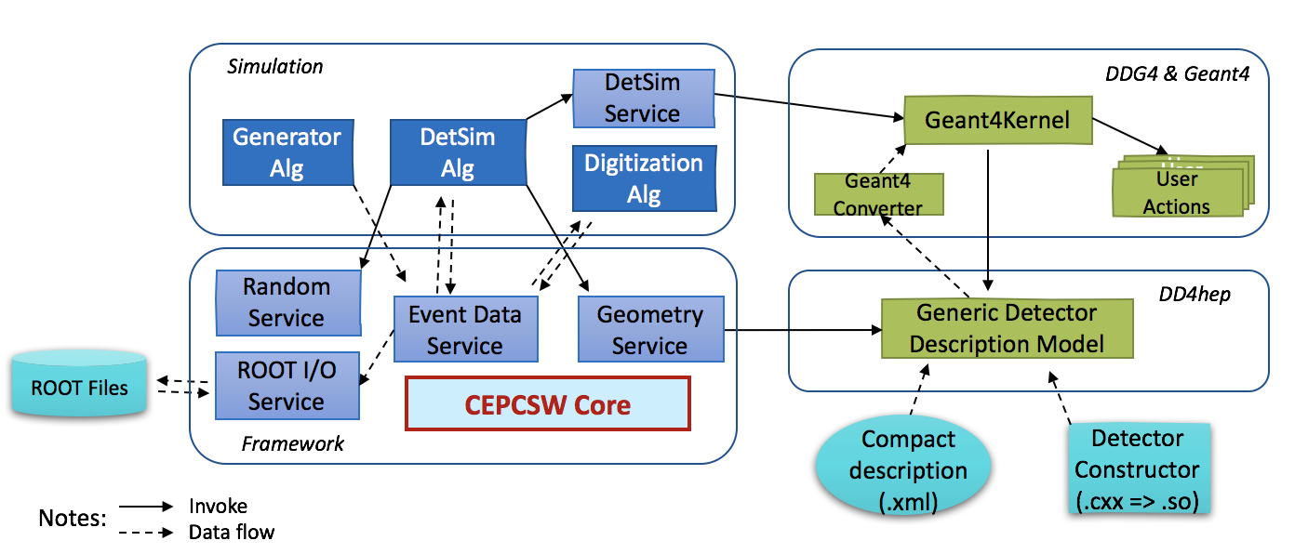
CEPC Software (1)
Detector Simulation
  Integration with generators (for example Whizard and Pythia)
  Adopt DD4hep for detector geometry description
  Integrate DD4hep with framework
  Support running different detector designs and comparison between them.
  Mixing of fast Simulation and full Simulation

Slide 11
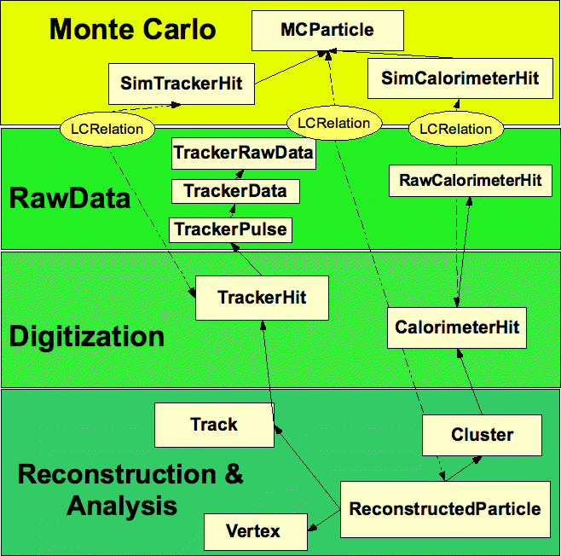
CEPC Software (2)
Event Data Model
  LCIO defines a common Event Data Model for Collider Experiments, including
    Monte Carlo Data, Raw Data
    Digitization, Reconstruction and Analysis Data
    Relations between different data objects
  Will be adopted for CEPC with ROOT extension
    Combine LCIO with ROOT
    Put LCIO object inheriting from TObject into Data Store
    Write Data Store objects into ROOT files
    Convert Data Store objects into other format (such as NumPy for machine learning)

Slide 12
CLiC Software
Future plan

Slide 13
iLCSoft
Current
Future Plan

Slide 14
Common Software Stack (CSS)

Slide 15
Workshop Outcome (1)
Development of a Common Turnkey Software Stack (Key4HEP), containing:
  HEP standard and new libraries / packages, such as ROOT, Geant4, HepMC, VecCore, VecMath, VecGeom, ...
  Externals, such as Boost, GSL, Eigen, ...
  EDM and Geo libraries, such as DD4Hep, PODIO
  Rec/Tracking libraries, such as ACTS, PandoraPFA, ...
  One framework
MARLIN framework will continue to be used by the LC community while the Key4HEP is commissioned.

Slide 16
Workshop Outcome (2)
Have a simple management scheme (Facilitators) for collaborating on a common software stack
    F. Gaede (ILC, DESY)
    W. Li (CEPC, IHEP)
    X. Huang (SCTF, Shandong)
    G. Ganis (FCC, CERN)
    A. Sailer (CLIC, CERN)
    D. Maximov (SCTF, Budker)
    D. Lange, X. Lou (USA)
    G. Stewart (HSF, CERN)
    T. Boccali (LHC,INFN)

Slide 17
Thank You !
谢谢

