Slide 1
R & D progress of CEPC vacuum system (MOST2)
Haiyi Dong
6/28/2019

Slide 2
Contents
Motivation
R&D of vacuum chambers
R&D of RF shielding bellows
NEG coating inside of vacuum chambers
R&D of all metal gate valves
Summary

Slide 3
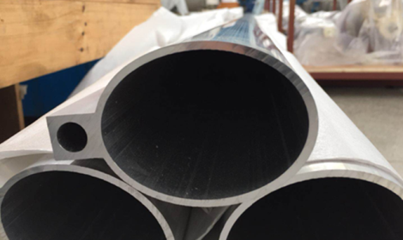
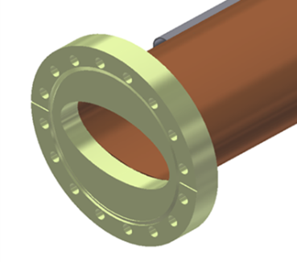
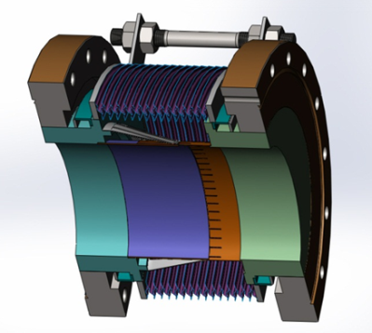
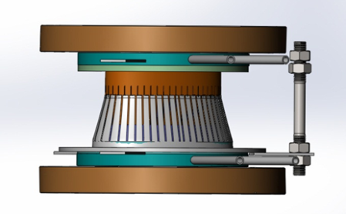
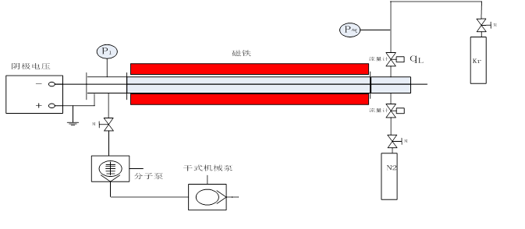
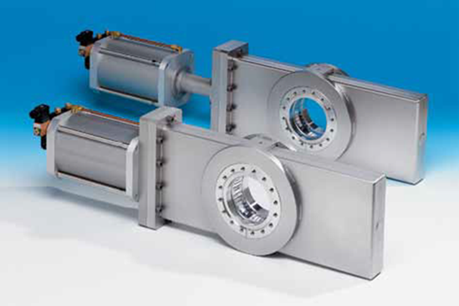
Motivation
Both types of dipole chambers are being fabricated. One is aluminum chamber for electron ring, another is copper chamber for positron ring. Some technical challenges such as extrusion, machining and welding will be solved.
The design method, machining and welding technology of the RF shielding bellows will be known well.
NEG coating setups will be built for a long vacuum chamber, and coating methods and process parameters will be studied. The structure, composition, SEY and pumping speed of NEG films will be measured.
The key technologies such as structure design, material choice, precision machining of components and accurate assembling etc. need to be solved, and the prototype of a all metal gate valve will be fabricated.
Switzerland VAT Co. exclusive products.

Slide 4
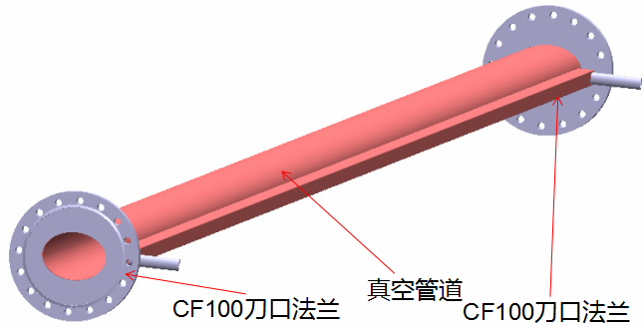
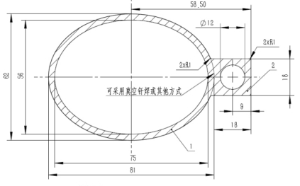
Al/Cu vacuum chamber
Material | Al (6061)、Cu (TU1)
Cross section | Ellipse with cooling water channel
Length | 1.5 m and 6 m for each material
Leak rate | ≤2.0*10⁻¹⁰Torr·L/s
Straightness | <0.5mm@6m; <0.2@1.5m

Slide 5
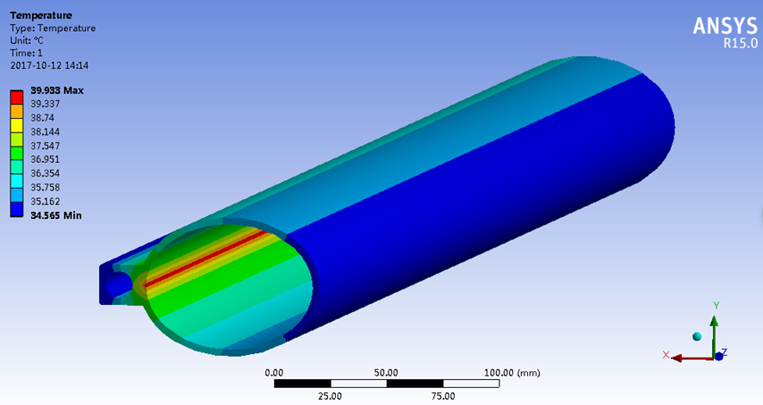
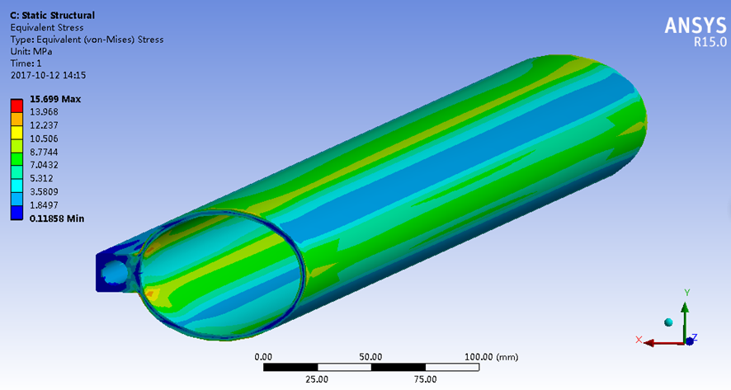
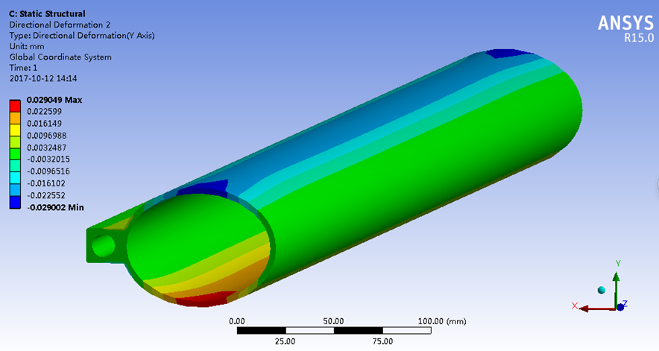
Finite element analysis for aluminum vacuum chamber
E=120GeV, I=17.4mA, h=1x10⁻³w/mm²⋅°C
The highest temperature reaches to 39.9 °C;
The maximum stress is 15.7 MPa;
The maximum deformation of X, Y and Z directions are 0.06 mm, 0.029 mm and 0.53 mm/m.

Slide 6
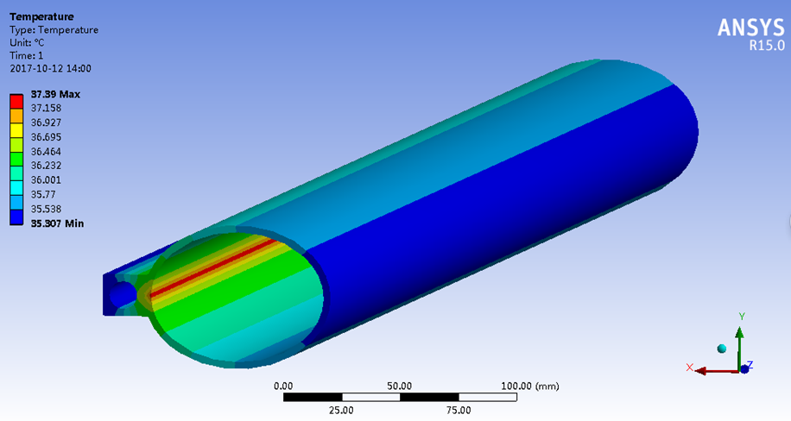
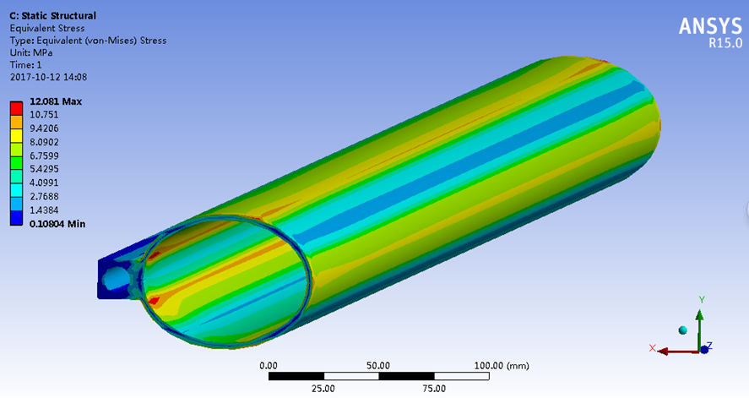
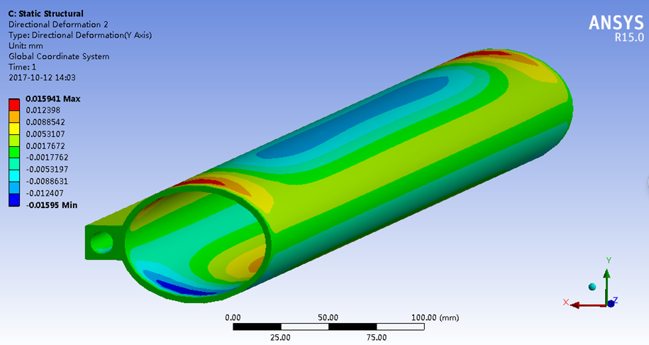
Finite element analysis for copper vacuum chamber
E=120GeV, I=17.4mA, h=1x10⁻³w/mm²⋅°C
The highest temperature reaches to 37.4 °C;
The maximum stress is 12.1 MPa;
The maximum deformation of X, Y and Z directions are 0.033 mm, 0.016 mm and 0.25 mm/m.

Slide 7
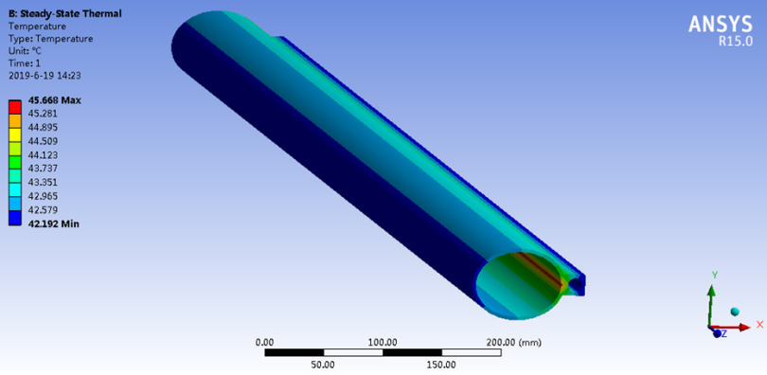
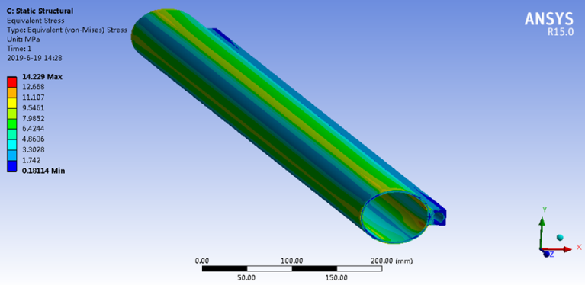
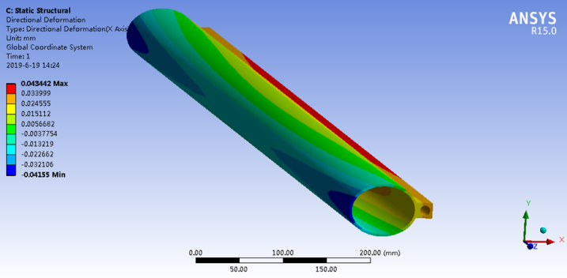
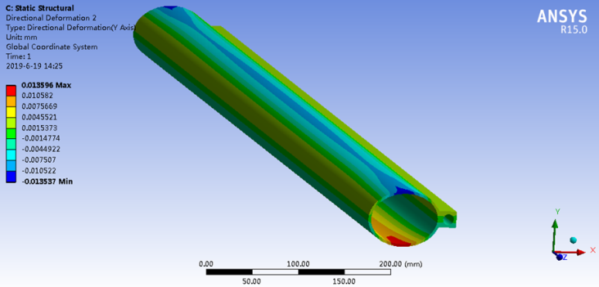
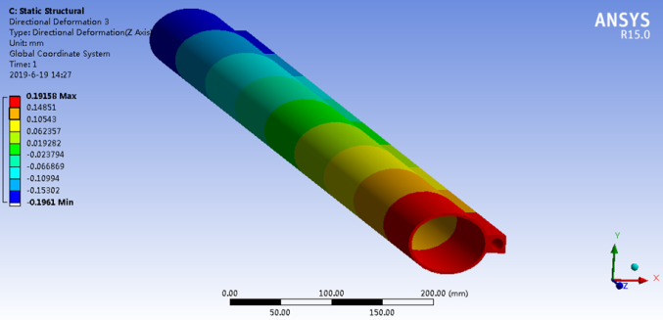
FEA of copper and aluminum vacuum chambers (50 MW Higgs)

Slide 8
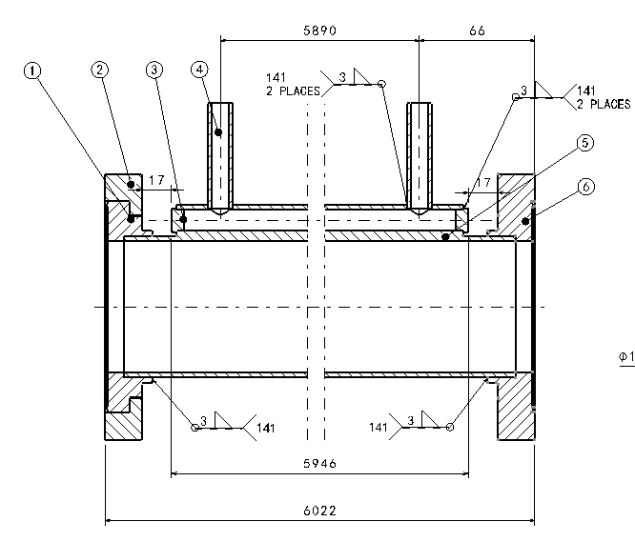
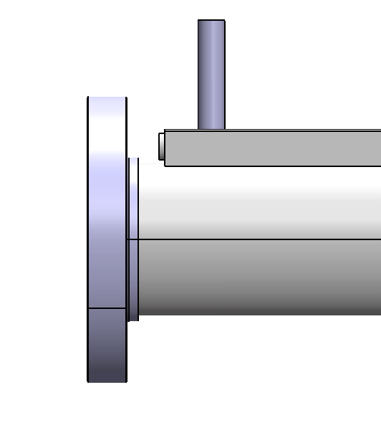
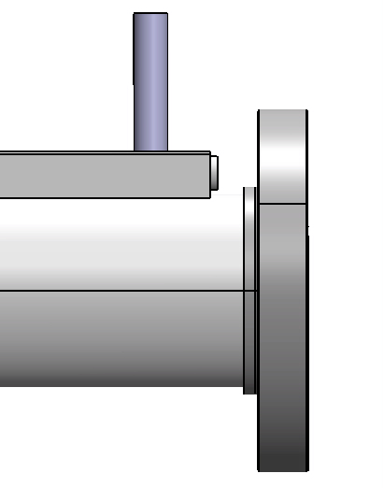
R&D of Al vacuum chamber
1. Structure of Al vacuum chamber
CF100 rotatable flange
CF100 no-rotatable flange
Al-6061 is chosen as the material of Al vacuum tube, and flanges are fabricated from explosion bonding S.S.-Al transition plate. Flange and tube are welded by manual AC TIG. The fittings for water cooling channels are also Al-6061 and are welded by TIG.

Slide 9
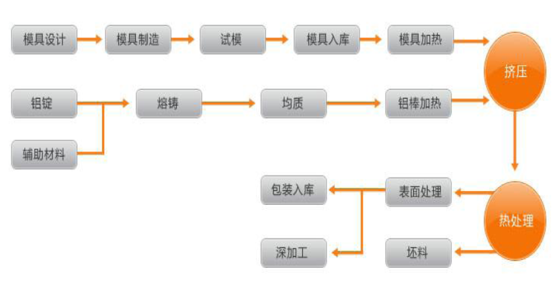
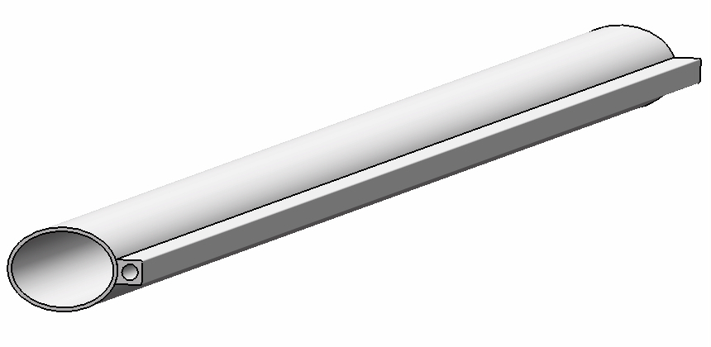
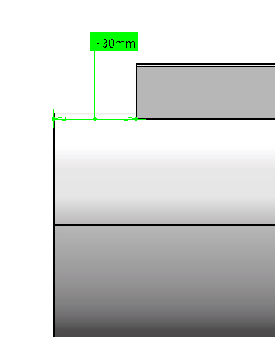
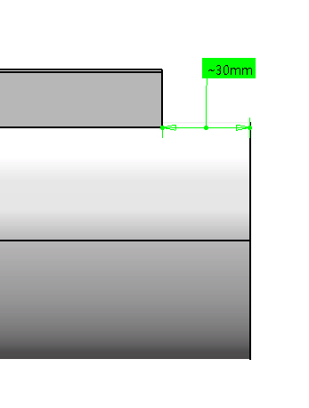
2. Fabrication process of Al vacuum tube
Aluminum vacuum tube is thermally extruded. Extrusion follows these steps as follows:
The connection ports of cooling water channel are machined by numerical control machine tool.

Slide 10
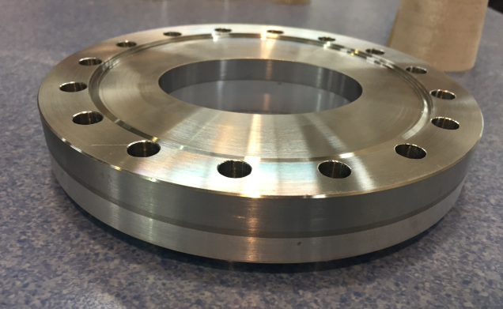
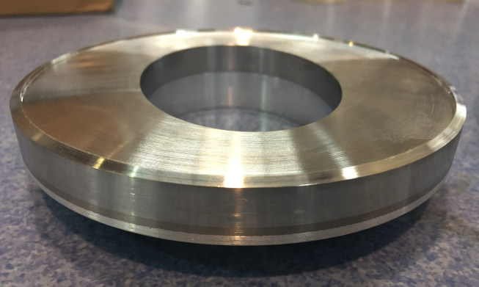
3. Conflat flanges of S.S.-Al transition material
S.S.-Al transition plate are fabricated through explosion bonding in a domestic company.
Ultrasonic flaw detection is used before the flange will be machined.
Leak detection is carried out after the flange has been machined.

Slide 11
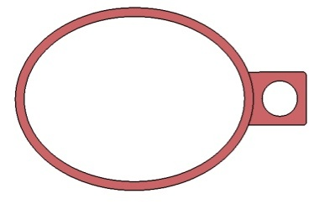
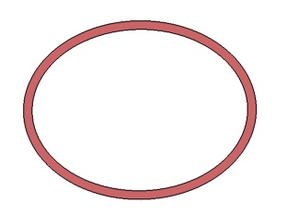
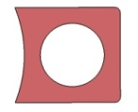
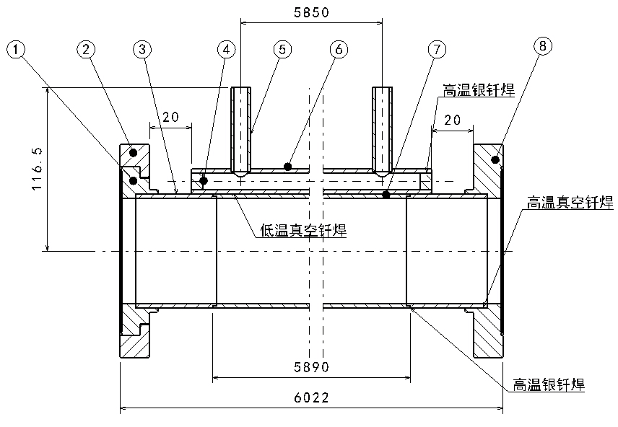
R&D of Cu vacuum chamber
Cu beam pipe and water cooling channel are extruded respectively, and brazed together.
Stainless steel material is used for flanges, and there is a rotatable flange at an end of vacuum chamber.
The flanges and beam pipe are welded by high temperature brazing solder, and low temperature brazing solder are used between the beam pipe and water cooling channel for a 6 m long high temperature vacuum furnace is difficult to be found.
Vacuum chamber
Beam pipe +
Cooling channel

Slide 12
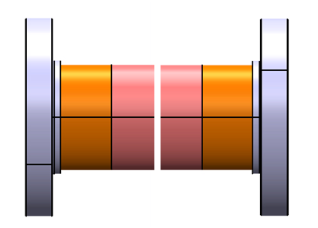
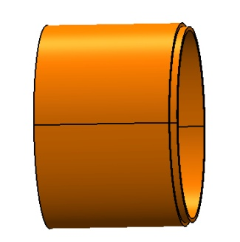
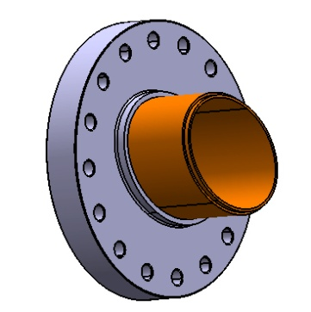
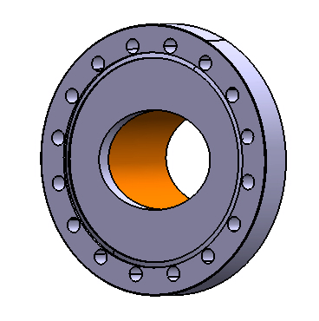
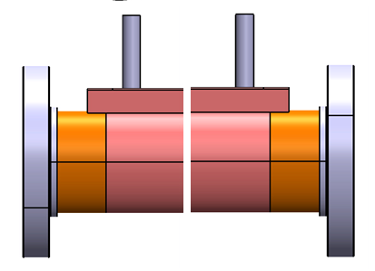
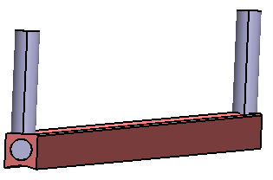
Technique process of Cu vacuum chamber
Leak detection
Transition tube machining
Brazing
Knife edge machining of flange
Silver brazing or TIG
Leak detection
Leak tests for hydraulic pressure and vacuum
Cleaning, leak detection, baking and pumping down
Welding between beam pipe and cooling channel with a low temperature brazing solder
Welding of fittings for cooling channel

Slide 13
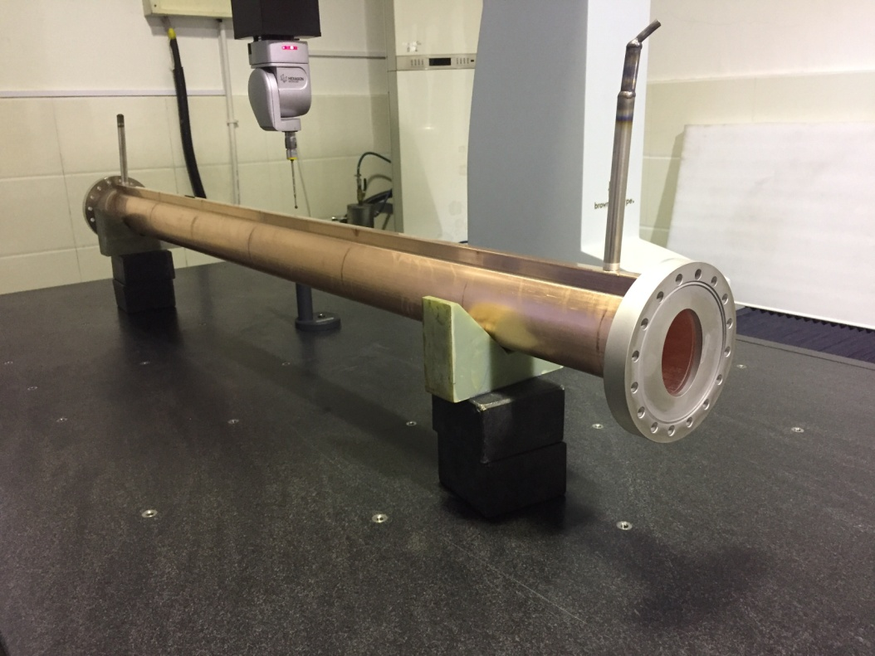
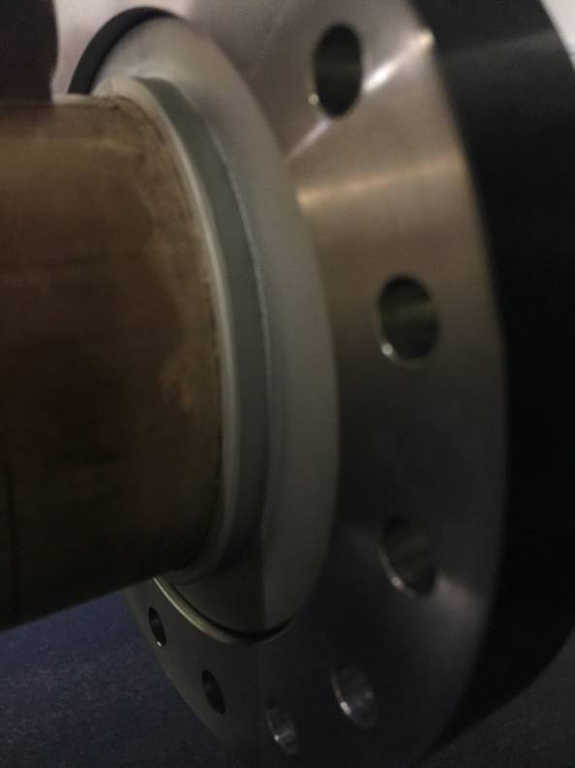
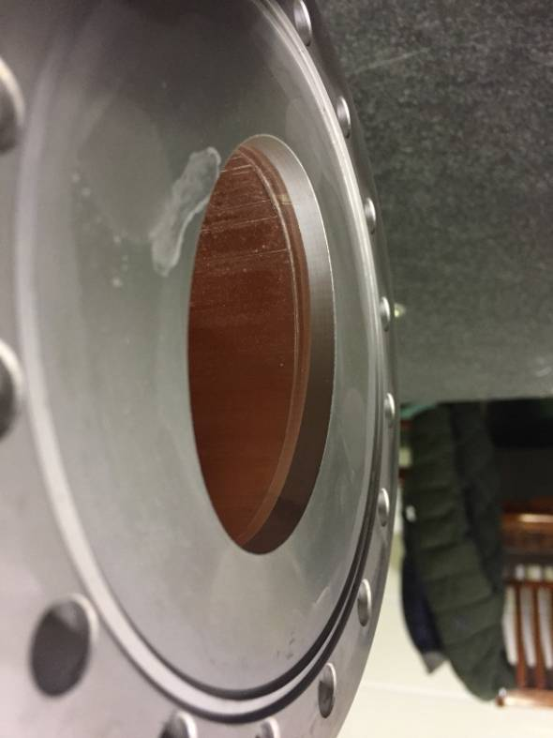
1.5 m long Cu vacuum chamber experiment prototype
The beam pipe, water cooling channel and flanges were together welded by 800℃ high temperature brazing solder in a vacuum furnace.
The prototype was checked by leak detection, hydraulic pressure test and three dimensional coordinate measurements.

Slide 14
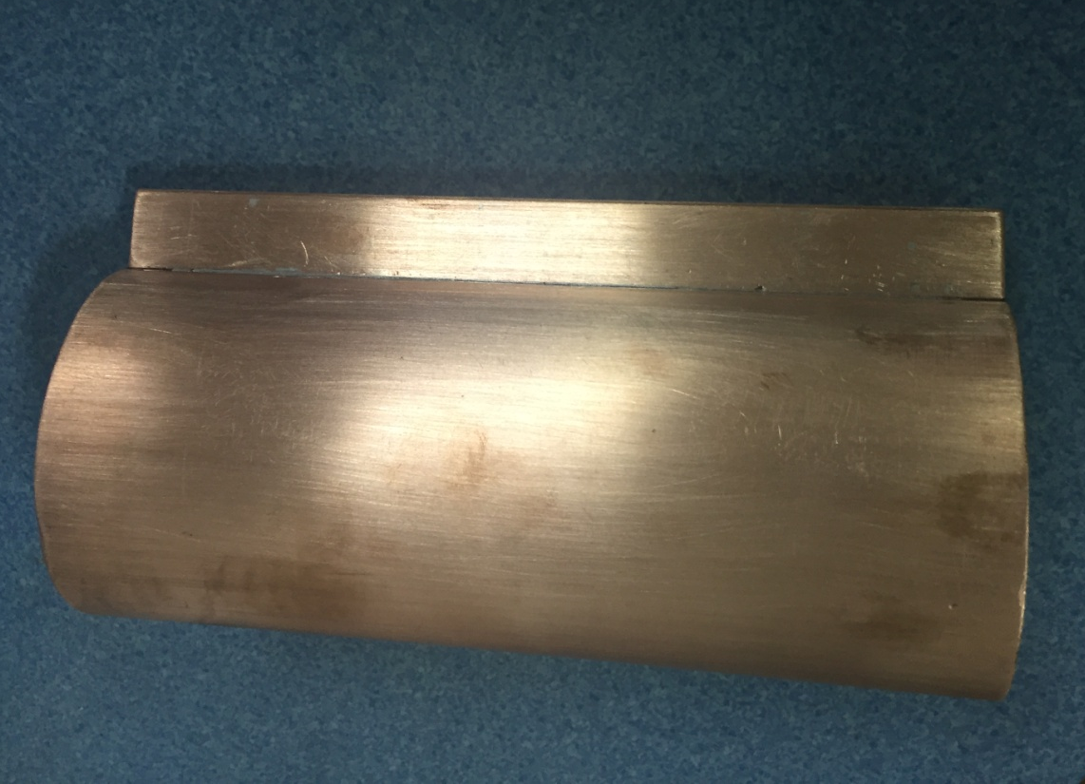
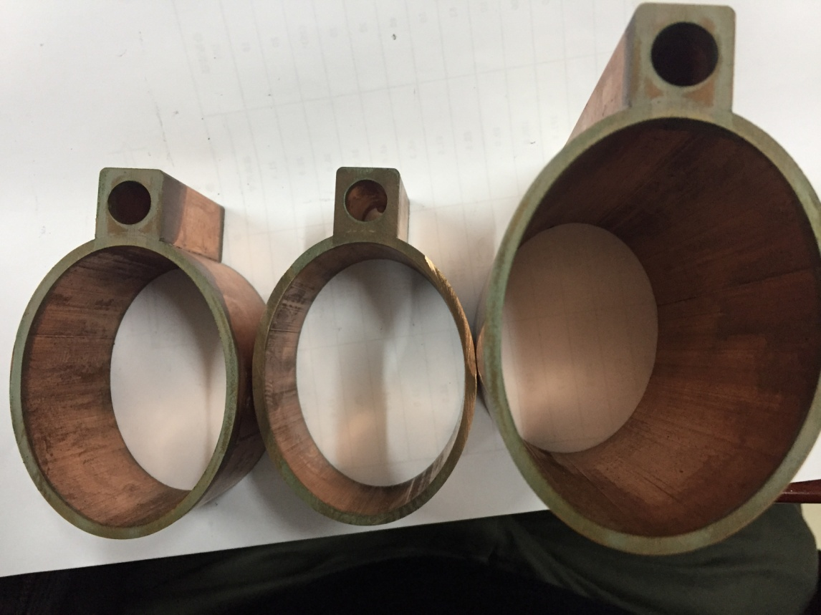
Welding samples with a low temperature brazing solder
The beam pipe and water cooling channel were welded by 300℃ low temperature brazing solder in a vacuum furnace.
A solder sheet was used to avoid the solder from overflowing or having interspaces.
The welding seams are checked by wire-electrode cutting.

Slide 15
Comparisons of several brazing experiments
First low temperature brazing
Second low temperature brazing
High temperature brazing
A solder wire was used in first low temperature brazing, the welding joints are rough and defective.
A solder sheet was used in second low temperature brazing, the welding joints are smooth and have good contacting.
High temperature brazing has a good result, and the strength of welding seam is higher than that of low temperature brazing.

Slide 16
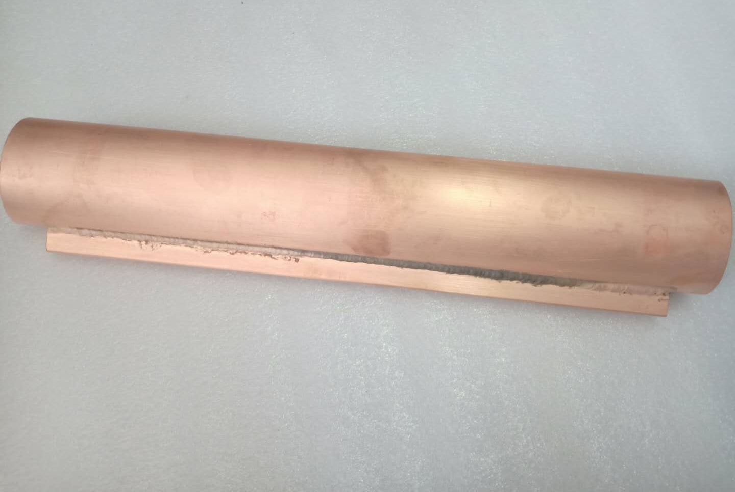
Cu pipe sample with a Tungsten Inert Gas welding
Welding method：manual TIG
Sample length：600mm
Straightness accuracy ：< 0.2mm
Good strength, weak contacting

Slide 17
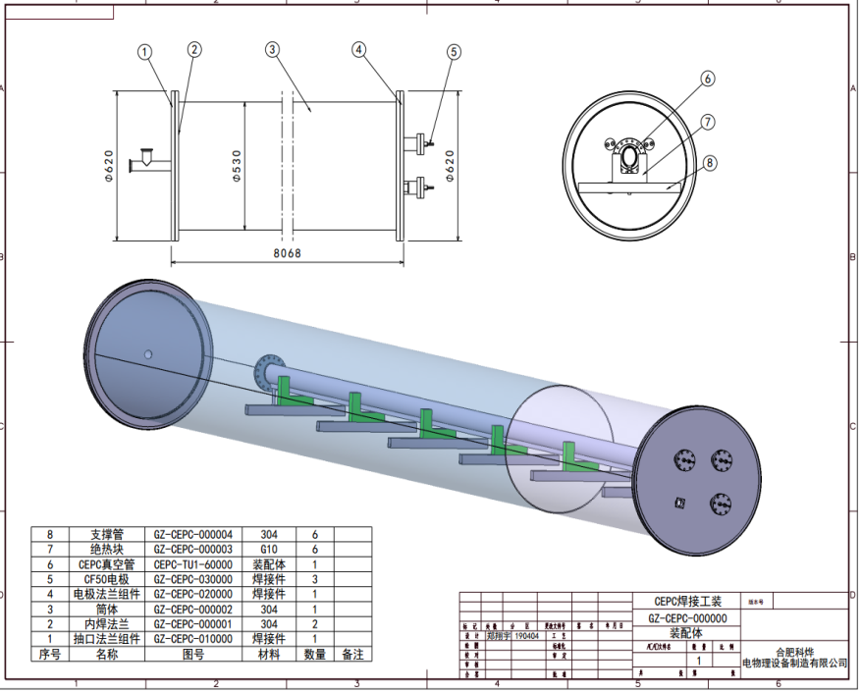
Next step plan for vacuum chambers
A 6 m long simple vacuum furnace will be fabricated, which is used to weld the water cooling channel of Cu chamber with low temperature brazing solder.
Al vacuum chamber with a length of 6 m will be welded, and its dimension and vacuum performance will be measured.
TIG welding experiments between stainless steel and copper will be carried out.
Simple vacuum furnace for brazing of Cu chamber

Slide 18
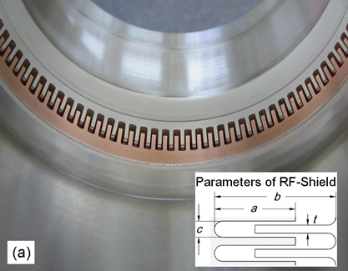
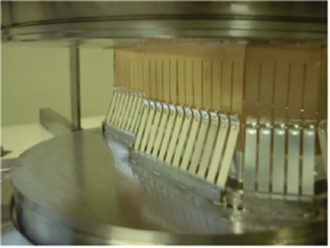
Bellows Module with RF Shielding
The primary function of the bellows module is to allow for thermal expansion of the chambers and for lateral, longitudinal and angular offsets due to tolerances and alignment, while providing a uniform chamber cross section to reduce the impedance seen by beam.
The usual RF-shielding is done with many narrow Be-Cu fingers that slide along the inside of the beam passage as the bellows is being compressed.
Comb-type (Supper KEKB)
High thermal strength
Low impedance, no sliding point
Limited stroke (±4 mm), small bending angle (±30 mrad )
Double-fingers type (usual)
Shielding finger + spring finger
Large expansion and contraction
Offset (±2mm), bending angle (±50 mrad )

Slide 19
RF shielding bellows Structure
Bellows module
Spring fingers module
Total length: 140 mm
Inner and exterior diameter of bellows: 125mm/140mm
Expansion/contraction: 5mm/12mm
Offset: 2 mm
Bending: 50 mrad
Contact fingers module

Slide 20
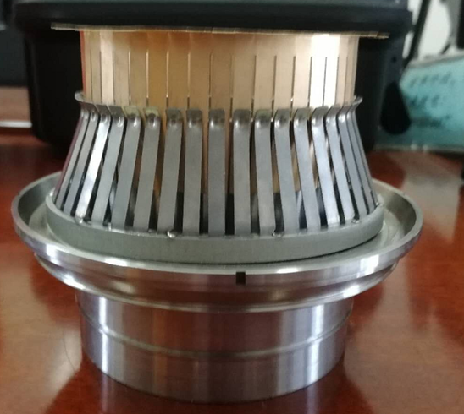
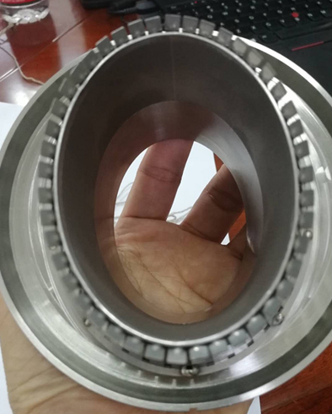
Spring fingers and contact fingers
There is a point contact between spring finger and contact finger in order to keep stable pressure.
Spring fingers material is Inconel 625, and thickness is 0.4 mm.
Contact fingers material is CuBe (C17200), and thickness is 0.2 mm.
The step between the inner tube and contact fingers is less than 1 mm.
Contact pressure is 125±25g/finger, allowing for the offset of 2 mm.

Slide 21
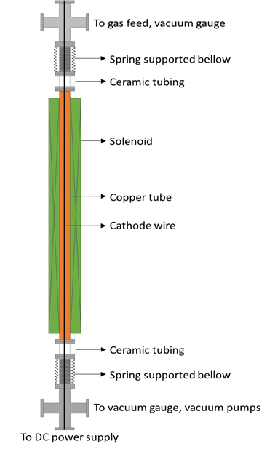
NEG coating inside of vacuum chamber
NEG coating suppresses electron multipacting (SEY < 1.2) and beam-induced pressure rises, as well as provides extra linear pumping.
The NEG coating is a titanium, zirconium, vanadium alloy, deposited on the inner surface of the chamber through magnetron sputtering.
Each dipole chamber will be fitted with three cathodes (made of twisting together Ti, Zr and V metal wires) mounted along the chamber axis to achieve uniform thickness distribution.
Minimum effective thickness of NEG films (such as 1 μm to 200 nm) or part of NEG coating inside the inner surface of a vacuum chamber need to be studied for decreasing the resistive wall impedance.

Slide 22
NEG coating setup
The setup of NEG coating has been built, and some experiments have been done.
All related parameters (plasma gas pressure, substrate temperature, plasma current, and magnetic field value) will be recorded and suitably adjusted to ensure the stability of the deposition process.
A horizontal coating equipment is easy to be installed, and long vacuum chambers can be coated by moving the magnet.

Slide 23
A 8 m long twisting wires device has been built.
Ti, Zr and V metal wires with length of 6 m and diameter of 1 mm each have been twisted together successfully.

Slide 24
NEG Coating experiments

Slide 25
XPS & SEM Analysis for NEG film samples
0 nm
10 nm
Thickness of film: ∼1.1 μm
Proportion: Ti：Zr：V=0.28 : 0.3 : 0.42
( after Ar⁺ surface etching of 10 nm)
Columnar film for high pumping speed.

Slide 26
Pumping speed measurements for NEG films
A high pure hydrogen（99.999%）is introduced by the injection valve, the gas passes through the coated pipe and is absorbed by the NEG film. The P2/P1 ratio is measured by the pressure gauges, which is related to the average sticking probability and pumping speed of the pipe walls.

Slide 27
Measurement results of pumping speed for NEG film
NO | P2/P1 | Sticking probability | S [L/(s⋅cm²)] | Note
CEPC4-B2-180-24 for H2 | 8.5 | 0.0055 | 0.242 | Stainless steel pipe Length * diameter：750*35
CEPC4-B2-200-20 for H2 | 11.6 | 0.0068 | 0.2992
CEPC4-B2-225-20 for H2 | 17.5 | 0.0088 | 0.3872
CEPC4-B2-250-20 for H2 | 17 | 0.0087 | 0.3828
CEPC4-B2-275-20 for H2 | 8 | 0.0052 | 0.2288
CEPC4-B2-300-20 for H2 | 3.5 | 0.0025 | 0.11

Slide 28
R&D of all metal gate valves
All metal gate valves are only produced by VAT company in Switzerland.
The VAT patents have not been applied in China.
The structure of the VAT gate valves may be copied.
A new sealing structure is being studied.
Three domestic companies are interested in R & D, and started the designs and experiments.

Slide 29
Patent investigation of VAT gate valves

Slide 30
Dismantle and measurement of DN100 gate valve
Inner structure of gate valve
Valve open status
Valve close status

Slide 31
Three dimensional drawings of a DN100 gate valve
VAT-Ring (gasket)

Slide 32
A new sealing mode with circular bowl structure
Open status
Close status

Slide 33
Summary
The engineering drawings, FEA, technique designs and manufacture contract for the vacuum chambers have been completed, and1.5m long experimental prototypes were fabricated.
The investigation and engineering designs of RF shielding bellows have been finished, the key components experiments such as spring fingers and contact fingers are carrying out.
The technology route of NEG coating for 6m long vacuum chamber has been proposed, NEG coating tests have been being carried out, and preliminary results meet the engineering requirements.
The structure of all metal gate valves are studied, and a three-dimensional model has been set up. The key technique experiments will be done.

Slide 34
Thank you！

