Slide 1
CEPC superconducting magnets in interaction region
Yingshun Zhu*, Xiangchen Yang, Ran Liang, Miaofu Xu, Da Chen
Institute of High Energy Physics, Chinese Academy of Sciences
June 28, 2019
CEPC working day

Slide 2
Outline
Overall introduction of CEPC IR superconducting magnets
Design progress of QD0
Detailed design of QD0 short model magnet
Fabrication preparation of QD0 short model magnet
Summary

Slide 3
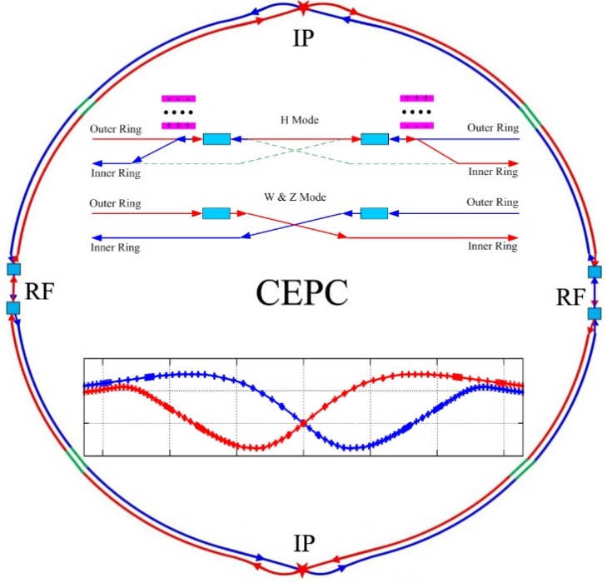
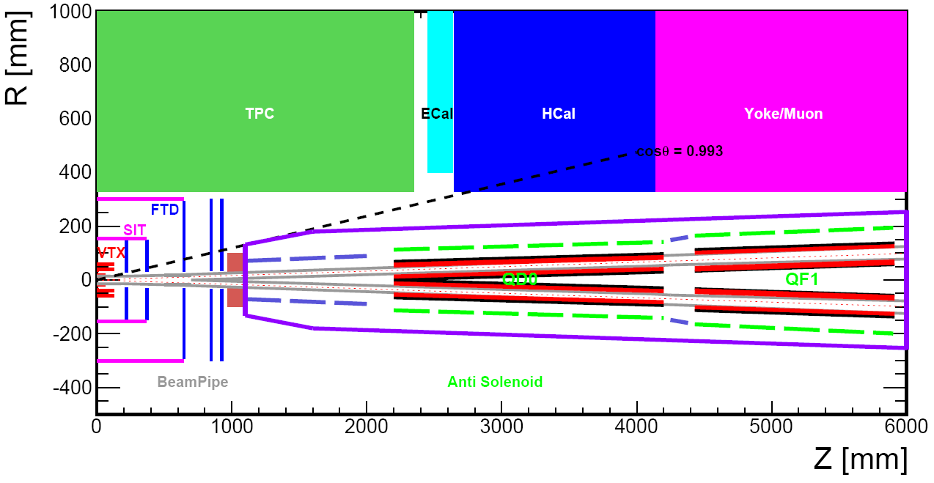
Introduction
CEPC is a Circular Electron Positron Collider with a circumference about 100 km, beam energy up to 120 GeV proposed by IHEP.
Most magnets needed for CEPC Accelerator are conventional magnets.
Compact high gradient final focus quadrupole magnets are required on both sides of the collision points in interaction region of CEPC collider ring.
CEPC MDI layout
Sketch of CEPC Collider ring

Slide 4
The CDR requirements of the Final Focus quadrupoles (QD0 and QF1) are based on the L* of 2.2 m, beam crossing angle of 33 mrad.
QD0 and QF1 magnets are operated full inside the field of Detector solenoid magnet with a central field of 3.0 T.
To minimize the effect of the longitudinal detector solenoid field on the accelerator beam, anti-solenoids before QD0, outside QD0 and QF1, after QF1 are needed, so that the total integral longitudinal field generated by the detector solenoid and accelerator anti-solenoid is zero.
Table 1: Requirements of Interaction Region quadrupole magnets for Higgs
Magnet | Central field gradient (T/m) | Magnetic length (m) | Width of GFR (mm) | Minimal distance between two aperture beam lines (mm)
QD0 | 136 | 2.0 | 19.6 | 72.6
QF1 | 110 | 1.48 | 27.0 | 146.20

Slide 5
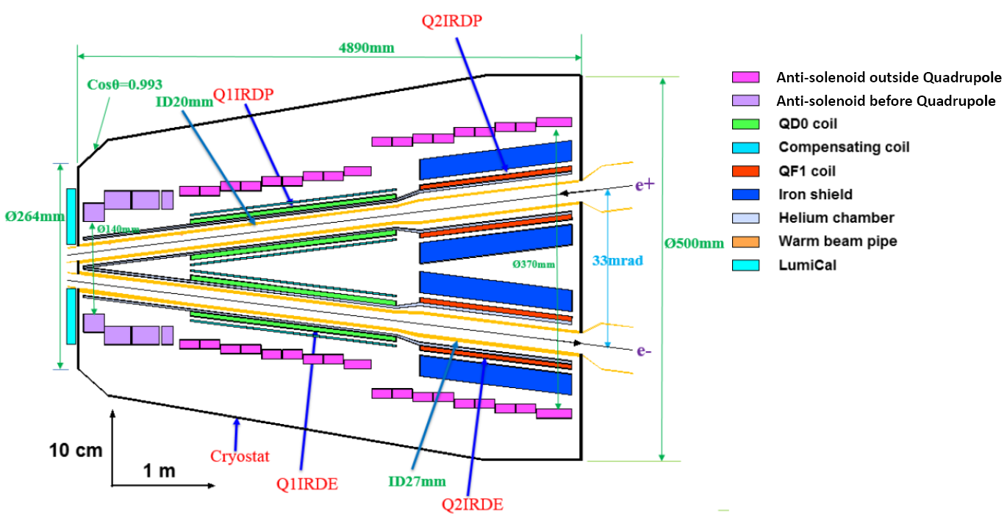
CEPC MDI SC Magnets including: superconducting QD0,QF1, anti-solenoid on each side of the IP points. In addition, there are 32 superconducting sextupole magnets in IR.
QD0, QF1, and anti-solenoid coils are in the same cryostat:
Schematic layout of QD0, QF1, and anti-solenoid

Slide 6
Design progress of QD0
In the R&D stage of CEPC project, superconducting prototype magnets for the MDI will be developed in three consecutive steps:
Development of double aperture superconducting quadrupole prototype magnets QD0 (0.5m model and 2m prototype).
Development of short combined function superconducting prototype magnet including QD0 and anti-solenoid.
3) Development of long combined function superconducting prototype
magnet including QD0, QF1 and anti-solenoid.
Supported by “Wang Yifang scientist studio” and National Natural Science Foundation of China, the Step 1 of the R&D has started: Development of double aperture superconducting quadrupole QD0.

Slide 7
Main design requirements of QD0
Other requirement: Heat load and Radiation dose resistant.
Item | Requirement
Central field gradient (T/m) | 136
Magnetic length (m) | 2.0
Radius of GFR (mm) | 9.8
Multipole field B_{n}/B₂ | ≤5.0×10⁻⁴ (each aperture)
Dipole field | ≤10Gs (each aperture)
Crossing angle of aperture centerlines | 33 mrad
Distance to IP point (m) | 2.2
Minimal distance between two aperture centerlines (mm) | 72.6

Slide 8
Design challenges of QD0:
High field strength
High field quality in small aperture
Elimination of magnetic field crosstalk between two apertures
Very limited radial space
Minimal distance between two aperture beam lines: 72.6 mm
Radius of GFR: 9.8mm
Minimum bore radius of aperture: 20mm (space for beam pipe, helium vessel)
Available radial space for single aperture quadrupole:72.6/2-20= 16.3mm.

Slide 9
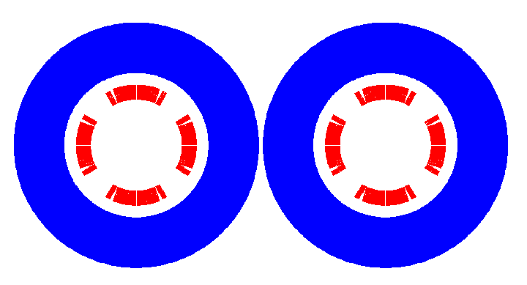
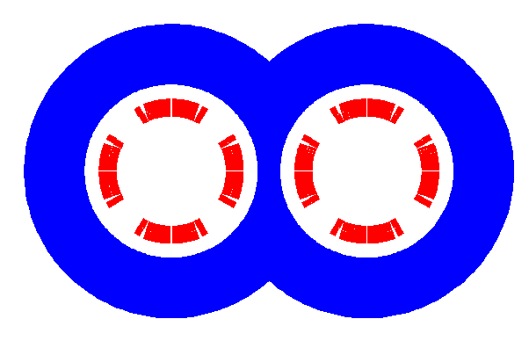
The only practical solution is: NbTi cos2θ quadrupole coil with iron yoke.
Main reason:
High magnetic efficiency, elimination of field crosstalk, high cooling capacity.

Slide 10
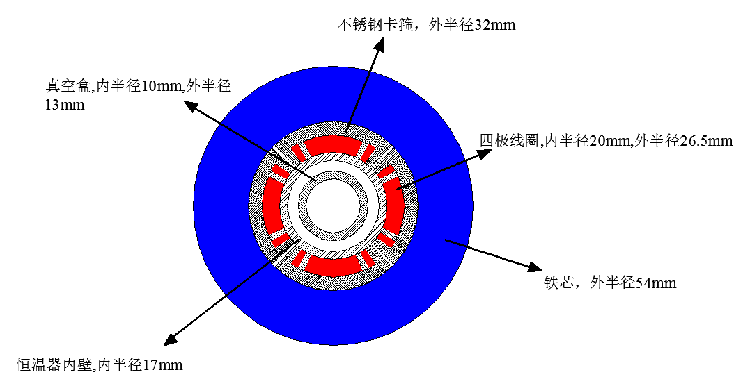
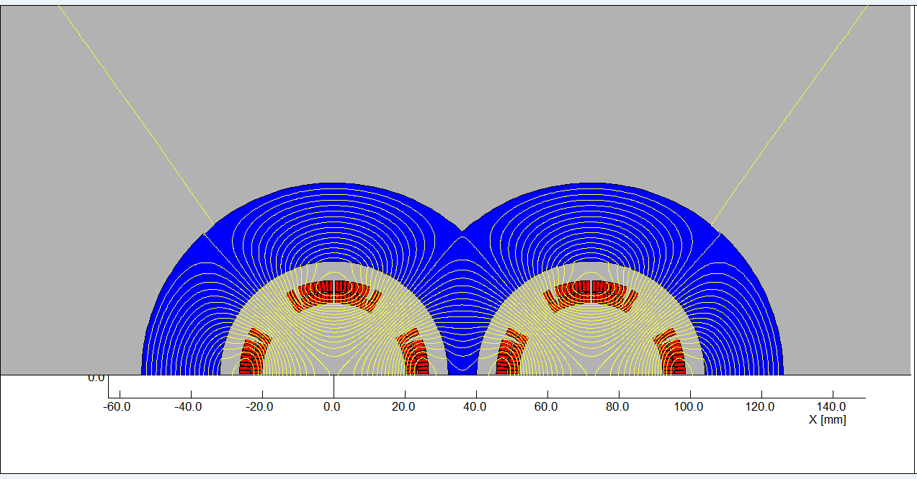
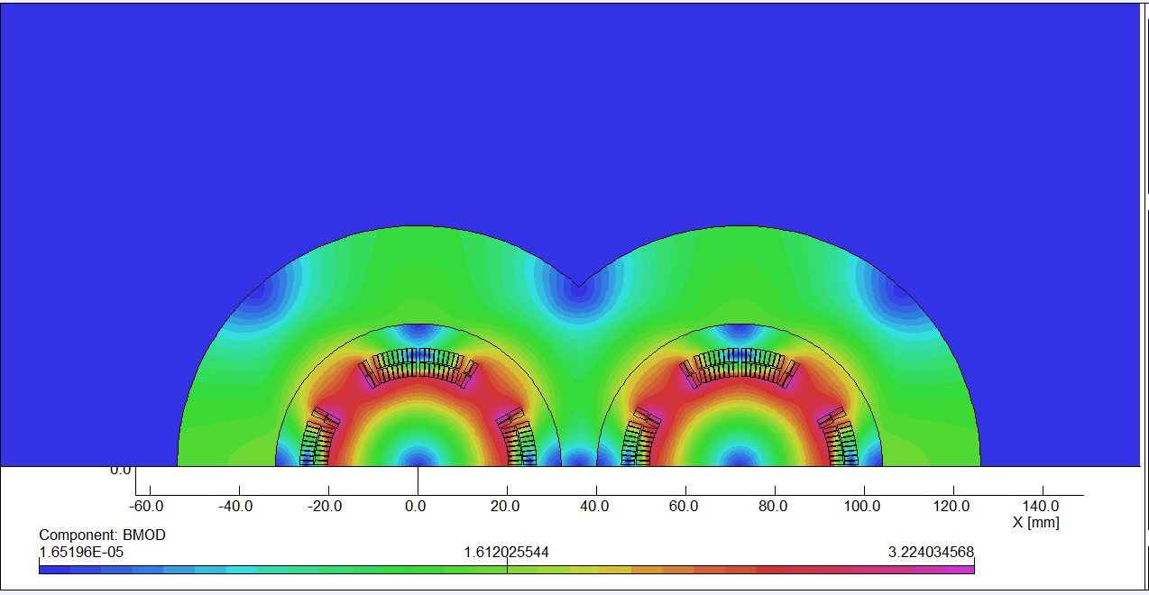
QD0 2D:

Slide 11
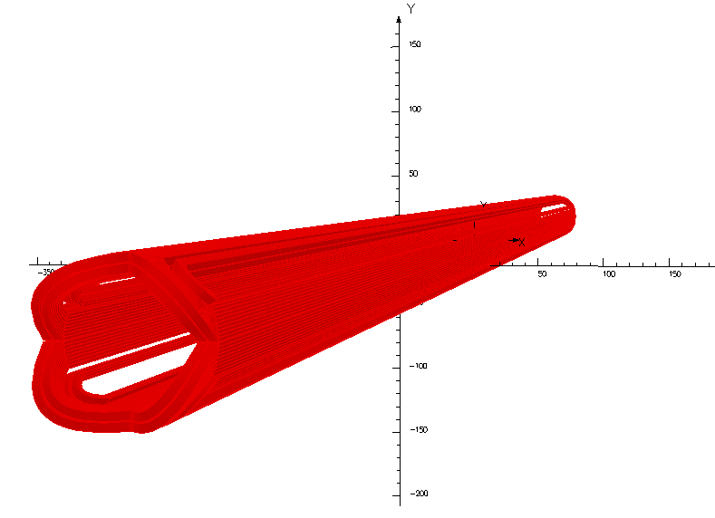
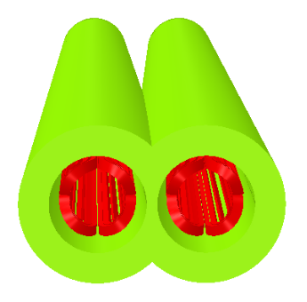
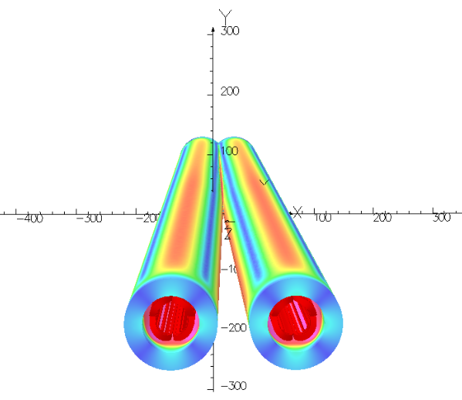
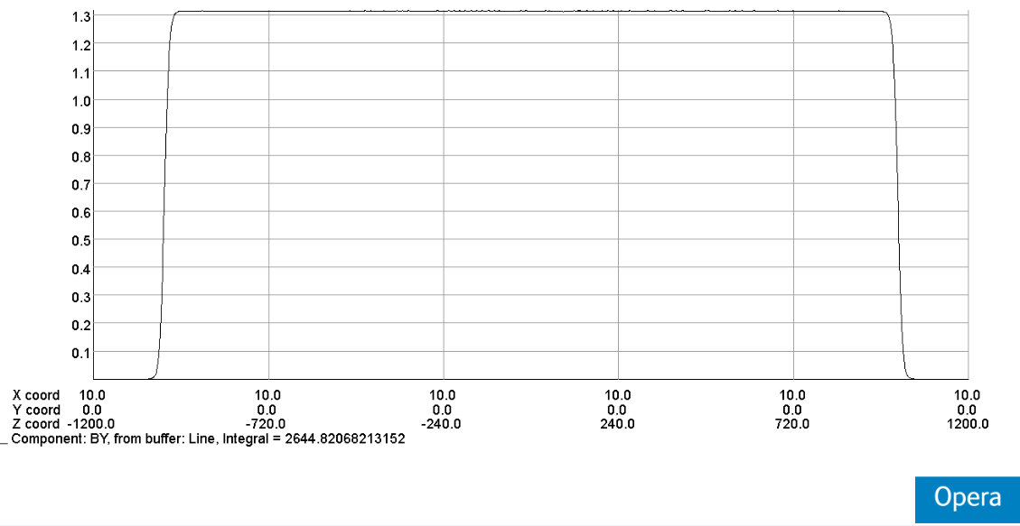
QD0: Quadrupole magnet using cos2θ coil with iron yoke, with crossing angle between two apertures. Satisfy all design requirements.
Novel design, the first such magnet in the world!

Slide 12
Detailed design of QD0 short model magnet
Magnetic design
cos2θ superconducting quadrupole magnet is one of the main magnets used in Tevatron, HERA, RHIC, LHC, etc.; It is also key devices in LEP, BEPCII, SuperKEKB, etc.
So far, there is no cos2θ superconducting quadrupole magnet developed in China.
In the R&D of CEPC interaction region superconducting magent, the first step is to develop a short QD0 model magnet with 0.5m length (near IP side).
The aim of QD0 short model magnet:
Verify magnet design
Exploring the magnet manufacturing technology
Master magnet cryogenic testing Technology
Lay the foundation for the development of long QD0 prototype

Slide 13
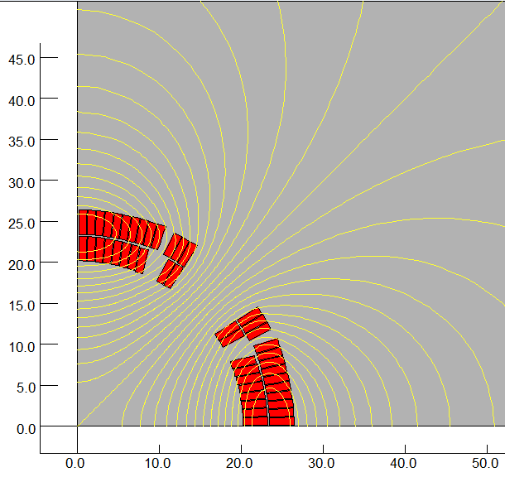
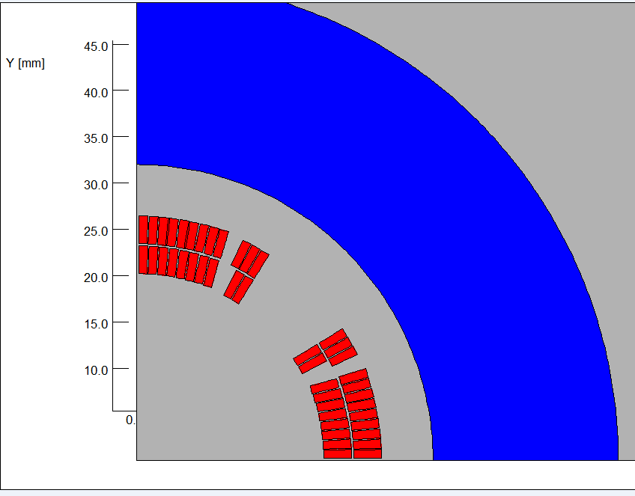
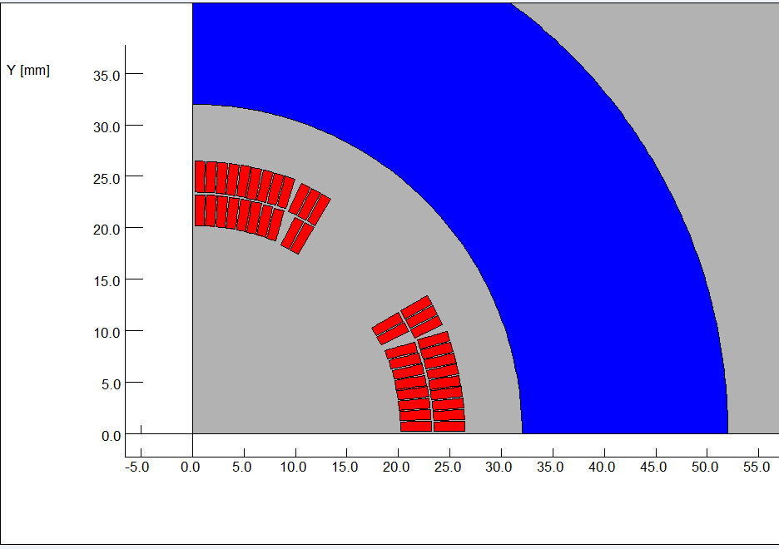
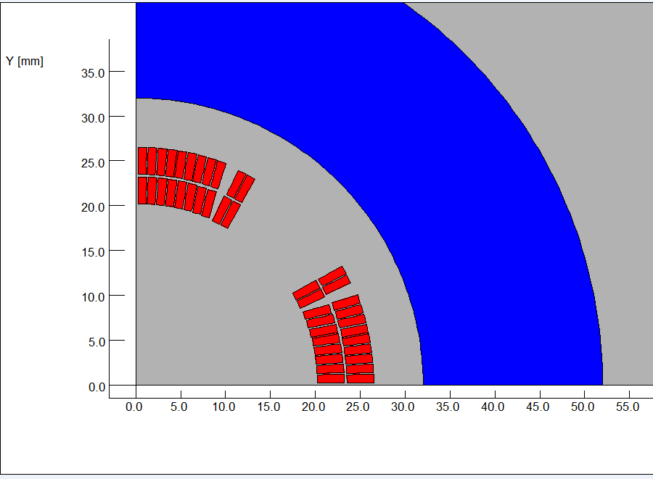
Magnetic design of QD0 short model magnet
Different coil layouts were investigated:

Slide 14
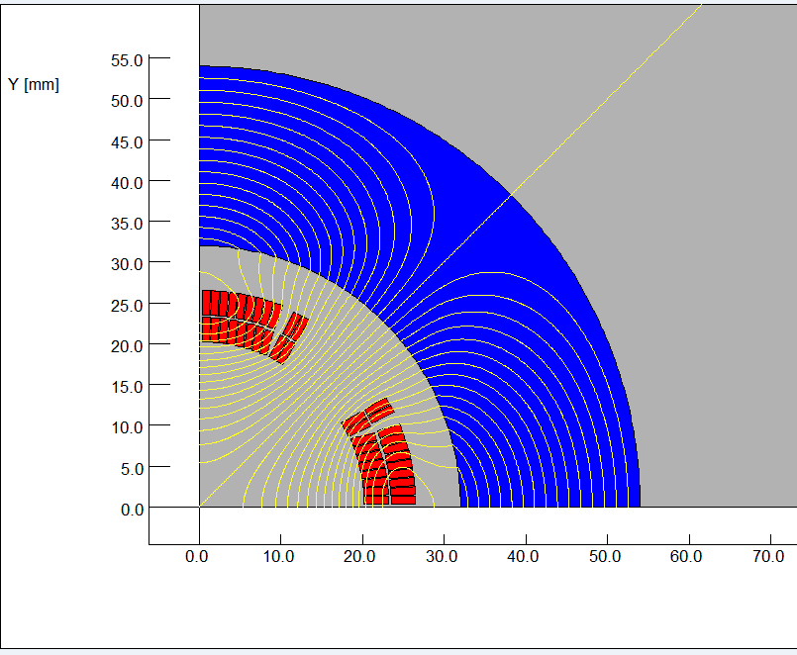
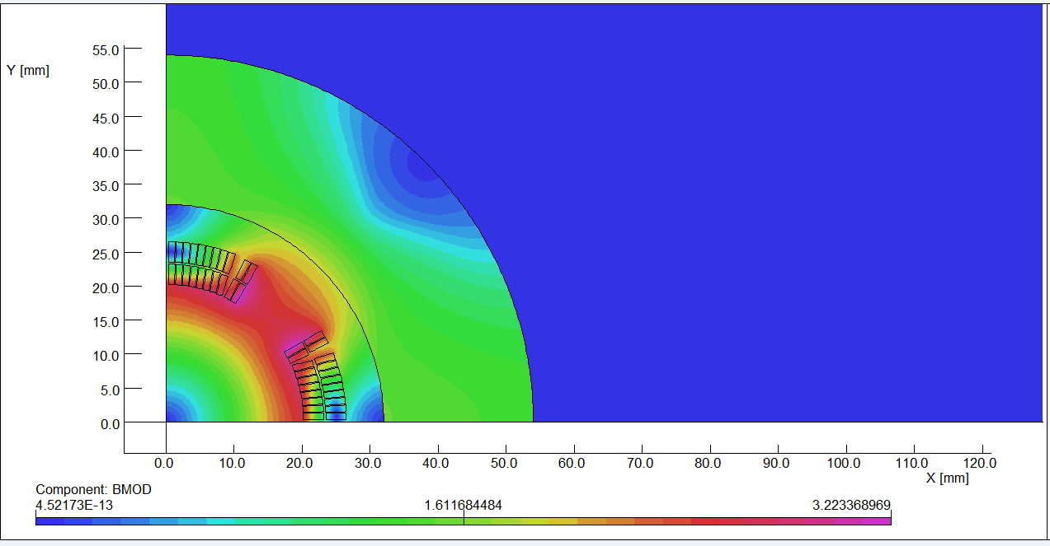
The design of QD0 short model magnet is based on two layers cos2θ quadrupole coil using Rutherford cable with iron yoke.
The QD0 single aperture coil cross section is optimized with four coil blocks in two layers separated by wedges, and there are 21 turns in each pole.
2D magnetic field calculation is performed using OPERA.
Actual insulation thickness and coil fabrication process are taken into account.
2D flux lines (1/4 cross section)
Magnetic flux density distribution

Slide 15
The excitation current of QD0 is 2080A, and I_{op}/_{Ic}<75% @4.2K.
Field quality in single aperture meets the requirement.
Each multipole field is smaller than 2×10⁻⁴.
Table 2: 2D field harmonics (unit, 1×10⁻⁴)
n | B_{n}/B₂@R=9.8mm
2 | 10000
6 | 1.04
10 | -1.85
14 | 0.03

Slide 16
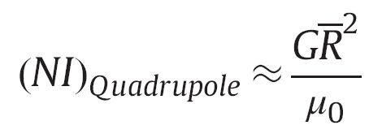
The coil turns, coil dimension, inner radius of iron yoke and the excitation current of QD0 are consistent with the self developed Ampere-Turns theoretical expressions for superconducting quadrupole magnets based on sector coils.
(no iron)
(with iron)
Yingshun Zhu, et al., Study on Ampere-Turns of Superconducting Dipole and Quadrupole Magnets Based on Sector Coils, Nuclear Instruments and Methods in Physics Research A, 2014, 741: 186-191.

Slide 17
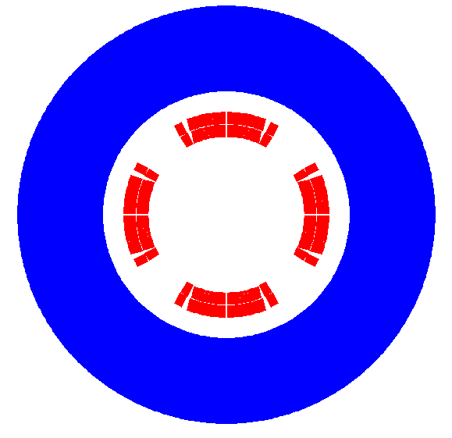
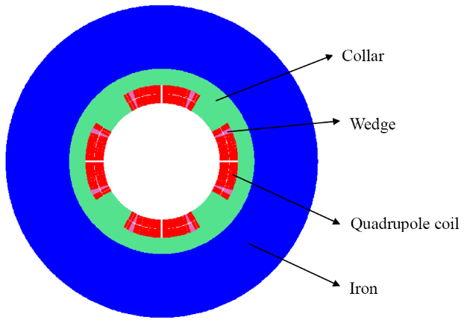
Single aperture QD0:

Slide 18
2D field cross talk of QD0 two apertures:
2D Flux lines
Bmod distribution

Slide 19
In 2D case where the distance between the two aperture is the smallest and the field crosstalk is the most serious, iron yoke can well shield the leakage field of each aperture. The field harmonics as a result of field crosstalk between the two apertures is smaller than 0.5×10⁻⁴.
The dipole field is smaller than 10 Gs.
In other cases where the distance between the two apertures becomes larger, the field harmonics as a result of field crosstalk will be smaller.
Using the iron yoke, the field harmonics as a result of the field crosstalk is not a problem.
In addition, compared with the iron-free design of QD0, the excitation current can be reduced.

Slide 20
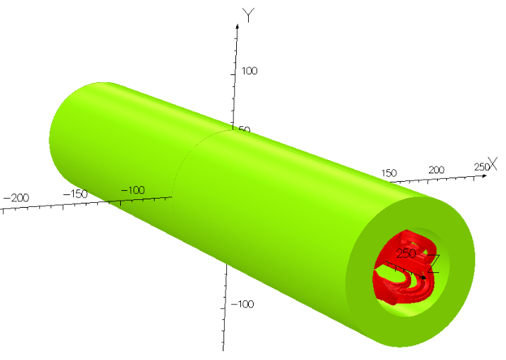
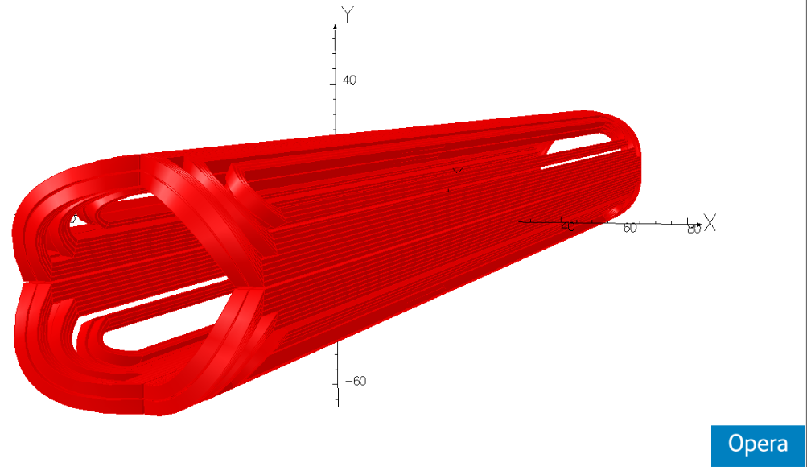
QD0 is modelled in OPERA-3D.
Firstly one single aperture QD0 is modelled, the field gradient exceeds 136 T/m, and field quality is good.
Then QD0 two apertures are modelled, the multipole fields induced by the field cross talk of the two apertures are obtained.

Slide 21
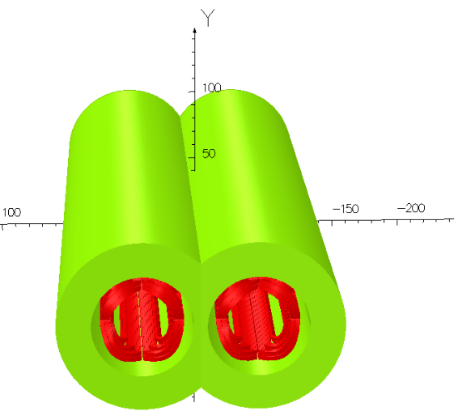
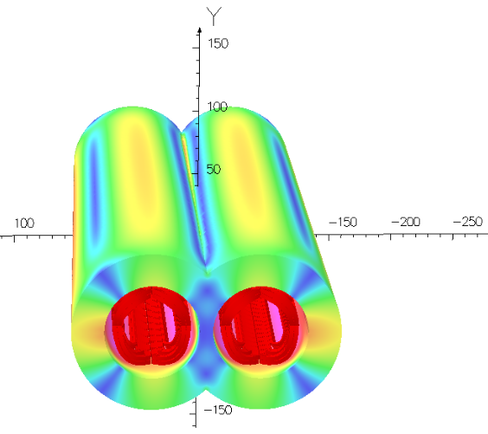
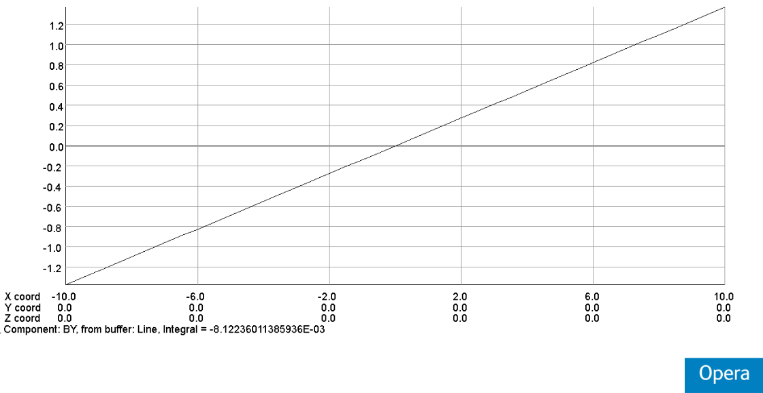
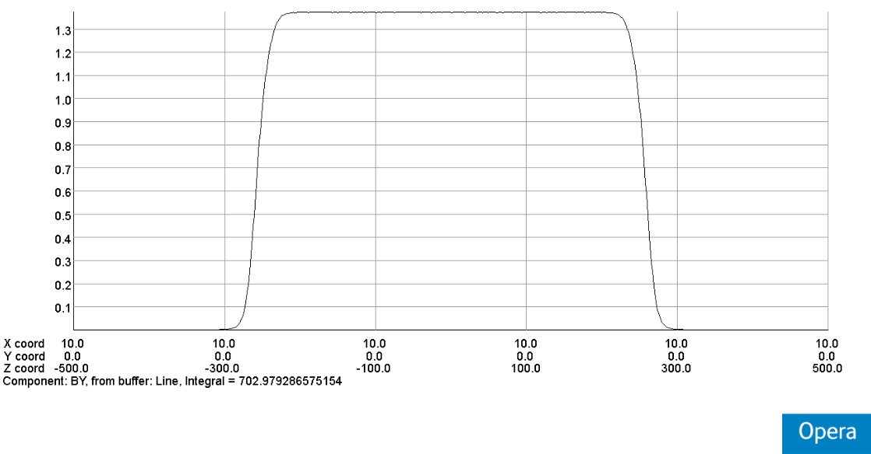
3D field simulation of two apertures 0.5m QD0.

Slide 22
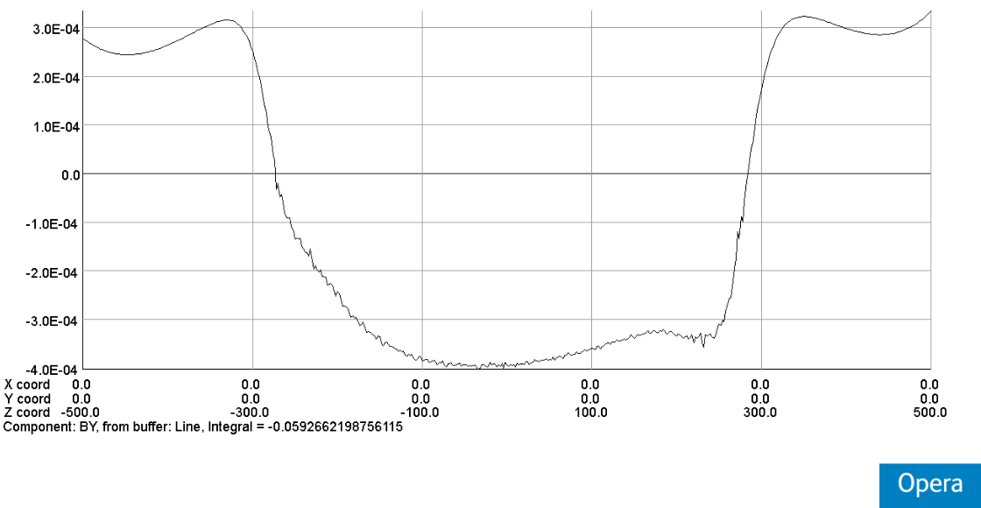
3D field simulation result shows that, iron yoke can well shield the leakage field of each aperture, so field cross talk is not a problem.
Each integrated multipole field as a result of field crosstalk between the two apertures is smaller than 0.5×10⁻⁴.
The dipole field is smaller than 10 Gs at each longitudinal position.
Table 3: 3D field harmonics（unit, 1×10⁻⁴）
n | B_{n}/B₂@R=9.8 mm
2 | 10000.0
3 | -0.28
4 | 0.017
5 | -0.01
6 | 0.06
7 | -0.02
8 | 0.022
9 | 0.012
10 | -1.78
11 | -0.02
12 | 0.015
By along (0,0)

Slide 23
Design parameters of QD0 short model magnet:
Table 4: Design parameters of QD0 model magnet
Magnet name | QD0 model magnet
Field gradient (T/m) (In two apertures) | 136
Magnetic length (m) | 0.5
Coil turns per pole | 21
Excitation current (A）(In two apertures) | 2080
Coil layers | 2
Conductor | Rutherford Cable, width 3 mm, mid thickness 0.93 mm, keystone angle 1.9 deg, Cu:Sc=1.3, 12 strands
Stored energy (KJ) (Double aperture) | 5.0
Inductance (H） | 0.0023
Peak field in coil (T) | 3.4
Coil inner diameter (mm) | 40
Coil outer diameter (mm) | 53.2
X direction Lorentz force/octant (kN) | 24.6
Y direction Lorentz force/octant (kN) | -23.7

Slide 24
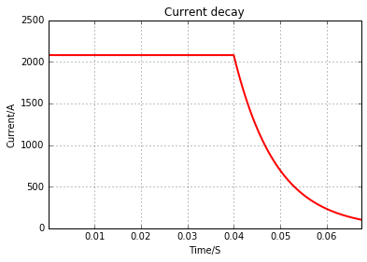
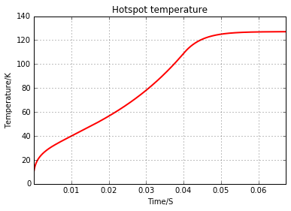
Quench simulation of QD0 model magnet
Dump resistance=25mΩ，Delay time= 40 ms.
Hot spot temperature: 127K
Magnet resistance: 2.18mΩ
Peak voltage : 500V

Slide 25
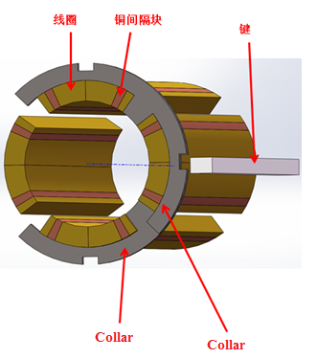
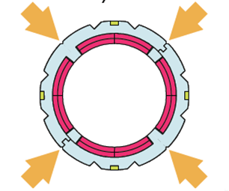
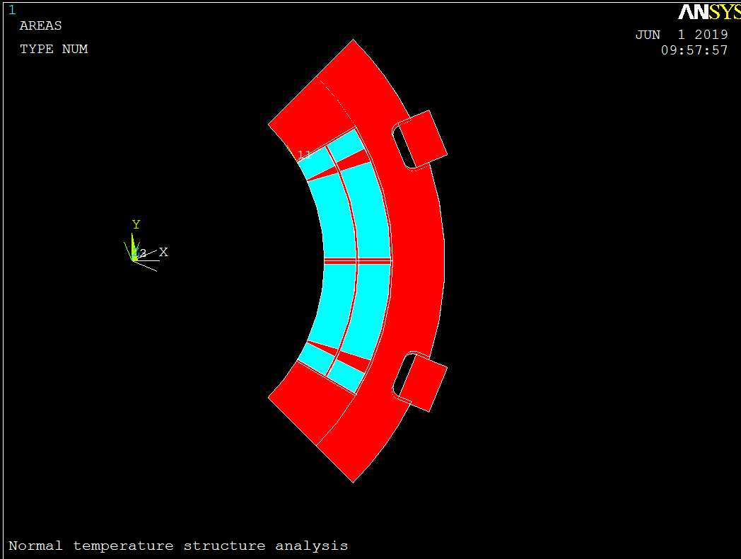
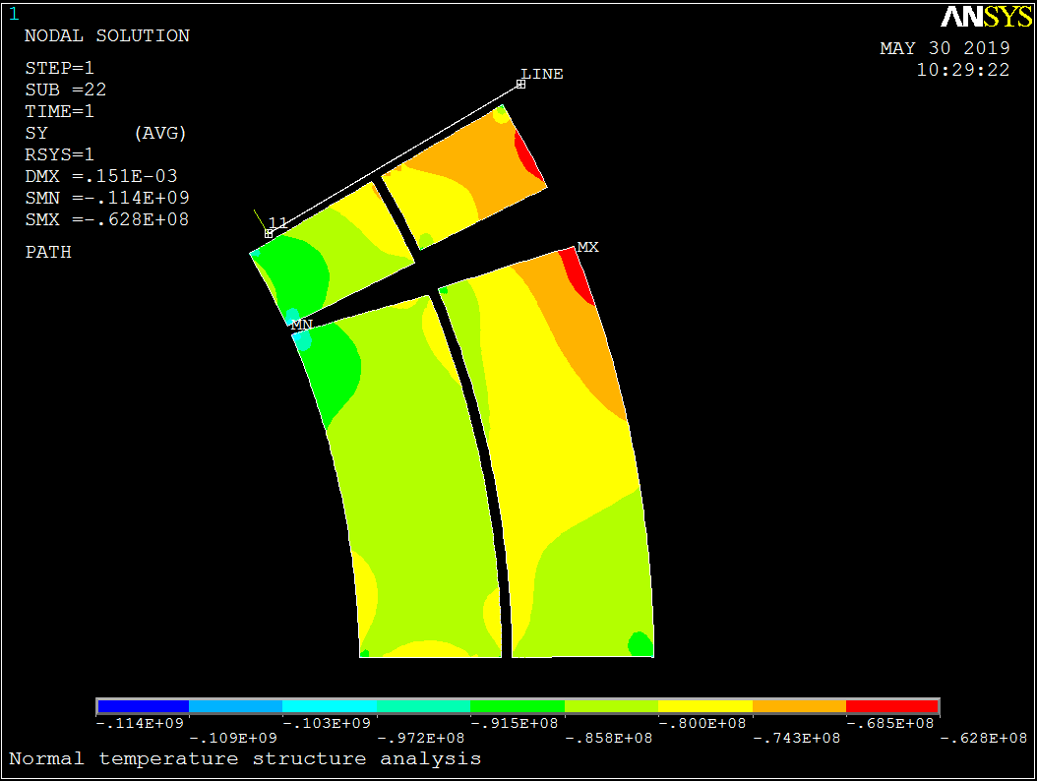
Stress analysis of QD0 short model magnet:
Model
Stress when assembled

Slide 26
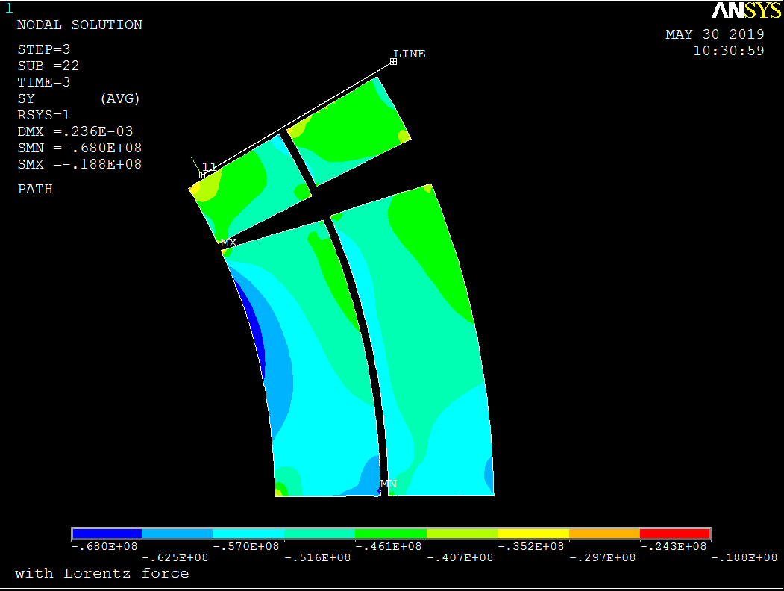
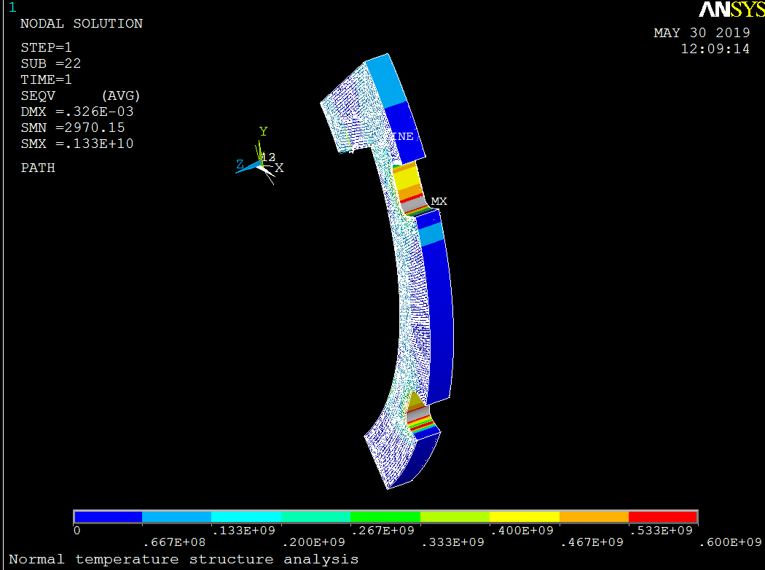
Stress analysis of QD0 short model magnet:
The FEM analysis result shows that, the stress in each component during each operation step is safe.
Collar material with high strength is required.
Stress in coil after excitation
Stress in collar

Slide 27
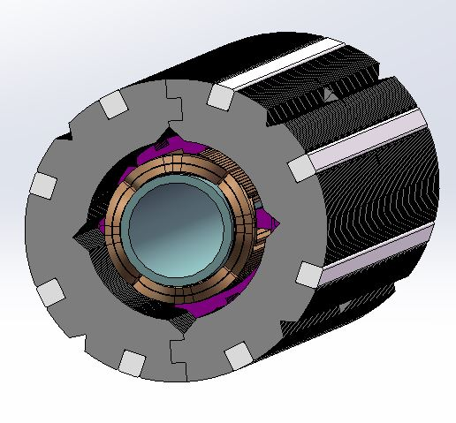
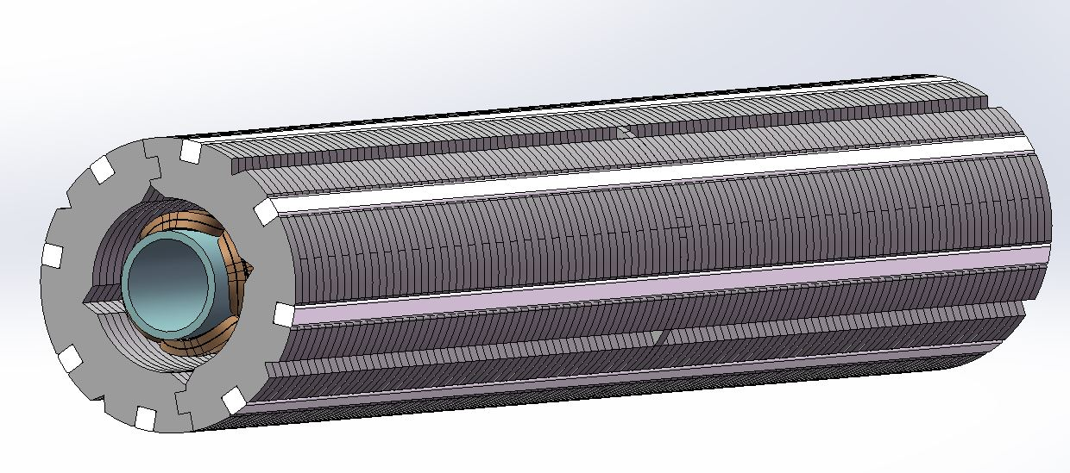
Mechanical design status of QD0 short model magnet:

Slide 28
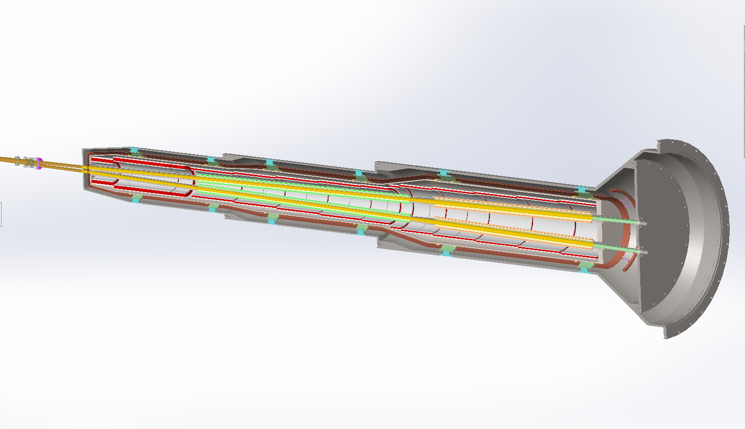
Design status of MDI SC magnet cryostat:

Slide 29
Fabrication preparation of QD0 short model magnet
Technical discussions on superconductor wire, cable manufacturer and magnet fabrication company were performed.
Literature survey of fabrication process of superconducting quadrupole.
The technical route for the development of QD0 prototype is determined
Superconducting strand Rutherford Cable Coil winding
Coil curing Magnet components fabrication
Single aperture magnet assembly Double aperture magnet assembly
Room temperature field measurement Cryogenic test and field measurement
Specifications on strand and cable are obtained for procurement.

Slide 30
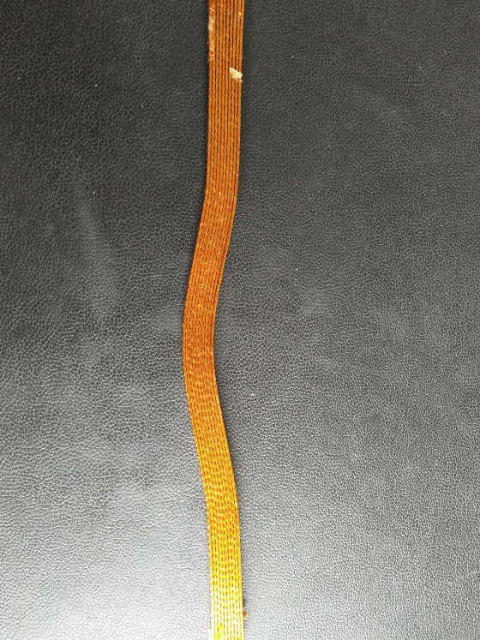
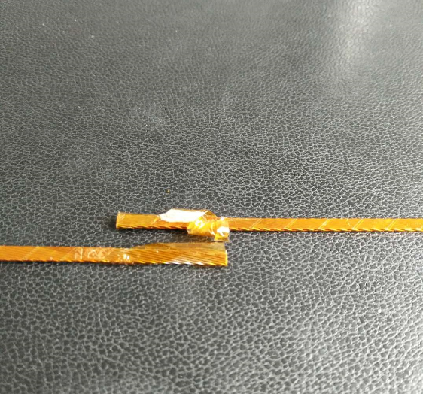
2018 Ordered: NbTi/Cu Strand, keystoned Rutherford Cable.
Strand:
NbTi/Cu, 0.5mm in diameter,
Cu/Sc=1.3, Filament diameter < 8μm,
@4.2K, Ic≥340A@3T，Ic≥280A@4T，Ic≥230A@5T.
Rutherford Cable:
Width: 3mm, mid thickness: 0.93 mm, keystone angle: 1.9 deg, No of stands: 12,
The critical current loss during cabling: less than 5%.
Cu Rutherford cable sample

Slide 31
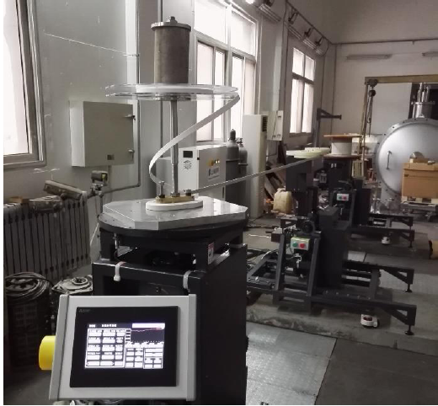
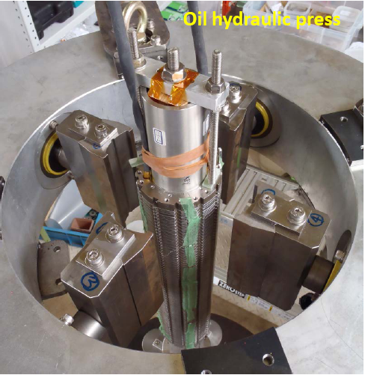
Fabrication requirements of QD0 model magnet was sent to companies.
The basic hardware necessary for prototype magnet was investigated.
Winding machine for 0.5m QD0 quadrupole coil is almost available in IHEP Magnet Group (need some tooling).
The design of QD0 short model magnet will be reviewed in July, and then the fabrication will start.
IHEP winding machine
SuperKEKB magnet collaring

Slide 32
Summary
IR superconducting magnets are key devices for CEPC.
Despite limited space, field cross talk effect between two apertures of QD0 can be eliminated using iron yoke.
The TDR design is in progress, and the first step of the R&D prototype magnets has started.
Physical design of QD0 model magnet has been finished, and all the design requirements have been met.
The fabrication of the QD0 model magnet will start soon.

Slide 33
Thanks for your attention!
CEPC working day

