Slide 1
Progress of mechanics system
Haijing Wang
CEPC DAY (June 28, 2019)

Slide 2
Outline
Installation scenario and vacuum connection of MDI
Regular supports and transport vehicles
Mockup design
Movable collimator
Risk management and control
Summary and plan

Slide 3
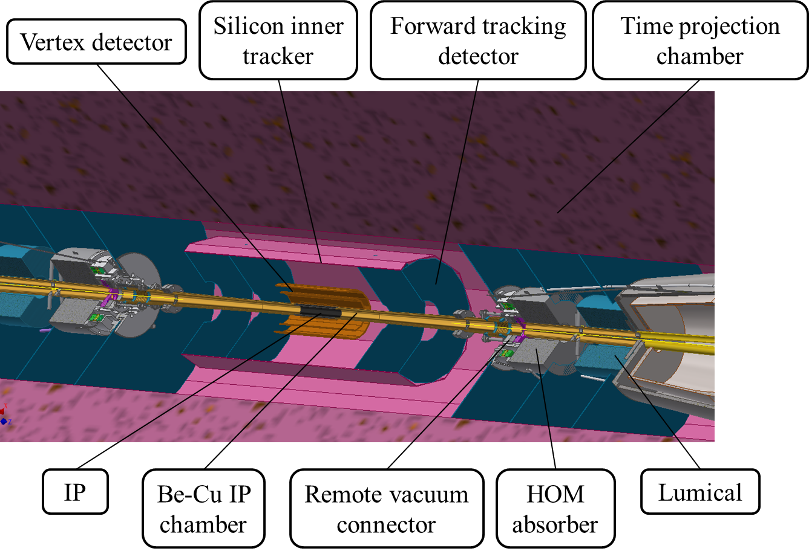
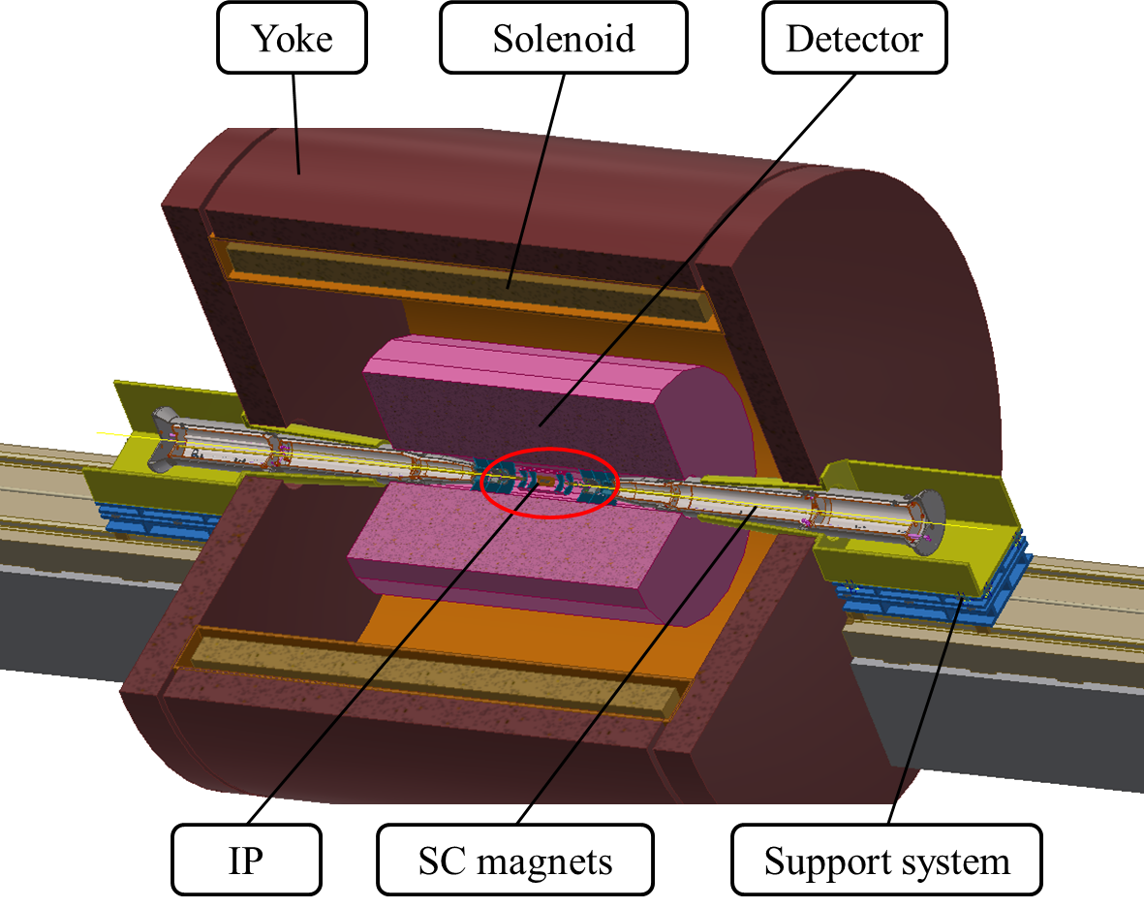
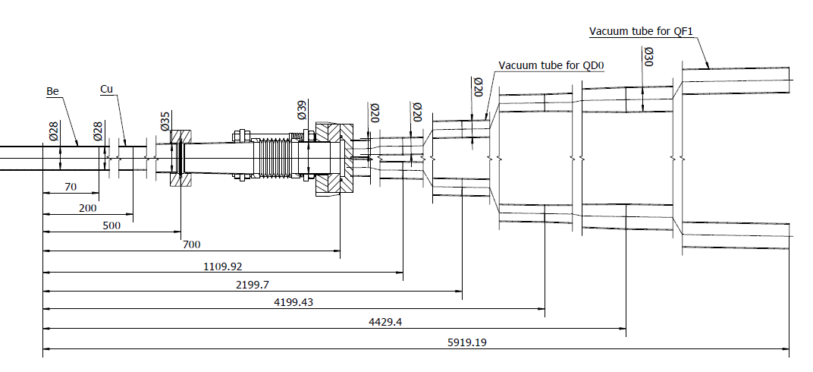
Installation scenario and vacuum connection of MDI

Slide 4
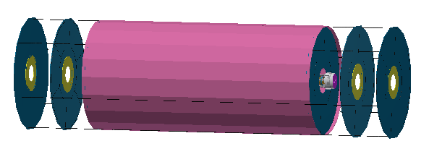
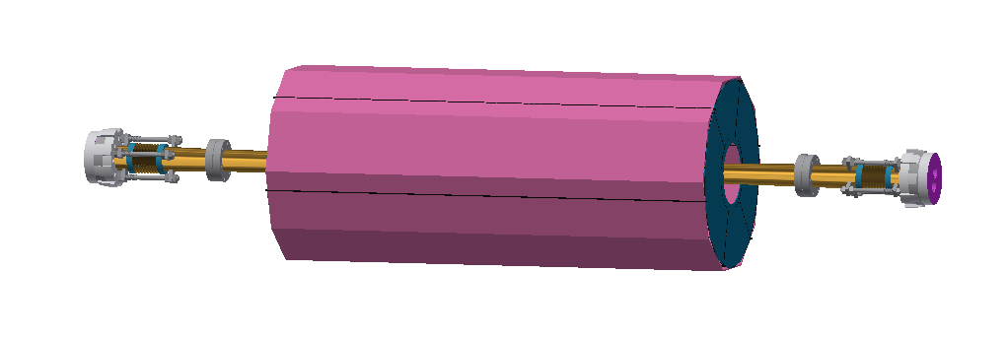
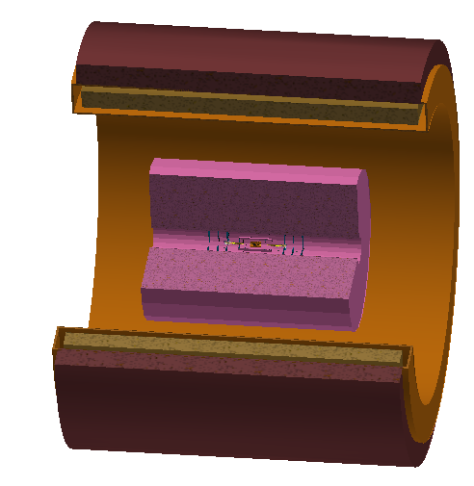
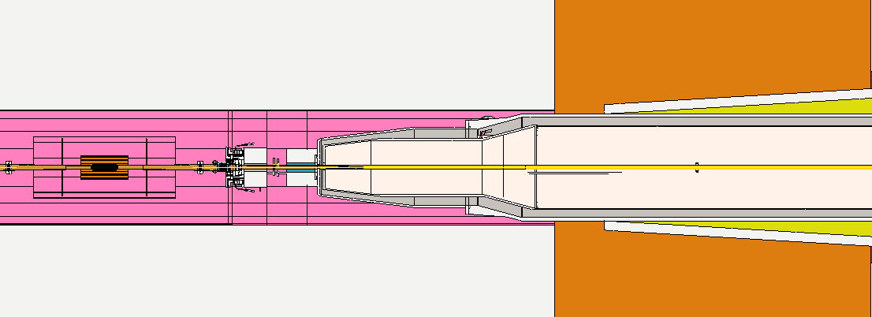
Basic conditions
Both sides of IP chamber are fixed to VTX transversally and are free longitudinally.
The IP chamber, VTX, SIT and FTD can be considered as one assembly.
The assembly above can be supported by TPC and be aligned transversally.
Remote vacuum connector can be used.
The high precision part of Lumical is with the detector and the main body is with the accelerator.
Little transversally space & long longitudinally distance. It is impossible to connect flanges by hands.

Slide 5
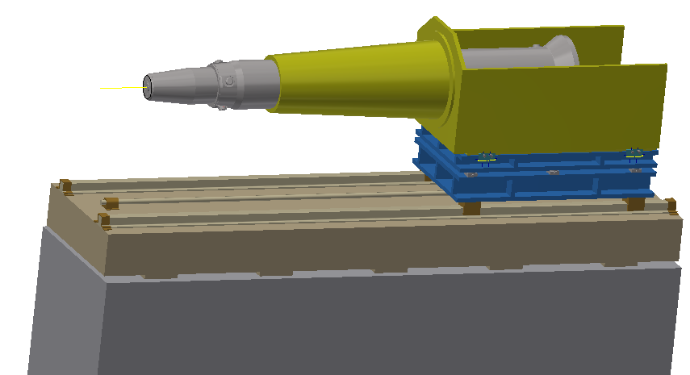
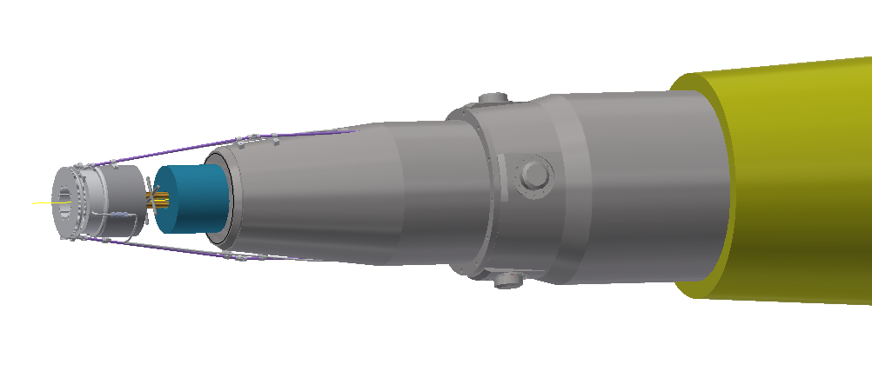
Assembly of detector side and accelerator side.
Suppose the IP chamber assembly has been fixed to TPC.
Pre-alignment of SC magnet: cryomodule in working condition.
Installation of Lumical, BPM, HOM absorber, RVC and relative support mechanism.

Slide 6
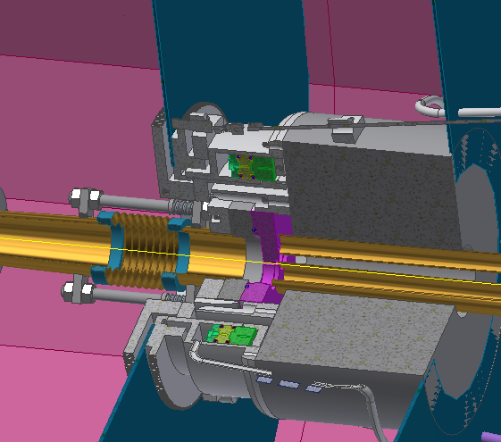
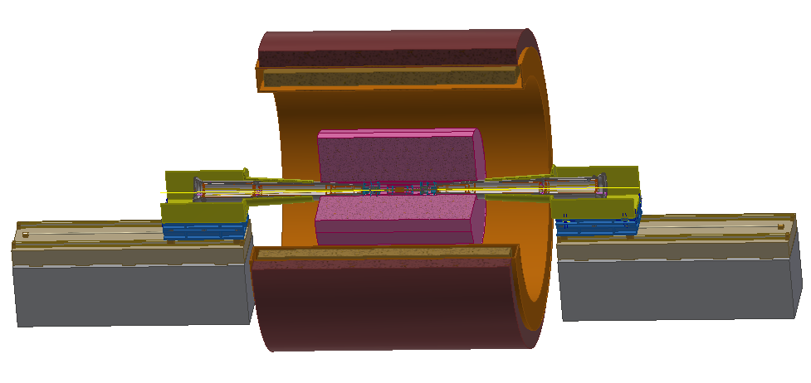
* Cooperate with Shenyang Huiyu vacuum technics co., Ltd on the RVC design.
Move the SC magnet to working location. Connect the flanges using RVC, do the alignment.
Requirements: accuracy: ≤(30 μm), leak rate ≤2e-10 Torr.L/s
Alternative design for remote vacuum connection is also under consideration.
Finish the connection and alignment for both sides, install the yoke walls.
We need holes through the yoke walls for alignment, or to open them.
We are trying our best to reach the accuracy requirement, but no clear solution yet.

Slide 7
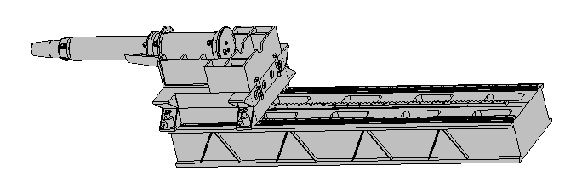
Methods to improve the accuracy in consideration
Adjustment mechanism: wedge jacks in three directions.
Movement mechanism: high precision tracks & rack, in Z direction.
Optimization will be done to increase the rigidity in limited space.
Sensors will be used for deformation monitoring.
Special structure and alignment method will be used for high accuracy requirement, but it’s not clear now.
* Cooperate with Beijing Institute of Space Mechatronics on the SC magnet support system

Slide 8
Vacuum connection of MDI
Methods
RVC similar to SuperKEKB as baseline.
Considering other methods meanwhile---safe and simple.
Facilities | Connection methods | Distance from connecting location to yoke boundary(mm) | Having manual operating space or not
BEPCII | Manual with long tools | 2348 | Yes
SuperKEKB | RVC (remote vacuum connection) | 3458 | At one side
FCC | --- | ~3000 | ---
CEPC | Remote, undetermined | 3757~6140 | No

Slide 9
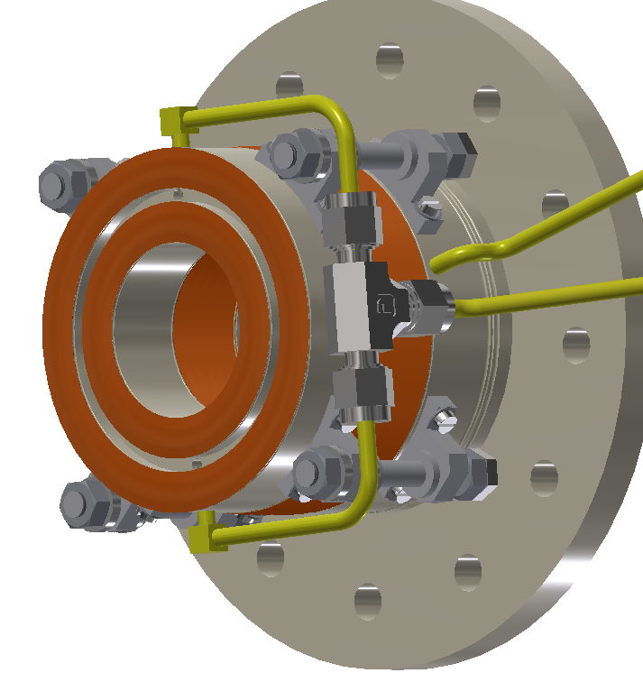
 | RVC | Inflatable seal | Long tools | Peanut seal
Sealing methods | Pneumatic clamping with auxiliary locking | Pneumatic clamping | Screws clamping using long tools | Pneumatic clamping with auxiliary locking
Advantages | Successful experience from SuperKEKB | Successful experience from CSNS; Small | Simple and small structure | Simple and small structure
Disadvantages | Big and complex structure | Difficult for leak rate requirement (four orders of magnitude higher than CSNS) | Difficult in operation | New idea, no experience.

Slide 10
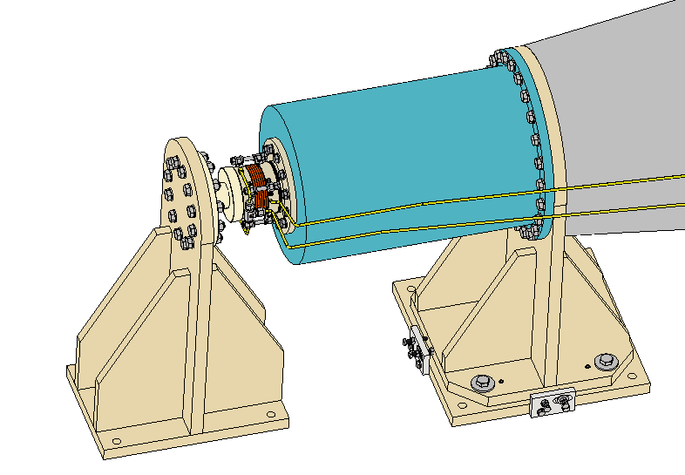
Support cylinder
Fake cryomodule
Fixed support of detector part
Fixed support of accelerator part (can be adjusted in three directions and locked)
The design review will be hold recently.
Vacuum connect mechanism

Slide 11
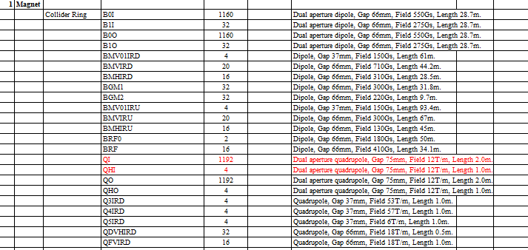
Regular supports and transport vehicles
CEPC is composed by the double ring Collider, the Booster, the Linac and Transport lines.
Over 80% of the length is covered by magnets of about 138 types, each magnet needs to be supported.
Accelerating tubes, vacuum tubes, instruments…, all need supports.
Aims
Simple & flexible structure: plates or standard elements
Small deformation & good stability: multi-point support, optimization
Low cost: concrete or steel frames, adjusted manually

Slide 12
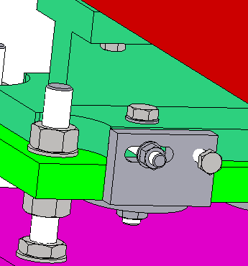
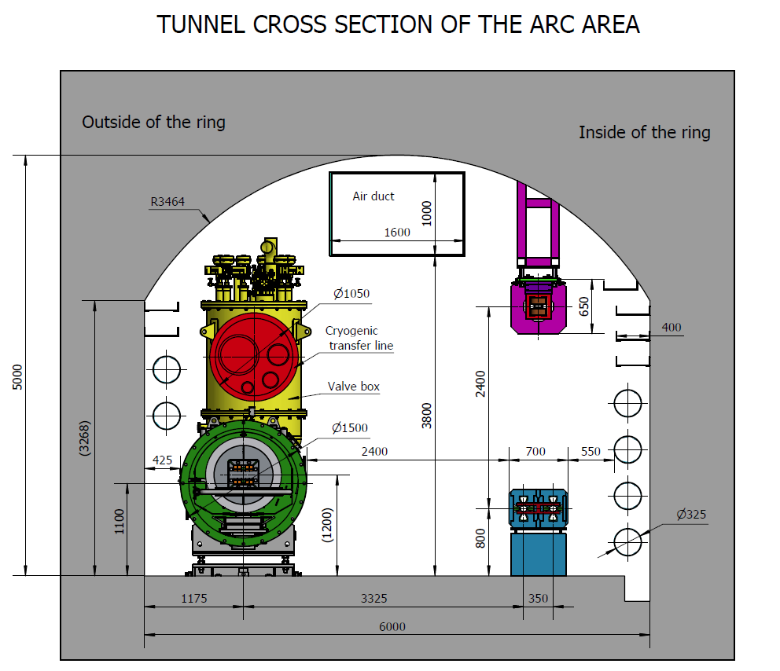
Regular supports and transport vehicles
Adjusting methods
Bolts & push-pull bolts
simple and low cost
Adjusting ranges
Support method
Magnets in Collider, Linac, Damping Ring: supported to the ground by concrete.
Magnets in Booster: hanged on the wall of the tunnel by steel frame
Magnets in Transport Line: due to the location of the magnet
Range of adjustment
X | ≥±20 mm | Δθx | ≥±10 mrad
Y | ≥±30 mm | Δθy | ≥±10 mrad
Z | ≥±20 mm | Δθz | ≥±10 mrad
Booster
Collider

Slide 13
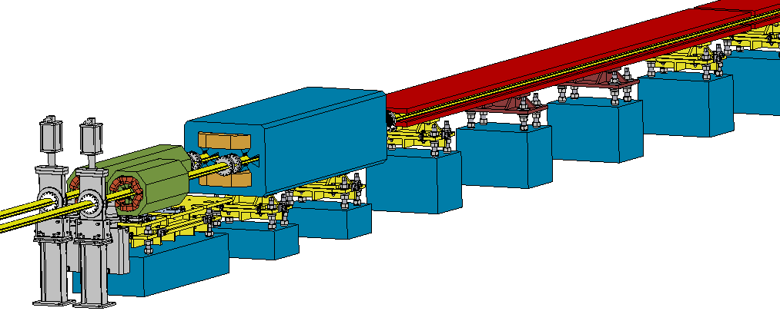
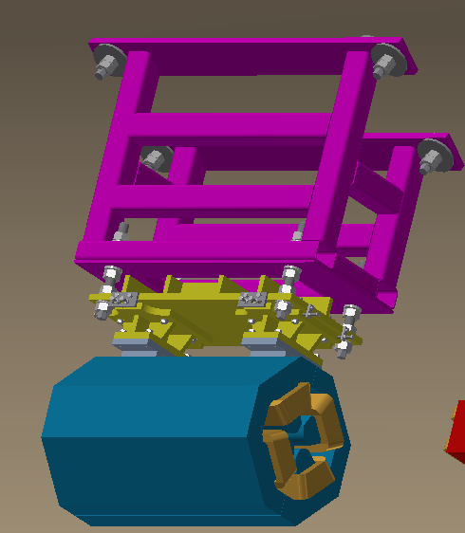
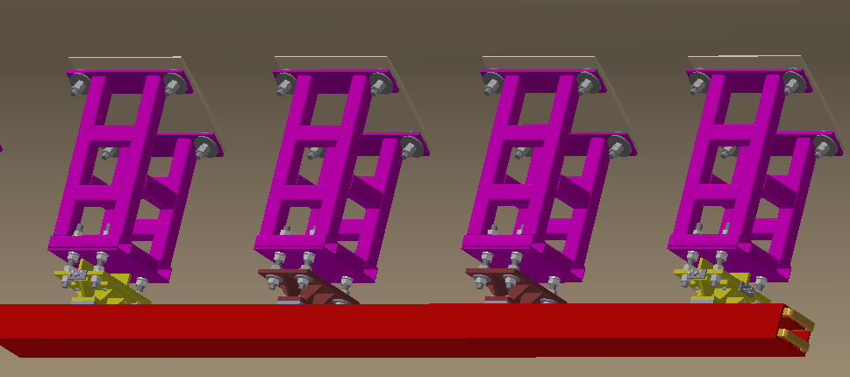
Regular supports and transport vehicles
Quadrupole in Collider and its support：
2 support points，2000mm
Dipole in Collider and its support：
4 support points，5670mm
图需换
Quadrupole in Booster and its support：
2 support points，940 mm
Sextupole in Collider and its support：
2 support points，1400mm
Dipole in Booster and its support：
4 support points，5445mm

Slide 14
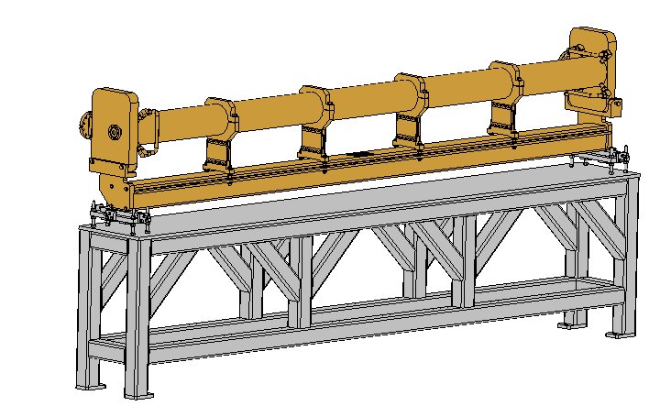
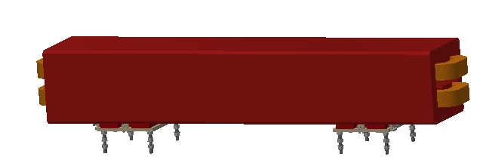
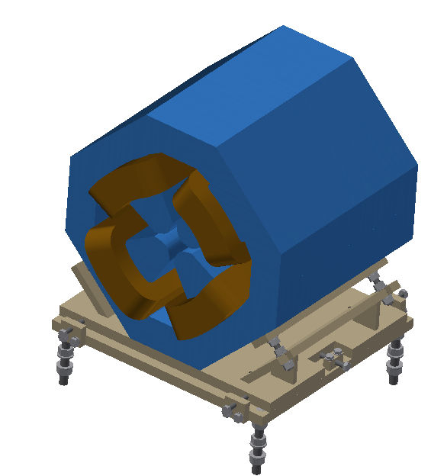
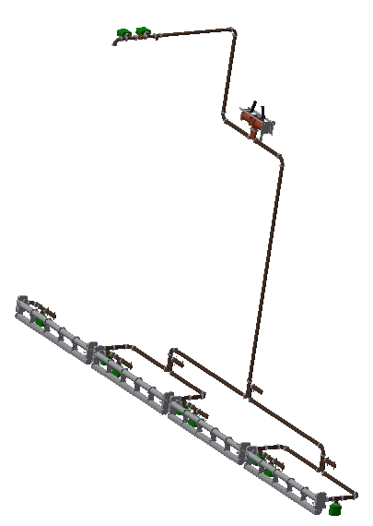
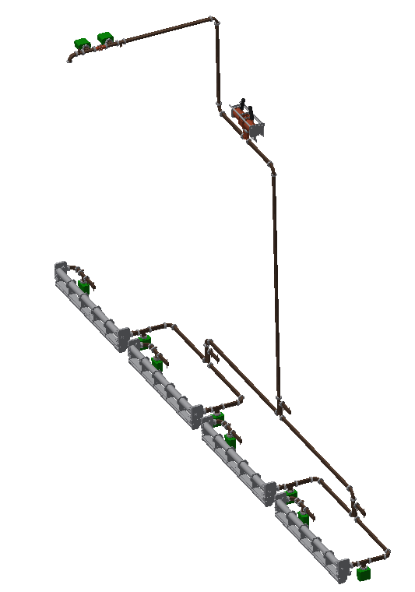
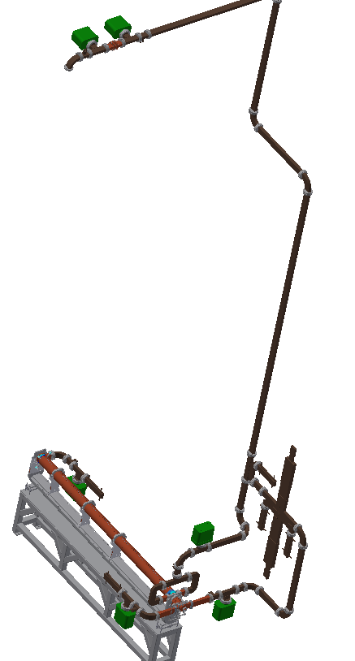
Regular supports and transport vehicles
Typical magnets and their supports
Accelerating tube in Linac and its support:
2 support points，3000 mm
Different accelerating tubes, wave guides, bunchers…

Slide 15
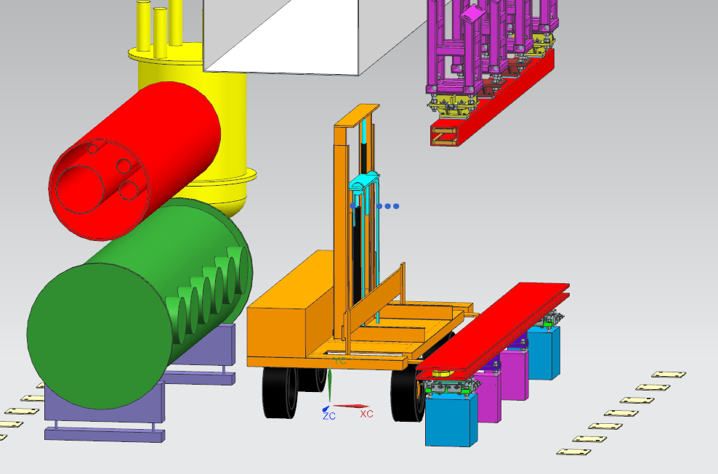
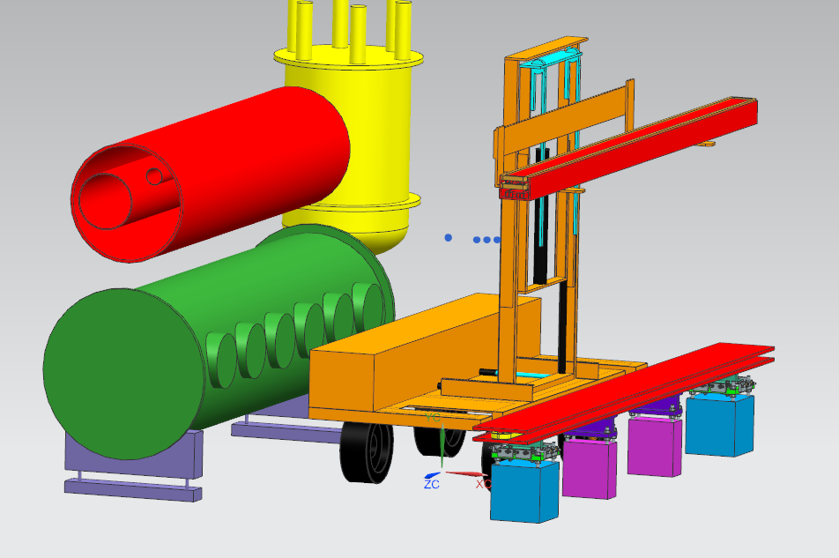
Regular supports and transport vehicles
Two types of vehicles
One for “long” magnets and the other for “short” magnets.
Transport, adjustment (horizontal and vertical)
Uneven ground is considered.
* Cooperate with Beijing North Vehicle Group Corporation.

Slide 16
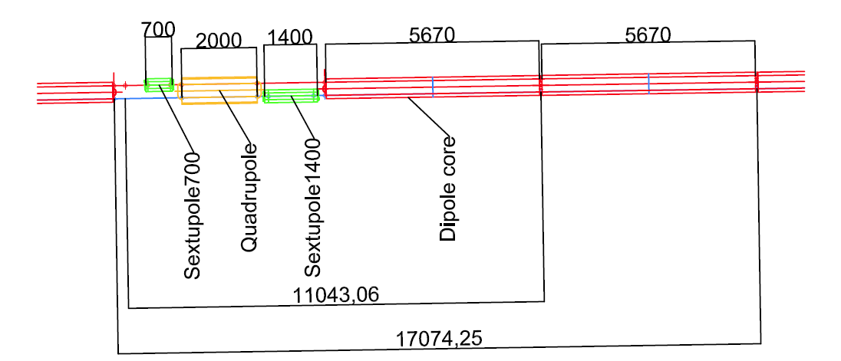
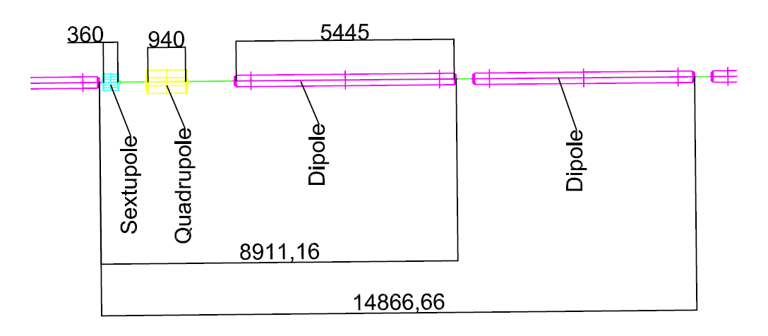
Mockup design
Preliminary design
Interface checking of the equipment locations, installation, alignment and transportation.
Including part of arc section and part of RF section.
The mockup for each ring includes two dipole cores (or two dipoles), one quadrupole, one sextupole, one BPM and one cryomodule.
The total length is about 40 meters.
A CEPC model of 100m is also under design for exhibition.

Slide 17
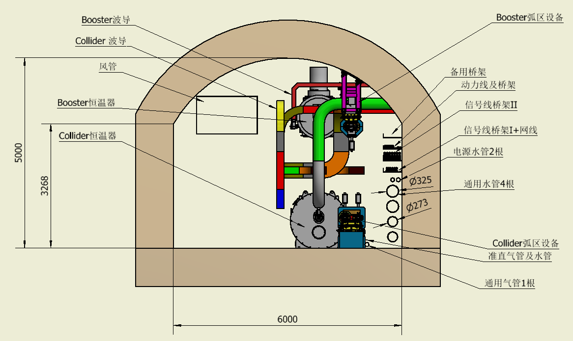
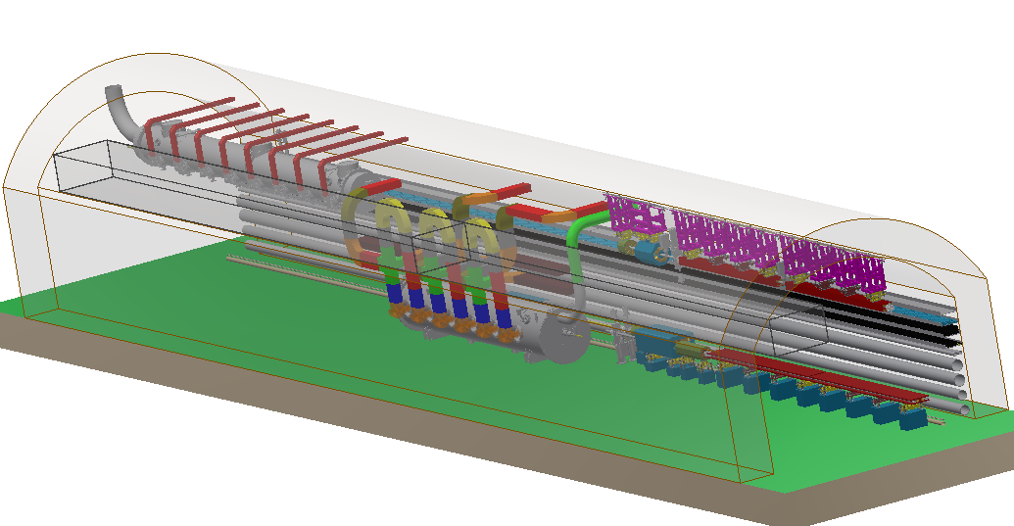
The preliminary design is over 42 meters. It may be possible within 40 meters after discussion. The detailed design is on-going.

Slide 19
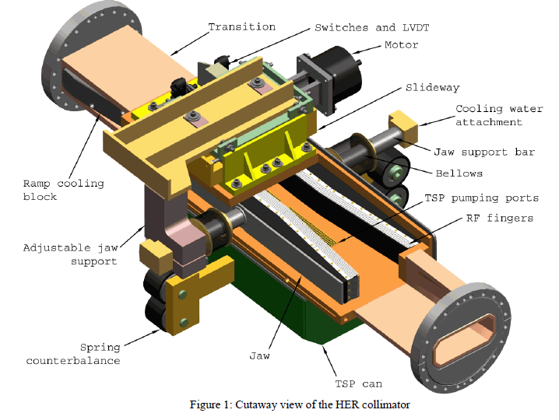
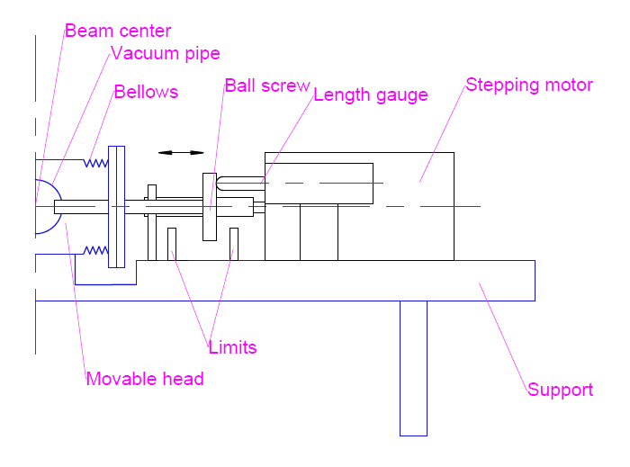
Movable collimators
Two types of collimators.
Movable and fixed. TDR stage mainly focus on movable collimators.
Collimator of SuperKEKB
Collimator of PEPII
Collimator of LEP
Sketch of movable collimator of CEPC

Slide 20
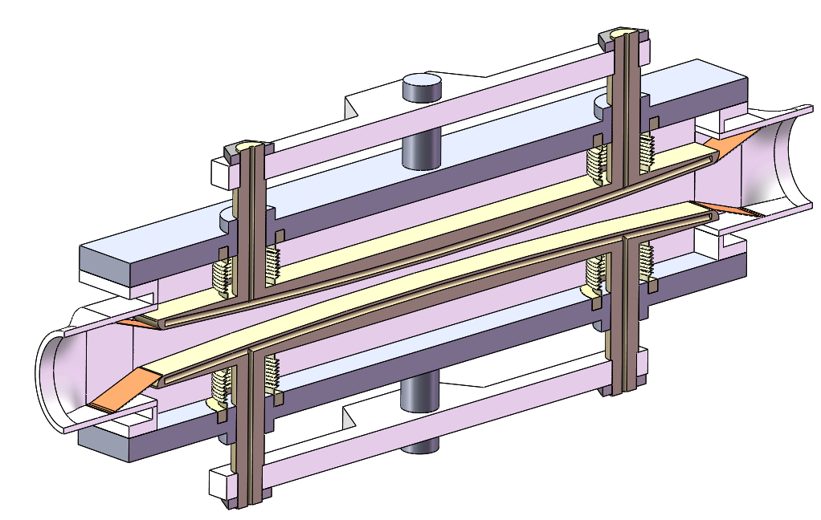
Movable collimators
Located in straight section between two dipoles, the length is 800 mm.
Primary impedance estimation has been done.
Evolution of inner profile owing to impedance

Slide 21
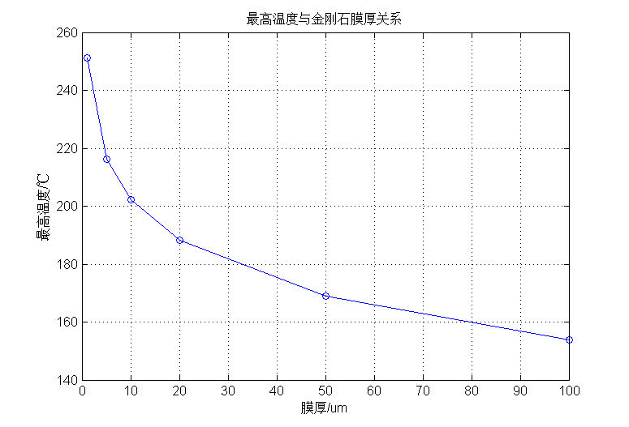
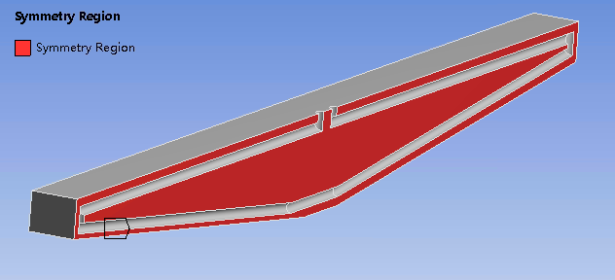
Difficulties
High thermal load. The synchrotron radiation power is 7700W
Minimize impedance. Design of RF fingers will be considered in the next step.
We proposed a design using laminated material with metal and membrane of high thermal conductivity, the photon absorber is also considered.
Y: Highest temperature;
X: Thickness of membrane of high thermal conductivity
Cooling method | Loads | Highest temperature（℃）
Copper & water | Linear load | 266
Laminated material & water | Linear load | 146
Copper & water | Surface load (Damping of X ray) | 141

Slide 22
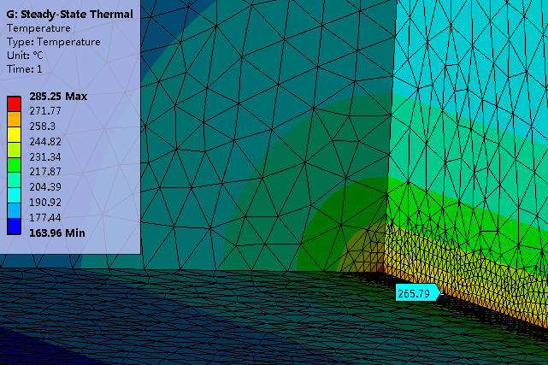
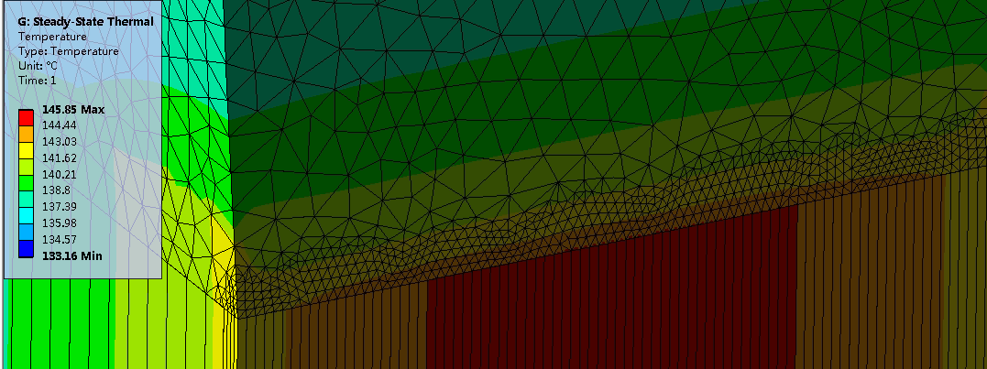
Laminated material & water, linear load
Copper & water, linear load
Copper & water, surface load
Laminated material with copper and graphene film
(Supported by one NSFC, have no money now)

Slide 23
Risk management and control
Vacuum connection of MDI
Risk: It is very difficult for the vacuum connection (far away from yoke boundary, no operation space, high leak rate requirement).
Solutions: Do the prototypes and tests in TDR stage, consider different methods.
Support system of SC magnets
Risk: It is very difficult for the accuracy and stability of SC magnets owing to the cantilever structure.
Solutions: Effective pre-alignment and alignment (have no clear ideas yet); Do the optimization to improve stability and decrease deformation; Design the tolerance carefully and control them strictly during development; Sufficient stress relieving; Anti-radiation design.

Slide 24
Risk management and control
Regular supports
Risk: The installation and tolerance.
Solutions: Using the mockup to verify the installation and adjusting methods; Design reasonable adjusting resolution and ranges; Reliable fixing methods of pedestals in collider and embedded plates in Booster.
Collimators
Risk: High thermal load and impedance.
Solutions: Sufficient optimization during the TDR stage; Effective heat dissipating method; Design of RF fingers; Reliable structure; Do the prototype and test in TDR stage.

Slide 25
Summary and plans
The rough layout of MDI has been done, based on which the primary installation scenario has been designed. For the vacuum connection, the RVC similar to SuperKEKB is the baseline, and some other methods are also in consideration. The design review will be hold recently. For the support system of SC magnets, the design is on-going.
Preliminary design of supports for typical magnets and transport vehicles have been done, and is on-going for other devices and under refining.
The 3D model of the tunnel mockup has been preliminary designed ,with part of arc section and part of RF section. The detailed design is on-going.
The preliminary impedance estimation and cooling methods design has been done for the movable collimators. Detailed cooling method and RF finger design will be considered next step.

Slide 26
Thanks for your attention!

