Slide 1
The Control system of CEPC
Presented by Gang Li
CEPC Day
June. 28th, 2019

Slide 2
Outline
Requirement and Scope of the CEPC control system
Requirement information of controlled devices
Control system and sub-system
Summary

Slide 3
Requirement of the Control System
Stability
Availability
Real Time
Flexibility
Extendibility
  Reliability

Slide 4
Scope of the Control System
Control Platform
Center Control System: computers, servers, etc
Network System
Timing System
Post Mortem System
Machine Protection System
Power Supply Control System
Vacuum Control System
Temperature Monitoring System
Linac Control System
Integration of other system: LLRF, Cryogenic system, Injection/Extraction system etc.
Others

Slide 5
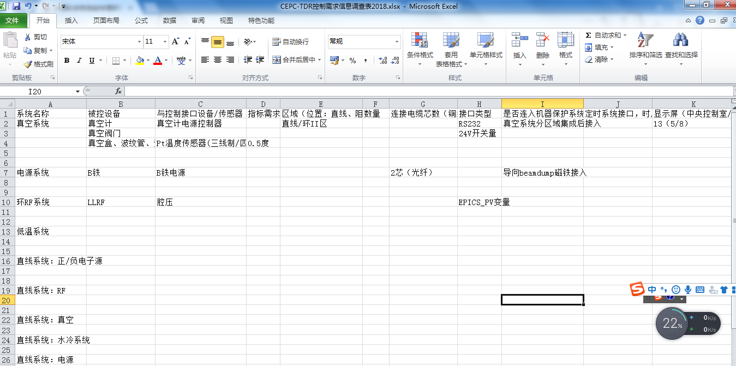
Requirement information of controlled devices

Slide 6
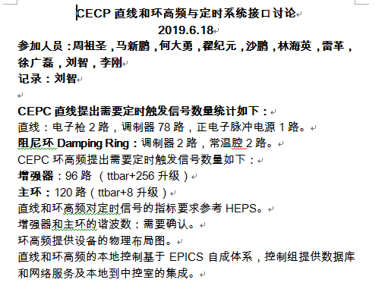
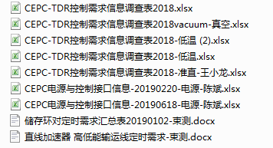
Requirement information of controlled devices

Slide 7
Control Platform: Software
The Choice of Control Platform
  CERN: PVSSII(Process Visualization and Steuerung (Control) System )
  European Accelerator facility: TANGO
  American/European/Asian…facility: EPICS

Slide 8
Control Platform: Software
EPICS (Experimental Physics and Industrial Control System)
  Open Source software toolkit
  To create distributed soft real-time control systems
    particle accelerators
    Telescopes
    other large scientific experiments
  Version:
    V3.13->V3.14-->V3.15->V3.16-->V4->V7….
    BEPCII:V3.13
    CSNS:V3.14
    HEPS:V3.15/V7
    CEPC:Vxnn(X>=7)
IHEP， Beijing

Slide 9
Ten Really Neat Things About EPICS
1. It is free
2. It is open source
3. There are lots of users
4. All a client needs to know to access data is a PV name
5. You can pick the best tools out
6. ... or build your own
7. The boring stuff is already done
8. There is a lot of expertise available close
9. A good contribution becomes internationally known
10. It doesn't matter whether you need 10 PVs or 10 Million PVs

Slide 10
Control Platform: Hardware
Standardization, Modularity and Commercial products
  PLC
  ATCA/MTCA
  Serial device servers
  Blade servers
  Motion controller/Driver
  etc.

Slide 11
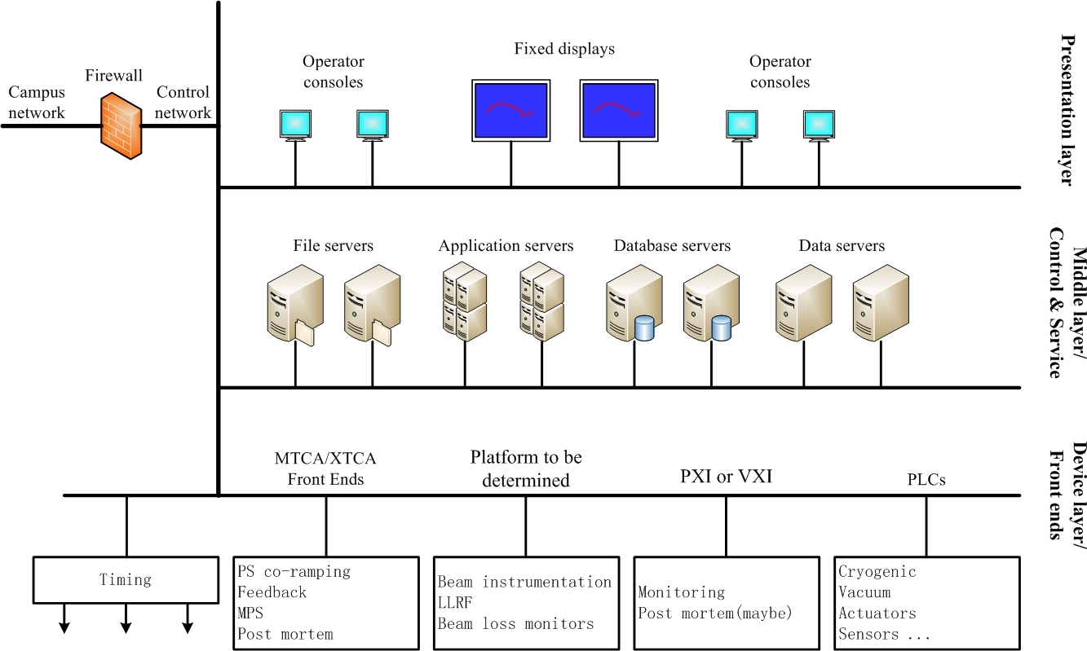
Control System and sub-system
Overall architecture of the control system

Slide 12
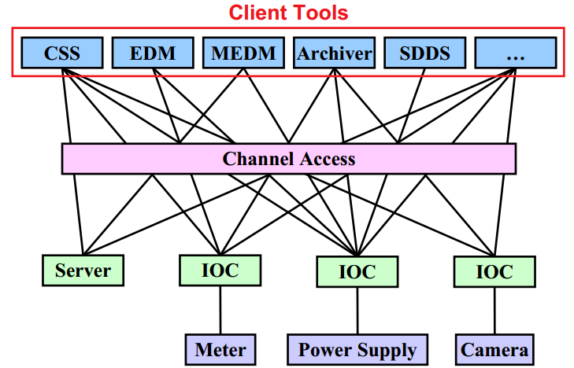
Control System and sub-system
IOC architecture of the control system

Slide 13
Control System and sub-system: CCS
Center control system
  Management and operation of IOCs/OPIs
  Server and management of High level software
  CA/PVA Gateway
  CSS, caQtDM, PyDM etc
  Data Archiver
  Alarming system
  Issue information of machine on Web/ instant tools(weChat)
  Elog
  Issue tracking
  Etc

Slide 14
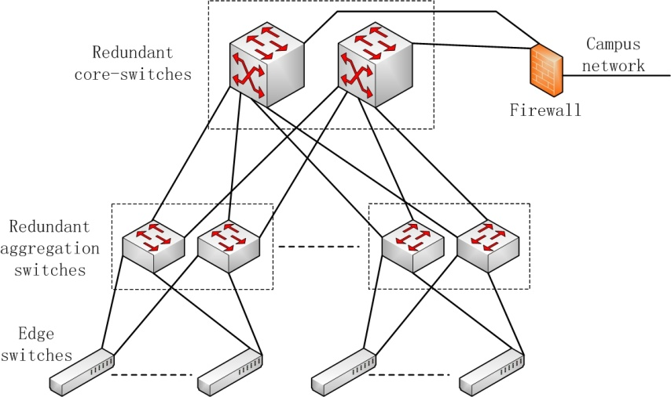
Control system and sub-system
Network System: three layers

Slide 15
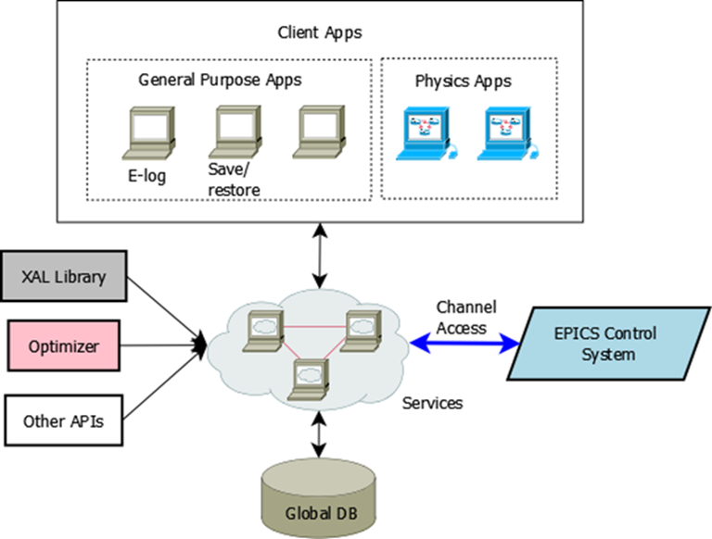
Control System and sub-system
High-level software : Database/CA(PVA) interface
Any important data throughout the entire life cycle of an accelerator should be captured systematically and stored persistently
High-Level software Architecture

Slide 16
Control System and sub-system
Prototypes of database based on the current requirement
Parameter Database
  Keep track of all important physics and equipment parameters consistently for an accelerator during the busy design period
Naming Convention Database
  For a large accelerator project, everything has to be named according to strict rules
Magnet Database
  Capture and store all essential data, including a few particular magnet measurement
  methods
Equipment Database
  Store all equipment including spared parts
Lattice and Model Database
  Keep design lattices and their corresponding model calculation data

Slide 17
Control System and sub-system
High-level software
  XAL: SNS, CSNS, J-Parc, FRIB, etc.
  SAD: TRISTAN, KEK-ATF, SLAC-FFTB, KEKB, Photon Factory, J-PARC, BEPC-II, and SuperKEKB, It has been also used for deign works of future machines such as Muon Collider, ILC, CEPC, and FCC-ee.（From web：https://conference-indico.kek.jp/indico/event/75/overview）
  Interface between SAD and EPICS: CA->PVA?

Slide 18
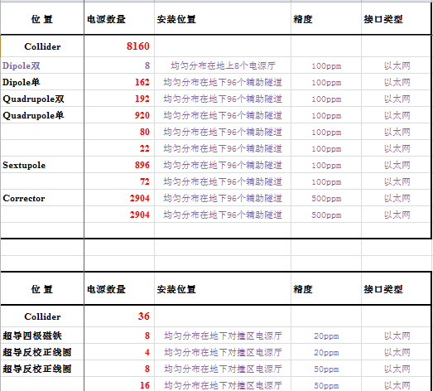
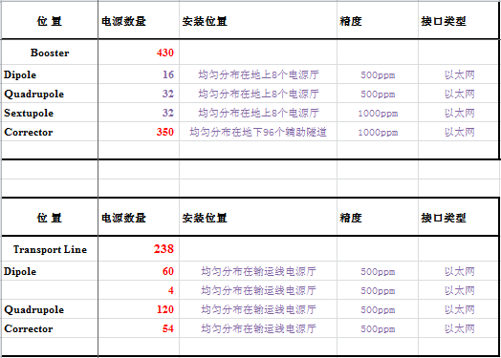
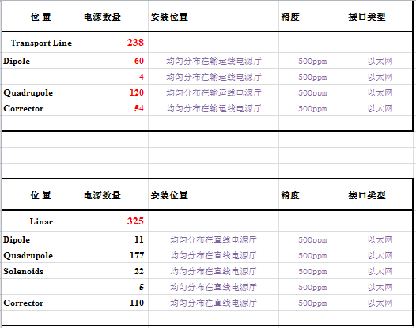
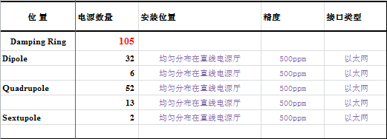
Control system and sub-system: PS

Slide 19
Control system and sub-system: PS
Accelerate from 10/20GeV to 120GeV.
Magnets’ power supply co-ramping within an accuracy of tens of μs.
Two methods of PS ramping
  Waveform can be pre-downloaded into the front end controller, then co-ramping starts with an synchronized signal.
  Waveform can be written into the front end controller in real time with an deterministic latency.
High reliability and high availability (Redundancy).

Slide 20
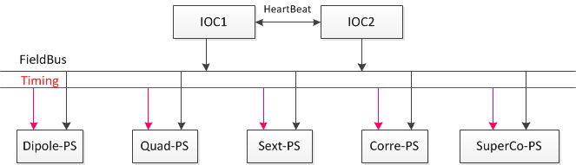
Control system and sub-system: PS
Redundant IOCs for power-supply controls

Slide 21
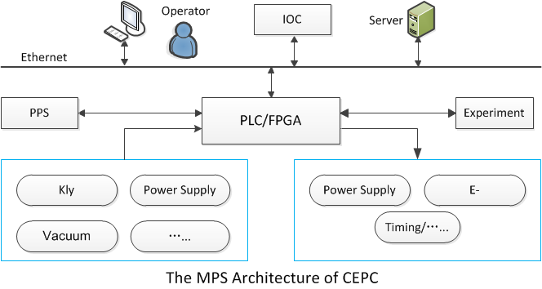
Control system and sub-system: MPS
Tightly related to the accelerator design
Stop beam or steer beam to dump, when key device or sub-system is a fault or abnormal
Generally, the structure of MPS=EPS (PLC)+FPS (FPGA)

Slide 22
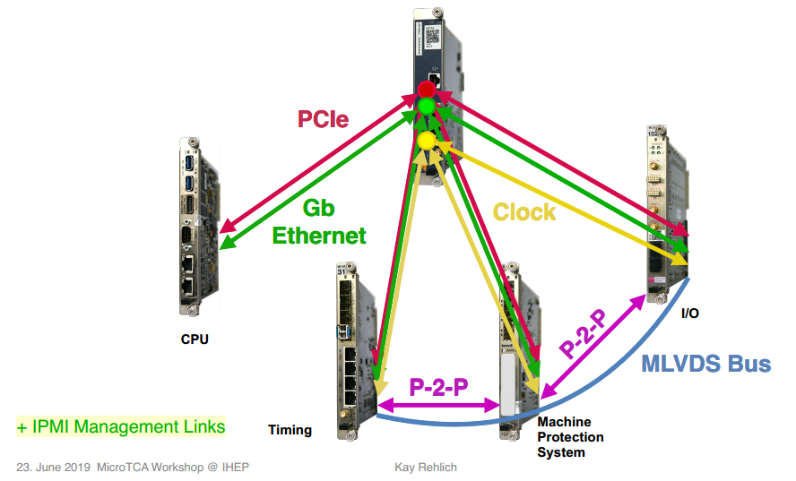
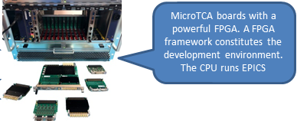
Control system and sub-system: MPS
  PLC for slow inputs, a response time of tens of ms is defined.
    The actuators are RF power ramp down and shutdown of electron gun.
    Preliminary name : Equipment Protection System (EPS).
  FPGA for fast inputs, a response time of tens of micro seconds is defined.
    The actuators are RF power off and shutdown of electron gun.
    Preliminary name : Fast Protection System (FPS).
  Individual systems for loose coupling, easy implementation and debug.
EPS based on PLC
FPS based on FPGA

Slide 23
Control system and sub-system: Post Mortem
For fast and accurate fault diagnostics.
Both hardware and software works.
Tightly related to the devices’ controls.
Accurate timestamp needed.
Global trigger, global clocks, global timing, analysis software …

Slide 24
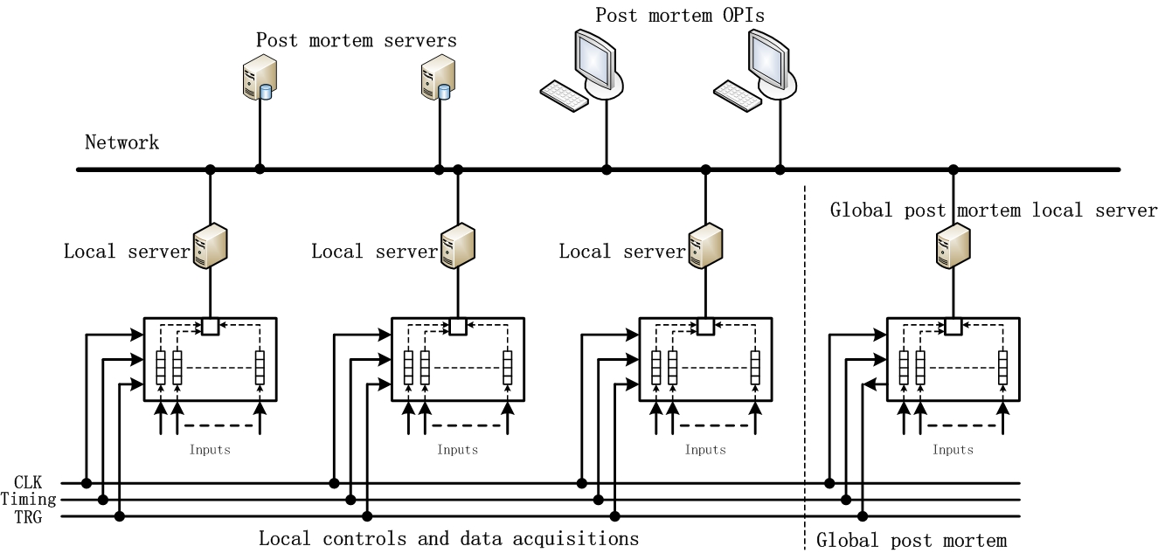
Control system and sub-system: PM
Preliminary design of post mortem

Slide 25
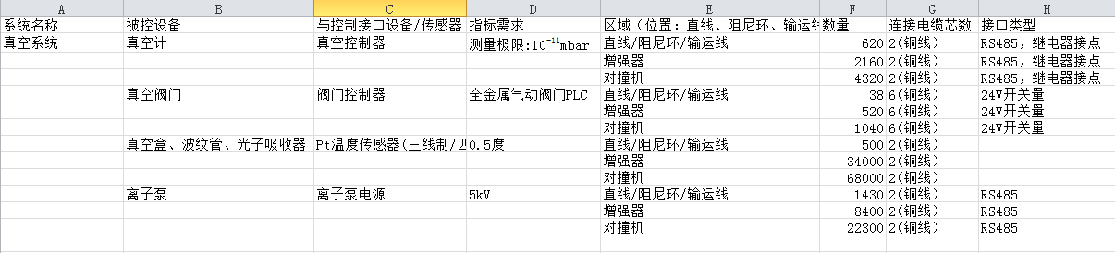
Control system and sub-system: Vacuum CS
Vacuum Gague：7000
Valve：1598
Temperature sensor：102500
Ion pump：32130

Slide 26
Control system and sub-system: Vacuum CS
Monitor
Interlock policy
Operating policy
本地控制
中央控制室
OPI
OPI
Ethernet
MPS
IOC
Fieldbus
Fieldbus
RS232
RS232
PLC/IO
真空计电源控制器
离子泵电源控制器
闸板阀
真空规
离子泵

Slide 27
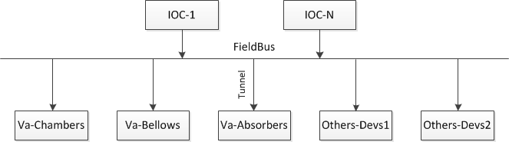
Control system and sub-system: TM
Temperature Monitoring
Quantity: 100,000+(Vacuum devices)
Others: … …

Slide 28
Control system and sub-system: Timing
系统区分 | 定时信号需求 数量 | 性能要求 | 备注
束测（TTL信号） | 10664路 | 抖动<50ps | BPM、profile、DCCT、工作点测量、BCM、束流损失
束测（RF信号） | 5030路 | 抖动<0.5ps, <1ps, <5ps | BPM、profile、DCCT、工作点测量、BCM、束流损失
电源 | 860路 | 抖动<5ns | Booster 、Dipole、Quadrupole、Sextupole、Corrector等磁铁电源
直线加速器 阻尼环 输运线 | 404路 | 抖动<50ps或者20ps | 回旋频率、注入频率、触发信号
直线和环高频 | 301路 | 抖动<20ps | 增强器和主环的谐波数有待确认

Slide 29
Control system and sub-system: Timing
An maximum distance of about 50 km (about half ring).
Latency change due to temperature variations(compensation)
An accuracy of tens of ps
Precise timestamp will be provided.
Event timing
White Rabbit
Optical RF transmission system

Slide 30
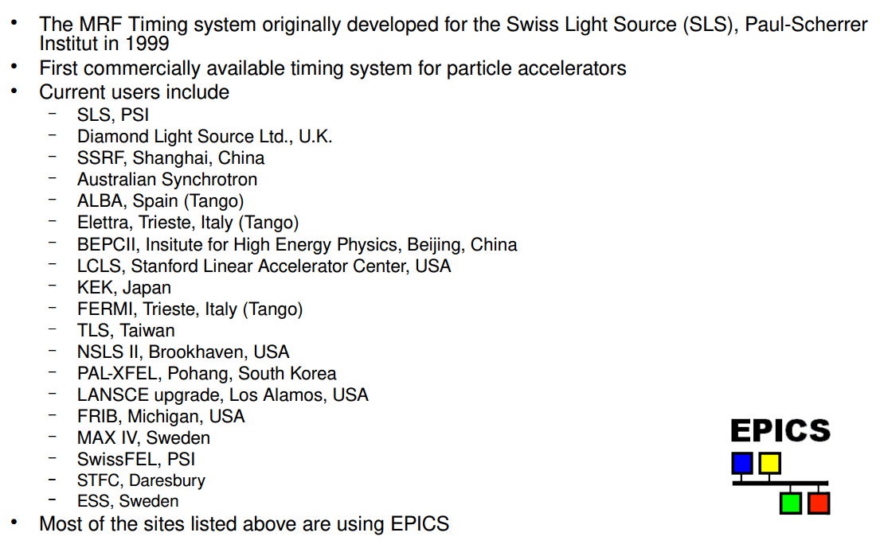
Control system and sub-system: Timing
事件定时系统
始于Swiss Light Source (SLS)，1999年，专为加速器设计
成熟的商业产品，已经用于多个加速器，包括BII以及即将建造的HEPS
组网简单，没有复杂的协议
事件钟频率及网络数据率大范围可调
运行稳定

Slide 31
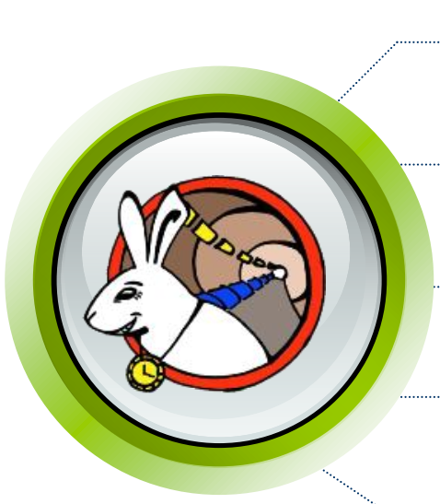
Control system and sub-system: Timing
白兔系统
起源于CERN 欧洲核子中心
使用单模光纤传输，传输距离远
确定、可靠、低延迟数据传输
已经用于大型物理实验的分布式时钟同步
不能直接用于加速器定时，需要从硬件层进行改进
相对时间定时，协议较复杂，比如PTP协议、快速生成树协议(Spanning Tree protocol)等

Slide 32
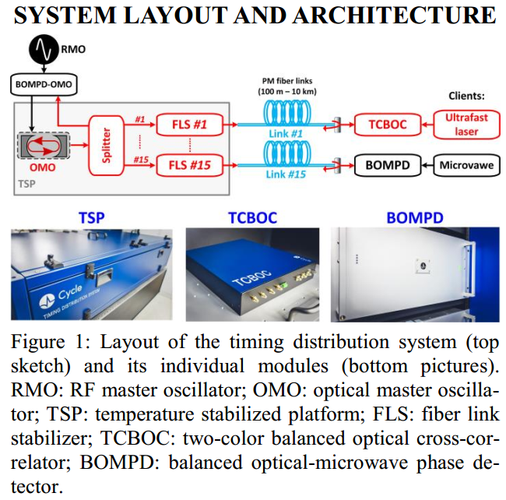
Control system and sub-system: Timing
高精度光学RF频率传输系统
可实现RF频率飞秒级传输
使用激光技术构建系统
成本非常高、只关注频率和相位控制
有成熟的商业产品

Slide 33
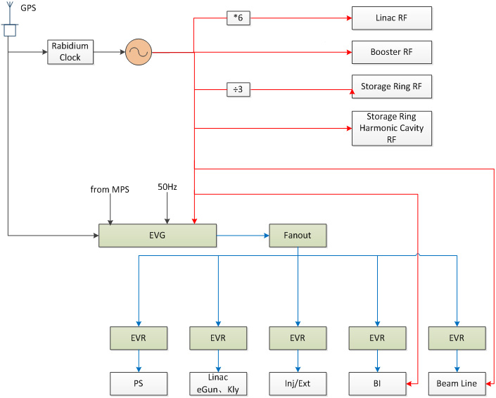
Control system and sub-system: Timing
定时系统基本结构
定时系统分为两部分：事件定时系统和RF传输系统
事件定时系统：产生触发信号和低频率时钟信号
RF传输系统：传输高稳定度RF信号
红线：RF系统；蓝线：事件定时系统

Slide 34
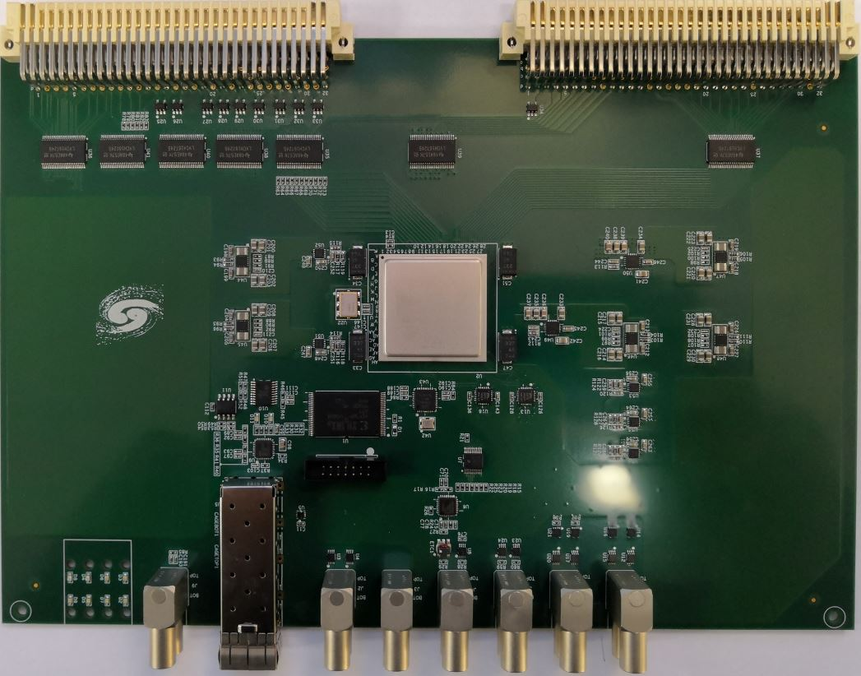
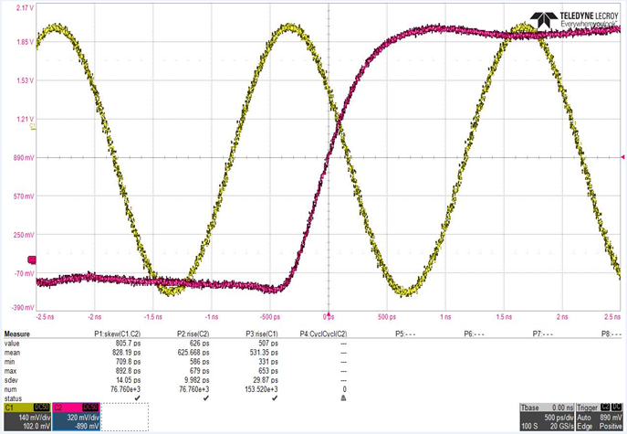
Control system and sub-system: Timing
精细延时步长5ps；
抖动性能，15ps以下；
能够满足加速器基本触发信号和时钟信号需求

Slide 35
Routine control and design considerations
Integration of other system control, such as RF, Cryogenic system, etc.
Video monitoring.
… …
To integrated into the control system, the following rules must be observed:
1. Consistent with version of EPICS
2. Interface to CA/PVA of EPICS
3. Reserve Hardware Interface
4. Agree with other standards of control system

Slide 36
Cooperation: Control System of CEPC
Cooperate with other accelerator complex (CSNS, HEPS,…)
  Management and design of Database
  Issue information
  BOFB(Beam Orbit Feedback)
  Etc

Slide 37
Cooperation: Database
Database based on the user’s requirement
Parameter Database Naming Convention Database
Magnet Database Equipment Database
Lattice and Model Database Management of File
Log and trouble tracking Alignment Database
Management of Cable and device Alarm database
Configuration of Security database MPS and interlock database
Etc..
More and more Database will be designed with the progress of the Project

Slide 38
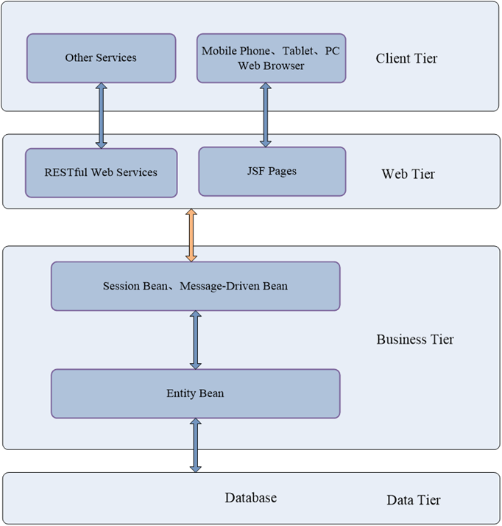
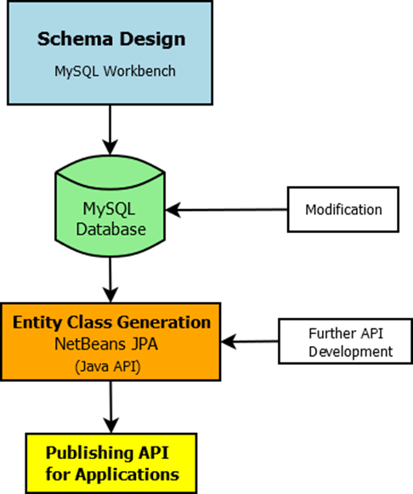
Cooperation: Database
The structure of RDB database

Slide 39
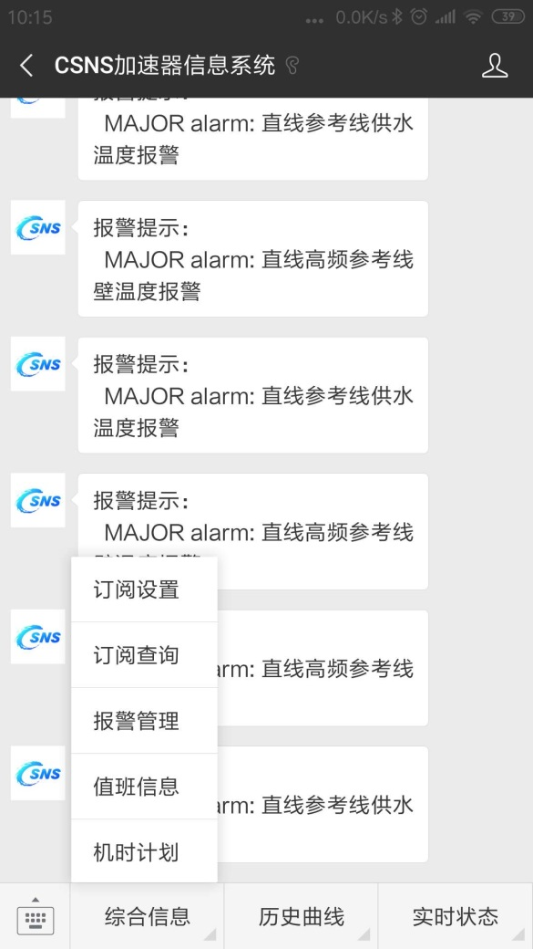
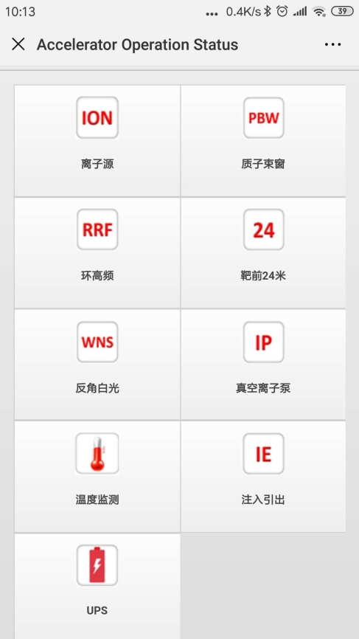
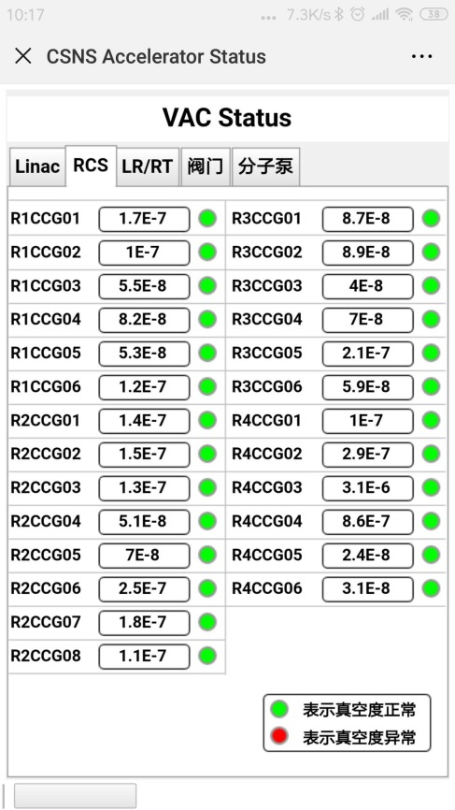
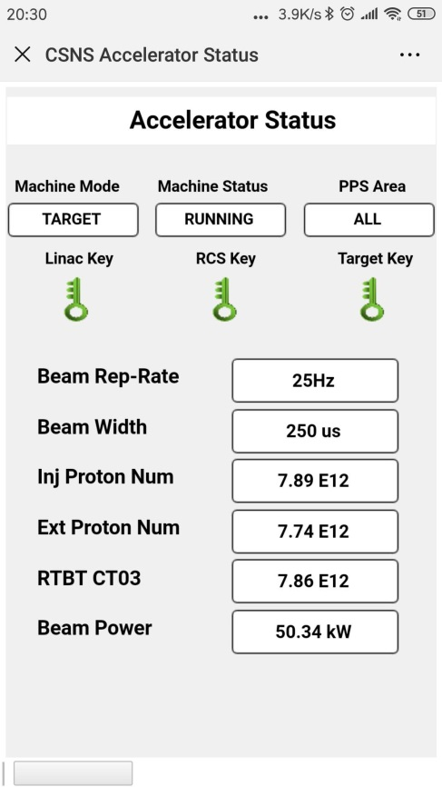
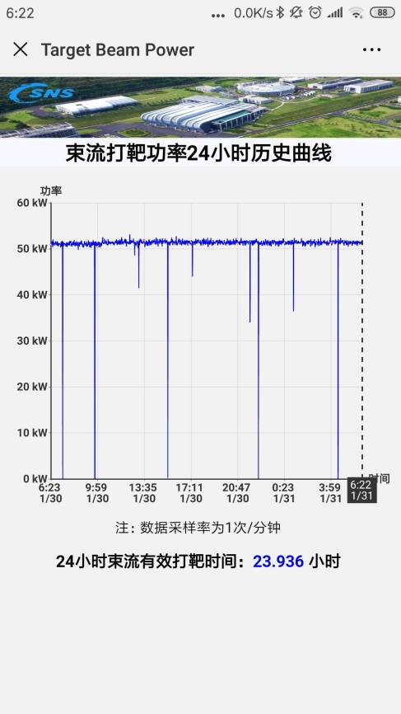
Cooperation: Issue information
Based on Wechat

Slide 40
Cooperation: BOFB
The stability of beam orbit
  Misalignment
  Ripple of Power supply
  Vibration of the earth
  Temperature drift and so on

Slide 41
The structure of BOFB
Process
Power Supply
BPM
校正子
真空盒

Slide 42
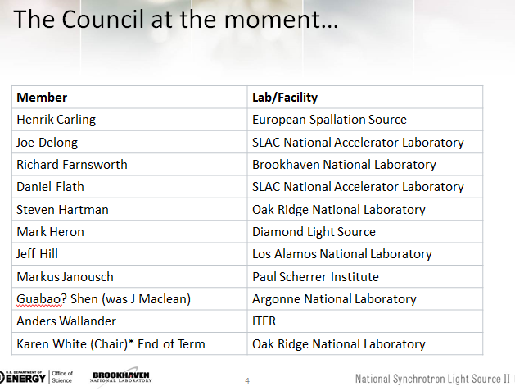
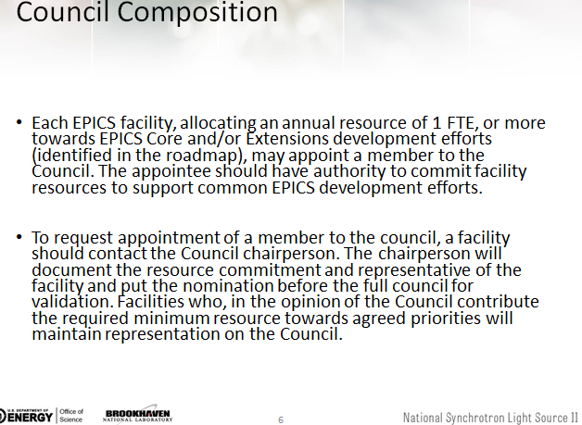
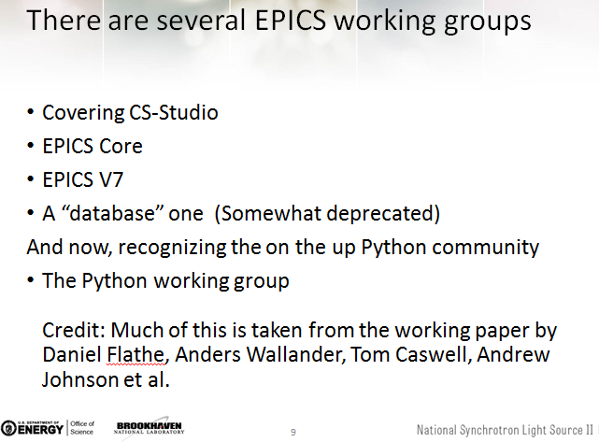
Summary
More detailed requirements should be made clear with the progress of CEPC TDR
EPICS：Following->Leading
AI/machine learning in control system
Thanks a lot!

