Slide 1
Positional relationship between CEPC and SPPC/ auxiliary tunnel
Dou Wang
Thanks to the discussions with SPPC group and CEPC hardware groups.
CEPC day, A623, IHEP, June 28th 2019.

Slide 2
CEPC – inner side of tunnel
Large separation between CEPC & SPPC to make sure two machines can work simultaneously.
- Bypasses are needed both for CEPC and SPPC to avoid the detectors.
Proton machine can only bypass from the outside.
SPPC is about 20 years later than CEPC
If CEPC is the outer ring
Add bypasses in IR and RF → new difficulties for the first-stage project
CEPC bypasses need to wait the fix of SPPC design
Future SPPC’s geometry lose freedom

Slide 3
Compatibility with e-P collision
Keep the possibility of future e-P collision program.
e-P collision prospect needs same circumference for CEPC and SPPC.
The inner ring has to been enlarged in the future.
Large modification of geometry for SPPC due to hard bending
Much easier for e- machine to adjust the circumference (local modification)

Slide 4
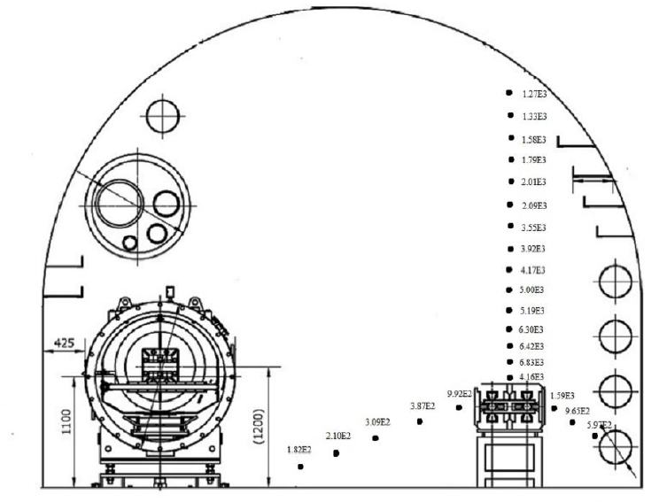
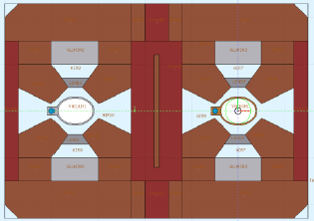
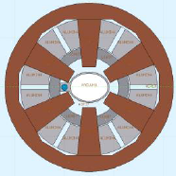
SR distribution inside tunnel
Lead shielding in all magnets for CEPC collier ring.
- SR on the outside is reduced significantly.
Little difference of energy deposition and radiation dose between two sides of tunnel (Ref：page 70 of CDR)
dipole
quadrupole
sextupole

Slide 5
Position of auxiliary tunnel-case I
CEPC — inner ring, SPPC — outer ring, auxiliary tunnel — inner side
Disadvantage:
Inconvenient to enter auxiliary tunnel for person (bridge)
No way to move out/in heavy/large equipments
SPPC’s auxiliary tunnels will be closed (assuming SPPC’s auxiliary tunnels are on the outer side )
Score of case I:
1 — comfortable
2 — uncomfortable
3 — not work
 | First 20 years | 20 years later
CEPC | 2/3 | 2/3
SPPC |  | 3

Slide 6
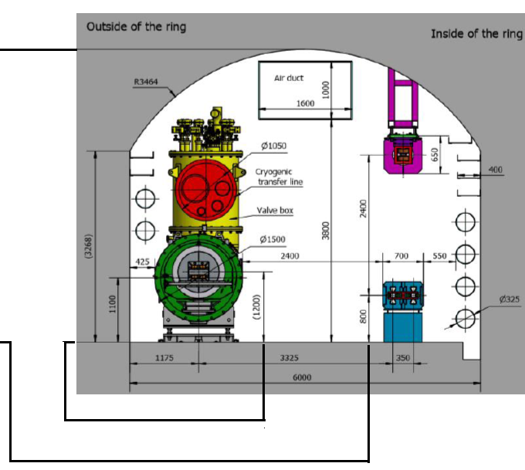
Position of auxiliary tunnel-case II
CEPC — inner ring, SPPC — outer ring, auxiliary tunnel — outer side
Disadvantage:
CEPC’s auxiliary tunnel will be closed after SPPC is finished.
No way to build SPPC’s auxiliary tunnels
Possible solution: bypass tunnel
1 — comfortable
2 — uncomfortable
3 — not work
Score of case II:
 | First 20 years | 20 years later
CEPC | 1 | 3 (→2)
SPPC |  | 3 (→2)

Slide 7
Summary
Positional relationship between CEPC and SPPC: comprehensive consideration of construction schedule and accelerator physics.
- CEPC — inner ring, SPPC — outer ring
Difficult to make choice for the position of auxiliary tunnel → trade-off
- Putting auxiliary tunnel to the outer side is the best choice at this stage.

