Slide 1
Super Tau Charm Factory: (STCF)
A Precision Frontier for Particle Physics
Outline
Introduction - Why
HIEPA - What
Status and future plan - How
Zhengguo Zhao
University of Science and Technology of China
11/1/2019

Slide 2
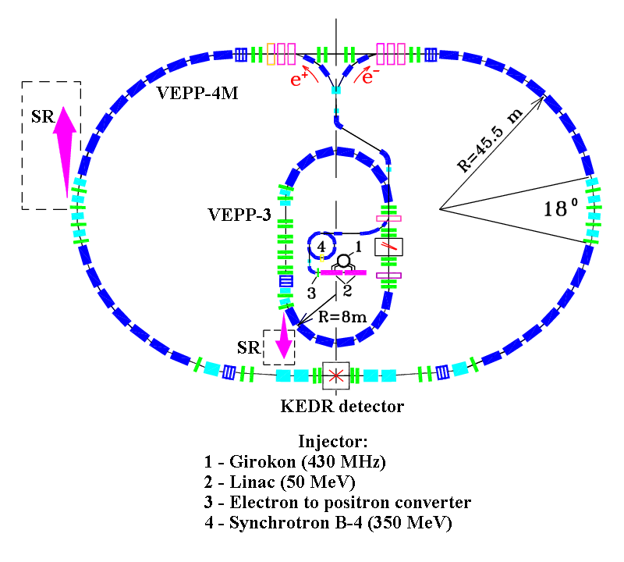
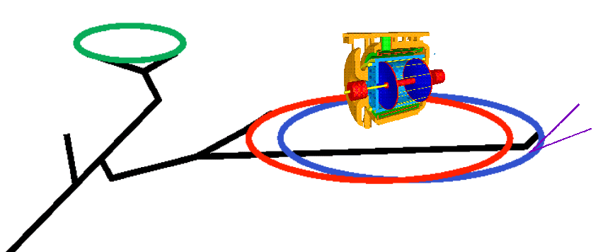
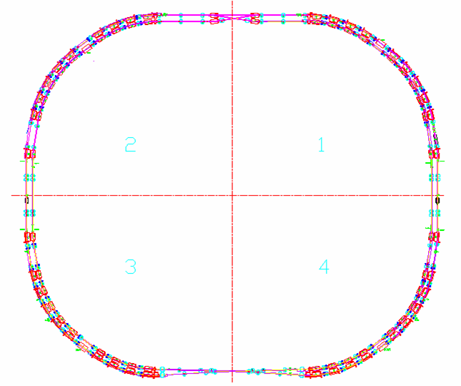
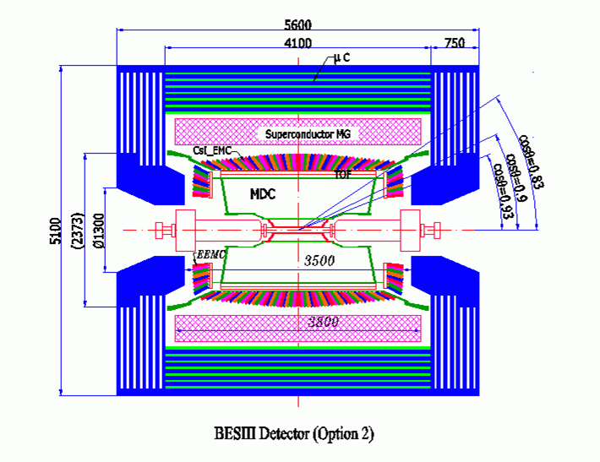
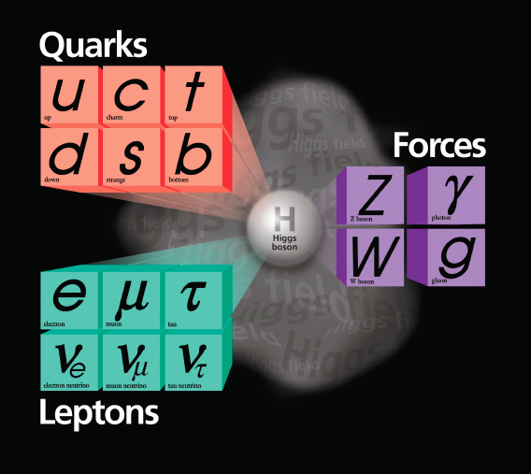
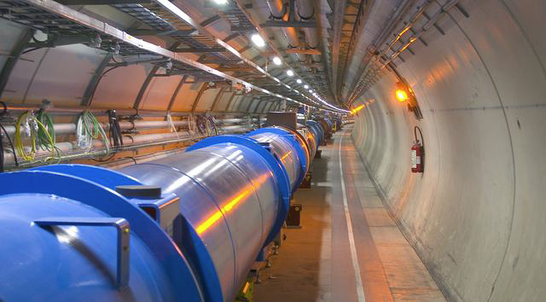


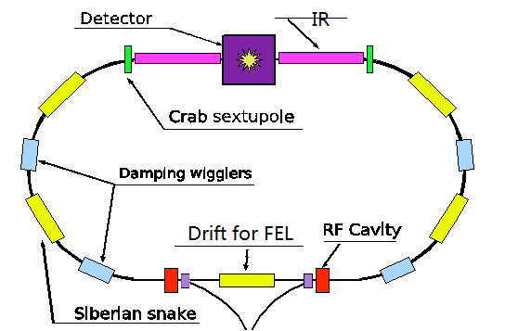
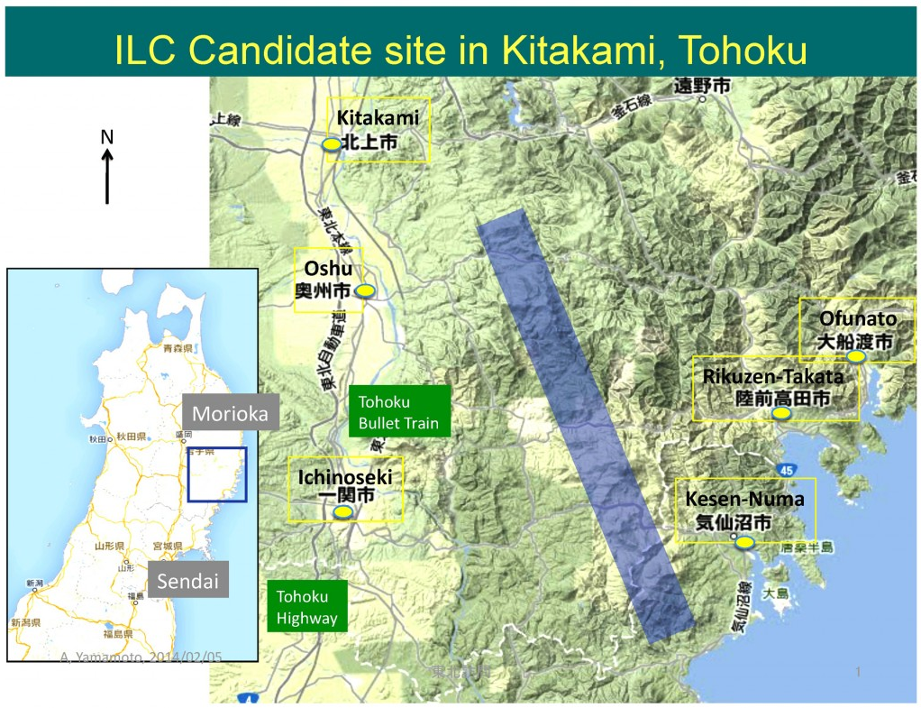
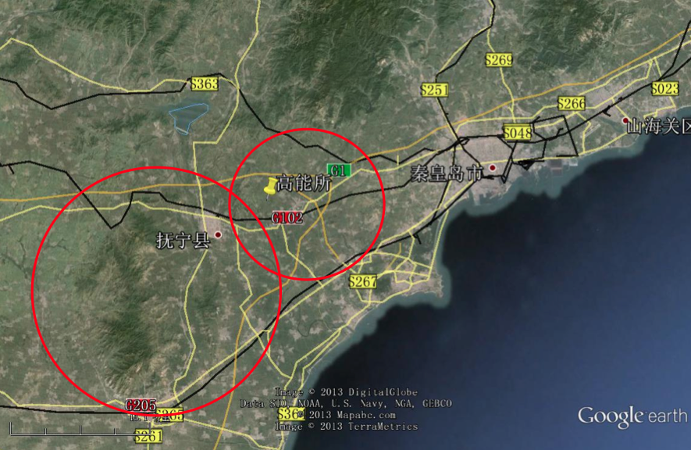
The Standard Model and Accelerators for Particle Physics
DAFNE
BEPC
SKEKB
Notes:
Add SBF, CEPC, HIEPA, DAMPE

Slide 3
Big Questions to the Standard Model
Cosmology:
Unable to explain matter anti-matter asymmetry;
Not account for the accelerating expansion of the universe (dark energy), no prediction power for dark matter candidates.
Force and unification:
Does not incorporate the full theory of gravity;
No answer to the origin of electroweak symmetry breaking;
No solution to hierarchy problem.
Particle properties:
Does not incorporate neutrino oscillation and their masses;
Does not explain electric charge quantization.
Expect new physics beyond SM
Higher energy: ILC, CEPC, Fcc
Higher precision: Belle2, STCF, μ→eγ, μ+A→e+A…

Slide 4
Forthcoming Discoveries in Particle Physics
Topic | Crucial measurement | Significance
Higgs boson | M =125 GeV | Confirm spontaneous symmetry breaking in gauge theory
Gravitational waves (Graviton) | Existence | Support general relativity
Glueball, exotic hadron | Existence | QCD
Dark matter | Existence | Missing mass in the universe
Antimatter | Existence | Baryon number asymmetry
Neutrino oscillation and mass | M < 1 eV | Structure of GUTs. Eventual fate of the universe
Proton decay | t > 1.67x10³⁴ years | Evidence for validity of GUTs
Magnetic monopole | Existence, mass, electric charge | Electric and magnetic charge symmetry predicted by Dirac. Structure of gauge field configuration
Fractionally charged particle | Existence | Would confuse all current prejudice
Super-symmetric particles | Existence, M > 1 TeV | Hope of understanding gravity
Extra dimension | Existence, Heavy W/Z like particle, graviton, microscopic black hole | Hierarchy problem
Is there any, beside STCF, better facility to search for exotic hadrons?

Slide 5
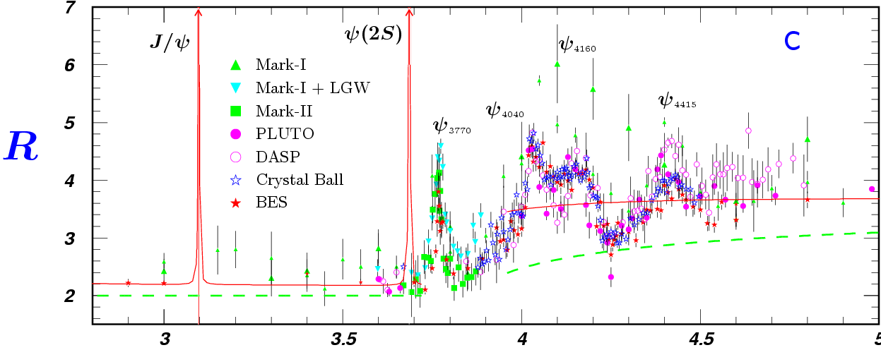
Features of the τ-c Energy Region
Rich of resonances, charmonium and charmed mesons.
Threshold characteristics (pairs of τ, D, D_{s}, charmed baryons…).
Transition between smooth and resonances, perturbative and non-perturbative QCD.
Mass location of the exotic hadrons, gluonic matter and hybrid.
5
τ⁺τ⁻
D_{s}D_{s}
Λ_{c}Λ_{c}

Slide 6
Physics at STCF
Test and understand QCD at low energy
Exotic hadrons, glueball, hybrid, multiquark, molecular states
Structure of hadrons (form factors)
Light hadron, Charmonium(-like) spectroscopy
Precision test of the Standard Model
R values, tau decays, CKM matrix, lepton universality test
Decay constants
CP violation in tau, charm, baryon, charmed baryon
New physics searches
Rare and forbidden decays relating to c and τ
→ LFV, LNV, BNV, FCNC, LFV, LNV, invisible decays
Light dark matter candidates, light Higgs boson(a₀)…

Slide 7
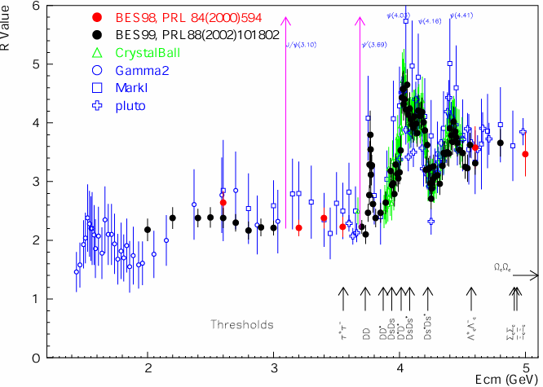
Physics at τ-c Energy Region
R=σ(e⁺e⁻→hadron)/
σ(e⁺e⁻→μ⁺μ⁻)
Hadron form factors
Y(2175) resonance
Mutltiquark states with s quark, Zs
MLLA/LPHD and QCD sum rule predictions
Light hadron spectroscopy
Gluonic and exotic states
Process of LFV and CPV
Rare and forbidden decays
Physics with τ lepton
XYZ particles
Physics with D mesons
f_{D} and f_{Ds}
D₀-D₀ mixing
Charmed baryons
_
R scan
Precision Δα_{QED}, a_{μ}, charm quark mass extraction.
Hadron form factor(nucleon, Λ, π).

Slide 8
Hadron – Ordinary Matter
Hadron: Bound state of quarks that Hadrons held together by the strong force
Meson
Baryon
Proton: uud
Neutron: udd
Is there any exotic hadron except for the ordinary matter?

Slide 9



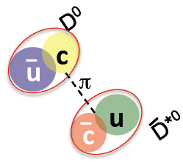


Exotic Hadrons
(possible combination of quark and glue)
Pentaquark
H-diBaryon
Tentraquark
Pentaquar
S=+1 Baryon
Tightly bound 6-quark state
Tightly bound
diquark-diantiquark
Meson molecule
Glueball
Hybrid
g
g
g
_
Loosely bound meson-antimeson
Color-single multi-glue bound state
qq glue hybrid

Slide 10
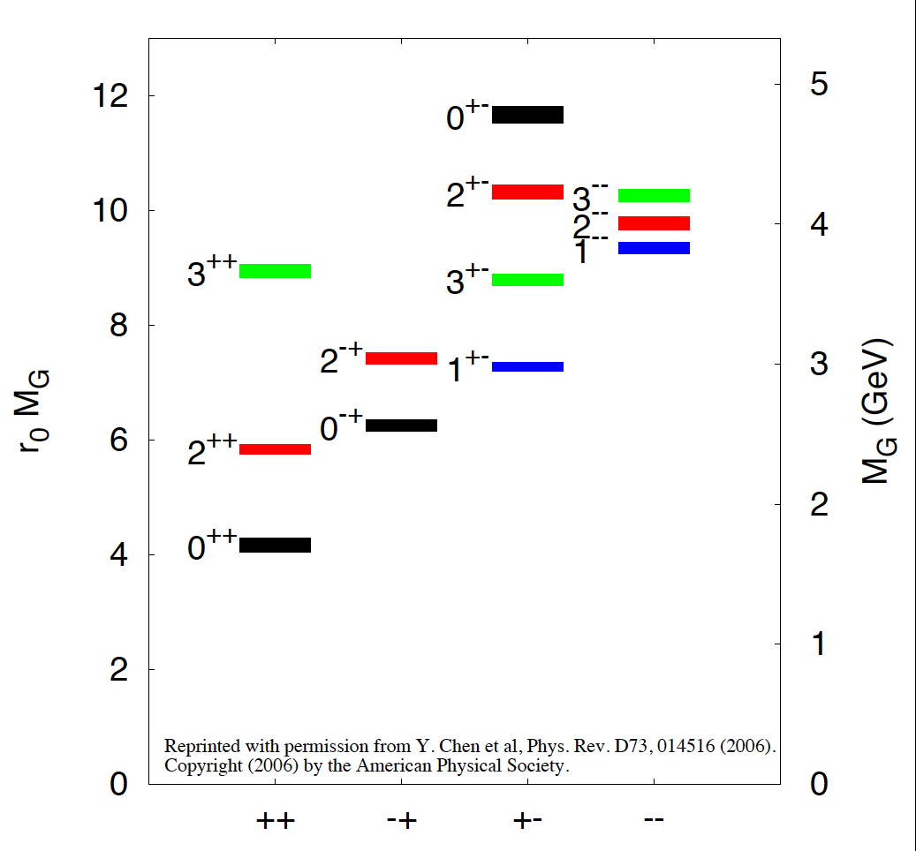
Mass of Glueball Calculated by Lattice QCD in Quenched Approximation

Slide 11
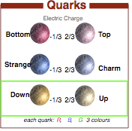
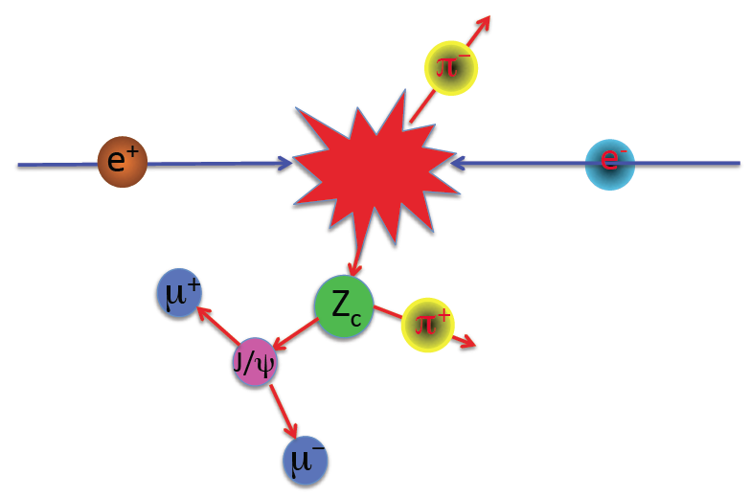
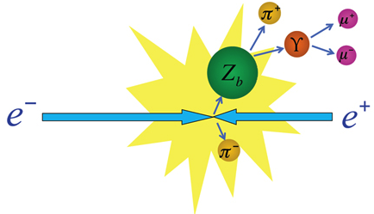
Do Z_{s}, Z_{t} Exist?
Meson
Baryon
b
u
b
u
_
Z_{b}⁺
Z_{b}⁻
Z_{c}⁺
d
b
d
b
_
_
_
c
u
c
u
_
Z_{c}⁺
Z_{c}⁻
Z_{c}⁺
d
c
_
_
d
c
_
Can we find Z_{s}, Z_{t} (too heavy and too short life time)?

Slide 12
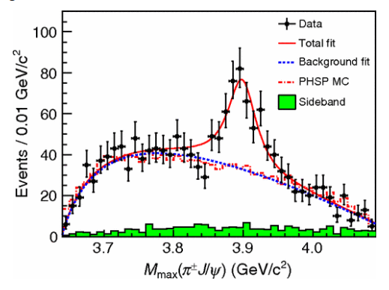
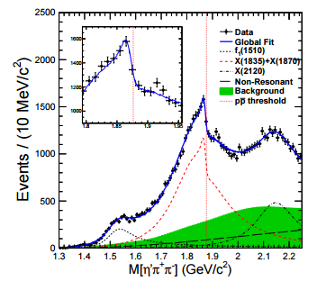
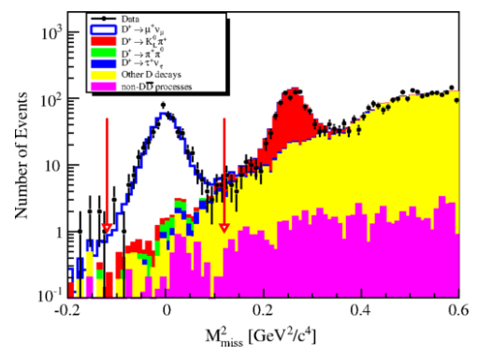
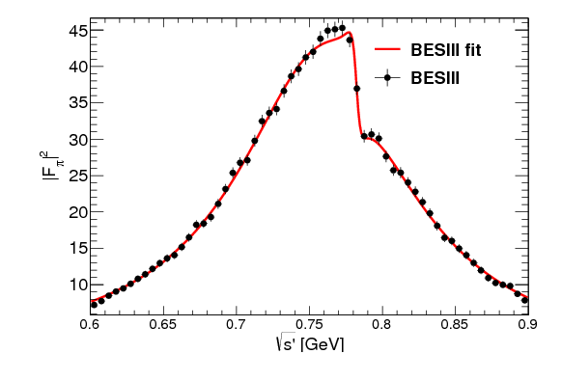
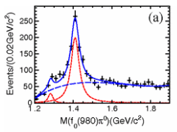
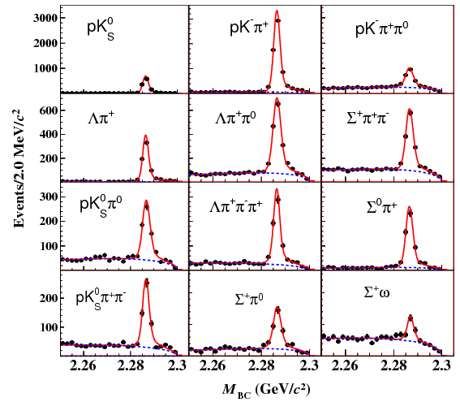
Fruitful BESIII Results
Z_{c}(3900)
Abrupt structure
Most precise measurement for D leptonic decay
X(1835)
Large Isospin Violation
η(1405)→f₀(980)π⁰
First Λc at BESIII
Precise measurement
Precise Measurement on Cross section
e ⁺e⁻→π⁺π⁻

Slide 13
Publication of BESIII
≈200 publications, 1/5 PRL
Excellent in both number and quality
http://bes3.ihep.ac.cn/pub/physics.htm

Slide 14
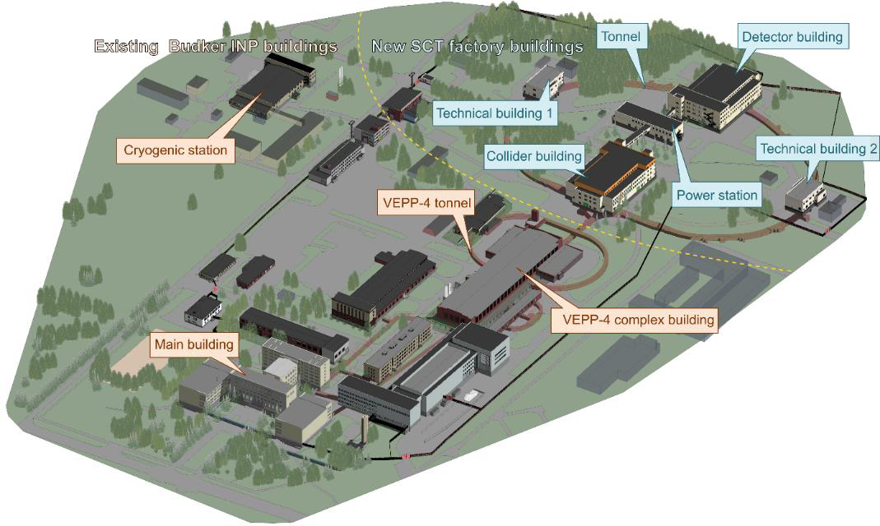
Super Charm Tau Facility in Russia
Existing underground tunnels and new buildings for the SCT accelerator complex

Slide 15
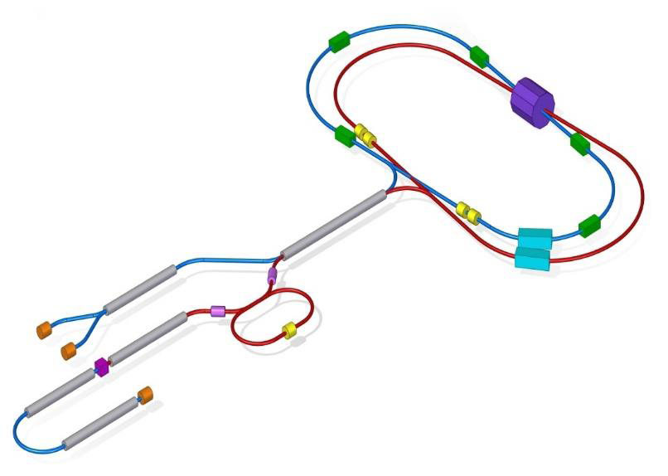
General Configuration of the SCT Factory
WG: damping wiggler
SS: Siberian snake
RF: accelerating cavity
DR: damping ring (1-1.5 GeV) 𝑒⁻pol: polarized electron source 𝑒⁻:electron source
𝑒⁻/𝑒⁺:conversion system

Slide 16
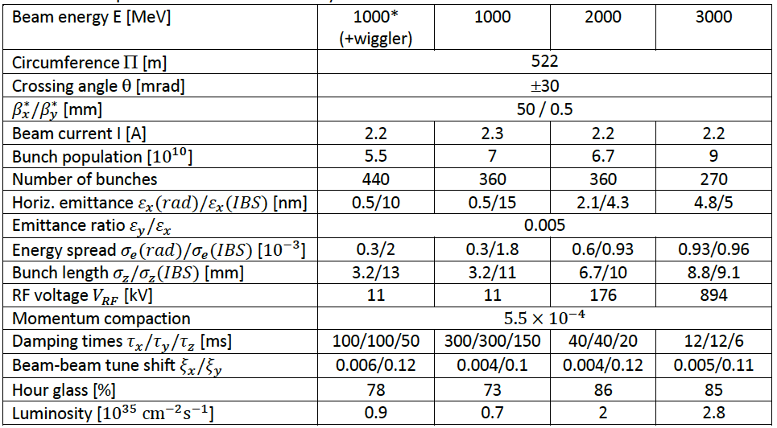
Main parameters of the SCT factory

Slide 17
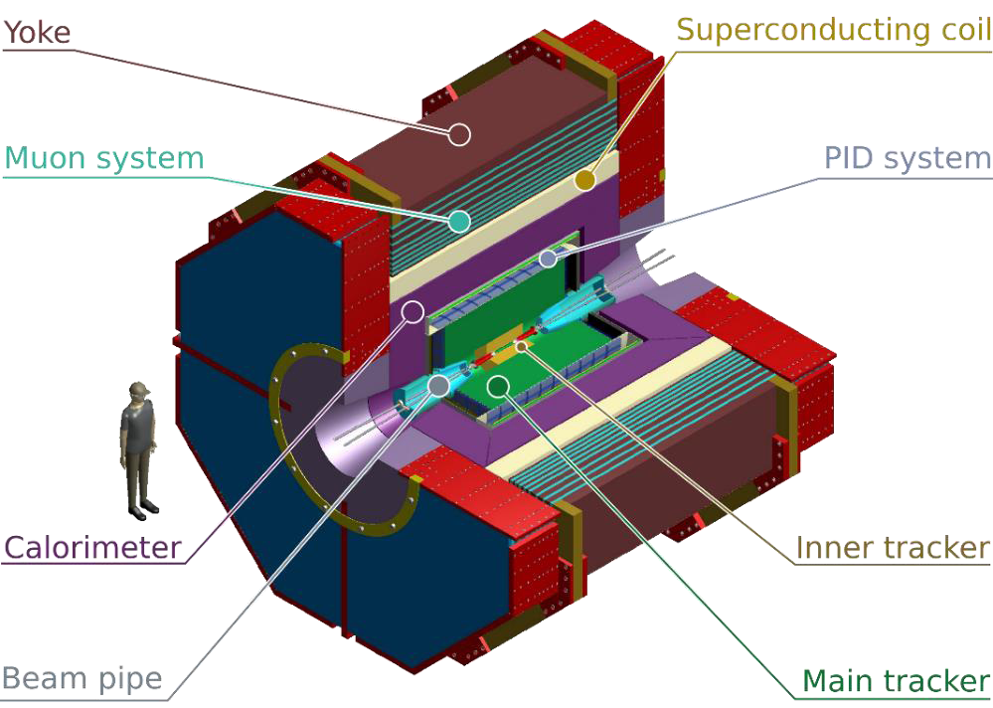
Detector for the SCT factory

Slide 18
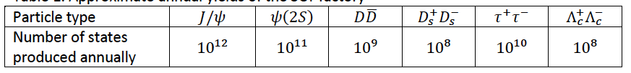
Super Charm Tau Facility in Russia

Slide 19
Super Tau-Charm Facility (STCF) in China
Peak luminosity 0.5-1×10³⁵ cm⁻²s⁻¹ at 4 GeV
Energy range E_{cm} = 2−7GeV
Upgrade to Polarization beam
Basic Features of the collider:
- Symmetric double ring with circumference of 600-1000 m
- Large Piwinski angle collision + crabbed waist for the IR
- Siberia snake for polarization
Notes:
BEPCII/BESIII will end her mission around 2020,
Led by the high energy Physics association of China, we are exploring possible
Future collider proejct post BEPCII and BESIII
High intensity Electron Positron accelerator (HIEPA) is one of the options.
HIEPA facility can be serviced as a collider machine,
Which provide peak lumin…..
The energy range from 2-7Gev, polarization available on one beam
And the symmertic machine with low currents and crabbed saist solution for the interation….
It also can

Slide 20
STCF
E_{cm}= 2-7 GeV, L: 0.5×10³⁵ cm⁻² s⁻¹
Circumference : 600-1000 米
Cost: ~50 亿
Detector
LINAC: ~300 m
RF cavity

Slide 21

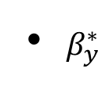
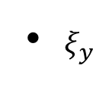
Parameters of Machine
Luminosity:
Increase beam current
Minimize β function
Optimize and H
Strategy:
Phase 0 pilot: 0.5×10³⁵
Phase I nominal: 1.0×10³⁵
Parameters | 1 | 2
Circumference/m | ~600 | ~600
Beam energy/GeV | 2 | 2
Current/A | 1.5 | 2
E/nm•rad | 5/0.05 | 5/0.05
β function @ IP /mm | 100/0.9 | 67/0.6
Collision angle (full θ)/mrad | 60 | 60
Tune shift | 0.06 | 0.08
Hour-glass factor | 0.8 | 0.8
Luminosity/×10³⁵cm⁻²s⁻¹ | ~0.5 | ~1.0

Slide 22
General Consideration of Detector
Much larger radiation tolerance, especially at IP and forward regions
The detector and electronics should withstand the expected does
Efficient event triggering and state reconstruction and tagging
  High efficiency and resolutions for charged and neutral particles
  Low noise and high rate capability
The Systematic uncertainty control
  Detector acceptance : geometrical acceptance and detector response
  Mis-measurement : mis-tracking, fake photon, particle mis-id, noise
  Luminosity measurement
Reasonable cost

Slide 23
General Consideration
Vertex performance and low-momenta tracking eff.
Tracking : multiple scattering effect is important
- P _{T} resolution : 0.5∼0.7%@ 1 GeV/c, and dE/dx resolution: 6%
- low material budge.
PID : π/K and K/p separation up to 2GeV/c
- modest material budget (<0.5X₀)
- Cherenkov detector is necessary
EMC : fast response to match the high luminosity
- stochastic term<2%/√E and constant term < 0.75%,
- angular resolution?
MUC : large-area fast sensors (RPC/MPRC etc)
- μ/π suppression power>10/30, down to p=0.5GeV/c
Large solid angle detector ∼nearly 4π

Slide 24
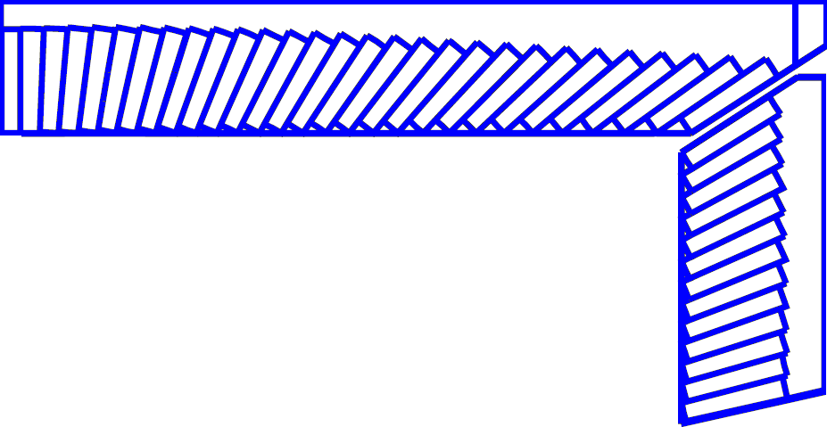
Detector
245 cm
PXD
Material budget ~0.15%X₀ / layer
σ_{xy}=50 μm
York/Muon
185 cm
MDC
σ_{xy}=130 μm
dE/dx<7%, σ_{p}/p =0.5% at 1 GeV
Superconducting magnet
(0.7-1 T)
York/Muon
135 cm
EMC
PID
π/K (and K/p) 3-4σ separation up to 2GeV/c
105 cm
PID-barrel
85 cm
20°
PID-endcap
EMC
Energy range: 0.02-2GeV
At 1 GeV σ_{E} (%)
Barrel(Cs(I): 2
Endcap (Cs): 4
MDC
15 cm
PXD/SSD
10 cm
MUD
μ/π suppression power >10
3~6 cm
IP
120 cm
140 cm
190 cm
240 cm
300 cm
Notes:
Better inner tracker to adapt high luminosity
Better PID
Better Muon detector
Better ECAL

Slide 25
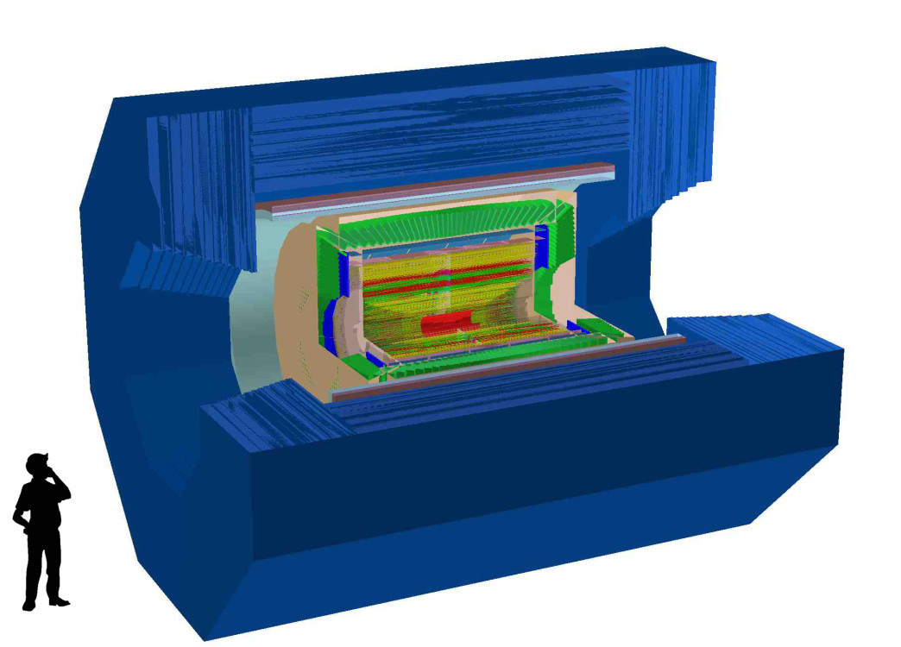
Detector Concept for STCF
PID system
Barrel: MPGD-RICH
Endcap: DIRC-like TOF
ECAL
Barrel: Pure CsI Endcaps: LYSO
Outer tracker
Drift chamber
Superconducting Magnetic (~1T)
Inner tracker
Silicon detector: DMAPS
A novel MPGD: uRWELL
MUC
MRPC timing layers
RPC layers

Slide 26
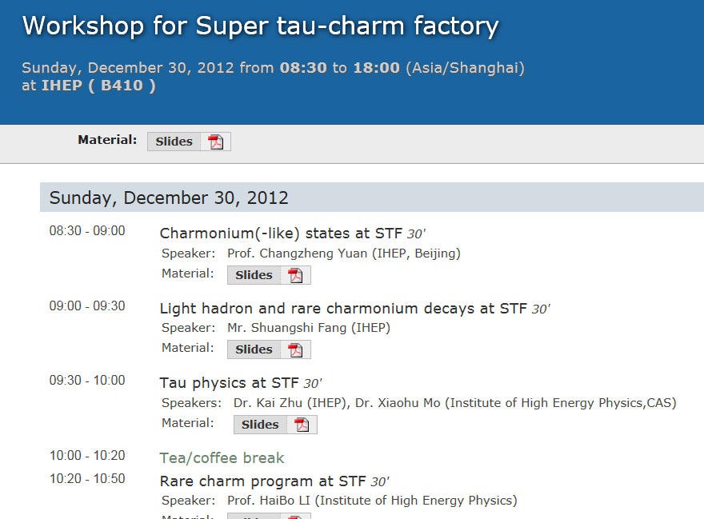
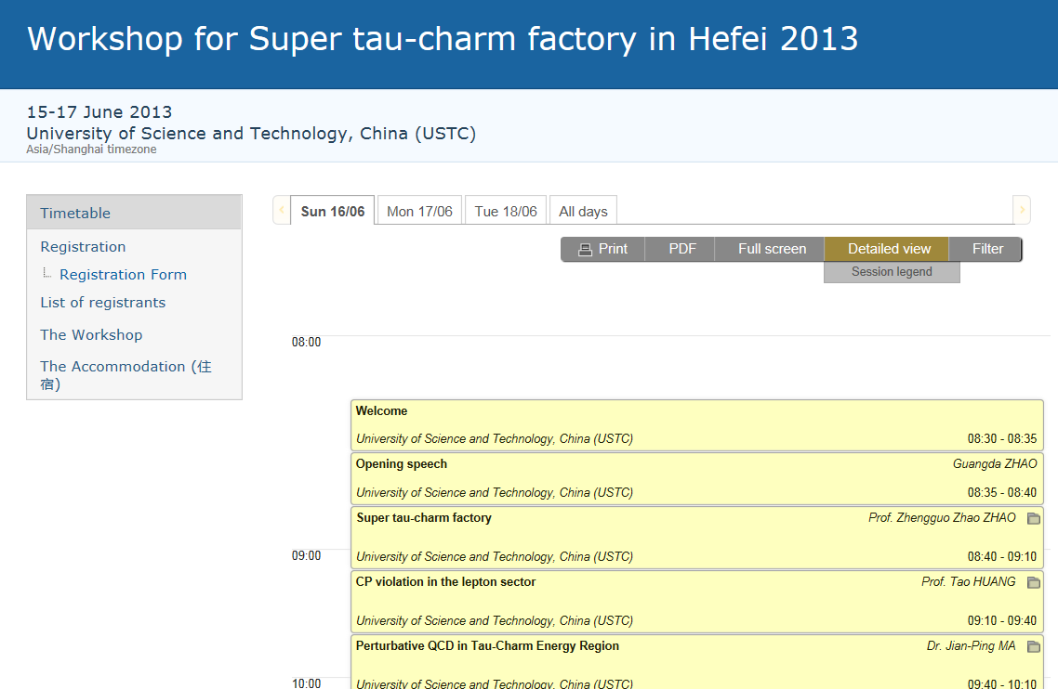
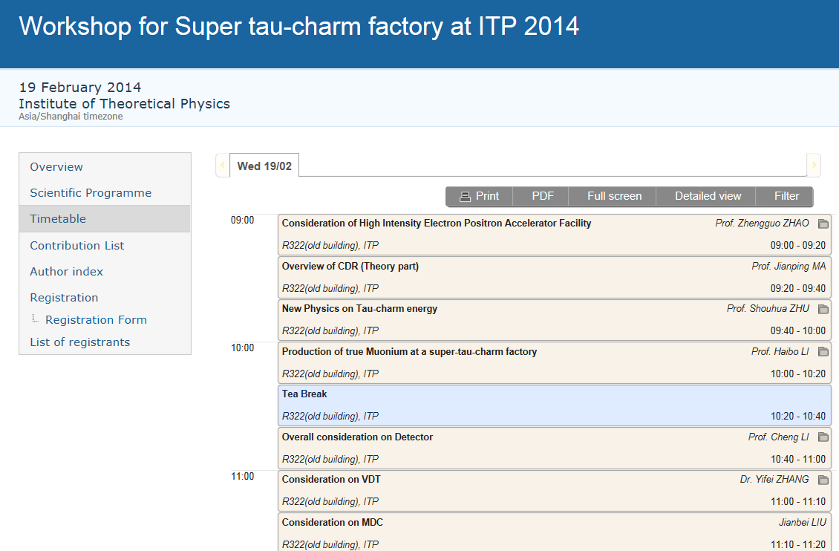
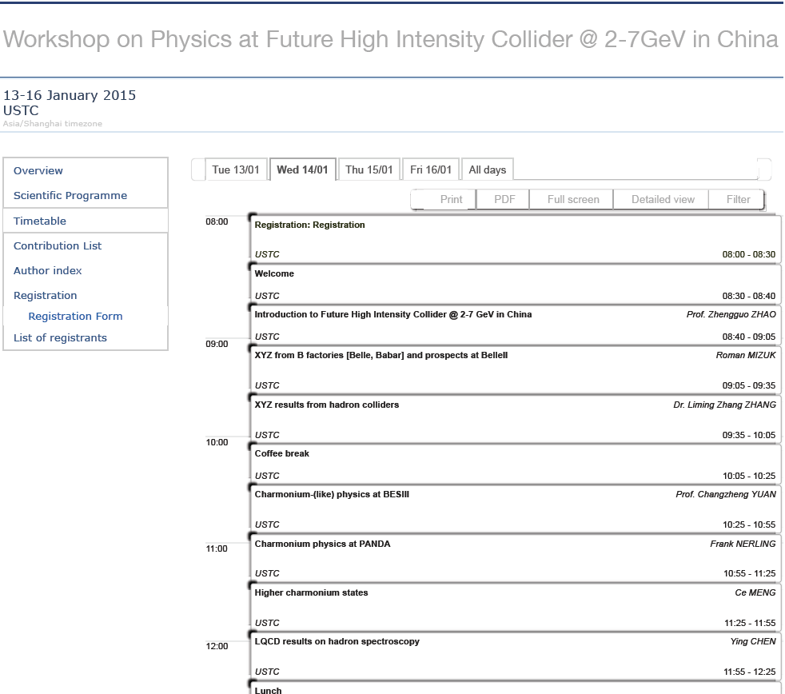
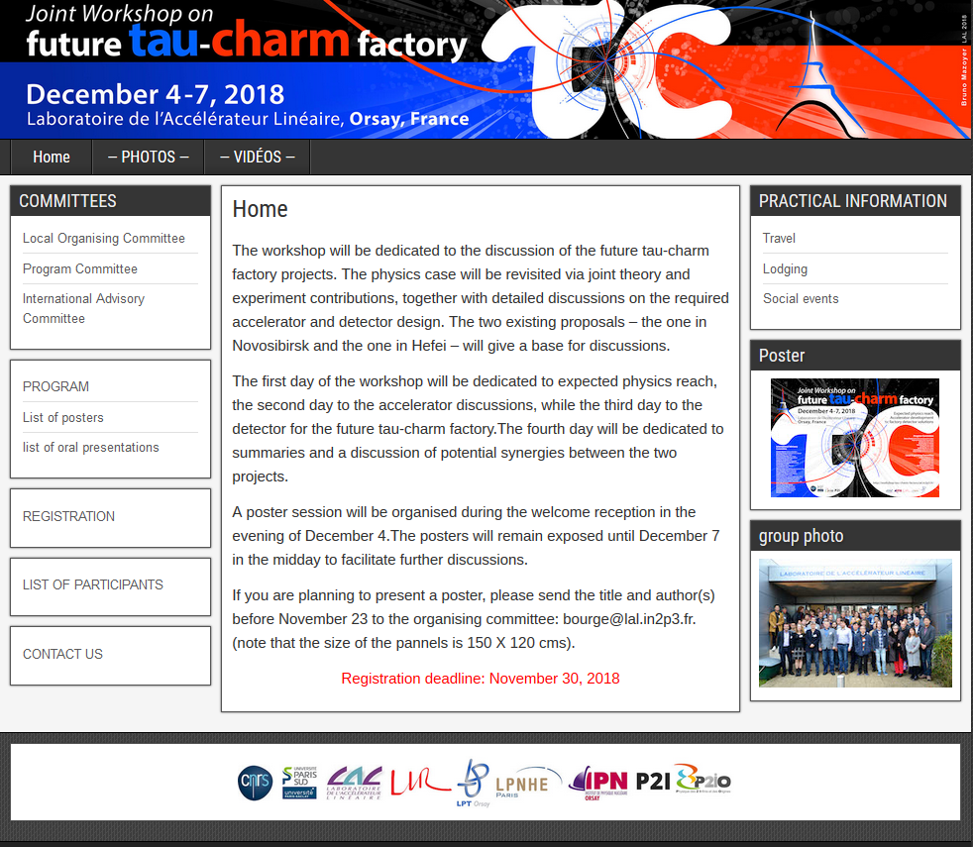
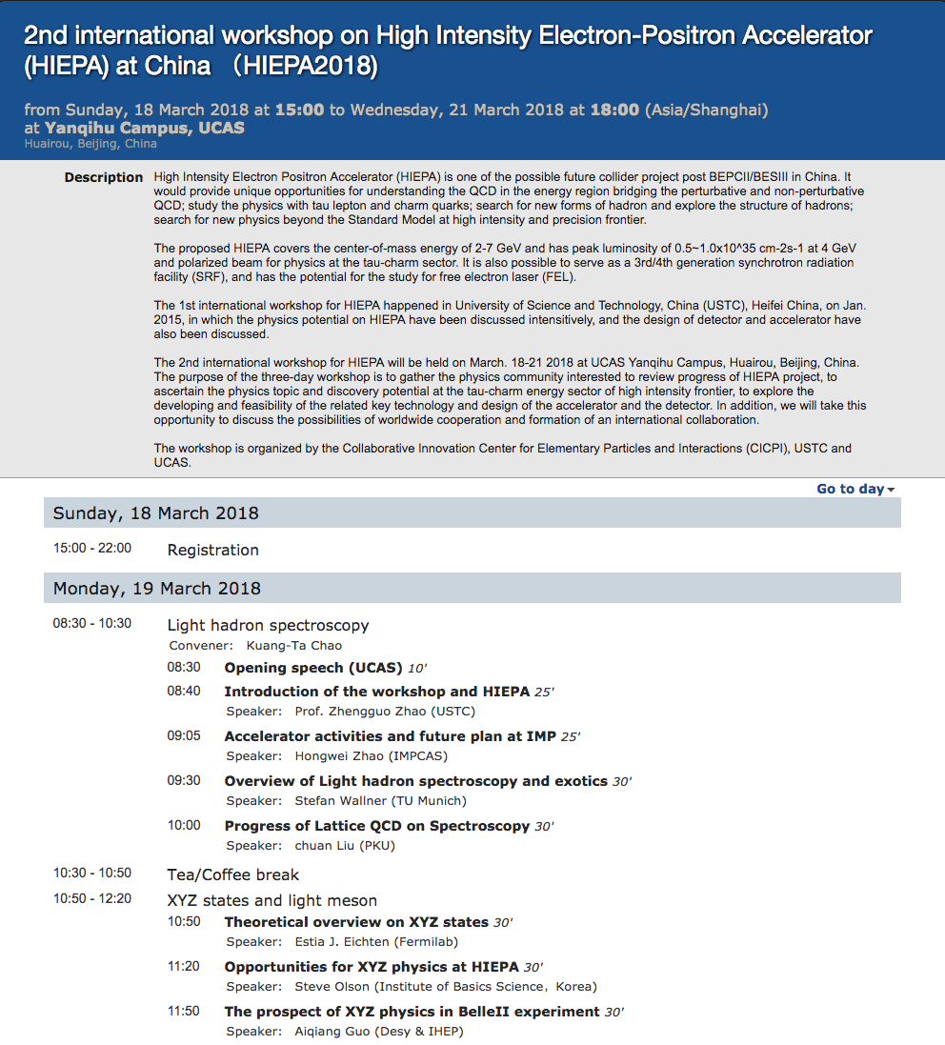
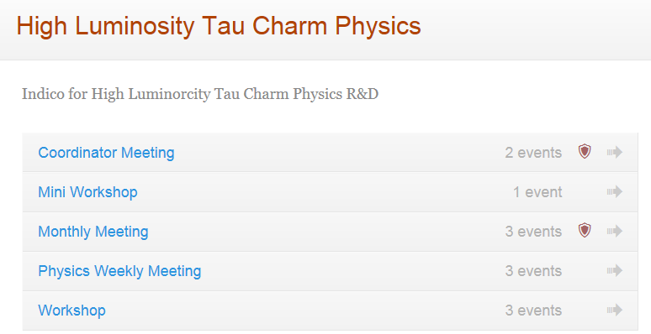
Workshops

Slide 27
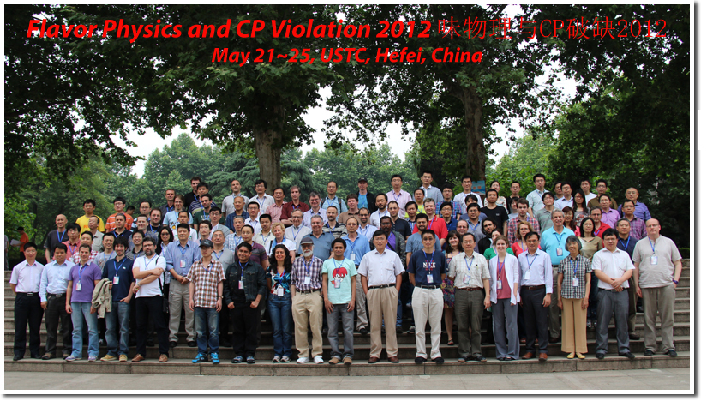
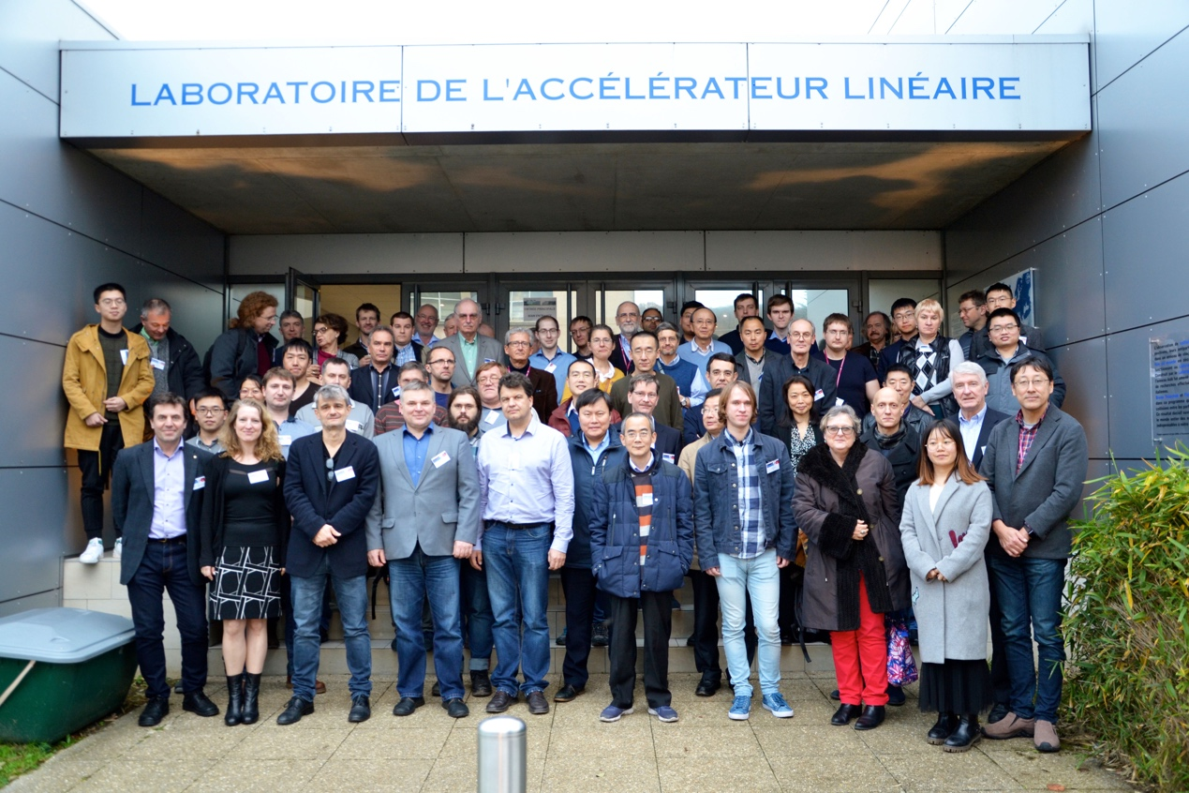
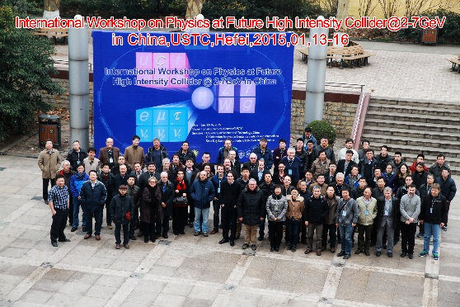
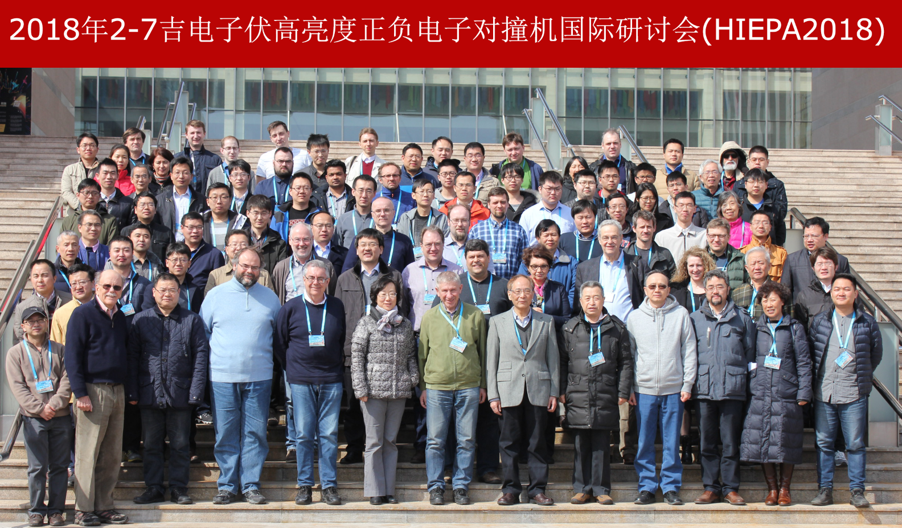
International Workshops
来自中，美，英，德，法，意，日等国 约150名科学家

Slide 28
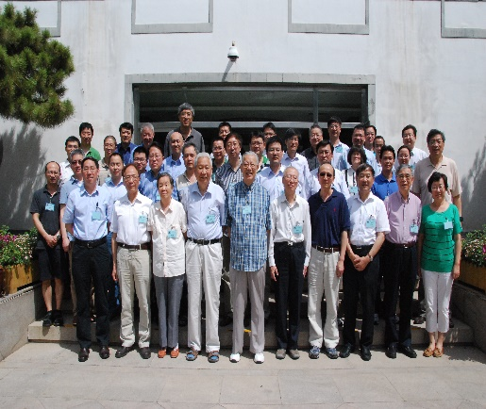
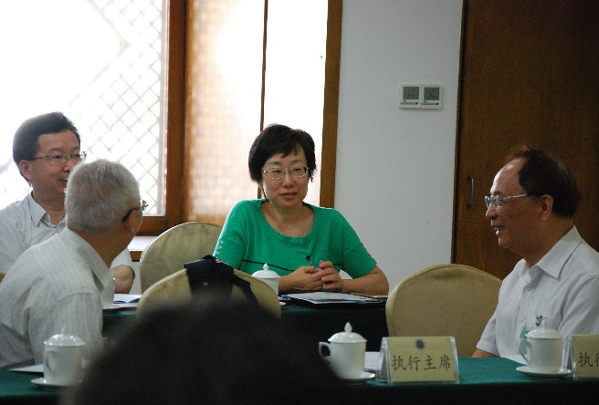
Fragrant Hill Forum (香山会议)
Almost all key persons of HEP community in China

Slide 29
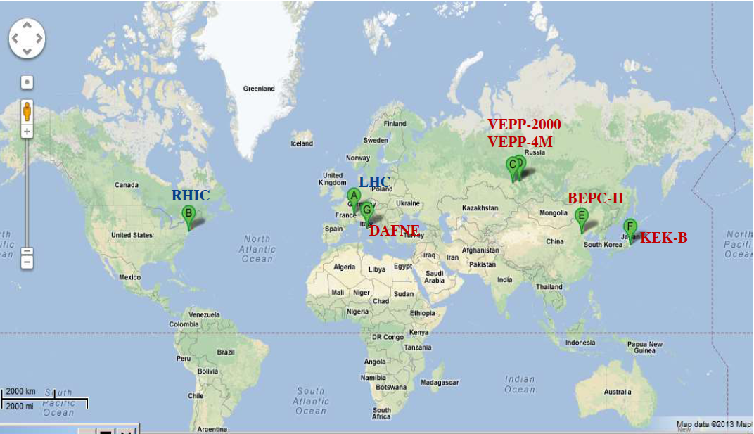
Operating accelerators for particle physics
China
CEPC (ZF)?
HIEPA ?
Europe
LHC
CLIC ?
F_{CC} ?
Russia
SCTF ?
USA
EIC ?
Japan
SKEK-B
ILC ?

Slide 30
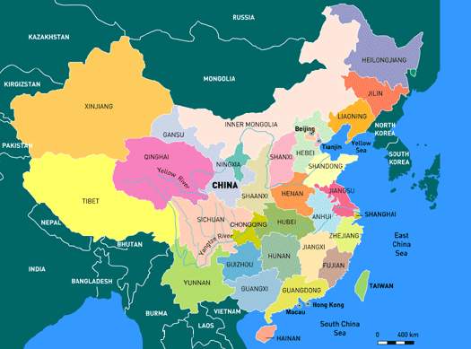
Big Facilities for Particle Physics in China
Beijing
BEPCII
HEPS
Lanzhou
HIRFL
Hefei
HLS2, HALS
HIEPA
Shanghai
SLS
Tibet
Cosmic observatory
Sichuan
CJPL
LHASSO
Guangdong
Daya Bay Reactor ν JUNO
CNSS
HIAF→HIEPA-EiC
Notes:
Yanba Jing in Tibet: Cosmic Ray Observatory
IMP of CAS in Lanzhou: Heavy Ion Accelerator
IHEP of CAS in Beijing: BEPC
Shanghai Light Source
Neutron Spallation Source in Dongguan, Guang Zhou
Daya Bay Nuclear Reactor Neutrino Experiment
Deep Underground Laboratory: Jing Ping Shan in Shi Chuan

Slide 31
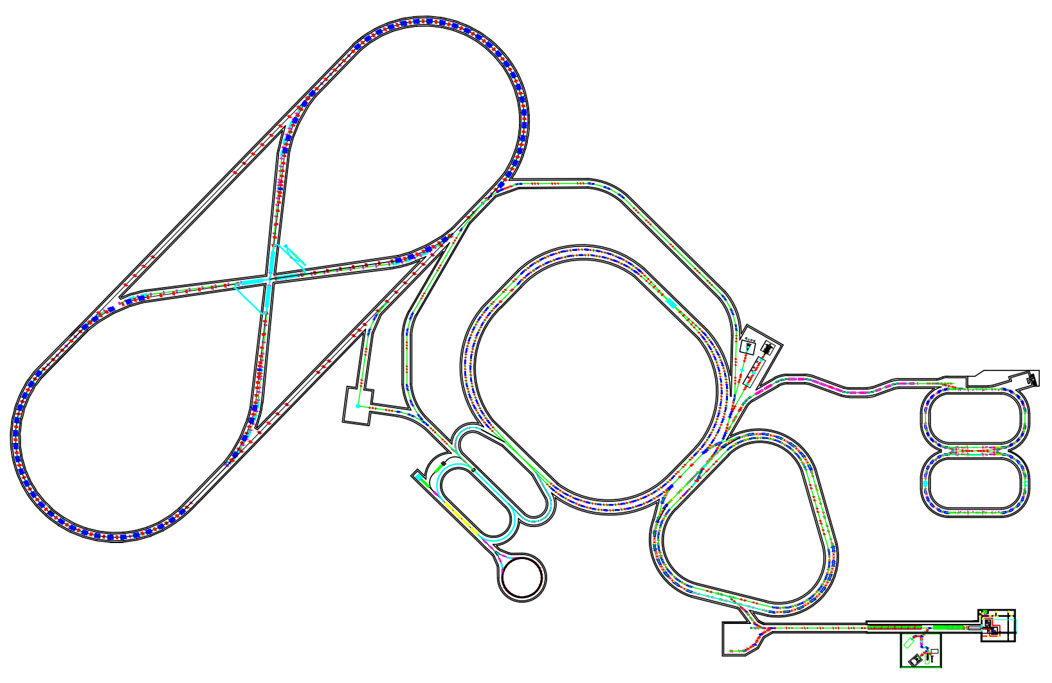
Accelerator Complex: HIAF-HIEPA-EicC
Storage rings: 2km
Polarized beam:
- E(e⁻) = 10 GeV
- E(p) = 60 – 100 GeV
e-ring
EicC-2
HIEPA
e⁻ & p rings
EicC-1
p-ring
BRing
e⁻ injector
SRF Linac-ring 3.5-10 GeV
HIAF
Proton ring

Slide 32
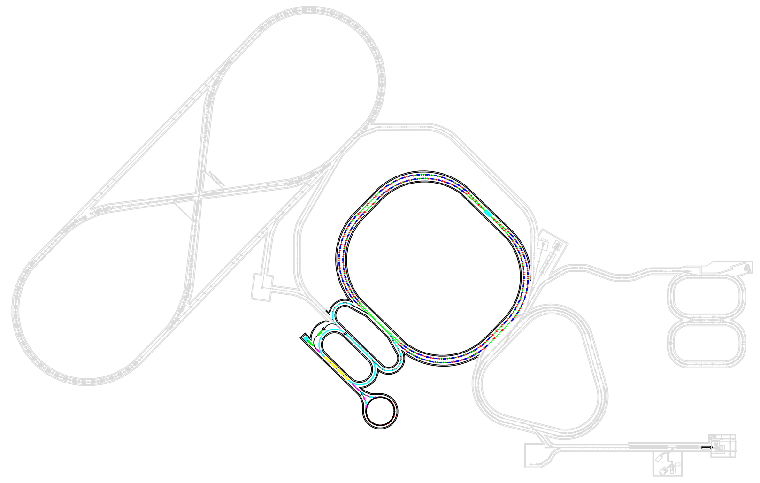
HIEPA Layout
HIEPA
Detector
e± rings: 800 m
E_{b}: 1-3.5 GeV
e⁻ injector
SRF Linac-ring 3.5-10 GeV

Slide 33
Organization for STCF
Institutional Board
Steering Committee
International Advisory Committee (IAC)
Project coordinator
Theory & MC Simulation
Accelerator
Detector
Light Hadron
Charmonium
XYZ
Charm decay
Charm Spectroscopy
Tau
R&QCQ
New Physics
…
Design
RF
IP
Linac
Vacuum
Beam diagnose
…
Tracking
PID
ECAL
Muon
SC
Trigger
DAQ
Software
Computing & Network
…

Slide 34
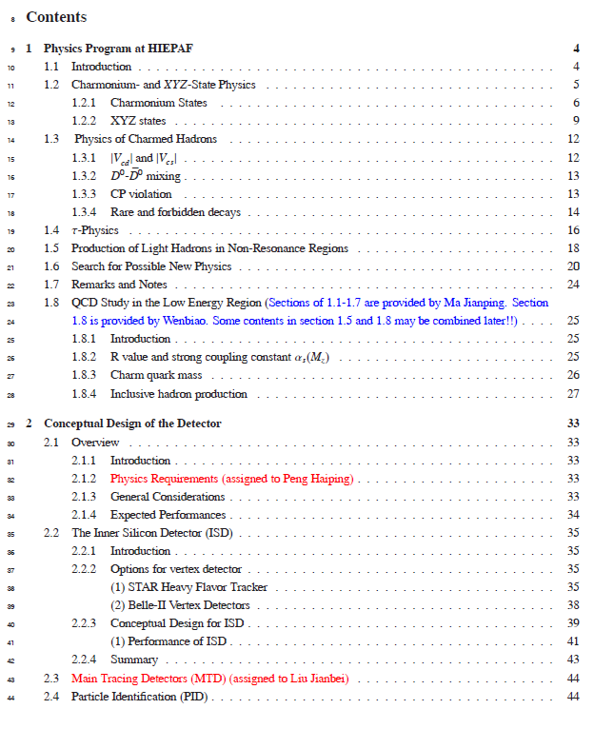
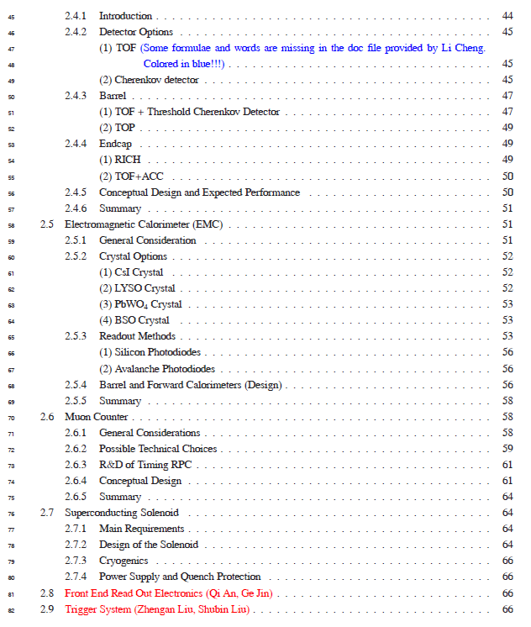

Connectional Design Report (CDR)

Slide 35
Institutions Shown Interest
中国科学技术大学
清华大学
北京大学
上海交通大学
复旦大学
山东大学
浙江大学
南京大学
南京师大
南开大学
中山大学
高能物理研究所
兰州近代物理所
合肥物质研究院
合肥同步辐射国家实验室
西安光极所
南华大学
北京航天航空大学
湖南大学
湖南师大
四川大学
河南师大
河南科技大学
辽宁大学
广西大学
广西师大
兰州大学
香港大学
香港中文大学
黄山学院
武汉大学
华中师大
Stanford University, USA
Wayne State University, USA
Carnegie Mellon University, USA
GSI Darmstadt and Goethe University Frankfurt,
Germany
Goethe University Frankfurt, Germany
GSI Darmstadt, Germany
Johannes Gutenberg University Mainz, Germany
Helmholtz Institute Mainz, Germany
LAL (IN2P3/CNRS and Paris-Sud University),
Orsay, France
Sezione di Ferrara, Italy
L'Istituto di Fisica Nucleare di Torino, Italy
L'Istituto di Fisica Nucleare di Firenze, Italy
Scuola Normale Superiore, Pisa, Italy
Laboratori Nazionali di Frascati, Italy
INFN, Padova, Italy
University of Pavia, Pavia, Italy
University of Parma, Italy
Institute for Basic Science, Daejeon, Korea
T. Shevchenko National University of Kyiv, Ukraine
University Ljubljana and Jozef Stefan Institute Ljubljana, Slovenia
Jozef Stefan Institute Ljubljana, Slovenia
University of Silesia, Katowice, Poland
Dubna, Russia
Budker Institute and Novosibirsk University, Russia

Slide 36
Tentative Plan
 | 2018 | 2019 | 2020 | 2021 | 2022 | 2023 | 2024 | 2025 | 2026 | 2027 | 2028 | 2029 | 2030- 2040 | 2041- 2042
Form International Collaboration
Conception Design Report (CDR)
Technical Design Report (TDR)
Construction
Commissioning
Upgrade
A unique precision frontier in the world for 30 years!

Slide 37

STCF in Perspective
SKEKB
STCF
BEPC-II
BEPC
2028
A luminosity 1×10³⁵ cm⁻²s⁻¹ at 4 GeV at 2028 is reasonable !!

Slide 38
Summary
HIEPA is Super τ-c Factory (STCF):
- double ring with circumference around 1000 m
- e⁺e⁻ collision with E_{cm} = 2 – 7 GeV, L = 1 × 10³⁵
STCF: one of the crucial precision frontier - rich of physics program, unique for physics with c quark and τ leptons, important playground for study of QCD, exotic hadrons and search for new physics.
We initialized about 10 M CNY (1 USD = 6.5 CYN) to start R&D.
Int. collab. is essential for promoting the project.

Slide 39
Extra Slides

Slide 40
Super Tau Charm Factory(STCF):
A Precision Frontier for Particle Physics
Abstract
A e⁺e⁻ collider that covers the center of mass energy of 2-7 GeV and has a luminosity of 10³⁵ cm⁻¹s⁻¹ could produce billions of charmonia, charmed baryon pairs and tau lepton pairs right at their production thresholds, which could be the unique data for systematically study physics with c quark and tau leptons, in particular the study of the hadron structure, search for exotic hadrons like glueball, hybrid and multiquark states, as well as new physics that is beyond the Standard Model through high precision measurements. This presentation will briefly introduce the STCF, mainly its physics motivation, the conception design of the machine and detector, as well as its current status of the project promotion in the world.

Slide 41
Activities
CDR → TDR → project application → construction → commissioning
Weber page: http://wcm.ustc.edu.cn/pub/CICPI2011/futureplans/
Workshops (2011, 12, 13, 14, 15, 16, 18)
Report to USTC Scientific Committee and USTC presidents
Report to Hefei High-tec Development Zone
Report to Anhui Development Planning Commission
Report to CAS Condition and Finance Bureau
Report to USTC new president
Organize for the project

Slide 42





Slide 43


Notes:
Fragrant Hill Forum

Slide 44


Slide 45

Candidate Site：Hefei

Slide 46

Regular and Intensive Activities

Slide 47



Slide 48




Slide 49




Z_{c}(3900) Observed at BESIIII and Belle
Belle with ISR: PRL110, 252002
967 fb⁻¹ in 10 years running time
BESIII at 4.260 GeV: PRL110, 252001
0.525 fb⁻¹ in one month running time
M = 3894.5±6.6±4.5 MeV
Γ = 63±24±26 MeV
159 ± 49 events
>5.2σ
M = 3899.0±3.6±4.9 MeV
Γ = 46±10±20 MeV
307 ± 48 events
>8σ
Notes:
The fit to the piJ/psi invariant mass distribution show clearly the contribution of a state at 3900 MeV, the Zc(3900), in both BESIII and the Belle data. The width is around 50 MeV, and the statistical significance is large than 5 sigma in both experiments, so it is an observation.
This is a good example indicating the advantage of tau-charm factory (threshold characteristics)

Slide 50



Competition from Belle II?
Integrated luminosity
0.4ab⁻¹ from Belle II 2024
1.0ab⁻¹ from HIEPA/year
Belle with ISR: PRL110, 252002
967 fb⁻¹ in 10 years running time
>5.2σ
@ 4.26 GeV for π⁺π⁻J/ψ
ε_{BESIII} = 46%, ε_{Belle} = 10%
BESIII at 4.260 GeV: PRL110, 252001
0.525 fb⁻¹ in one month running time
>8σ
Have incomparable superiority to explore Charmonium(like) states

Slide 51


τ→μγ
The process e⁺e⁻→τ⁺τ⁻γ, dominant background source at Υ(4S), does not contribute below 2E ≈ 4m_{τ}/√3 ≈ 4.1 GeV.
The favorable kinematical condition and the use of polarization can allow an UL(STCF in 1-2 years) ≤ UL(SuperBelle@Y in 12-15 yrs).
γ
μ⁻
μ
e⁻
ν
τ⁻
τ
γ
γ
ν
ν
e⁺
τ⁺
ν
4.0 GeV
10.6 GeV
τ→μγ
τ→μγ
E_{γ}
E_{γ}

Slide 52






Nucleon Electromagnetic Form Factors(NEFFs)
, Λ Λ
Time-like:
FF complex
Space-like:
FF real
time-like
Only 2 measurements, but
results are contradict
JLab
10-24% precision from
B factory
Cristina Morales
Notes:
Complete picture of the nucleon structure requires space-like and time-like measurements!

Slide 53




CP Violation in τ Decay
CP violation is observed in B, D and K systems to date
No CPV has been observed in the lepton sector
The discovery of CPV in the tau sector would be a clean signature of NP
One of the most promising CPV channels is τ⁻→K_{S}π⁻ν
SM CP asymmetry from K_{S}-K_{L} mixing is expected to be :
[Bigi & Sanda, PLB 625, 2005, Grossman &Nir JHEP 1204 (2012) 002]
BaBar measurement [PRD 85, 031102]
Belle measurement [PRL 107, 131801]
Charge Higgs, new Scalar,
W_{L}-W_{R} Mixings, LeptonQuarks
A_{cp} = (1.8±2.1± 1.4) ×10^{-3 @} W ∼ [0.89-1.11] GeV
Notes:
Now, we move to the CPV in tau decay.
To day, CP violation is observed in B,D and Ksystem
But no ovserved in the lepton sector,
The discovery of CPV in tau decay is a clean signture of NP.
The most promising CPV channels is tau-Ks pi v,
The SM predicted the CVP at 10-3 level duo to the Ks-Kl mixing,
But Belle and Babar did not observed any evindence for it CPV

Slide 54



τ CPV in Angle Distribution
Need new measurement on the angular CPV asymmetry
Use T-odd rotationally invariant products : e.g.
in τ⁺ and τ⁻ decays to >=2 hadrons such as :
τ⁻→π⁻π⁰ν_{τ} /k⁻π⁰ν_{τ} , τ⁻→π⁻π⁺π⁻ν_{τ} /K⁻π⁺π⁻ν_{τ} ,
Need
polarized beam
tau-charm
“Figure Of Merits” -- Y. S. TSAI
BESIII @ 4.25 (10³³cm⁻²s⁻¹) FOM=1
HIEPA @ 4.25 (10³⁵cm⁻²s⁻¹) FOM=100
Super B @ (10³⁶cm⁻²s⁻¹ ) FOM=65
B factory
Y. S. Tsai, PRD 51.3172
Notes:
So we need a new measurement on the angular CPV asymmerty.
Like use T-od ratationally invariant products.
The kind of analysis can be performed in the tau decay into final state with more than 2 hadron.
But the polarized beam is necessary.
As we know, the polarization of electron beam can be transver to the produce
Tau,
In tau-charm region, all the produce tau is expected to the 100% poralaztion
While in the super factor, the proporazation is expected to be about 50% with
Tau cos\thet is 0.
A important variable “Figure Of Merits” proposed by the Y.S TSAI which take
into accouting luminorcist, polarization and total cross section,
to quantitative evaluate the feature of different experiment on CPV study
And HIEPA is found to be with the best quilaty.
Evaluate the characters of

Slide 55





Lepton Flavour Violating (LFV)
CLFV processes sensitive to New Physics (NP)
through lepton-lepton coupling
PSI
Mu2e
Anomalous
magnetic
moment
μ, τ anomalous decays
μ → e
conversion

Slide 56

Charged Lepton Flavor Violation (cLFV)
In SM, cLFV is negligibly even taking into account neutrino mass
μ/τ anomalous decays
μ → e
conversion
Anomalous
magnetic moment
In tau-charm factory, τ→μγ decay is a golden mode to search for NP
W. Altmannshofer et al. arXiv : 0909.1333
Notes:
Now we move the new physics,
As we know, the discovery of Higgs complete the list of the partilce in SM.
But there some still a lots questions can not be explain the the SM framework.
To date, there are not any evidence of new physics at high energy frontiers,
So it is important and complementart to directly search for new physics in the presision frontier.
This table is DNA for the new physics search in flavor physics,
and charge letpon Falvor violavation decay is found to be a promising process to find the new physics
And discribmate the different models and contraint theirs parameters.

Slide 57


cLFV Decay τ→μγ @ B Factory
From A. Bondar, Charm2010
Current limit : ~ 4×10⁻⁸ (5×10⁸ τ-pairs)
BABAR : 516fb⁻¹ [PRL, 104, 021802]
BELLE : 545fb⁻¹
At (4S) :
ISR background e+e-→τ⁺τ⁻γ
Upper Limit ∝ 1/√L
Expected limit : 3x10⁻⁹@75ab⁻¹ (7×10¹⁰ τ-pairs)
Background e⁺e⁻→τ⁺τ⁻γ
Super-B 75 ab⁻¹
7×10¹⁰ τ-pairs
Does not contribute below √s ≈ 4m_{τ}/√3 ≈ 4.1 GeV.
Notes:
Tua->gamma mu have been detail studying for many years in B facotry.
This plot show the update limint as function of luminosity for the different experiment.
The current update limit is about 4x10-8 from both BABAR and BELLE,
It is clear see that the upper limit is proportional to 1/sqrt(L)
The strudy from Supper B show the expected UL is 3x10-9 with 75ab-1 data.
At HIEPA, we expected to collected 3x109 tau pair per year
It is interesting to know what the expected UL can be acieved in hiepa.

Slide 58
Expected τ→μγ Br upper limit
Dominant background
E(GeV) | σ(nb) | L(ab⁻¹) | N_{ττ}(10¹⁰)
3.686 | 5.0 | 1.5 | 0.75
3.77 | 2.9 | 3.5 | 1.03
4.17 | 3.6 | 2.0 | 0.71
Total |  | 7.0 | 2.49
τ decays, direct (τ⁺→π⁺π⁰ν_{τ}) and combinatorial
QED processes: e⁺e⁻ → μ⁺μ⁻γγ, e⁺e⁻ → e⁺e⁻ μ⁺μ⁻γ
Continuum hadron production e⁺e⁻ → qq
ψ(2S) and D-meson decays
 | σ_{E}/E=1.5% | σ_{E}/E=2.5%
Signal (Br=10⁻⁹) | 17 | 15
Muon background | 7 | 11
Pion background | 83 | 271
Expected 90% CL upper limit for Br | 1.1×10⁻⁹ | 3.0×10⁻⁹
Expected 90% CL upper limit for Br with pion suppression by a factor of 30 | 3.3×10⁻¹⁰ | 5.1×10⁻¹⁰
Supper-B Expected limit : 3x10⁻⁹@75ab⁻¹ (7×10¹⁰ τ-pairs)
Notes:
The study from Vlaimir show with 7ab-1 data, super tau-charm can get
The comparable or better upple limit than that of Supper-B expections.
We are prosssing the correspond fast simulation for NP sensitivity and to
Optimization the detector perfromance.

Slide 59
HIAF-HIEPA-EicC-1&EicC-2
e-ring
“8”字形电子对撞环
极化电子, 2.0 km, 10GeV
EicC-2
HIEPA
p-ring
Electron & Positron
rings
“8”字形离子对撞环
极化质子, 2.0 km, 60-100GeV
EicC-1
BRing
HIAF
Proton ring
电子注入器
SRF Linac-ring，3.5-10 GeV

Slide 60
HIEPA cost estimation
单位：亿元
 | EIC
eLinac | 4.0+1.0 (阻尼环)
Electron ring | 7.0
Positron ring | 7.0
束线 | 1.2
实验谱仪 | 8.0 ?
低温 | 1.0
配套设施 | 1.8
装置土建 | 6.0
不可预见 | 2.0
合计 | 39

Slide 61

Beam Parameters
(Lattice and other related AP studies are under way)
Notes:
The very preliminary parameters for accelerator are list in this table.
And Lattice and other related AP studies are under way.

Slide 62


Integral Luminosity of STCF
No Synchrotron radiation mode, assume running time 9 months/year
Assume data taking efficiency 85%
10³⁵cm⁻²s⁻¹ × 86400s × 270days × 85% ∼ 2.0ab⁻¹ /year
10 years data taking, total 20 ab⁻¹ conservatively
Excellent opportunities for the τ-charm physics
BELLEII
Native question : Compete between STCF and BELLE II ?
Notes:
With assumed 10^35 luminrocity, it is estimated to get the 1.4ab-1 data per year
Taking into account really running days and data taking efficiency.
It is expected to collected 10^9 D meson pair and Tau lepton pairs.
These data is about 1/3 of BELLE-II data/per year which is expected to run with luminosity at 10^36

Slide 63

Data samples
Data samples with 1 ab⁻¹ integral luminosity
STCF have more yields /per luminosity
STCF is expected to have higher detection efficiency
Belle II can have larger integral luminosity
Detail simulations are ongoing to study the potential for the physics research

Slide 64

Another Lattice with 5BA arc (under work)
Dr Weiwei Gao, Fujian University of Technology
Schematic diagram(one ring)
Circumference 452.924m
Injection / RF cavities(20.058m)
Dispersion free straight sections for installing damping wiggler or Siberian snake
Arc section, 10 periods, each period has 5 bending magnets
Interaction point detector
Crab sextupole
Anti crab sextupole
Matching section
Interaction region
Matching section

Slide 65

Detector Concept for STCF
MUC
Magnetic
ECAL
PID system
Outer tracker
Inner tracker
Highlight:
Powerful separation of K/pi with Cherenkov detector
Timing information provided by EMC
Promotion of π/μ separation

Slide 66
What is HIPEA
→ Super Tau Charm Facility(STCF)
E_{cm}=2-7 GeV, L=1x10³⁵ cm⁻² s⁻¹ at 4 GeV
C=1000 m double rings
Total cost: 5 B CNY
Crabbed Waist

Slide 67
Layout of Machine
Interaction Region : Large Piwinski Angle Collision
+ Crabbed Waist
Detector
Snakes
Crab Sextupole
Injector
Wigglers
Linac
0.5-3.5
GeV
Injector:
No booster, 0.5GeV→1~3.5GeV
e+, a convertor, a linac and a damping ring, 0.5GeV
e-, a polarized e- source, accelerated to 0.5GeV
Key Technology ：
Luminosity ：Large Piwinski Angle Collision + Crabbed Waist
Polarization：Siberlan Snake
e+0.5GeV
e- 0.5GeV

Slide 68

USTC Scientific Committee Review
USTC president agreed, and scientific committee
endorsed supporting R&D → 10 M CYN for this year

Slide 69



Workshops (2011-2018)
150 participants

Slide 70







Fragrant Hill Forum(香山会议)
九位院士， 十余位千人，杰青，长江教授

Slide 71




High Energy Physics in Post Higgs Era
Origin of the electroweak spontaneous symmetry breaking
- Higgs property (m_{H}, Γ, J^{PC}, couplings, σ, Br of all possible modes)
- Higgs as a tool for discovery (structure, additional Higgs bosons..)
New physics beyond the SM
- New energy territory → F_{cc}, CEPC+SppC
- Precision measurements of SM rare processes: SKEKB, LHCb
Mu2e
g−2
μ→eγ
0.14 ppm
4.2×10⁻¹³ 90% C.L.

Slide 72
Data Samples / Year
Luminosity
Seconds/days
Running time/year
Efficiency
10³⁵cm⁻²s⁻¹ × 86400s × 180days × 90% = 1.4ab⁻¹
 | CLEO-C |  | BES-III/ year 10³³cm⁻²s⁻¹(10fb⁻¹) | HIEPA/year 10³⁵cm⁻²s⁻¹ (1ab⁻¹)
J/ψ | − | − | 10×10⁹ | 10×10¹¹
ψ(2S) | 54 pb⁻¹ | 27×10⁶ | 3×10⁹ | 3×10¹¹
ψ(3770) | 818 pb⁻¹ | 5×10⁶ D-pair | 4×10⁷ | 4×10⁹
4.17 GeV | 586 pb⁻¹ | 7×10⁵ D_{s}-pair | 1×10⁶ | 1×10⁸
τ⁺τ⁻ (4.25) |  | 4×10⁶ | 3×10⁷ | 3×10⁹
Notes:
With assumed 10^35 luminrocity, it is estimated to get the 1.4ab-1 data per year
Taking into account the data taking efficiency.
It is expected to collected 10^9 D meson pair and Tau lepton pairs.
These data is about 1/3 of BELLE-II data/per year which is expected to run with luminosity at 10^36

