Slide 1
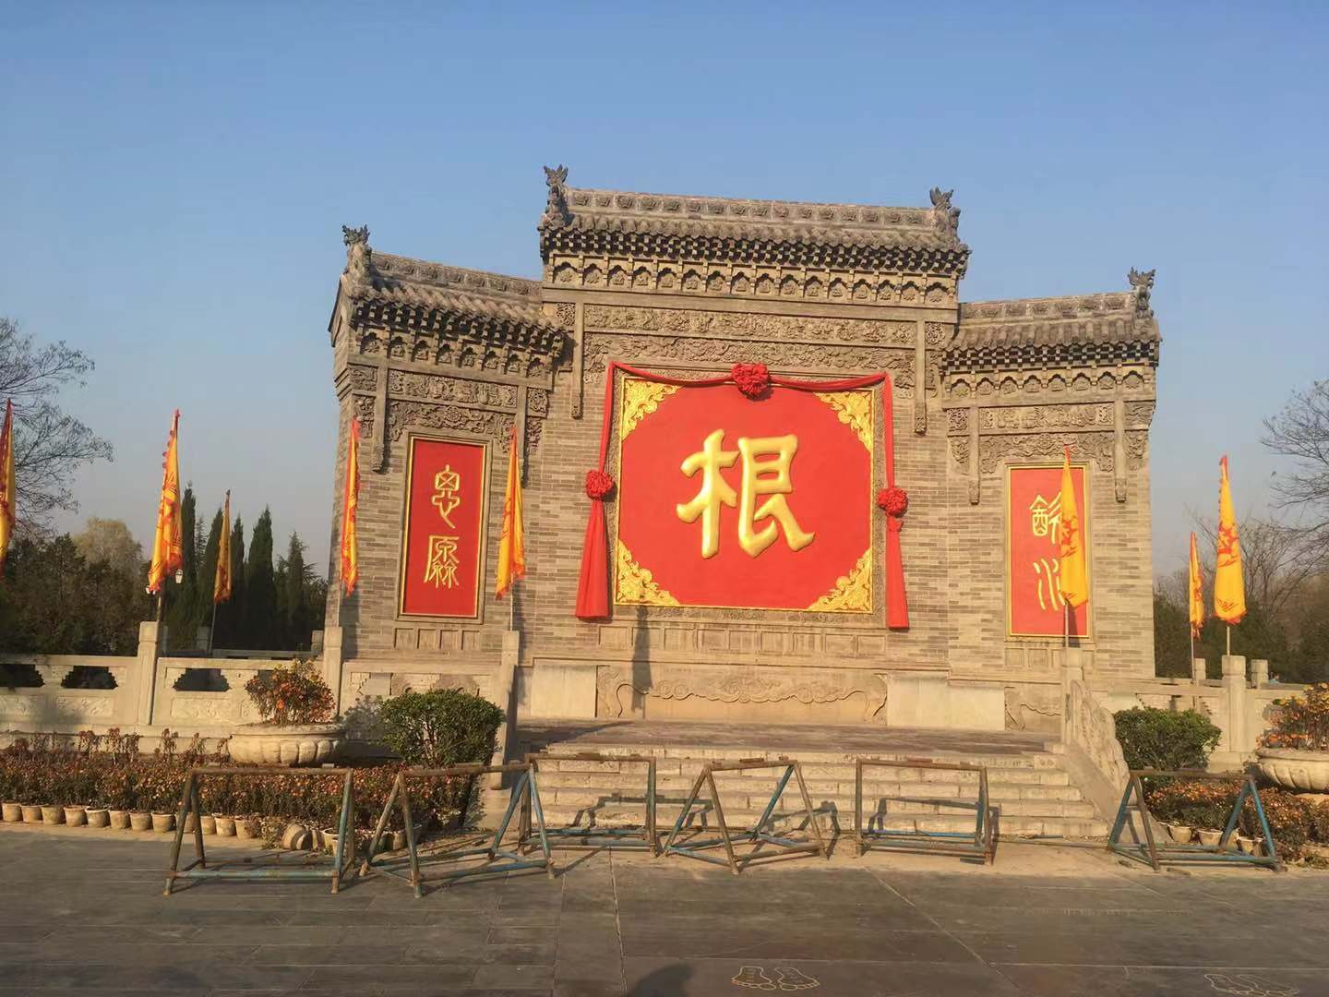
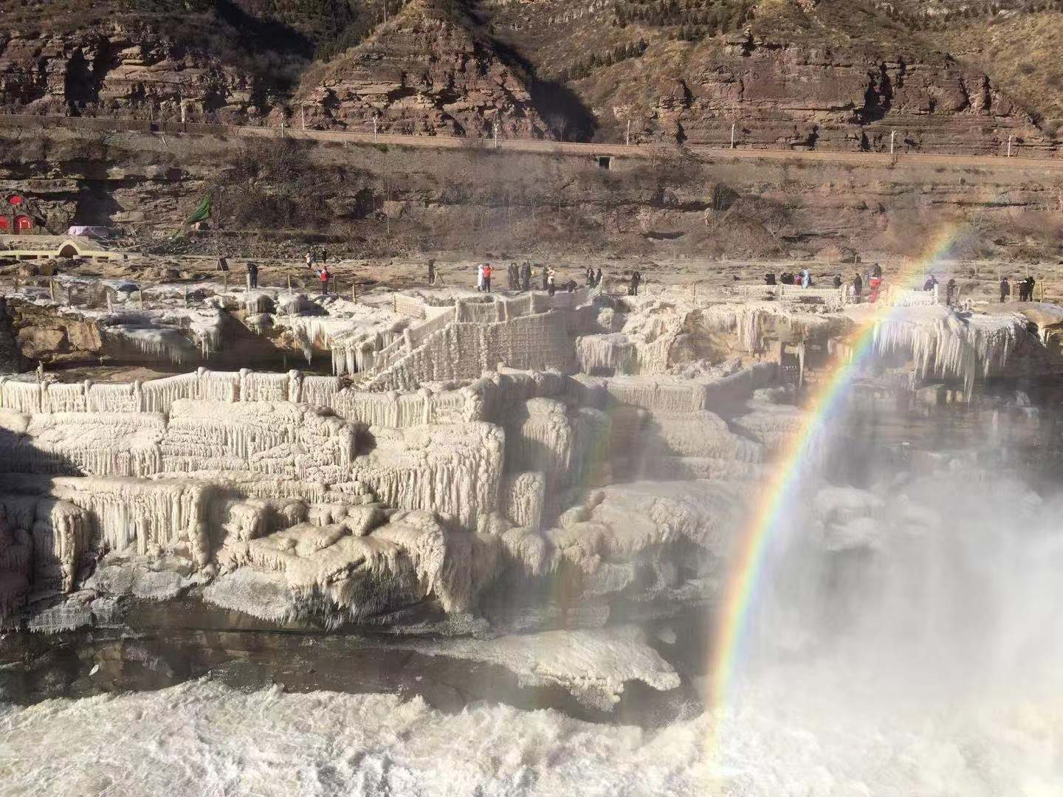
Precision hyperon physics at BESIII
李海波
中国科学院高能物理研究所
BESIII-Belle-LHCb Joint Workshop on Charm Physics， 1-3 Novemebr 2019
山西师范大学，临汾，山西

Slide 2
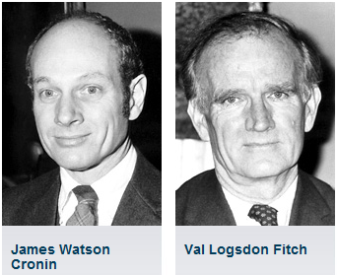
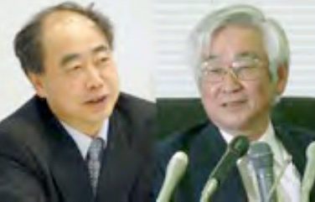
Roadmap of CP violation in flavored hadrons
1980
2008
In 1964, the first CPV was discovered in Kaon；
In 2001, CPV in B was established by two B-factories;
In 2019, CPV discovered in D meson: 10⁻⁴, 10⁸ reconstructed D mesons (LHCb)
All are consistent with CKM theory in the Standard model
But no evidence was found in baryon system?
Baryon asymmetry of the Universe means that there must be non-SM CPV source.

Slide 3
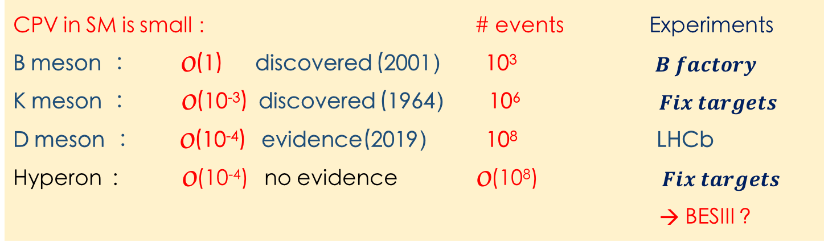
CPV in hyperon decays, # we need?
CPV in SM is small ： # events Experiments
B meson : O(1) discovered (2001） 10³$B factory$
K meson : O(10⁻³) discovered (1964） 10⁶ $Fix targets$
D meson : O(10⁻⁴) evidence(2019） 10⁸ LHCb
Hyperon : O(10⁻⁴) no evidence O(10⁸) $Fix targets$
→ BESIII ?
Flavor-SU(3) Octet of spin ½
Flavor-SU(3) Decuplet of spin 3/2

Slide 4
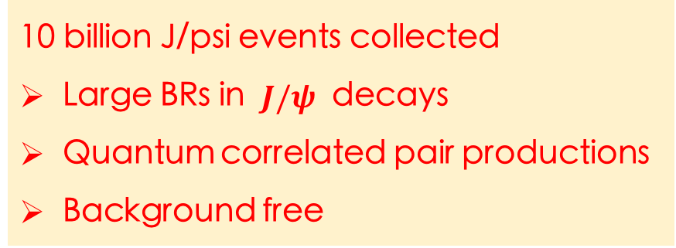
Why Hyperon physics at BESIII？
10 billion J/psi events collected
Large BRs in $J/ψ$ decays
Quantum correlated pair productions
Background free
Hai-Bo Li, arXiv:1612.01775
A. Adlarson, A. Kupsc, arXiv:1908.03102
Detection
Efficiency Number of reconstructed
40% 3200 X 10³
25% 600 X 10³
24% 640 X 10³
14% 670 X 10³
19% 810 X 10³

Slide 5
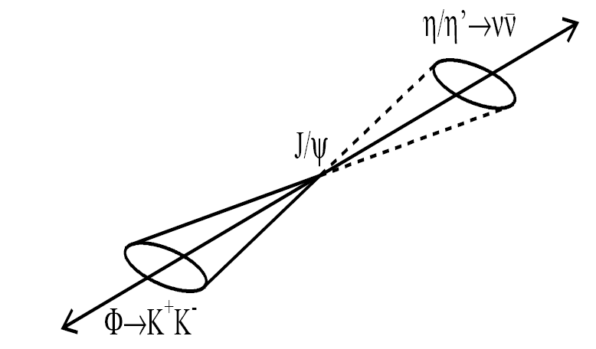

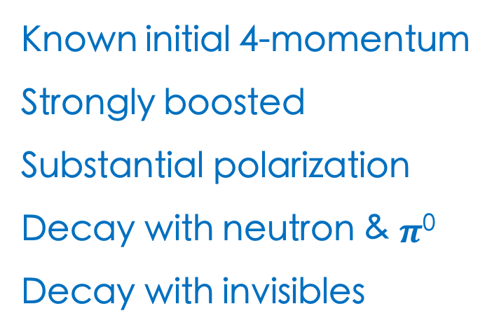

Advantage at e⁺e$−$ machine
Known initial 4-momentum
Strongly boosted
Substantial polarization
Decay with neutron & $π$⁰
Decay with invisibles
Single tag
e+
e-
$$Σ^{+}→pπ^{0}$$
Both hyperons can be reconstructed, and the systematic uncertainties are under control.

Slide 6
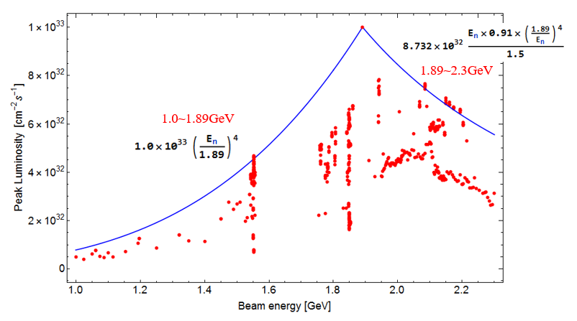
BEPCII luminosity optimized for $ψ\left(3770\right)$ running
A factor of 2 gain for lattice optimized at J/$ψ$ running

Slide 7
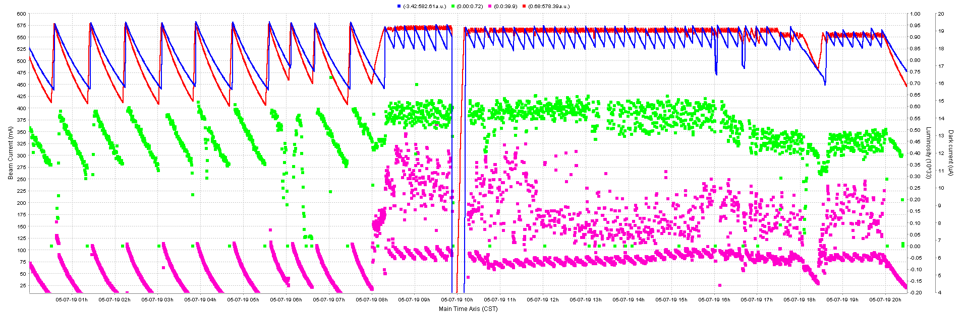
Gain on integrated luminosity from “Topup” injection
12 injections every 12 hours
20% gain on the integrated luminosity
Notes:
“Topup” injection is a highly efficient operation scheme for the accelerator, The
beam current will be kept nearly constant, so that the integral luminosity based on the
542 current decay scheme can be improved by 20%. In order to obtain stable online luminosity,

Slide 8
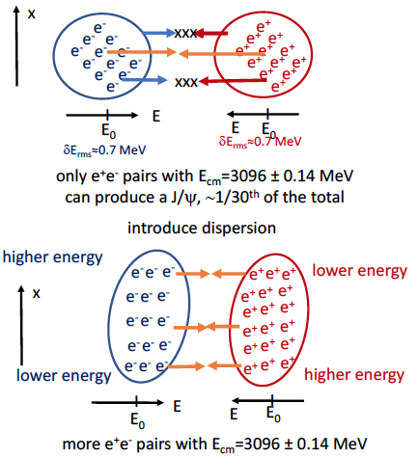
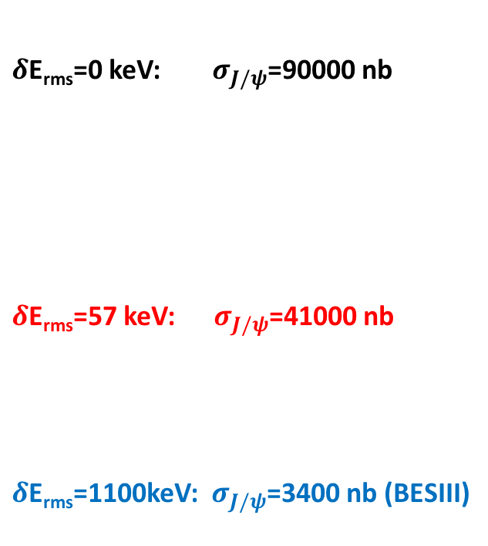






Monochromatic collision: factor of 10 from reduction of e⁺e⁻ CM spread
$J/ψ$ production cross-section
Xiaoshuai Qin
$δ$E_{rms}=0 keV: ${ σ}_{J/ψ}$=90000 nb
$δ$E_{rms}=57 keV: ${ σ}_{J/ψ}$=41000 nb
$δ$E_{rms}=1100keV: $σ_{J/ψ}$=3400 nb (BESIII)
$J/ψ width$: 92 keV
E+$∆E$
E-$∆E$
E
E
E-$∆E$
E+$∆E$
Alexander Zholents
CERN SL/92-27/AP
Notes:
Monochromator scheme of e+e- collision, which reduce the center of mass spread , to the value smaller than the width of J/psi resonance. The Monochromatization of e+e- collisions can be obtained by introducing a dispersion function at IP with opposite signs for the electron and positron . The monocromator scheme permits to obtain a large dispersion with low beta-function and reduce mixing of particles with different energy inside the beam by betatron oscillations. As a results, the center of mass energy spread is insensitive to the beam energy spread.

Slide 9
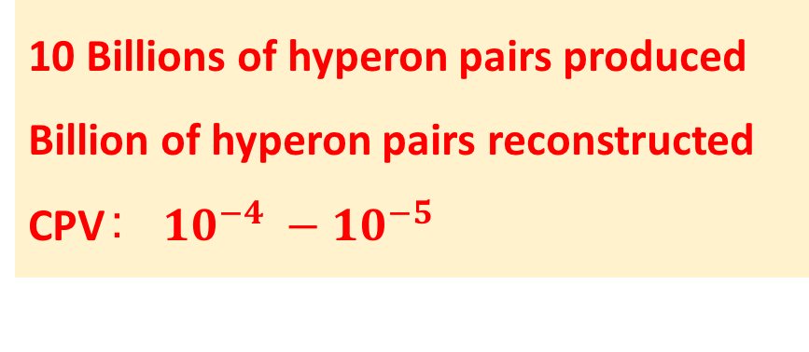
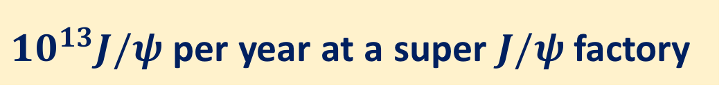
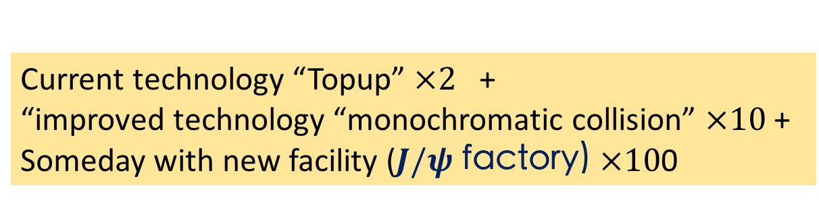
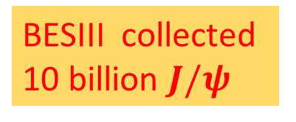
Future $J/ψ$ factory
Current technology “Topup” $×2$ +
“improved technology “monochromatic collision” $×10$ +
Someday with new facility ($J/ψ$ factory) $×10$0
BESIII collected
10 billion $J/ψ$
${10}^{13}J/ψ$ per year at a super $J/ψ$ factory
10 Billions of hyperon pairs produced
Billion of hyperon pairs reconstructed
CPV： ${10}^{−4} −{10}^{−5}$
Challenge the SM

Slide 10
Notes:
Under CP transformation, the strong phase does not change the sign, while the the sign of the CP phase will be changed .

Slide 11
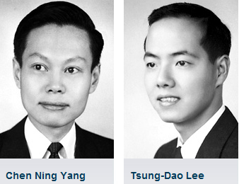
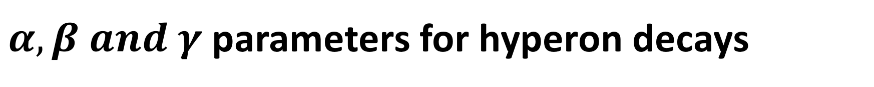
$α,β and γ$parameters for hyperon decays
1957
CP asymmetry
Notes:
These decays are described by the usual decay parameters given by Lee
and Yang' with the convention used here of
The experimental observables are the total rate \Gamma, and
the decay parameters \alpha, beta, and gamma which govern the
decay-angular distribution and the polarization of the final
baryon. Among alpha, beta, and gamma, only two are independent
as they are related by
The angular distribution of the pion from a completely polarized hyperon at rest.
The three parameters are related through this relation ?

Slide 12
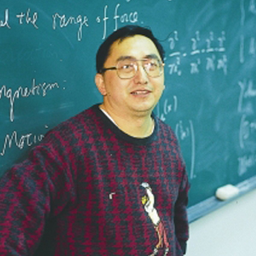

CPV observables
PRD 34,833 1986
See hep-ph/991023v1
and hep-ph/0002210
Sandip PAKVASA
X.G. He
John Donoghue
Notes:
Sandip from Hawai, who was one of early researchers of CPV in hyperons.

Slide 13
From Sandip
CPV measurement in Kaon system strongly constrains NP in S-waves, but no P-waves.
Thus, searches of CPV in hyperon are complementary to those with Kaons.

Slide 14
Entangled hyperon pairs
Kang, Li, Lu, Phys.Rev. D81 (2010) 051901
To determine parameters:

Slide 15
Production: 2 independent helicity amplitudes: A_{½ ½}, A_{½ -½}
m=±1
m=±1
A_{½ -½}
θ,φ
A_{½ ½}
θ,φ
J/ψ
J/ψ
A_{-½ ½}
m=±1
A_{-½ -½}
m=±1
θ,φ
θ,φ
J/ψ
J/ψ
parity: A_{½} _{-½} =A_{-½ ½}
parity: A_{½ ½} =A_{-½ -½}
Δ= complex phase between A_{½} _{½} and A_{½ -½}
Notes:
According to parity convervation,

Slide 16
if Δ ≠ 0, Λ and Λ are transversely polarized
_
Polarization is:
perpendicular to the production plane
θ_{Λ}-dependent
Same direction for Λ and Λ
_

Slide 17
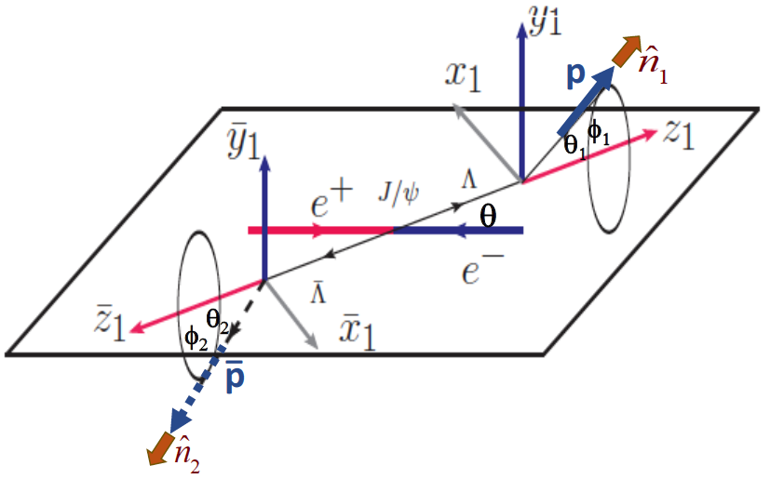
Correlated 5-dim. angular distribution
polarization-term
independent α₋ and α₊ dependence
Λ
Notes:
the joint angular distribution is [

Slide 19
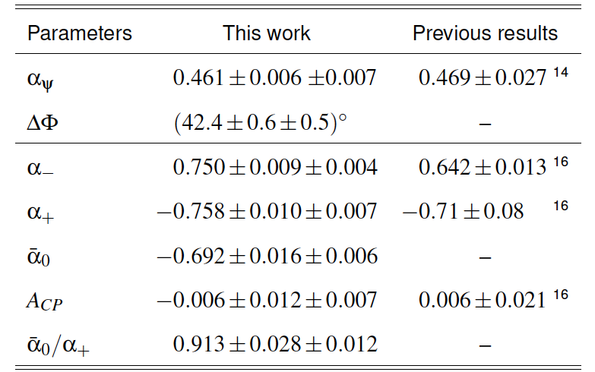
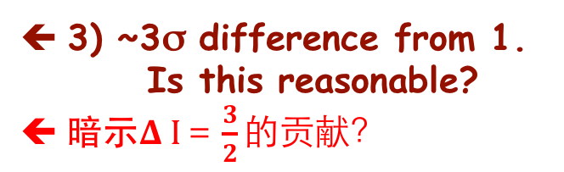


BESIII results with 1.3 billion $J/ψ$
Nature Physics 15,631-634 2019
arXiv:1808.08917
⬅ 1) 3x precision improvement
-same data sample-
2) ~7σ upward shift from all previous measurements
3) ~3σ difference from 1. Is this reasonable?
暗示$Δ I＝\frac{3}{2}的贡献？$
帮助理解$ΔI＝1/2疑难$

Slide 20
α₊/α₀ ≠ 1: ΔI=1/2 law violation
_
lifetime=12 ns
ΔI=1/2 law: K⁺→π⁺π⁰ (ΔI=3/2 transition) : Γ(K⁺→π⁺π⁰)= |T_{3/2}|²≈ Bf (K⁺→π⁺π⁰)/τ_{K+}
K_{S}→π⁺π⁻ (ΔI=1/2 transition) : Γ(K_{S}→π⁺π⁻)= |T_{1/2}|²≈ Bf (K_{S}→π⁺π⁻)/τ_{KS}
lifetime=0.21 ns
good agreement
Notes:
广义全同性原理： 赝标－－ >赝标粒子对， 玻色子－粒子对交换对称，同位旋交换对称，空间波函数对称，所以末态的同位旋只能是 0或者2， K+ → pi+ pi0, I3=1, 所以 I = 2, 不能是0, 得\Delta I = 3/2 . Ks → pi+pi-, I3 可以为0， 所以 I = 0, 不能为2.

Slide 21
PDG2019 updates

Slide 22
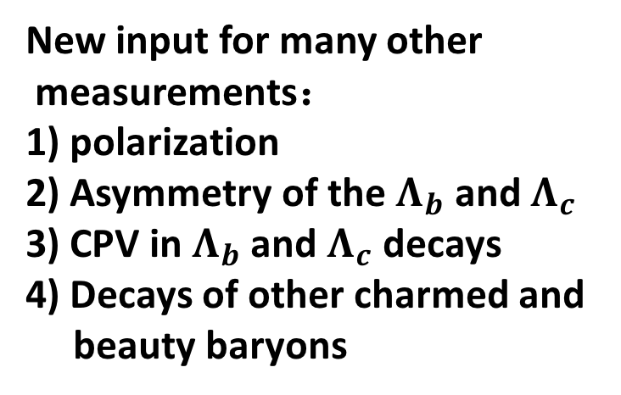
New input for many other
measurements：
1) polarization
2) Asymmetry of the $Λ_{b}$ and $Λ_{c}$
3) CPV in $Λ_{b}$ and $Λ_{c}$ decays
4) Decays of other charmed and
beauty baryons

Slide 26
CP violation with 10 billion $J/ψ$, and future facilities
From A. Kupas

Slide 27
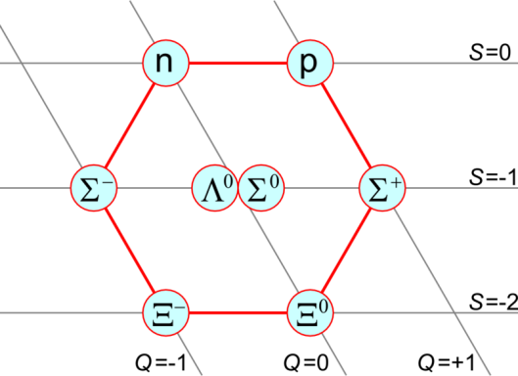
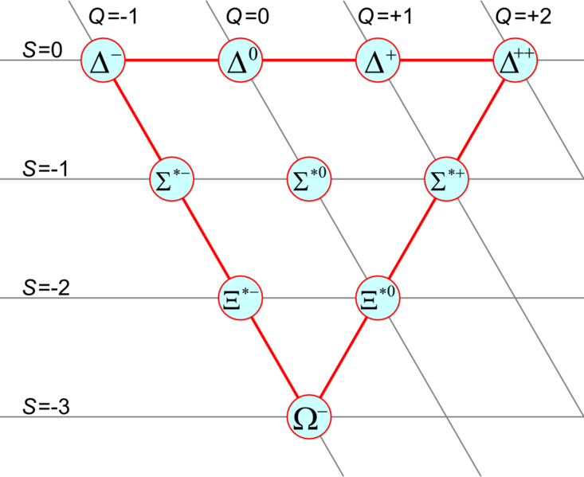
How about other weakly decaying hyperons?
Ω⁻→ΛK⁻
→Ξ⁰π⁻
→Ξ⁻π⁰
Σ⁺→pπ⁰
→nπ⁺
Σ⁻→nπ⁻
need ψ’→Ω⁻Ω⁺ data
rates are low
final state baryon polarization
measurements impractical with BESIII

Slide 28
CPV observables in Ξ⁻ →Λπ decay
decay rate
difference
⎜ Λπ final states are purely Ispin=1, only ΔI=1/2 transitions
allowed, no ΔI=3/2 transition possible
decay asymmetry
difference
⬅ in this case, the strong phase (Δ_{s}= δ_{S}-δ_{P}) is measureable (see below)
final-state polarization
difference
⬅ Strong phase cancels out
big advantage
for Ξ over Λ
⬅ measures the strong phase
Notes:
Final-state polarization: the beta can be measured only through the polarization of the final baryon from the decay of the polarized hyperon. This can be only done in the \Xi and Omega decays since the baryon polarization can be measured from its decay.

Slide 29
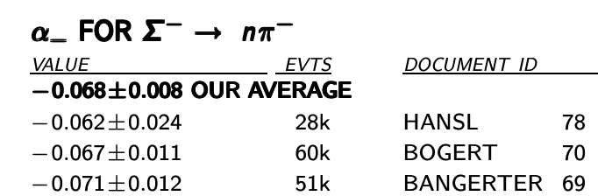
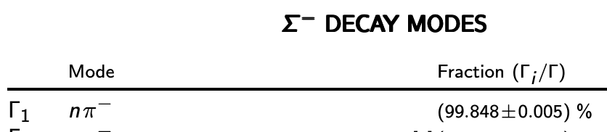
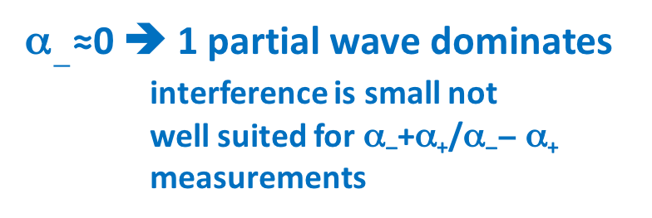

Σ⁻?
From S.L. Olsen
40∼50 year-old measurements,
probably wrong for the same reason
the Λ measurements were wrong
α$−$≈0 ➔ 1 partial wave dominates
interference is small not
well suited for α₋+α₊/α₋− α₊
measurements
no measurements of α₊ for $\overline{Σ}+$
_
single dominant decay mode
no suitable for ΔΓ measurements

Slide 30
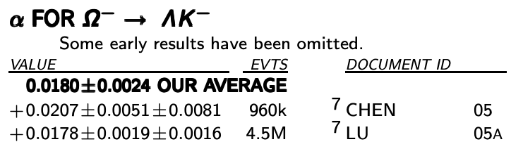
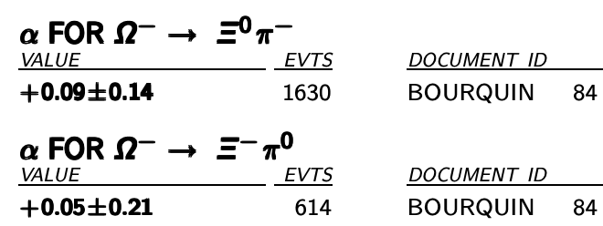
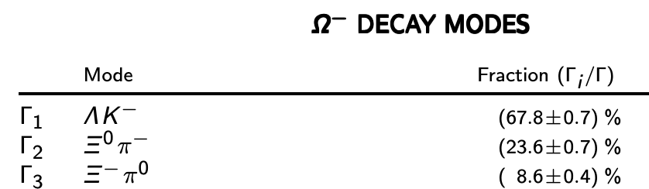
Ω⁻?
Ω⁻?
α≈0 ➔ 1 partial wave dominates all modes
interference is small, not well suited
for α + α/α—α measurements
_
_
Γ(Ξ⁰π⁻) ≈3x Γ(Ξ⁻π⁰) ⬅T_{3/2} ≈ T_{1/2}
ΔΓ will be enhanced

Slide 31
Hyperon decays

Slide 32

Rare and forbidden decays
EM penguin
$$γ$$
Weak penguin
Neutrinoless
double beta decays
FCNC: radiative decays
Most of them never studied.

Slide 33
Semileptonic decays
Fully reconstruct one of the
hyperons, then the momentum of the other hyperon will be known, which provides hyperon beam, so we can look for invisible final states:
－neutrino ; other invisible particles
e+
e-

Slide 34


Semileptonic decays: V_{us}
$$Λ$$
usu
dss
$$Ξ^{−}$$
V_{us} measurements are inconsistent:
K semileptonic and leptonic decays
tau decays
N. Cabibbo, E. Swallon, R. Winston
Ann.Rev.Nucl.Part.Sci. 53:39-75,2003

Slide 35
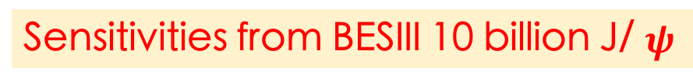
Search for rare decay and New physics
SM predictions:
Sensitivities from BESIII 10 billion J/ $ψ$
Notes:
Weak penquin dominated decays, the BR is tiny in the SM, and suppressed by GIM machinism.

Slide 36
Advantage: data near to the thresholds
Baryon pair productions near thresholds:
precision branching fractions, unique access to
the relative phase, test of QCD
Hyperon and charmed baryon Spin
polarization in QC
Form-factors in the time-like production
CP violation with quantum-correlated pair
productions of hyperons and charmed baryon

Slide 37

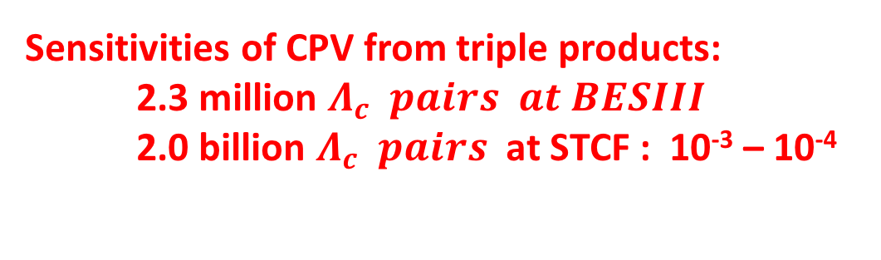
CPV in charmed baryon
X.W. Kang, HBL, G.R. Lu and A. Datta Int.J.Mod.Phys. A26 (2011) 2523
CPV from asymmetry parameters:
$$Λ_{c}→BP$$
Triple product asymmetry:
Sensitivities of CPV from triple products:
2.3 million $Λ_{c} pairs at BESIII$
2.0 billion $Λ_{c} pairs$ at STCF : 10⁻³ – 10⁻⁴

Slide 38

CPV in charmed baryon
X.W. Kang, HBL, G.R. Lu and A. Datta Int.J.Mod.Phys. A26 (2011) 2523
CPV from asymmetry parameters:
$$Λ_{c}→BV$$
Triple product asymmetry:
Sensitivities of CPV from triple products:
2.3 million $Λ_{c} pairs at BESIII$
2.0 billion $Λ_{c} pairs$ at STCF : 10⁻³ – 10⁻⁴

Slide 39
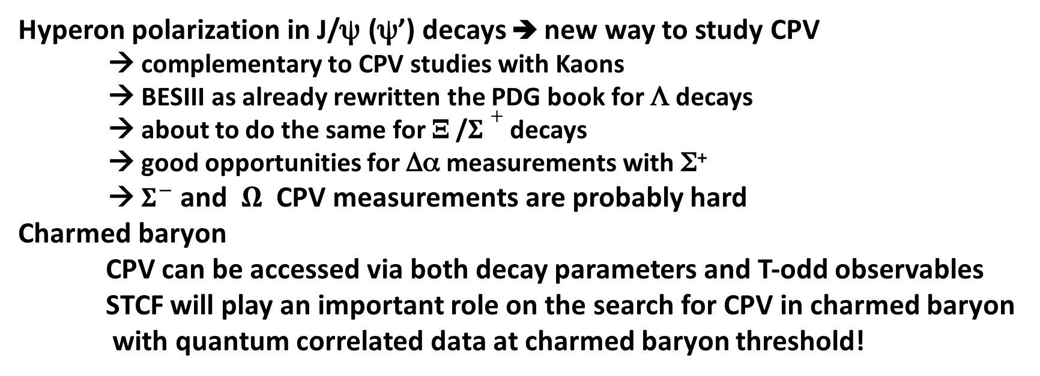
summary
Hyperon polarization in J/ψ (ψ’) decays ➔ new way to study CPV
→ complementary to CPV studies with Kaons
→ BESIII as already rewritten the PDG book for Λ decays
→ about to do the same for Ξ /$Σ+$decays
→ good opportunities for Δα measurements with Σ⁺
→ $Σ^{−}$ and $Ω$ CPV measurements are probably hard
Charmed baryon
CPV can be accessed via both decay parameters and T-odd observables
STCF will play an important role on the search for CPV in charmed baryon
with quantum correlated data at charmed baryon threshold!
Hyperon physics at BESIII &STCF: next new frontier for CPV studies!
Thank you!

Slide 40
附件

Slide 41
T_{3/2}≠ 0: decay rate asymmetry in BESIII?

Slide 42
Decay rate asymmetry in BESIII
using partially reconstructed J/ψ→ ΛΛ events --

Slide 43
Notes:
Multi-scattering will change the spin direction of the hyperon, and results to the change of the angular distributions. Lamor precession will also induce the change of the

Slide 44
轻子数和重子数破坏的寻找
BESIII的敏感度

Slide 45
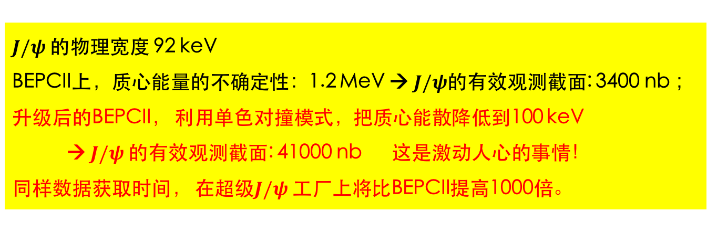
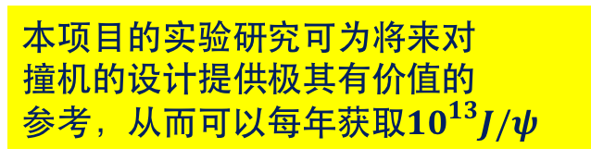

对未来J$/ψ工厂的影响$
目前BEPCII的亮度，每年可以积累100亿$J/ψ$样本： ${10}^{10}$
$J/ψ$的物理宽度 92 keV
BEPCII上，质心能量的不确定性：1.2 MeV → $J/ψ$的有效观测截面: 3400 nb ；
升级后的BEPCII， 利用单色对撞模式，把质心能散降低到100 keV
→ $J/ψ$的有效观测截面: 41000 nb 这是激动人心的事情！
同样数据获取时间， 在超级$J/ψ$工厂上将比BEPCII提高1000倍。
本项目的实验研究可为将来对
撞机的设计提供极其有价值的
参考，从而可以每年获取${10}^{13}J/ψ$

Slide 46
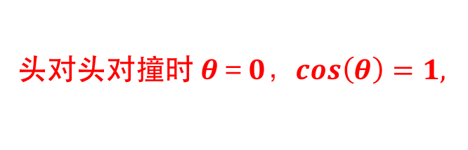
单色对撞模式
单色模式概念，垂直位置的质心能量
对撞质心能量：
头对头对撞时 $θ＝0，cos\left(θ\right)=1,$
为两束流能量偏差的相对值，假设：
如果
束流质心能量散度为零.

Slide 47
单色对撞模式

Slide 48

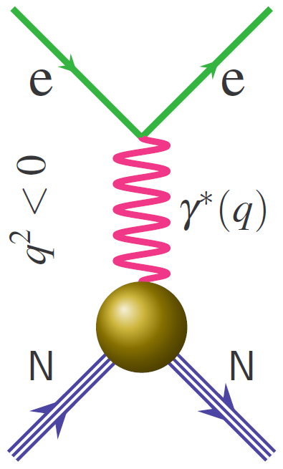
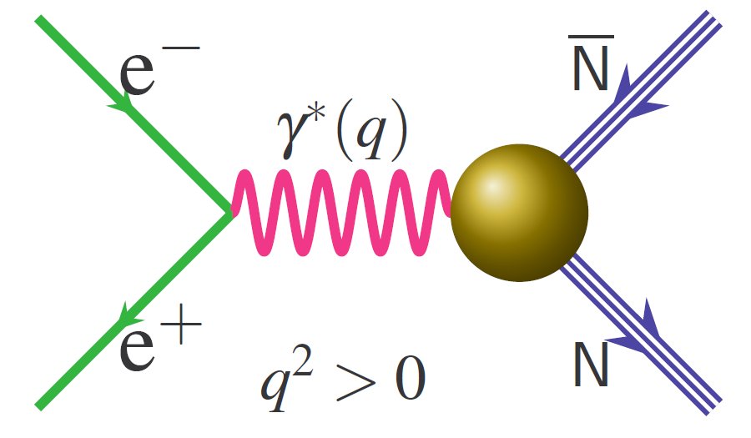
Nucleon Form Factor
Fundamental properties of the nucleon
  Connected to charge, magnetization distribution
  Crucial testing ground for models of the nucleon internal structure
Can be measured from space-like processes (eN) (precision 1%)
or time-like process (e⁺e⁻ annihilation) (precision 10%-30%)
eN → eN
, Λ Λ
Space-like:
FF real
Time-like:
FF complex

